Slide 1
Boosted Decision Trees for Supersymmetry Searches
Timothy Brooks
Year 1 PhD Student
Royal Holloway University of London

Slide 2
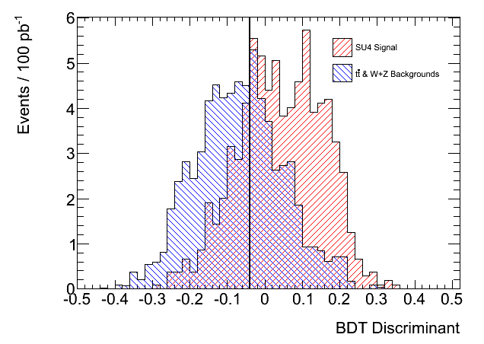
Boosted Decision Tree
Separation
SU4 mSUGRA Point
Backgrounds considered:
  Ttbar production
  W+Z production
Comparisons made to Multi-lepton cuts.
Precut requires N_{Leptons} >= 3
Trained on full MC sample (without cuts) to maximise training sample.
400 trees used here.
  s = 63.4
  b = 32.8
  Z = 8.96

Slide 3
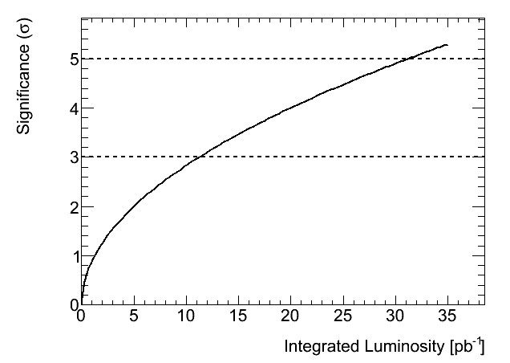
Boosted Decision Tree
Significance
5 σ excess at 31.15 pb⁻¹
Effect of over boosting investigated.
Significance estimation needs to include background uncertainties.
Need to move to Di-lepton + 4 jet analysis.
Aim is to investigate if a BDT run on control and expected signal regions can extract the top component in the signal region.
To recover higher statistics, channels with jet multiplicities lower than 4 will be investigated.

