Slide 1

PH3010 / MSci Skills
Statistical Data Analysis
Lecture 1: The Method of Least Squares
Autumn term 2017
Glen D. Cowan
RHUL Physics

Slide 2
The Statistical Data Analysis Module
This module on Statistical Data Analysis contains two parts:
Curve fitting with the method of least squares (weeks 1, 2)
Introduction to Machine Learning (week 3)
You will be given a number of exercises that should be written up in the form of a mini-project report. The standard rules apply:
Use the LaTeX template from the PH3010 moodle page.
Word limit is 3000, not including appendices.
All code should be submitted as an appendix.
The exercises for the least-squares part of the module are at the end of the script on moodle. Core exercises are numbers 1, 2, 3.
There may be some adjustment of the assigned exercises depending on how fast we are able to get through the material. (Exercise 4 may become optional.)

Slide 3
Outline (part 1)
Today:
Basic ideas of fitting a curve to data
The method of least squares
Finding the fitted parameters
Find the statistical errors of the fitted parameters
Using error propagation
Start of exercises
-----------------------------
Next week:
goodness-of-fit, fitting correlated data, more exercises

Slide 4
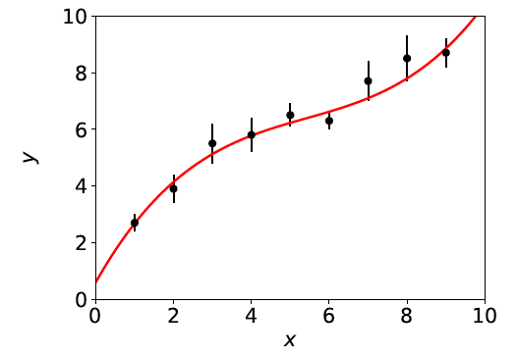
Curve fitting: the basic problem
Suppose we have a set of N measured values y_{i}, i = 1,.., N.
Each y_{i} has an “error bar” σ_{i}, and is measured at a value x_{i} of
a control variable x known with negligible uncertainty:
Roughly speaking, the goal is to find a curve that passes “close to”
the data points, called “curve fitting”.

Slide 5
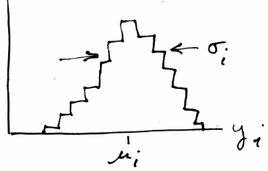
Measured values → random variables
We will regard the measured y_{i}
as independent observations
of random variables (r.v.s).
Idea of an r.v.: imagine making
repeated observations of the same
y_{i} , and put these in a histogram:
The distribution of y_{i} has a mean μ_{i} and standard deviation σ_{i}.
We only know the data values y_{i} from a single measurement, i.e.,
we do not know the μ_{i} (goal is to estimate this).
y_{i} = measured value
x_{i} = control variable value
μ_{i} = “true value” (unknown)
σ_{i} = error bar ← suppose these are known

Slide 6


Fitting a curve
The standard deviation σ_{i} reflects the reproducibility (statistical
error) of the measurement y_{i}.
If σ_{i} were to be very small, we can imagine that y_{i} would we be
very close to its mean μ_{i}, and lie on a smooth curve given by some
function of the control variable, i.e., μ_{i} = f (x_{i}).
Goal is to find the function f (x). Here we will assume that
we have some hypothesis for its functional form, but that it
contains some unknown constants (parameters), e.g., a straight line:
vector of parameters
Curve fitting is thus reduced to estimating the parameters.

Slide 7
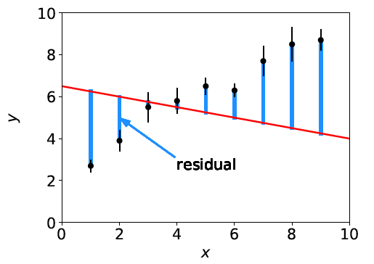
Least Squares: main idea
Consider fitting a straight line ad suppose we pick an arbitrary
point in parameter space (θ₀, θ₁), which gives a certain curve:
Here the curve does not describe the data very well, as can be
seen by the large values for the residuals:
residual of i^{th} point =

Slide 8


Minimising the residuals
If a measured value y_{i} has a small σ_{i}, we want it to be
closer to the curve, i.e., measure the distance from point to
curve in units of σ_{i}:
normalized residual of i^{th} point =
Idea of the method of Least Squares is to choose the parameters
that give the minimum of the sum of squared normalized residuals,
i.e., we should minimize the “chi-squared”:

Slide 9

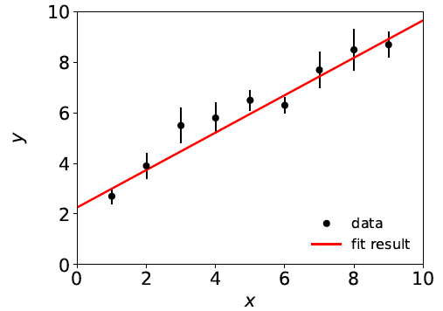
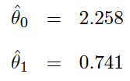
Least squares estimators
The values that minimize χ²(θ) are called the least-squares
estimators for the parameters, written with hats:
The fitted curve is thus “best” in the least-squares sense:

Slide 10


Comments on LS estimators
We can derive the method of Least Squares from a more
general principle called the method of Maximum Likelihood
applied to the special case where the y_{i} are independent
and Gaussian distributed:
,
It is equally valid to take the minimum of χ²(θ) as the definition
of the least-squares estimators, and in fact there is no general
rule for finding estimators for parameters that are optimal in
every relevant sense.

Slide 11
Next steps
1. How do we find the estimators, i.e., how do we minimize χ²(θ)?
2. How do we quantify the statistical uncertainty in the estimated parameters that stems from the random fluctuations in the measurements, and how is this information used in an analysis problem, e.g., using error propagation?
3. How do we assess whether the hypothesized functional form
f (x; θ) adequately describes the data?

Slide 12



Finding estimators in closed form
For a limited class of problem it is possible to find the estimators
in closed form. An important example is when the function f (x; θ)
is linear in the parameters θ , e.g., a polynomial of order M (note
the function does not have to be linear in x):
As an example consider a straight line (two parameters):
We need to minimize:

Slide 13
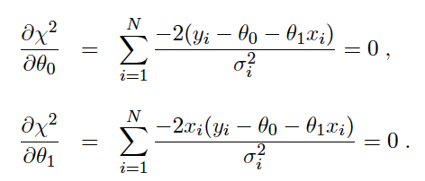
Finding estimators in closed form (2)
Set the derivatives of χ²(θ) with respect to the parameters equal
to zero:

Slide 14
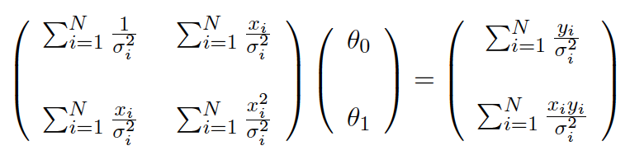
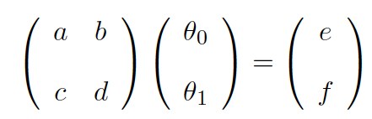
Finding estimators in closed form (3)
The equations can be rewritten in matrix form as
which has the general form
Read off a, b, c, d,
e, f, by comparing
with eq. above.

Slide 15
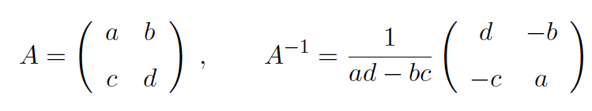
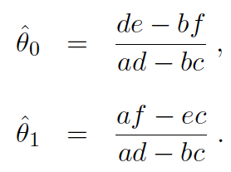
Finding estimators in closed form (4)
Recall how to invert a 2×2 matrix:
Apply A⁻¹ to both sides of previous eq. to find solution (written
with hats, because these are the estimators):

Slide 16
Comments on solution when f (x;θ) is linear in the parameters
Finding solution requires solving a system of linear equations;
can be done with standard matrix methods.
Estimators are linear functions of the y_{i}. This is true in general
for problems of this type with an arbitrary number of parameters.
Even though we could find the solution in closed form, the
formulas get a bit complicated.
If the fit function f (x; θ) is not linear in the parameters, it is not
always possible to solve for the estimators in closed form.
So for many problems we need to find the solution numerically.

Slide 17
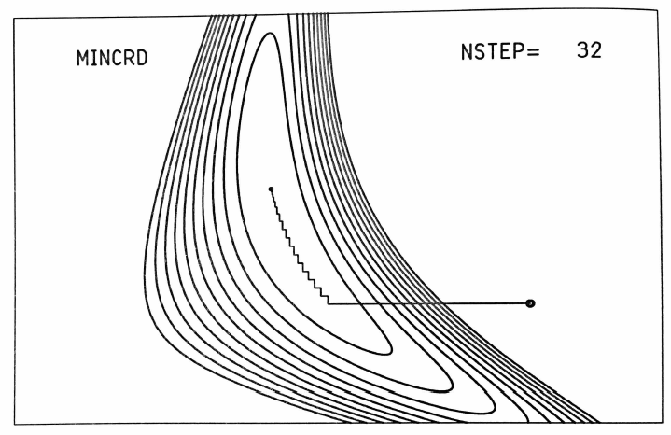
Finding LS estimators numerically
Start at a given point in the parameter space and move around
according to some strategy to find the point where χ²(θ) is a
minimum.
θ_{j}
For example, alternate minimizing with respect to each component of θ:
minimum
starting point
Many strategies possible,
e.g., steepest descent,
conjugate gradients, ...
(see Brandt Ch. 10).
θ_{i}
Siegmund Brandt, Data Analysis: Statistical and Computational Methods for Scientists and Engineers 4th ed., Springer 2014

Slide 18

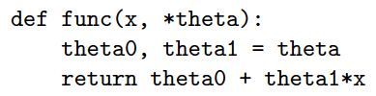
Fitting the parameters with Python
The routine routine curve_fit from scipy.optimize can
find LS estimators numerically. To use it you need:
We need to define the fit function f (x; θ), e.g., a straight line:

Slide 19


Fitting the parameters with Python (2)
The data values (x_{i}, y_{i}, σ_{i}) need to be in the form of NumPy
arrays, e.g,
Start values of the parameters can be specified:
To find the parameter values that minimize χ²(θ), call curve_fit:
Returns estimators and covariance matrix as NumPy arrays.
Need absolute_sigma=True for the fit errors (cov. matrix) to have
desired interpretation.

Slide 20
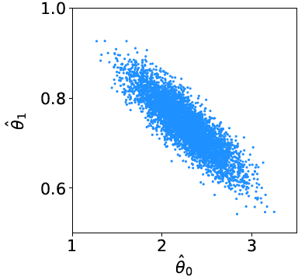
Statistical errors of fitted parameters
The estimators have statistical errors that are due to the random
nature of the measured data (the y_{i}).
If we were to obtain a new independent set of measured values,
y₁,..., y_{N}, then these would in general give different values for the
estimated parameters.
We can simulate the data set
y₁,..., y_{N} many times with the
Monte Carlo method.
For each set evaluate the
estimators for θ₀ and θ₁ from
the straight-line fit and enter
into a scatter plot:

Slide 21
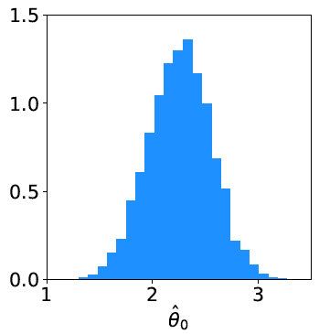
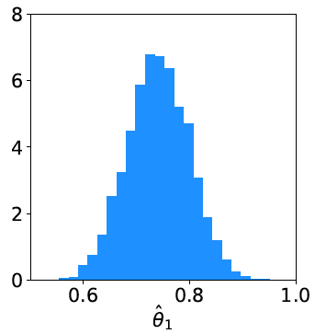
Statistical errors of fitted parameters (2)
^
^
Project points onto the θ₀ and θ₁ axes:
Each distribution’s standard deviation (~width) is used as a
measure of the corresponding estimator’s statistical error.

Slide 22


(Co)variance, correlation
^
^
The scatter plot of θ₀ versus θ₁ showed that if one estimate
came out high, the other tended to be low and vice versa.
This indicates that the estimators are (negatively) correlated.
To quantify the degree of correlation in any two random
variables u and v we define the covariance,
The covariance of a variable u with itself is its variance V[u] = σ_{u}²
The square root of the variance = standard deviation σ_{u}.
Also define dimensionless correlation
coefficient (can show −1 ≤ ρ ≤ 1):

Slide 23
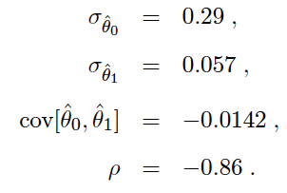
Covariance etc. from straight-line fit
From the simulated values shown in the scatter plot, use
standard formulae (see RHUL Physics formula book) to obtain
the standard deviations and covariance:

Slide 24



Covariance matrix
If we have a set of estimators
we can find the covariance for each pair and put into a matrix
Covariance matrix is square and symmetric.
Diagonal elements are the variances:
The vector of estimators and their covariance matrix are the
two objects returned by the routine curve_fit:

Slide 25

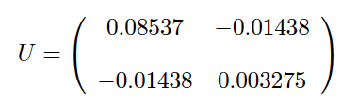
Covariance from derivatives of χ²(θ)
It is also possible to obtain the covariance matrix from second
derivatives of χ²(θ) with respect to the parameters at its minimum.
First find U⁻¹,
and then invert to find the covariance matrix U.
This is what curve_fit does (derivatives computed numerically).
Example with straight-line fit gives:

Slide 26

Using the covariance matrix:
error propagation
Suppose we’ve done a fit for parameters (θ₁,..., θ_{m}) and
obtained estimators and their covariance matrix.
We may then be interested in a given function of the fitted
parameters, e.g.,
What is the standard deviation of the quantity u? That is, how
do we propagate the statistical errors in the estimated parameters
through to u?
Or suppose we have two functions u and v. What is are their
standard deviations and what is their covariance cov[u,v]?

Slide 27



The error propagation formulae
By expanding the functions to first order about the parameter
estimates, one can show that the covariance is approximately
and thus the variance for a single function is
In the special case where the
covariance matrix is diagonal,
U_{ij} = σ_{i} σ_{j} δ_{ij}, we can carry out
one of the sums to find

Slide 28



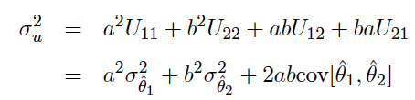
Comments on error propagation
In general the estimators from a fit are correlated, so their full
covariance matrix must be used for error propagation.
The approximation of error propagation is that the functions are
linear in a region of plus-or-minus one standard deviation about
the estimators.
Simple example:

Slide 29
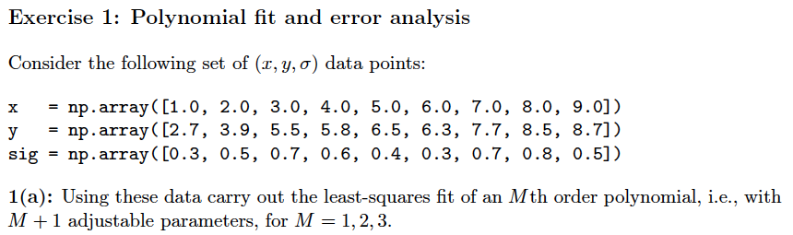
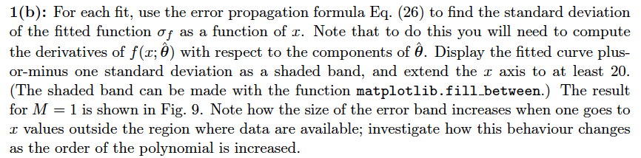
Exercise 1: polynomial fit

Slide 30
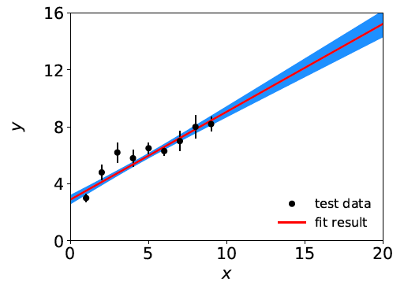
Polynomial fit: error band

Slide 31

Polynomial fit: error propagation
Consider the difference between the fitted curve values at x = a
and x = b:
Use error propagation to find the standard deviation of Δ_{ab}
(see script).

Slide 32
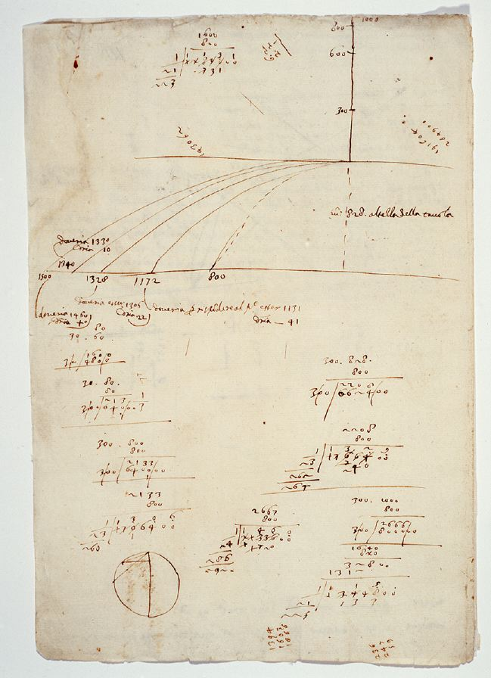
Ball and ramp
data from Galileo
Galileo Galilei, Manuscript f.116,
Biblioteca Nazionale Centrale di Firenze,
bncf.firenze.sbn.it
In 1608 Galileo carried out
experiments rolling a ball
down an inclined ramp to
investigate the trajectory of
falling objects.

Slide 33
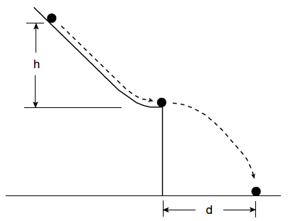
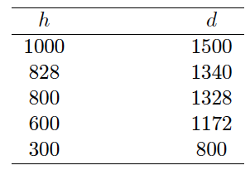
Ball and ramp data from Galileo
Units in punti
(approx. 1 mm)
Suppose h is set with negligible uncertainty, and
d is measured with an uncertainty σ = 15 punti.

Slide 34



Analysis of ball and ramp data
What is the correct law that relates d and h?
Try different hypotheses:
For now, fit the parameters α and β, find their standard deviations
and covariance.
Next week we will discuss how to test whether a given
hypothesized function is in good or bad agreement with the data.

Slide 35
Extra slides

Slide 36
History
Least Squares fitting also called “regression”
F. Galton, Regression towards mediocrity in hereditary
stature, The Journal of the Anthropological Institute of Great
Britain and Ireland. 15: 246–263 (1886).
Developed earlier by Laplace and Gauss:
C.F. Gauss, Theoria Motus Corporum Coelestium in Sectionibus
Conicis Solem Ambentium, Hamburgi Sumtibus Frid. Perthes et
H. Besser Liber II, Sectio II (1809);
C.F. Gauss, Theoria Combinationis Observationum Erroribus
Minimis Obnoxiae, pars prior (15.2.1821) et pars posterior
(2.2.1823), Commentationes Societatis Regiae Scientiarium
Gottingensis Recectiores Vol. V (MDCCCXXIII).

