Slide 1

PH3010 / MSci Skills
Statistical Data Analysis
Lecture 2: Goodness-of-fit,
LS fitting with correlated data,
Autumn term 2017
Glen D. Cowan
RHUL Physics

Slide 2
Outline – lecture 2
Today:
Goodness-of-fit
Fitting correlated data
More exercises
Discussion of project report
-----------------------------
Next week:
Introduction to machine learning

Slide 3
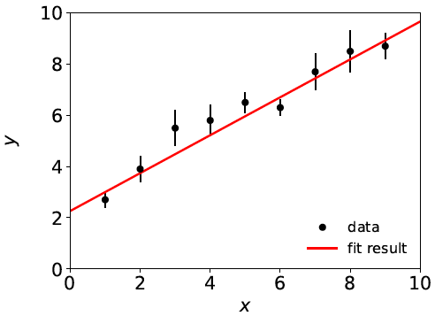
A “good” fit
Last week we fitted data that were reasonably well described
by a straight line:

Slide 4
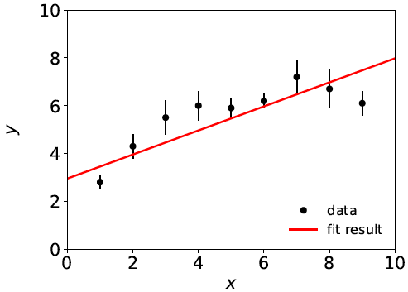
A “bad” fit
But what if a straight-line fit looks like this:
Maybe here we should fit a higher-order polynomial?

Slide 5

Goodness-of-fit: the questions
How do we quantify the level of agreement between the
data and the hypothesized form of the fit function?
How do we decide whether to try a different fit function?
Note first the following common misunderstanding:
If the fit is “bad”, you may expect large statistical errors for
the fitted parameters. This is not the case.
The statistical errors say how much the parameter estimates
will fluctuate under repetition of the experiment, under assumption
of the hypothesized fit function. This is not the same as the degree
to which the function is able to describe the data.
If the hypothesized f (x; θ) is not correct, the fitted parameters
will have some systematic uncertainty – a more complex question
that we will not take up here.

Slide 6

Quantifying goodness-of-fit
We can quantify the goodness-of-fit directly from the
value of χ²(θ) evaluated at its minimum, i.e., at θ = θ :
^
If the fitted function is in good agreement with the data, then
the numerator of each term in the sum should be small.
If f (x_{i}; θ) were equal to the true mean of y_{i}, then we would expect
the residual y_{i} − f (x_{i}; θ) to have an rms value of σ_{i}. Each term
in the sum would contribute 1, and we’d have χ²_{min} = N.
This is not quite true: if we have fitted m parameters and the
hypothesized function is correct, the expected value of χ²_{min} is
N – m (called the number of degrees of freedom of the fit.)
^
^

Slide 7



Distribution of χ²_{min}
χ²_{min} is a function of the data so is itself a random variable.
If the hypothesized fit function is correct and the data are
Gaussian distributed, one can show χ²_{min} follows a chi-square
distribution with n = N – m degrees of freedom (here let χ²_{min} = z):
Mean and standard deviation
of the chi-square distribution:
If the hypothesized fit function is not correct, then one would
obtain a distribution of χ²_{min} shifted to higher values.

Slide 8
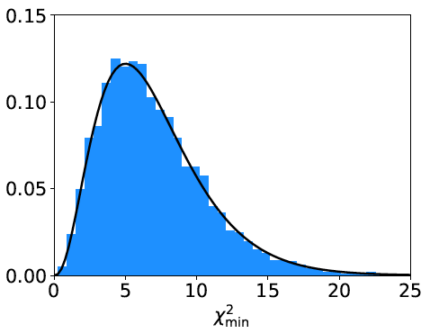
Distribution of χ²_{min} from straight-line fit
χ²_{min} from straight-line fit with N = 9 data points,
m = 2 fitted parameters.
Curve: chi-square pdf
for n = 7 degrees of
freedom.
Histogram: values of
χ²_{min} from straight-line
fit from repeated Monte
Carlo simulation of
the experiment.
mean = N – m = 7

Slide 9
How to interpret χ²_{min}
A simple way to assess the goodness-of-fit is simply to compare
χ²_{min} to the number of degrees of freedom, n_{dof} = N – m.
χ²_{min} ~ n_{dof} → fit is “good”
χ²_{min} ≫ n_{dof} → fit is “bad”
χ²_{min} ≪ n_{dof} → fit is better than what one would expect given
fluctuations that should be present in the data.
Often this is done using the ratio χ²_{min}/n_{dof}, i.e. fit is good if
the “chi-square per degree of freedom” comes out not much
greater than 1.
Often report as, e.g., χ²_{min}/n_{dof} = 8.2/7. It is best to communicate both χ²_{min} and n_{dof}, not just their ratio.

Slide 10

p-value from χ²_{min}
Another way to assess the goodness-of-fit is to give the
probability, assuming the fit function is correct, to obtain
a χ²_{min} value as high as the one we got or higher:
This is an example of what is called a p-value of the
hypothesis (here the hypothesized form of the fit function).
p-value is not the same as the probability that the hypothesis is true!
Nevertheless, a small p-value indicates that the hypothesis is
disfavoured.
Compute using: scipy.stats.chisqprob

Slide 11
χ²_{min} from the “bad” fit
Straight-line fit with N = 9 data points, m = 2 fitted parameters.
χ²_{min} = 20.9 for n_{dof} = 7
χ²_{min} /n_{dof} = 3.7
p-value = 0.0039
So is the straight-line hypothesis correct? It could be, but if
so we would expect a χ²_{min} as high as observed or higher
only 4 times out of a thousand.

Slide 12

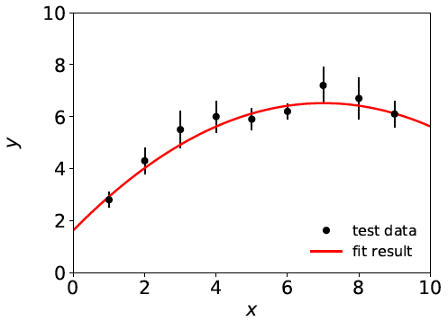
A better fit
If we decide the agreement between data and hypothesis is
not good enough (exact threshold is a subjective choice), we can
try a different model, e.g., a 2nd order polynomial:
χ²_{min} = 3.5 for n_{dof} = 6
χ²_{min} /n_{dof} = 0.58
p-value = 0.75

Slide 13


Least squares with correlated measurements
Up to now we have assumed that the measurements y₁,...,y_{N}
are all independent.
This means that if one value fluctuates, say, high, then this has no
influence on whether one of the others will fluctuate high or low.
But there could be cases where the y_{i} are correlated, i.e., they have
nonzero covariances
In this case, the formula for χ²(θ) becomes
where V ⁻¹ is the inverse of the covariance matrix of the data V.

Slide 14
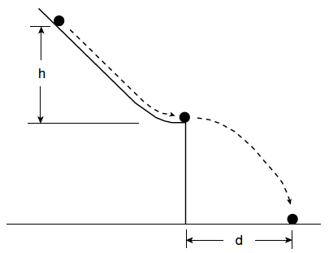
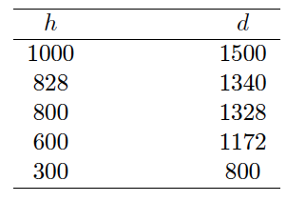
Goodness-of-fit with Galileo’s data
Last week we used data from Galileo...

Slide 15



Goodness-of-fit with Galileo’s data
...to fit several hypotheses for the functional relation between
the initial height h and flight distance d:
So now we can put ourselves in Galileo’s position and, without
knowledge of Newton’s laws, find which hypotheses are compatible
with or disfavoured by the data (find χ²_{min} /n_{dof} and p-value).
You can also use your knowledge of Newtonian mechanics
to work out the predicted law and compare to what you find
empirically.

Slide 16
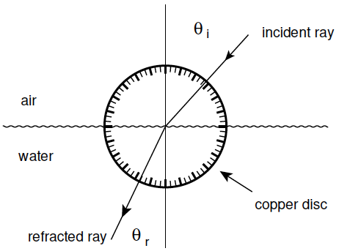
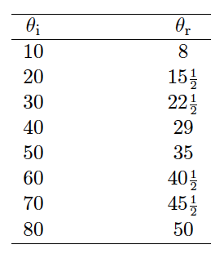
Exercise 3: refraction data from Ptolemy
Astronomer Claudius Ptolemy obtained data on refraction of
light by water in around 140 A.D.:
Angles of incidence and
refraction (degrees)
Suppose the angle of incidence is set with negligible error, and
the measured angle of refraction has a standard deviation of ½°.

Slide 17



Laws of refraction
A commonly used law of refraction was
,
although it is reported that Ptolemy preferred
.
The law of refraction discovered by Ibn Sahl in 984 (and rediscovered by Snell in 1621) is
.
where r = n_{r}/n_{i} is the ratio of indices of refraction of the two media.

Slide 18
Analysis of refraction data
Fit the parameters and find their statistical errors and (where
relevant) covariance matrix.
Assess goodness-of-fit of each hypothesis (χ²_{min}/n_{dof} and p-value).
What can you conclude?
(See The Feynman Lectures on Physics, Vol I., Addison-Wesley,
1963, Section 26-2, www.feynmanlectures.caltech.edu .)

Slide 19
Discussion of project report
Exercise 4 in the Least Squares script is optional.
There will be some exercises next week on Machine Learning.
Guidelines for report writing are on the Moodle page
(section Reports 2017-2018), with LaTeX template, etc.
You should submit the electronic version of your report to the
Turnitin Repository on the Moodle page Topic 6: Report Repository for Statistical Analysis Miniproject.
Deadline is 17 Nov 2017 at 10:00 a.m. (extended one week).
You should also submit 2 bound copies of the report to the
departmental office (same deadline).
Do not put off writing to the last minute (start ~now).

Slide 20
Discussion of project report (2)
Your report should have
A short introduction
A section for each exercise
Brief conclusions
Bibliography
Appendices (including all code you’ve written)
Use the relevant tools in LaTeX for the components of the report
(sections, figures, bibliography, etc.).
Maximum word count is (including captions but not including
appendices) is 3000.

