Slide 1
PH3010 / Advanced Skills Miniproject
Introduction to Statistical Data Analysis
Week 2: Goodness-of-fit,
LS fitting with correlated data,
Autumn term 2022
Glen D. Cowan
RHUL Physics

Slide 2
Statistical Data Analysis
Lecture 2-1
General idea of goodness-of-fit
Distribution of minimum of chi-squared

Slide 3
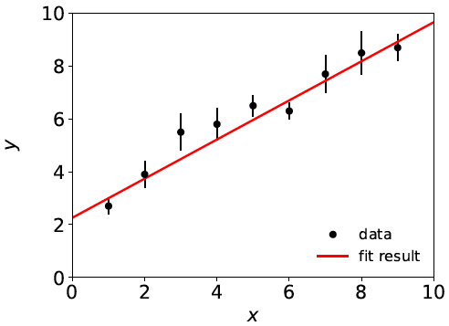
A “good” fit
Last week we fitted data that were reasonably well described
by a straight line:

Slide 4
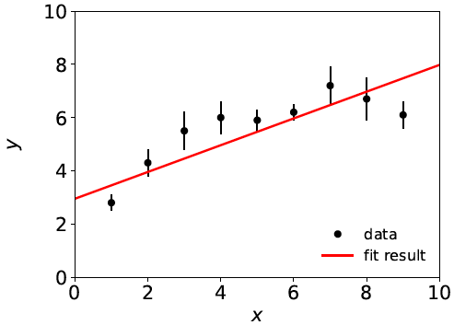
A “bad” fit
But what if a straight-line fit looks like this:
Maybe here we should fit a higher-order polynomial?

Slide 5
Goodness-of-fit: the questions
How do we quantify the level of agreement between the
data and the hypothesized form of the fit function?
How do we decide whether to try a different fit function?
Note first the following common misunderstanding:
If the fit is “bad”, you may expect large statistical errors for
the fitted parameters. This is not the case.
The statistical errors say how much the parameter estimates
will fluctuate under repetition of the experiment. This is not the same as the degree to which the function is able to describe the data.
If the hypothesized f (x; θ) is not correct, the fitted parameters
will have some systematic uncertainty – a more complex question
that we will not take up here.

Slide 6
Statistical errors versus goodness-of-fit

Slide 7
Statistical errors versus goodness-of-fit

Slide 8
Quantifying goodness-of-fit
We can quantify the goodness-of-fit directly from the
value of χ²(θ) evaluated at its minimum, i.e., at θ = θ :
^
If the fitted function is in good agreement with the data, then
the numerator of each term in the sum should be small.
If f (x_{i}; θ) were equal to the true mean of y_{i}, then we would expect
the residual y_{i} - f (x_{i}; θ) to have an rms value of σ_{i}. Each term
in the sum would contribute 1, and we’d have χ²_{min} = N.
This is not quite true: if we have fitted m parameters and the
hypothesized function is correct, the expected value of χ²_{min} is
N – m (called the number of degrees of freedom of the fit.)
^
^

Slide 9
Distribution of χ²_{min}

Slide 10
Distribution of χ²_{min}

Slide 11
Distribution of χ²_{min}
χ²_{min} is a function of the data so is itself a random variable.
If the hypothesized fit function is correct and the data are
Gaussian distributed, one can show χ²_{min} follows a chi-square
distribution with n = N – m degrees of freedom (here let χ²_{min} = z):
Mean and standard deviation
of the chi-square distribution:
If the hypothesized fit function is not correct, then one would
obtain a distribution of χ²_{min} shifted to higher values.

Slide 12
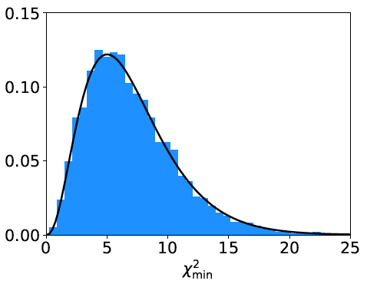
Distribution of χ²_{min} from straight-line fit
χ²_{min} from straight-line fit with N = 9 data points,
m = 2 fitted parameters.
Curve: chi-square pdf
for n = 7 degrees of
freedom.
Histogram: values of
χ²_{min} from straight-line
fit from repeated Monte
Carlo simulation of
the experiment.
mean = N – m = 7

Slide 13
χ²_{min} from the “good” fit
9 data points, 2 fitted parameters
→ 7 degrees of freedom
χ²_{min} = 8.2
By eye one would say that under the assumption of the straight-line
hypothesis, the goodness-of-fit was “typical”.

Slide 14
Statistical Data Analysis
Lecture 2-2
How to interpret χ²_{min}
p-value from χ²_{min}
Least squares with correlated data

Slide 15
How to interpret χ²_{min}
A simple way to assess the goodness-of-fit is simply to compare
χ²_{min} to the number of degrees of freedom, n_{dof} = N – m .
χ²_{min} ~ n_{dof} → fit is “good”
χ²_{min} ≫ n_{dof} → fit is “bad”
χ²_{min} ≪ n_{dof} → fit is better than what one would expect given
fluctuations that should be present in the data.
Often this is done using the ratio χ²_{min}/n_{dof}, i.e. fit is good if
the “chi-square per degree of freedom” comes out not much
greater than 1.
Often report as, e.g., χ²_{min}/n_{dof} = 8.2/7. It is best to communicate both χ²_{min} and n_{dof}, not just their ratio.

Slide 16
p-value from χ²_{min}
Another way to assess the goodness-of-fit is to give the
probability, assuming the fit function is correct, to obtain
a χ²_{min} value as high as the one we got or higher:
This is an example of what is called a p-value of the
hypothesis (here the hypothesized form of the fit function).
p-value is not the same as the probability that the hypothesis is true!
Nevertheless, a small p-value indicates that the hypothesis is
disfavoured.
Compute using: scipy.stats.chi2.sf

Slide 17
p-value for the “good” fit
N = 9 data points, m = 2 fitted parameters,
χ²_{min} /n_{dof} = 8.2/7 = 1.2
χ²_{min} = 8.2
p-value
= 0.32
If the straight-line hypothesis is true, expect equal or worse
agreement almost 1/3 of the time (i.e. our result is not unusual).

Slide 18
p-value for the “bad” fit
N = 9 data points, m = 2 fitted parameters,
χ²_{min} /n_{dof} = 20.9/7 = 3.0
χ²_{min} = 20.9
p-value
= 0.0039
So is the straight-line hypothesis correct? It could be, but if
so we would expect a χ²_{min} as high as observed or higher
only 4 times out of a thousand.

Slide 19
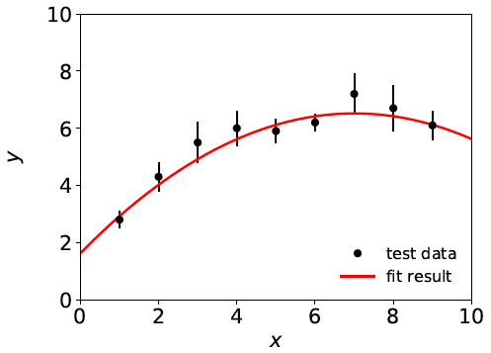
A better fit
If we decide the agreement between data and hypothesis is
not good enough (exact threshold is a subjective choice), we can
try a different model, e.g., a 2nd order polynomial:
χ²_{min} = 3.5 for n_{dof} = 6
χ²_{min} /n_{dof} = 0.58
p-value = 0.75

Slide 20
Least squares with correlated measurements
Up to now we have assumed that the measurements y₁,...,y_{N}
are all independent.
This means that if one value fluctuates, say, high, then this has no
influence on whether one of the others will fluctuate high or low.
But there could be cases where the y_{i} are correlated, i.e., they have
nonzero covariances
In this case, the formula for χ²(θ) becomes
where V ⁻¹ is the inverse of the covariance matrix of the data V.

Slide 21
LS with correlated measurements (2)
As a check, suppose we have the special case of a diagonal
covariance matrix, i.e., uncorrelated measurements. Then
→
V ⁻¹_{ij} = δ_{ij} /σ_{i}², carry out one of the sums, χ ²(θ) same as before:

Slide 22
Statistical Data Analysis
Lecture 2-3
Further discussion of the exercises
Structure of the report

Slide 23
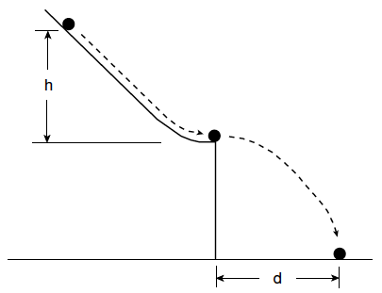
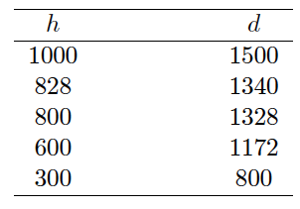
Goodness-of-fit with Galileo’s data
Last week we used data from Galileo...

Slide 24
Goodness-of-fit with Galileo’s data
...to fit several hypotheses for the functional relation between
the initial height h and flight distance d:
So now we can put ourselves in Galileo’s position and, without
knowledge of Newton’s laws, find which hypotheses are compatible
with or disfavoured by the data (find χ²_{min} /n_{dof} and p-value).

Slide 25
Extended analysis of Galileo’s data
You can also use your knowledge of Newtonian mechanics
to work out the predicted law and compare to what you find empirically.
Hints: apply conservation of energy to the rolling ball; do not forget that some of the gravitational potential energy goes into rotational energy.
Bonus question: work out the height of the table in terms of the measured data and compare to the value recorded in Galileo’s notebook. Are the values consistent? You will need to use error propagation to work out the uncertainty on the predicted height of the table.

Slide 26
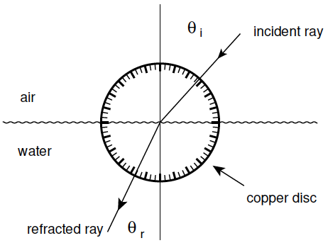
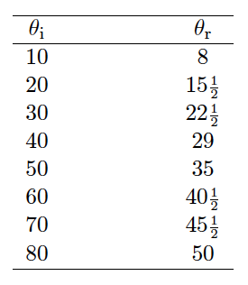
Exercise 3: refraction data from Ptolemy
Astronomer Claudius Ptolemy obtained data on refraction of
light by water in around 140 A.D.:
Angles of incidence and
refraction (degrees)
Suppose the angle of incidence is set with negligible error, and
the measured angle of refraction has a standard deviation of ½°.

Slide 27
Laws of refraction
A commonly used law of refraction was
,
although it is reported that Ptolemy preferred
.
The law of refraction discovered by Ibn Sahl in 984 (and rediscovered by Snell in 1621) is
.
where r = n_{r}/n_{i} is the ratio of indices of refraction of the two media.

Slide 28
Analysis of refraction data
Fit the parameters and find their statistical errors and (where
relevant) covariance matrix.
Assess goodness-of-fit of each hypothesis (χ²_{min}/n_{dof} and p-value).
What can you conclude?
(See The Feynman Lectures on Physics, Vol I., Addison-Wesley,
1963, Section 26-2, www.feynmanlectures.caltech.edu .)

Slide 29
Discussion of project report
Your report should have
Title, abstract on separate page
An introduction
A brief description of the statistical methods (can be a
separate section or combined with others)
A section for each exercise
Brief conclusions
Bibliography
Appendices (including all code you’ve written)
Further details on this next week.

Slide 30
Discussion of project report (2)
Guidelines for report writing are on the moodle page, with LaTeX template, etc.
Use the relevant tools in LaTeX for the components of the report
(sections, figures, bibliography, etc.).
For the code listings you can use e.g. LaTeX’s minted package.
Deadlines and instructions for submission are on moodle.
Do not put off writing to the last minute (start ~now); more info
on writing will be given in week 3.

