Slide 1
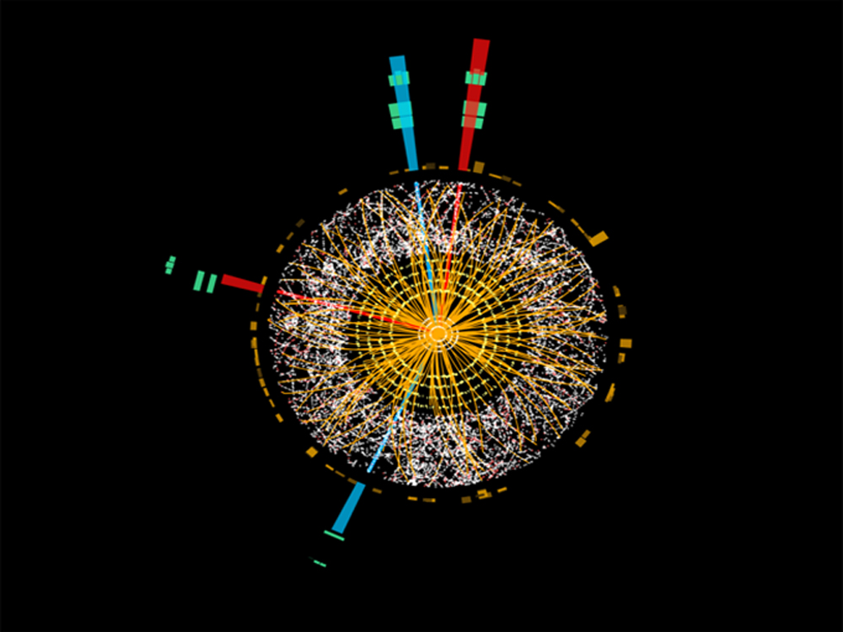
Learning from Data at the
Large Hadron Collider
Braga, 26 March 2019
Glen Cowan
Physics Dept.
Royal Holloway, U. London

Slide 2
Outline
Particle physics: the short story
The Large Hadron Collider and the ATLAS Detector
Learning from data: using Machine Learning to
classify events
search for New Physics
Outlook for Machine Learning and Particle Physics

Slide 3
The Particle Scale

Slide 4
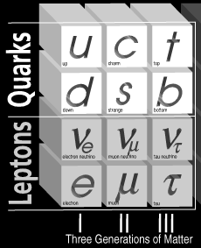
The Current Picture of Particle Physics
Matter...
+ force carriers...
photon (γ)
W±
Z
gluon (g)
+ Higgs boson + relativity + quantum mechanics + symmetries...
= “The Standard Model”
almost certainly incomplete
no gravity yet
25 free parameters (!)
agrees with ~all experimental observations!

Slide 5
Open Questions
What is responsible for dark matter (and dark energy)?
Why is Nature left-right asymmetric? Why three families?
Why does the universe consist almost entirely of matter,
rather than a mixture of matter and antimatter?
Why are there 3 space dimensions and 1 time dimension?
Why is gravity ~10⁴⁰ times weaker than electromagnetism?
Why is charge quantised?
Why 25 free parameters?
Theoretical Physicists have proposed a number of alternatives to
the Standard Model that address (some of) these questions:
Supersymmetry, Grand Unified Theories, extra dimensions,...

Slide 6
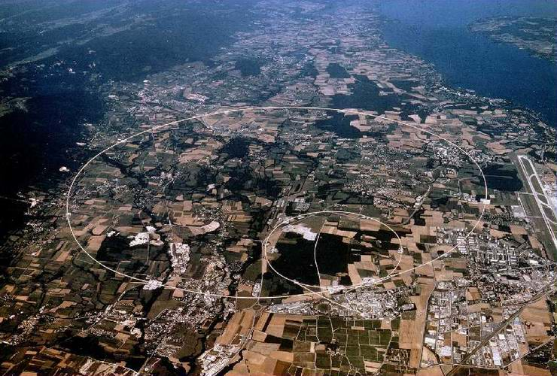
The Large Hadron Collider
CMS
LHCb
ATLAS
ALICE

Slide 7
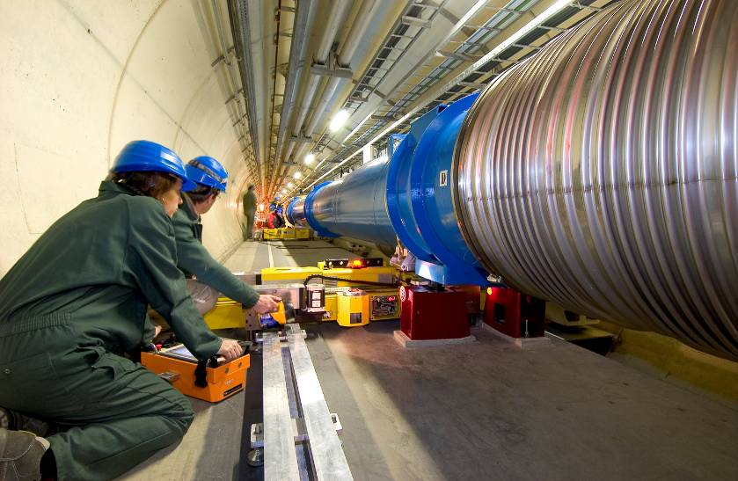
Physics of the Large Hadron Collider
Inside the LHC
TexPoint fonts used in EMF.
Read the TexPoint manual before you delete this box.: AAAA

Slide 8
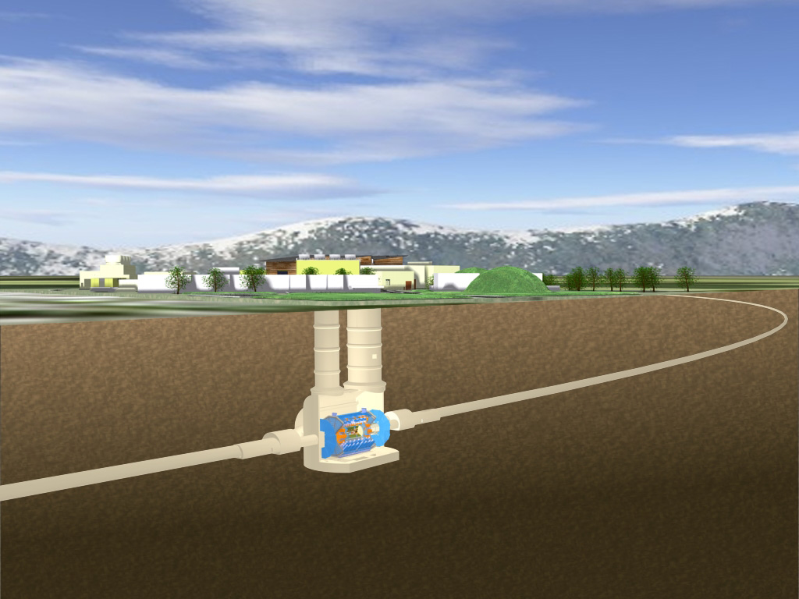
The ATLAS Detector at the LHC

Slide 9
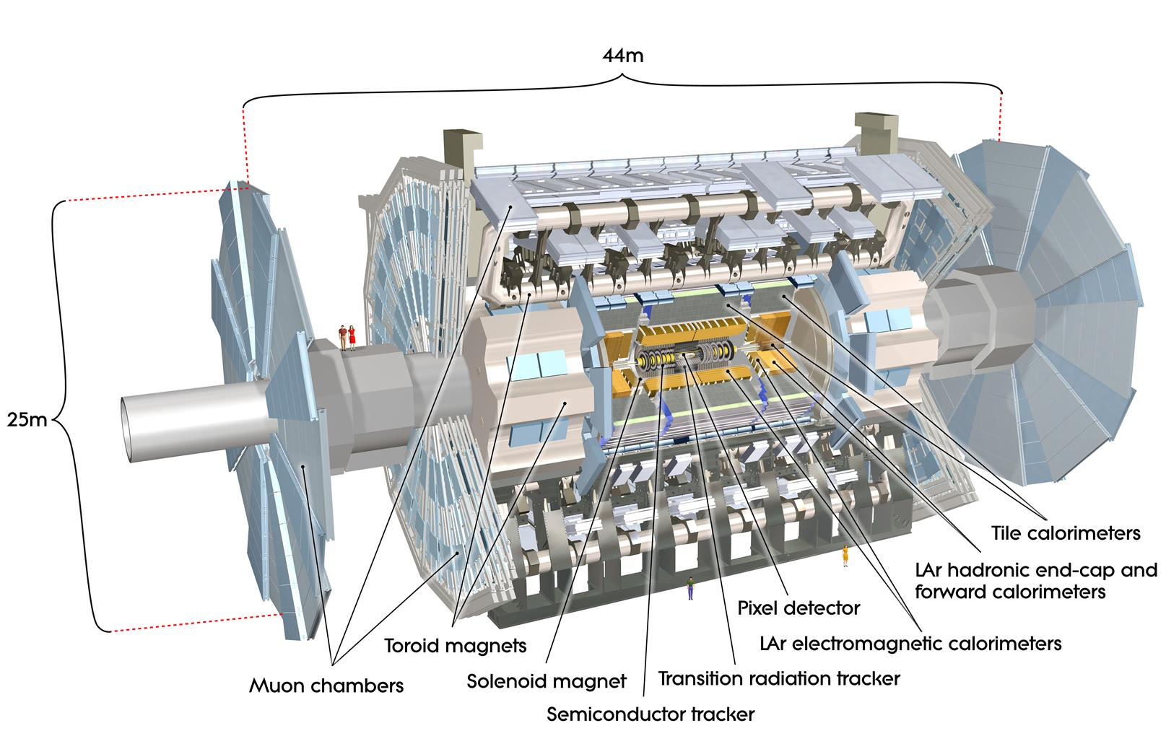
The ATLAS Detector

Slide 11
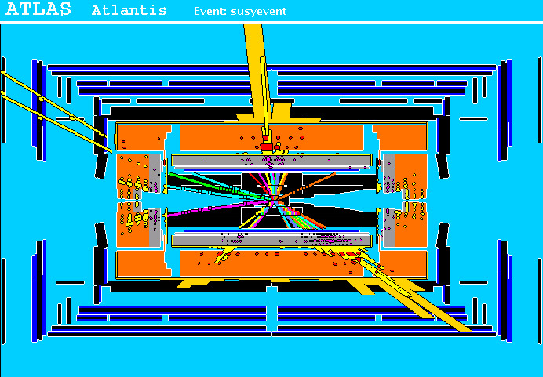
A simulated supersymmetry event
high p_{T}
muons
high p_{T} jets
of hadrons
p
p
missing energy from undetected neutralinos

Slide 12
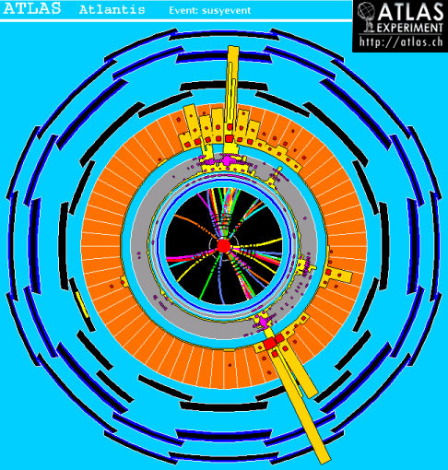
Simulated event from supersymmetry
Here momentum imbalance
towards upper right
indicates that invisible
particles (here neutralinos)
escaped to lower left
(“missing energy”).

Slide 13
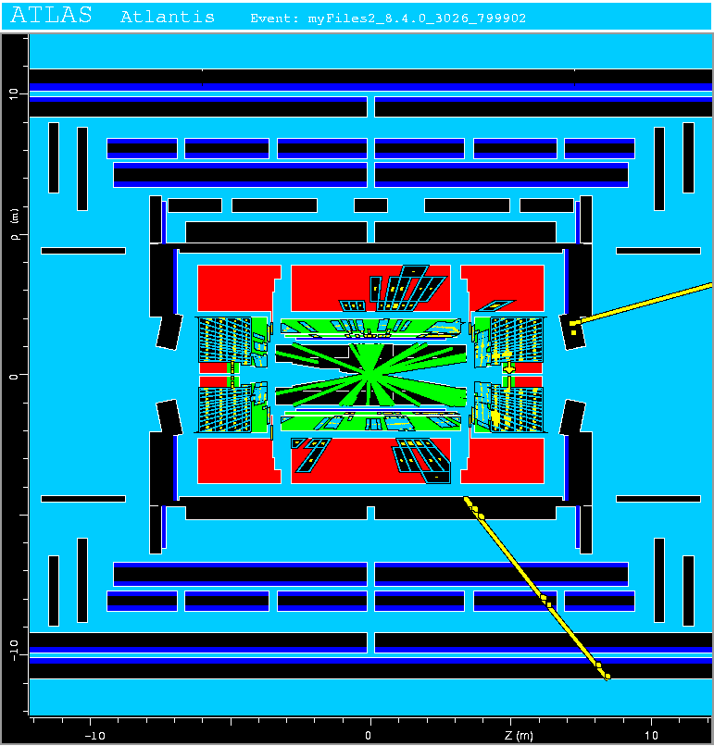
Background events
This event from Standard
Model top-antitop production
also has high p_{T} jets and
muons, and some missing
transverse energy.
→ can easily mimic a
SUSY event.

Slide 14
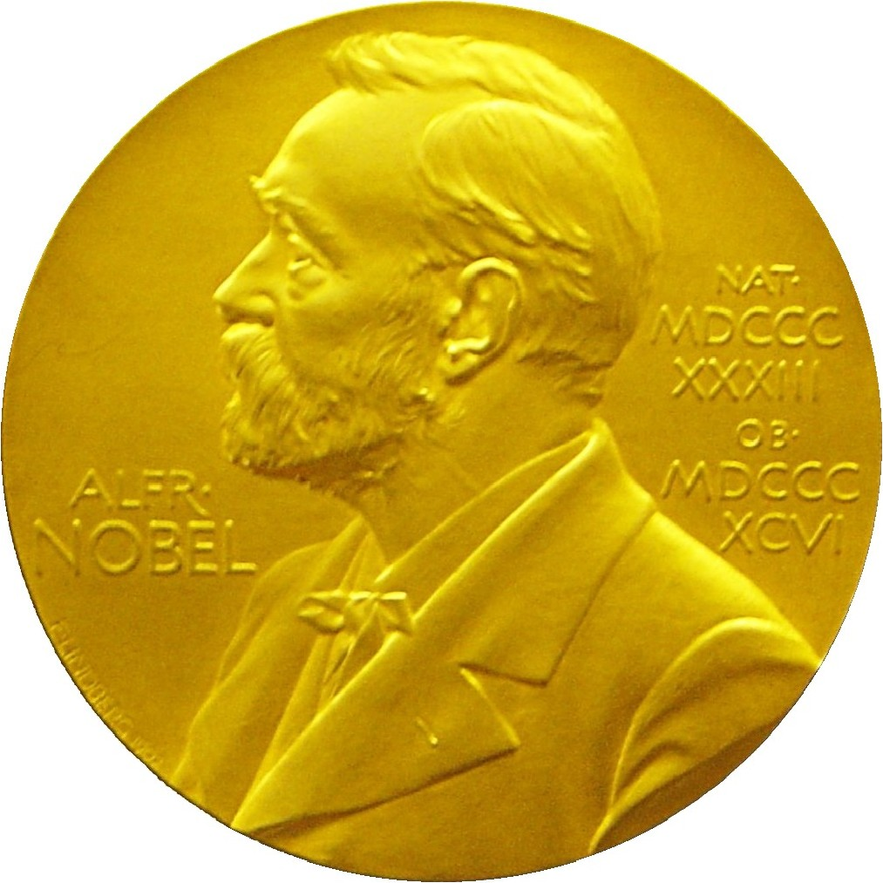
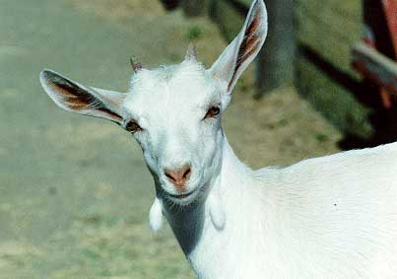
Discovering “New Physics”
For each proton-proton collision, record some set of measured
properties (energies and directions of the particles).
Compare the observations to the predictions of different theories
and see how well they agree.
Nobel
prize
If we can find a set of measurements where the data are incompatible with the Standard Model and in good agreement with some alternative, we’ve made a discovery.
But the data are “random”! An observed disagreement might
be a statistical fluctuation.
2nd
prize

Slide 15
Learning from Data
The term Machine Learning (ML) refers to algorithms that “learn
from data” and make predictions based on what has been learned.
In its simplest sense, “learning” means the algorithm contains adjustable parameters whose values are estimated using data.
ML can be seen as a part of or related to:
Artificial Intelligence
Pattern Recognition
Statistical Learning
Multivariate Analysis
Development from (mainly) Computer Science, (also) Statistics;
sometimes “Data Science” used to refer to all of above.
In Particle Physics, the most important application is the use of classification to search for New Physics.

Slide 16
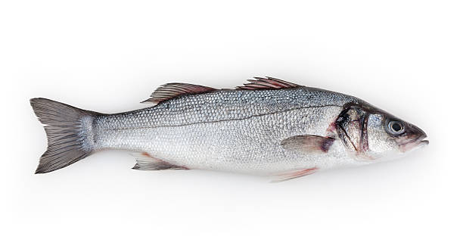
Example of classification: Industrial Fishing
You scoop up fish which are of two types:
Sea
Bass
Cod
You examine the fish with automatic sensors and for each one
you measure a set of features:
x₁ = length x₄ = area of fins
x₂ = width x₅ = mean spectral reflectance
x₃ = weight x₆ = ...
These constitute the “feature vector” x = (x₁,..., x_{n}).
In addition you hire a fish expert to identify the “true class label”
y = 0 or 1 (i.e., 0 = sea bass, 1 = cod) for each fish.

Slide 17
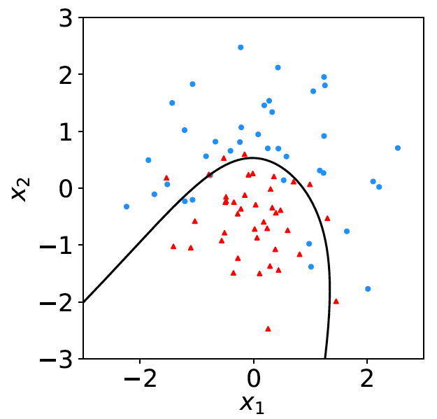
Distributions of the features
blue = class 1
If we consider only two
features x = (x₁, x₂), we can display the results in a scatter plot.
decision
boundary
red = class 0
Goal is to determine a decision boundary, so that, without the help of the fish expert, we can classify new fish by seeing where their measured features lie relative to the boundary.
Same idea in multi-dimensional feature space, but cannot represent as 2-D plot. Decision boundary is n-dim. hypersurface.

Slide 18
Classification of proton-proton collisions
Proton-proton collisions can be considered to come in two classes:
signal (the kind of event we’re looking for, y = 1)
background (the kind that mimics signal, y = 0)
For each collision (event), we measure a collection of features:
x₁ = energy of muon x₄ = missing transverse energy
x₂ = angle between jets x₅ = invariant mass of muon pair
x₃ = total jet energy x₆ = ...
The real events don’t come with true class labels, but computer-simulated events do. So we can have a set of simulated events that consist of a feature vector x and true class label y (0 for background, 1 for signal):
(x, y)₁, (x, y)₂, ..., (x, y)_{N}
The simulated events are called “training data”.

Slide 19
Separating Signal from Background
What is the best “decision boundary”?
signal events
background
events
Complications:
The boundary is a hypersurface in a space with, say,
tens or hundreds of dimensions.
The events of the signal type may not exist in Nature! Goal
is to see if anything “signal-like” is present in the real data.

Slide 20
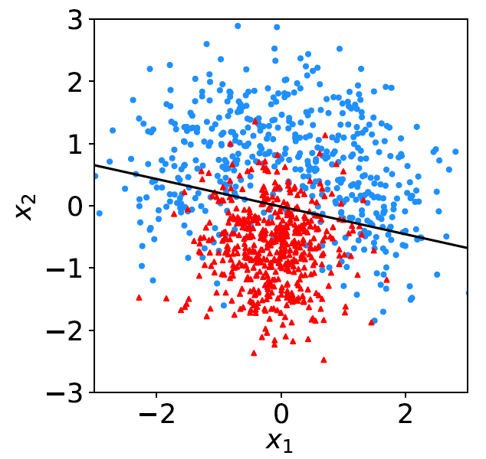
Mathematics of the decision boundary
A general surface in the
n-dimensional feature space can be described by an equation of the form:
For example, if the
function is linear:
then the surface is linear:
The values of the constants
c₁, c₂,... are adjusted using
the training data.

Slide 21
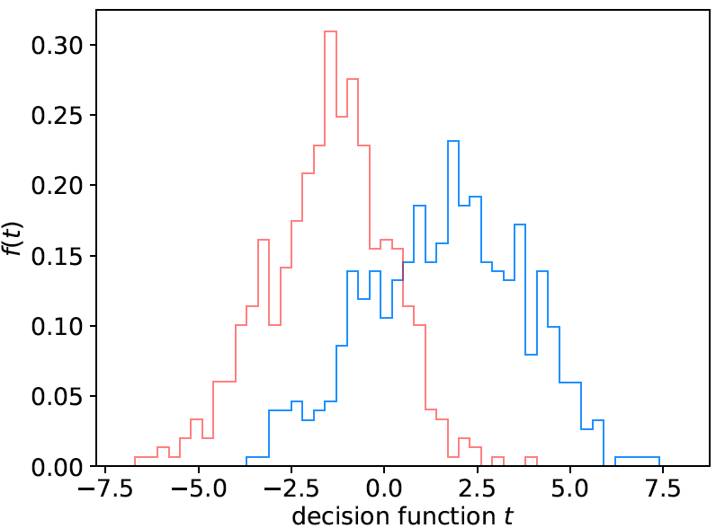
Distribution of linear decision function
back-
ground
signal

Slide 22
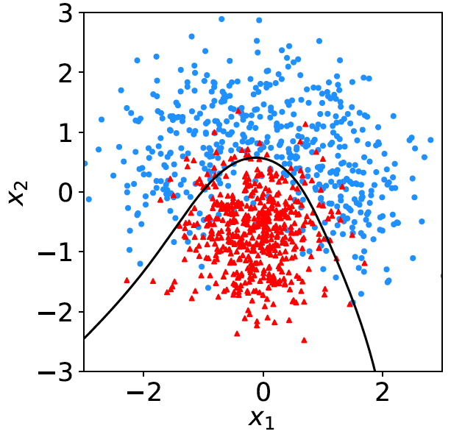
Nonlinear decision boundaries
From the scatter plot below it’s clear that some nonlinear boundary
would be better than a linear one:
And to have a nonlinear boundary, the decision function t (x) must be nonlinear in x.

Slide 23
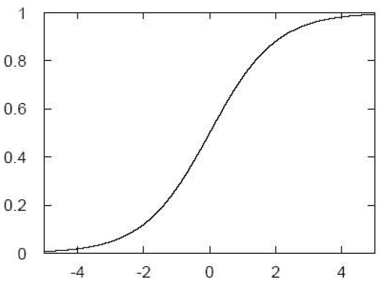
Neural Networks
A simple nonlinear decision function can be constructed as
where h is called the “activation function”. For this one
can use, e.g., a logistic sigmoid function,
u

Slide 24
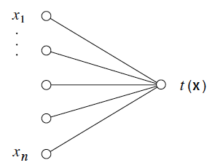
Single Layer Perceptron
In this form, the decision function is called a Single Layer Perceptron – the simplest example of a Neural Network.
output node
input layer

Slide 25
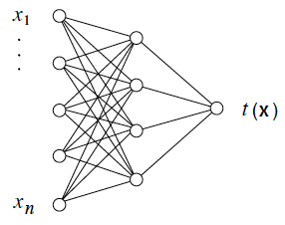
Multilayer Perceptron
output node
hidden layer with m nodes
φ₁(x),..., φ_{m}(x)
input
layer
Each line in the graph represents a parameter which must
be adjusted using the training data.

Slide 26
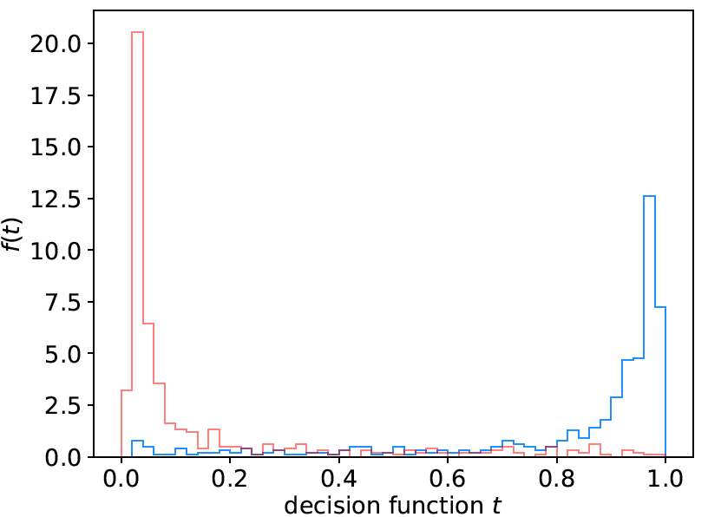
Distribution of neural net output
Degree of separation between classes now much better than
with linear decision function:
back-
ground
signal

Slide 27
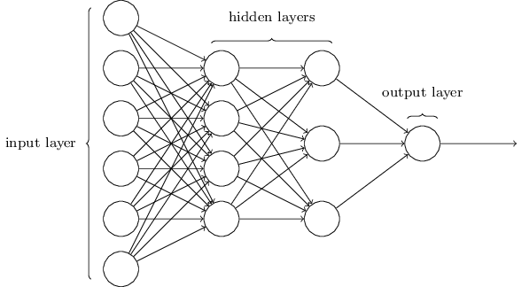
http://neuralnetworksanddeeplearning.com/chap1.html
Deep Neural Networks
The multilayer perceptron can have be generalized to have an arbitrary number of hidden layers, with an arbitrary number of nodes in each (= “network architecture”).
A “deep” network has several (or many) hidden layers:
“Deep Learning” is a very recent and active field of research.

Slide 28
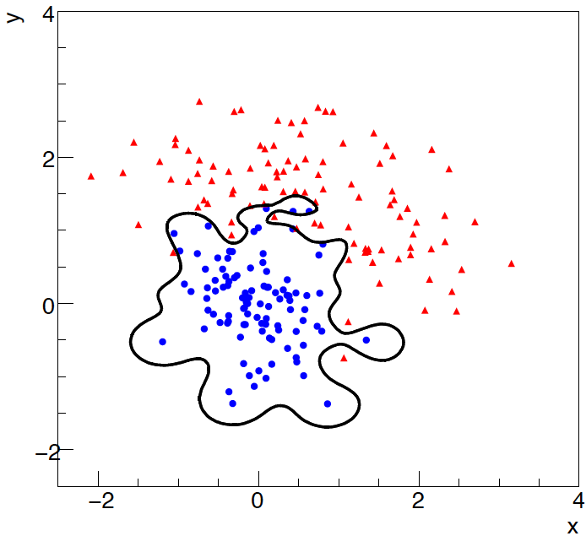
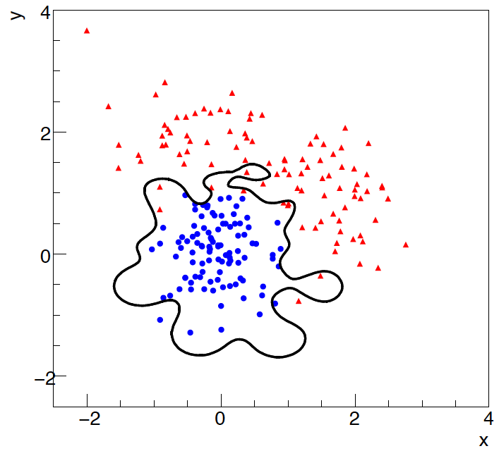
Overtraining
Including more adjustable constants in the decision function makes
it flexible, and it may conform too closely to the training points.
The same boundary will not perform well on an independent test
data sample (→ “overtraining”).
training sample
independent test sample

Slide 29
More Machine Learning
Many other ways of defining classifiers:
Support Vector Machines,
Boosted Decision Trees,
K-Nearest Neighbour,
...
There are lots of free software tools, especially with Python:
scikit-learn.org
and many online courses; here’s a good one (K. Markham):
www.dataschool.io/machine-learning-with-scikit-learn/
and here is a website for experimenting with neural networks:
playground.tensorflow.org

Slide 30
The Higgs Machine Learning Challenge
higgsml.lal.in2p3.fr
Highly popular competition
to foster exchange of ideas
between Machine Learning
and Particle Physics
The Challenge: optimise
search for Higgs boson decay
to pair of tau leptons

Slide 31
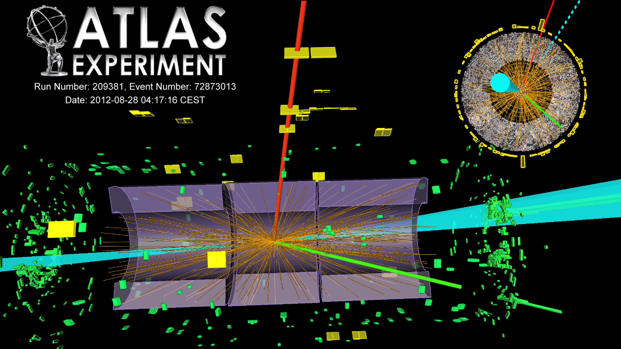
Searching for Higgs → tau leptons

Slide 32
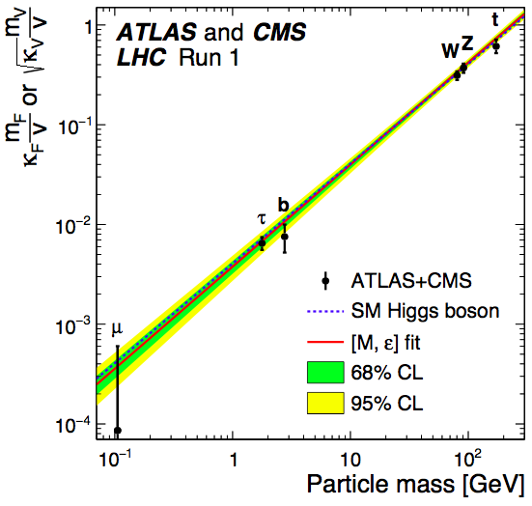
G. Aad et al. [ATLAS and CMS Collaborations], JHEP 1608 (2016) 045 doi:10.1007/JHEP08(2016)045 [arXiv:1606.02266 [hep-ex]].
Coupling strength of Higgs to other particles
Probability of Higgs
decay to a pair of particles of a given type is proportional to the square of the “coupling strength”.
Excellent agreement with predictions of Standard Model observed.

Slide 33
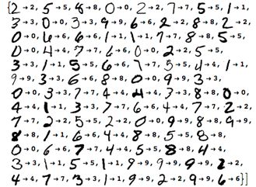
https://www.wolfram.com/mathematica/new-in-10/highly-automated-machine-learning/
Machine Learning for handwriting recognition
Initial feature vector = set of pixels of an image

Slide 34
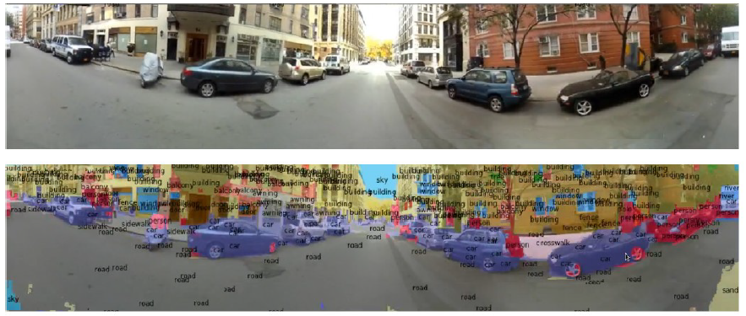
Y. LeCun
Scene parsing/labeling with Convolutional Neural Nets
Deep Learning and the Future of AI, seminar at CERN by
Yann LeCun: https://indico.cern.ch/event/510372/

Slide 35
Summary and Outlook
We are continuing to learn about the fundamental particles of Nature with the Large Hadron Collider
Precision measurements of Higgs boson properties
Search for supersymmetry
Search for micro black holes, gravitons, Wʹ, Zʹ
(extra dimensions)
Machine Learning is or soon will be ~everywhere:
Huge interest in Particle Physics, many interdisciplinary initiatives, opportunities for under- and post-grad students.
Lots of accessible software tools (e.g., scikit-learn)
Huge impact on society

Slide 36
Extra slides

Slide 37
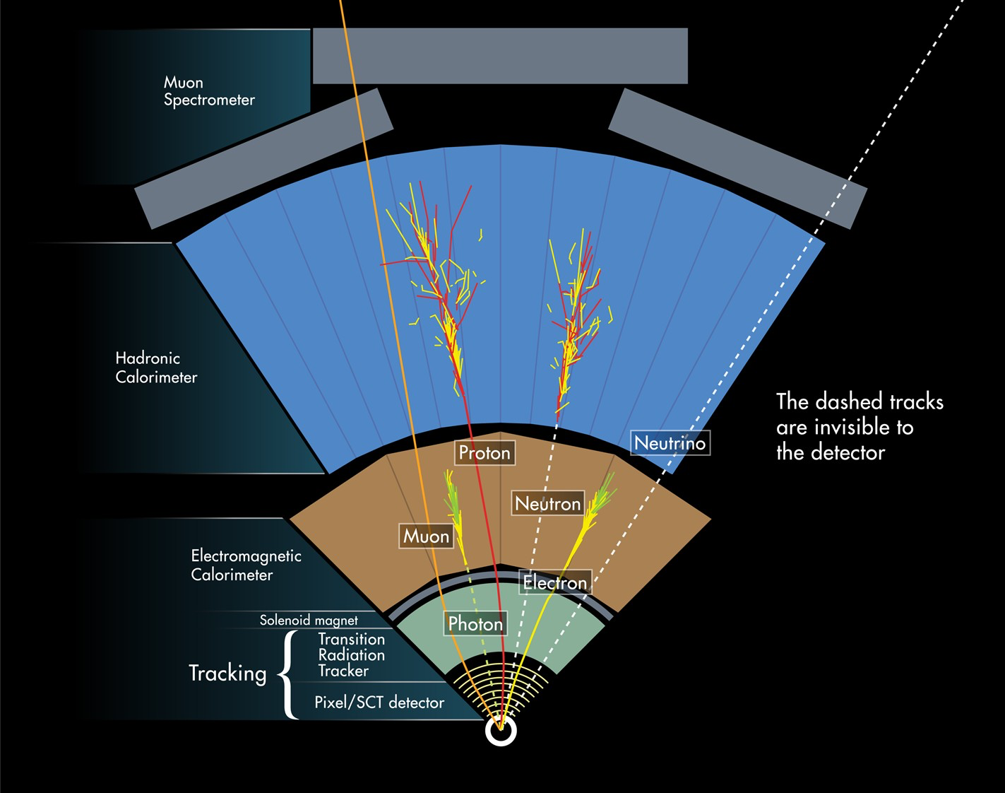
Outline
How ATLAS works

Slide 38
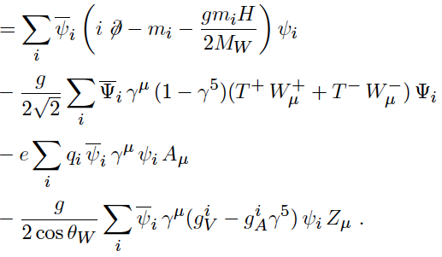
Simulated “Monte Carlo” Data
Once we define a theory of
particle physics, we should in
in principle be able to work out
the probability for any possible
data outcome:
Prob(data | theory)
But the calculations are too difficult. Instead we can create
computer programs that “generate” simulated data using
random numbers (the Monte Carlo method).
We have separate Monte Carlo programs that generate events
corresponding to different theories:
Standard Model, Supersymmetry, extra dimensions,...

Slide 39
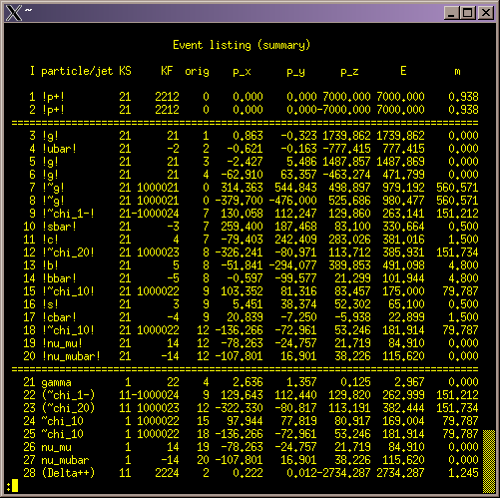
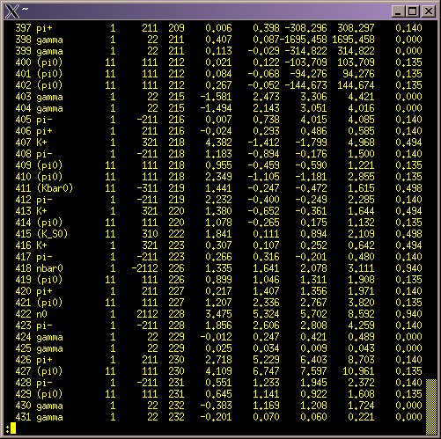
A generated event
PYTHIA Monte Carlo
pp → gluino-gluino

Slide 40
Training data
The most widely used Machine Learning algorithms used in
Particle Physics involve “supervised learning” – this requires
samples of data where the type of event is known.
Nature does not provide labels for the real data, so for this we use
the simulated (Monte Carlo) data.
So for two event types (signal and background) we have
simulated events each with a feature vector and true class label.

Slide 41
A simple example (2D)
Consider two variables, x₁ and x₂, and suppose we have formulas for the joint pdfs for both signal (s) and background (b) events (in real problems the formulas are usually notavailable).
f(x₁|x₂) ~ Gaussian, different means for s/b,
Gaussians have same σ, which depends on x₂,
f(x₂) ~ exponential, same for both s and b,
f(x₁, x₂) = f(x₁|x₂) f(x₂):

Slide 42
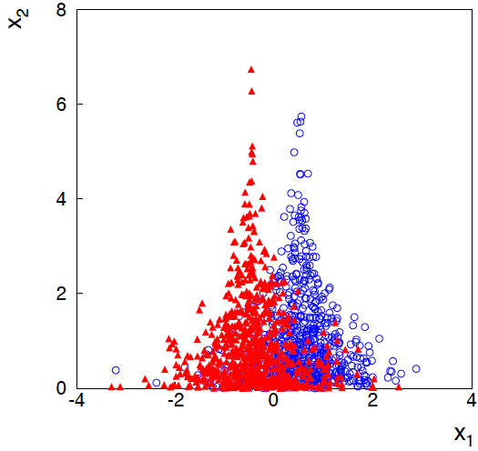
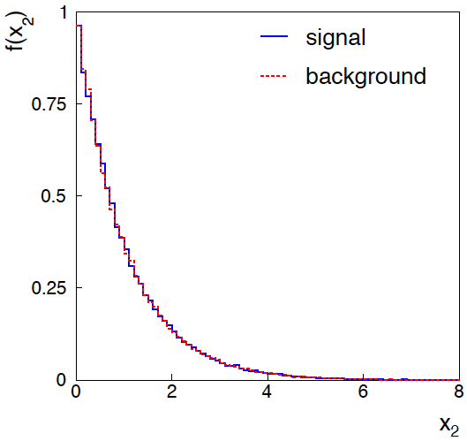
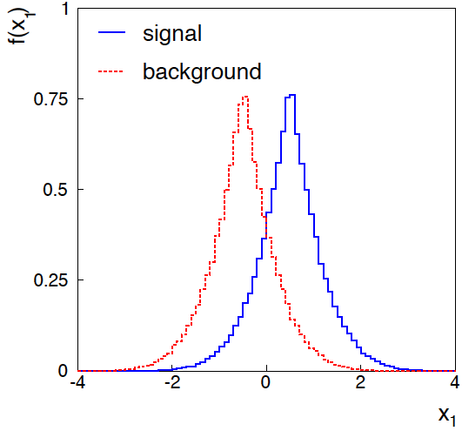
Joint and marginal distributions of x₁, x₂
background
signal
Distribution f(x₂) same for s, b.
So does x₂ help discriminate
between the two event types?

Slide 43
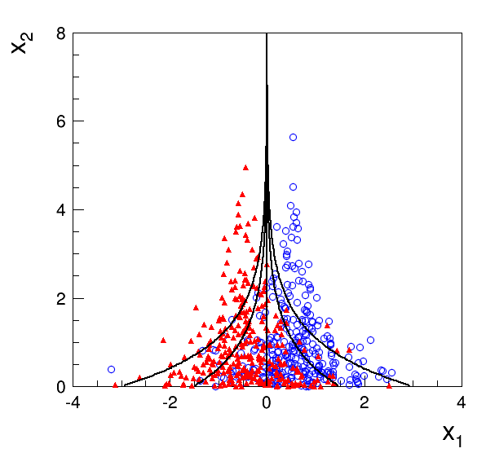
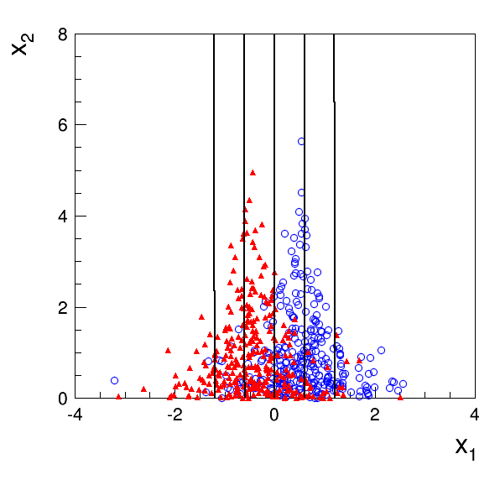
Contours of constant decision function
Exact likelihood ratio
Fisher discriminant
Exact likelihood ratio
(theoretical optimum)
Linear boundary

Slide 44
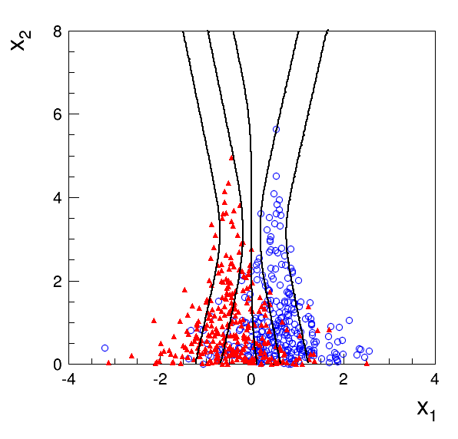
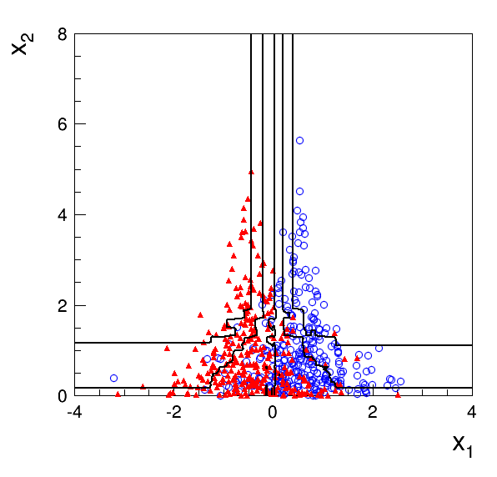
Contours of constant decision function (2)
Multilayer Perceptron
1 hidden layer with 2 nodes
Boosted Decision Tree
200 iterations (AdaBoost)
Training samples: 10⁵ signal and 10⁵ background events

