Slide 1
Confidence Interval Basics
Interval estimation
Confidence interval from inverting a test
Example: limits on mean of Gaussian
Confidence intervals from the likelihood function

Slide 2
Confidence intervals by inverting a test
In addition to a ‘point estimate’ of a parameter we should report
an interval reflecting its statistical uncertainty.
Confidence intervals for a parameter θ can be found by
defining a test of the hypothesized value θ (do this for all θ):
Specify values of the data that are ‘disfavoured’ by θ
(critical region) such that P(data in critical region|θ) ≤ α
for a prespecified α, e.g., 0.05 or 0.1.
If data observed in the critical region, reject the value θ.
Now invert the test to define a confidence interval as:
set of θ values that are not rejected in a test of size α
(confidence level CL is 1− α).

Slide 3
Relation between confidence interval and p-value
Equivalently we can consider a significance test for each
hypothesized value of θ, resulting in a p-value, p_{θ}.
If p_{θ} ≤ α, then we reject θ.
The confidence interval at CL = 1 – α consists of those values of
θ that are not rejected.
E.g. an upper limit on θ is the greatest value for which p_{θ} > α.
In practice find by setting p_{θ} = α and solve for θ.
For a multidimensional parameter space θ = (θ₁,... θ_{M}) use same idea – result is a confidence “region” with boundary determined by p_{θ} = α.

Slide 4
Coverage probability of confidence interval
If the true value of θ is rejected, then it’s not in the confidence interval. The probability for this is by construction (equality for continuous data):
P(reject θ|θ) ≤ α = type-I error rate
Therefore, the probability for the interval to contain or “cover” θ is
P(conf. interval “covers” θ|θ) ≥ 1 – α
This assumes that the set of θ values considered includes the true value, i.e., it assumes the composite hypothesis P(x|H,θ).

Slide 5
Example: upper limit on mean of Gaussian
When we test the parameter, we should take the critical region to maximize the power with respect to the relevant alternative(s).
Example: x ~ Gauss(μ, σ) (take σ known)
Test H₀ : μ = μ₀ versus the alternative H₁ : μ < μ₀
→ Put w_{μ} at region of x-space
characteristic of low μ (i.e. at low x)
Equivalently, take the p-value to be

Slide 6
Upper limit on Gaussian mean (2)
To find confidence interval, repeat for all μ₀, i.e., set p_{μ0} = α and solve for μ₀ to find the interval’s boundary
This is an upper limit on μ, i.e., higher μ have even lower p-value and are in even worse agreement with the data.
Usually use Φ⁻¹(α) = −Φ⁻¹(1−α) so as to express the upper limit as x_{obs} plus a positive quantity. E.g. for α = 0.05, Φ⁻¹(1−0.05) = 1.64.

Slide 7
Approximate confidence intervals/regions from the likelihood function
Suppose we test parameter value(s) θ = (θ₁, ..., θ_{N}) using the ratio
Lower λ(θ) means worse agreement between data and hypothesized θ. Equivalently, usually define
so higher t_{θ} means worse agreement between θ and the data.
p-value of θ therefore
need pdf

Slide 8
Confidence region from Wilks’ theorem
Wilks’ theorem says (in large-sample limit and provided
certain conditions hold...)
chi-square dist. with # d.o.f. =
# of components in θ = (θ₁, ..., θ_{N}).
Assuming this holds, the p-value is
← set equal to α
To find boundary of confidence region set p_{θ} = α and solve for t_{θ}:
Recall also

Slide 9
Confidence region from Wilks’ theorem (cont.)
i.e., boundary of confidence region in θ space is where
For example, for 1 – α = 68.3% and n = 1 parameter,
and so the 68.3% confidence level interval is determined by
Same as recipe for finding the estimator’s standard deviation, i.e.,
is a 68.3% CL confidence interval.

Slide 10
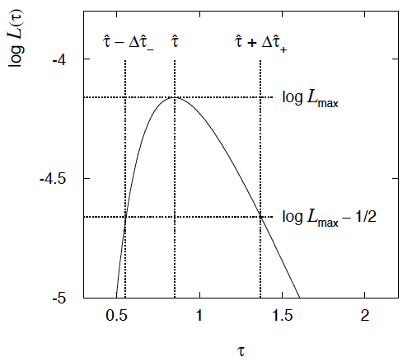
Example of interval from ln L(θ)
For N =1 parameter, CL = 0.683, Q_{α} = 1.
Our exponential
example, now with
only n = 5 events.
Can report ML estimate
with approx. confidence
interval from ln L_{max} – 1/2
as “asymmetric error bar”:

Slide 11
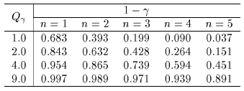
Multiparameter case
For increasing number of parameters, CL = 1 – α decreases for
confidence region determined by a given
← # of par.

Slide 12
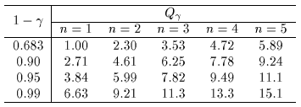
Multiparameter case (cont.)
Equivalently, Q_{α} increases with n for a given CL = 1 – α.
← # of par.

