Slide 1
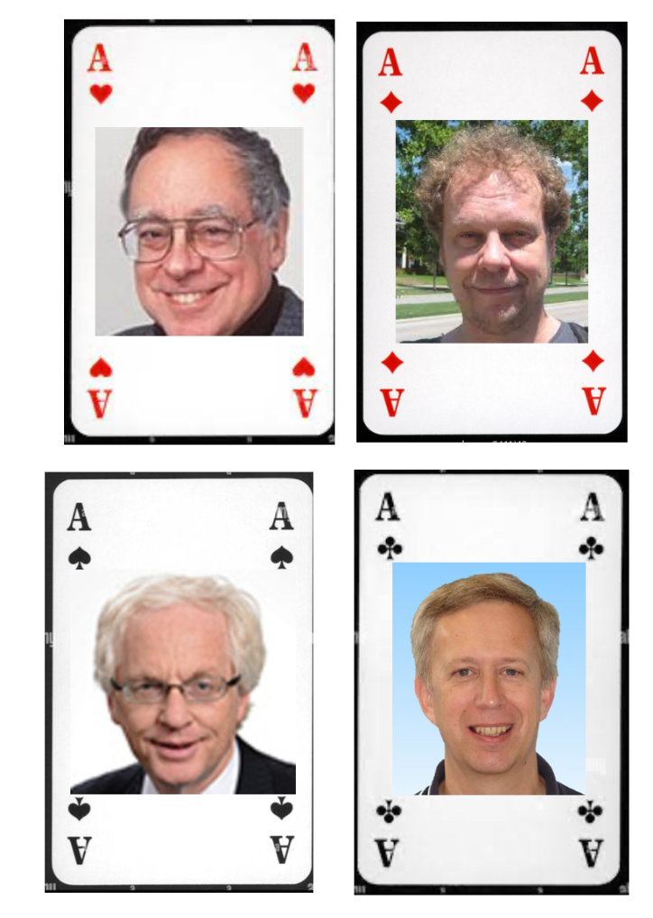


Aachen Online Statistics School
GDC Lecture 1: Bayesian probability and credible intervals
RWTH Aachen (online)
13-17 March 2023
https://indico.desy.de/event/37562/
Glen Cowan
Physics Department
Royal Holloway, University of London
g.cowan@rhul.ac.uk
www.pp.rhul.ac.uk/~cowan

Slide 2
Outline of GDC lectures
→ Tue. 14.3 Probability (Bayes vs. Frequentist) Bayesian parameter and interval estimation
Wed. 15.3 Frequentist confidence regions and intervals
Thu. 16.3 Python software for frequentist and Bayesian confidence regions.
Fri. 17.3 Searches and discoveries using likelihoods

Slide 3
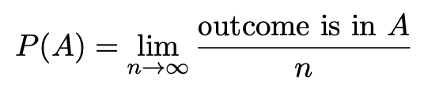

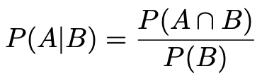

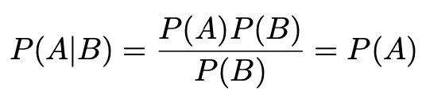
A quick review of probability
Frequentist (A = outcome of
repeatable observation)
Subjective (A = hypothesis)
Conditional probability:
E.g. rolling a die, outcome n = 1,2,...,6:
A and B are independent iff:
I.e. if A, B independent, then

Slide 4

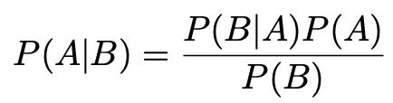
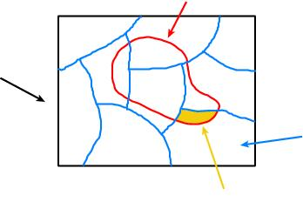
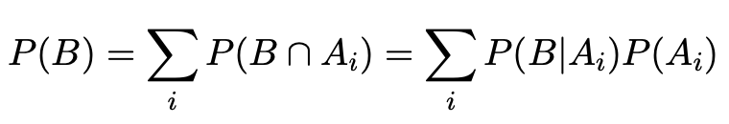
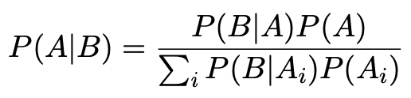
Bayes’ theorem
Use definition of conditional probability and
→
(Bayes’ theorem)
B
If set of all outcomes S = ∪_{i} A_{i}
with A_{i} disjoint, then law of total probability for P(B) says
S
A_{i}
B ∩ A_{i}
so that Bayes’ theorem becomes
Bayes’ theorem holds regardless of how probability is interpreted (frequency, degree of belief...).

Slide 5
Frequentist Statistics − general philosophy
In frequentist statistics, probabilities are associated only with
the data, i.e., outcomes of repeatable observations (shorthand: x).
Probability = limiting frequency
Probabilities such as
P (string theory is true),
P (0.117 < α_{s} < 0.119),
P (Biden wins in 2024),
etc. are either 0 or 1, but we don’t know which.
The tools of frequentist statistics tell us what to expect, under
the assumption of certain probabilities, about hypothetical
repeated observations.
Preferred theories (models, hypotheses, ...) are those that predict a high probability for data “like” the data observed.

Slide 6
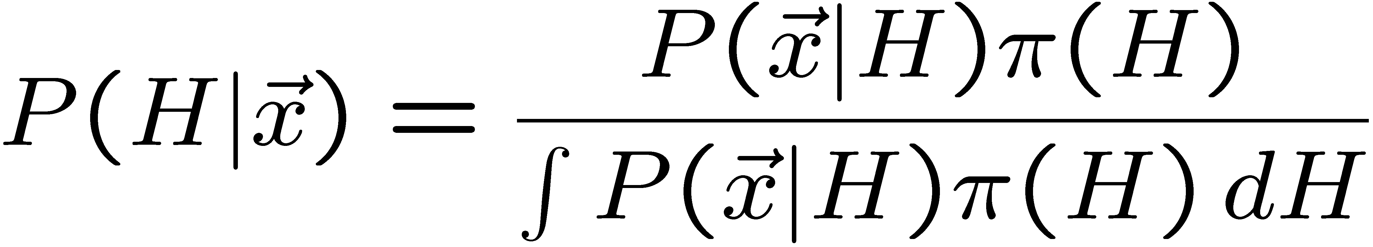
Bayesian Statistics − general philosophy
In Bayesian statistics, use subjective probability for hypotheses:
probability of the data assuming
hypothesis H (the likelihood)
prior probability, i.e.,
before seeing the data
posterior probability, i.e.,
after seeing the data
normalization involves sum
over all possible hypotheses
Bayes’ theorem has an “if-then” character: If your prior
probabilities were π(H), then it says how these probabilities
should change in the light of the data.
No general prescription for priors (subjective!)

Slide 7
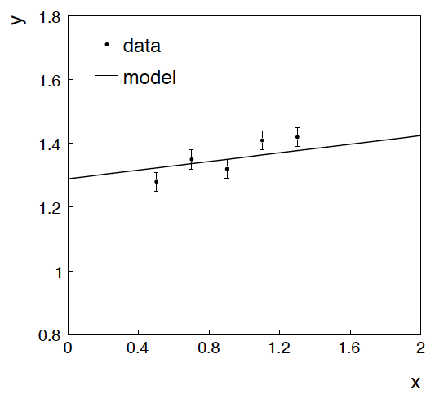
Bayesian parameter estimation
Example: fitting a straight line
Data:
Model: y_{i} independent and all follow y_{i} ~ Gauss(μ(x_{i} ), σ_{i} )
assume x_{i} and σ_{i} known.
Goal: estimate θ₀
Here suppose we don’t care
about θ₁ (example of a
“nuisance parameter”)

Slide 8
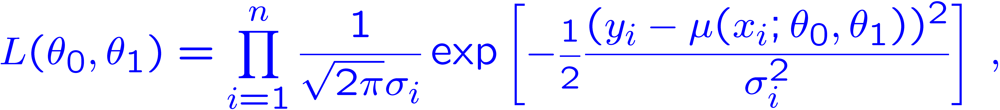
Connection with Maximum Likelihood and Least Squares
Both the Bayesian a Frequentist approaches require the likelihood, P(data|parameters) = P(y|θ) = L(θ₀, θ₁).
In this example, the y_{i} are assumed independent, so the
likelihood function is a product of Gaussians:
Maximizing the likelihood is here equivalent to minimizing
i.e., for Gaussian data, ML same as Method of Least Squares (LS)

Slide 9
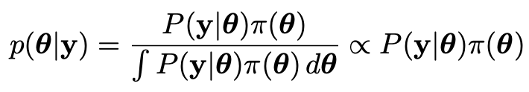
Probability in the Bayesian approach
In Bayesian statistics we can associate a probability with
a hypothesis, e.g., a parameter θ.
Interpret probability of θ as ‘degree of belief’ (subjective).
Need to start with ‘prior pdf’ π(θ), this reflects degree
of belief about θ before doing the experiment.
Our experiment has data y, → likelihood P(y|θ).
Bayes’ theorem tells how our beliefs should be updated in
light of the data y:
Posterior pdf p(θ|y) contains all our knowledge about θ.

Slide 10
Assigning prior probabilities
We need to associate prior probabilities with θ₀ and θ₁, e.g.,
← suppose knowledge of θ₀ has no influence on knowledge of θ₁
← ‘non-informative’, in any
case much broader than L(θ₀)
Suppose we have an independent control measurement of θ₁, e.g., t₁ ~ Gauss(θ₁, σ_{t1}). Take “prior” to mean after t₁, before y:
prior after t₁,
before y
Ur = “primordial”
prior
Likelihood for control
measurement t₁

Slide 11
Posterior for parameters from Bayes’ theorem
Putting the ingredients into Bayes’ theorem gives:
posterior ∝ likelihood ✕ prior
Note here the likelihood only reflects the measurements y.
The information from the control measurement t₁ has been put into the prior for θ₁.
We would get the same result using the likelihood P(y,t|θ₀,θ₁) and the constant “Ur-prior” for θ₁.

Slide 12
Marginalizing the posterior pdf
We then integrate (marginalize) p(θ₀, θ₁ | y) to find p(θ₀ | y):
In this example we can do the integral (rare). We find
same as from maximum likelihood
(same as for maximum likelihood)
For this example, numbers come out same as in frequentist approach, but interpretation different.

Slide 13
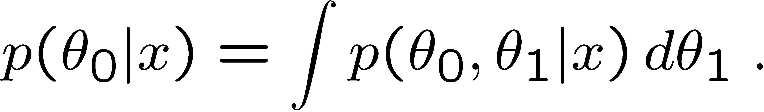

Marginalization with MCMC
Bayesian computations involve integrals like
often high dimensionality and impossible in closed form,
also impossible with ‘normal’ acceptance-rejection Monte Carlo.
→ Use Markov Chain Monte Carlo (MCMC)
Bayesian Analysis Toolkit: https://github.com/bat/BAT.jl
MCMC (e.g., Metropolis-Hastings algorithm) generates
correlated sequence of random numbers:
cannot use for many applications, e.g., detector MC;
effective stat. error greater than if all values independent .
Basic idea: sample multidimensional θ but look only at distribution of parameters of interest.

Slide 14
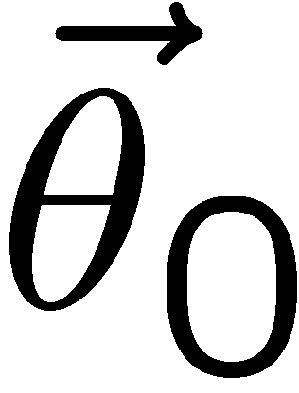
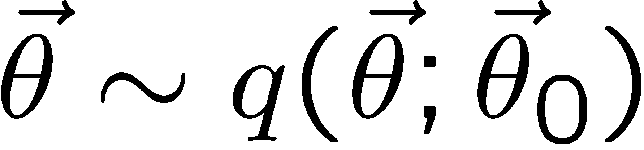
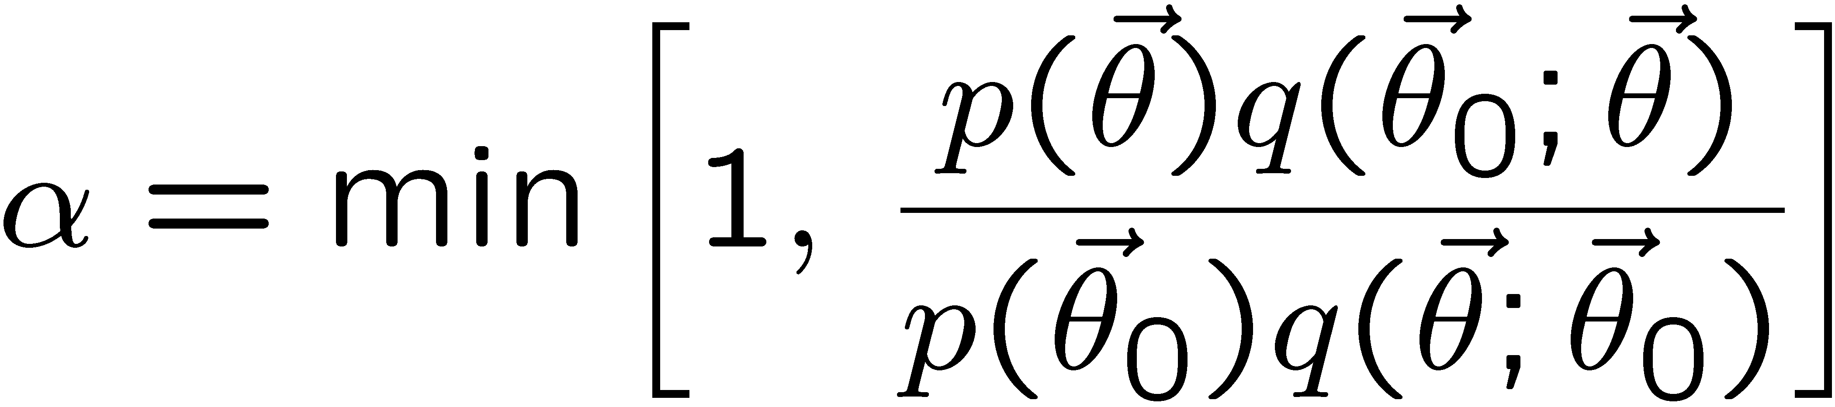
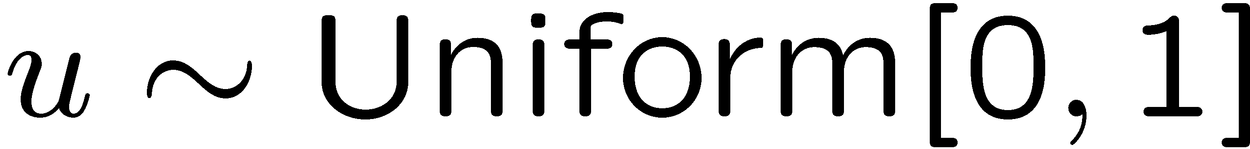
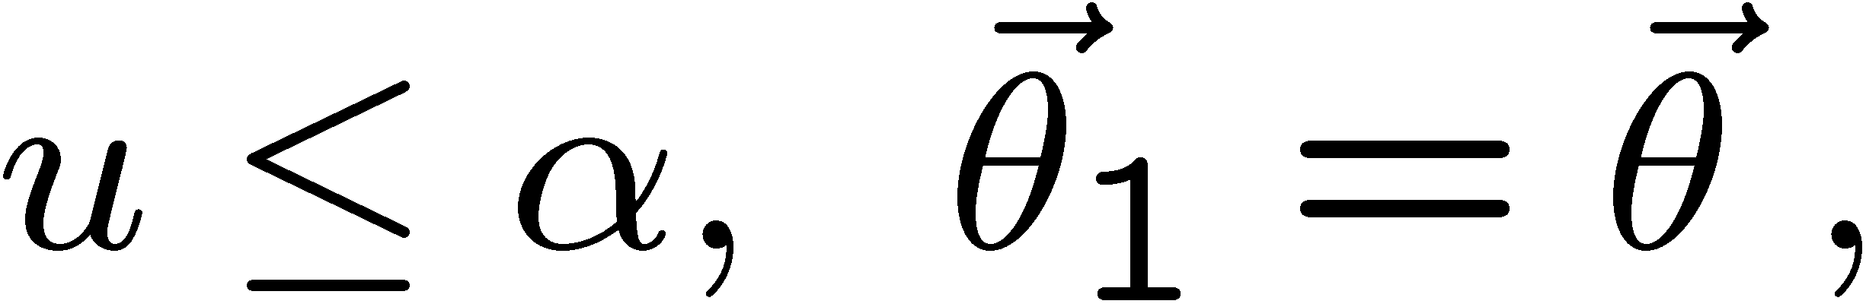
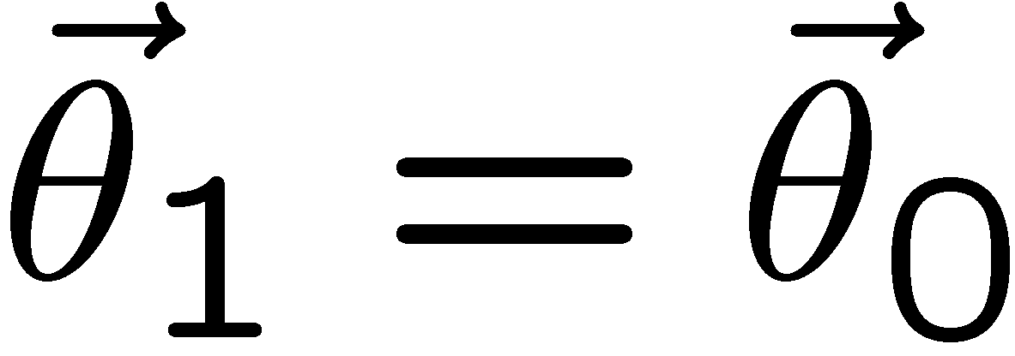
MCMC basics: Metropolis-Hastings algorithm
Goal: given an n-dimensional pdf p(θ) up to a proportionality constant, generate a sequence of points θ₁ , θ₂ , θ₃ ,...
Proposal density q(θ; θ₀ )
e.g. Gaussian centred
about θ₀
1) Start at some point
2) Generate
3) Form test ratio
4) Generate
5) If
move to proposed point
else
old point repeated
6) Iterate

Slide 15
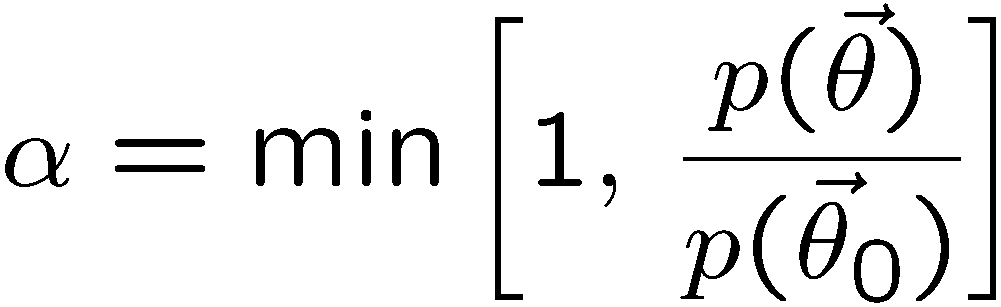
Metropolis-Hastings (continued)
This rule produces a correlated sequence of points (note how
each new point depends on the previous one).
Still works if p(θ) is known only as a proportionality, which is
usually what we have from Bayes’ theorem: p(θ|x) ∝ p(x|θ) π(θ).
The proposal density can be (almost) anything, but choose
so as to minimize autocorrelation. Often take proposal
density symmetric: q(θ; θ₀ ) = q(θ₀; θ )
Test ratio is (Metropolis-Hastings):
I.e. if the proposed step is to a point of higher p(θ), take it;
if not, only take the step with probability p(θ)/p(θ₀).
If proposed step rejected, repeat the current point.

Slide 16

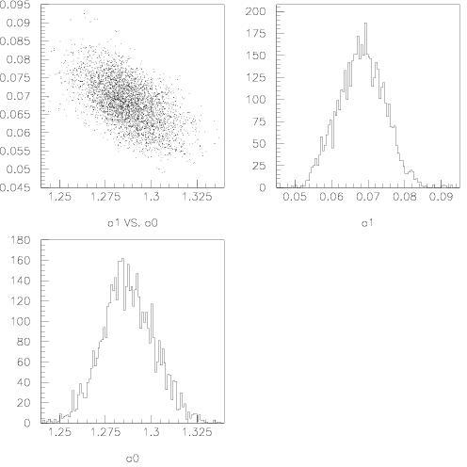
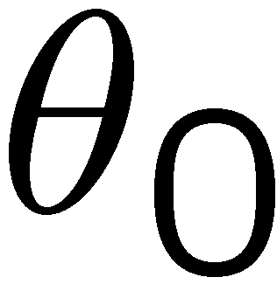
Example: posterior pdf from MCMC
Sample the posterior pdf from previous example with MCMC:
Normalized histogram of θ₀ gives its marginal posterior pdf:

Slide 17
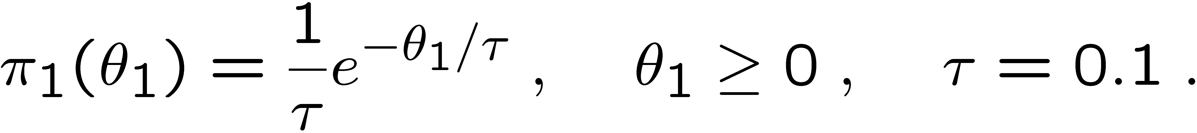
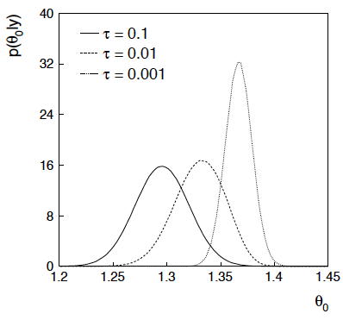
Bayesian method with alternative priors
Suppose we don’t have a previous measurement of θ₁ but rather,
an “expert” says it should be positive and not too much greater than 0.1 or so, i.e., something like
From this we obtain (numerically) the posterior pdf for θ₀:
This summarizes all
knowledge about θ₀.
Look also at result from
variety of priors.

Slide 18

The Poisson counting experiment
Suppose we do a counting experiment and observe n events.
Events could be from signal process or from background –
we only count the total number.
Poisson model:
s = mean (i.e., expected) # of signal events
b = mean # of background events (suppose known)
Goal is to make inference about s, e.g., given an observed n, set an upper limit on s.

Slide 19
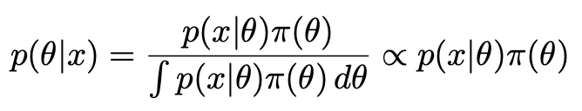
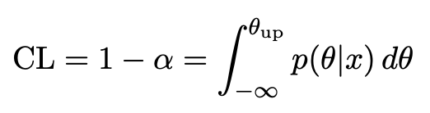

The Bayesian approach to limits
In Bayesian statistics need to start with ‘prior pdf’ π(θ), this
reflects degree of belief about θ before doing the experiment.
Bayes’ theorem tells how our beliefs should be updated in
light of the data x:
Normalize posterior pdf p(θ|x) to unity, then integrate to give interval with any desired probability content (or “credibility level” CL or 1 − α), e.g., CL = 95%:

Slide 20
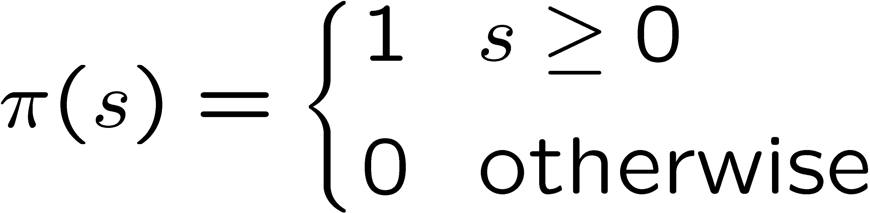
Bayesian prior for Poisson parameter
Include knowledge that s ≥ 0 by setting prior π(s) = 0 for s < 0.
Could try to reflect ‘prior ignorance’ with e.g.
Not normalized; can be OK provided p(n|s) dies off quickly for large s.
Not invariant under change of parameter — if we had used instead a flat prior for a nonlinear function of s, then this would imply a non-flat prior for s.
Doesn’t really reflect a reasonable degree of belief, but often used as a point of reference; or viewed as a recipe for producing an interval whose frequentist properties can be studied (e.g., coverage probability, which will depend on true s).

Slide 21
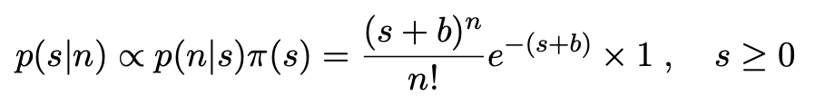


Bayesian upper limit with flat prior for s
Put Poisson likelihood and flat prior into Bayes’ theorem:
Normalize to unit area:
upper incomplete
gamma function
Upper limit s_{up} determined by

Slide 22


Bayesian interval with flat prior for s
Solve to find limit s_{up}:
quantile of chi-square distribution
where
For special case b = 0, Bayesian upper limit with flat prior
numerically same as one-sided frequentist case (‘coincidence’).

Slide 23
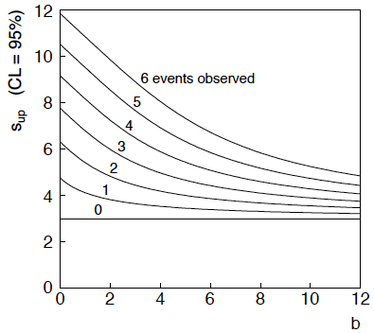
Bayesian interval with flat prior for s
For b > 0 Bayesian limit is everywhere greater than the (one sided) frequentist upper limit.
Never goes negative. Doesn’t depend on b if n = 0.

Slide 24
Priors from formal rules
We took the prior for a Poisson mean to be constant to reflect a lack of prior knowledge and noted this was not invariant under change of parameter.
Because of difficulties in encoding a vague degree of belief
in a prior, one often attempts to derive the prior from formal rules,
e.g., to satisfy certain invariance principles or to provide maximum
information gain for a certain set of measurements.
Often called “objective priors”
Form basis of Objective Bayesian Statistics
The priors do not reflect a degree of belief (but might represent
possible extreme cases).
In Objective Bayesian analysis, can use the intervals in a
frequentist way, i.e., regard Bayes’ theorem as a recipe to produce
an interval with a given coverage probability.

Slide 25

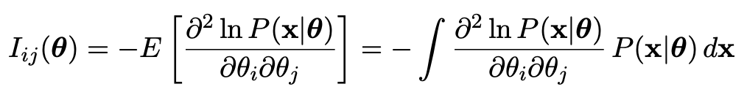
Jeffreys prior
According to Jeffreys’ rule, take prior according to
where
is the Fisher information matrix.
One can show that this leads to inference that is invariant under
a transformation of parameters in the following sense:
Start with the Jeffreys prior for θ: π_{θ}(θ) ~ √(det I(θ))
Use it in Bayes’ theorem to find:

Slide 26
Jeffreys prior (2)
Now consider a function η(θ). The posterior for η is
Alternatively, start with η and use its Jeffreys’ prior:
Use this in Bayes’ theorem:
One can show that Jeffreys’ prior results in the same P(η|x) in both cases. For details (single-parameter case) see:
http://www.pp.rhul.ac.uk/~cowan/stat/notes/JeffreysInvariance.pdf

Slide 27
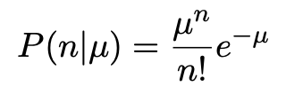
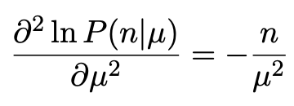
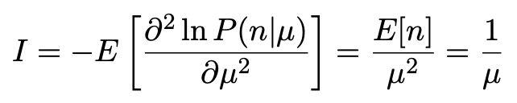

Jeffreys prior for Poisson mean
Suppose n ~ Poisson(μ). To find the Jeffreys’ prior for μ,
So e.g. for μ = s + b, this means the prior π(s) ~ 1/√(s + b), which depends on b. But this is not designed as a degree of belief about s.

Slide 28
Posterior pdf for Poisson mean
From Bayes’ theorem,
Flat, π(μ) = const.
Jeffreys, π(μ) ~ 1/√μ
In both cases, posterior is special case of gamma distribution.

Slide 29
Upper limit for Poisson mean
To find upper limit at CL = 1−α, solve
Jeffreys prior:
= 7.03
n=3,
CL=0.95
Flat prior:
= 7.75
where P⁻¹ is the inverse of the normalized lower incomplete gamma function (see scipy.special)

Slide 30
Summing up...
Bayesian methods allow one to associate a probability with a hypothesis, e.g., a hypothesized parameter.
The final result consists of the posterior probability for the hypothesis (or parameter) given the observed data (or a summary statistic obtained from it, e.g., a limit).
Requires one to specify prior probabilities.
Bayesian computation involves integrals over parameter space (MCMC).
Sometimes (often?) use Bayesian methods to obtain a result, then “forget” its Bayesian origins and exploit its frequentist properties.

Slide 31
Extra slides

Slide 32
Priors from formal rules (cont.)
For a review of priors obtained by formal rules see, e.g.,
Formal priors have not been widely used in Particle Physics, but there has been interest in this direction, especially the reference priors of Bernardo and Berger; see e.g.
L. Demortier, S. Jain and H. Prosper, Reference priors for high
energy physics, Phys. Rev. D 82 (2010) 034002, arXiv:1002.1111.
D. Casadei, Reference analysis of the signal + background model
in counting experiments, JINST 7 (2012) 01012; arXiv:1108.4270.

