Slide 1


Statistics for Particle Physicists
Lecture 2
Academic Training Lectures
CERN / Zoom
21-24 June 2021
https://indico.cern.ch/event/1040094/
Glen Cowan
Physics Department
Royal Holloway, University of London
g.cowan@rhul.ac.uk
www.pp.rhul.ac.uk/~cowan

Slide 2
Outline
Lecture 1: Introduction, probability, parameter estimation
Lecture 2: Hypothesis tests, limits
Lecture 3: Systematic uncertainties, experimental sensitivity
Lecture 4: Bayesian methods, Student’s t regression

Slide 3
Frequentist hypothesis tests
Suppose a measurement produces data x; consider a hypothesis H₀
we want to test and alternative H₁
H₀, H₁ specify probability for x: P(x|H₀), P(x|H₁)
A test of H₀ is defined by specifying a critical region w of the
data space such that there is no more than some (small) probability
α, assuming H₀ is correct, to observe the data there, i.e.,
P(x ∈ w | H₀) ≤ α
Need inequality if data are
discrete.
α is called the size or
significance level of the test.
If x is observed in the
critical region, reject H₀.
data space Ω
critical region w

Slide 4



Definition of a test (2)
But in general there are an infinite number of possible critical regions that give the same size α.
Use the alternative hypothesis H₁ to motivate where to place the critical region.
Roughly speaking, place the critical region where there is a low
probability (α) to be found if H₀ is true, but high if H₁ is true:

Slide 5


Classification viewed as a statistical test
Suppose events come in two possible types:
s (signal) and b (background)
For each event, test hypothesis that it is background, i.e., H₀ = b.
Carry out test on many events, each is either of type s or b, i.e., here the hypothesis is the “true class label”, which varies randomly from event to event, so we can assign to it a frequentist probability.
Select events for which where H₀ is rejected as “candidate events of type s”. Equivalent Particle Physics terminology:
background efficiency
signal efficiency

Slide 6
Example of a test for classification
Suppose we can measure for
each event a quantity x, where
with 0 ≤ x ≤ 1.
For each event in a mixture of signal (s) and background (b) test
H₀ : event is of type b
using a critical region W of the form: W = { x : x ≤ x_{c} }, where
x_{c} is a constant that we choose to give a test with the desired size α.

Slide 7
Classification example (2)
Suppose we want α = 10⁻⁴. Require:
and therefore
For this test (i.e. this critical region W), the power with respect to the signal hypothesis (s) is
Note: the optimal size and power is a separate question that will depend on goals of the subsequent analysis.

Slide 8
Classification example (3)
Suppose that the prior probabilities for an event to be of type s or b are:
π_{s} = 0.001
π_{b} = 0.999
The “purity” of the selected signal sample (events where b hypothesis rejected) is found using Bayes’ theorem:

Slide 9
Test statistic based on likelihood ratio
How can we choose a test’s critical region in an ‘optimal way’, in particular if the data space is multidimensional?
Neyman-Pearson lemma states:
For a test of H₀ of size α, to get the highest power with respect to the
alternative H₁ we need for all x in the critical region W
”likelihood
ratio (LR)”
inside W and ≤ c_{α} outside, where c_{α} is a constant chosen to give a test of the desired size.
Equivalently, optimal scalar test statistic is
N.B. any monotonic function of this is leads to the same test.

Slide 10
Testing significance / goodness-of-fit
Suppose hypothesis H predicts pdf f (x|H) for a set of
observations x = (x₁,...x_{n}).
We observe a single point in this space: x_{obs}.
How can we quantify the level of compatibility between the data and the predictions of H?
x_{j}
x_{obs}
Decide what part of
the data space represents equal or less compatibility with H than does the point x_{obs}. (Not unique!)
ω> = { x : x “more
compatible” with H }
ω≤ = { x : x “less
or eq. compatible”
with H }
x_{i}

Slide 11
p-values
Express level of compatibility between data and hypothesis (sometimes ‘goodness-of-fit’) by giving the p-value for H:
= probability, under assumption of H, to observe data with equal or lesser compatibility with H relative to the data we got.
= probability, under assumption of H, to observe data as discrepant with H as the data we got or more so.
Basic idea: if there is only a very small probability to find data
with even worse (or equal) compatibility, then H is “disfavoured by the data”.
If the p-value is below a user-defined threshold α (e.g. 0.05) then H is rejected (equivalent to hypothesis test as discussed previously).

Slide 12

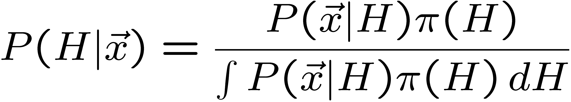
p-value of H is not P(H)
The p-value of H is not the probability that H is true!
In frequentist statistics we don’t talk about P(H) (unless H
represents a repeatable observation).
If we do define P(H), e.g., in Bayesian statistics as a degree of belief, then we need to use Bayes’ theorem to obtain
where π(H) is the prior probability for H.
For now stick with the frequentist approach;
result is p-value, regrettably easy to misinterpret as P(H).

Slide 13

The Poisson counting experiment
Suppose we do a counting experiment and observe n events.
Events could be from signal process or from background –
we only count the total number.
Poisson model:
s = mean (i.e., expected) # of signal events
b = mean # of background events
Goal is to make inference about s, e.g.,
test s = 0 (rejecting H₀ ≈ “discovery of signal process”)
test all non-zero s (values not rejected = confidence interval)
In both cases need to ask what is relevant alternative hypothesis.

Slide 14
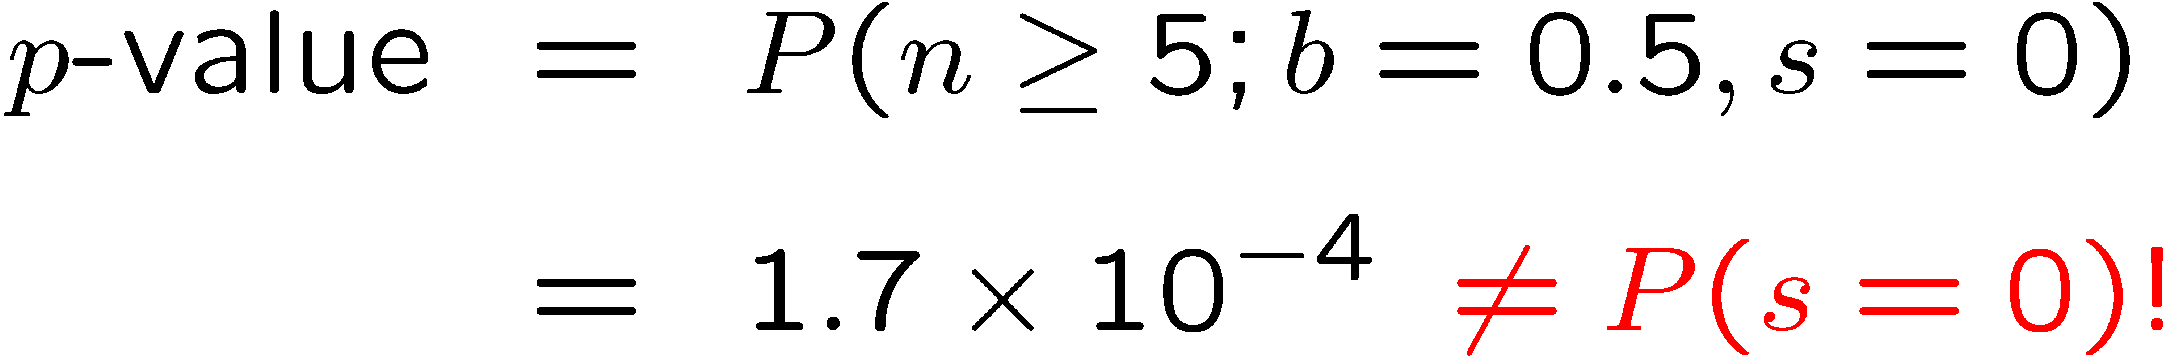
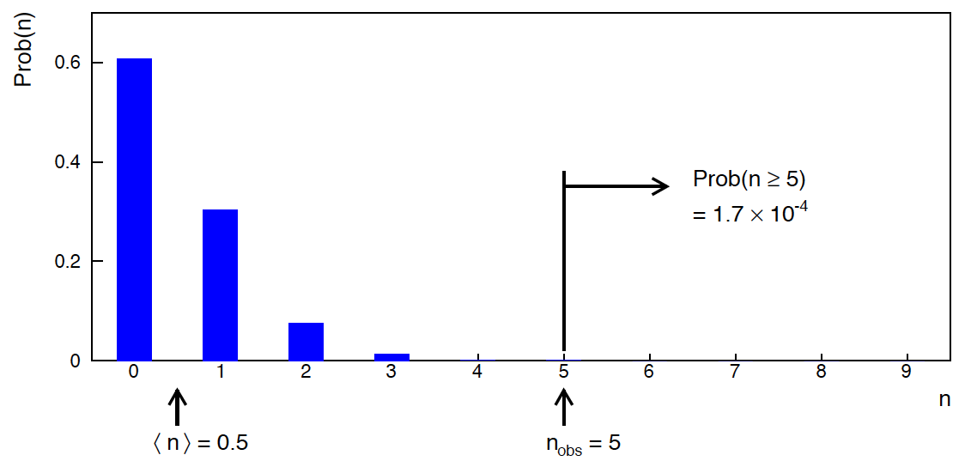
Poisson counting experiment: discovery p-value
Suppose b = 0.5 (known), and we observe n_{obs} = 5.
Should we claim evidence for a new discovery?
Give p-value for hypothesis s = 0:

Slide 15
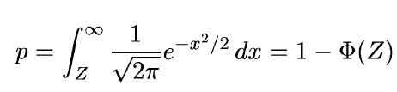
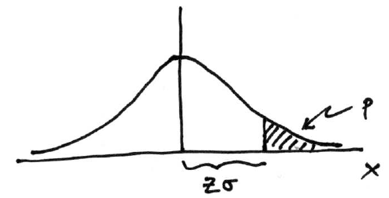

Significance from p-value
Often define significance Z as the number of standard deviations
that a Gaussian variable would fluctuate in one direction
to give the same p-value.
in ROOT:
p = 1 - TMath::Freq(Z)
Z = TMath::NormQuantile(1-p)
in python (scipy.stats):
p = 1 - norm.cdf(Z) = norm.sf(Z)
Z = norm.ppf(1-p)
Result Z is a “number of sigmas”. Note this does not mean that
the original data was Gaussian distributed.

Slide 16

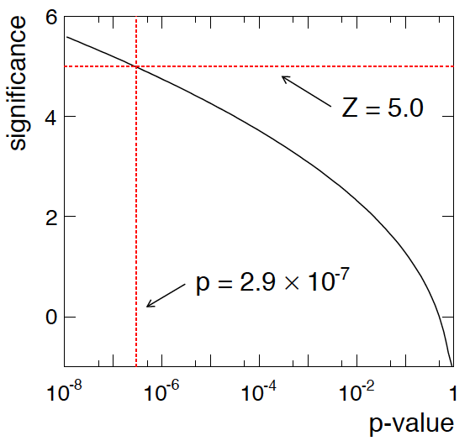
Poisson counting experiment: discovery significance
Equivalent significance for p = 1.7 × 10⁻⁴:
Often claim discovery if Z > 5 (p < 2.9 × 10⁻⁷, i.e., a “5-sigma effect”)
In fact this tradition should be revisited: p-value intended to quantify probability of a signal-like fluctuation assuming background only; not intended to cover, e.g., hidden systematics, plausibility signal model, compatibility of data with signal, “look-elsewhere effect”
(~multiple testing), etc.

Slide 17
Confidence intervals by inverting a test
In addition to a ‘point estimate’ of a parameter we should report
an interval reflecting its statistical uncertainty.
Confidence intervals for a parameter θ can be found by
defining a test of the hypothesized value θ (do this for all θ):
Specify values of the data that are ‘disfavoured’ by θ
(critical region) such that P(data in critical region|θ) ≤ α
for a prespecified α, e.g., 0.05 or 0.1.
If data observed in the critical region, reject the value θ.
Now invert the test to define a confidence interval as:
set of θ values that are not rejected in a test of size α
(confidence level CL is 1− α).

Slide 18
Relation between confidence interval and p-value
Equivalently we can consider a significance test for each
hypothesized value of θ, resulting in a p-value, p_{θ}.
If p_{θ} ≤ α, then we reject θ.
The confidence interval at CL = 1 – α consists of those values of
θ that are not rejected.
E.g. an upper limit on θ is the greatest value for which p_{θ} > α.
In practice find by setting p_{θ} = α and solve for θ.
For a multidimensional parameter space θ = (θ₁,... θ_{M}) use same idea – result is a confidence “region” with boundary determined by p_{θ} = α.

Slide 19
Coverage probability of confidence interval
If the true value of θ is rejected, then it’s not in the confidence interval. The probability for this is by construction (equality for continuous data):
P(reject θ|θ) ≤ α = type-I error rate
Therefore, the probability for the interval to contain or “cover” θ is
P(conf. interval “covers” θ|θ) ≥ 1 – α
This assumes that the set of θ values considered includes the true value, i.e., it assumes the composite hypothesis P(x|H,θ).

Slide 20



Frequentist upper limit on Poisson parameter
Consider again the case of observing n ~ Poisson(s + b).
Suppose b = 4.5, n_{obs} = 5. Find upper limit on s at 95% CL.
Relevant alternative is s = 0 (critical region at low n)
p-value of hypothesized s is P(n ≤ n_{obs}; s, b)
Upper limit s_{up} at CL = 1 – α found from

Slide 21
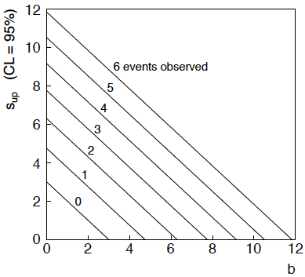
n ~ Poisson(s+b): frequentist upper limit on s
For low fluctuation of n, formula can give negative result for s_{up}; i.e. confidence interval is empty; all values of s ≥ 0 have p_{s} ≤ α.

Slide 22
Limits near a boundary of the parameter space
Suppose e.g. b = 2.5 and we observe n = 0.
If we choose CL = 0.9, we find from the formula for s_{up}
Physicist:
We already knew s ≥ 0 before we started; can’t use negative
upper limit to report result of expensive experiment!
Statistician:
The interval is designed to cover the true value only 90%
of the time — this was clearly not one of those times.
Not uncommon dilemma when testing parameter values for which
one has very little experimental sensitivity, e.g., very small s.

Slide 23
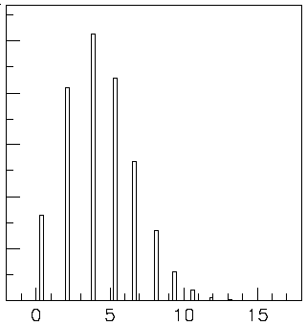

Expected limit for s = 0
Physicist: I should have used CL = 0.95 — then s_{up} = 0.496
Even better: for CL = 0.917923 we get s_{up} = 10⁻⁴ !
Reality check: with b = 2.5, typical Poisson fluctuation in n is
at least √2.5 = 1.6. How can the limit be so low?
Look at the mean limit for the
no-signal hypothesis (s = 0)
(sensitivity).
Distribution of 95% CL limits
with b = 2.5, s = 0.
Mean upper limit = 4.44

Slide 24




Approximate confidence intervals/regions
from the likelihood function
Suppose we test parameter value(s) θ = (θ₁, ..., θ_{n}) using the ratio
Lower λ(θ) means worse agreement between data and hypothesized θ. Equivalently, usually define
so higher t_{θ} means worse agreement between θ and the data.
p-value of θ therefore
need pdf

Slide 25




Confidence region from Wilks’ theorem
Wilks’ theorem says (in large-sample limit and provided
certain conditions hold...)
chi-square dist. with # d.o.f. =
# of components in θ = (θ₁, ..., θ_{n}).
Assuming this holds, the p-value is
← set equal to α
To find boundary of confidence region set p_{θ} = α and solve for t_{θ}:
Recall also

Slide 26




Confidence region from Wilks’ theorem (cont.)
i.e., boundary of confidence region in θ space is where
For example, for 1 – α = 68.3% and n = 1 parameter,
and so the 68.3% confidence level interval is determined by
Same as recipe for finding the estimator’s standard deviation, i.e.,
is a 68.3% CL confidence interval.

Slide 27
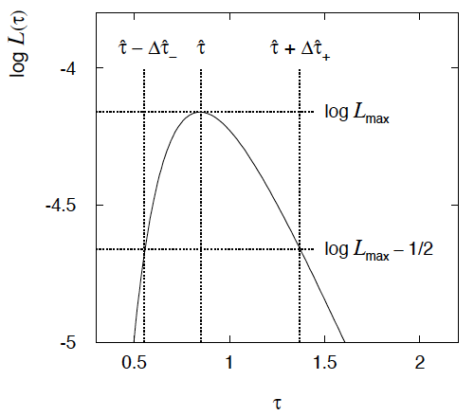

Example of interval from ln L(θ)
For n=1 parameter, CL = 0.683, Q_{α} = 1.
Our exponential
example, now with
only n = 5 events.
Can report ML estimate
with approx. confidence
interval from ln L_{max} – 1/2
as “asymmetric error bar”:

Slide 28

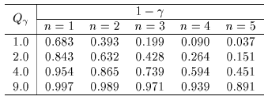

Multiparameter case
For increasing number of parameters, CL = 1 – α decreases for
confidence region determined by a given

Slide 29
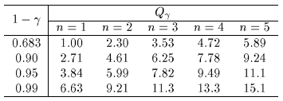
Multiparameter case (cont.)
Equivalently, Q_{α} increases with n for a given CL = 1 – α.

Slide 30
Next time...
Lecture 1: Introduction, probability, parameter estimation
Lecture 2: Hypothesis tests, limits
Lecture 3: Systematic uncertainties, experimental sensitivity
Lecture 4: Bayesian methods, Student’s t regression

Slide 31
Extra slides

Slide 32
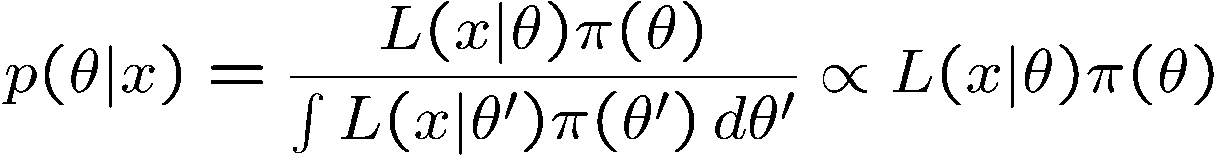
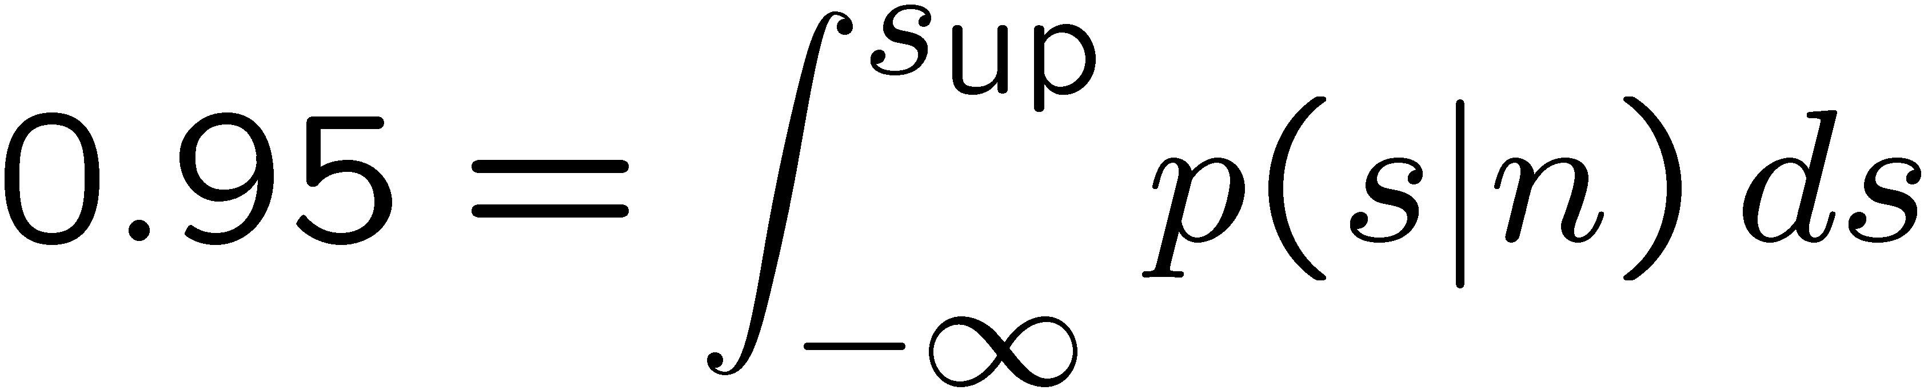
The Bayesian approach to limits
In Bayesian statistics need to start with ‘prior pdf’ π(θ), this
reflects degree of belief about θ before doing the experiment.
Bayes’ theorem tells how our beliefs should be updated in
light of the data x:
Integrate posterior pdf p(θ|x) to give interval with any desired
probability content.
For e.g. n ~ Poisson(s+b), 95% CL upper limit on s from

Slide 33
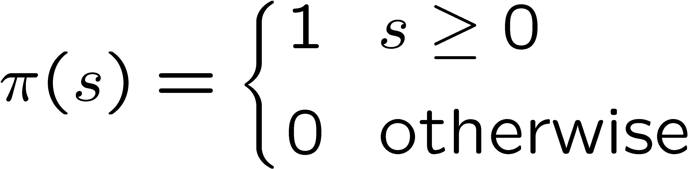
Bayesian prior for Poisson parameter
Include knowledge that s ≥ 0 by setting prior π(s) = 0 for s < 0.
Could try to reflect ‘prior ignorance’ with e.g.
Not normalized; can be OK provided L(s) dies off quickly for large s.
Not invariant under change of parameter — if we had used instead a flat prior for a nonlinear function of s, then this would imply a non-flat prior for s.
Doesn’t really reflect a reasonable degree of belief, but often used as a point of reference; or viewed as a recipe for producing an interval whose frequentist properties can be studied (e.g., coverage probability, which will depend on true s).

Slide 34



Bayesian upper limit with flat prior for s
Put Poisson likelihood and flat prior into Bayes’ theorem:
Normalize to unit area:
upper incomplete
gamma function
Upper limit s_{up} determined by requiring

Slide 35


Bayesian interval with flat prior for s
Solve to find limit s_{up}:
where
For special case b = 0, Bayesian upper limit with flat prior
numerically same as one-sided frequentist case (‘coincidence’).

Slide 36
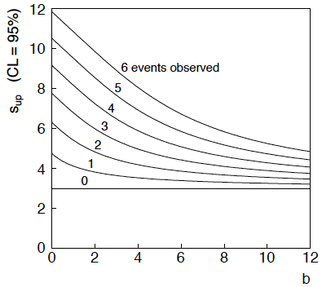
Bayesian interval with flat prior for s
For b > 0 Bayesian limit is everywhere greater than the (one sided) frequentist upper limit.
Never goes negative. Doesn’t depend on b if n = 0.

Slide 37
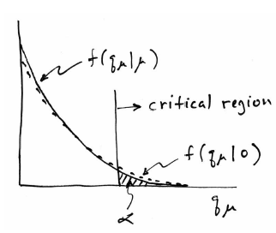
Low sensitivity to μ
It can be that the effect of a given hypothesized μ is very small
relative to the background-only (μ = 0) prediction.
This means that the distributions f (q_{μ}|μ) and f (q_{μ}|0) will be
almost the same:

Slide 38
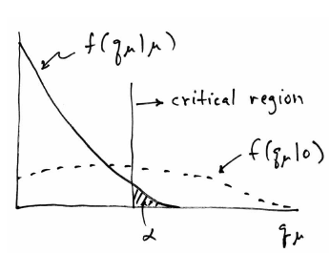
Having sufficient sensitivity
In contrast, having sensitivity to μ means that the distributions
f(q_{μ}|μ) and f(q_{μ}|0) are more separated:
That is, the power (probability to reject μ if μ = 0) is substantially
higher than α. Use this power as a measure of the sensitivity.

Slide 39
Spurious exclusion
Consider again the case of low sensitivity. By construction the probability to reject μ if μ is true is α (e.g., 5%).
And the probability to reject μ if μ = 0 (the power) is only slightly greater than α.
This means that with probability of around α = 5% (slightly higher), one excludes hypotheses to which one has essentially no sensitivity (e.g., m_{H} = 1000 TeV).
“Spurious exclusion”

Slide 40
Ways of addressing spurious exclusion
The problem of excluding parameter values to which one has
no sensitivity known for a long time; see e.g.,
In the 1990s this was re-examined for the LEP Higgs search by
Alex Read and others
and led to the “CL_{s}” procedure for upper limits.
Unified intervals also effectively reduce spurious exclusion by
the particular choice of critical region.

Slide 41
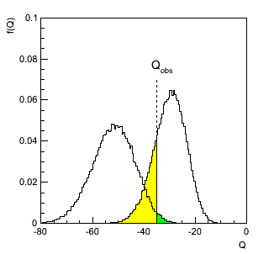
The CL_{s} procedure
In the usual formulation of CL_{s}, one tests both the μ = 0 (b) and
μ > 0 (μs+b) hypotheses with the same statistic Q = -2ln L_{s+b}/L_{b}:
f (Q|b)
f (Q|s+b)
p_{s+b}
p_{b}

Slide 42
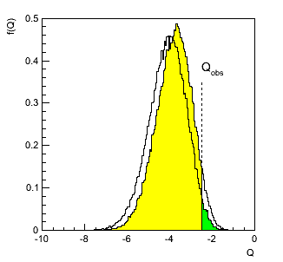
The CL_{s} procedure (2)
As before, “low sensitivity” means the distributions of Q under
b and s+b are very close:
f (Q|b)
f (Q|s+b)
p_{b}
p_{s+b}

Slide 43
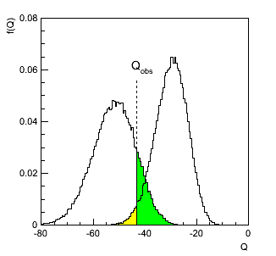



The CL_{s} procedure (3)
The CL_{s} solution (A. Read et al.) is to base the test not on
the usual p-value (CL_{s+b}), but rather to divide this by CL_{b}
(~ one minus the p-value of the b-only hypothesis), i.e.,
Define:
f (Q|s+b)
f (Q|b)
1-CL_{b}
= p_{b}
CL_{s+b}
= p_{s+b}
Reject s+b
hypothesis if:
Increases “effective” p-value when the two
distributions become close (prevents
exclusion if sensitivity is low).

Slide 44
Choice of test for limits (2)
In some cases μ = 0 is no longer a relevant alternative and we
want to try to exclude μ on the grounds that some other measure of
incompatibility between it and the data exceeds some threshold.
If the measure of incompatibility is taken to be the likelihood ratio
with respect to a two-sided alternative, then the critical region can
contain both high and low data values.
→ unified intervals, G. Feldman, R. Cousins,
Phys. Rev. D 57, 3873–3889 (1998)
The Big Debate is whether to use one-sided or unified intervals
in cases where small (or zero) values of the parameter are relevant
alternatives. Professional statisticians have voiced support
on both sides of the debate.

Slide 45
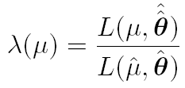

Unified (Feldman-Cousins) intervals
We can use directly
where
as a test statistic for a hypothesized μ.
Large discrepancy between data and hypothesis can correspond
either to the estimate for μ being observed high or low relative
to μ.
This is essentially the statistic used for Feldman-Cousins intervals
(here also treats nuisance parameters).
G. Feldman and R.D. Cousins, Phys. Rev. D 57 (1998) 3873.
Lower edge of interval can be at μ = 0, depending on data.

Slide 46
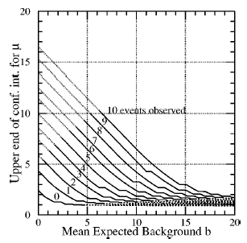
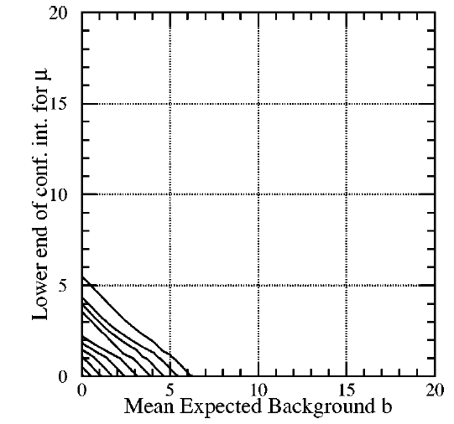
Upper/lower edges of F-C interval for μ versus b for n ~ Poisson(μ+b)
Feldman & Cousins, PRD 57 (1998) 3873
Lower edge may be at zero, depending on data.
For n = 0, upper edge has (weak) dependence on b.

