Slide 1
Statistics for Particle Physicists
Lecture 3
Academic Training Lectures
CERN / Zoom
21-24 June 2021
https://indico.cern.ch/event/1040095/
Glen Cowan
Physics Department
Royal Holloway, University of London
g.cowan@rhul.ac.uk
www.pp.rhul.ac.uk/~cowan

Slide 2
Outline
Lecture 1: Introduction, probability, parameter estimation
Lecture 2: Hypothesis tests, limits
Lecture 3: Systematic uncertainties, experimental sensitivity
Lecture 4: Bayesian methods, Student’s t regression

Slide 3
Systematic uncertainties and nuisance parameters
P (x|μ)
In general, our model of the data is not perfect:
model:
truth:
x
Can improve model by including
additional adjustable parameters.
Nuisance parameter ↔ systematic uncertainty. Some point in the
parameter space of the enlarged model should be “true”.
Presence of nuisance parameter decreases sensitivity of analysis
to the parameter of interest (e.g., increases variance of estimate).

Slide 4
Profile Likelihood
Suppose we have a likelihood L(μ,θ) = P(x|μ,θ) with N parameters of interest μ = (μ₁,..., μ_{N}) and M nuisance parameters θ = (θ₁,..., θ_{M}). The “profiled” (or “constrained”) values of θ are:
and the profile likelihood is:
The profile likelihood depends only on the parameters of interest; the nuisance parameters are replaced by their profiled values.
The profile likelihood can be used to obtain confidence intervals/regions for the parameters of interest in the same way as one would for all of the parameters from the full likelihood.

Slide 5
Profile Likelihood Ratio – Wilks theorem
Goal is to test/reject regions of μ space (param. of interest).
Rejecting a point μ should mean p_{μ} ≤ α for all possible values of the nuisance parameters θ.
Test μ using the “profile likelihood ratio”:
Let t_{μ} = −2 ln λ(μ). Wilks’ theorem says in large-sample limit:
where the number of degrees of freedom is the number of
parameters of interest (components of μ). So p-value for μ is

Slide 6
Profile Likelihood Ratio – Wilks theorem (2)
If we have a large enough data sample to justify use of the
asymptotic chi-square pdf, then if μ is rejected, it is rejected for any values of the nuisance parameters.
The recipe to get confidence regions/intervals for the parameters of interest at CL = 1 – α is thus the same as before, simply use the profile likelihood:
where the number of degrees of freedom N for the chi-square quantile is equal to the number of parameters of interest.
If the large-sample limit is not justified, then use e.g. Monte Carlo to get distribution of t_{μ}.

Slide 7
Prototype search analysis
Search for signal in a region of phase space; result is histogram
of some variable x giving numbers:
Assume the n_{i} are Poisson distributed with expectation values
strength parameter
where
signal
background

Slide 8
Prototype analysis (II)
Often also have a subsidiary measurement that constrains some
of the background and/or shape parameters:
Assume the m_{i} are Poisson distributed with expectation values
nuisance parameters (θ_{s}, θ_{b},b_{tot})
Likelihood function is

Slide 9
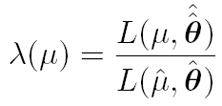
The profile likelihood ratio
Base significance test on the profile likelihood ratio:
maximizes L for
specified μ
maximize L
Define critical region of test of μ by the region of data space
that gives the lowest values of λ(μ).
Important advantage of profile LR is that its distribution becomes independent of nuisance parameters in large sample limit.

Slide 10
Test statistic for discovery
Suppose relevant alternative to background-only (μ = 0) is μ ≥ 0.
So take critical region for test of μ = 0 corresponding to high q₀
and > 0 (data characteristic for μ ≥ 0).
That is, to test background-only hypothesis define statistic
i.e. here only large (positive) observed signal strength is evidence against the background-only hypothesis.
Note that even though here physically μ ≥ 0, we allow
to be negative. In large sample limit its distribution becomes
Gaussian, and this will allow us to write down simple
expressions for distributions of our test statistics.

Slide 11
Cowan, Cranmer, Gross, Vitells, arXiv:1007.1727, EPJC 71 (2011) 1554
Distribution of q₀ in large-sample limit
Assuming approximations valid in the large sample (asymptotic)
limit, we can write down the full distribution of q₀ as
The special case μ′ = 0 is a “half chi-square” distribution:
In large sample limit, f (q₀|0) independent of nuisance parameters;
f (q₀|μ′) depends on nuisance parameters through σ.

Slide 12
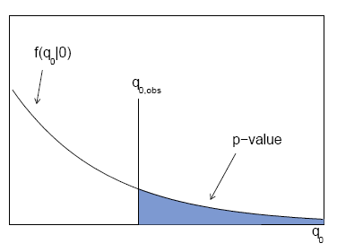
p-value for discovery
Large q₀ means increasing incompatibility between the data
and hypothesis, therefore p-value for an observed q_{0,obs} is
use e.g. asymptotic formula
From p-value get
equivalent significance,

Slide 13
Cowan, Cranmer, Gross, Vitells, arXiv:1007.1727, EPJC 71 (2011) 1554
Cumulative distribution of q₀, significance
From the pdf, the cumulative distribution of q₀ is found to be
The special case μ′ = 0 is
The p-value of the μ = 0 hypothesis is
Therefore the discovery significance Z is simply

Slide 14
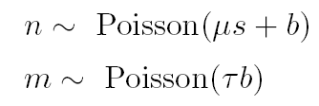
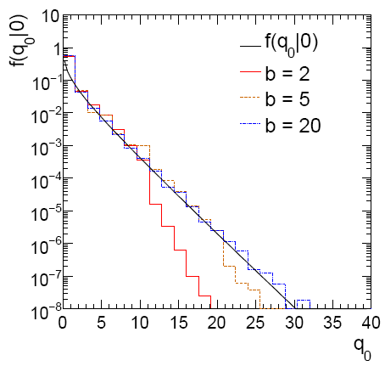
Cowan, Cranmer, Gross, Vitells, arXiv:1007.1727, EPJC 71 (2011) 1554
Monte Carlo test of asymptotic formula
μ = param. of interest
b = nuisance parameter
Here take s known, τ = 1.
Asymptotic formula is
good approximation to 5σ
level (q₀ = 25) already for
b ~ 20.

Slide 15
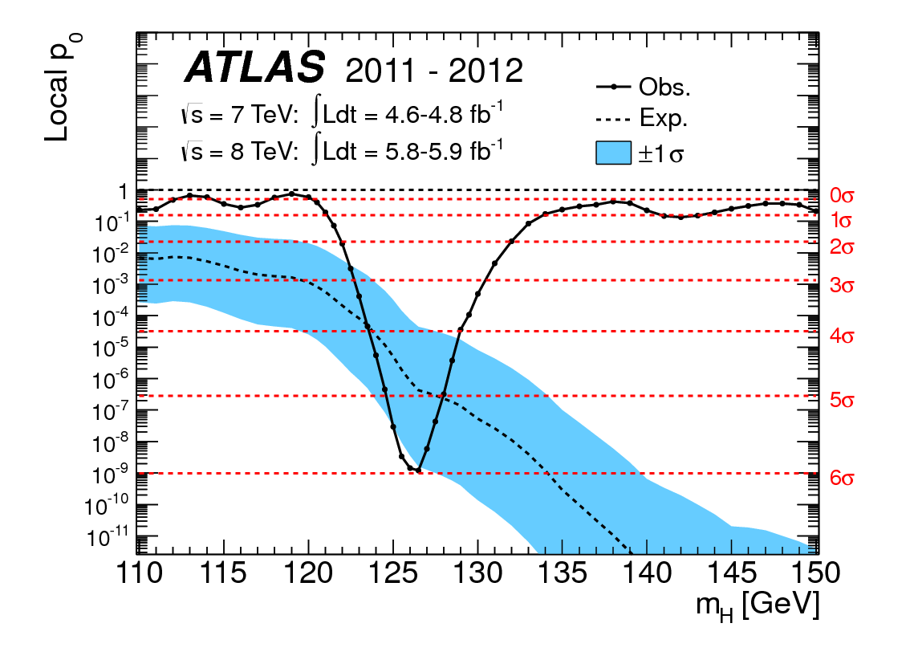
How to read the p₀ plot
The “local” p₀ means the p-value of the background-only
hypothesis obtained from the test of μ = 0 at each individual m_{H}, without any correct for the Look-Elsewhere Effect.
The “Expected” (dashed) curve gives the median p₀ under assumption of the SM Higgs (μ = 1) at each m_{H}.
ATLAS, Phys. Lett. B 716 (2012) 1-29
The blue band gives the
width of the distribution
(±1σ) of significances
under assumption of the
SM Higgs.

Slide 16
Cowan, Cranmer, Gross, Vitells, arXiv:1007.1727, EPJC 71 (2011) 1554
Test statistic for upper limits
For purposes of setting an upper limit on μ use
where
I.e. when setting an upper limit, an upwards fluctuation of the data
is not taken to mean incompatibility with the hypothesized μ :
From observed q_{μ} find p-value:
Large sample approximation:
To find upper limit at CL = 1−α, set p_{μ} = α and solve for μ.

Slide 17
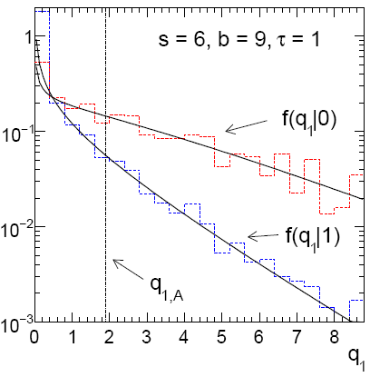
Cowan, Cranmer, Gross, Vitells, arXiv:1007.1727, EPJC 71 (2011) 1554
Monte Carlo test of asymptotic formulae
Consider again n ~ Poisson(μs + b), m ~ Poisson(τb)
Use q_{μ} to find p-value of hypothesized μ values.
E.g. f (q₁|1) for p-value of μ =1.
Typically interested in 95% CL, i.e., p-value threshold = 0.05, i.e.,
q₁ = 2.69 or Z₁ = √q₁ = 1.64.
Median[q₁ |0] gives “exclusion sensitivity”.
Here asymptotic formulae good
for s = 6, b = 9.

Slide 18
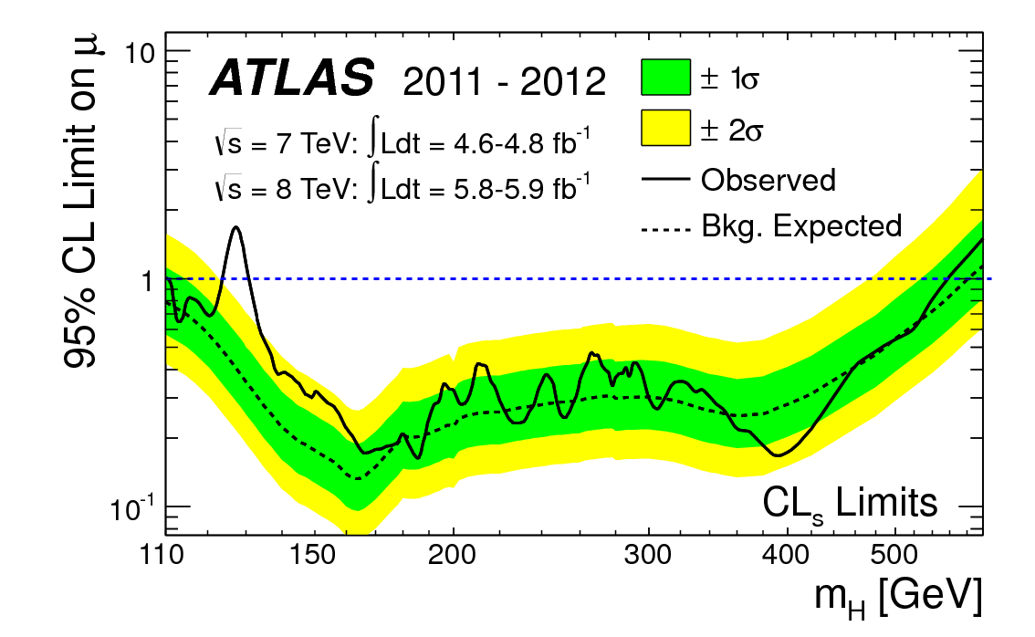
How to read the green and yellow limit plots
For every value of m_{H}, find the upper limit on μ.
Also for each m_{H}, determine the distribution of upper limits μ_{up} one would obtain under the hypothesis of μ = 0.
The dashed curve is the median μ_{up}, and the green (yellow) bands give the ± 1σ (2σ) regions of this distribution.
ATLAS, Phys. Lett. B 716 (2012) 1-29

Slide 19
Expected discovery significance for counting
experiment with background uncertainty
I. Discovery sensitivity for counting experiment with b known:
(a)
(b) Profile likelihood
ratio test & Asimov:
II. Discovery sensitivity with uncertainty in b, σ_{b}:
(a)
(b) Profile likelihood ratio test & Asimov:

Slide 20
Counting experiment with known background
Count a number of events n ~ Poisson(s+b), where
s = expected number of events from signal,
b = expected number of background events.
To test for discovery of signal compute p-value of s = 0 hypothesis,
Usually convert to equivalent significance:
where Φ is the standard Gaussian cumulative distribution, e.g.,
Z > 5 (a 5 sigma effect) means p < 2.9 ×10⁻⁷.
To characterize sensitivity to discovery, give expected (mean
or median) Z under assumption of a given s.

Slide 21
s/√b for expected discovery significance
For large s + b, n → x ~ Gaussian(μ,σ) , μ = s + b, σ = √(s + b).
For observed value x_{obs}, p-value of s = 0 is Prob(x > x_{obs} | s = 0),:
Significance for rejecting s = 0 is therefore
Expected (median) significance assuming signal rate s is

Slide 22
Better approximation for significance
Poisson likelihood for parameter s is
For now
no nuisance
params.
To test for discovery use profile likelihood ratio:
So the likelihood ratio statistic for testing s = 0 is

Slide 23
Approximate Poisson significance (continued)
For sufficiently large s + b, (use Wilks’ theorem),
To find median[Z|s], let n → s + b (i.e., the Asimov data set):
This reduces to s/√b for s << b.

Slide 24
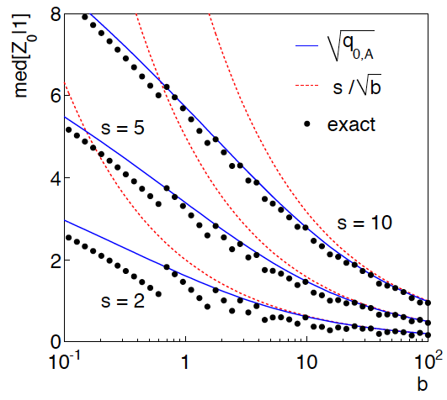
n ~ Poisson(s+b), median significance, assuming s, of the hypothesis s = 0
CCGV, EPJC 71 (2011) 1554, arXiv:1007.1727
“Exact” values from MC,
jumps due to discrete data.
Asimov √q_{0,A} good approx.
for broad range of s, b.
s/√b only good for s ≪ b.

Slide 25
Extending s/√b to case where b uncertain
The intuitive explanation of s/√b is that it compares the signal,
s, to the standard deviation of n assuming no signal, √b.
Now suppose the value of b is uncertain, characterized by a
standard deviation σ_{b}.
A reasonable guess is to replace √b by the quadratic sum of
√b and σ_{b}, i.e.,
This has been used to optimize some analyses e.g. where
σ_{b} cannot be neglected.

Slide 26
Profile likelihood with b uncertain
This is the well studied “on/off” problem: Cranmer 2005;
Cousins, Linnemann, and Tucker 2008; Li and Ma 1983,...
Measure two Poisson distributed values:
n ~ Poisson(s+b) (primary or “search” measurement)
m ~ Poisson(τb) (control measurement, τ known)
The likelihood function is
Use this to construct profile likelihood ratio (b is nuisance
parameter):

Slide 27
Ingredients for profile likelihood ratio
To construct profile likelihood ratio from this need estimators:
and in particular to test for discovery (s = 0),

Slide 28
Asymptotic significance
Use profile likelihood ratio for q₀, and then from this get discovery
significance using asymptotic approximation (Wilks’ theorem):
Essentially same as in:

Slide 29
Asimov approximation for median significance
To get median discovery significance, replace n, m by their
expectation values assuming background-plus-signal model:
n → s + b
m → τb
ˆ
Or use the variance of b = m/τ,
, to eliminate τ:

Slide 30
Limiting cases
Expanding the Asimov formula in powers of s/b and
σ_{b}²/b (= 1/τ) gives
So the “intuitive” formula can be justified as a limiting case
of the significance from the profile likelihood ratio test evaluated
with the Asimov data set.

Slide 31
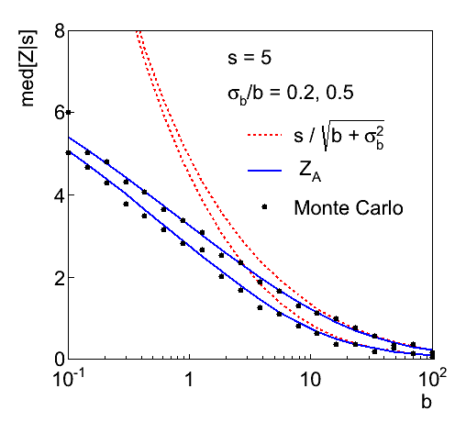
Testing the formulae: s = 5

Slide 32
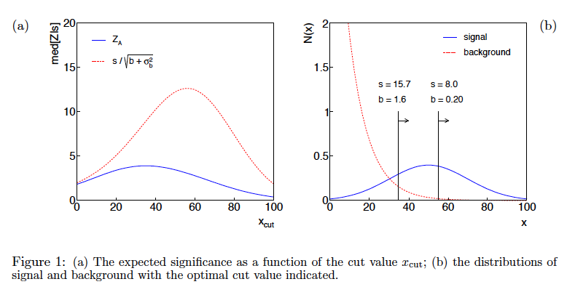
Using sensitivity to optimize a cut

Slide 33
Summary on discovery sensitivity
Simple formula for expected discovery significance based on
profile likelihood ratio test and Asimov approximation:
For large b, all formulae OK.
For small b, s/√b and s/√(b+σ_{b}²) overestimate the significance.
Could be important in optimization of searches with
low background.
Formula maybe also OK if model is not simple on/off experiment,
e.g., several background control measurements (check this).

Slide 34
Next time...
Lecture 1: Introduction, probability, parameter estimation
Lecture 2: Hypothesis tests, limits
Lecture 3: Systematic uncertainties, experimental sensitivity
Lecture 4: Bayesian methods, Student’s t regression

Slide 35
Extra slides

Slide 36
p-values in cases with nuisance parameters
Suppose we have a statistic q_{θ} that we use to test a hypothesized
value of a parameter θ, such that the p-value of θ is
But what values of ν to use for f (q_{θ} |θ, ν)?
Fundamentally we want to reject θ only if p_{θ} < α for all ν.
→ “exact” confidence interval
But in general for finite data samples this is not true; one may be unable to reject some θ values if all values of ν must be considered (resulting interval for θ “overcovers”).

Slide 37
Profile construction (“hybrid resampling”)
Approximate procedure is to reject θ if p_{θ} ≤ α where
the p-value is computed assuming the value of the nuisance
parameter that best fits the data for the specified θ :
“double hat” notation means profiled
value, i.e., parameter that maximizes
likelihood for the given θ.
The resulting confidence interval will have the correct coverage
for the points
.
Elsewhere it may under- or overcover, but this is usually as good
as we can do (check with MC if crucial or small sample problem).

