Slide 1
Statistics for Particle Physicists
Lecture 4
Academic Training Lectures
CERN / Zoom
21-24 June 2021
https://indico.cern.ch/event/1040096/
Glen Cowan
Physics Department
Royal Holloway, University of London
g.cowan@rhul.ac.uk
www.pp.rhul.ac.uk/~cowan

Slide 2
Outline
Lecture 1: Introduction, probability, parameter estimation
Lecture 2: Hypothesis tests, limits
Lecture 3: Systematic uncertainties, experimental sensitivity
Lecture 4: Bayesian methods, Student’s t regression

Slide 3
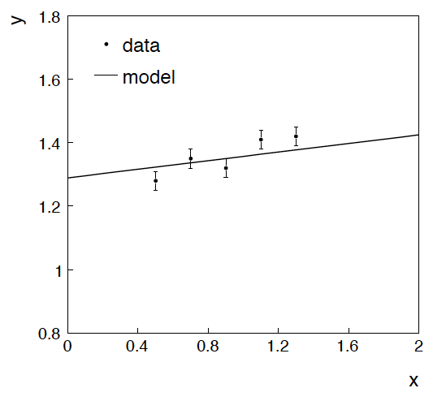
Example: fitting a straight line
Data:
Model: y_{i} independent and all follow y_{i} ~ Gauss(μ(x_{i} ), σ_{i} )
assume x_{i} and σ_{i} known.
Goal: estimate θ₀
Here suppose we don’t care
about θ₁ (example of a
“nuisance parameter”)

Slide 4
Maximum likelihood fit with Gaussian data
In this example, the y_{i} are assumed independent, so the
likelihood function is a product of Gaussians:
Maximizing the likelihood is here equivalent to minimizing
i.e., for Gaussian data, ML same as Method of Least Squares (LS)

Slide 5
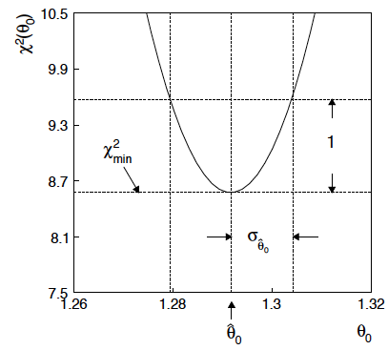
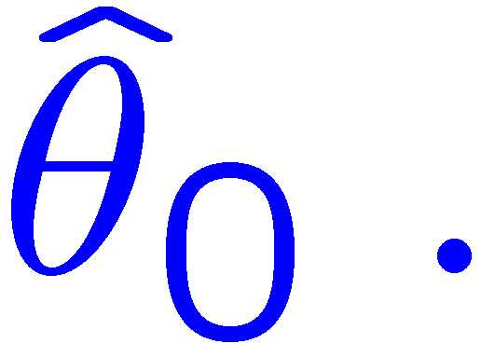
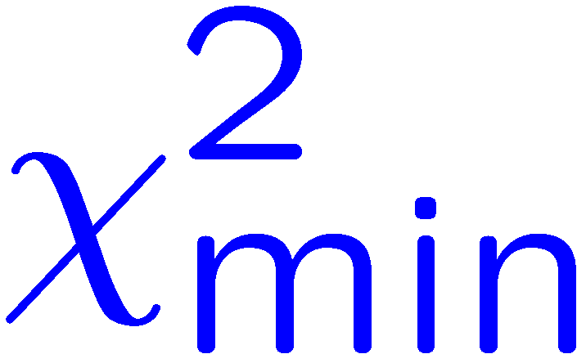
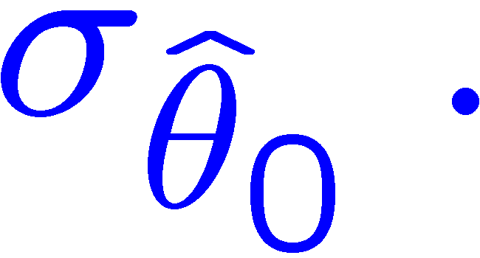
θ₁ known a priori
For Gaussian y_{i}, ML same as LS
Minimize χ² → estimator
Come up one unit from
to find

Slide 6
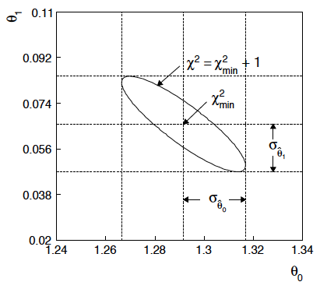
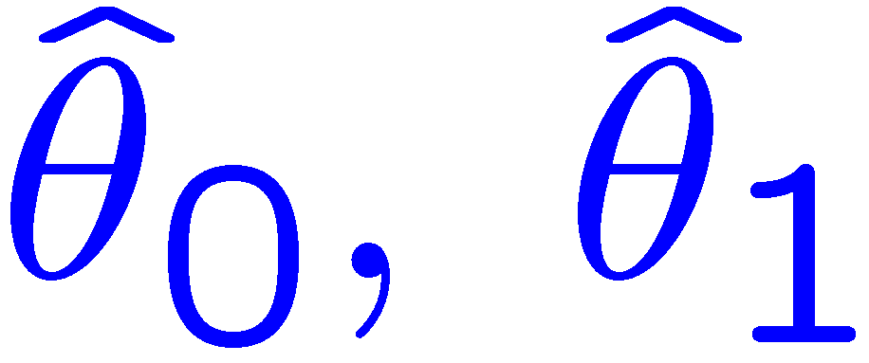
ML (or LS) fit of θ₀ and θ₁
Standard deviations from
tangent lines to contour
Correlation between
causes errors
to increase.

Slide 7
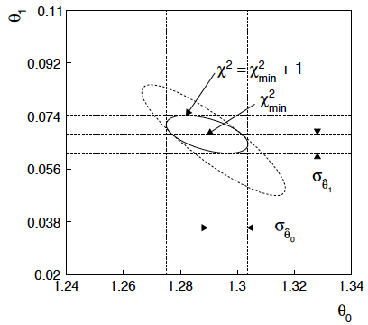
If we have a measurement t₁ ~ Gauss (θ₁, σ_{t1})
The information on θ₁
improves accuracy of

Slide 8
Profiling
The lnL = lnL_{max} – ½ contour in the (θ₀, θ₁) plane is a confidence region at CL = 39.3%.
Furthermore if one wants to know only about, say, θ₀, then the
interval in θ₀ corresponding to lnL = lnL_{max} – ½ is a confidence interval at CL = 68.3% (i.e., ±1 std. dev.).
I.e., form the interval for θ₀ using
where θ₁ is replaced by its “profiled” value

Slide 9
Reminder of Bayesian approach
In Bayesian statistics we can associate a probability with
a hypothesis, e.g., a parameter value θ.
Interpret probability of θ as ‘degree of belief’ (subjective).
Need to start with ‘prior pdf’ π(θ), this reflects degree
of belief about θ before doing the experiment.
Our experiment has data x, → likelihood L(x|θ).
Bayes’ theorem tells how our beliefs should be updated in
light of the data x:
Posterior pdf p(θ|x) contains all our knowledge about θ.

Slide 10
Bayesian approach: y_{i} ~ Gauss(μ(x_{i}; θ₀, θ₁), σ_{i})
We need to associate prior probabilities with θ₀ and θ₁, e.g.,
← suppose knowledge of θ₀ has no influence on knowledge of θ₁
← ‘non-informative’, in any
case much broader than L(θ₀)
prior after t₁,
before y
Ur = “primordial”
prior
Likelihood for control
measurement t₁

Slide 11
Bayesian example: y_{i} ~ Gauss(μ(x_{i}; θ₀, θ₁), σ_{i})
Putting the ingredients into Bayes’ theorem gives:
posterior ∝ likelihood ✕ prior
Note here the likelihood only reflects the measurements y.
The information from the control measurement t₁ has been put into the prior for θ₁.
We would get the same result using the likelihood P(y,t|θ₀,θ₁) and the constant “Ur-prior” for θ₁.

Slide 12
Marginalizing the posterior pdf
We then integrate (marginalize) p(θ₀, θ₁ | y) to find p(θ₀ | y):
In this example we can do the integral (rare). We find
(same as for MLE)
For this example, numbers come out same as in frequentist approach, but interpretation different.

Slide 13
Marginalization with MCMC
Bayesian computations involve integrals like
often high dimensionality and impossible in closed form,
also impossible with ‘normal’ acceptance-rejection Monte Carlo.
Markov Chain Monte Carlo (MCMC) has revolutionized
Bayesian computation.
MCMC (e.g., Metropolis-Hastings algorithm) generates
correlated sequence of random numbers:
cannot use for many applications, e.g., detector MC;
effective stat. error greater than if all values independent .
Basic idea: sample multidimensional θ but look only at distribution of parameters of interest.

Slide 14
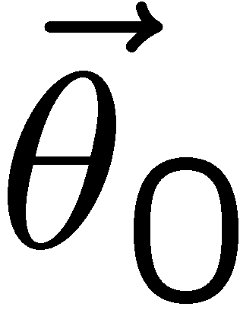
MCMC basics: Metropolis-Hastings algorithm
Goal: given an n-dimensional pdf p(θ), generate a sequence of points θ₁ , θ₂ , θ₃ ,...
Proposal density q(θ; θ₀ )
e.g. Gaussian centred
about θ₀
1) Start at some point
2) Generate
3) Form Hastings test ratio
4) Generate
5) If
move to proposed point
else
old point repeated
6) Iterate

Slide 15
Metropolis-Hastings (continued)
This rule produces a correlated sequence of points (note how
each new point depends on the previous one).
Still works if p(θ) is known only as a proportionality, which is
usually what we have from Bayes’ theorem: p(θ|x) ∝ p(x|θ) π(θ).
The proposal density can be (almost) anything, but choose
so as to minimize autocorrelation. Often take proposal
density symmetric: q(θ; θ₀ ) = q(θ₀; θ )
Test ratio is (Metropolis-Hastings):
I.e. if the proposed step is to a point of higher p(θ), take it;
if not, only take the step with probability p(θ)/p(θ₀).
If proposed step rejected, repeat the current point.

Slide 16
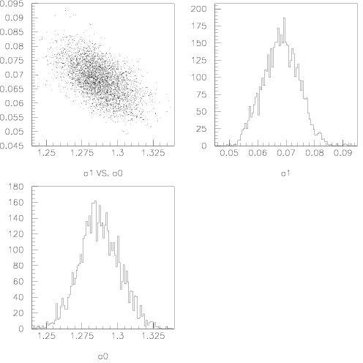
Example: posterior pdf from MCMC
Sample the posterior pdf from previous example with MCMC:
Normalized histogram of θ₀ gives its marginal posterior pdf:

Slide 17
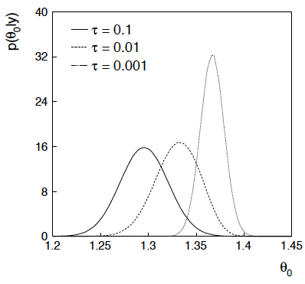
Bayesian method with alternative priors
Suppose we don’t have a previous measurement of θ₁ but rather,
an “expert” says it should be positive and not too much greater than 0.1 or so, i.e., something like
From this we obtain (numerically) the posterior pdf for θ₀:
This summarizes all
knowledge about θ₀.
Look also at result from
variety of priors.

Slide 18
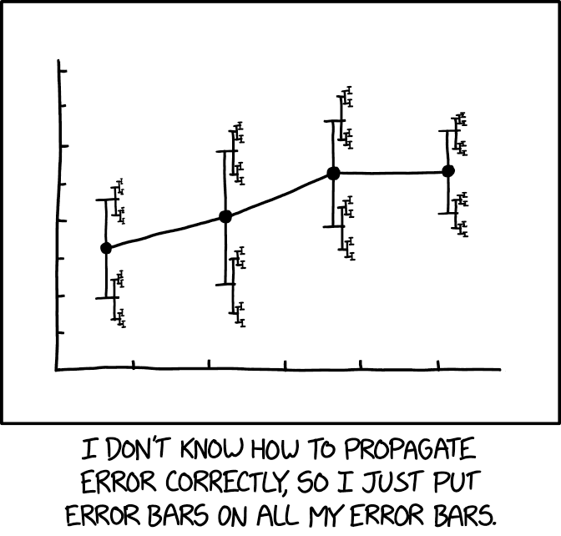
Motivation, disclosure, etc.
For several years I’ve been pushing the idea that the uncertainties
on estimated systematic errors (“errors on errors”) should play
a role in HEP analyses, particularly for combinations.
Details in: G. Cowan, Statistical Models with Uncertain Error
Parameters, Eur. Phys. J. C (2019) 79:133, arXiv:1809.05778
https://xkcd.com/2110/
It turns out that models that use
errors on errors have qualitatively
new, interesting, desirable features:
Sensitivity to outliers reduced.
Confidence intervals sensitive
to goodness of fit.

Slide 19
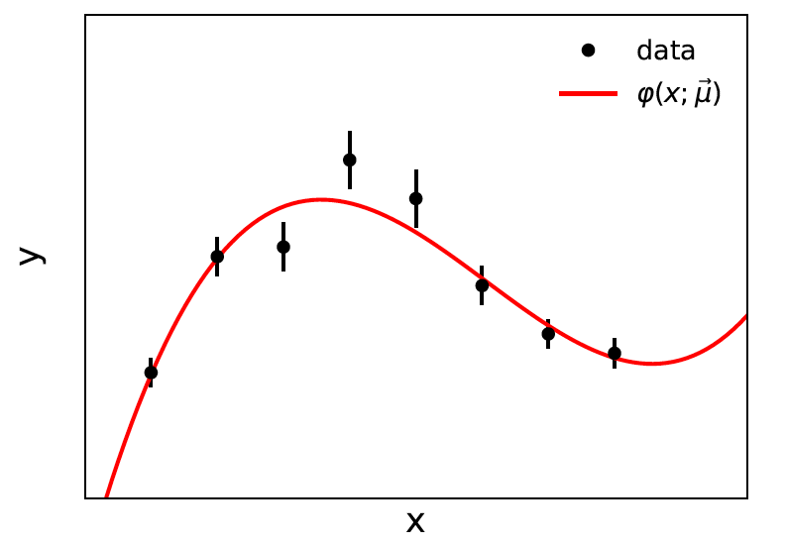
Prototype example: curve fitting, averages
Suppose independent
y_{i} ~ Gauss, i = 1,...,N, with
μ are the parameters in the fit function φ(x;μ).
If we take the σ_{i} as known, we have the usual log-likelihood
which leads to the Least Squares estimators for μ.

Slide 20
Model with uncertain σ_{i}²
If the σ_{i}² are uncertain, we can take them as adjustable parameters.
The estimated variances v_{i} = s_{i}² are modeled as gamma distributed.
The likelihood becomes
Want
(s_{i} = √v_{i})
→

Slide 21
Profile log-likelihood
One can profile over the σ_{i}² in close form.
The log-profile-likelihood is
Quadratic terms replace by sum of logs.
Equivalent to replacing Gauss pdf for y_{i} by Student’s t, ν_{dof} = 1/2r_{i}²
Confidence interval for μ becomes sensitive to goodness-of-fit
(increases if data internally inconsistent).
Fitted curve less sensitive to outliers.
Simple program for Student’s t average: stave.py
http://www.pp.rhul.ac.uk/~cowan/stat/stave/

Slide 22
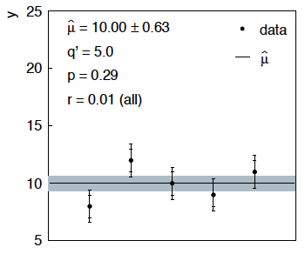
Sensitivity of average to outliers
Suppose we average 5 values, y = 8, 9, 10, 11, 12, all with
stat. and sys. errors of 1.0, and suppose negligible error on error
(here take r = 0.01 for all).
inner error bars
= σ_{y,i}
outer error bars
= (σ_{y,i}² + σ_{u,i}²)^{½}

Slide 23
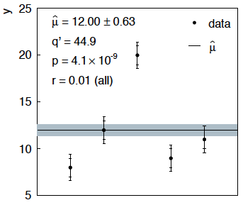
Sensitivity of average to outliers (2)
Now suppose the measurement at 10 had come out at 20:
“outlier”
Estimate pulled up to 12.0, size of confidence interval ~unchanged
(would be exactly unchanged with r → 0).

Slide 24
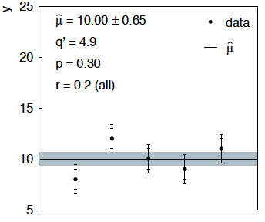
Average with all r = 0.2
If we assign to each measurement r = 0.2,
Estimate still at 10.00, size of interval moves 0.63 → 0.65

Slide 25
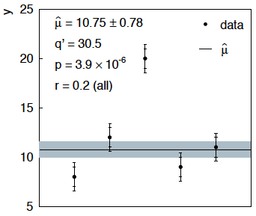
Average with all r = 0.2 with outlier
Same now with the outlier (middle measurement 10 → 20)
Estimate →10.75 (outlier pulls much less).
Half-size of interval → 0.78 (inflated because of bad g.o.f.).

Slide 26
Discussion
Gamma variance model gives confidence intervals that
increase in size when the data are internally inconsistent,
and gives decreased sensitivity to outliers (known property of
Student’s t based regression).
Equivalence with Student’s t model, ν = 1/2r² degrees of freedom.
Simple profile likelihood – quadratic terms replaced by logarithmic:

Slide 27
Discussion (2)
Method assumes that meaningful r_{i} values can be assigned and there is enough “expert knowledge” is available to do so.
I.e. best if the experts publish some information on the reliability of their reported systematics.
Could the public likelihood standard include at least the possibility to include this information?

Slide 28
Finally
Four lectures only enough for a brief introduction to:
Parameter estimation, maximum likelihood
Hypothesis tests, p-values
Limits (confidence intervals/regions)
Systematics (nuisance parameters)
Asymptotics (Wilks’ theorem)
Bayesian parameter estimation
Student’s t regression, gamma variance model
Final thought: once the basic formalism is fixed, most of the
work focuses on writing down the likelihood, e.g., P(x|θ), and
including in it enough parameters to adequately describe the data
(true for both Bayesian and frequentist approaches).

Slide 29
Extra slides

