Slide 1


Statistics for Particle Physicists
Lecture 3: Hypothesis Tests, Confidence Intervals
Summer Student Lectures
CERN
4 – 7 July 2023
https://indico.cern.ch/event/1254879/timetable/
Glen Cowan
Physics Department
Royal Holloway, University of London
g.cowan@rhul.ac.uk
www.pp.rhul.ac.uk/~cowan

Slide 2
Outline
Lecture 1: Introduction, probability,
Lecture 2: Parameter estimation
Lecture 3: Hypothesis tests and confidence intervals
(some exercises here).
Lecture 4: Introduction to Machine Learning

Slide 3
Frequentist hypothesis tests
Suppose a measurement produces data x; consider a hypothesis H₀
we want to test and alternative H₁
H₀, H₁ specify probability for x: P(x|H₀), P(x|H₁)
A test of H₀ is defined by specifying a critical region w of the
data space such that there is no more than some (small) probability
α, assuming H₀ is correct, to observe the data there, i.e.,
P(x ∈ w | H₀) ≤ α
Need inequality if data are
discrete.
α is called the size or
significance level of the test.
If x is observed in the
critical region, reject H₀.
data space Ω
critical region w

Slide 4



Definition of a test (2)
But in general there are an infinite number of possible critical regions that give the same size α.
Use the alternative hypothesis H₁ to motivate where to place the critical region.
Roughly speaking, place the critical region where there is a low
probability (α) to be found if H₀ is true, but high if H₁ is true:

Slide 5


Classification viewed as a statistical test
Suppose events come in two possible types:
s (signal) and b (background)
For each event, test hypothesis that it is background, i.e., H₀ = b.
Carry out test on many events, each is either of type s or b, i.e., here the hypothesis is the “true class label”, which varies randomly from event to event, so we can assign to it a frequentist probability.
Select events for which where H₀ is rejected as “candidate events of type s”. Equivalent Particle Physics terminology:
background efficiency
signal efficiency

Slide 6
Example of a test for classification
Suppose we can measure for
each event a quantity x, where
with 0 ≤ x ≤ 1.
For each event in a mixture of signal (s) and background (b) test
H₀ : event is of type b
using a critical region W of the form: W = { x : x ≤ x_{c} }, where
x_{c} is a constant that we choose to give a test with the desired size α.

Slide 7
Classification example (2)
Suppose we want α = 10⁻⁴. Require:
and therefore
For this test (i.e. this critical region W), the power with respect to the signal hypothesis (s) is
Note: the optimal size and power is a separate question that will depend on goals of the subsequent analysis.

Slide 8
Classification example (3)
Suppose that the prior probabilities for an event to be of type s or b are:
π_{s} = 0.001
π_{b} = 0.999
The “purity” of the selected signal sample (events where b hypothesis rejected) is found using Bayes’ theorem:

Slide 9
Testing significance / goodness-of-fit
Suppose hypothesis H predicts pdf f (x|H) for a set of
observations x = (x₁,...x_{n}).
We observe a single point in this space: x_{obs}.
How can we quantify the level of compatibility between the data and the predictions of H?
x_{j}
x_{obs}
Decide what part of
the data space represents equal or less compatibility with H than does the point x_{obs}. (Not unique!)
ω> = { x : x “more
compatible” with H }
ω≤ = { x : x “less
or eq. compatible”
with H }
x_{i}

Slide 10
p-values
Express level of compatibility between data and hypothesis (sometimes ‘goodness-of-fit’) by giving the p-value for H:
= probability, under assumption of H, to observe data with equal or lesser compatibility with H relative to the data we got.
= probability, under assumption of H, to observe data as discrepant with H as the data we got or more so.
Basic idea: if there is only a very small probability to find data
with even worse (or equal) compatibility, then H is “disfavoured by the data”.
If the p-value is below a user-defined threshold α (e.g. 0.05) then H is rejected (equivalent to hypothesis test of size α as seen earlier).

Slide 11

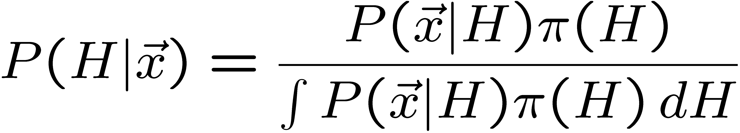
p-value of H is not P(H)
The p-value of H is not the probability that H is true!
In frequentist statistics we don’t talk about P(H) (unless H
represents a repeatable observation).
If we do define P(H), e.g., in Bayesian statistics as a degree of belief, then we need to use Bayes’ theorem to obtain
where π(H) is the prior probability for H.
For now stick with the frequentist approach;
result is p-value, regrettably easy to misinterpret as P(H).

Slide 12

The Poisson counting experiment
Suppose we do a counting experiment and observe n events.
Events could be from signal process or from background –
we only count the total number.
Poisson model:
s = mean (i.e., expected) # of signal events
b = mean # of background events
Goal is to make inference about s, e.g.,
test s = 0 (rejecting H₀ ≈ “discovery of signal process”)
test all non-zero s (values not rejected = confidence interval)
In both cases need to ask what is relevant alternative hypothesis.

Slide 13
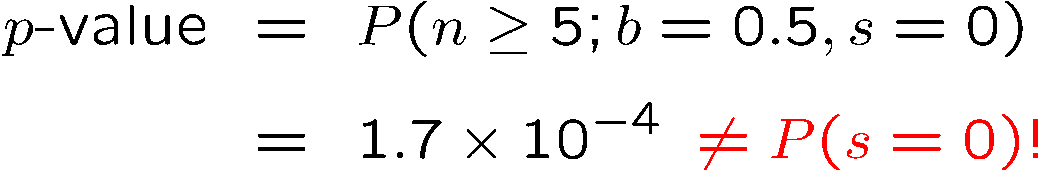
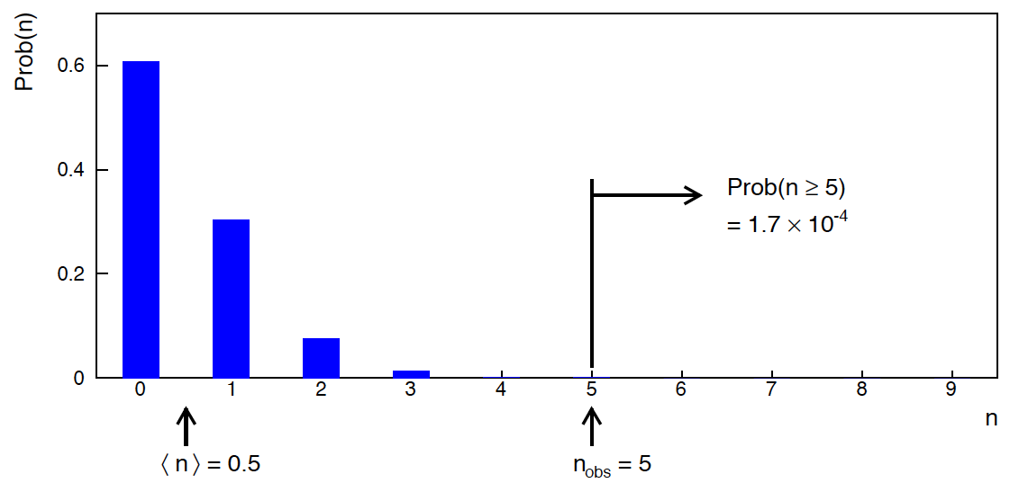
Poisson counting experiment: discovery p-value
Suppose b = 0.5 (known), and we observe n_{obs} = 5.
Should we claim evidence for a new discovery?
Give p-value for hypothesis s = 0:

Slide 14
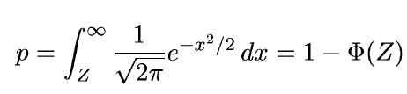
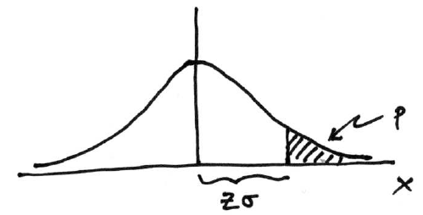

Significance from p-value
Often define significance Z as the number of standard deviations
that a Gaussian variable would fluctuate in one direction
to give the same p-value.
in ROOT:
p = 1 - TMath::Freq(Z)
Z = TMath::NormQuantile(1-p)
in python (scipy.stats):
p = 1 - norm.cdf(Z) = norm.sf(Z)
Z = norm.ppf(1-p)
Result Z is a “number of sigmas”. Note this does not mean that
the original data was Gaussian distributed.

Slide 15

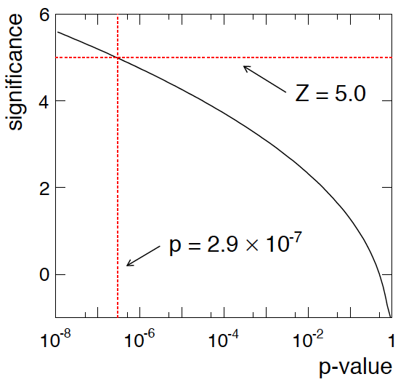
Poisson counting experiment: discovery significance
Equivalent significance for p = 1.7 × 10⁻⁴:
Often claim discovery if Z > 5 (p < 2.9 × 10⁻⁷, i.e., a “5-sigma effect”)
In fact this tradition should be revisited: p-value intended to quantify probability of a signal-like fluctuation assuming background only; not intended to cover, e.g., hidden systematics, plausibility signal model, compatibility of data with signal, “look-elsewhere effect”
(~multiple testing), etc.

Slide 16
Confidence intervals by inverting a test
In addition to a ‘point estimate’ of a parameter we should report
an interval reflecting its statistical uncertainty.
Confidence intervals for a parameter θ can be found by
defining a test of the hypothesized value θ (do this for all θ):
Specify values of the data that are ‘disfavoured’ by θ
(critical region) such that P(data in critical region|θ) ≤ α
for a prespecified α, e.g., 0.05 or 0.1.
If data observed in the critical region, reject the value θ.
Now invert the test to define a confidence interval as:
set of θ values that are not rejected in a test of size α
(confidence level CL is 1− α).

Slide 17
Relation between confidence interval and p-value
Equivalently we can consider a significance test for each
hypothesized value of θ, resulting in a p-value, p_{θ}.
If p_{θ} ≤ α, then we reject θ.
The confidence interval at CL = 1 – α consists of those values of
θ that are not rejected.
E.g. an upper limit on θ is the greatest value for which p_{θ} > α.
In practice find by setting p_{θ} = α and solve for θ.
For a multidimensional parameter space θ = (θ₁,... θ_{M}) use same idea – result is a confidence “region” with boundary determined by p_{θ} = α.

Slide 18
Coverage probability of confidence interval
If the true value of θ is rejected, then it’s not in the confidence interval. The probability for this is by construction (equality for continuous data):
P(reject θ|θ) ≤ α = type-I error rate
Therefore, the probability for the interval to contain or “cover” θ is
P(conf. interval “covers” θ|θ) ≥ 1 – α
This assumes that the set of θ values considered includes the true value, i.e., it assumes the composite hypothesis P(x|H,θ).

Slide 19



Frequentist upper limit on Poisson parameter
Consider again the case of observing n ~ Poisson(s + b).
Suppose b = 4.5, n_{obs} = 5. Find upper limit on s at 95% CL.
Relevant alternative is s = 0 (critical region at low n)
p-value of hypothesized s is P(n ≤ n_{obs}; s, b)
Upper limit s_{up} at CL = 1 – α found from

Slide 20
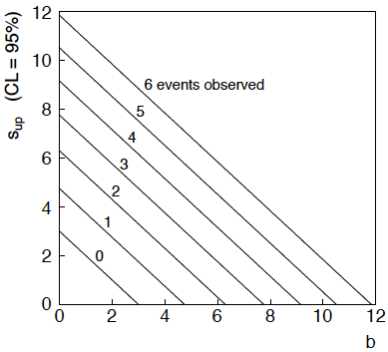
n ~ Poisson(s+b): frequentist upper limit on s
For low fluctuation of n, formula can give negative result for s_{up}; i.e. confidence interval is empty; all values of s ≥ 0 have p_{s} ≤ α.

Slide 21
Limits near a boundary of the parameter space
Suppose e.g. b = 2.5 and we observe n = 0.
If we choose CL = 0.9, we find from the formula for s_{up}
Physicist:
We already knew s ≥ 0 before we started; can’t use negative
upper limit to report result of expensive experiment!
Statistician:
The interval is designed to cover the true value only 90%
of the time — this was clearly not one of those times.
Not uncommon dilemma when testing parameter values for which
one has very little experimental sensitivity, e.g., very small s.

Slide 22
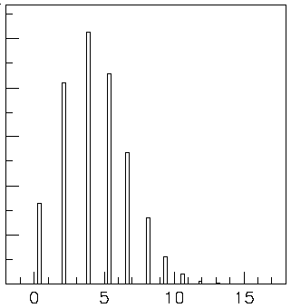

Expected limit for s = 0
Physicist: I should have used CL = 0.95 — then s_{up} = 0.496
Even better: for CL = 0.917923 we get s_{up} = 10⁻⁴ !
Reality check: with b = 2.5, typical Poisson fluctuation in n is
at least √2.5 = 1.6. How can the limit be so low?
Look at the mean limit for the
no-signal hypothesis (s = 0)
(sensitivity).
Distribution of 95% CL limits
with b = 2.5, s = 0.
Mean upper limit = 4.44

Slide 23
Extra slides

Slide 24




Approximate confidence intervals/regions
from the likelihood function
Suppose we test parameter value(s) θ = (θ₁, ..., θ_{n}) using the ratio
Lower λ(θ) means worse agreement between data and hypothesized θ. Equivalently, usually define
so higher t_{θ} means worse agreement between θ and the data.
p-value of θ therefore
need pdf

Slide 25




Confidence region from Wilks’ theorem
Wilks’ theorem says (in large-sample limit and provided
certain conditions hold...)
chi-square dist. with # d.o.f. =
# of components in θ = (θ₁, ..., θ_{n}).
Assuming this holds, the p-value is
← set equal to α
To find boundary of confidence region set p_{θ} = α and solve for t_{θ}:
Recall also

Slide 26




Confidence region from Wilks’ theorem (cont.)
i.e., boundary of confidence region in θ space is where
For example, for 1 – α = 68.3% and n = 1 parameter,
and so the 68.3% confidence level interval is determined by
Same as recipe for finding the estimator’s standard deviation, i.e.,
is a 68.3% CL confidence interval.

Slide 27
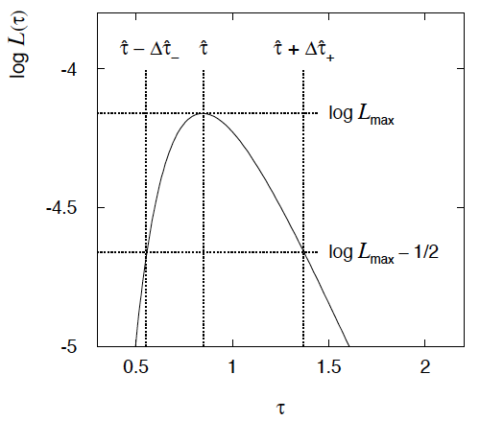

Example of interval from ln L(θ)
For n=1 parameter, CL = 0.683, Q_{α} = 1.
Our exponential
example, now with
only n = 5 events.
Can report ML estimate
with approx. confidence
interval from ln L_{max} – 1/2
as “asymmetric error bar”:

Slide 28

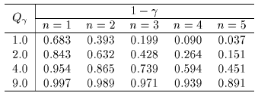

Multiparameter case
For increasing number of parameters, CL = 1 – α decreases for
confidence region determined by a given

Slide 29
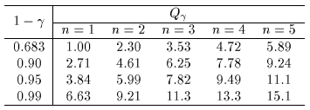
Multiparameter case (cont.)
Equivalently, Q_{α} increases with n for a given CL = 1 – α.

Slide 30

Obvious where to put W?
In the 1930s there were great debates as to the role of the alternative hypothesis.
Fisher held that one could test a hypothesis H₀ without reference to an alternative.
Suppose, e.g., H₀ predicts that x (suppose positive) usually comes out low. High values of x are less characteristic of H₀, so if a high value is observed, we should reject H₀, i.e., we put W at high x:
If we see x here, reject H₀.

Slide 31


Or not so obvious where to put W?
But what if the only relevant alternative to H₀ is H₁ as below:
Here high x is more characteristic of H₀ and not like what we expect from H₁. So better to put W at low x.
Neyman and Pearson argued that “less characteristic of H₀” is well defined only when taken to mean “more characteristic of some relevant alternative H₁”.

Slide 32
Type-I, Type-II errors
Rejecting the hypothesis H₀ when it is true is a Type-I error.
The maximum probability for this is the size of the test:
P(x ∈ W | H₀ ) ≤ α
But we might also accept H₀ when it is false, and an alternative
H₁ is true.
This is called a Type-II error, and occurs with probability
P(x ∈ S − W | H₁ ) = β
One minus this is called the power of the test with respect to
the alternative H₁:
Power = 1 − β

Slide 33


Distribution of the p-value
The p-value is a function of the data, and is thus itself a random
variable with a given distribution. Suppose the p-value of H is
found from a test statistic t(x) as
The pdf of p_{H} under assumption of H is
g(p_{H}|H′)
In general for continuous data, under
assumption of H, p_{H} ~ Uniform[0,1]
and is concentrated toward zero for
some (broad) class of alternatives.
g(p_{H}|H)
p_{H}
0
1

Slide 34


Using a p-value to define test of H₀
One can show that under assumption of a hypothesis H₀, its
p-value, p₀, follows a uniform distribution in [0,1].
So the probability to find p₀ less than a given α is
So we can define the critical region of a test of H₀ with size α as the set of data space where p₀ ≤ α .
Formally the p-value relates only to H₀, but the resulting test will
have a given power with respect to a given alternative H₁.

