Slide 1
Statistics for Particle Physicists
Lecture 4: Introduction to Machine Learning
Summer Student Lectures
CERN
4 – 7 July 2023
https://indico.cern.ch/event/1254879/timetable/
Glen Cowan
Physics Department
Royal Holloway, University of London
g.cowan@rhul.ac.uk
www.pp.rhul.ac.uk/~cowan

Slide 2
Outline
Lecture 1: Introduction, probability,
Lecture 2: Parameter estimation
Lecture 3: Hypothesis tests
Lecture 4: Introduction to Machine Learning
(some exercises on ML here).

Slide 3
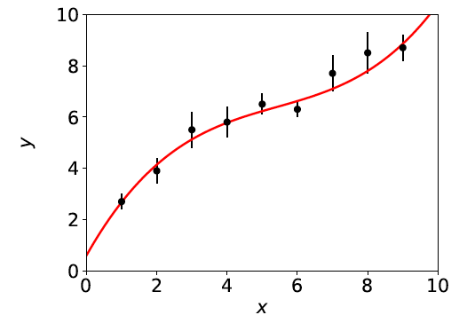
What Machine Learning is
The term Machine Learning (ML) refers to algorithms that “learn
from data” and make predictions based on what has been learned.
In its simplest sense, “learning” means the algorithm contains adjustable parameters whose values are estimated using data.
Formally, curve fitting can be seen as Machine Learning.
Hypothesized curve:
Values of parameters are “learned”
from the data.
Fitted curve can make predictions
at x values of future measurements.

Slide 4
More general Machine Learning
But generally ML refers to situations in which:
the hypothesized model is very general (e.g., not just
a polynomial) and contains many adjustable parameters;
the quantity we want to predict could depend on many
variables, e.g., not just x but a set x = (x₁,...,x_{n}).
ML can be seen as a part of or related to:
Artificial Intelligence
Pattern Recognition
Statistical Learning
Multivariate Analysis
Development from (mainly) Computer Science, (also) Statistics;
sometimes “Data Science” used to refer to all of above.

Slide 5
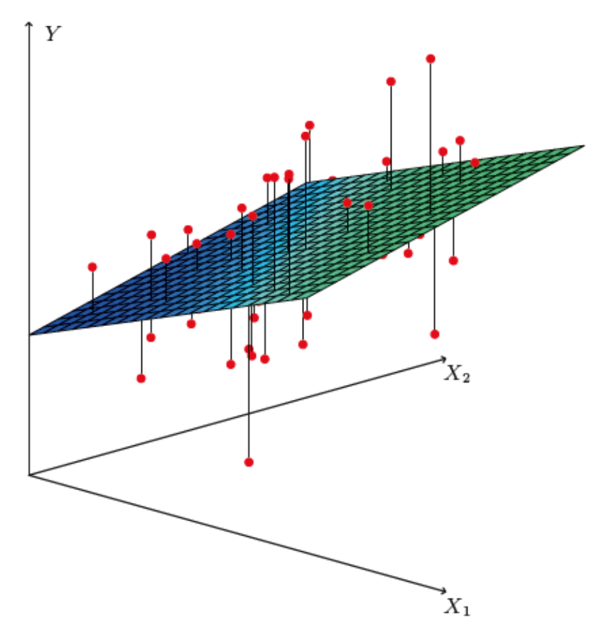
Curve fitting → regression
The generalisation of curve fitting with a multidimensional control
variable x → x = (x₁,..., x_{n}) is called multiple regression.
The data consist of sets of points (x_{i}, y_{i}), where now x_{i} is a
multidimensional vector, and usually the y_{i} does not come with
an error bar.
Goal is to predict the expected y value for a new x.
https://web.stanford.edu/~hastie/ISLR2/ISLRv2_website.pdf
E.g. in two dimensions,
multiple regression means
fitting a surface f (x₁, x₂)
to data points (x_{1,i}, x_{2,i}, y_{i}):

Slide 6
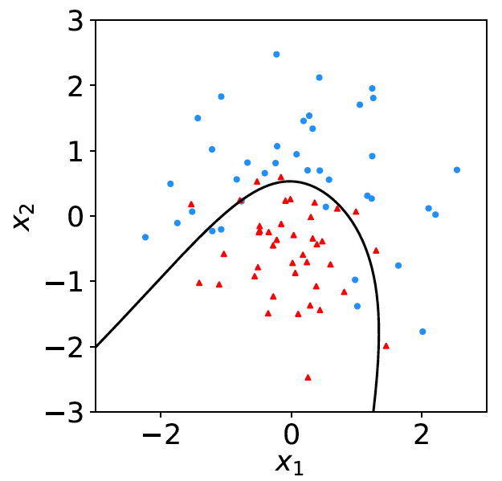
Classification
A related type of ML algorithm is called classification: the data consist of points (x_{i}, y_{i}), where now y_{i} is discrete class label,
(e.g., 0 or 1, red or blue, etc.).
Learning based on events with known y_{i} = supervised learning.
Goal is to create a decision boundary in x-space so as to predict the class y of a new instance of x.
blue = class 1
decision boundary
red = class 0

Slide 7
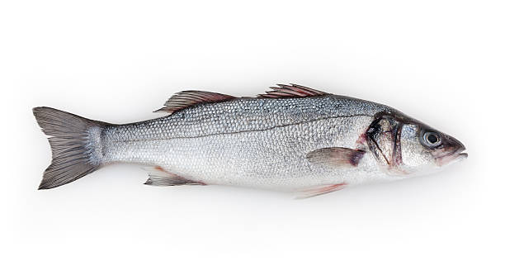
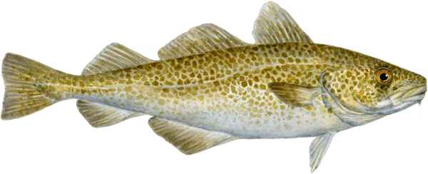
Example of classification: Industrial Fishing
You scoop up fish which are of two types:
Sea
Bass
Cod
You examine the fish with automatic sensors and for each one
you measure a set of features:
x₁ = length x₄ = area of fins
x₂ = width x₅ = mean spectral reflectance
x₃ = weight x₆ = ...
These constitute the “feature vector” x = (x₁,..., x_{n}).
In addition you hire a fish expert to identify the “true class label”
y = 0 or 1 (i.e., 0 =sea bass, 1 = cod) for each fish.

Slide 8
Distributions of the features
If we consider only two
features x = (x₁, x₂), we can
display the results in a scatter
plot (red: y = 0, blue: y = 1).
Goal is to determine a decision boundary, so that, without the help of the fish expert, we can classify new fish by seeing where their measured features lie relative to the boundary.
Same idea in multi-dimensional feature space, but cannot represent as 2-D plot. Decision boundary is n-dim. hypersurface.

Slide 9
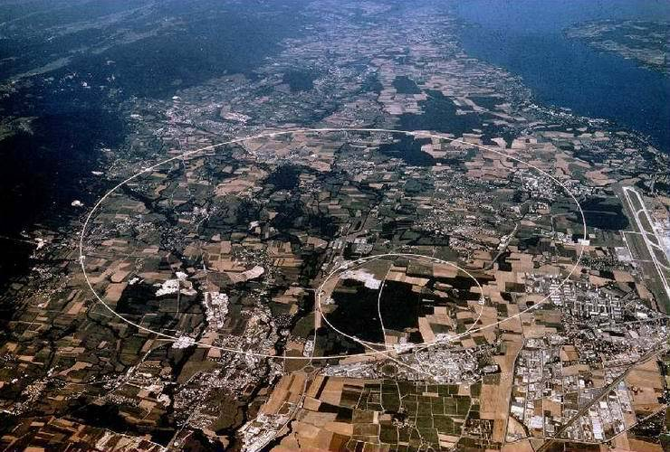
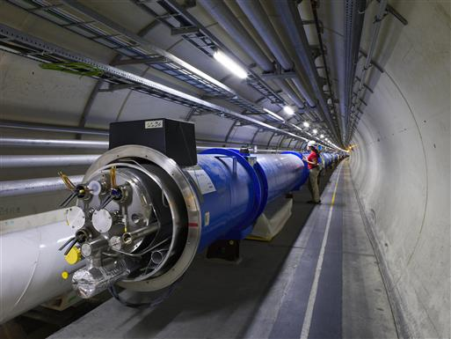
Example use of Machine Learning: Particle Physics at the LHC
Counter-rotating proton beams
in 27 km circumference ring
pp centre-of-mass energy 14 TeV
Detectors at 4 pp collision points:
ATLAS
CMS
LHCb (b physics)
ALICE (heavy ion physics)
general purpose

Slide 10
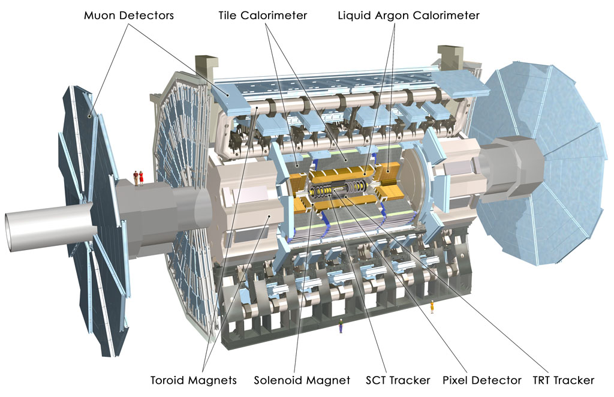
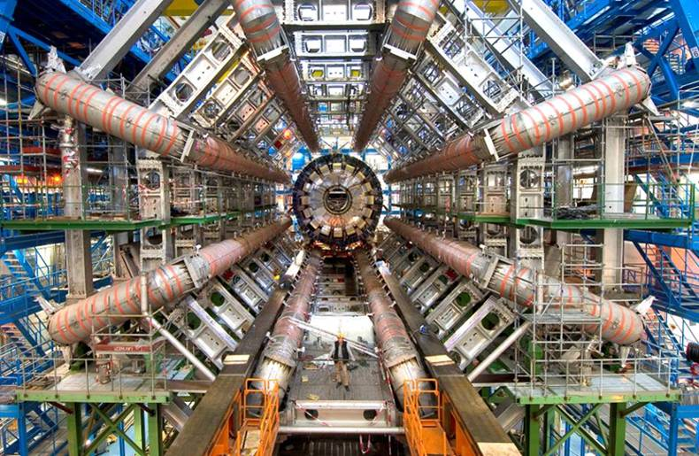
The ATLAS Detector at the LHC
3000 physicists
37 countries
167 universities/labs
25 m diameter
46 m length
7000 tonnes
~10⁸ electronic channels

Slide 11
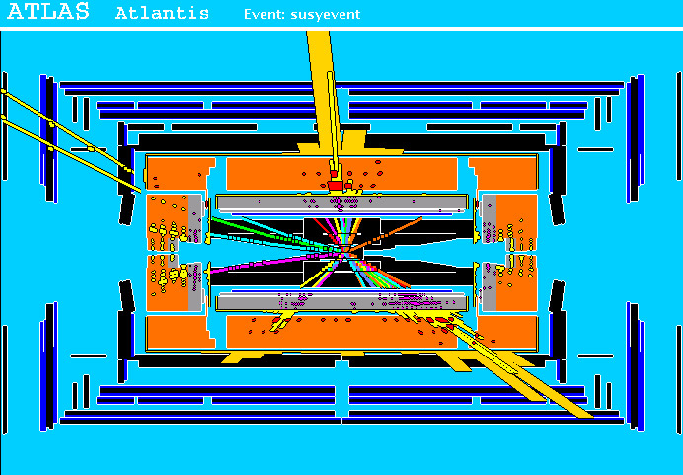
A simulated proton-proton collision
from supersymmetry (“signal”)
high p_{T}
muons
high p_{T} jets
of hadrons
p
p
missing transverse energy

Slide 12
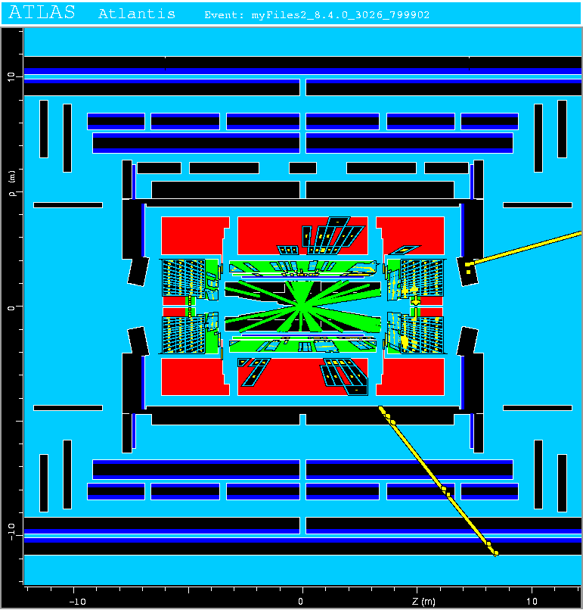
A simulated proton-proton collision from production of top quarks (“background”)
This event has features
similar to what we hope
to see in supersymmetric
events, and thus constitutes
a “background” that can
mimic the “signal”.

Slide 13
Classification of proton-proton collisions
Proton-proton collisions can be considered to come in two classes:
signal (the kind of event we’re looking for, y = 1)
background (the kind that mimics signal, y = 0)
For each collision (event), we measure a collection of features:
x₁ = energy of muon x₄ = missing transverse energy
x₂ = angle between jets x₅ = invariant mass of muon pair
x₃ = total jet energy x₆ = ...
The real events don’t come with true class labels, but computer-simulated events do. So we can have a set of simulated events that consist of a feature vector x and true class label y (0 for background, 1 for signal):
(x, y)₁, (x, y)₂, ..., (x, y)_{N}
The simulated events are called “training data”.

Slide 14
What is the best decision boundary?
“cuts”
linear
nonlinear

Slide 15
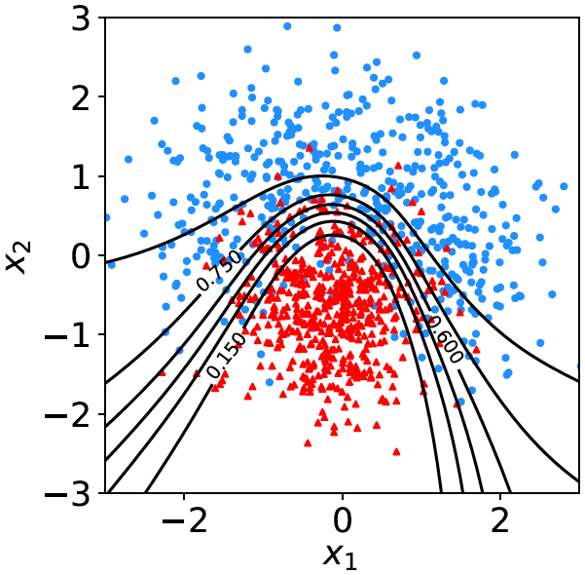
What is the best decision function?
A surface in an n-dimensional
space can be described by
scalar
function
constant
Different values of the constant
t_{c} result in a family of surfaces.
Problem is reduced to finding
the best decision function t (x).

Slide 16
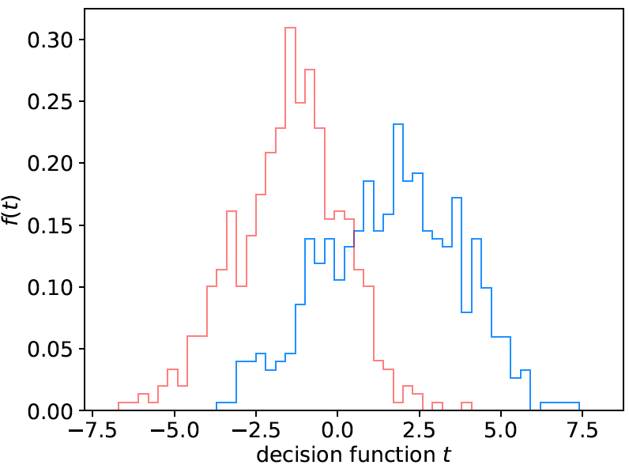
Linear decision boundary
A simple Ansatz is to try a
decision function of the form
where the coefficients w₁,..., w_{n} are constants (or “weights”) we
need to determine using the training data.
A given choice of the weights
fixes the function t (x).
Look at the training events
from the two classes, for
each evaluate t (x) and enter
into a histogram.
Goal is to maximize the
“separation” between the
two distributions.
back-
ground
signal

Slide 17
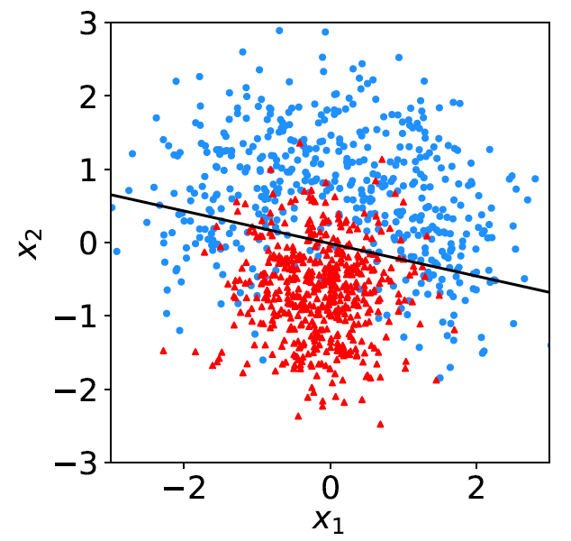
Fisher discriminant
Using a particular definition of what constitutes “best separation”
due to R. Fisher one obtains a Fisher discriminant:

Slide 18
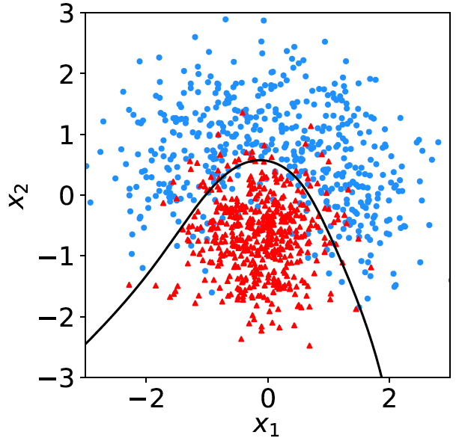
Nonlinear decision boundaries
From the scatter plot below it’s clear that some nonlinear boundary
would be better than a linear one:
And to have a nonlinear boundary, the decision function t (x) must be nonlinear in x.

Slide 19
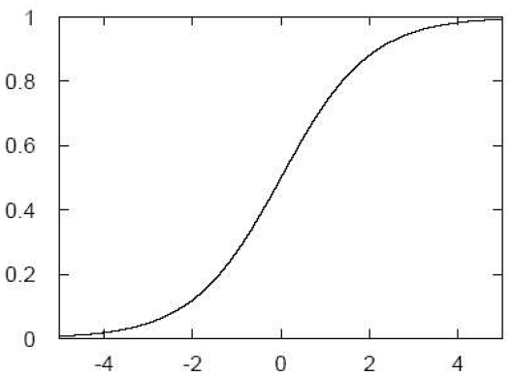
Neural Networks
A simple nonlinear decision function can be constructed as
where h is called the “activation function”. For this one
can use, e.g., a logistic sigmoid function,
u

Slide 20
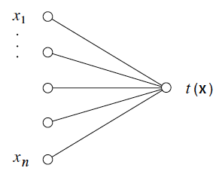
Single Layer Perceptron
In this form, the decision
function is called a
Single Layer Perceptron –
the simplest example of a
Neural Network.
output node
input layer
But the surface described by t (x) = t_{c} is the same as by
So here we still have a linear decision boundary.

Slide 21
Multilayer Perceptron
The Single Layer Perceptron can be generalized by defining
first a set of functions φ_{i}(x), with i = 1,..., m:
The φ_{i}(x) are then treated as if they were the input variables, in
a perceptron, i.e., the decision function (output node) is

Slide 22
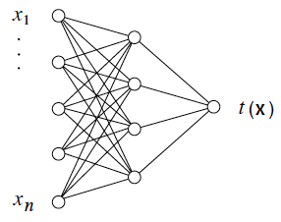
Multilayer Perceptron (2)
output node
hidden layer with m nodes
φ₁(x),..., φ_{m}(x)
input
layer
Each line in the graph represents one of the weights w_{ij}^{(k)},
which must be adjusted using the training data.

Slide 23
Training a Neural Network
To train the network (i.e., determine the best values for the
weights), define a loss function, e.g.,
where w represents the set of all weights, the sum is over the
set of training events, and y_{i} is the (numeric) true class label
of each event (0 or 1).
The optimal values of the weights are found by minimizing
E(w) with respect to the weights (non-trivial algorithms:
backpropagation, stochastic gradient descent,...).
The desired result for an event with feature vector x is:
if the event is of type 0, want t (x) ~ 0,
if the event is of type 1, want t (x) ~ 1.

Slide 24
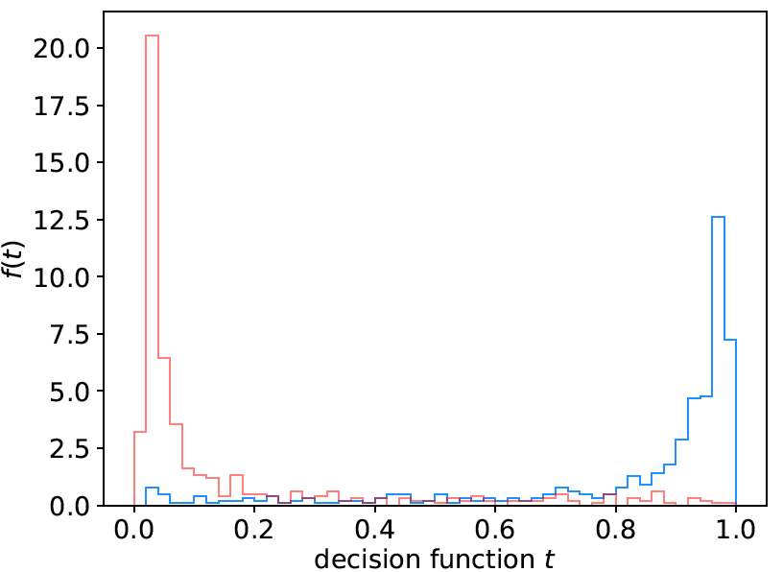
Distribution of neural net output
Degree of separation between classes now much better than
with linear decision function:
back-
ground
signal

Slide 25
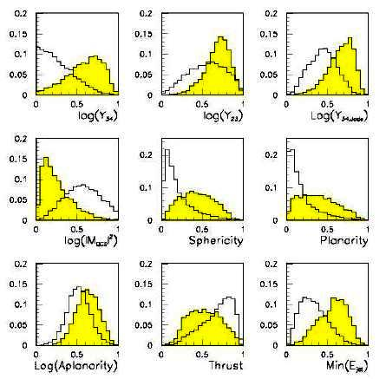
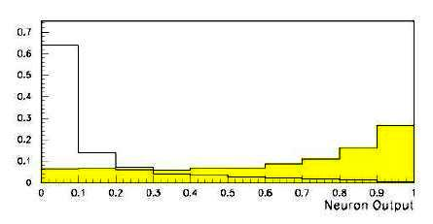
Neural network example from LEP II
Signal: e⁺e⁻ → W⁺W⁻ (often 4 well separated hadron jets)
Background: e⁺e⁻ → qqgg (4 less well separated hadron jets)
← input variables based on jet
structure, event shape, ...
none by itself gives much separation.
Neural network output:
(Garrido, Juste and Martinez, ALEPH 96-144)

Slide 26
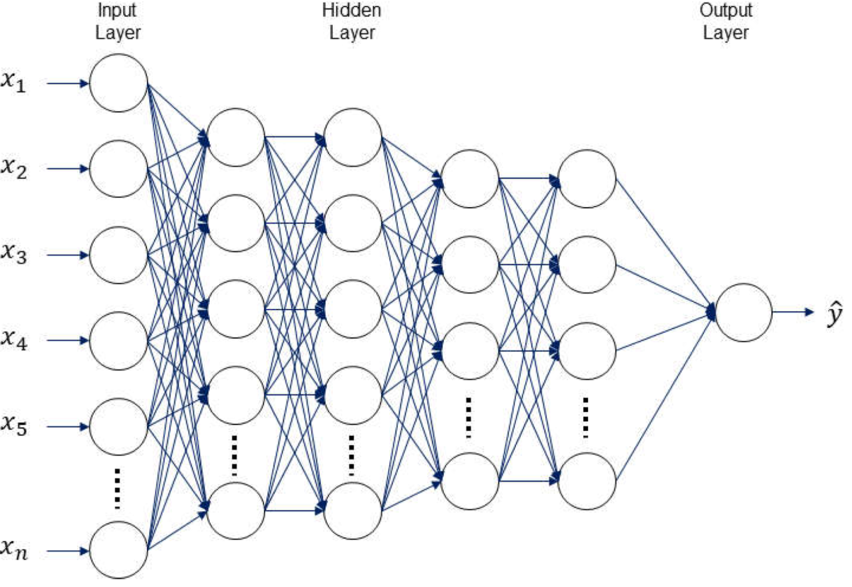
H.I. Kim and K.Y. Han, Water 2020, 12(3), 899
Deep Neural Networks
The multilayer perceptron can be generalized to have an arbitrary number of hidden layers, with an arbitrary number of nodes in each (= “network architecture”).
A “deep” network has several (or many) hidden layers:
“Deep Learning” is a very recent and active field of research.

Slide 27
Other types of classifiers
We have seen only two types of classifiers:
Linear (Fisher discriminant)
Neural Network
There are many others:
Support Vector Machine
Boosted Decision Tree
K-Nearest Neighbour
...
The field is rapidly developing with advances, e.g., that allow one
to use feature vectors of very high dimension, such as the pixels
of an image.
→ face/handwriting recognition, driverless cars...

Slide 28
Finally
Four lectures only enough for a brief introduction to:
Probability, frequentist & Bayesian approaches
Parameter estimation, maximum likelihood
Hypothesis tests, p-values, limits
Intro to Machine Learning
Many other important areas:
Treatment of systematic uncertainties (nuisance parameters)
Profile likelihood ratio tests, asymptotics,...
I have put links to some exercises that contain simple python programs on the web pages for lectures 2 (parameter estimation), 3 (hypothesis tests) and 4 (machine learning) – enjoy!

Slide 29
Extra slides

Slide 30
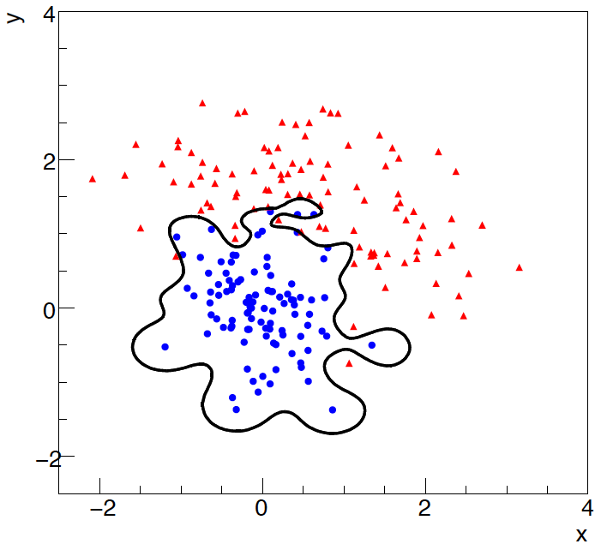
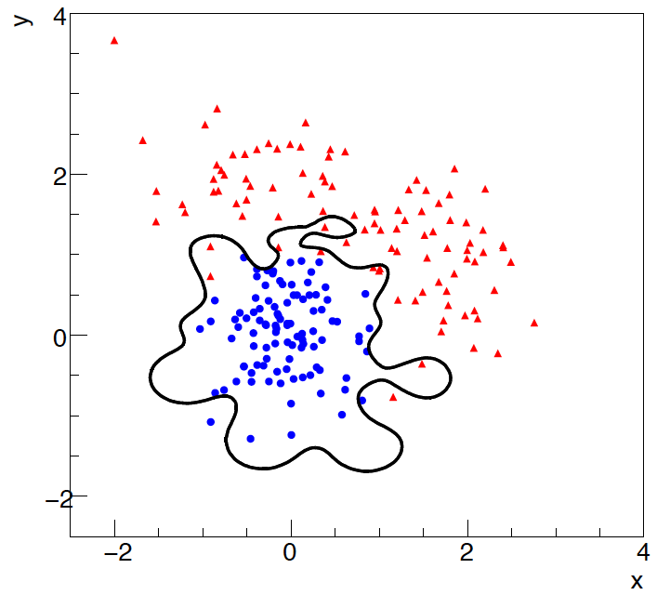
Overtraining
Including more parameters in a classifier makes its decision boundary
increasingly flexible, e.g., more nodes/layers for a neural network.
A “flexible” classifier may conform too closely to the training points;
the same boundary will not perform well on an independent test
data sample (→ “overtraining”).
training sample
independent test sample

Slide 31
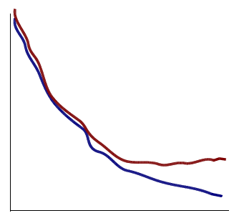
Monitoring overtraining
If we monitor the fraction of misclassified events (or similar, e.g.,
loss function E(w)) for test and training samples, it will usually
decrease for both as the boundary is made more flexible:
optimum at minimum of
error rate for test sample
error
rate
increase in error rate
indicates overtraining
test sample
training sample
complexity/flexibility (e.g., number
of nodes/layers in MLP)

Slide 32
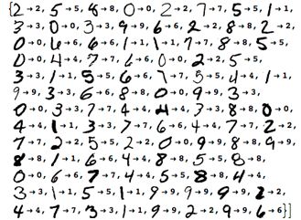
https://www.wolfram.com/mathematica/new-in-10/highly-automated-machine-learning/
Machine Learning for handwriting recognition
Initial feature vector = set of pixel values of an image

Slide 33
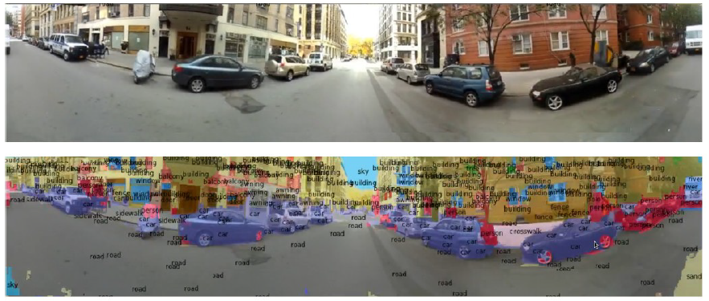
Y. LeCun
Scene parsing/labeling with Convolutional Neural Nets
See Deep Learning and the Future of AI, seminar at CERN by
Yann LeCun: https://indico.cern.ch/event/510372/

