Slide 1
Statistics for Particle Physicists
Lecture 2: Parameter Estimation
Summer Student Lectures
CERN
9 – 12 July 2024
https://indico.cern.ch/event/1347523/timetable/
Glen Cowan
Physics Department
Royal Holloway, University of London
g.cowan@rhul.ac.uk
www.pp.rhul.ac.uk/~cowan

Slide 2
Outline
Lecture 1: Introduction, probability,
Lecture 2: Parameter estimation
(see exercise on fitting with iminuit here)
Lecture 3: Hypothesis tests
Lecture 4: Introduction to Machine Learning

Slide 3
Hypothesis, likelihood
Suppose the entire result of an experiment (set of measurements) is a collection of numbers x.
A (simple) hypothesis is a rule that assigns a probability to each possible data outcome:
= the likelihood of H
Often we deal with a family of hypotheses labeled by one or
more undetermined parameters (a composite hypothesis):
= the “likelihood function”
Note:
1) For the likelihood we treat the data x as fixed.
2) The likelihood function L(θ) is not a pdf for θ.

Slide 4
The likelihood function for i.i.d.* data
* i.i.d. = independent and identically distributed
Consider n independent observations of x: x₁, ..., x_{n}, where
x follows f (x; θ). The joint pdf for the whole data sample is:
In this case the likelihood function is
(x_{i} constant)

Slide 5
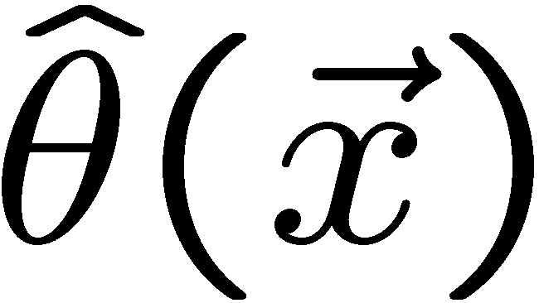
Parameter estimation
The parameters of a pdf are any constants that characterize it,
i.e., θ indexes a
set of hypotheses.
r.v.
parameter
Suppose we have a sample of observed values: x = (x₁, ..., x_{n})
We want to find some function of the data to estimate the
parameter(s):
← estimator written with a hat
Sometimes we say ‘estimator’ for the function of x₁, ..., x_{n};
‘estimate’ for the value of the estimator with a particular data set.

Slide 6
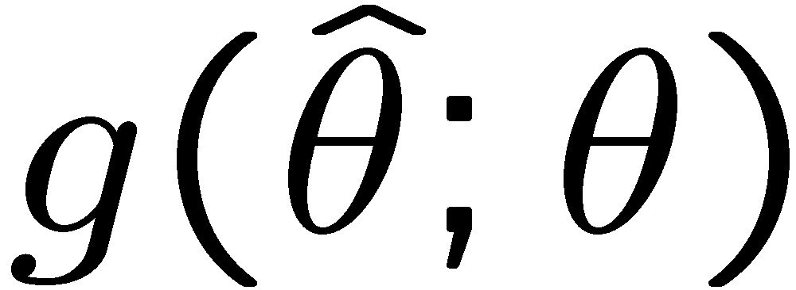
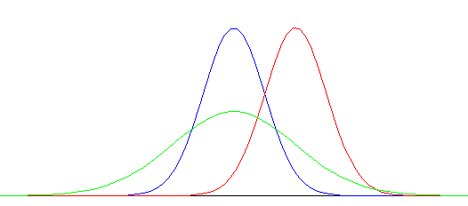
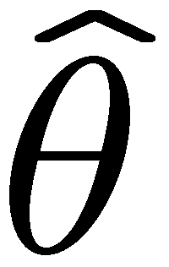
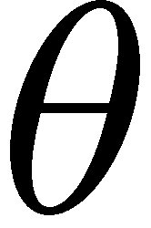
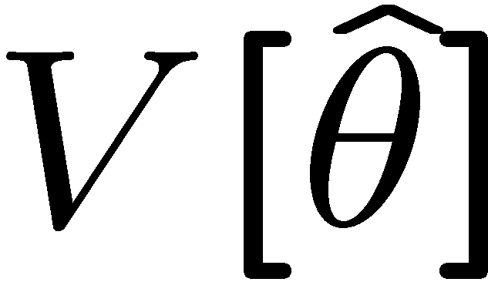
Properties of estimators
If we were to repeat the entire measurement, the estimates
from each would follow a pdf:
best
large
variance
biased
We want small (or zero) bias (systematic error):
→ average of repeated measurements should tend to true value.
And we want a small variance (statistical error):
→ small bias & variance are in general conflicting criteria

Slide 7
Maximum Likelihood Estimators (MLEs)
We define the maximum likelihood estimators or MLEs to be
the parameter values for which the likelihood is maximum.
Maximizing L equivalent to maximizing log L
Could have multiple maxima (take highest).
MLEs not guaranteed to have any ‘optimal’ properties, (but in practice they’re very good).

Slide 8
MLE example: parameter of exponential pdf
Consider exponential pdf,
and suppose we have i.i.d. data,
The likelihood function is
The value of τ for which L(τ) is maximum also gives the
maximum value of its logarithm (the log-likelihood function):

Slide 9
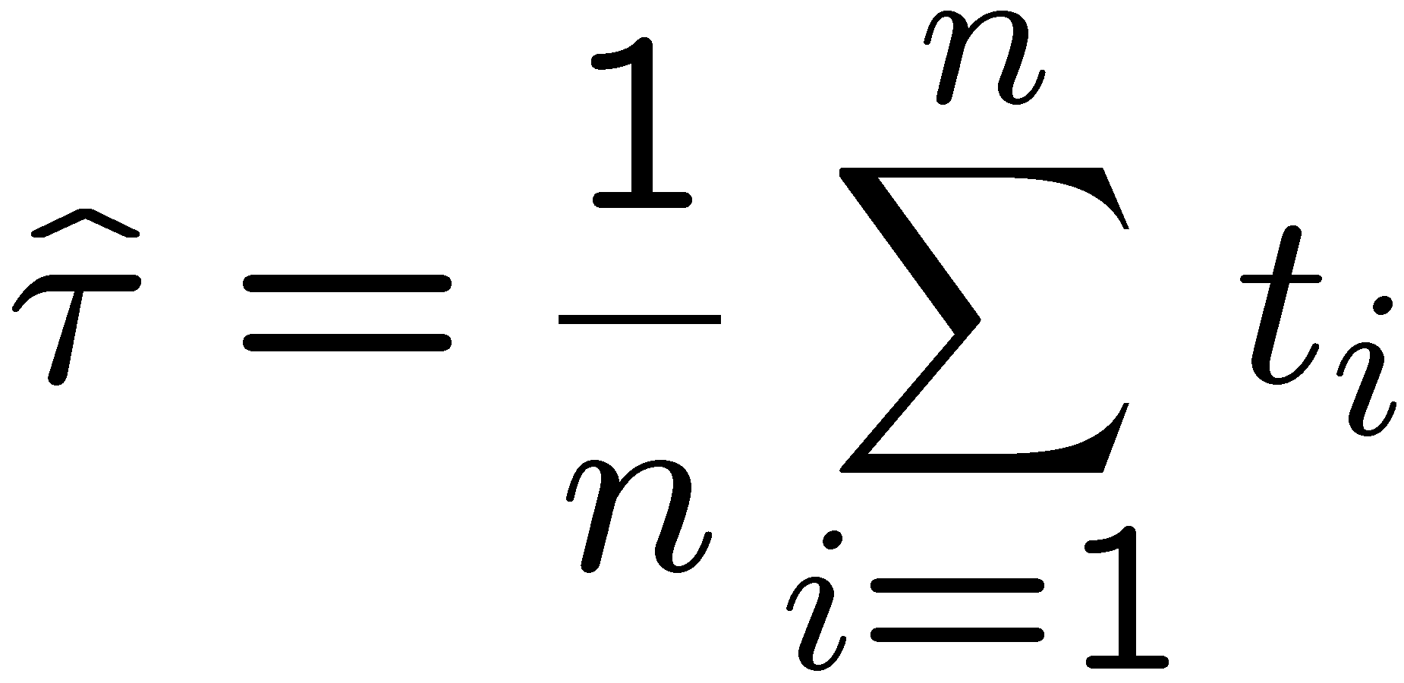
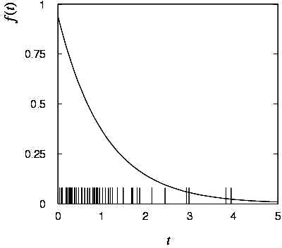
MLE example: parameter of exponential pdf (2)
Find its maximum by setting
→
Monte Carlo test:
generate 50 values
using τ = 1:
We find the ML estimate:

Slide 10
MLE example: parameter of exponential pdf (3)
For the exponential distribution one has for mean, variance:
For the MLE
we therefore find
→
→

Slide 11
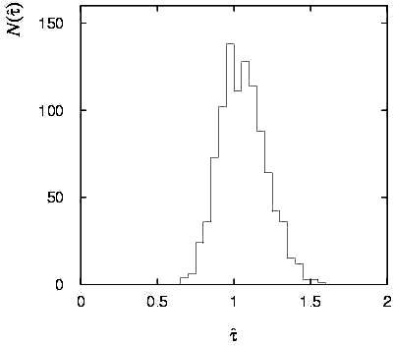
Variance of estimators: Monte Carlo method
Having estimated our parameter we now need to report its
‘statistical error’, i.e., how widely distributed would estimates
be if we were to repeat the entire measurement many times.
One way to do this would be to simulate the entire experiment
many times with a Monte Carlo program (use ML estimate for MC).
For exponential example, from
sample variance of estimates
we find:
Note distribution of estimates is roughly
Gaussian − (almost) always true for
ML in large sample limit.

Slide 12
Variance of estimators from information inequality
The information inequality (RCF) sets a lower bound on the
variance of any estimator (not only ML):
Minimum Variance
Bound (MVB)
Often the bias b is small, and equality either holds exactly or
is a good approximation (e.g. large data sample limit). Then,
Estimate this using the 2nd derivative of ln L at its maximum:

Slide 13
MVB for MLE of exponential parameter
Find
We found for the exponential parameter the MLE
and we showed b = 0, hence 𝜕b/𝜕τ = 0.
We find
and since E[t_{i}] = τ for all i,
,
and therefore
.
(Here MLE is “efficient”).

Slide 14
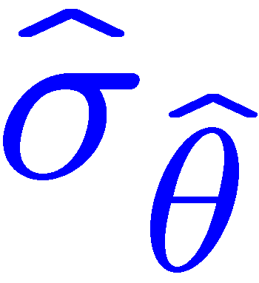
Variance of estimators: graphical method
Expand ln L(θ) about its maximum:
First term is ln L_{max}, second term is zero, for third term use
information inequality (assume equality):
i.e.,
→ to get
, change θ away from
until ln L decreases by 1/2.

Slide 15
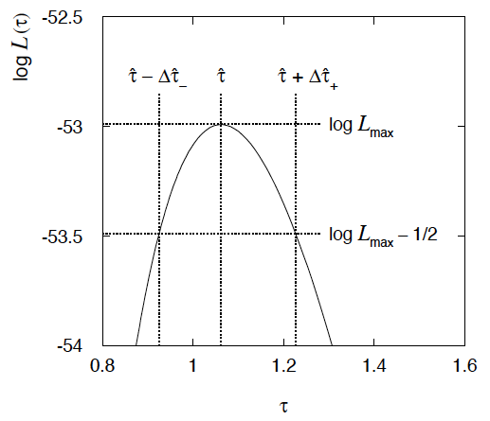
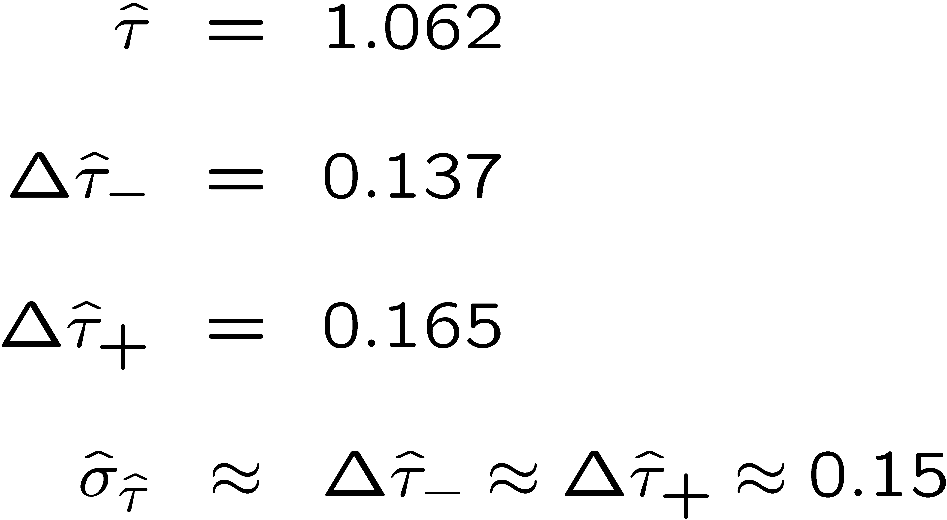
Example of variance by graphical method
ML example with exponential:
Not quite parabolic ln L since finite sample size (n = 50).

Slide 16
Information inequality for N parameters
Suppose we have estimated N parameters θ = (θ₁,...,θ_{N})
The Fisher information matrix is
^
and the covariance matrix of estimators θ is
The information inequality states that the matrix
is positive semi-definite:
z^{T}Mz ≥ 0 for all z ≠ 0, diagonal elements ≥ 0

Slide 17
Information inequality for N parameters (2)
In practice the inequality is ~always used in the large-sample limit:
bias → 0
inequality → equality, i.e, M = 0, and therefore V⁻¹ = I
That is,
This can be estimated from data using
Find the matrix V⁻¹ numerically (or with automatic differentiation),
then invert to get the covariance matrix of the estimators

Slide 18
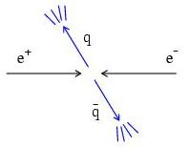
Example of ML with 2 parameters
Consider a scattering angle distribution with x = cos θ,
or if x_{min} < x < x_{max}, need to normalize so that
Example: α = 0.5, β = 0.5, x_{min} = −0.95, x_{max} = 0.95, generate n = 2000 events with Monte Carlo.
need to find maximum
numerically

Slide 19
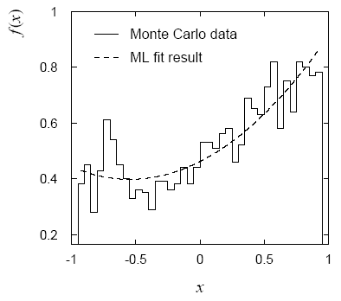
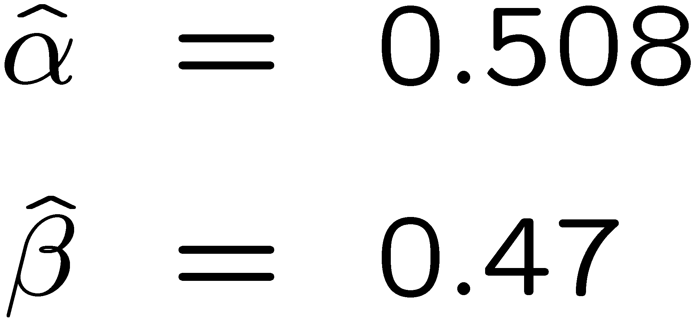
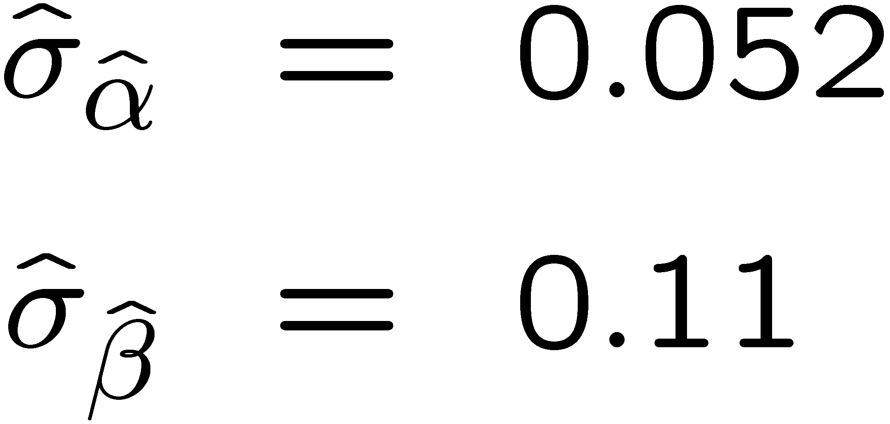
Example of ML with 2 parameters: fit result
Finding maximum of ln L(α, β) numerically gives
N.B. No binning of data for fit,
but can compare to histogram for
goodness-of-fit (e.g. ‘visual’ or χ²).
(Co)variances from
= correlation coefficient

Slide 20
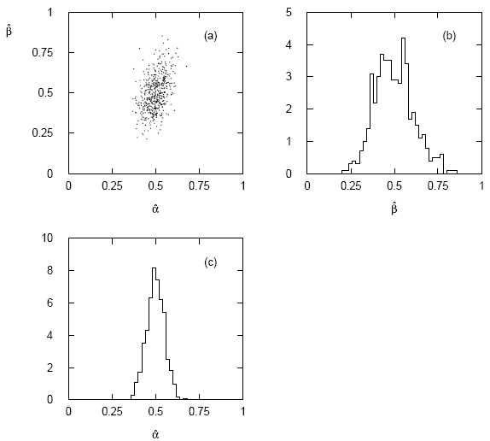
Two-parameter fit: MC study
Repeat ML fit with 500 experiments, all with n = 2000 events:
Estimates average to ~true values;
(Co)variances close to previous estimates;
marginal pdfs approximately Gaussian.

Slide 21
Multiparameter graphical method for variances
Expand ln L(θ) to 2nd order about MLE:
ln L_{max}
zero
relate to covariance matrix of MLEs using information (in)equality.
Result:
So the surface
corresponds to
, which is the equation of a (hyper-) ellipse.

Slide 22
Multiparameter graphical method (2)
Distance from MLE to tangent planes gives standard deviations.

Slide 23
The ln L_{max} − 1/2 contour for two parameters
For large n, ln L takes on quadratic form near maximum:
The contour
is an ellipse:

Slide 24
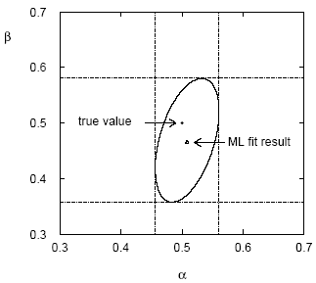
(Co)variances from ln L contour
The α, β plane for the first
MC data set
→ Tangent lines to contours give standard deviations.
→ Angle of ellipse φ related to correlation:

Slide 25
Extra slides

