Slide 1
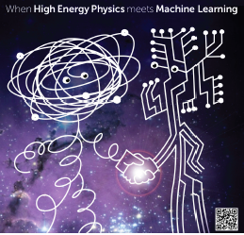


The ATLAS Higgs
Machine Learning Challenge
CHEP, Okinawa, Japan
16 April 2015
Claire Adam-Bourdarios¹, Glen Cowan², Cécile Germain-Renaud³, Isabelle Guyon⁴, Balázs, Kégl¹, David Rousseau¹
¹ Laboratoire de l’Accélérateur Linéaire, Orsay, France
² Royal Holloway, University of London, UK
³ Laboratoire de Recherche en Informatique, Orsay, France
⁴ Chalearn, California, USA

Slide 2
Outline
Multivariate analysis in High Energy Physics
The ATLAS Higgs Machine Learning Challenge
https://www.kaggle.com/c/higgs-boson
http://higgsml.lal.in2p3.fr/
C. Adam-Bourdarios et al., Learning to discover: the
Higgs boson machine learning challenge, CERN Open Data Portal,
DOI: 10.7483 OPENDATA.ATLAS.MQ5J.GHXA
The Problem
The Solutions
Future challenges

Slide 3
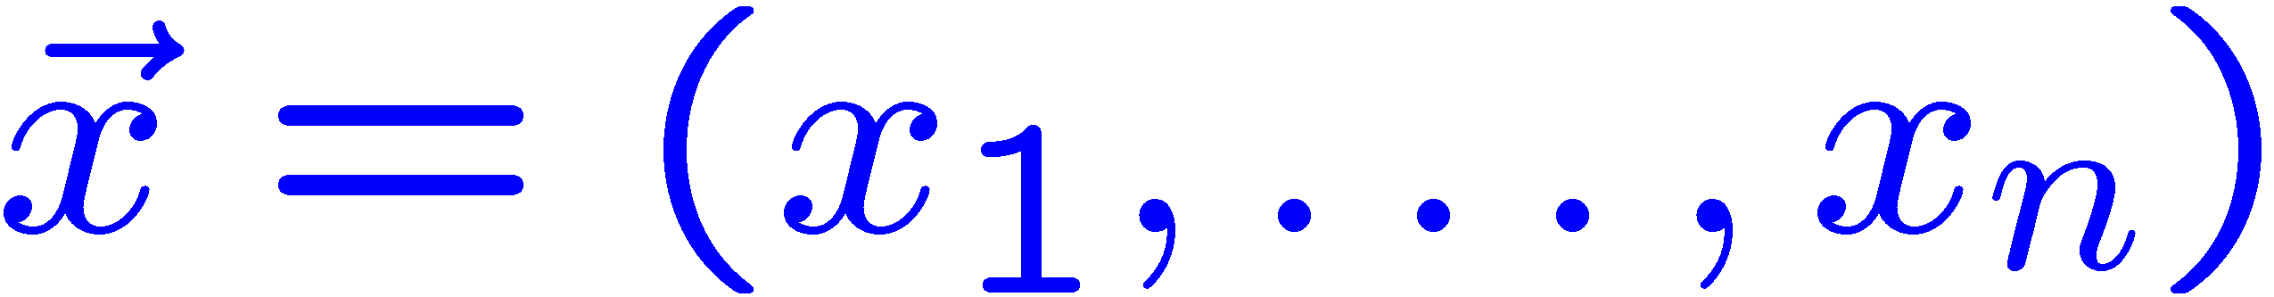

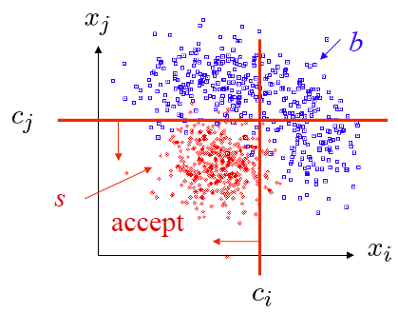
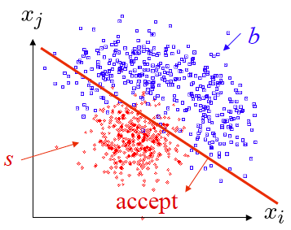
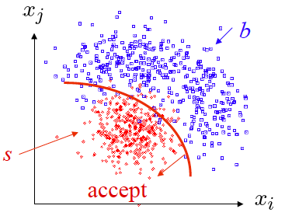
Prototype analysis in HEP
Each event yields a collection of numbers
x₁ = number of muons, x₂ = p_{t} of jet, ...
follows some n-dimensional joint pdf, which depends on
the type of event produced, i.e., signal or background.
1) What kind of decision boundary best separates the two classes?
H₀
2) What is optimal test of hypothesis that event sample contains
only background?

Slide 4
Machine Learning in HEP
Optimal analysis uses information from all (or in any case many) of the measured quantities → Multivariate Analysis (MVA)
Long history of cut-based analyses, followed by:
1990s Fisher Discriminants, Neural Networks
Early 2000s Boosted Decision Trees,
Support Vector Machines
But much recent work in Machine Learning only slowly percolating
into HEP (deep neural networks, random forests,...)
Therefore try to promote transmission of ideas from ML into HEP
using a Data Challenge.

Slide 5
Challenge ?
Challenges have become in the last 10 years a common way of working for the machine learning community
Machine learning scientists are eager to test their algorithms on real life problems; more valuable (= publishable) than artificial problems
Company or academics want to outsource a problem to machine learning scientist, but also geeks, etc. The company sets up a challenge like:
  Netflix : predict movie preference from past movie selection
  NASA/JPL mapping dark matter through (simulated) galaxy distortion
Some companies makes a business from organising challenges: datascience.net, kaggle

Slide 6
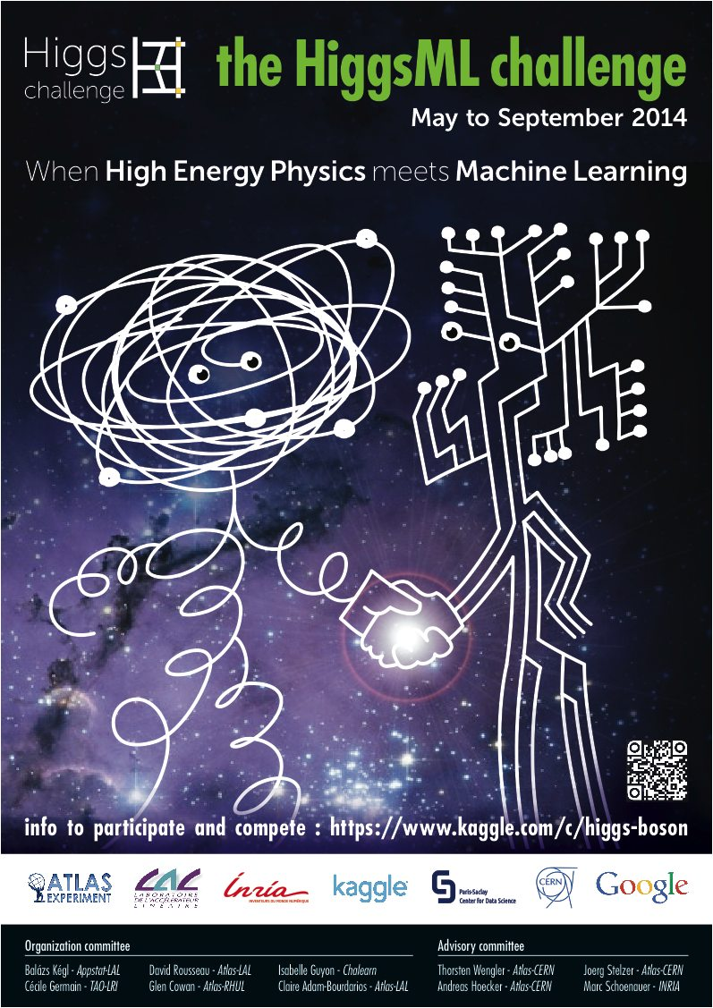
The Higgs Machine Learning Challenge

Slide 7
… in a nutshell
Why not put some ATLAS simulated data on the web and ask data scientists to find the best machine learning algorithm to find the Higgs?
  Instead of HEP people browsing machine learning papers, coding or downloading a possibly interesting algorithm, trying and seeing whether it can work for our problems
Challenge for us: make a full ATLAS Higgs analysis simple for non-physicists, but sufficiently close to reality to still be useful for us.
Also try to foster long-term collaborations between HEP and ML.

Slide 8
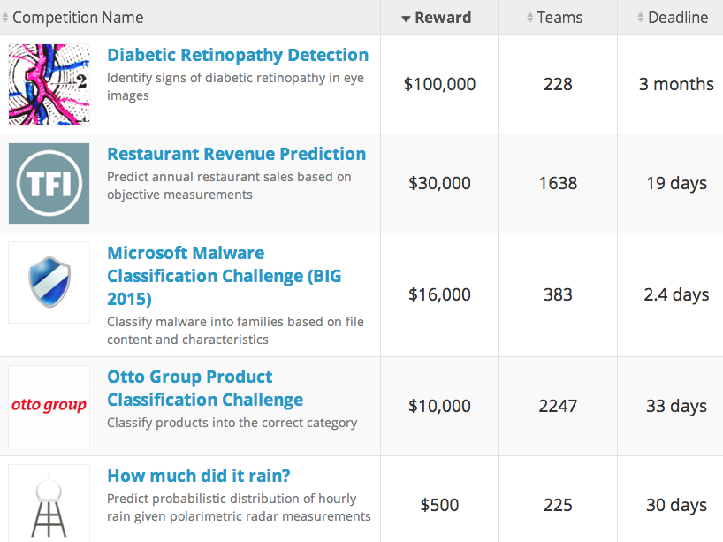
The Host
Competition hosted by Kaggle, which provides platform for many data science challenges, e.g.,
www.kaggle.com

Slide 9
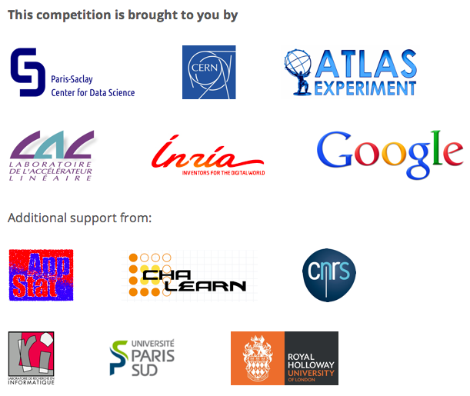
Sponsors

Slide 10
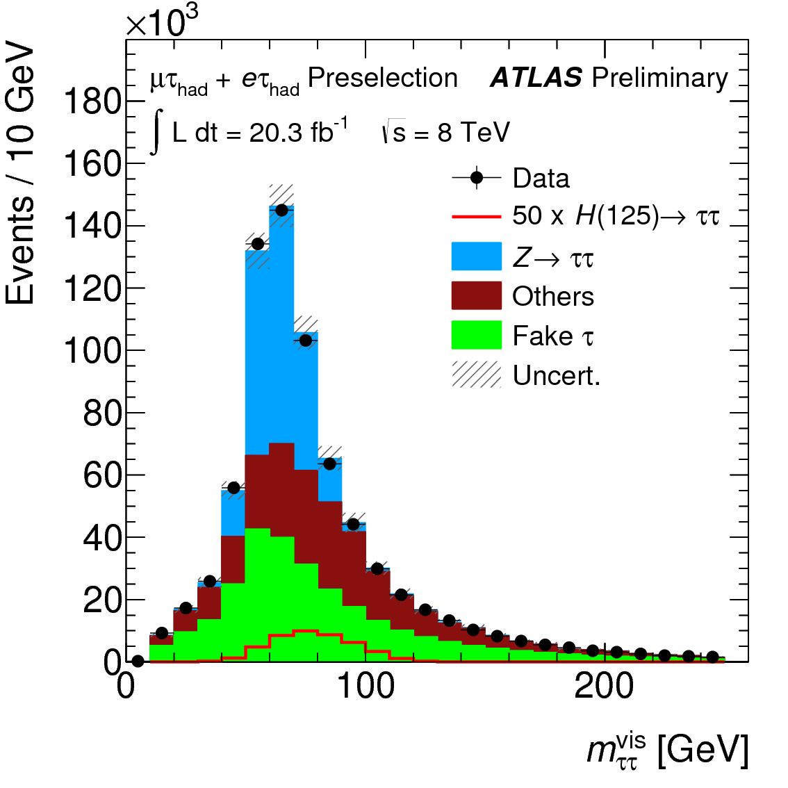
The signal process: Higgs → τ⁺τ⁻
ATLAS-CONF-2013-108
4.1 σ evidence
Νow superseded by
ATLAS paper: Evidence for the Higgs-boson Yukawa coupling to tau leptons with the ATLAS detector, arXiv:1501.04943

Slide 11
ATLAS Monte Carlo Data
ASCII csv file, with mixture of Higgs to ττ signal and corresponding
background, from official GEANT4 ATLAS simulation
250k training sample (event type s or b given)
100k public + 450k private test samples (event type hidden)
30 variables (derived and “primitive”)
+ event weight (given for training sample only):
DER_mass_MMC
DER_mass_transverse_met_lep
DER_mass_vis
DER_pt_h
DER_deltaeta_jet_jet
DER_mass_jet_jet
DER_prodeta_jet_jet
DER_deltar_tau_lep
DER_pt_tot
DER_sum_pt
DER_pt_ratio_lep_tau
DER_met_phi_centrality
DER_lep_eta_centrality
PRI_tau_pt
PRI_tau_eta
PRI_tau_phi
PRI_lep_pt
PRI_lep_eta
PRI_lep_phi
PRI_met
PRI_met_phi
PRI_met_sumet
PRI_jet_num (0,1,2,3, capped at 3)
PRI_jet_leading_pt
PRI_jet_leading_eta
PRI_jet_leading_phi
PRI_jet_subleading_pt
PRI_jet_subleading_eta
PRI_jet_subleading_phi
PRI_jet_all_pt

Slide 12

Objective Function
Typical Machine Learning goal is event classification; try to
minimize e.g. classification error rate.
Goal in HEP search is to establish whether event sample contains
only background; rejecting this hypothesis ≈ discovery of signal.
Often approach in HEP is to use distribution of MVA classifier.
Simplest case, use classifier to define “search region” and count:
s = expected number of signal events (assuming it exists)
b = expected number of background events
Goal: Minimize Approximate Median Significance of discovery:
(Modified in the Challenge to prevent small search region where estimate of b may fluctuate very low: b → b + b_{reg}.)

Slide 13
Real analysis vs challenge
Systematics
2 categories x n BDT score bins
Background estimated from data (embedded, anti tau, control region) and some MC
Weights include all corrections. Some negative weights (tt)
Potentially use any information from all 2012 data and MC events
Few variables fed in two BDT
Significance from complete fit with NP etc…
MVA with TMVA BDT
No systematics
No categories, one signal region
Straight use of ATLAS G4 MC
Weights only include normalisation and pythia weight. Neg. weight events rejected.
Only use variables and events preselected by the real analysis
All BDT variables + categorisation variables + primitives 3-vector
Significance from “regularised Asimov”
MVA “no-limit”
Simpler, but not too simple!

Slide 14
Participation & Outcome
Competition ran 12 May to 15 September 2014
Kaggle’s most popular challenge ever!
1785 teams (1942 people) made submissions
(6517 people downloaded the data)
35772 solutions uploaded
136 forum topics with 1100 posts
The winners:
Gabor Melis (3.806) $7000
Tim Salimans (3.789) $4000
Pierre Courtiol (3.787) $2000
Tianqi Chen and Tong He “HEP meets ML” award

Slide 15
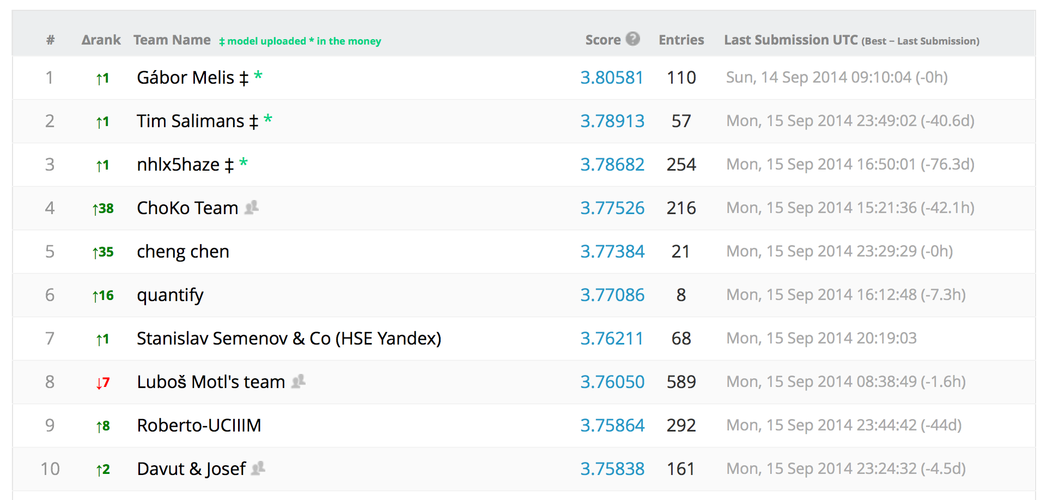
Final leaderboard
$7000
$4000
$2000
Best physicist
HEP meets ML award
XGBoost authors
Free trip to CERN
TMVA expert, with TMVA
improvements

Slide 16
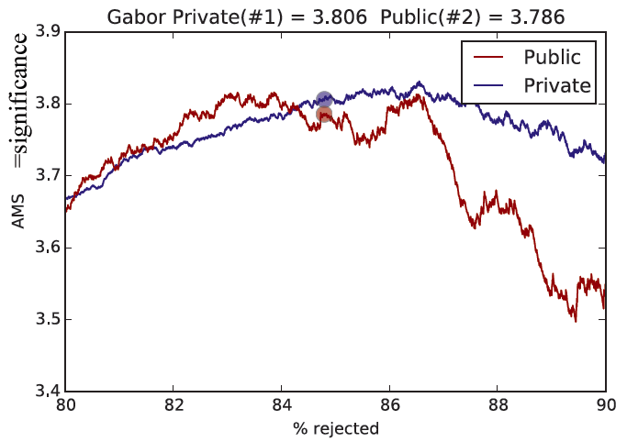
Winning entry by Gábor Melis: bag of 70 NNs

Slide 17
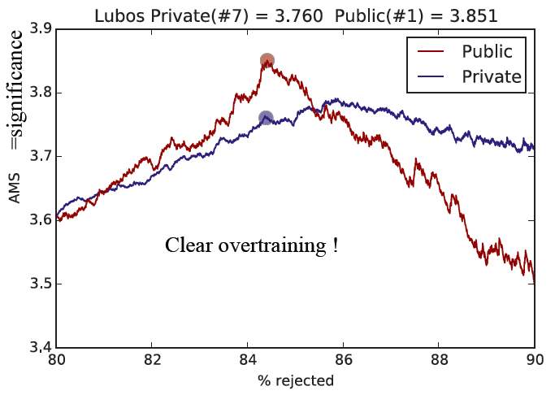
Significance from (public)
test data overestimated.

Slide 18
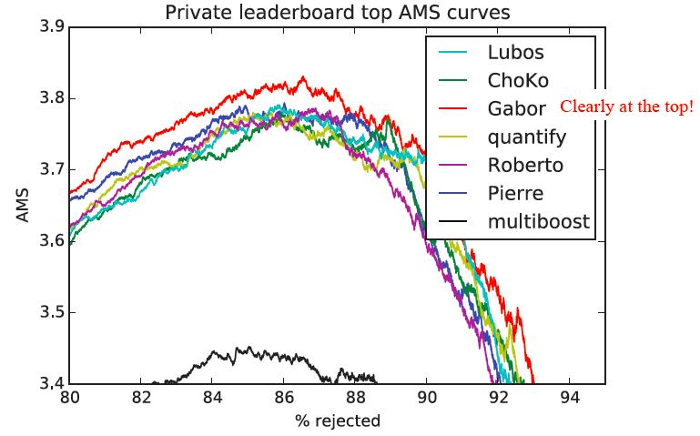

Slide 19
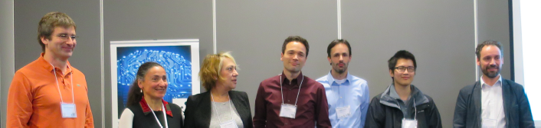
What we’ve learned
Very successful satellite workshop at NIPS in Dec 2014 @ Montreal: https://indico.lal.in2p3.fr/event/2632/
  20% gain w.r.t. to untuned TMVA
  Deep Neural nets
  Ensemble methods (random forest, boosting)
  Meta-ensembles of diverse models
  careful cross-validation (250k training sample really small)
  Complex software suites using routinely multithreading, GPU, etc…
  Some techniques (e.g. meta-ensembles) too complex to be practical, and marginal gain, others appear practical and useful

Slide 20
Next steps
Re-importing into HEP all the ML developments (will take time!);
e.g., discussions on-going with TMVA experts.
Dataset will remain on CERN Open Data Portal with citeable d.o.i.:
http://opendata.cern.ch/collection/ATLAS-Higgs-Challenge-2014
  ~800k events with full truth info
HEPML@NIPS contributions to be published in Proceedings of Machine Learning Research 42
Award winners at CERN (authors of XGboost and HEP meets ML winners Tianqi Chen and Tong He, and overall winner Gabor Melis)
  Mini workshop 19th May 2015, 3 pm in CERN Auditorium, http://cern.ch/higgsml-visit (will be webcast)
  Related:
  1) Data Science @ LHC workshop at CERN 9-13 Nov 2015
  2) New mailing list: HEP-data-science@googlegroups.com

Slide 21
Extra slides

Slide 22
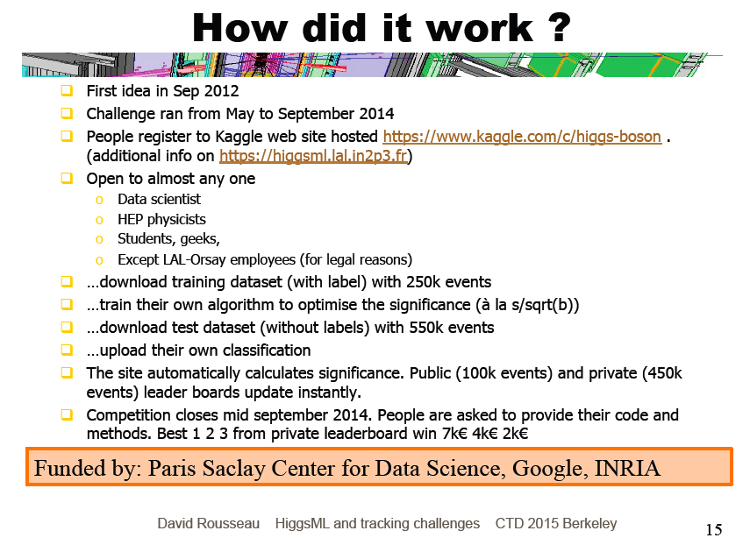

Slide 23
Cross validation
Common practice in HEP has been to divide the available MC
data into a training sample and test sample:
Training sample used to train classifier
Test sample used to estimate its performance
But then only ~half of the expensive MC data is used for each task.
In k-fold cross validation, divide sample into k subsets or “folds” (say, k = 10), then:
Use all but the jth fold for training, jth fold for testing
→ get performance measure ε_{j}.
Repeat for all k folds, average resulting ε_{j} and use this to
optimize classifier and estimate performance.
Train final classifier using all of the available events.
Many flavours, see e.g. Cross Validation wikipedia page
http://en.wikipedia.org/wiki/Cross-validation_(statistics)

Slide 24
Committees
Organization committee:
  David Rousseau ATLAS-LAL
  Claire Adam-Bourdarios ATLAS-LAL (outreach, legal matters)
  Glen Cowan ATLAS-RHUL (statistics)
  Balázs, Kégl Appstat-LAL
  Cécile Germain TAO-LRI
  Isabelle Guyon Chalearn (challenges organization)
Advisory committee:
  Andreas Hoecker ATLAS-CERN (PC,TMVA)
  Joerg Stelzer ATLAS-CERN (TMVA)
  Thorsten Wengler ATLAS-CERN (ATLAS management)
  Marc Schoenauer INRIA (French computer science institute)
{
ATLAS
{
Machine
Learning

Slide 25
Why challenges work
Not just ML, but a general trend:
Open Innovation

Slide 26
From domain to challenge and back
Domain e.g. HEP
Challenge
simplify
Problem
Problem
Domain
experts
solve
the domain
problem
The crowd
solves
the challenge
problem
reimport
Solution
Solution

