Slide 1





Errors on Errors: Refining Particle Physics Analyses with the Gamma Variance Model
STAMPS Seminar
CMU via London
12 November 2021
Glen Cowan
Physics Department
Royal Holloway, University of London
g.cowan@rhul.ac.uk
www.pp.rhul.ac.uk/~cowan

Slide 2
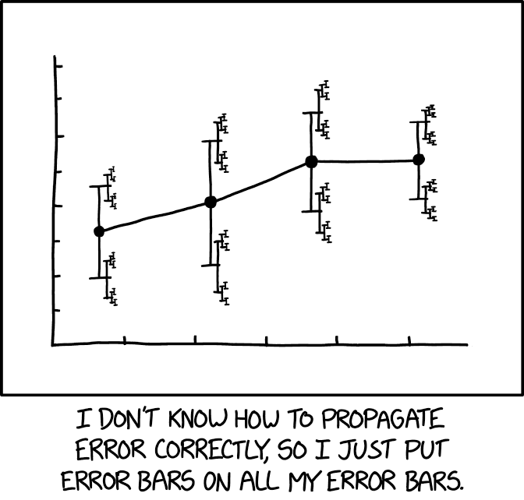
https://xkcd.com/2110/
Randall Munroe, xkcd.com

Slide 3
Outline
Intro, motivation
Using measurements with “known” systematic errors:
Least Squares (BLUE)
Allowing for uncertainties in the systematic errors
Estimates of sys errors ~ Gamma
Asymptotics, Bartlett correction
Curve fitting, averages
Confidence intervals, goodness-of-fit, outliers
Application to the muon g−2 anomaly (arXiv:2107.02652)
Discussion and conclusions
Details in: G. Cowan, Statistical Models with Uncertain Error
Parameters, Eur. Phys. J. C (2019) 79:133, arXiv:1809.05778

Slide 4



A typical particle physics measurement
A typical analysis involves primary measurements y modeled with probability P(y|μ,θ),
μ = parameters of interest
θ = nuisance parameters
To provide info on nuisance parameters, often treat their best
estimates u as indep. Gaussian distributed with known std. dev. σ_{u}:
or log-likelihood (up to additive const.)
assumes ”systematic
errors” σ_{ui}
are known

Slide 5
Motivation
Analyses are often sensitive to the values σ_{u} assigned to control measurements (the “systematic errors”).
But these error estimates are also uncertain (→ errors on errors)
Could just try inflating the systematic error estimates, but this turns out not to be enough, especially if the analysis uses least squares (equivalent to assuming Gaussian pdfs in likelihood).
Need for “errors on errors” most visible when measurements are not internally consistent within their estimated uncertainties.
Candidate use cases in particle physics:
Combinations of inconsistent measurements
Analyses where systematic error assigned by ad hoc recipe
Any analysis where assigned systematic error is uncertain

Slide 6

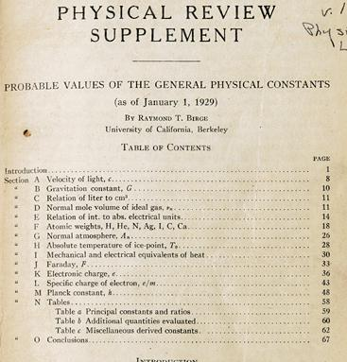
http://bancroft.berkeley.edu/Exhibits/physics/learning01.html
Least Squares for Averaging
_{= fit of horizontal line}
Raymond T. Birge,
Probable Values of the General Physical Constants (as of January 1, 1929), Physical Review Supplement, Vol 1, Number 1, July 1929
Forerunner of the
Particle Data Group

Slide 7
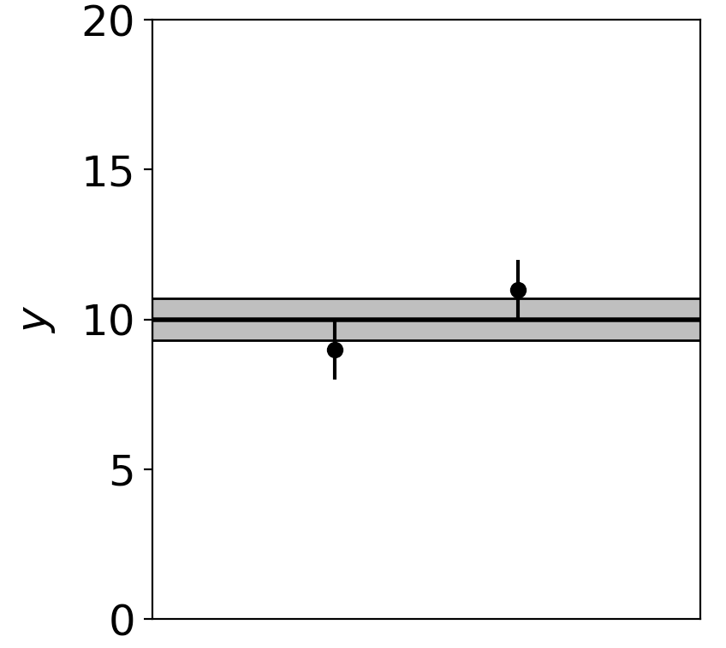
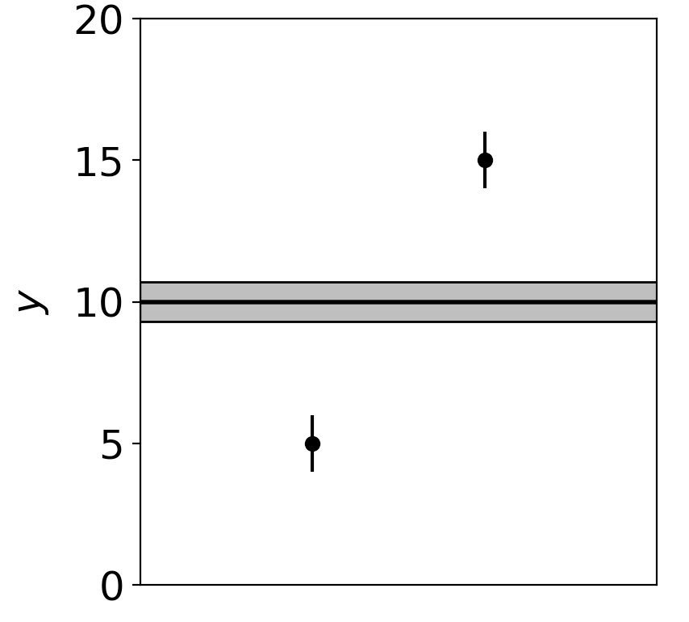
Motivation (2)
Assuming known standard deviations for least squares, uncertainty (e.g. confidence interval) does not reflect goodness of fit:
Least squares average of 9 ± 1 and 11 ± 1 is 10 ± 0.71
Least squares average of 5 ± 1 and 15 ± 1 is 10 ± 0.71
Width of confidence interval for the mean does not reflect the consistency of the values being averaged.

Slide 8
Systematic errors and their uncertainty
Sometimes σ_{u,i} is well known, e.g., it is itself a statistical error known from sample size of a control measurement.
Other times the u_{i} are from an indirect measurement, Gaussian model approximate and/or the σ_{u,i} are not exactly known.
Or sometimes σ_{u,i} is at best a guess that represents an uncertainty in the underlying model (“theoretical error”).
In any case we can allow that the σ_{u,i} are not known in general with perfect accuracy.

Slide 9



Gamma variance model
As the systematic errors σ_{u,i} are uncertain, let them be adjustable nuisance parameters.
Treat their assigned values as estimates s_{i} for σ_{u,i} or equivalently v_{i} = s_{i}², is an estimate of σ_{u,i}².
Model the v_{i} as independent and gamma distributed:
Set α and β so that they give desired relative uncertainty r in σ_{u}.
Leads to model equivalent to replacing Gaussian by Student’s t with ν = 1/2r² degrees of freedom.

Slide 10


Gamma model for estimates of variance
Suppose the estimated variance v was obtained as the sample
variance from n observations of a Gaussian distributed bias
estimate u.
In this case v is gamma distributed with
Furthermore choice of the gamma distribution for v allows one
to profile over the nuisance parameters σ_{u}² in closed form and
leads to a simple profile likelihood.

Slide 11



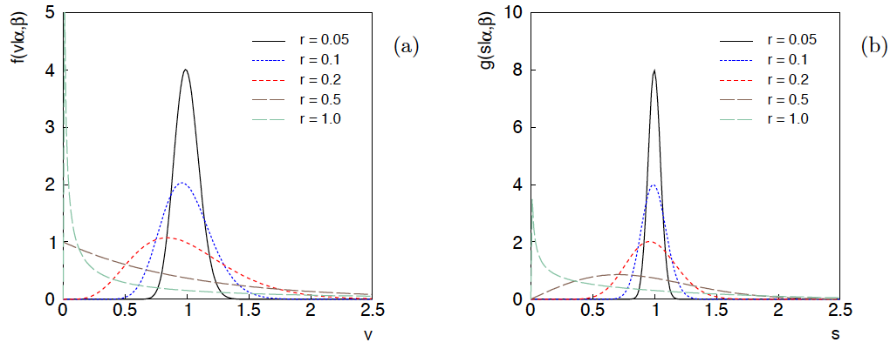
Distributions of v and s = √v
For α, β of gamma distribution,
relative “error on error”

Slide 12
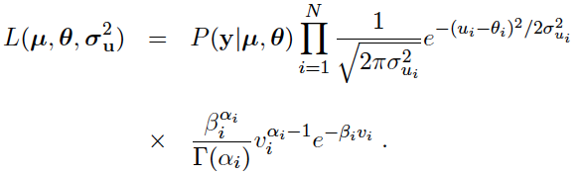
Full likelihood for gamma variance model
Treated like data: y₁,...,y_{L} (the primary measurements)
u₁,...,u_{N} (estimates of nuisance par.)
v₁,...,v_{N} (estimates of variances
of estimates of NP)
Adjustable parameters: μ₁,...,μ_{M} (parameters of interest)
θ₁,...,θ_{N} (nuisance parameters)
σ_{u,1},...,σ_{u,N} (sys. errors = std. dev. of
of NP estimates)
Fixed parameters: r₁,...,r_{N} (rel. err. in estimate of σ_{u,i})

Slide 13

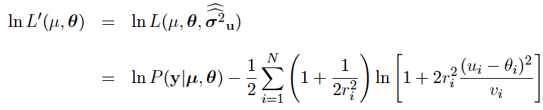
Profiling over systematic errors
We can profile over the σ_{u,i} in closed form
which gives the profile log-likelihood (up to additive const.)
In limit of small r_{i} and v_{i} → σ_{u,i}², the log terms revert back to the
quadratic form seen with known σ_{u,i}.

Slide 14




Equivalent likelihood from Student’s t
We can arrive at same likelihood by defining
Since u_{i} ~ Gauss and v_{i} ~ Gamma, z_{i} ~ Student’s t
with
Resulting likelihood same as profile Lʹ(μ,θ) from gamma model

Slide 15
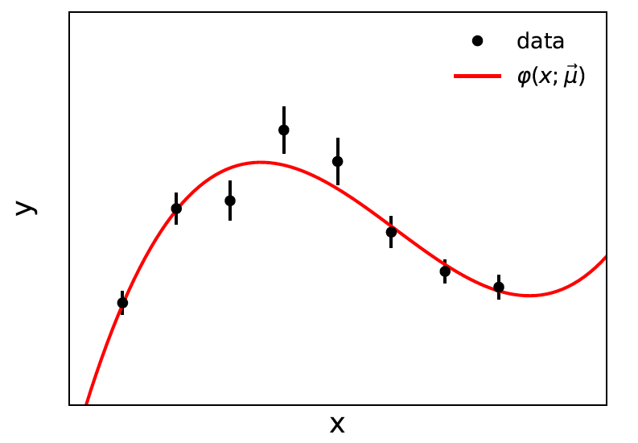


Curve fitting, averages
Suppose independent
y_{i} ~ Gauss, i = 1,...,N, with
μ are the parameters of interest in the fit function φ(x;μ),
θ are bias parameters constrained by control measurements
u_{i} ~ Gauss(θ_{i}, σ_{u,i}), so that if σ_{u,i} are known we have

Slide 16


Goodness of fit
Can quantify goodness of fit with statistic
where Lʹ (φ,θ) has an adjustable φ_{i} for each y_{i} (the saturated
model).
Asymptotically should have q ~ chi-squared(N−M).
For increasing r_{i}, asymptotics breaks down: ongoing studies
with Alessandra Brazzale (Uni. Padova) on higher order asymptotics.
Some improvement possible with Bartlett correction.

Slide 17
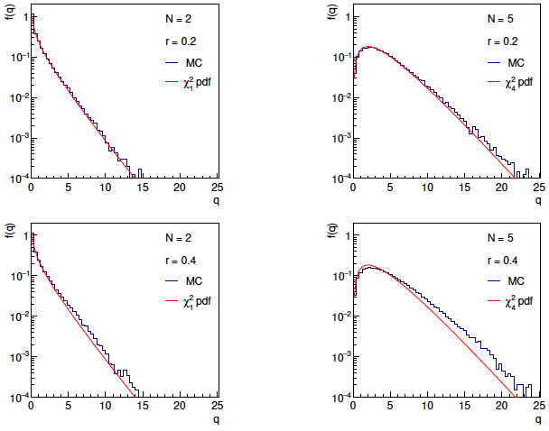
Distributions of q

Slide 18

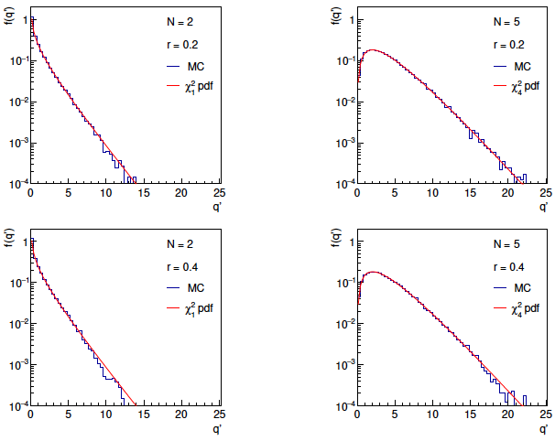
Distributions of Bartlett-corrected

Slide 19
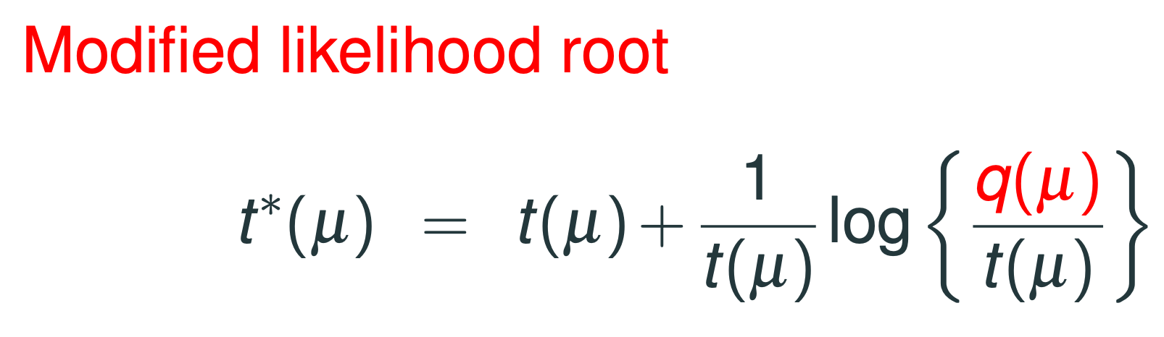
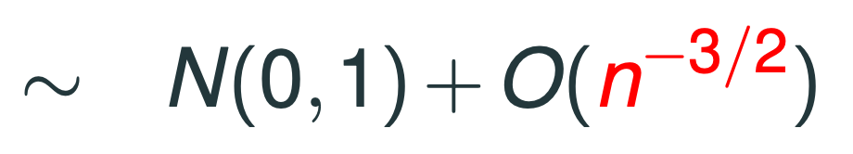
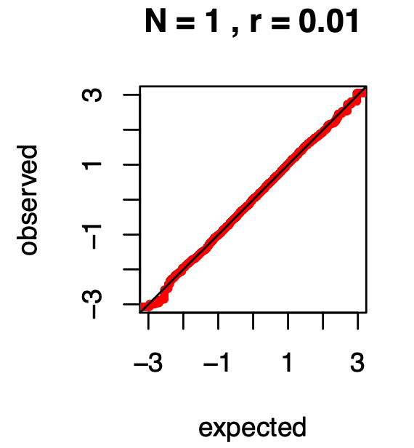
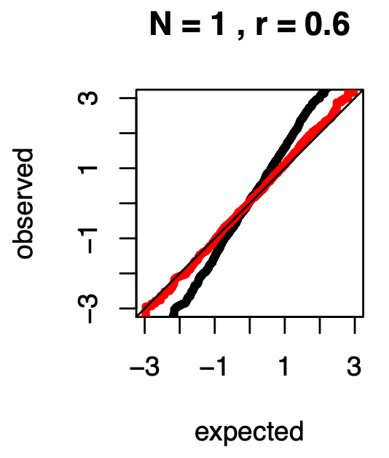
Higher-order asymptotics (A. Brazzale)
https://indico.cern.ch/event/1051224/contributions/4540321/attachments/2337195/3983787/PhyStatSyst_Brazzale%5B7%5D.pdf
Modified statistic
shows close to
asymptotic distribution even for r ~ 0.6. No simulation required.

Slide 20


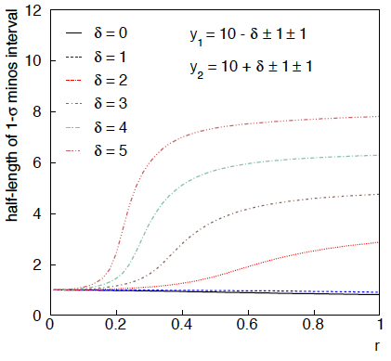
Example: average of two measurements
MINOS interval (= approx. confidence interval) based on
with
Increased discrepancy
between values to be
averaged gives larger
interval.
Interval length saturates
at ~level of absolute
discrepancy between
input values.
relative error
on sys. error

Slide 21
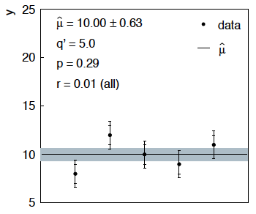
Sensitivity of average to outliers
Suppose we average 5 values, y = 8, 9, 10, 11, 12, all with
stat. and sys. errors of 1.0, and suppose negligible error on error
(here take r = 0.01 for all).
inner error bars = σ_{y,i}
outer error bars
= (σ_{y,i}² + σ_{u,i}²)^{½}

Slide 22
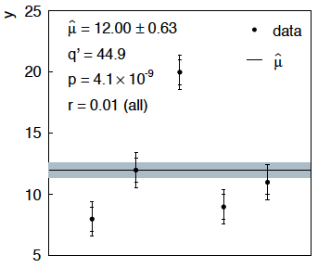
Sensitivity of average to outliers (2)
Now suppose the measurement at 10 was actually at 20:
“outlier”
Estimate pulled up to 12.0, size of confidence interval ~unchanged
(would be exactly unchanged with r → 0).

Slide 23
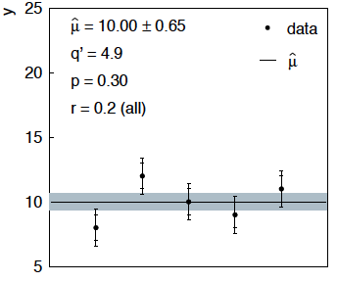
Average with all r = 0.2
If we assign to each measurement r = 0.2,
Estimate still at 10.00, size of interval moves 0.63 → 0.65

Slide 24
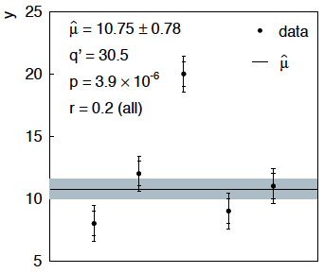
Average with all r = 0.2 with outlier
Same now with the outlier (middle measurement 10 → 20)
Estimate →10.75 (outlier pulls much less).
Half-size of interval → 0.78 (inflated because of bad g.o.f.).

Slide 25



Naive approach to errors on errors
Naively one might think that the error on the error in the previous
example could be taken into account conservatively by inflating
the systematic errors, i.e.,
But this gives
without outlier (middle meas. 10)
with outlier (middle meas. 20)
So the sensitivity to the outlier is not reduced and the size of the
confidence interval is still independent of goodness of fit.

Slide 26
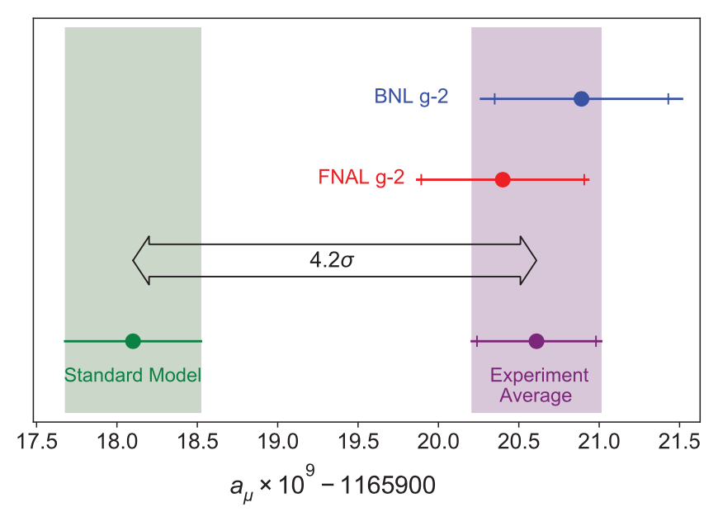
Application to the muon g − 2 anomaly
The recently measured muon g − 2 (ave. of 2006, 2021) disagrees with the Standard Model prediction with a significance of 4.2σ.
Muon g-2 Collab., PRL 126, 141801 (2021)
Discrepancy significantly
reduced by 2021 lattice-based prediction of Borsanyi et al. (BMW).
Current goal is to investigate sensitivity of significance to error assumptions, so for now focus on the 4.2σ problem.

Slide 27



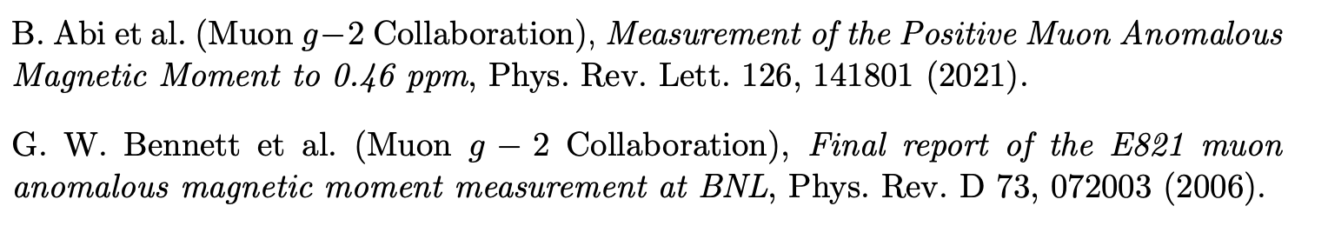

Muon g − 2 ingredients
Using
the ingredients of the 4.2σ effect are:
(ave. of BNL 2006 and FNAL 2021)
0.37 (stat.) ± 0.17 (sys.)
(SM pred. by Muon g −2 theory initiative)
0.40 (Had. Vac. Pol.) ± 0.18 (Had. Light-by-Light)

Slide 28
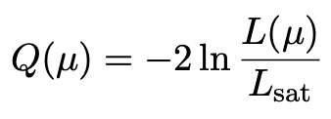
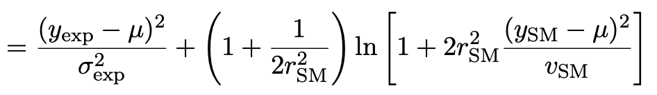
Suppose σ_{SM} uncertain
Suppose measurement errors well known, but that the SM theory
error σ_{SM} (estimated 0.43) could be uncertain.
This is the largest systematic and probably hardest to estimate.
Treat estimate v_{SM} = (0.43)² of variance σ²_{SM} as gamma distributed, width from relative uncertainty parameter r_{SM}.
Work ongoing with Bogdan Malaescu of Muon g-2 Theory Initiative on the HVP uncertainty, see, e.g., M. Davier et al., Eur. Phys. J. C 80 (2020) 241 , arXiv:1908.00921
Maximum-likelihood for mean from minimum of

Slide 29

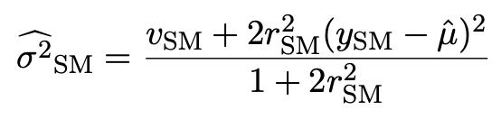
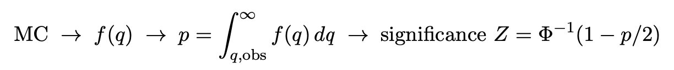
p-value/significance of common-mean hypothesis
Significance (goodness of fit) from
Because of non-quadratic term in Q(μ), distribution of q departs from chi-square(1) for increasing r_{SM}.
Best to get distribution of q from Monte Carlo (and speed up with Bartlett correction – see EPJC (2019) 79:133).
For r_{SM} > 0 distribution of q depends on σ²_{SM}. For MC use Maximum-Likelihood estimate (“profile construction”):
# of sigmas

Slide 30
Significance of discrepancy versus r_{SM}
Naive model: use least squares but let σ_{SM} → (1 + r_{SM}) σ_{SM}
Gamma variance model gives greater decrease in significance for r_{SM} ≳ 0.2, e.g., 3.1σ for r_{SM} = 0.3, 2.0σ for r_{SM} = 0.6.

Slide 31
Significance of discrepancy versus r_{SM}
Establishing 4σ effect requires r_{SM} ≲ 0.3 even if nominal exp.
and SM uncertainties become half of present values.

Slide 32


Discussion / Conclusions
Gamma model for variance estimates gives confidence intervals
that increase in size when the data are internally inconsistent,
and gives decreased sensitivity to outliers (known property of
Student’s t based regression).
Equivalence with Student’s t model, ν = 1/2r² degrees of freedom.
Simple profile likelihood – quadratic terms replaced by logarithmic:

Slide 33
Discussion / Conclusions (2)
Method assumes that meaningful r_{i} values can be assigned and is valuable when systematic errors are not well known but enough “expert opinion” is available to do so.
Alternatively, one could try to fit a global r to all systematic
errors, analogous to PDG scale factor method or meta-analysis
à la DerSimonian and Laird. (→ future work).
Could also use e.g. as “stress test” – crank up the r_{i} values until significance of result degrades and ask if you really trust the assigned systematic errors at that level.
Ongoing studies with Alessandra Brazzale (higher-order asymptotics), Enzo Canonero (ATLAS, top-quark mass), Bogdan Malaescu (muon g−2).

Slide 34
Extra slides

Slide 35
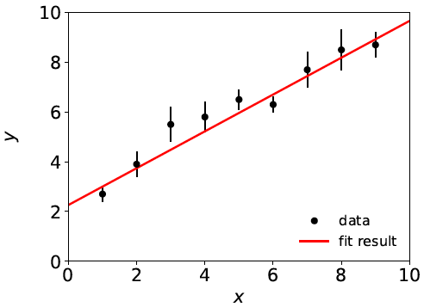

Curve Fitting History: Least Squares
Method of Least Squares by Laplace, Gauss, Legendre, Galton...
C.F. Gauss, Theoria Combinationis Observationum Erroribus Minimis Obnoxiae, Commentationes Societatis Regiae Scientiarium Gottingensis Recectiores Vol. V (MDCCCXXIII).
To fit curve f (x;θ) to data y_{i} ± σ_{i},
adjust parameters θ = (θ₁,..., θ_{M})
to minimize
f (x;θ)
y_{i} ± σ_{i}
Assumes σ_{i} known.

Slide 36
Developments of LS for Averaging
Much work in HEP and elsewhere on application/extension of
least squares to the problem of averaging or meta-analysis, e.g.,
A. C. Aitken, On Least Squares and Linear Combinations of
Observations, Proc. Roy. Soc. Edinburgh 55 (1935) 42.
L. Lyons, D. Gibaut and P. Clifford, How to Combine Correlated
Estimates of a Single Physical Quantity, Nucl. Instr. Meth. A270
(1988) 110.
A. Valassi, Combining Correlated Measurements of Several
Different Physical Quantities, Nucl. Instr. Meth. A500 (2003) 391.
R. Nisius, On the combination of correlated estimates of a physics
observable, Eur. Phys. J. C 74 (2014) 3004.
R. DerSimonian and N. Laird, Meta-analysis in clinical trials,
Controlled Clinical Trials 7 (1986) 177-188.

Slide 37
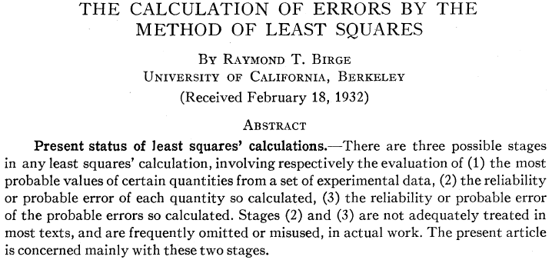
“Errors on Errors”
→ PDG “scale factor method” ≈ scale sys. errors with common
factor until χ²_{min} = appropriate no. of degrees of freedom.

Slide 38
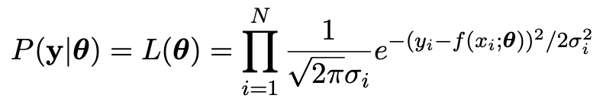

Least Squares ← Maximum Likelihood
Method of Least Squares follows from method of Maximum
Likelihood if independent measured y_{i} ~ Gaussian(f (x_{i};θ), σ_{i})
Tails of Gaussian fall off very fast; points away from the
curve (“outliers”) have strong influence on parameter estimates.

Slide 39
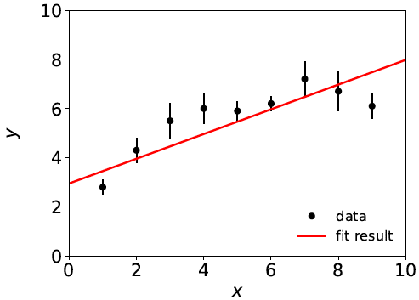
Goodness of fit
If the hypothesized model f (x;θ) is correct, χ²_{min} should
follow a chi-square distribution for N (# meas.) – M (# fitted par.)
degrees of freedom; expectation value = N – M.
Suppose initial guess for model is: f (x;θ) = θ₀ + θ₁ x
χ²_{min} = 20.9,
N – M = 9 – 2 = 7,
so goodness of fit is “poor”.
This is an indication that the
model is inadequate, and thus
the values it predicts will
have a “systematic error”.

Slide 40
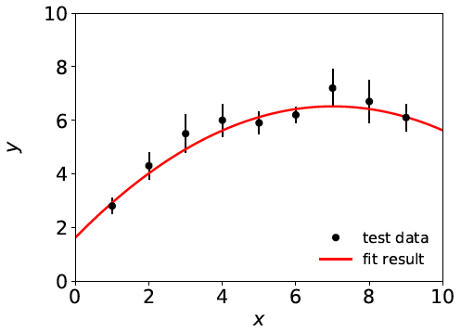
Systematic errors ↔ nuisance parameters
Solution: fix the model, generally by inserting additional
adjustable parameters (“nuisance parameters”). Try, e.g.,
f (x;θ) = θ₀ + θ₁ x + θ₂ x²
χ²_{min} = 3.5, N – M = 6
For some point in the
enlarged parameter space
we hope the model is
now ~correct.
Sys. error gone?
Estimators for all parameters correlated, and as a consequence the presence of the nuisance parameters inflates the statistical errors of the parameter(s) of interest.

Slide 41


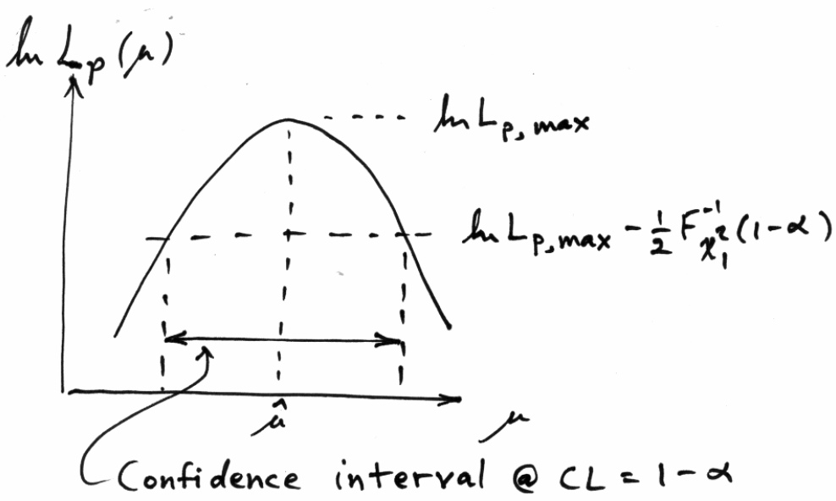

Uncertainty of fitted parameters
Suppose parameter of interest μ, nuisance parameter θ,
confidence interval for μ from “profile likelihood”:
Width of interval in usual LS fit independent of goodness of fit.

Slide 42





Single-measurement model
As a simplest example consider
y ~ Gauss(μ, σ²),
v ~ Gamma(α, β),
Test values of μ with t_{μ} = −2 ln λ(μ) with

Slide 43
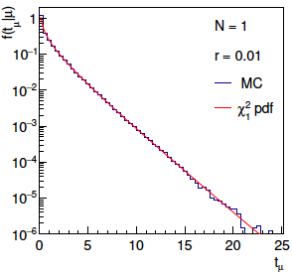
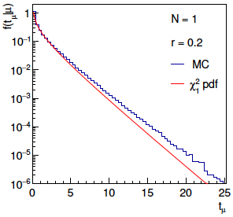
Distribution of t_{μ}
From Wilks’ theorem, in the asymptotic limit we should
find t_{μ} ~ chi-squared(1).
Here “asymptotic limit” means all estimators ~Gauss, which
means r → 0. For increasing r, clear deviations visible:

Slide 44
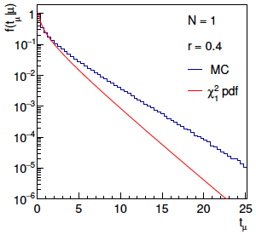
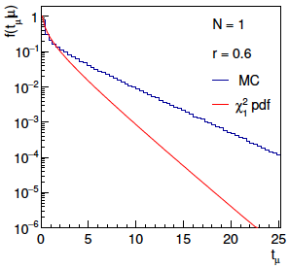
Distribution of t_{μ} (2)
For larger r, breakdown of asymptotics gets worse:
Values of r ~ several tenths are relevant so we cannot in general
rely on asymptotics to get confidence intervals, p-values, etc.

Slide 45

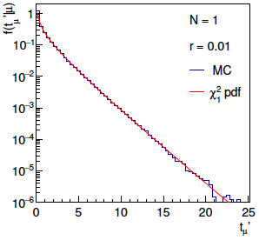
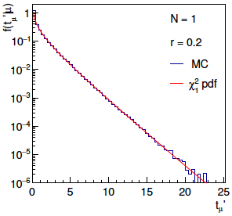
Bartlett corrections
One can modify t_{μ} defining
such that the new statistic’s distribution is better approximated
by chi-squared for n_{d} degrees of freedom (Bartlett, 1937).
For this example E[t_{μ}] ≈ 1 + 3r² + 2r⁴ works well:

Slide 46
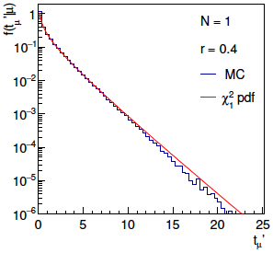
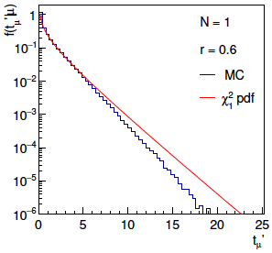
Bartlett corrections (2)
Good agreement for r ~ several tenths out to √t_{μ}ʹ ~ several, i.e.,
good for significances of several sigma:

Slide 47
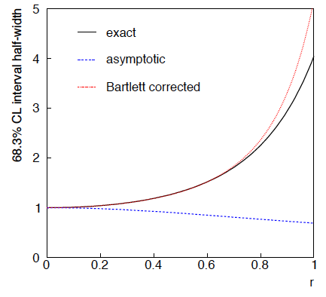
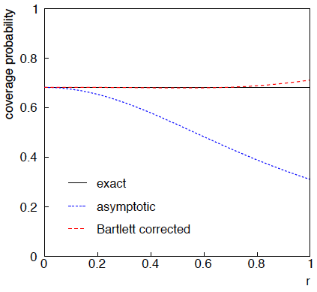
68.3% CL confidence interval for μ

Slide 48

Correlated uncertainties
The phrase “correlated uncertainties” usually means that a single
nuisance parameter affects the distribution (e.g., the mean) of more
than one measurement.
For example, consider measurements y, parameters of interest μ,
nuisance parameters θ with
That is, the θ_{i} are defined here as contributing to a bias and
the (known) factors R_{ij} determine how much θ_{j} affects y_{i}.
As before suppose one has independent control measurements
u_{i}~ Gauss(θ_{i}, σ_{ui}).

Slide 49



Correlated uncertainties (2)
The total bias of y_{i} can be defined as
which can be estimated with
These estimators are correlated having covariance
In this sense the present method treats “correlated uncertainties”,
i.e., the control measurements u_{i} are independent, but nuisance
parameters affect multiple measurements, and thus bias estimates
are correlated.

Slide 50




Exact relation between r parameter and relative error on error
r parameter defined as:
v ~ Gamma(α, β) so s = √v follows a Nakagami distribution

Slide 51

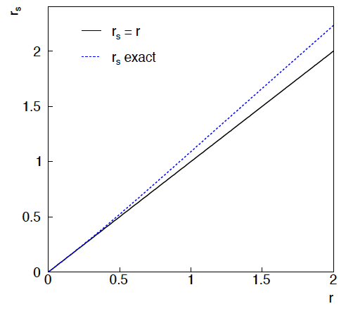


Exact relation between r parameter and relative error on error (2)
The exact relation between the error and the error r_{s} and
the parameter r is therefore
→ r_{s} ≈ r good for r ≲ 1.

Slide 52
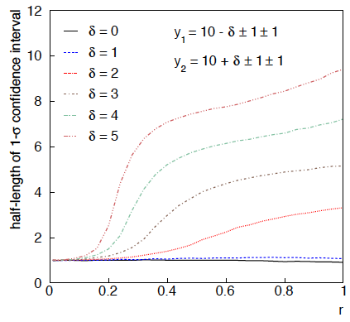
Same with interval from p_{μ} = α with nuisance parameters profiled at μ

Slide 53
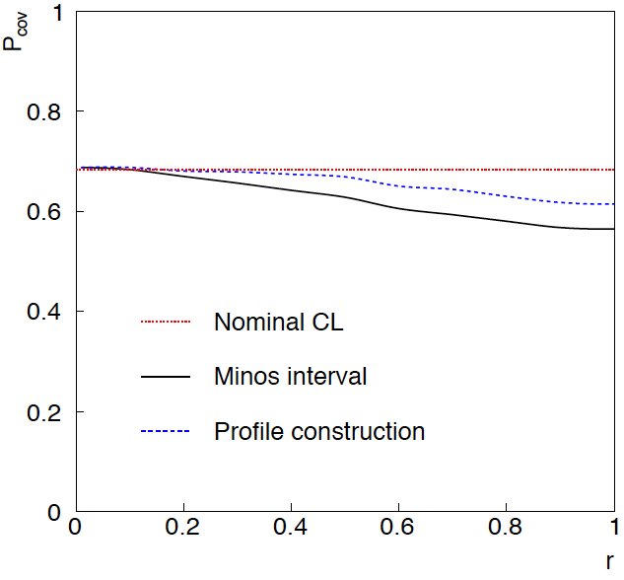
Coverage of intervals
Consider previous average of
two numbers but now generate
for i = 1, 2 data values
y_{i} ~ Gauss(μ, σ_{y,i})
u_{i} ~ Gauss(0, σ_{u,i})
v_{i} ~ Gamma(σ_{u,i}, r_{i})
σ_{y,i} = σ_{u,i} = 1
and look at the probability
that the interval covers the
true value of μ.
Coverage stays reasonable
to r ~ 0.5, even not bad
for Profile Construction
out to r ~ 1.

Slide 54





PDG scale factor
Suppose we do not want to take the quoted errors as
known constants. Scale the variances by a factor ϕ,
The likelihood
function becomes
The estimator for μ is the same as before; for ϕ the MLE is
which has a bias;
is unbiased.
^
The variance of μ is inflated by ϕ:

Slide 55

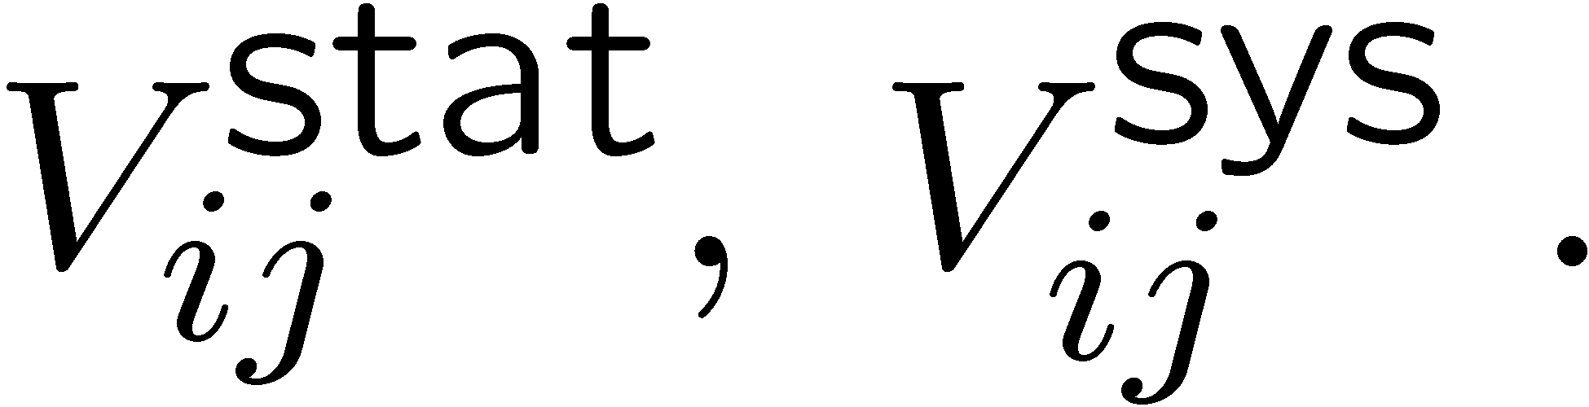
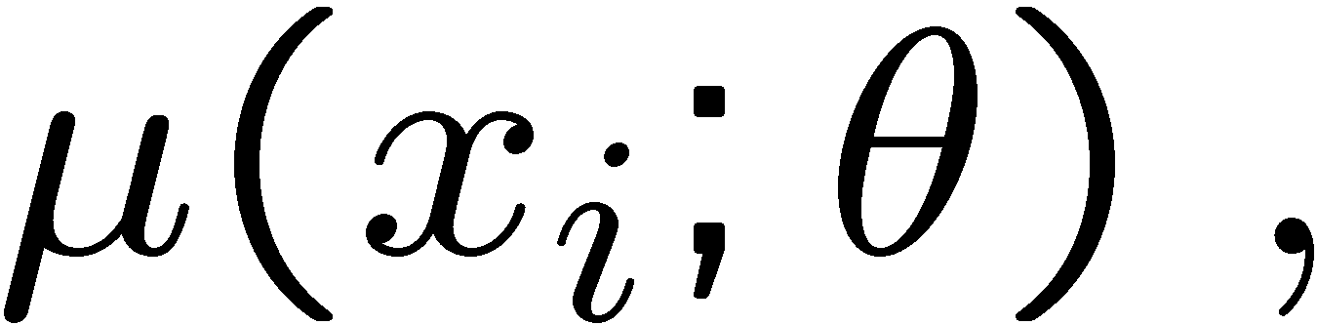
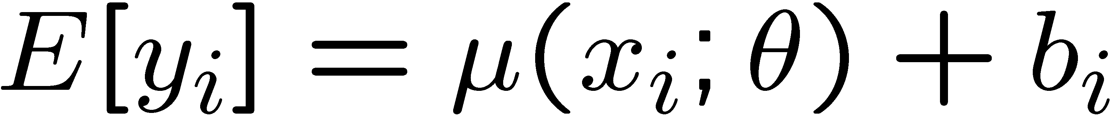
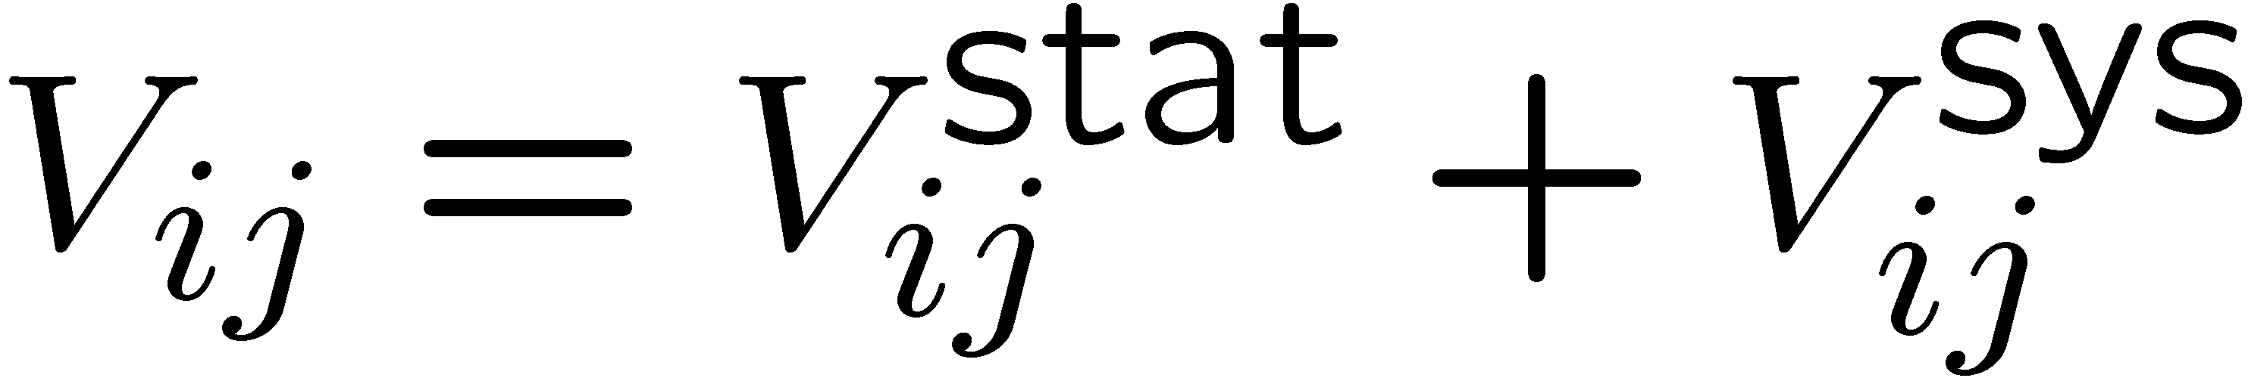
Bayesian approach
Given measurements:
and (usually) covariances:
Predicted value:
expectation value
control variable
parameters
bias
Frequentist approach:
Minimize

Slide 56
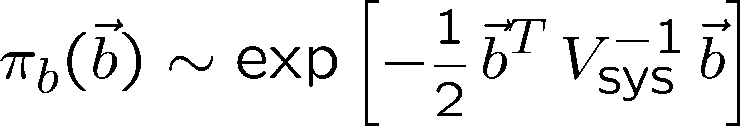
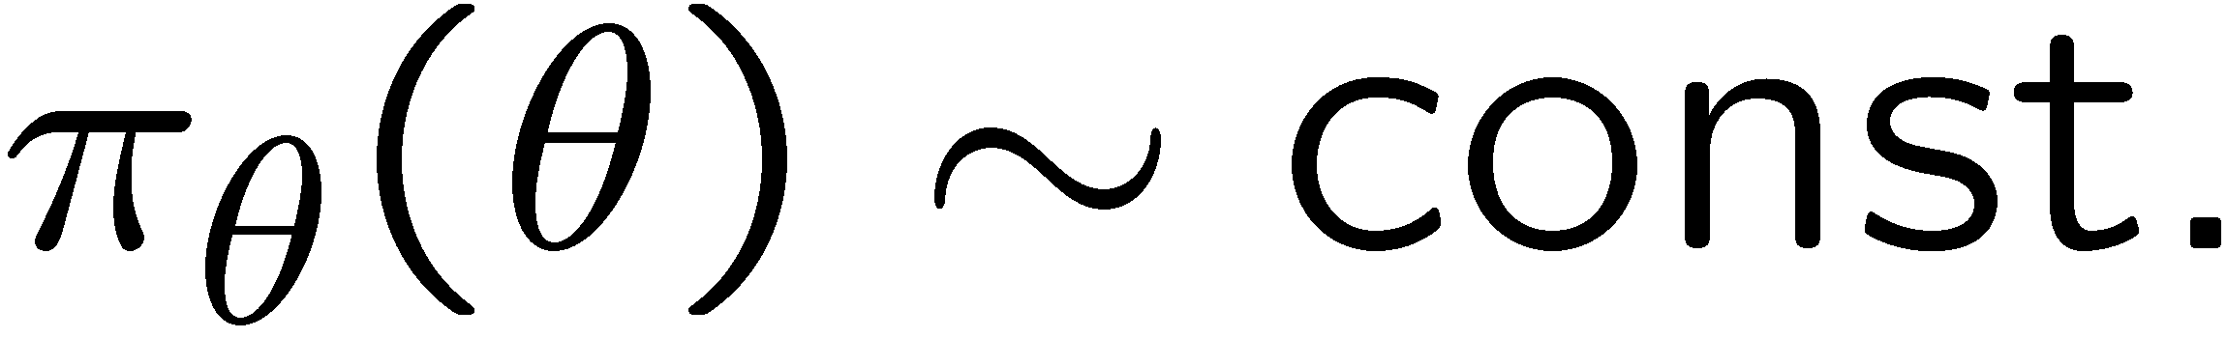

Its Bayesian equivalent
Take
Joint probability
for all parameters
and use Bayes’ theorem:
To get desired probability for θ, integrate (marginalize) over b:
→ Posterior is Gaussian with mode same as least squares estimator,
σ_{θ} same as from χ² = χ²_{min} + 1. (Back where we started!)

Slide 57

Bayesian approach with non-Gaussian prior π_{b}(b)
Suppose now the experiment is characterized by
where s_{i} is an (unreported) factor by which the systematic error is
over/under-estimated.
Assume correct error for a Gaussian π_{b}(b) would be s_{i}σ_{i}^{sys}, so
Width of σ_{s}(s_{i}) reflects
‘error on the error’.

Slide 58




Error-on-error function π_{s}(s)
A simple unimodal probability density for 0 < s < 1 with
adjustable mean and variance is the Gamma distribution:
mean = b/a
variance = b/a²
Want e.g. expectation value
of 1 and adjustable standard
Deviation σ_{s} , i.e.,
s
In fact if we took π_{s} (s) ~ inverse Gamma, we could find π_{b}(b)
in closed form (cf. D’Agostini, Dose, von Linden). But Gamma seems more natural & numerical treatment not too painful.

Slide 59


Prior for bias π_{b}(b) now has longer tails
b
Gaussian (σ_{s} = 0) P(|b| > 4σ_{sys}) = 6.3 × 10⁻⁵
σ_{s} = 0.5 P(|b| > 4σ_{sys}) = 0.65%

Slide 60


A simple test
Suppose a fit effectively averages four measurements.
Take σ_{sys} = σ_{stat} = 0.1, uncorrelated.
Case #1: data appear compatible
Posterior p(μ|y):
measurement
p(μ|y)
experiment
μ
Usually summarize posterior p(μ|y)
with mode and standard deviation:

Slide 61




Simple test with inconsistent data
Case #2: there is an outlier
Posterior p(μ|y):
measurement
p(μ|y)
experiment
μ
→ Bayesian fit less sensitive to outlier. See also

Slide 62


Goodness-of-fit vs. size of error
In LS fit, value of minimized χ² does not affect size
of error on fitted parameter.
In Bayesian analysis with non-Gaussian prior for systematics,
a high χ² corresponds to a larger error (and vice versa).
post-
erior
2000 repetitions of
experiment, σ_{s} = 0.5,
here no actual bias.
σ_{μ} from least squares
χ²

