Slide 1



Parameter Estimation
Hands-on Session
https://pages.lip.pt/data-science/school/
Glen Cowan
Physics Department
Royal Holloway, University of London
g.cowan@rhul.ac.uk
www.pp.rhul.ac.uk/~cowan

Slide 2
Introduction and materials
The exercises for parameter estimation are at (linked also to indico)
https://www.pp.rhul.ac.uk/~cowan/stat/exercises/fitting
The exercise and are described in the file fitting_exercises.pdf.
There are both python and ROOT/C++ versions.
For python, you need python 3 and install iminuit from https://pypi.org/project/iminuit/ with pip install iminuit
For ROOT you should have version 6 and C++ installed with a “cern-like” (e.g., lxplus) setup.
Prior to the exercises we will see how to obtain a confidence interval/region directly from contours of the log-likelihood.

Slide 3
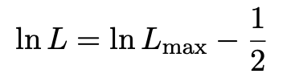
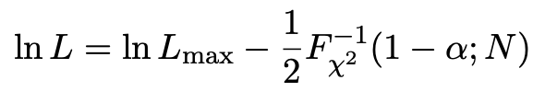

Comment on the lnL = lnL_{max} – ½ contour
In the lectures, we saw that the standard deviations of fitted parameters are found from the tanget lines (planes) to the contour
A similar procedure can be used to find a “confidence region” in the parameter space that will cover the true parameter with probability CL = 1 – α (the “confidence level). This uses the contour
, N = number of parameters
If you want the contour lnL = lnL_{max} – ½ in iminuit, you need to choose CL (= 1 – α) such that Fχ²⁻¹(1 – α,N) = 1, i.e.,

Slide 4




Approximate confidence intervals/regions
from the likelihood function
Suppose we test parameter value(s) θ = (θ₁, ..., θ_{n}) using the ratio
Lower λ(θ) means worse agreement between data and hypothesized θ. Equivalently, usually define
so higher t_{θ} means worse agreement between θ and the data.
p-value of θ therefore
need pdf

Slide 5




Confidence region from Wilks’ theorem
Wilks’ theorem says (in large-sample limit and provided
certain conditions hold...)
chi-square dist. with # d.o.f. =
# of components in θ = (θ₁, ..., θ_{n}).
Assuming this holds, the p-value is
← set equal to α
To find boundary of confidence region set p_{θ} = α and solve for t_{θ}:
Recall also

Slide 6




Confidence region from Wilks’ theorem (cont.)
i.e., boundary of confidence region in θ space is where
For example, for 1 – α = 68.3% and n = 1 parameter,
and so the 68.3% confidence level interval is determined by
Same as recipe for finding the estimator’s standard deviation, i.e.,
is a 68.3% CL confidence interval.

Slide 7
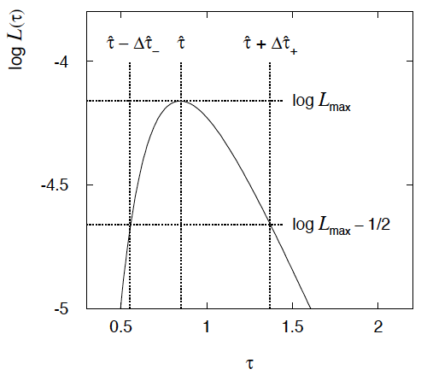

Example of interval from ln L(θ)
For n=1 parameter, CL = 0.683, Q_{α} = 1.
Our exponential
example, now with
only n = 5 events.
Can report ML estimate
with approx. confidence
interval from ln L_{max} – 1/2
as “asymmetric error bar”:

Slide 8

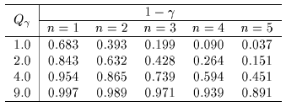

Multiparameter case
For increasing number of parameters, CL = 1 – α decreases for
confidence region determined by a given

Slide 9
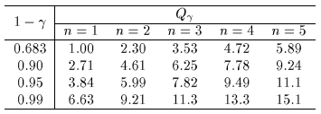
Multiparameter case (cont.)
Equivalently, Q_{α} increases with n for a given CL = 1 – α.

Slide 10
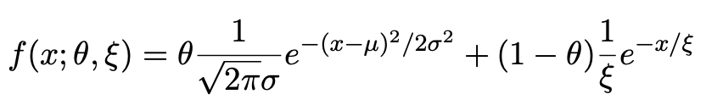
Introduction to the exercises
Consider a pdf for continuous random variable x, (truncate and renormalize in 0 ≤ x ≤ x_{max})
θ = parameter of interest ,
gives signal rate.
Depending on context, take ξ, μ, σ as nuisance parameters or fixed.
Generate i.i.d. sample x₁,..., x_{n}.
Estimate θ (and other params.)

Slide 11
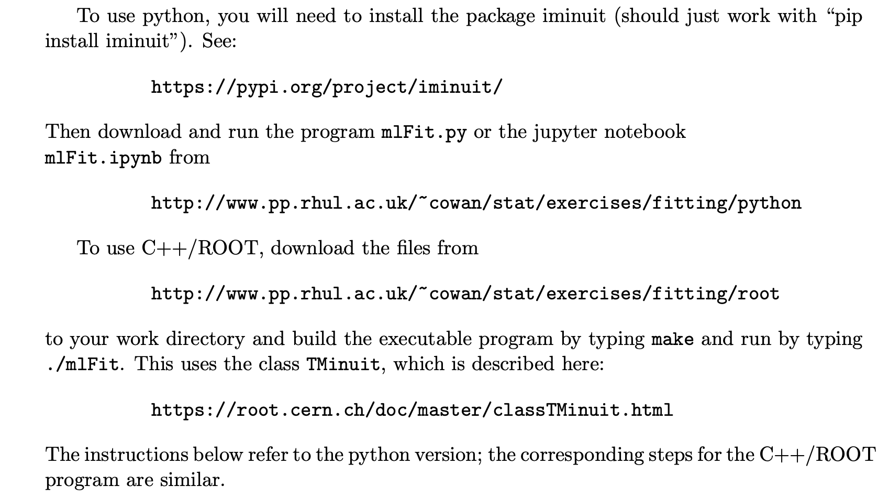
Fitting with MINUIT (python or root/C++)

Slide 12
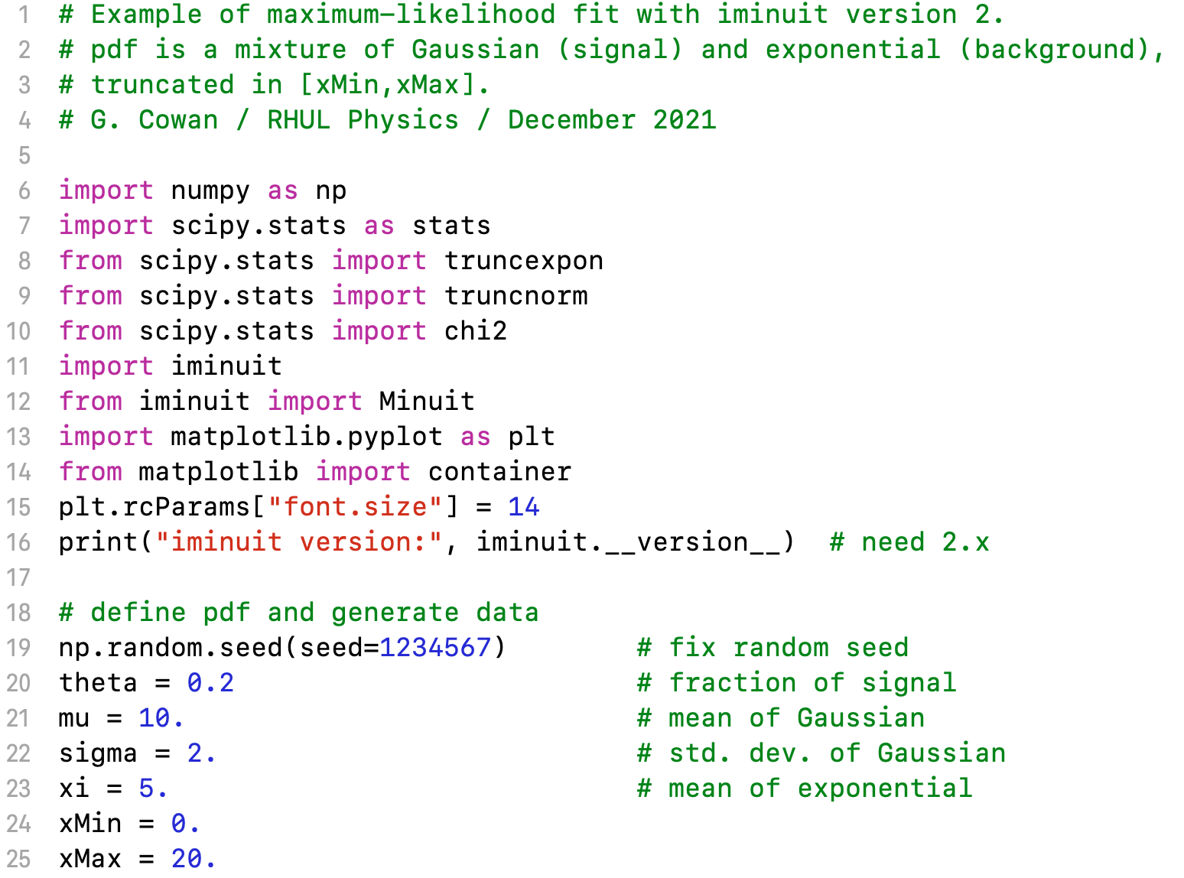
mlFit.py (also jupyter notebook mlFit.ipynb)

Slide 13
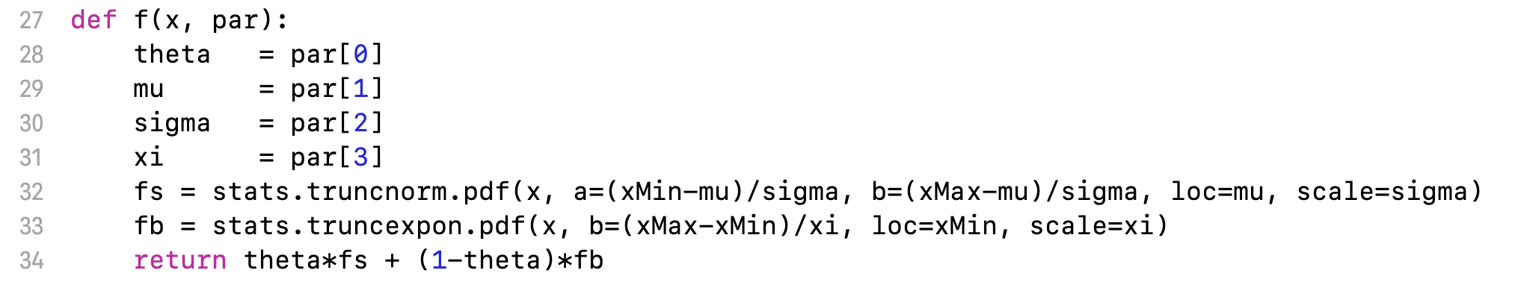
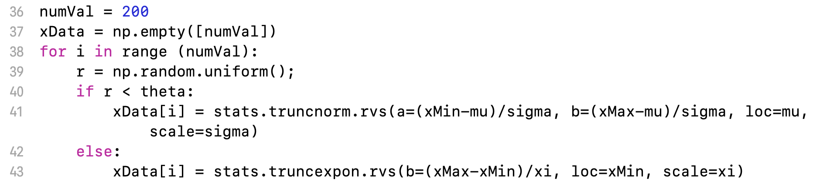
Define the fit function
Generate the data

Slide 14
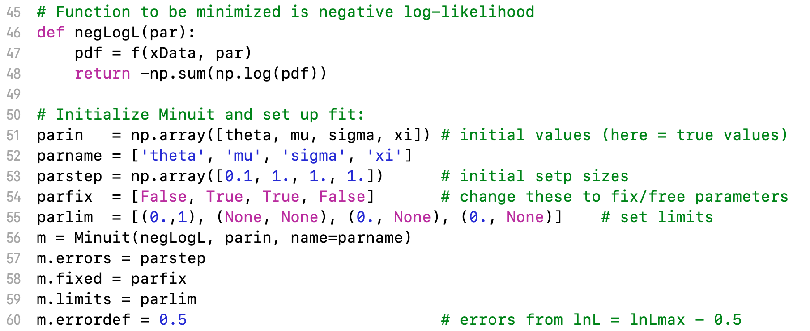
Set up the fit

Slide 15
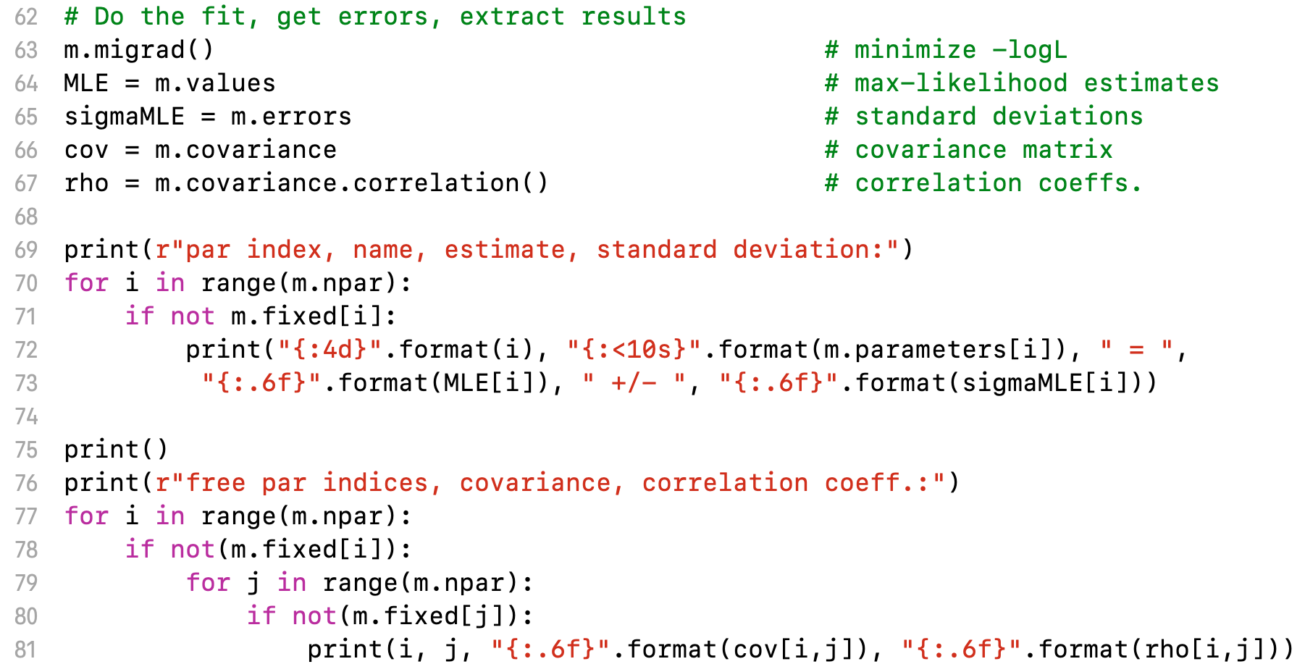
Do the fit, get errors, extract results
Make some plots...

Slide 16
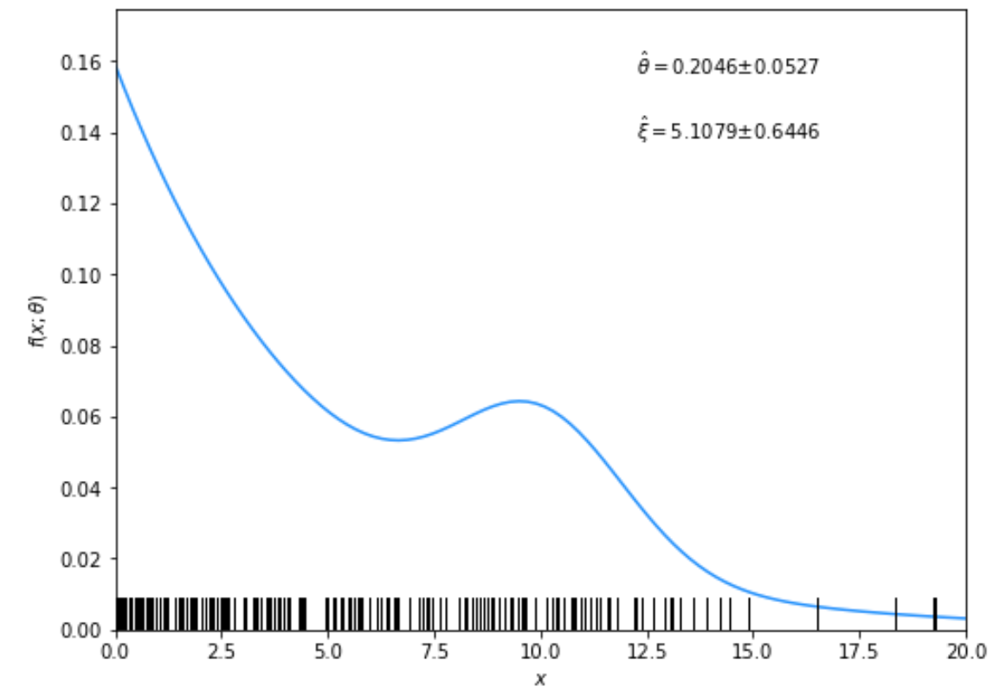
Solutions to exercises
1a) Running the program mlFit.py produces the following plots:
A fit of the pdf:

Slide 17
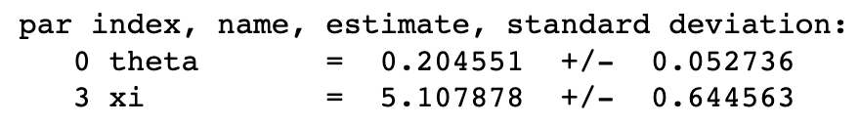
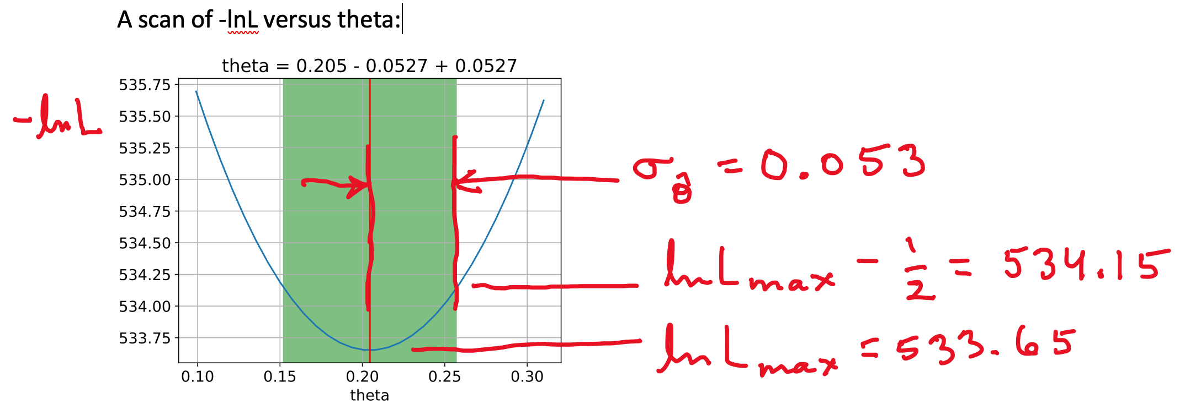
From running program:

Slide 18
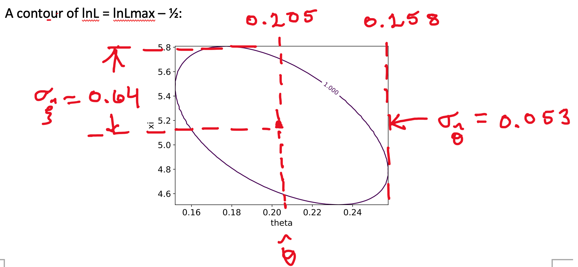

Slide 19
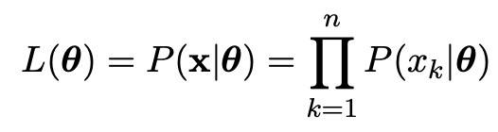
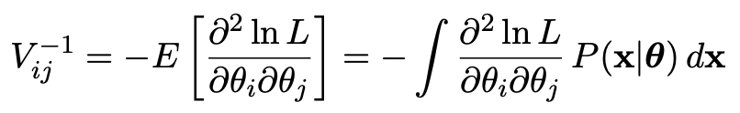
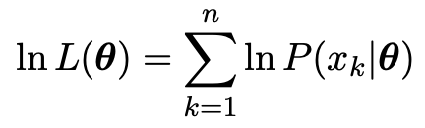
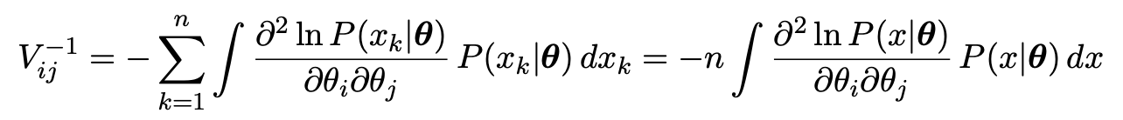

1b) Assume i.i.d. data sample, so
Assume inverse covariance from Fisher Information (large sample):
Since
we find
But V⁻¹V = I so if V⁻¹ ∝ n, then V ∝ 1/n, and so from the square roots of the diagonal elements

Slide 20
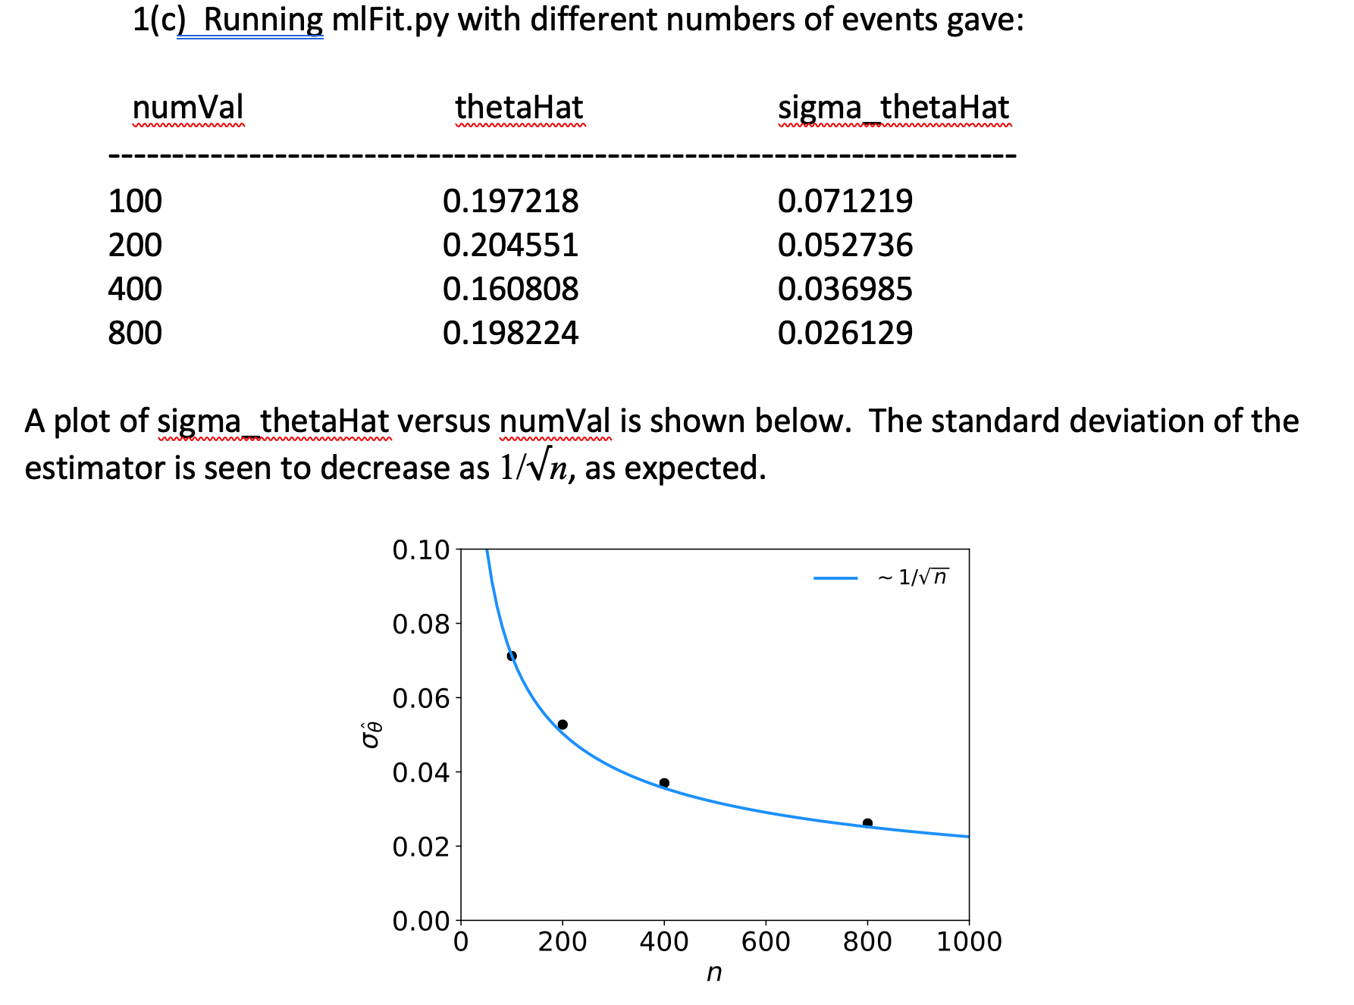

Slide 21
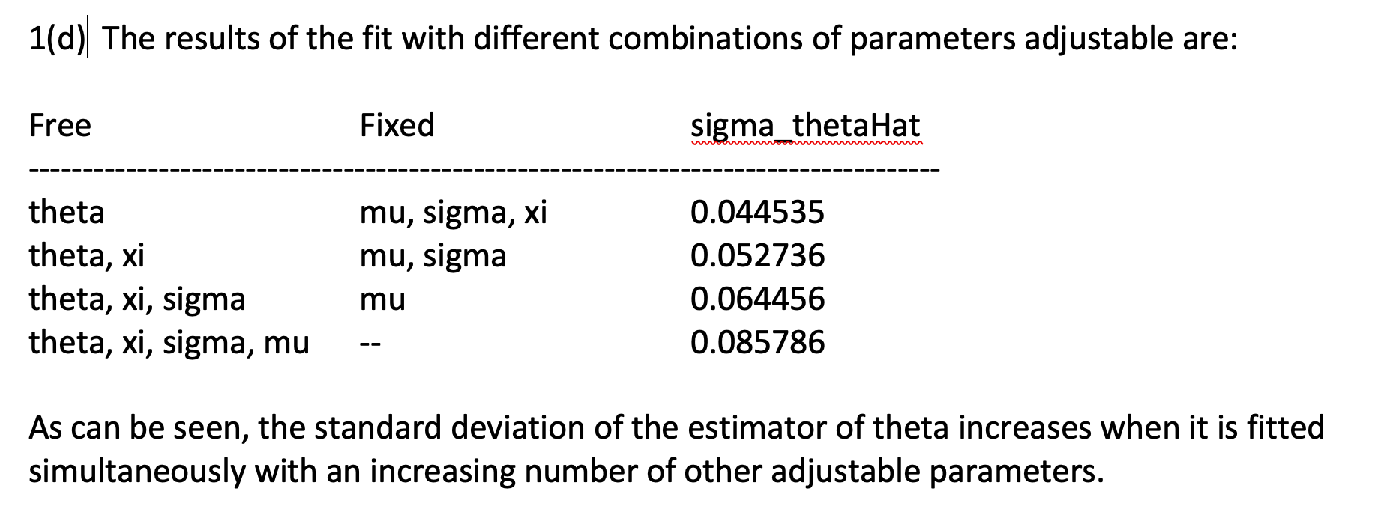

Slide 22
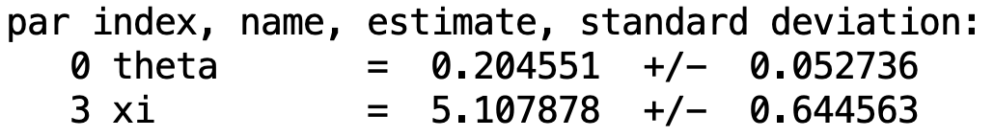
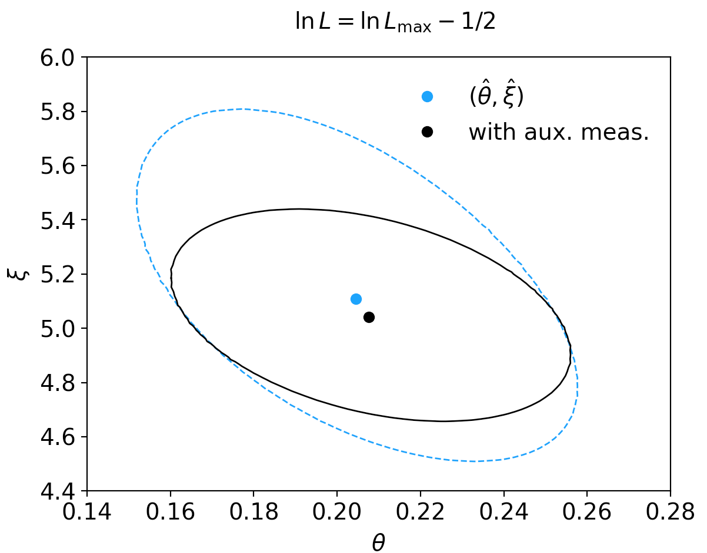
1(e) By including the auxiliary measurement u one uses more information about ξ and thus the covariance ellipse shrinks. This reduces the standard deviations of the MLEs for both ξ and θ.

Slide 23
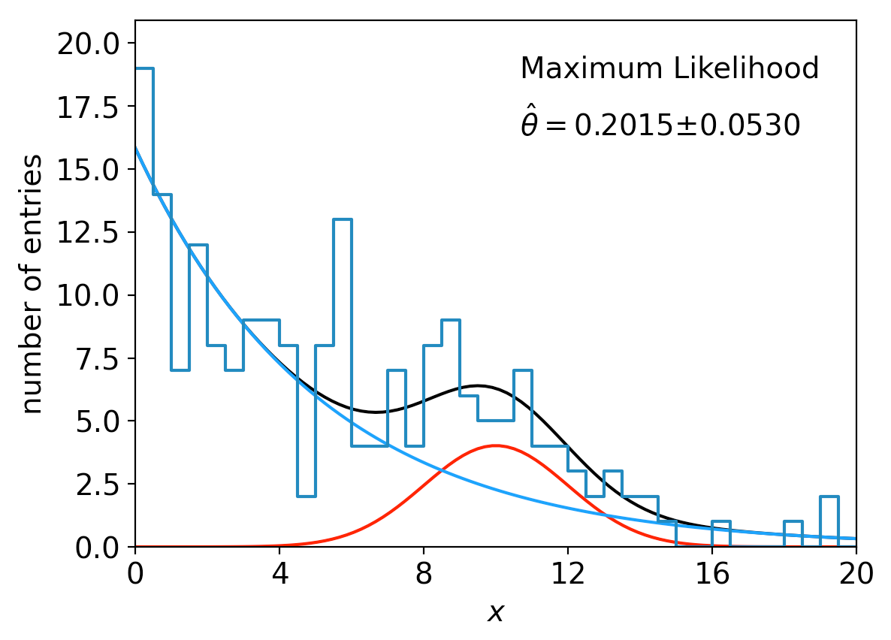
lnL in a class, binned data,...
Sometimes it is convenient to have the function being minimized as a method of a class. An example of this is shown in the program histFit.py (in same directory), which does the same fit as in mlFit but with a histogram of the data:

