Slide 1



Statistics for Particle Physicists
Lecture 2
https://pages.lip.pt/data-science/school/
Glen Cowan
Physics Department
Royal Holloway, University of London
g.cowan@rhul.ac.uk
www.pp.rhul.ac.uk/~cowan

Slide 2
Outline
Lecture 1: Introduction
Probability
Hypothesis tests
From hypothesis tests to machine learning
→ Lecture 2: Parameter estimation
Confidence limits
Systematic uncertainties

Slide 3
Hypothesis, likelihood
Suppose the entire result of an experiment (set of measurements) is a collection of numbers x.
A (simple) hypothesis is a rule that assigns a probability to each possible data outcome:
= the likelihood of H
Often we deal with a family of hypotheses labeled by one or
more undetermined parameters (a composite hypothesis):
= the “likelihood function”
Note:
1) For the likelihood we treat the data x as fixed.
2) The likelihood function L(θ) is not a pdf for θ.

Slide 4
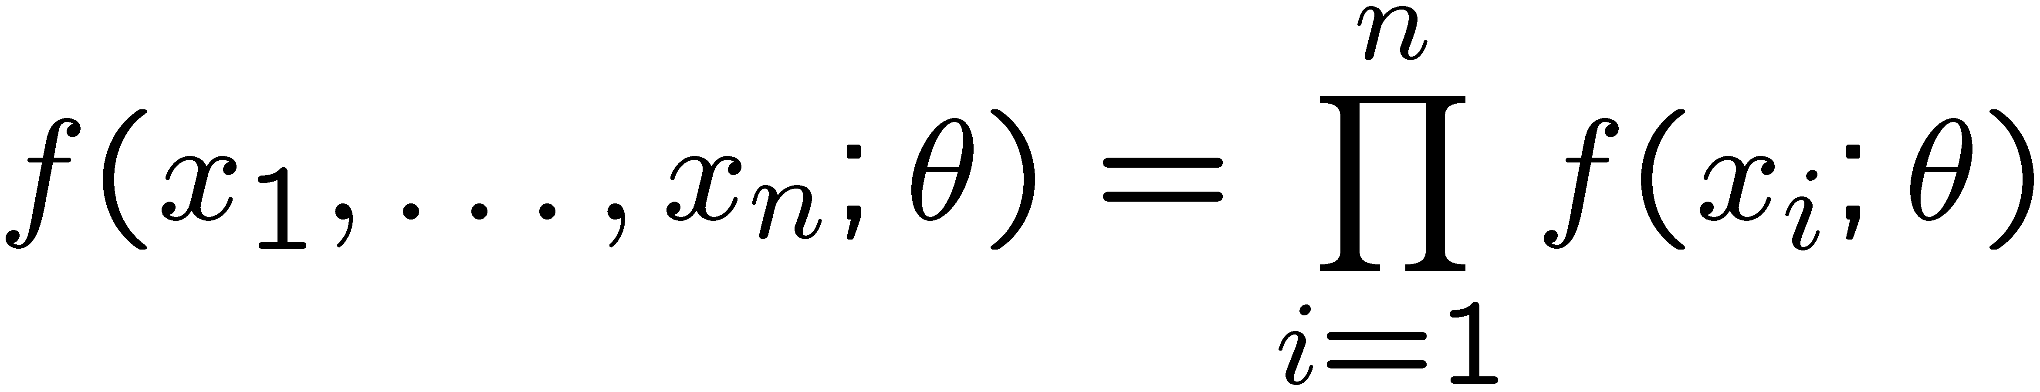
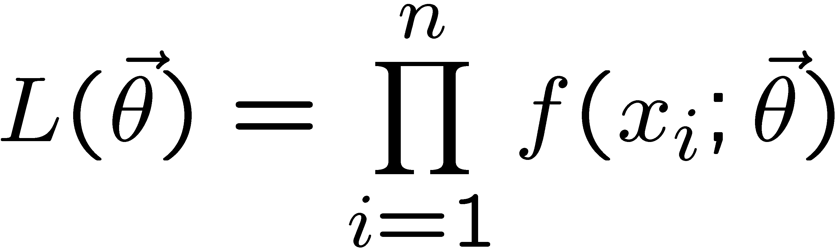
The likelihood function for i.i.d.* data
* i.i.d. = independent and identically distributed
Consider n independent observations of x: x₁, ..., x_{n}, where
x follows f (x; θ). The joint pdf for the whole data sample is:
In this case the likelihood function is
(x_{i} constant)

Slide 5
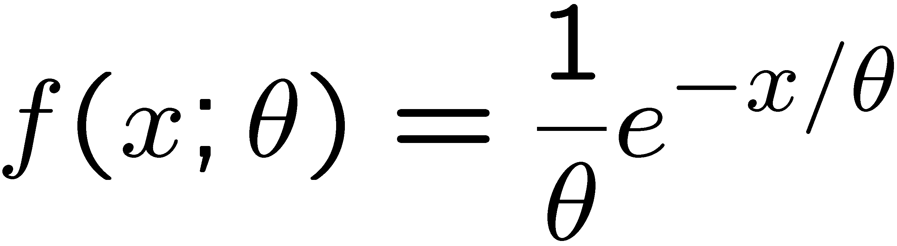
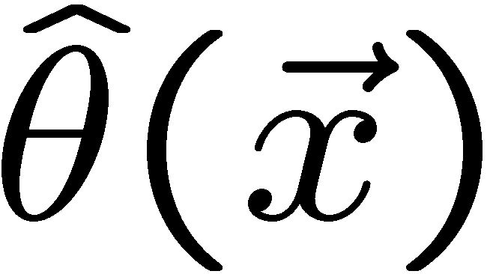
Parameter estimation
The parameters of a pdf are any constants that characterize it,
i.e., θ indexes a
set of hypotheses.
r.v.
parameter
Suppose we have a sample of observed values: x = (x₁, ..., x_{n})
We want to find some function of the data to estimate the
parameter(s):
← estimator written with a hat
Sometimes we say ‘estimator’ for the function of x₁, ..., x_{n};
‘estimate’ for the value of the estimator with a particular data set.

Slide 6
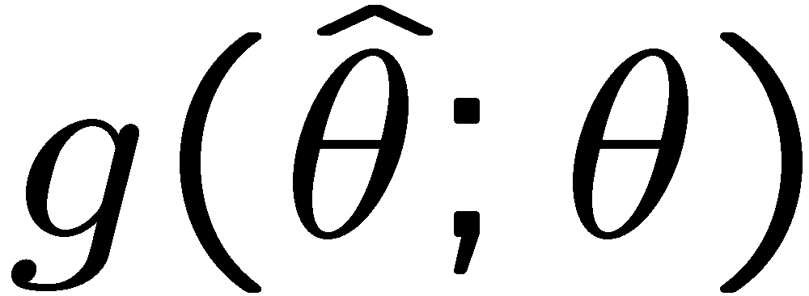
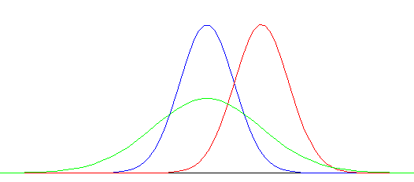


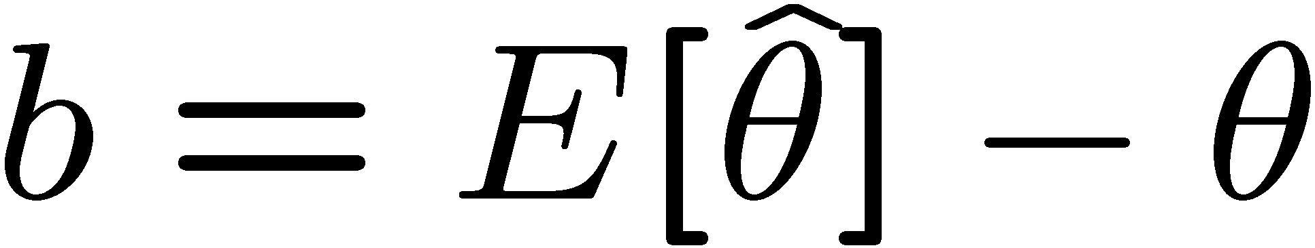
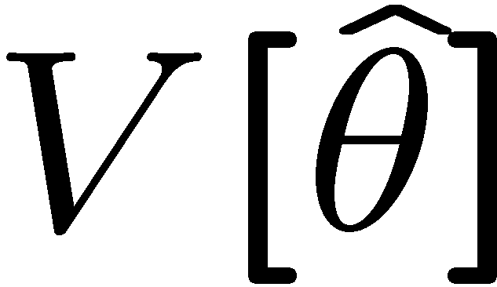
Properties of estimators
If we were to repeat the entire measurement, the estimates
from each would follow a pdf:
best
large
variance
biased
We want small (or zero) bias (systematic error):
→ average of repeated measurements should tend to true value.
And we want a small variance (statistical error):
→ small bias & variance are in general conflicting criteria

Slide 7
Maximum Likelihood Estimators (MLEs)
We define the maximum likelihood estimators or MLEs to be
the parameter values for which the likelihood is maximum.
Maximizing L equivalent to maximizing log L
Could have multiple maxima (take highest).
MLEs not guaranteed to have any ‘optimal’ properties, (but in practice they’re very good).

Slide 8
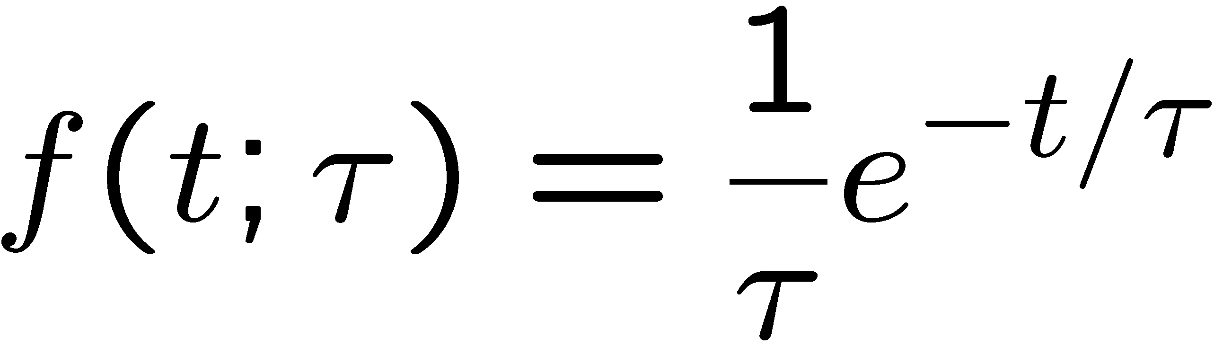
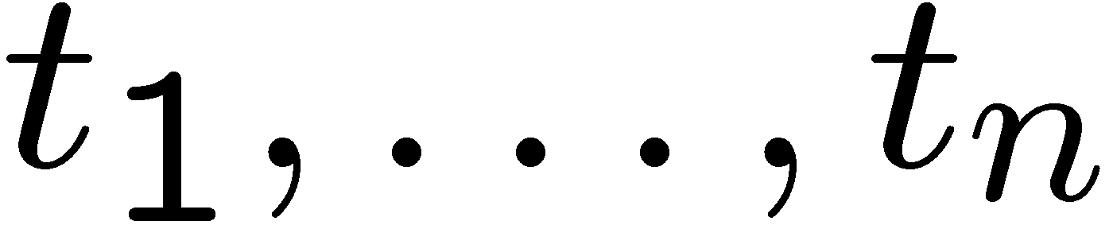
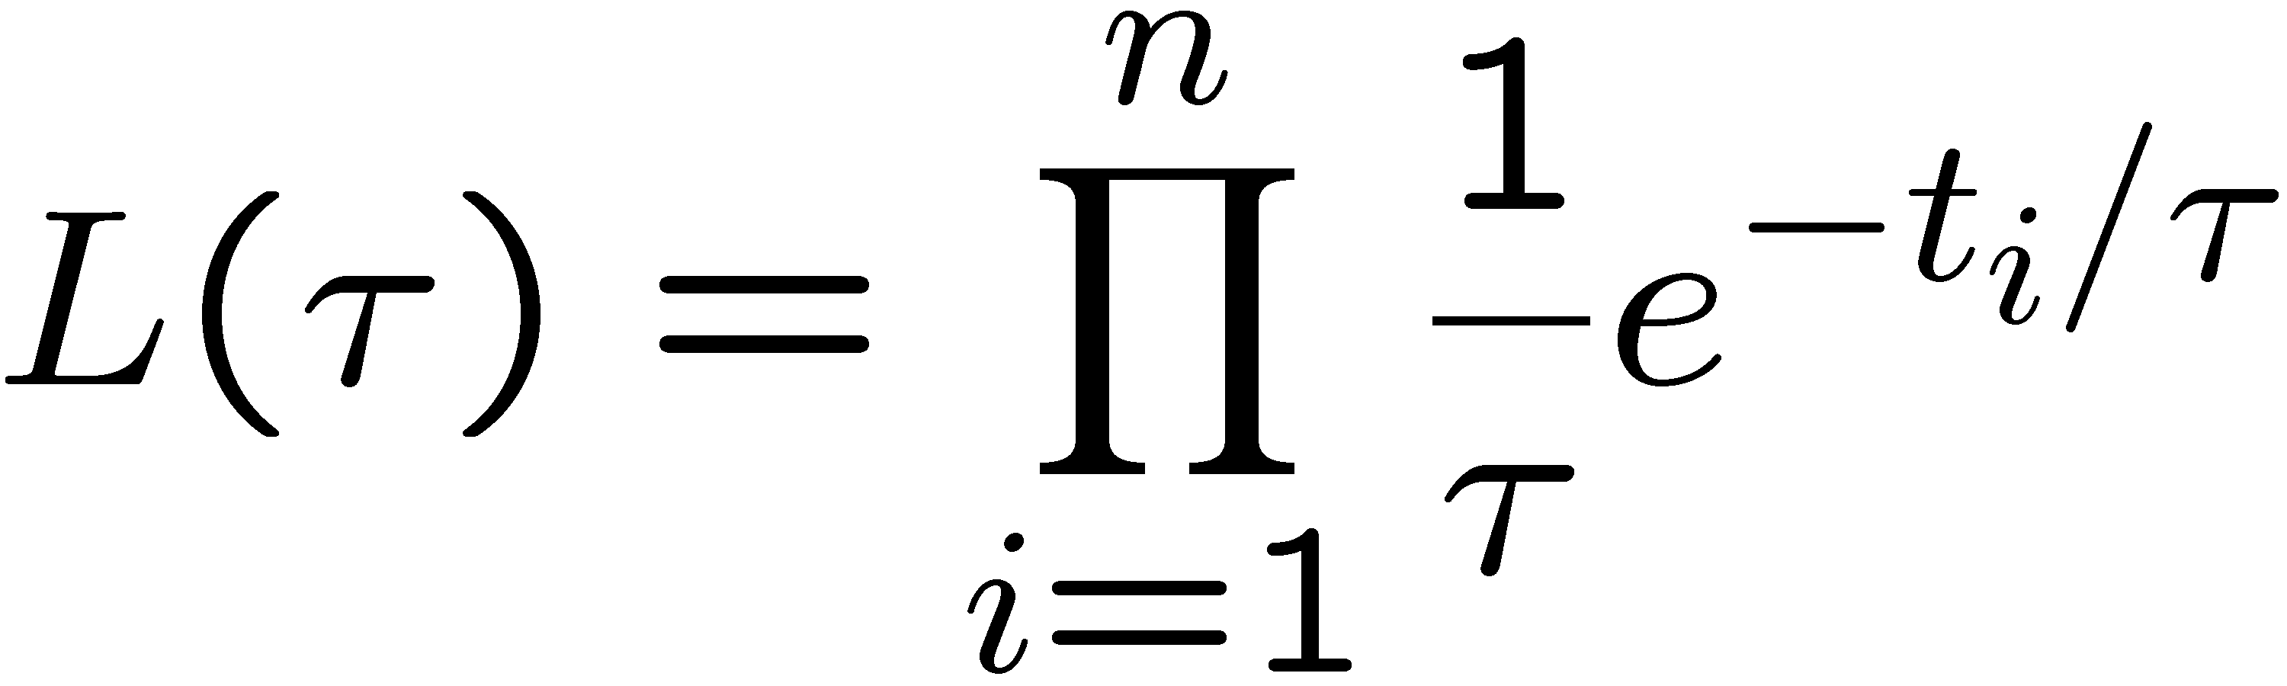
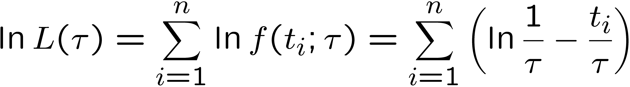
MLE example: parameter of exponential pdf
Consider exponential pdf,
and suppose we have i.i.d. data,
The likelihood function is
The value of τ for which L(τ) is maximum also gives the
maximum value of its logarithm (the log-likelihood function):

Slide 9
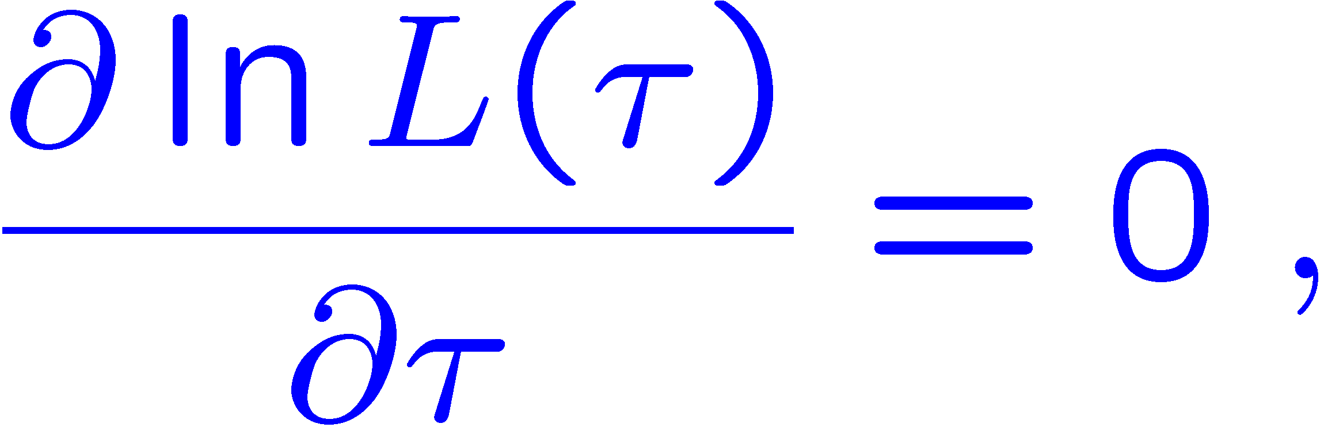
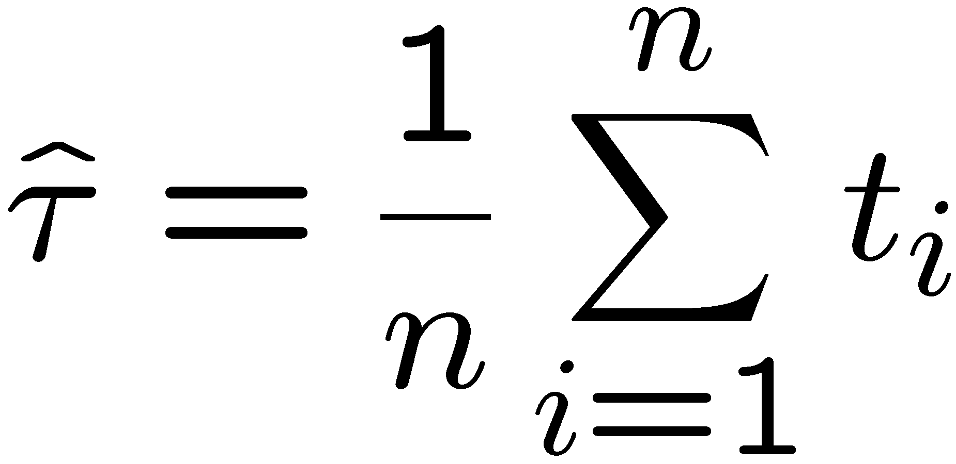
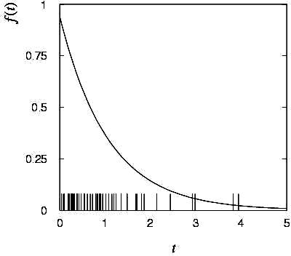

MLE example: parameter of exponential pdf (2)
Find its maximum by setting
→
Monte Carlo test:
generate 50 values
using τ = 1:
We find the ML estimate:

Slide 10






MLE example: parameter of exponential pdf (3)
For the exponential distribution one has for mean, variance:
For the MLE
we therefore find
→
→

Slide 11
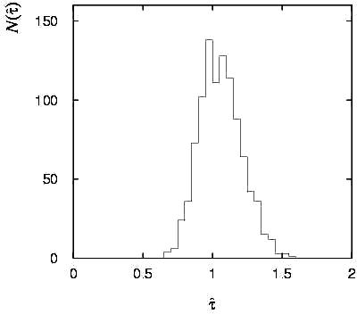
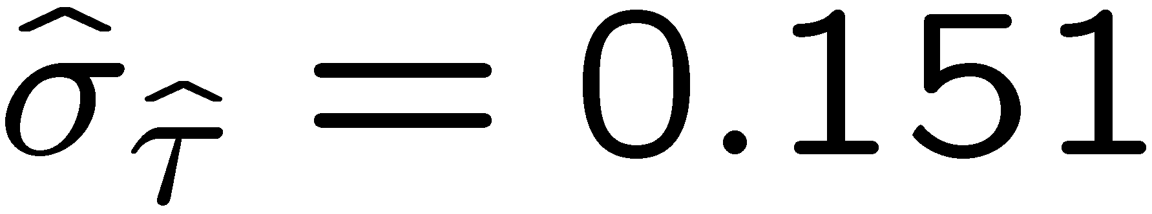
Variance of estimators: Monte Carlo method
Having estimated our parameter we now need to report its
‘statistical error’, i.e., how widely distributed would estimates
be if we were to repeat the entire measurement many times.
One way to do this would be to simulate the entire experiment
many times with a Monte Carlo program (use ML estimate for MC).
For exponential example, from
sample variance of estimates
we find:
Note distribution of estimates is roughly
Gaussian − (almost) always true for
ML in large sample limit.

Slide 12
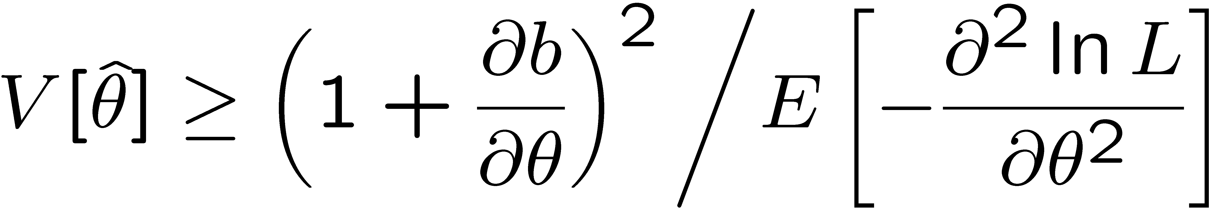
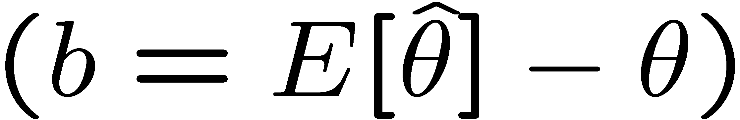
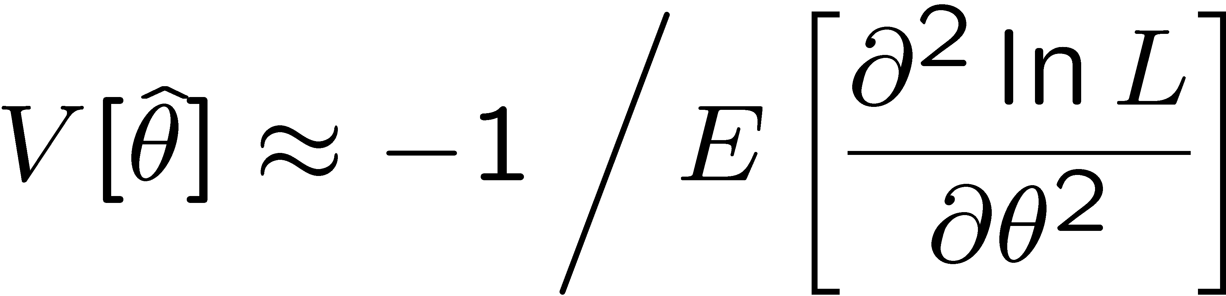
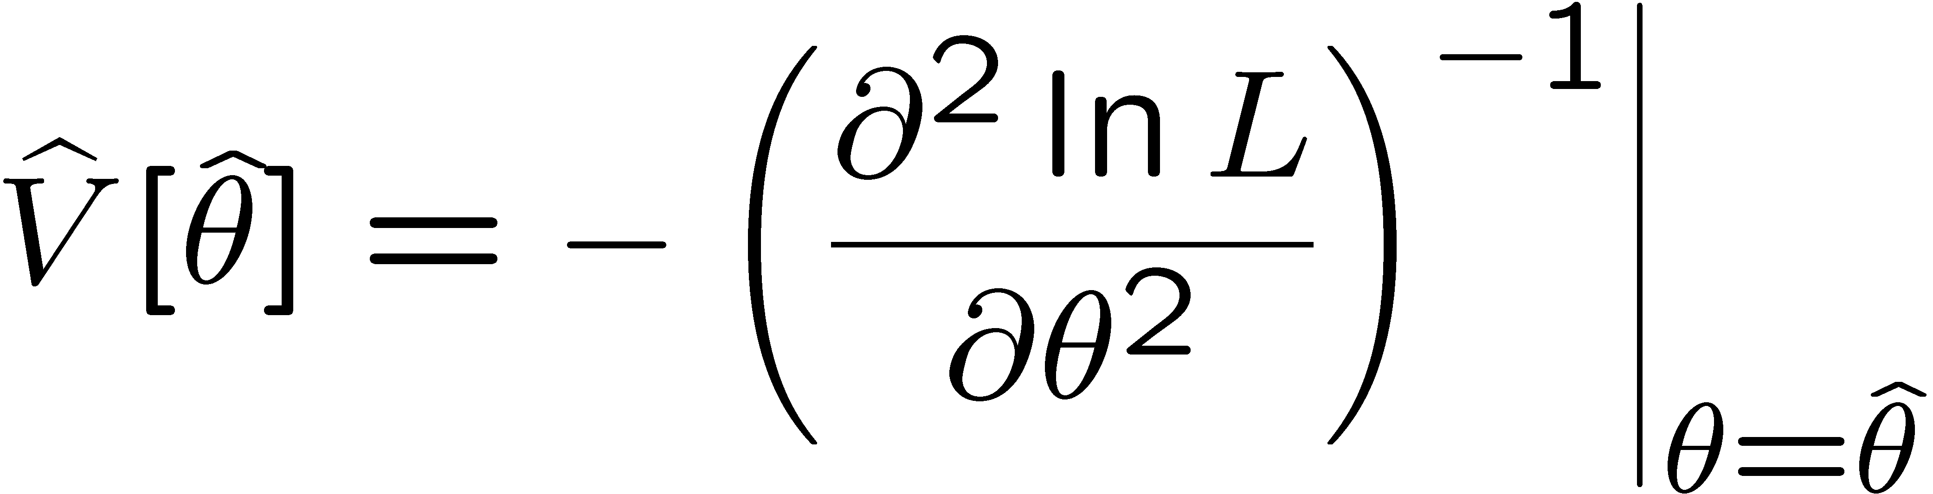
Variance of estimators from information inequality
The information inequality (RCF) sets a lower bound on the
variance of any estimator (not only ML):
Minimum Variance
Bound (MVB)
Often the bias b is small, and equality either holds exactly or
is a good approximation (e.g. large data sample limit). Then,
Estimate this using the 2nd derivative of ln L at its maximum:

Slide 13
MVB for MLE of exponential parameter
Find
We found for the exponential parameter the MLE
and we showed b = 0, hence 𝜕b/𝜕τ = 0.
We find
and since E[t_{i}] = τ for all i,
,
and therefore
.
(Here MLE is “efficient”).

Slide 14
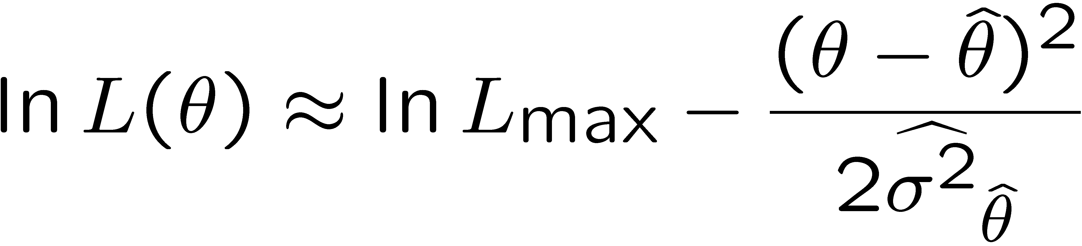
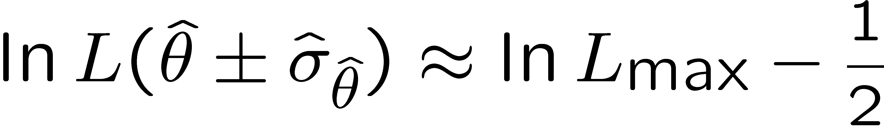
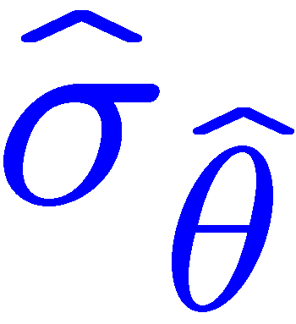

Variance of estimators: graphical method
Expand ln L(θ) about its maximum:
First term is ln L_{max}, second term is zero, for third term use
information inequality (assume equality):
i.e.,
→ to get
, change θ away from
until ln L decreases by 1/2.

Slide 15
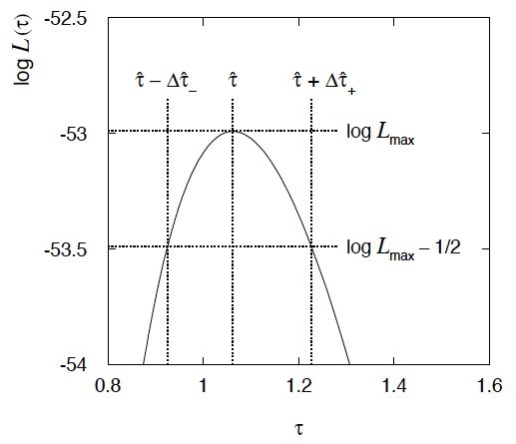
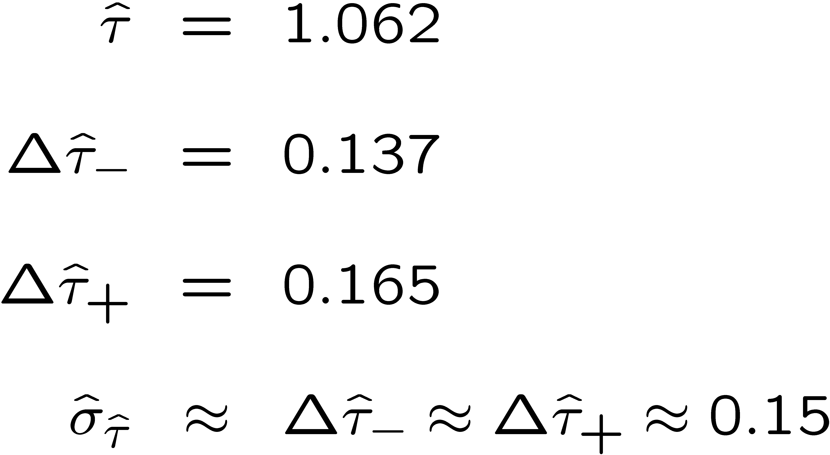
Example of variance by graphical method
ML example with exponential:
Not quite parabolic ln L since finite sample size (n = 50).

Slide 16
Information inequality for N parameters
Suppose we have estimated N parameters θ = (θ₁,...,θ_{N})
The Fisher information matrix is
^
and the covariance matrix of estimators θ is
The information inequality states that the matrix
is positive semi-definite:
z^{T}Mz ≥ 0 for all z ≠ 0, diagonal elements ≥ 0

Slide 17
Information inequality for N parameters (2)
In practice the inequality is ~always used in the large-sample limit:
bias → 0
inequality → equality, i.e, M = 0, and therefore V⁻¹ = I
That is,
This can be estimated from data using
Find the matrix V⁻¹ numerically (or with automatic differentiation),
then invert to get the covariance matrix of the estimators

Slide 18
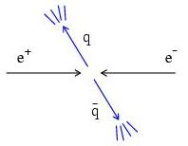
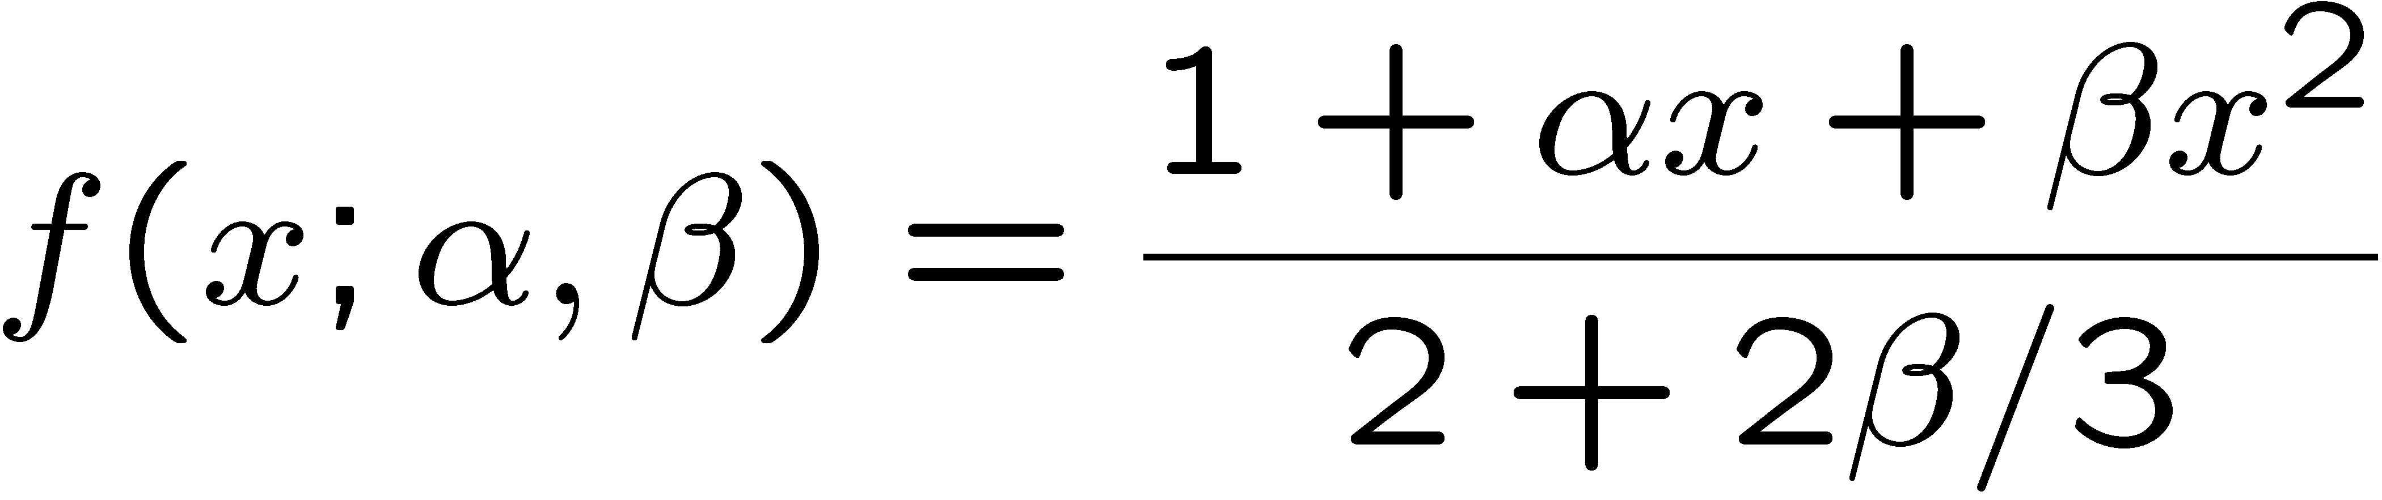
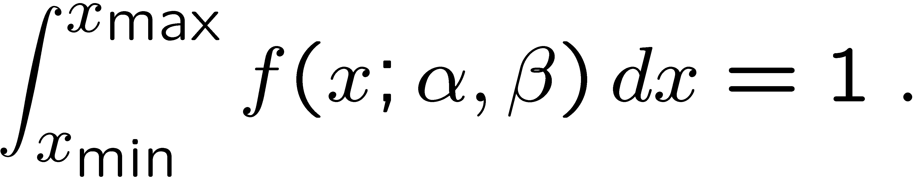
Example of ML with 2 parameters
Consider a scattering angle distribution with x = cos θ,
or if x_{min} < x < x_{max}, need to normalize so that
Example: α = 0.5, β = 0.5, x_{min} = −0.95, x_{max} = 0.95, generate n = 2000 events with Monte Carlo.
need to find maximum
numerically

Slide 19
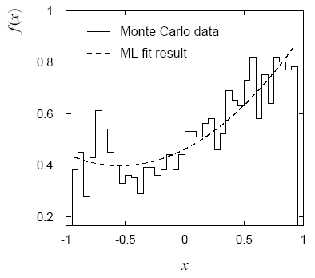
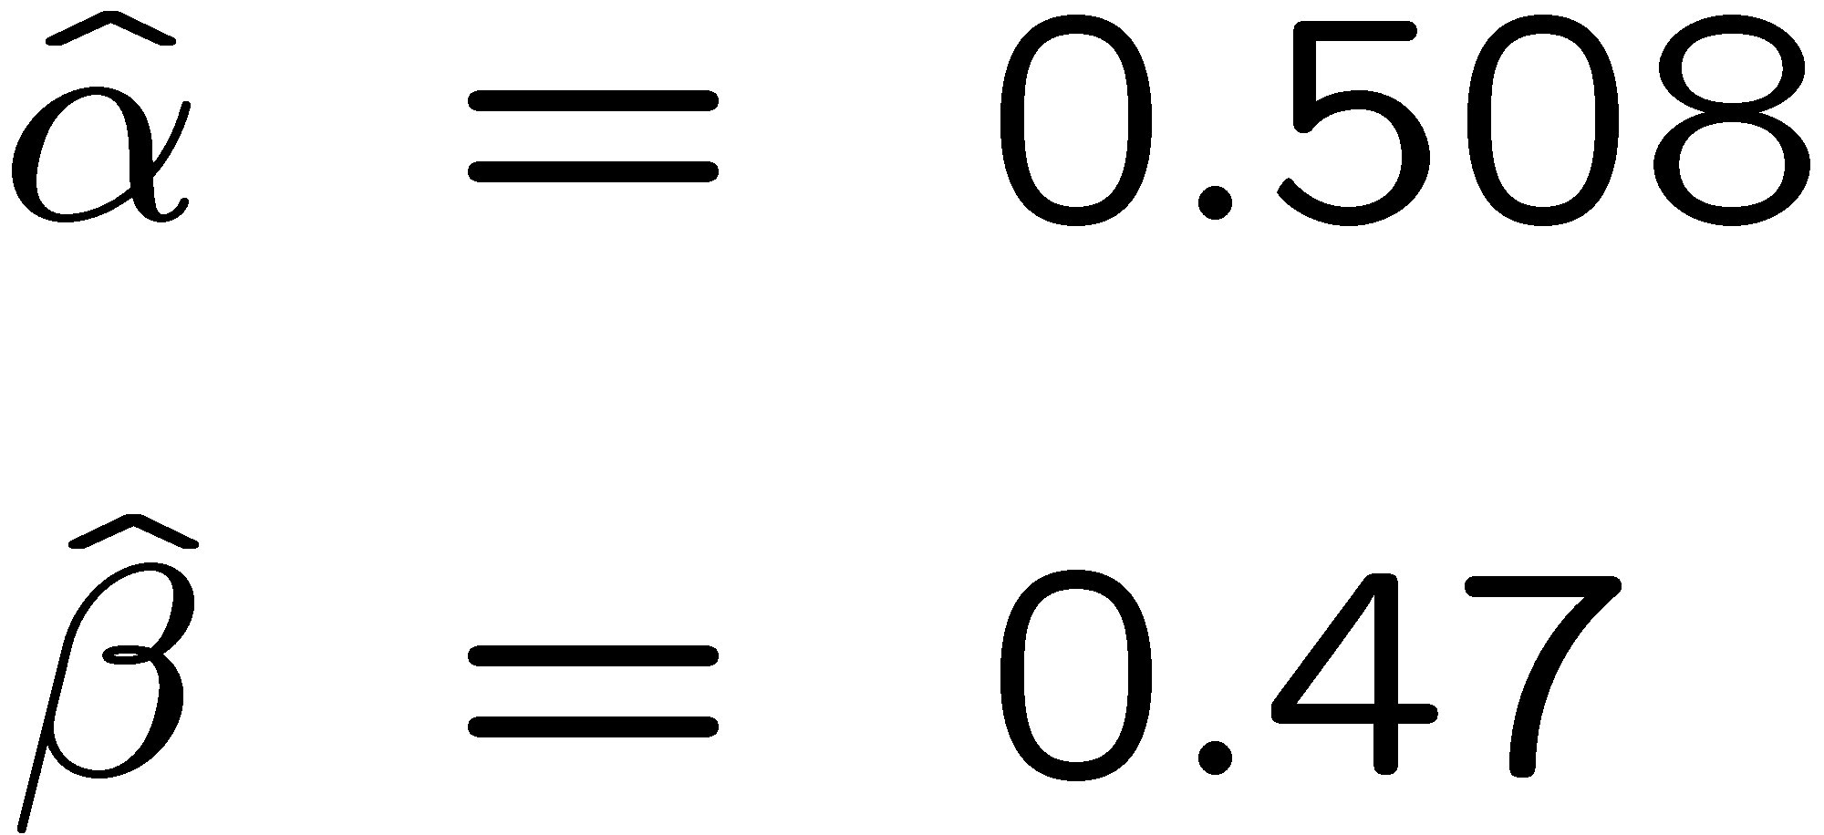
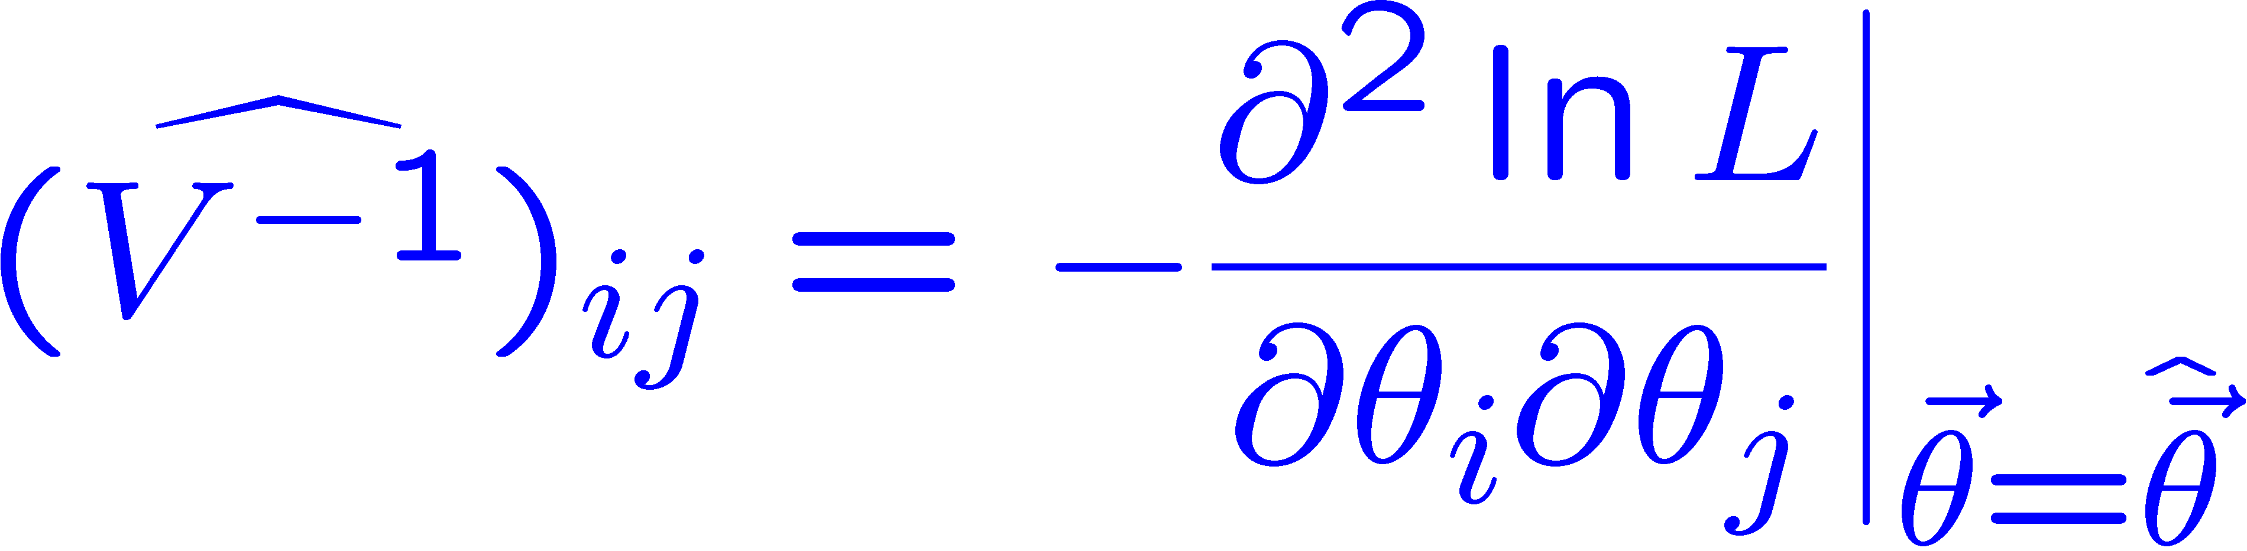
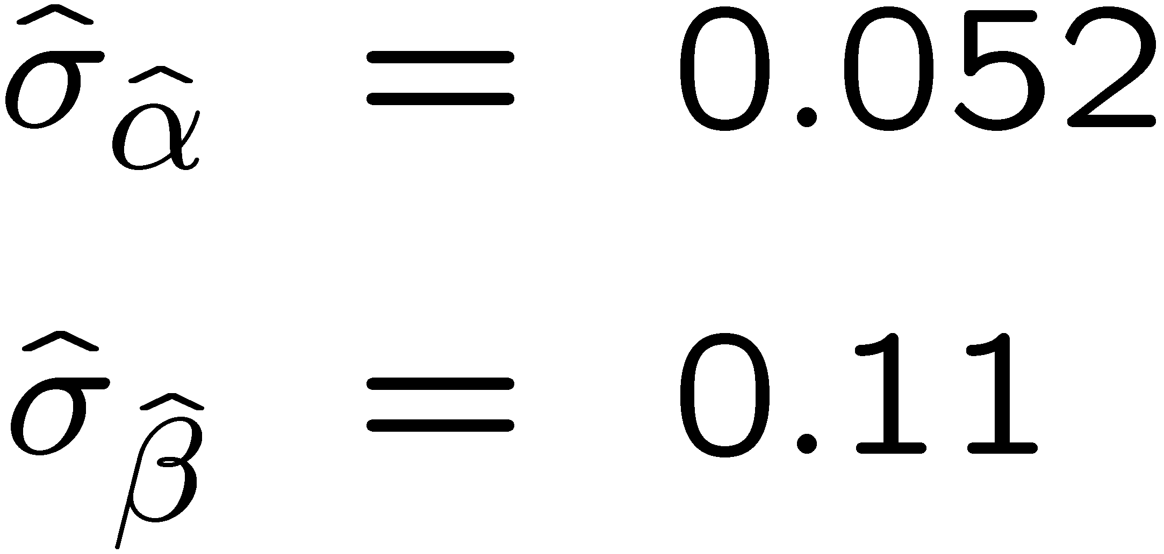
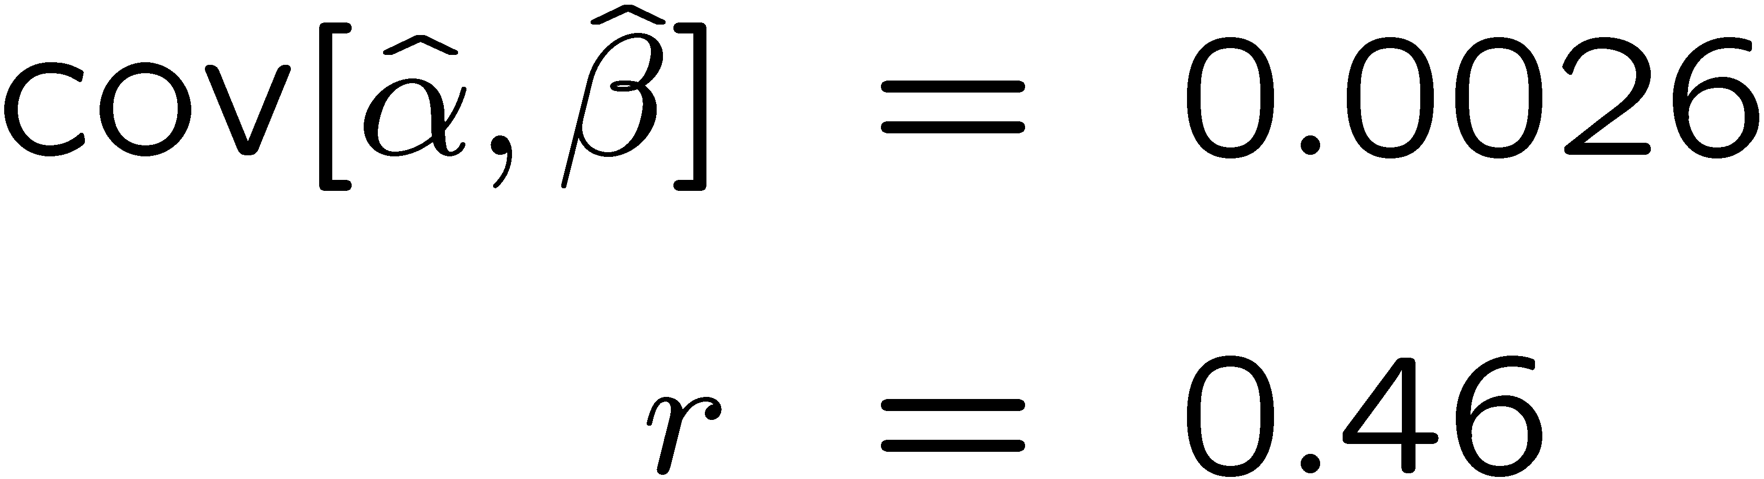
Example of ML with 2 parameters: fit result
Finding maximum of ln L(α, β) numerically gives
N.B. No binning of data for fit,
but can compare to histogram for
goodness-of-fit (e.g. ‘visual’ or χ²).
(Co)variances from
= correlation coefficient

Slide 20
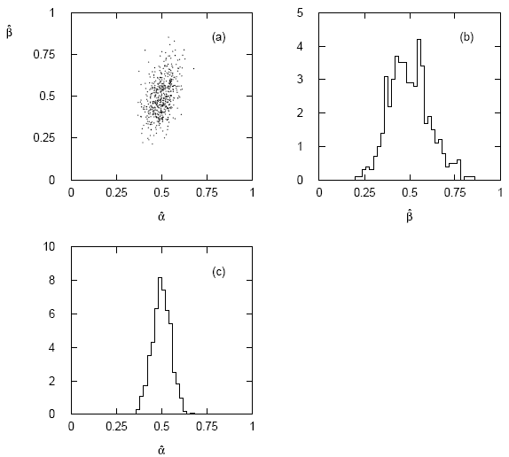




Two-parameter fit: MC study
Repeat ML fit with 500 experiments, all with n = 2000 events:
Estimates average to ~true values;
(Co)variances close to previous estimates;
marginal pdfs approximately Gaussian.

Slide 21
Multiparameter graphical method for variances
Expand ln L(θ) to 2nd order about MLE:
ln L_{max}
zero
relate to covariance matrix of MLEs using information (in)equality.
Result:
So the surface
corresponds to
, which is the equation of a (hyper-) ellipse.

Slide 22



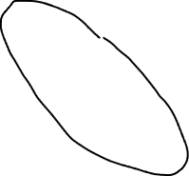
Multiparameter graphical method (2)
Distance from MLE to tangent planes gives standard deviations.

Slide 23
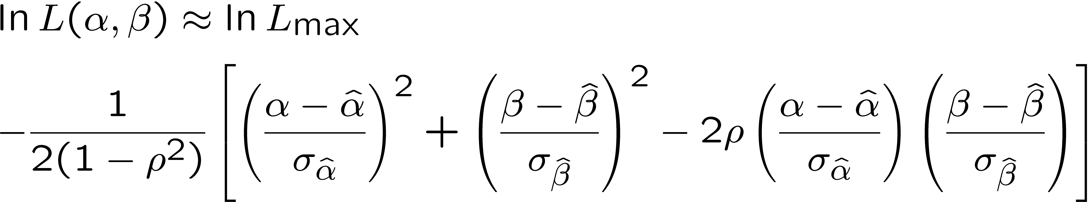
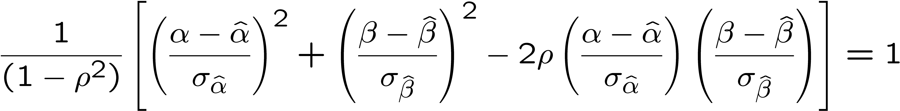
The ln L_{max} − 1/2 contour for two parameters
For large n, ln L takes on quadratic form near maximum:
The contour
is an ellipse:

Slide 24
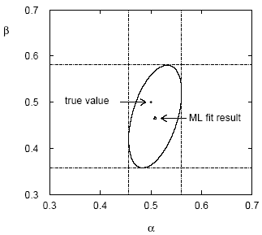
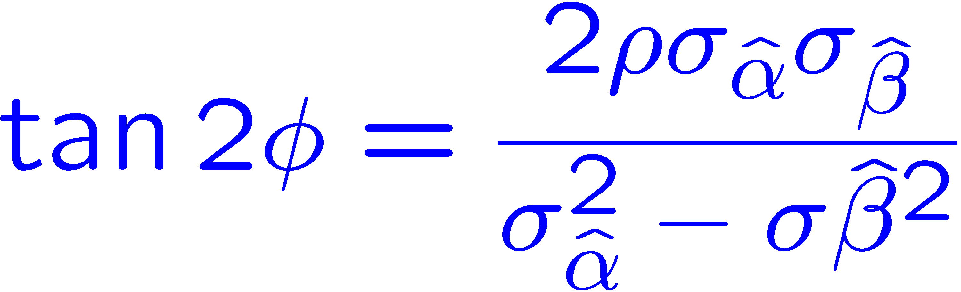
(Co)variances from ln L contour
The α, β plane for the first
MC data set
→ Tangent lines to contours give standard deviations.
→ Angle of ellipse φ related to correlation:

Slide 25
Confidence intervals by inverting a test
In addition to a ‘point estimate’ of a parameter we should report
an interval reflecting its statistical uncertainty.
Confidence intervals for a parameter θ can be found by
defining a test of the hypothesized value θ (do this for all θ):
Specify values of the data that are ‘disfavoured’ by θ
(critical region) such that P(data in critical region|θ) ≤ α
for a prespecified α, e.g., 0.05 or 0.1.
If data observed in the critical region, reject the value θ.
Now invert the test to define a confidence interval as:
set of θ values that are not rejected in a test of size α
(confidence level CL is 1− α).

Slide 26
Relation between confidence interval and p-value
Equivalently we can consider a significance test for each
hypothesized value of θ, resulting in a p-value, p_{θ}.
If p_{θ} ≤ α, then we reject θ.
The confidence interval at CL = 1 – α consists of those values of
θ that are not rejected.
E.g. an upper limit on θ is the greatest value for which p_{θ} > α.
In practice find by setting p_{θ} = α and solve for θ.
For a multidimensional parameter space θ = (θ₁,... θ_{M}) use same idea – result is a confidence “region” with boundary determined by p_{θ} = α.

Slide 27
Coverage probability of confidence interval
If the true value of θ is rejected, then it’s not in the confidence interval. The probability for this is by construction (equality for continuous data):
P(reject θ|θ) ≤ α = type-I error rate
Therefore, the probability for the interval to contain or “cover” θ is
P(conf. interval “covers” θ|θ) ≥ 1 – α
This assumes that the set of θ values considered includes the true value, i.e., it assumes the composite hypothesis P(x|H,θ).

Slide 28



Frequentist upper limit on Poisson parameter
Consider again the case of observing n ~ Poisson(s + b).
Suppose b = 4.5, n_{obs} = 5. Find upper limit on s at 95% CL.
Relevant alternative is s = 0 (critical region at low n)
p-value of hypothesized s is P(n ≤ n_{obs}; s, b)
Upper limit s_{up} at CL = 1 – α found from

Slide 29
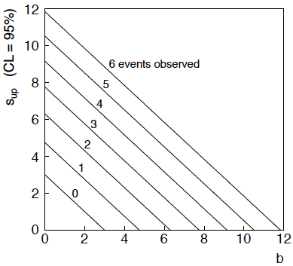
n ~ Poisson(s+b): frequentist upper limit on s
For low fluctuation of n, formula can give negative result for s_{up}; i.e. confidence interval is empty; all values of s ≥ 0 have p_{s} ≤ α.

Slide 30
Limits near a boundary of the parameter space
Suppose e.g. b = 2.5 and we observe n = 0.
If we choose CL = 0.9, we find from the formula for s_{up}
Physicist:
We already knew s ≥ 0 before we started; can’t use negative
upper limit to report result of expensive experiment!
Statistician:
The interval is designed to cover the true value only 90%
of the time — this was clearly not one of those times.
Not uncommon dilemma when testing parameter values for which
one has very little experimental sensitivity, e.g., very small s.

Slide 31
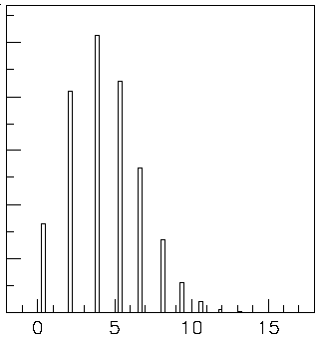

Expected limit for s = 0
Physicist: I should have used CL = 0.95 — then s_{up} = 0.496
Even better: for CL = 0.917923 we get s_{up} = 10⁻⁴ !
Reality check: with b = 2.5, typical Poisson fluctuation in n is
at least √2.5 = 1.6. How can the limit be so low?
Look at the mean limit for the
no-signal hypothesis (s = 0)
(sensitivity).
Distribution of 95% CL limits
with b = 2.5, s = 0.
Mean upper limit = 4.44

Slide 32



Systematic uncertainties and nuisance parameters
P (x|θ)
In general, our model of the data is not perfect:
model:
truth:
x
Can improve model by including
additional adjustable parameters.
Nuisance parameter ↔ systematic uncertainty. Some point in the
parameter space of the enlarged model should be “true”.
Presence of nuisance parameter decreases sensitivity of analysis
to the parameter of interest (e.g., increases variance of estimate).

Slide 33
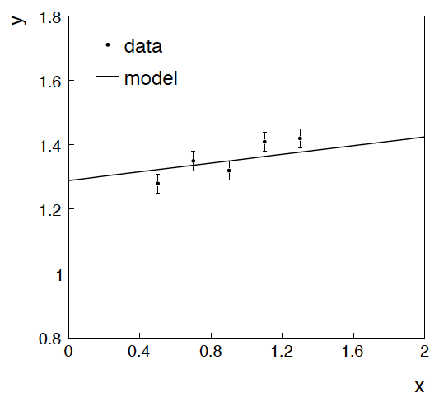
Example: fitting a straight line
Data:
Model: y_{i} independent and all follow y_{i} ~ Gauss(μ(x_{i} ), σ_{i} )
assume x_{i} and σ_{i} known.
Goal: estimate θ₀
Here suppose we don’t care
about θ₁ (example of a
“nuisance parameter”)

Slide 34
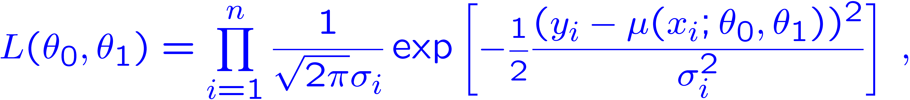
Maximum likelihood fit with Gaussian data
In this example, the y_{i} are assumed independent, so the
likelihood function is a product of Gaussians:
Maximizing the likelihood is here equivalent to minimizing
i.e., for Gaussian data, ML same as Method of Least Squares (LS)

Slide 35
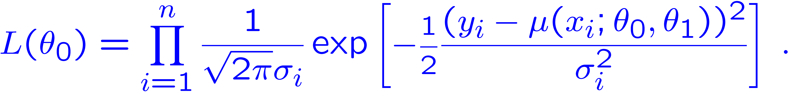
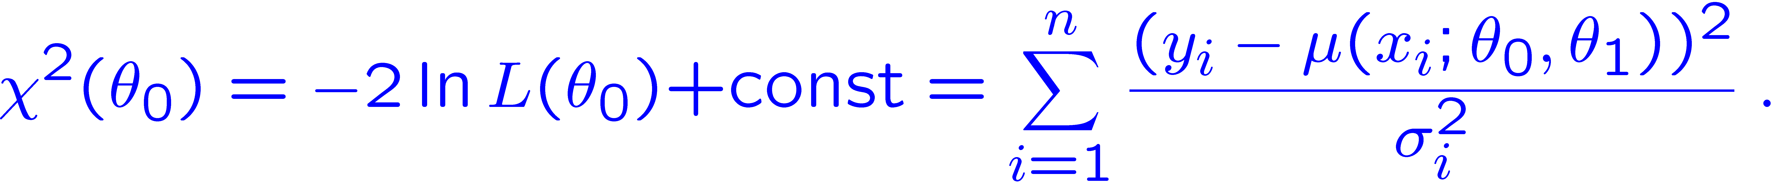
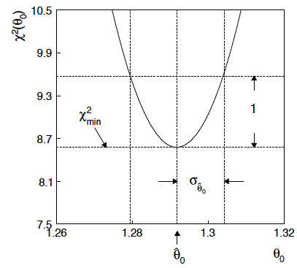
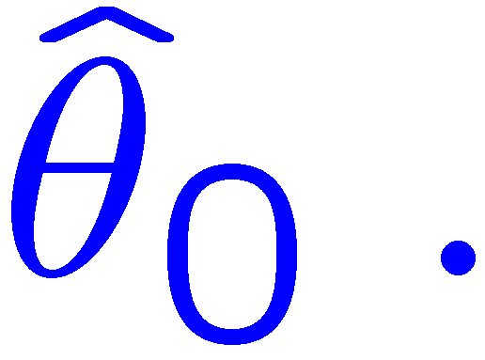
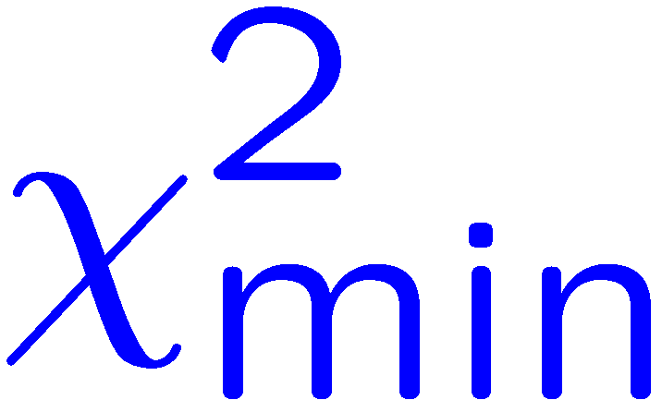
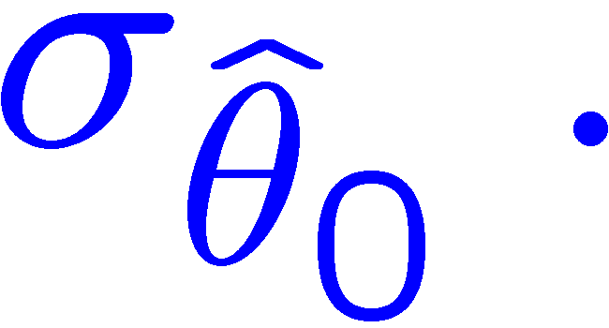
θ₁ known a priori
For Gaussian y_{i}, ML same as LS
Minimize χ² → estimator
Come up one unit from
to find

Slide 36



ML (or LS) fit of θ₀ and θ₁
Standard deviations from
tangent lines to contour
Correlation between
causes errors
to increase.

Slide 37



If we have a measurement t₁ ~ Gauss (θ₁, σ_{t1})
The information on θ₁
improves accuracy of

Slide 38

Reminder of Bayesian approach
In Bayesian statistics we can associate a probability with
a hypothesis, e.g., a parameter value θ.
Interpret probability of θ as ‘degree of belief’ (subjective).
Need to start with ‘prior pdf’ π(θ), this reflects degree
of belief about θ before doing the experiment.
Our experiment has data x, → likelihood L(x|θ).
Bayes’ theorem tells how our beliefs should be updated in
light of the data x:
Posterior pdf p(θ|x) contains all our knowledge about θ.

Slide 39
Bayesian approach: y_{i} ~ Gauss(μ(x_{i}; θ₀, θ₁), σ_{i})
We need to associate prior probabilities with θ₀ and θ₁, e.g.,
← suppose knowledge of θ₀ has no influence on knowledge of θ₁
← ‘non-informative’, in any
case much broader than L(θ₀)
prior after t₁,
before y
Ur = “primordial”
prior
Likelihood for control
measurement t₁

Slide 40
Bayesian example: y_{i} ~ Gauss(μ(x_{i}; θ₀, θ₁), σ_{i})
Putting the ingredients into Bayes’ theorem gives:
posterior ∝ likelihood ✕ prior
Note here the likelihood only reflects the measurements y.
The information from the control measurement t₁ has been put into the prior for θ₁.
We would get the same result using the likelihood P(y,t|θ₀,θ₁) and the constant “Ur-prior” for θ₁.

Slide 41
Marginalizing the posterior pdf
We then integrate (marginalize) p(θ₀, θ₁ | y) to find p(θ₀ | y):
In this example we can do the integral (rare). We find
(same as for MLE)
For this example, numbers come out same as in frequentist approach, but interpretation different.

Slide 42

Marginalization with MCMC
Bayesian computations involve integrals like
often high dimensionality and impossible in closed form,
also impossible with ‘normal’ acceptance-rejection Monte Carlo.
Markov Chain Monte Carlo (MCMC) has revolutionized
Bayesian computation.
MCMC (e.g., Metropolis-Hastings algorithm) generates
correlated sequence of random numbers:
cannot use for many applications, e.g., detector MC;
effective stat. error greater than if all values independent .
Basic idea: sample multidimensional θ but look only at distribution of parameters of interest.

Slide 43






MCMC basics: Metropolis-Hastings algorithm
Goal: given an n-dimensional pdf p(θ), generate a sequence of points θ₁ , θ₂ , θ₃ ,...
Proposal density q(θ; θ₀ )
e.g. Gaussian centred
about θ₀
1) Start at some point
2) Generate
3) Form Hastings test ratio
4) Generate
5) If
move to proposed point
else
old point repeated
6) Iterate

Slide 44

Metropolis-Hastings (continued)
This rule produces a correlated sequence of points (note how
each new point depends on the previous one).
Still works if p(θ) is known only as a proportionality, which is
usually what we have from Bayes’ theorem: p(θ|x) ∝ p(x|θ) π(θ).
The proposal density can be (almost) anything, but choose
so as to minimize autocorrelation. Often take proposal
density symmetric: q(θ; θ₀ ) = q(θ₀; θ )
Test ratio is (Metropolis-Hastings):
I.e. if the proposed step is to a point of higher p(θ), take it;
if not, only take the step with probability p(θ)/p(θ₀).
If proposed step rejected, repeat the current point.

Slide 45



Example: posterior pdf from MCMC
Sample the posterior pdf from previous example with MCMC:
Normalized histogram of θ₀ gives its marginal posterior pdf:

Slide 46


Bayesian method with alternative priors
Suppose we don’t have a previous measurement of θ₁ but rather,
an “expert” says it should be positive and not too much greater than 0.1 or so, i.e., something like
From this we obtain (numerically) the posterior pdf for θ₀:
This summarizes all
knowledge about θ₀.
Look also at result from
variety of priors.

Slide 47
Finally
Two lectures only enough for a brief introduction to:
Parameter estimation
Hypothesis tests (→ path to Machine Learning)
Limits (confidence intervals/regions)
Systematics (nuisance parameters)
A bit beyond... (Bayesian methods, MCMC)
Final thought: once the basic formalism is fixed, most of the
work focuses on writing down the likelihood, e.g., P(x|θ), and
including in it enough parameters to adequately describe the data (true for both Bayesian and frequentist approaches) so often best to invest most of your time with it.

Slide 48
Extra slides

