Slide 1



Basics of Statistical Data Analysis
Quantum Universe Lecture
DESY / U. Hamburg
Zoom / 13 April 2021
https://indico.desy.de/event/29561/
Glen Cowan
Physics Department
Royal Holloway, University of London
g.cowan@rhul.ac.uk
www.pp.rhul.ac.uk/~cowan

Slide 2
Outline
Basic introduction to frequentist vs Bayesian approaches
Basics of fitting, hypothesis tests and asymptotics
Treating systematic uncertainties with nuisance parameters
Everything here is a subset of the University of London course:
http://www.pp.rhul.ac.uk/~cowan/stat_course.html

Slide 3
Some statistics books, papers, etc.
G. Cowan, Statistical Data Analysis, Clarendon, Oxford, 1998
R.J. Barlow, Statistics: A Guide to the Use of Statistical Methods in the Physical Sciences, Wiley, 1989
Ilya Narsky and Frank C. Porter, Statistical Analysis Techniques in Particle Physics, Wiley, 2014.
Luca Lista, Statistical Methods for Data Analysis in Particle Physics, Springer, 2017.
L. Lyons, Statistics for Nuclear and Particle Physics, CUP, 1986
F. James., Statistical and Computational Methods in Experimental Physics, 2nd ed., World Scientific, 2006
S. Brandt, Statistical and Computational Methods in Data Analysis, Springer, New York, 1998.
P.A. Zyla et al. (Particle Data Group), Prog. Theor. Exp. Phys. 2020, 083C01 (2020); pdg.lbl.gov sections on probability, statistics, MC.

Slide 4
Theory ↔ Statistics ↔ Experiment
Theory (model, hypothesis):
Experiment (observation):
+ response of measurement
apparatus
= model prediction
data
Uncertainty enters
on many levels
→ quantify with
probability

Slide 5
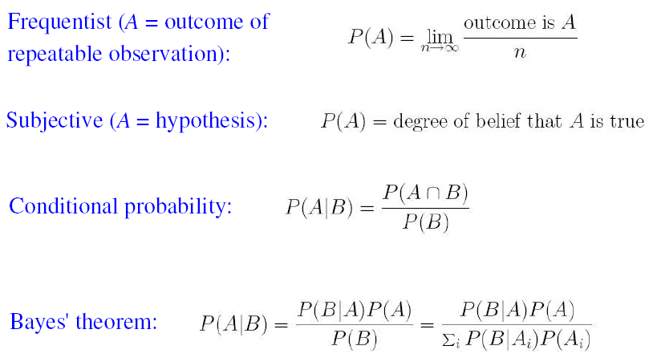
Quick review of probablility

Slide 6
Frequentist Statistics − general philosophy
In frequentist statistics, probabilities are associated only with
the data, i.e., outcomes of repeatable observations (shorthand: x).
Probability = limiting frequency
Probabilities such as
P (string theory is true),
P (0.117 < α_{s} < 0.119),
P (Biden wins in 2024),
etc. are either 0 or 1, but we don’t know which.
The tools of frequentist statistics tell us what to expect, under
the assumption of certain probabilities, about hypothetical
repeated observations.
Preferred theories (models, hypotheses, ...) are those that predict a high probability for data “like” the data observed.

Slide 7
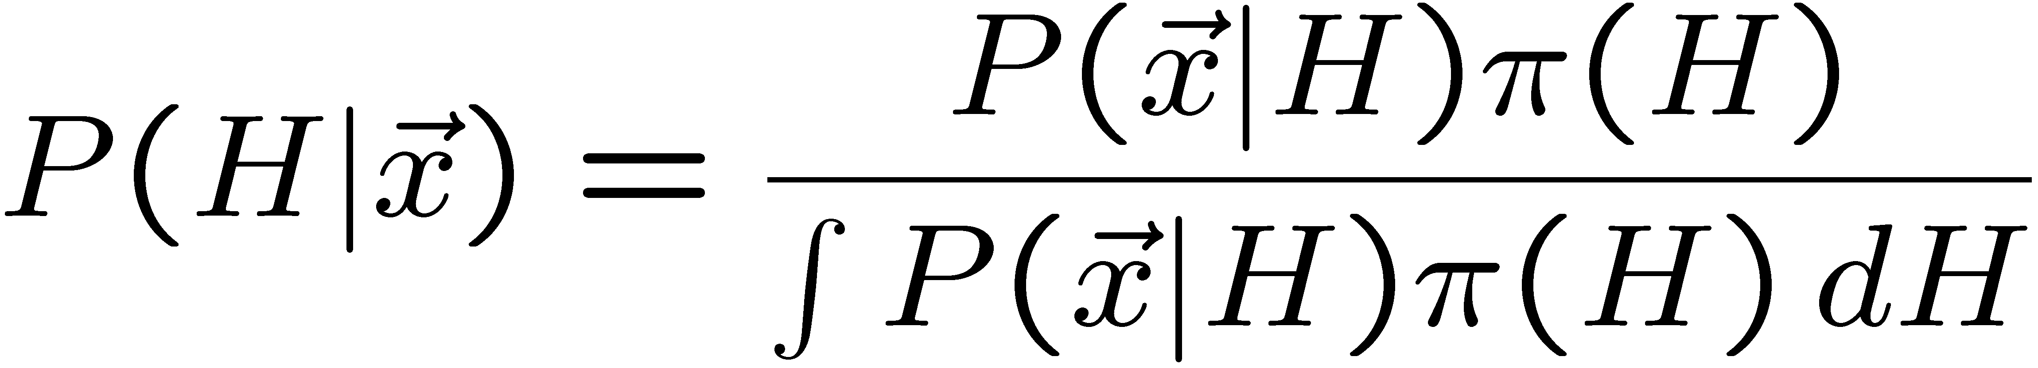
Bayesian Statistics − general philosophy
In Bayesian statistics, use subjective probability for hypotheses:
probability of the data assuming
hypothesis H (the likelihood)
prior probability, i.e.,
before seeing the data
posterior probability, i.e.,
after seeing the data
normalization involves sum
over all possible hypotheses
Bayes’ theorem has an “if-then” character: If your prior
probabilities were π(H), then it says how these probabilities
should change in the light of the data.
No general prescription for priors (subjective!)

Slide 8
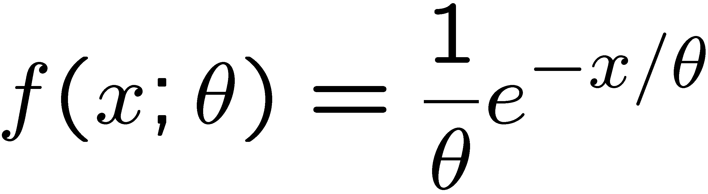
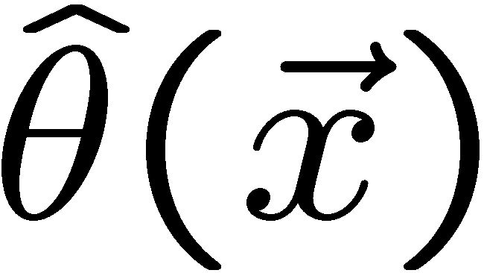
Parameter estimation
The parameters of a pdf are any constants that characterize it,
i.e., θ indexes a
set of hypotheses.
r.v.
parameter
Suppose we have a sample of observed values: x = (x₁, ..., x_{n})
We want to find some function of the data to estimate the
parameter(s):
← estimator written with a hat
Sometimes we say ‘estimator’ for the function of x₁, ..., x_{n};
‘estimate’ for the value of the estimator with a particular data set.

Slide 9
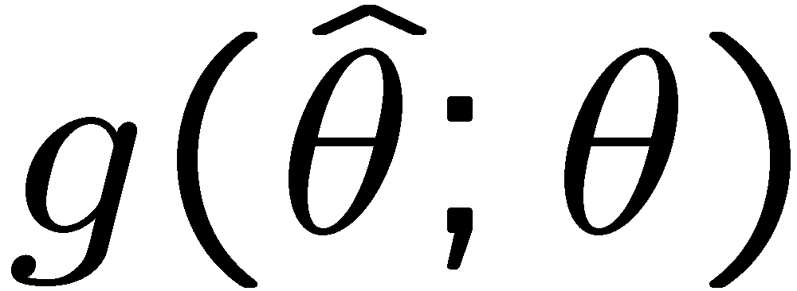
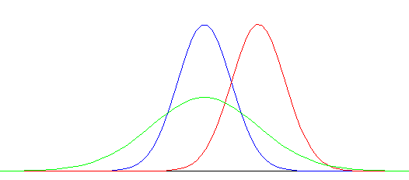


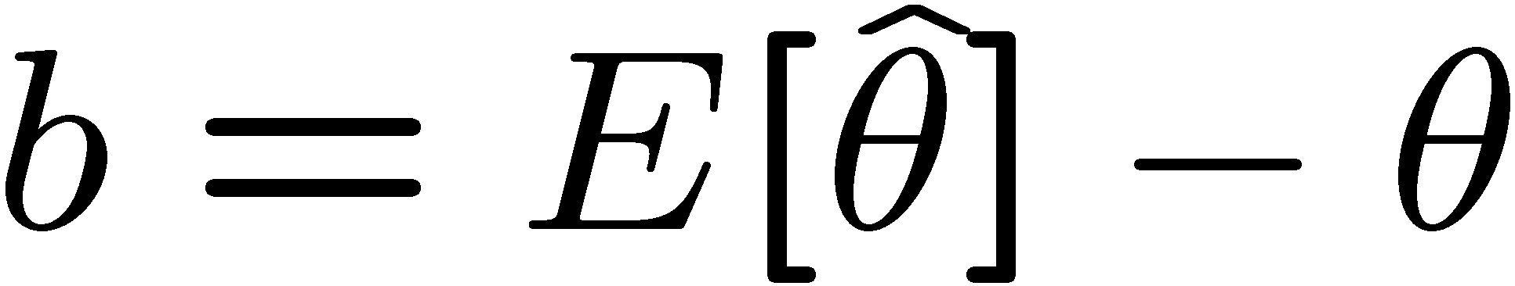

Properties of estimators
If we were to repeat the entire measurement, the estimates
from each would follow a pdf:
best
large
variance
biased
We want small (or zero) bias (systematic error):
→ average of repeated measurements should tend to true value.
And we want a small variance (statistical error):
→ small bias & variance are in general conflicting criteria

Slide 10
Hypothesis, likelihood
Suppose the entire result of an experiment (set of measurements) is a collection of numbers x.
A (simple) hypothesis is a rule that assigns a probability to each possible data outcome:
= the likelihood of H
Often we deal with a family of hypotheses labeled by one or
More undetermined parameters (a composite hypothesis):
= the “likelihood function”
Note:
1) For the likelihood we treat the data x as fixed.
2) The likelihood function L(θ) is not a pdf for θ.

Slide 11
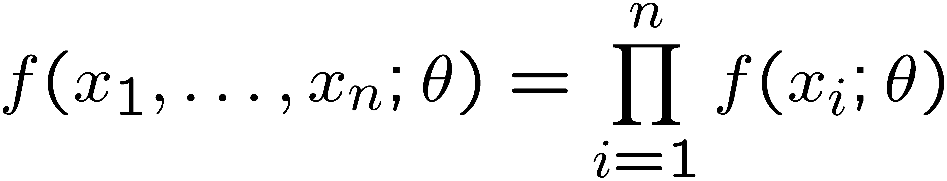
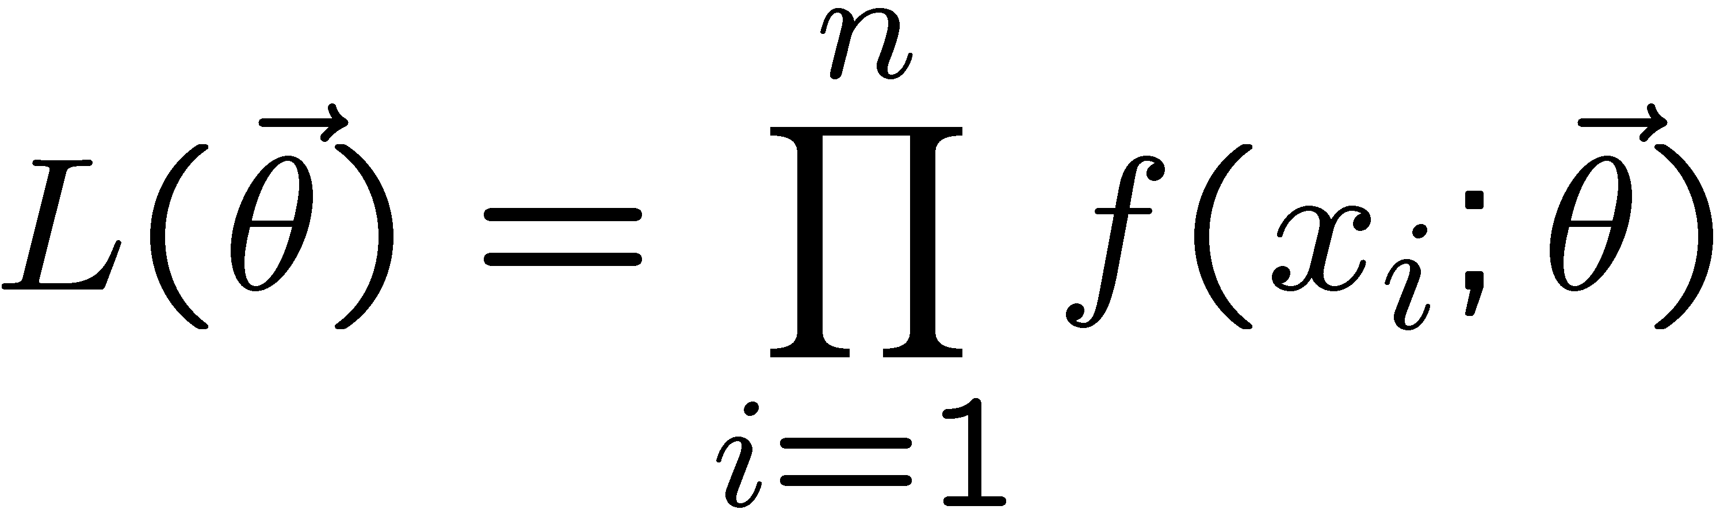
The likelihood function for i.i.d.*. data
* i.i.d. = independent and identically distributed
Consider n independent observations of x: x₁, ..., x_{n}, where
x follows f (x; θ). The joint pdf for the whole data sample is:
In this case the likelihood function is
(x_{i} constant)

Slide 12
Maximum Likelihood Estimators (MLEs)
We define the maximum likelihood estimators or MLEs to be
the parameter values for which the likelihood is maximum.
Maximizing L equivalent to maximizing log L
Could have multiple maxima (take highest).
MLEs not guaranteed to have any ‘optimal’ properties, (but in practice they’re very good).

Slide 13
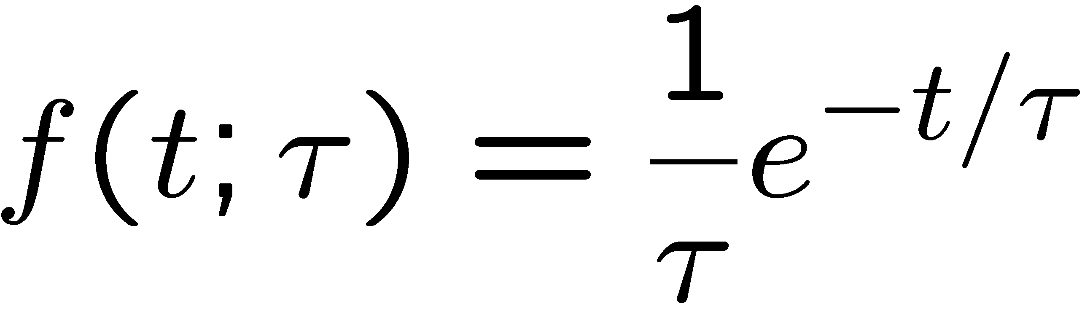

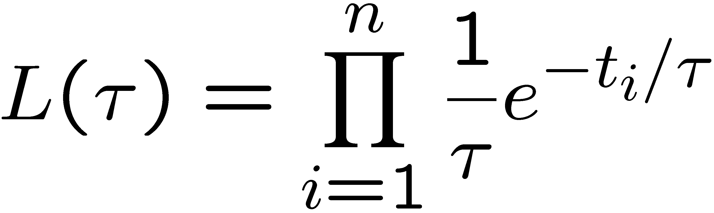
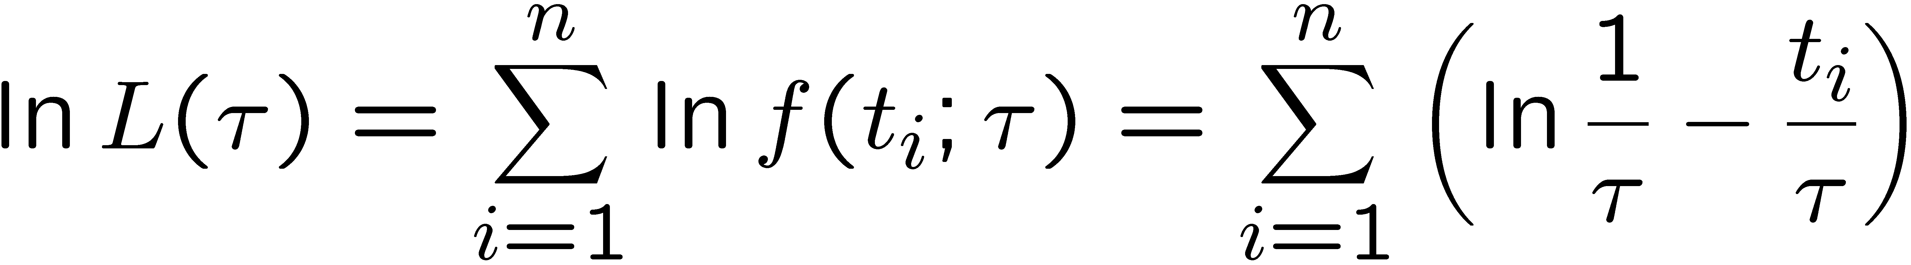
MLE example: parameter of exponential pdf
Consider exponential pdf,
and suppose we have i.i.d. data,
The likelihood function is
The value of τ for which L(τ) is maximum also gives the
maximum value of its logarithm (the log-likelihood function):

Slide 14
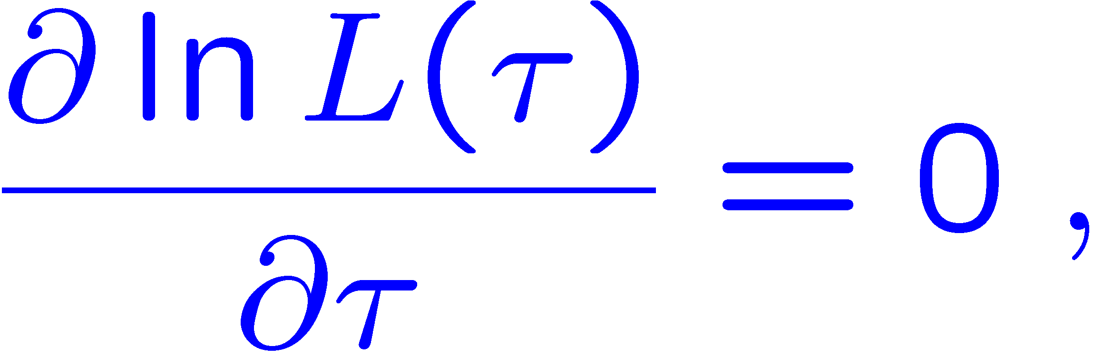
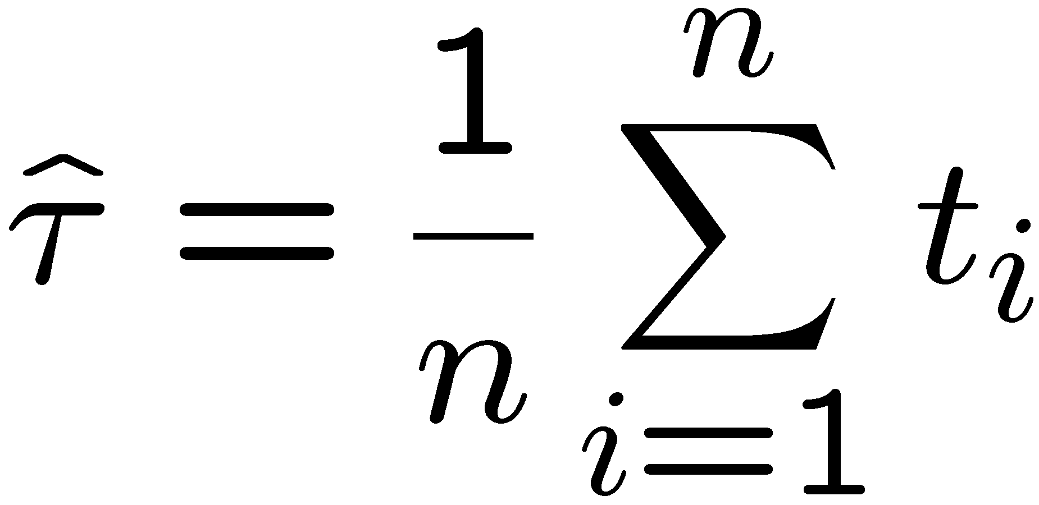
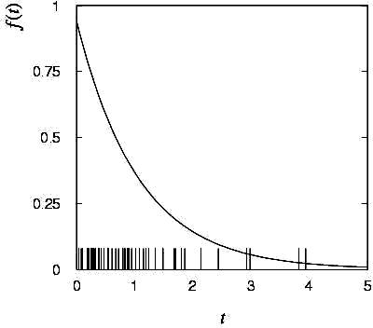

MLE example: parameter of exponential pdf (2)
Find its maximum by setting
→
Monte Carlo test:
generate 50 values
using τ = 1:
We find the ML estimate:

Slide 15
Frequentist hypothesis tests
Suppose a measurement produces data x; consider a hypothesis H₀
we want to test and alternative H₁
H₀, H₁ specify probability for x: P(x|H₀), P(x|H₁)
A test of H₀ is defined by specifying a critical region w of the
data space such that there is no more than some (small) probability
α, assuming H₀ is correct, to observe the data there, i.e.,
P(x ∈ w | H₀) ≤ α
Need inequality if data are
discrete.
α is called the size or
significance level of the test.
If x is observed in the
critical region, reject H₀.
data space Ω
critical region w

Slide 16



Definition of a test (2)
But in general there are an infinite number of possible critical regions that give the same size α.
Use the alternative hypothesis H₁ to motivate where to place the critical region.
Roughly speaking, place the critical region where there is a low
probability (α) to be found if H₀ is true, but high if H₁ is true:

Slide 17


Classification viewed as a statistical test
Suppose events come in two possible types:
s (signal) and b (background)
For each event, test hypothesis that it is background, i.e., H₀ = b.
Carry out test on many events, each is either of type s or b, i.e., here the hypothesis is the “true class label”, which varies randomly from event to event, so we can assign to it a frequentist probability.
Select events for which where H₀ is rejected as “candidate events of type s”. Equivalent Particle Physics terminology:
background efficiency
signal efficiency

Slide 18
Example of a test for classification
Suppose we can measure for
each event a quantity x, where
with 0 ≤ x ≤ 1.
For each event in a mixture of signal (s) and background (b) test
H₀ : event is of type b
using a critical region W of the form: W = { x : x ≤ x_{c} }, where
x_{c} is a constant that we choose to give a test with the desired size α.

Slide 19
Classification example (2)
Suppose we want α = 10⁻⁴. Require:
and therefore
For this test (i.e. this critical region W), the power with respect to the signal hypothesis (s) is
Note: the optimal size and power is a separate question that will depend on goals of the subsequent analysis.

Slide 20
Test statistic based on likelihood ratio
How can we choose a test’s critical region in an ‘optimal way’, in particular if the data space is multidimensional?
Neyman-Pearson lemma states:
For a test of H₀ of size α, to get the highest power with respect to the
alternative H₁ we need for all x in the critical region W
”likelihood
ratio (LR)”
inside W and ≤ c_{α} outside, where c_{α} is a constant chosen to give a test of the desired size.
Equivalently, optimal scalar test statistic is
N.B. any monotonic function of this is leads to the same test.

Slide 21
Testing significance / goodness-of-fit
Suppose hypothesis H predicts pdf f (x|H) for a set of
observations x = (x₁,...x_{n}).
We observe a single point in this space: x_{obs}.
How can we quantify the level of compatibility between the data and the predictions of H?
x_{j}
x_{obs}
Decide what part of
the data space represents equal or less compatibility with H than does the point x_{obs}. (Not unique!)
ω> = { x : x “more
compatible” with H }
ω≤ = { x : x “less
or eq. compatible”
with H }
x_{i}

Slide 22
p-values
Express level of compatibility between data and hypothesis (sometimes ‘goodness-of-fit’) by giving the p-value for H:
= probability, under assumption of H, to observe data with equal or lesser compatibility with H relative to the data we got.
= probability, under assumption of H, to observe data as discrepant with H as the data we got or more so.
Basic idea: if there is only a very small probability to find data
with even worse (or equal) compatibility, then H is “disfavoured by the data”.
If the p-value is below a user-defined threshold α (e.g. 0.05) then H is rejected (equivalent to hypothesis test as discussed previously).

Slide 23

p-value of H is not P(H)
The p-value of H is not the probability that H is true!
In frequentist statistics we don’t talk about P(H) (unless H
represents a repeatable observation).
If we do define P(H), e.g., in Bayesian statistics as a degree of belief, then we need to use Bayes’ theorem to obtain
where π(H) is the prior probability for H.
For now stick with the frequentist approach;
result is p-value, regrettably easy to misinterpret as P(H).

Slide 24

The Poisson counting experiment
Suppose we do a counting experiment and observe n events.
Events could be from signal process or from background –
we only count the total number.
Poisson model:
s = mean (i.e., expected) # of signal events
b = mean # of background events
Goal is to make inference about s, e.g.,
test s = 0 (rejecting H₀ ≈ “discovery of signal process”)
test all non-zero s (values not rejected = confidence interval)
In both cases need to ask what is relevant alternative hypothesis.

Slide 25
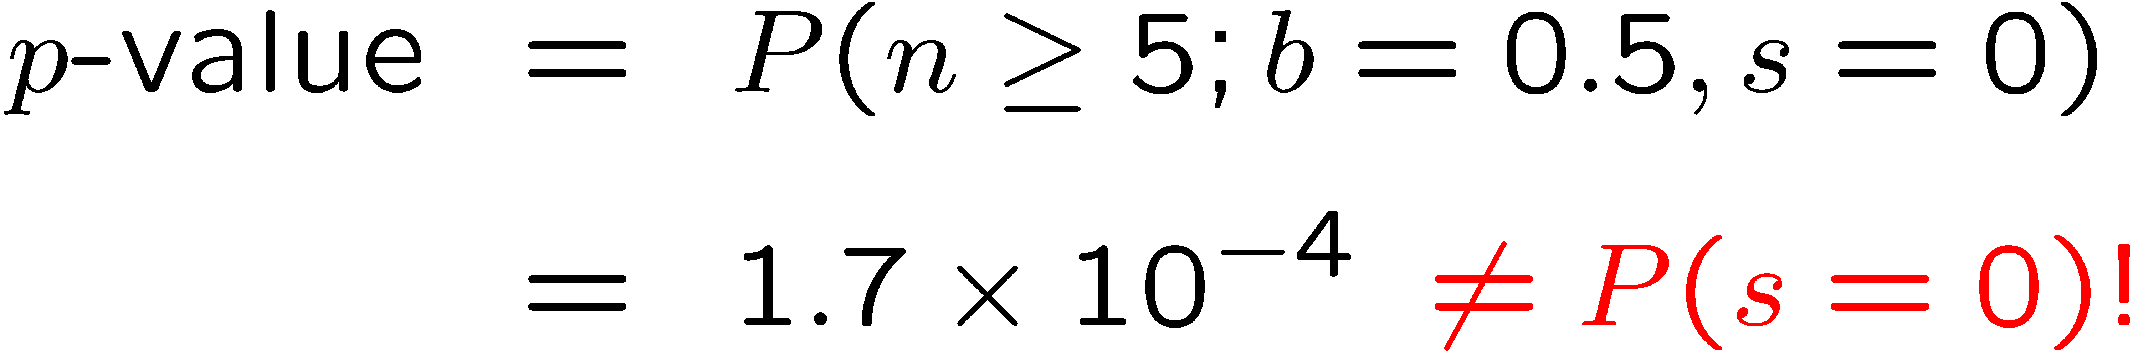
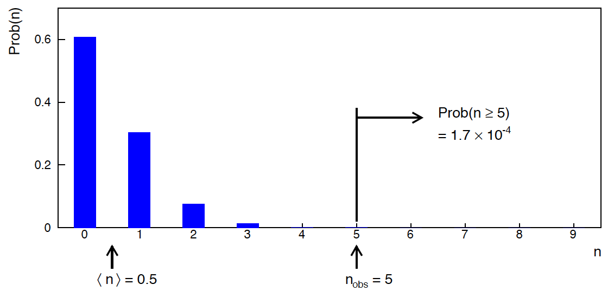
Poisson counting experiment: discovery p-value
Suppose b = 0.5 (known), and we observe n_{obs} = 5.
Should we claim evidence for a new discovery?
Give p-value for hypothesis s = 0:

Slide 26
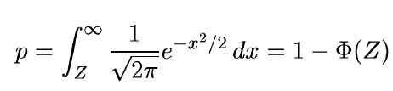
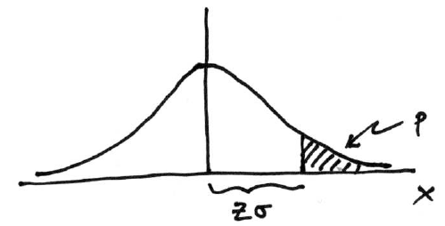

Significance from p-value
Often define significance Z as the number of standard deviations
that a Gaussian variable would fluctuate in one direction
to give the same p-value.
in ROOT:
p = 1 - TMath::Freq(Z)
Z = TMath::NormQuantile(1-p)
in python (scipy.stats):
p = 1 - norm.cdf(Z) = norm.sf(Z)
Z = norm.ppf(1-p)
Result Z is a “number of sigmas”. Note this does not mean that
the original data was Gaussian distributed.

Slide 27

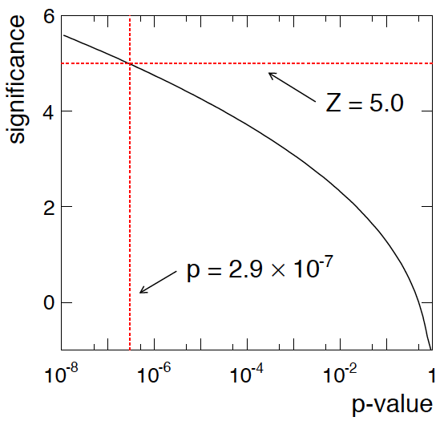
Poisson counting experiment: discovery significance
Equivalent significance for p = 1.7 × 10⁻⁴:
Often claim discovery if Z > 5 (p < 2.9 × 10⁻⁷, i.e., a “5-sigma effect”)
In fact this tradition should be revisited: p-value intended to quantify probability of a signal-like fluctuation assuming background only; not intended to cover, e.g., hidden systematics, plausibility signal model, compatibility of data with signal, “look-elsewhere effect”
(~multiple testing), etc.

Slide 28
Confidence intervals by inverting a test
In addition to a ‘point estimate’ of a parameter we should report
an interval reflecting its statistical uncertainty.
Confidence intervals for a parameter θ can be found by
defining a test of the hypothesized value θ (do this for all θ):
Specify values of the data that are ‘disfavoured’ by θ
(critical region) such that P(data in critical region|θ) ≤ α
for a prespecified α, e.g., 0.05 or 0.1.
If data observed in the critical region, reject the value θ.
Now invert the test to define a confidence interval as:
set of θ values that are not rejected in a test of size α
(confidence level CL is 1− α).

Slide 29
Relation between confidence interval and p-value
Equivalently we can consider a significance test for each
hypothesized value of θ, resulting in a p-value, p_{θ}.
If p_{θ} ≤ α, then we reject θ.
The confidence interval at CL = 1 – α consists of those values of
θ that are not rejected.
E.g. an upper limit on θ is the greatest value for which p_{θ} > α.
In practice find by setting p_{θ} = α and solve for θ.
For a multidimensional parameter space θ = (θ₁,... θ_{M}) use same idea – result is a confidence “region” with boundary determined by p_{θ} = α.

Slide 30
Coverage probability of confidence interval
If the true value of θ is rejected, then it’s not in the confidence interval. The probability for this is by construction (equality for continuous data):
P(reject θ|θ) ≤ α = type-I error rate
Therefore, the probability for the interval to contain or “cover” θ is
P(conf. interval “covers” θ|θ) ≥ 1 – α
This assumes that the set of θ values considered includes the true value, i.e., it assumes the composite hypothesis P(x|H,θ).

Slide 31



Frequentist upper limit on Poisson parameter
Consider again the case of observing n ~ Poisson(s + b).
Suppose b = 4.5, n_{obs} = 5. Find upper limit on s at 95% CL.
Relevant alternative is s = 0 (critical region at low n)
p-value of hypothesized s is P(n ≤ n_{obs}; s, b)
Upper limit s_{up} at CL = 1 – α found from

Slide 32
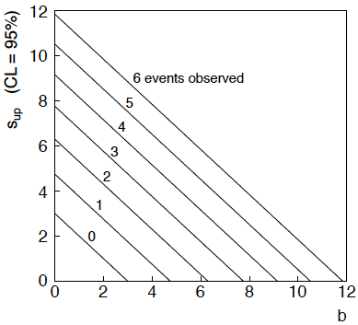
n ~ Poisson(s+b): frequentist upper limit on s
For low fluctuation of n, formula can give negative result for s_{up}; i.e. confidence interval is empty; all values of s ≥ 0 have p_{s} ≤ α.

Slide 33
Limits near a boundary of the parameter space
Suppose e.g. b = 2.5 and we observe n = 0.
If we choose CL = 0.9, we find from the formula for s_{up}
Physicist:
We already knew s ≥ 0 before we started; can’t use negative
upper limit to report result of expensive experiment!
Statistician:
The interval is designed to cover the true value only 90%
of the time — this was clearly not one of those times.
Not uncommon dilemma when testing parameter values for which
one has very little experimental sensitivity, e.g., very small s.

Slide 34
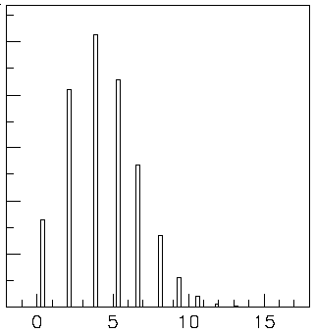

Expected limit for s = 0
Physicist: I should have used CL = 0.95 — then s_{up} = 0.496
Even better: for CL = 0.917923 we get s_{up} = 10⁻⁴ !
Reality check: with b = 2.5, typical Poisson fluctuation in n is
at least √2.5 = 1.6. How can the limit be so low?
Look at the mean limit for the
no-signal hypothesis (s = 0)
(sensitivity).
Distribution of 95% CL limits
with b = 2.5, s = 0.
Mean upper limit = 4.44

Slide 35




Approximate confidence intervals/regions
from the likelihood function
Suppose we test parameter value(s) θ = (θ₁, ..., θ_{n}) using the ratio
Lower λ(θ) means worse agreement between data and hypothesized θ. Equivalently, usually define
so higher t_{θ} means worse agreement between θ and the data.
p-value of θ therefore
need pdf

Slide 36




Confidence region from Wilks’ theorem
Wilks’ theorem says (in large-sample limit and provided
certain conditions hold...)
chi-square dist. with # d.o.f. =
# of components in θ = (θ₁, ..., θ_{n}).
Assuming this holds, the p-value is
← set equal to α
To find boundary of confidence region set p_{θ} = α and solve for t_{θ}:
Recall also

Slide 37




Confidence region from Wilks’ theorem (cont.)
i.e., boundary of confidence region in θ space is where
For example, for 1 – α = 68.3% and n = 1 parameter,
and so the 68.3% confidence level interval is determined by
Same as recipe for finding the estimator’s standard deviation, i.e.,
is a 68.3% CL confidence interval.

Slide 38
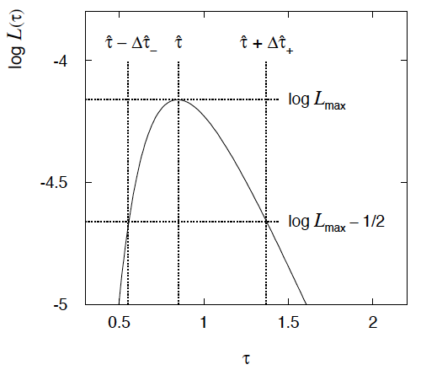

Example of interval from ln L(θ)
For n=1 parameter, CL = 0.683, Q_{α} = 1.
Our exponential
example, now with
only n = 5 events.
Can report ML estimate
with approx. confidence
interval from ln L_{max} – 1/2
as “asymmetric error bar”:

Slide 39

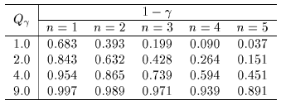

Multiparameter case
For increasing number of parameters, CL = 1 – α decreases for
confidence region determined by a given

Slide 40
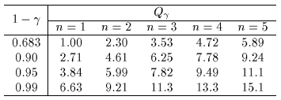
Multiparameter case (cont.)
Equivalently, Q_{α} increases with n for a given CL = 1 – α.

Slide 41



Systematic uncertainties and nuisance parameters
P (x|μ)
In general, our model of the data is not perfect:
model:
truth:
x
Can improve model by including
additional adjustable parameters.
Nuisance parameter ↔ systematic uncertainty. Some point in the
parameter space of the enlarged model should be “true”.
Presence of nuisance parameter decreases sensitivity of analysis
to the parameter of interest (e.g., increases variance of estimate).

Slide 42




Prototype search analysis
Search for signal in a region of phase space; result is histogram
of some variable x giving numbers:
Assume the n_{i} are Poisson distributed with expectation values
strength parameter
where
signal
background

Slide 43


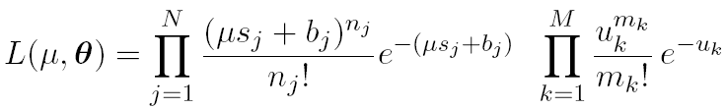
Prototype analysis (II)
Often also have a subsidiary measurement that constrains some
of the background and/or shape parameters:
Assume the m_{i} are Poisson distributed with expectation values
nuisance parameters (θ_{s}, θ_{b},b_{tot})
Likelihood function is

Slide 44
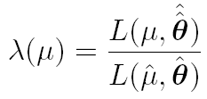
The profile likelihood ratio
Base significance test on the profile likelihood ratio:
maximizes L for
specified μ
maximize L
Define critical region of test of μ by the region of data space
that gives the lowest values of λ(μ).
Important advantage of profile LR is that its distribution becomes independent of nuisance parameters in large sample limit.

Slide 45
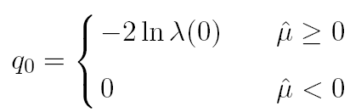
Test statistic for discovery
Suppose relevant alternative to background-only (μ = 0) is μ ≥ 0.
So take critical region for test of μ = 0 corresponding to high q₀
and > 0 (data characteristic for μ ≥ 0).
That is, to test background-only hypothesis define statistic
i.e. here only large (positive) observed signal strength is evidence against the background-only hypothesis.
Note that even though here physically μ ≥ 0, we allow
to be negative. In large sample limit its distribution becomes
Gaussian, and this will allow us to write down simple
expressions for distributions of our test statistics.

Slide 46


Cowan, Cranmer, Gross, Vitells, arXiv:1007.1727, EPJC 71 (2011) 1554
Distribution of q₀ in large-sample limit
Assuming approximations valid in the large sample (asymptotic)
limit, we can write down the full distribution of q₀ as
The special case μ′ = 0 is a “half chi-square” distribution:
In large sample limit, f (q₀|0) independent of nuisance parameters;
f (q₀|μ′) depends on nuisance parameters through σ.

Slide 47
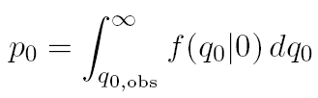
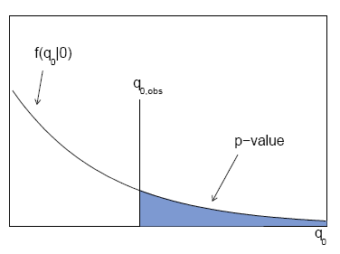

p-value for discovery
Large q₀ means increasing incompatibility between the data
and hypothesis, therefore p-value for an observed q_{0,obs} is
use e.g. asymptotic formula
From p-value get
equivalent significance,

Slide 48
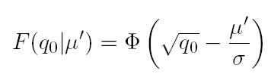



Cowan, Cranmer, Gross, Vitells, arXiv:1007.1727, EPJC 71 (2011) 1554
Cumulative distribution of q₀, significance
From the pdf, the cumulative distribution of q₀ is found to be
The special case μ′ = 0 is
The p-value of the μ = 0 hypothesis is
Therefore the discovery significance Z is simply

Slide 49
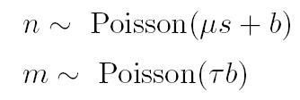
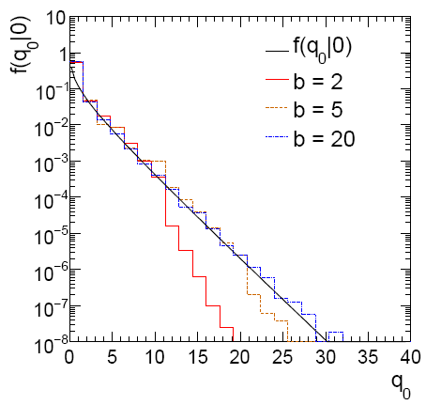
Cowan, Cranmer, Gross, Vitells, arXiv:1007.1727, EPJC 71 (2011) 1554
Monte Carlo test of asymptotic formula
μ = param. of interest
b = nuisance parameter
Here take s known, τ = 1.
Asymptotic formula is
good approximation to 5σ
level (q₀ = 25) already for
b ~ 20.

Slide 50
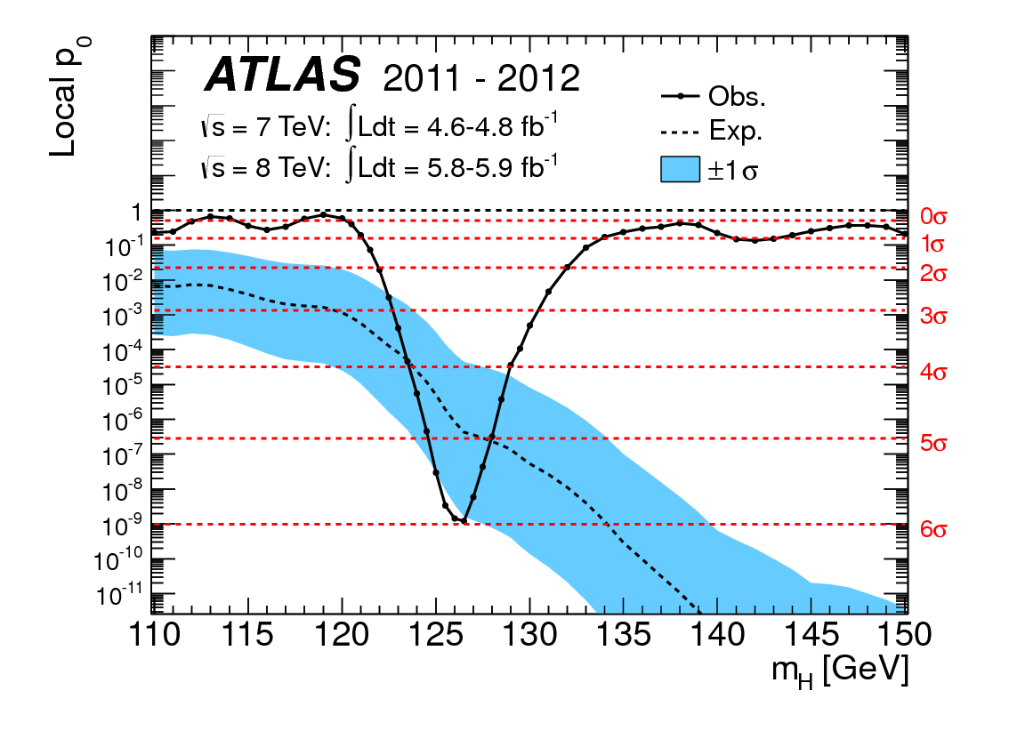
How to read the p₀ plot
The “local” p₀ means the p-value of the background-only
hypothesis obtained from the test of μ = 0 at each individual m_{H}, without any correct for the Look-Elsewhere Effect.
The “Expected” (dashed) curve gives the median p₀ under assumption of the SM Higgs (μ = 1) at each m_{H}.
ATLAS, Phys. Lett. B 716 (2012) 1-29
The blue band gives the
width of the distribution
(±1σ) of significances
under assumption of the
SM Higgs.

Slide 51
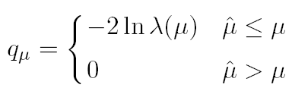



Cowan, Cranmer, Gross, Vitells, arXiv:1007.1727, EPJC 71 (2011) 1554
Test statistic for upper limits
For purposes of setting an upper limit on μ use
where
I.e. when setting an upper limit, an upwards fluctuation of the data
is not taken to mean incompatibility with the hypothesized μ :
From observed q_{μ} find p-value:
Large sample approximation:
To find upper limit at CL = 1−α, set p_{μ} = α and solve for μ.

Slide 52
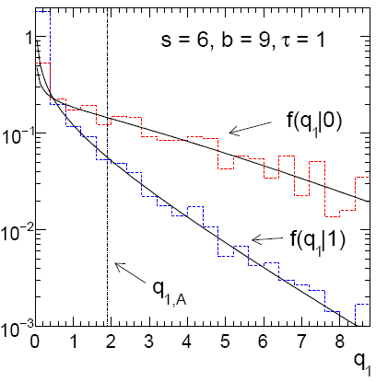
Cowan, Cranmer, Gross, Vitells, arXiv:1007.1727, EPJC 71 (2011) 1554
Monte Carlo test of asymptotic formulae
Consider again n ~ Poisson(μs + b), m ~ Poisson(τb)
Use q_{μ} to find p-value of hypothesized μ values.
E.g. f (q₁|1) for p-value of μ =1.
Typically interested in 95% CL, i.e., p-value threshold = 0.05, i.e.,
q₁ = 2.69 or Z₁ = √q₁ = 1.64.
Median[q₁ |0] gives “exclusion sensitivity”.
Here asymptotic formulae good
for s = 6, b = 9.

Slide 53
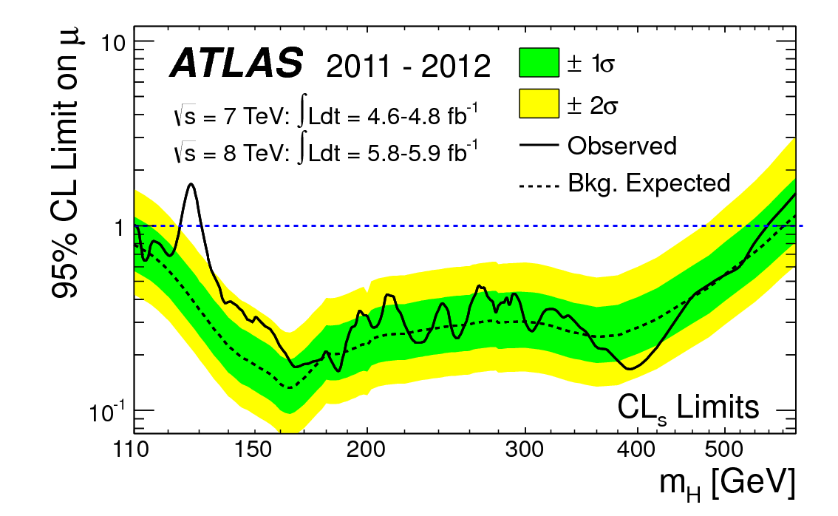
How to read the green and yellow limit plots
For every value of m_{H}, find the upper limit on μ.
Also for each m_{H}, determine the distribution of upper limits μ_{up} one would obtain under the hypothesis of μ = 0.
The dashed curve is the median μ_{up}, and the green (yellow) bands give the ± 1σ (2σ) regions of this distribution.
ATLAS, Phys. Lett. B 716 (2012) 1-29

Slide 54
Finally
One lecture only enough for a brief introduction to:
Parameter estimation, maximum likelihood
Hypothesis tests, p-values
Limits (confidence intervals/regions)
Systematics (nuisance parameters)
Asymptotics (Wilks’ theorem)
Final thought: once the basic formalism is fixed, most of the
work focuses on writing down the likelihood, e.g., P(x|θ), and
including in it enough parameters to adequately describe the data
(true for both Bayesian and frequentist approaches).

Slide 55
Extra slides

Slide 56




Expected discovery significance for counting
experiment with background uncertainty
I. Discovery sensitivity for counting experiment with b known:
(a)
(b) Profile likelihood
ratio test & Asimov:
II. Discovery sensitivity with uncertainty in b, σ_{b}:
(a)
(b) Profile likelihood ratio test & Asimov:

Slide 57


Counting experiment with known background
Count a number of events n ~ Poisson(s+b), where
s = expected number of events from signal,
b = expected number of background events.
To test for discovery of signal compute p-value of s = 0 hypothesis,
Usually convert to equivalent significance:
where Φ is the standard Gaussian cumulative distribution, e.g.,
Z > 5 (a 5 sigma effect) means p < 2.9 ×10⁻⁷.
To characterize sensitivity to discovery, give expected (mean
or median) Z under assumption of a given s.

Slide 58



s/√b for expected discovery significance
For large s + b, n → x ~ Gaussian(μ,σ) , μ = s + b, σ = √(s + b).
For observed value x_{obs}, p-value of s = 0 is Prob(x > x_{obs} | s = 0),:
Significance for rejecting s = 0 is therefore
Expected (median) significance assuming signal rate s is

Slide 59



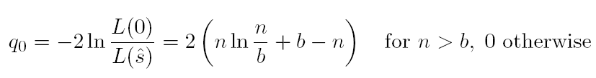
Better approximation for significance
Poisson likelihood for parameter s is
For now
no nuisance
params.
To test for discovery use profile likelihood ratio:
So the likelihood ratio statistic for testing s = 0 is

Slide 60


Approximate Poisson significance (continued)
For sufficiently large s + b, (use Wilks’ theorem),
To find median[Z|s], let n → s + b (i.e., the Asimov data set):
This reduces to s/√b for s << b.

Slide 61
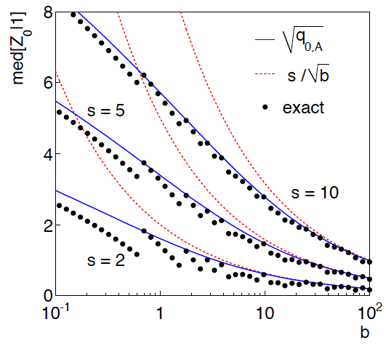
n ~ Poisson(s+b), median significance,
assuming s, of the hypothesis s = 0
CCGV, EPJC 71 (2011) 1554, arXiv:1007.1727
“Exact” values from MC,
jumps due to discrete data.
Asimov √q_{0,A} good approx.
for broad range of s, b.
s/√b only good for s ≪ b.

Slide 62

Extending s/√b to case where b uncertain
The intuitive explanation of s/√b is that it compares the signal,
s, to the standard deviation of n assuming no signal, √b.
Now suppose the value of b is uncertain, characterized by a
standard deviation σ_{b}.
A reasonable guess is to replace √b by the quadratic sum of
√b and σ_{b}, i.e.,
This has been used to optimize some analyses e.g. where
σ_{b} cannot be neglected.

Slide 63


Profile likelihood with b uncertain
This is the well studied “on/off” problem: Cranmer 2005;
Cousins, Linnemann, and Tucker 2008; Li and Ma 1983,...
Measure two Poisson distributed values:
n ~ Poisson(s+b) (primary or “search” measurement)
m ~ Poisson(τb) (control measurement, τ known)
The likelihood function is
Use this to construct profile likelihood ratio (b is nuisance
parameter):

Slide 64
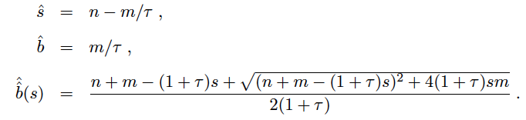

Ingredients for profile likelihood ratio
To construct profile likelihood ratio from this need estimators:
and in particular to test for discovery (s = 0),

Slide 65



Asymptotic significance
Use profile likelihood ratio for q₀, and then from this get discovery
significance using asymptotic approximation (Wilks’ theorem):
Essentially same as in:

Slide 66



Asimov approximation for median significance
To get median discovery significance, replace n, m by their
expectation values assuming background-plus-signal model:
n → s + b
m → τb
ˆ
Or use the variance of b = m/τ,
, to eliminate τ:

Slide 67

Limiting cases
Expanding the Asimov formula in powers of s/b and
σ_{b}²/b (= 1/τ) gives
So the “intuitive” formula can be justified as a limiting case
of the significance from the profile likelihood ratio test evaluated
with the Asimov data set.

Slide 68
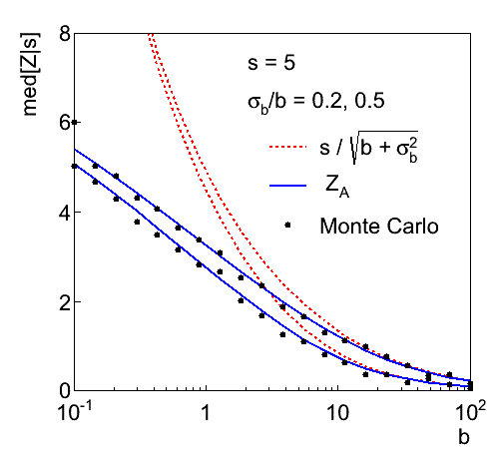
Testing the formulae: s = 5

Slide 69
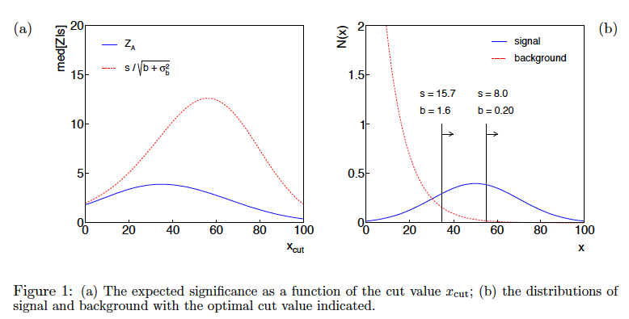
Using sensitivity to optimize a cut

Slide 70
Summary on discovery sensitivity
Simple formula for expected discovery significance based on
profile likelihood ratio test and Asimov approximation:
For large b, all formulae OK.
For small b, s/√b and s/√(b+σ_{b}²) overestimate the significance.
Could be important in optimization of searches with
low background.
Formula maybe also OK if model is not simple on/off experiment,
e.g., several background control measurements (check this).

Slide 71
Classification example (3)
Suppose that the prior probabilities for an event to be of type s or b are:
π_{s} = 0.001
π_{b} = 0.999
The “purity” of the selected signal sample (events where b hypothesis rejected) is found using Bayes’ theorem:

Slide 72
Large-sample (asymptotic) properties of MLEs
Suppose we have an i.i.d. data sample of size n: x₁,...,x_{n}
In the large-sample (or “asymptotic”) limit (n → ∞) and assuming regularity conditions one can show that the likelihood and MLE have several important properties.
The regularity conditions include:
the boundaries of the data space cannot depend on the parameter;
the parameter cannot be on the edge of the parameter space;
ln L(θ) must be differentiable;
the only solution to 𝜕ln L/𝜕θ = 0 is θ.
^
In the slides immediately following the properties are shown without proof for a single parameter; the corresponding properties hold also for the multiparameter case, θ = (θ₁,...,θ_{m}).

Slide 73
log-likelihood becomes quadratic
The likelihood function becomes Gaussian in shape, i.e. the log-likelihood becomes quadratic (parabolic).
The MLE becomes increasingly precise as the (log)-likelihood becomes more tightly concentrated about its peak,
but L(θ) = P(x|θ) is the probability for x, not a pdf for θ.

Slide 74
The MLE converges to the true parameter value
In the large-sample limit, the MLE converges in probability
to the true parameter value.
That is, for any ε > 0,
The MLE is said to be consistent.

Slide 75
MLE is asymptotically unbiased
In general the MLE can be biased, but in the large-sample limit, this bias goes to zero:
(Recall for the exponential parameter we found the bias was
identically zero regardless of the sample size n.)

Slide 76
The MLE’s variance approaches the MVB
In the large-sample limit, the variance of the MLE approaches the minimum-variance bound, i.e., the information inequality becomes an equality (and bias goes to zero):
The MLE is said to be asymptotically efficient.

Slide 77
The MLE’s distribution becomes Gaussian
In the large-sample limit, the pdf of the MLE becomes Gaussian,
where
is the minimum variance bound (note bias is zero).
For example, exponential MLE with sample size n = 100.
Note that for exponential, MLE is arithmetic average, so Gaussian MLE seen to stem from Central Limit Theorem.

Slide 78
Distribution of MLE of exponential parameter

Slide 79
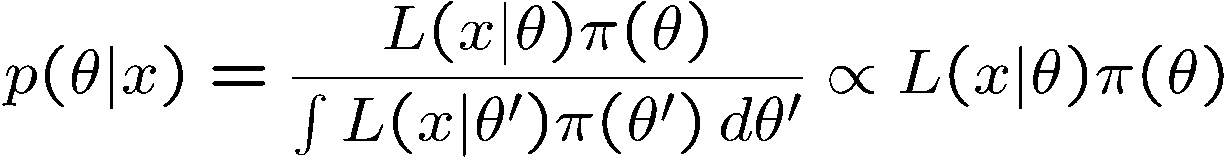
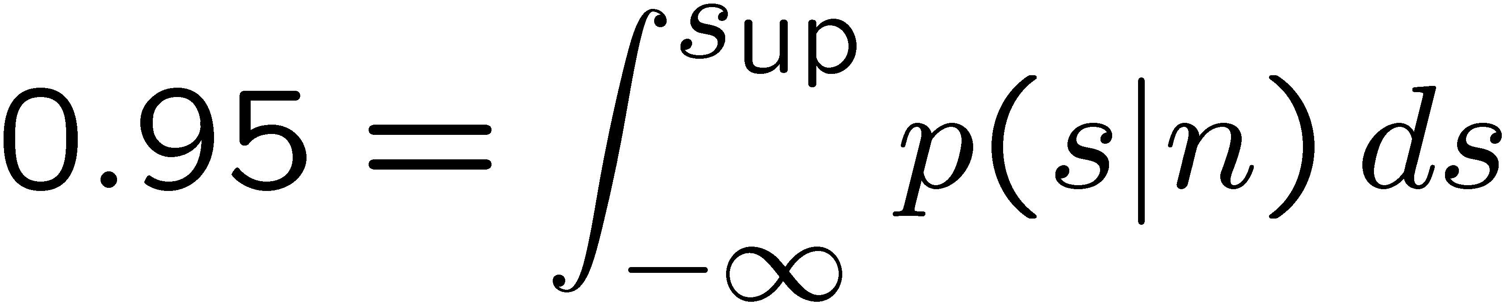
The Bayesian approach to limits
In Bayesian statistics need to start with ‘prior pdf’ π(θ), this
reflects degree of belief about θ before doing the experiment.
Bayes’ theorem tells how our beliefs should be updated in
light of the data x:
Integrate posterior pdf p(θ|x) to give interval with any desired
probability content.
For e.g. n ~ Poisson(s+b), 95% CL upper limit on s from

Slide 80
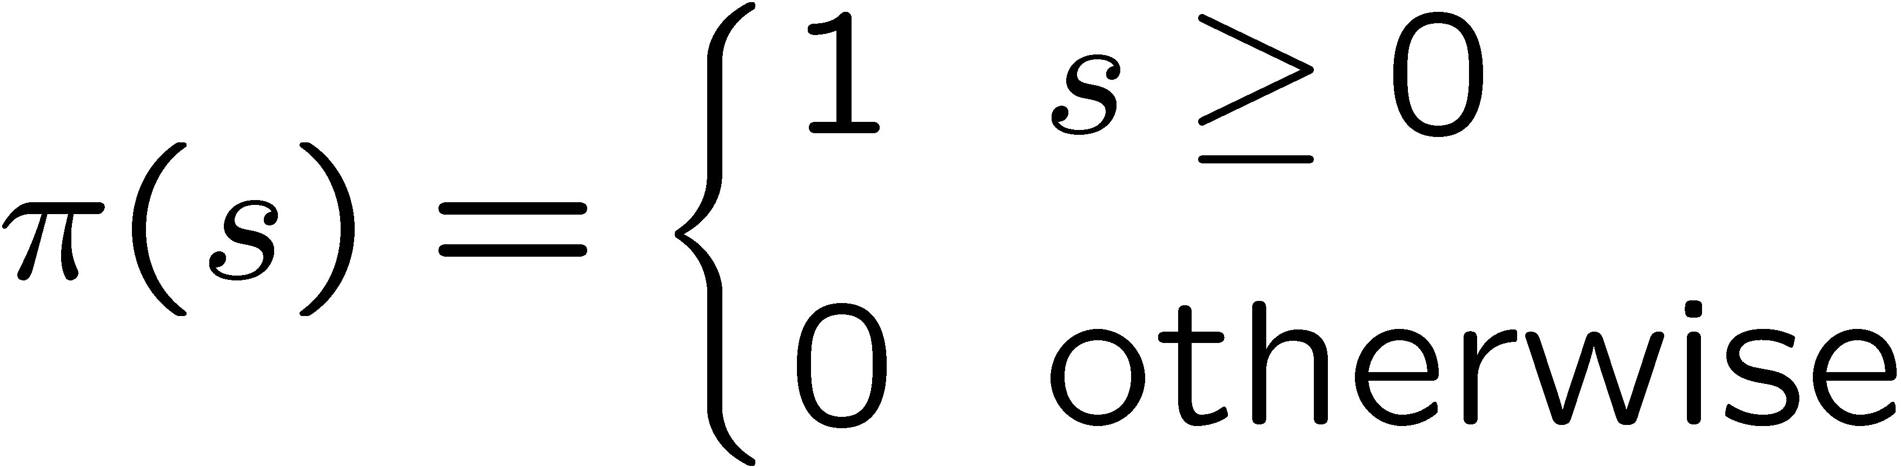
Bayesian prior for Poisson parameter
Include knowledge that s ≥ 0 by setting prior π(s) = 0 for s < 0.
Could try to reflect ‘prior ignorance’ with e.g.
Not normalized; can be OK provided L(s) dies off quickly for large s.
Not invariant under change of parameter — if we had used instead a flat prior for a nonlinear function of s, then this would imply a non-flat prior for s.
Doesn’t really reflect a reasonable degree of belief, but often used as a point of reference; or viewed as a recipe for producing an interval whose frequentist properties can be studied (e.g., coverage probability, which will depend on true s).

Slide 81



Bayesian upper limit with flat prior for s
Put Poisson likelihood and flat prior into Bayes’ theorem:
Normalize to unit area:
upper incomplete
gamma function
Upper limit s_{up} determined by requiring

Slide 82


Bayesian interval with flat prior for s
Solve to find limit s_{up}:
where
For special case b = 0, Bayesian upper limit with flat prior
numerically same as one-sided frequentist case (‘coincidence’).

Slide 83
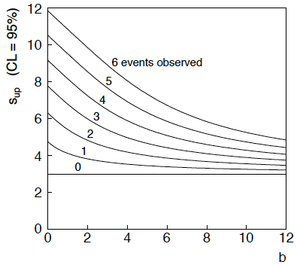
Bayesian interval with flat prior for s
For b > 0 Bayesian limit is everywhere greater than the (one sided) frequentist upper limit.
Never goes negative. Doesn’t depend on b if n = 0.

