Slide 1



Statistics for Particle Physics
Lecture 1
Terascale Statistics School
https://indico.desy.de/event/43398/
DESY, Hamburg
2-5 April 2024
Glen Cowan
Physics Department
Royal Holloway, University of London
g.cowan@rhul.ac.uk
www.pp.rhul.ac.uk/~cowan

Slide 2
Outline
→ Tuesday 11:05 Introduction
Probability
Hypothesis tests, parameter estimation
Wednesday 9:15 Confidence limits
Systematic uncertainties
General analysis, asymptotics
Thursday 16:00 “Errors on errors”
More resources in the University of London course:
https://www.pp.rhul.ac.uk/~cowan/stat_course.html

Slide 3
Theory ↔ Statistics ↔ Experiment
Theory (model, hypothesis):
Experiment (observation):
+ response of measurement
apparatus
= model prediction
data
Uncertainty enters
on many levels
→ quantify with
probability

Slide 4
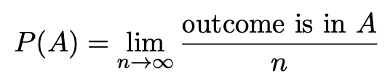

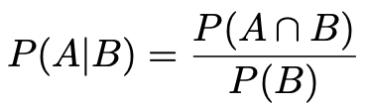

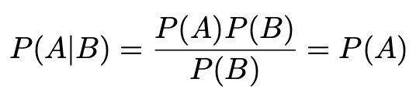
A quick review of probability
Frequentist (A = outcome of
repeatable observation)
Subjective (A = hypothesis)
Conditional probability:
E.g. rolling a die, outcome n = 1,2,...,6:
A and B are independent iff:
I.e. if A, B independent, then

Slide 5

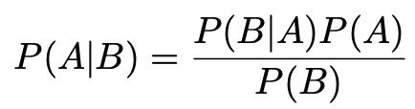
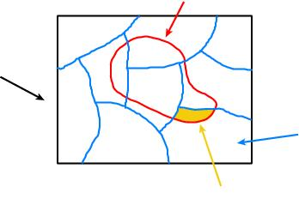
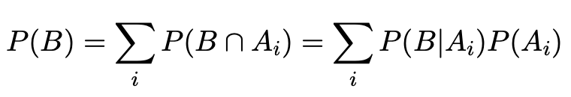
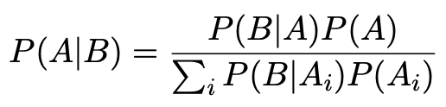
Bayes’ theorem
Use definition of conditional probability and
→
(Bayes’ theorem)
B
If set of all outcomes S = ∪_{i} A_{i}
with A_{i} disjoint, then law of total probability for P(B) says
S
A_{i}
B ∩ A_{i}
so that Bayes’ theorem becomes
Bayes’ theorem holds regardless of how probability is interpreted (frequency, degree of belief...).

Slide 6
Frequentist Statistics − general philosophy
In frequentist statistics, probabilities are associated only with
the data, i.e., outcomes of repeatable observations (shorthand: x).
Probability = limiting frequency
Probabilities such as
P (string theory is true),
P (0.117 < α_{s} < 0.119),
P (Biden wins in 2024),
etc. are either 0 or 1, but we don’t know which.
The tools of frequentist statistics tell us what to expect, under
the assumption of certain probabilities, about hypothetical
repeated observations.
Preferred theories (models, hypotheses, ...) are those that predict a high probability for data “like” the data observed.

Slide 7
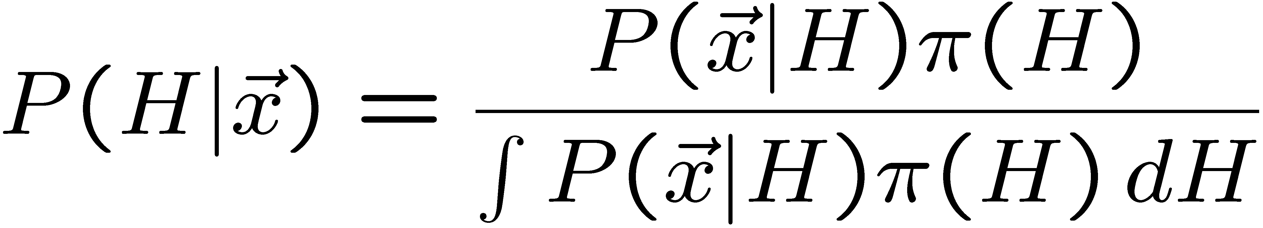
Bayesian Statistics − general philosophy
In Bayesian statistics, use subjective probability for hypotheses:
probability of the data assuming
hypothesis H (the likelihood)
prior probability, i.e.,
before seeing the data
posterior probability, i.e.,
after seeing the data
normalization involves sum
over all possible hypotheses
Bayes’ theorem has an “if-then” character: If your prior
probabilities were π(H), then it says how these probabilities
should change in the light of the data.
No general prescription for priors (subjective!)

Slide 8
Hypothesis, likelihood
Suppose the entire result of an experiment (set of measurements) is a collection of numbers x.
A (simple) hypothesis is a rule that assigns a probability to each possible data outcome:
= the likelihood of H
Often we deal with a family of hypotheses labeled by one or
more undetermined parameters (a composite hypothesis):
= the “likelihood function”
Note:
1) For the likelihood we treat the data x as fixed.
2) The likelihood function L(θ) is not a pdf for θ.

Slide 9
Frequentist hypothesis tests
Suppose a measurement produces data x; consider a hypothesis H₀
we want to test and alternative H₁
H₀, H₁ specify probability for x: P(x|H₀), P(x|H₁)
A test of H₀ is defined by specifying a critical region w of the
data space such that there is no more than some (small) probability
α, assuming H₀ is correct, to observe the data there, i.e.,
P(x ∈ w | H₀) ≤ α
Need inequality if data are
discrete.
α is called the size or
significance level of the test.
If x is observed in the
critical region, reject H₀.
data space Ω
critical region w

Slide 10



Definition of a test (2)
But in general there are an infinite number of possible critical regions that give the same size α.
Use the alternative hypothesis H₁ to motivate where to place the critical region.
Roughly speaking, place the critical region where there is a low
probability (α) to be found if H₀ is true, but high if H₁ is true:

Slide 11


Classification viewed as a statistical test
Suppose events come in two possible types:
s (signal) and b (background)
For each event, test hypothesis that it is background, i.e., H₀ = b.
Carry out test on many events, each is either of type s or b, i.e., here the hypothesis is the “true class label”, which varies randomly from event to event, so we can assign to it a frequentist probability.
Select events for which where H₀ is rejected as “candidate events of type s”. Equivalent Particle Physics terminology:
background efficiency
signal efficiency

Slide 12
Example of a test for classification
Suppose we can measure for
each event a quantity x, where
with 0 ≤ x ≤ 1.
For each event in a mixture of signal (s) and background (b) test
H₀ : event is of type b
using a critical region W of the form: W = { x : x ≤ x_{c} }, where
x_{c} is a constant that we choose to give a test with the desired size α.

Slide 13
Classification example (2)
Suppose we want α = 10⁻⁴. Require:
and therefore
For this test (i.e. this critical region W), the power with respect to the signal hypothesis (s) is
Note: the optimal size and power is a separate question that will depend on goals of the subsequent analysis.

Slide 14
Classification example (3)
Suppose that the prior probabilities for an event to be of type s or b are:
π_{s} = 0.001
π_{b} = 0.999
The “purity” of the selected signal sample (events where b hypothesis rejected) is found using Bayes’ theorem:

Slide 15
Testing significance / goodness-of-fit
Suppose hypothesis H predicts pdf f (x|H) for a set of
observations x = (x₁,...x_{n}).
We observe a single point in this space: x_{obs}.
How can we quantify the level of compatibility between the data and the predictions of H?
x_{j}
x_{obs}
Decide what part of
the data space represents equal or less compatibility with H than does the point x_{obs}. (Not unique!)
ω> = { x : x “more
compatible” with H }
ω≤ = { x : x “less
or eq. compatible”
with H }
x_{i}

Slide 16
p-values
Express level of compatibility between data and hypothesis (sometimes ‘goodness-of-fit’) by giving the p-value for H:
= probability, under assumption of H, to observe data with equal or lesser compatibility with H relative to the data we got.
= probability, under assumption of H, to observe data as discrepant with H as the data we got or more so.
Basic idea: if there is only a very small probability to find data
with even worse (or equal) compatibility, then H is “disfavoured by the data”.
If the p-value is below a user-defined threshold α (e.g. 0.05) then H is rejected (equivalent to hypothesis test of size α as seen earlier).

Slide 17

p-value of H is not P(H)
The p-value of H is not the probability that H is true!
In frequentist statistics we don’t talk about P(H) (unless H
represents a repeatable observation).
If we do define P(H), e.g., in Bayesian statistics as a degree of belief, then we need to use Bayes’ theorem to obtain
where π(H) is the prior probability for H.
For now stick with the frequentist approach;
result is p-value, regrettably easy to misinterpret as P(H).

Slide 18

The Poisson counting experiment
Suppose we do a counting experiment and observe n events.
Events could be from signal process or from background –
we only count the total number.
Poisson model:
s = mean (i.e., expected) # of signal events
b = mean # of background events
Goal is to make inference about s, e.g.,
test s = 0 (rejecting H₀ ≈ “discovery of signal process”)
test all non-zero s (values not rejected = confidence interval)
In both cases need to ask what is relevant alternative hypothesis.

Slide 19
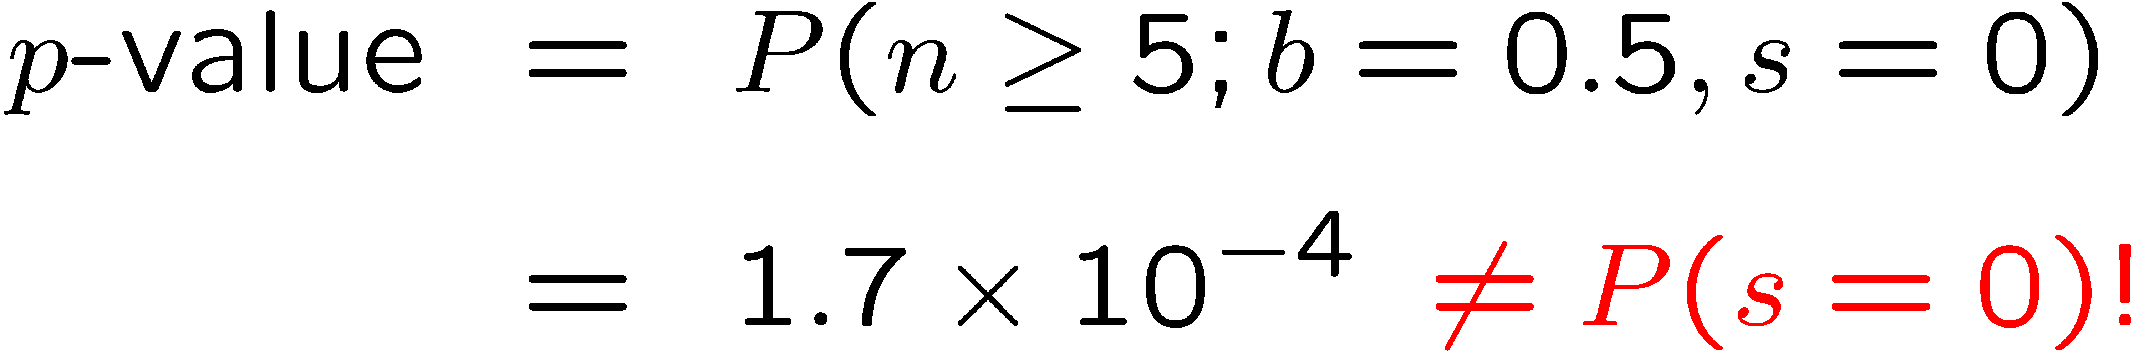
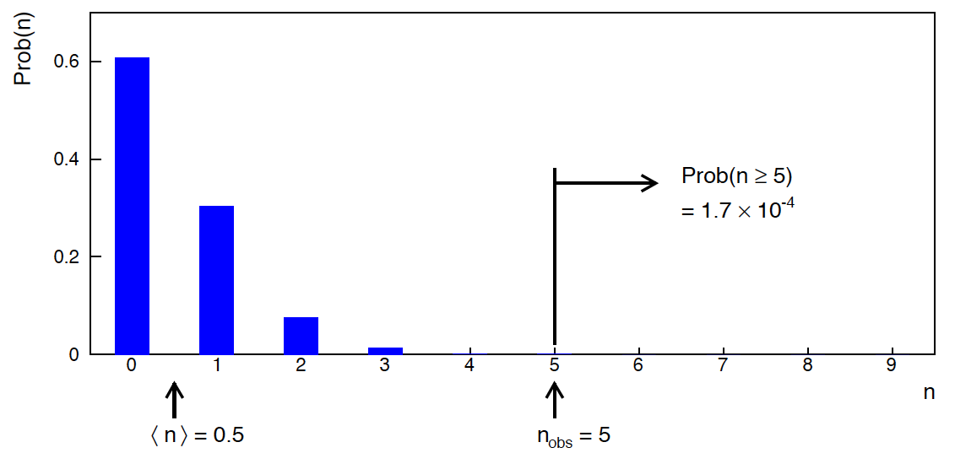
Poisson counting experiment: discovery p-value
Suppose b = 0.5 (known), and we observe n_{obs} = 5.
Should we claim evidence for a new discovery?
Give p-value for hypothesis s = 0, suppose relevant alt. is s > 0.

Slide 20
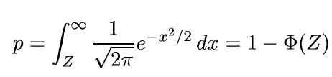
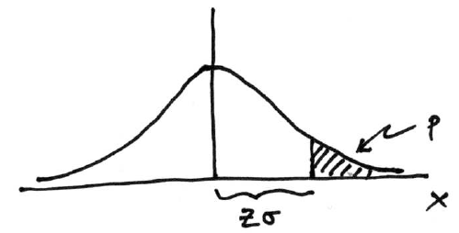

Significance from p-value
Often define significance Z as the number of standard deviations
that a Gaussian variable would fluctuate in one direction
to give the same p-value.
in ROOT:
p = 1 - TMath::Freq(Z)
Z = TMath::NormQuantile(1-p)
in python (scipy.stats):
p = 1 - norm.cdf(Z) = norm.sf(Z)
Z = norm.ppf(1-p)
Result Z is a “number of sigmas”. Note this does not mean that
the original data was Gaussian distributed.

Slide 21

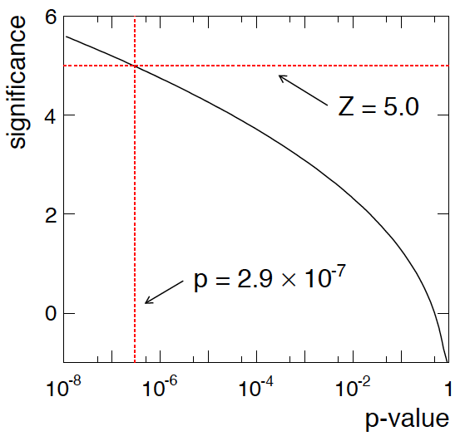
Poisson counting experiment: discovery significance
Equivalent significance for p = 1.7 × 10⁻⁴:
Often claim discovery if Z > 5 (p < 2.9 × 10⁻⁷, i.e., a “5-sigma effect”)
In fact this tradition should be revisited: p-value intended to quantify probability of a signal-like fluctuation assuming background only; not intended to cover, e.g., hidden systematics, plausibility signal model, compatibility of data with signal, “look-elsewhere effect”
(~multiple testing), etc.

Slide 22
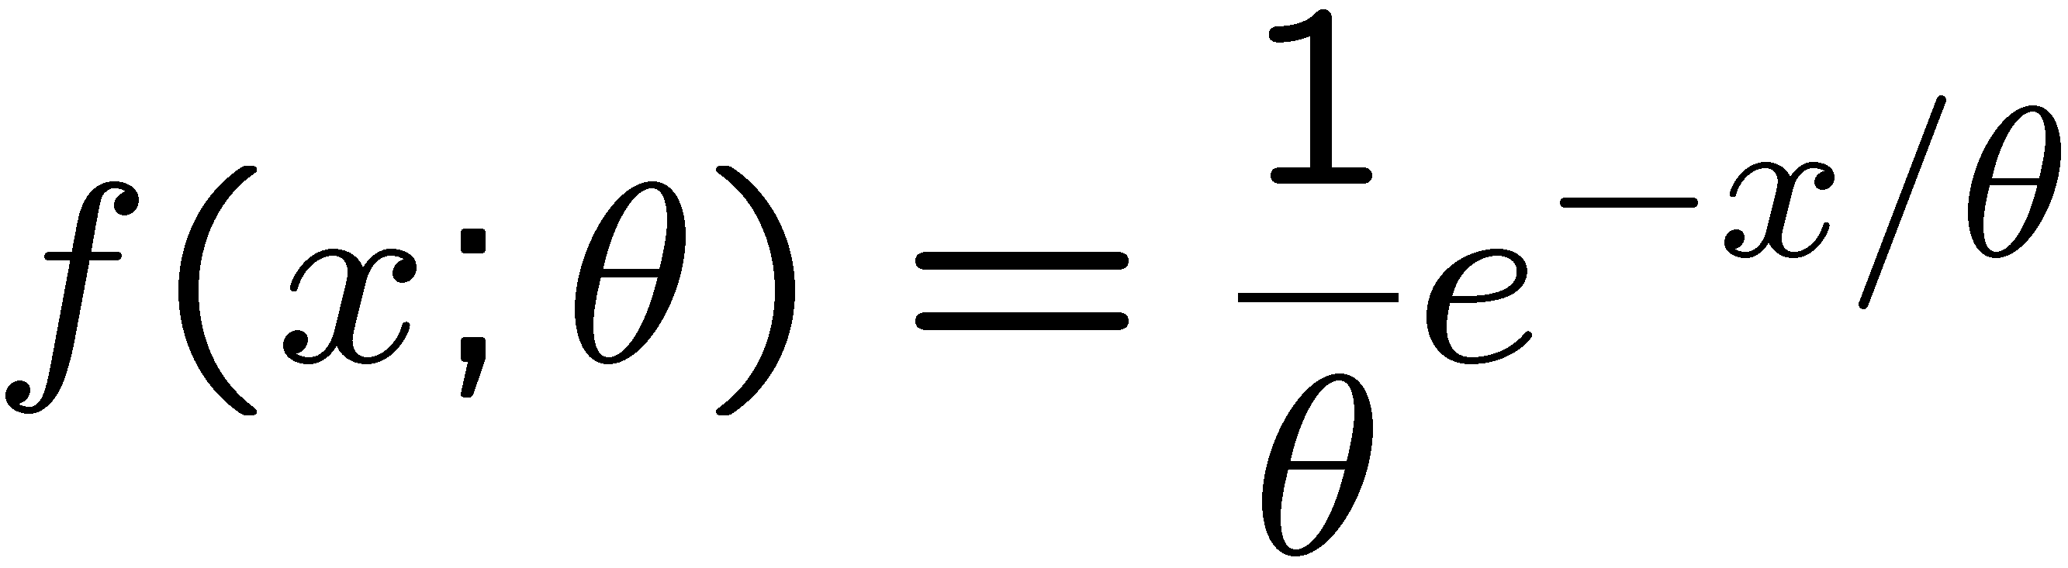
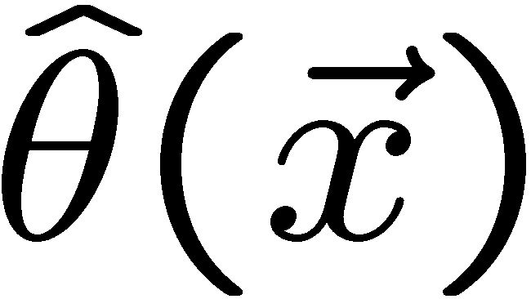
Parameter estimation
The parameters of a pdf are any constants that characterize it,
i.e., θ indexes a
set of hypotheses.
r.v.
parameter
Suppose we have a sample of observed values: x = (x₁, ..., x_{n})
We want to find some function of the data to estimate the
parameter(s):
← estimator written with a hat
Sometimes we say ‘estimator’ for the function of x₁, ..., x_{n};
‘estimate’ for the value of the estimator with a particular data set.

Slide 23
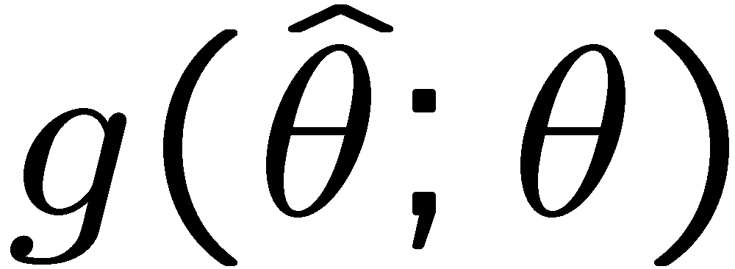
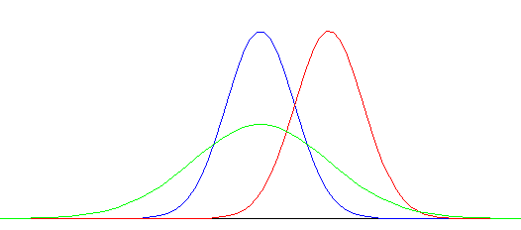


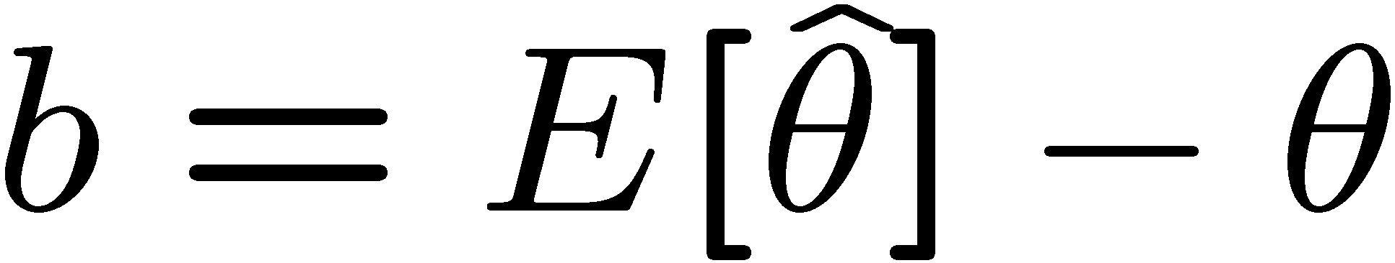

Properties of estimators
If we were to repeat the entire measurement, the estimates
from each would follow a pdf:
best
large
variance
biased
We want small (or zero) bias (systematic error):
→ average of repeated measurements should tend to true value.
And we want a small variance (statistical error):
→ small bias & variance are in general conflicting criteria

Slide 24
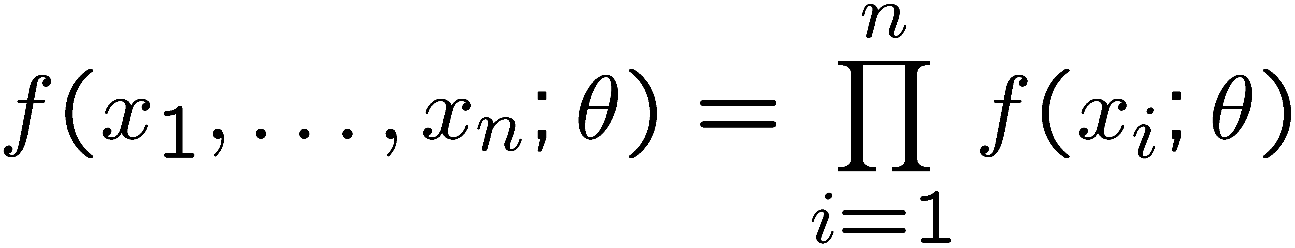
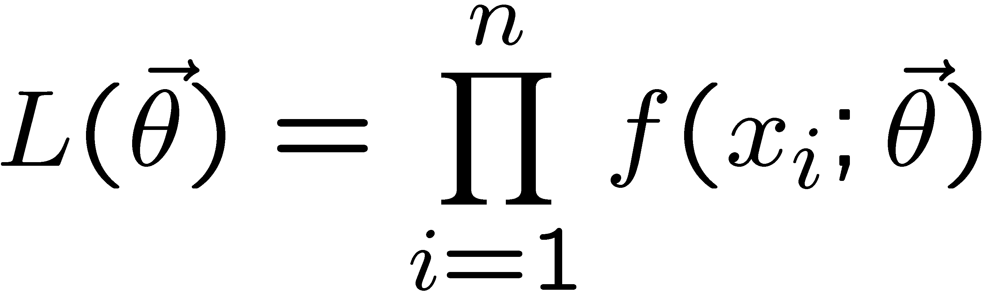
The likelihood function for i.i.d.* data
* i.i.d. = independent and identically distributed
Consider n independent observations of x: x₁, ..., x_{n}, where
x follows f (x; θ). The joint pdf for the whole data sample is:
In this case the likelihood function is
(x_{i} constant)

Slide 25
Maximum Likelihood Estimators (MLEs)
We define the maximum likelihood estimators or MLEs to be
the parameter values for which the likelihood is maximum.
Maximizing L equivalent to maximizing log L
Could have multiple maxima (take highest).
MLEs not guaranteed to have any ‘optimal’ properties, (but in practice they’re very good).

Slide 26
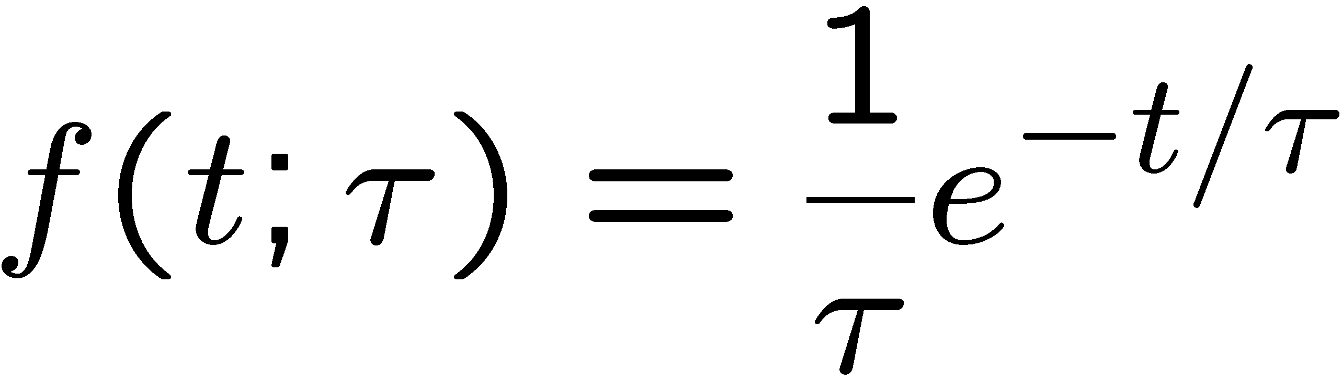
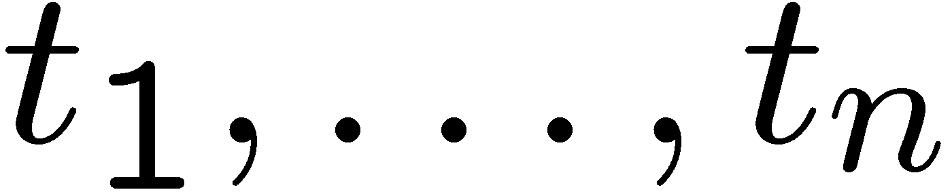
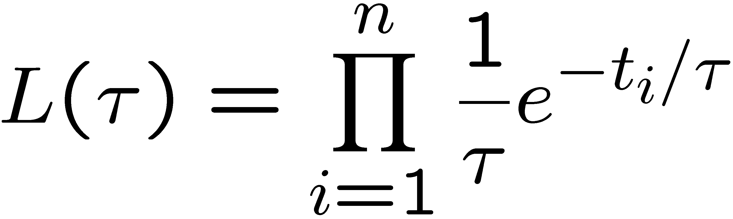
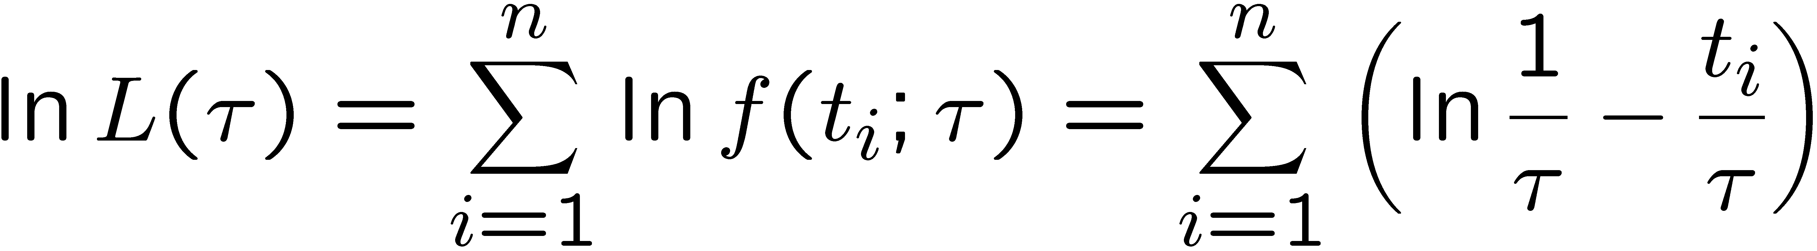
MLE example: parameter of exponential pdf
Consider exponential pdf,
and suppose we have i.i.d. data,
The likelihood function is
The value of τ for which L(τ) is maximum also gives the
maximum value of its logarithm (the log-likelihood function):

Slide 27
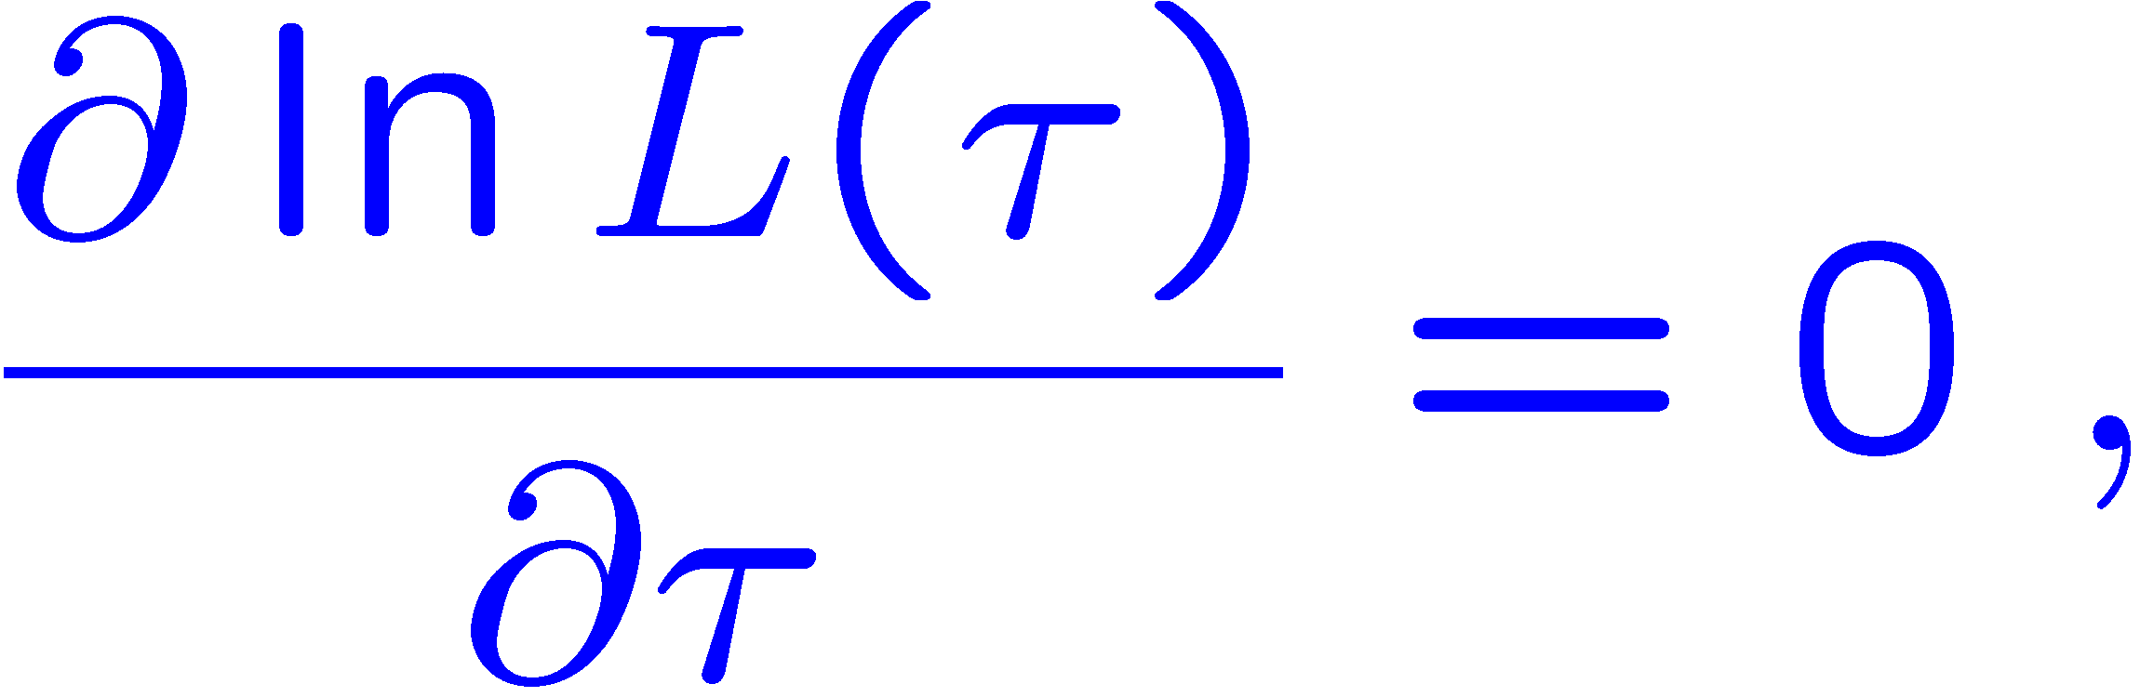
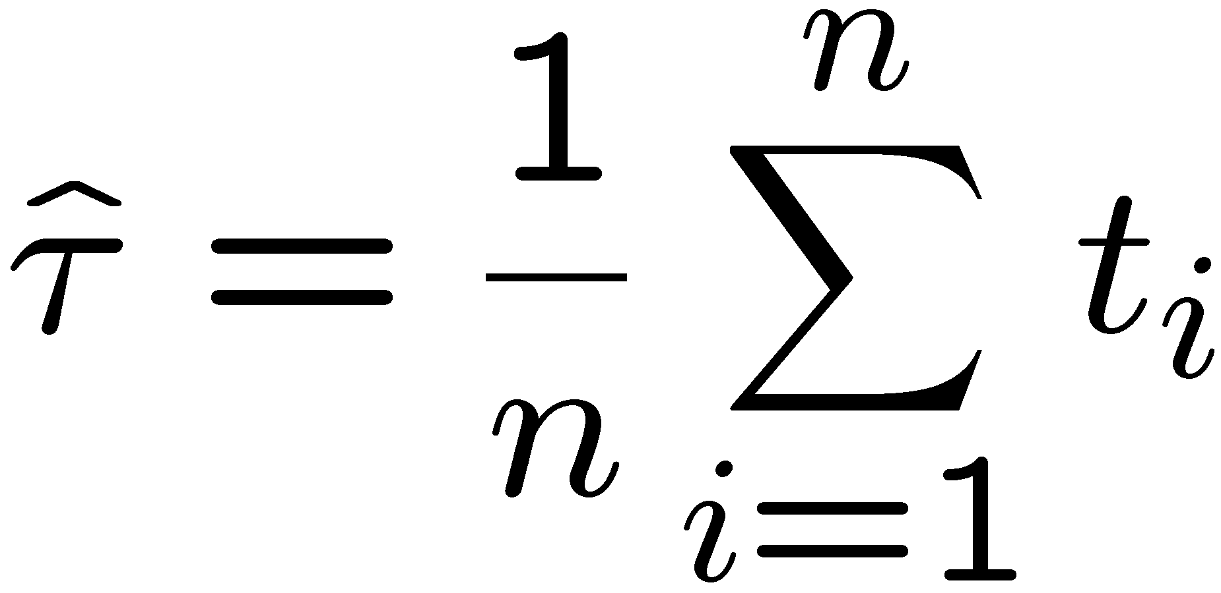
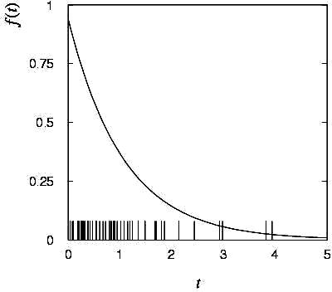

MLE example: parameter of exponential pdf (2)
Find its maximum by setting
→
Monte Carlo test:
generate 50 values
using τ = 1:
We find the ML estimate:

Slide 28






MLE example: parameter of exponential pdf (3)
For the exponential distribution one has for mean, variance:
For the MLE
we therefore find
→
→

Slide 29
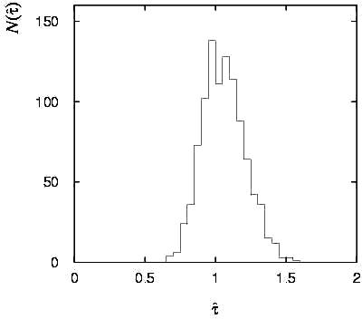

Variance of estimators: Monte Carlo method
Having estimated our parameter we now need to report its
‘statistical error’, i.e., how widely distributed would estimates
be if we were to repeat the entire measurement many times.
One way to do this would be to simulate the entire experiment
many times with a Monte Carlo program (use ML estimate for MC).
For exponential example, from
sample variance of estimates
we find:
Note distribution of estimates is roughly
Gaussian − (almost) always true for
ML in large sample limit.

Slide 30
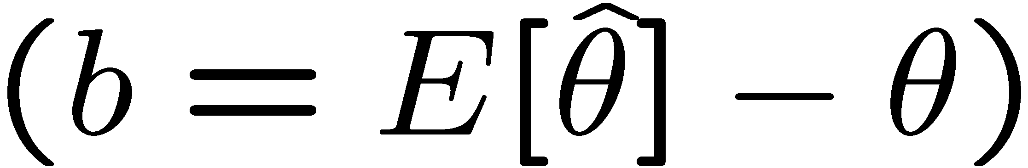
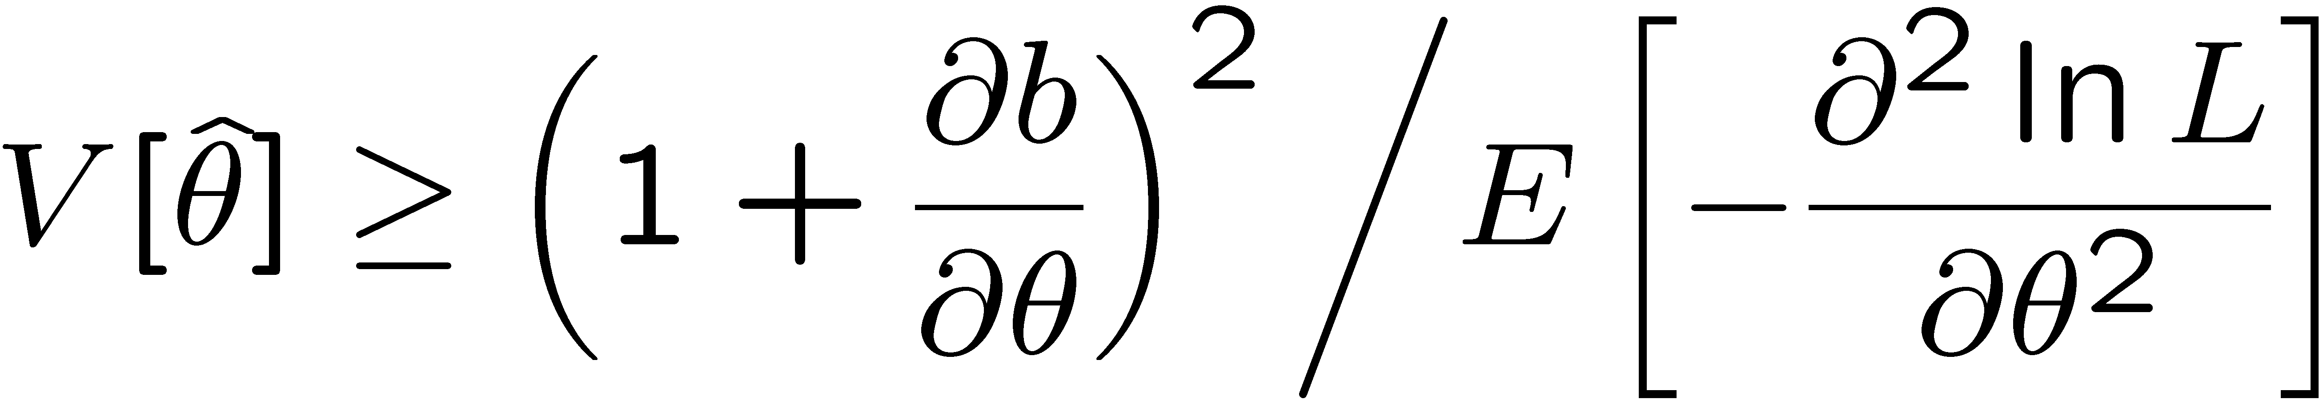
The information inequality
The information inequality (RCF) sets a lower bound on the
variance of any estimator (not only MLE). For a single parameter:
= MVB (Minimum
Variance Bound)
where
Proof in Exercise 6.6 of SDA, https://www.pp.rhul.ac.uk/~cowan/sda/prob/prob_6.pdf
“Efficiency” of an estimator = MVB / actual variance.
An estimator whose variance equals the MVB is said to be efficient.

Slide 31
MVB for MLE of exponential parameter
Find
We found for the exponential parameter the MLE
and we showed b = 0, hence 𝜕b/𝜕τ = 0.
We find
and since E[t_{i}] = τ for all i,
,
and therefore
.
So here the MLE is efficient.

Slide 32
Large-sample (asymptotic) properties of MLEs
Suppose we have an i.i.d. data sample of size n: x₁,...,x_{n}
In the large-sample (or “asymptotic”) limit (n → ∞) and assuming regularity conditions one can show that the likelihood and MLE have several important properties.
The regularity conditions include:
the boundaries of the data space cannot depend on the parameter;
the parameter cannot be on the edge of the parameter space;
ln L(θ) must be differentiable;
the only solution to 𝜕ln L/𝜕θ = 0 is θ.
^
In the slides immediately following, the properties are shown without proof for a single parameter; the corresponding properties hold also for the multiparameter case, θ = (θ₁,..., θ_{m}).

Slide 33
log-likelihood becomes quadratic
The likelihood function becomes Gaussian in shape, i.e. the log-likelihood becomes quadratic (parabolic).
The MLE becomes increasingly precise as the (log)-likelihood becomes more tightly concentrated about its peak,
but L(θ) = P(x|θ) is the probability for x, not a pdf for θ.

Slide 34
The MLE converges to the true parameter value
In the large-sample limit, the MLE converges in probability
to the true parameter value.
That is, for any ε > 0,
The MLE is said to be consistent.

Slide 35
MLE is asymptotically unbiased
In general the MLE can be biased, but in the large-sample limit, this bias goes to zero:
(Recall for the exponential parameter we found the bias was
identically zero regardless of the sample size n.)

Slide 36
The MLE’s variance approaches the MVB
In the large-sample limit, the variance of the MLE approaches the minimum-variance bound, i.e., the information inequality becomes an equality (and bias goes to zero):
The MLE is said to be asymptotically efficient.

Slide 37
The MLE’s distribution becomes Gaussian
In the large-sample limit, the pdf of the MLE becomes Gaussian,
where
is the minimum variance bound (note bias is zero).
For example, exponential MLE with sample size n = 100.
Note that for exponential, MLE is arithmetic average, so Gaussian MLE seen to stem from Central Limit Theorem.

Slide 38
Distribution of MLE of exponential parameter

Slide 39
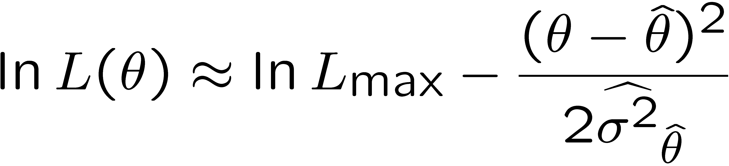
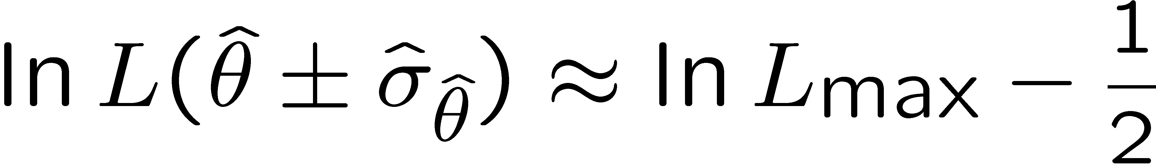


Variance of estimators: graphical method
Expand ln L(θ) about its maximum:
First term is ln L_{max}, second term is zero, for third term use
information inequality (assume equality):
i.e.,
→ to get
, change θ away from
until ln L decreases by 1/2.

Slide 40
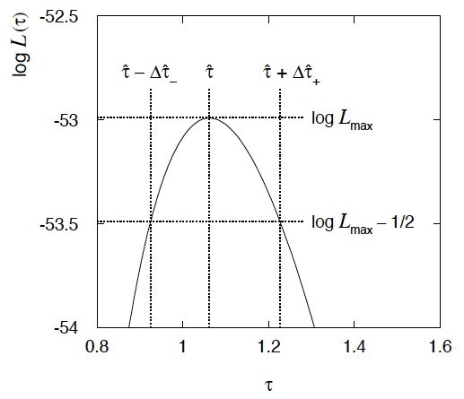
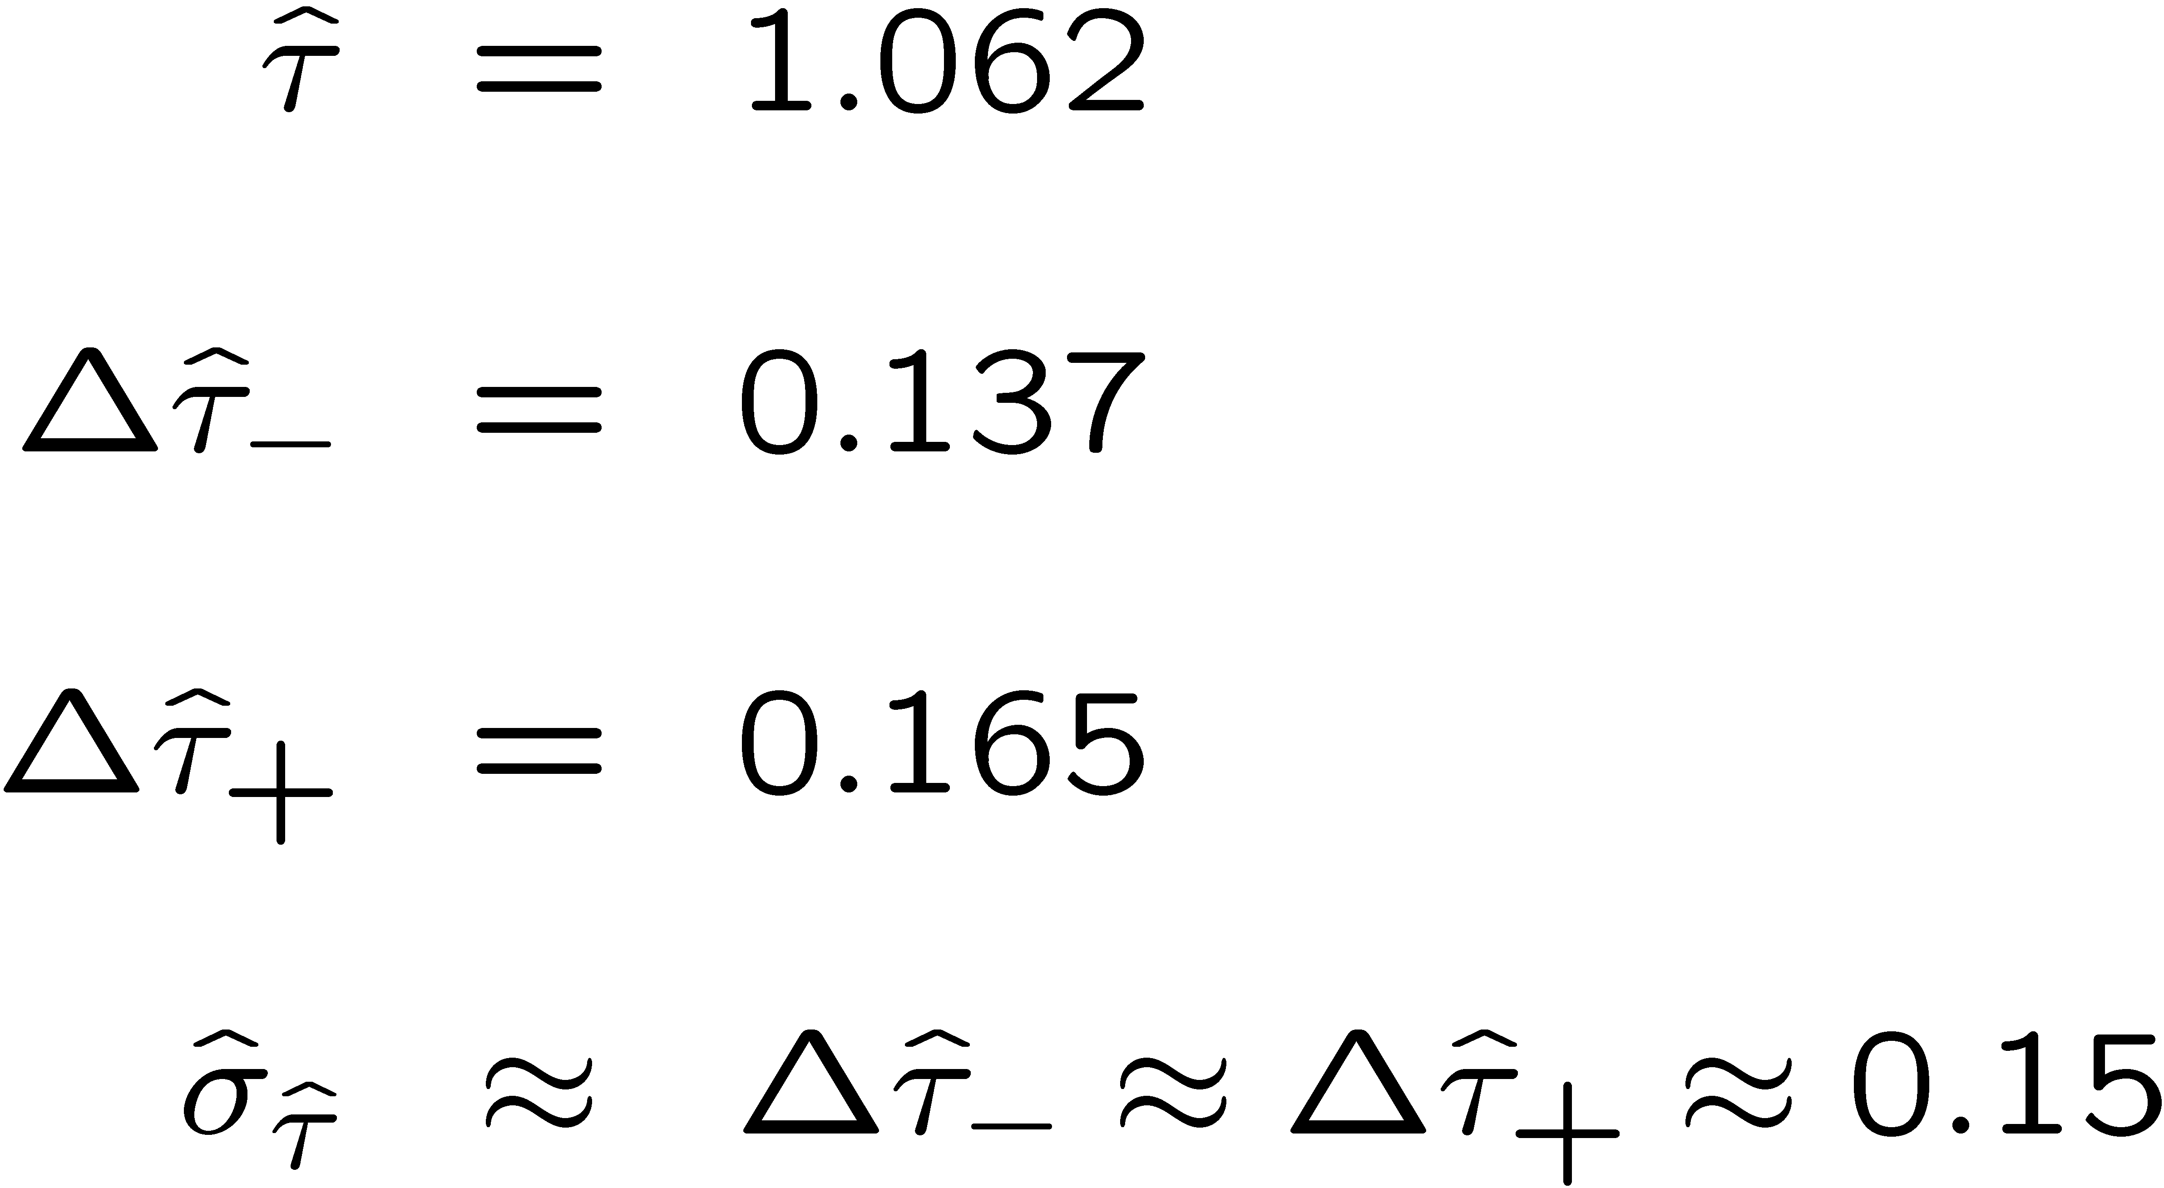
Example of variance by graphical method
ML example with exponential:
Not quite parabolic ln L since finite sample size (n = 50).

Slide 41
Extra slides

Slide 42
Statistical Data Analysis
Lecture 9-2
Goodness-of-fit from the likelihood ratio
Wilks’ theorem
MLE and goodness-of-fit all in one

Slide 43


Goodness of fit from the likelihood ratio
Suppose we model data using a likelihood L(μ) that depends on N
parameters μ = (μ₁,..., μ_{Ν}). Define the statistic
⌃
where μ is the ML estimator for μ. Value of t_{μ} reflects agreement
between hypothesized μ and the data.
Good agreement means μ ≈ μ, so t_{μ} is small;
Larger t_{μ} means less compatibility between data and μ.
⌃
Quantify “goodness of fit” with p-value:
need this pdf

Slide 44
Likelihood ratio (2)
Now suppose the parameters μ = (μ₁,..., μ_{Ν}) can be determined by
another set of parameters θ = (θ₁,..., θ_{M}), with M < N.
E.g., curve fit with μ_{i} = E[y_{i}] = μ (x_{i}; θ), i = 1,...,N, θ = (θ₁,..., θ_{M}).
Want to test hypothesis that the true model is somewhere in the subspace μ = μ(θ) versus the alternative of the full parameter space μ. Generalize the LR test statistic to be
fit M parameters
fit N parameters
To get p-value, need pdf f (t_{μ}|μ(θ)).

Slide 45
Wilks’ Theorem
Wilks’ Theorem: if the hypothesized μ_{i}(θ), i = 1,...,N, are true for some choice of the parameters θ = (θ₁,..., θ_{M}), then in the large sample limit (and provided regularity conditions are satisfied)
MLE of (θ₁,..., θ_{M})
follows a chi-square distribution for N – M degrees of freedom.
MLE of (μ₁,..., μ_{Ν})
The regularity conditions include: the model in the numerator of the likelihood ratio is “nested” within the one in the denominator, i.e., μ(θ) is a special case of μ = (μ₁,..., μ_{Ν}).
Proof boils down to having all estimators ~ Gaussian.

Slide 46
Wilks’ Theorem (2)
The chi-square pdf for −2lnλ breaks down:
if the sample size is too small;
if the true value of a parameter is on the boundary of the
allowed parameter space;
if the model in the numerator is not a special case of the
denominator (models must be “nested”);
if variance of estimators of any components of μ too large (e.g., parameter refers to location of a feature not present in the null hypothesis, such as the position of a peak).

Slide 47




Goodness of fit with Gaussian data
Suppose the data are N independent Gaussian distributed values:
want to estimate
known
N measurements and N parameters ( = “saturated model”)
Likelihood:
Log-likelihood:
ML estimators:

Slide 48
Likelihood ratio for Gaussian data
Now suppose μ = μ(θ), e.g., in an LS fit with μ_{i}(θ) = μ(x_{i}; θ).
The goodness-of-fit statistic for the test of the hypothesis
μ(θ) becomes
chi-square pdf for N-M degrees of freedom
Here t_{μ} is the same as χ ²_{min} from an LS fit.
So Wilks’ theorem formally states the property that we claimed
for the minimized chi-squared from an LS fit with N measurements and M fitted parameters.

Slide 49



Likelihood ratio for Poisson data
Suppose the data are a set of values n = (n₁,..., n_{Ν}), e.g., the
numbers of events in a histogram with N bins.
Assume n_{i} ~ Poisson(ν_{i}), i = 1,..., N, all independent.
First (for LR denominator) treat ν = (ν₁,..., ν_{Ν}) as all adjustable:
Likelihood:
Log-likelihood:
ML estimators:

Slide 50
Goodness of fit with Poisson data (2)
For LR numerator find ν(θ) with M fitted parameters θ = (θ₁,..., θ_{M}):
if n_{i} = 0, skip log term
Wilks’ theorem: in large-sample limit
Exact in large sample limit; in practice good approximation for
surprisingly small n_{i} (~several).
As before use t_{ν} to get p-value of ν(θ),
independent of θ

Slide 51





Goodness of fit with multinomial data
Similar if data n = (n₁,..., n_{Ν}) follow multinomial distribution:
E.g. histogram with N bins but fix:
Log-likelihood:
ML estimators:
(Only N−1 independent; one
is n_{tot} minus sum of rest.)

Slide 52
Goodness of fit with multinomial data (2)
The likelihood ratio statistics become:
if n_{i} = 0, skip term
Wilks: in large sample limit
One less degree of freedom than in Poisson case because
effectively only N−1 parameters fitted in denominator of LR.

Slide 53


Estimators and g.o.f. all at once
Evaluate numerators with θ (not its estimator); if any n_{i} = 0, omit the corresponding log terms:
(Poisson)
(Multinomial)
These are equal to the corresponding −2 ln L(θ) plus terms not
depending on θ, so minimizing them gives the usual ML
estimators for θ.
The minimized value gives the statistic t_{ν}, so we get
goodness-of-fit for free.

Slide 54
Examples of ML/LS fits
Unbinned maximum likelihood (mlFit.py, minimize negLogL)
No useful measure
of goodness-of-fit
from unbinned ML.

Slide 55
Examples of ML/LS fits
Least Squares fit (histFit.py, minimize chi2LS)
χ ²_{min} = 32.7
n_{dof} = 38
p = 0.71
Many bins with few entries, LS not expected to be reliable.

Slide 56
Examples of ML/LS fits
Multinomial maximum likelihood fit (histFit.py, minimize chi2M)
χ ²_{min} = 35.3
n_{dof} = 37
p = 0.55
Essentially same result
as unbinned ML.

Slide 57
Some statistics books, papers, etc.
G. Cowan, Statistical Data Analysis, Clarendon, Oxford, 1998
R.J. Barlow, Statistics: A Guide to the Use of Statistical Methods in the Physical Sciences, Wiley, 1989
Ilya Narsky and Frank C. Porter, Statistical Analysis Techniques in Particle Physics, Wiley, 2014.
Luca Lista, Statistical Methods for Data Analysis in Particle Physics, Springer, 2017.
L. Lyons, Statistics for Nuclear and Particle Physics, CUP, 1986
F. James., Statistical and Computational Methods in Experimental Physics, 2nd ed., World Scientific, 2006
S. Brandt, Statistical and Computational Methods in Data Analysis, Springer, New York, 1998.
R.L. Workman et al. (Particle Data Group), Prog. Theor. Exp. Phys. 083C01 (2022); pdg.lbl.gov sections on probability, statistics, MC.

Slide 58
Some distributions
Distribution/pdf Example use in Particle Physics
Binomial Branching ratio
Multinomial Histogram with fixed N
Poisson Number of events found
Uniform Monte Carlo method
Exponential Decay time
Gaussian Measurement error
Chi-square Goodness-of-fit
Cauchy Mass of resonance
Landau Ionization energy loss
Beta Prior pdf for efficiency
Gamma Sum of exponential variables
Student’s t Resolution function with adjustable tails

Slide 59
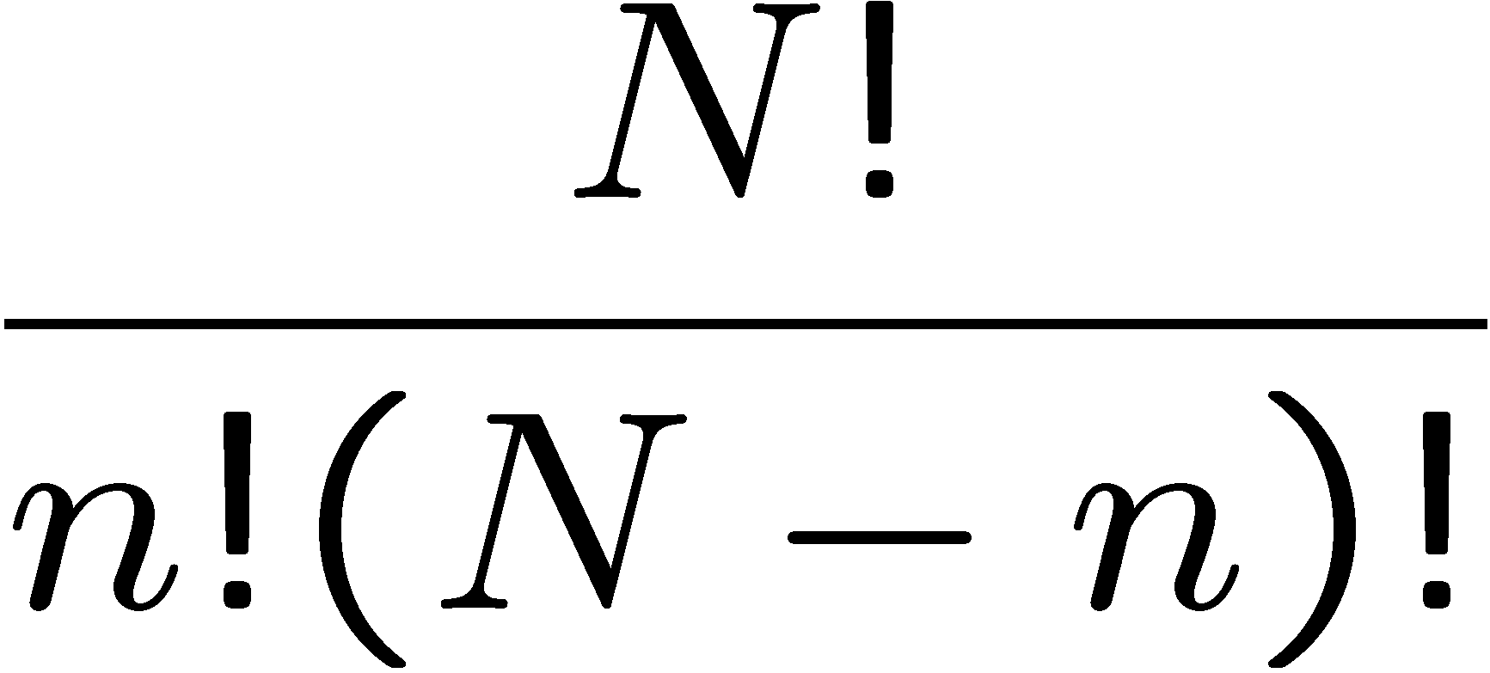
Binomial distribution
Consider N independent experiments (Bernoulli trials):
outcome of each is ‘success’ or ‘failure’,
probability of success on any given trial is p.
Define discrete r.v. n = number of successes (0 ≤ n ≤ N).
Probability of a specific outcome (in order), e.g. ‘ssfsf’ is
But order not important; there are
ways (permutations) to get n successes in N trials, total
probability for n is sum of probabilities for each permutation.

Slide 60
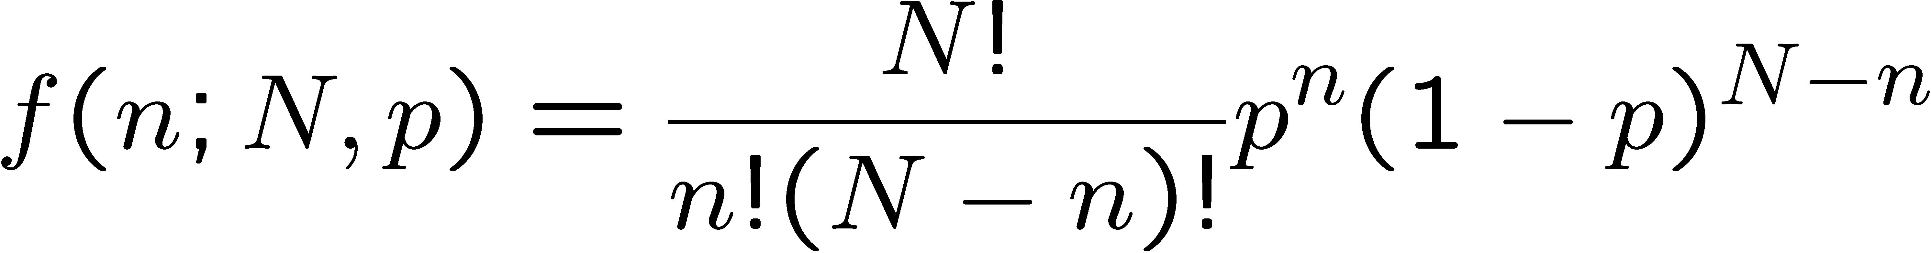
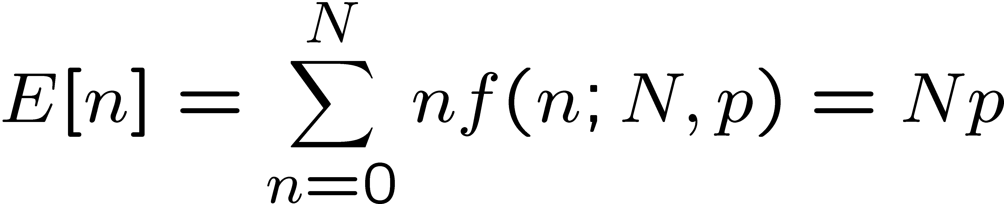
Binomial distribution (2)
The binomial distribution is therefore
random
variable
parameters
For the expectation value and variance we find:

Slide 61
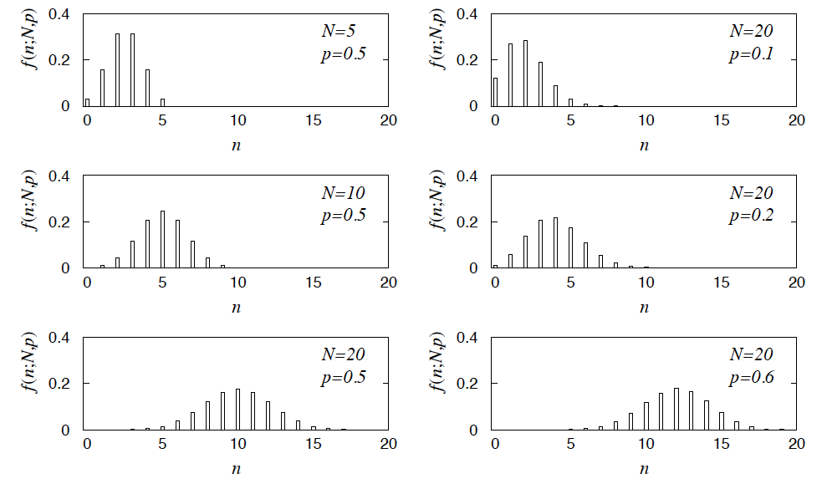
Binomial distribution (3)
Binomial distribution for several values of the parameters:
Example: observe N decays of W±, the number n of which are
W→μν is a binomial r.v., p = branching ratio.

Slide 62
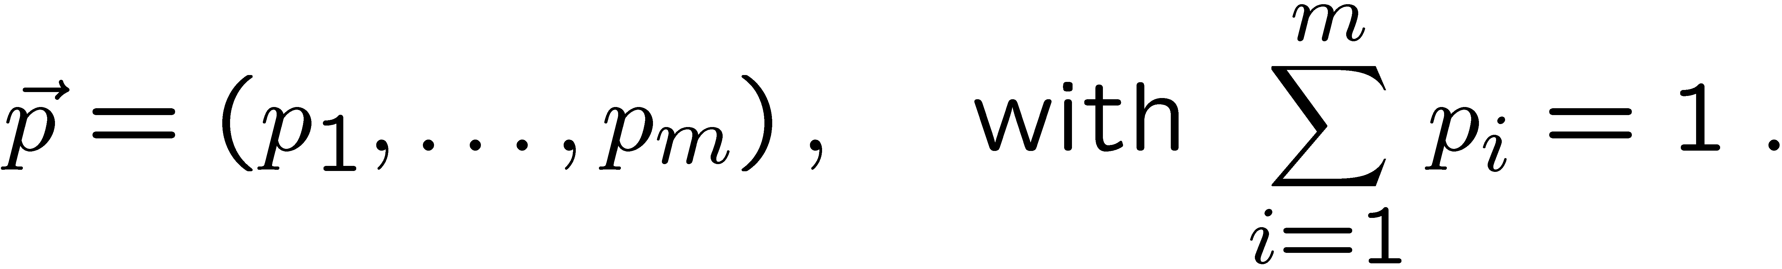
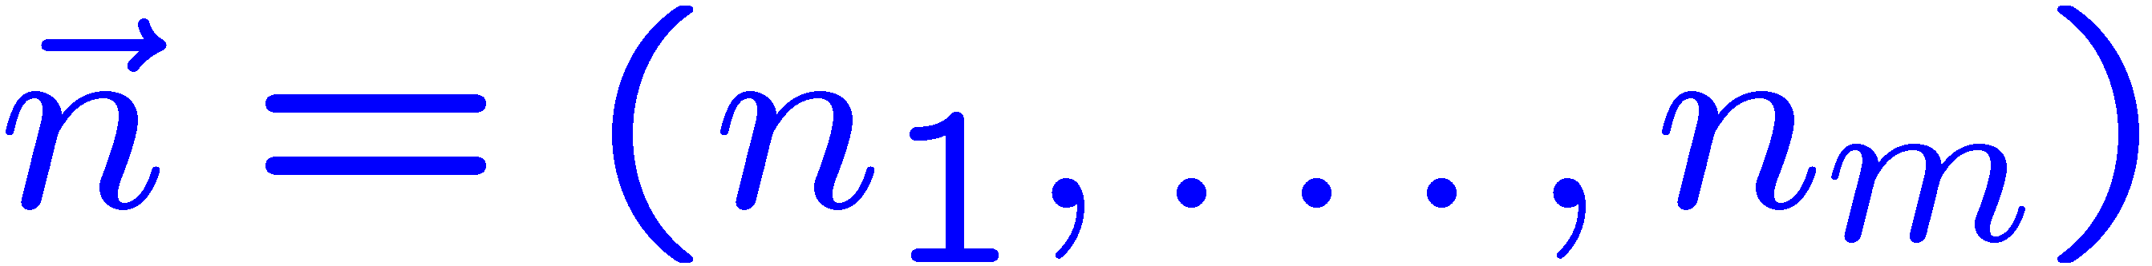
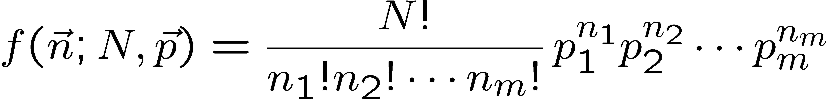
Multinomial distribution
Like binomial but now m outcomes instead of two, probabilities are
For N trials we want the probability to obtain:
n₁ of outcome 1,
n₂ of outcome 2,
⠇
n_{m} of outcome m.
This is the multinomial distribution for

Slide 63
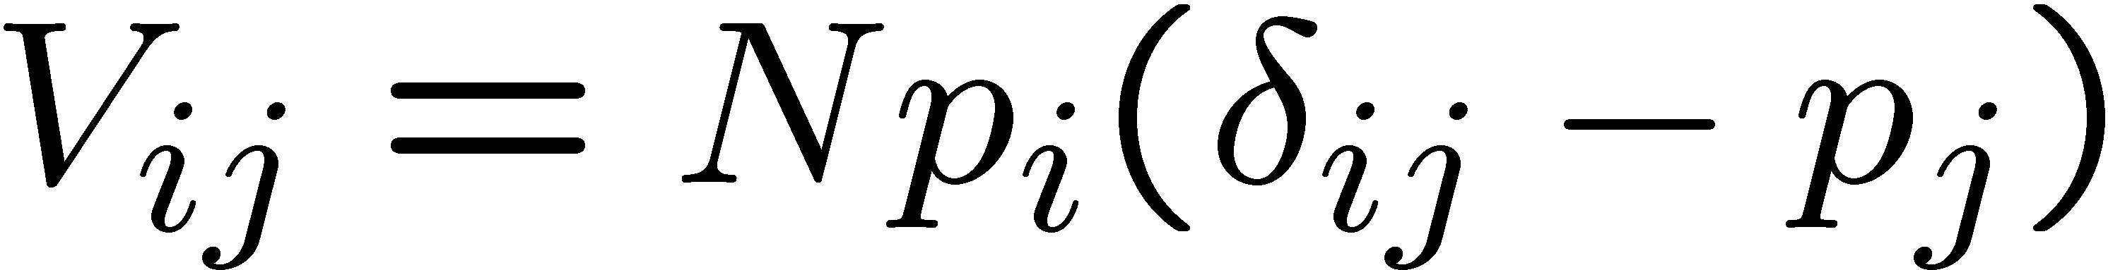
Multinomial distribution (2)
Now consider outcome i as ‘success’, all others as ‘failure’.
→ all n_{i} individually binomial with parameters N, p_{i}
for all i
One can also find the covariance to be
Example:
represents a histogram
with m bins, N total entries, all entries independent.

Slide 64
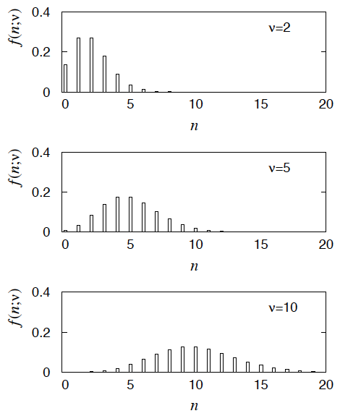
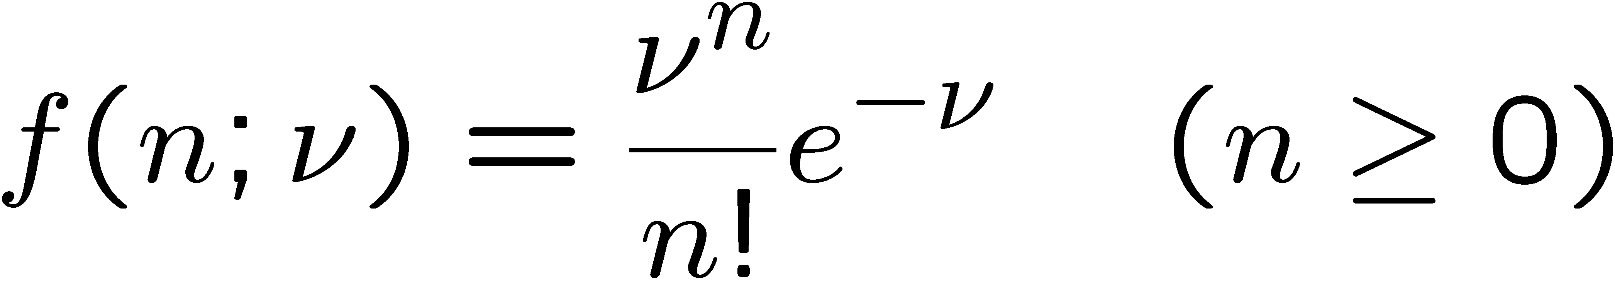
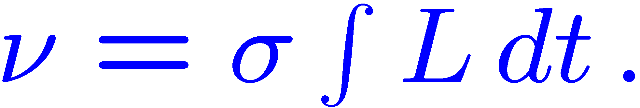
Poisson distribution
Consider binomial n in the limit
→ n follows the Poisson distribution:
Example: number of scattering events
n with cross section σ found for a fixed
integrated luminosity, with

Slide 65
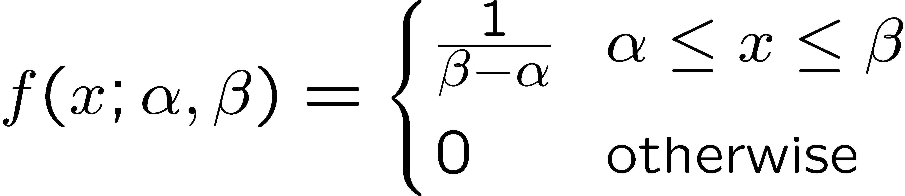
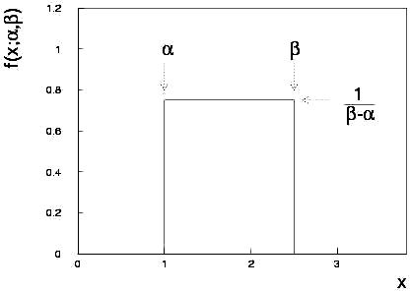
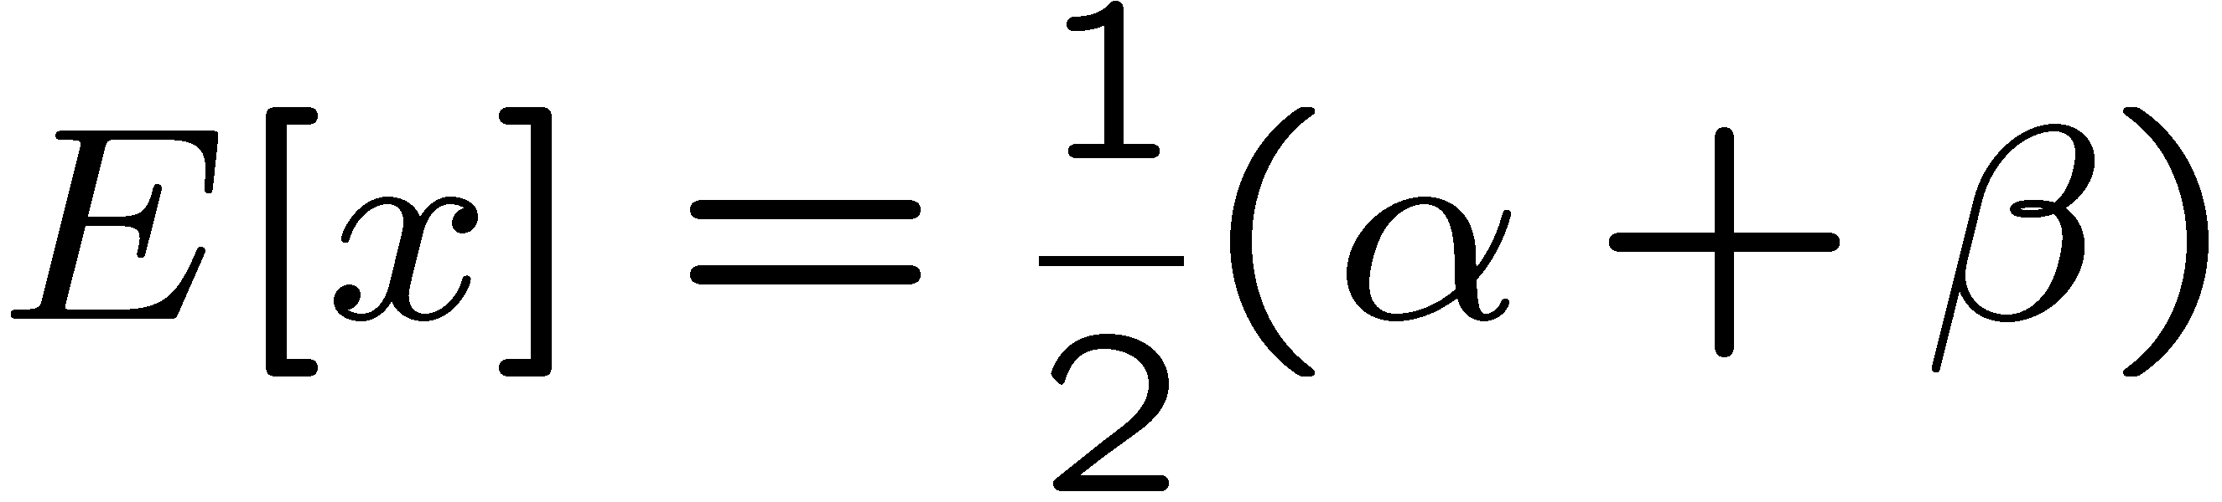
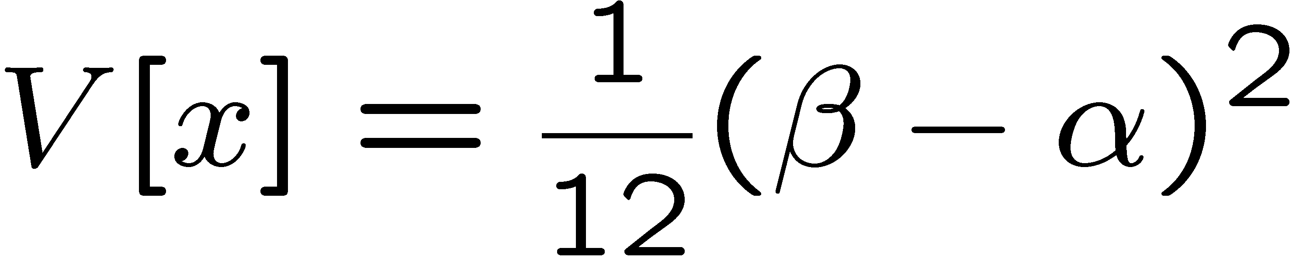
Uniform distribution
Consider a continuous r.v. x with −∞ < x < ∞ . Uniform pdf is:
Notation: x follows a uniform distribution between α and β
write as: x ~ U[α,β]

Slide 66
Uniform distribution (2)
Very often used with α = 0, β = 1 (e.g., Monte Carlo method).
For any r.v. x with pdf f (x), cumulative distribution F(x), the function y = F(x) is uniform in [0,1]:
because f (x) = dF/dx = dy/dx

Slide 67
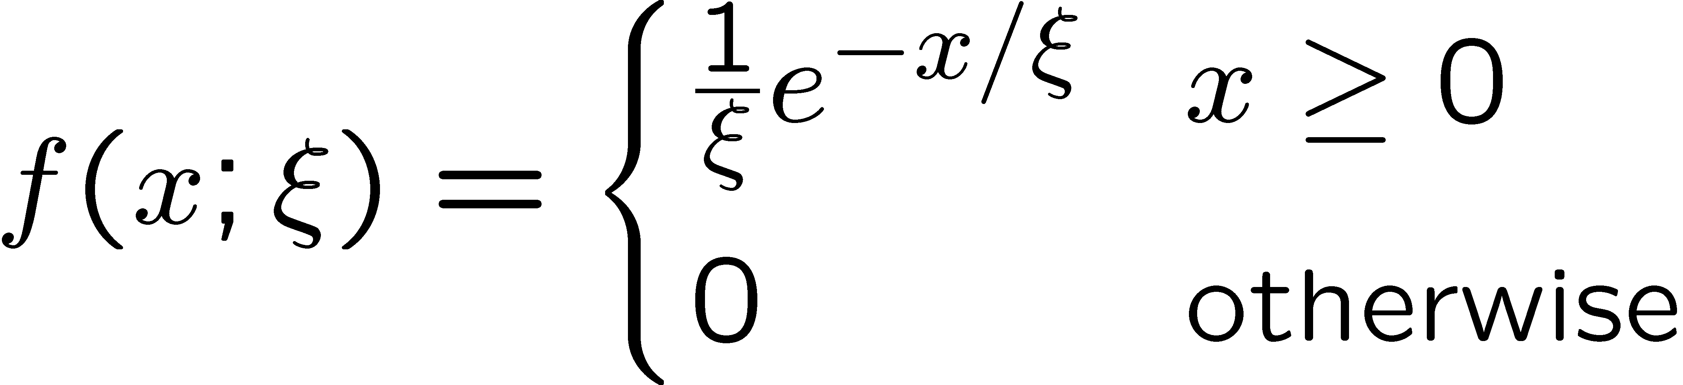



Exponential distribution
The exponential pdf for the continuous r.v. x is defined by:

Slide 68
Exponential distribution (2)
Example: proper decay time t of an unstable particle
(τ = mean lifetime)
Lack of memory (unique to exponential):
Question for discussion:
A cosmic ray muon is created 30 km high in the atmosphere, travels to sea level and is stopped in a block of scintillator, giving a start signal at t₀. At a time t it decays to an electron giving a stop signal. What is distribution of the difference between stop and start times, i.e., the pdf of t – t₀ given t > t₀?

Slide 69




Gaussian (normal) distribution
The Gaussian (normal) pdf for a continuous r.v. x is defined by:
N.B. often μ, σ² denote
mean, variance of any
r.v., not only Gaussian.

Slide 70

Standardized random variables
If a random variable y has pdf f (y) with mean μ and std. dev. σ,
then the standardized variable
has the pdf
has mean of zero and standard deviation of 1.
Often work with the standard Gaussian distribution (μ = 0. σ = 1)
using notation:
Then e.g. y = μ + σ x follows

Slide 71




Multivariate Gaussian distribution
Multivariate Gaussian pdf for the vector
are column vectors,
are transpose (row) vectors,
Marginal pdf of each x_{i} is Gaussian with mean μ_{i}, standard deviation σ_{i} = √V_{ii} .

Slide 72


https://en.wikipedia.org/wiki/Multivariate_normal_distribution
Two-dimensional Gaussian distribution
where ρ = cov[x₁, x₂]/(σ₁σ₂)
is the correlation coefficient.

Slide 73



Chi-square (χ²) distribution
The chi-square pdf for the continuous r.v. z (z ≥ 0) is defined by
n = 1, 2, ... = number of ‘degrees of
freedom’ (dof)
For independent Gaussian x_{i}, i = 1, ..., n, means μ_{i}, variances σ_{i}²,
follows χ² pdf with n dof.
Example: goodness-of-fit test variable especially in conjunction
with method of least squares.

Slide 74


Cauchy (Breit-Wigner) distribution
The Breit-Wigner pdf for the continuous r.v. x is defined by
(Γ = 2, x₀ = 0 is the Cauchy pdf.)
E[x] not well defined, V[x] → ∞.
x₀ = mode (most probable value)
Γ = full width at half maximum
Example: mass of resonance particle, e.g. ρ, K*, φ⁰, ...
Γ = decay rate (inverse of mean lifetime)

Slide 75





Landau distribution
For a charged particle with β = ν /c traversing a layer of matter
of thickness d, the energy loss Δ follows the Landau pdf:
Δ
β
+ - + -
- + - +
d
L. Landau, J. Phys. USSR 8 (1944) 201; see also
W. Allison and J. Cobb, Ann. Rev. Nucl. Part. Sci. 30 (1980) 253.

Slide 76

Landau distribution (2)
Long ‘Landau tail’
→ all moments ∞
Mode (most probable
value) sensitive to β ,
→ particle i.d.

Slide 77




Beta distribution
Often used to represent pdf
of continuous r.v. nonzero only
between finite limits, e.g.,
y = a₀ + a₁x, a₀ ≤ y ≤ a₀ + a₁

Slide 78




Gamma distribution
Often used to represent pdf
of continuous r.v. nonzero only
in [0,∞].
Also e.g. sum of n exponential
r.v.s or time until nth event
in Poisson process ~ Gamma

Slide 79




Student's t distribution
ν = number of degrees of freedom
(not necessarily integer)
ν = 1 gives Cauchy,
ν → ∞ gives Gaussian.

Slide 80
Student's t distribution (2)
If x ~ Gaussian with μ = 0, σ² = 1, and
z ~ χ² with n degrees of freedom, then
t = x / (z/n)^{1/2} follows Student's t with ν = n.
This arises in problems where one forms the ratio of a sample
mean to the sample standard deviation of Gaussian r.v.s.
The Student's t provides a bell-shaped pdf with adjustable
tails, ranging from those of a Gaussian, which fall off very
quickly, (ν → ∞, but in fact already very Gauss-like for
ν = two dozen), to the very long-tailed Cauchy (ν = 1).
Developed in 1908 by William Gosset, who worked under
the pseudonym "Student" for the Guinness Brewery.
Notes:
here

Slide 81




Proof of Neyman-Pearson Lemma
Consider a critical region W and suppose the LR satisfies the criterion of the Neyman-Pearson lemma:
P(x|H₁)/P(x|H₀) ≥ c_{α} for all x in W,
P(x|H₁)/P(x|H₀) ≤ c_{α} for all x not in W.
W
Try to change this into a different critical region W′ retaining the same size α, i.e.,
δW₊
To do so add a part δW₊, but to keep the size α, we need to remove a part δW₋, i.e.,
W′
δW₋

Slide 82
Proof of Neyman-Pearson Lemma (2)
δW₊
But we are supposing the LR is higher for all x in δW₋ removed than for the x in δW₊ added, and therefore
W′
δW₋
The right-hand sides are equal and therefore

Slide 83
Proof of Neyman-Pearson Lemma (3)
We have
δW₊
W′
Note W and δW₊ are disjoint, and W′ and δW₋ are disjoint, so by Kolmogorov’s 3rd axiom,
δW₋
Therefore

Slide 84
Proof of Neyman-Pearson Lemma (4)
And therefore
i.e. the deformed critical region W′ cannot have higher power than the original one that satisfied the LR criterion of the Neyman-Pearson lemma.

