Slide 1



Statistics for Particle Physics
Lecture 2
Terascale Statistics School
https://indico.desy.de/event/43398/
DESY, Hamburg
2-5 April 2024
Glen Cowan
Physics Department
Royal Holloway, University of London
g.cowan@rhul.ac.uk
www.pp.rhul.ac.uk/~cowan

Slide 2
Outline
Tuesday 11:05 Introduction
Probability
Hypothesis tests, parameter estimation
→ Wednesday 9:15 From tests to ML (finish from Tuesday)
Confidence limits
Systematic uncertainties
General analysis, asymptotics
Thursday 16:00 “Errors on errors”
More resources in the University of London course:
http://www.pp.rhul.ac.uk/~cowan/stat_course.html

Slide 3
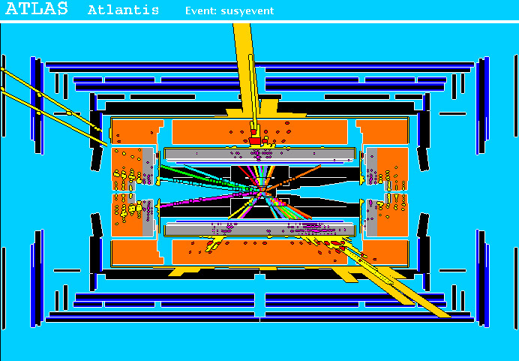
Particle Physics context for a hypothesis test
A simulated SUSY event (“signal”):
high p_{T}
muons
high p_{T} jets
of hadrons
p
p
missing transverse energy

Slide 4
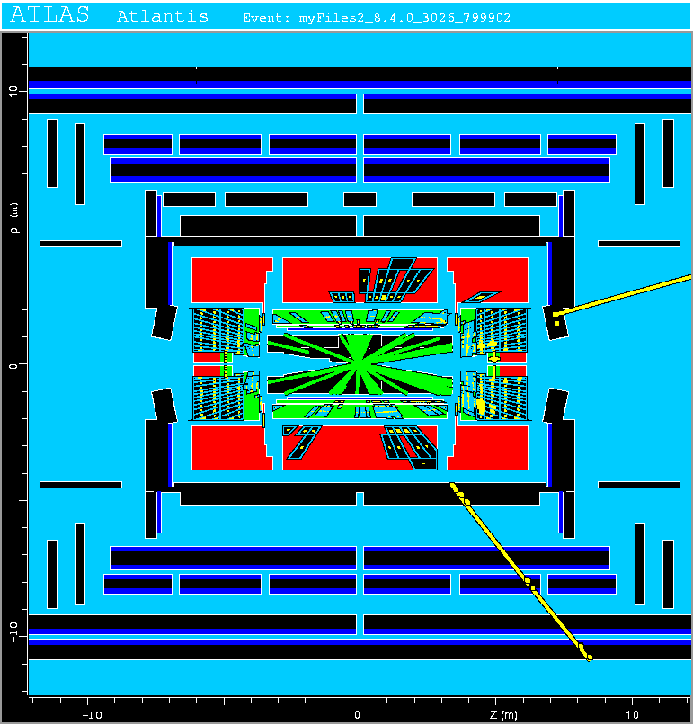
Background events
This event from Standard
Model ttbar production also
has high p_{T} jets and muons,
and some missing transverse
energy.
→ can easily mimic a
signal event.

Slide 5
Classification of proton-proton collisions
Proton-proton collisions can be considered to come in two classes:
signal (the kind of event we’re looking for, y = 1)
background (the kind that mimics signal, y = 0)
For each collision (event), we measure a collection of features:
x₁ = energy of muon x₄ = missing transverse energy
x₂ = angle between jets x₅ = invariant mass of muon pair
x₃ = total jet energy x₆ = ...
The real events don’t come with true class labels, but computer-simulated events do. So we can have a set of simulated events that consist of a feature vector x and true class label y (0 for background, 1 for signal):
(x, y)₁, (x, y)₂, ..., (x, y)_{N}
The simulated events are called “training data”.

Slide 6
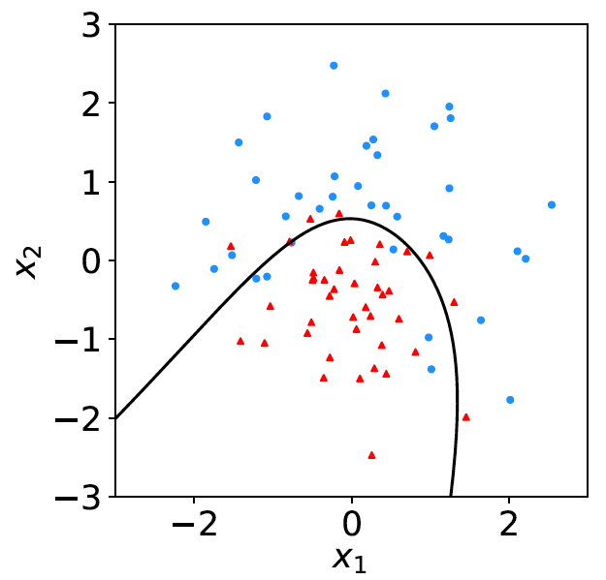
Distributions of the features
If we consider only two
features x = (x₁, x₂), we can
display the results in a scatter
plot (red: y = 0, blue: y = 1).
For real events, the dots are black (true type is not known).
For each real event test the hypothesis that it is background.
(Related to this: test that a sample of events is all background.)
The test’s critical region is defined by a “decision boundary” – without knowing the event type, we can classify them by seeing where their measured features lie relative to the boundary.

Slide 7
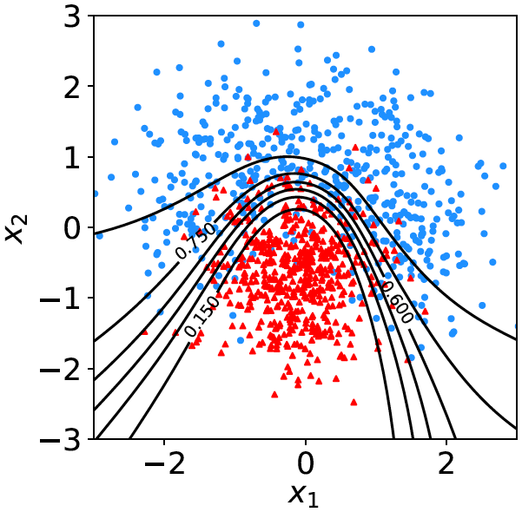

Decision function, test statistic
A surface in an n-dimensional
space can be described by
scalar
function
constant
Different values of the constant
t_{c} result in a family of surfaces.
Problem is reduced to finding
the best decision function or test statistic t (x).

Slide 8
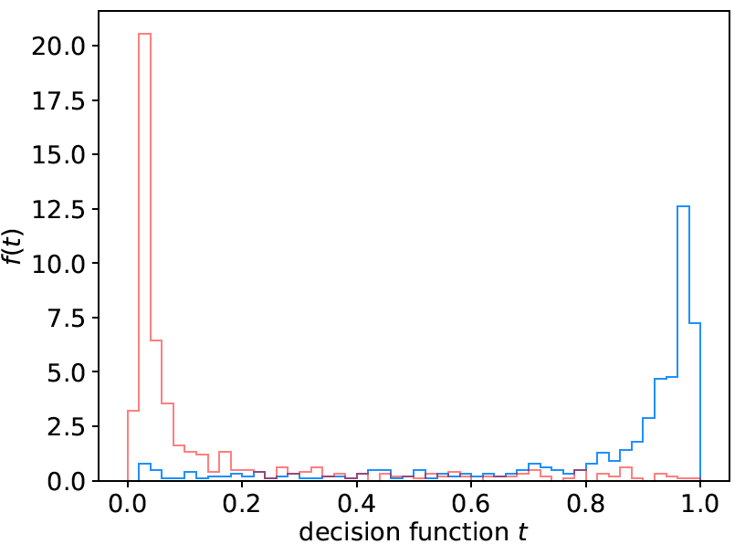
Distribution of t(x)
By forming a test statistic t(x), the boundary of the critical region in the n-dimensional x-space is determined by a single single value t_{c}.
f (t|H₀)
f (t|H₁)
t_{c}
W

Slide 9
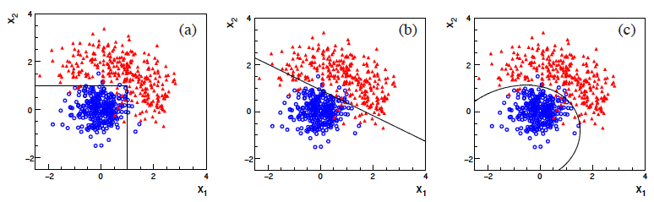
Types of decision boundaries
So what is the optimal boundary for the critical region, i.e., what
is the optimal test statistic t(x)?
First find best t(x), later address issue of optimal size of test.
Remember x-space can have many dimensions.
“cuts”
linear
non-linear

Slide 10
Test statistic based on likelihood ratio
How can we choose a test’s critical region in an ‘optimal way’, in particular if the data space is multidimensional?
Neyman-Pearson lemma states:
For a test of H₀ of size α, to get the highest power with respect to the
alternative H₁ we need for all x in the critical region W
”likelihood
ratio (LR)”
inside W and ≤ c_{α} outside, where c_{α} is a constant chosen to give a test of the desired size.
Equivalently, optimal scalar test statistic is
N.B. any monotonic function of this is leads to the same test.

Slide 11

Neyman-Pearson doesn’t usually help
We usually don’t have explicit formulae for the pdfs f (x|s), f (x|b), so for a given x we can’t evaluate the likelihood ratio
Instead we may have Monte Carlo models for signal and background processes, so we can produce simulated data:
generate x ~ f (x|s) → x₁,..., x_{N}
generate x ~ f (x|b) → x₁,..., x_{N}
This gives samples of “training data” with events of known type.
Use these to construct a statistic that is as close as possible to the optimal likelihood ratio (→ Machine Learning).

Slide 12
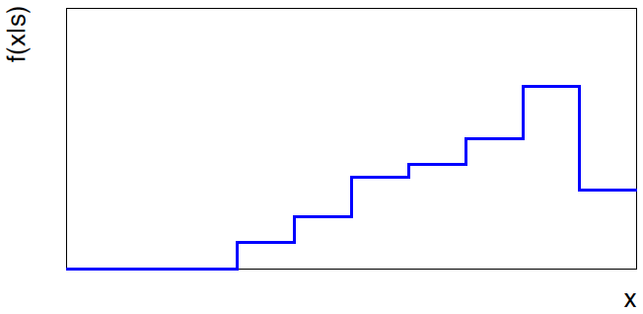
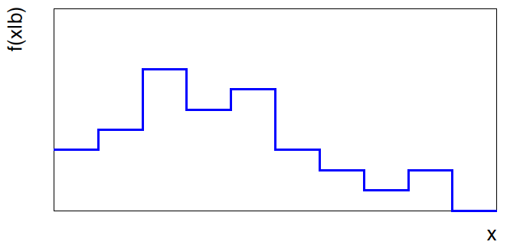


Approximate LR from histograms
Want t(x) = f (x|s)/ f(x|b) for x here
One possibility is to generate
MC data and construct
histograms for both
signal and background.
Use (normalized) histogram
values to approximate LR:
N(x|s)
N (x|s) ≈ f (x|s)
x
N(x|b)
N (x|b) ≈ f (x|b)
Can work well for single
variable.
x

Slide 13
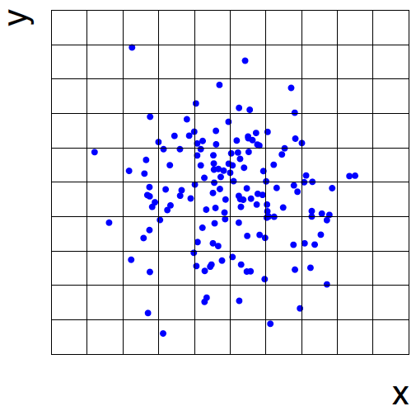
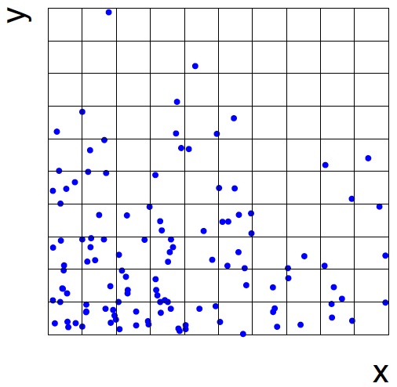
Approximate LR from 2D-histograms
Suppose problem has 2 variables. Try using 2-D histograms:
signal
back-
ground
Approximate pdfs using N (x,y|s), N (x,y|b) in corresponding cells.
But if we want M bins for each variable, then in n-dimensions we
have M^{n} cells; can’t generate enough training data to populate.
→ Histogram method usually not usable for n > 1 dimension.

Slide 14
Strategies for multivariate analysis
Neyman-Pearson lemma gives optimal answer, but cannot be
used directly, because we usually don’t have f (x|s), f (x|b).
Histogram method with M bins for n variables requires that
we estimate M^{n} parameters (the values of the pdfs in each cell),
so this is rarely practical.
A compromise solution is to assume a certain functional form
for the test statistic t (x) with fewer parameters; determine them
(using MC) to give best separation between signal and background.
Alternatively, try to estimate the probability densities f (x|s) and
f (x|b) (with something better than histograms) and use the
estimated pdfs to construct an approximate likelihood ratio.

Slide 15
Multivariate methods (Machine Learning)
Many new (and some old) methods:
Fisher discriminant
(Deep) Neural Networks
Kernel density methods
Support Vector Machines
Decision trees
Boosting
Bagging
More in the lectures by Tilman Plehn

Slide 16
Confidence intervals by inverting a test
In addition to a ‘point estimate’ of a parameter we should report
an interval reflecting its statistical uncertainty.
Confidence intervals for a parameter θ can be found by
defining a test of the hypothesized value θ (do this for all θ):
Specify values of the data that are ‘disfavoured’ by θ
(critical region) such that P(data in critical region|θ) ≤ α
for a prespecified α, e.g., 0.05 or 0.1.
If data observed in the critical region, reject the value θ.
Now invert the test to define a confidence interval as:
set of θ values that are not rejected in a test of size α
(confidence level CL is 1− α).

Slide 17
Relation between confidence interval and p-value
Equivalently we can consider a significance test for each
hypothesized value of θ, resulting in a p-value, p_{θ}.
If p_{θ} ≤ α, then we reject θ.
The confidence interval at CL = 1 – α consists of those values of
θ that are not rejected.
E.g. an upper limit on θ is the greatest value for which p_{θ} > α.
In practice find by setting p_{θ} = α and solve for θ.
For a multidimensional parameter space θ = (θ₁,... θ_{M}) use same idea – result is a confidence “region” with boundary determined by p_{θ} = α.

Slide 18
Coverage probability of confidence interval
If the true value of θ is rejected, then it’s not in the confidence interval. The probability for this is by construction (equality for continuous data):
P(reject θ|θ) ≤ α = type-I error rate
Therefore, the probability for the interval to contain or “cover” θ is
P(conf. interval “covers” θ|θ) ≥ 1 – α
This assumes that the set of θ values considered includes the true value, i.e., it assumes the composite hypothesis P(x|H,θ).

Slide 19



Frequentist upper limit on Poisson parameter
Consider again the case of observing n ~ Poisson(s + b).
Suppose b = 4.5, n_{obs} = 5. Find upper limit on s at 95% CL.
Relevant alternative is s = 0 (critical region at low n)
p-value of hypothesized s is P(n ≤ n_{obs}; s, b)
Upper limit s_{up} at CL = 1 – α found from

Slide 20
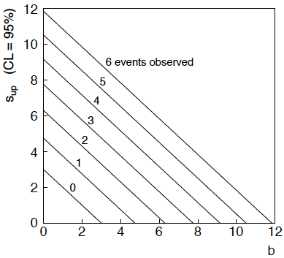
n ~ Poisson(s+b): frequentist upper limit on s
For low fluctuation of n, formula can give negative result for s_{up}; i.e. confidence interval is empty; all values of s ≥ 0 have p_{s} ≤ α.

Slide 21
Limits near a boundary of the parameter space
Suppose e.g. b = 2.5 and we observe n = 0.
If we choose CL = 0.9, we find from the formula for s_{up}
Physicist:
We already knew s ≥ 0 before we started; can’t use negative
upper limit to report result of expensive experiment!
Statistician:
The interval is designed to cover the true value only 90%
of the time — this was clearly not one of those times.
Not uncommon dilemma when testing parameter values for which
one has very little experimental sensitivity, e.g., very small s.

Slide 22
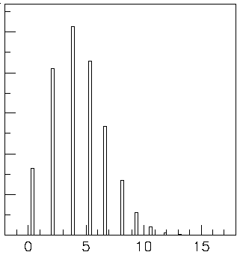

Expected limit for s = 0
Physicist: I should have used CL = 0.95 — then s_{up} = 0.496
Even better: for CL = 0.917923 we get s_{up} = 10⁻⁴ !
Reality check: with b = 2.5, typical Poisson fluctuation in n is
at least √2.5 = 1.6. How can the limit be so low?
Look at the mean limit for the
no-signal hypothesis (s = 0)
(sensitivity).
Distribution of 95% CL limits
with b = 2.5, s = 0.
Mean upper limit = 4.44

Slide 23




Approximate confidence intervals/regions
from the likelihood function
Suppose we test parameter value(s) θ = (θ₁, ..., θ_{n}) using the ratio
Lower λ(θ) means worse agreement between data and hypothesized θ. Equivalently, usually define
so higher t_{θ} means worse agreement between θ and the data.
p-value of θ therefore
need pdf

Slide 24




Confidence region from Wilks’ theorem
Wilks’ theorem says (in large-sample limit and provided
certain conditions hold...)
chi-square dist. with # d.o.f. =
# of components in θ = (θ₁, ..., θ_{n}).
Assuming this holds, the p-value is
← set equal to α
To find boundary of confidence region set p_{θ} = α and solve for t_{θ}:
Recall also

Slide 25




Confidence region from Wilks’ theorem (cont.)
i.e., boundary of confidence region in θ space is where
For example, for 1 – α = 68.3% and n = 1 parameter,
and so the 68.3% confidence level interval is determined by
Same as recipe for finding the estimator’s standard deviation, i.e.,
is a 68.3% CL confidence interval.

Slide 26
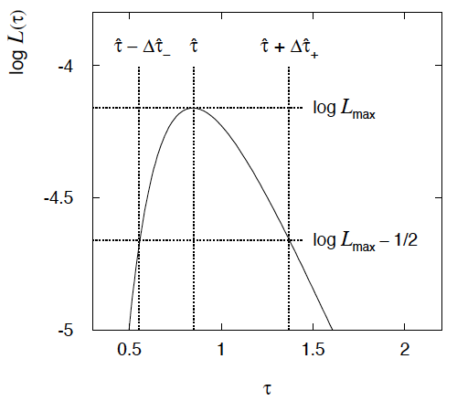

Example of interval from ln L(θ)
For n=1 parameter, CL = 0.683, Q_{α} = 1.
Our exponential
example, now with
only n = 5 events.
Can report ML estimate
with approx. confidence
interval from ln L_{max} – 1/2
as “asymmetric error bar”:

Slide 27

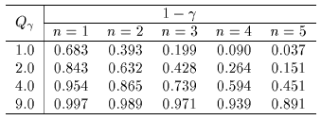

Multiparameter case
For increasing number of parameters, CL = 1 – α decreases for
confidence region determined by a given

Slide 28
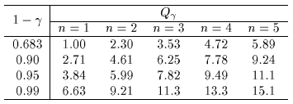
Multiparameter case (cont.)
Equivalently, Q_{α} increases with n for a given CL = 1 – α.

Slide 29



Systematic uncertainties and nuisance parameters
P (x|μ)
In general, our model of the data is not perfect:
model:
truth:
x
Can improve model by including
additional adjustable parameters.
Nuisance parameter ↔ systematic uncertainty. Some point in the
parameter space of the enlarged model should be “true”.
Presence of nuisance parameter decreases sensitivity of analysis
to the parameter of interest (e.g., increases variance of estimate).

Slide 30
Profile Likelihood
Suppose we have a likelihood L(μ,θ) = P(x|μ,θ) with N parameters of interest μ = (μ₁,..., μ_{N}) and M nuisance parameters θ = (θ₁,..., θ_{M}). The “profiled” (or “constrained”) values of θ are:
and the profile likelihood is:
The profile likelihood depends only on the parameters of interest; the nuisance parameters are replaced by their profiled values.
The profile likelihood can be used to obtain confidence intervals/regions for the parameters of interest in the same way as one would for all of the parameters from the full likelihood.

Slide 31
Profile Likelihood Ratio – Wilks theorem
Goal is to test/reject regions of μ space (param. of interest).
Rejecting a point μ should mean p_{μ} ≤ α for all possible values of the nuisance parameters θ.
Test μ using the “profile likelihood ratio”:
Let t_{μ} = −2 ln λ(μ). Wilks’ theorem says in large-sample limit:
where the number of degrees of freedom is the number of
parameters of interest (components of μ). So p-value for μ is

Slide 32
Profile Likelihood Ratio – Wilks theorem (2)
If we have a large enough data sample to justify use of the
asymptotic chi-square pdf, then if μ is rejected, it is rejected for any values of the nuisance parameters.
The recipe to get confidence regions/intervals for the parameters of interest at CL = 1 – α is thus the same as before, simply use the profile likelihood:
where the number of degrees of freedom N for the chi-square quantile is equal to the number of parameters of interest.
If the large-sample limit is not justified, then use e.g. Monte Carlo to get distribution of t_{μ}.

Slide 33




Prototype search analysis
Search for signal in a region of phase space; result is histogram
of some variable x giving numbers:
Assume the n_{i} are Poisson distributed with expectation values
strength parameter
where
signal
background

Slide 34


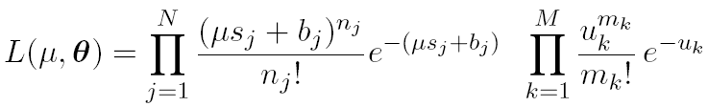
Prototype analysis (II)
Often also have a subsidiary measurement that constrains some
of the background and/or shape parameters:
Assume the m_{i} are Poisson distributed with expectation values
nuisance parameters (θ_{s}, θ_{b},b_{tot})
Likelihood function is

Slide 35
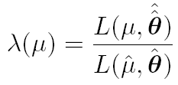
The profile likelihood ratio
Base significance test on the profile likelihood ratio:
maximizes L for
specified μ
maximize L
Define critical region of test of μ by the region of data space
that gives the lowest values of λ(μ).
Important advantage of profile LR is that its distribution becomes independent of nuisance parameters in large sample limit.

Slide 36
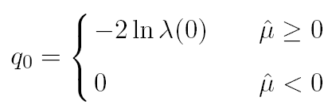
Test statistic for discovery
Suppose relevant alternative to background-only (μ = 0) is μ ≥ 0.
So take critical region for test of μ = 0 corresponding to high q₀
and > 0 (data characteristic for μ ≥ 0).
That is, to test background-only hypothesis define statistic
i.e. here only large (positive) observed signal strength is evidence against the background-only hypothesis.
Note that even though here physically μ ≥ 0, we allow
to be negative. In large sample limit its distribution becomes
Gaussian, and this will allow us to write down simple
expressions for distributions of our test statistics.

Slide 37


Cowan, Cranmer, Gross, Vitells, arXiv:1007.1727, EPJC 71 (2011) 1554
Distribution of q₀ in large-sample limit
Assuming approximations valid in the large sample (asymptotic)
limit, we can write down the full distribution of q₀ as
The special case μ′ = 0 is a “half chi-square” distribution:
In large sample limit, f (q₀|0) independent of nuisance parameters;
f (q₀|μ′) depends on nuisance parameters through σ.

Slide 38
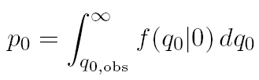
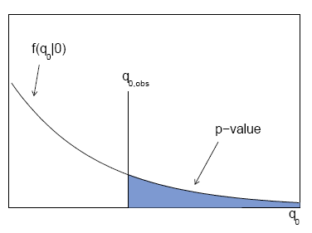

p-value for discovery
Large q₀ means increasing incompatibility between the data
and hypothesis, therefore p-value for an observed q_{0,obs} is
use e.g. asymptotic formula
From p-value get
equivalent significance,

Slide 39
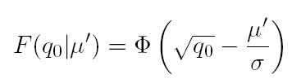



Cowan, Cranmer, Gross, Vitells, arXiv:1007.1727, EPJC 71 (2011) 1554
Cumulative distribution of q₀, significance
From the pdf, the cumulative distribution of q₀ is found to be
The special case μ′ = 0 is
The p-value of the μ = 0 hypothesis is
Therefore the discovery significance Z is simply

Slide 40
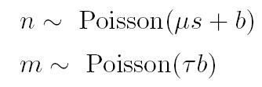
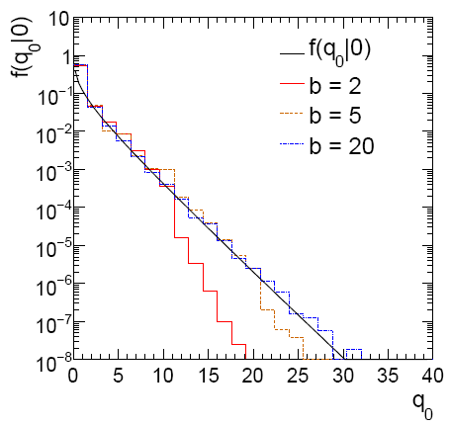
Cowan, Cranmer, Gross, Vitells, arXiv:1007.1727, EPJC 71 (2011) 1554
Monte Carlo test of asymptotic formula
μ = param. of interest
b = nuisance parameter
Here take s known, τ = 1.
Asymptotic formula is
good approximation to 5σ
level (q₀ = 25) already for
b ~ 20.

Slide 41
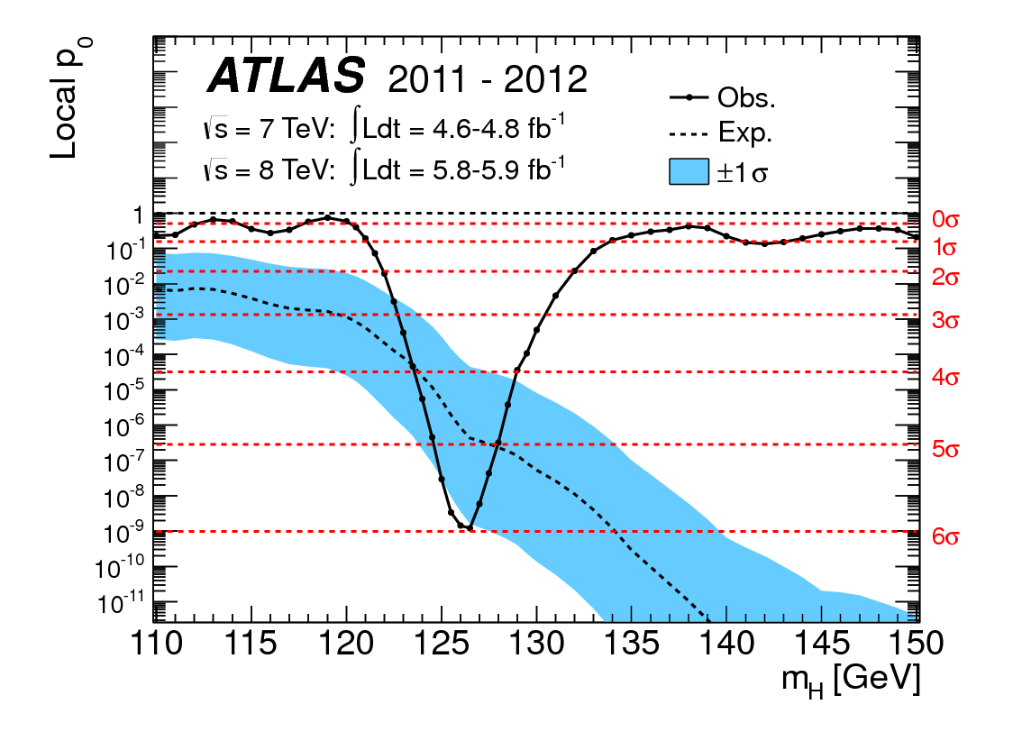
How to read the p₀ plot
The “local” p₀ means the p-value of the background-only
hypothesis obtained from the test of μ = 0 at each individual m_{H}, without any correct for the Look-Elsewhere Effect.
The “Expected” (dashed) curve gives the median p₀ under assumption of the SM Higgs (μ = 1) at each m_{H}.
ATLAS, Phys. Lett. B 716 (2012) 1-29
The blue band gives the
width of the distribution
(±1σ) of significances
under assumption of the
SM Higgs.

Slide 42
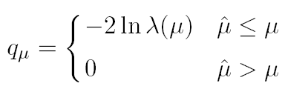



Cowan, Cranmer, Gross, Vitells, arXiv:1007.1727, EPJC 71 (2011) 1554
Test statistic for upper limits
For purposes of setting an upper limit on μ use
where
I.e. when setting an upper limit, an upwards fluctuation of the data
is not taken to mean incompatibility with the hypothesized μ :
From observed q_{μ} find p-value:
Large sample approximation:
To find upper limit at CL = 1−α, set p_{μ} = α and solve for μ.

Slide 43
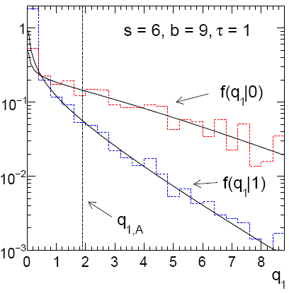
Cowan, Cranmer, Gross, Vitells, arXiv:1007.1727, EPJC 71 (2011) 1554
Monte Carlo test of asymptotic formulae
Consider again n ~ Poisson(μs + b), m ~ Poisson(τb)
Use q_{μ} to find p-value of hypothesized μ values.
E.g. f (q₁|1) for p-value of μ =1.
Typically interested in 95% CL, i.e., p-value threshold = 0.05, i.e.,
q₁ = 2.69 or Z₁ = √q₁ = 1.64.
Median[q₁ |0] gives “exclusion sensitivity”.
Here asymptotic formulae good
for s = 6, b = 9.

Slide 44
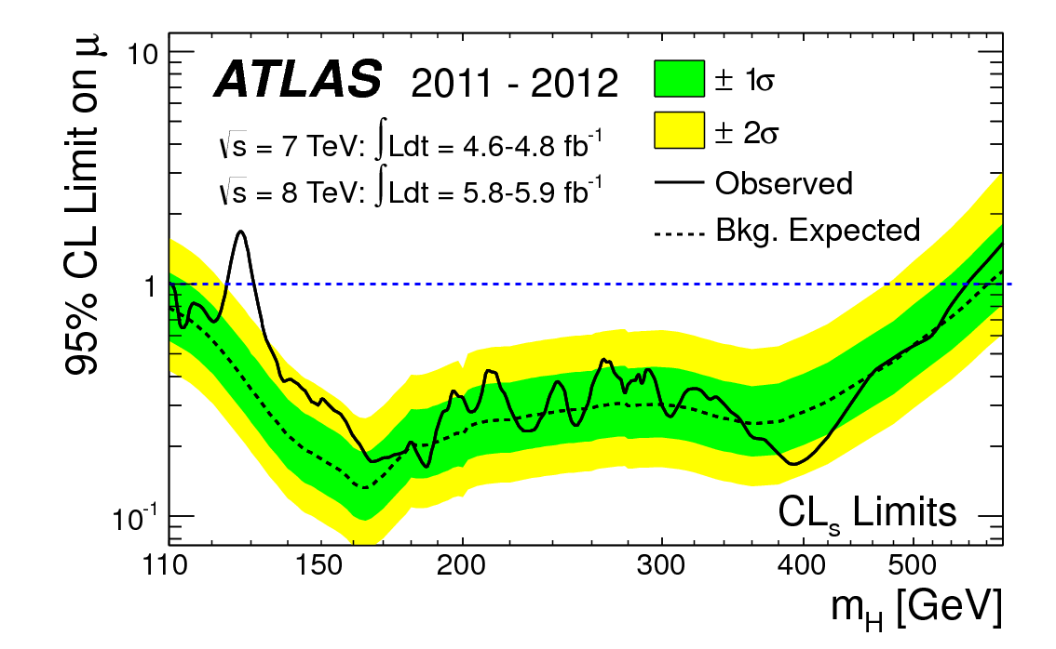
How to read the green and yellow limit plots
For every value of m_{H}, find the upper limit on μ.
Also for each m_{H}, determine the distribution of upper limits μ_{up} one would obtain under the hypothesis of μ = 0.
The dashed curve is the median μ_{up}, and the green (yellow) bands give the ± 1σ (2σ) regions of this distribution.
ATLAS, Phys. Lett. B 716 (2012) 1-29

Slide 45
Finally
Two lectures only enough for a brief introduction to:
Parameter estimation
Hypothesis tests (→ path to Machine Learning)
Limits (confidence intervals/regions)
Systematics (nuisance parameters)
No time for many other interesting topics:
Experimental sensitivity
Bayesian parameter estimation
Final thought: once the basic formalism is fixed, most of the
work focuses on writing down the likelihood, e.g., P(x|θ), and
including in it enough parameters to adequately describe the data (true for both Bayesian and frequentist approaches) so often best to invest most of your time with it.

Slide 46
Extra slides

Slide 47
Information inequality for N parameters
Suppose we have estimated N parameters θ = (θ₁,...,θ_{N})
The Fisher information matrix is
^
and the covariance matrix of estimators θ is
The information inequality states that the matrix
is positive semi-definite:
z^{T}Mz ≥ 0 for all z ≠ 0, diagonal elements ≥ 0

Slide 48
Information inequality for N parameters (2)
In practice the inequality is ~always used in the large-sample limit:
bias → 0
inequality → equality, i.e, M = 0, and therefore V⁻¹ = I
That is,
This can be estimated from data using
Find the matrix V⁻¹ numerically (or with automatic differentiation),
then invert to get the covariance matrix of the estimators

Slide 49
Multiparameter graphical method for variances
Expand ln L(θ) to 2nd order about MLE:
ln L_{max}
zero
relate to covariance matrix of MLEs using information (in)equality.
Result:
So the surface
corresponds to
, which is the equation of a (hyper-) ellipse.

Slide 50




Multiparameter graphical method (2)
Distance from MLE to tangent planes gives standard deviations.

Slide 51


Sensitivity for Poisson counting experiment
Count a number of events n ~ Poisson(s+b), where
s = expected number of events from signal,
b = expected number of background events.
To test for discovery of signal compute p-value of s = 0 hypothesis,
Usually convert to equivalent significance:
where Φ is the standard Gaussian cumulative distribution, e.g.,
Z > 5 (a 5 sigma effect) means p < 2.9 ×10⁻⁷.
To characterize sensitivity to discovery, give expected (mean
or median) Z under assumption of a given s.

Slide 52



s/√b for expected discovery significance
For large s + b, n → x ~ Gaussian(μ,σ) , μ = s + b, σ = √(s + b).
For observed value x_{obs}, p-value of s = 0 is Prob(x > x_{obs} | s = 0),:
Significance for rejecting s = 0 is therefore
Expected (median) significance assuming signal rate s is

Slide 53



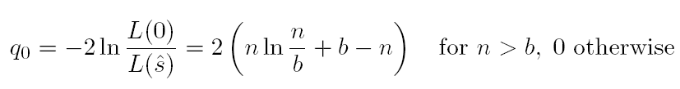
Better approximation for significance
Poisson likelihood for parameter s is
For now
no nuisance
params.
To test for discovery use profile likelihood ratio:
So the likelihood ratio statistic for testing s = 0 is

Slide 54


Approximate Poisson significance (continued)
For sufficiently large s + b, (use Wilks’ theorem),
To find median[Z|s], let n → s + b (i.e., the Asimov data set):
This reduces to s/√b for s << b.

Slide 55
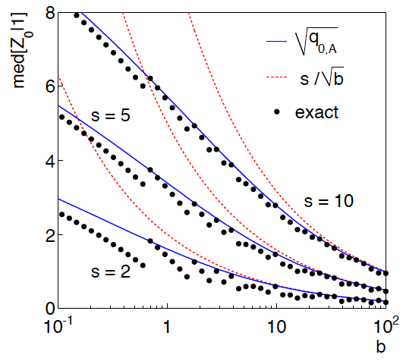
n ~ Poisson(s+b), median significance,
assuming s, of the hypothesis s = 0
CCGV, EPJC 71 (2011) 1554, arXiv:1007.1727
“Exact” values from MC,
jumps due to discrete data.
Asimov √q_{0,A} good approx.
for broad range of s, b.
s/√b only good for s ≪ b.

