Slide 1



Statistics for Particle Physics
“Errors on Errors”
Terascale Statistics School
https://indico.desy.de/event/43398/
DESY, Hamburg
2-5 April 2024
Glen Cowan
Physics Department
Royal Holloway, University of London
g.cowan@rhul.ac.uk
www.pp.rhul.ac.uk/~cowan

Slide 2
Outline
Tuesday 11:05 Introduction
Probability
Hypothesis tests, parameter estimation
Wednesday 9:15 From tests to ML (finish from Tuesday)
Confidence limits
Systematic uncertainties
General analysis, asymptotics
→ Thursday 16:00 “Errors on errors”
Based on
G. Cowan, Eur. Phys. J. C (2019) 79:133; arXiv:1809.05778
G. Cowan, , EPJ Web of Conferences 258, 09002 (2022); arXiv:2107.02652
E. Canonero, A. Brazzale and G. Cowan, Eur. Phys. J. C (2023) 83:1100; arXiv:2304.10574

Slide 3
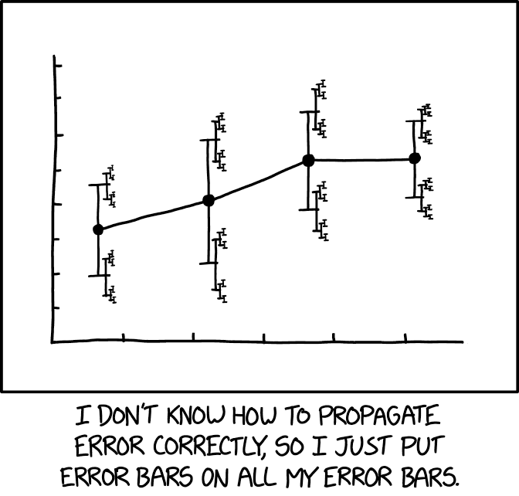
https://xkcd.com/2110/
Randall Munroe, xkcd.com

Slide 4
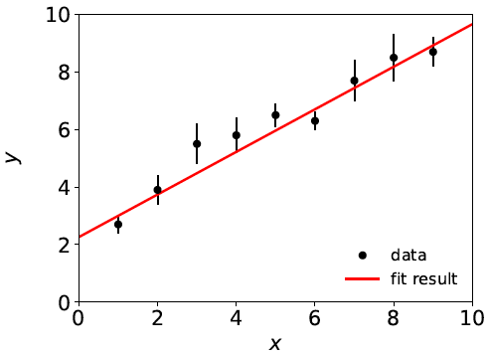

Curve Fitting History: Least Squares
Method of Least Squares by Laplace, Gauss, Legendre, Galton...
C.F. Gauss, Theoria Combinationis Observationum Erroribus Minimis Obnoxiae, Commentationes Societatis Regiae Scientiarium Gottingensis Recectiores Vol. V (MDCCCXXIII).
To fit curve f (x;θ) to data y_{i} ± σ_{i},
adjust parameters θ = (θ₁,..., θ_{M})
to minimize
f (x;θ)
y_{i} ± σ_{i}
Assumes σ_{i} known.

Slide 5




Least Squares ← Maximum Likelihood
Method of Least Squares follows from method of Maximum
Likelihood if independent measured y_{i} ~ Gaussian.

Slide 6
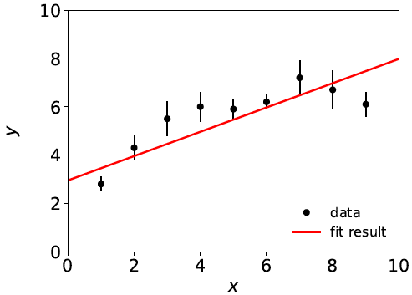
Goodness of fit
^
If the hypothesized model f (x;θ) is correct, χ²_{min} = χ²(θ) should
follow a chi-square distribution for N (# meas.) – M (# fitted par.)
degrees of freedom; expectation value = N – M.
Suppose initial guess for model is: f (x;θ) = θ₀ + θ₁ x
χ²_{min} = 20.9,
N – M = 9 – 2 = 7,
so goodness of fit is “poor”.
This is an indication that the
model is inadequate, and thus
the values it predicts will
have a “systematic error”.

Slide 7
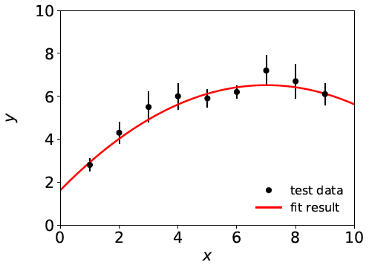
Systematic errors ↔ nuisance parameters
Solution: fix the model, generally by inserting additional
adjustable parameters (“nuisance parameters”). Try, e.g.,
f (x;θ) = θ₀ + θ₁ x + θ₂ x²
χ²_{min} = 3.5, N – M = 6
For some point in the
enlarged parameter space
we hope the model is
now ~correct.
Sys. error gone?
Estimators for all parameters correlated, and as a consequence the presence of the nuisance parameters inflates the statistical errors of the parameter(s) of interest.

Slide 8

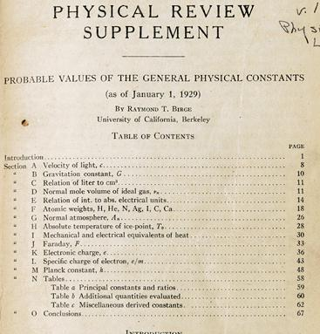
http://bancroft.berkeley.edu/Exhibits/physics/learning01.html
Least Squares for Averaging
_{= fit of horizontal line}
Raymond T. Birge,
Probable Values of the General Physical Constants (as of January 1, 1929), Physical Review Supplement, Vol 1, Number 1, July 1929
Forerunner of the
Particle Data Group

Slide 9
Least squares: some issues
The method of least squares requires the standard deviations of the measured quantities, but often these are poorly known.
The uncertainty (e.g. confidence interval) of an LS average does not reflect goodness of fit:
LS average of 9 ± 1 and 11 ± 1 is 10 ± 0.71
LS average of 5 ± 1 and 15 ± 1 is 10 ± 0.71
LS estimators are equivalent to maximum-likelihood assuming Gaussian distributed measurements; but the tails of a Gaussian fall off very fast, not always an appropriate model.
→ Outliers in LS average have very large influence.
Solution: incorporate the uncertainty in the standard deviations of the measurements into the analysis.

Slide 10
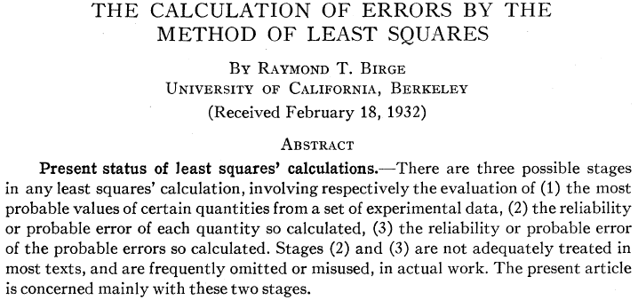
“Errors on Errors”
→ PDG “scale factor method” ≈ scale sys. errors with common
factor until χ²_{min} = appropriate no. of degrees of freedom.

Slide 11



Formulation of the problem
Suppose measurements y have probability (density) P(y|μ,θ),
μ = parameters of interest
θ = nuisance parameters
To provide info on nuisance parameters, often treat their best
estimates u as indep. Gaussian distributed r.v.s., giving likelihood
or log-likelihood (up to additive const.)

Slide 12
Systematic errors and their uncertainty
Often the θ_{i} could represent a systematic bias and its best estimate u_{i} in the real measurement is zero.
The σ_{u,i} are the corresponding “systematic errors”.
Sometimes σ_{u,i} is well known, e.g., it is itself a statistical error known from sample size of a control measurement.
Other times the u_{i} are from an indirect measurement, Gaussian model approximate and/or the σ_{u,i} are not exactly known.
Or sometimes σ_{u,i} is at best a guess that represents an uncertainty in the underlying model (“theoretical error”).
In any case we can allow that the σ_{u,i} are not known in general with perfect accuracy.

Slide 13



Gamma model for variance estimates
Suppose we want to treat the systematic errors as uncertain,
so let the σ_{u,i} be adjustable nuisance parameters.
Suppose we have estimates s_{i} for σ_{u,i} or equivalently v_{i} = s_{i}², is an estimate of σ_{u,i}².
Model the v_{i} as independent and gamma distributed:
Set α and β so that they give desired mean and width for f (v):
E[v] = σ_{u}² = α/β,
r = 1/2√α ≈ relative “error on the error” = σ_{s}/E[s] .

Slide 14



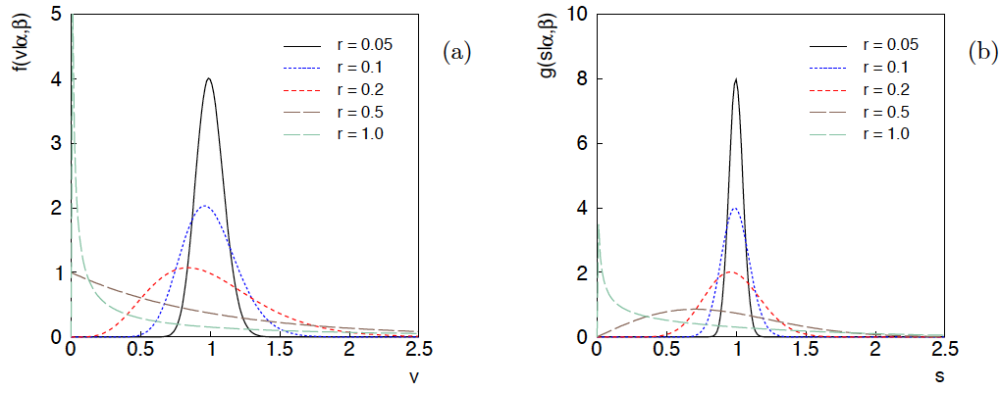
Distributions of v and s = √v
For α, β of gamma distribution,
relative “error on error”

Slide 15

Motivation for gamma variance model
If one were to have n independent observations u₁,..,u_{n}, with all
u ~ Gauss(θ, σ_{u}²), and we use the sample variance
to estimate σ_{u}², then (n−1)v/σ_{u}² follows a chi-square distribution
for n−1 degrees of freedom, which is a special case of the
gamma distribution (α = n/2, β = 1/2). (In general one doesn’t
have a sample of u_{i} values, but if this were to be how v was
estimated, the gamma model would follow.)
Furthermore choice of the gamma distribution for v allows one
to profile over the nuisance parameters σ_{u}² in closed form and
leads to a simple profile likelihood.

Slide 16
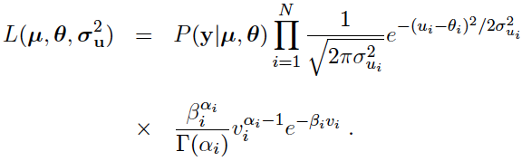
Likelihood for gamma variance model
α_{i} = 1/4r_{i}²
β_{i} = α_{i}/σ_{ui}²
,
Treated like data: y₁,...,y_{L} (the primary measurements)
u₁,...,u_{N} (estimates of nuisance par.)
v₁,...,v_{N} (estimates of variances
of estimates of NP)
Adjustable parameters: μ₁,...,μ_{M} (parameters of interest)
θ₁,...,θ_{N} (nuisance parameters)
σ_{u,1},...,σ_{u,N} (sys. errors = std. dev. of
of NP estimates)
Fixed parameters: r₁,...,r_{N} (rel. err. in estimate of σ_{u,i})

Slide 17

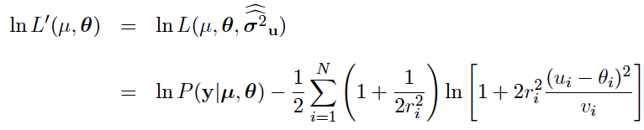
Profiling over systematic errors
We can profile over the σ_{u,i} in closed form
which gives the profile log-likelihood (up to additive const.)
In limit of small r_{i} and v_{i} → σ_{u,i}², the log terms revert back to the
quadratic form seen with known σ_{u,i}.

Slide 18




Equivalent likelihood from Student’s t
We can arrive at same likelihood by defining
Since u_{i} ~ Gauss and v_{i} ~ Gamma, z_{i} ~ Student’s t
with
Resulting likelihood same as profile Lʹ(μ,θ) from gamma model

Slide 19
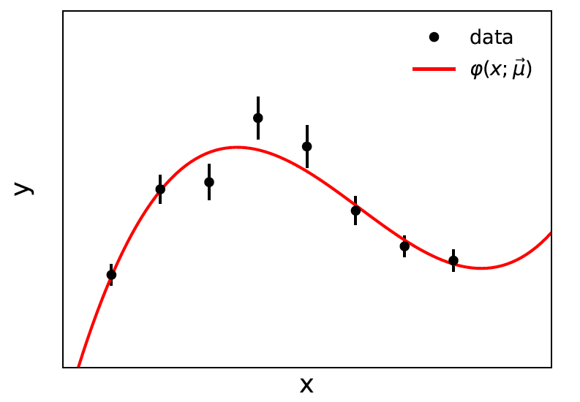


Curve fitting, averages
Suppose independent
y_{i} ~ Gauss, i = 1,...,N, with
(known).
μ are the parameters of interest in the fit function φ(x;μ),
θ are bias parameters constrained by control measurements
u_{i} ~ Gauss(θ_{i}, σ_{u,i}), so that if σ_{u,i} are known we have

Slide 20

Profiling over θ_{i} with known σ_{u,i}
Profiling over the bias parameters θ_{i} for known σ_{u,i} gives usual least-squares (BLUE)
Widely used technique for curve fitting in Particle Physics.
Generally in real measurement, u_{i} = 0.
Generalized to case of correlated y_{i} and u_{i} by summing
statistical and systematic covariance matrices.

Slide 21

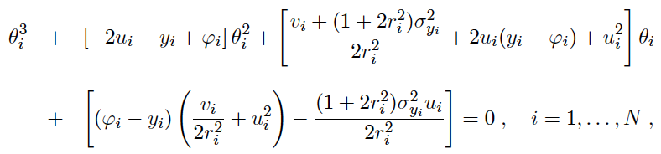
Curve fitting with uncertain σ_{u,i}
Suppose now σ_{u,i}² are adjustable parameters with gamma distributed estimates v_{i}.
Retaining the θ_{i} but profiling over σ_{u,i}² gives
Profiled values of θ_{i} from solution to cubic equations:

Slide 22


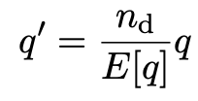
Goodness of fit
Can quantify goodness of fit with statistic
where Lʹ (φ,θ) has an adjustable φ_{i} for each y_{i} (the saturated model).
Asymptotically should have q ~ chi-squared(N−M).
For increasing r_{i}, asymptotic distribution no longer valid.
Bartlett (1937) defines modified statistic:
By construction q′ has mean n_{d} = N-M and turns out to have a distribution significantly closer to the asymptotic chi-square.
(See Canonero et al., Eur. Phys. J. C (2023) 83:1100.)

Slide 23
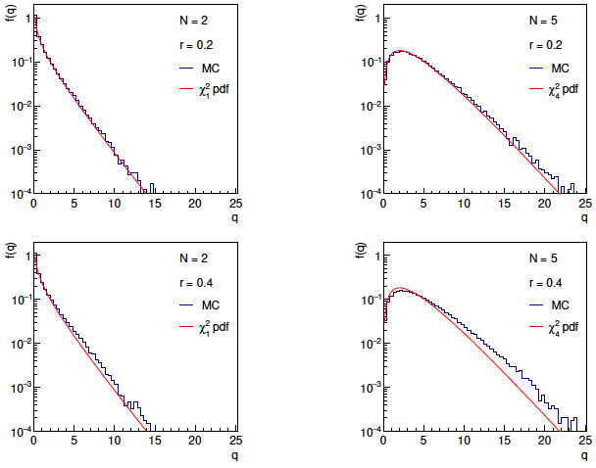
Distributions of q

Slide 24
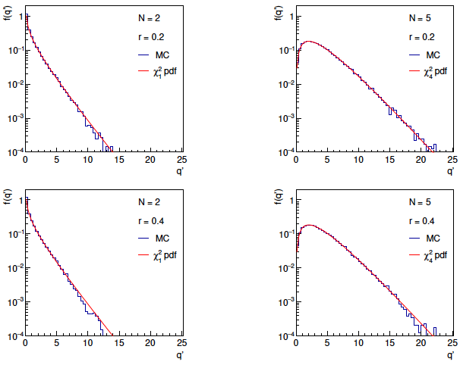
Distributions of Bartlett-corrected qʹ

Slide 25


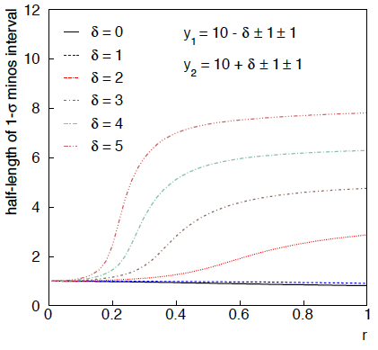
Example: average of two measurements
Approximate (”MINOS”) confidence interval based on
with
Increased discrepancy
between values to be
averaged gives larger
interval.
Interval length saturates
at ~level of absolute
discrepancy between
input values.
relative error
on sys. error

Slide 26
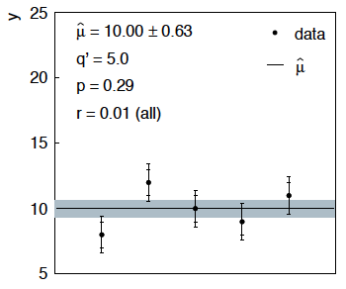
Sensitivity of average to outliers
Suppose we average 5 values, y = 8, 9, 10, 11, 12, all with
stat. and sys. errors of 1.0, and suppose negligible error on error
(here take r = 0.01 for all).
inner error bars
= σ_{y,i}
outer error bars
= (σ_{y,i}² + σ_{u,i}²)^{½}

Slide 27
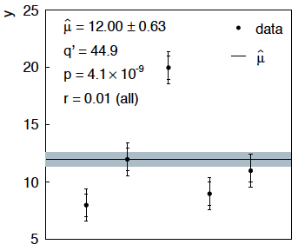
Sensitivity of average to outliers (2)
Now suppose the measurement at 10 had come out at 20:
“outlier”
Estimate pulled up to 12.0, size of confidence interval ~unchanged
(would be exactly unchanged with r → 0).

Slide 28
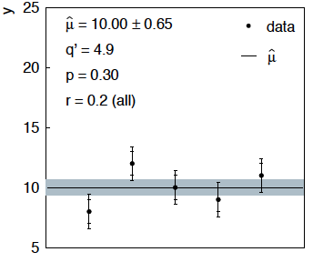
Average with all r = 0.2
If we assign to each measurement r = 0.2,
Estimate still at 10.00, size of interval moves 0.63 → 0.65

Slide 29
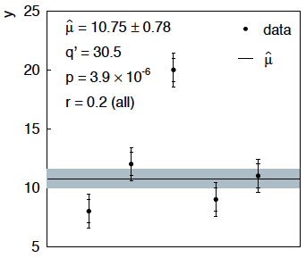
Average with all r = 0.2 with outlier
Same now with the outlier (middle measurement 10 → 20)
Estimate →10.75 (outlier pulls much less).
Half-size of interval → 0.78 (inflated because of bad g.o.f.).

Slide 30



Naive approach to errors on errors
Naively one might think that the error on the error in the previous
example could be taken into account conservatively by inflating
the systematic errors, i.e.,
But this gives
without outlier (middle meas. 10)
with outlier (middle meas. 20)
So the sensitivity to the outlier is not reduced and the size of the
confidence interval is still independent of goodness of fit.

Slide 31
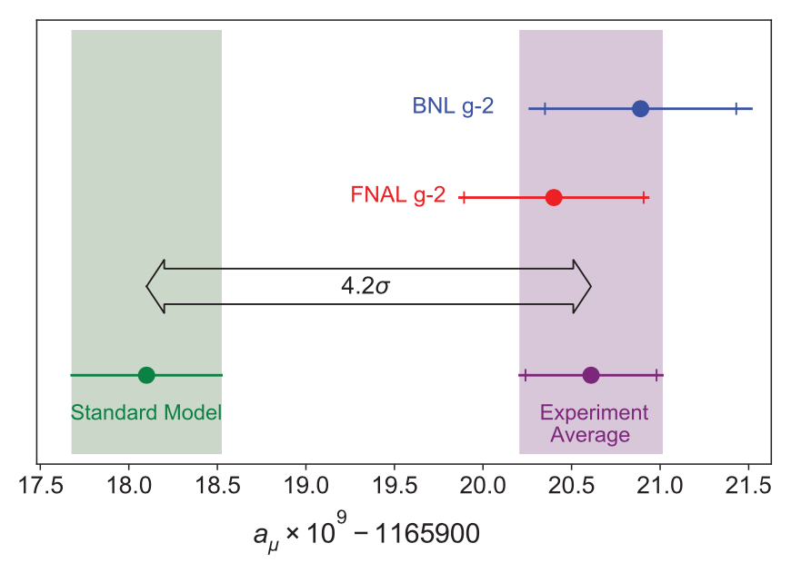
Application to the muon g − 2 anomaly
The recently measured muon g − 2 (ave. of 2006, 2021) disagrees with the Standard Model prediction with a significance of 4.2σ.
Muon g-2 Collab., PRL 126, 141801 (2021)
Discrepancy significantly
reduced by 2021 lattice-based prediction of Borsanyi et al. (BMW).
Current goal is to investigate sensitivity of significance to error assumptions, so for now focus on the 4.2σ problem.
Here using 2021 meausrement; see also D. P. Aguillard et al. (The Muon g−2 Collaboration)
Phys. Rev. Lett. 131, 161802 (2023)

Slide 32



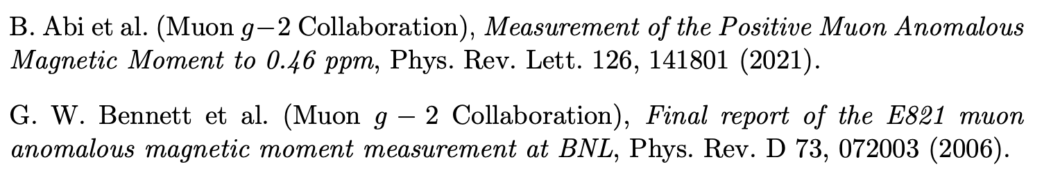

Muon g − 2 ingredients
Using
the ingredients of the 4.2σ effect are:
(ave. of BNL 2006 and FNAL 2021)
0.37 (stat.) ± 0.17 (sys.)
(SM pred. by Muon g −2 theory initiative)
0.40 (Had. Vac. Pol.) ± 0.18 (Had. Light-by-Light)

Slide 33
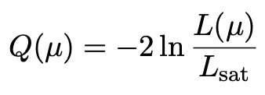
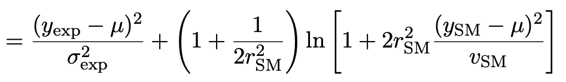
Suppose σ_{SM} uncertain
Suppose measurement errors well known, but that the SM theory
error σ_{SM} (estimated 0.43) could be uncertain.
This is the largest systematic and probably hardest to estimate.
Treat estimate v_{SM} = (0.43)² of variance σ²_{SM} as gamma distributed, width from relative uncertainty parameter r_{SM}.
Maximum-likelihood for mean from minimum of

Slide 34

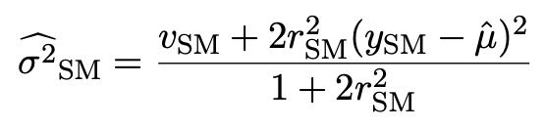
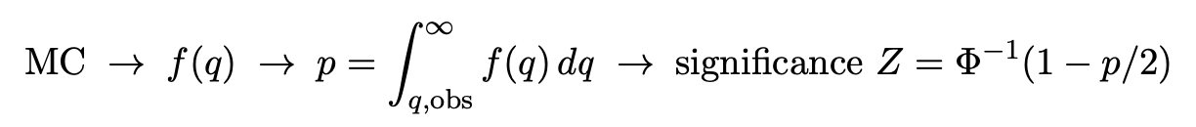
p-value/significance of common-mean hypothesis
Significance (goodness of fit) from
Because of non-quadratic term in Q(μ), distribution of q departs from chi-square(1) for increasing r_{SM}.
Best to get distribution of q from Monte Carlo (and speed up with Bartlett correction – see EPJC (2019) 79:133).
For r_{SM} > 0 distribution of q depends on σ²_{SM}. For MC use Maximum-Likelihood estimate (“profile construction”):
# of sigmas

Slide 35
Significance of discrepancy versus r_{SM}
Naive model: use least squares but let σ_{SM} → (1 + r_{SM}) σ_{SM}
Gamma variance model gives greater decrease in significance for r_{SM} ≳ 0.2, e.g., 3.1σ for r_{SM} = 0.3, 2.0σ for r_{SM} = 0.6.

Slide 36
Significance of discrepancy versus r_{SM}
Establishing 4σ effect requires r_{SM} ≲ 0.3 even if nominal exp.
and SM uncertainties become half of present values.

Slide 37
Discussion on muon g−2
Including uncertainties on estimates of uncertainties can have large effect on hypothesis test, esp. for high significance.
To establish e.g. a 5σ effect it is crucial to have both:
small uncertainties
accurate estimates of those uncertainties (~ 20% level)
This is ultimately because the tails of the Gaussian fall off so quickly.
Gamma Variance Model ~ Student’s t likelihood with ν = 1/2r² degrees of freedom → longer tails than Gaussian.
Ongoing discussion with Bogdan Malaescu of Muon g-2 Theory Initiative on the HVP uncertainty, see, e.g.,
B. Malaescu et al., https://indico.him.uni-mainz.de/event/11/contributions/80/attachments/50/51/amuWorkshop_Correlations_Malaescu.pdf
M. Davier et al., Eur. Phys. J. C 80 (2020) 241 , arXiv:1908.00921

Slide 38


Discussion / Conclusions
Gamma model for variance estimates gives confidence intervals
that increase in size when the data are internally inconsistent,
and gives decreased sensitivity to outliers (known property of
Student’s t based regression).
Equivalence with Student’s t model, ν = 1/2r² degrees of freedom.
Simple profile likelihood – quadratic terms replaced by logarithmic:

Slide 39
Discussion / Conclusions (2)
Asymptotics can break for increased error-on-error, may need
Bartlett correction, higher-order asymptotics or MC.
Method assumes that meaningful r_{i} values can be assigned and is valuable when systematic errors are not well known but enough “expert knowledge” is available to do so.
Alternatively, one could try to fit a global r to all systematic
errors, analogous to PDG scale factor method or meta-analysis
à la DerSimonian and Laird. (→ current work).
Could also use e.g. as “stress test” – crank up the r_{i} values until significance of result degrades and ask if you really trust the assigned systematic errors at that level.
Ongoing studies (with E. Canonero): application to averages of top mass, W mass; general software framework.

Slide 40
Extra Slides

Slide 41
Developments of LS for Averaging
Much work in HEP and elsewhere on application/extension of
least squares to the problem of averaging or meta-analysis, e.g.,
A. C. Aitken, On Least Squares and Linear Combinations of
Observations, Proc. Roy. Soc. Edinburgh 55 (1935) 42.
L. Lyons, D. Gibaut and P. Clifford, How to Combine Correlated
Estimates of a Single Physical Quantity, Nucl. Instr. Meth. A270
(1988) 110.
A. Valassi, Combining Correlated Measurements of Several
Different Physical Quantities, Nucl. Instr. Meth. A500 (2003) 391.
R. Nisius, On the combination of correlated estimates of a physics
observable, Eur. Phys. J. C 74 (2014) 3004.
R. DerSimonian and N. Laird, Meta-analysis in clinical trials,
Controlled Clinical Trials 7 (1986) 177-188.

Slide 42
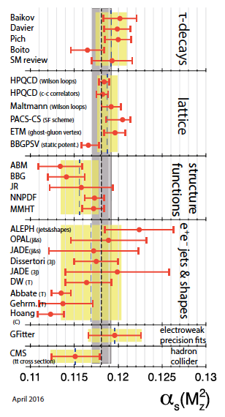
Errors on theory errors, e.g., in QCD
Uncertainties related to theoretical
predictions are notoriously difficult
to quantify, e.g., in QCD may come
from variation of renormalization
scale in some “appropriate range”.
Problematic e.g. for α_{s} →
If, e.g., some (theory) errors are
underestimated, one may obtain poor
goodness of fit, but size of confidence
interval from usual recipe will not
reflect this.
An outlier with an underestimated
error bar can have an inordinately
strong influence on the average.
M. Tanabashi et al. (Particle Data Group),
Phys. Rev. D 98, 030001 (2018)

Slide 43

Correlated uncertainties
The phrase “correlated uncertainties” usually means that a single
nuisance parameter affects the distribution (e.g., the mean) of more
than one measurement.
For example, consider measurements y, parameters of interest μ,
nuisance parameters θ with
That is, the θ_{i} are defined here as contributing to a bias and
the (known) factors R_{ij} determine how much θ_{j} affects y_{i}.
As before suppose one has independent control measurements
u_{i}~ Gauss(θ_{i}, σ_{ui}).

Slide 44



Correlated uncertainties (2)
The total bias of y_{i} can be defined as
which can be estimated with
These estimators are correlated having covariance
In this sense the present method treats “correlated uncertainties”,
i.e., the control measurements u_{i} are independent, but nuisance
parameters affect multiple measurements, and thus bias estimates
are correlated.

Slide 45





Single-measurement model
As a simplest example consider
y ~ Gauss(μ, σ²),
v ~ Gamma(α, β),
Test values of μ with t_{μ} = -2 ln λ(μ) with

Slide 46
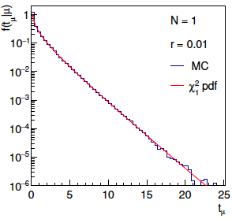
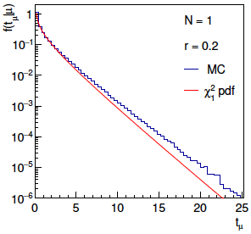
Distribution of t_{μ}
From Wilks’ theorem, in the asymptotic limit we should
find t_{μ} ~ chi-squared(1).
Here “asymptotic limit” means all estimators ~Gauss, which
means r → 0. For increasing r, clear deviations visible:

Slide 47
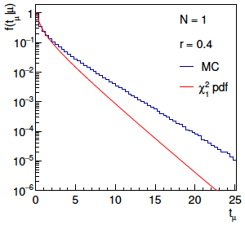
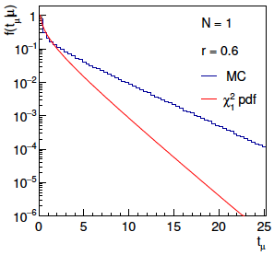
Distribution of t_{μ} (2)
For larger r, breakdown of asymptotics gets worse:
Values of r ~ several tenths are relevant so we cannot in general
rely on asymptotics to get confidence intervals, p-values, etc.

Slide 48

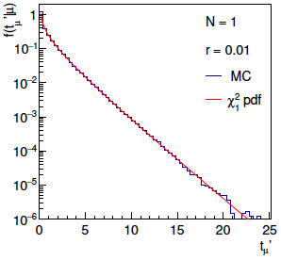
Bartlett corrections
One can modify t_{μ} defining
such that the new statistic’s distribution is better approximated
by chi-squared for n_{d} degrees of freedom (Bartlett, 1937).
For this example E[t_{μ}] ≈ 1 + 3r² + 2r⁴ works well:

Slide 49
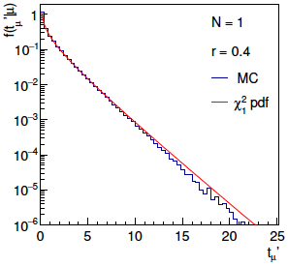
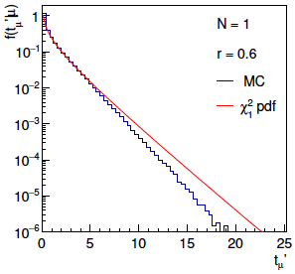
Bartlett corrections (2)
Good agreement for r ~ several tenths out to √t_{μ}ʹ ~ several, i.e.,
good for significances of several sigma:

Slide 50
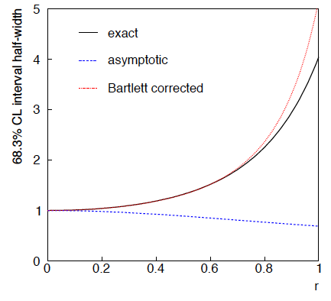
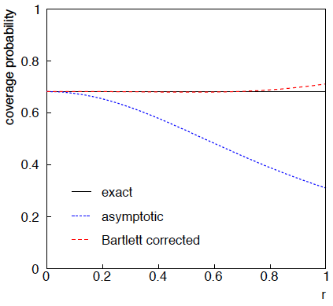
68.3% CL confidence interval for μ

Slide 51
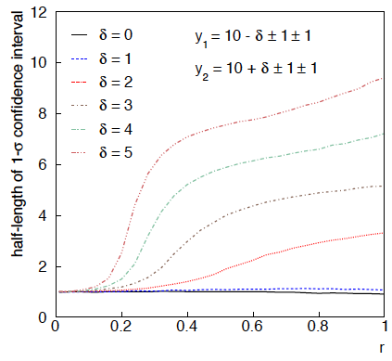
Same with interval from p_{μ} = α with nuisance parameters profiled at μ

Slide 52
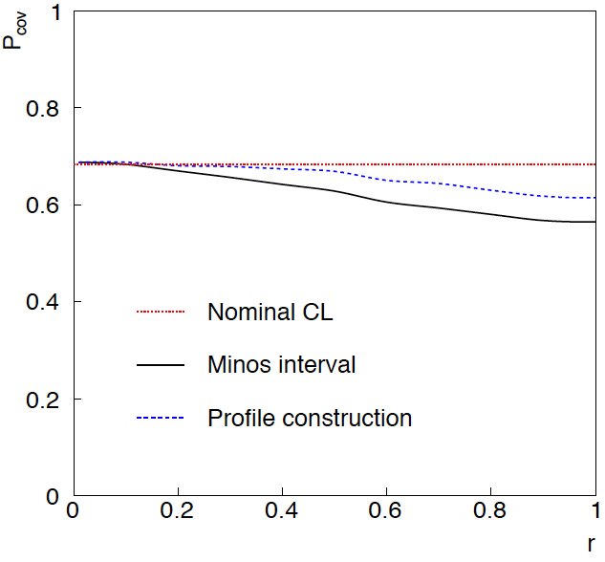
Coverage of intervals
Consider previous average of
two numbers but now generate
for i = 1, 2 data values
y_{i} ~ Gauss(μ, σ_{y,i})
u_{i} ~ Gauss(0, σ_{u,i})
v_{i} ~ Gamma(σ_{u,i}, r_{i})
σ_{y,i} = σ_{u,i} = 1
and look at the probability
that the interval covers the
true value of μ.
Coverage stays reasonable
to r ~ 0.5, even not bad
for Profile Construction
out to r ~ 1.

Slide 53
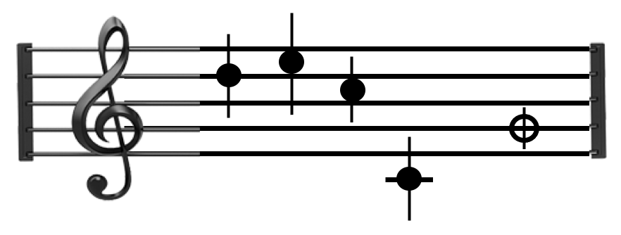
Tutorial: Student’s t average
Software: https://www.pp.rhul.ac.uk/~cowan/stat/exercises/stave/stave.py
The program stave.py implements the Gamma Variance Model (GVM) described in Lecture 3 for averaging N measurements.
For details see G. Cowan, EPJC (2019) 79:133.
In this version the model does not distinguish between statistical and systematic errors.
Confidence interval for the mean μ becomes sensitive to goodness-of-fit (increases if data internally inconsistent).
Estimated mean less sensitive to outliers.

Slide 54
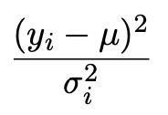
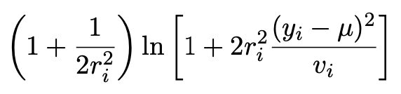
Least Squares vs Gamma Variance Model
Quadratic terms from Least Squares replaced by logarithmic ones:
where
y_{i} = measured value
v_{i} = s_{i}² = estimated variance
r_{i} = relative uncertainty on estimate of variance
Equivalent to replacing Gauss pdf for measurements by Student’s t, number of degrees of freedom = 1/2r_{i}²

Slide 55
A quick look at stave.py
Set measured values, estimates of std. dev., errors on errors:
y = np.array([17., 19., 15., 3.]) # measured values
s = np.array([1.5, 1.5, 1.5, 1.5]) # estimates of std. dev
v = s**2 # estimates of variances
r = np.array([0.2, 0.2, 0.2, 0.2]) # relative errors on errors
log-likelihood:
class NegLogL:
def __init__(self, y, s, r):
self.setData(y, s, r)
def setData(self, y, s, r):
self.data = y, s, r
def __call__(self, mu):
y, s, r = self.data
v = s ** 2
lnf = -0.5*(1. + 1./(2.*r**2))*np.log(1. + 2.*(r*(y-mu))**2/v)
return -np.sum(lnf)

Slide 56
Example average with GVM
Suppose four measurements of the parameter μ.
Each reports an estimated standard dev. of s = 1.5 and
a “relative error on the error” r = 0.2.
Suggested exercise:
Experiment with different numbers of measurements, different levels of internal consistency, different values for the std. dev. and error on error.
outlier

