Slide 1
Statistics for Particle Physics
Lecture 2
Terascale Statistics School
https://indico.desy.de/event/46667/
DESY, Hamburg
24-28 Feb 2025
Glen Cowan
Physics Department
Royal Holloway, University of London
g.cowan@rhul.ac.uk
www.pp.rhul.ac.uk/~cowan

Slide 2
Outline
Lectures/tutorials from me:
Monday 15:30 Hypothesis testing
Monday 16:30 Hypothesis testing tutorial
Tuesday 10:30 Parameter estimation tutorial
→ Tuesday 14:00 Setting limits
Wednesday 9:00 Bayesian parameter estimation
Wednesday 11:00 Errors on errors

Slide 3
Confidence intervals by inverting a test
In addition to a ‘point estimate’ of a parameter we should report
an interval reflecting its statistical uncertainty.
Confidence intervals for a parameter θ can be found by
defining a test of the hypothesized value θ (do this for all θ):
Specify values of the data that are ‘disfavoured’ by θ
(critical region) such that P(data in critical region|θ) ≤ α
for a prespecified α, e.g., 0.05 or 0.1.
If data observed in the critical region, reject the value θ.
Now invert the test to define a confidence interval as:
set of θ values that are not rejected in a test of size α
(confidence level CL is 1− α).

Slide 4
Relation between confidence interval and p-value
Equivalently we can consider a significance test for each
hypothesized value of θ, resulting in a p-value, p_{θ}.
If p_{θ} ≤ α, then we reject θ.
The confidence interval at CL = 1 – α consists of those values of
θ that are not rejected.
E.g. an upper limit on θ is the greatest value for which p_{θ} > α.
In practice find by setting p_{θ} = α and solve for θ.
For a multidimensional parameter space θ = (θ₁,... θ_{M}) use same idea – result is a confidence “region” with boundary determined by p_{θ} = α.

Slide 5
Coverage probability of confidence interval
If the true value of θ is rejected, then it’s not in the confidence interval. The probability for this is by construction (equality for continuous data):
P(reject θ|θ) ≤ α = type-I error rate
Therefore, the probability for the interval to contain or “cover” θ is
P(conf. interval “covers” θ|θ) ≥ 1 – α
This assumes that the set of θ values considered includes the true value, i.e., it assumes the composite hypothesis P(x|H,θ).

Slide 6
Frequentist upper limit on Poisson parameter
Consider again the case of observing n ~ Poisson(s + b).
Suppose b = 4.5, n_{obs} = 5. Find upper limit on s at 95% CL.
Relevant alternative is s = 0 (critical region at low n)
p-value of hypothesized s is P(n ≤ n_{obs}; s, b)
Upper limit s_{up} at CL = 1 – α found from

Slide 7
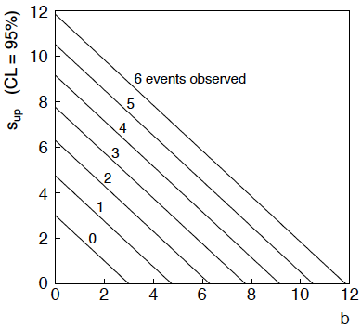
n ~ Poisson(s+b): frequentist upper limit on s
For low fluctuation of n, formula can give negative result for s_{up}; i.e. confidence interval is empty; all values of s ≥ 0 have p_{s} ≤ α.

Slide 8
Limits near a boundary of the parameter space
Suppose e.g. b = 2.5 and we observe n = 0.
If we choose CL = 0.9, we find from the formula for s_{up}
Physicist:
We already knew s ≥ 0 before we started; can’t use negative
upper limit to report result of expensive experiment!
Statistician:
The interval is designed to cover the true value only 90%
of the time — this was clearly not one of those times.
Not uncommon dilemma when testing parameter values for which
one has very little experimental sensitivity, e.g., very small s.

Slide 9
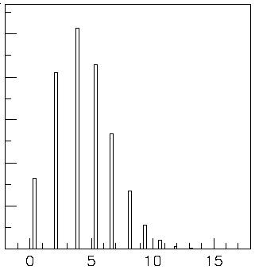
Expected limit for s = 0
Physicist: I should have used CL = 0.95 — then s_{up} = 0.496
Even better: for CL = 0.917923 we get s_{up} = 10⁻⁴ !
Reality check: with b = 2.5, typical Poisson fluctuation in n is
at least √2.5 = 1.6. How can the limit be so low?
Look at the mean limit for the
no-signal hypothesis (s = 0)
(sensitivity).
Distribution of 95% CL limits
with b = 2.5, s = 0.
Mean upper limit = 4.44

Slide 10
The Bayesian approach to limits
In Bayesian statistics need to start with ‘prior pdf’ π(θ), this
reflects degree of belief about θ before doing the experiment.
Bayes’ theorem tells how our beliefs should be updated in
light of the data x:
Integrate posterior pdf p(θ|x) to give interval with any desired
probability content.
For e.g. n ~ Poisson(s+b), 95% CL upper limit on s from

Slide 11
Bayesian prior for Poisson parameter
Include knowledge that s ≥ 0 by setting prior π(s) = 0 for s < 0.
Could try to reflect ‘prior ignorance’ with e.g.
Not normalized; can be OK provided p(n|s) dies off quickly for large s.
Not invariant under change of parameter — if we had used instead a flat prior for a nonlinear function of s, then this would imply a non-flat prior for s.
Doesn’t really reflect a reasonable degree of belief, but often used as a point of reference; or viewed as a recipe for producing an interval whose frequentist properties can be studied (e.g., coverage probability, which will depend on true s).

Slide 12
Bayesian upper limit with flat prior for s
Put Poisson likelihood and flat prior into Bayes’ theorem:
Normalize to unit area:
upper incomplete
gamma function
Upper limit s_{up} determined by

Slide 13
Bayesian interval with flat prior for s
Solve to find limit s_{up}:
where
For special case b = 0, Bayesian upper limit with flat prior
numerically same as one-sided frequentist case (‘coincidence’).

Slide 14
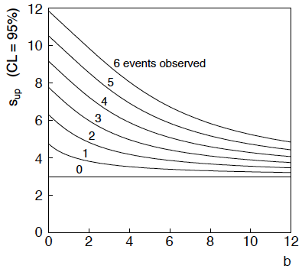
Bayesian interval with flat prior for s
For b > 0 Bayesian limit is everywhere greater than the (one sided) frequentist upper limit.
For b = 0 , Bayesian and frequentist upper limits come out equal.
Never goes negative.
Doesn’t depend on b if n = 0.

Slide 15
Systematic uncertainties and nuisance parameters
P (x|μ)
In general, our model of the data is not perfect:
model:
truth:
x
Can improve model by including
additional adjustable parameters.
Nuisance parameter ↔ systematic uncertainty. Some point in the
parameter space of the enlarged model should be “true”.
Presence of nuisance parameter decreases sensitivity of analysis
to the parameter of interest (e.g., increases variance of estimate).

Slide 16
Profile Likelihood
Suppose we have a likelihood L(μ,θ) = P(x|μ,θ) with N parameters of interest μ = (μ₁,..., μ_{N}) and M nuisance parameters θ = (θ₁,..., θ_{M}). The “profiled” (or “constrained”) values of θ are:
and the profile likelihood is:
The profile likelihood depends only on the parameters of interest; the nuisance parameters are replaced by their profiled values.
The profile likelihood can be used to obtain confidence intervals/regions for the parameters of interest in the same way as one would for all of the parameters from the full likelihood.

Slide 17
Profile Likelihood Ratio – Wilks theorem
Goal is to test/reject regions of μ space (param. of interest).
Rejecting a point μ should mean p_{μ} ≤ α for all possible values of the nuisance parameters θ.
Test μ using the “profile likelihood ratio”:
Let t_{μ} = −2 ln λ(μ). Wilks’ theorem says in large-sample limit:
where the number of degrees of freedom is the number of
parameters of interest (components of μ). So p-value for μ is

Slide 18
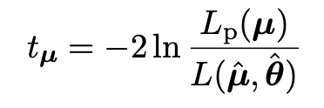
Profile Likelihood Ratio – Wilks theorem (2)
Set p_{μ} = α and solve for t_{μ} (here means observed value)
which is also
Equate and solve for ln L_{p}(μ) gives the recipe to get confidence regions/intervals for the parameters of interest at CL = 1 – α:
where the number of degrees of freedom N for the chi-square quantile is equal to the number of parameters of interest.
If the large-sample limit is not justified, then use e.g. Monte Carlo to get distribution of t_{μ}.

Slide 19
Prototype search analysis
Search for signal in a region of phase space; result is histogram
of some variable x giving numbers:
Assume the n_{i} are Poisson distributed with expectation values
strength parameter
where
signal
background

Slide 20
Prototype analysis (II)
Often also have a subsidiary measurement that constrains some
of the background and/or shape parameters:
Assume the m_{i} are Poisson distributed with expectation values
nuisance parameters (θ_{s}, θ_{b},b_{tot})
Likelihood function is

Slide 21
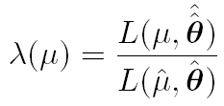
The profile likelihood ratio
Base significance test on the profile likelihood ratio:
maximizes L for
specified μ
maximize L
Define critical region of test of μ by the region of data space
that gives the lowest values of λ(μ).
Important advantage of profile LR is that its distribution becomes independent of nuisance parameters in large sample limit.

Slide 22
Test statistic for discovery
Suppose relevant alternative to background-only (μ = 0) is μ ≥ 0.
So take critical region for test of μ = 0 corresponding to high q₀
and > 0 (data characteristic for μ ≥ 0).
That is, to test background-only hypothesis define statistic
i.e. here only large (positive) observed signal strength is evidence against the background-only hypothesis.
Note that even though here physically μ ≥ 0, we allow
to be negative. In large sample limit its distribution becomes
Gaussian, and this will allow us to write down simple
expressions for distributions of our test statistics.

Slide 23
Cowan, Cranmer, Gross, Vitells, arXiv:1007.1727, EPJC 71 (2011) 1554
Distribution of q₀ in large-sample limit
Assuming approximations valid in the large sample (asymptotic)
limit, we can write down the full distribution of q₀ as
The special case μ′ = 0 is a “half chi-square” distribution:
In large sample limit, f (q₀|0) independent of nuisance parameters;
f (q₀|μ′) depends on nuisance parameters through σ.

Slide 24
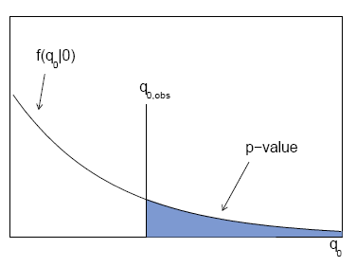
p-value for discovery
Large q₀ means increasing incompatibility between the data
and hypothesis, therefore p-value for an observed q_{0,obs} is
use e.g. asymptotic formula
From p-value get
equivalent significance,

Slide 25
Cowan, Cranmer, Gross, Vitells, arXiv:1007.1727, EPJC 71 (2011) 1554
Cumulative distribution of q₀, significance
From the pdf, the cumulative distribution of q₀ is found to be
The special case μ′ = 0 is
The p-value of the μ = 0 hypothesis is
Therefore the discovery significance Z is simply

Slide 26
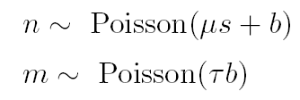
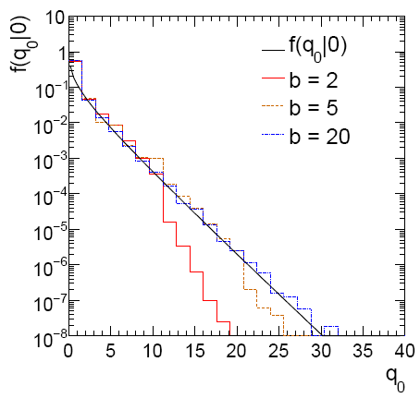
Cowan, Cranmer, Gross, Vitells, arXiv:1007.1727, EPJC 71 (2011) 1554
Monte Carlo test of asymptotic formula
μ = param. of interest
b = nuisance parameter
Here take s known, τ = 1.
Asymptotic formula is
good approximation to 5σ
level (q₀ = 25) already for
b ~ 20.

Slide 27
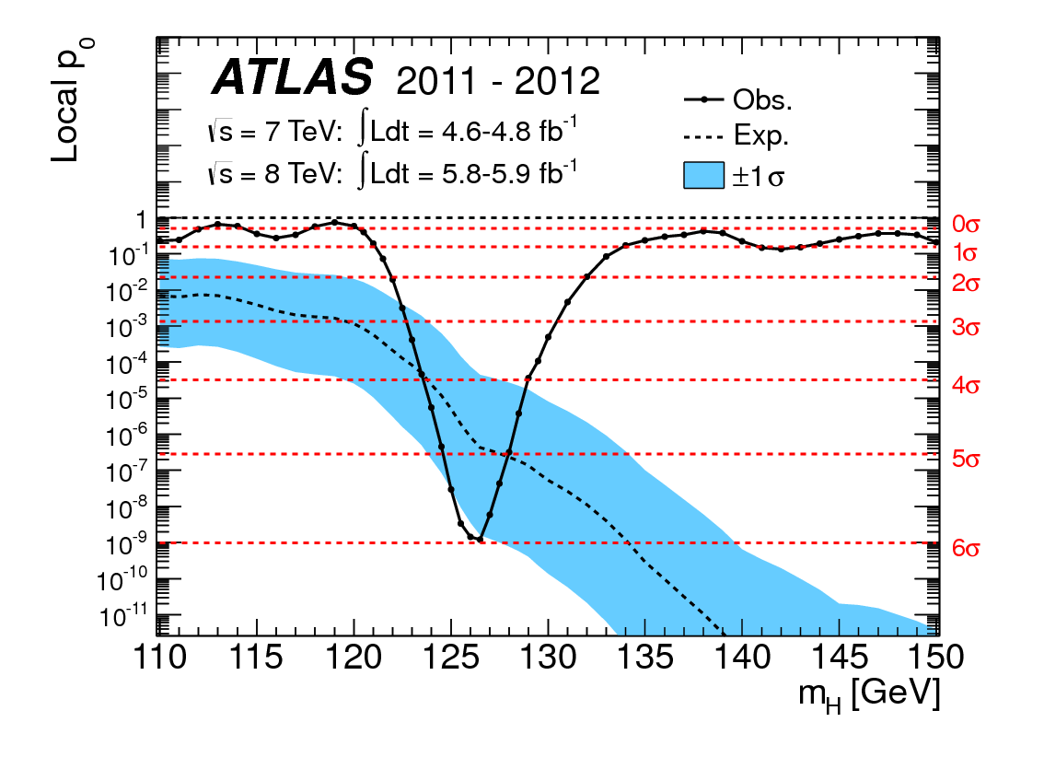
How to read the p₀ plot
The “local” p₀ means the p-value of the background-only
hypothesis obtained from the test of μ = 0 at each individual m_{H}, without any correct for the Look-Elsewhere Effect.
The “Expected” (dashed) curve gives the median p₀ under assumption of the SM Higgs (μ = 1) at each m_{H}.
ATLAS, Phys. Lett. B 716 (2012) 1-29
The blue band gives the
width of the distribution
(±1σ) of significances
under assumption of the
SM Higgs.

Slide 28
Cowan, Cranmer, Gross, Vitells, arXiv:1007.1727, EPJC 71 (2011) 1554
Test statistic for upper limits
For purposes of setting an upper limit on μ use
where
I.e. when setting an upper limit, an upwards fluctuation of the data
is not taken to mean incompatibility with the hypothesized μ :
From observed q_{μ} find p-value:
Large sample approximation:
To find upper limit at CL = 1−α, set p_{μ} = α and solve for μ.

Slide 29
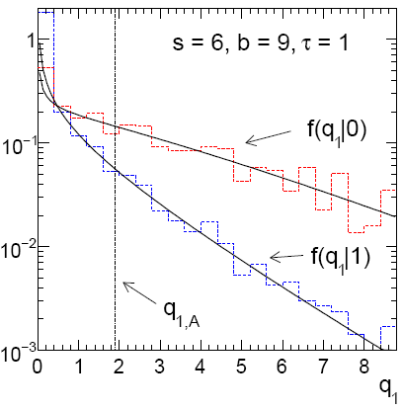
Cowan, Cranmer, Gross, Vitells, arXiv:1007.1727, EPJC 71 (2011) 1554
Monte Carlo test of asymptotic formulae
Consider again n ~ Poisson(μs + b), m ~ Poisson(τb)
Use q_{μ} to find p-value of hypothesized μ values.
E.g. f (q₁|1) for p-value of μ =1.
Typically interested in 95% CL, i.e., p-value threshold = 0.05, i.e.,
q₁ = 2.69 or Z₁ = √q₁ = 1.64.
Median[q₁ |0] gives “exclusion sensitivity”.
Here asymptotic formulae good
for s = 6, b = 9.

Slide 30
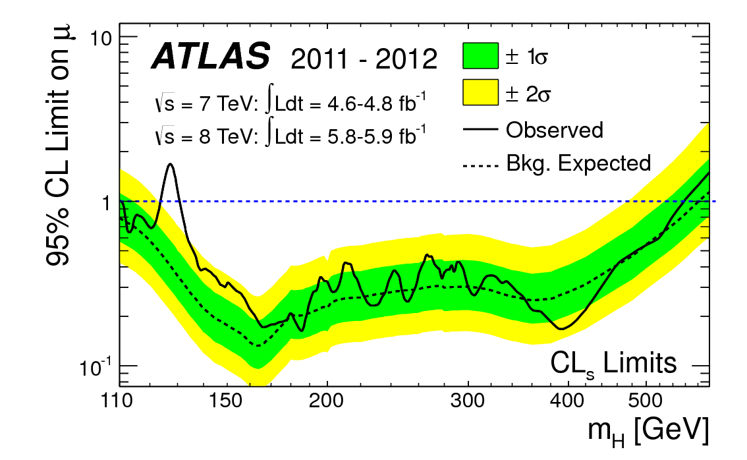
How to read the green and yellow limit plots
For every value of m_{H}, find the upper limit on μ.
Also for each m_{H}, determine the distribution of upper limits μ_{up} one would obtain under the hypothesis of μ = 0.
The dashed curve is the median μ_{up}, and the green (yellow) bands give the ± 1σ (2σ) regions of this distribution.
ATLAS, Phys. Lett. B 716 (2012) 1-29

Slide 31
Extra slides

Slide 32
Approximate confidence intervals/regions from the likelihood function
Suppose we test parameter value(s) θ = (θ₁, ..., θ_{n}) using the ratio
Lower λ(θ) means worse agreement between data and hypothesized θ. Equivalently, usually define
so higher t_{θ} means worse agreement between θ and the data.
p-value of θ therefore
need pdf

Slide 33
Confidence region from Wilks’ theorem
Wilks’ theorem says (in large-sample limit and provided
certain conditions hold...)
chi-square dist. with # d.o.f. =
# of components in θ = (θ₁, ..., θ_{n}).
Assuming this holds, the p-value is
← set equal to α
To find boundary of confidence region set p_{θ} = α and solve for t_{θ}:
Recall also

Slide 34
Confidence region from Wilks’ theorem (cont.)
i.e., boundary of confidence region in θ space is where
For example, for 1 – α = 68.3% and n = 1 parameter,
and so the 68.3% confidence level interval is determined by
Same as recipe for finding the estimator’s standard deviation, i.e.,
is a 68.3% CL confidence interval.

Slide 35
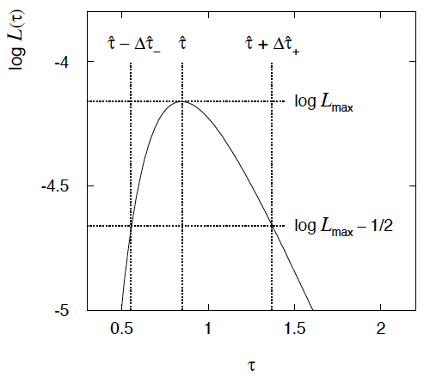
Example of interval from ln L(θ)
For n=1 parameter, CL = 0.683, Q_{α} = 1.
Our exponential
example, now with
only n = 5 events.
Can report ML estimate
with approx. confidence
interval from ln L_{max} – 1/2
as “asymmetric error bar”:

Slide 36
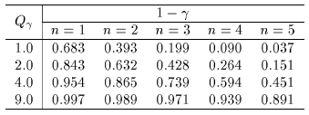
Multiparameter case
For increasing number of parameters, CL = 1 – α decreases for
confidence region determined by a given

Slide 37
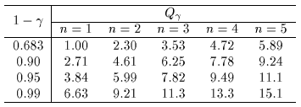
Multiparameter case (cont.)
Equivalently, Q_{α} increases with n for a given CL = 1 – α.

Slide 38
Expected significance (sensitivity)
To characterize sensitivity to discovery, give expected (mean
or median) Z under assumption of a given s.
For large s + b, n → x ~ Gaussian(μ,σ) , μ = s + b, σ = √(s + b).
For observed value x_{obs}, p-value of s = 0 is Prob(x > x_{obs} | s = 0),:
Significance for rejecting s = 0 is therefore
Expected (median) significance assuming signal rate s is

Slide 39
Better approximation for significance
Poisson likelihood for parameter s is
For now
no nuisance
params.
To test for discovery use profile likelihood ratio:
So the likelihood ratio statistic for testing s = 0 is

Slide 40
Approximate Poisson significance (continued)
For sufficiently large s + b, (use Wilks’ theorem),
To find median[Z|s], let n → s + b (i.e., the Asimov data set):
This reduces to s/√b for s << b.

Slide 41
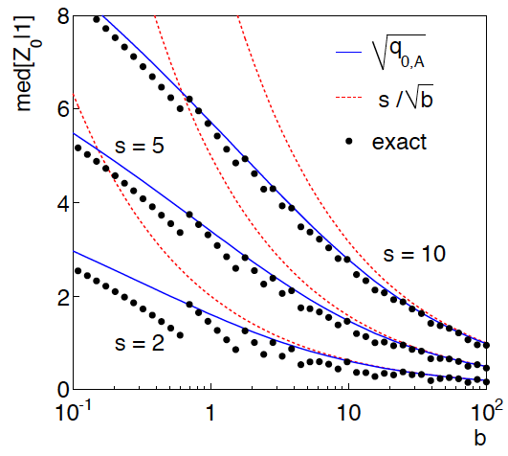
n ~ Poisson(s+b), median significance, assuming s, of the hypothesis s = 0
CCGV, EPJC 71 (2011) 1554, arXiv:1007.1727
“Exact” values from MC,
jumps due to discrete data.
Asimov √q_{0,A} good approx.
for broad range of s, b.
s/√b only good for s ≪ b.

Slide 42
Extending s/√b to case where b uncertain
The intuitive explanation of s/√b is that it compares the signal,
s, to the standard deviation of n assuming no signal, √b.
Now suppose the value of b is uncertain, characterized by a
standard deviation σ_{b}.
A reasonable guess is to replace √b by the quadratic sum of
√b and σ_{b}, i.e.,
This has been used to optimize some analyses e.g. where
σ_{b} cannot be neglected.

Slide 43
Profile likelihood with b uncertain
This is the well studied “on/off” problem: Cranmer 2005;
Cousins, Linnemann, and Tucker 2008; Li and Ma 1983,...
Measure two Poisson distributed values:
n ~ Poisson(s+b) (primary or “search” measurement)
m ~ Poisson(τb) (control measurement, τ known)
The likelihood function is
Use this to construct profile likelihood ratio (b is nuisance
parameter):

Slide 44
Ingredients for profile likelihood ratio
To construct profile likelihood ratio from this need estimators:
and in particular to test for discovery (s = 0),

Slide 45
Asymptotic significance
Use profile likelihood ratio for q₀, and then from this get discovery
significance using asymptotic approximation (Wilks’ theorem):
Essentially same as in:

Slide 46
Asimov approximation for median significance
To get median discovery significance, replace n, m by their
expectation values assuming background-plus-signal model:
n → s + b
m → τb
ˆ
Or use the variance of b = m/τ,
, to eliminate τ:

Slide 47
Limiting cases
Expanding the Asimov formula in powers of s/b and
σ_{b}²/b (= 1/τ) gives
So the “intuitive” formula can be justified as a limiting case
of the significance from the profile likelihood ratio test evaluated
with the Asimov data set.

Slide 48
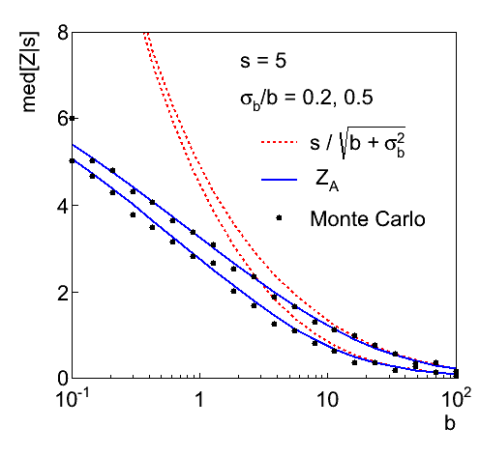
Testing the formulae: s = 5

Slide 49
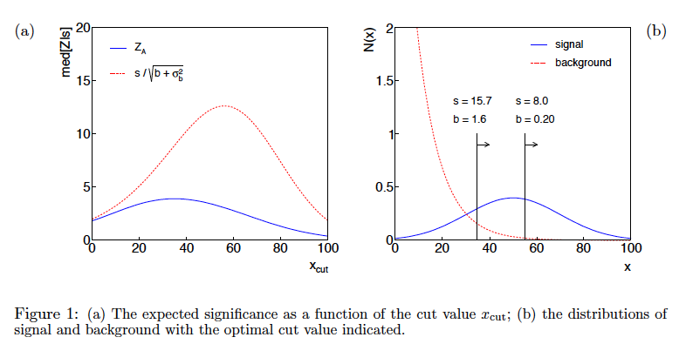
Using sensitivity to optimize a cut

Slide 50
Summary on discovery sensitivity
Simple formula for expected discovery significance based on
profile likelihood ratio test and Asimov approximation:
For large b, all formulae OK.
For small b, s/√b and s/√(b+σ_{b}²) overestimate the significance.
Could be important in optimization of searches with
low background.
Formula maybe also OK if model is not simple on/off experiment,
e.g., several background control measurements (check this).

