Slide 1



Statistics for Particle Physics
Lecture 3
Terascale Statistics School
https://indico.desy.de/event/46667/
DESY, Hamburg
24-28 Feb 2025
Glen Cowan
Physics Department
Royal Holloway, University of London
g.cowan@rhul.ac.uk
www.pp.rhul.ac.uk/~cowan

Slide 2
Outline
Monday 15:30 Hypothesis testing
Monday 16:30 Hypothesis testing tutorial
Tuesday 10:30 Parameter estimation tutorial
Tuesday 14:00 Setting limits
→ Wednesday 9:00 Bayesian parameter estimation
Wednesday 11:00 Errors on errors

Slide 3
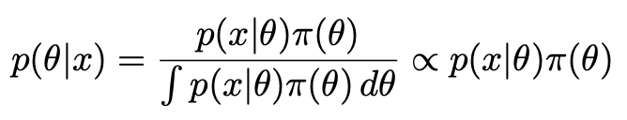
Reminder of Bayesian approach
In Bayesian statistics we can associate a probability with
a hypothesis, e.g., a parameter value θ.
Interpret probability of θ as ‘degree of belief’ (subjective).
Need to start with ‘prior pdf’ π(θ), this reflects degree
of belief about θ before doing the experiment.
Our experiment has data x, → likelihood p(x|θ).
Bayes’ theorem tells how our beliefs should be updated in
light of the data x:
Posterior pdf p(θ|x) contains all our knowledge about θ.

Slide 4
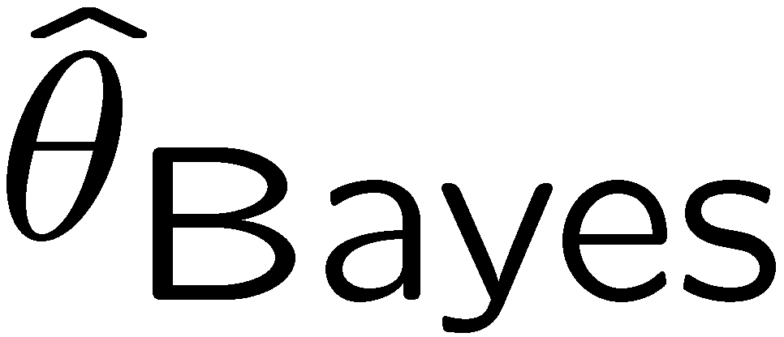


ML and Bayesian estimators
Purist Bayesian: p(θ | x) contains all knowledge about θ.
Pragmatist Bayesian: p(θ | x) could be a complicated function,
→ summarize using an estimator
Take mode of p(θ | x), (could also use e.g. expectation value)
What do we use for π(θ)?
No golden rule (subjective!), often represent ‘prior ignorance’ by π(θ) = constant, in which case

Slide 5
ML and Bayesian estimators (2)
Note π_{θ}(θ) = const. cannot be normalized – “improper prior”.
Can be allowed for some problems; prior always appears multiplied
by likelihood, so product L(θ)π_{θ}(θ) can result in normalizable posterior probability.
But... we could have used a different parameter, e.g., λ= 1/θ,
and if prior π_{θ}(θ) is constant, then π_{λ}(λ) is not:
Maybe we know say we nothing about λ, so take π_{λ}(λ) = const.
Then
‘Complete prior ignorance’ is not well defined.

Slide 6
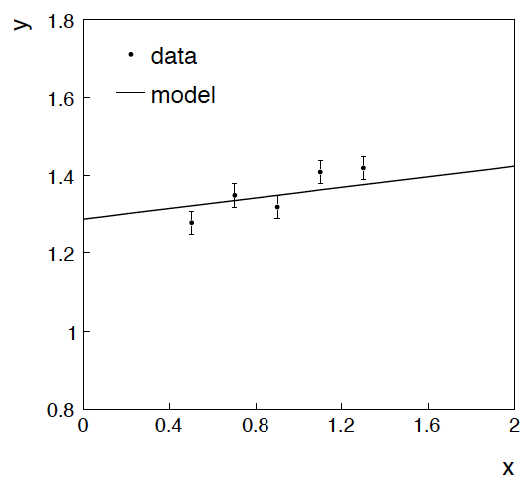
Example: fitting a straight line
Data:
Model: y_{i} independent and all follow y_{i} ~ Gauss(μ(x_{i} ), σ_{i} )
assume x_{i} and σ_{i} known.
Goal: estimate θ₀
Here suppose we don’t care
about θ₁ (example of a
“nuisance parameter”)

Slide 7
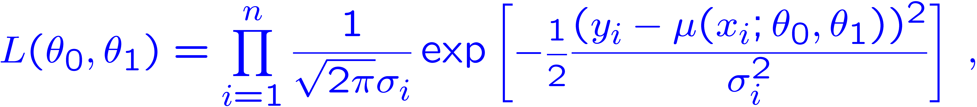
Maximum likelihood fit with Gaussian data
In this example, the y_{i} are assumed independent, so the
likelihood function is a product of Gaussians:
Maximizing the likelihood is here equivalent to minimizing
i.e., for Gaussian data, ML same as Method of Least Squares (LS)

Slide 8
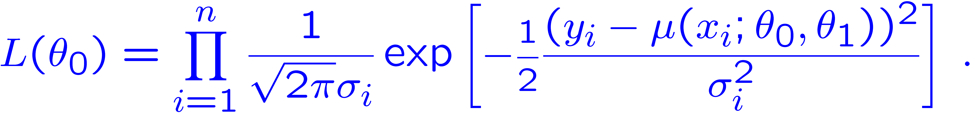
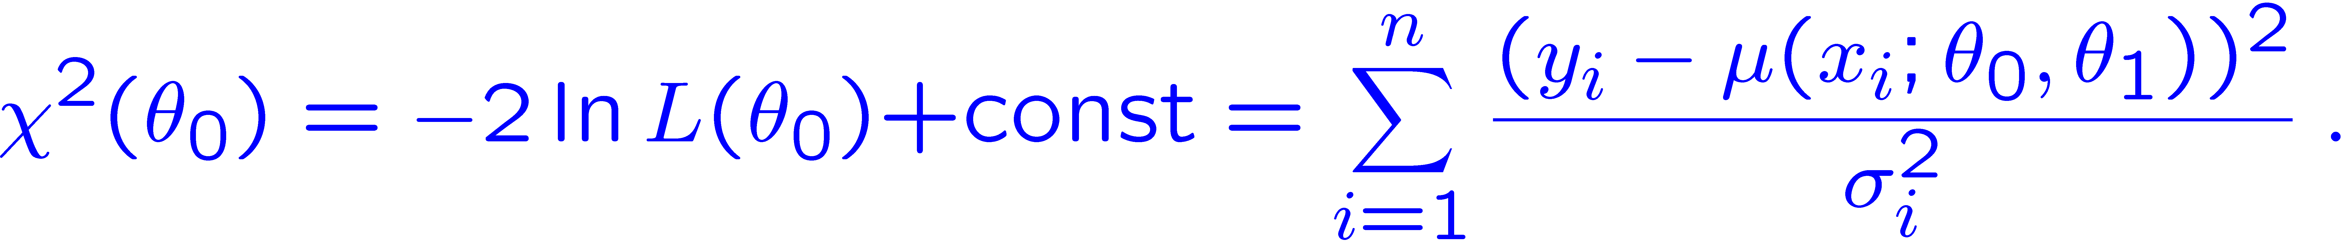
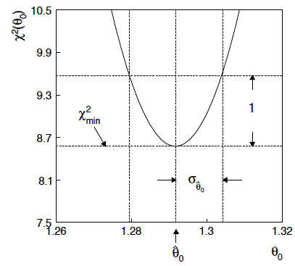
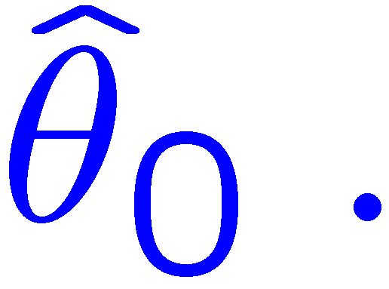
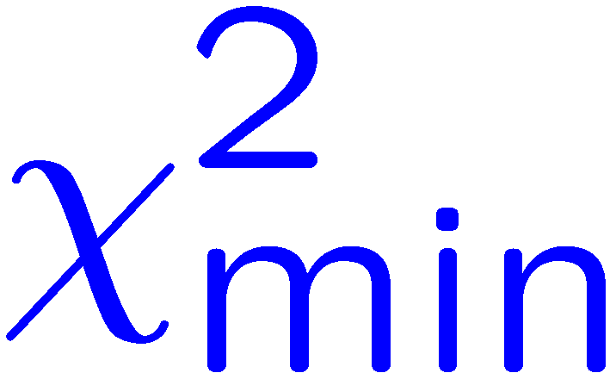
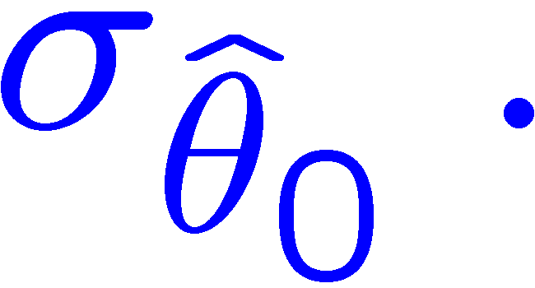
θ₁ known a priori
For Gaussian y_{i}, ML same as LS
Minimize χ² → estimator
Come up one unit from
to find

Slide 9
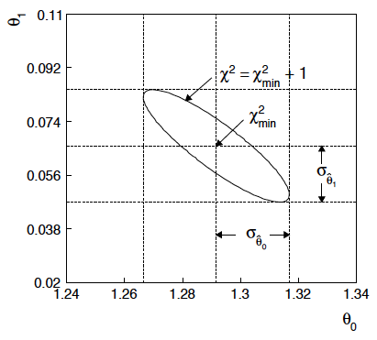
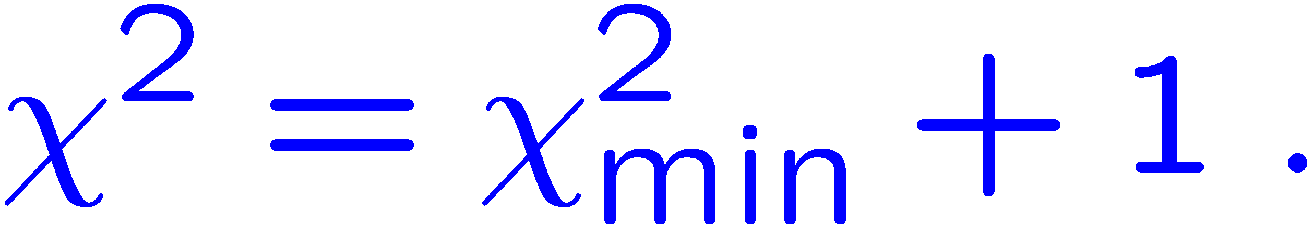
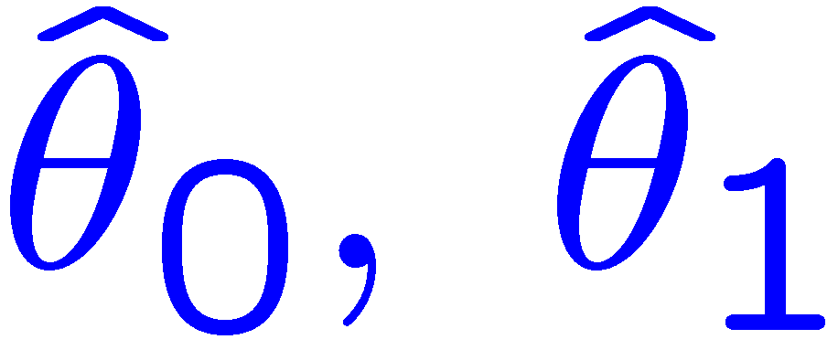
ML (or LS) fit of θ₀ and θ₁
Standard deviations from
tangent lines to contour
Correlation between
causes errors
to increase.

Slide 10


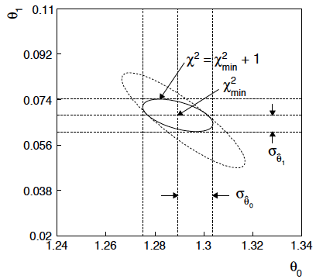
If we have a measurement t₁ ~ Gauss (θ₁, σ_{t1})
The information on θ₁
improves accuracy of

Slide 11
Bayesian approach: y_{i} ~ Gauss(μ(x_{i}; θ₀, θ₁), σ_{i})
We need to associate prior probabilities with θ₀ and θ₁, e.g.,
← suppose knowledge of θ₀ has no influence on knowledge of θ₁
← ‘non-informative’, in any
case much broader than L(θ₀)
prior after t₁,
before y
Ur = “primordial”
prior
Likelihood for control
measurement t₁

Slide 12
Bayesian example: y_{i} ~ Gauss(μ(x_{i}; θ₀, θ₁), σ_{i})
Putting the ingredients into Bayes’ theorem gives:
posterior ∝ likelihood ✕ prior
Note here the likelihood only reflects the measurements y.
The information from the control measurement t₁ has been put into the prior for θ₁.
We would get the same result using the likelihood P(y,t|θ₀,θ₁) and the constant “Ur-prior” for θ₁.
Here posterior only found as a proportionality.

Slide 13
Marginalizing the posterior pdf
We then integrate (marginalize) p(θ₀, θ₁ | y) to find p(θ₀ | y):
In this example we can do the integral (rare). We find
(same as for MLE)
For this example, numbers come out same as in frequentist approach, but interpretation different.

Slide 14
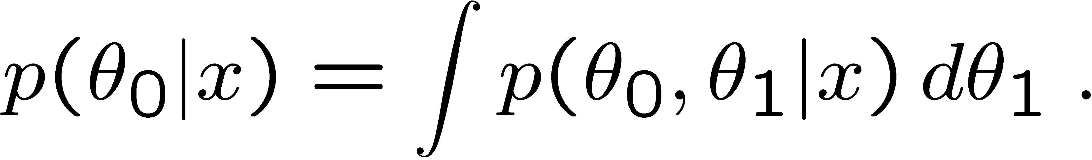
Marginalization with MCMC
Bayesian computations involve integrals like
often high dimensionality and impossible in closed form,
also impossible with ‘normal’ acceptance-rejection Monte Carlo.
Markov Chain Monte Carlo (MCMC) has revolutionized
Bayesian computation.
MCMC (e.g., Metropolis-Hastings algorithm) generates
correlated sequence of random numbers:
cannot use for many applications, e.g., detector MC;
effective stat. error greater than if all values independent .
Basic idea: sample multidimensional θ but look only at distribution of parameters of interest.

Slide 15
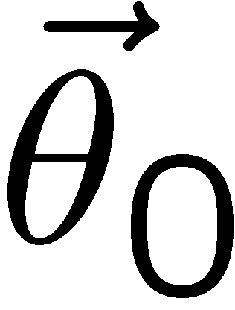
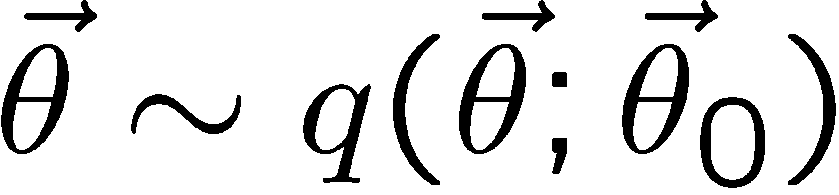
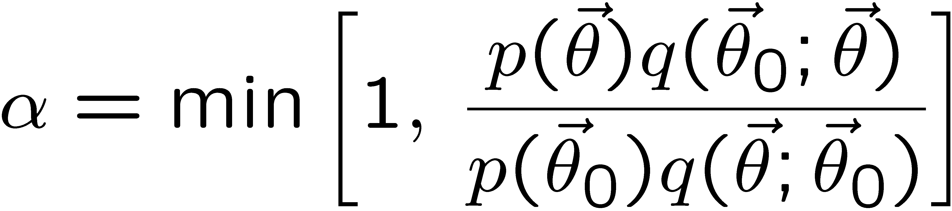
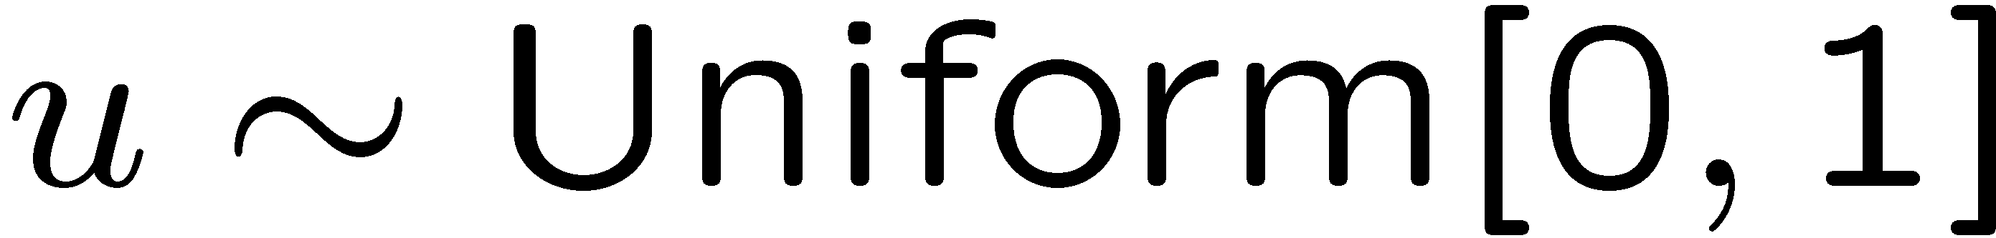
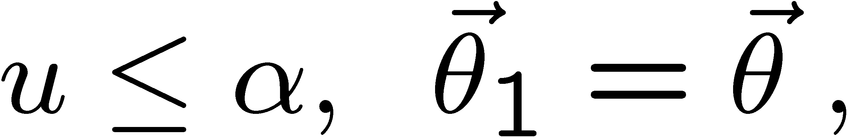
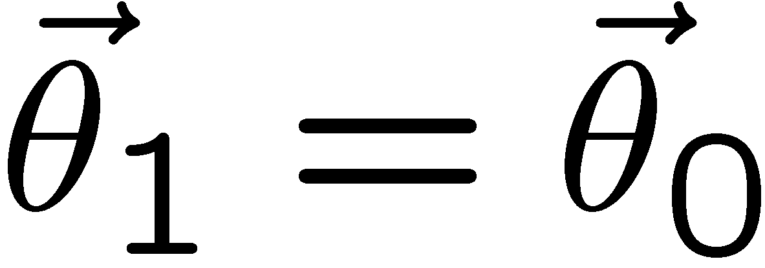
MCMC basics: Metropolis-Hastings algorithm
Goal: given an n-dimensional pdf p(θ) up to a proportionality constant, generate a sequence of points θ₁ , θ₂ , θ₃ ,...
Proposal density q(θ; θ₀ )
e.g. Gaussian centred
about θ₀
1) Start at some point
2) Generate
3) Form test ratio
4) Generate
5) If
move to proposed point
else
old point repeated
6) Iterate

Slide 16
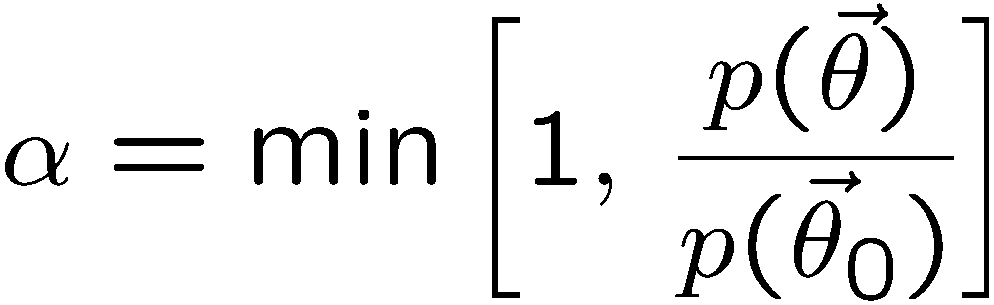
Metropolis-Hastings (continued)
This rule produces a correlated sequence of points (note how
each new point depends on the previous one).
Still works if p(θ) is known only as a proportionality, which is
usually what we have from Bayes’ theorem: p(θ|x) ∝ p(x|θ) π(θ).
The proposal density can be (almost) anything, but choose
so as to minimize autocorrelation. Often take proposal
density symmetric: q(θ; θ₀ ) = q(θ₀; θ )
Test ratio is (Metropolis-Hastings):
I.e. if the proposed step is to a point of higher p(θ), take it;
if not, only take the step with probability p(θ)/p(θ₀).
If proposed step rejected, repeat the current point.

Slide 17

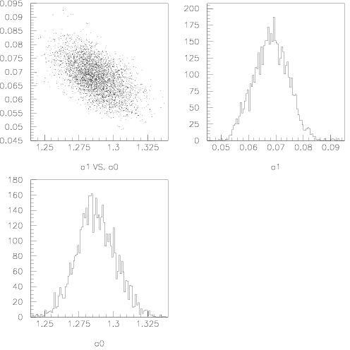
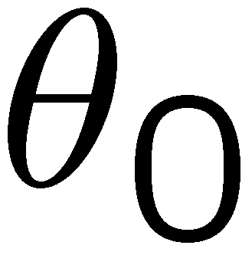
Example: posterior pdf from MCMC
Sample the posterior pdf from previous example with MCMC:
Normalized histogram of θ₀ gives its marginal posterior pdf:

Slide 18
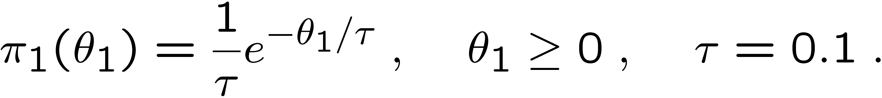
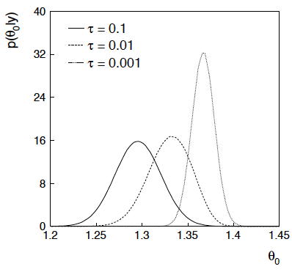
Bayesian method with alternative priors
Suppose we don’t have a previous measurement of θ₁ but rather,
an “expert” says it should be positive and not too much greater than 0.1 or so, i.e., something like
From this we obtain (numerically) the posterior pdf for θ₀:
This summarizes all
knowledge about θ₀.
Look also at result from
variety of priors.

Slide 19
Tutorial: Bayesian parameter estimation
The exercise is described
https://www.pp.rhul.ac.uk/~cowan/stat/exercises/bayesFit/
in the file bayes_fit_exercise.pdf.
The program is in bayesFit.py or bayesFit.ipynb.
This exercise treats the same fitting problem as seen with maximum likelihood, here using the Bayesian approach.
Bayes’ theorem is used to find the posterior pdf for the parameters, and these are summarized using the posterior mode (MAP estimators).
The posterior pdf is marginalized over the nuisance parameters using Markov Chain Monte Carlo.

Slide 20
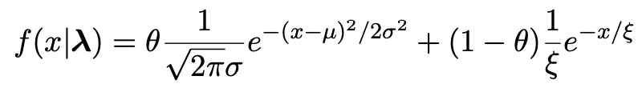
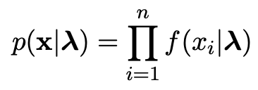

Gaussian signal on exponential background
Same pdf as from mlFit.py (see tutorial 1) with n = 400 independent values of x from
Posterior pdf for parameters λ = (θ, μ, σ, ξ) from Bayes theorem,
where
At first take prior pdf constant for all parameters subject to 0 ≤ θ ≤ 1, σ > 0, ξ > 0 (later try different priors).

Slide 21
Data and MAP estimates
Maximize posterior with minuit (minimize – ln p(λ|x)).
Standard deviations from minuit correspond to approximating posterior as Gaussian near its peak.
Here priors constant so
MAP estimates same as MLE, covariance matrix
V_{ij} = cov[θ_{i}, θ_{j}] also same.

Slide 22
A look at bayesFit.py
Find maximum of posterior with iminuit (minimize – ln p(λ|x)), similar to maximum likelihood:
# Negative log-likelihood
def negLogL(par):
fx = f(xData, par)
return -np.sum(np.log(fx))
# Prior pdf
def prior(par):
theta = par[0]
mu = par[1]
sigma = par[2]
xi = par[3]
pi_theta = 1. if theta >= 0. and theta <= 1. else 0.
pi_mu = 1. if mu >= 0. else 0.
pi_sigma = 1. if sigma > 0. else 0.
pi_xi = 1. if xi > 0. else 0.
piArr = np.array([pi_theta, pi_mu, pi_sigma, pi_xi])
pi = np.product(piArr[np.array(parfix) == False]) # exclude fixed par
return pi
# Negative log of posterior pdf
def negLogPost(par):
return negLogL(par) - np.log(prior(par))
minimize with iminuit

Slide 23
Metropolis-Hastings algorithm in bayesFit.py
# Iterate with Metropolis-Hastings algorithm
chain = [np.array(MAP)] # start point is MAP estimate
numIterate = 10000
numBurn = 100
numAccept = 0
print("Start MCMC iterations: ", end="")
while len(chain) < numIterate:
par = chain[-1]
log_post = -negLogL(par) + np.log(prior(par))
par_prop = np.random.multivariate_normal(par, cov_prop)
if prior(par_prop) <= 0:
chain.append(chain[-1]) # never accept if prob<=0.
else:
log_post_prop = -negLogL(par_prop) + np.log(prior(par_prop))
alpha = np.exp(log_post_prop - log_post)
u = np.random.uniform(0, 1)
if u <= alpha:
chain.append(par_prop)
numAccept += 1
else:
chain.append(chain[-1])
if len(chain)%(numIterate/100) == 0:
print(".", end="", flush=True)
chain = np.array(chain)
Try increasing number of iterations (10k runs in about 20 s).

Slide 24
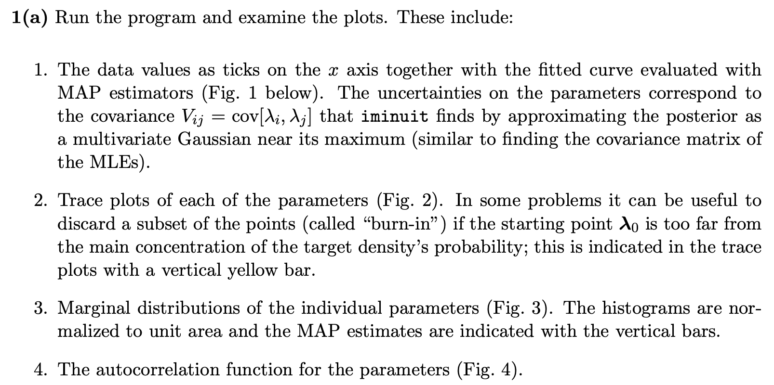
Exercises on Bayesian parameter estimation (a)
1a) Run bayesFit.py, look at the plots

Slide 25
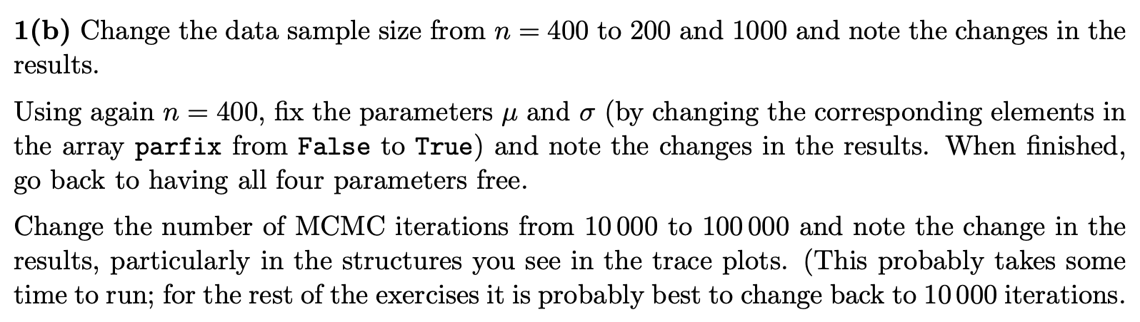
Exercises on Bayesian parameter estimation (b,c)
1b) Investigate effect of data sample size, fixing parameters and length of MCMC chains.
1c) Investigate changing the prior

Slide 26
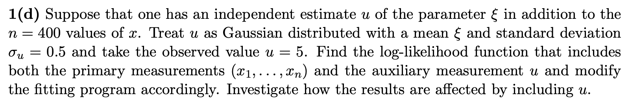
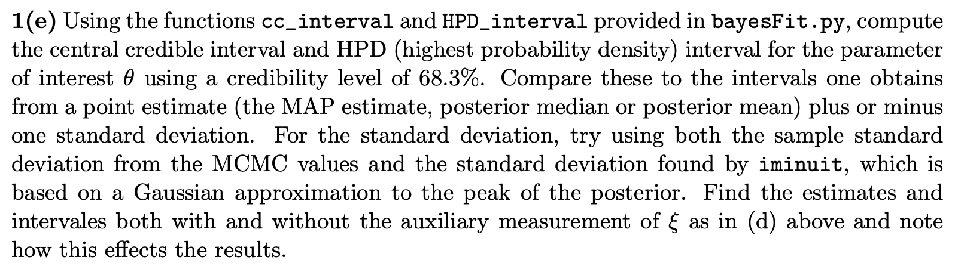
Exercises on Bayesian parameter estimation (d)
1d) Include auxiliary measurement to constrain ξ
1e) Investigate point and interval estimates for θ

Slide 27
MCMC trace plots
Take θ as parameter of interest, rest are nuisance parameters.
Marginalize by sampling posterior pdf with Metropolis-Hastings.
Gaussian proposal pdf, covariance U = sV,
s = (2.38)²/N_{par} = 1.41, gives acceptance
probability ~ 0.24.
Here 10 000 iterations (should use more).

Slide 28

Marginal distributions
MAP estimates shown with vertical bars
Note long tails.
Interpretation: data distribution can be approximated by Gaussian term only, (θ large, μ small) with large width (σ ~ 4-8) and a narrow exponential (ξ ~ 1-3).

Slide 29
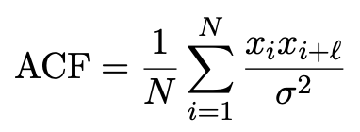
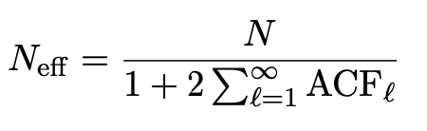
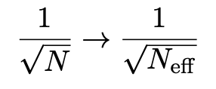
Autocorrelation versus lag
MCMC samples are not independent, autocorrelation function = correlation coefficient of sample x_{i} with x_{i+l} as a function of the lag, l, where x = any of θ, μ, σ, ξ minus its mean:
Effective sample size
In stat. error estimates

Slide 30
Ways to summarize the posterior
Point estimates:
Posterior mode (MAP, coincides with MLE for constant prior).
Posterior median (invariant under monotonic transformation of parameter).
Posterior mean; coincides with above in large-sample limit.
Intervals:
Highest Probability Density (HPD) interval, shortest for a given probability content, not invariant under param. trans.
Central credible intervals, equal upper and lower tail areas, e.g., α/2 for CL = 1 – α.
Point estimate +/- standard deviation, std. dev. from MCMC sample or by approximating core of posterior as Gaussian (from minuit); coincides with above in large-sample limit.

Slide 31
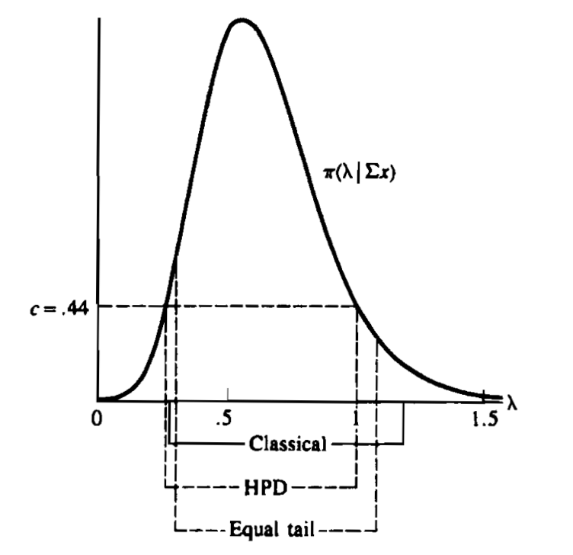
Types of intervals
HPD = Highest Posterior Density
Equal tail (central) from posterior
Classical (frequentist)
G. Casella and R. Berger, Statistical Inference, 2002

