Slide 1



Statistics for Particle Physics
Lecture 1
Introduction to the Terascale
https://indico.desy.de/event/46666/
DESY, Hamburg
19 March 2025
Glen Cowan
Physics Department
Royal Holloway, University of London
g.cowan@rhul.ac.uk
www.pp.rhul.ac.uk/~cowan

Slide 2
Outline
→ Wednesday 9:00 Quick review of probability
Hypothesis testing
Wednesday 9:45 p-values
Confidence intervals / limits
More resources in the University of London course:
https://www.pp.rhul.ac.uk/~cowan/stat_course.html

Slide 3
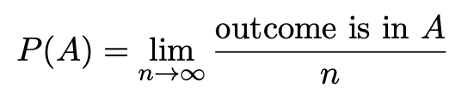

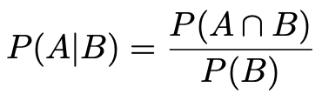

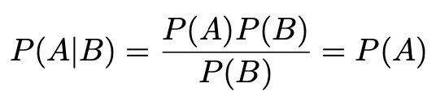
A quick review of probability
Frequentist (A = outcome of
repeatable observation)
Subjective (A = hypothesis)
Conditional probability:
E.g. rolling a die, outcome n = 1,2,...,6:
A and B are independent iff:
I.e. if A, B independent, then

Slide 4

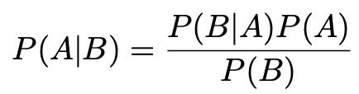
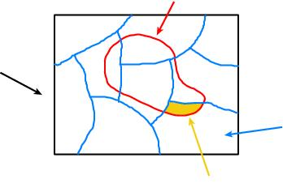
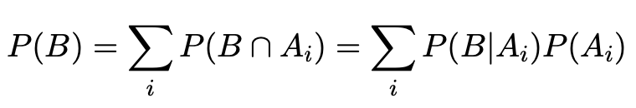
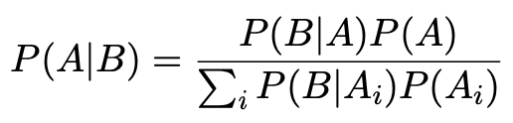
Bayes’ theorem
Use definition of conditional probability and
→
(Bayes’ theorem)
B
If set of all outcomes S = ∪_{i} A_{i}
with A_{i} disjoint, then law of total probability for P(B) says
S
A_{i}
B ∩ A_{i}
so that Bayes’ theorem becomes
Bayes’ theorem holds regardless of how probability is interpreted (frequency, degree of belief...).

Slide 5
Hypothesis, likelihood
Suppose the entire result of an experiment (set of measurements) is a collection of numbers x.
A (simple) hypothesis is a rule that assigns a probability to each possible data outcome:
= the likelihood of H
Often we deal with a family of hypotheses labeled by one or
more undetermined parameters (a composite hypothesis):
= the “likelihood function”
Note:
1) For the likelihood we treat the data x as fixed.
2) The likelihood function L(θ) is not a pdf for θ.

Slide 6
Frequentist hypothesis tests
Suppose a measurement produces data x; consider a hypothesis H₀
we want to test and alternative H₁
H₀, H₁ specify probability for x: P(x|H₀), P(x|H₁)
A test of H₀ is defined by specifying a critical region w of the
data space such that there is no more than some (small) probability
α, assuming H₀ is correct, to observe the data there, i.e.,
P(x ∈ w | H₀) ≤ α
Need inequality if data are
discrete.
α is called the size or
significance level of the test.
If x is observed in the
critical region, reject H₀.
data space Ω
critical region w

Slide 7



Definition of a test (2)
But in general there are an infinite number of possible critical regions that give the same size α.
Use the alternative hypothesis H₁ to motivate where to place the critical region.
Roughly speaking, place the critical region where there is a low
probability (α) to be found if H₀ is true, but high if H₁ is true:

Slide 8


Classification viewed as a statistical test
Suppose events come in two possible types:
s (signal) and b (background)
For each event, test hypothesis that it is background, i.e., H₀ = b.
Carry out test on many events, each is either of type s or b, i.e., here the hypothesis is the “true class label”, which varies randomly from event to event, so we can assign to it a frequentist probability.
Select events for which where H₀ is rejected as “candidate events of type s”. Equivalent Particle Physics terminology:
background efficiency
signal efficiency

Slide 9
Example of a test for classification
Suppose we can measure for
each event a quantity x, where
with 0 ≤ x ≤ 1.
For each event in a mixture of signal (s) and background (b) test
H₀ : event is of type b
using a critical region W of the form: W = { x : x ≤ x_{c} }, where
x_{c} is a constant that we choose to give a test with the desired size α.

Slide 10
Classification example (2)
Suppose we want α = 10⁻⁴. Require:
and therefore
For this test (i.e. this critical region W), the power with respect to the signal hypothesis (s) is
Note: the optimal size and power is a separate question that will depend on goals of the subsequent analysis.

Slide 11
Classification example (3)
Suppose that the prior probabilities for an event to be of type s or b are:
π_{s} = 0.001
π_{b} = 0.999
The “purity” of the selected signal sample (events where b hypothesis rejected) is found using Bayes’ theorem:

Slide 12
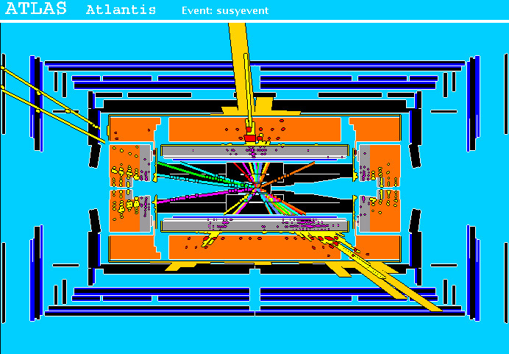
Particle Physics context for a hypothesis test
A simulated SUSY event (“signal”):
high p_{T}
muons
high p_{T} jets
of hadrons
p
p
missing transverse energy

Slide 13
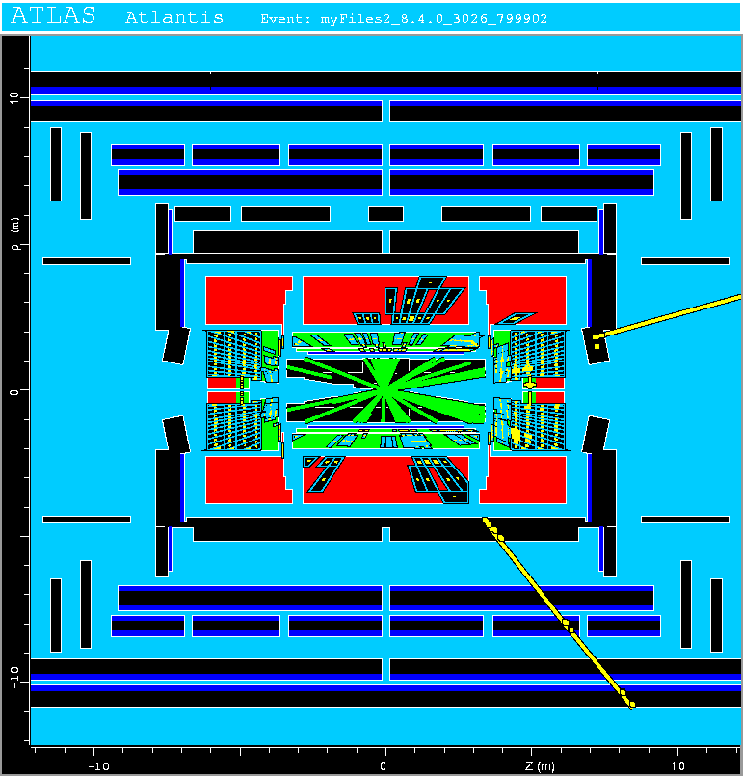
Background events
This event from Standard
Model ttbar production also
has high p_{T} jets and muons,
and some missing transverse
energy.
→ can easily mimic a
signal event.

Slide 14
Classification of proton-proton collisions
Proton-proton collisions can be considered to come in two classes:
signal (the kind of event we’re looking for, y = 1)
background (the kind that mimics signal, y = 0)
For each collision (event), we measure a collection of features:
x₁ = energy of muon x₄ = missing transverse energy
x₂ = angle between jets x₅ = invariant mass of muon pair
x₃ = total jet energy x₆ = ...
The real events don’t come with true class labels, but computer-simulated events do. So we can have a set of simulated events that consist of a feature vector x and true class label y (0 for background, 1 for signal):
(x, y)₁, (x, y)₂, ..., (x, y)_{N}
The simulated events are called “training data”.

Slide 15
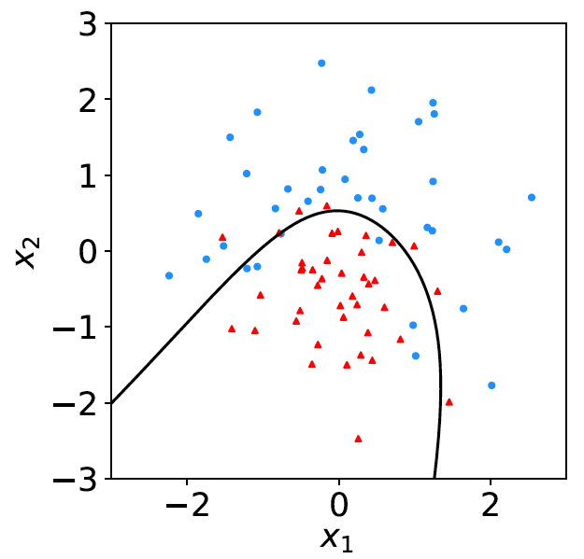
Distributions of the features
If we consider only two
features x = (x₁, x₂), we can
display the results in a scatter
plot (red: y = 0, blue: y = 1).
For real events, the dots are black (true type is not known).
For each real event test the hypothesis that it is background.
(Related to this: test that a sample of events is all background.)
The test’s critical region is defined by a “decision boundary” – without knowing the event type, we can classify them by seeing where their measured features lie relative to the boundary.

Slide 16
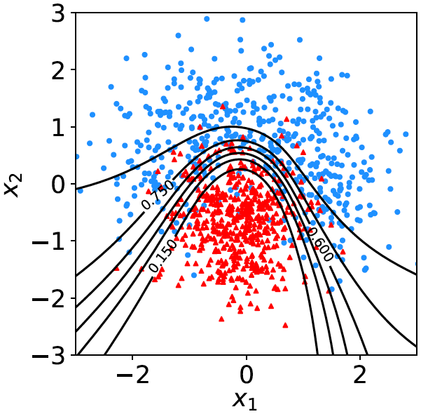

Decision function, test statistic
A surface in an n-dimensional
space can be described by
scalar
function
constant
Different values of the constant
t_{c} result in a family of surfaces.
Problem is reduced to finding
the best decision function or test statistic t (x).

Slide 17
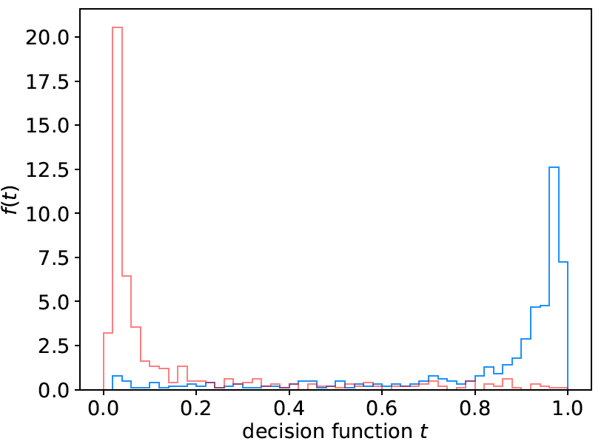
Distribution of t(x)
By forming a test statistic t(x), the boundary of the critical region in the n-dimensional x-space is determined by a single single value t_{c}.
f (t|H₀)
f (t|H₁)
t_{c}
W

Slide 18
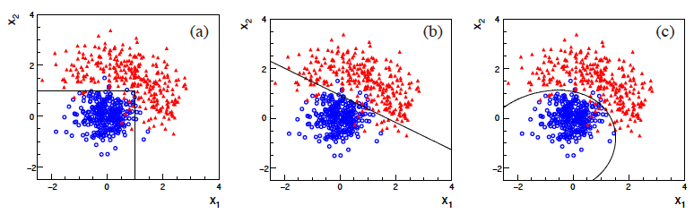
Types of decision boundaries
So what is the optimal boundary for the critical region, i.e., what
is the optimal test statistic t(x)?
First find best t(x), later address issue of optimal size of test.
Remember x-space can have many dimensions.
“cuts”
linear
non-linear

Slide 19
Test statistic based on likelihood ratio
How can we choose a test’s critical region in an ‘optimal way’, in particular if the data space is multidimensional?
Neyman-Pearson lemma states:
For a test of H₀ of size α, to get the highest power with respect to the
alternative H₁ we need for all x in the critical region W
”likelihood
ratio (LR)”
inside W and ≤ c_{α} outside, where c_{α} is a constant chosen to give a test of the desired size.
Equivalently, optimal scalar test statistic is
N.B. any monotonic function of this is leads to the same test.

Slide 20

Neyman-Pearson doesn’t usually help
We usually don’t have explicit formulae for the pdfs f (x|s), f (x|b), so for a given x we can’t evaluate the likelihood ratio
Instead we may have Monte Carlo models for signal and background processes, so we can produce simulated data:
generate x ~ f (x|s) → x₁,..., x_{N}
generate x ~ f (x|b) → x₁,..., x_{N}
This gives samples of “training data” with events of known type.
Use these to construct a statistic that is as close as possible to the optimal likelihood ratio (→ Machine Learning).

Slide 21
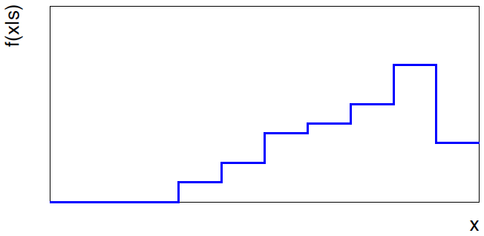
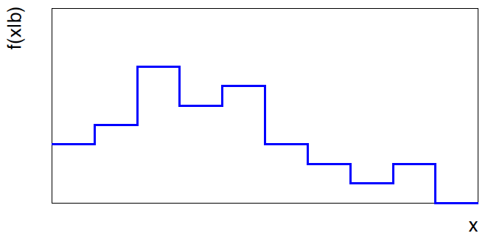


Approximate LR from histograms
Want t(x) = f (x|s)/ f(x|b) for x here
One possibility is to generate
MC data and construct
histograms for both
signal and background.
Use (normalized) histogram
values to approximate LR:
N(x|s)
N (x|s) ≈ f (x|s)
x
N(x|b)
N (x|b) ≈ f (x|b)
Can work well for single
variable.
x

Slide 22
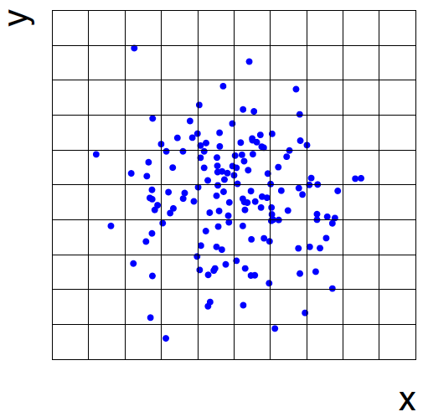
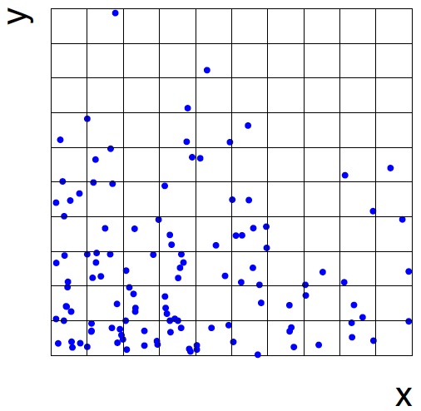
Approximate LR from 2D-histograms
Suppose problem has 2 variables. Try using 2-D histograms:
signal
back-
ground
Approximate pdfs using N (x,y|s), N (x,y|b) in corresponding cells.
But if we want M bins for each variable, then in n-dimensions we
have M^{n} cells; can’t generate enough training data to populate.
→ Histogram method usually not usable for n > 1 dimension.

Slide 23
Strategies for multivariate analysis
Neyman-Pearson lemma gives optimal answer, but cannot be
used directly, because we usually don’t have f (x|s), f (x|b).
Histogram method with M bins for n variables requires that
we estimate M^{n} parameters (the values of the pdfs in each cell),
so this is rarely practical.
A compromise solution is to assume a certain functional form
for the test statistic t (x) with fewer parameters; determine them
(using MC) to give best separation between signal and background.
Alternatively, try to estimate the probability densities f (x|s) and
f (x|b) (with something better than histograms) and use the
estimated pdfs to construct an approximate likelihood ratio.

Slide 24
Multivariate methods (Machine Learning)
Many new (and some old) methods:
Fisher discriminant
(Deep) Neural Networks
Kernel density methods
Support Vector Machines
Decision trees
Boosting
Bagging

Slide 25
Extra slides

Slide 26




Proof of Neyman-Pearson Lemma
Consider a critical region W and suppose the LR satisfies the criterion of the Neyman-Pearson lemma:
P(x|H₁)/P(x|H₀) ≥ c_{α} for all x in W,
P(x|H₁)/P(x|H₀) ≤ c_{α} for all x not in W.
W
Try to change this into a different critical region W′ retaining the same size α, i.e.,
δW₊
To do so add a part δW₊, but to keep the size α, we need to remove a part δW₋, i.e.,
W′
δW₋

Slide 27
Proof of Neyman-Pearson Lemma (2)
δW₊
But we are supposing the LR is higher for all x in δW₋ removed than for the x in δW₊ added, and therefore
W′
δW₋
The right-hand sides are equal and therefore

Slide 28
Proof of Neyman-Pearson Lemma (3)
We have
δW₊
W′
Note W and δW₊ are disjoint, and W′ and δW₋ are disjoint, so by Kolmogorov’s 3rd axiom,
δW₋
Therefore

Slide 29
Proof of Neyman-Pearson Lemma (4)
And therefore
i.e. the deformed critical region W′ cannot have higher power than the original one that satisfied the LR criterion of the Neyman-Pearson lemma.

