Slide 1
Statistics for Particle Physics
Lecture 2
Introduction to the Terascale
https://indico.desy.de/event/46666/
DESY, Hamburg
19 March 2025
Glen Cowan
Physics Department
Royal Holloway, University of London
g.cowan@rhul.ac.uk
www.pp.rhul.ac.uk/~cowan

Slide 2
Outline
Wednesday 9:00 Quick review of probability
Hypothesis testing
→ Wednesday 9:45 p-values
Confidence intervals / limits
More resources in the University of London course:
https://www.pp.rhul.ac.uk/~cowan/stat_course.html

Slide 3
Testing significance / goodness-of-fit
Suppose hypothesis H predicts pdf f (x|H) for a set of
observations x = (x₁,...x_{n}).
We observe a single point in this space: x_{obs}.
How can we quantify the level of compatibility between the data and the predictions of H?
x_{j}
x_{obs}
Decide what part of
the data space represents equal or less compatibility with H than does the point x_{obs}. (Not unique!)
ω> = { x : x “more
compatible” with H }
ω≤ = { x : x “less
or eq. compatible”
with H }
x_{i}

Slide 4
p-values
Express level of compatibility between data and hypothesis (sometimes ‘goodness-of-fit’) by giving the p-value for H:
= probability, under assumption of H, to observe data with equal or lesser compatibility with H relative to the data we got.
= probability, under assumption of H, to observe data as discrepant with H as the data we got or more so.
Basic idea: if there is only a very small probability to find data
with even worse (or equal) compatibility, then H is “disfavoured by the data”.
If the p-value is below a user-defined threshold α (e.g. 0.05) then H is rejected (equivalent to hypothesis test of size α as seen earlier).

Slide 5
p-value of H is not P(H)
The p-value of H is not the probability that H is true!
In frequentist statistics we don’t talk about P(H) (unless H
represents a repeatable observation).
If we do define P(H), e.g., in Bayesian statistics as a degree of belief, then we need to use Bayes’ theorem to obtain
where π(H) is the prior probability for H.
For now stick with the frequentist approach;
result is p-value, regrettably easy to misinterpret as P(H).

Slide 6
The Poisson counting experiment
Suppose we do a counting experiment and observe n events.
Events could be from signal process or from background –
we only count the total number.
Poisson model:
s = mean (i.e., expected) # of signal events
b = mean # of background events
Goal is to make inference about s, e.g.,
test s = 0 (rejecting H₀ ≈ “discovery of signal process”)
test all non-zero s (values not rejected = confidence interval)
In both cases need to ask what is relevant alternative hypothesis.

Slide 7
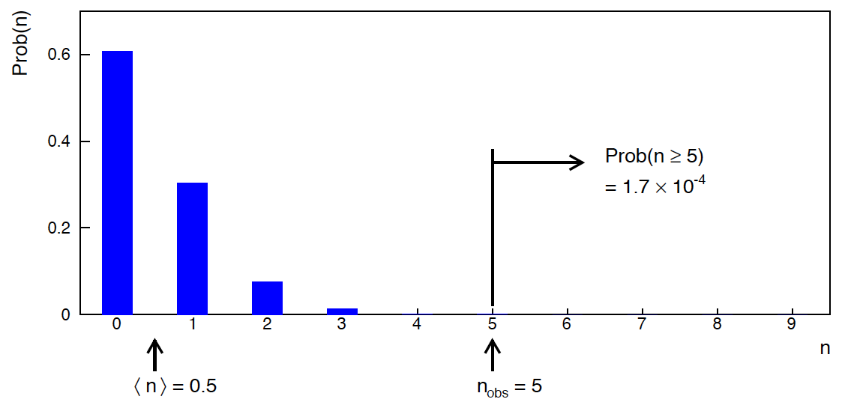
Poisson counting experiment: discovery p-value
Suppose b = 0.5 (known), and we observe n_{obs} = 5.
Should we claim evidence for a new discovery?
Give p-value for hypothesis s = 0, suppose relevant alt. is s > 0.

Slide 8
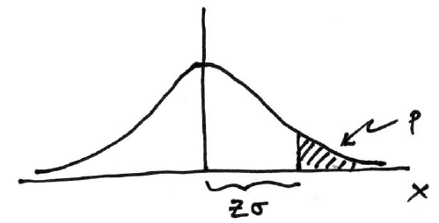
Significance from p-value
Often define significance Z as the number of standard deviations
that a Gaussian variable would fluctuate in one direction
to give the same p-value.
in ROOT:
p = 1 - TMath::Freq(Z)
Z = TMath::NormQuantile(1-p)
in python (scipy.stats):
p = 1 - norm.cdf(Z) = norm.sf(Z)
Z = norm.ppf(1-p)
Result Z is a “number of sigmas”. Note this does not mean that
the original data was Gaussian distributed.

Slide 9
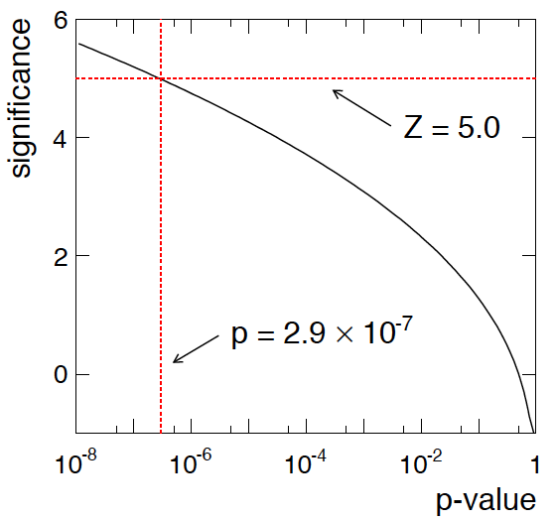
Poisson counting experiment: discovery significance
Equivalent significance for p = 1.7 × 10⁻⁴:
Often claim discovery if Z > 5 (p < 2.9 × 10⁻⁷, i.e., a “5-sigma effect”)
In fact this tradition should be revisited: p-value intended to quantify probability of a signal-like fluctuation assuming background only; not intended to cover, e.g., hidden systematics, plausibility signal model, compatibility of data with signal, “look-elsewhere effect”
(~multiple testing), etc.

Slide 10
Confidence intervals by inverting a test
In addition to a ‘point estimate’ of a parameter we should report
an interval reflecting its statistical uncertainty.
Confidence intervals for a parameter θ can be found by
defining a test of the hypothesized value θ (do this for all θ):
Specify values of the data that are ‘disfavoured’ by θ
(critical region) such that P(data in critical region|θ) ≤ α
for a prespecified α, e.g., 0.05 or 0.1.
If data observed in the critical region, reject the value θ.
Now invert the test to define a confidence interval as:
set of θ values that are not rejected in a test of size α
(confidence level CL is 1− α).

Slide 11
Relation between confidence interval and p-value
Equivalently we can consider a significance test for each
hypothesized value of θ, resulting in a p-value, p_{θ}.
If p_{θ} ≤ α, then we reject θ.
The confidence interval at CL = 1 – α consists of those values of
θ that are not rejected.
E.g. an upper limit on θ is the greatest value for which p_{θ} > α.
In practice find by setting p_{θ} = α and solve for θ.
For a multidimensional parameter space θ = (θ₁,... θ_{M}) use same idea – result is a confidence “region” with boundary determined by p_{θ} = α.

Slide 12
Coverage probability of confidence interval
If the true value of θ is rejected, then it’s not in the confidence interval. The probability for this is by construction (equality for continuous data):
P(reject θ|θ) ≤ α = type-I error rate
Therefore, the probability for the interval to contain or “cover” θ is
P(conf. interval “covers” θ|θ) ≥ 1 – α
This assumes that the set of θ values considered includes the true value, i.e., it assumes the composite hypothesis P(x|H,θ).

Slide 13
Frequentist upper limit on Poisson parameter
Consider again the case of observing n ~ Poisson(s + b).
Suppose b = 4.5, n_{obs} = 5. Find upper limit on s at 95% CL.
Relevant alternative is s = 0 (critical region at low n)
p-value of hypothesized s is P(n ≤ n_{obs}; s, b)
Upper limit s_{up} at CL = 1 – α found from

Slide 14
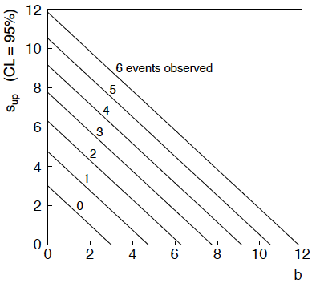
n ~ Poisson(s+b): frequentist upper limit on s
For low fluctuation of n, formula can give negative result for s_{up}; i.e. confidence interval is empty; all values of s ≥ 0 have p_{s} ≤ α.

Slide 15
Limits near a boundary of the parameter space
Suppose e.g. b = 2.5 and we observe n = 0.
If we choose CL = 0.9, we find from the formula for s_{up}
Physicist:
We already knew s ≥ 0 before we started; can’t use negative
upper limit to report result of expensive experiment!
Statistician:
The interval is designed to cover the true value only 90%
of the time — this was clearly not one of those times.
Not uncommon dilemma when testing parameter values for which
one has very little experimental sensitivity, e.g., very small s.

Slide 16
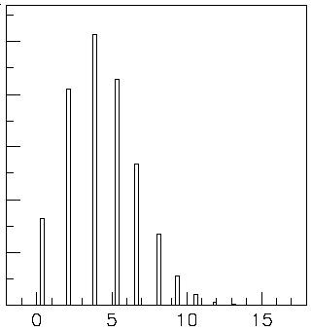
Expected limit for s = 0
Physicist: I should have used CL = 0.95 — then s_{up} = 0.496
Even better: for CL = 0.917923 we get s_{up} = 10⁻⁴ !
Reality check: with b = 2.5, typical Poisson fluctuation in n is
at least √2.5 = 1.6. How can the limit be so low?
Look at the mean limit for the
no-signal hypothesis (s = 0)
(sensitivity).
Distribution of 95% CL limits
with b = 2.5, s = 0.
Mean upper limit = 4.44

Slide 17
Approximate confidence intervals/regions from the likelihood function
Suppose we test parameter value(s) θ = (θ₁, ..., θ_{n}) using the ratio
Lower λ(θ) means worse agreement between data and hypothesized θ. Equivalently, usually define
so higher t_{θ} means worse agreement between θ and the data.
p-value of θ therefore
need pdf

Slide 18
Confidence region from Wilks’ theorem
Wilks’ theorem says (in large-sample limit and provided
certain conditions hold...)
chi-square dist. with # d.o.f. =
# of components in θ = (θ₁, ..., θ_{n}).
Assuming this holds, the p-value is
← set equal to α
To find boundary of confidence region set p_{θ} = α and solve for t_{θ}:
Recall also

Slide 19
Confidence region from Wilks’ theorem (cont.)
i.e., boundary of confidence region in θ space is where
For example, for 1 – α = 68.3% and n = 1 parameter,
and so the 68.3% confidence level interval is determined by
Same as recipe for finding the estimator’s standard deviation, i.e.,
is a 68.3% CL confidence interval.

Slide 20
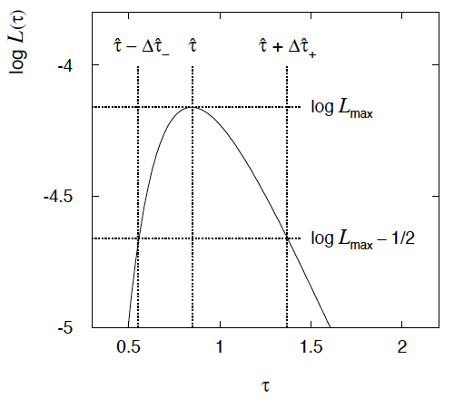
Example of interval from ln L(θ)
For n=1 parameter, CL = 0.683, Q_{α} = 1.
Our exponential
example, now with
only n = 5 events.
Can report ML estimate
with approx. confidence
interval from ln L_{max} – 1/2
as “asymmetric error bar”:

Slide 21
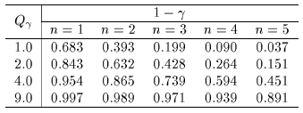
Multiparameter case
For increasing number of parameters, CL = 1 – α decreases for
confidence region determined by a given

Slide 22
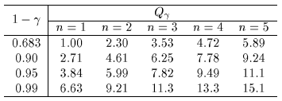
Multiparameter case (cont.)
Equivalently, Q_{α} increases with n for a given CL = 1 – α.

Slide 23
Summary
Here only time to talk about a limited number of topics:
Hypothesis tests
p-values
Confidence intervals, regions, limits...
Going further:
Machine Learning
Bayesian methods
Systematic uncertainties
...
For some exercises and software, see:
https://www.pp.rhul.ac.uk/~cowan/stat/exercises/cowan_stat_exercises.pdf

Slide 24
Extra slides

Slide 25
MLE example: parameter of exponential pdf
Consider exponential pdf,
and suppose we have i.i.d. data,
The likelihood function is
The value of τ for which L(τ) is maximum also gives the
maximum value of its logarithm (the log-likelihood function):

Slide 26
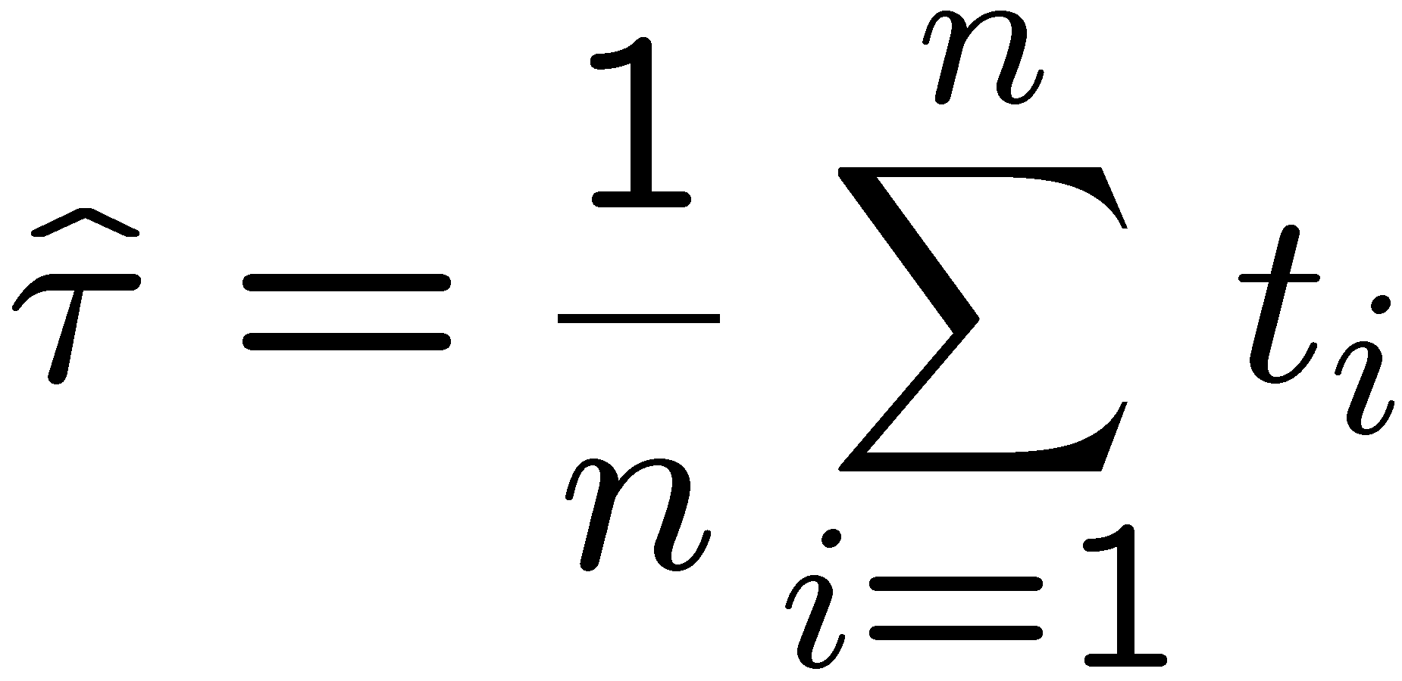
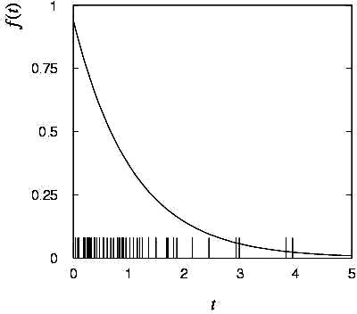
MLE example: parameter of exponential pdf (2)
Find its maximum by setting
→
Monte Carlo test:
generate 50 values
using τ = 1:
We find the ML estimate:

Slide 27
MLE example: parameter of exponential pdf (3)
For the exponential distribution one has for mean, variance:
For the MLE
we therefore find
→
→

Slide 28
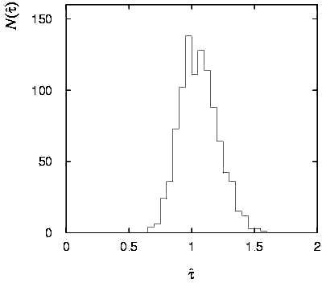
Variance of estimators: Monte Carlo method
Having estimated our parameter we now need to report its
‘statistical error’, i.e., how widely distributed would estimates
be if we were to repeat the entire measurement many times.
One way to do this would be to simulate the entire experiment
many times with a Monte Carlo program (use ML estimate for MC).
For exponential example, from
sample variance of estimates
we find:
Note distribution of estimates is roughly
Gaussian − (almost) always true for
ML in large sample limit.

Slide 29
Variance of estimators from information inequality
The information inequality (RCF) sets a lower bound on the
variance of any estimator (not only ML):
Minimum Variance
Bound (MVB)
Often the bias b is small, and equality either holds exactly or
is a good approximation (e.g. large data sample limit). Then,
Estimate this using the 2nd derivative of ln L at its maximum:

Slide 30
MVB for MLE of exponential parameter
Find
We found for the exponential parameter the MLE
and we showed b = 0, hence 𝜕b/𝜕τ = 0.
We find
and since E[t_{i}] = τ for all i,
,
and therefore
.
(Here MLE is “efficient”).

Slide 31
Variance of estimators: graphical method
Expand ln L(θ) about its maximum:
First term is ln L_{max}, second term is zero, for third term use
information inequality (assume equality):
i.e.,
→ to get
, change θ away from
until ln L decreases by 1/2.

Slide 32
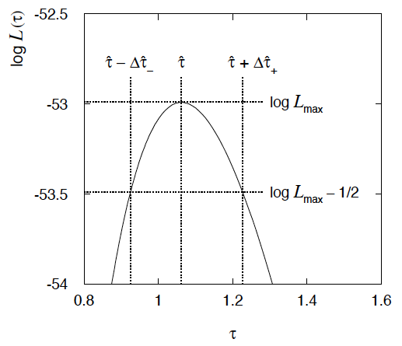
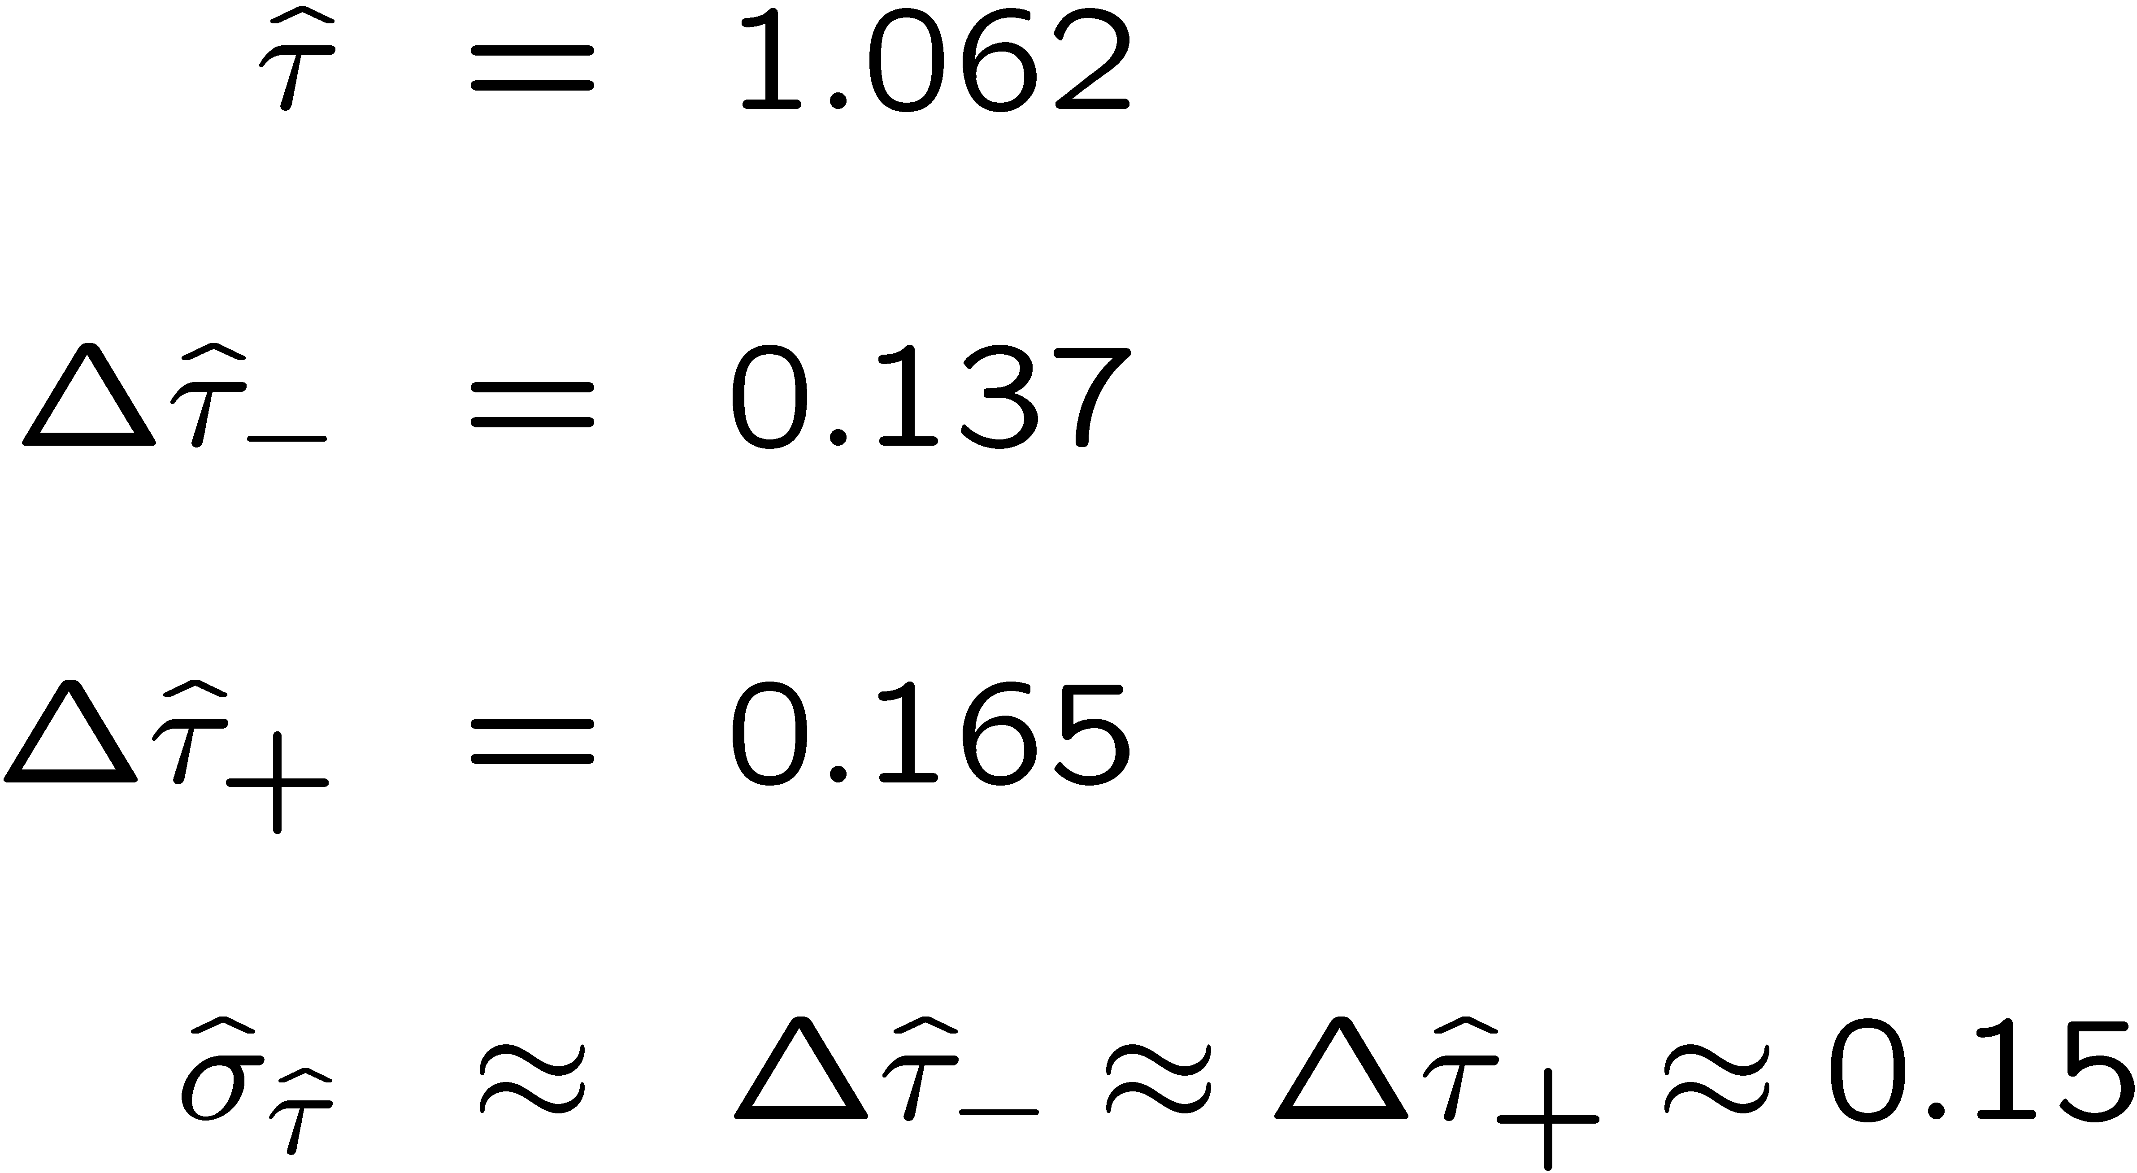
Example of variance by graphical method
ML example with exponential:
Not quite parabolic ln L since finite sample size (n = 50).

