Slide 1
Combinations in Statistical Data Analysis
From basics to errors on errors
DESY 2nd Pan-European Advanced School of Statistics
https://indico.desy.de/event/32536/
Glen Cowan
Physics Department
Royal Holloway, University of London
g.cowan@rhul.ac.uk
www.pp.rhul.ac.uk/~cowan

Slide 2
Outline
Basic formalism
Frequentist vs Bayesian approach
Systematic uncertainties
Combination based on a full likelihood
Simplified approaches
Errors on errors
Discussion and conclusions

Slide 3
Basic formalism: likelihood
Suppose the outcome of a measurement is a collection of
numbers x (scalar or vector) – here, the “data”.
And suppose a model (hypothesis H) predicts the probability for the data:
Often a family of models is indexed by a set of parameters, i.e.,
If we view this as a function of the model (or of the parameters),
then this is the likelihood; often written

Slide 4
Frequentist approach
Frequentist statistics: probability only associated with data x, not hypotheses or parameters.
Hypothesis (or model or parameter value) is “preferred” if the model predicts a high probability for data like what we got.
Important tools:
Maximum likelihood estimator for parameters
Hypothesis test of size α
Reject H if data found in critical region w with P(x in w | H) ≤ α
p-value of hypothesis H
= P(x equally or more incompatible with H | H)
Confidence interval at CL = 1 – α
= set of parameter values with p-value > α

Slide 5
Bayesian approach
Probability associated with both data and hypotheses
probability of the data assuming
hypothesis H (the likelihood)
prior probability, i.e.,
before seeing the data
posterior probability, i.e.,
after seeing the data
normalization involves sum
over all possible hypotheses
Requires prior probabilities for all relevant parameters/hypotheses.
Inference follows from the posterior probability, e.g., point estimate from mode of posterior, credible intervals,...
For both Bayesian and Frequentist approaches, the model P(x|θ) is a fundamental ingredient.

Slide 6
Systematic uncertainties and nuisance parameters
P (x|θ)
In general, our model of the data is not perfect:
model:
truth:
x
Can improve model by including
additional adjustable parameters.
Nuisance parameter ↔ systematic uncertainty. Some point in the
parameter space of the enlarged model should be “true”.
Presence of nuisance parameter decreases sensitivity of analysis
to the parameter of interest (e.g., increases variance of estimate).

Slide 7
Combinations: simplest case
Suppose two measurements yield independent data whose model contains a parameter μ understood to be the same for both.
x ~ P(x |μ)
y ~ P(y | μ)
Goal: combine the information from x and y to estimate/test μ.
If x and y are independent, then the joint probability for the data is
P(x, y | μ) = P(x | μ) P(y | μ)
= L( μ) ← the likelihood
So use this for e.g.
Frequentist: maximum likelihood, p-value, conf. interval
Bayesian: use in Bayes’ theorem → posterior P(μ | x, y)

Slide 8
Combo with nuisance parameters
Suppose that the models contains a nuisance parameters θ, λ, ξ, in addition to the parameter of interest μ, where θ is common to both models but λ and ξ are not.
x ~ P(x |μ, θ, λ)
y ~ P(y |μ, θ, ξ)
Auxiliary measurements to constrain the nuisance parameters:
u ~ P(u |θ, λ, ξ)
If the primary and auxiliary measurements are independent, then
the joint probability for x, y and u is
P(x, y, u | μ, θ, λ, ξ) = P(x |μ, θ, λ) P(y |μ, θ, ξ) P(u | θ, λ, ξ)
Having θ common to the models for both x and y corresponds to a “correlated systematic”.

Slide 9
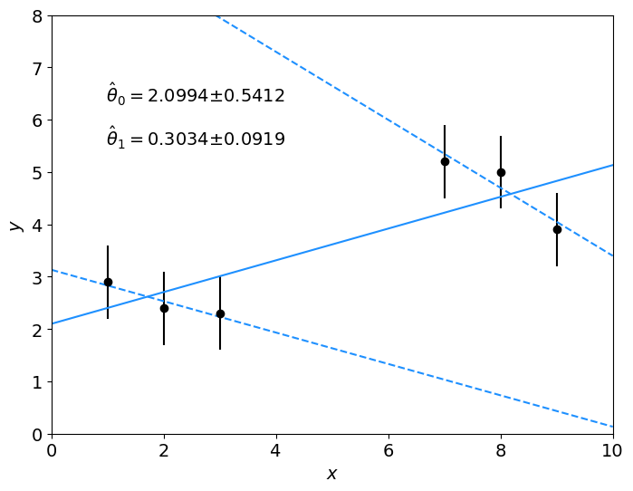
Example of a combination
Inspiration from Louis Lyons via Olaf Behnke
Fit a straight line: f (x; θ₀, θ₁) = θ₀ + θ₁ x
Minimize
2 data sets with 3 measurements each:
Data set 1 only:
θ₀ = 3.13 ± 1.07
θ₁ = -0.30 ± 0.49
p-value = 0.82
Data set 2 only:
θ₀ = 9.90 ± 3.98
θ₁ = -0.65 ± 0.49
p-value = 0.60
Combination:
θ₀ = 2.10 ± 0.54
θ₁ = 0.303 ± 0.092
p-value = 0.21
data set 2
data set 1

Slide 10
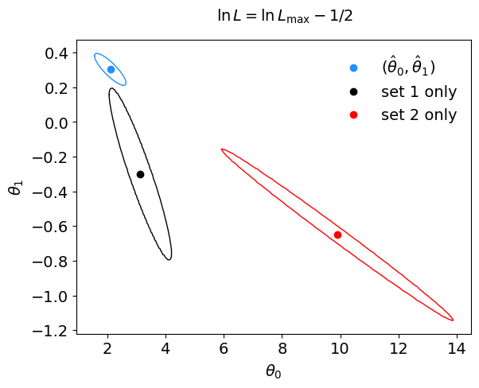
Results from combination
In this example the combination leads to a very large reduction
in the uncertainties.
combined fit

Slide 11
More nuisance parameters
But what if we allowed for systematic biases in each of the
two data sets, i.e.,
nuisance
parameters
for data set 1:
for data set 2:
auxiliary measurements
−2 ln L(θ, λ) becomes:

Slide 12
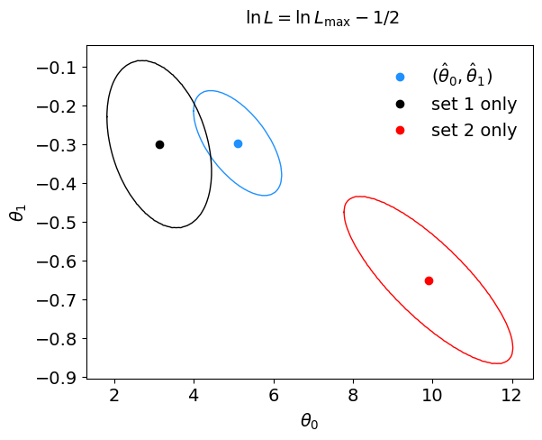
Independent nuisance parameters
Separately adjustable λ₁ and λ₂ each with independent Gaussian
distributed estimate u_{i}, ~Gauss(λ₁, σ_{u})
Combination now prefers negative slope parameter θ₁,
since each data set can tolerate some separate vertical shift.
combined fit

Slide 13
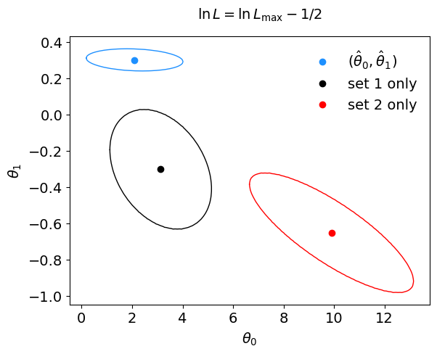
Common nuisance parameter
Alternatively, we might have λ₁ = λ₂ ≡ λ, so minimize
Now the two data sets
can only move up and down coherently, so the slope parameter θ₁ from the combination is again very accurate.
The key (and the hard part) in a combination is identifying common nuisance parameters.

Slide 14
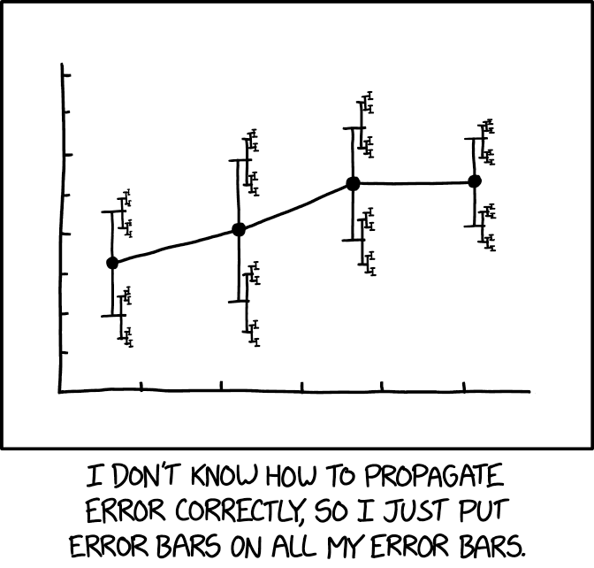
https://xkcd.com/2110/
Randall Munroe, xkcd.com
Errors on Errors
Details in G. Cowan, Eur. Phys. J. C (2019) 79:133, arXiv:1809.05778
Collaborators include:
Enzo Canonero (RHUL), Alessandra Brazzale (U. Padova)

Slide 15
Motivation
Analyses that are limited by systematic uncertainties become
sensitive to the assigned values of systematic errors.
But these error estimates are also uncertain (→ errors on errors)
Could just try inflating the systematic error estimates, but this turns out not to be enough, especially if the analysis uses least squares (equivalent to assuming Gaussian pdfs in likelihood).
Need for “errors on errors” most visible when measurements are not internally consistent within their estimated uncertainties.
Candidate use cases in particle physics:
Combinations of inconsistent measurements
Analyses where systematic error assigned by ad hoc recipe
Any analysis where assigned systematic error is uncertain

Slide 16
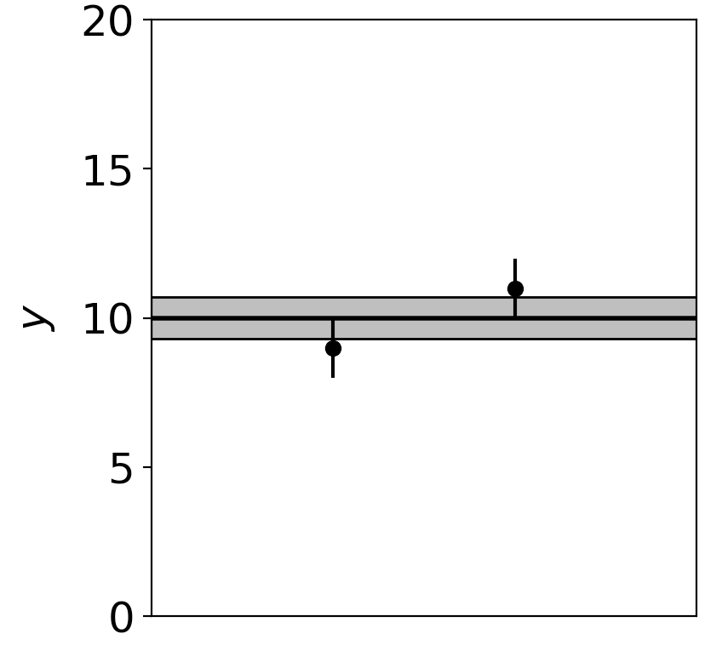
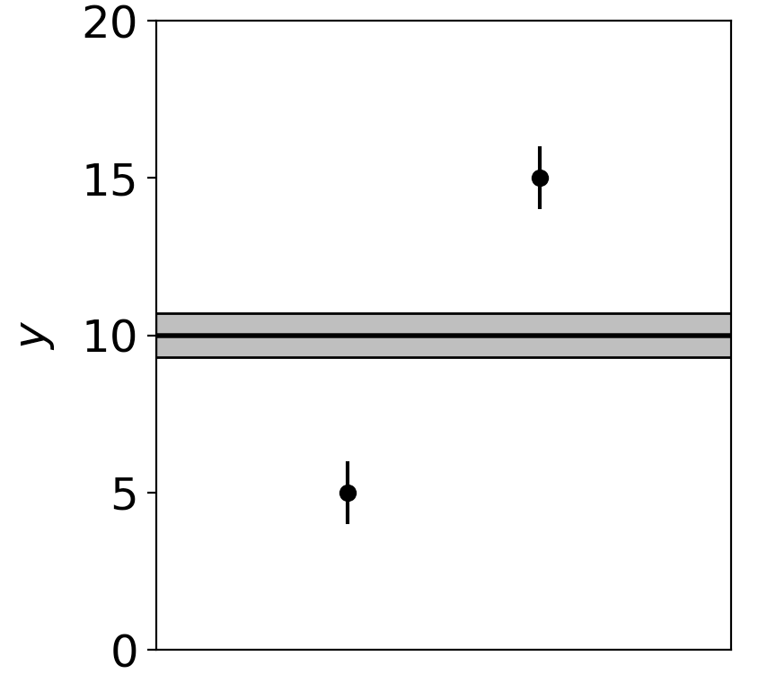
Motivation (2)
Assuming known standard deviations for least squares, uncertainty (e.g. confidence interval) does not reflect goodness of fit:
Least squares average of 9 ± 1 and 11 ± 1 is 10 ± 0.71
Least squares average of 5 ± 1 and 15 ± 1 is 10 ± 0.71
Width of confidence interval for the mean does not reflect the consistency of the values being averaged.

Slide 17
Formulation of the problem
Suppose measurements y have probability (density) P(y|μ,θ),
μ = parameters of interest
θ = nuisance parameters
To provide info on nuisance parameters, often treat their best
estimates u as indep. Gaussian distributed r.v.s., giving likelihood
or log-likelihood (up to additive const.)

Slide 18
Systematic errors and their uncertainty
Sometimes σ_{u,i} is well known, e.g., it is itself a statistical error known from sample size of a control measurement.
Other times the u_{i} are from an indirect measurement, Gaussian model approximate and/or the σ_{u,i} are not exactly known.
Or sometimes σ_{u,i} is at best a guess that represents an uncertainty in the underlying model (“theoretical error”).
In any case we can allow that the σ_{u,i} are not known in general with perfect accuracy.

Slide 19
Gamma model for variance estimates
Suppose we want to treat the systematic errors as uncertain,
so let the σ_{u,i} be adjustable nuisance parameters.
Suppose we have estimates s_{i} for σ_{u,i} or equivalently v_{i} = s_{i}², is an estimate of σ_{u,i}².
Model the v_{i} as independent and gamma distributed:
Set α and β so that they give desired relative uncertainty r in σ_{u}.
Other ”bell-shaped” models tried; qualitatively similar results.
Gamma pdf leads to important mathematical simplifications.

Slide 20
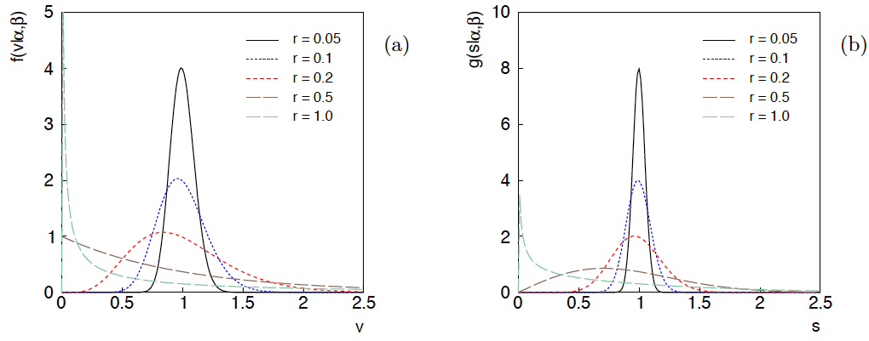
Distributions of v and s = √v
For α, β of gamma distribution,
relative “error on error”

Slide 21
Likelihood for Gamma Variance Model
Treated like data: y₁,...,y_{L} (the primary measurements)
u₁,...,u_{N} (estimates of nuisance par.)
v₁,...,v_{N} (estimates of variances
of estimates of NP)
Adjustable parameters: μ₁,...,μ_{M} (parameters of interest)
θ₁,...,θ_{N} (nuisance parameters)
σ_{u,1},...,σ_{u,N} (sys. errors = std. dev. of
of NP estimates)
Fixed parameters: r₁,...,r_{N} (rel. err. in estimate of σ_{u,i})

Slide 22
Profiling over systematic errors
We can profile over the σ_{u,i} in closed form
which gives the profile log-likelihood (up to additive const.)
In limit of small r_{i} and v_{i} → σ_{u,i}², the log terms revert back to the
quadratic form seen with known σ_{u,i}.

Slide 23
Equivalent likelihood from Student’s t
We can arrive at same likelihood by defining
Since u_{i} ~ Gauss and v_{i} ~ Gamma, z_{i} ~ Student’s t
with
Resulting likelihood same as profile Lʹ(μ,θ) from gamma model

Slide 24
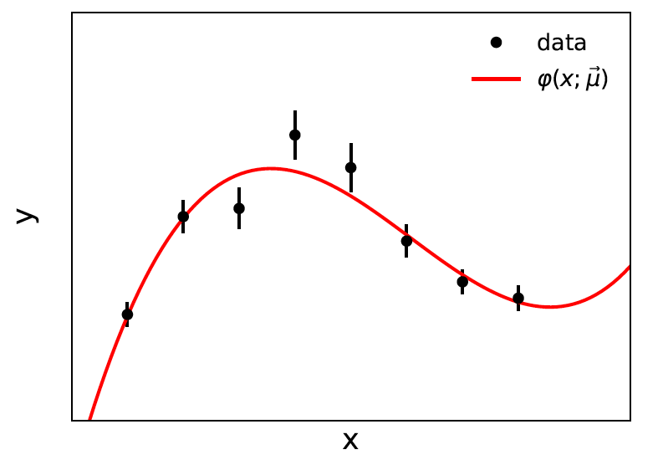
Curve fitting, averages
Suppose independent
y_{i} ~ Gauss, i = 1,...,N, with
μ are the parameters of interest in the fit function φ(x;μ),
θ are bias parameters constrained by control measurements
u_{i} ~ Gauss(θ_{i}, σ_{u,i}), so that if σ_{u,i} are known we have

Slide 25
Profiling over θ_{i} with known σ_{u,i}
Profiling over the bias parameters θ_{i} for known σ_{u,i} gives usual least-squares (BLUE)
Widely used technique for curve fitting in Particle Physics.
Generally in real measurement, u_{i} = 0.
Generalized to case of correlated y_{i} and u_{i} by summing
statistical and systematic covariance matrices.

Slide 26
Curve fitting with uncertain σ_{u,i}
Suppose now σ_{u,i}² are adjustable parameters with gamma distributed estimates v_{i}.
Retaining the θ_{i} but profiling over σ_{u,i}² gives
Profiled values of θ_{i} from solution to cubic equations

Slide 27
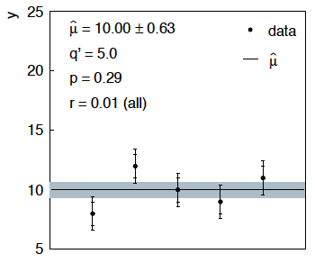
Sensitivity of average to outliers
Suppose we average 5 values, y = 8, 9, 10, 11, 12, all with
stat. and sys. errors of 1.0, and suppose negligible error on error
(here take r = 0.01 for all).

Slide 28
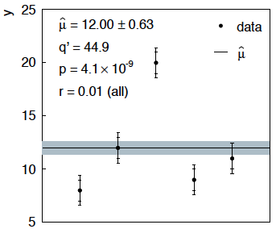
Sensitivity of average to outliers (2)
Now suppose the measurement at 10 was actually at 20:
“outlier”
Estimate pulled up to 12.0, size of confidence interval ~unchanged
(would be exactly unchanged with r → 0).

Slide 29
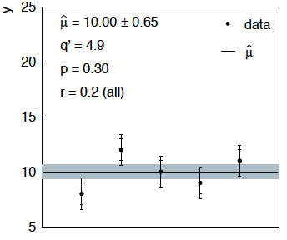
Average with all r = 0.2
If we assign to each measurement r = 0.2,
Estimate still at 10.00, size of interval moves 0.63 → 0.65

Slide 30
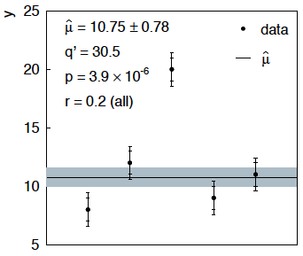
Average with all r = 0.2 with outlier
Same now with the outlier (middle measurement 10 → 20)
Estimate →10.75 (outlier pulls much less).
Half-size of interval → 0.78 (inflated because of bad g.o.f.).

Slide 31
Naive approach to errors on errors
Naively one might think that the error on the error in the previous
example could be taken into account conservatively by inflating
the systematic errors, i.e.,
But this gives
without outlier (middle meas. 10)
with outlier (middle meas. 20)
So the sensitivity to the outlier is not reduced and the size of the
confidence interval is still independent of goodness of fit.

Slide 32
Conclusions on errors on errors
Gamma model for variance estimates gives confidence intervals
that increase in size when the data are internally inconsistent,
and gives decreased sensitivity to outliers.
Method assumes that meaningful r_{i} values can be assigned and is valuable when systematic errors are not well known but enough “expert opinion” is available to do so.
Equivalence with Student’s t model, ν = 1/2r² degrees of freedom.
Simple profile likelihood – quadratic terms replaced by logs:

Slide 33
Discussion / Conclusions on combinations
The fundamental approach to combinations is to construct a likelihood that represents all the measurements.
Need to identify common nuisance parameters that are common.
Sometimes not enough information available to reconstruct a meaningful likelihood (only have p-values, confidence intervals,...)
This can be a difficult situation – best to try to cobble together some approximation to the likelihood; include
additional nuisance parameters as appropriate.
Many aspects not treated due to time, e.g., Bayesian methods; see e.g. G. Cowan, arXiv:1012.3589.

Slide 34
Extra slides

Slide 35
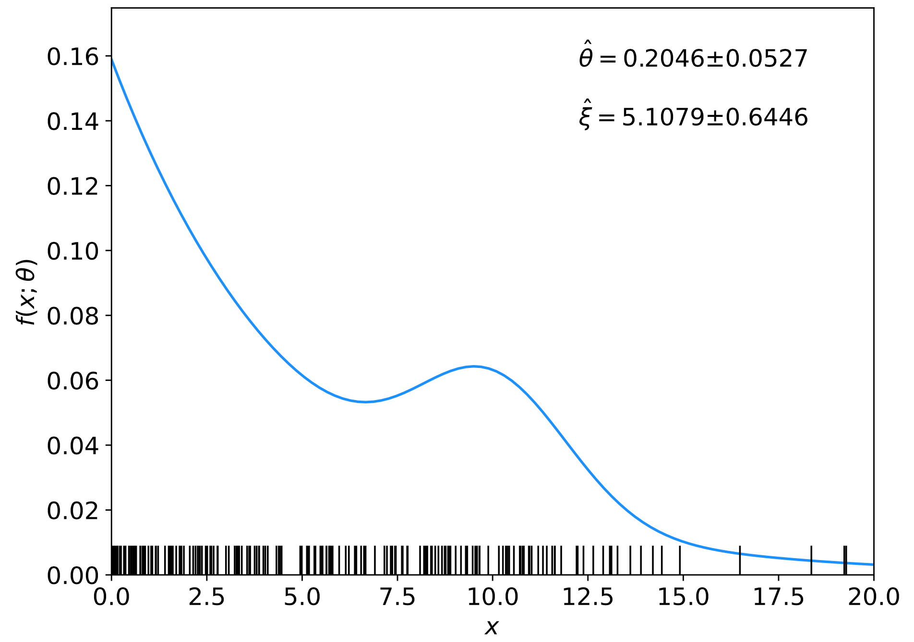
Example with nuisance parameters
Suppose x follows the pdf
and we have an
i.i.d. data sample:
Goal: estimate parameter of interest θ; the rest are nuisance parameters.

Slide 36
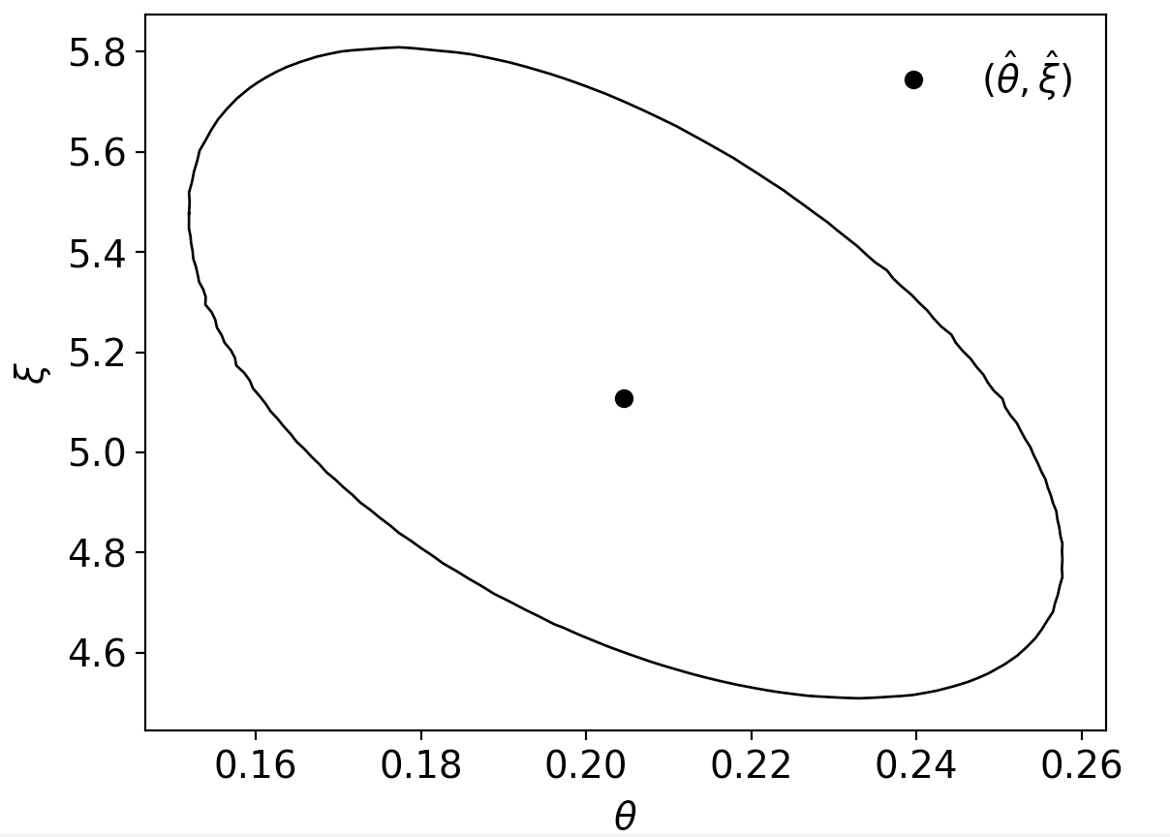
Example with nuisance parameters (2)
Standard deviation of estimator θ from tangents to contour
^
Would be smaller if nuisance parameter ξ were to be exactly known.
Presence of nuisance
params. inflates uncertainty on param. of interest

Slide 37
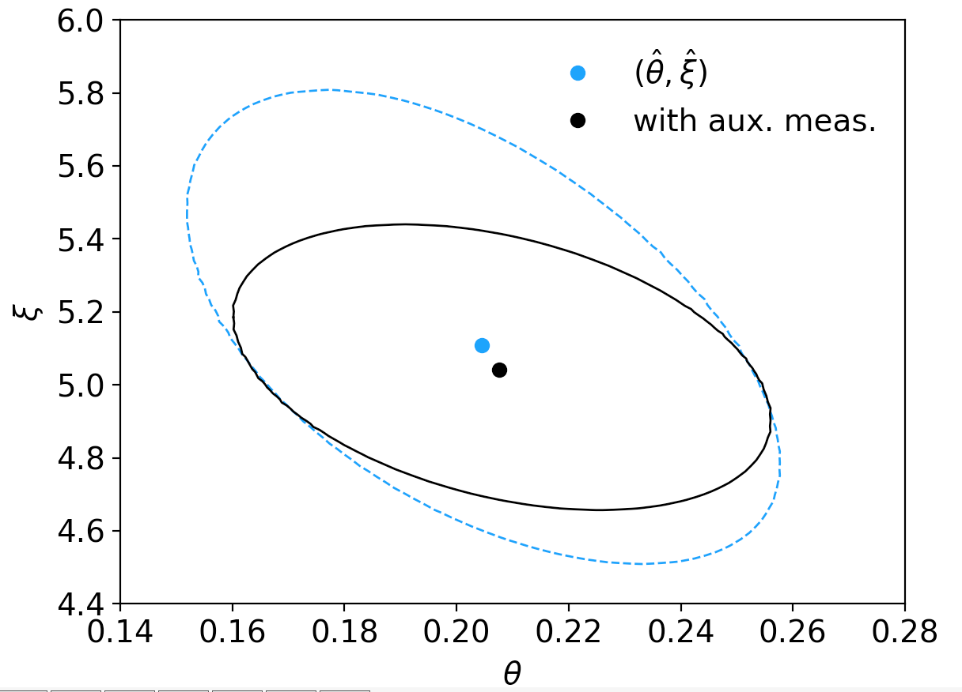
Auxiliary measurement to constrain nuisance param.
So often include an auxiliary measurement that constrains ξ, e.g., suppose u ~ Gauss(ξ, σ_{u}).
The aux. measurement u compresses the contour in both the ξ and θ directions and thus decreases the uncertainty on the estimate of θ.

Slide 38
Motivation for gamma model
If one were to have n independent observations u₁,..,u_{n}, with all
u ~ Gauss(θ, σ_{u}²), and we use the sample variance
to estimate σ_{u}², then (n-1)v/σ_{u}² follows a chi-square distribution
for n−1 degrees of freedom, which is a special case of the
gamma distribution (α = n/2, β = 1/2). (In general one doesn’t
have a sample of u_{i} values, but if this were to be how v was
estimated, the gamma model would follow.)
Furthermore choice of the gamma distribution for v allows one
to profile over the nuisance parameters σ_{u}² in closed form and
leads to a simple profile likelihood.

Slide 39
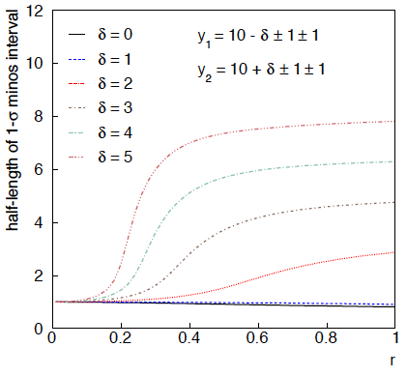
Example: average of two measurements
MINOS interval (= approx. confidence interval) based on
with
Increased discrepancy
between values to be
averaged gives larger
interval.
Interval length saturates
at ~level of absolute
discrepancy between
input values.
relative error
on sys. error

Slide 40
Goodness of fit
Can quantify goodness of fit with statistic
where Lʹ (φ,θ) has an adjustable φ_{i} for each y_{i} (the saturated
model).
Asymptotically should have q ~ chi-squared(N−M).
For increasing r_{i}, may need Bartlett correction or MC.

Slide 41
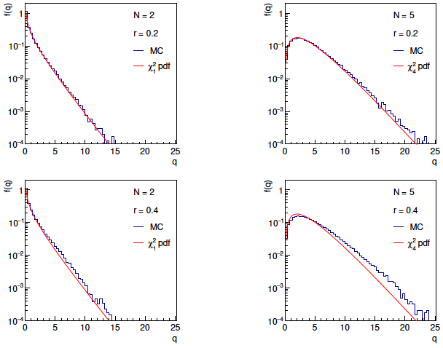
Distributions of q

Slide 42
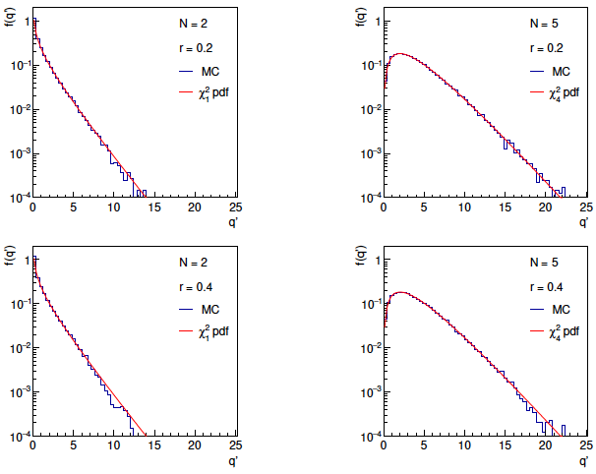
Distributions of Bartlett-corrected qʹ

Slide 43
Correlated uncertainties
The phrase “correlated uncertainties” usually means that a single
nuisance parameter affects the distribution (e.g., the mean) of more
than one measurement.
For example, consider measurements y, parameters of interest μ,
nuisance parameters θ with
That is, the θ_{i} are defined here as contributing to a bias and
the (known) factors R_{ij} determine how much θ_{j} affects y_{i}.
As before suppose one has independent control measurements
u_{i}~ Gauss(θ_{i}, σ_{ui}).

Slide 44
Correlated uncertainties (2)
The total bias of y_{i} can be defined as
which can be estimated with
These estimators are correlated having covariance
In this sense the present method treats “correlated uncertainties”,
i.e., the control measurements u_{i} are independent, but nuisance
parameters affect multiple measurements, and thus bias estimates
are correlated.

Slide 45
PDG scale factor
Suppose we do not want to take the quoted errors as
known constants. Scale the variances by a factor ϕ,
The likelihood
function becomes
The estimator for μ is the same as before; for ϕ ML gives
which has a bias;
is unbiased.
^
The variance of μ is inflated by ϕ:

Slide 46
Bayesian approach
Given measurements:
and (usually) covariances:
Predicted value:
expectation value
control variable
parameters
bias
Frequentist approach:
Minimize

Slide 47
Its Bayesian equivalent
Take
Joint probability
for all parameters
and use Bayes’ theorem:
To get desired probability for θ, integrate (marginalize) over b:
→ Posterior is Gaussian with mode same as least squares estimator,
σ_{θ} same as from χ² = χ²_{min} + 1. (Back where we started!)

Slide 48
Bayesian approach with non-Gaussian prior π_{b}(b)
Suppose now the experiment is characterized by
where s_{i} is an (unreported) factor by which the systematic error is
over/under-estimated.
Assume correct error for a Gaussian π_{b}(b) would be s_{i}σ_{i}^{sys}, so
Width of σ_{s}(s_{i}) reflects
‘error on the error’.

Slide 49
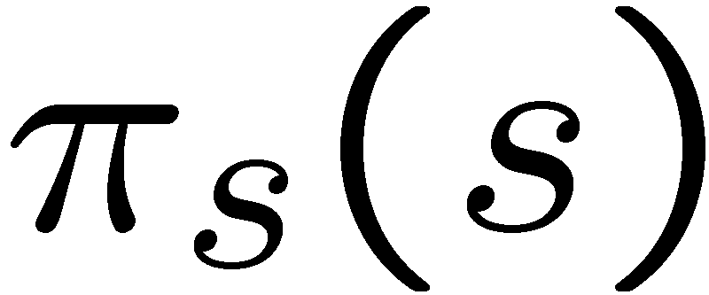
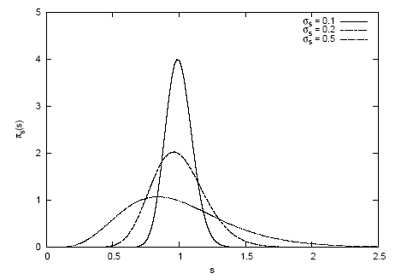
Error-on-error function π_{s}(s)
A simple unimodal probability density for 0 < s < 1 with
adjustable mean and variance is the Gamma distribution:
mean = b/a
variance = b/a²
Want e.g. expectation value
of 1 and adjustable standard
Deviation σ_{s} , i.e.,
s
In fact if we took π_{s} (s) ~ inverse Gamma, we could find π_{b}(b)
in closed form (cf. D’Agostini, Dose, von Linden). But Gamma seems more natural & numerical treatment not too painful.

Slide 50
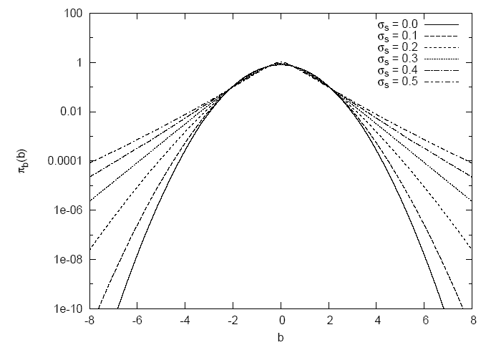
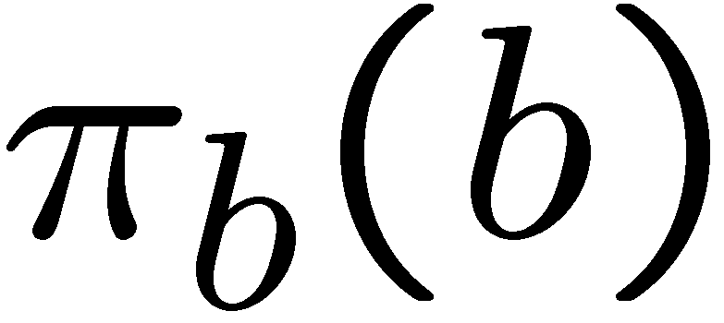
Prior for bias π_{b}(b) now has longer tails
b
Gaussian (σ_{s} = 0) P(|b| > 4σ_{sys}) = 6.3 × 10⁻⁵
σ_{s} = 0.5 P(|b| > 4σ_{sys}) = 0.65%

Slide 51
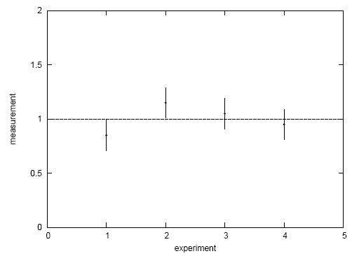
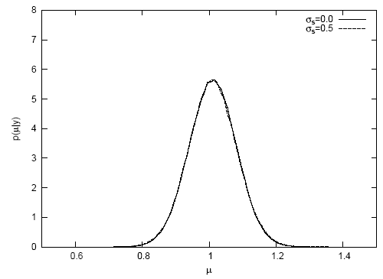
A simple test
Suppose a fit effectively averages four measurements.
Take σ_{sys} = σ_{stat} = 0.1, uncorrelated.
Case #1: data appear compatible
Posterior p(μ|y):
measurement
p(μ|y)
experiment
μ
Usually summarize posterior p(μ|y)
with mode and standard deviation:

Slide 52
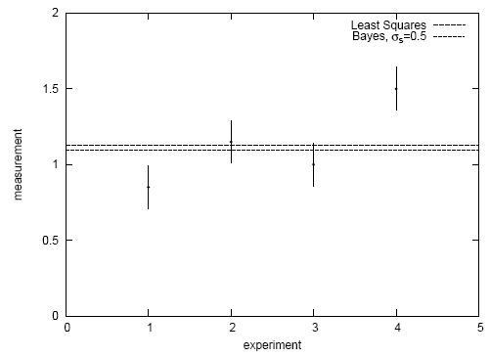
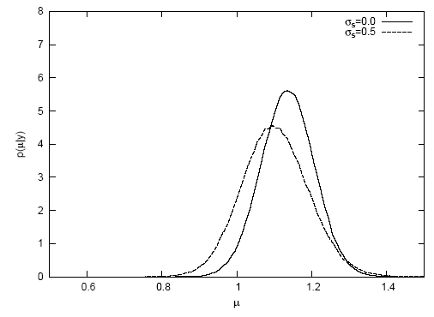
Simple test with inconsistent data
Case #2: there is an outlier
Posterior p(μ|y):
measurement
p(μ|y)
experiment
μ
→ Bayesian fit less sensitive to outlier. See also

Slide 53
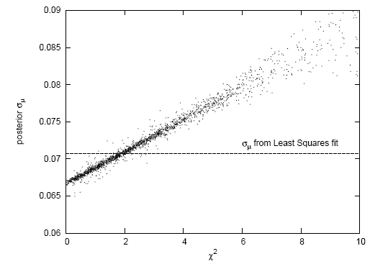
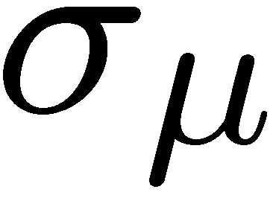
Goodness-of-fit vs. size of error
In LS fit, value of minimized χ² does not affect size
of error on fitted parameter.
In Bayesian analysis with non-Gaussian prior for systematics,
a high χ² corresponds to a larger error (and vice versa).
post-
erior
2000 repetitions of
experiment, σ_{s} = 0.5,
here no actual bias.
σ_{μ} from least squares
χ²

