Slide 1


Statistics for Data Analysis
Lecture 1
Flavour Physics at LHC School
CERN, Geneva
26-30 May 2025
https://indico.cern.ch/event/1508466/
Glen Cowan
Physics Department
Royal Holloway, University of London
g.cowan@rhul.ac.uk
www.pp.rhul.ac.uk/~cowan

Slide 2
Outline
→ Lecture 1: Probability, Bayes vs. Frequentist
Frequentist parameter estimation
Hypothesis tests
Lecture 2: p-values
Confidence limits
Systematic uncertainties
Bayesian parameter estimation
Lecture 3: Significance, sensitivity
Bayes factors
Models for anomalies

Slide 3
Theory ↔ Statistics ↔ Experiment
Theory (model, hypothesis):
Experiment (observation):
+ response of measurement
apparatus
= model prediction
data
Uncertainty enters
on many levels
→ quantify with
probability

Slide 4
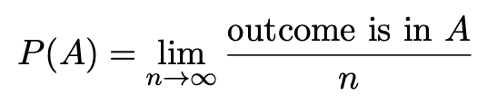

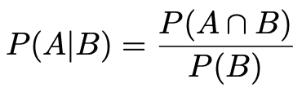

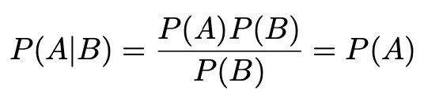
A quick review of probability
Frequentist (A = outcome of
repeatable observation)
Subjective (A = hypothesis)
Conditional probability:
E.g. rolling a die, outcome n = 1,2,...,6:
A and B are independent iff:
I.e. if A, B independent, then

Slide 5

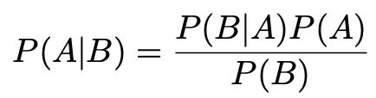
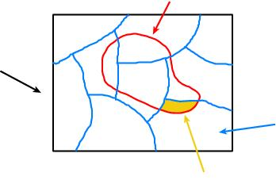
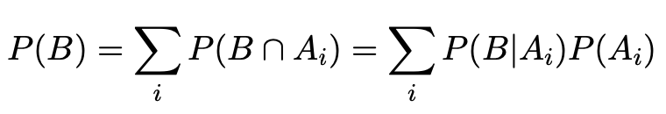
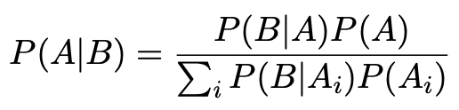
Bayes’ theorem
Use definition of conditional probability and
→
(Bayes’ theorem)
B
If set of all outcomes S = ∪_{i} A_{i}
with A_{i} disjoint, then law of total probability for P(B) says
S
A_{i}
B ∩ A_{i}
so that Bayes’ theorem becomes
Bayes’ theorem holds regardless of how probability is interpreted (frequency, degree of belief...).

Slide 6
Frequentist Statistics − general philosophy
In frequentist statistics, probabilities are associated only with
the data, i.e., outcomes of repeatable observations (shorthand: x).
Probability = limiting frequency
Probabilities such as
P (string theory is true),
P (0.117 < α_{s} < 0.119),
P (Biden wins in 2024),
etc. are either 0 or 1, but we don’t know which.
The tools of frequentist statistics tell us what to expect, under
the assumption of certain probabilities, about hypothetical
repeated observations.
Preferred theories (models, hypotheses, ...) are those that predict a high probability for data “like” the data observed.

Slide 7
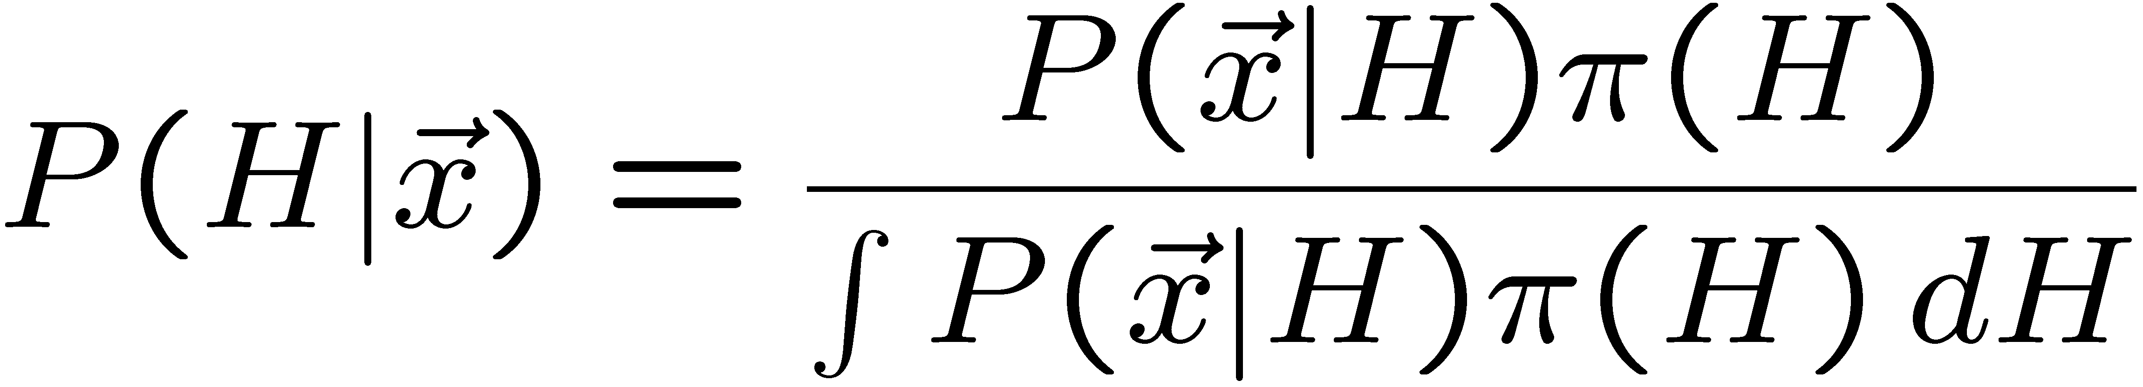
Bayesian Statistics − general philosophy
In Bayesian statistics, use subjective probability for hypotheses:
probability of the data assuming
hypothesis H (the likelihood)
prior probability, i.e.,
before seeing the data
posterior probability, i.e.,
after seeing the data
normalization involves sum
over all possible hypotheses
Bayes’ theorem has an “if-then” character: If your prior
probabilities were π(H), then it says how these probabilities
should change in the light of the data.
No general prescription for priors (subjective!)

Slide 8
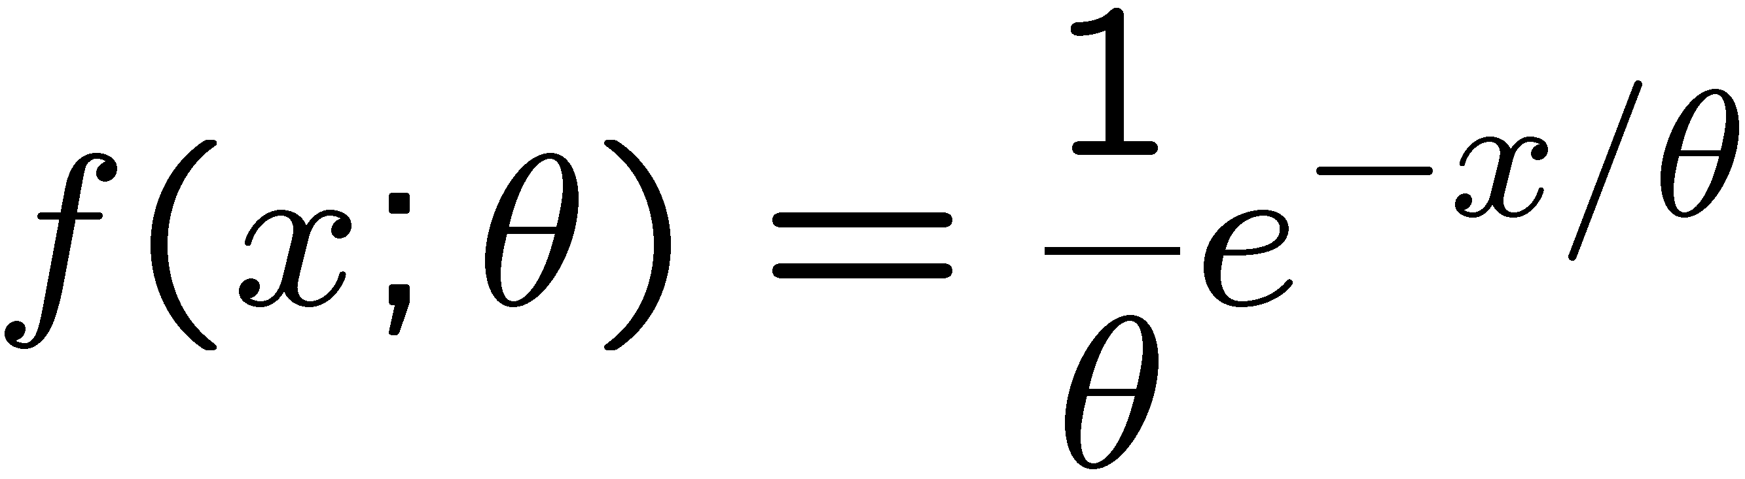
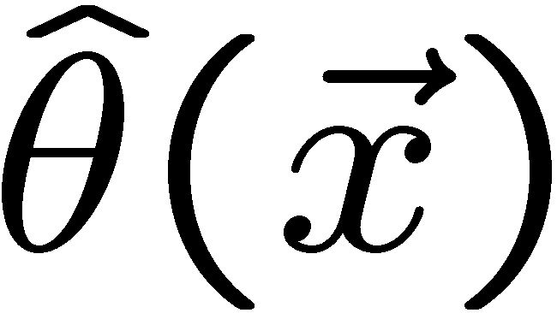
Parameter estimation
The parameters of a pdf are any constants that characterize it,
i.e., θ indexes a
set of hypotheses.
r.v.
parameter
Suppose we have a sample of observed values: x = (x₁, ..., x_{n})
We want to find some function of the data to estimate the
parameter(s):
← estimator written with a hat
Sometimes we say ‘estimator’ for the function of x₁, ..., x_{n};
‘estimate’ for the value of the estimator with a particular data set.

Slide 9
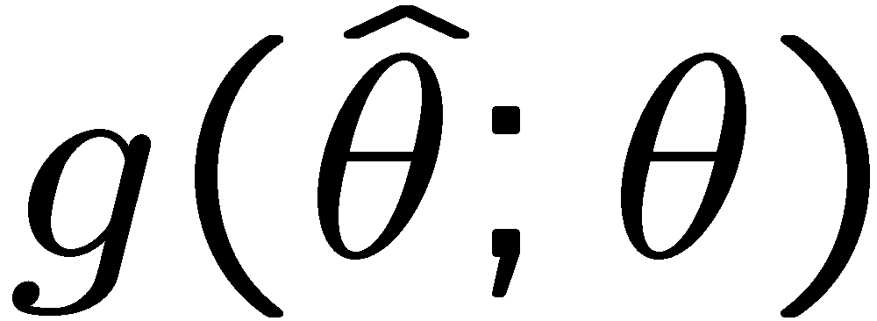
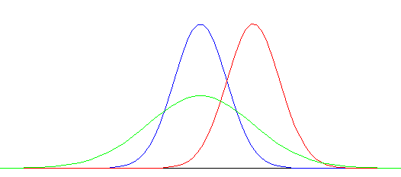


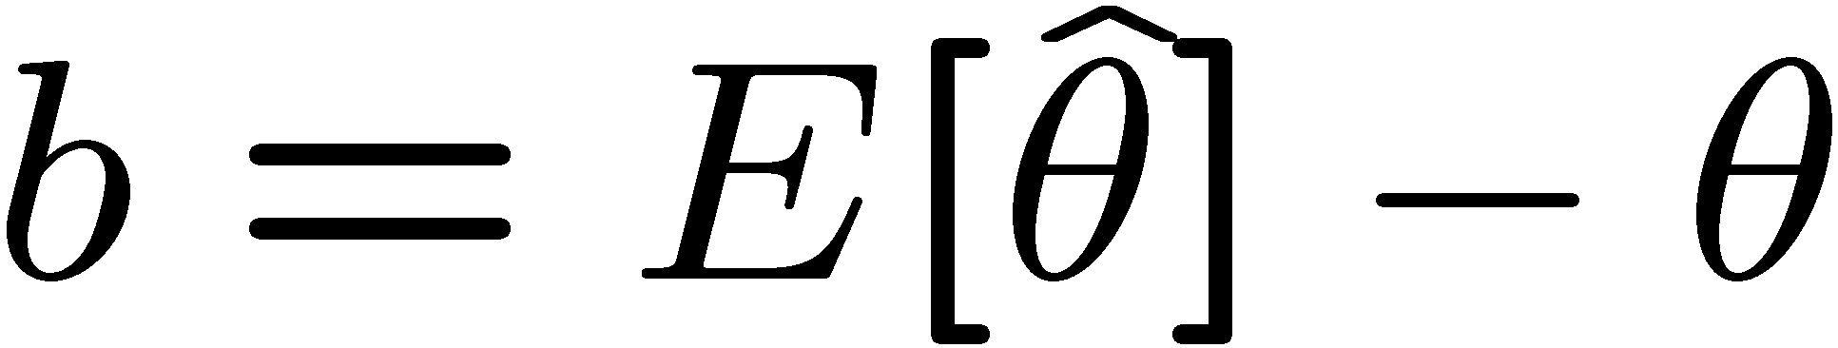
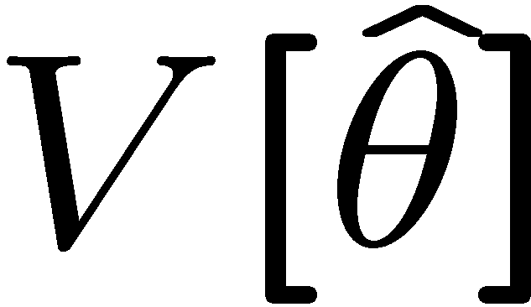
Properties of estimators
If we were to repeat the entire measurement, the estimates
from each would follow a pdf:
best
large
variance
biased
We want small (or zero) bias (systematic error):
→ average of repeated measurements should tend to true value.
And we want a small variance (statistical error):
→ small bias & variance are in general conflicting criteria

Slide 10
Hypothesis, likelihood
Suppose the entire result of an experiment (set of measurements) is a collection of numbers x.
A (simple) hypothesis is a rule that assigns a probability to each possible data outcome:
= the likelihood of H
Often we deal with a family of hypotheses labeled by one or
more undetermined parameters (a composite hypothesis):
= the “likelihood function”
Note:
1) For the likelihood we treat the data x as fixed.
2) The likelihood function L(θ) is not a pdf for θ.

Slide 11
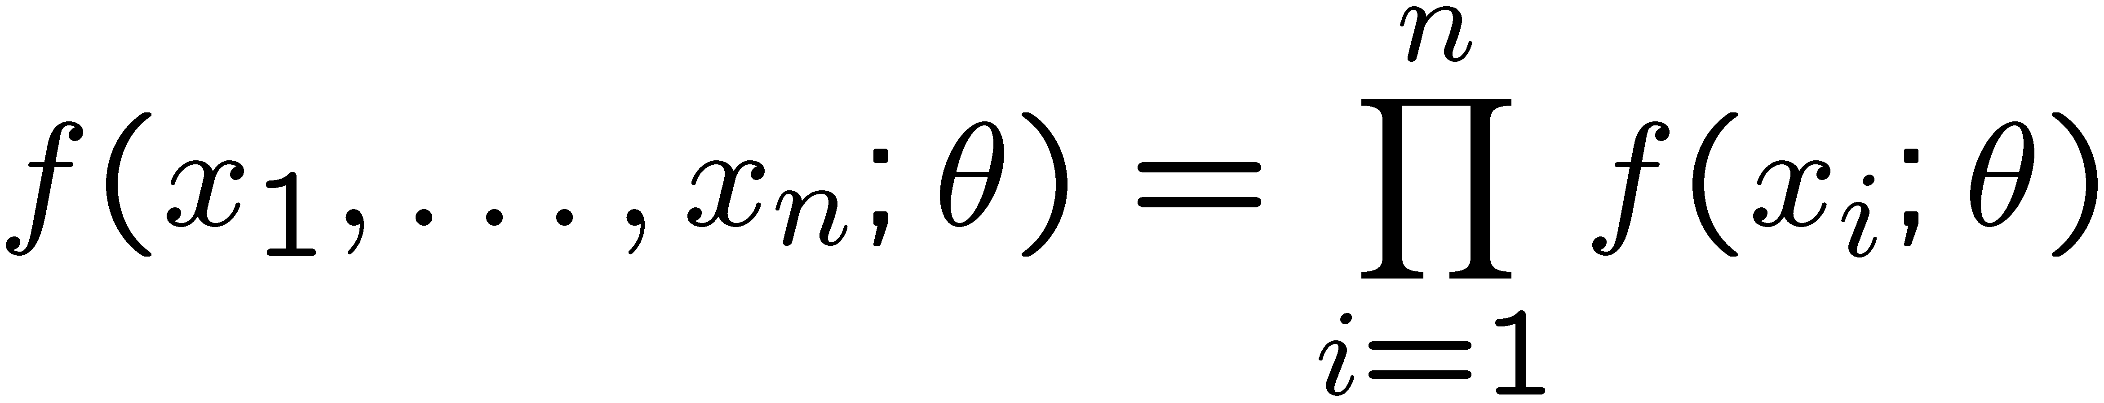
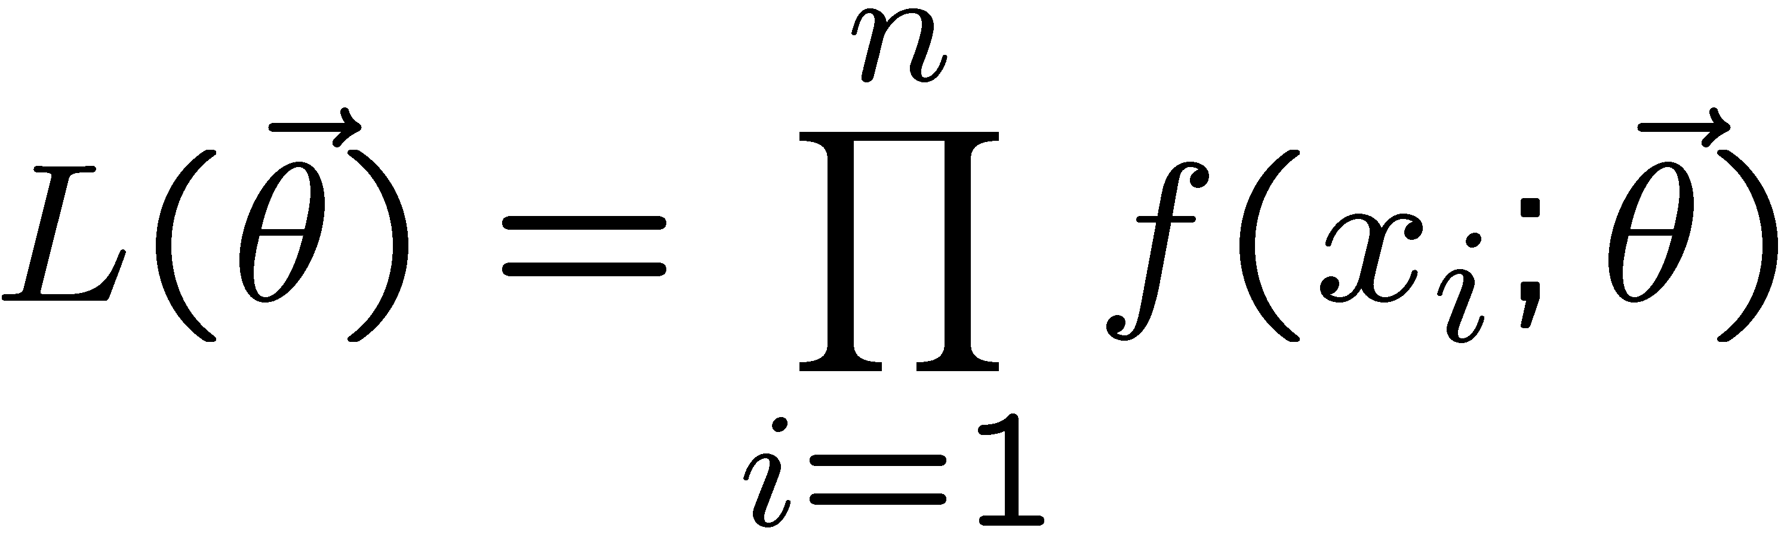
The likelihood function for i.i.d.* data
* i.i.d. = independent and identically distributed
Consider n independent observations of x: x₁, ..., x_{n}, where
x follows f (x; θ). The joint pdf for the whole data sample is:
In this case the likelihood function is
(x_{i} constant)

Slide 12
Maximum Likelihood Estimators (MLEs)
We define the maximum likelihood estimators or MLEs to be
the parameter values for which the likelihood is maximum.
Maximizing L equivalent to maximizing log L
Could have multiple maxima (take highest).
MLEs not guaranteed to have any ‘optimal’ properties, (but in practice they’re very good).

Slide 13
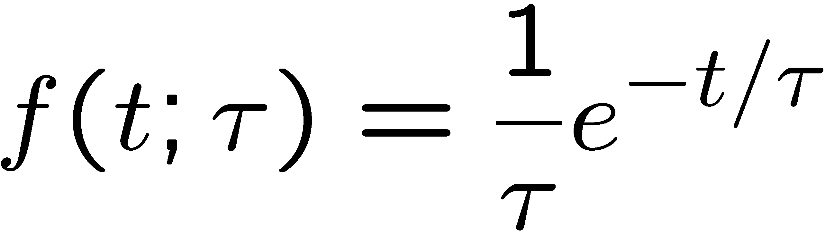
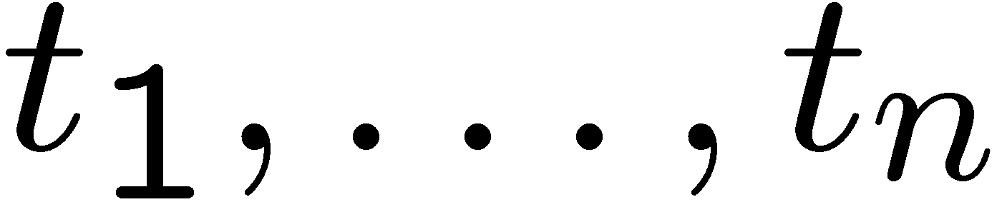
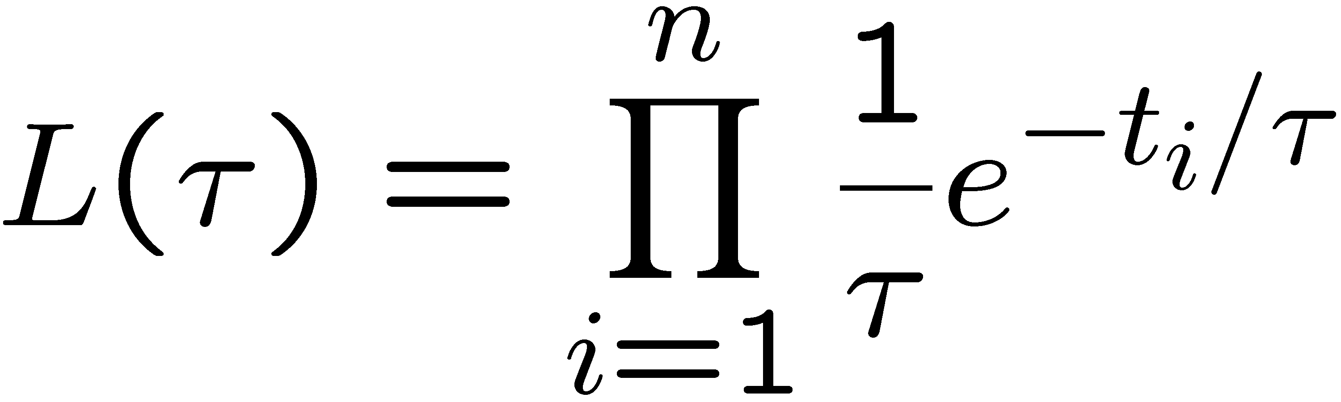
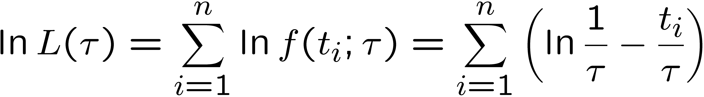
MLE example: parameter of exponential pdf
Consider exponential pdf,
and suppose we have i.i.d. data,
The likelihood function is
The value of τ for which L(τ) is maximum also gives the
maximum value of its logarithm (the log-likelihood function):

Slide 14
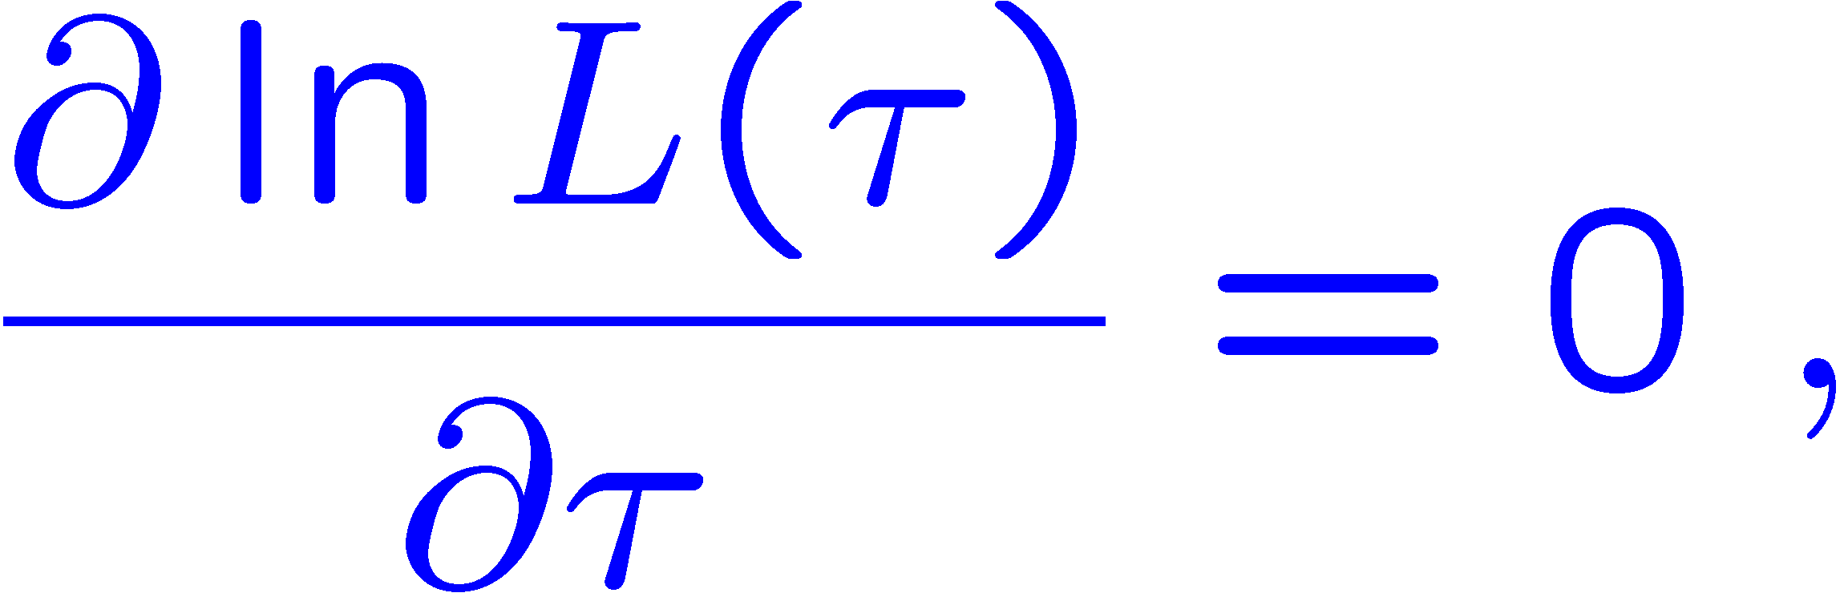
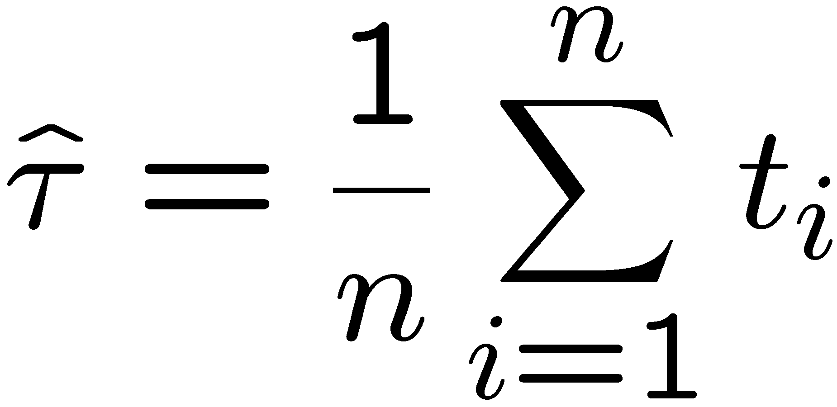
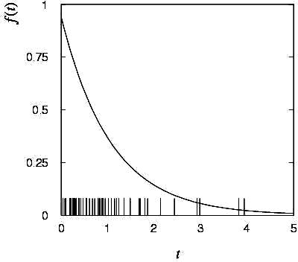

MLE example: parameter of exponential pdf (2)
Find its maximum by setting
→
Monte Carlo test:
generate 50 values
using τ = 1:
We find the ML estimate:

Slide 15






MLE example: parameter of exponential pdf (3)
For the exponential distribution one has for mean, variance:
For the MLE
we therefore find
→
→

Slide 16
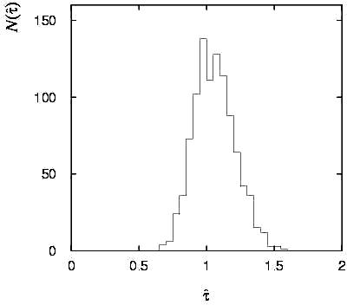

Variance of estimators: Monte Carlo method
Having estimated our parameter we now need to report its
‘statistical error’, i.e., how widely distributed would estimates
be if we were to repeat the entire measurement many times.
One way to do this would be to simulate the entire experiment
many times with a Monte Carlo program (use ML estimate for MC).
For exponential example, from
sample variance of estimates
we find:
Note distribution of estimates is roughly
Gaussian − (almost) always true for
ML in large sample limit.

Slide 17
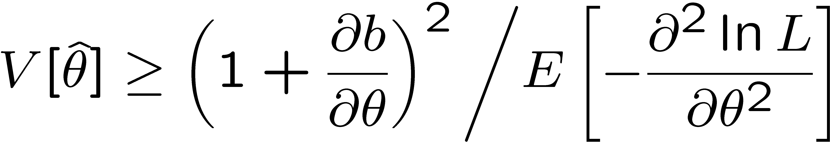
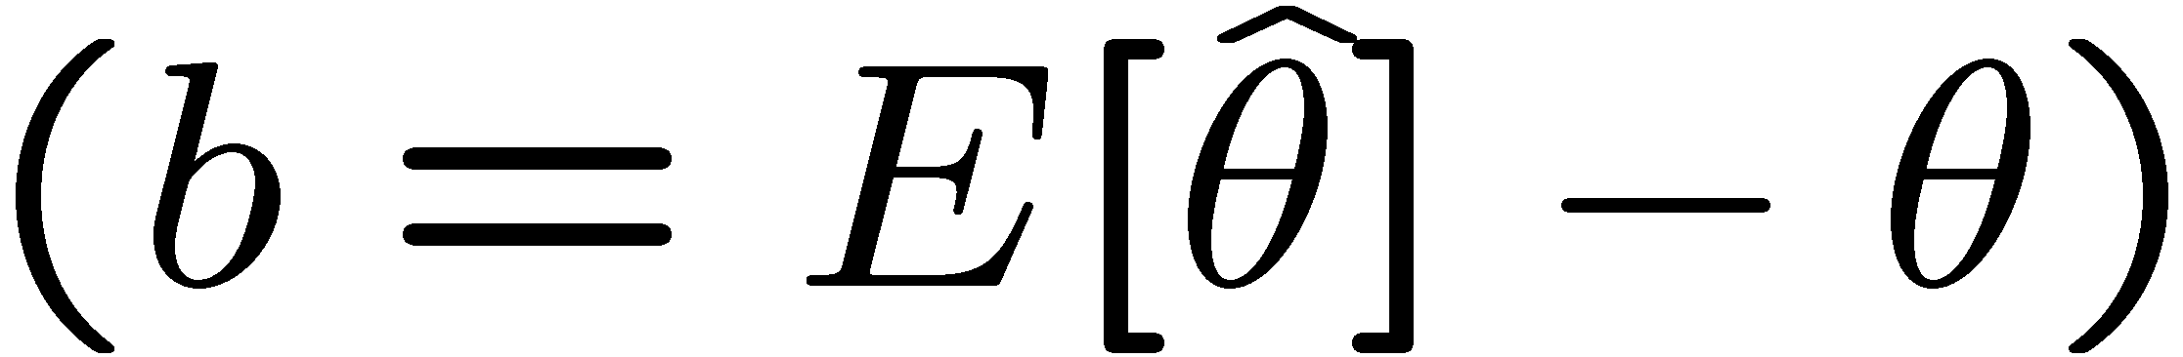
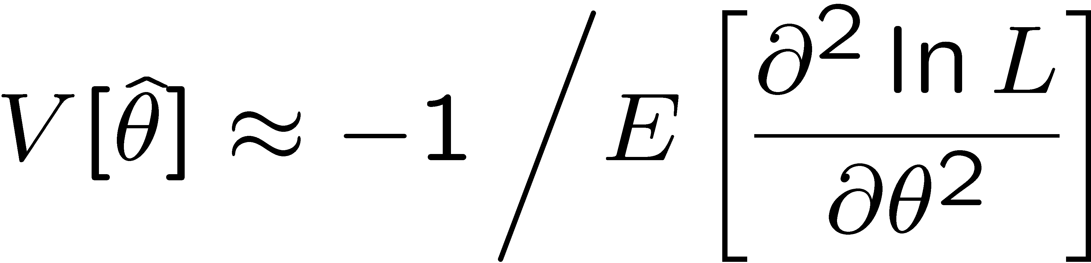
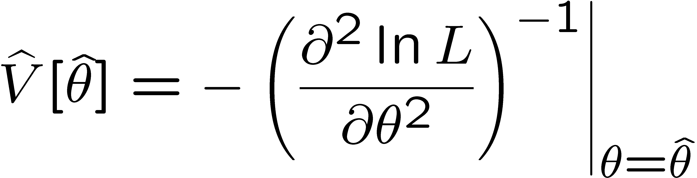
Variance of estimators from information inequality
The information inequality (RCF) sets a lower bound on the
variance of any estimator (not only ML):
Minimum Variance
Bound (MVB)
Often the bias b is small, and equality either holds exactly or
is a good approximation (e.g. large data sample limit). Then,
Estimate this using the 2nd derivative of ln L at its maximum:

Slide 18
Large-sample (asymptotic) properties of MLEs
Suppose we have an i.i.d. data sample of size n: x₁,...,x_{n}
In the large-sample (or “asymptotic”) limit (n → ∞) and assuming regularity conditions one can show that the likelihood and MLE have several important properties.
The regularity conditions include:
the boundaries of the data space cannot depend on the parameter;
the parameter cannot be on the edge of the parameter space;
ln L(θ) must be differentiable;
the only solution to 𝜕ln L/𝜕θ = 0 is θ.
^
In the slides immediately following, the properties are shown without proof for a single parameter; the corresponding properties hold also for the multiparameter case, θ = (θ₁,..., θ_{m}).

Slide 19
log-likelihood becomes quadratic
The likelihood function becomes Gaussian in shape, i.e. the log-likelihood becomes quadratic (parabolic).
The MLE becomes increasingly precise as the (log)-likelihood becomes more tightly concentrated about its peak,
but L(θ) = P(x|θ) is the probability for x, not a pdf for θ.

Slide 20
The MLE converges to the true parameter value
In the large-sample limit, the MLE converges in probability
to the true parameter value.
That is, for any ε > 0,
The MLE is said to be consistent.

Slide 21
MLE is asymptotically unbiased
In general the MLE can be biased, but in the large-sample limit, this bias goes to zero:
(Recall for the exponential parameter we found the bias was
identically zero regardless of the sample size n.)

Slide 22
The MLE’s variance approaches the MVB
In the large-sample limit, the variance of the MLE approaches the minimum-variance bound, i.e., the information inequality becomes an equality (and bias goes to zero):
The MLE is said to be asymptotically efficient.

Slide 23
The MLE’s distribution becomes Gaussian
In the large-sample limit, the pdf of the MLE becomes Gaussian,
where
is the minimum variance bound (note bias is zero).
For example, exponential MLE with sample size n = 100.
Note that for exponential, MLE is arithmetic average, so Gaussian MLE seen to stem from Central Limit Theorem.

Slide 24
Distribution of MLE of exponential parameter

Slide 25
MVB for MLE of exponential parameter
Find
We found for the exponential parameter the MLE
and we showed b = 0, hence 𝜕b/𝜕τ = 0.
We find
and since E[t_{i}] = τ for all i,
,
and therefore
.
(Here MLE is “efficient”).

Slide 26
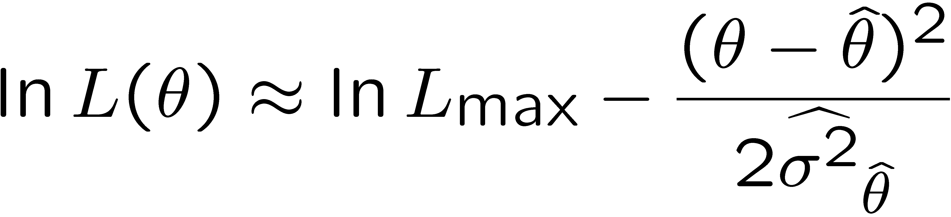
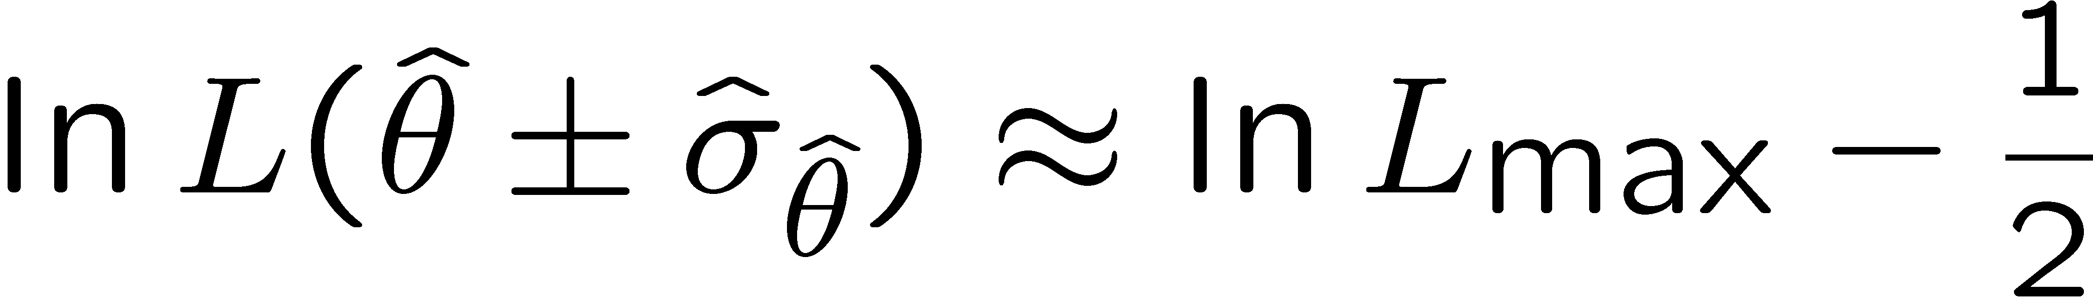


Variance of estimators: graphical method
Expand ln L(θ) about its maximum:
First term is ln L_{max}, second term is zero, for third term use
information inequality (assume equality):
i.e.,
→ to get
, change θ away from
until ln L decreases by 1/2.

Slide 27
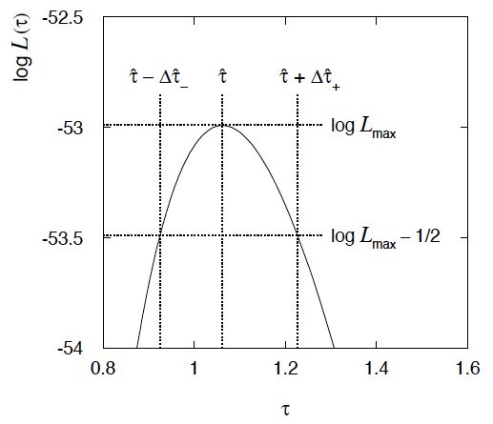
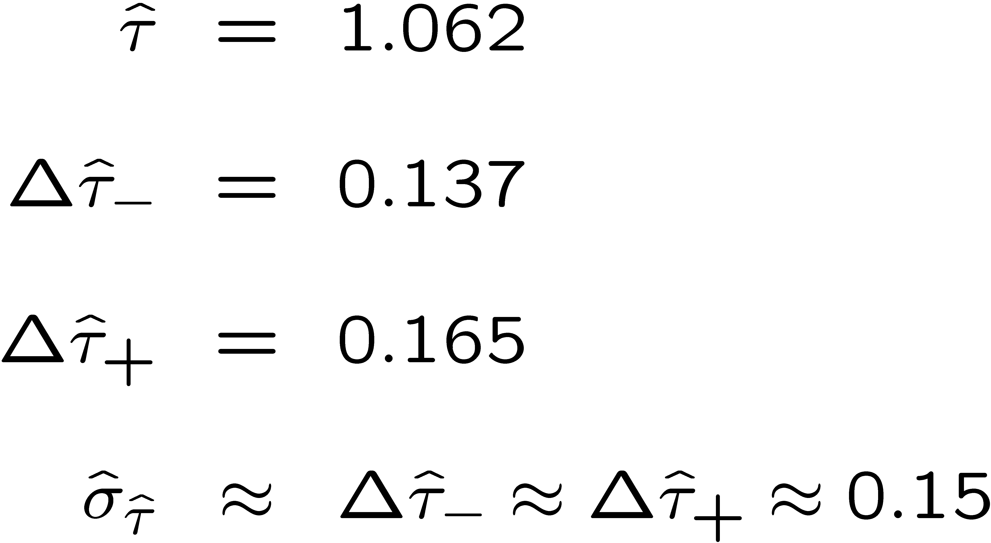
Example of variance by graphical method
ML example with exponential:
Not quite parabolic ln L since finite sample size (n = 50).

Slide 28
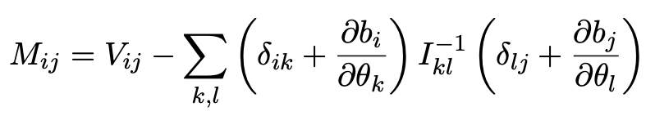
Information inequality for N parameters
Suppose we have estimated N parameters θ = (θ₁,...,θ_{N})
The Fisher information matrix is
^
and the covariance matrix of estimators θ is
The information inequality states that the matrix
is positive semi-definite:
z^{T}Mz ≥ 0 for all z ≠ 0, diagonal elements ≥ 0

Slide 29
Information inequality for N parameters (2)
In practice the inequality is ~always used in the large-sample limit:
bias → 0
inequality → equality, i.e, M = 0, and therefore V⁻¹ = I
That is,
This can be estimated from data using
Find the matrix V⁻¹ numerically (or with automatic differentiation),
then invert to get the covariance matrix of the estimators

Slide 30
Multiparameter graphical method for variances
Expand ln L(θ) to 2nd order about MLE:
ln L_{max}
zero
relate to covariance matrix of MLEs using information (in)equality.
Result:
So the surface
corresponds to
, which is the equation of a (hyper-) ellipse.

Slide 31
Multiparameter graphical method (2)
Distance from MLE to tangent planes gives standard deviations.

Slide 32
Frequentist hypothesis tests
Suppose a measurement produces data x; consider a hypothesis H₀
we want to test and alternative H₁
H₀, H₁ specify probability for x: P(x|H₀), P(x|H₁)
A test of H₀ is defined by specifying a critical region w of the
data space such that there is no more than some (small) probability
α, assuming H₀ is correct, to observe the data there, i.e.,
P(x ∈ w | H₀) ≤ α
Need inequality if data are
discrete.
α is called the size or
significance level of the test.
If x is observed in the
critical region, reject H₀.
data space Ω
critical region w

Slide 33



Definition of a test (2)
But in general there are an infinite number of possible critical regions that give the same size α.
Use the alternative hypothesis H₁ to motivate where to place the critical region.
Roughly speaking, place the critical region where there is a low
probability (α) to be found if H₀ is true, but high if H₁ is true:

Slide 34


Classification viewed as a statistical test
Suppose events come in two possible types:
s (signal) and b (background)
For each event, test hypothesis that it is background, i.e., H₀ = b.
Carry out test on many events, each is either of type s or b, i.e., here the hypothesis is the “true class label”, which varies randomly from event to event, so we can assign to it a frequentist probability.
Select events for which where H₀ is rejected as “candidate events of type s”. Equivalent Particle Physics terminology:
background efficiency
signal efficiency

Slide 35
Example of a test for classification
Suppose we can measure for
each event a quantity x, where
with 0 ≤ x ≤ 1.
For each event in a mixture of signal (s) and background (b) test
H₀ : event is of type b
using a critical region W of the form: W = { x : x ≤ x_{c} }, where
x_{c} is a constant that we choose to give a test with the desired size α.

Slide 36
Classification example (2)
Suppose we want α = 10⁻⁴. Require:
and therefore
For this test (i.e. this critical region W), the power with respect to the signal hypothesis (s) is
Note: the optimal size and power is a separate question that will depend on goals of the subsequent analysis.

Slide 37
Classification example (3)
Suppose that the prior probabilities for an event to be of type s or b are:
π_{s} = 0.001
π_{b} = 0.999
The “purity” of the selected signal sample (events where b hypothesis rejected) is found using Bayes’ theorem:

Slide 38
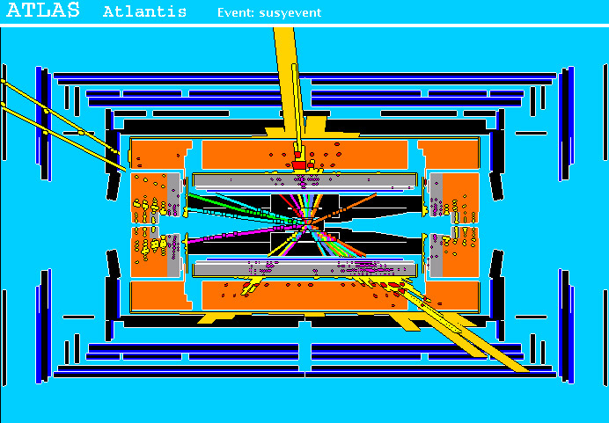
Particle Physics context for a hypothesis test
A simulated SUSY event (“signal”):
high p_{T}
muons
high p_{T} jets
of hadrons
p
p
missing transverse energy

Slide 39
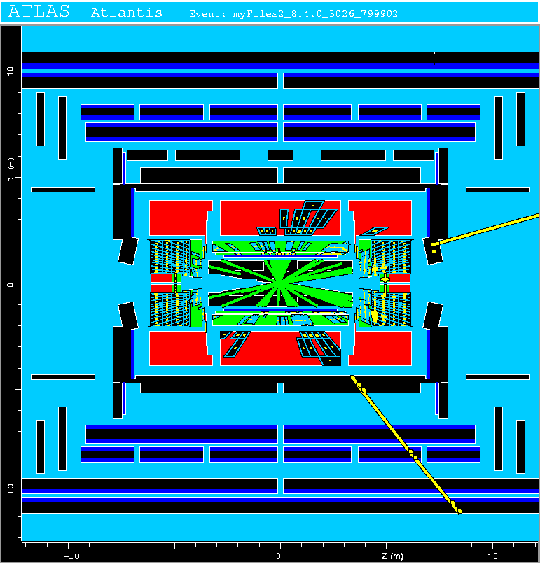
Background events
This event from Standard
Model ttbar production also
has high p_{T} jets and muons,
and some missing transverse
energy.
→ can easily mimic a
signal event.

Slide 40
Classification of proton-proton collisions
Proton-proton collisions can be considered to come in two classes:
signal (the kind of event we’re looking for, y = 1)
background (the kind that mimics signal, y = 0)
For each collision (event), we measure a collection of features:
x₁ = energy of muon x₄ = missing transverse energy
x₂ = angle between jets x₅ = invariant mass of muon pair
x₃ = total jet energy x₆ = ...
The real events don’t come with true class labels, but computer-simulated events do. So we can have a set of simulated events that consist of a feature vector x and true class label y (0 for background, 1 for signal):
(x, y)₁, (x, y)₂, ..., (x, y)_{N}
The simulated events are called “training data”.

Slide 41
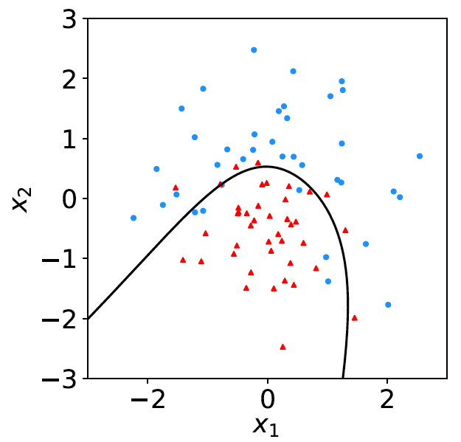
Distributions of the features
If we consider only two
features x = (x₁, x₂), we can
display the results in a scatter
plot (red: y = 0, blue: y = 1).
For real events, the dots are black (true type is not known).
For each real event test the hypothesis that it is background.
(Related to this: test that a sample of events is all background.)
The test’s critical region is defined by a “decision boundary” – without knowing the event type, we can classify them by seeing where their measured features lie relative to the boundary.

Slide 42
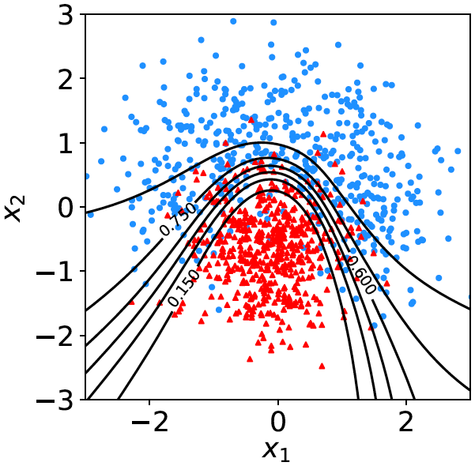

Decision function, test statistic
A surface in an n-dimensional
space can be described by
scalar
function
constant
Different values of the constant
t_{c} result in a family of surfaces.
Problem is reduced to finding
the best decision function or test statistic t (x).

Slide 43
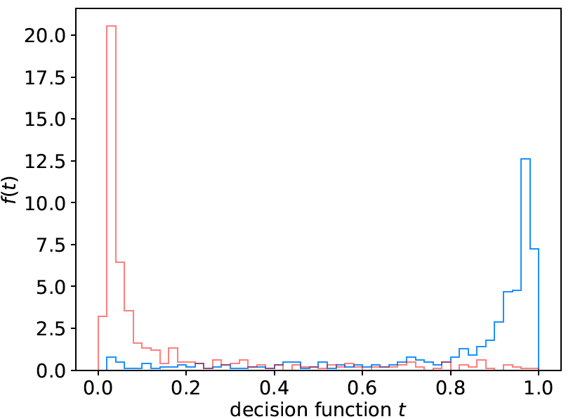
Distribution of t(x)
By forming a test statistic t(x), the boundary of the critical region in the n-dimensional x-space is determined by a single single value t_{c}.
f (t|H₀)
f (t|H₁)
t_{c}
W

Slide 44
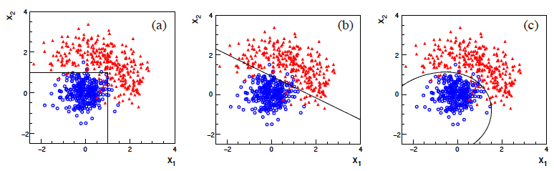
Types of decision boundaries
So what is the optimal boundary for the critical region, i.e., what
is the optimal test statistic t(x)?
First find best t(x), later address issue of optimal size of test.
Remember x-space can have many dimensions.
“cuts”
linear
non-linear

Slide 45
Test statistic based on likelihood ratio
How can we choose a test’s critical region in an ‘optimal way’, in particular if the data space is multidimensional?
Neyman-Pearson lemma states:
For a test of H₀ of size α, to get the highest power with respect to the
alternative H₁ we need for all x in the critical region W
”likelihood
ratio (LR)”
inside W and ≤ c_{α} outside, where c_{α} is a constant chosen to give a test of the desired size.
Equivalently, optimal scalar test statistic is
N.B. any monotonic function of this is leads to the same test.

Slide 46

Neyman-Pearson doesn’t usually help
We usually don’t have explicit formulae for the pdfs f (x|s), f (x|b), so for a given x we can’t evaluate the likelihood ratio
Instead we may have Monte Carlo models for signal and background processes, so we can produce simulated data:
generate x ~ f (x|s) → x₁,..., x_{N}
generate x ~ f (x|b) → x₁,..., x_{N}
This gives samples of “training data” with events of known type.
Use these to construct a statistic that is as close as possible to the optimal likelihood ratio (→ Machine Learning).

Slide 47
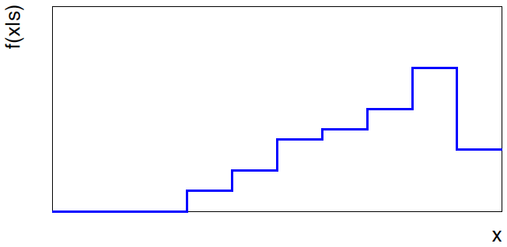
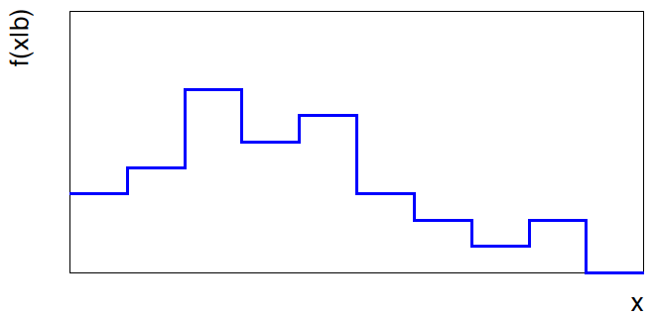


Approximate LR from histograms
Want t(x) = f (x|s)/ f(x|b) for x here
One possibility is to generate
MC data and construct
histograms for both
signal and background.
Use (normalized) histogram
values to approximate LR:
N(x|s)
N (x|s) ≈ f (x|s)
x
N(x|b)
N (x|b) ≈ f (x|b)
Can work well for single
variable.
x

Slide 48
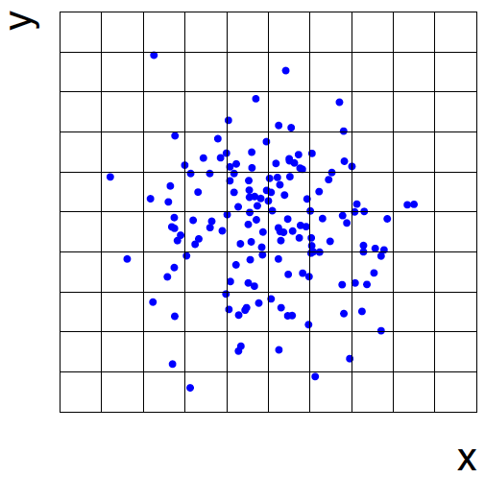
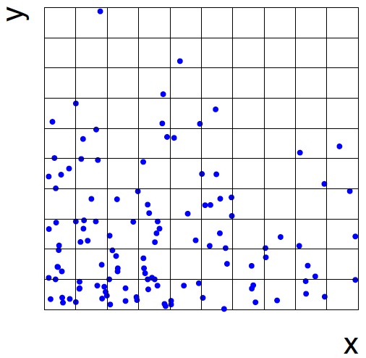
Approximate LR from 2D-histograms
Suppose problem has 2 variables. Try using 2-D histograms:
signal
back-
ground
Approximate pdfs using N (x,y|s), N (x,y|b) in corresponding cells.
But if we want M bins for each variable, then in n-dimensions we
have M^{n} cells; can’t generate enough training data to populate.
→ Histogram method usually not usable for n > 1 dimension.

Slide 49
Strategies for multivariate analysis
Neyman-Pearson lemma gives optimal answer, but cannot be
used directly, because we usually don’t have f (x|s), f (x|b).
Histogram method with M bins for n variables requires that
we estimate M^{n} parameters (the values of the pdfs in each cell),
so this is rarely practical.
A compromise solution is to assume a certain functional form
for the test statistic t (x) with fewer parameters; determine them
(using MC) to give best separation between signal and background.
Alternatively, try to estimate the probability densities f (x|s) and
f (x|b) (with something better than histograms) and use the
estimated pdfs to construct an approximate likelihood ratio.

Slide 50
Multivariate methods (Machine Learning)
Many new (and some old) methods:
Fisher discriminant
(Deep) Neural Networks
Kernel density methods
Support Vector Machines
Decision trees
Boosting
Bagging

Slide 51
Extra slides

Slide 52
Some statistics books, papers, etc.
G. Cowan, Statistical Data Analysis, Clarendon, Oxford, 1998
R.J. Barlow, Statistics: A Guide to the Use of Statistical Methods in the Physical Sciences, Wiley, 1989
Ilya Narsky and Frank C. Porter, Statistical Analysis Techniques in Particle Physics, Wiley, 2014.
Luca Lista, Statistical Methods for Data Analysis in Particle Physics, Springer, 2017.
L. Lyons, Statistics for Nuclear and Particle Physics, CUP, 1986
F. James., Statistical and Computational Methods in Experimental Physics, 2nd ed., World Scientific, 2006
S. Brandt, Statistical and Computational Methods in Data Analysis, Springer, New York, 1998.
R.L. Workman et al. (Particle Data Group), Prog. Theor. Exp. Phys. 083C01 (2022); pdg.lbl.gov sections on probability, statistics, MC.

Slide 53
Some distributions
Distribution/pdf Example use in Particle Physics
Binomial Branching ratio
Multinomial Histogram with fixed N
Poisson Number of events found
Uniform Monte Carlo method
Exponential Decay time
Gaussian Measurement error
Chi-square Goodness-of-fit
Cauchy Mass of resonance
Landau Ionization energy loss
Beta Prior pdf for efficiency
Gamma Sum of exponential variables
Student’s t Resolution function with adjustable tails

Slide 54
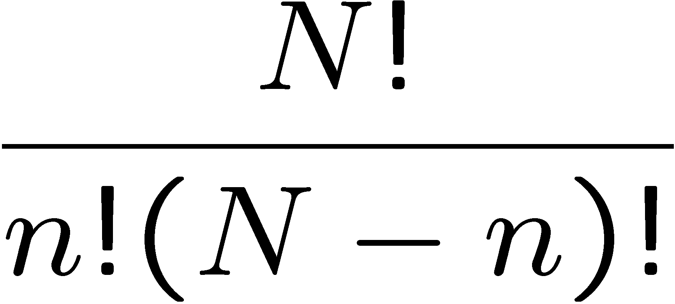
Binomial distribution
Consider N independent experiments (Bernoulli trials):
outcome of each is ‘success’ or ‘failure’,
probability of success on any given trial is p.
Define discrete r.v. n = number of successes (0 ≤ n ≤ N).
Probability of a specific outcome (in order), e.g. ‘ssfsf’ is
But order not important; there are
ways (permutations) to get n successes in N trials, total
probability for n is sum of probabilities for each permutation.

Slide 55
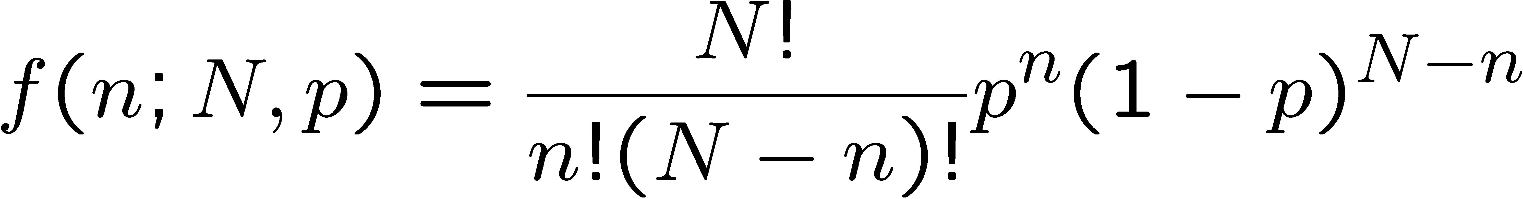
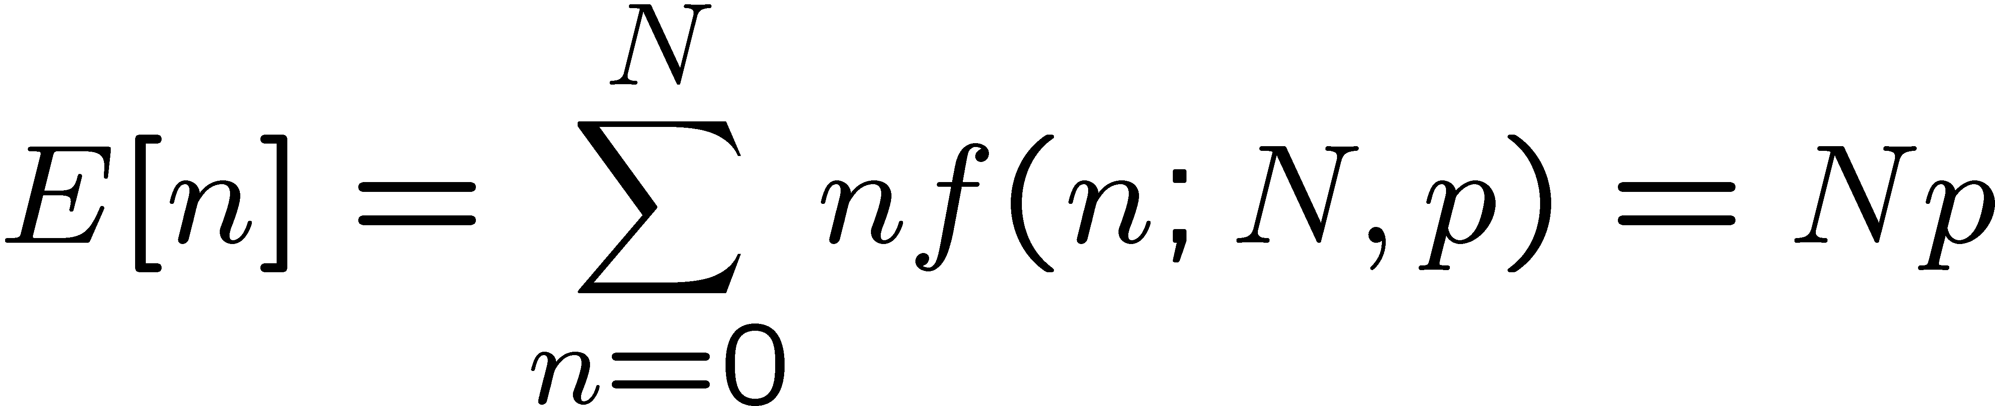
Binomial distribution (2)
The binomial distribution is therefore
random
variable
parameters
For the expectation value and variance we find:

Slide 56
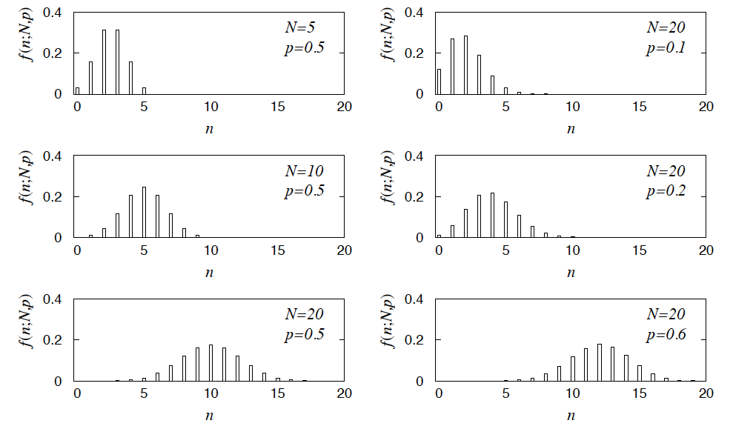
Binomial distribution (3)
Binomial distribution for several values of the parameters:
Example: observe N decays of W±, the number n of which are
W→μν is a binomial r.v., p = branching ratio.

Slide 57
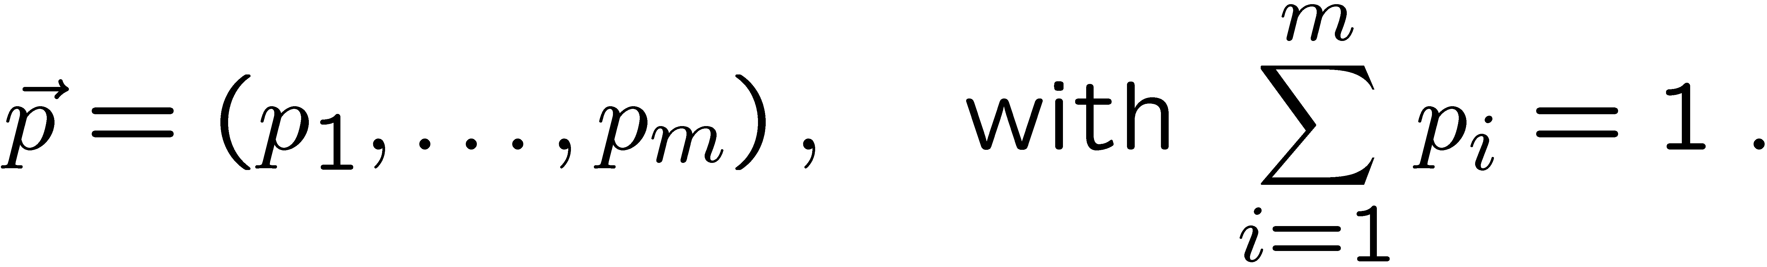
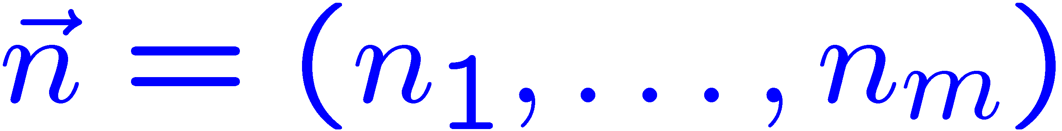
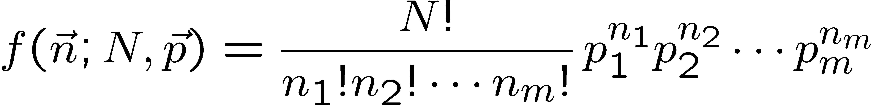
Multinomial distribution
Like binomial but now m outcomes instead of two, probabilities are
For N trials we want the probability to obtain:
n₁ of outcome 1,
n₂ of outcome 2,
⠇
n_{m} of outcome m.
This is the multinomial distribution for

Slide 58

Multinomial distribution (2)
Now consider outcome i as ‘success’, all others as ‘failure’.
→ all n_{i} individually binomial with parameters N, p_{i}
for all i
One can also find the covariance to be
Example:
represents a histogram
with m bins, N total entries, all entries independent.

Slide 59



Poisson distribution
Consider binomial n in the limit
→ n follows the Poisson distribution:
Example: number of scattering events
n with cross section σ found for a fixed
integrated luminosity, with

Slide 60




Uniform distribution
Consider a continuous r.v. x with −∞ < x < ∞ . Uniform pdf is:
Notation: x follows a uniform distribution between α and β
write as: x ~ U[α,β]

Slide 61




Exponential distribution
The exponential pdf for the continuous r.v. x is defined by:

Slide 62




Gaussian (normal) distribution
The Gaussian (normal) pdf for a continuous r.v. x is defined by:
N.B. often μ, σ² denote
mean, variance of any
r.v., not only Gaussian.

Slide 63




Multivariate Gaussian distribution
Multivariate Gaussian pdf for the vector
are column vectors,
are transpose (row) vectors,
Marginal pdf of each x_{i} is Gaussian with mean μ_{i}, standard deviation σ_{i} = √V_{ii} .

Slide 64


https://en.wikipedia.org/wiki/Multivariate_normal_distribution
Two-dimensional Gaussian distribution
where ρ = cov[x₁, x₂]/(σ₁σ₂)
is the correlation coefficient.

Slide 65



Chi-square (χ²) distribution
The chi-square pdf for the continuous r.v. z (z ≥ 0) is defined by
n = 1, 2, ... = number of ‘degrees of
freedom’ (dof)
For independent Gaussian x_{i}, i = 1, ..., n, means μ_{i}, variances σ_{i}²,
follows χ² pdf with n dof.
Example: goodness-of-fit test variable especially in conjunction
with method of least squares.

Slide 66


Cauchy (Breit-Wigner) distribution
The Breit-Wigner pdf for the continuous r.v. x is defined by
(Γ = 2, x₀ = 0 is the Cauchy pdf.)
E[x] not well defined, V[x] → ∞.
x₀ = mode (most probable value)
Γ = full width at half maximum
Example: mass of resonance particle, e.g. ρ, K*, φ⁰, ...
Γ = decay rate (inverse of mean lifetime)

Slide 67





Landau distribution
For a charged particle with β = ν /c traversing a layer of matter
of thickness d, the energy loss Δ follows the Landau pdf:
Δ
β
+ - + -
- + - +
d
L. Landau, J. Phys. USSR 8 (1944) 201; see also
W. Allison and J. Cobb, Ann. Rev. Nucl. Part. Sci. 30 (1980) 253.

Slide 68

Landau distribution (2)
Long ‘Landau tail’
→ all moments ∞
Mode (most probable
value) sensitive to β ,
→ particle i.d.

Slide 69




Beta distribution
Often used to represent pdf
of continuous r.v. nonzero only
between finite limits, e.g.,
y = a₀ + a₁x, a₀ ≤ y ≤ a₀ + a₁

Slide 70




Gamma distribution
Often used to represent pdf
of continuous r.v. nonzero only
in [0,∞].
Also e.g. sum of n exponential
r.v.s or time until nth event
in Poisson process ~ Gamma

Slide 71




Student's t distribution
ν = number of degrees of freedom
(not necessarily integer)
ν = 1 gives Cauchy,
ν → ∞ gives Gaussian.

Slide 72



Example of ML with 2 parameters
Consider a scattering angle distribution with x = cos θ,
or if x_{min} < x < x_{max}, need to normalize so that
Example: α = 0.5, β = 0.5, x_{min} = −0.95, x_{max} = 0.95, generate n = 2000 events with Monte Carlo.
need to find maximum
numerically

Slide 73





Example of ML with 2 parameters: fit result
Finding maximum of ln L(α, β) numerically gives
N.B. No binning of data for fit,
but can compare to histogram for
goodness-of-fit (e.g. ‘visual’ or χ²).
(Co)variances from
= correlation coefficient

Slide 74





Two-parameter fit: MC study
Repeat ML fit with 500 experiments, all with n = 2000 events:
Estimates average to ~true values;
(Co)variances close to previous estimates;
marginal pdfs approximately Gaussian.

Slide 75


The ln L_{max} − 1/2 contour for two parameters
For large n, ln L takes on quadratic form near maximum:
The contour
is an ellipse:

Slide 76


(Co)variances from ln L contour
The α, β plane for the first
MC data set
→ Tangent lines to contours give standard deviations.
→ Angle of ellipse φ related to correlation:

Slide 77




Proof of Neyman-Pearson Lemma
Consider a critical region W and suppose the LR satisfies the criterion of the Neyman-Pearson lemma:
P(x|H₁)/P(x|H₀) ≥ c_{α} for all x in W,
P(x|H₁)/P(x|H₀) ≤ c_{α} for all x not in W.
W
Try to change this into a different critical region W′ retaining the same size α, i.e.,
δW₊
To do so add a part δW₊, but to keep the size α, we need to remove a part δW₋, i.e.,
W′
δW₋

Slide 78
Proof of Neyman-Pearson Lemma (2)
δW₊
But we are supposing the LR is higher for all x in δW₋ removed than for the x in δW₊ added, and therefore
W′
δW₋
The right-hand sides are equal and therefore

Slide 79
Proof of Neyman-Pearson Lemma (3)
We have
δW₊
W′
Note W and δW₊ are disjoint, and W′ and δW₋ are disjoint, so by Kolmogorov’s 3rd axiom,
δW₋
Therefore

Slide 80
Proof of Neyman-Pearson Lemma (4)
And therefore
i.e. the deformed critical region W′ cannot have higher power than the original one that satisfied the LR criterion of the Neyman-Pearson lemma.

