Slide 1


Statistics for Data Analysis
Lecture 3
Flavour Physics at LHC School
CERN, Geneva
26-30 May 2025
https://indico.cern.ch/event/1508466/
Glen Cowan
Physics Department
Royal Holloway, University of London
g.cowan@rhul.ac.uk
www.pp.rhul.ac.uk/~cowan

Slide 2
Outline
Lecture 1: Probability, Bayes vs. Frequentist
Frequentist parameter estimation
Hypothesis tests
Lecture 2: p-values
Confidence limits
Systematic uncertainties
Bayesian parameter estimation
→ Lecture 3: Prototype search analysis
Significance, sensitivity
Errors on errors
--------------------------------
Bayes factors

Slide 3




Prototype search analysis
Search for signal in a region of phase space; result is histogram
of some variable x giving numbers:
Assume the n_{i} are Poisson distributed with expectation values
strength parameter
where
signal
background

Slide 4


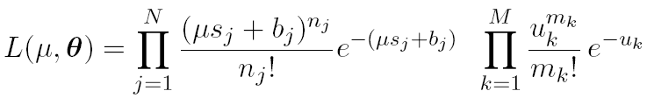
Prototype analysis (II)
Often also have a subsidiary measurement that constrains some
of the background and/or shape parameters:
Assume the m_{i} are Poisson distributed with expectation values
nuisance parameters (θ_{s}, θ_{b},b_{tot})
Likelihood function is

Slide 5
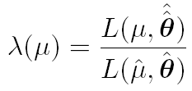
The profile likelihood ratio
Base significance test on the profile likelihood ratio:
maximizes L for
specified μ
maximize L
Define critical region of test of μ by the region of data space
that gives the lowest values of λ(μ).
Important advantage of profile LR is that its distribution becomes independent of nuisance parameters in large sample limit.

Slide 6
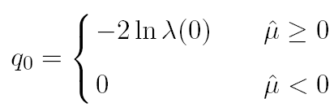
Test statistic for discovery
Suppose relevant alternative to background-only (μ = 0) is μ ≥ 0.
So take critical region for test of μ = 0 corresponding to high q₀
and > 0 (data characteristic for μ ≥ 0).
That is, to test background-only hypothesis define statistic
i.e. here only large (positive) observed signal strength is evidence against the background-only hypothesis.
Note that even though here physically μ ≥ 0, we allow
to be negative. In large sample limit its distribution becomes
Gaussian, and this will allow us to write down simple
expressions for distributions of our test statistics.

Slide 7


Cowan, Cranmer, Gross, Vitells, arXiv:1007.1727, EPJC 71 (2011) 1554
Distribution of q₀ in large-sample limit
Assuming approximations valid in the large sample (asymptotic)
limit, we can write down the full distribution of q₀ as
The special case μ′ = 0 is a “half chi-square” distribution:
In large sample limit, f (q₀|0) independent of nuisance parameters;
f (q₀|μ′) depends on nuisance parameters through σ.

Slide 8
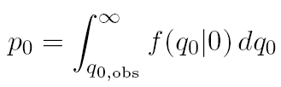
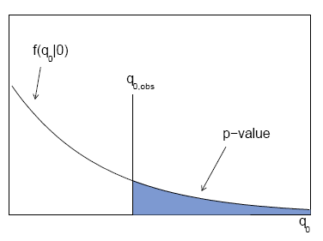

p-value for discovery
Large q₀ means increasing incompatibility between the data
and hypothesis, therefore p-value for an observed q_{0,obs} is
use e.g. asymptotic formula
From p-value get
equivalent significance,

Slide 9
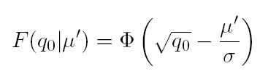



Cowan, Cranmer, Gross, Vitells, arXiv:1007.1727, EPJC 71 (2011) 1554
Cumulative distribution of q₀, significance
From the pdf, the cumulative distribution of q₀ is found to be
The special case μ′ = 0 is
The p-value of the μ = 0 hypothesis is
Therefore the discovery significance Z is simply

Slide 10
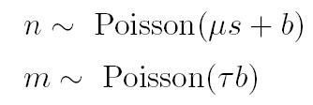
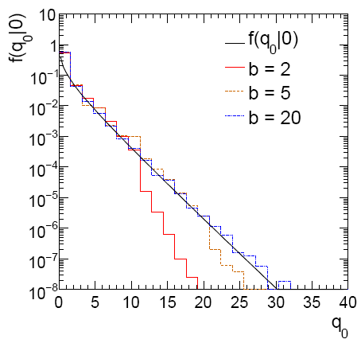
Cowan, Cranmer, Gross, Vitells, arXiv:1007.1727, EPJC 71 (2011) 1554
Monte Carlo test of asymptotic formula
μ = param. of interest
b = nuisance parameter
Here take s known, τ = 1.
Asymptotic formula is
good approximation to 5σ
level (q₀ = 25) already for
b ~ 20.

Slide 11
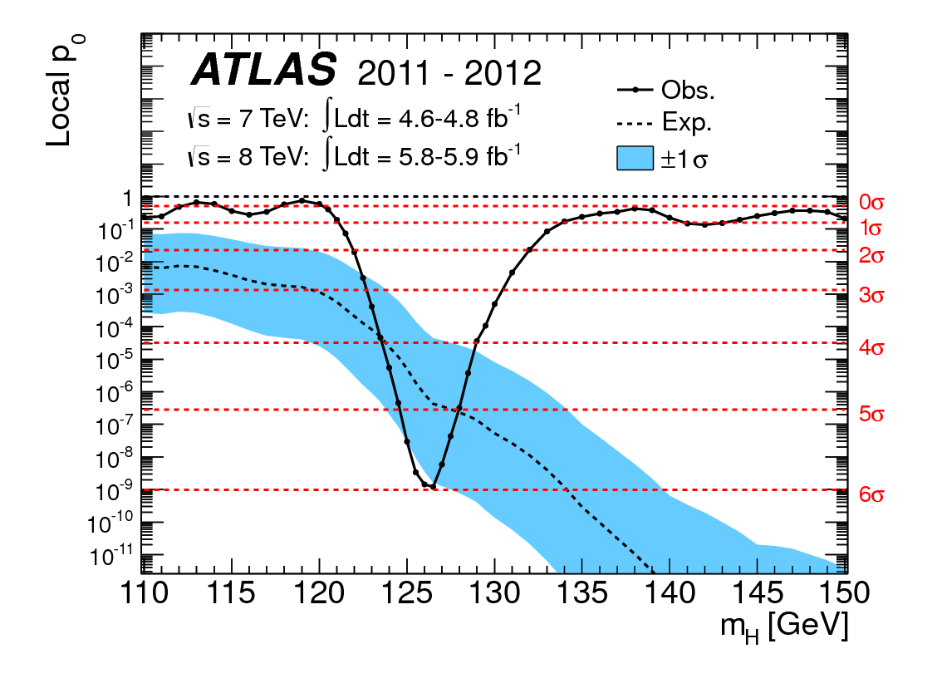
How to read the p₀ plot
The “local” p₀ means the p-value of the background-only
hypothesis obtained from the test of μ = 0 at each individual m_{H}, without any correct for the Look-Elsewhere Effect.
The “Expected” (dashed) curve gives the median p₀ under assumption of the SM Higgs (μ = 1) at each m_{H}.
ATLAS, Phys. Lett. B 716 (2012) 1-29
The blue band gives the
width of the distribution
(±1σ) of significances
under assumption of the
SM Higgs.

Slide 12
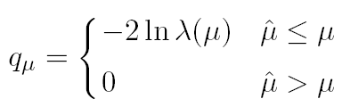



Cowan, Cranmer, Gross, Vitells, arXiv:1007.1727, EPJC 71 (2011) 1554
Test statistic for upper limits
For purposes of setting an upper limit on μ use
where
I.e. when setting an upper limit, an upwards fluctuation of the data
is not taken to mean incompatibility with the hypothesized μ :
From observed q_{μ} find p-value:
Large sample approximation:
To find upper limit at CL = 1−α, set p_{μ} = α and solve for μ.

Slide 13
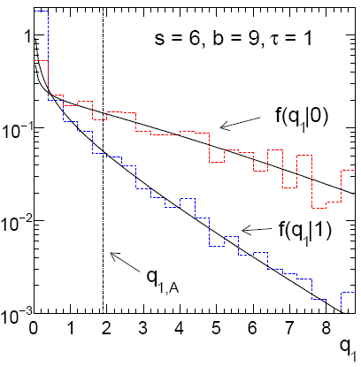
Cowan, Cranmer, Gross, Vitells, arXiv:1007.1727, EPJC 71 (2011) 1554
Monte Carlo test of asymptotic formulae
Consider again n ~ Poisson(μs + b), m ~ Poisson(τb)
Use q_{μ} to find p-value of hypothesized μ values.
E.g. f (q₁|1) for p-value of μ =1.
Typically interested in 95% CL, i.e., p-value threshold = 0.05, i.e.,
q₁ = 2.69 or Z₁ = √q₁ = 1.64.
Median[q₁ |0] gives “exclusion sensitivity”.
Here asymptotic formulae good
for s = 6, b = 9.

Slide 14
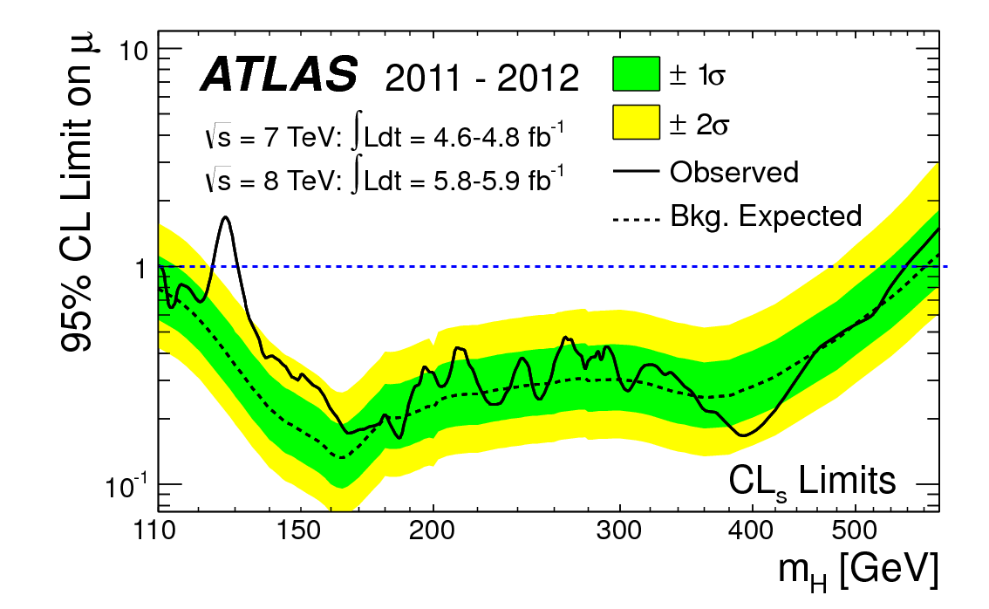
How to read the green and yellow limit plots
For every value of m_{H}, find the upper limit on μ.
Also for each m_{H}, determine the distribution of upper limits μ_{up} one would obtain under the hypothesis of μ = 0.
The dashed curve is the median μ_{up}, and the green (yellow) bands give the ± 1σ (2σ) regions of this distribution.
ATLAS, Phys. Lett. B 716 (2012) 1-29

Slide 15




Expected discovery significance for counting
experiment with background uncertainty
I. Discovery sensitivity for counting experiment with b known:
(a)
(b) Profile likelihood
ratio test & Asimov:
II. Discovery sensitivity with uncertainty in b, σ_{b}:
(a)
(b) Profile likelihood ratio test & Asimov:

Slide 16


Counting experiment with known background
Count a number of events n ~ Poisson(s+b), where
s = expected number of events from signal,
b = expected number of background events.
To test for discovery of signal compute p-value of s = 0 hypothesis,
Usually convert to equivalent significance:
where Φ is the standard Gaussian cumulative distribution, e.g.,
Z > 5 (a 5 sigma effect) means p < 2.9 ×10⁻⁷.
To characterize sensitivity to discovery, give expected (mean
or median) Z under assumption of a given s.

Slide 17



s/√b for expected discovery significance
For large s + b, n → x ~ Gaussian(μ,σ) , μ = s + b, σ = √(s + b).
For observed value x_{obs}, p-value of s = 0 is Prob(x > x_{obs} | s = 0),:
Significance for rejecting s = 0 is therefore
Expected (median) significance assuming signal rate s is

Slide 18



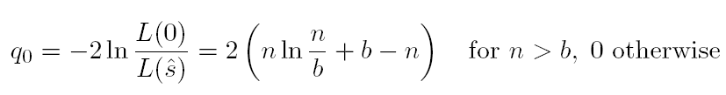
Better approximation for significance
Poisson likelihood for parameter s is
For now
no nuisance
params.
To test for discovery use profile likelihood ratio:
So the likelihood ratio statistic for testing s = 0 is

Slide 19


Approximate Poisson significance (continued)
For sufficiently large s + b, (use Wilks’ theorem),
To find median[Z|s], let n → s + b (i.e., the Asimov data set):
This reduces to s/√b for s << b.

Slide 20
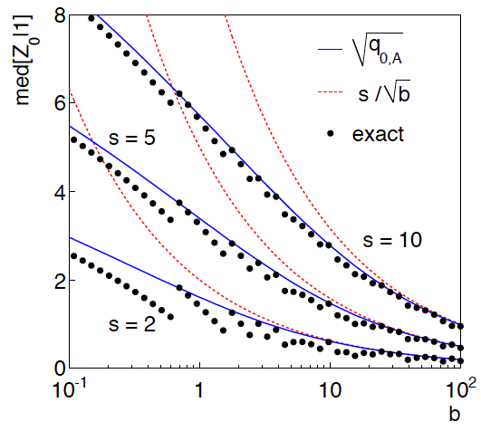
n ~ Poisson(s+b), median significance,
assuming s, of the hypothesis s = 0
CCGV, EPJC 71 (2011) 1554, arXiv:1007.1727
“Exact” values from MC,
jumps due to discrete data.
Asimov √q_{0,A} good approx.
for broad range of s, b.
s/√b only good for s ≪ b.

Slide 21

Extending s/√b to case where b uncertain
The intuitive explanation of s/√b is that it compares the signal,
s, to the standard deviation of n assuming no signal, √b.
Now suppose the value of b is uncertain, characterized by a
standard deviation σ_{b}.
A reasonable guess is to replace √b by the quadratic sum of
√b and σ_{b}, i.e.,
This has been used to optimize some analyses e.g. where
σ_{b} cannot be neglected.

Slide 22


Profile likelihood with b uncertain
This is the well studied “on/off” problem: Cranmer 2005;
Cousins, Linnemann, and Tucker 2008; Li and Ma 1983,...
Measure two Poisson distributed values:
n ~ Poisson(s+b) (primary or “search” measurement)
m ~ Poisson(τb) (control measurement, τ known)
The likelihood function is
Use this to construct profile likelihood ratio (b is nuisance
parameter):

Slide 23
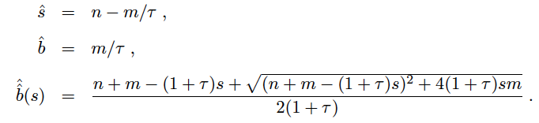

Ingredients for profile likelihood ratio
To construct profile likelihood ratio from this need estimators:
and in particular to test for discovery (s = 0),

Slide 24



Asymptotic significance
Use profile likelihood ratio for q₀, and then from this get discovery
significance using asymptotic approximation (Wilks’ theorem):
Essentially same as in:

Slide 25



Asimov approximation for median significance
To get median discovery significance, replace n, m by their
expectation values assuming background-plus-signal model:
n → s + b
m → τb
ˆ
Or use the variance of b = m/τ,
, to eliminate τ:

Slide 26

Limiting cases
Expanding the Asimov formula in powers of s/b and
σ_{b}²/b (= 1/τ) gives
So the “intuitive” formula can be justified as a limiting case
of the significance from the profile likelihood ratio test evaluated
with the Asimov data set.

Slide 27
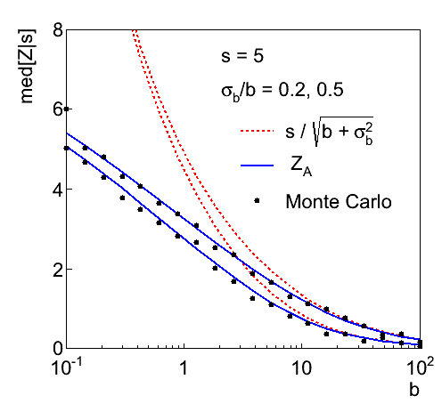
Testing the formulae: s = 5

Slide 28
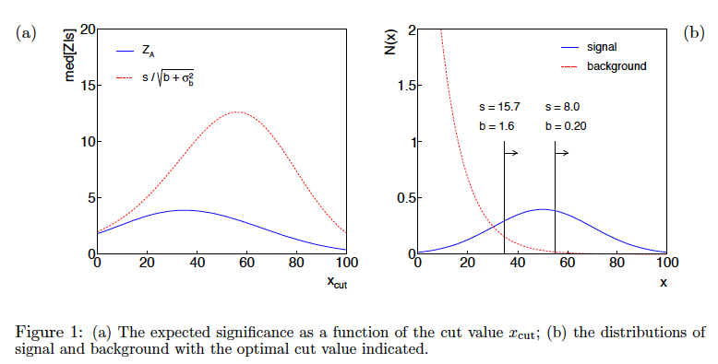
Using sensitivity to optimize a cut

Slide 29
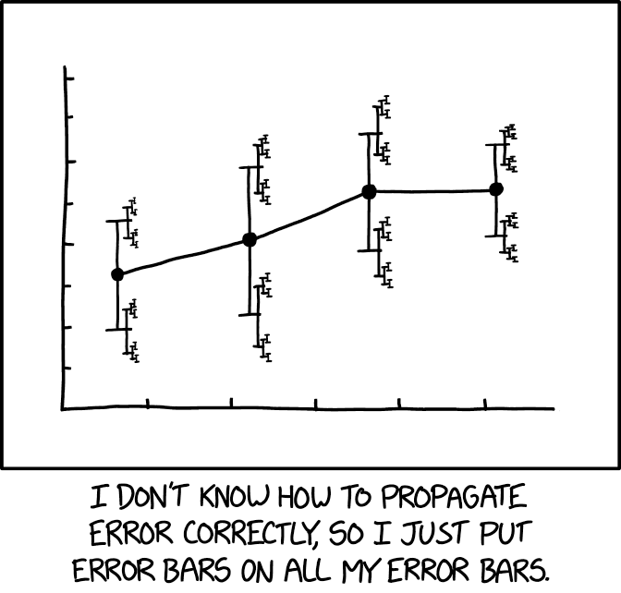
”Errors on errors”
The uncertainties on estimated systematic errors (“errors on errors”) can in general play an important role in many analyses, see:
G. Cowan, Statistical Models with Uncertain Error Parameters, Eur. Phys. J. C (2019) 79:133, arXiv:1809.05778
E. Canonero, A. Brazzale and G. Cowan, Higher-order asymptotic corrections and their application to the Gamma Variance Model, Eur. Phys. J. C (2023) 83:1100, arXiv:2304.10574
It turns out that models that use
errors on errors have qualitatively
new, interesting, desirable features:
https://xkcd.com/2110/
Sensitivity to outliers reduced.
Confidence intervals sensitive to goodness of fit.
Effect on goodness of fit, p-values, significance.

Slide 30



Formulation of the problem
Suppose measurements y have probability (density) P(y|μ,θ),
μ = parameters of interest
θ = nuisance parameters
To provide info on nuisance parameters, often treat their best
estimates u as indep. Gaussian distributed r.v.s., giving likelihood
or log-likelihood (up to additive const.)

Slide 31
Systematic errors and their uncertainty
Often the θ_{i} could represent a systematic bias and its best estimate u_{i} in the real measurement is zero.
The σ_{u,i} are the corresponding “systematic errors”.
Sometimes σ_{u,i} is well known, e.g., it is itself a statistical error known from sample size of a control measurement.
Other times the u_{i} are from an indirect measurement, Gaussian model approximate and/or the σ_{u,i} are not exactly known.
Or sometimes σ_{u,i} is at best a guess that represents an uncertainty in the underlying model (“theoretical error”).
In any case we can allow that the σ_{u,i} are not known in general with perfect accuracy.

Slide 32



Gamma model for variance estimates
Suppose we want to treat the systematic errors as uncertain,
so let the σ_{u,i} be adjustable nuisance parameters.
Suppose we have estimates s_{i} for σ_{u,i} or equivalently v_{i} = s_{i}², is an estimate of σ_{u,i}².
Model the v_{i} as independent and gamma distributed:
Set α and β so that they give desired mean and width for f (v):
E[v] = σ_{u}² = α/β,
r = 1/2√α ≈ relative “error on the error” = σ_{s}/E[s] .

Slide 33



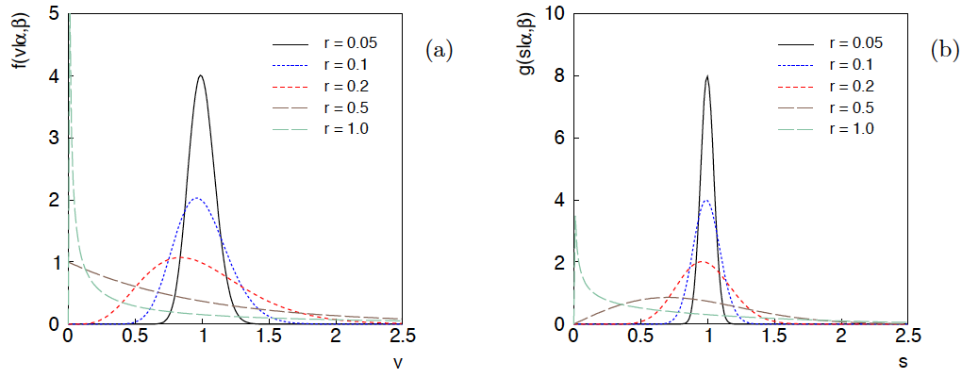
Distributions of v and s = √v
For α, β of gamma distribution,
relative “error on error”

Slide 34

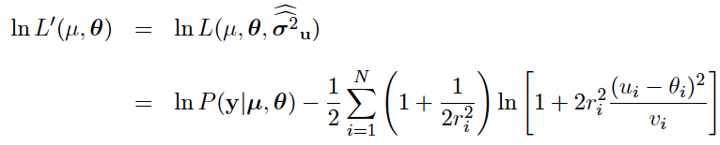
Profiling over systematic errors
We can profile over the σ_{u,i} in closed form
which gives the profile log-likelihood (up to additive const.)
In limit of small r_{i} and v_{i} → σ_{u,i}², the log terms revert back to the
quadratic form seen with known σ_{u,i}.

Slide 35




Equivalent likelihood from Student’s t
We can arrive at same likelihood by defining
Since u_{i} ~ Gauss and v_{i} ~ Gamma, z_{i} ~ Student’s t
with
Resulting likelihood same as profile Lʹ(μ,θ) from gamma model

Slide 36


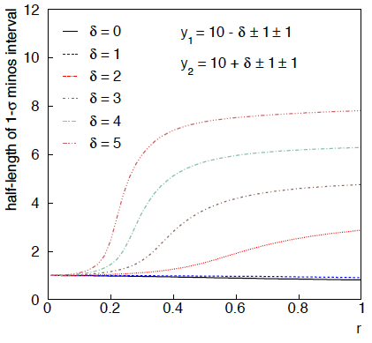
Example: average of two measurements
Approximate (”MINOS”) confidence interval based on
with
Increased discrepancy
between values to be
averaged gives larger
interval.
Interval length saturates
at ~level of absolute
discrepancy between
input values.
relative error
on sys. error

Slide 37
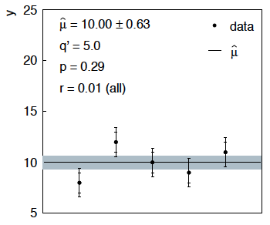
Sensitivity of average to outliers
Suppose we average 5 values, y = 8, 9, 10, 11, 12, all with
stat. and sys. errors of 1.0, and suppose negligible error on error
(here take r = 0.01 for all).
inner error bars
= σ_{y,i}
outer error bars
= (σ_{y,i}² + σ_{u,i}²)^{½}

Slide 38
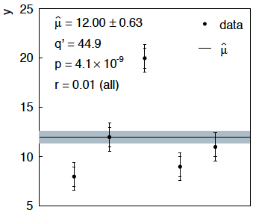
Sensitivity of average to outliers (2)
Now suppose the measurement at 10 had come out at 20:
“outlier”
Estimate pulled up to 12.0, size of confidence interval ~unchanged
(would be exactly unchanged with r → 0).

Slide 39
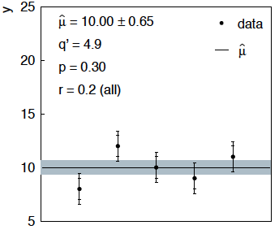
Average with all r = 0.2
If we assign to each measurement r = 0.2,
Estimate still at 10.00, size of interval moves 0.63 → 0.65

Slide 40
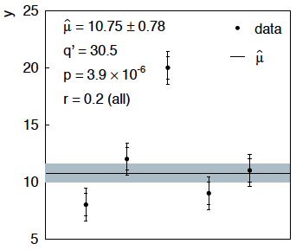
Average with all r = 0.2 with outlier
Same now with the outlier (middle measurement 10 → 20)
Estimate →10.75 (outlier pulls much less).
Half-size of interval → 0.78 (inflated because of bad g.o.f.).

Slide 41



Naive approach to errors on errors
Naively one might think that the error on the error in the previous
example could be taken into account conservatively by inflating
the systematic errors, i.e.,
But this gives
without outlier (middle meas. 10)
with outlier (middle meas. 20)
So the sensitivity to the outlier is not reduced and the size of the
confidence interval is still independent of goodness of fit.

Slide 42
Discussion on Gamma Variance Model
Other features of Gamma Variance Model (see EPJC (2019) 79:133 and the extra slides)
averages/fits become less sensitive to outliers;
confidence intervals linked to goodness of fit;
straightforward to include multiple correlated error sources.
But... is part of the reason for requiring 5σ for discovery not to account for uncertainties in assigned errors? Is there a trade-off between “errors on errors” and the requirement for discovery?
Best to have most realistic model. If the estimated errors are indeed uncertain, this should be reflected in the model.
Bottom line – it is very difficult to establish convincing evidence for a new physics if relevant uncertainties are estimated in an ad hoc way. We need robust procedures for their assignment.

Slide 43
Finally
Three lectures only enough for a brief discussion of:
Parameter estimation
Hypothesis tests (→ path to Machine Learning)
Limits (confidence intervals/regions)
Systematics (nuisance parameters)
Bayesian methods, MCMC
A bit beyond... (“errors on errors”)
Final thought: once the basic formalism is fixed, most of the
work focuses on writing down the likelihood, e.g., P(x|θ), and
including in it enough parameters to adequately describe the data (true for both Bayesian and frequentist approaches) so often best to invest most of your time with it.

Slide 44
Extra Slides

Slide 45
Bayesian model selection
Fundamentally the probability of a hypothesis H_{i} in the Bayesian approach is given by its posterior probability given the data: P(H_{i}|x).
Finding this requires assignment of prior probabilities to all hypotheses that are considered.
We can give the posterior odds (ratio of probabilities) for any pair of hypotheses H_{i} and H_{j} (use Bayes’ theorem; factors of P(x) cancel):
posterior odds
Bayes factor
prior odds
See: Kass and Raftery, Bayes Factors, J. Am Stat. Assoc 90 (1995) 773.

Slide 46
The Bayes factor
The Bayes factor B_{ij} is the likelihood ratio of the two hypotheses:
= posterior odds if one takes
prior odds equal to one.
The Bayes factor is regarded as measuring the weight of
evidence of the data in support of H_{i} over H_{j}. and can be used much like a p-value (or Z value).
The Jeffreys scale, analogous to the 5σ rule in Particle Physics:
B₁₀ Evidence against H₀
--------------------------------------------
1 to 3 Not worth more than a bare mention
3 to 20 Positive
20 to 150 Strong
> 150 Very strong

Slide 47
Marginal likelihood (evidence)
If the model H_{i} contains internal parameters θ_{i}, then these must be characterized by a prior pdf π_{i}(θ_{i} |H_{i}) and marginalized:
This is called the “marginal likelihood” or “evidence” of H_{i}.
It is independent of the overall prior probability of H_{i}
but it depends on the prior pdf for the model’s internal
parameters θ_{i} :

Slide 48
Bayes factor for models with internal parameters
The Bayes factor is thus the ratio of marginal likelihoods for the two models:
Simplifying the notation, the numerator and denominator are both of the form
For high-dimensional θ these integrals can be very difficult to compute (more on this later).

Slide 49

Priors for Bayes factors
Prior pdfs for the marginal likelihoods used in Bayes factors
cannot be improper, i.e., they cannot be defined only up to an arbitrary normalization constant, in which case B_{ij} would not be well defined.
Suppose we try to take a ”non-informative” prior to be constant
out to some large cut-off, in the hope that the Bayes factor will decouple from it:
In such cases we find that the Bayes factor remains sensitive to the cut-off even for a → ∞.
So all priors used for Bayes factors must reflect a meaningful degrees of uncertainty about the parameters.

Slide 50
Bayes factor for Poisson counting experiment
Suppose n ~ Poisson(s + b) with b known. We want to compare
The likelihoods of H₀ and H₁ are

Slide 51
Bayes factor for Poisson counting experiment (2)
Suppose the prior pdf for the parameter s in H₁ is:
(0 ≤ s ≤ s_{max})
The posterior probability for s given n is, assuming H₁,
(0 ≤ s ≤ s_{max})
γ = lower
incomplete
gamma
function

Slide 52
Bayes factor for Poisson counting experiment (3)
In the limit s_{max} → ∞ this goes to
where
is the lower incomplete gamma function.
Thus the posterior pdf for s given n under assumption of H₁
decouples from s_{max} in the limit s_{max} → ∞, and hence we
can use this limiting case e.g. for finding an upper limit (credibility interval) for s.

Slide 53
Bayes factor for Poisson counting experiment (4)
The hypothesis H₀ has no internal parameters so its marginal likelihood is simply m₀ = L(n| H₀).
The marginal likelihood of H₁ is

Slide 54
Bayes factor for Poisson counting experiment (5)
So the Bayes factor is
Example: b = 2, n = 8
As s_{max} increases the data start to favour H₁.
As s_{max} increases further, the larger volume of H₁’s parameter space penalizes it (Ockham’s razor).

Slide 55
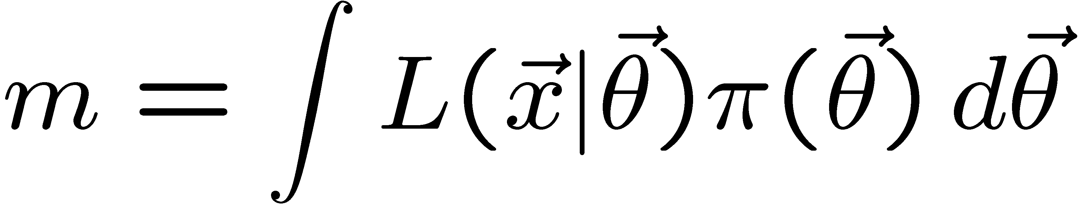
Numerical determination of Bayes factors
Both numerator and denominator of B_{ij} are of the form
‘marginal likelihood’
Various ways to compute these, e.g., using sampling of the posterior pdf (which we can do with MCMC).
Harmonic Mean (and improvements)
Importance sampling
Parallel tempering (~thermodynamic integration)
Nested Sampling (MultiNest), ...

Slide 56

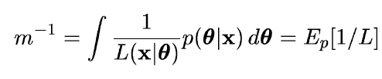
Harmonic mean estimator
E.g., consider only one model and write Bayes theorem as:
π(θ) is normalized to unity so integrate both sides,
posterior
expectation
Therefore sample θ from the posterior via MCMC and estimate m
with one over the average of 1/L (the harmonic mean of L).
Called the “worst Monte Carlo method ever”
https://radfordneal.wordpress.com/2008/08/17/the-harmonic-mean-of-the-likelihood-worst-monte-carlo-method-ever/

Slide 57

Improvements to harmonic mean estimator
The harmonic mean estimator is numerically very unstable;
formally infinite variance (!). A variant (cf. Gelfand and Dey):
Rearrange Bayes thm; multiply
both sides by arbitrary pdf f (θ):
Integrate over θ :
Improved convergence if tails of f (θ) fall off faster than L(x|θ)π(θ)
Note harmonic mean estimator is special case f (θ) = π(θ).
.

Slide 58



Adaptive Harmonic Mean Integration
A. Caldwell et al., International Journal of Modern Physics A Vol. 35, No. 24 (2020) 2050142
Want to compute
(Ω = support of f)
E.g. f (λ) = L(λ) π(λ) = unnormalized target density; we can sample from this with MCMC.
Define integral over subvolume Δ of Ω with volume V_{Δ}

Slide 59
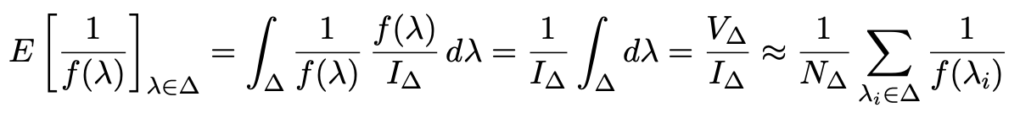
Adaptive Harmonic Mean Integration (2)
If f (λ) not small in Δ, then we can find I_{Δ} from harmonic mean:
Sample λ from f (λ) using MCMC, estimate r = I_{Δ}/I with fraction of points found in Δ:
Use these to estimate I:
“The task of estimating our integral, therefore reduces to choosing one or several
subspaces ∆ — typically small regions around local modes of f (λ). The full space
Ω over which the integration ought to be performed can be large or even inﬁnite,
while this does not aﬀect the outcome of our integral estimate.”
A. Caldwell et al., IJMP A Vol. 35, No. 24 (2020) 2050142

Slide 60

A. Caldwell et al., IJMP A Vol. 35, No. 24 (2020) 2050142
Adaptive Harmonic Mean Integration (3)
Testing AHMI with multimodal multidimensional Cauchy pdf
Challenging pdf because of long tails.
Good results for up to 7 dimensions for MCMC sample size of 10⁶.
Software: Bayesian Analysis Toolkit
https://github.com/bat/BAT.jl

Slide 61
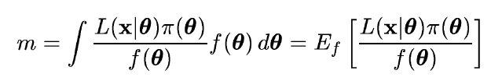
Importance sampling
Need pdf f (θ) which we can evaluate at arbitrary θ and also
sample with MC.
The marginal likelihood can be written
Sample θ ~ f (θ), compute average of L(x|θ) π(θ) / f (θ).
Best convergence when f (θ) approximates shape of L(x|θ)π(θ).
Use for f (θ) e.g. multivariate Gaussian with mean and covariance
estimated from posterior.

Slide 62
Nested sampling
J. Skilling, Bayesian Analysis, No. 4, pp. 833-860 (2006)
We want to compute
Can add up portions of X (equivalently, θ) space in any order. Use
X near 1 means low λ, all of
θ space included.
Write inverse function as
so that the desired result is
Elements of θ space are sorted
by decreasing likelihood.

Slide 63
J. Skilling, Bayesian Analysis, No. 4, pp. 833-860 (2006)
Nested sampling (2)
The evidence Z
is the area under
the curve of L(X).
Computational challenge is to sample θ space from prior subject to constraint L(θ) > λ. Software: MultiNest
Farhan Feroz, Mike Hobson, Mon. Not. Roy. Astron. Soc., 384, 2, 449-463 (2008); arXiv:0704.3704,
F. Feroz, M.P. Hobson, M. Bridges, Mon. Not. Roy. Astron. Soc. 398: 1601-1614,2009; arXiv:0809.3437
F. Feroz, M.P. Hobson, E. Cameron, A.N. Pettitt, arXiv:1306.2144

Slide 64


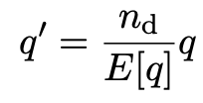
Goodness of fit
Can quantify goodness of fit with statistic
where Lʹ (φ,θ) has an adjustable φ_{i} for each y_{i} (the saturated model).
Asymptotically should have q ~ chi-squared(N−M).
For increasing r_{i}, asymptotic distribution no longer valid.
Bartlett (1937) defines modified statistic:
By construction q′ has mean n_{d} = N-M and turns out to have a distribution significantly closer to the asymptotic chi-square.
(See Canonero et al., Eur. Phys. J. C (2023) 83:1100.)

Slide 65
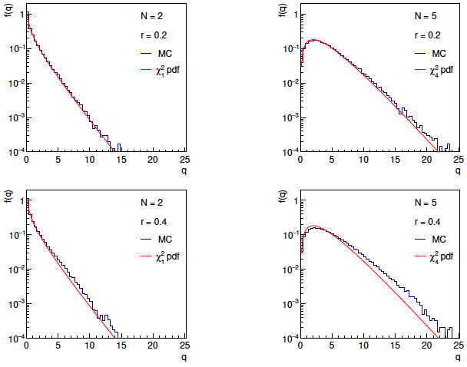
Distributions of q

Slide 66
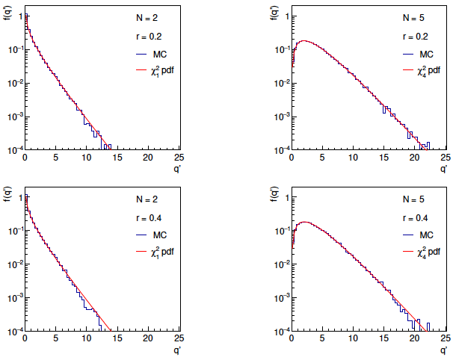
Distributions of Bartlett-corrected qʹ

Slide 67
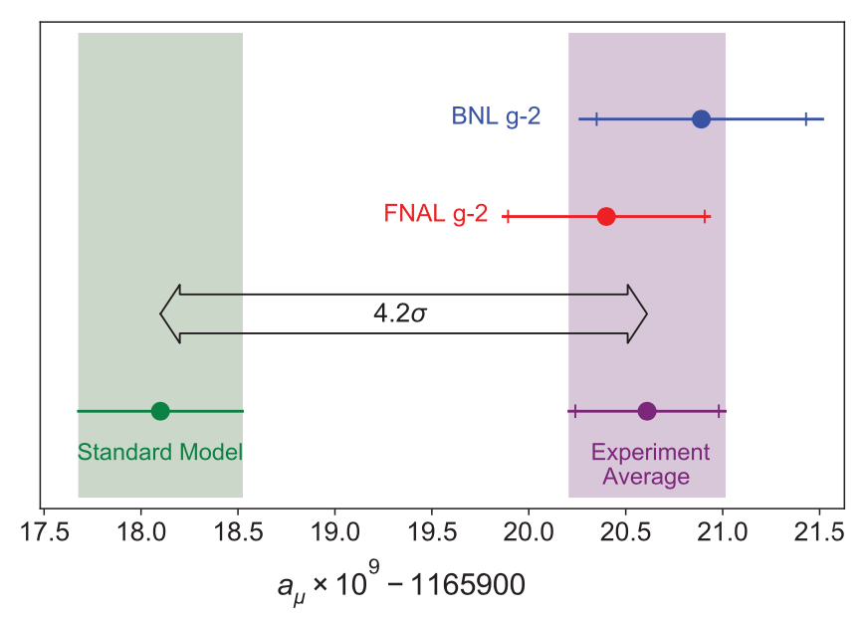
Application to the muon g − 2 anomaly
G. Cowan, Effect of Systematic Uncertainty Estimation on the Muon g − 2 Anomaly, EPJ Web of Conferences 258, 09002 (2022), arXiv:2107.02652
The recently measured muon g − 2 (ave. of 2006, 2021) disagrees with the Standard Model prediction with a significance of 4.2σ.
Muon g-2 Collab., PRL 126, 141801 (2021)
Discrepancy significantly
reduced by 2021 lattice-based prediction of Borsanyi et al. (BMW).
Current goal is to investigate sensitivity of significance to error assumptions, so for now focus on the 4.2σ problem.

Slide 68



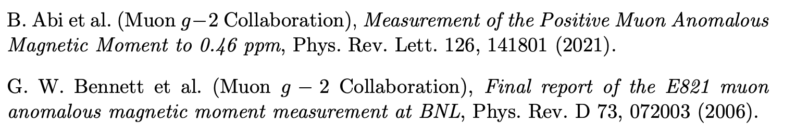

Muon g − 2 ingredients
Using
the ingredients of the 4.2σ effect are:
(ave. of BNL 2006 and FNAL 2021)
0.37 (stat.) ± 0.17 (sys.)
(SM pred. by Muon g −2 theory initiative)
0.40 (Had. Vac. Pol.) ± 0.18 (Had. Light-by-Light)

Slide 69
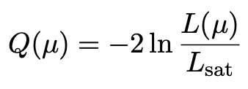
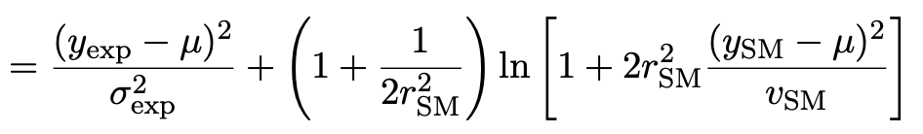
Suppose σ_{SM} uncertain
Suppose measurement errors well known, but that the SM theory
error σ_{SM} (estimated 0.43) could be uncertain.
This is the largest systematic and probably hardest to estimate.
Treat estimate v_{SM} = (0.43)² of variance σ²_{SM} as gamma distributed, width from relative uncertainty parameter r_{SM}.
Maximum-likelihood for mean from minimum of

Slide 70

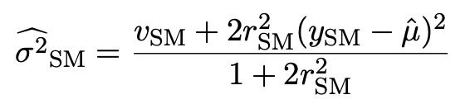
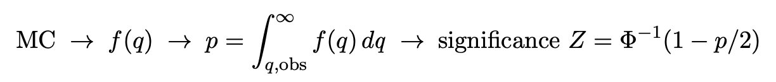
p-value/significance of common-mean hypothesis
Significance (goodness of fit) from
Because of non-quadratic term in Q(μ), distribution of q departs from chi-square(1) for increasing r_{SM}.
Best to get distribution of q from Monte Carlo (and speed up with Bartlett correction – see EPJC (2019) 79:133).
For r_{SM} > 0 distribution of q depends on σ²_{SM}. For MC use Maximum-Likelihood estimate (“profile construction”):
# of sigmas

Slide 71
Significance of discrepancy versus r_{SM}
Naive model: use least squares but let σ_{SM} → (1 + r_{SM}) σ_{SM}
Gamma variance model gives greater decrease in significance for r_{SM} ≳ 0.2, e.g., 3.1σ for r_{SM} = 0.3, 2.0σ for r_{SM} = 0.6.

Slide 72
Significance of discrepancy versus r_{SM}
Establishing 4σ effect requires r_{SM} ≲ 0.3 even if nominal exp.
and SM uncertainties become half of present values.

