Slide 1


Recommendations for Statistical Approach
Heavy Flavor Workshop
Zoom, 17 Sep 2020
https://indico.cern.ch/event/947843/
Glen Cowan
Physics Department
Royal Holloway, University of London
g.cowan@rhul.ac.uk
www.pp.rhul.ac.uk/~cowan

Slide 2
Outline
General comments on statistical approach
Maximum Likelihood, Least squares
Nuisance parameters
Confidence intervals
Treatment of systematics
Profile Likelihood
Marginal Likelihood
“Errors on Errors” à la
GDC, Eur. Phys. J. C (2019) 79:133, arXiv:1809.05778

Slide 3


Least Squares ← Maximum Likelihood
HFLAV averaging based on Least Squares, which follows from method of Maximum Likelihood e.g. if independent measured
y_{i} ~ Gaussian(f (x_{i};θ), σ_{i})
Warning – tails of Gaussian fall off very fast;
“outliers” have strong influence on parameter estimates.

Slide 4
Systematic errors ↔ nuisance parameters
Suppose we have primary measurements y,
want to infer parameters of interest μ with model P (y | μ).
Model not perfect – need nuisance parameters → P (y | μ, θ).
“Converts” sys. error to part of overall stat. error
Nuisance parameters decrease sensitivity to parameters of
interest, so constrain using independent control measurements u,
which follow P (u | θ). So now full likelihood is:
Often the control measurements u are estimates of the corresponding parameters θ, e.g., with Gaussian pdf.

Slide 5
Combining measurements
Starting point: reconstruct likelihood for full set of observed data and use to find a new limit. E.g. for independent data:
parameters
of interest
nuisance
parameters
Maybe likelihoods not available in full, need to approximate.
Need some assumptions about parameters common to different terms in the likelihood.
Same basic approach for limits and averages: start with best available approximation for the full likelihood.

Slide 6


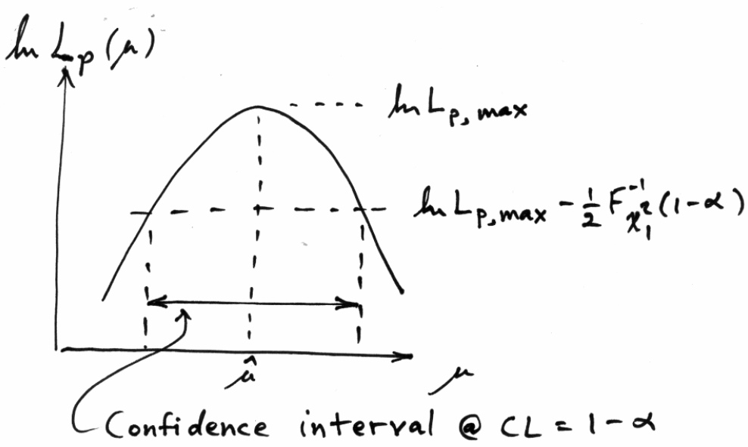

Uncertainty of fitted parameters
Suppose parameter of interest μ, nuisance parameter θ,
confidence interval for μ from “profile likelihood”:
Width of interval in usual LS fit independent of goodness of fit.

Slide 7
Profiling nuisance parameters
Constrained (profiled) nuisance par.:
Test μ using profile likelihood ratio
p-value of μ:
Wilks’ theorem:
pdf f (t_{μ} | μ, θ) in “large sample limit” + regularity conditions is chi-square with n_{dof} = num. par. of interest, independent of nuisance par. θ.
To the extent that asymptotic pdf is good approx., inference about μ is independent of the nuisance parameters.

Slide 8
Marginalizing nuisance parameters
Alternatively, test μ with a statistic such as the likelihood
ratio using fixed (or estimated) values of nuisance parameters,
, here
Assign prior (Bayesian) pdf to nuisance parameters π(θ)
based on the control measurements:
, π₀(θ) e.g. const.
The effect of the systematic uncertainty is built in by averaging
over θ with respect to π(θ) (→ “marginalize” over nuisance par.):
use for p-values,
CLs, etc.

Slide 9
Profile vs. marginal likelihood approach
Strict frequentist approach: test points in (μ, θ) space and reject
μ if for all θ.
Obtained automatically if asymptotics à la Wilks holds.
Holds approximately if asymptotics not toο badly broken.
Approximate alternative: reject μ if ,
profile construction (Cranmer); hybrid resampling (B. Sen et al.)
Marginal approach does not test individual points in (μ, θ) space, rather the model for a given μ averaged over θ.
Marginal likelihood usually requires MC integration to find pdf of test statistic (e.g., q_{μ}) needed to find p-value.
Results from profile and marginal likelihoods equal in simple
cases and very similar in “most cases of practical interest”.

Slide 10
HFLAV approach for a bad fit
In cases where χ²/dof > 1, we do not usually scale the resulting uncertainty, in contrast to what is done by the Particle Data Group [5]. Rather, we examine the systematic uncertainties of each measurement to better understand them. Unless we find systematic discrepancies among the measurements, we do not apply any additional correction to the calculated uncertainty.
HFLAV, arXiv:1909.12524
Reasonable but... to be rigorous one would prefer that the statistical procedure not be subject to a posteriori modifications. If one has reason to suspect that potential biases could be present, then this should be built into the original statistical model.
GDC comment

Slide 11
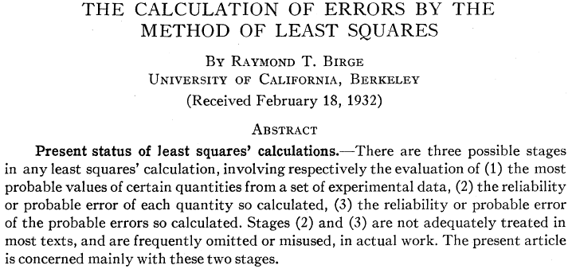
“Errors on Errors”
→ PDG “scale factor method” ≈ scale sys. errors with common
factor until χ²_{min} = appropriate no. of degrees of freedom.

Slide 12
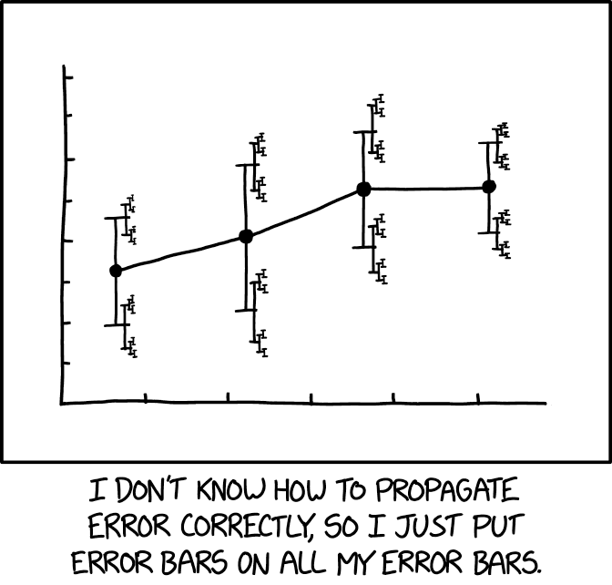
https://xkcd.com/2110/
Randall Munroe, xkcd.com

Slide 13



Formulation of the problem
Suppose measurements y have probability (density) P(y|μ,θ),
μ = parameters of interest
θ = nuisance parameters
To provide info on nuisance parameters, often treat their best
estimates u as indep. Gaussian distributed r.v.s., giving likelihood
or log-likelihood (up to additive const.)

Slide 14
Systematic errors and their uncertainty
Often the θ_{i} could represent a systematic bias and its best estimate u_{i} in the real measurement is zero.
The σ_{u,i} are the corresponding “systematic errors”.
Sometimes σ_{u,i} is well known, e.g., it is itself a statistical error known from sample size of a control measurement.
Other times the u_{i} are from an indirect measurement, Gaussian model approximate and/or the σ_{u,i} are not exactly known.
Or sometimes σ_{u,i} is at best a guess that represents an uncertainty in the underlying model (“theoretical error”).
In any case we can allow that the σ_{u,i} are not known in general with perfect accuracy.

Slide 15



Gamma model for variance estimates
Suppose we want to treat the systematic errors as uncertain,
so let the σ_{u,i} be adjustable nuisance parameters.
Suppose we have estimates s_{i} for σ_{u,i} or equivalently v_{i} = s_{i}², is an estimate of σ_{u,i}².
Model the v_{i} as independent and gamma distributed:
Set α and β so that they give desired relative uncertainty r in σ_{u}.
Similar to method 2 in W.J. Browne and D. Draper, Bayesian Analysis, Volume 1, Number 3 (2006), 473-514.

Slide 16



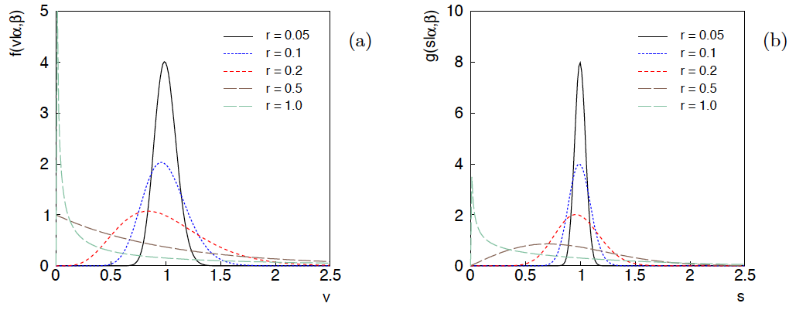
Distributions of v and s = √v
For α, β of gamma distribution,
relative “error on error”

Slide 17

Motivation for gamma model
If one were to have n independent observations u₁,..,u_{n}, with all
u ~ Gauss(θ, σ_{u}²), and we use the sample variance
to estimate σ_{u}², then (n−1)v/σ_{u}² follows a chi-square distribution
for n−1 degrees of freedom, which is a special case of the
gamma distribution (α = n/2, β = 1/2). (In general one doesn’t
have a sample of u_{i} values, but if this were to be how v was
estimated, the gamma model would follow.)
Furthermore choice of the gamma distribution for v allows one
to profile over the nuisance parameters σ_{u}² in closed form and
leads to a simple profile likelihood.

Slide 18
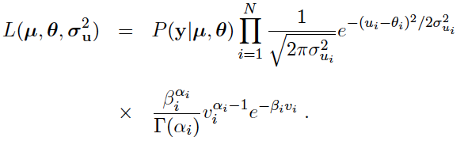
Likelihood for gamma error model
Treated like data: y₁,...,y_{L} (the primary measurements)
u₁,...,u_{N} (estimates of nuisance par.)
v₁,...,v_{N} (estimates of variances
of estimates of NP)
Adjustable parameters: μ₁,...,μ_{M} (parameters of interest)
θ₁,...,θ_{N} (nuisance parameters)
σ_{u,1},...,σ_{u,N} (sys. errors = std. dev. of
of NP estimates)
Fixed parameters: r₁,...,r_{N} (rel. err. in estimate of σ_{u,i})

Slide 19

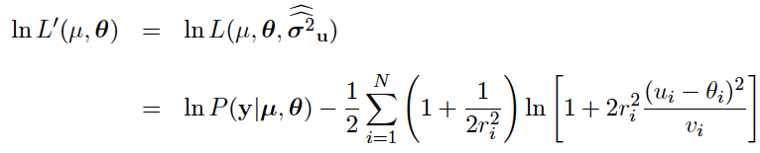
Profiling over systematic errors
We can profile over the σ_{u,i} in closed form
which gives the profile log-likelihood (up to additive const.)
In limit of small r_{i} and v_{i} → σ_{u,i}², the log terms revert back to the
quadratic form seen with known σ_{u,i}.

Slide 20




Equivalent likelihood from Student’s t
We can arrive at same likelihood by defining
Since u_{i} ~ Gauss and v_{i} ~ Gamma, z_{i} ~ Student’s t
with
Resulting likelihood same as profile Lʹ(μ,θ) from gamma model

Slide 21
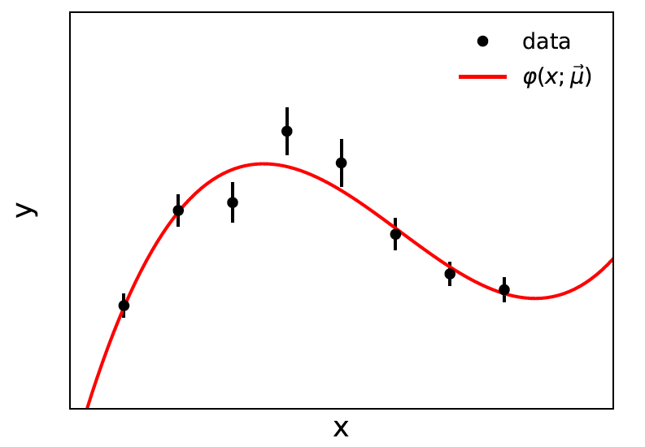


Curve fitting, averages
Suppose independent
y_{i} ~ Gauss, i = 1,...,N, with
μ are the parameters of interest in the fit function φ(x;μ),
θ are bias parameters constrained by control measurements
u_{i} ~ Gauss(θ_{i}, σ_{u,i}), so that if σ_{u,i} are known we have

Slide 22

Profiling over θ_{i} with known σ_{u,i}
Profiling over the bias parameters θ_{i} for known σ_{u,i} gives usual least-squares (BLUE)
Widely used technique for curve fitting in Particle Physics.
Generally in real measurement, u_{i} = 0.
Generalized to case of correlated y_{i} and u_{i} by summing
statistical and systematic covariance matrices.

Slide 23

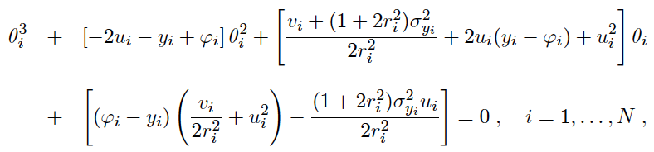
Curve fitting with uncertain σ_{u,i}
Suppose now σ_{u,i}² are adjustable parameters with gamma distributed
estimates v_{i}.
Retaining the θ_{i} but profiling over σ_{u,i}² gives
Profiled values of θ_{i} from solution to cubic equations

Slide 24


Goodness of fit
Can quantify goodness of fit with statistic
where Lʹ (φ,θ) has an adjustable φ_{i} for each y_{i} (the saturated
model).
Asymptotically should have q ~ chi-squared(N−M).
For increasing r_{i}, may need Bartlett correction or MC.

Slide 25
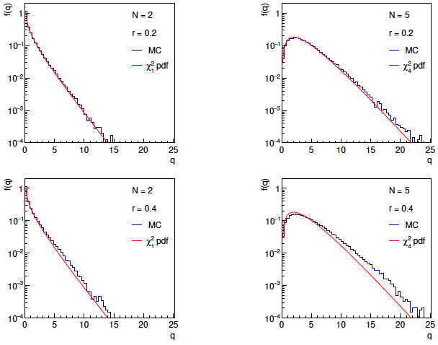
Distributions of q

Slide 26
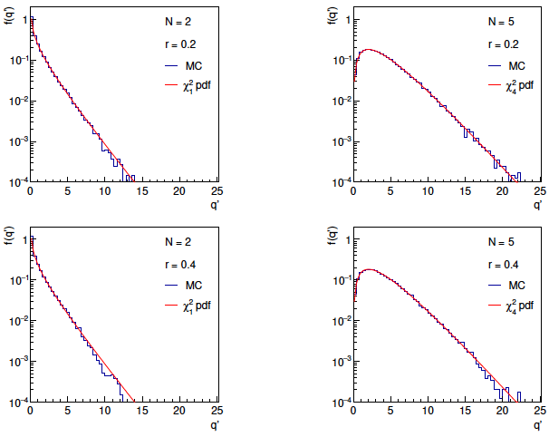
Distributions of Bartlett-corrected qʹ

Slide 27


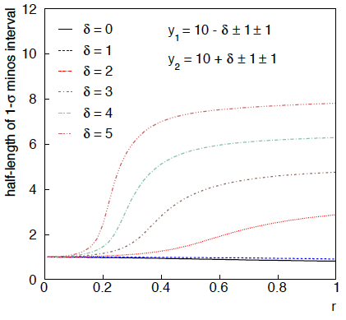
Example: average of two measurements
MINOS interval (= approx. confidence interval) based on
with
Increased discrepancy
between values to be
averaged gives larger
interval.
Interval length saturates
at ~level of absolute
discrepancy between
input values.
relative error
on sys. error

Slide 28
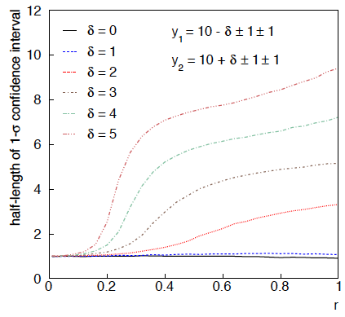
Same with interval from p_{μ} = α with nuisance parameters profiled at μ

Slide 29
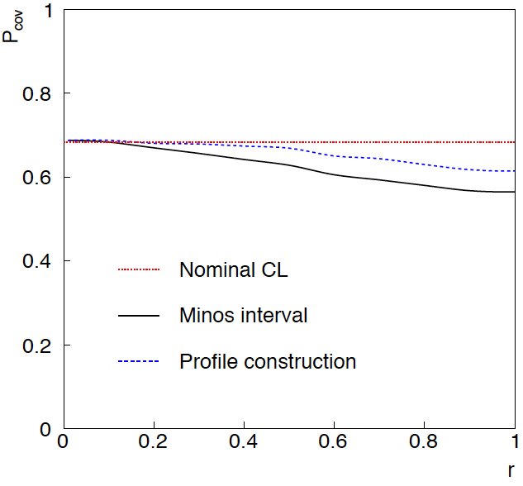
Coverage of intervals
Consider previous average of
two numbers but now generate
for i = 1, 2 data values
y_{i} ~ Gauss(μ, σ_{y,i})
u_{i} ~ Gauss(0, σ_{u,i})
v_{i} ~ Gamma(σ_{u,i}, r_{i})
σ_{y,i} = σ_{u,i} = 1
and look at the probability
that the interval covers the
true value of μ.
Coverage stays reasonable
to r ~ 0.5, even not bad
for Profile Construction
out to r ~ 1.

Slide 30
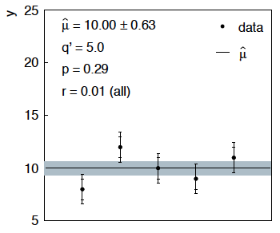
Sensitivity of average to outliers
Suppose we average 5 values, y = 8, 9, 10, 11, 12, all with
stat. and sys. errors of 1.0, and suppose negligible error on error
(here take r = 0.01 for all).

Slide 31
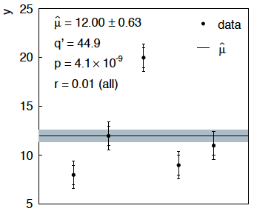
Sensitivity of average to outliers (2)
Now suppose the measurement at 10 was actually at 20:
“outlier”
Estimate pulled up to 12.0, size of confidence interval ~unchanged
(would be exactly unchanged with r → 0).

Slide 32
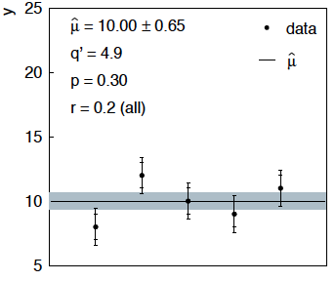
Average with all r = 0.2
If we assign to each measurement r = 0.2,
Estimate still at 10.00, size of interval moves 0.63 → 0.65

Slide 33
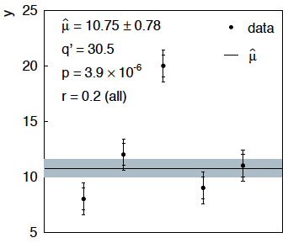
Average with all r = 0.2 with outlier
Same now with the outlier (middle measurement 10 → 20)
Estimate →10.75 (outlier pulls much less).
Half-size of interval → 0.78 (inflated because of bad g.o.f.).

Slide 34



Naive approach to errors on errors
Naively one might think that the error on the error in the previous
example could be taken into account conservatively by inflating
the systematic errors, i.e.,
But this gives
without outlier (middle meas. 10)
with outlier (middle meas. 20)
So the sensitivity to the outlier is not reduced and the size of the
confidence interval is still independent of goodness of fit.

Slide 35

Correlated uncertainties
The phrase “correlated uncertainties” usually means that a single
nuisance parameter affects the distribution (e.g., the mean) of more
than one measurement.
For example, consider measurements y, parameters of interest μ,
nuisance parameters θ with
That is, the θ_{i} are defined here as contributing to a bias and
the (known) factors R_{ij} determine how much θ_{j} affects y_{i}.
As before suppose one has independent control measurements
u_{i}~ Gauss(θ_{i}, σ_{ui}).

Slide 36



Correlated uncertainties (2)
The total bias of y_{i} can be defined as
which can be estimated with
These estimators are correlated having covariance
In this sense the present method treats “correlated uncertainties”,
i.e., the control measurements u_{i} are independent, but nuisance
parameters affect multiple measurements, and thus bias estimates
are correlated.

Slide 37
Discussion / Conclusions (1)
My view: general approach of HFLAV is perfectly reasonable.
Report confidence interval/region (plus covariance?),
systematics from profiling nuisance parameters.
Clarify treatment of common nuisance parameters.
Recommend some tweaks of notation and vocabulary:
Greek letters for parameters, Latin letters for data
CL → p-value
Recommend avoiding a posteriori changes to model
in case of bad fit (→ “errors on errors”?)

Slide 38


Discussion / Conclusions (2)
Gamma model for variance estimates gives confidence intervals
that increase in size when the data are internally inconsistent,
and gives decreased sensitivity to outliers (known property of
Student’s t based regression).
Equivalence with Student’s t model, ν = 1/2r² degrees of freedom.
Simple profile likelihood – quadratic terms replaced by logarithmic:

Slide 39
Discussion / Conclusions (3)
Asymptotics can break for increased error-on-error, may need
Bartlett correction or MC.
Method assumes that meaningful r_{i} values can be assigned and is valuable when systematic errors are not well known but enough “expert opinion” is available to do so.
Alternatively one could try to fit a global r to all systematic
errors, analogous to PDG scale factor method or meta-analysis
à la DerSimonian and Laird. (→ future work).
Could also use e.g. as “stress test” – crank up the r_{i} values until significance of result degrades and ask if you really trust the assigned systematic errors at that level.

Slide 40
Extra slides

Slide 41
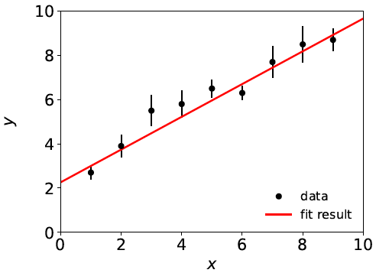

Curve Fitting History: Least Squares
Method of Least Squares by Laplace, Gauss, Legendre, Galton...
C.F. Gauss, Theoria Combinationis Observationum Erroribus Minimis Obnoxiae, Commentationes Societatis Regiae Scientiarium Gottingensis Recectiores Vol. V (MDCCCXXIII).
To fit curve f (x;θ) to data y_{i} ± σ_{i},
adjust parameters θ = (θ₁,..., θ_{M})
to minimize
f (x;θ)
y_{i} ± σ_{i}
Assumes σ_{i} known.

Slide 42
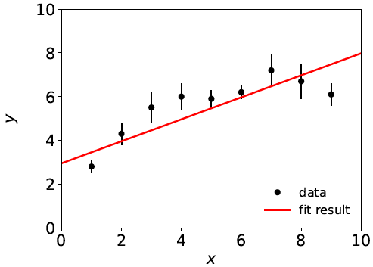
Goodness of fit
If the hypothesized model f (x;θ) is correct, χ²_{min} should
follow a chi-square distribution for N (# meas.) – M (# fitted par.)
degrees of freedom; expectation value = N – M.
Suppose initial guess for model is: f (x;θ) = θ₀ + θ₁ x
χ²_{min} = 20.9,
N – M = 9 – 2 = 7,
so goodness of fit is “poor”.
This is an indication that the
model is inadequate, and thus
the values it predicts will
have a “systematic error”.

Slide 43
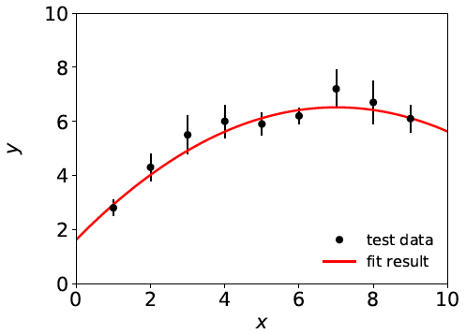
Systematic errors ↔ nuisance parameters
Solution: fix the model, generally by inserting additional
adjustable parameters (“nuisance parameters”). Try, e.g.,
f (x;θ) = θ₀ + θ₁ x + θ₂ x²
χ²_{min} = 3.5, N – M = 6
For some point in the
enlarged parameter space
we hope the model is
now ~correct.
Sys. error gone?
Estimators for all parameters correlated, and as a consequence the presence of the nuisance parameters inflates the statistical errors of the parameter(s) of interest.

Slide 44
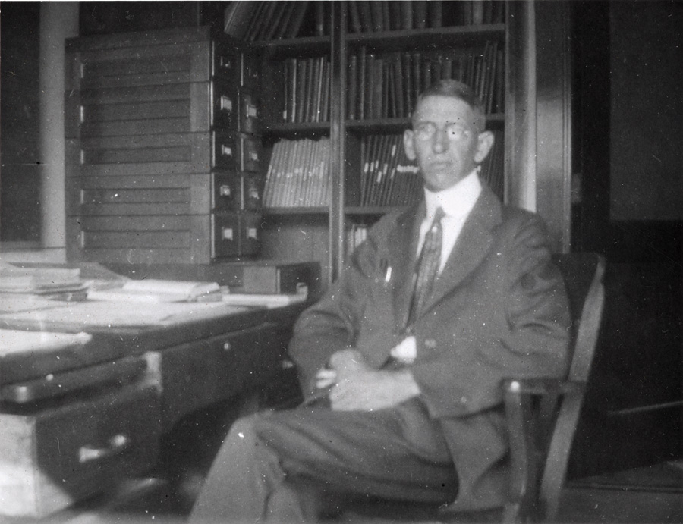
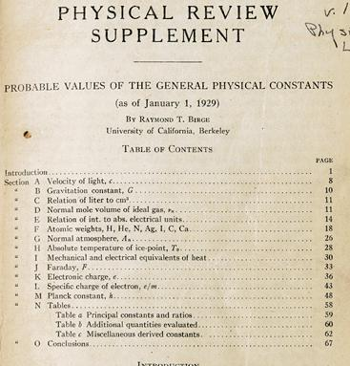
http://bancroft.berkeley.edu/Exhibits/physics/learning01.html
Least Squares for Averaging
_{= fit of horizontal line}
Raymond T. Birge,
Probable Values of the General Physical Constants (as of January 1, 1929), Physical Review Supplement, Vol 1, Number 1, July 1929
Forerunner of the
Particle Data Group

Slide 45
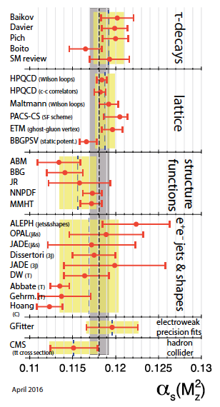
Errors on theory errors, e.g., in QCD
Uncertainties related to theoretical
predictions are notoriously difficult
to quantify, e.g., in QCD may come
from variation of renormalization
scale in some “appropriate range”.
Problematic e.g. for α_{s} →
If, e.g., some (theory) errors are
underestimated, one may obtain poor
goodness of fit, but size of confidence
interval from usual recipe will not
reflect this.
An outlier with an underestimated
error bar can have an inordinately
strong influence on the average.
M. Tanabashi et al. (Particle Data Group),
Phys. Rev. D 98, 030001 (2018)

Slide 46
Developments of LS for Averaging
Much work in HEP and elsewhere on application/extension of
least squares to the problem of averaging or meta-analysis, e.g.,
A. C. Aitken, On Least Squares and Linear Combinations of
Observations, Proc. Roy. Soc. Edinburgh 55 (1935) 42.
L. Lyons, D. Gibaut and P. Clifford, How to Combine Correlated
Estimates of a Single Physical Quantity, Nucl. Instr. Meth. A270
(1988) 110.
A. Valassi, Combining Correlated Measurements of Several
Different Physical Quantities, Nucl. Instr. Meth. A500 (2003) 391.
R. Nisius, On the combination of correlated estimates of a physics
observable, Eur. Phys. J. C 74 (2014) 3004.
R. DerSimonian and N. Laird, Meta-analysis in clinical trials,
Controlled Clinical Trials 7 (1986) 177-188.

Slide 47





Single-measurement model
As a simplest example consider
y ~ Gauss(μ, σ²),
v ~ Gamma(α, β),
Test values of μ with t_{μ} = -2 ln λ(μ) with

Slide 48
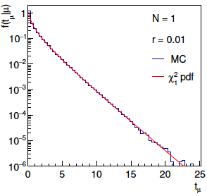
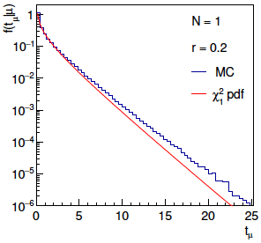
Distribution of t_{μ}
From Wilks’ theorem, in the asymptotic limit we should
find t_{μ} ~ chi-squared(1).
Here “asymptotic limit” means all estimators ~Gauss, which
means r → 0. For increasing r, clear deviations visible:

Slide 49
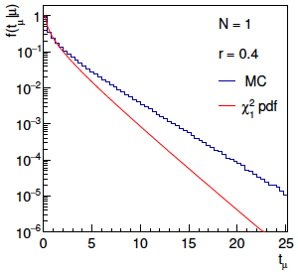
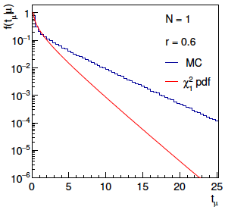
Distribution of t_{μ} (2)
For larger r, breakdown of asymptotics gets worse:
Values of r ~ several tenths are relevant so we cannot in general
rely on asymptotics to get confidence intervals, p-values, etc.

Slide 50

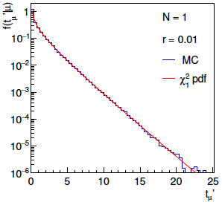
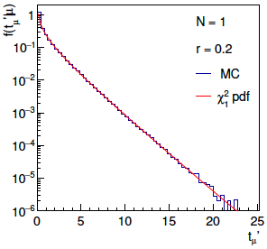
Bartlett corrections
One can modify t_{μ} defining
such that the new statistic’s distribution is better approximated
by chi-squared for n_{d} degrees of freedom (Bartlett, 1937).
For this example E[t_{μ}] ≈ 1 + 3r² + 2r⁴ works well:

Slide 51
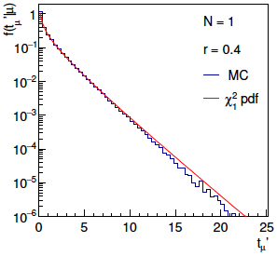
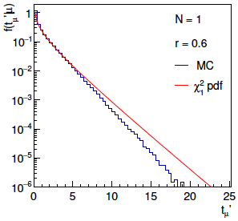
Bartlett corrections (2)
Good agreement for r ~ several tenths out to √t_{μ}ʹ ~ several, i.e.,
good for significances of several sigma:

Slide 52
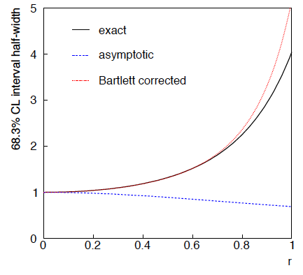
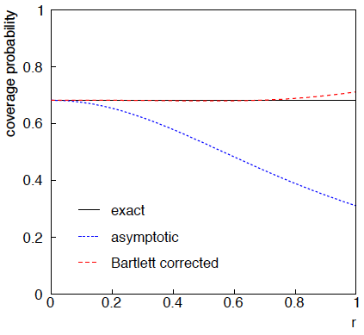
68.3% CL confidence interval for μ

Slide 53



Gamma model for estimates of variance
Suppose the estimated variance v was obtained as the sample
variance from n observations of a Gaussian distributed bias
estimate u.
In this case one can show v is gamma distributed with
We can relate α and β to the relative uncertainty r in the systematic
uncertainty as reflected by the standard deviation of the sampling
distribution of s, σ_{s}

Slide 54




Exact relation between r parameter and relative error on error
r parameter defined as:
v ~ Gamma(α, β) so s = √v follows a Nakagami distribution

Slide 55

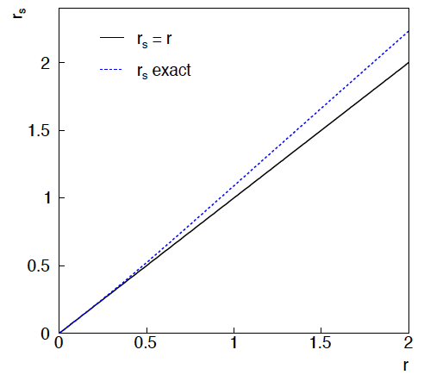


Exact relation between r parameter and relative error on error (2)
The exact relation between the error and the error r_{s} and
the parameter r is therefore
→ r_{s} ≈ r good for r ⪅ 1.

Slide 56





PDG scale factor
Suppose we do not want to take the quoted errors as
known constants. Scale the variances by a factor ϕ,
The likelihood
function becomes
The estimator for μ is the same as before; for ϕ ML gives
which has a bias;
is unbiased.
^
The variance of μ is inflated by ϕ:

Slide 57

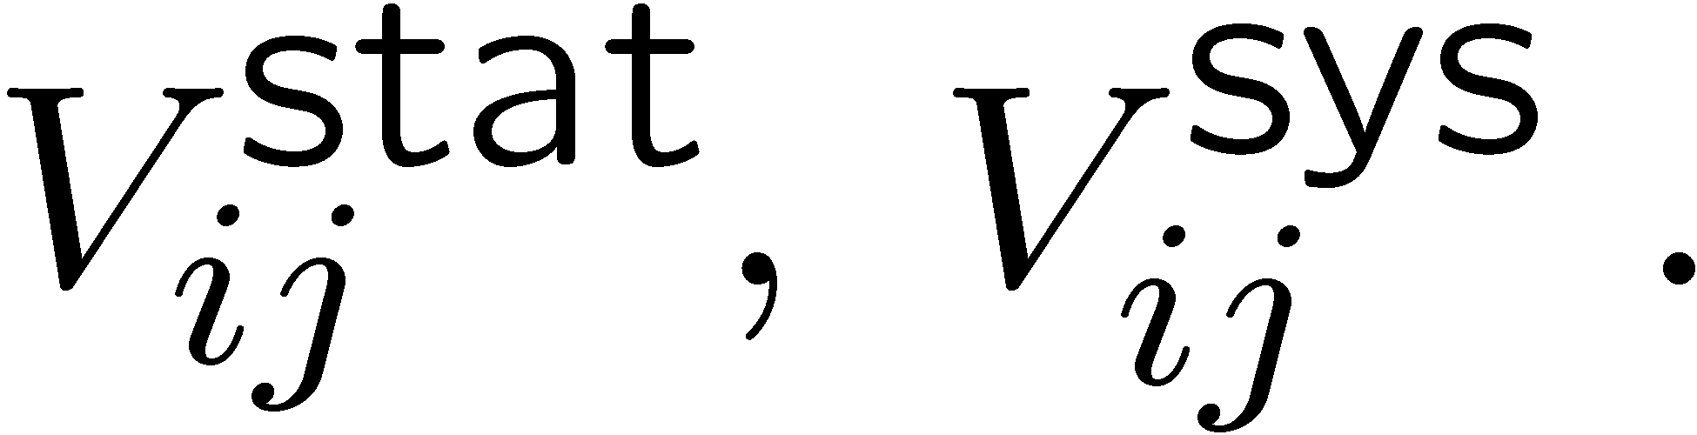
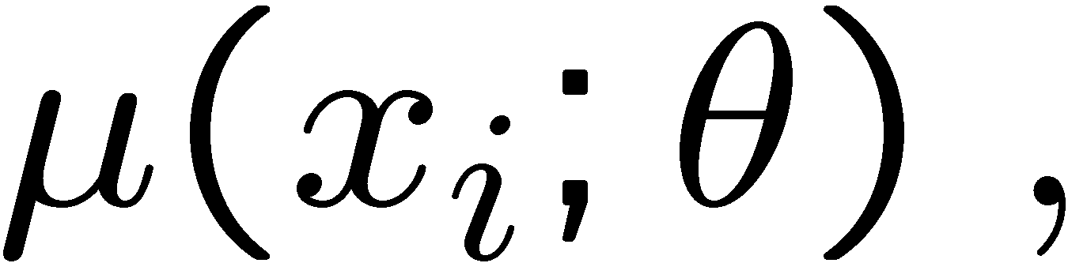
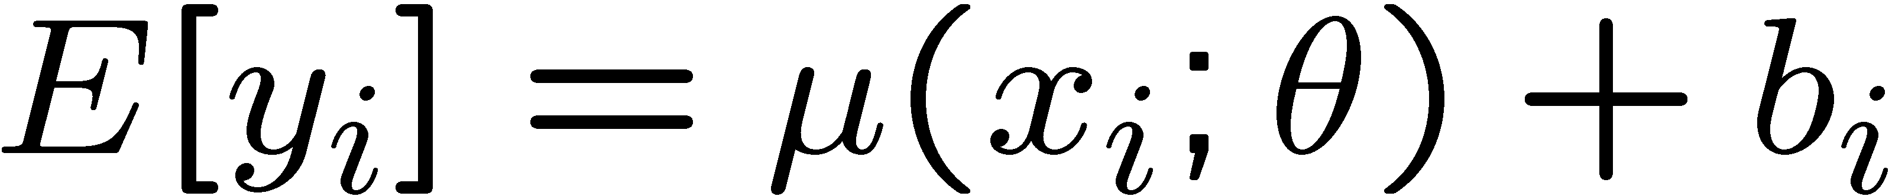
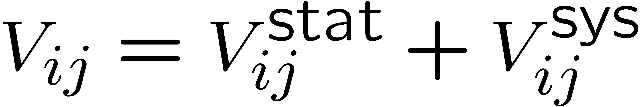
Bayesian approach
Given measurements:
and (usually) covariances:
Predicted value:
expectation value
control variable
parameters
bias
Frequentist approach:
Minimize

Slide 58
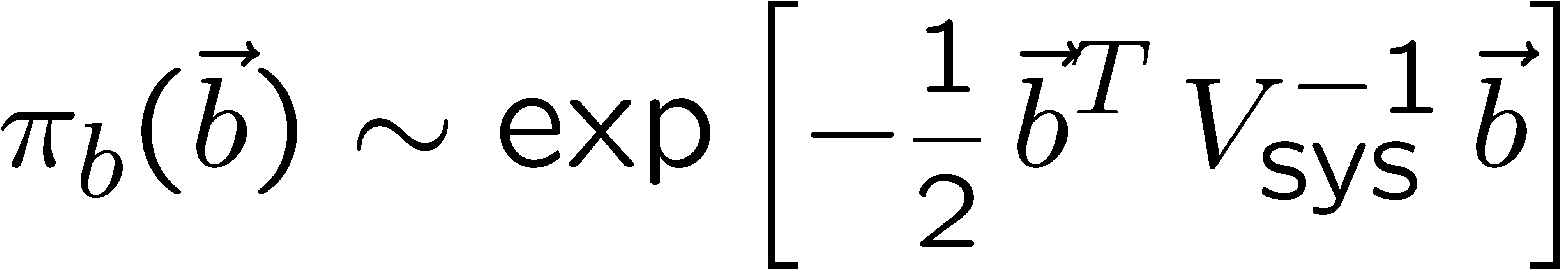
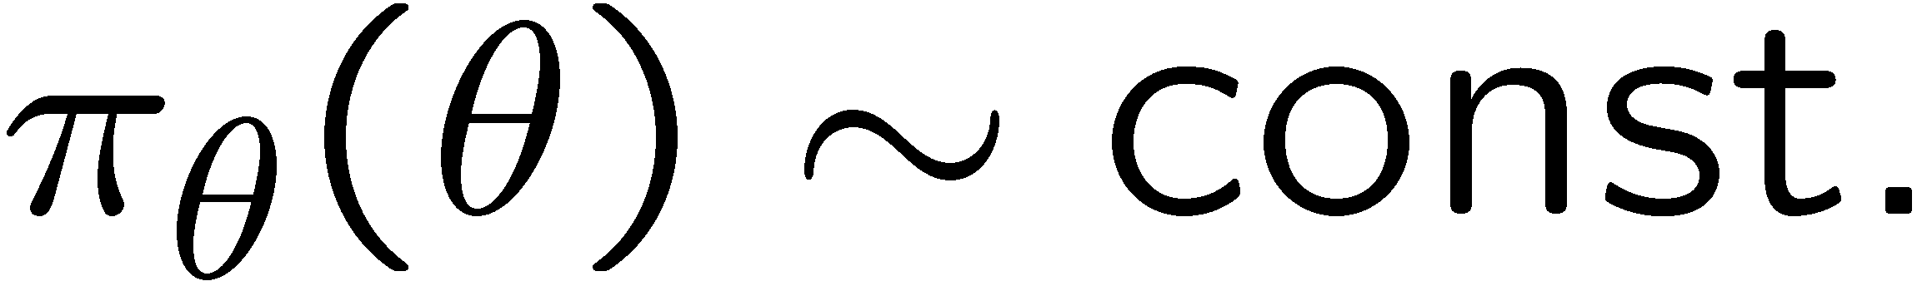
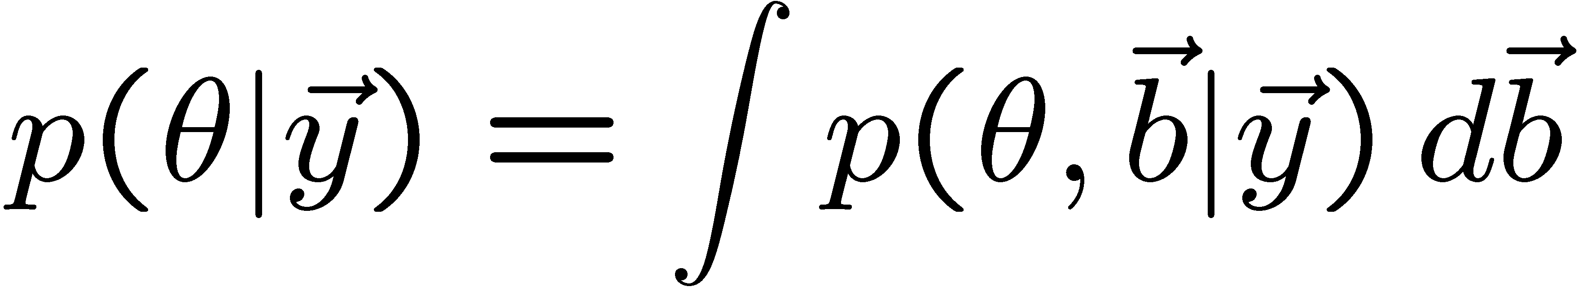
Its Bayesian equivalent
Take
Joint probability
for all parameters
and use Bayes’ theorem:
To get desired probability for θ, integrate (marginalize) over b:
→ Posterior is Gaussian with mode same as least squares estimator,
σ_{θ} same as from χ² = χ²_{min} + 1. (Back where we started!)

Slide 59
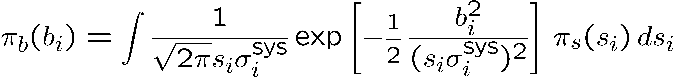
Bayesian approach with non-Gaussian prior π_{b}(b)
Suppose now the experiment is characterized by
where s_{i} is an (unreported) factor by which the systematic error is
over/under-estimated.
Assume correct error for a Gaussian π_{b}(b) would be s_{i}σ_{i}^{sys}, so
Width of σ_{s}(s_{i}) reflects
‘error on the error’.

Slide 60
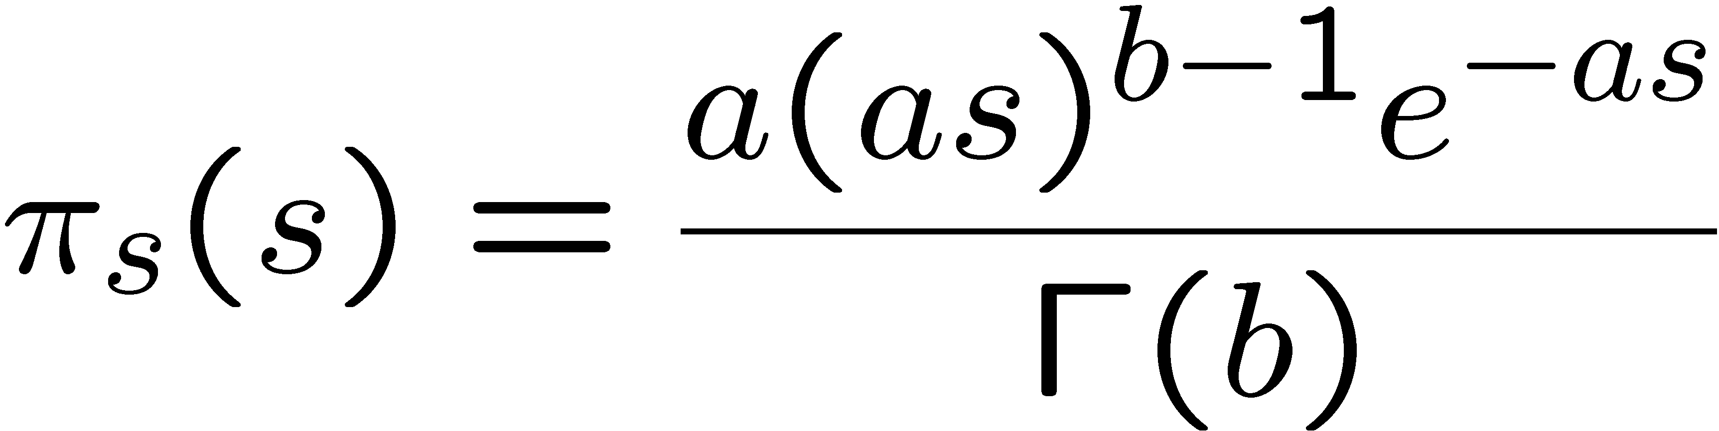
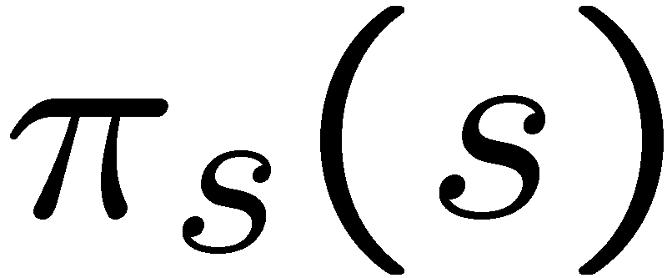
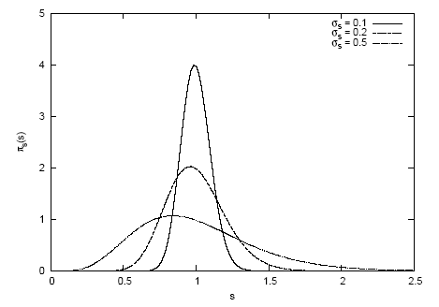
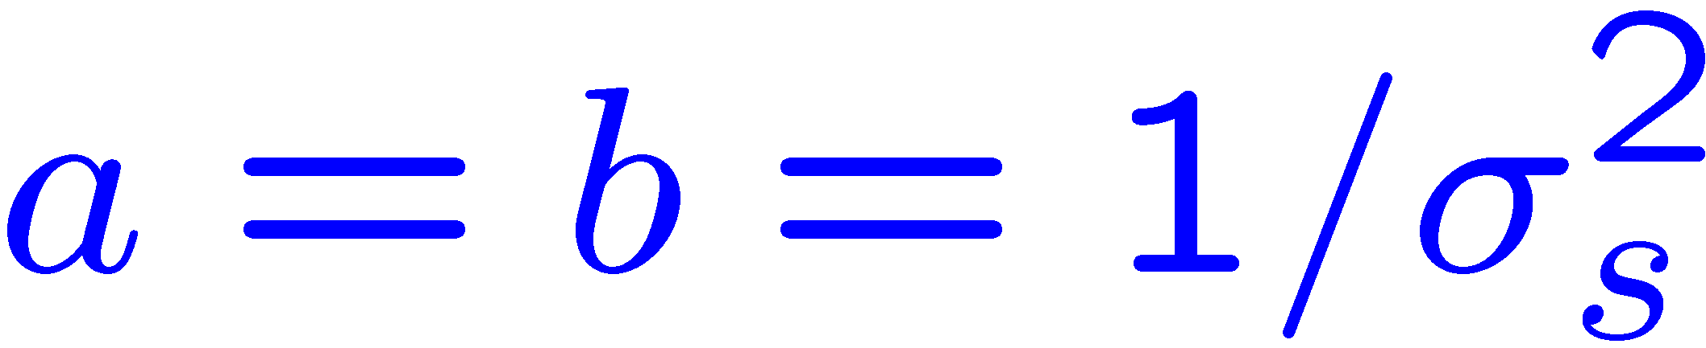
Error-on-error function π_{s}(s)
A simple unimodal probability density for 0 < s < 1 with
adjustable mean and variance is the Gamma distribution:
mean = b/a
variance = b/a²
Want e.g. expectation value
of 1 and adjustable standard
Deviation σ_{s} , i.e.,
s
In fact if we took π_{s} (s) ~ inverse Gamma, we could find π_{b}(b)
in closed form (cf. D’Agostini, Dose, von Linden). But Gamma seems more natural & numerical treatment not too painful.

Slide 61
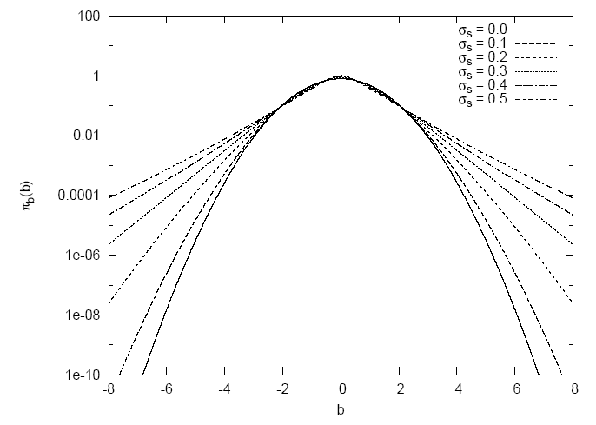
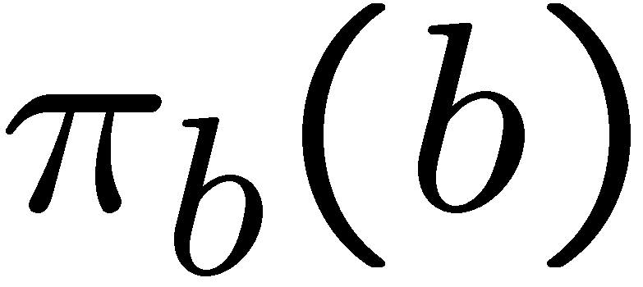
Prior for bias π_{b}(b) now has longer tails
b
Gaussian (σ_{s} = 0) P(|b| > 4σ_{sys}) = 6.3 × 10⁻⁵
σ_{s} = 0.5 P(|b| > 4σ_{sys}) = 0.65%

Slide 62
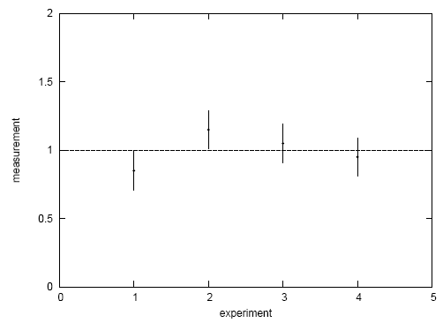
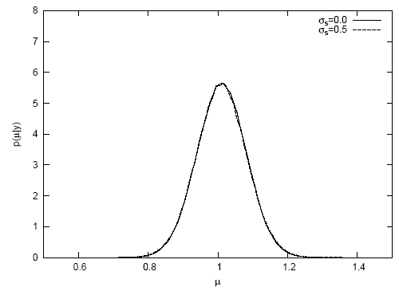
A simple test
Suppose a fit effectively averages four measurements.
Take σ_{sys} = σ_{stat} = 0.1, uncorrelated.
Case #1: data appear compatible
Posterior p(μ|y):
measurement
p(μ|y)
experiment
μ
Usually summarize posterior p(μ|y)
with mode and standard deviation:

Slide 63




Simple test with inconsistent data
Case #2: there is an outlier
Posterior p(μ|y):
measurement
p(μ|y)
experiment
μ
→ Bayesian fit less sensitive to outlier. See also

Slide 64


Goodness-of-fit vs. size of error
In LS fit, value of minimized χ² does not affect size
of error on fitted parameter.
In Bayesian analysis with non-Gaussian prior for systematics,
a high χ² corresponds to a larger error (and vice versa).
post-
erior
2000 repetitions of
experiment, σ_{s} = 0.5,
here no actual bias.
σ_{μ} from least squares
χ²

