Slide 1
The Look Elsewhere Effect
Discussion for ODSL Journal Club
Zoom / 25 June 2021
Glen Cowan
Physics Department
Royal Holloway, University of London
g.cowan@rhul.ac.uk
www.pp.rhul.ac.uk/~cowan

Slide 2
Outline
Multiple testing
The Look Elsewhere Effect
An example and practical solution (Gross and Vitells)
Brief comments on:
Multidimensional LEE
Bayesian approach to LEE

Slide 3
Frequentist Hypothesis Test
For a frequentist hypothesis test of a null (no-signal) hypothesis H₀ define a ”critical region” w in the data space x, which has probability content assuming H₀ not greater than a prespecified small constant α (the “size” of the test):
Inequality needed
for discrete data;
here suppose equality.
Choose w to maximize power wrt alternative = P(x in w | H₁ )
If x is found in w, reject H₀ and announce discovery of new signal.
Equivalently, reject H₀ if its p-value is less than α:
The probability to reject H₀ if it is true is equal to α (the type-I error rate).

Slide 4
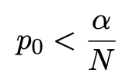
Multiple Testing, Bonferroni Correction
If we carry out N tests, the “Family Wise Error Rate” is
If the tests are independent and each of size α, then
For N large, FWER → 1 and one will surely discover a signal.
Even if the tests are not independent, can show
So we can ensure the FWER does not exceed α if we reject H₀ if we reject H₀ when
Bonferroni, C. E., Teoria statistica delle classi e calcolo delle probabilità, Pubblicazioni del R Istituto Superiore di Scienze Economiche e Commerciali di Firenze 1936
Other corrections less conservative (Sidak, Holm-Bonferroni,...)

Slide 5
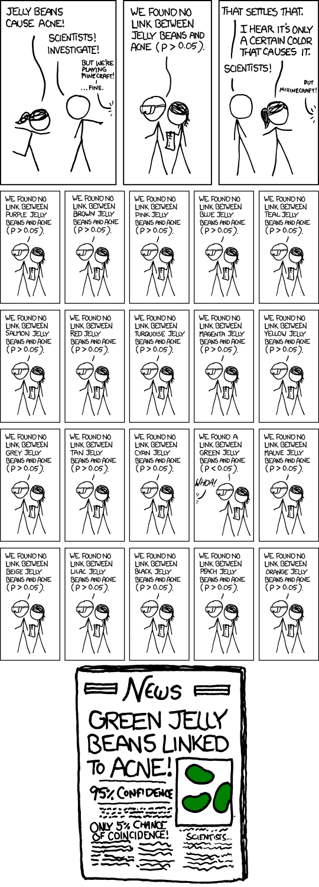
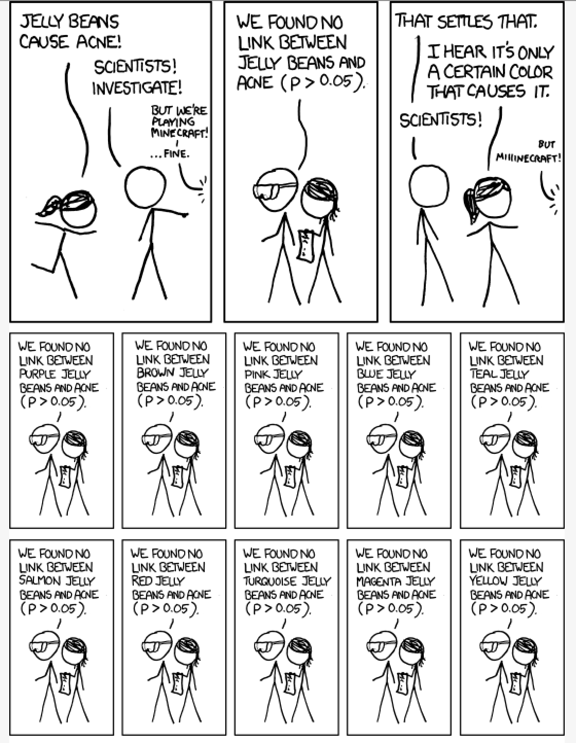
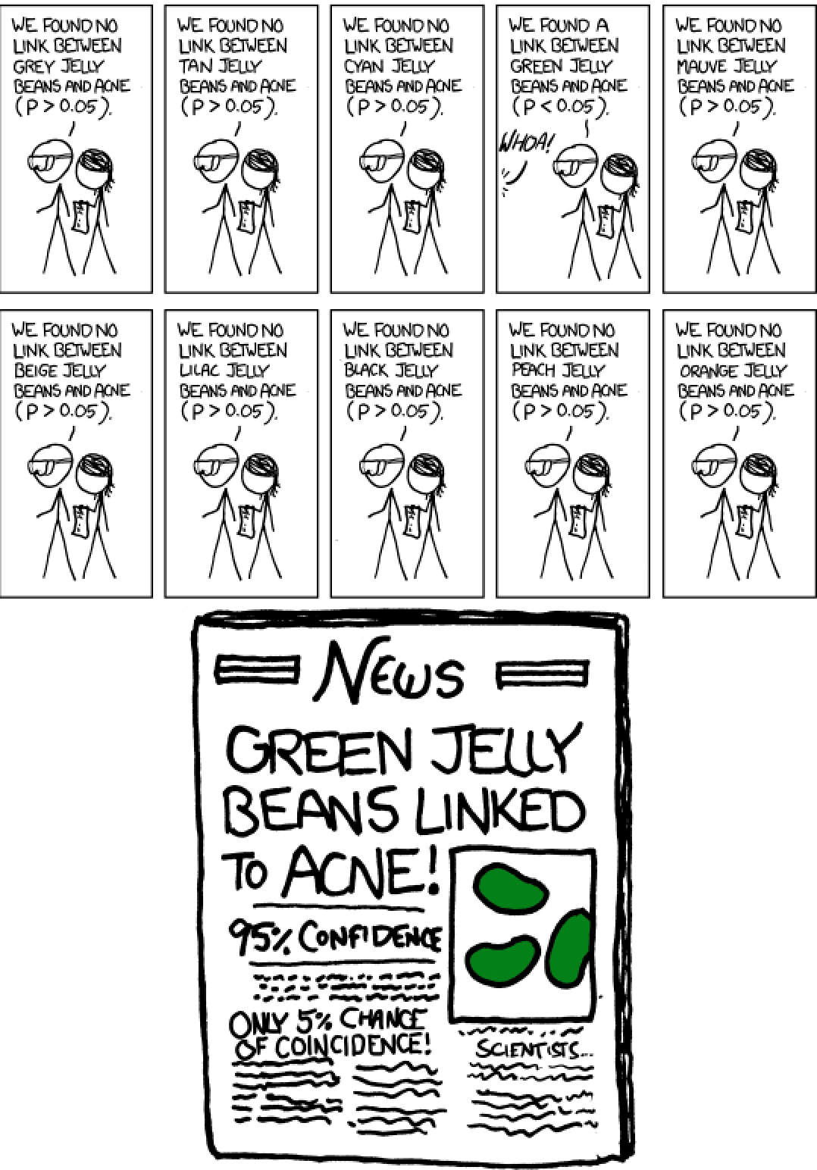
https://imgs.xkcd.com/comics/significant.png
For α = 0.05, N = 20, FWER = 0.64

Slide 6
Multiple Testing → LEE
For discrete tests this is called “multiple testing” or “multiple comparisons”.
In particle physics we often carry out a test of H₀ (no-signal) designed to have high power with respect to an alternative H₁(θ) indexed by a continuous parameter (e.g., mass of a new particle).
There is a test for each θ, so N → ∞ but the tests are not independent (e.g., two masses close to each other).
This is the Look Elsewhere Effect (~ continuous multiple testing).
Out of the tests carried out, the let the smallest p-value = p_{local}.
We want p_{global} = P(p_{local} ≤ p_{local,obs} | H₀)
For N independent tests,
(not useful here).

Slide 7
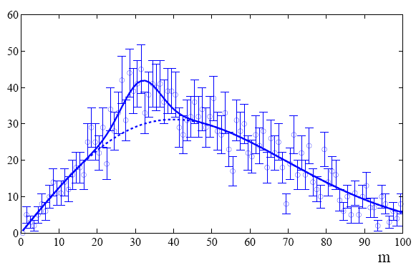
Protype example of LEE and a solution
Eilam Gross and Ofer Vitells. Trial factors for the look elsewhere effect in high energy physics. The European Physical Journal C - Particles and Fields, 70:525–530, 2010.
R. B. Davies, Hypothesis testing when a nuisance parameter is present only under the alternative, Biometrika 74 (1987), 33-43.
Suppose a model for a mass distribution allows for a peak at
a mass m with amplitude μ.
The data show a bump at a mass m₀.
How consistent is this with the no-bump (μ = 0) hypothesis?

Slide 8
Local p-value
First, suppose the mass m₀ of the peak was specified a priori.
Test consistency of bump with the no-signal (μ = 0) hypothesis
with e.g. likelihood ratio
where “fix” indicates that the mass of the peak is fixed to m₀.
The resulting p-value
gives the probability to find a value of t_{fix} at least as great as
observed at the specific mass m₀ and is called the local p-value.

Slide 9
Global p-value
But suppose we did not know where in the distribution to
expect a peak.
What we want is the probability to find a peak at least as
significant as the one observed anywhere in the distribution.
Include the mass as an adjustable parameter in the fit, test
significance of peak using
(Note m does not appear
in the μ = 0 model.)

Slide 10
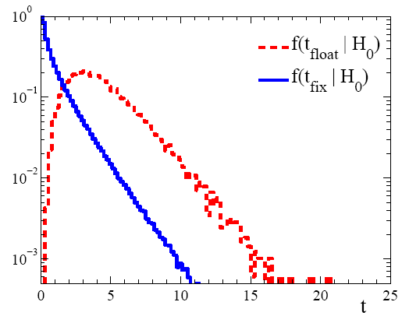
E. Gross and O. Vitells, EPJC 70:525–530, 2010.
Distributions of t_{fix}, t_{float}
For a sufficiently large data sample, t_{fix} ~ chi-square for 1 degree
of freedom (Wilks’ theorem), significance Z_{fix} = Φ⁻¹(1− p_{local}) = √t_{fix}.
For t_{float} there are two adjustable parameters, μ and m, and naively
Wilks theorem says t_{float} ~ chi-square for 2 d.o.f.
In fact Wilks’ theorem does not hold in the floating mass case because on of the parameters (m) is not-defined in the μ = 0 model.
So getting t_{float} distribution is more difficult.

Slide 11
E. Gross and O. Vitells, EPJC 70:525–530, 2010.
Approximate correction for LEE
We would like to be able to relate the p-values for the fixed and
floating mass analyses (at least approximately).
Gross and Vitells (using result from Davies) show the p-values are approximately related by
where 〈N(c)〉 is the mean number “upcrossings” of
t_{fix} = −2ln λ in the fit range based on a threshold
and where Z_{local} = Φ⁻¹(1 – p_{local}) is the local significance.
So we can either carry out the full floating-mass analysis (e.g.
use MC to get p-value), or do fixed mass analysis and apply a
correction factor (much faster than MC).

Slide 12
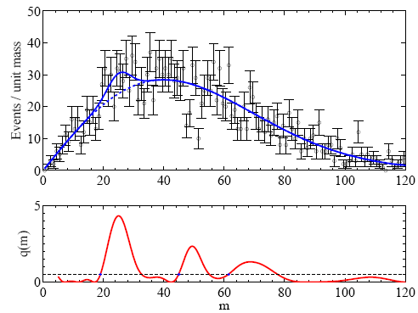
E. Gross and O. Vitells, EPJC 70:525–530, 2010.
Upcrossings of −2lnL
The Gross-Vitells formula for the trials factor requires 〈N(c)〉,
the mean number “upcrossings” of t_{fix} = −2ln λ in the fit range based
on a threshold c = t_{fix}= Z_{fix}².
〈N(c)〉 can be estimated
from MC (or the real
data) using a much lower
threshold c₀:
In this way 〈N(c)〉 can be
estimated without need of
large MC samples, even if
the the threshold c is quite
high.

Slide 13
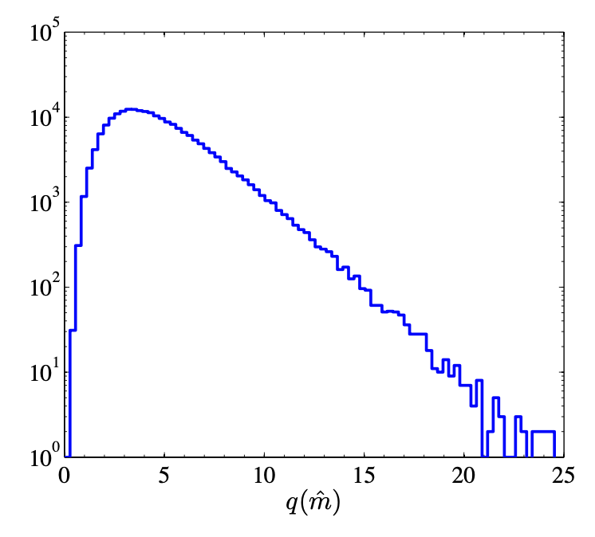
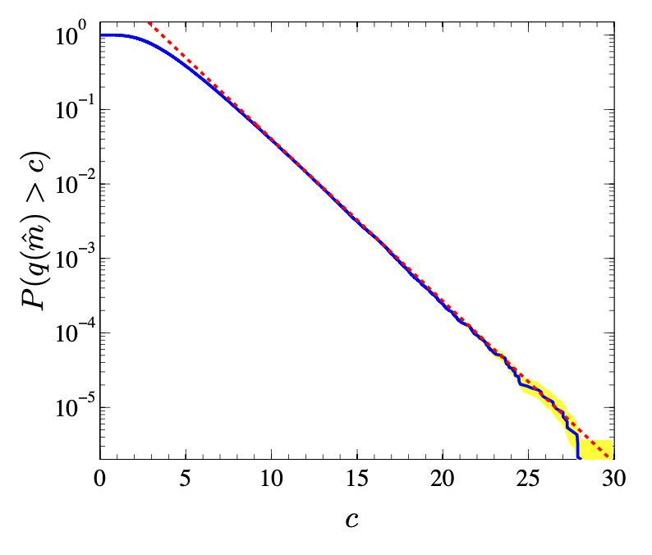
E. Gross and O. Vitells, EPJC 70:525–530, 2010.
MC study by Gross and Vitells validating approximation for
finding mean number of upcrossings (c₀ = 0.5)

Slide 14
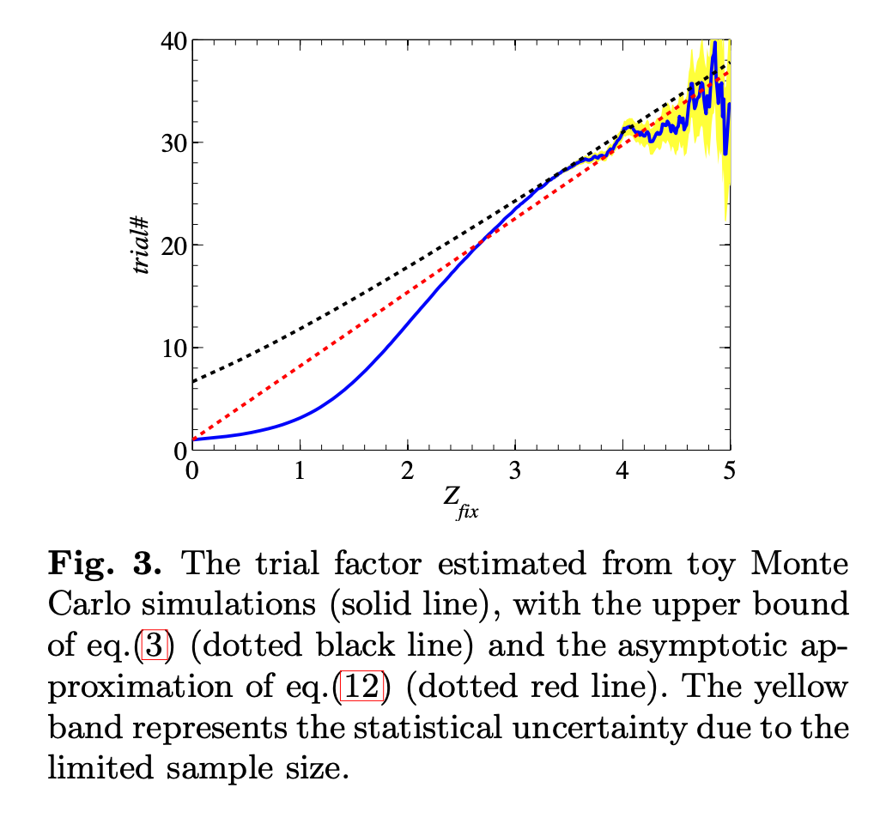
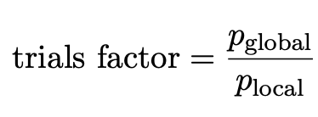
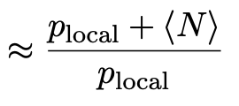
E. Gross and O. Vitells, EPJC 70:525–530, 2010.
Trails factor for example of Gross and Vitells
Approximate correction
is good for Z > 3, i.e., relevant for claiming signal at 3-sigma or more.

Slide 15
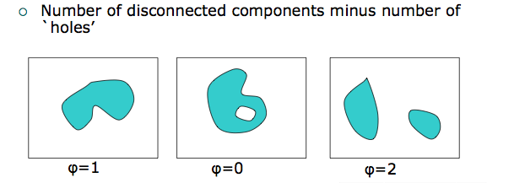
Vitells and Gross, Astropart. Phys. 35 (2011) 230-234; arXiv:1105.4355
Multidimensional look-elsewhere effect
Generalization to multiple dimensions: number of upcrossings
replaced by expectation of Euler characteristic:
Applications: astrophysics (coordinates on sky), search for
resonance of unknown mass and width, ...

Slide 16
Bayesian approach to LEE
See, e.g., James Berger, Bayesian approach to discovery, PHYSTAT11
contribution, https://indico.cern.ch/event/107747/
In Bayesian statistics, probability is associated with hypotheses.
A Bayesian tool for discovery of a new signal is the Bayes factor:
= posterior odds if
prior odds one.
The large parameter space of the alternative H₁ is automatically taken into account by integrating over the internal parameter.
The prior pdf π(θ) encodes what region of the parameter space is deemed relevant (i.e., “where else you need to look”).

Slide 17
Summary on Look-Elsewhere Effect
The Look-Elsewhere Effect is when we test a single model (e.g., SM) with multiple observations, i.e., in multiple places.
This is distinct from the case of exclusion limits. There we test different signal hypotheses (typically once) and say whether each is excluded (result is a confidence interval).
With exclusion there is, however, the also problematic issue of
testing many signal models (or parameter values) and thus
excluding some for which one has little or no sensitivity.
Approximate correction for LEE should be sufficient, and one
should also report the uncorrected significance.

Slide 18
Extra slides

Slide 19
Thoughts on the LEE
Louis Lyons, Open statistical issues in particle physics,
Annals of Applied Statistics 2008, Vol. 2, No. 3, 887-915
“There's no sense in being precise when you don't even
know what you're talking about.” –– John von Neumann

Slide 20
Some papers I didn’t manage to get through
S. Algeri, D.A. van Dyk, J. Conrad, B. Anderson, On methods for correcting the look-elsewhere effect in searches for new physics, Journal of Instrumentation 11 P12010, 2016, arXiv:1602.03765.
Multidimensional method; also nice description of the formalism.
Adrian E. Bayer, Uros Seljak, The look-elsewhere effect from a unified Bayesian and frequentist perspective, JCAP 10 (2020) 009, arXiv:2007.13821
...a continuous generalization of the Bonferroni and Sidak corrections by applying the Laplace approximation to evaluate the Bayes factor, and in turn relating the trials factor to the prior-to-posterior volume ratio. We use this to define a test statistic whose frequentist properties have a simple interpretation in terms of the global p-value,...

