Slide 1

Effect of Systematic Uncertainty Estimation on the Muon g − 2 Anomaly
G. Cowan, arXiv:2107.02652
LHCb Statistics and Machine Learning Working Group
Zoom / 26 July 2021
https://indico.cern.ch/event/1058629/
Glen Cowan
Physics Department
Royal Holloway, University of London
g.cowan@rhul.ac.uk
www.pp.rhul.ac.uk/~cowan

Slide 2
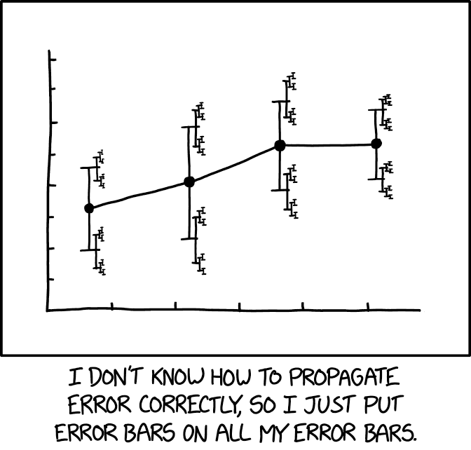
Motivation
The uncertainties on estimated systematic errors (“errors on errors”) can in general play an important role in HEP analyses, see:
G. Cowan, Statistical Models with Uncertain Error Parameters, Eur. Phys. J. C (2019) 79:133, arXiv:1809.05778
https://xkcd.com/2110/
It turns out that models that use
errors on errors have qualitatively
new, interesting, desirable features:
Sensitivity to outliers reduced.
Confidence intervals sensitive to goodness of fit.
Effect on goodness of fit, p-values, significance.

Slide 3
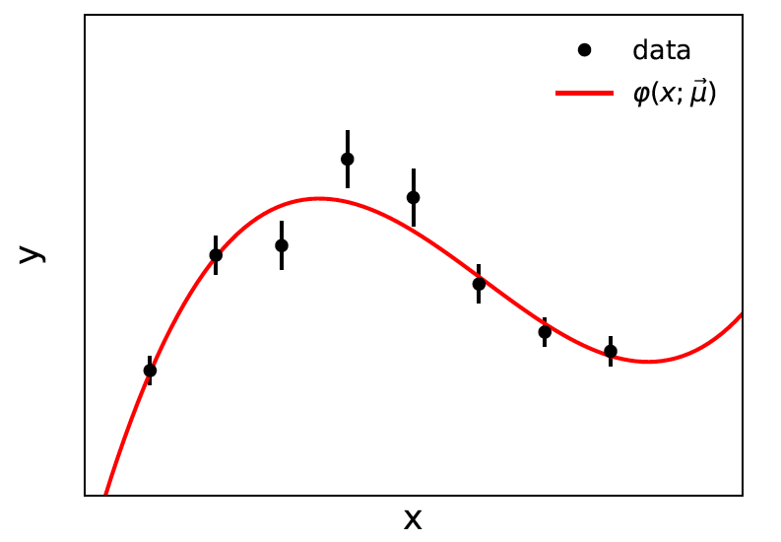
Prototype example: curve fitting, averages
Suppose independent
y_{i} ~ Gauss, i = 1,...,N, with
μ = (μ₁,..., μ_{M}) are M parameters in the fit function φ(x;μ).
If we take the σ_{i} as known, we have the usual log-likelihood
which leads to the Least Squares estimators for μ.

Slide 4
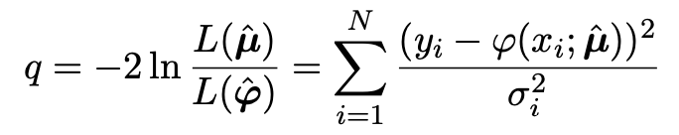
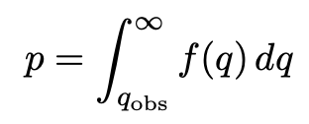

Goodness of fit for Least Squares
In the least-squares approach, the statistic
Likelihood of saturated model L(φ₁,..., φ_{N})
provides a measure of goodness of fit. The p-value of the
composite hypothesis φ(x_{i};μ) is
If the y_{i} ~ Gauss(φ(x_{i};μ), σ_{i}) then f (t) is chi-squared for N−M degrees
of freedom, independent of μ (Wilks).
Special case: φ(x_{i};μ) = μ, i.e., test if the y_{i} have a common mean μ
→ q ~ chi-square(N−1) →

Slide 5
What if the σ_{i} are not known?
The LS approach assumes that the standard deviations σ_{i} of the measurements are known.
σ_{i} = statistical error, usually well estimated from sample size.
σ_{i} = systematic error:
related to stat. error of control measurement – well estimated
related to size of MC event sample – well estimated
systematic uncertainty from modelling of experiment – could be poorly estimated
reflects uncertainty resulting from some mathematical approximation (theory error) – could be poorly estimated
In general, we should allow that the σ_{i} may not be exactly known.

Slide 6
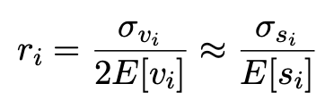
Gamma Variance Model
G. Cowan, EPJC (2019) 79:133
If the σ_{i}² are uncertain, we can take them as adjustable parameters.
The estimated variances v_{i} = s_{i}² are modeled as gamma distributed.
The likelihood becomes
Want
→

Slide 7
Profile log-likelihood
One can profile over the σ_{i}² in close form.
The log-profile-likelihood is
Quadratic terms replace by sum of logs.
Equivalent to replacing Gauss pdf for y_{i} by Student’s t, ν_{dof} = 1/2r_{i}²
Confidence interval for μ becomes sensitive to goodness-of-fit
(increases if data internally inconsistent).
Fitted curve less sensitive to outliers.
Simple program for Student’s t average: stave.py
http://www.pp.rhul.ac.uk/~cowan/stat/stave/

Slide 8
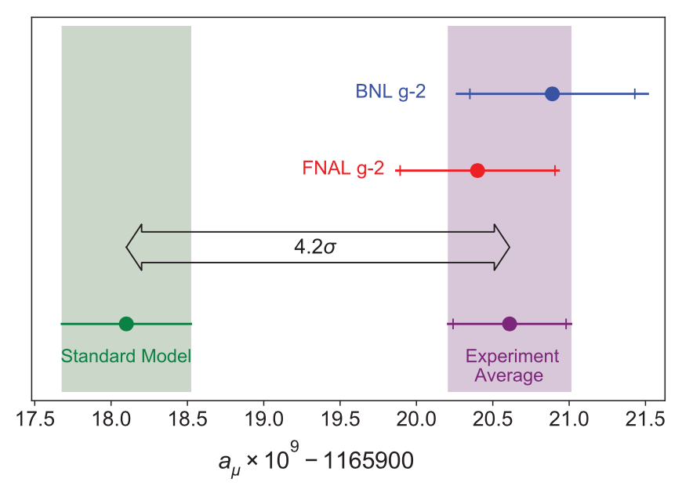
Application to the muon g − 2 anomaly
The recently measured muon g − 2 (ave. of 2006, 2021) disagrees with the Standard Model prediction with a significance of 4.2σ.
Muon g-2 Collab., PRL 126, 141801 (2021)
Discrepancy significantly
reduced by 2021 lattice-based prediction of Borsanyi et al. (BMW).
Current goal is to investigate sensitivity of significance to error assumptions, so for now focus on the 4.2σ problem.

Slide 9



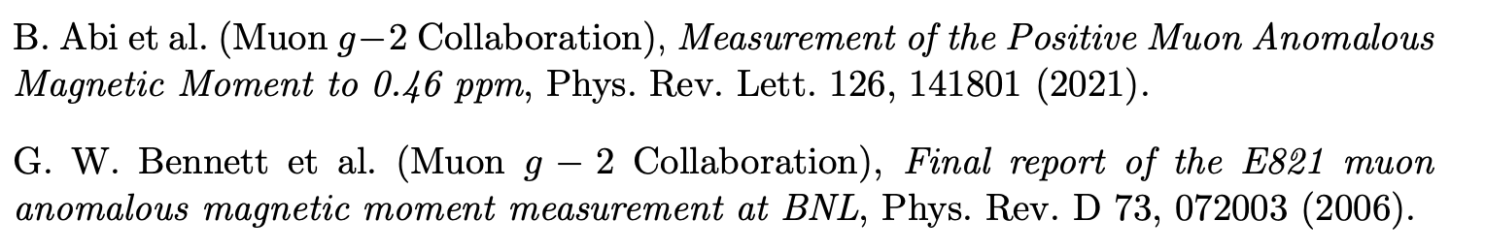

Muon g − 2 ingredients
Using
the ingredients of the 4.2σ effect are:
(ave. of BNL 2006 and FNAL 2021)
0.37 (stat.) ± 0.17 (sys.)
(SM pred. by Muon g −2 theory initiative)
0.40 (Had. Vac. Pol.) ± 0.18 (Had. Light-by-Light)

Slide 10
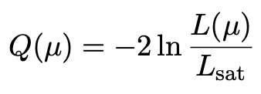
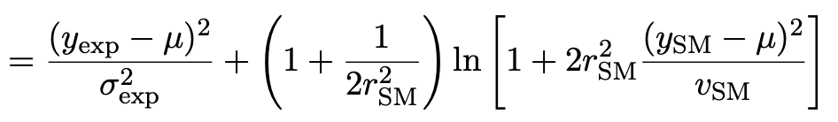
Suppose σ_{SM} uncertain
Suppose measurement errors well known, but that the SM theory
error σ_{SM} (estimated 0.43) could be uncertain.
This is the largest systematic and probably hardest to estimate.
Treat estimate v_{SM} of variance σ²_{SM} as gamma distributed, width from relative uncertainty parameter r_{SM}.
Maximum-likelihood for mean from minimum of

Slide 11

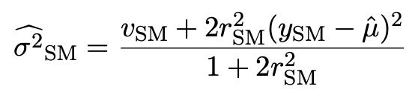
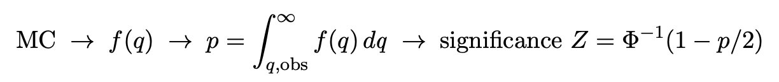
p-value/significance of common-mean hypothesis
Significance (goodness of fit) from
Because of non-quadratic term in Q(μ), distribution of q departs from chi-square(1) for increasing r_{SM}.
Best to get distribution of q from Monte Carlo (and speed up with Bartlett correction – see EPJC (2019) 79:133).
For r_{SM} > 0 distribution of q depends on σ²_{SM}. For MC use Maximum-Likelihood estimate (“profile construction”):
# of sigmas

Slide 12
Significance of discrepancy versus r_{SM}
Naive model: use least squares but let σ_{SM} → (1 + r_{SM}) σ_{SM}
Gamma variance model gives greater decrease in significance for r_{SM} ≳ 0.2, e.g., 3.1σ for r_{SM} = 0.3, 2.0σ for r_{SM} = 0.6.

Slide 13
Significance of discrepancy versus r_{SM}
Establishing 4σ effect requires r_{SM} ≲ 0.3 even if nominal exp.
and SM uncertainties become half of present values.

Slide 14
Discussion / conclusions
Including uncertainties on estimates of uncertainties can have large effect on hypothesis test, esp. for high significance.
To establish e.g. a 5σ effect it is crucial to have both:
small uncertainties
accurate estimates of those uncertainties (~ 20% level)
This is ultimately because the tails of the Gaussian fall off so quickly.
Gamma Variance Model ~ Student’s t likelihood with ν = 1/2r² degrees of freedom → longer tails than Gaussian.
Work ongoing with Bogdan Malaescu of Muon g-2 Theory Initiative on the HVP uncertainty, see, e.g.,
B. Malaescu et al., https://indico.him.uni-mainz.de/event/11/contributions/80/attachments/50/51/amuWorkshop_Correlations_Malaescu.pdf
M. Davier et al., Eur. Phys. J. C 80 (2020) 241 , arXiv:1908.00921

Slide 15
Discussion / conclusions (2)
Other features of Gamma Variance Model (see EPJC (2019) 79:133 and the extra slides)
averages/fits become less sensitive to outliers;
confidence intervals linked to goodness of fit;
straightforward to include multiple correlated error sources.
But... is part of the reason for requiring 5σ for discovery not to account for uncertainties in assigned errors? Is there a trade-off between “errors on errors” and the requirement for discovery?
Best to have most realistic model. If the estimated errors are indeed uncertain, this should be reflected in the model.
Bottom line – it is very difficult to establish convincing evidence for a new physics if relevant uncertainties are estimated in an ad hoc way. We need robust procedures for their assignment.

Slide 16
Extra Slides

Slide 17
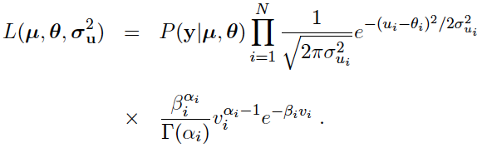
Full likelihood for gamma variance model
α_{i} = 1/4r_{i}²
β_{i} = α_{i}/σ_{ui}²
,
Treated like data: y₁,...,y_{L} (the primary measurements)
u₁,...,u_{N} (estimates of nuisance par.)
v₁,...,v_{N} (estimates of variances
of estimates of NP)
Adjustable parameters: μ₁,...,μ_{M} (parameters of interest)
θ₁,...,θ_{N} (nuisance parameters)
σ_{u,1},...,σ_{u,N} (sys. errors = std. dev. of
of NP estimates)
Fixed parameters: r₁,...,r_{N} (rel. err. in estimate of σ_{u,i})

Slide 18
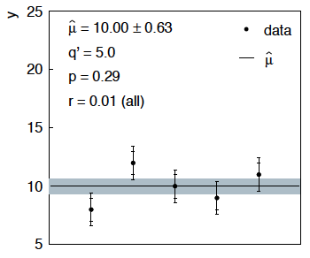
Sensitivity of average to outliers
Suppose we average 5 values, y = 8, 9, 10, 11, 12, all with
stat. and sys. errors of 1.0, and suppose negligible error on error
(here take r = 0.01 for all).
inner error bars
= σ_{y,i}
outer error bars
= (σ_{y,i}² + σ_{u,i}²)^{½}

Slide 19
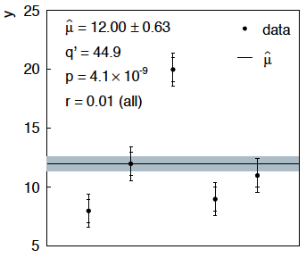
Sensitivity of average to outliers (2)
Now suppose the measurement at 10 had come out at 20:
“outlier”
Estimate pulled up to 12.0, size of confidence interval ~unchanged
(would be exactly unchanged with r → 0).

Slide 20
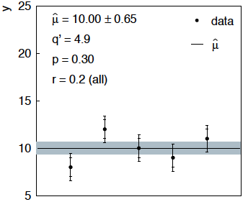
Average with all r = 0.2
If we assign to each measurement r = 0.2,
Estimate still at 10.00, size of interval moves 0.63 → 0.65

Slide 21
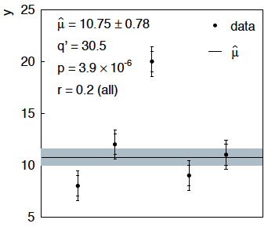
Average with all r = 0.2 with outlier
Same now with the outlier (middle measurement 10 → 20)
Estimate →10.75 (outlier pulls much less).
Half-size of interval → 0.78 (inflated because of bad g.o.f.).

Slide 22



Naive approach to errors on errors
Naively one might think that the error on the error in the previous
example could be taken into account conservatively by inflating
the systematic errors, i.e.,
But this gives
without outlier (middle meas. 10)
with outlier (middle meas. 20)
So the sensitivity to the outlier is not reduced and the size of the
confidence interval is still independent of goodness of fit.

Slide 23

Correlated uncertainties
The phrase “correlated uncertainties” usually means that a single
nuisance parameter affects the distribution (e.g., the mean) of more
than one measurement.
For example, consider measurements y, parameters of interest μ,
nuisance parameters θ with
That is, the θ_{i} are defined here as contributing to a bias and
the (known) factors R_{ij} determine how much θ_{j} affects y_{i}.
As before suppose one has independent control measurements
u_{i}~ Gauss(θ_{i}, σ_{ui}).

Slide 24



Correlated uncertainties (2)
The total bias of y_{i} can be defined as
which can be estimated with
These estimators are correlated having covariance
In this sense the present method treats “correlated uncertainties”,
i.e., the control measurements u_{i} are independent, but nuisance
parameters affect multiple measurements, and thus bias estimates
are correlated.

