Slide 1


Errors on Errors in Particle Physics
University of Manchester
Bohr Seminar, 13 Feb 2026
https://indico.global/event/16667/
Glen Cowan
Physics Department
Royal Holloway, University of London
g.cowan@rhul.ac.uk
www.pp.rhul.ac.uk/~cowan

Slide 2
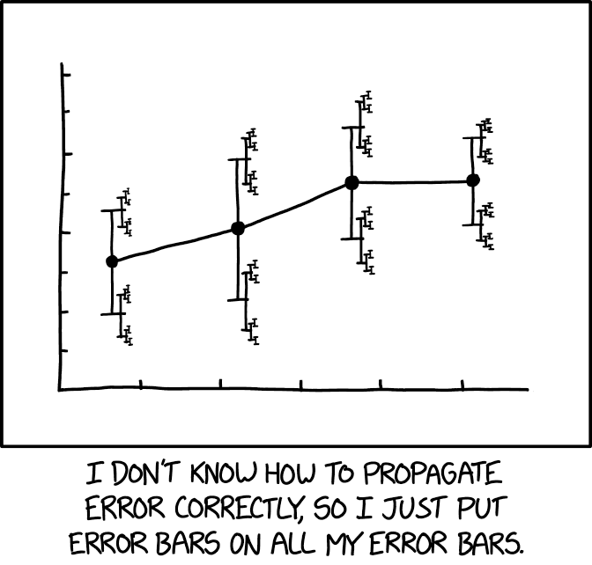
Preface
Why error bars on error bars?
Not just an extra layer of complexity:
Reduces sensitivity to outliers in fit/combination
Gives connection between goodness of fit and size of confidence intervals
Randall Munroe, xkcd.com https://xkcd.com/2110/
Based on work esp. with Enzo Canonero:
G. Cowan, Eur. Phys. J. C (2019) 79:133; arXiv:1809.05778
G. Cowan, , EPJ Web of Conferences 258, 09002 (2022); arXiv:2107.02652
E. Canonero, A. Brazzale and G. Cowan, Eur. Phys. J. C (2023) 83:1100; arXiv:2304.10574
E. Canonero, G. Cowan, Eur. Phys. J. C (2025) 85: 156; arXiv:2407.05322

Slide 3
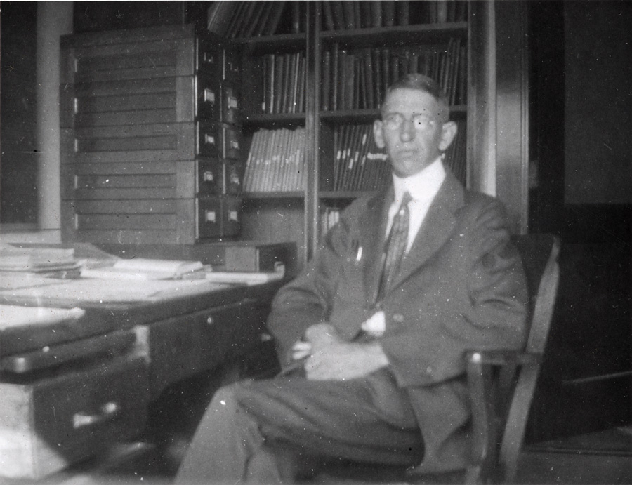
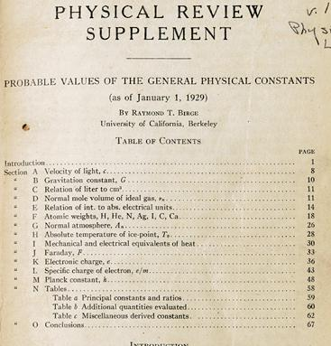
http://bancroft.berkeley.edu/Exhibits/physics/learning01.html
Least Squares for Averaging
_{= fit of horizontal line}
Raymond T. Birge,
Probable Values of the General Physical Constants (as of January 1, 1929), Physical Review Supplement, Vol 1, Number 1, July 1929
Forerunner of the
Particle Data Group

Slide 4
Least squares: some issues
The method of least squares requires the standard deviations of the measured quantities, but often these are poorly known.
The uncertainty (e.g. confidence interval) of an LS average does not reflect goodness of fit:
LS average of 9 ± 1 and 11 ± 1 is 10 ± 0.71
LS average of 5 ± 1 and 15 ± 1 is 10 ± 0.71
LS estimators are equivalent to maximum-likelihood assuming Gaussian distributed measurements; but the tails of a Gaussian fall off very fast, not always an appropriate model.
→ Outliers in LS average have very large influence.
Solution: incorporate the uncertainty in the standard deviations of the measurements into the analysis.

Slide 5
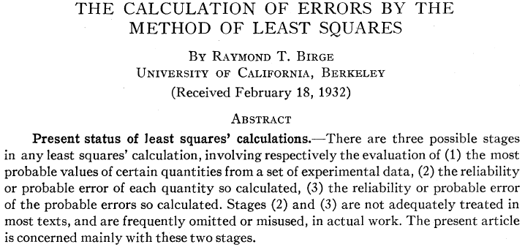
“Errors on Errors”
→ PDG “scale factor method” ≈ scale sys. errors with common
factor until χ²_{min} = appropriate no. of degrees of freedom.

Slide 6



Formulation of the problem
Suppose measurements y have probability (density) P(y|μ,θ),
μ = parameters of interest
θ = nuisance parameters
To provide info on nuisance parameters, often treat their best
estimates u as indep. Gaussian distributed r.v.s., giving likelihood
or log-likelihood (up to additive const.)

Slide 7
Systematic errors and their uncertainty
Often the θ_{i} could represent a systematic bias and its best estimate u_{i} in the real measurement is zero.
The σ_{u,i} are the corresponding “systematic errors”.
Sometimes σ_{u,i} is well known, e.g., it is itself a statistical error known from sample size of a control measurement.
Other times the u_{i} are from an indirect measurement, Gaussian model approximate and/or the σ_{u,i} are not exactly known.
Or sometimes σ_{u,i} is at best a guess that represents an uncertainty in the underlying model (“theoretical error”).
In any case we can allow that the σ_{u,i} are not known in general with perfect accuracy.

Slide 8



Gamma distribution for variance estimates
Suppose we want to treat the systematic errors as uncertain,
so let the σ_{u,i} be adjustable nuisance parameters.
Suppose we have estimates s_{i} for σ_{u,i} or equivalently v_{i} = s_{i}², is an estimate of σ_{u,i}².
Model the v_{i} as independent and gamma distributed:
Set α and β so that they give desired mean and width for f (v):
E[v] = σ_{u}² = α/β,
ε = 1/2√α ≈ relative “error on the error” = σ_{s}/E[s] .

Slide 9
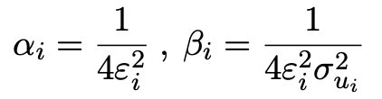


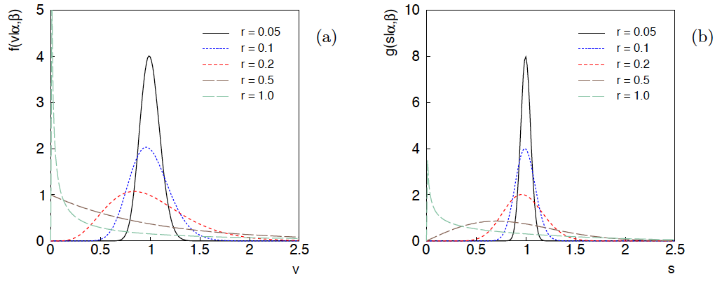
Distributions of v and s = √v
For α, β of gamma distribution,
relative “error on error”

Slide 10

Motivation for Gamma Variance Model (GVM)
If one were to have n independent observations u₁,..,u_{n}, with all
u ~ Gauss(θ, σ_{u}²), and we use the sample variance
to estimate σ_{u}², then (n−1)v/σ_{u}² follows a chi-square distribution
for n−1 degrees of freedom, which is a special case of the
gamma distribution (α = n/2, β = 1/2). (In general one doesn’t
have a sample of u_{i} values, but if this were to be how v was
estimated, the gamma model would follow.)
Furthermore choice of the gamma distribution for v allows one
to profile over the nuisance parameters σ_{u}² in closed form and
leads to a simple profile likelihood.

Slide 11
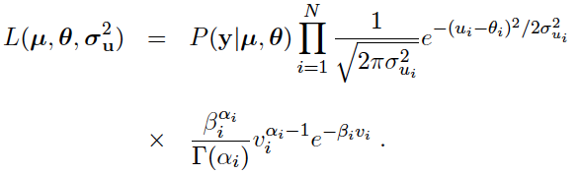
Likelihood for gamma variance model
α_{i} = 1/4ε_{i}²
β_{i} = α_{i}/σ_{ui}²
,
Treated like data: y₁,...,y_{L} (the primary measurements)
u₁,...,u_{N} (estimates of nuisance par.)
v₁,...,v_{N} (estimates of variances
of estimates of NP)
Adjustable parameters: μ₁,...,μ_{M} (parameters of interest)
θ₁,...,θ_{N} (nuisance parameters)
σ_{u,1},...,σ_{u,N} (sys. errors = std. dev. of
of NP estimates)
Fixed parameters: ε₁,...,ε_{N} (rel. err. in estimate of σ_{u,i})

Slide 12
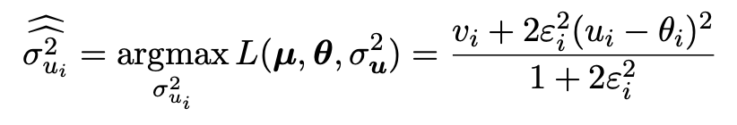
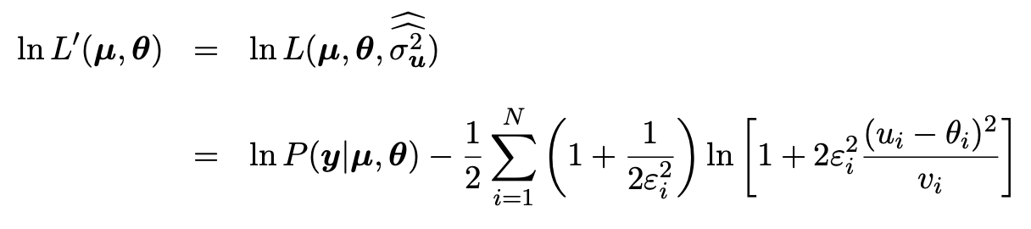
Profiling over systematic errors
We can profile over the σ_{u,i} in closed form
which gives the profile log-likelihood (up to additive const.)
In limit of small ε_{i} and v_{i} → σ_{u,i}², the log terms revert back to the
quadratic form seen with known σ_{u,i}.

Slide 13


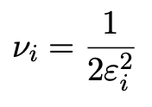

Equivalent likelihood from Student’s t
We can arrive at same likelihood by defining
Since u_{i} ~ Gauss and v_{i} ~ Gamma, z_{i} ~ Student’s t
with
Resulting likelihood same as profile Lʹ(μ,θ) from gamma model

Slide 14
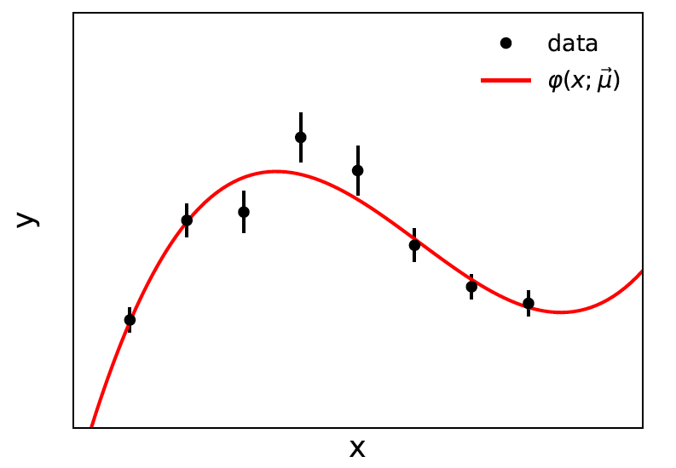


Curve fitting, averages
Suppose independent
y_{i} ~ Gauss, i = 1,...,N, with
(known).
μ are the parameters of interest in the fit function φ(x;μ),
θ are bias parameters constrained by control measurements
u_{i} ~ Gauss(θ_{i}, σ_{u,i}), so that if σ_{u,i} are known we have

Slide 15

Profiling over θ_{i} with known σ_{u,i}
Profiling over the bias parameters θ_{i} for known σ_{u,i} gives usual least-squares (BLUE)
Widely used technique for curve fitting in Particle Physics.
Generally in real measurement, u_{i} = 0.
Generalized to case of correlated y_{i} and u_{i} by summing
statistical and systematic covariance matrices.

Slide 16
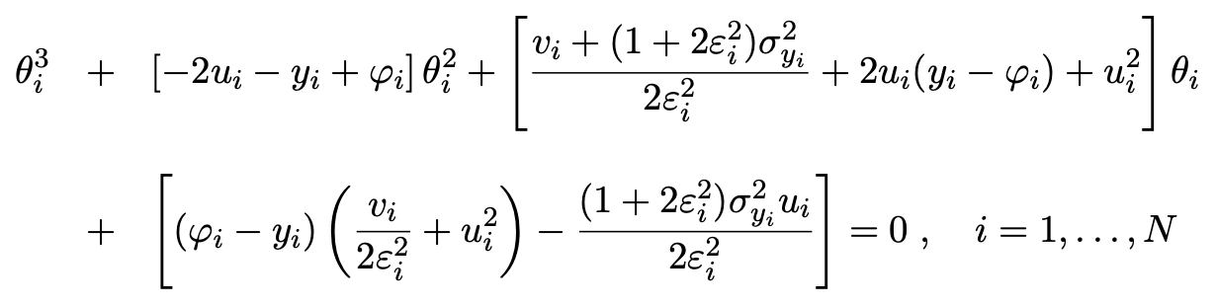
Curve fitting with uncertain σ_{u,i}
Suppose now σ_{u,i}² are adjustable parameters with gamma distributed estimates v_{i}.
Retaining the θ_{i} but profiling over σ_{u,i}² gives
Profiled values of θ_{i} from solution to cubic equations:

Slide 17
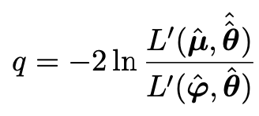
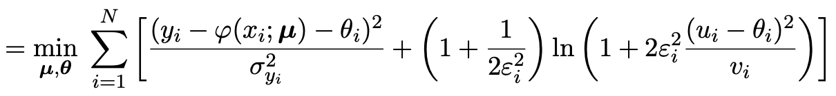
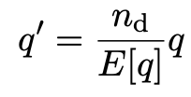
Goodness of fit
Can quantify goodness of fit with statistic
where Lʹ (φ,θ) has an adjustable φ_{i} for each y_{i} (the saturated model).
Asymptotically should have q ~ chi-squared(N−M).
For increasing ε_{i}, asymptotic distribution no longer valid.
Bartlett (1937) defines modified statistic:
By construction q′ has mean n_{d} = N−M and turns out to have a distribution significantly closer to the asymptotic chi-square.
(See Canonero et al., Eur. Phys. J. C (2023) 83:1100.)

Slide 18
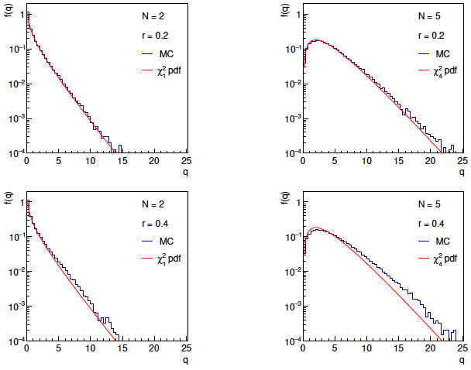
Distributions of q

Slide 19
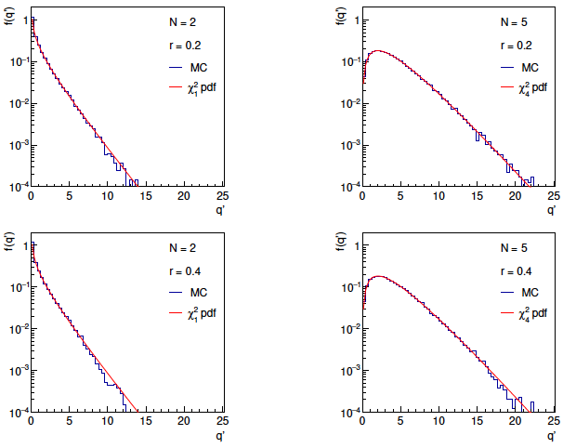
Distributions of Bartlett-corrected qʹ

Slide 20
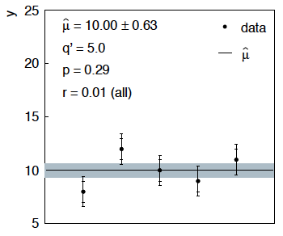
Sensitivity of average to outliers
Suppose we average 5 values, y = 8, 9, 10, 11, 12, all with
stat. and sys. errors of 1.0, and suppose negligible error on error
(here take ε = 0.01 for all).
inner error bars
= σ_{y,i}
outer error bars
= (σ_{y,i}² + σ_{u,i}²)^{½}

Slide 21
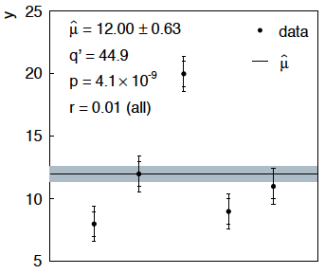
Sensitivity of average to outliers (2)
Now suppose the measurement at 10 had come out at 20:
“outlier”
Estimate pulled up to 12.0, size of confidence interval ~unchanged
(would be exactly unchanged with ε → 0).

Slide 22
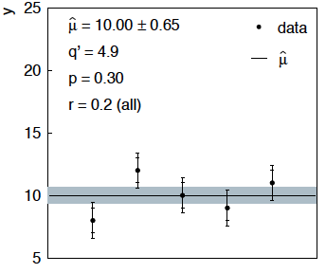
Average with all ε = 0.2
If we assign to each measurement ε = 0.2,
Estimate still at 10.00, size of interval moves 0.63 → 0.65

Slide 23
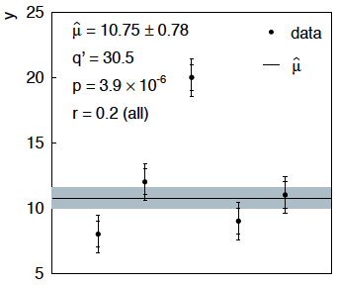
Average with all ε = 0.2 with outlier
Same now with the outlier (middle measurement 10 → 20)
Estimate →10.75 (outlier pulls much less).
Half-size of interval → 0.78 (inflated because of bad g.o.f.).

Slide 24



Naive approach to errors on errors
Naively one might think that the error on the error in the previous
example could be taken into account conservatively by inflating
the systematic errors, i.e.,
But this gives
without outlier (middle meas. 10)
with outlier (middle meas. 20)
So the sensitivity to the outlier is not reduced and the size of the
confidence interval is still independent of goodness of fit.

Slide 25
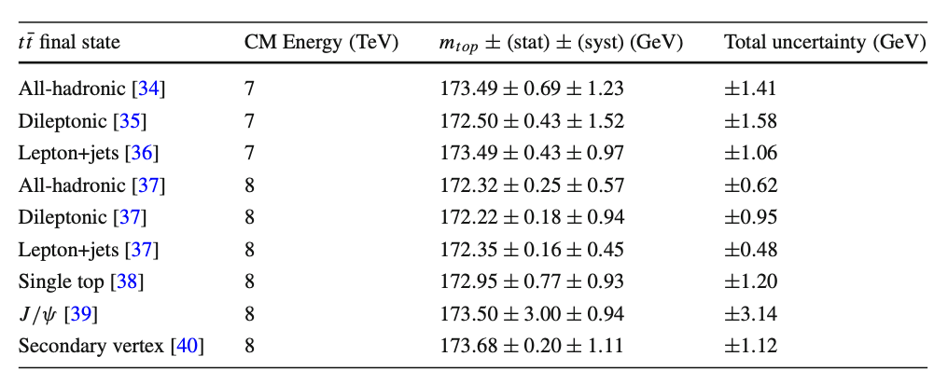
Application to top-quark mass
E. Canonero, G. Cowan, Eur. Phys. J. C (2025) 85: 156; arXiv:2407.05322 and E. Canonero (thesis) inspirehep.net/literature/2971307
Based on: 2024 7–8 TeV ATLAS–CMS top quark mass combination,
https://doi.org/10.1103/physrevlett.132.261902. arXiv:2402.08713
average:

Slide 26
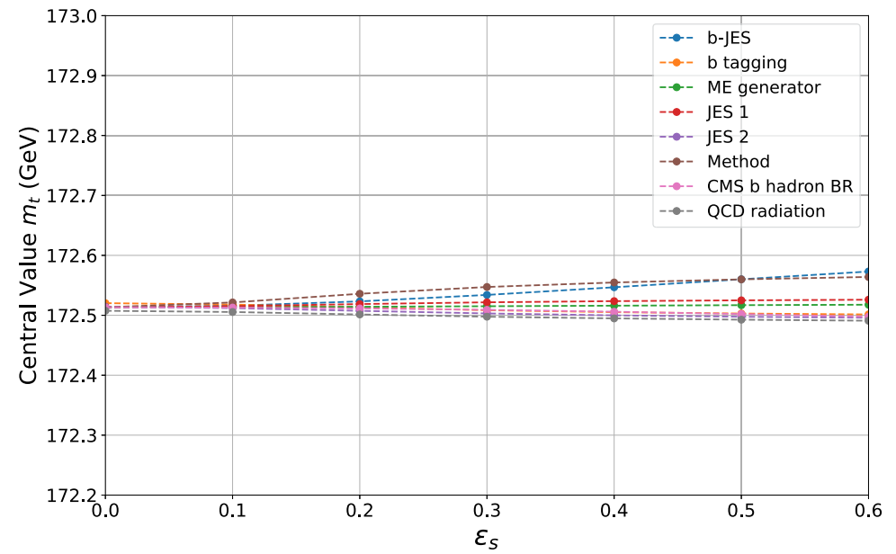
Application to top-quark mass (2)
For the 8 largest systematics, apply errors-on-errors in turn:
Estimated value of m_{t} quite stable.
ε → 0 reproduces published average.

Slide 27
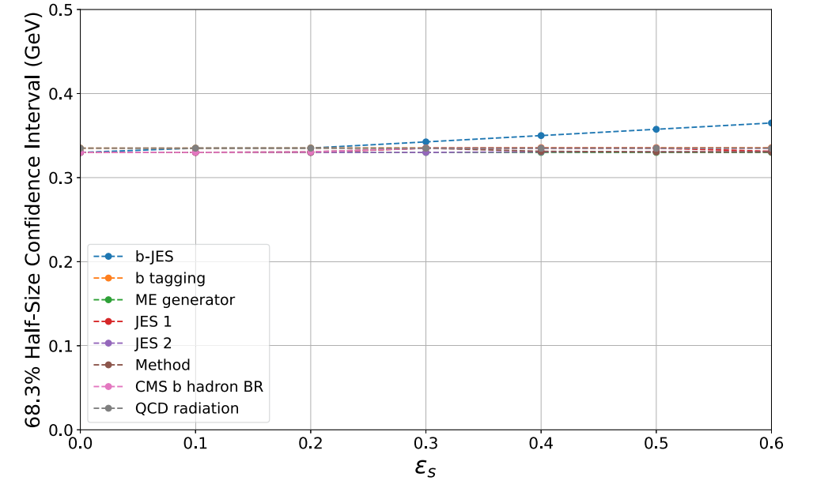
Application to top-quark mass (3)
Size of error bar on average also fairly stable (expected since
input values in relatively good agreement).
Conclusion: this m_{t} combination is robust wrt errors-on-errors.

Slide 28
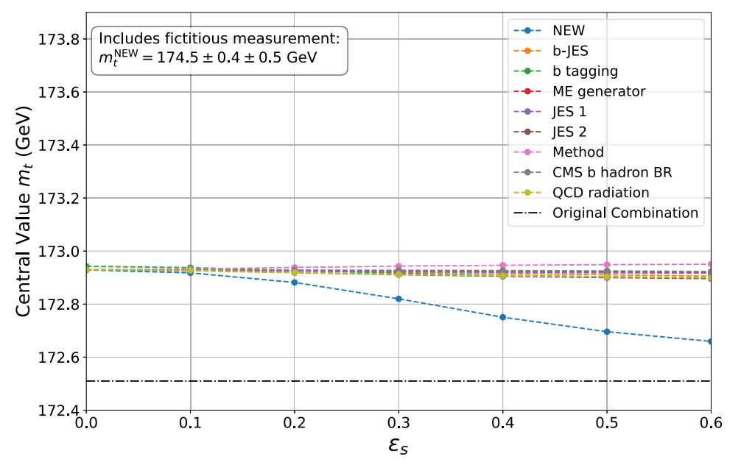
Application to top-quark mass (4)
If there were to be an outlier, things would change:
→ include fictitious measurement m_{t} = 174.5 ± 0.4 ± 0.5 GeV:
If assigned small ε, fictitious outlier pulls average significantly.

Slide 29
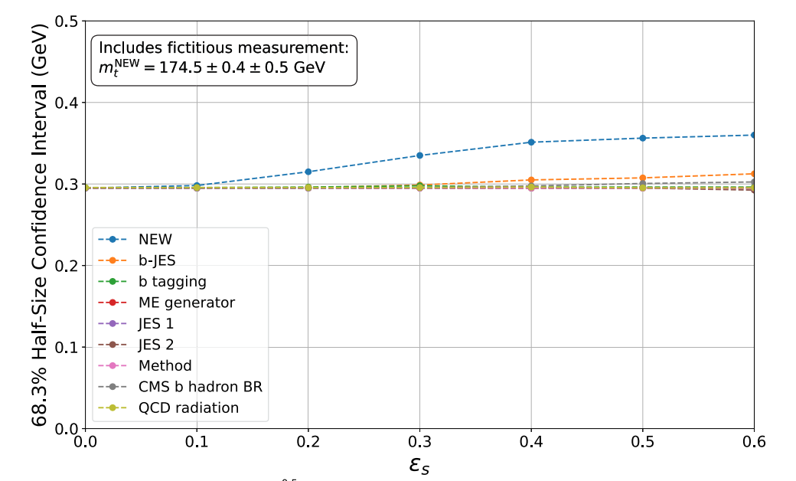
Application to top-quark mass (5)
And with the fictitious outlier, error on average is inflated provided
one assumes the outliner has large enough ε.

Slide 30
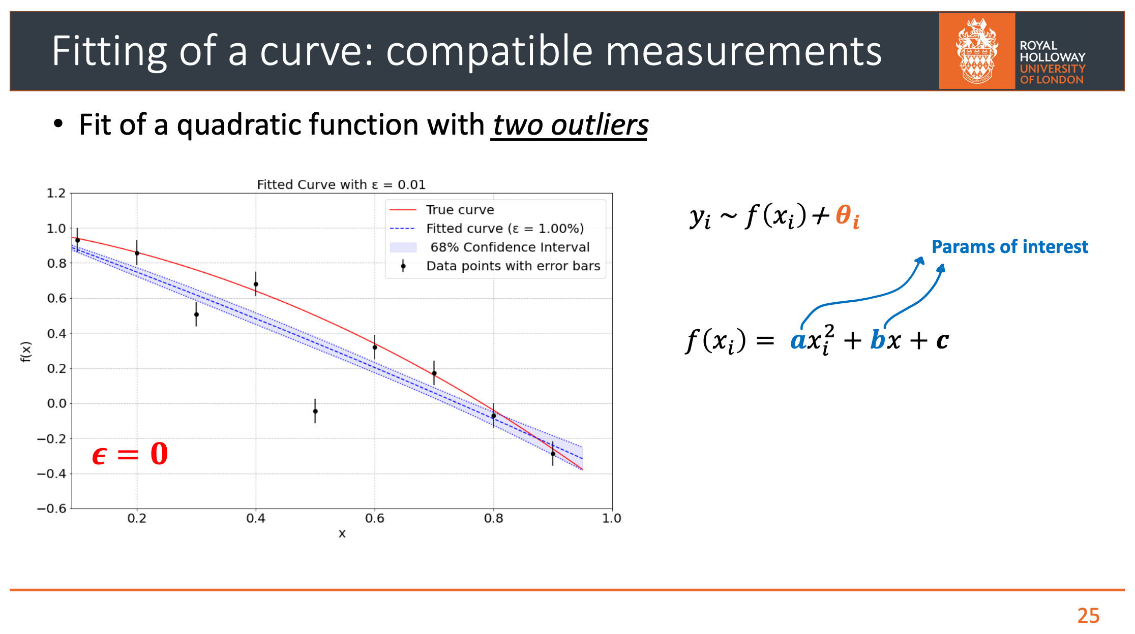
Enzo Canonero
Fitting with outliers (e.g., parton fits)

Slide 31
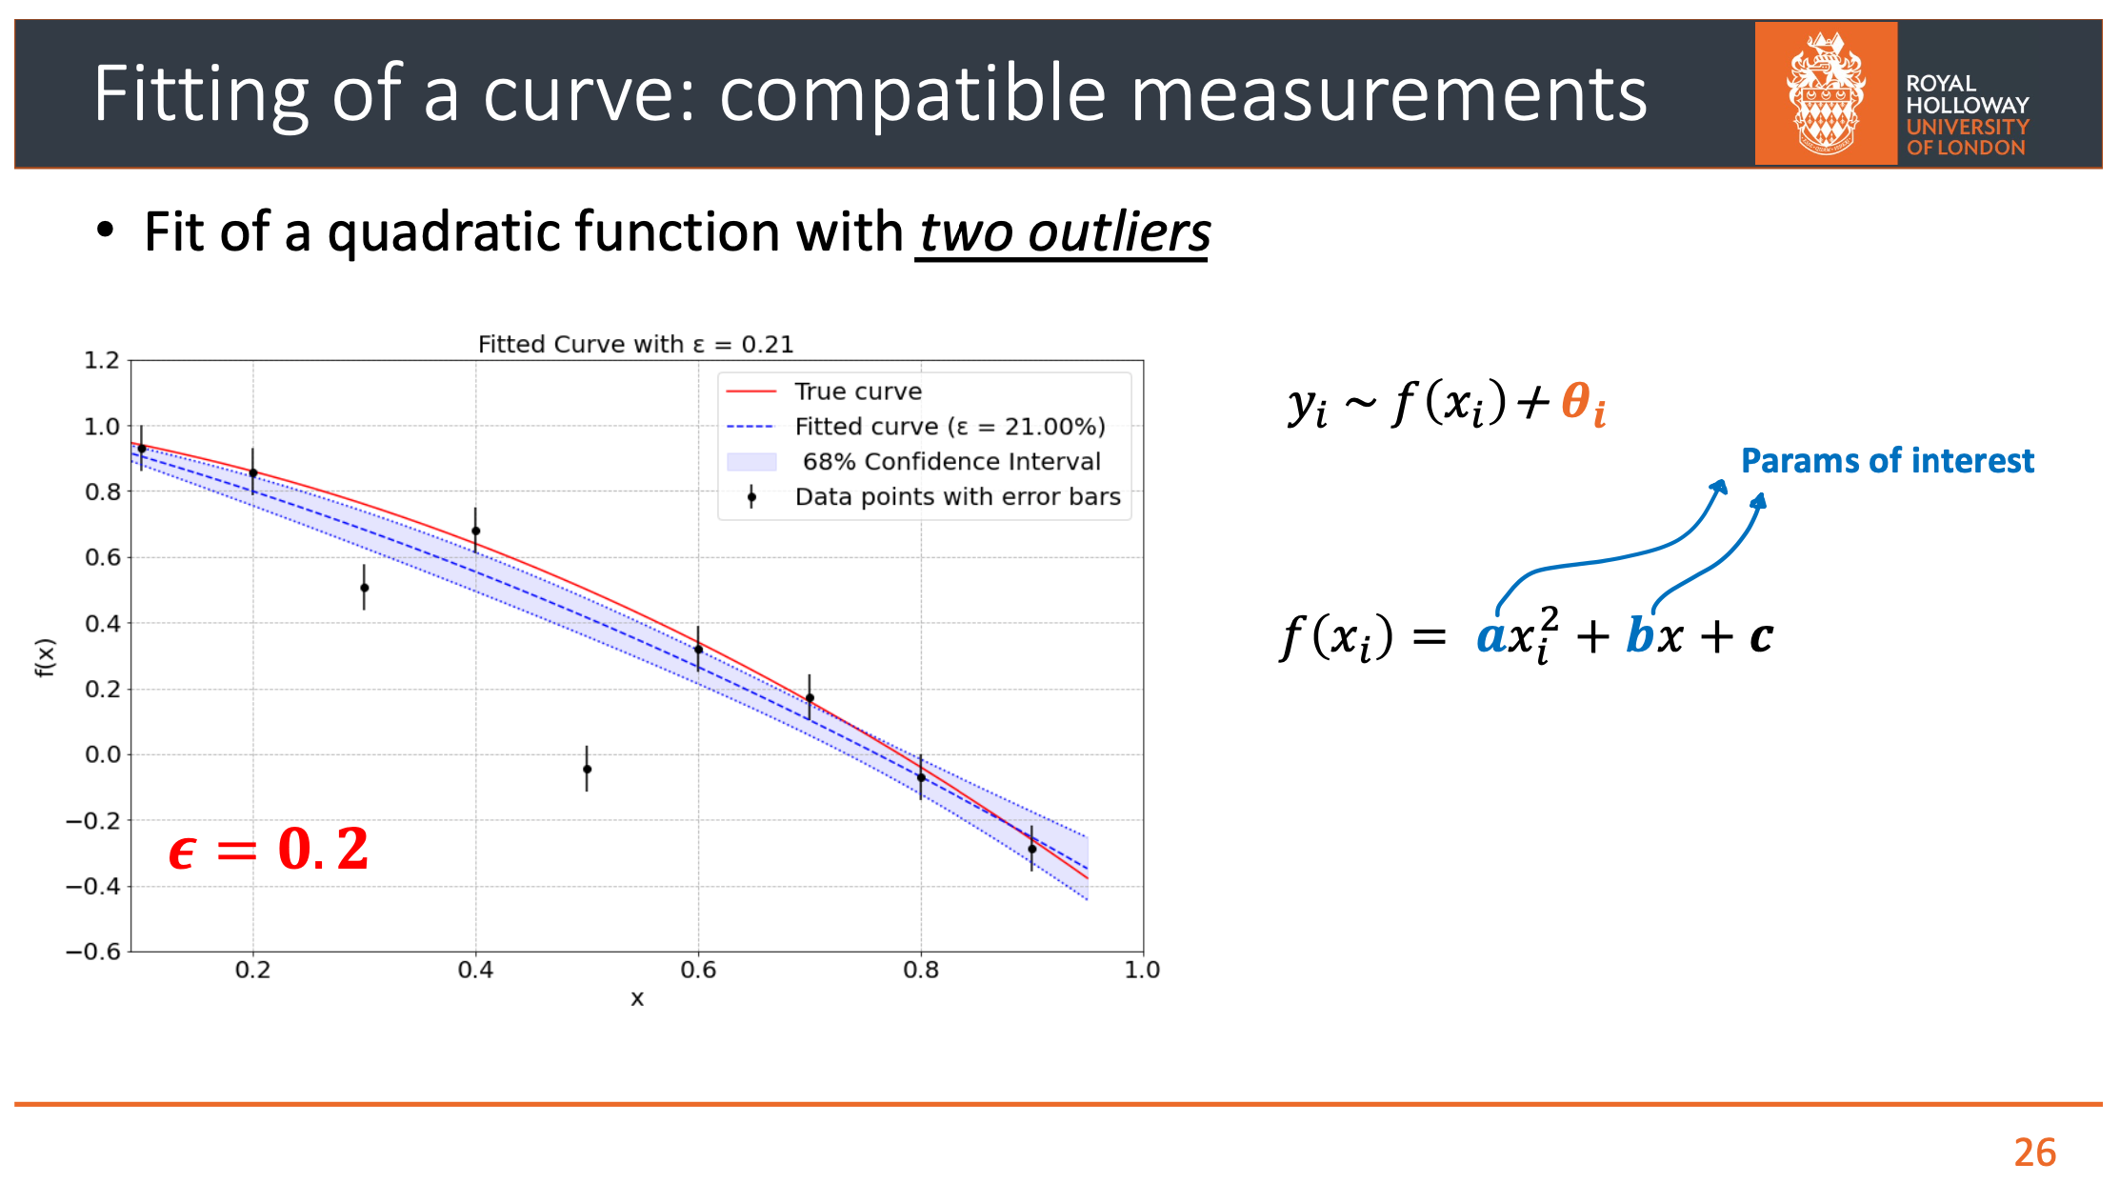
Enzo Canonero

Slide 32
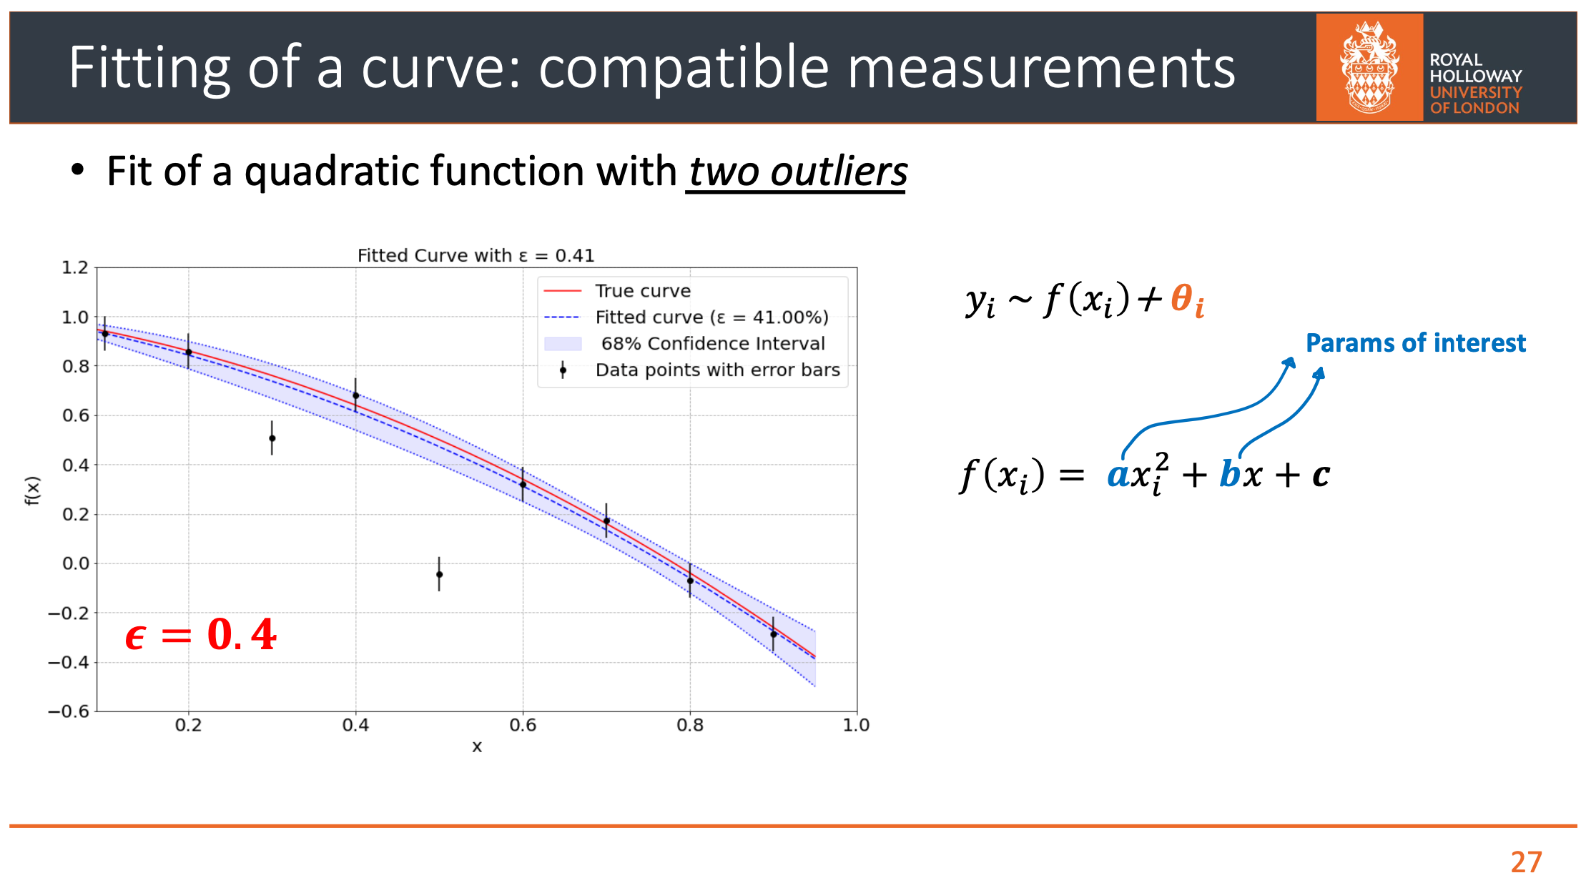
Enzo Canonero

Slide 33
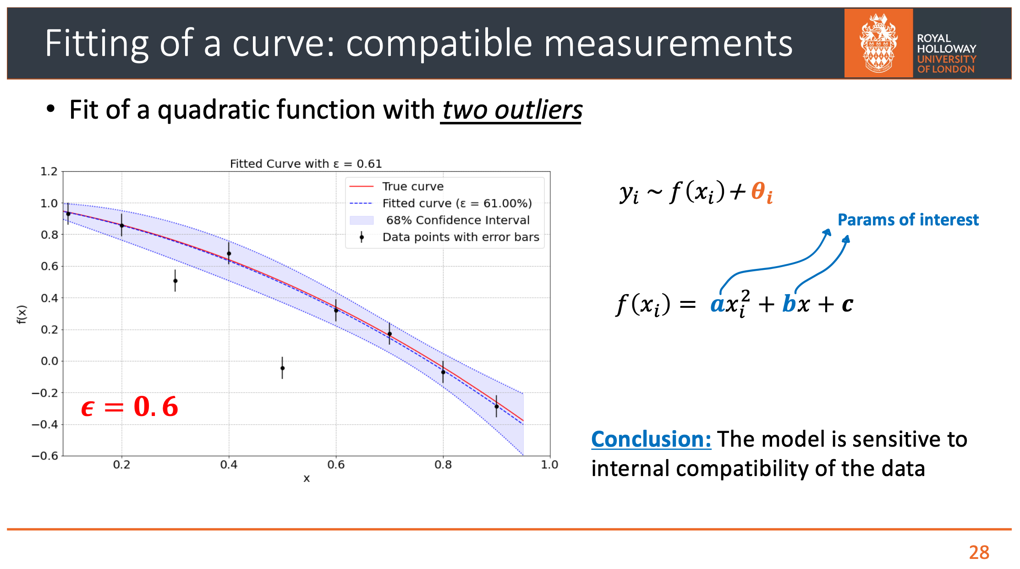
Enzo Canonero

Slide 34
Recent and Ongoing Developments
With Enzo Canonero, esp. Eur. Phys. J. C (2025) 85:156
Fully extended to problems with correlated systematic uncertainties.
Fast approximations of expectation values for Bartlett-corrected goodness of fit and confidence intervals.
Closed-form solutions for estimators (→ fast profile-likelihood fitting).
github.com/EnzoCanonero/GVM-Combinations Combination Toolkit
Applications to estimates of top, W masses: EC, GDC EPJC (2025) 85:156 and EC thesis: inspirehep.net/literature/2971307
Investigation of higher-order asymptotics: E. Canonero, A. Brazzale and G. Cowan, Eur. Phys. J. C (2023) 83:1100; arXiv:2304.10574
Application to muon g-2 anomaly: G. Cowan, , EPJ Web of Conferences 258, 09002 (2022); arXiv:2107.02652
Parton fits (ongoing w/ Enzo Canonero, Georgia Brown)
Preliminary (EC): errors-on-errors branch in gitlab.cern.ch/fitters/xfitter

Slide 35

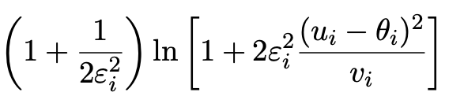
Discussion / Conclusions
Gamma Variance Model gives confidence intervals that increase in size when the data are internally inconsistent, and gives decreased sensitivity to outliers (known property of Student’s t based regression).
Equivalence with Student’s t model, ν = 1/2ε² degrees of freedom.
Simple profile likelihood – quadratic terms replaced by logarithmic:

Slide 36

Discussion / Conclusions (2)
Asymptotics can break for increased error-on-error, may need
Bartlett correction, higher-order asymptotics or MC.
Method assumes that meaningful ε_{i} values can be assigned and is valuable when systematic errors are not well known but enough “expert knowledge” is available to do so.
Realistic approach: classify systematic uncertainties as:
good → ε = 0 (error related to sample size)
bad → ε = 0.3 (~justified but still uncertain)
ugly → ε = 0.6 (2-point sys., theory uncertainties)
Could also use e.g. as “stress test” – crank up the ε_{i} values until significance of result degrades and ask if you really trust the assigned systematic errors at that level (→ muon g-2, m_{t}, M_{W},).
Ongoing: application to parton density fits, MC tuning,...

Slide 37
Extra Slides

Slide 38
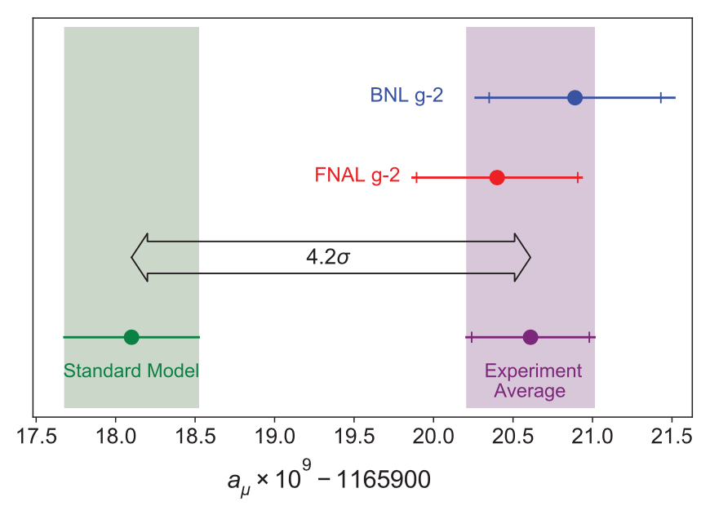
Application to the muon g − 2 anomaly
The recently measured muon g − 2 (ave. of 2006, 2021) disagrees with the Standard Model prediction with a significance of 4.2σ.
Muon g-2 Collab., PRL 126, 141801 (2021)
Discrepancy significantly
reduced by 2021 lattice-based prediction of Borsanyi et al. (BMW).
Current goal is to investigate sensitivity of significance to error assumptions, so for now focus on the 4.2σ problem.
Here using 2021 meausrement; see also D. P. Aguillard et al. (The Muon g−2 Collaboration)
Phys. Rev. Lett. 131, 161802 (2023)

Slide 39



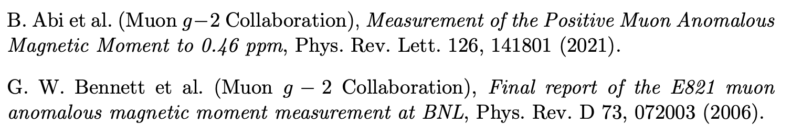

Muon g − 2 ingredients
Using
the ingredients of the 4.2σ effect are:
(ave. of BNL 2006 and FNAL 2021)
0.37 (stat.) ± 0.17 (sys.)
(SM pred. by Muon g −2 theory initiative)
0.40 (Had. Vac. Pol.) ± 0.18 (Had. Light-by-Light)

Slide 40
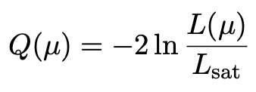
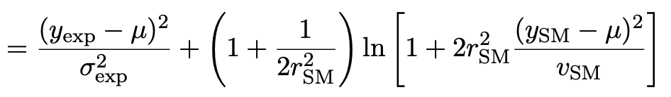
Suppose σ_{SM} uncertain
Suppose measurement errors well known, but that the SM theory
error σ_{SM} (estimated 0.43) could be uncertain.
This is the largest systematic and probably hardest to estimate.
Treat estimate v_{SM} = (0.43)² of variance σ²_{SM} as gamma distributed, width from relative uncertainty parameter r_{SM}.
Maximum-likelihood for mean from minimum of

Slide 41

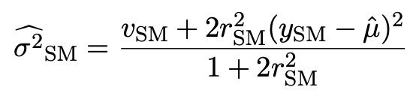
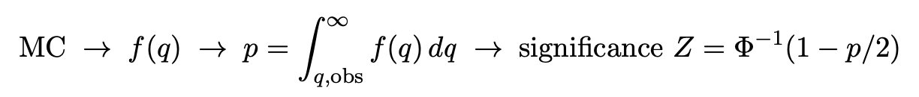
p-value/significance of common-mean hypothesis
Significance (goodness of fit) from
Because of non-quadratic term in Q(μ), distribution of q departs from chi-square(1) for increasing r_{SM}.
Best to get distribution of q from Monte Carlo (and speed up with Bartlett correction – see EPJC (2019) 79:133).
For r_{SM} > 0 distribution of q depends on σ²_{SM}. For MC use Maximum-Likelihood estimate (“profile construction”):
# of sigmas

Slide 42
Significance of discrepancy versus r_{SM}
Naive model: use least squares but let σ_{SM} → (1 + r_{SM}) σ_{SM}
Gamma variance model gives greater decrease in significance for r_{SM} ≳ 0.2, e.g., 3.1σ for r_{SM} = 0.3, 2.0σ for r_{SM} = 0.6.

Slide 43
Significance of discrepancy versus r_{SM}
Establishing 4σ effect requires r_{SM} ≲ 0.3 even if nominal exp.
and SM uncertainties become half of present values.

Slide 44
Discussion on muon g−2
Including uncertainties on estimates of uncertainties can have large effect on hypothesis test, esp. for high significance.
To establish e.g. a 5σ effect it is crucial to have both:
small uncertainties
accurate estimates of those uncertainties (~ 20% level)
This is ultimately because the tails of the Gaussian fall off so quickly.
Gamma Variance Model ~ Student’s t likelihood with ν = 1/2r² degrees of freedom → longer tails than Gaussian.
Ongoing discussion with Bogdan Malaescu of Muon g-2 Theory Initiative on the HVP uncertainty, see, e.g.,
B. Malaescu et al., https://indico.him.uni-mainz.de/event/11/contributions/80/attachments/50/51/amuWorkshop_Correlations_Malaescu.pdf
M. Davier et al., Eur. Phys. J. C 80 (2020) 241 , arXiv:1908.00921

Slide 45
Developments of LS for Averaging
Much work in HEP and elsewhere on application/extension of
least squares to the problem of averaging or meta-analysis, e.g.,
A. C. Aitken, On Least Squares and Linear Combinations of
Observations, Proc. Roy. Soc. Edinburgh 55 (1935) 42.
L. Lyons, D. Gibaut and P. Clifford, How to Combine Correlated
Estimates of a Single Physical Quantity, Nucl. Instr. Meth. A270
(1988) 110.
A. Valassi, Combining Correlated Measurements of Several
Different Physical Quantities, Nucl. Instr. Meth. A500 (2003) 391.
R. Nisius, On the combination of correlated estimates of a physics
observable, Eur. Phys. J. C 74 (2014) 3004.
R. DerSimonian and N. Laird, Meta-analysis in clinical trials,
Controlled Clinical Trials 7 (1986) 177-188.

Slide 46
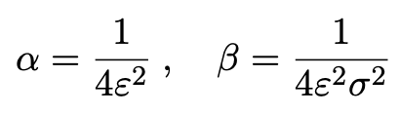


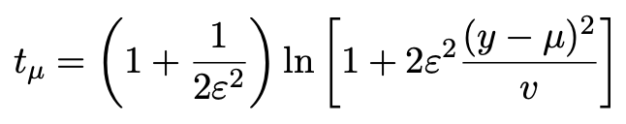
Single-measurement model
As a simplest example consider
y ~ Gauss(μ, σ²),
v ~ Gamma(α, β),
Test values of μ with t_{μ} = −2 ln λ(μ) with

Slide 47
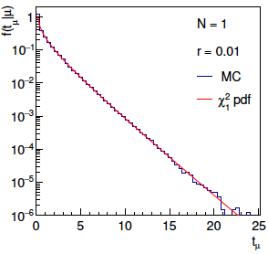
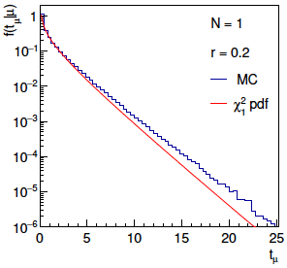
Distribution of t_{μ}
From Wilks’ theorem, in the asymptotic limit we should
find t_{μ} ~ chi-squared(1).
Here “asymptotic limit” means all estimators ~Gauss, which
means ε → 0. For increasing ε, clear deviations visible:

Slide 48
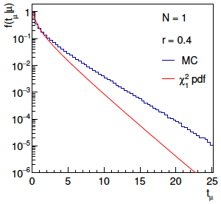
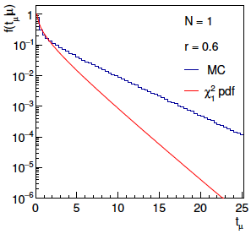
Distribution of t_{μ} (2)
For larger ε, breakdown of asymptotics gets worse:
Values of ε ~ several tenths are relevant so we cannot in general
rely on asymptotics to get confidence intervals, p-values, etc.

Slide 49

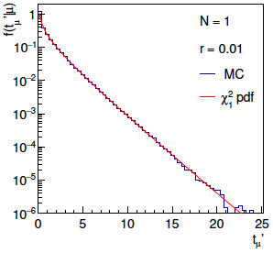
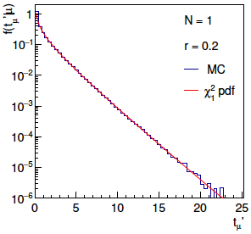
Bartlett corrections
One can modify t_{μ} defining
such that the new statistic’s distribution is better approximated
by chi-squared for n_{d} degrees of freedom (Bartlett, 1937).
For this example E[t_{μ}] ≈ 1 + 3ε² + 2ε⁴ works well:

Slide 50
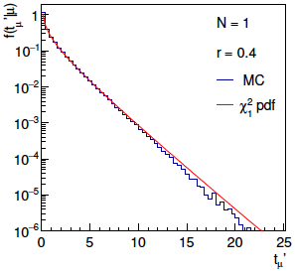
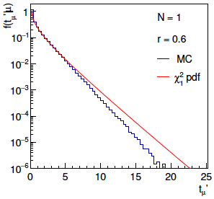
Bartlett corrections (2)
Good agreement for ε ~ several tenths out to √t_{μ}ʹ ~ several, i.e.,
good for significances of several sigma:

Slide 51
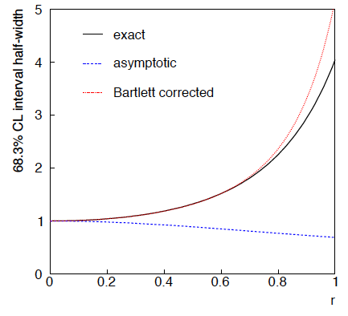
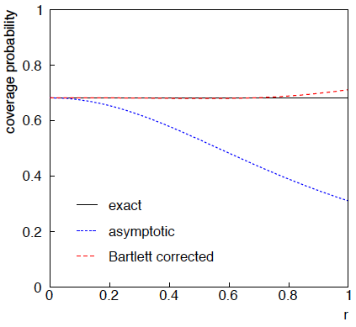
68.3% CL confidence interval for μ

Slide 52


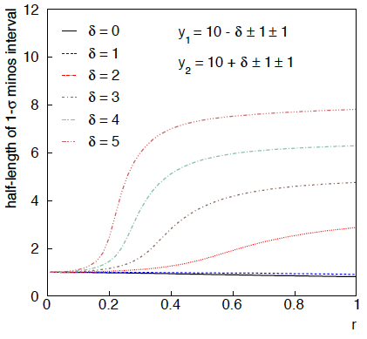
Example: average of two measurements
Approximate (”MINOS”) confidence interval based on
with
Increased discrepancy
between values to be
averaged gives larger
interval.
Interval length saturates
at ~level of absolute
discrepancy between
input values.
relative error
on sys. error

Slide 53

Same with interval from p_{μ} = α with nuisance parameters profiled at μ

Slide 54

Coverage of intervals
Consider previous average of
two numbers but now generate
for i = 1, 2 data values
y_{i} ~ Gauss(μ, σ_{y,i})
u_{i} ~ Gauss(0, σ_{u,i})
v_{i} ~ Gamma(σ_{u,i}, r_{i})
σ_{y,i} = σ_{u,i} = 1
and look at the probability
that the interval covers the
true value of μ.
Coverage stays reasonable
to ε ~ 0.5, even not bad
for Profile Construction
out to ε ~ 1.

Slide 55

Student’s t average software
Software: stave.py https://www.pp.rhul.ac.uk/~cowan/stat/exercises/stave/
The program stave.py implements the Gamma Variance Model (GVM) for averaging N measurements.
For details see G. Cowan, EPJC (2019) 79:133.
In this version the model does not distinguish between statistical and systematic errors.
Confidence interval for the mean μ becomes sensitive to goodness-of-fit (increases if data internally inconsistent).
Estimated mean less sensitive to outliers.

Slide 56
Least Squares vs Gamma Variance Model
Quadratic terms from Least Squares replaced by logarithmic ones:
where
y_{i} = measured value
v_{i} = s_{i}² = estimated variance
ε_{i} = relative uncertainty on estimate of variance
Equivalent to replacing Gauss pdf for measurements by Student’s t, number of degrees of freedom = 1/2ε_{i}²

Slide 57
A quick look at stave.py
Set measured values, estimates of std. dev., errors on errors:
y = np.array([17., 19., 15., 3.]) # measured values
s = np.array([1.5, 1.5, 1.5, 1.5]) # estimates of std. dev
v = s**2 # estimates of variances
r = np.array([0.2, 0.2, 0.2, 0.2]) # relative errors on errors
log-likelihood:
class NegLogL:
def __init__(self, y, s, r):
self.setData(y, s, r)
def setData(self, y, s, r):
self.data = y, s, r
def __call__(self, mu):
y, s, r = self.data
v = s ** 2
lnf = -0.5*(1. + 1./(2.*r**2))*np.log(1. + 2.*(r*(y-mu))**2/v)
return -np.sum(lnf)

Slide 58
Example average with GVM
Suppose four measurements of the parameter μ.
Each reports an estimated standard dev. of s = 1.5 and
a “relative error on the error” ε = 0.2.
Suggested exercise:
Experiment with different numbers of measurements, different levels of internal consistency, different values for the std. dev. and error on error.
outlier

