Slide 1





“Errors on Errors” – Refining Statistical Analyses for Particle Physics
Particle Physics Colloquium
MPI für Physik
Munich, 12 February, 2019
Glen Cowan
Physics Department
Royal Holloway, University of London
g.cowan@rhul.ac.uk
www.pp.rhul.ac.uk/~cowan

Slide 2
Outline
Intro, history, motivation
Using measurements with “known” systematic errors:
Least Squares (BLUE)
Allowing for uncertainties in the systematic errors
Estimates of sys errors ~ Gamma
Single-measurement model
Asymptotics, Bartlett correction
Curve fitting, averages
Confidence intervals, goodness-of-fit, outliers
Discussion and conclusions
Details in: G. Cowan, Statistical Models with Uncertain Error
Parameters, arXiv:1809.05778 [physics.data-an] → EPJC

Slide 3
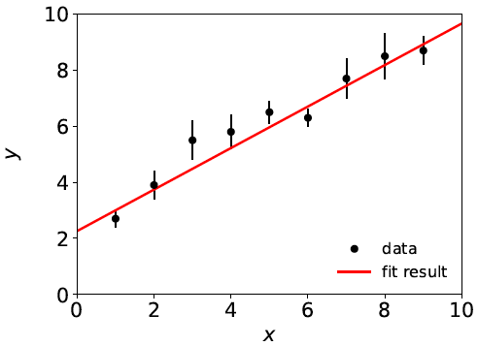

Curve Fitting History: Least Squares
Method of Least Squares by Laplace, Gauss, Legendre, Galton...
C.F. Gauss, Theoria Combinationis Observationum Erroribus Minimis Obnoxiae, Commentationes Societatis Regiae Scientiarium Gottingensis Recectiores Vol. V (MDCCCXXIII).
To fit curve f (x;θ) to data y_{i} ± σ_{i},
adjust parameters θ = (θ₁,..., θ_{M})
to minimize
f (x;θ)
y_{i} ± σ_{i}
Assumes σ_{i} known.

Slide 4


Least Squares ← Maximum Likelihood
Method of Least Squares follows from method of Maximum
Likelihood if the measured y_{i} ~ Gaussian.
Tails of Gaussian fall off very fast; points away from the
curve (“outliers”) have strong influence on parameter estimates.

Slide 5
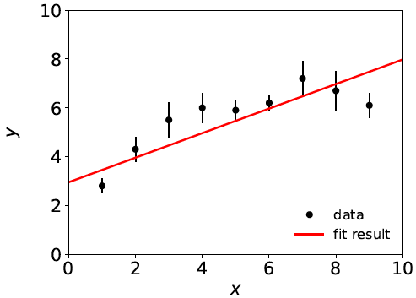
Goodness of fit
If the hypothesized model f (x;θ) is correct, χ²_{min} should
follow a chi-square distribution for N (# meas.) – M (# fitted par.)
degrees of freedom; expectation value = N – M.
Suppose initial guess for model is: f (x;θ) = θ₀ + θ₁ x
χ²_{min} = 20.9,
N – M = 9 – 2 = 7,
so goodness of fit is “poor”.
This is an indication that the
model is inadequate, and thus
the values it predicts will
have a “systematic error”.

Slide 6
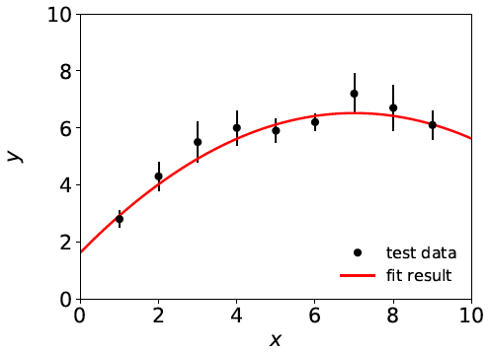
Systematic errors ↔ nuisance parameters
Solution: fix the model, generally by inserting additional
adjustable parameters (“nuisance parameters”). Try, e.g.,
f (x;θ) = θ₀ + θ₁ x + θ₂ x²
χ²_{min} = 3.5, N – M = 6
For some point in the
enlarged parameter space
we hope the model is
now ~correct.
Sys. error gone?
Estimators for all parameters correlated, and as a consequence the presence of the nuisance parameters inflates the statistical errors of the parameter(s) of interest.

Slide 7


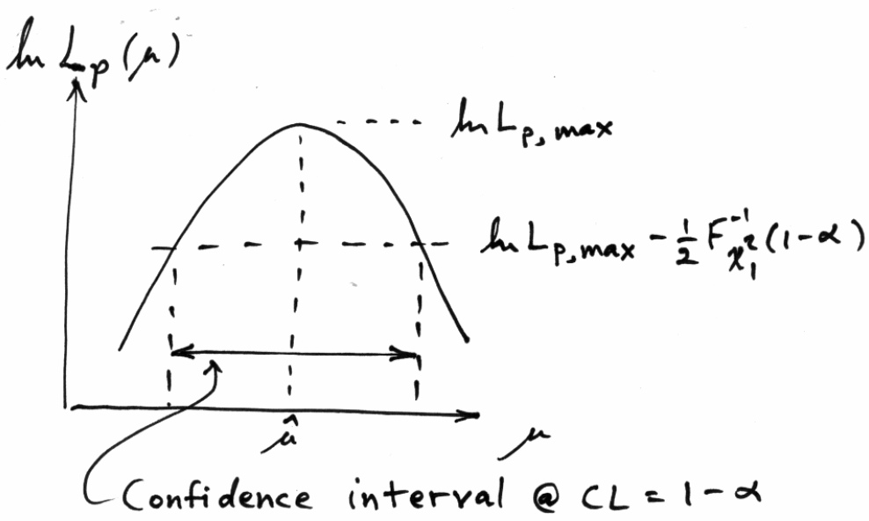

Uncertainty of fitted parameters
Suppose parameter of interest μ, nuisance parameter θ,
confidence interval for μ from “profile likelihood”:
Width of interval in usual LS fit independent of goodness of fit.

Slide 8

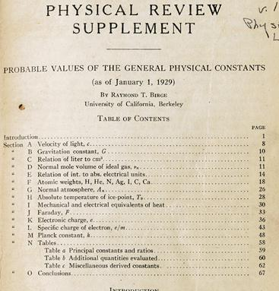
http://bancroft.berkeley.edu/Exhibits/physics/learning01.html
Least Squares for Averaging
_{= fit of horizontal line}
Raymond T. Birge,
Probable Values of the General Physical Constants (as of January 1, 1929), Physical Review Supplement, Vol 1, Number 1, July 1929
Forerunner of the
Particle Data Group

Slide 9
Developments of LS for Averaging
Much work in HEP and elsewhere on application/extension of
least squares to the problem of averaging or meta-analysis, e.g.,
A. C. Aitken, On Least Squares and Linear Combinations of
Observations, Proc. Roy. Soc. Edinburgh 55 (1935) 42.
L. Lyons, D. Gibaut and P. Clifford, How to Combine Correlated
Estimates of a Single Physical Quantity, Nucl. Instr. Meth. A270
(1988) 110.
A. Valassi, Combining Correlated Measurements of Several
Different Physical Quantities, Nucl. Instr. Meth. A500 (2003) 391.
R. Nisius, On the combination of correlated estimates of a physics
observable, Eur. Phys. J. C 74 (2014) 3004.
R. DerSimonian and N. Laird, Meta-analysis in clinical trials,
Controlled Clinical Trials 7 (1986) 177-188.

Slide 10
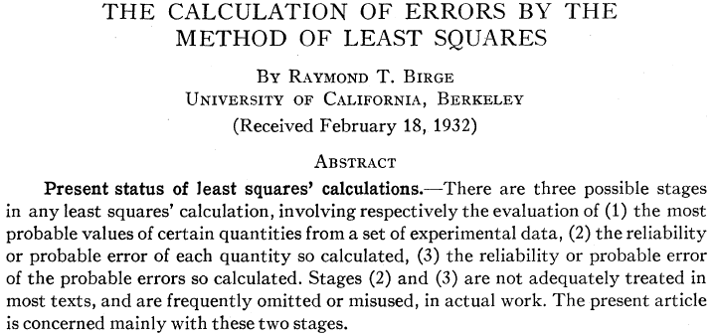
“Errors on Errors”
→ PDG “scale factor method” ≈ scale sys. errors with common
factor until χ²_{min} = appropriate no. of degrees of freedom.

Slide 11
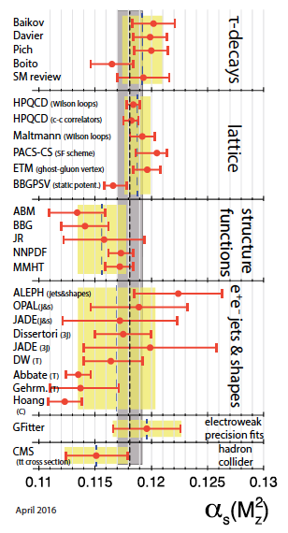
Errors on theory errors, e.g., in QCD
Uncertainties related to theoretical
predictions are notoriously difficult
to quantify, e.g., in QCD may come
from variation of renormalization
scale in some “appropriate range”.
Problematic e.g. for α_{s} →
If, e.g., some (theory) errors are
underestimated, one may obtain poor
goodness of fit, but size of confidence
interval from usual recipe will not
reflect this.
An outlier with an underestimated
error bar can have an inordinately
strong influence on the average.
M. Tanabashi et al. (Particle Data Group),
Phys. Rev. D 98, 030001 (2018)

Slide 12



Formulation of the problem
Suppose measurements y have probability (density) P(y|μ,θ),
μ = parameters of interest
θ = nuisance parameters
To provide info on nuisance parameters, often treat their best
estimates u as indep. Gaussian distributed r.v.s., giving likelihood
or log-likelihood (up to additive const.)

Slide 13
Systematic errors and their uncertainty
Often the θ_{i} could represent a systematic bias and its best estimate u_{i} in the real measurement is zero.
The σ_{u,i} are the corresponding “systematic errors”.
Sometimes σ_{u,i} is well known, e.g., it is itself a statistical error known from sample size of a control measurement.
Other times the u_{i} are from an indirect measurement, Gaussian model approximate and/or the σ_{u,i} are not exactly known.
Or sometimes σ_{u,i} is at best a guess that represents an uncertainty in the underlying model (“theoretical error”).
In any case we can allow that the σ_{u,i} are not known in general with perfect accuracy.

Slide 14



Gamma model for variance estimates
Suppose we want to treat the systematic errors as uncertain,
so let the σ_{u,i} be adjustable nuisance parameters.
Suppose we have estimates s_{i} for σ_{u,i} or equivalently v_{i} = s_{i}², is an estimate of σ_{u,i}².
Model the v_{i} as independent and gamma distributed:
Set α and β so that they give desired relative uncertainty r in σ_{u}.
Similar to method 2 in W.J. Browne and D. Draper, Bayesian Analysis, Volume 1, Number 3 (2006), 473-514.

Slide 15



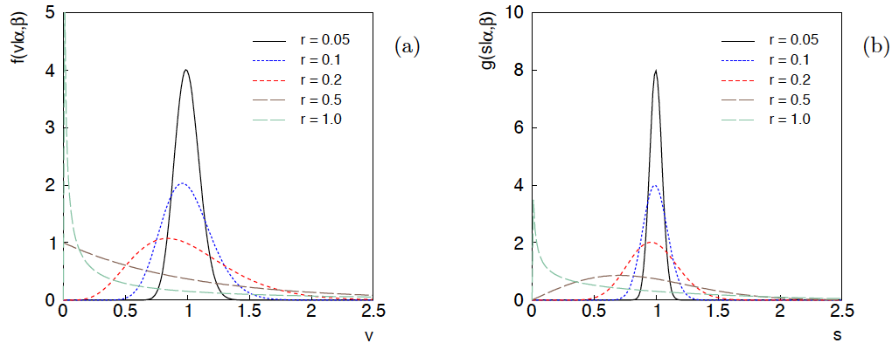
Distributions of v and s = √v
For α, β of gamma distribution,
relative “error on error”

Slide 16

Motivation for gamma model
If one were to have n independent observations u₁,..,u_{n}, with all
u ~ Gauss(θ, σ_{u}²), and we use the sample variance
to estimate σ_{u}², then (n−1)v/σ_{u}² follows a chi-square distribution
for n−1 degrees of freedom, which is a special case of the
gamma distribution (α = n/2, β = 1/2). (In general one doesn’t
have a sample of u_{i} values, but if this were to be how v was
estimated, the gamma model would follow.)
Furthermore choice of the gamma distribution for v allows one
to profile over the nuisance parameters σ_{u}² in closed form and
leads to a simple profile likelihood.

Slide 17
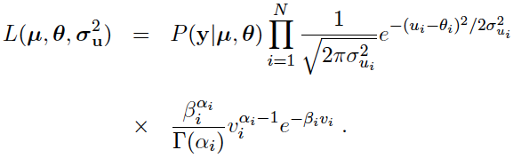
Likelihood for gamma error model
Treated like data: y₁,...,y_{L} (the primary measurements)
u₁,...,u_{N} (estimates of nuisance par.)
v₁,...,v_{N} (estimates of variances
of estimates of NP)
Parameters: μ₁,...,μ_{M} (parameters of interest)
θ₁,...,θ_{N} (nuisance parameters)
σ_{u,1},..., σ_{u,N} (sys. errors = std. dev. of
of NP estimates)

Slide 18

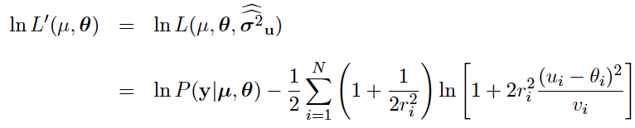
Profiling over systematic errors
We can profile over the σ_{u,i} in closed form
which gives the profile log-likelihood (up to additive const.)
In limit of small r_{i}, v_{i} → σ_{u,i}² and the log terms revert back to the
quadratic form seen with known σ_{u,i}.

Slide 19




Equivalent likelihood from Student’s t
We can arrive at same likelihood by defining
Since u_{i} ~ Gauss and v_{i} ~ Gamma, z_{i} ~ Student’s t
with
Resulting likelihood same as profile Lʹ(μ,θ) from gamma model

Slide 20





Single-measurement model
As a simplest example consider
y ~ Gauss(μ, σ²),
v ~ Gamma(α, β),
Test values of μ with t_{μ} = -2 ln λ(μ) with

Slide 21
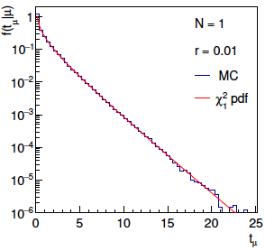
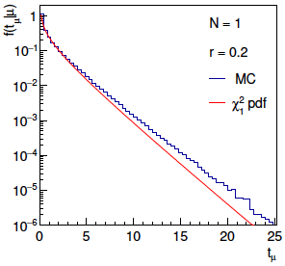
Distribution of t_{μ}
From Wilks’ theorem, in the asymptotic limit we should
find t_{μ} ~ chi-squared(1).
Here “asymptotic limit” means all estimators ~Gauss, which
means r → 0. For increasing r, clear deviations visible:

Slide 22
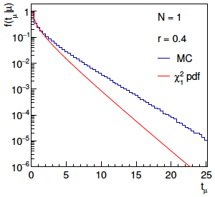
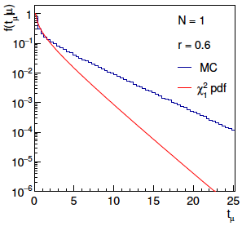
Distribution of t_{μ} (2)
For larger r, breakdown of asymptotics gets worse:
Values of r ~ several tenths are relevant so we cannot in general
rely on asymptotics to get confidence intervals, p-values, etc.

Slide 23

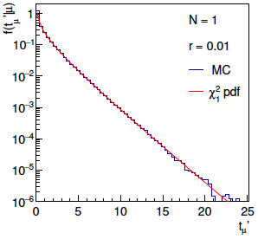
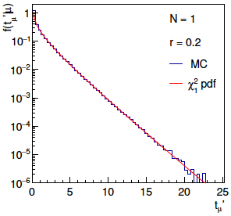
Bartlett corrections
One can modify t_{μ} defining
such that the new statistic’s distribution is better approximated
by chi-squared for n_{d} degrees of freedom (Bartlett, 1937).
For this example E[t_{μ}] ≈ 1 + 3r² + 2r⁴ works well:

Slide 24
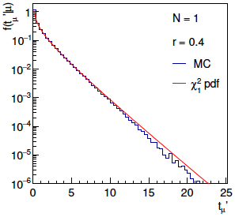
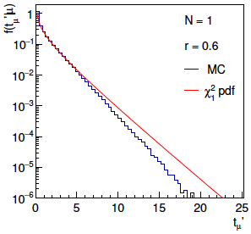
Bartlett corrections (2)
Good agreement for r ~ several tenths out to √t_{μ}ʹ ~ several, i.e.,
good for significances of several sigma:

Slide 25
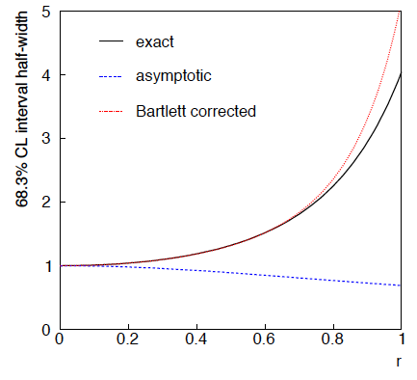
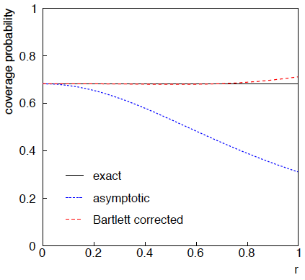
68.3% CL confidence interval for μ

Slide 26
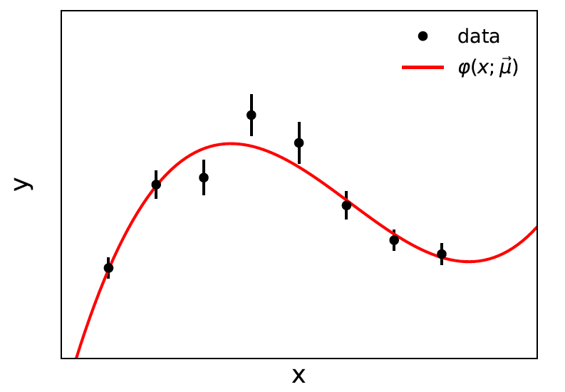


Curve fitting, averages
Suppose independent
y_{i} ~ Gauss, i = 1,...,N, with
μ are the parameters of interest in the fit function φ(x;μ),
θ are bias parameters constrained by control measurements
u_{i} ~ Gauss(θ_{i}, σ_{u,i}), so that if σ_{u,i} are known we have

Slide 27

Profiling over θ_{i} with known σ_{u,i}
Profiling over the bias parameters θ_{i} for known σ_{u,i} gives usual least-squares (BLUE)
Widely used technique for curve fitting in Particle Physics.
Generally in real measurement, u_{i} = 0.
Generalized to case of correlated y_{i} and u_{i} by summing
statistical and systematic covariance matrices.

Slide 28

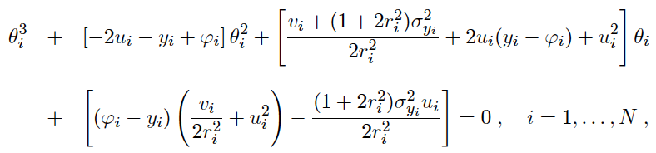
Curve fitting with uncertain σ_{u,i}
Suppose now σ_{u,i}² are adjustable parameters with gamma distributed
estimates v_{i}.
Retaining the θ_{i} but profiling over σ_{u,i}² gives
Profiled values of θ_{i} from solution to cubic equations

Slide 29


Goodness of fit
Can quantify goodness of fit with statistic
where Lʹ (φ,θ) has an adjustable φ_{i} for each y_{i} (the saturated
model).
Asymptotically should have q ~ chi-squared(N−M).
For increasing r_{i}, may need Bartlett correction or MC.

Slide 30
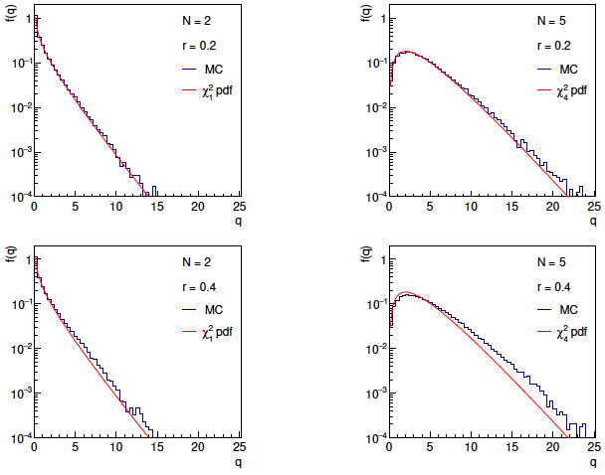
Distributions of q

Slide 31
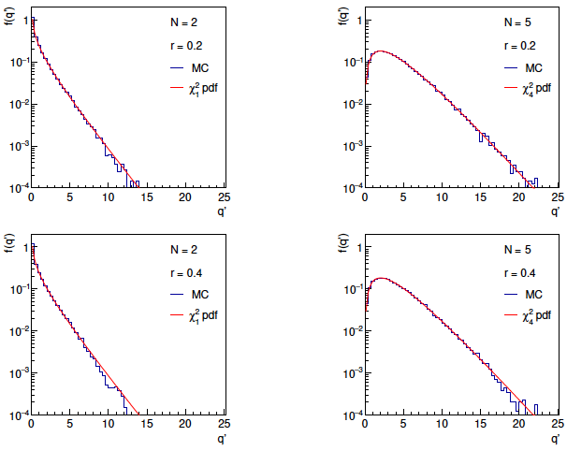
Distributions of Bartlett-corrected qʹ

Slide 32


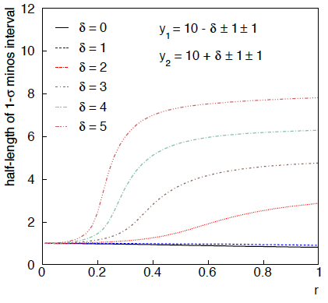
Example: average of two measurements
MINOS interval (= approx. confidence interval) based on
with
Increased discrepancy
between values to be
averaged gives larger
interval.
Interval length saturates
at ~level of absolute
discrepancy between
input values.
relative error
on sys. error

Slide 33
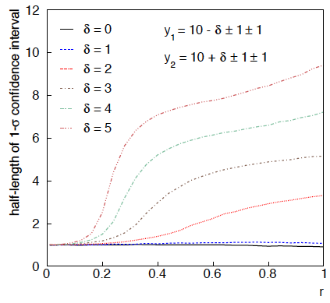
Same with interval from p_{μ} = α with nuisance parameters profiled at μ

Slide 34
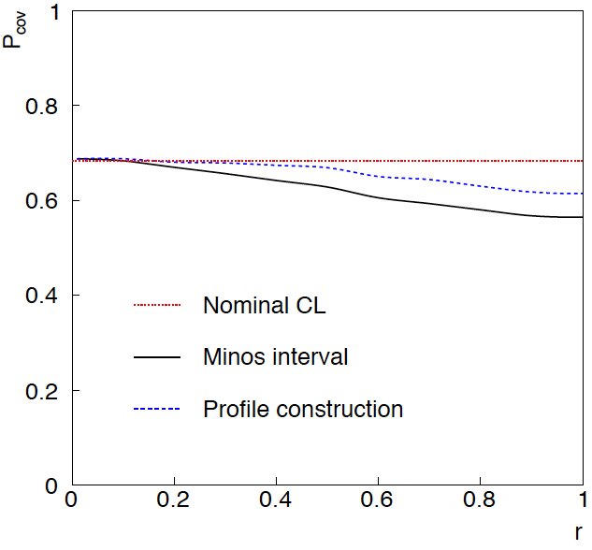
Coverage of intervals
Consider previous average of
two numbers but now generate
for i = 1, 2 data values
y_{i} ~ Gauss(μ, σ_{y,i})
u_{i} ~ Gauss(0, σ_{u,i})
v_{i} ~ Gamma(σ_{u,i}, r_{i})
σ_{y,i} = σ_{u,i} = 1
and look at the probability
that the interval covers the
true value of μ.
Coverage stays reasonable
to r ~ 0.5, even not bad
for Profile Construction
out to r ~ 1.

Slide 35
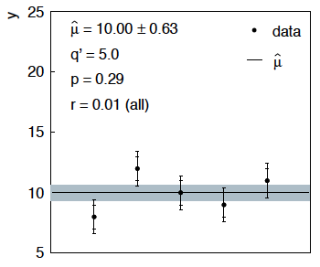
Sensitivity of average to outliers
Suppose we average 5 values, y = 8, 9, 10, 11, 12, all with
stat. and sys. errors of 1.0, and suppose negligible error on error
(here take r = 0.01 for all).

Slide 36
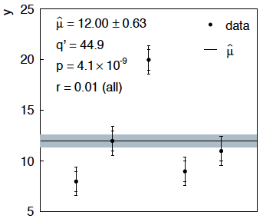
Sensitivity of average to outliers (2)
Now suppose the measurement at 10 was actually at 20:
“outlier”
Estimate pulled up to 12.0, size of confidence interval ~unchanged
(would be exactly unchanged with r → 0).

Slide 37
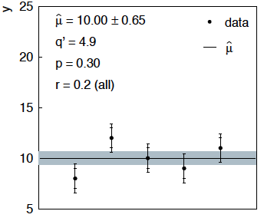
Average with all r = 0.2
If we assign to each measurement r = 0.2,
Estimate still at 10.00, size of interval moves 0.63 → 0.65

Slide 38
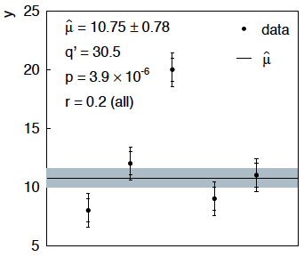
Average with all r = 0.2 with outlier
Same now with the outlier (middle measurement 10 → 20)
Estimate →10.75 (outlier pulls much less).
Half-size of interval → 0.78 (inflated because of bad g.o.f.).

Slide 39



Naive approach to errors on errors
Naively one might think that the error on the error in the previous
example could be taken into account conservatively by inflating
the systematic errors, i.e.,
But this gives
without outlier (middle meas. 10)
with outlier (middle meas. 20)
So the sensitivity to the outlier is not reduced and the size of the
confidence interval is still independent of goodness of fit.

Slide 40

Correlated uncertainties
The phrase “correlated uncertainties” usually means that a single
nuisance parameter affects the distribution (e.g., the mean) of more
than one measurement.
For example, consider measurements y, parameters of interest μ,
nuisance parameters θ with
That is, the θ_{i} are defined here as contributing to a bias and
the (known) factors R_{ij} determine how much θ_{j} affects y_{i}.
As before suppose one has independent control measurements
u_{i}~ Gauss(θ_{i}, σ_{ui}).

Slide 41



Correlated uncertainties (2)
The total bias of y_{i} can be defined as
which can be estimated with
These estimators are correlated having covariance
In this sense the present method treats “correlated uncertainties”,
i.e., the control measurements u_{i} are independent, but nuisance
parameters affect multiple measurements, and thus bias estimates
are correlated.

Slide 42


Discussion / Conclusions
Gamma model for variance estimates gives confidence intervals
that increase in size when the data are internally inconsistent,
and gives decreased sensitivity to outliers (known property of
Student’s t based regression).
Equivalence with Student’s t model, ν = 1/2r² degrees of freedom.
Simple profile likelihood – quadratic terms replaced by logarithmic:

Slide 43
Discussion / Conclusions (2)
Asymptotics can break for increased error-on-error, may need
Bartlett correction or MC.
Method assumes that meaningful r_{i} values can be assigned and is valuable when systematic errors are not well known but enough “expert opinion” is available to do so.
Alternatively one could try to fit a global r to all systematic
errors, analogous to PDG scale factor method or meta-analysis
à la DerSimonian and Laird. (→ future work).
Could also use e.g. as “stress test” – crank up the r_{i} values until significance of result degrades and ask if you really trust the assigned systematic errors at that level.
Decisions on new facilities require one to know how accurately important parameters have and will be measured; it’s important to get this right.

Slide 44
Extra slides

Slide 45



Gamma model for estimates of variance
Suppose the estimated variance v was obtained as the sample
variance from n observations of a Gaussian distributed bias
estimate u.
In this case one can show v is gamma distributed with
We can relate α and β to the relative uncertainty r in the systematic
uncertainty as reflected by the standard deviation of the sampling
distribution of s, σ_{s}

Slide 46




Exact relation between r parameter and relative error on error
r parameter defined as:
v ~ Gamma(α, β) so s = √v follows a Nakagami distribution

Slide 47

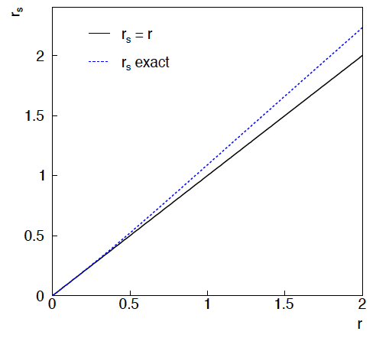


Exact relation between r parameter and relative error on error (2)
The exact relation between the error and the error r_{s} and
the parameter r is therefore
→ r_{s} ≈ r good for r ⪅ 1.

Slide 48





PDG scale factor
Suppose we do not want to take the quoted errors as
known constants. Scale the variances by a factor ϕ,
The likelihood
function becomes
The estimator for μ is the same as before; for ϕ ML gives
which has a bias;
is unbiased.
^
The variance of μ is inflated by ϕ:

Slide 49

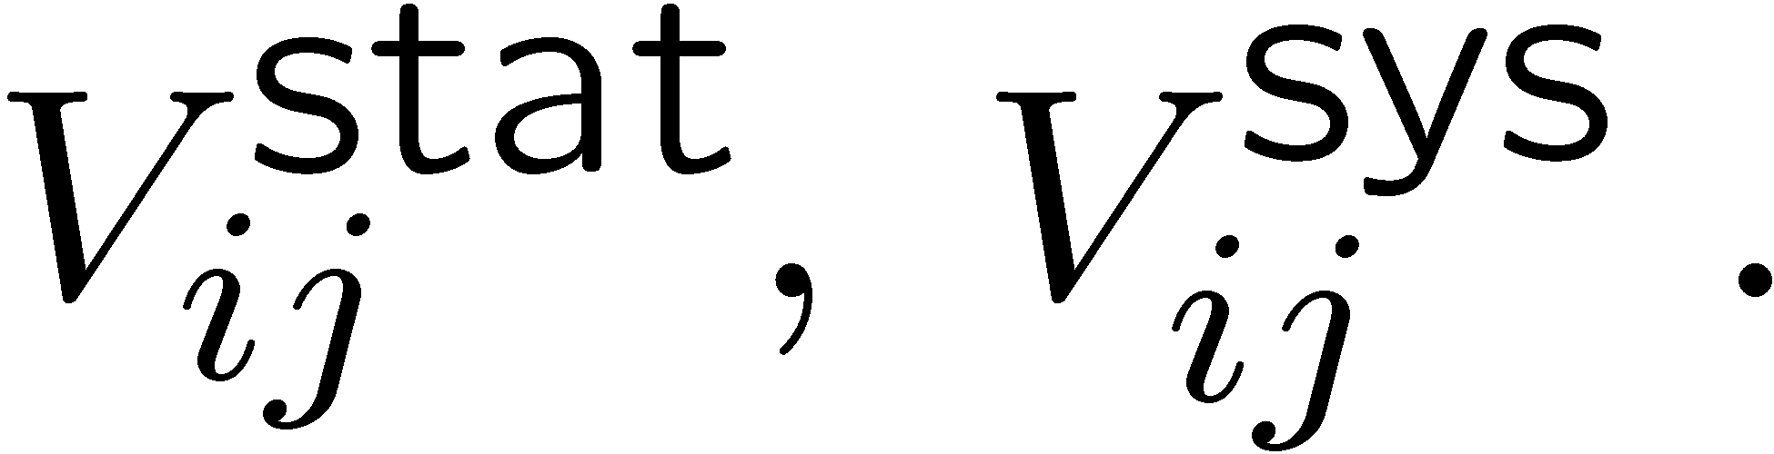
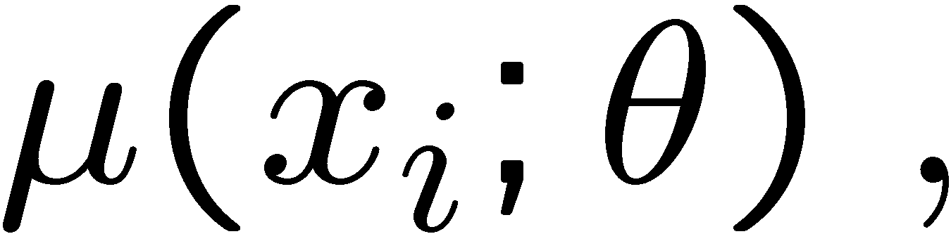
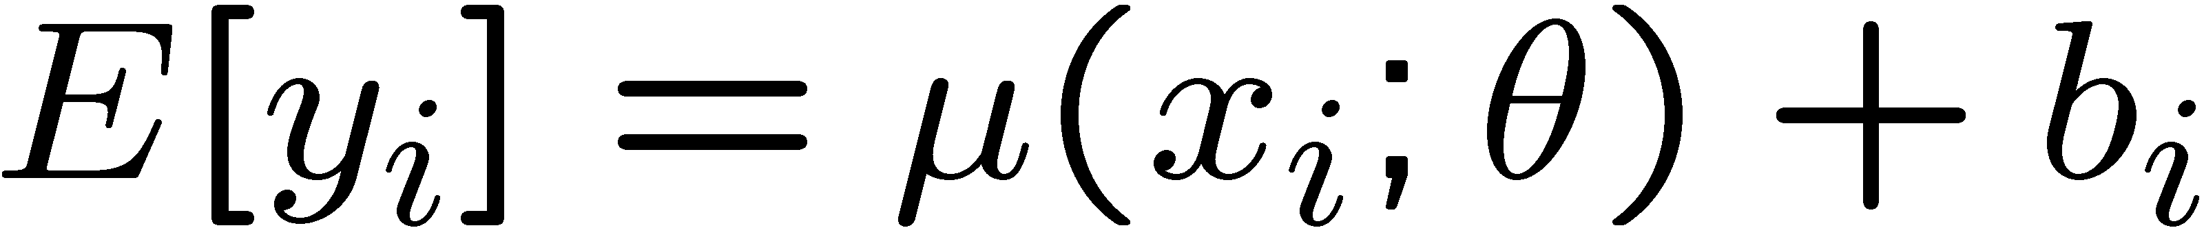
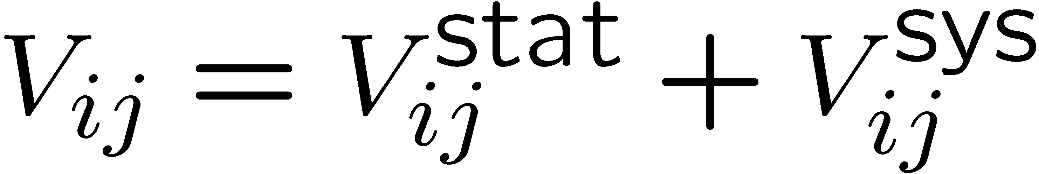
Bayesian approach
Given measurements:
and (usually) covariances:
Predicted value:
expectation value
control variable
parameters
bias
Frequentist approach:
Minimize

Slide 50
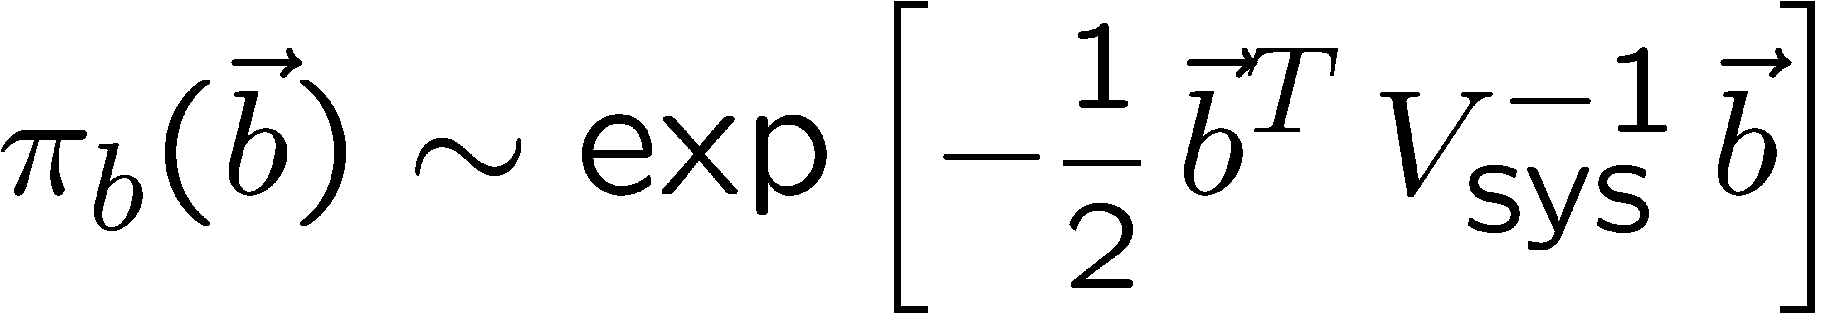
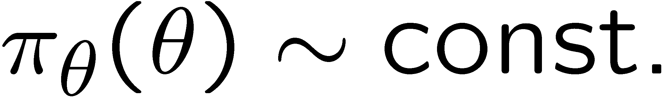
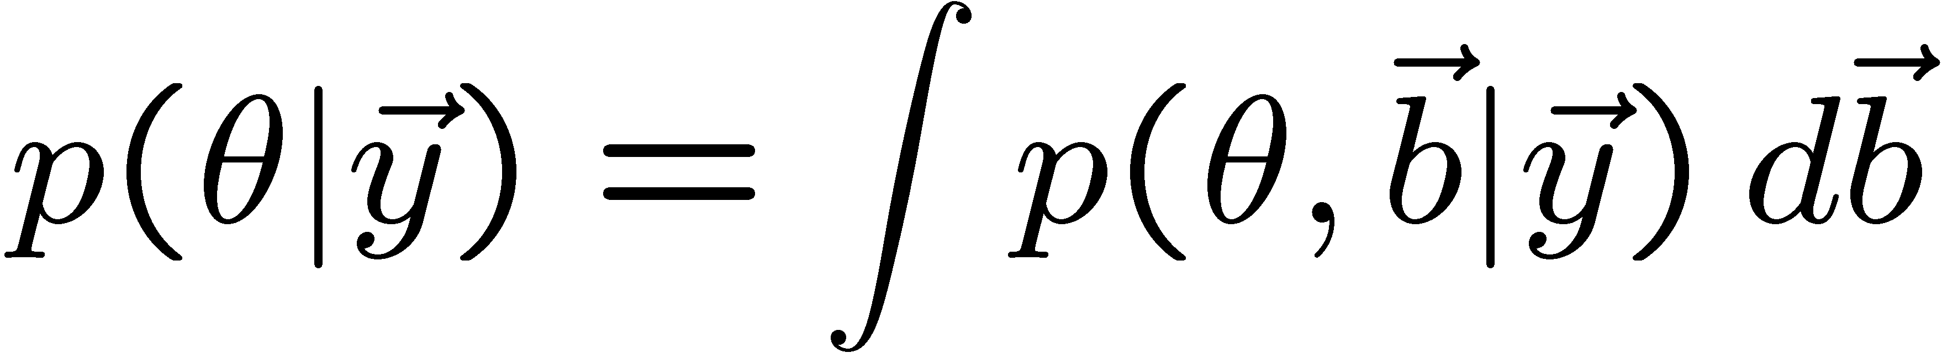
Its Bayesian equivalent
Take
Joint probability
for all parameters
and use Bayes’ theorem:
To get desired probability for θ, integrate (marginalize) over b:
→ Posterior is Gaussian with mode same as least squares estimator,
σ_{θ} same as from χ² = χ²_{min} + 1. (Back where we started!)

Slide 51
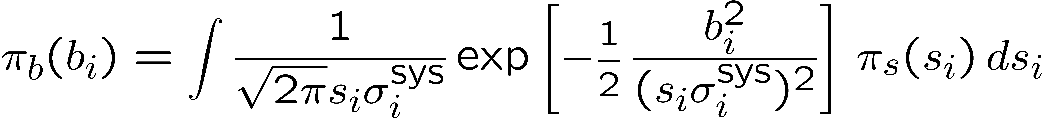
Bayesian approach with non-Gaussian prior π_{b}(b)
Suppose now the experiment is characterized by
where s_{i} is an (unreported) factor by which the systematic error is
over/under-estimated.
Assume correct error for a Gaussian π_{b}(b) would be s_{i}σ_{i}^{sys}, so
Width of σ_{s}(s_{i}) reflects
‘error on the error’.

Slide 52
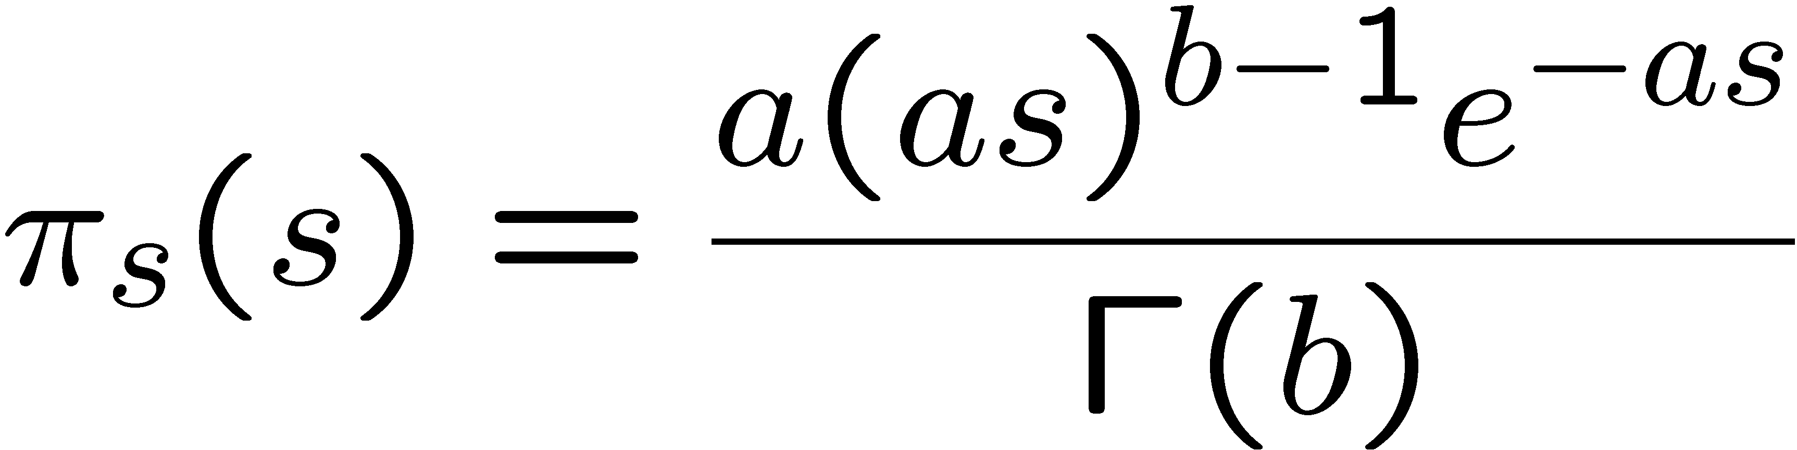
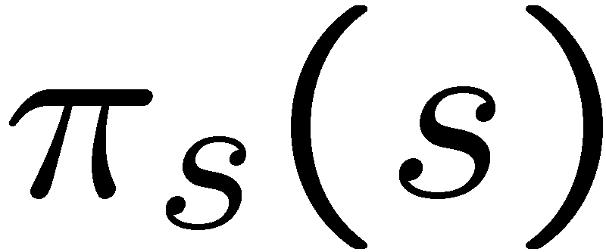
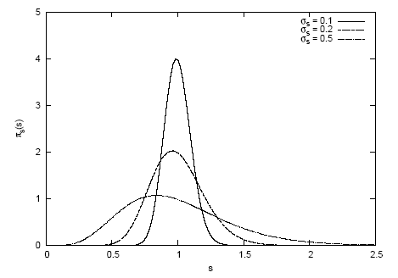
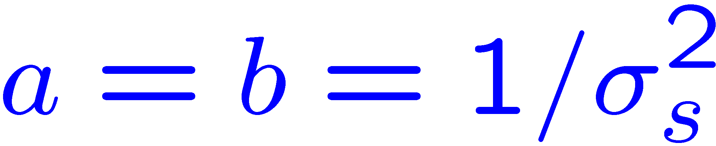
Error-on-error function π_{s}(s)
A simple unimodal probability density for 0 < s < 1 with
adjustable mean and variance is the Gamma distribution:
mean = b/a
variance = b/a²
Want e.g. expectation value
of 1 and adjustable standard
Deviation σ_{s} , i.e.,
s
In fact if we took π_{s} (s) ~ inverse Gamma, we could find π_{b}(b)
in closed form (cf. D’Agostini, Dose, von Linden). But Gamma seems more natural & numerical treatment not too painful.

Slide 53
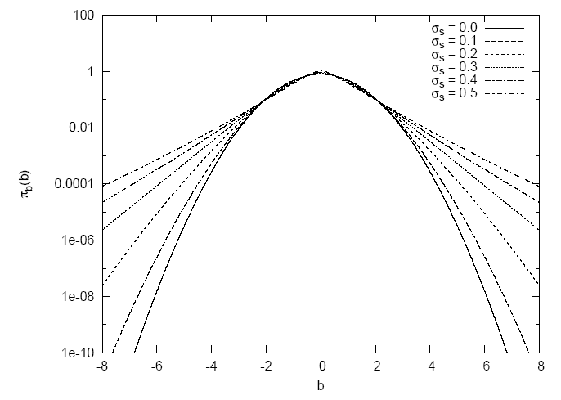
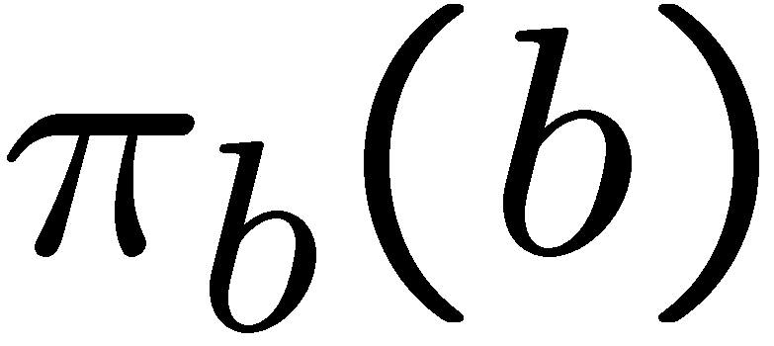
Prior for bias π_{b}(b) now has longer tails
b
Gaussian (σ_{s} = 0) P(|b| > 4σ_{sys}) = 6.3 × 10⁻⁵
σ_{s} = 0.5 P(|b| > 4σ_{sys}) = 0.65%

Slide 54
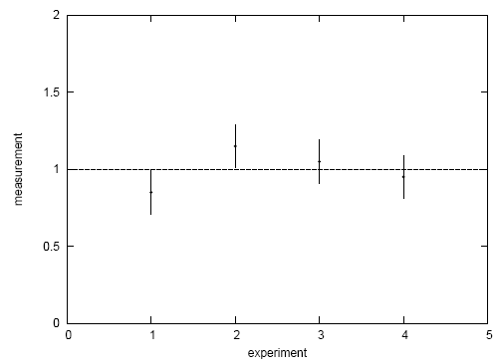
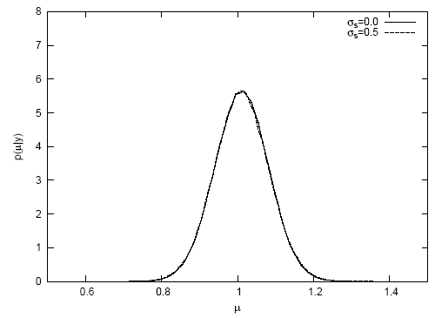
A simple test
Suppose a fit effectively averages four measurements.
Take σ_{sys} = σ_{stat} = 0.1, uncorrelated.
Case #1: data appear compatible
Posterior p(μ|y):
measurement
p(μ|y)
experiment
μ
Usually summarize posterior p(μ|y)
with mode and standard deviation:

Slide 55
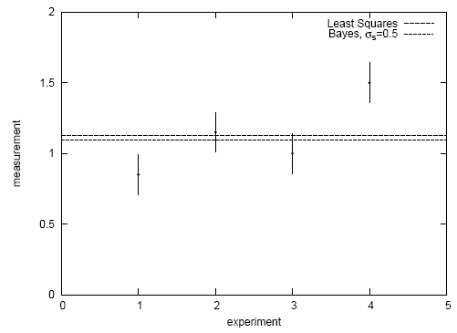
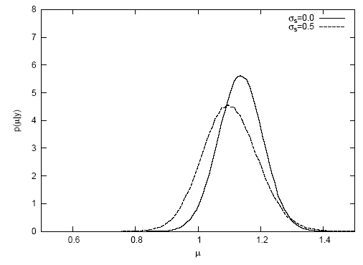


Simple test with inconsistent data
Case #2: there is an outlier
Posterior p(μ|y):
measurement
p(μ|y)
experiment
μ
→ Bayesian fit less sensitive to outlier. See also

Slide 56


Goodness-of-fit vs. size of error
In LS fit, value of minimized χ² does not affect size
of error on fitted parameter.
In Bayesian analysis with non-Gaussian prior for systematics,
a high χ² corresponds to a larger error (and vice versa).
post-
erior
2000 repetitions of
experiment, σ_{s} = 0.5,
here no actual bias.
σ_{μ} from least squares
χ²

