Slide 1
Parameter Estimation
Lecture 2
INFN School of Statistics
Paestum, 12-18 May 2024
https://agenda.infn.it/event/36980/
Glen Cowan
Physics Department
Royal Holloway, University of London
g.cowan@rhul.ac.uk
www.pp.rhul.ac.uk/~cowan

Slide 2
Outline
Lecture 1: Introduction, Maximum Likelihood
Lecture 2: Least squares, Bayesian approach, unfolding
For some slides/links with exercises and code you can see:
https://www.pp.rhul.ac.uk/~cowan/stat/exercises/cowan_stat_exercises.pdf
https://www.pp.rhul.ac.uk/~cowan/stat/exercises/cowan_stat_exercises_full.pdf
Most material here is taken from the University of London course:
https://www.pp.rhul.ac.uk/~cowan/stat_course.html

Slide 3
Parameter Estimation 2-1
Nuisance parameters, systematic uncertainties
From Maximum LIkelihood to Least Squares
Bayesian parameter estimation
Marginalization of posterior pdf
Markov Chain Monte Carlo

Slide 4
Systematic uncertainties and nuisance parameters
P (x|θ)
In general, our model of the data is not perfect:
model:
truth:
x
Can improve model by including
additional adjustable parameters.
Nuisance parameter ↔ systematic uncertainty. Some point in the
parameter space of the enlarged model should be “true”.
Presence of nuisance parameter decreases sensitivity of analysis
to the parameter of interest (e.g., increases variance of estimate).

Slide 5
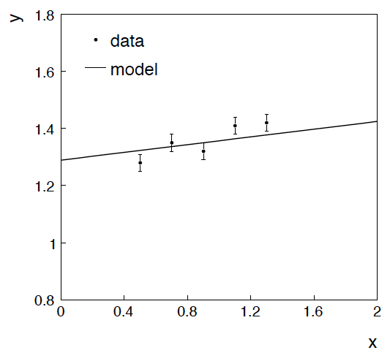
Example: fitting a straight line
Data:
Model: y_{i} independent and all follow y_{i} ~ Gauss(μ(x_{i} ), σ_{i} )
assume x_{i} and σ_{i} known.
Goal: estimate θ₀
Here suppose we don’t care
about θ₁ (example of a
“nuisance parameter”)

Slide 6
Maximum likelihood fit with Gaussian data
In this example, the y_{i} are assumed independent, so the
likelihood function is a product of Gaussians:
Maximizing the likelihood is here equivalent to minimizing
i.e., for Gaussian data, ML same as Method of Least Squares (LS)

Slide 7
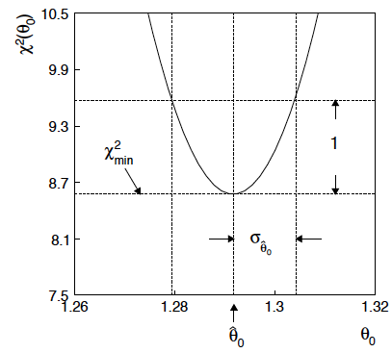
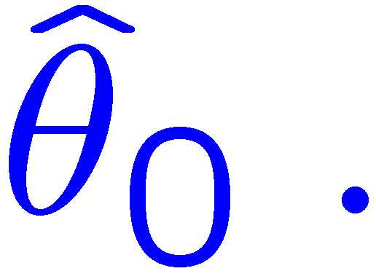
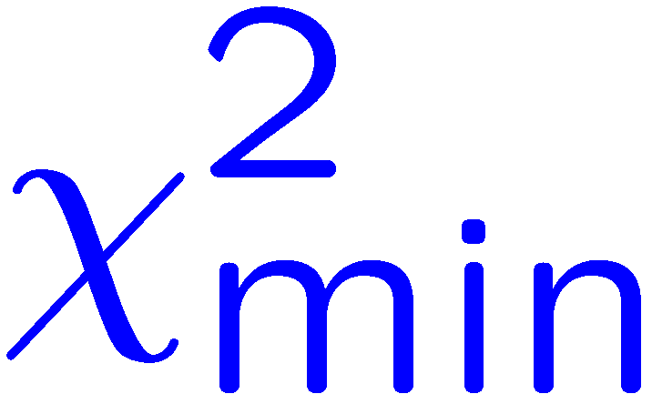
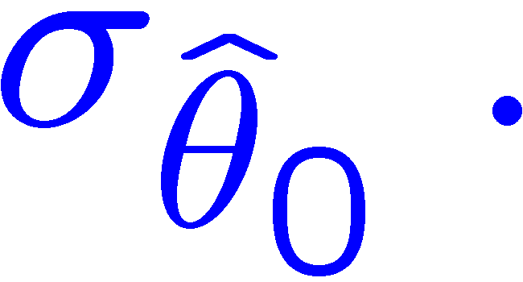
θ₁ known a priori
For Gaussian y_{i}, ML same as LS
Minimize χ² → estimator
Come up one unit from
to find

Slide 8
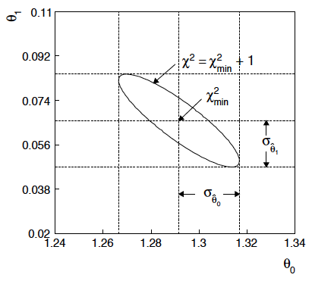
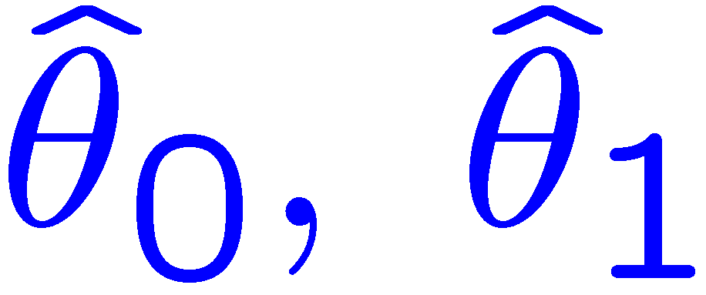
ML (or LS) fit of θ₀ and θ₁
Standard deviations from
tangent lines to contour
Correlation between
causes errors
to increase.

Slide 9
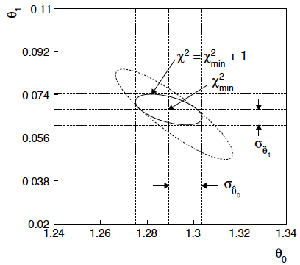
If we have a measurement t₁ ~ Gauss (θ₁, σ_{t1})
The information on θ₁
improves accuracy of

Slide 10
Reminder of Bayesian approach
In Bayesian statistics we can associate a probability with
a hypothesis, e.g., a parameter value θ.
Interpret probability of θ as ‘degree of belief’ (subjective).
Need to start with ‘prior pdf’ π(θ), this reflects degree
of belief about θ before doing the experiment.
Our experiment has data x, → likelihood P(x|θ).
Bayes’ theorem tells how our beliefs should be updated in
light of the data x:
Posterior pdf p(θ|x) contains all our knowledge about θ.

Slide 11
Bayesian approach: y_{i} ~ Gauss(μ(x_{i}; θ₀, θ₁), σ_{i})
We need to associate prior probabilities with θ₀ and θ₁, e.g.,
← suppose knowledge of θ₀ has no influence on knowledge of θ₁
← ‘non-informative’, in any
case much broader than L(θ₀)
prior after t₁,
before y
Ur = “primordial”
prior
Likelihood for control
measurement t₁

Slide 12
Bayesian example: y_{i} ~ Gauss(μ(x_{i}; θ₀, θ₁), σ_{i})
Putting the ingredients into Bayes’ theorem gives:
posterior ∝ likelihood ✕ prior
Note here the likelihood only reflects the measurements y.
The information from the control measurement t₁ has been put into the prior for θ₁.
We would get the same result using the likelihood P(y,t|θ₀,θ₁) and the constant “Ur-prior” for θ₁.

Slide 13
Marginalizing the posterior pdf
We then integrate (marginalize) p(θ₀, θ₁ | y) to find p(θ₀ | y):
In this example we can do the integral (rare). We find
(same as for MLE)
For this example, numbers come out same as in frequentist approach, but interpretation different.

Slide 14
Marginalization with MCMC
Bayesian computations involve integrals like
often high dimensionality and impossible in closed form,
also impossible with ‘normal’ acceptance-rejection Monte Carlo.
Markov Chain Monte Carlo (MCMC) has revolutionized
Bayesian computation.
MCMC (e.g., Metropolis-Hastings algorithm) generates
correlated sequence of random numbers:
cannot use for many applications, e.g., detector MC;
effective stat. error greater than if all values independent .
Basic idea: sample multidimensional θ but look only at distribution of parameters of interest.

Slide 15
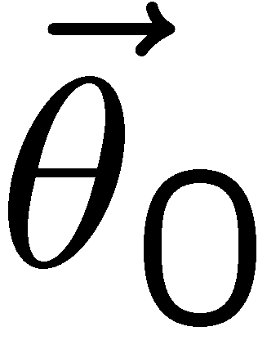
MCMC basics: Metropolis-Hastings algorithm
Goal: given an n-dimensional pdf p(θ), generate a sequence of points θ₁ , θ₂ , θ₃ ,...
Proposal density q(θ; θ₀ )
e.g. Gaussian centred
about θ₀
1) Start at some point
2) Generate
3) Form Hastings test ratio
4) Generate
5) If
move to proposed point
else
old point repeated
6) Iterate

Slide 16
Metropolis-Hastings (continued)
This rule produces a correlated sequence of points (note how
each new point depends on the previous one).
Still works if p(θ) is known only as a proportionality, which is
usually what we have from Bayes’ theorem: p(θ|x) ∝ p(x|θ) π(θ).
The proposal density can be (almost) anything, but choose
so as to minimize autocorrelation. Often take proposal
density symmetric: q(θ; θ₀ ) = q(θ₀; θ )
Test ratio is (Metropolis-Hastings):
I.e. if the proposed step is to a point of higher p(θ), take it;
if not, only take the step with probability p(θ)/p(θ₀).
If proposed step rejected, repeat the current point.

Slide 17
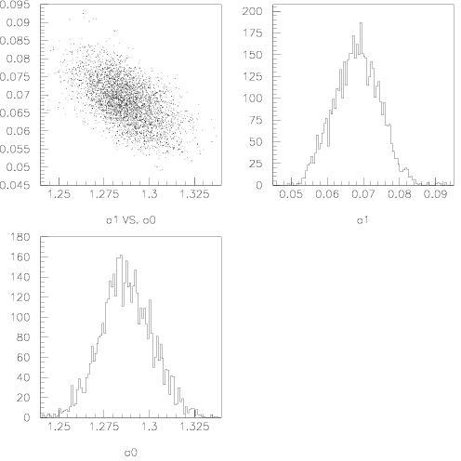
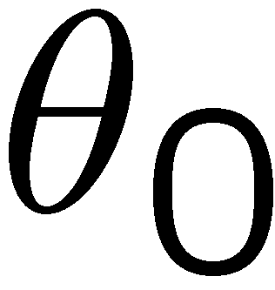
Example: posterior pdf from MCMC
Sample the posterior pdf from previous example with MCMC:
Normalized histogram of θ₀ gives its marginal posterior pdf:

Slide 18
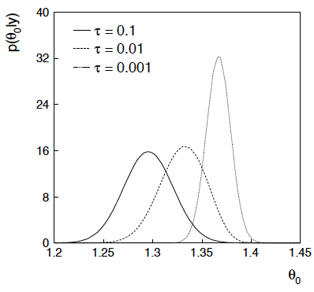
Bayesian method with alternative priors
Suppose we don’t have a previous measurement of θ₁ but rather,
an “expert” says it should be positive and not too much greater than 0.1 or so, i.e., something like
From this we obtain (numerically) the posterior pdf for θ₀:
This summarizes all
knowledge about θ₀.
Look also at result from
variety of priors.

Slide 19
Parameter Estimation 2-2
Unfolding:
Formulation of the problem
Maximum Likelihood for unfolding
Regularized unfolding

Slide 20
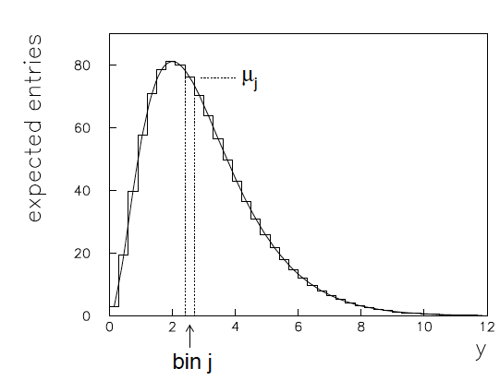
Formulation of the unfolding problem
Consider a random variable y, goal is to determine pdf f(y).
If parameterization f(y;θ) known, find e.g. ML estimators .
If no parameterization available, often construct histogram:
“true” histogram
New goal: construct
estimators for the μ_{j} (or p_{j}).

Slide 21
Migration
Effect of measurement errors: y = true value, x = observed value,
migration of entries between bins,
f(y) is ‘smeared out’, peaks broadened.
discretize: data are
response
matrix
Note μ, ν are constants; n subject to statistical fluctuations.

Slide 22
Efficiency, background
Sometimes an event goes undetected:
efficiency
Sometimes an observed event is due to a background process:
β_{i} = expected number of background events in observed histogram.
For now, assume the β_{i} are known.

Slide 23
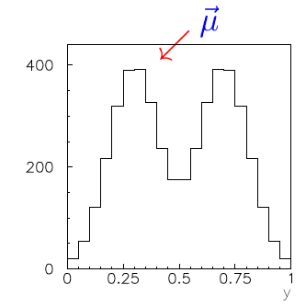
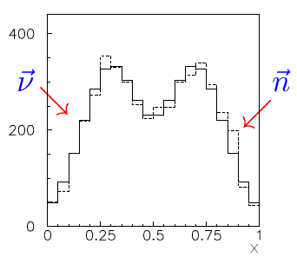
The basic ingredients
“true”
“observed”

Slide 24
Summary of ingredients
‘true’ histogram:
probabilities:
expectation values for observed histogram:
observed histogram:
response matrix:
efficiencies:
expected background:
These are related by:

Slide 25
Maximum likelihood (ML) estimator from inverting the response matrix
Assume
can be inverted:
Suppose data are independent Poisson:
So the log-likelihood is
ML estimator is

Slide 26
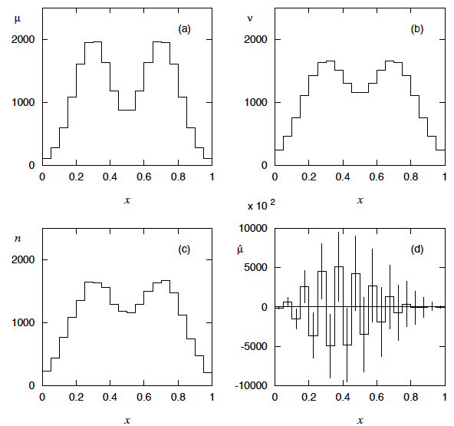
Example with ML solution
Catastrophic
failure???

Slide 27
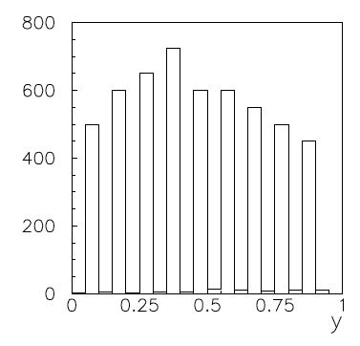
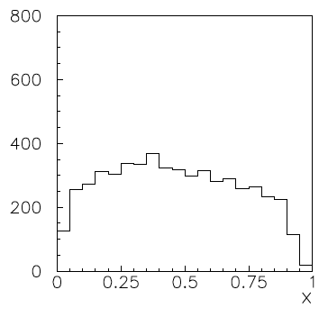
What went wrong?
Suppose μ really had a lot of
fine structure.
Applying R washes this
out, but leaves a residual
structure:
But we don’t have ν, only n. R⁻¹ “thinks” fluctuations in n are
the residual of original fine structure, puts this back into

Slide 28
Maximum likelihood solution revisited
For Poisson data the ML estimators are unbiased:
Their covariance is:
(Recall these statistical errors were huge for the example shown.)

Slide 29
ML solution revisited (2)
The information inequality gives for unbiased estimators the
minimum (co)variance bound:
invert →
This is the same as the actual variance! I.e. ML solution gives
smallest variance among all unbiased estimators, even though
this variance was huge.
In unfolding one must accept some bias in exchange for a
(hopefully large) reduction in variance.

Slide 30
Correction factor method
Often C_{i} ~ O(1) so statistical errors far smaller than for ML.
Nonzero bias unless MC = Nature.

Slide 31
Example from Bob Cousins
Reality check on the statistical errors
Suppose for some bin i we have:
(10% stat.
error)
But according to the estimate, only 10 of the 100 events
found in the bin belong there; the rest spilled in from outside.
How can we have a 10% measurement if it is based on only 10
events that really carry information about the desired parameter?

Slide 32
Discussion of correction factor method
As with all unfolding methods, we get a reduction in statistical
error in exchange for a bias..
The bias should be small if the bin width is substantially larger
than the resolution, so that there is not much bin migration.
So if other uncertainties dominate in an analysis, correction factors
may provide a quick and simple solution (a “first-look”).
For a more careful analysis the other regularized unfolding methods are usually preferred.

Slide 33
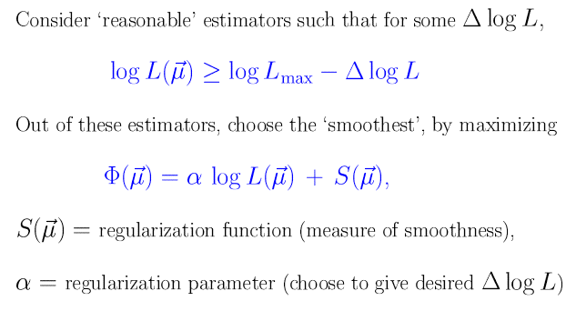
Regularized unfolding

Slide 34
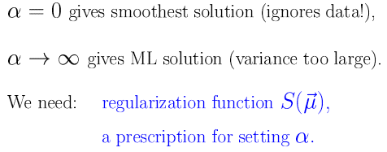
Regularized unfolding (2)

Slide 35
Tikhonov regularization
Solution using Singular Value Decomposition (SVD).

Slide 36
SVD implementation of Tikhonov unfolding
A. Hoecker, V. Kartvelishvili, NIM A372 (1996) 469;
(TSVDUnfold in ROOT).
Minimizes
Numerical implementation using Singular Value Decomposition.
Recommendations for setting regularization parameter τ:
Transform variables so errors ~ Gauss(0,1);
number of transformed values significantly different
from zero gives prescription for τ;
or base choice of τ on unfolding of test distributions.

Slide 37
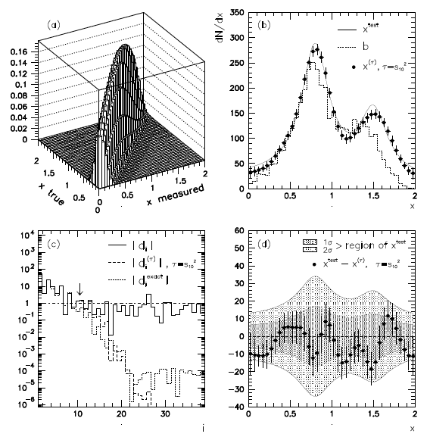
SVD example

Slide 38
Regularization function based on entropy
Can have Bayesian motivation:

Slide 39
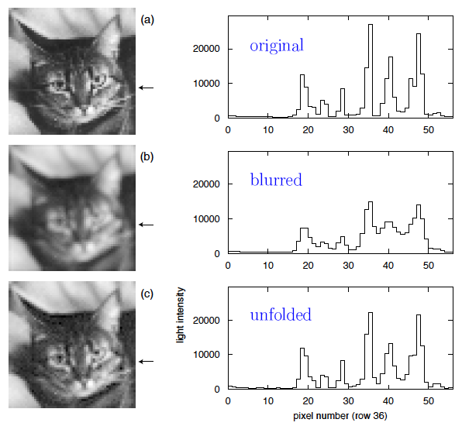
Example of entropy-based unfolding

Slide 40
G. Cowan, Statistical Data Analysis, OUP (1998) Ch. 11
Estimating bias and variance

Slide 41
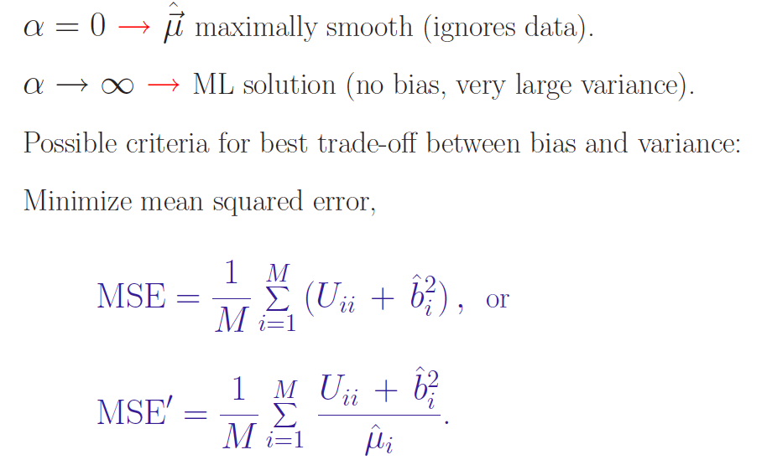
G. Cowan, Statistical Data Analysis, OUP (1998) Ch. 11
Choosing the regularization parameter

Slide 42
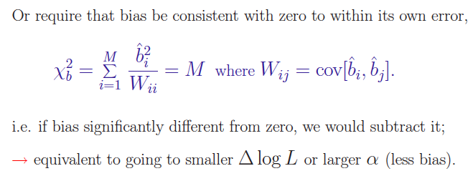
G. Cowan, Statistical Data Analysis, OUP (1998) Ch. 11
Choosing the regularization parameter (2)

Slide 43
Choosing the regularization parameter (3)
Or look at the average coverage probability of the 68.3% confidence intervals for individual bins
In the limit of no regularization, the coverage probability should converge to its nominal value P_{nom} = 0.683.
So choose the regularization parameter that gives a minimum P_{cov} = P_{nom} − ε defined by a tolerance parameter ε.
M. Kuusela and V. M. Panaretos, “Statistical unfolding of elementary particle spectra: Empirical Bayes estimation and bias-corrected uncertainty quantifica- tion,” Ann. Appl. Stat., vol. 9, pp. 1671–1705, 2015.
Pim Jordi Verschuuren, Novel Unfolding Methods and Measurements of tt ̄ Differential Cross Sections with SMEFT interpretation using the ATLAS detector at the LHC (PhD thesis), Royal Holloway, University of London, 2021.

Slide 44
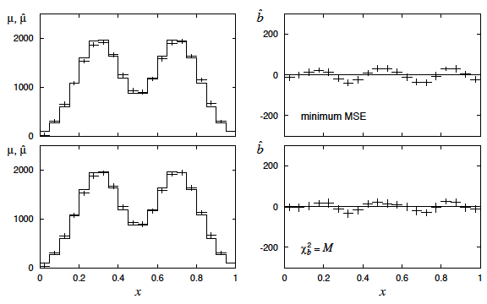
G. Cowan, Statistical Data Analysis, OUP (1998) Ch. 11
Some examples with Tikhonov regularization

Slide 45
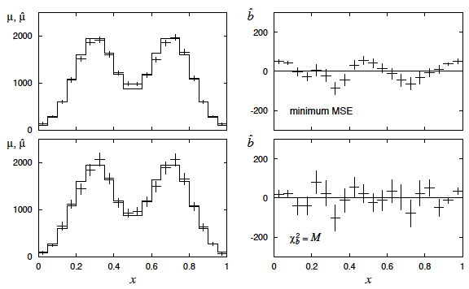
G. Cowan, Statistical Data Analysis, OUP (1998) Ch. 11
Some examples with entropy regularization

Slide 46
Stat. and sys. errors of unfolded solution
In general the statistical covariance matrix of the unfolded
estimators is not diagonal; need to report full
But unfolding necessarily introduces biases as well, corresponding
to a systematic uncertainty (also correlated between bins).
This is more difficult to estimate. Suppose, nevertheless,
we manage to report both U_{stat} and U_{sys}.
To test a new theory depending on parameters θ, use e.g.
Mixes frequentist and Bayesian elements; interpretation of result
can be problematic, especially if U_{sys} itself has large uncertainty.

Slide 47
Folding
Suppose a theory predicts f(y) → μ (may depend on parameters θ).
Given the response matrix R and expected background β, this
predicts the expected numbers of observed events:
From this we can get the likelihood, e.g., for Poisson data,
And using this we can fit parameters and/or test, e.g., using
the likelihood ratio statistic

Slide 48
Versus unfolding
If we have an unfolded spectrum and full statistical and
systematic covariance matrices, to compare this to a model μ
compute likelihood
where
Complications because one needs estimate of systematic bias U_{sys}.
If we find a gain in sensitivity from the test using the unfolded
distribution, e.g., through a decrease in statistical errors, then we
are exploiting information inserted via the regularization (e.g.,
imposed smoothness).

Slide 49
ML solution again
From the standpoint of testing a theory or estimating its parameters,
the ML solution, despite catastrophically large errors, is equivalent
to using the uncorrected data (same information content).
There is no bias (at least from unfolding), so use
The estimators of θ should have close to optimal properties:
zero bias, minimum variance.
The corresponding estimators from any unfolded solution cannot
in general match this.
Crucial point is to use full covariance, not just diagonal errors.

Slide 50
Summary/discussion on unfolding
Unfolding can be a minefield and is not necessary if goal is to
compare measured distribution with a model prediction.
Even comparison of uncorrected distribution with future theories
not a problem, as long as it is reported together with the expected
background and response matrix.
In practice complications because these ingredients have
uncertainties, and they must be reported as well.
Unfolding useful for getting an actual estimate of the distribution
we think we’ve measured; can e.g. compare ATLAS/CMS.
Model test using unfolded distribution should take account of
the (correlated) bias introduced by the unfolding procedure.

Slide 51
Some references on unfolding
Lydia Brenner, et al., Comparison of unfolding methods using RooFitUnfold, International Journal of Modern Physics A, Vol. 35, No. 24, 2050145 (2020); e-print: arXiv:1910.14654.
P.A. Zyla et al., (PDG), Prog. Theor. Exp. Phys. 2020, 083C01 (2020) and 2021 update; (Sec. 40.2.5 on unfolding).
G. Cowan, Statistical Data Analysis (1998) (Ch. 11).
O. Behnke et al., editors, Data analysis in high energy physics, Wiley-VCH, Weinheim, (2013) (Ch. 6 by Volker Blobel).
S. Schmitt, Data Unfolding Methods in High Energy Physics, EPJ Web of Conferences 137, 11008 (2017), e-print arXiv:1611.01927.
G. Cowan, A Survey of Unfolding Methods in Particle Physics, in M. Whalley and L. Lyons (eds.), Advanced Statistical Techniques in Particle Physics (Proceedings) Durham, UK, March 18-22, 2002, Conf. Proc. C 0203181 (2002) 248-257.

Slide 52
Finally...
Estimation of parameters is usually the “easy” part of
statistics:
Frequentist: maximize the likelihood.
Bayesian: find posterior pdf and summarize (e.g. mode).
Standard tools for quantifying precision of estimates:
Variance of estimators, confidence intervals,...
But there are many potential stumbling blocks:
bias versus variance trade-off (how many parameters to fit?);
goodness of fit (usually only for LS or binned data);
choice of prior for Bayesian approach;
unexpected behaviour in LS averages with correlations,
unknown errors (“errors on errors”)

Slide 53
Extra Slides

Slide 54
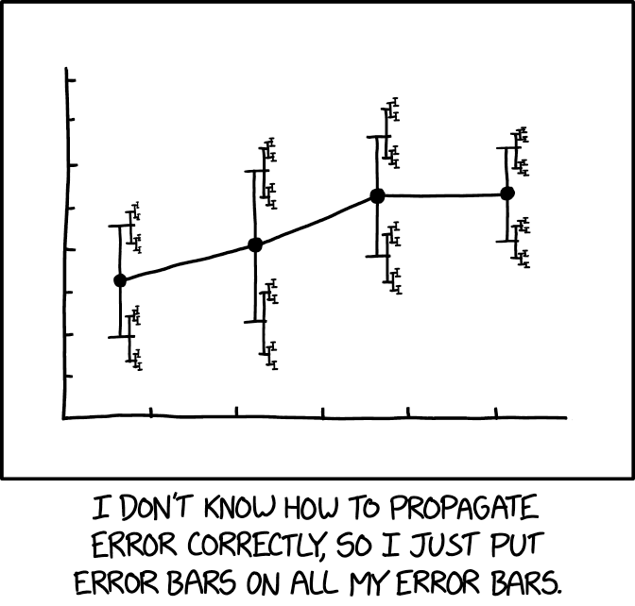
https://xkcd.com/2110/
Randall Munroe, xkcd.com
Errors on Errors
Details in G. Cowan, Eur. Phys. J. C (2019) 79:133, arXiv:1809.05778
Collaborators include:
Enzo Canonero (RHUL), Alessandra Brazzale (U. Padova)

Slide 55
Motivation
Analyses that are limited by systematic uncertainties become
sensitive to the assigned values of systematic errors.
But these error estimates are also uncertain (→ errors on errors)
Could just try inflating the systematic error estimates, but this turns out not to be enough, especially if the analysis uses least squares (equivalent to assuming Gaussian pdfs in likelihood).
Need for “errors on errors” most visible when measurements are not internally consistent within their estimated uncertainties.
Candidate use cases in particle physics:
Combinations of inconsistent measurements
Analyses where systematic error assigned by ad hoc recipe
Any analysis where assigned systematic error is uncertain

Slide 56
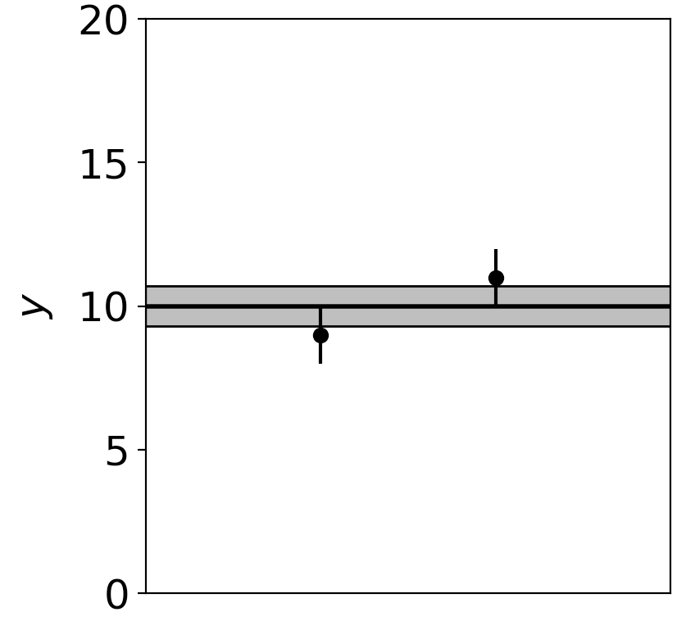
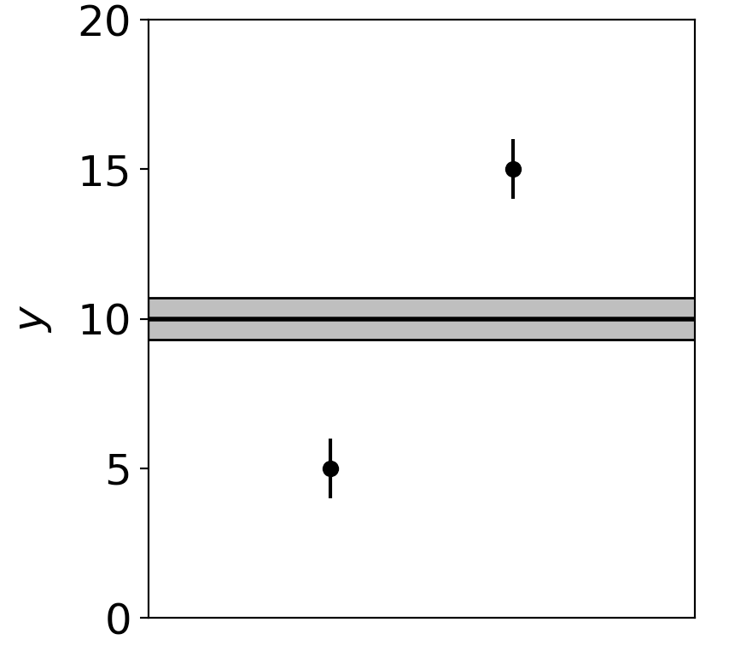
Motivation (2)
Assuming known standard deviations for least squares, uncertainty (e.g. confidence interval) does not reflect goodness of fit:
Least squares average of 9 ± 1 and 11 ± 1 is 10 ± 0.71
Least squares average of 5 ± 1 and 15 ± 1 is 10 ± 0.71
Width of confidence interval for the mean does not reflect the consistency of the values being averaged.

Slide 57
Formulation of the problem
Suppose measurements y have probability (density) P(y|μ,θ),
μ = parameters of interest
θ = nuisance parameters
To provide info on nuisance parameters, often treat their best
estimates u as indep. Gaussian distributed r.v.s., giving likelihood
or log-likelihood (up to additive const.)

Slide 58
Systematic errors and their uncertainty
Sometimes σ_{u,i} is well known, e.g., it is itself a statistical error known from sample size of a control measurement.
Other times the u_{i} are from an indirect measurement, Gaussian model approximate and/or the σ_{u,i} are not exactly known.
Or sometimes σ_{u,i} is at best a guess that represents an uncertainty in the underlying model (“theoretical error”).
In any case we can allow that the σ_{u,i} are not known in general with perfect accuracy.

Slide 59
Gamma model for variance estimates
Suppose we want to treat the systematic errors as uncertain,
so let the σ_{u,i} be adjustable nuisance parameters.
Suppose we have estimates s_{i} for σ_{u,i} or equivalently v_{i} = s_{i}², is an estimate of σ_{u,i}².
Model the v_{i} as independent and gamma distributed:
Set α and β so that they give desired relative uncertainty r in σ_{u}.
Other ”bell-shaped” models tried; qualitatively similar results.
Gamma pdf leads to important mathematical simplifications.

Slide 60
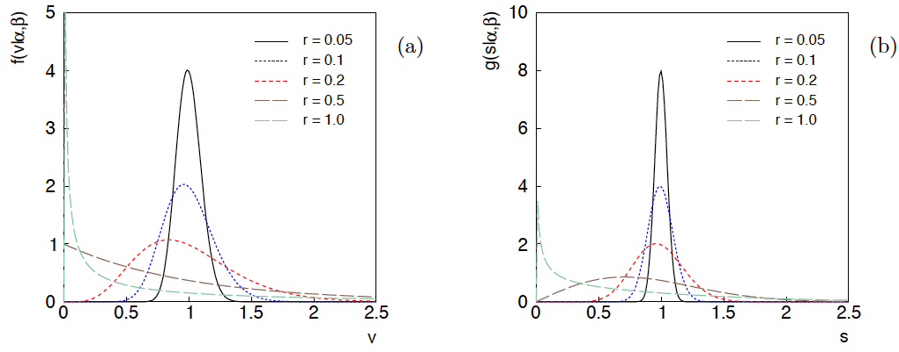
Distributions of v and s = √v
For α, β of gamma distribution,
relative “error on error”

Slide 61
Likelihood for Gamma Variance Model
Treated like data: y₁,...,y_{L} (the primary measurements)
u₁,...,u_{N} (estimates of nuisance par.)
v₁,...,v_{N} (estimates of variances
of estimates of NP)
Adjustable parameters: μ₁,...,μ_{M} (parameters of interest)
θ₁,...,θ_{N} (nuisance parameters)
σ_{u,1},...,σ_{u,N} (sys. errors = std. dev. of
of NP estimates)
Fixed parameters: r₁,...,r_{N} (rel. err. in estimate of σ_{u,i})

Slide 62
Profiling over systematic errors
We can profile over the σ_{u,i} in closed form
which gives the profile log-likelihood (up to additive const.)
In limit of small r_{i} and v_{i} → σ_{u,i}², the log terms revert back to the
quadratic form seen with known σ_{u,i}.

Slide 63
Equivalent likelihood from Student’s t
We can arrive at same likelihood by defining
Since u_{i} ~ Gauss and v_{i} ~ Gamma, z_{i} ~ Student’s t
with
Resulting likelihood same as profile Lʹ(μ,θ) from gamma model

Slide 64
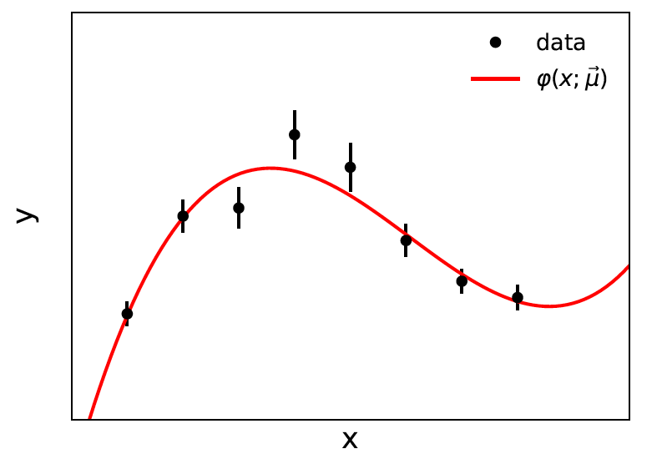
Curve fitting, averages
Suppose independent
y_{i} ~ Gauss, i = 1,...,N, with
μ are the parameters of interest in the fit function φ(x;μ),
θ are bias parameters constrained by control measurements
u_{i} ~ Gauss(θ_{i}, σ_{u,i}), so that if σ_{u,i} are known we have

Slide 65
Profiling over θ_{i} with known σ_{u,i}
Profiling over the bias parameters θ_{i} for known σ_{u,i} gives usual least-squares (BLUE)
Widely used technique for curve fitting in Particle Physics.
Generally in real measurement, u_{i} = 0.
Generalized to case of correlated y_{i} and u_{i} by summing
statistical and systematic covariance matrices.

Slide 66
Curve fitting with uncertain σ_{u,i}
Suppose now σ_{u,i}² are adjustable parameters with gamma distributed estimates v_{i}.
Retaining the θ_{i} but profiling over σ_{u,i}² gives
Profiled values of θ_{i} from solution to cubic equations

Slide 67
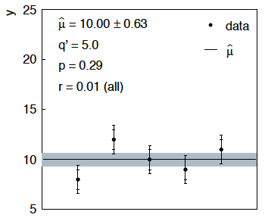
Sensitivity of average to outliers
Suppose we average 5 values, y = 8, 9, 10, 11, 12, all with
stat. and sys. errors of 1.0, and suppose negligible error on error
(here take r = 0.01 for all).

Slide 68
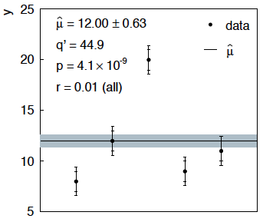
Sensitivity of average to outliers (2)
Now suppose the measurement at 10 was actually at 20:
“outlier”
Estimate pulled up to 12.0, size of confidence interval ~unchanged
(would be exactly unchanged with r → 0).

Slide 69
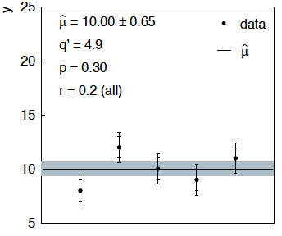
Average with all r = 0.2
If we assign to each measurement r = 0.2,
Estimate still at 10.00, size of interval moves 0.63 → 0.65

Slide 70
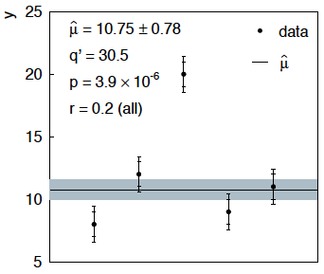
Average with all r = 0.2 with outlier
Same now with the outlier (middle measurement 10 → 20)
Estimate →10.75 (outlier pulls much less).
Half-size of interval → 0.78 (inflated because of bad g.o.f.).

Slide 71
Naive approach to errors on errors
Naively one might think that the error on the error in the previous
example could be taken into account conservatively by inflating
the systematic errors, i.e.,
But this gives
without outlier (middle meas. 10)
with outlier (middle meas. 20)
So the sensitivity to the outlier is not reduced and the size of the
confidence interval is still independent of goodness of fit.

Slide 72
Conclusions on errors on errors
Gamma model for variance estimates gives confidence intervals
that increase in size when the data are internally inconsistent,
and gives decreased sensitivity to outliers.
Method assumes that meaningful r_{i} values can be assigned and is valuable when systematic errors are not well known but enough “expert opinion” is available to do so.
Equivalence with Student’s t model, ν = 1/2r² degrees of freedom.
Simple profile likelihood – quadratic terms replaced by logs:

