Slide 1


Confidence Interval Basics
INFN School of Statistics
Paestum, 12-18 May 2024
https://agenda.infn.it/event/36980/
Glen Cowan
Physics Department
Royal Holloway, University of London
g.cowan@rhul.ac.uk
www.pp.rhul.ac.uk/~cowan

Slide 2
Confidence Interval Basics
Interval estimation
Confidence interval from inverting a test
Example: limits on mean of Gaussian
Confidence intervals from the likelihood function
Confidence intervals in problems with nuisance parameters
Extra slides: CL_{s}

Slide 3
Confidence intervals by inverting a test
In addition to a ‘point estimate’ of a parameter we should report
an interval reflecting its statistical uncertainty.
Confidence intervals for a parameter θ can be found by
defining a test of the hypothesized value θ (do this for all θ):
Specify region of data ‘disfavoured’ by θ (critical region w_{θ}),
i.e., more favoured by some relevant alternative value of θ,
P(data in critical region|θ) ≤ α for prespecified α, e.g., 0.05.
If data observed in the critical region, reject the value θ.
Now invert the test to define a confidence interval as:
set of θ values that are not rejected in a test of size α
(confidence level CL is 1− α).

Slide 4
Confidence interval from p-values
Equivalently, define a p-value for all hypothesized values of θ.
p_{θ} = P(data having incompatibility with θ ≥ observed | θ )
Critical region of size α = data values for which p-value ≤ α.
Then the confidence region at confidence level CL = 1− α is
the set of θ values for which p_{θ} > α.
E.g. an upper limit on θ is the greatest value for which p_{θ} > α.
In practice find by setting p_{θ} = α and solve for θ.
Same idea for multidimensional parameter space θ = (θ₁,... θ_{M}), result is confidence “region” with boundary determined by p_{θ} = α.

Slide 5
Coverage probability of confidence interval
If the true value of θ is rejected, then it’s not in the confidence interval. The probability for this is by construction (equality for continuous data):
P(reject θ|θ) ≤ α = type-I error rate
Therefore, the probability for the interval to contain or “cover” θ is
P(conf. interval “covers” θ|θ) ≥ 1 – α
This assumes that the set of θ values considered includes the true value, i.e., it assumes the composite hypothesis P(x|H,θ).

Slide 6


Example: upper limit on mean of Gaussian
When we test the parameter, we should take the critical region to maximize the power with respect to the relevant alternative(s).
Example: x ~ Gauss(μ, σ) (take σ known)
Test H₀ : μ = μ₀ versus the alternative H₁ : μ < μ₀
→ Put w_{μ} at region of x-space
characteristic of low μ (i.e. at low x)
Equivalently, take the p-value to be

Slide 7
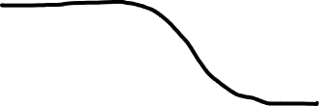
Upper limit on Gaussian mean (2)
To find confidence interval, repeat for all μ₀, i.e., set p_{μ0} = α and solve for μ₀ to find the interval’s boundary
This is an upper limit on μ, i.e., higher μ have even lower p-value and are in even worse agreement with the data.
Usually use Φ⁻¹(α) = −Φ⁻¹(1−α) so as to express the upper limit as x_{obs} plus a positive quantity. E.g. for α = 0.05, Φ⁻¹(1−0.05) = 1.64.

Slide 8

Upper limit on Gaussian mean (3)
μ_{up} = the hypothetical value of μ such that there is only a probability α to find x ≤ x_{obs}.

Slide 9

1- vs. 2-sided intervals
Now test: H₀ : μ = μ₀ versus the alternative H₁ : μ ≠ μ₀
I.e. we consider the alternative to μ₀ to include higher and lower values, so take critical region on both sides:
Result is a “central” confidence interval [μ_{lo}, μ_{up}]:
E.g. for
Note upper edge of two-sided interval is higher (i.e. not as tight
of a limit) than obtained from the one-sided test.

Slide 10




Approximate confidence intervals/regions
from the likelihood function
Suppose we test parameter value(s) θ = (θ₁, ..., θ_{N}) using the ratio
Lower λ(θ) means worse agreement between data and hypothesized θ. Equivalently, usually define
so higher t_{θ} means worse agreement between θ and the data.
p-value of θ therefore
need pdf

Slide 11




Confidence region from Wilks’ theorem
Wilks’ theorem says (in large-sample limit and provided
certain conditions hold...)
chi-square dist. with # d.o.f. =
# of components in θ = (θ₁, ..., θ_{N}).
Assuming this holds, the p-value is
← set equal to α
To find boundary of confidence region set p_{θ} = α and solve for t_{θ}:
Recall also

Slide 12




Confidence region from Wilks’ theorem (cont.)
i.e., boundary of confidence region in θ space is where
For example, for 1 – α = 68.3% and n = 1 parameter,
and so the 68.3% confidence level interval is determined by
Same as recipe for finding the estimator’s standard deviation, i.e.,
is a 68.3% CL confidence interval.

Slide 13
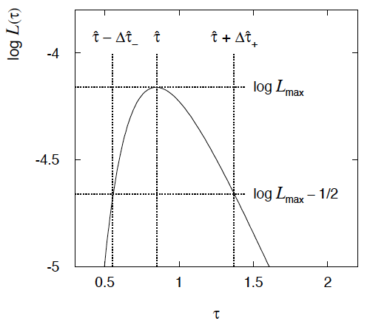

Example of interval from ln L(θ)
For N =1 parameter, CL = 0.683, Q_{α} = 1.
Our exponential
example, now with
only n = 5 events.
Can report ML estimate
with approx. confidence
interval from ln L_{max} – 1/2
as “asymmetric error bar”:

Slide 14

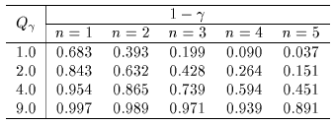

Multiparameter case
For increasing number of parameters, CL = 1 – α decreases for
confidence region determined by a given
← # of par.

Slide 15
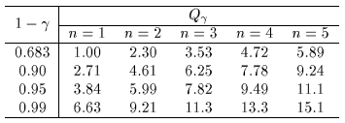
Multiparameter case (cont.)
Equivalently, Q_{α} increases with n for a given CL = 1 – α.
← # of par.

Slide 16
Profile Likelihood
Suppose we have a likelihood L(μ,θ) = P(x|μ,θ) with N parameters of interest μ = (μ₁,..., μ_{N}) and M nuisance parameters θ = (θ₁,..., θ_{M}). The “profiled” (or “constrained”) values of θ are:
and the profile likelihood is:
The profile likelihood depends only on the parameters of interest; the nuisance parameters are replaced by their profiled values.
The profile likelihood can be used to obtain confidence intervals/regions for the parameters of interest in the same way as one would for all of the parameters from the full likelihood.

Slide 17
Profile Likelihood Ratio – Wilks theorem
Goal is to test/reject regions of μ space (param. of interest).
Rejecting a point μ should mean p_{μ} ≤ α for all possible values of the nuisance parameters θ.
Test μ using the “profile likelihood ratio”:
Let t_{μ} = −2 ln λ(μ). Wilks’ theorem says in large-sample limit:
where the number of degrees of freedom is the number of
parameters of interest (components of μ). So p-value for μ is

Slide 18
Profile Likelihood Ratio – Wilks theorem (2)
If we have a large enough data sample to justify use of the
asymptotic chi-square pdf, then if μ is rejected, it is rejected for any values of the nuisance parameters.
The recipe to get confidence regions/intervals for the parameters of interest at CL = 1 – α is thus the same as before, simply use the profile likelihood:
where the number of degrees of freedom N for the chi-square quantile is equal to the number of parameters of interest.
If the large-sample limit is not justified, then use e.g. Monte Carlo to get distribution of t_{μ}.

Slide 19
Extra Slides

Slide 20
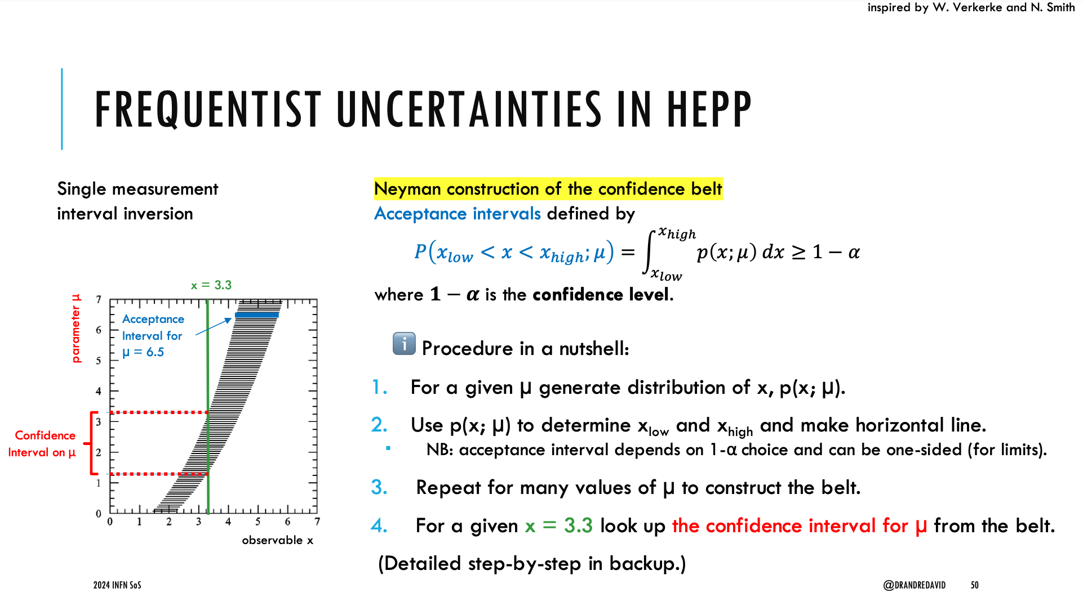
Confidence belt of Neyman construction is a graphical representation of the acceptance region (complement of critical region) of the test of the parameter.
André David

Slide 21
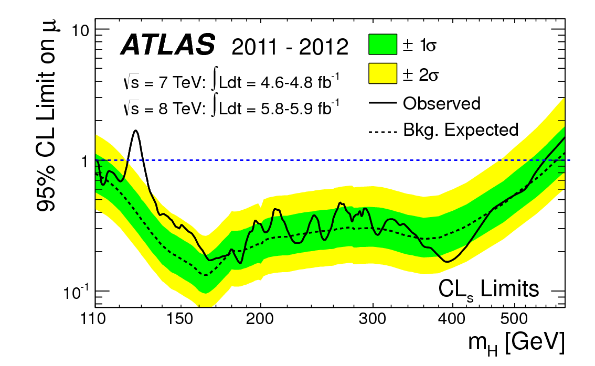
How to read the green and yellow limit plots
For every value of m_{H}, find the upper limit on μ.
Also for each m_{H}, determine the distribution of upper limits μ_{up} one would obtain under the hypothesis of μ = 0.
The dashed curve is the median μ_{up}, and the green (yellow) bands give the ± 1σ (2σ) regions of this distribution.
ATLAS, Phys. Lett. B 716 (2012) 1-29

Slide 22
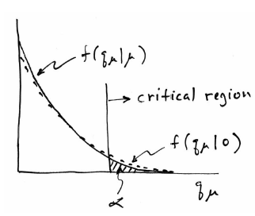
Low sensitivity to μ
It can be that the effect of a given hypothesized μ is very small
relative to the background-only (μ = 0) prediction.
This means that the distributions f (q_{μ}|μ) and f (q_{μ}|0) will be
almost the same:

Slide 23
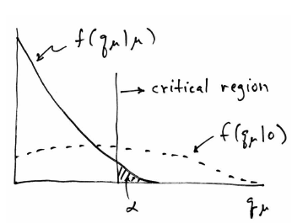
Having sufficient sensitivity
In contrast, having sensitivity to μ means that the distributions
f (q_{μ}|μ) and f (q_{μ}|0) are more separated:
That is, the power (probability to reject μ if μ = 0) is substantially
higher than α. Use this power as a measure of the sensitivity.

Slide 24
Spurious exclusion
Consider again the case of low sensitivity. By construction the probability to reject μ if μ is true is α (e.g., 5%).
And the probability to reject μ if μ = 0 (the power) is only slightly greater than α.
This means that with probability of around α = 5% (slightly higher), one excludes hypotheses to which one has essentially no sensitivity (e.g., m_{H} = 1000 TeV).
“Spurious exclusion”

Slide 25
Ways of addressing spurious exclusion
The problem of excluding parameter values to which one has
no sensitivity known for a long time; see e.g.,
In the 1990s this was re-examined for the LEP Higgs search by
Alex Read and others
and led to the “CL_{s}” procedure for upper limits.
Unified intervals also effectively reduce spurious exclusion by
the particular choice of critical region.

Slide 26
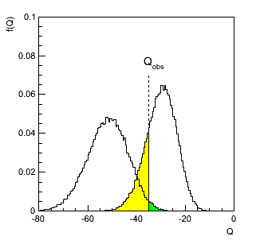
The CL_{s} procedure
In the usual formulation of CL_{s}, one tests both the μ = 0 (b) and
μ > 0 (μs+b) hypotheses with the same statistic Q = −2ln L_{s+b}/L_{b}:
f (Q|b)
f (Q|s+b)
p_{s+b}
p_{b}

Slide 27
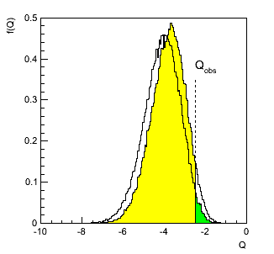
The CL_{s} procedure (2)
As before, “low sensitivity” means the distributions of Q under
b and s+b are very close:
f (Q|b)
f (Q|s+b)
p_{b}
p_{s+b}

Slide 28
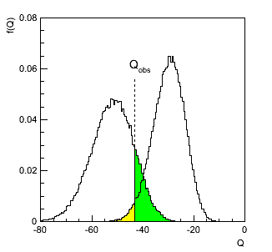



The CL_{s} procedure (3)
The CL_{s} solution (A. Read et al.) is to base the test not on
the usual p-value (CL_{s+b}), but rather to divide this by CL_{b}
(~ one minus the p-value of the b-only hypothesis), i.e.,
Define:
f (Q|s+b)
f (Q|b)
1−CL_{b}
= p_{b}
CL_{s+b}
= p_{s+b}
Reject s+b
hypothesis if:
Increases “effective” p-value when the two
distributions become close (prevents
exclusion if sensitivity is low).

