Slide 1
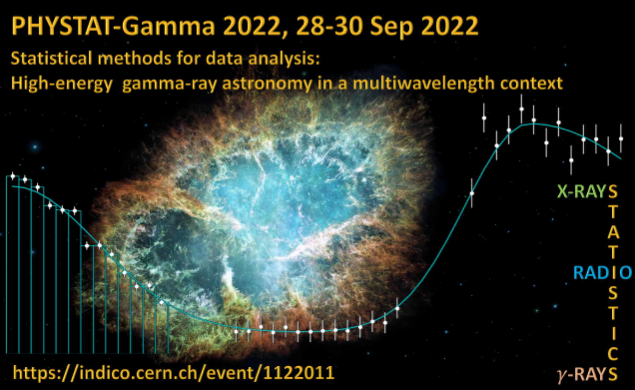

Statistics 101 – a very fast introduction
Lecture 2
PHYSTAT-Gamma
(online)
26-30 September 2022
https://indico.cern.ch/event/1122011/
Glen Cowan
Physics Department
Royal Holloway, University of London
g.cowan@rhul.ac.uk
www.pp.rhul.ac.uk/~cowan

Slide 2
Outline
Lecture 1: Probability and Bayes theorem,
Frequentist and Bayesian statistics,
likelihood function, parameter estimation,
maximum likelihood, information inequality,
properties of MLE
→ Lecture 2: Frequentist hypothesis tests,
Neyman-Pearson lemma/likelihood ratio,
goodness of fit, p values and significances,
confidence interval from a test,
Wilk's theorem and confidence regions
Almost everything is a subset of the University of London course:
http://www.pp.rhul.ac.uk/~cowan/stat_course.html

Slide 3
Frequentist hypothesis tests
Suppose a measurement produces data x; consider a hypothesis H₀
we want to test and alternative H₁
H₀, H₁ specify probability for x: P(x|H₀), P(x|H₁)
A test of H₀ is defined by specifying a critical region w of the
data space such that there is no more than some (small) probability
α, assuming H₀ is correct, to observe the data there, i.e.,
P(x ∈ w | H₀) ≤ α
Need inequality if data are
discrete.
α is called the size or
significance level of the test.
If x is observed in the
critical region, reject H₀.
data space Ω
critical region w

Slide 4



Definition of a test (2)
But in general there are an infinite number of possible critical regions that give the same size α.
Use the alternative hypothesis H₁ to motivate where to place the critical region.
Roughly speaking, place the critical region where there is a low
probability (α) to be found if H₀ is true, but high if H₁ is true:

Slide 5


Classification viewed as a statistical test
Suppose events come in two possible types:
s (signal) and b (background)
For each event, test hypothesis that it is background, i.e., H₀ = b.
Carry out test on many events, each is either of type s or b, i.e., here the hypothesis is the “true class label”, which varies randomly from event to event, so we can assign to it a frequentist probability.
Select events for which where H₀ is rejected as “candidate events of type s”. Equivalent Physics terminology:
background efficiency
signal efficiency

Slide 6
Example of a test for classification
Suppose we can measure for
each event a quantity x, where
with 0 ≤ x ≤ 1.
For each event in a mixture of signal (s) and background (b) test
H₀ : event is of type b
using a critical region W of the form: W = { x : x ≤ x_{c} }, where
x_{c} is a constant that we choose to give a test with the desired size α.

Slide 7
Classification example (2)
Suppose we want α = 10⁻⁴. Require:
and therefore
For this test (i.e. this critical region W), the power with respect to the signal hypothesis (s) is
Note: the optimal size and power is a separate question that will depend on goals of the subsequent analysis.

Slide 8
Classification example (3)
Suppose that the prior probabilities for an event to be of type s or b are:
π_{s} = 0.001
π_{b} = 0.999
The “purity” of the selected signal sample (events where b hypothesis rejected) is found using Bayes’ theorem:

Slide 9
Test statistic based on likelihood ratio
How can we choose a test’s critical region in an ‘optimal way’, in particular if the data space is multidimensional?
Neyman-Pearson lemma states:
For a test of H₀ of size α, to get the highest power with respect to the
alternative H₁ we need for all x in the critical region W
”likelihood
ratio (LR)”
inside W and ≤ c_{α} outside, where c_{α} is a constant chosen to give a test of the desired size.
Equivalently, optimal scalar test statistic is
N.B. any monotonic function of this is leads to the same test.

Slide 10

Neyman-Pearson doesn’t usually help
We usually don’t have explicit formulae for the pdfs f (x|s), f (x|b), so for a given x we can’t evaluate the likelihood ratio
Instead we may have Monte Carlo models for signal and background processes, so we can produce simulated data:
generate x ~ f (x|s) → x₁,..., x_{N}
generate x ~ f (x|b) → x₁,..., x_{N}
This gives samples of “training data” with events of known type.
Use these to construct a statistic that is as close as possible to the optimal likelihood ratio (→ Machine Learning).

Slide 11
Testing significance / goodness-of-fit
Suppose hypothesis H predicts pdf f (x|H) for a set of
observations x = (x₁,...,x_{n}).
We observe a single point in this space: x_{obs}.
How can we quantify the level of compatibility between the data and the predictions of H?
x_{j}
x_{obs}
Decide what part of
the data space represents equal or less compatibility with H than does the point x_{obs}. (Not unique!)
ω> = { x : x “more
compatible” with H }
ω≤ = { x : x “less
or eq. compatible”
with H }
x_{i}

Slide 12
p-values
Express level of compatibility between data and hypothesis (sometimes ‘goodness-of-fit’) by giving the p-value for H:
= probability, under assumption of H, to observe data with equal or lesser compatibility with H relative to the data we got.
= probability, under assumption of H, to observe data as discrepant with H as the data we got or more so.
Basic idea: if there is only a very small probability to find data
with even worse (or equal) compatibility, then H is “disfavoured by the data”.
If the p-value is below a user-defined threshold α (e.g. 0.05) then H is rejected (equivalent to hypothesis test as discussed previously).

Slide 13

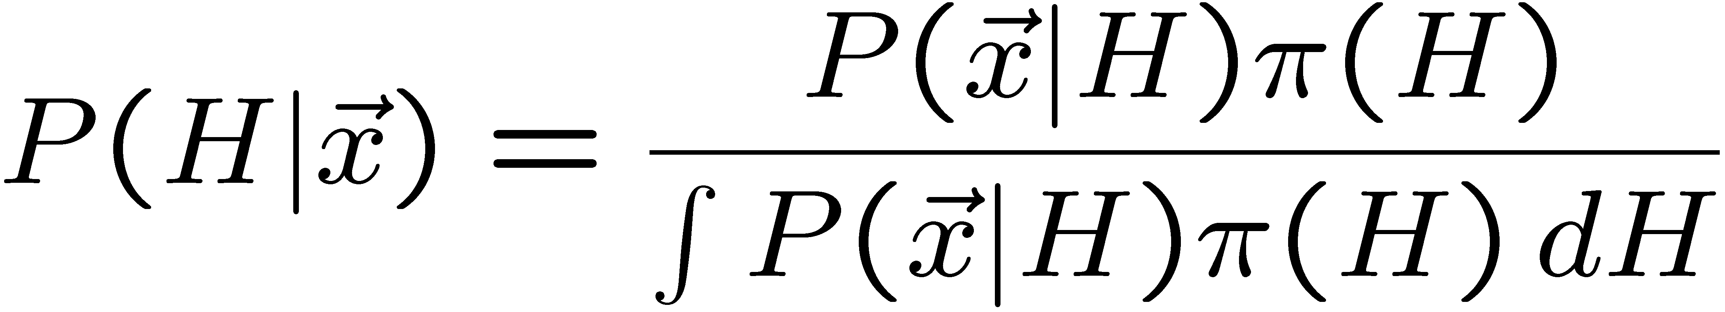
p-value of H is not P(H)
The p-value of H is not the probability that H is true!
In frequentist statistics we don’t talk about P(H) (unless H
represents a repeatable observation).
If we do define P(H), e.g., in Bayesian statistics as a degree of belief, then we need to use Bayes’ theorem to obtain
where π(H) is the prior probability for H.
For now stick with the frequentist approach;
result is p-value, regrettably easy to misinterpret as P(H).

Slide 14
p-value from test statistic
x_{j}
x_{obs}
ω> = { x : x “more
compatible” with H }
surface described by test statistic
ω≤ = { x : x “less
or eq. compatible”
with H }
x_{i}
If e.g. we define the region of less or eq. compatibility to be t(x) ≥ t_{obs} then the p-value of H is

Slide 15

The Poisson counting experiment
Suppose we do a counting experiment and observe n events.
Events could be from signal process or from background –
we only count the total number.
Poisson model:
s = mean (i.e., expected) # of signal events
b = mean # of background events
Goal is to make inference about s, e.g.,
test s = 0 (rejecting H₀ ≈ “discovery of signal process”)
test all non-zero s (values not rejected = confidence interval)
In both cases need to ask what is relevant alternative hypothesis.

Slide 16
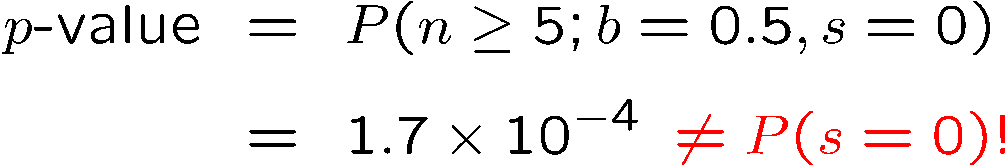
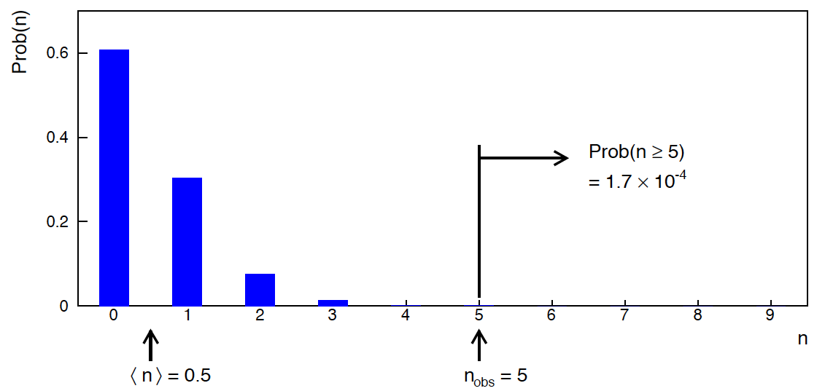
Poisson counting experiment: discovery p-value
Suppose b = 0.5 (known), and we observe n_{obs} = 5.
Should we claim evidence for a new discovery?
Give p-value for hypothesis s = 0:

Slide 17
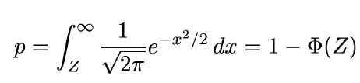
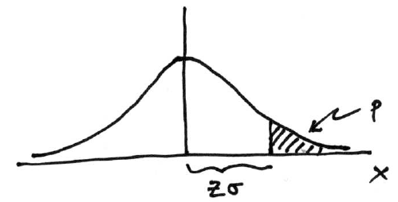

Significance from p-value
Often define significance Z as the number of standard deviations
that a Gaussian variable would fluctuate in one direction
to give the same p-value.
in ROOT:
p = 1 - TMath::Freq(Z)
Z = TMath::NormQuantile(1-p)
in python (scipy.stats):
p = 1 - norm.cdf(Z) = norm.sf(Z)
Z = norm.ppf(1-p)
Result Z is a “number of sigmas”. Note this does not mean that
the original data was Gaussian distributed.

Slide 18

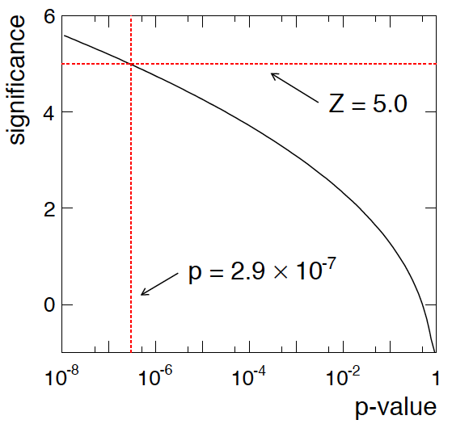
Poisson counting experiment: discovery significance
Equivalent significance for p = 1.7 × 10⁻⁴:
Often claim discovery if Z > 5 (p < 2.9 × 10⁻⁷, i.e., a “5-sigma effect”)
In fact this tradition should be revisited: p-value intended to quantify probability of a signal-like fluctuation assuming background only; not intended to cover, e.g., hidden systematics, plausibility signal model, compatibility of data with signal, “look-elsewhere effect”
(~multiple testing), etc.

Slide 19
Confidence intervals by inverting a test
In addition to a ‘point estimate’ of a parameter we should report
an interval reflecting its statistical uncertainty.
Confidence intervals for a parameter θ can be found by
defining a test of the hypothesized value θ (do this for all θ):
Specify values of the data that are ‘disfavoured’ by θ
(critical region) such that P(data in critical region|θ) ≤ α
for a prespecified α, e.g., 0.05 or 0.1.
If data observed in the critical region, reject the value θ.
Now invert the test to define a confidence interval as:
set of θ values that are not rejected in a test of size α
(confidence level CL is 1− α).

Slide 20
Relation between confidence interval and p-value
Equivalently we can consider a significance test for each
hypothesized value of θ, resulting in a p-value, p_{θ}.
If p_{θ} ≤ α, then we reject θ.
The confidence interval at CL = 1 – α consists of those values of
θ that are not rejected.
E.g. an upper limit on θ is the greatest value for which p_{θ} > α.
In practice find by setting p_{θ} = α and solve for θ.
For a multidimensional parameter space θ = (θ₁,... θ_{M}) use same idea – result is a confidence “region” with boundary determined by p_{θ} = α.

Slide 21
Coverage probability of confidence interval
If the true value of θ is rejected, then it’s not in the confidence interval. The probability for this is by construction (equality for continuous data):
P(reject θ|θ) ≤ α = type-I error rate
Therefore, the probability for the interval to contain or “cover” θ is
P(conf. interval “covers” θ|θ) ≥ 1 – α
This assumes that the set of θ values considered includes the true value, i.e., it assumes the composite hypothesis P(x|H,θ).

Slide 22



Frequentist upper limit on Poisson parameter
Consider again the case of observing n ~ Poisson(s + b).
Suppose b = 4.5, n_{obs} = 5. Find upper limit on s at 95% CL.
Relevant alternative is s = 0 (critical region at low n)
p-value of hypothesized s is P(n ≤ n_{obs}; s, b)
Upper limit s_{up} at CL = 1 – α found from

Slide 23




Approximate confidence intervals/regions
from the likelihood function
Suppose we test parameter value(s) θ = (θ₁, ..., θ_{n}) using the ratio
Lower λ(θ) means worse agreement between data and hypothesized θ. Equivalently, usually define
so higher t_{θ} means worse agreement between θ and the data.
p-value of θ therefore
need pdf

Slide 24




Confidence region from Wilks’ theorem
Wilks’ theorem says (in large-sample limit and provided
certain conditions hold...)
chi-square dist. with # d.o.f. =
# of components in θ = (θ₁, ..., θ_{n}).
Assuming this holds, the p-value is
← set equal to α
To find boundary of confidence region set p_{θ} = α and solve for t_{θ}:
Recall also

Slide 25




Confidence region from Wilks’ theorem (cont.)
i.e., boundary of confidence region in θ space is where
For example, for 1 – α = 68.3% and n = 1 parameter,
and so the 68.3% confidence level interval is determined by
Same as recipe for finding the estimator’s standard deviation, i.e.,
is a 68.3% CL confidence interval.

Slide 26
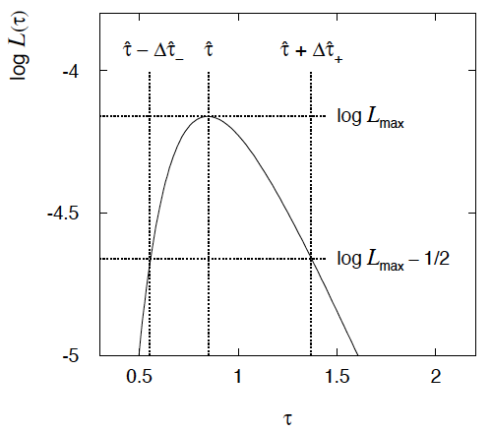

Example of interval from ln L(θ)
For n=1 parameter, CL = 0.683, Q_{α} = 1.
Our exponential
example, now with
only n = 5 events.
Can report ML estimate
with approx. confidence
interval from ln L_{max} – 1/2
as “asymmetric error bar”:

Slide 27

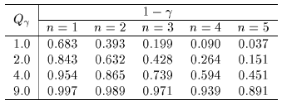

moved to tutorial
Multiparameter case
For increasing number of parameters, CL = 1 – α decreases for
confidence region determined by a given

Slide 28
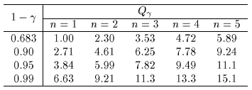
Multiparameter case (cont.)
Equivalently, Q_{α} increases with n for a given CL = 1 – α.

Slide 29
Finally
Two lectures only enough for a brief introduction to:
Parameter estimation
Hypothesis tests (→ path to Machine Learning)
Limits (confidence intervals/regions)
No time today for many important things, e.g.,
Systematics (nuisance parameters)
Experimental sensitivity
Final thought: once the basic formalism is fixed, most of the
work focuses on writing down the likelihood, e.g., P(x|θ), and
including in it enough parameters to adequately describe the data (true for both Bayesian and frequentist approaches) so often best to invest most of your time with it.

Slide 30
Extra slides

Slide 31




Proof of Neyman-Pearson Lemma
Consider a critical region W and suppose the LR satisfies the criterion of the Neyman-Pearson lemma:
P(x|H₁)/P(x|H₀) ≥ c_{α} for all x in W,
P(x|H₁)/P(x|H₀) ≤ c_{α} for all x not in W.
W
Try to change this into a different critical region W′ retaining the same size α, i.e.,
δW₊
To do so add a part δW₊, but to keep the size α, we need to remove a part δW₋, i.e.,
W′
δW₋

Slide 32
Proof of Neyman-Pearson Lemma (2)
δW₊
But we are supposing the LR is higher for all x in δW₋ removed than for the x in δW₊ added, and therefore
W′
δW₋
The right-hand sides are equal and therefore

Slide 33
Proof of Neyman-Pearson Lemma (3)
We have
δW₊
W′
Note W and δW₊ are disjoint, and W′ and δW₋ are disjoint, so by Kolmogorov’s 3rd axiom,
δW₋
Therefore

Slide 34
Proof of Neyman-Pearson Lemma (4)
And therefore
i.e. the deformed critical region W′ cannot have higher power than the original one that satisfied the LR criterion of the Neyman-Pearson lemma.

Slide 35
Example of p-value: exponential decay time
A nuclear sample contains two radioactive isotopes with mean lifetimes τ = 0.2 s and τ = 1.0 s.
For either isotope we expect the decay time to follow
A nucleus is observed to decay after a time t_{obs} = 0.6 s.
The p-value of the hypothesis H that the
nucleus is of the type with τ = 0.2 s is
Here we take t ≥ t_{obs} as being less compatible with τ = 0.2 s , because greater t is more characteristic of τ = 1.0 s.
If the relevant alternative had been τ = 0.1 s, then one would define the p-value as

Slide 36


Distribution of the p-value
The p-value is a function of the data, and is thus itself a random
variable with a given distribution. Suppose the p-value of H is
found from a test statistic t(x) as
The pdf of p_{H} under assumption of H is
g(p_{H}|H′)
In general for continuous data, under
assumption of H, p_{H} ~ Uniform[0,1]
and is concentrated toward zero for
some (broad) class of alternatives.
g(p_{H}|H)
p_{H}
0
1

Slide 37


Using a p-value to define test of H₀
So the probability to find the p-value of H₀, p₀, less than α is
We started by defining critical region in the original data space (x), then reformulated this in terms of a scalar test statistic t(x).
We can take this one step further and define the critical region
of a test of H₀ with size α as the set of data space where p₀ ≤ α .
Formally the p-value relates only to H₀, but the resulting test will
have a given power with respect to a given alternative H₁.

Slide 38
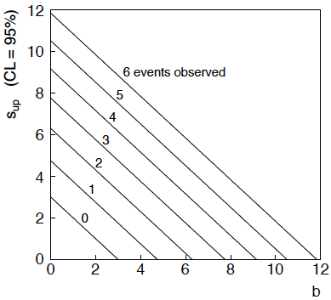
n ~ Poisson(s+b): frequentist upper limit on s
For low fluctuation of n, formula can give negative result for s_{up}; i.e. confidence interval is empty; all values of s ≥ 0 have p_{s} ≤ α.

Slide 39
Limits near a boundary of the parameter space
Suppose e.g. b = 2.5 and we observe n = 0.
If we choose CL = 0.9, we find from the formula for s_{up}
Physicist:
We already knew s ≥ 0 before we started; can’t use negative
upper limit to report result of expensive experiment!
Statistician:
The interval is designed to cover the true value only 90%
of the time — this was clearly not one of those times.
Not uncommon dilemma when testing parameter values for which
one has very little experimental sensitivity, e.g., very small s.

Slide 40
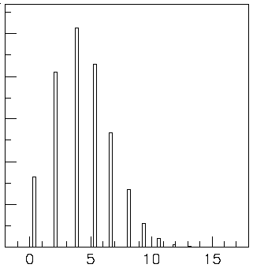

Expected limit for s = 0
Physicist: I should have used CL = 0.95 — then s_{up} = 0.496
Even better: for CL = 0.917923 we get s_{up} = 10⁻⁴ !
Reality check: with b = 2.5, typical Poisson fluctuation in n is
at least √2.5 = 1.6. How can the limit be so low?
Look at the mean limit for the
no-signal hypothesis (s = 0)
(sensitivity).
Distribution of 95% CL limits
with b = 2.5, s = 0.
Mean upper limit = 4.44

Slide 41



Systematic uncertainties and nuisance parameters
P (x|μ)
In general, our model of the data is not perfect:
model:
truth:
x
Can improve model by including
additional adjustable parameters.
Nuisance parameter ↔ systematic uncertainty. Some point in the
parameter space of the enlarged model should be “true”.
Presence of nuisance parameter decreases sensitivity of analysis
to the parameter of interest (e.g., increases variance of estimate).

Slide 42
Profile Likelihood
Suppose we have a likelihood L(μ,θ) = P(x|μ,θ) with N parameters of interest μ = (μ₁,..., μ_{N}) and M nuisance parameters θ = (θ₁,..., θ_{M}). The “profiled” (or “constrained”) values of θ are:
and the profile likelihood is:
The profile likelihood depends only on the parameters of interest; the nuisance parameters are replaced by their profiled values.
The profile likelihood can be used to obtain confidence intervals/regions for the parameters of interest in the same way as one would for all of the parameters from the full likelihood.

Slide 43
Profile Likelihood Ratio – Wilks theorem
Goal is to test/reject regions of μ space (param. of interest).
Rejecting a point μ should mean p_{μ} ≤ α for all possible values of the nuisance parameters θ.
Test μ using the “profile likelihood ratio”:
Let t_{μ} = −2 ln λ(μ). Wilks’ theorem says in large-sample limit:
where the number of degrees of freedom is the number of
parameters of interest (components of μ). So p-value for μ is

Slide 44
Profile Likelihood Ratio – Wilks theorem (2)
If we have a large enough data sample to justify use of the
asymptotic chi-square pdf, then if μ is rejected, it is rejected for any values of the nuisance parameters.
The recipe to get confidence regions/intervals for the parameters of interest at CL = 1 – α is thus the same as before, simply use the profile likelihood:
where the number of degrees of freedom N for the chi-square quantile is equal to the number of parameters of interest.
If the large-sample limit is not justified, then use e.g. Monte Carlo to get distribution of t_{μ}.

