Slide 1
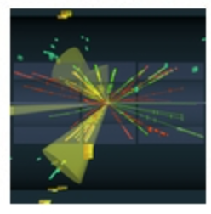


Statistics for Particle Physics
Lecture 1
Taller de Altas Energías
Benasque, Spain
6 September 2021
http://benasque.org/2021tae/
Glen Cowan
Physics Department
Royal Holloway, University of London
g.cowan@rhul.ac.uk
www.pp.rhul.ac.uk/~cowan

Slide 2
Outline
Lecture 1: Introduction, probability, parameter estimation
Lecture 2: Hypothesis tests, limits
Lecture 3: Systematic uncertainties, experimental sensitivity
Almost everything is a subset of the University of London course:
http://www.pp.rhul.ac.uk/~cowan/stat_course.html

Slide 3
Some statistics books, papers, etc.
G. Cowan, Statistical Data Analysis, Clarendon, Oxford, 1998
R.J. Barlow, Statistics: A Guide to the Use of Statistical Methods in the Physical Sciences, Wiley, 1989
Ilya Narsky and Frank C. Porter, Statistical Analysis Techniques in Particle Physics, Wiley, 2014.
Luca Lista, Statistical Methods for Data Analysis in Particle Physics, Springer, 2017.
L. Lyons, Statistics for Nuclear and Particle Physics, CUP, 1986
F. James., Statistical and Computational Methods in Experimental Physics, 2nd ed., World Scientific, 2006
S. Brandt, Statistical and Computational Methods in Data Analysis, Springer, New York, 1998.
P.A. Zyla et al. (Particle Data Group), Prog. Theor. Exp. Phys. 2020, 083C01 (2020); pdg.lbl.gov sections on probability, statistics, MC.

Slide 4
Theory ↔ Statistics ↔ Experiment
Theory (model, hypothesis):
Experiment (observation):
+ response of measurement
apparatus
= model prediction
data
Key goals:
Estimate parameters
Quantify uncertainty of parameter estimates
Test hypotheses
Uncertainty enters on many levels → quantify with probability

Slide 5
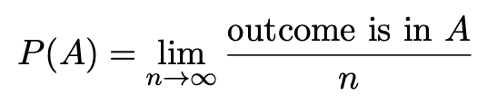

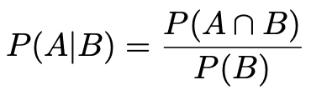

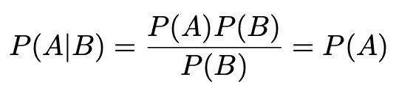
A quick review of probability
Frequentist (A = outcome of
repeatable observation)
Subjective (A = hypothesis)
Conditional probability:
A and B are independent iff:
I.e. if A, B independent, then

Slide 6

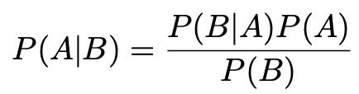
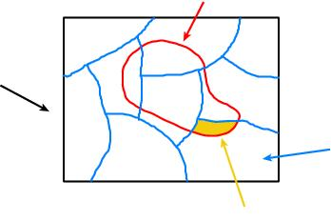
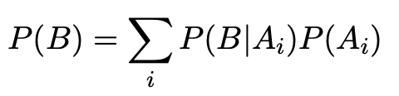
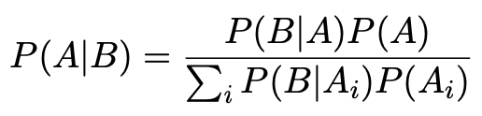
Bayes’ theorem
Use definition of conditional probability and
→
(Bayes’ theorem)
If set of all outcomes S = ∪_{i} A_{i}
with A_{i} disjoint, then law of total probability for P(B) says
B
S
A_{i}
B ∩ A_{i}
so that Bayes’ theorem becomes
Bayes’ theorem holds regardless of how probability is interpreted (frequency, degree of belief...).

Slide 7
Frequentist Statistics − general philosophy
In frequentist statistics, probabilities are associated only with
the data, i.e., outcomes of repeatable observations (shorthand: x).
Probability = limiting frequency
Probabilities such as
P (string theory is true),
P (0.117 < α_{s} < 0.119),
P (Biden wins in 2024),
etc. are either 0 or 1, but we don’t know which.
The tools of frequentist statistics tell us what to expect, under
the assumption of certain probabilities, about hypothetical
repeated observations.
Preferred theories (models, hypotheses, ...) are those that predict a high probability for data “like” the data observed.

Slide 8
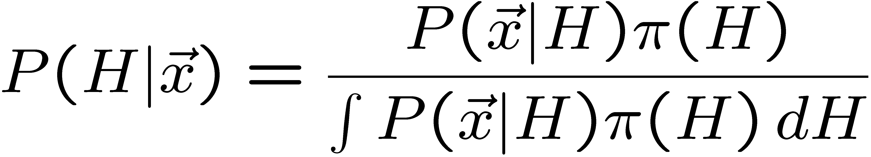
Bayesian Statistics − general philosophy
In Bayesian statistics, use subjective probability for hypotheses:
probability of the data assuming
hypothesis H (the likelihood)
prior probability, i.e.,
before seeing the data
posterior probability, i.e.,
after seeing the data
normalization involves sum
over all possible hypotheses
Bayes’ theorem has an “if-then” character: If your prior
probabilities were π(H), then it says how these probabilities
should change in the light of the data.
No general prescription for priors (subjective!)

Slide 9
Hypothesis, likelihood
Suppose the entire result of an experiment (set of measurements) is a collection of numbers x.
A (simple) hypothesis is a rule that assigns a probability to each possible data outcome:
= the likelihood of H
Often we deal with a family of hypotheses labeled by one or
more undetermined parameters (a composite hypothesis):
= the “likelihood function”
Note:
1) For the likelihood we treat the data x as fixed.
2) The likelihood function L(θ) is not a pdf for θ.

Slide 10
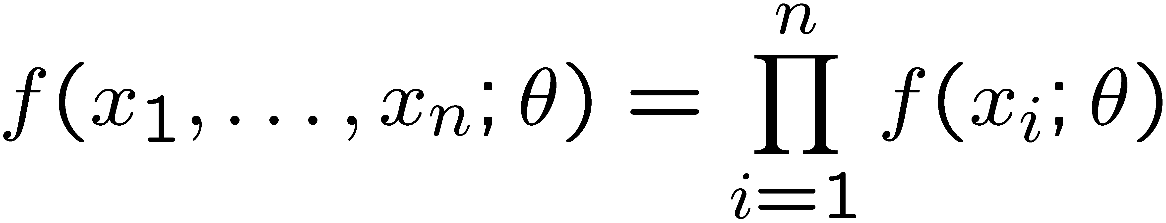
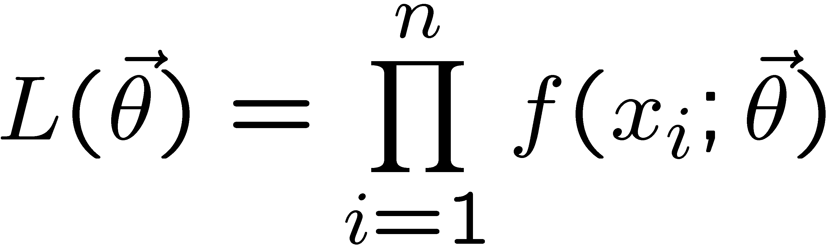
The likelihood function for i.i.d.* data
* i.i.d. = independent and identically distributed
Consider n independent observations of x: x₁, ..., x_{n}, where
x follows f (x; θ). The joint pdf for the whole data sample is:
In this case the likelihood function is
(x_{i} constant)

Slide 11
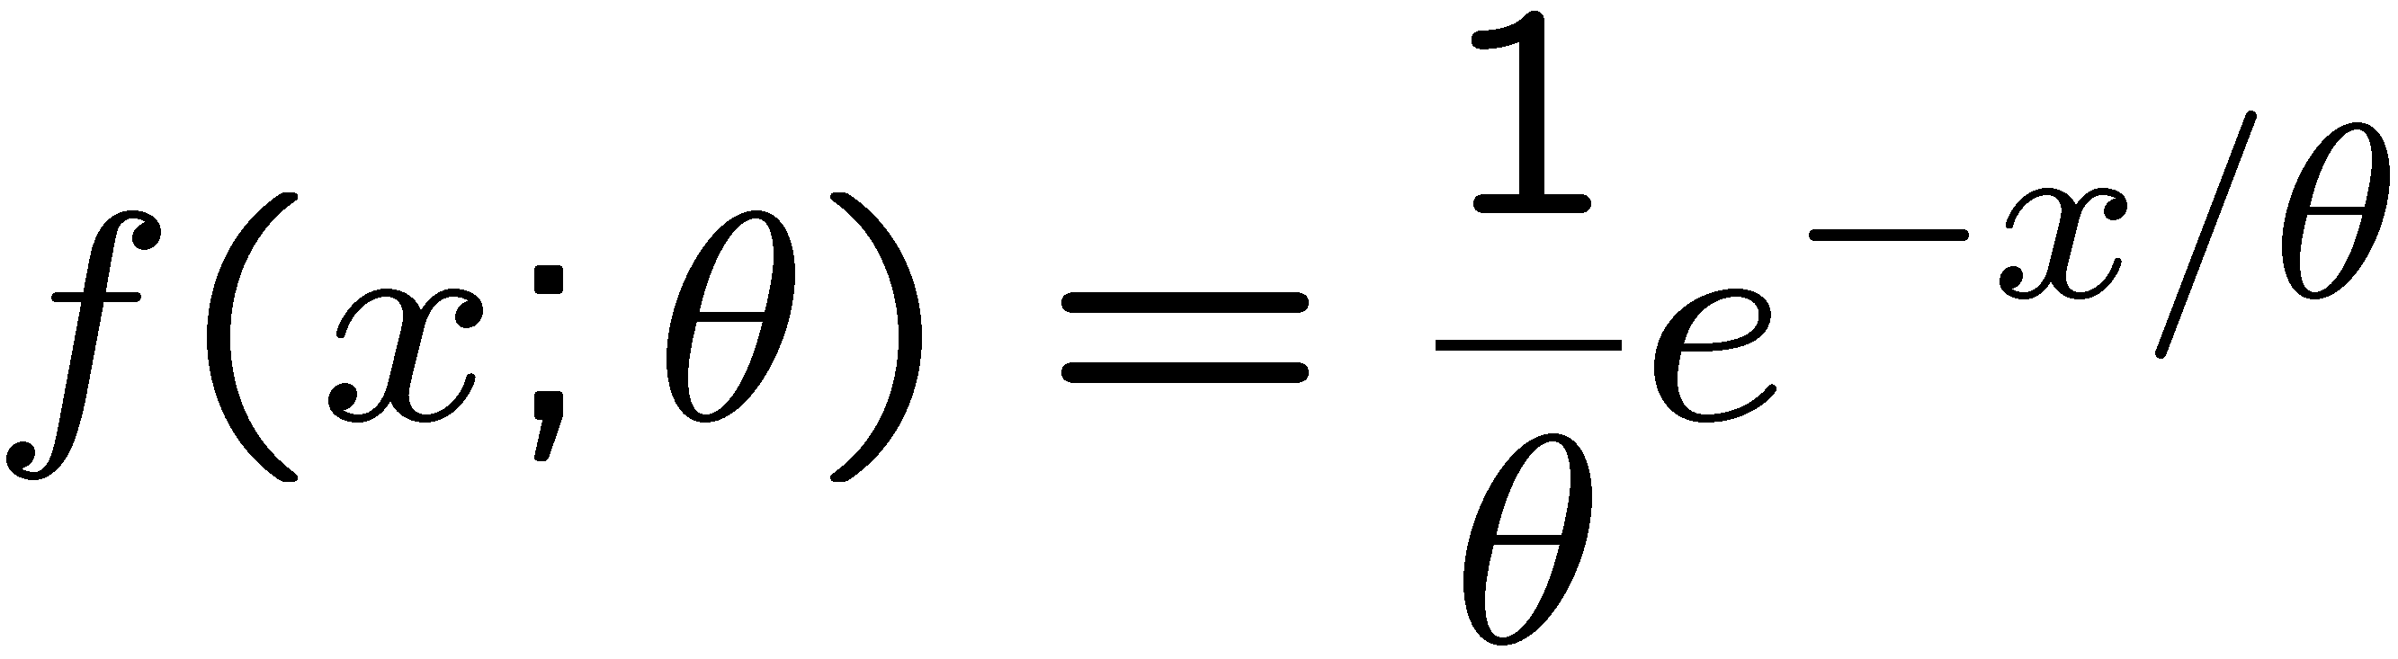
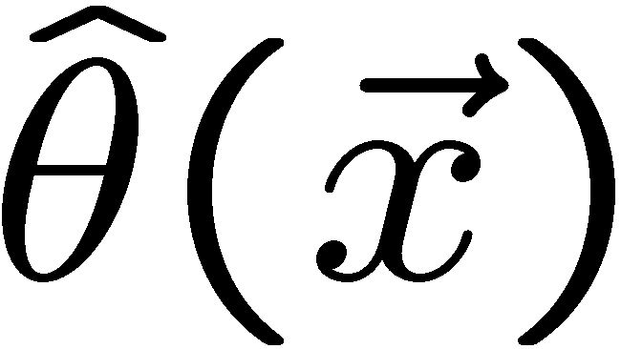
Parameter estimation
The parameters of a pdf are any constants that characterize it,
i.e., θ indexes a
set of hypotheses.
r.v.
parameter
Suppose we have a sample of observed values: x = (x₁, ..., x_{n})
We want to find some function of the data to estimate the
parameter(s):
← estimator written with a hat
Sometimes we say ‘estimator’ for the function of x₁, ..., x_{n};
‘estimate’ for the value of the estimator with a particular data set.

Slide 12
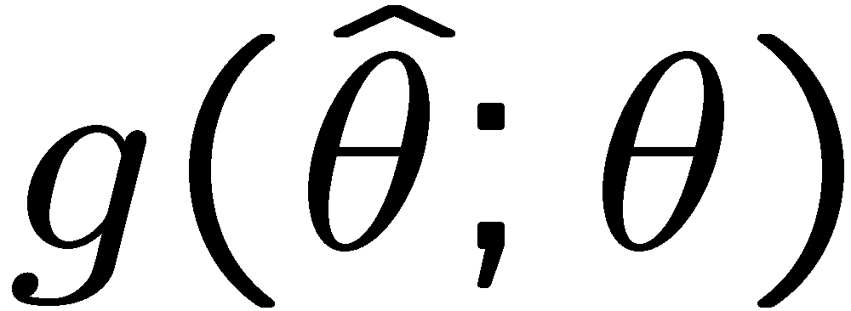
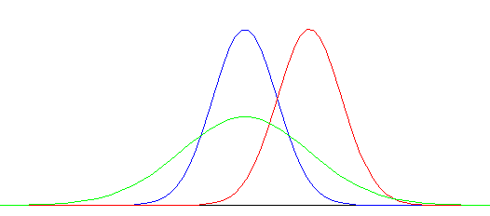
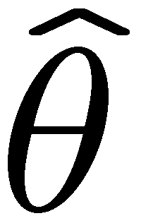
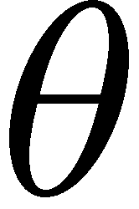
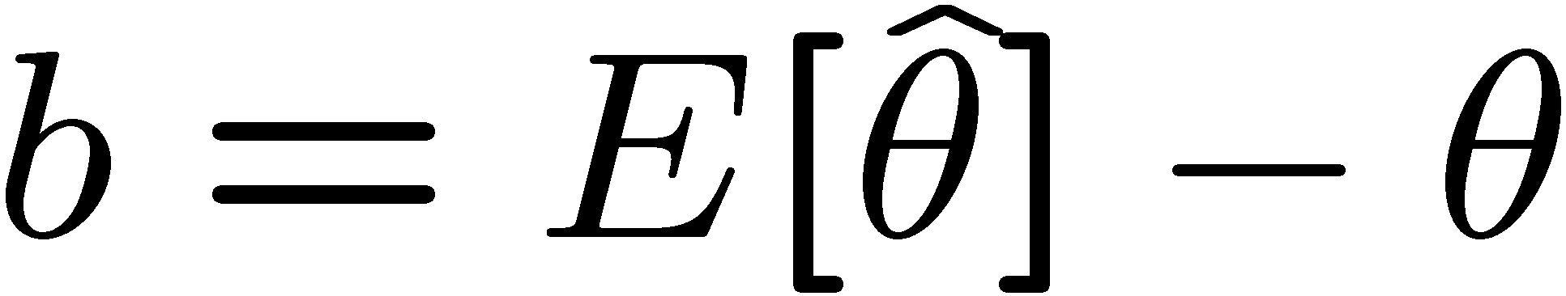
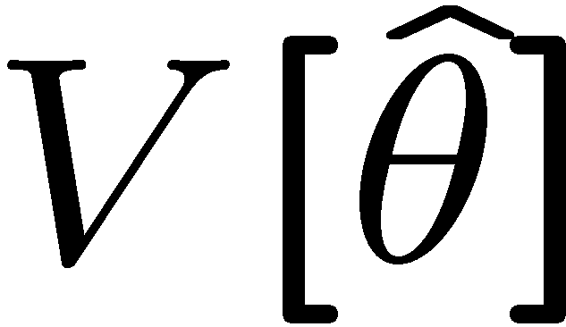
Properties of estimators
If we were to repeat the entire measurement, the estimates
from each would follow a pdf:
best
large
variance
biased
We want small (or zero) bias (systematic error):
→ average of repeated measurements should tend to true value.
And we want a small variance (statistical error):
→ small bias & variance are in general conflicting criteria

Slide 13
Maximum Likelihood Estimators (MLEs)
We define the maximum likelihood estimators or MLEs to be
the parameter values for which the likelihood is maximum.
Maximizing L equivalent to maximizing log L
Could have multiple maxima (take highest).
MLEs not guaranteed to have any ‘optimal’ properties, (but in practice they’re very good).

Slide 14
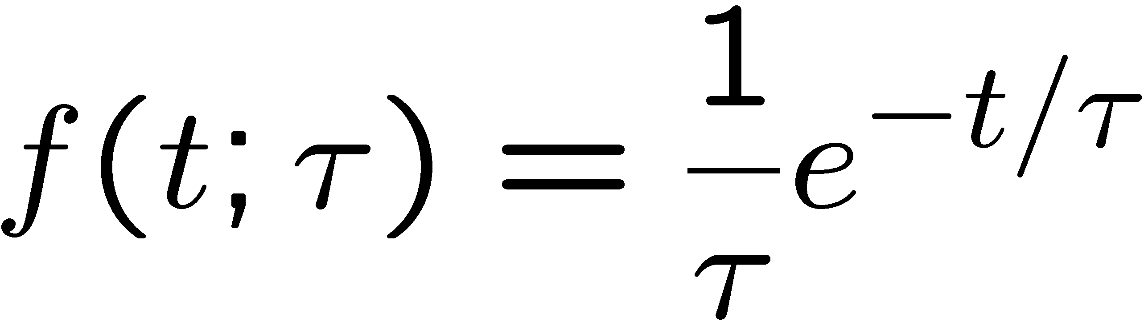
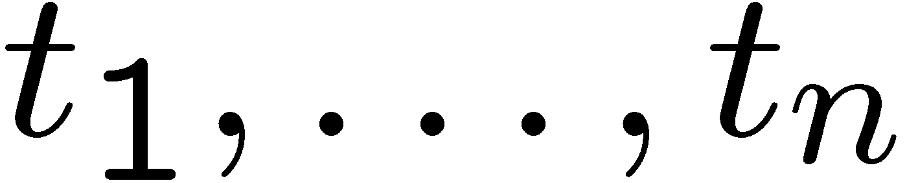
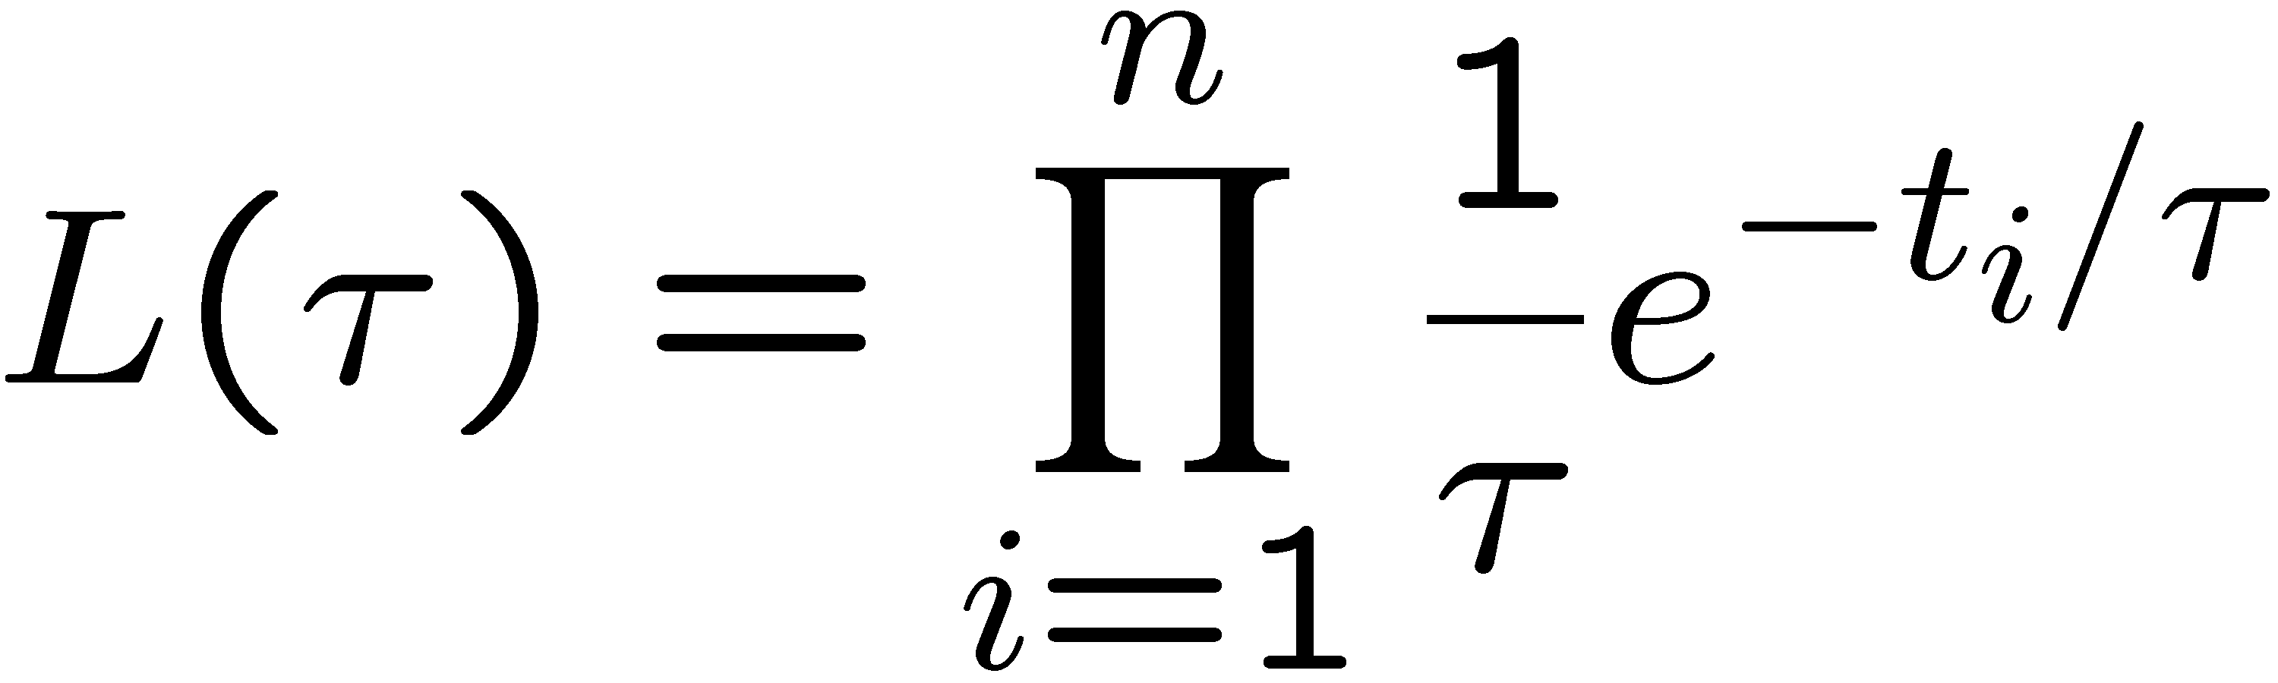
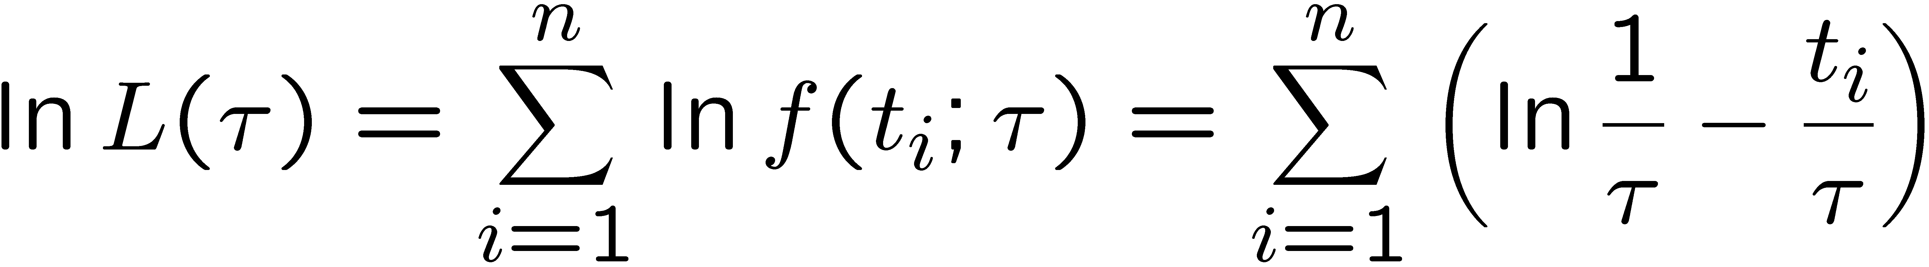
MLE example: parameter of exponential pdf
Consider exponential pdf,
and suppose we have i.i.d. data,
The likelihood function is
The value of τ for which L(τ) is maximum also gives the
maximum value of its logarithm (the log-likelihood function):

Slide 15
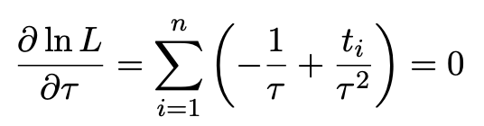
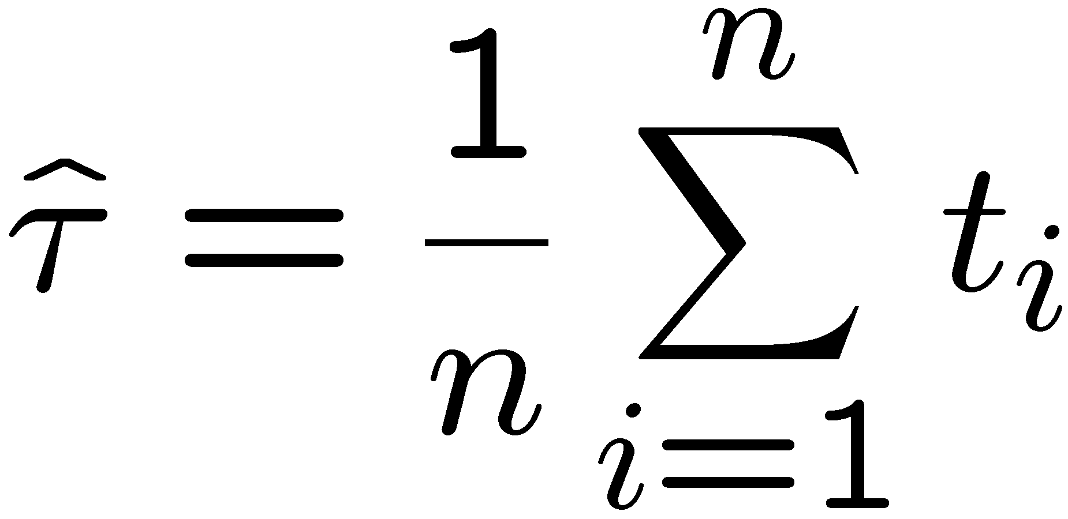
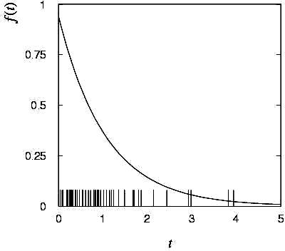
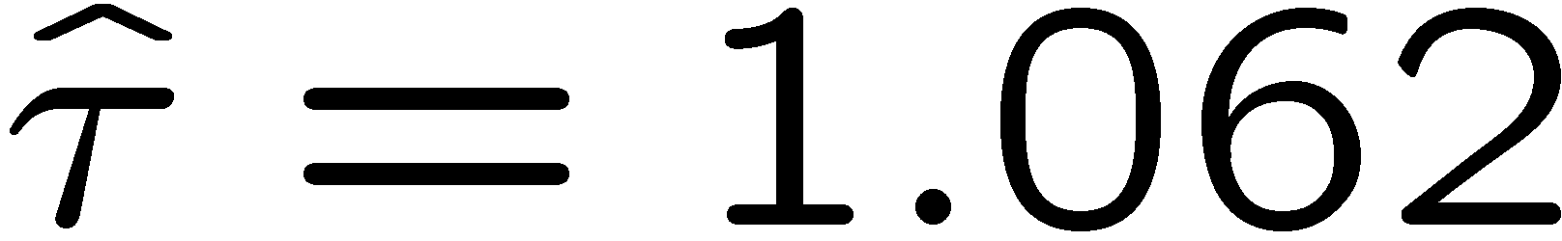
MLE example: parameter of exponential pdf (2)
Find its maximum by setting
→
Monte Carlo test:
generate 50 values
using τ = 1:
We find the ML estimate:

Slide 16






MLE example: parameter of exponential pdf (3)
For the exponential distribution one has for mean, variance:
For the MLE
we therefore find
→
→

Slide 17
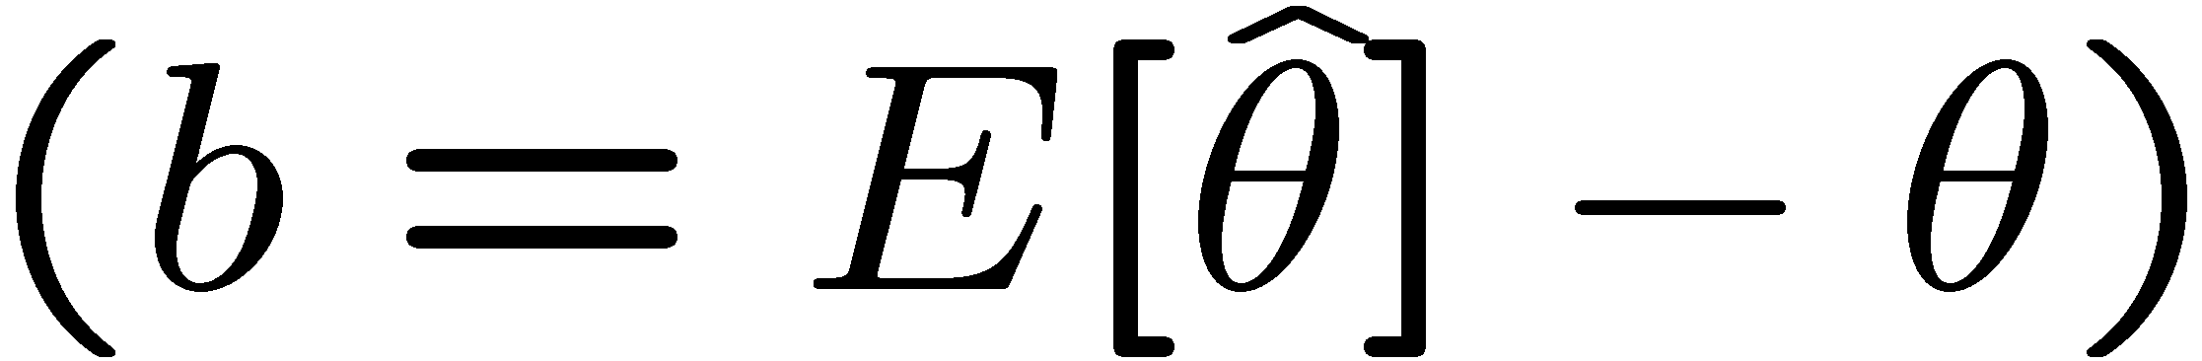
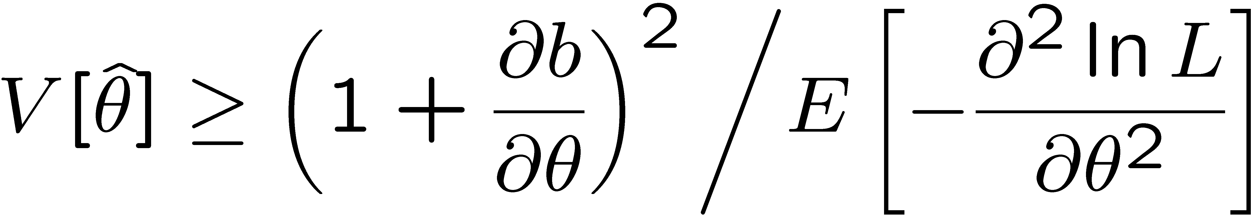
The information inequality
The information inequality (RCF) sets a lower bound on the
variance of any estimator (not only MLE). For a single parameter:
= MVB (Minimum
Variance Bound)
where
Proof in Exercise 6.6 of SDA, http://www.pp.rhul.ac.uk/~cowan/sda/prob/prob_6.pdf
“Efficiency” of an estimator = MVB / actual variance.
An estimator whose variance equals the MVB is said to be efficient.

Slide 18
MVB for MLE of exponential parameter
Find
We found for the exponential parameter the MLE
and we showed b = 0, hence 𝜕b/𝜕τ = 0.
We find
and since E[t_{i}] = τ for all i,
,
and therefore
.
So here the MLE is efficient.

Slide 19
Large-sample (asymptotic) properties of MLEs
Suppose we have an i.i.d. data sample of size n: x₁,...,x_{n}
In the large-sample (or “asymptotic”) limit (n → ∞) and assuming regularity conditions one can show that the likelihood and MLE have several important properties.
The regularity conditions include:
the boundaries of the data space cannot depend on the parameter;
the parameter cannot be on the edge of the parameter space;
ln L(θ) must be differentiable;
the only solution to 𝜕ln L/𝜕θ = 0 is θ.
^
In the slides immediately following the properties are shown without proof for a single parameter; the corresponding properties hold also for the multiparameter case, θ = (θ₁,...,θ_{m}).

Slide 20
log-likelihood becomes quadratic
The likelihood function becomes Gaussian in shape, i.e. the log-likelihood becomes quadratic (parabolic).
The MLE becomes increasingly precise as the (log)-likelihood becomes more tightly concentrated about its peak,
but L(θ) = P(x|θ) is the probability for x, not a pdf for θ.

Slide 21
The MLE converges to the true parameter value
In the large-sample limit, the MLE converges in probability
to the true parameter value.
That is, for any ε > 0,
The MLE is said to be consistent.

Slide 22
MLE is asymptotically unbiased
In general the MLE can be biased, but in the large-sample limit, this bias goes to zero:
(Recall for the exponential parameter we found the bias was
identically zero regardless of the sample size n.)

Slide 23
The MLE’s variance approaches the MVB
In the large-sample limit, the variance of the MLE approaches the minimum-variance bound, i.e., the information inequality becomes an equality (and bias goes to zero):
The MLE is said to be asymptotically efficient.

Slide 24
The MLE’s distribution becomes Gaussian
In the large-sample limit, the pdf of the MLE becomes Gaussian,
where
is the minimum variance bound (note bias is zero).
For example, exponential MLE with sample size n = 100.
Note that for exponential, MLE is arithmetic average, so Gaussian MLE seen to stem from Central Limit Theorem.

Slide 25
Distribution of MLE of exponential parameter

Slide 26
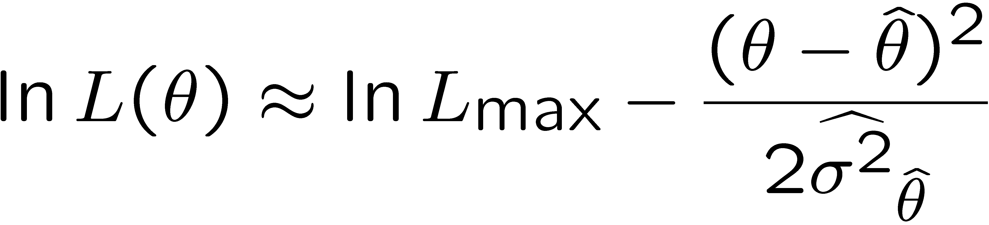
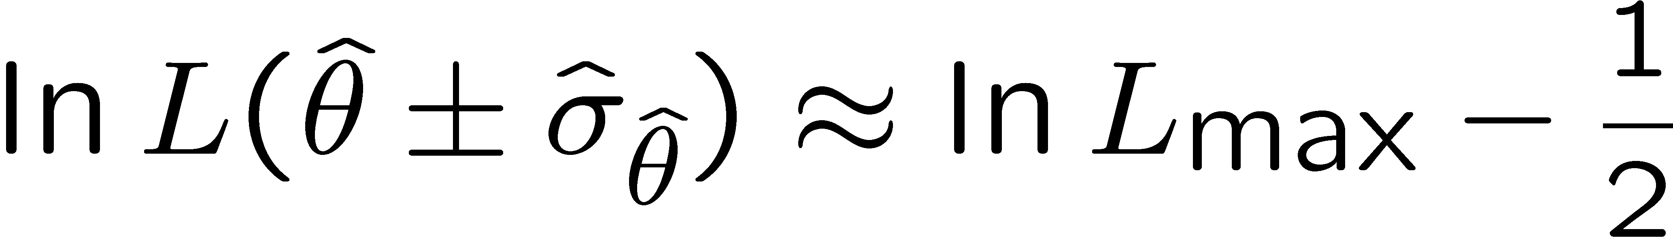
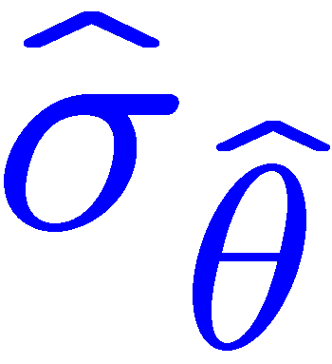

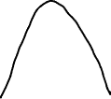
Variance of estimators: graphical method
Expand ln L (θ) about its maximum:
First term is ln L_{max}, second term is zero, for third term use
information inequality (assume equality):
→ to get
, change θ away from
until ln L decreases by 1/2.

Slide 27
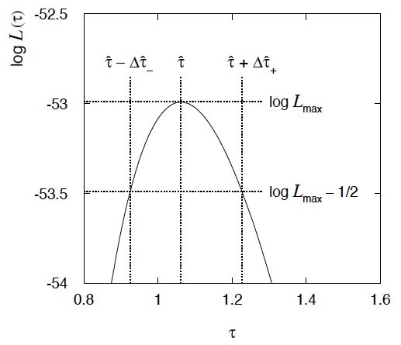
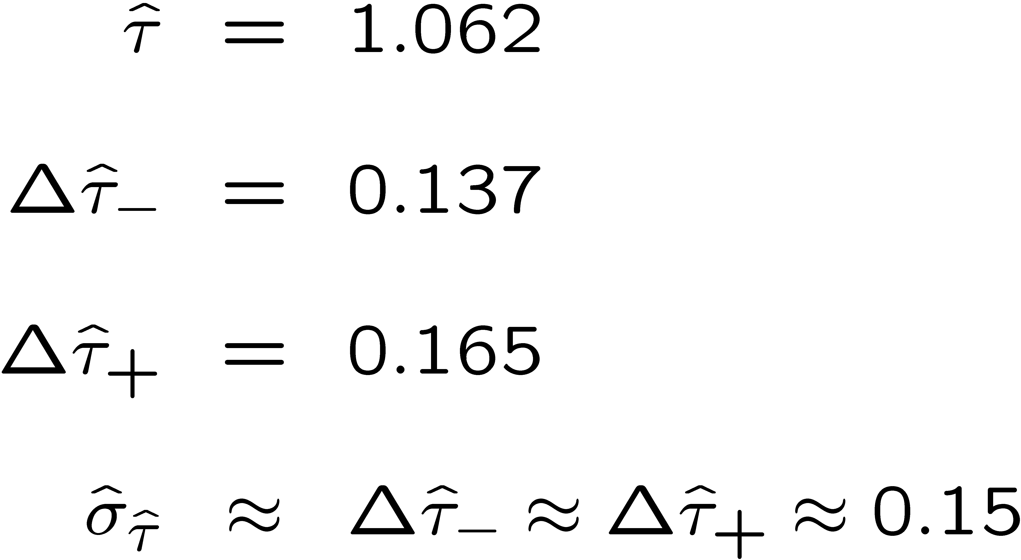
Example of variance by graphical method
ML example with exponential:
Not quite parabolic ln L since finite sample size (n = 50).

Slide 28
Next time...
Lecture 1: Introduction, probability, parameter estimation
Lecture 2: Hypothesis tests, limits
Lecture 3: Systematic uncertainties, experimental sensitivity

Slide 29
Extra slides

Slide 30



An example using Bayes’ theorem
Suppose the probability (for anyone) to have a disease D is:
← prior probabilities, i.e.,
before any test carried out
Consider a test for the disease: result is + or −
← probabilities to (in)correctly
identify a person with the disease
← probabilities to (in)correctly
identify a healthy person
Suppose your result is +. How worried should you be?

Slide 31
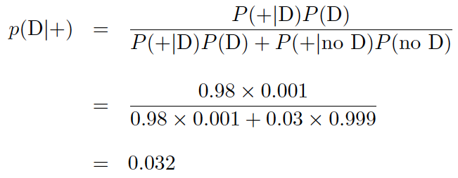
Bayes’ theorem example (cont.)
The probability to have the disease given a + result is
← posterior probability
i.e. you’re probably OK!
Your viewpoint: my degree of belief that I have the disease is 3.2%.
Your doctor’s viewpoint: 3.2% of people like this have the disease.

Slide 32
Information inequality for N parameters
Suppose we have estimated N parameters θ = (θ₁,...,θ_{N})
The Fisher information matrix is
^
and the covariance matrix of estimators θ is
The information inequality states that the matrix
is positive semi-definite:
z^{T}Mz ≥ 0 for all z ≠ 0, diagonal elements ≥ 0

Slide 33
Information inequality for N parameters (2)
In practice the inequality is ~always used in the large-sample limit:
bias → 0
inequality → equality, i.e, M = 0, and therefore V⁻¹ = I
That is,
This can be estimated from data using
Find the matrix V⁻¹ numerically (or with automatic differentiation),
then invert to get the covariance matrix of the estimators

Slide 34
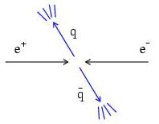
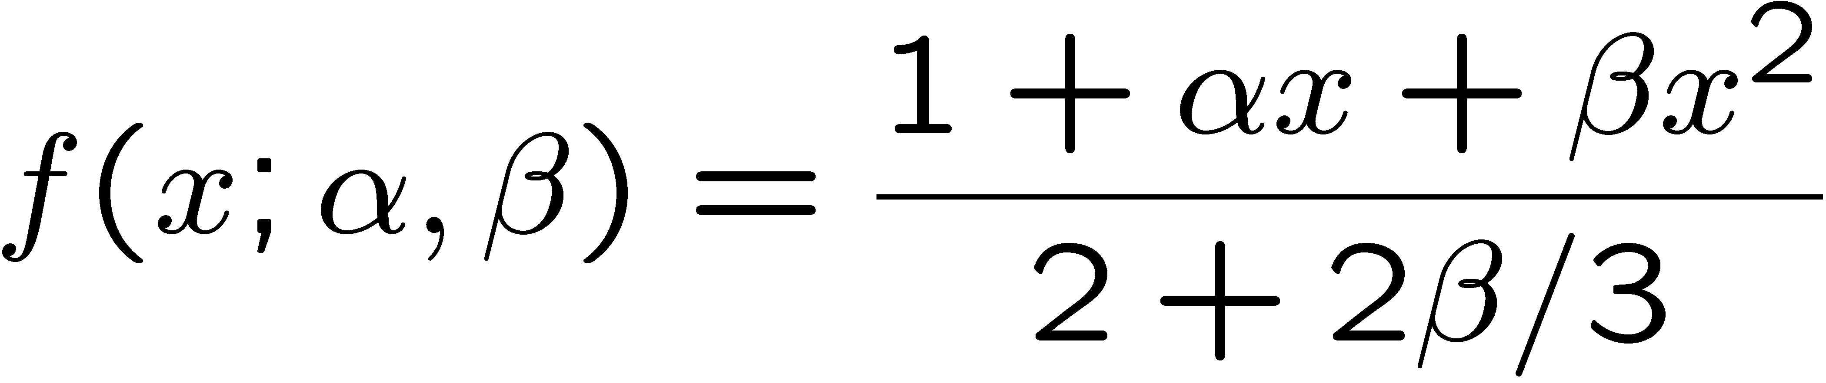
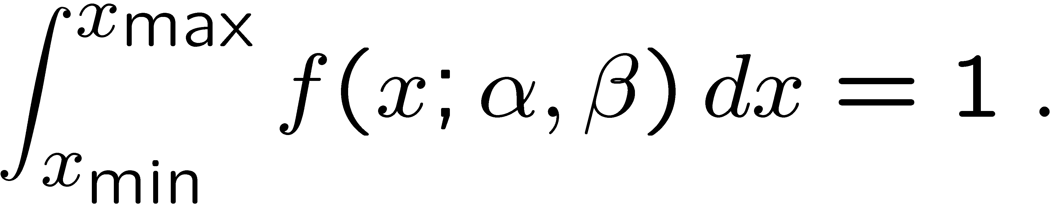
Example of ML with 2 parameters
Consider a scattering angle distribution with x = cos θ,
or if x_{min} < x < x_{max}, need to normalize so that
Example: α = 0.5, β = 0.5, x_{min} = −0.95, x_{max} = 0.95, generate n = 2000 events with Monte Carlo.
need to find maximum
numerically

Slide 35
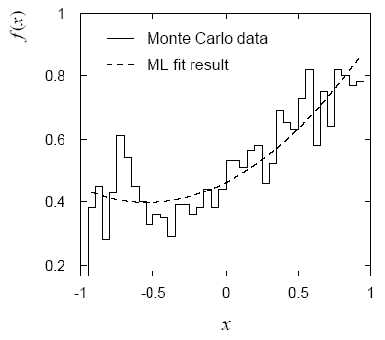
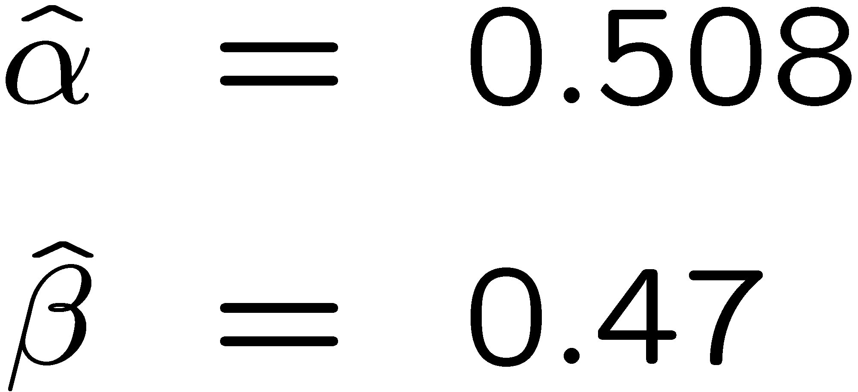
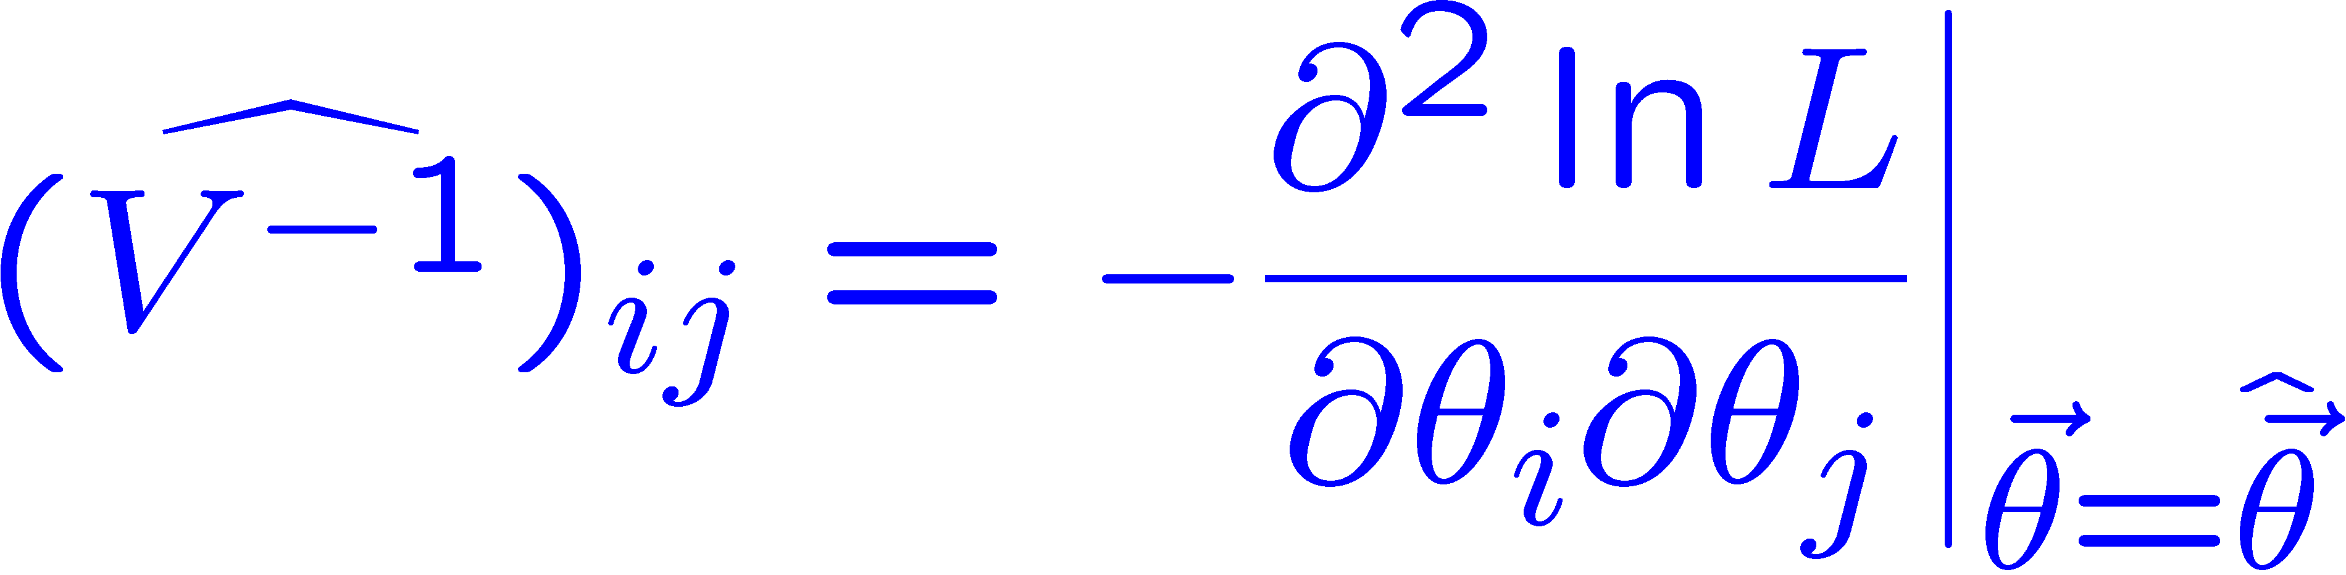
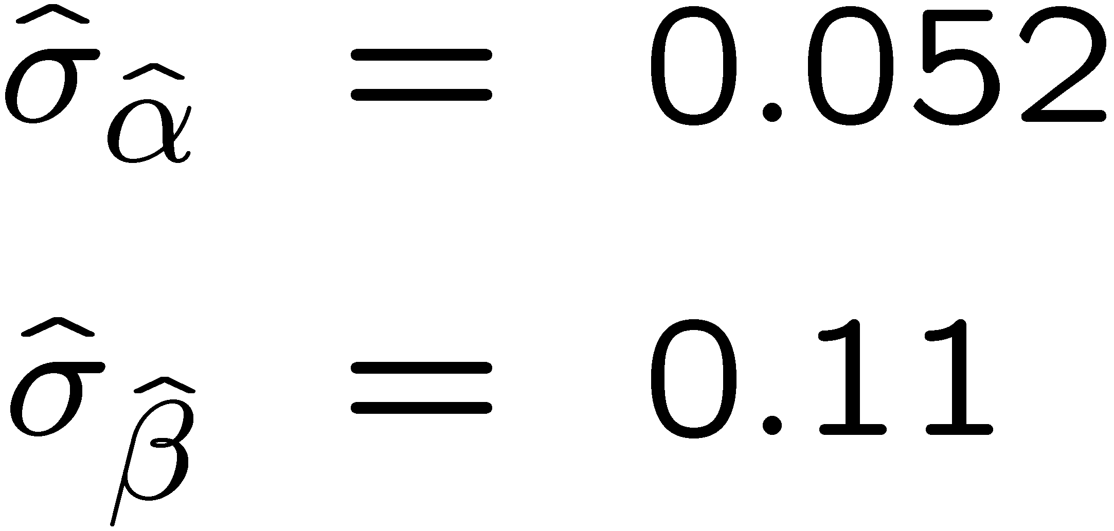
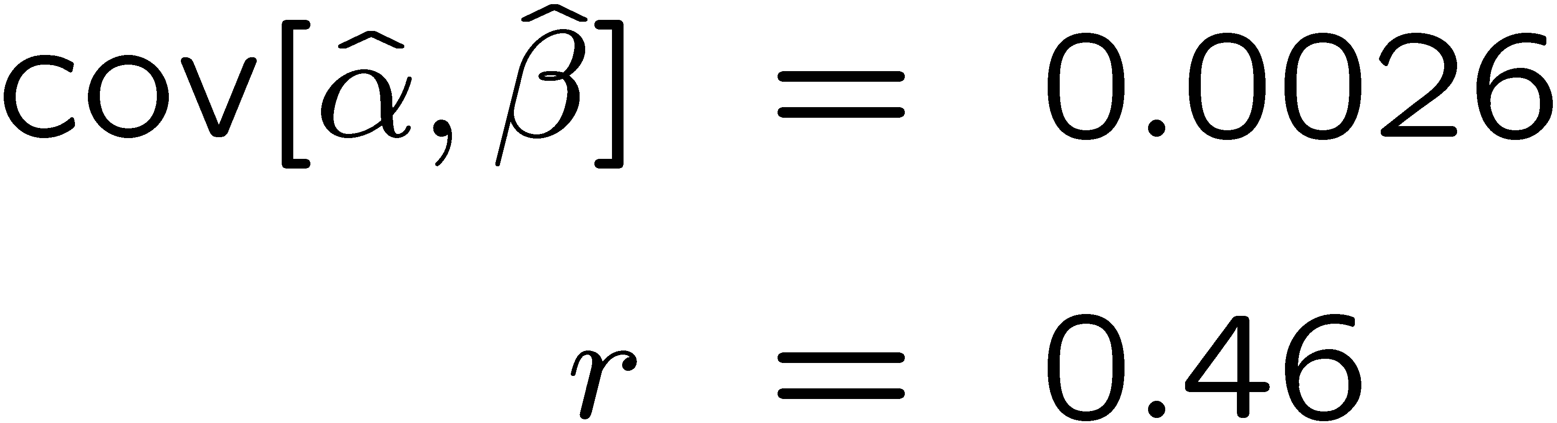
Example of ML with 2 parameters: fit result
Finding maximum of ln L(α, β) numerically gives
N.B. No binning of data for fit,
but can compare to histogram for
goodness-of-fit (e.g. ‘visual’ or χ²).
(Co)variances from
= correlation coefficient

Slide 36
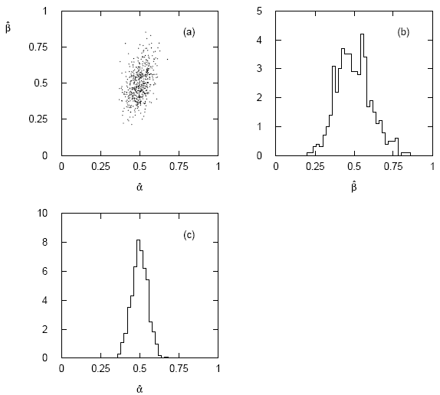




Two-parameter fit: MC study
Repeat ML fit with 500 experiments, all with n = 2000 events:
Estimates average to ~true values;
(Co)variances close to previous estimates;
marginal pdfs approximately Gaussian.

Slide 37
Multiparameter graphical method for variances
Expand ln L(θ) to 2nd order about MLE:
ln L_{max}
zero
relate to covariance matrix of MLEs using information (in)equality.
Result:
So the surface
corresponds to
, which is the equation of a (hyper-) ellipse.

Slide 38



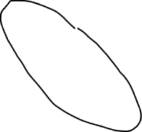
Multiparameter graphical method (2)
Distance from MLE to tangent planes gives standard deviations.

Slide 39
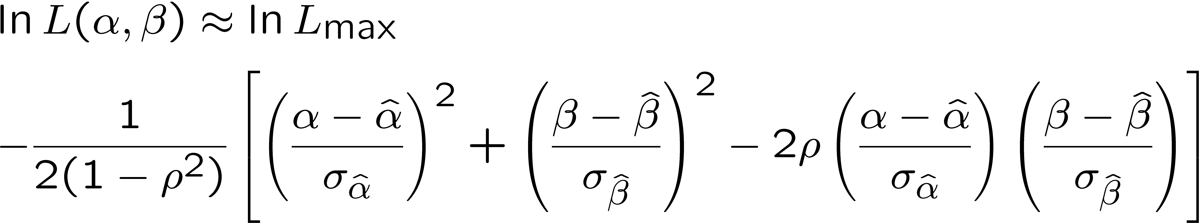
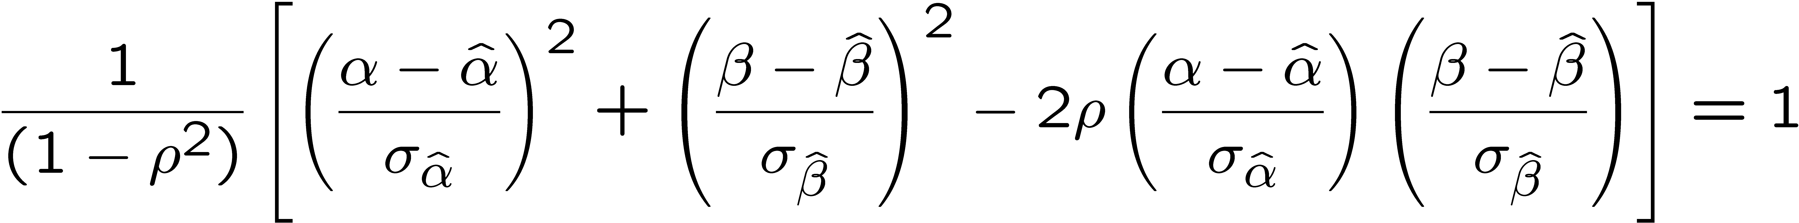
The ln L_{max} − 1/2 contour for two parameters
For large n, ln L takes on quadratic form near maximum:
The contour
is an ellipse:

Slide 40
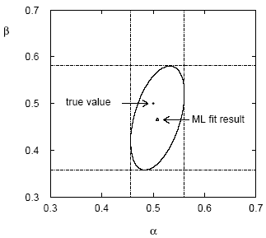
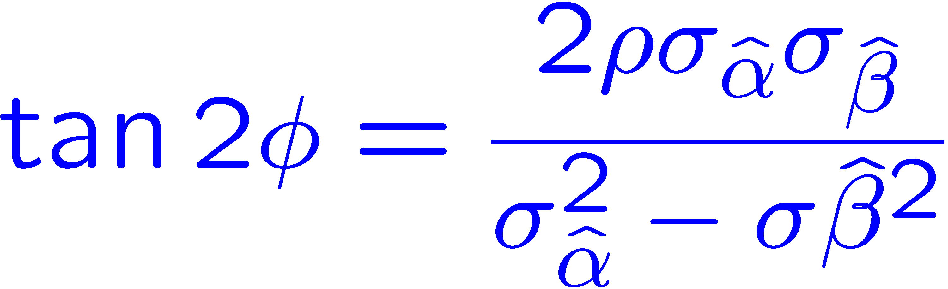
(Co)variances from ln L contour
The α, β plane for the first
MC data set
→ Tangent lines to contours give standard deviations.
→ Angle of ellipse φ related to correlation:

