Slide 1
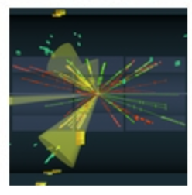


Statistics for Particle Physics
Lecture day 1
Taller de Altas Energías
Benasque, Spain (online)
5,6 September 2022
http://benasque.org/2022tae/
Glen Cowan
Physics Department
Royal Holloway, University of London
g.cowan@rhul.ac.uk
www.pp.rhul.ac.uk/~cowan

Slide 2
Outline
→ Monday 9-11 : Introduction
Probability
Hypothesis tests
Machine Learning
Tuesday 9-11 : Parameter estimation
Confidence limits
Systematic uncertainties
Experimental sensitivity
Tuesday 15:30: Tutorial on parameter estimation
Almost everything is a subset of the University of London course:
http://www.pp.rhul.ac.uk/~cowan/stat_course.html

Slide 3
Some statistics books, papers, etc.
G. Cowan, Statistical Data Analysis, Clarendon, Oxford, 1998
R.J. Barlow, Statistics: A Guide to the Use of Statistical Methods in the Physical Sciences, Wiley, 1989
Ilya Narsky and Frank C. Porter, Statistical Analysis Techniques in Particle Physics, Wiley, 2014.
Luca Lista, Statistical Methods for Data Analysis in Particle Physics, Springer, 2017.
L. Lyons, Statistics for Nuclear and Particle Physics, CUP, 1986
F. James., Statistical and Computational Methods in Experimental Physics, 2nd ed., World Scientific, 2006
S. Brandt, Statistical and Computational Methods in Data Analysis, Springer, New York, 1998.
R.L. Workman et al. (Particle Data Group), Prog. Theor. Exp. Phys. 083C01 (2022); pdg.lbl.gov sections on probability, statistics, MC.

Slide 4
Theory ↔ Statistics ↔ Experiment
Theory (model, hypothesis):
Experiment (observation):
+ response of measurement
apparatus
= model prediction
data
Uncertainty enters
on many levels
→ quantify with
probability

Slide 5
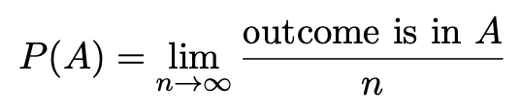

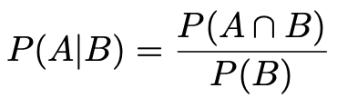

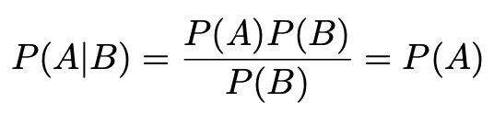
A quick review of probability
Frequentist (A = outcome of
repeatable observation)
Subjective (A = hypothesis)
Conditional probability:
E.g. rolling a die, outcome n = 1,2,...,6:
A and B are independent iff:
I.e. if A, B independent, then

Slide 6

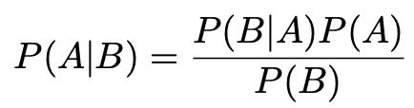
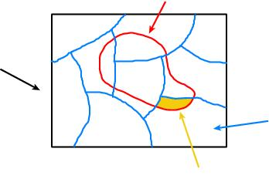
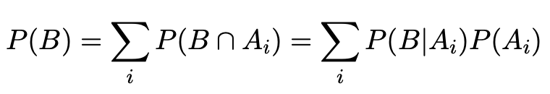
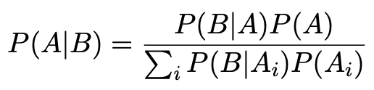
Bayes’ theorem
Use definition of conditional probability and
→
(Bayes’ theorem)
B
If set of all outcomes S = ∪_{i} A_{i}
with A_{i} disjoint, then law of total probability for P(B) says
S
A_{i}
B ∩ A_{i}
so that Bayes’ theorem becomes
Bayes’ theorem holds regardless of how probability is interpreted (frequency, degree of belief...).

Slide 7
Frequentist Statistics − general philosophy
In frequentist statistics, probabilities are associated only with
the data, i.e., outcomes of repeatable observations (shorthand: x).
Probability = limiting frequency
Probabilities such as
P (string theory is true),
P (0.117 < α_{s} < 0.119),
P (Biden wins in 2024),
etc. are either 0 or 1, but we don’t know which.
The tools of frequentist statistics tell us what to expect, under
the assumption of certain probabilities, about hypothetical
repeated observations.
Preferred theories (models, hypotheses, ...) are those that predict a high probability for data “like” the data observed.

Slide 8
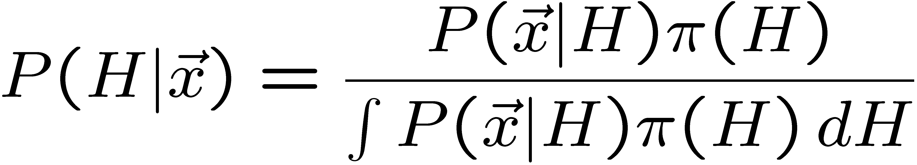
Bayesian Statistics − general philosophy
In Bayesian statistics, use subjective probability for hypotheses:
probability of the data assuming
hypothesis H (the likelihood)
prior probability, i.e.,
before seeing the data
posterior probability, i.e.,
after seeing the data
normalization involves sum
over all possible hypotheses
Bayes’ theorem has an “if-then” character: If your prior
probabilities were π(H), then it says how these probabilities
should change in the light of the data.
No general prescription for priors (subjective!)

Slide 9
Hypothesis, likelihood
Suppose the entire result of an experiment (set of measurements) is a collection of numbers x.
A (simple) hypothesis is a rule that assigns a probability to each possible data outcome:
= the likelihood of H
Often we deal with a family of hypotheses labeled by one or
more undetermined parameters (a composite hypothesis):
= the “likelihood function”
Note:
1) For the likelihood we treat the data x as fixed.
2) The likelihood function L(θ) is not a pdf for θ.

Slide 10
Frequentist hypothesis tests
Suppose a measurement produces data x; consider a hypothesis H₀
we want to test and alternative H₁
H₀, H₁ specify probability for x: P(x|H₀), P(x|H₁)
A test of H₀ is defined by specifying a critical region w of the
data space such that there is no more than some (small) probability
α, assuming H₀ is correct, to observe the data there, i.e.,
P(x ∈ w | H₀) ≤ α
Need inequality if data are
discrete.
α is called the size or
significance level of the test.
If x is observed in the
critical region, reject H₀.
data space Ω
critical region w

Slide 11



Definition of a test (2)
But in general there are an infinite number of possible critical regions that give the same size α.
Use the alternative hypothesis H₁ to motivate where to place the critical region.
Roughly speaking, place the critical region where there is a low
probability (α) to be found if H₀ is true, but high if H₁ is true:

Slide 12


Classification viewed as a statistical test
Suppose events come in two possible types:
s (signal) and b (background)
For each event, test hypothesis that it is background, i.e., H₀ = b.
Carry out test on many events, each is either of type s or b, i.e., here the hypothesis is the “true class label”, which varies randomly from event to event, so we can assign to it a frequentist probability.
Select events for which where H₀ is rejected as “candidate events of type s”. Equivalent Particle Physics terminology:
background efficiency
signal efficiency

Slide 13
Example of a test for classification
Suppose we can measure for
each event a quantity x, where
with 0 ≤ x ≤ 1.
For each event in a mixture of signal (s) and background (b) test
H₀ : event is of type b
using a critical region W of the form: W = { x : x ≤ x_{c} }, where
x_{c} is a constant that we choose to give a test with the desired size α.

Slide 14
Classification example (2)
Suppose we want α = 10⁻⁴. Require:
and therefore
For this test (i.e. this critical region W), the power with respect to the signal hypothesis (s) is
Note: the optimal size and power is a separate question that will depend on goals of the subsequent analysis.

Slide 15
Classification example (3)
Suppose that the prior probabilities for an event to be of type s or b are:
π_{s} = 0.001
π_{b} = 0.999
The “purity” of the selected signal sample (events where b hypothesis rejected) is found using Bayes’ theorem:

Slide 16
Testing significance / goodness-of-fit
Suppose hypothesis H predicts pdf f (x|H) for a set of
observations x = (x₁,...x_{n}).
We observe a single point in this space: x_{obs}.
How can we quantify the level of compatibility between the data and the predictions of H?
x_{j}
x_{obs}
Decide what part of
the data space represents equal or less compatibility with H than does the point x_{obs}. (Not unique!)
ω> = { x : x “more
compatible” with H }
ω≤ = { x : x “less
or eq. compatible”
with H }
x_{i}

Slide 17
p-values
Express level of compatibility between data and hypothesis (sometimes ‘goodness-of-fit’) by giving the p-value for H:
= probability, under assumption of H, to observe data with equal or lesser compatibility with H relative to the data we got.
= probability, under assumption of H, to observe data as discrepant with H as the data we got or more so.
Basic idea: if there is only a very small probability to find data
with even worse (or equal) compatibility, then H is “disfavoured by the data”.
If the p-value is below a user-defined threshold α (e.g. 0.05) then H is rejected (equivalent to hypothesis test of size α as seen earlier).

Slide 18

p-value of H is not P(H)
The p-value of H is not the probability that H is true!
In frequentist statistics we don’t talk about P(H) (unless H
represents a repeatable observation).
If we do define P(H), e.g., in Bayesian statistics as a degree of belief, then we need to use Bayes’ theorem to obtain
where π(H) is the prior probability for H.
For now stick with the frequentist approach;
result is p-value, regrettably easy to misinterpret as P(H).

Slide 19

The Poisson counting experiment
Suppose we do a counting experiment and observe n events.
Events could be from signal process or from background –
we only count the total number.
Poisson model:
s = mean (i.e., expected) # of signal events
b = mean # of background events
Goal is to make inference about s, e.g.,
test s = 0 (rejecting H₀ ≈ “discovery of signal process”)
test all non-zero s (values not rejected = confidence interval)
In both cases need to ask what is relevant alternative hypothesis.

Slide 20
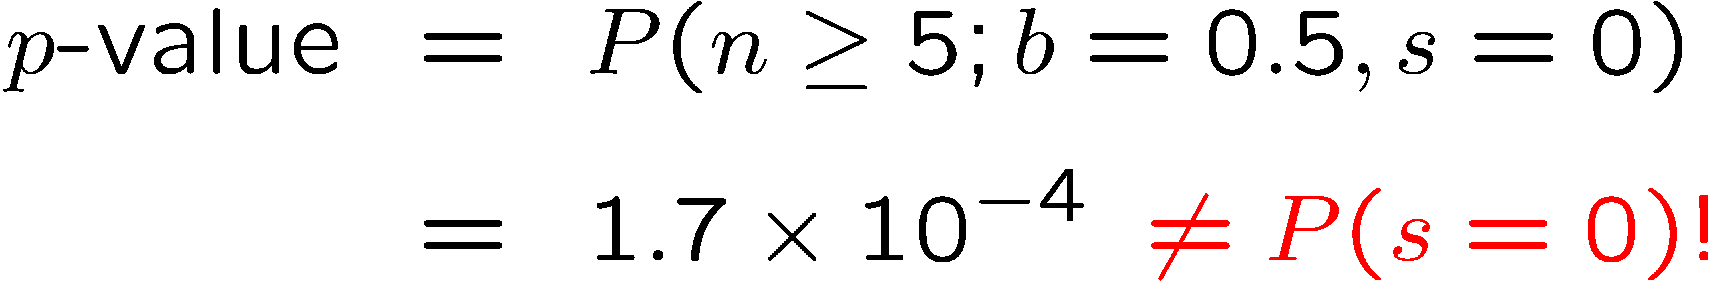
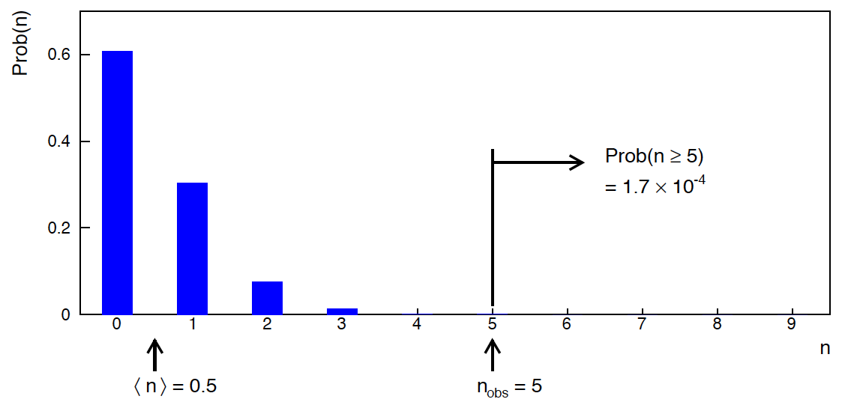
Poisson counting experiment: discovery p-value
Suppose b = 0.5 (known), and we observe n_{obs} = 5.
Should we claim evidence for a new discovery?
Give p-value for hypothesis s = 0, suppose relevant alt. is s > 0.

Slide 21
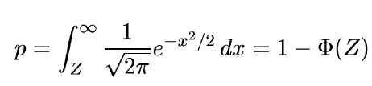
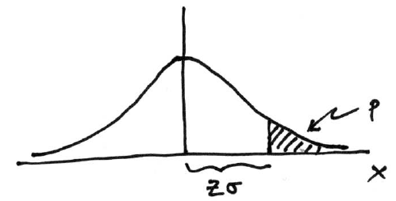

Significance from p-value
Often define significance Z as the number of standard deviations
that a Gaussian variable would fluctuate in one direction
to give the same p-value.
in ROOT:
p = 1 - TMath::Freq(Z)
Z = TMath::NormQuantile(1-p)
in python (scipy.stats):
p = 1 - norm.cdf(Z) = norm.sf(Z)
Z = norm.ppf(1-p)
Result Z is a “number of sigmas”. Note this does not mean that
the original data was Gaussian distributed.

Slide 22

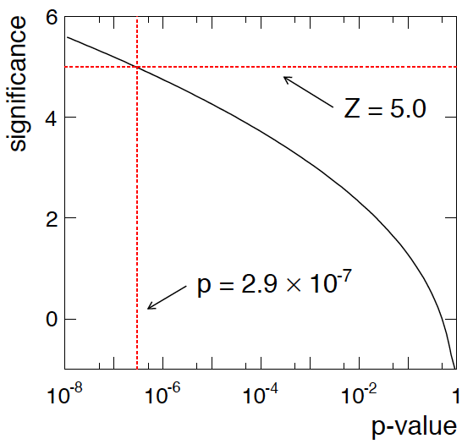
Poisson counting experiment: discovery significance
Equivalent significance for p = 1.7 × 10⁻⁴:
Often claim discovery if Z > 5 (p < 2.9 × 10⁻⁷, i.e., a “5-sigma effect”)
In fact this tradition should be revisited: p-value intended to quantify probability of a signal-like fluctuation assuming background only; not intended to cover, e.g., hidden systematics, plausibility signal model, compatibility of data with signal, “look-elsewhere effect”
(~multiple testing), etc.

Slide 23
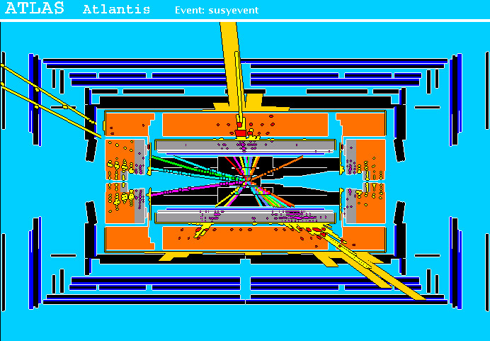
Particle Physics context for a hypothesis test
A simulated SUSY event (“signal”):
high p_{T}
muons
high p_{T} jets
of hadrons
p
p
missing transverse energy

Slide 24
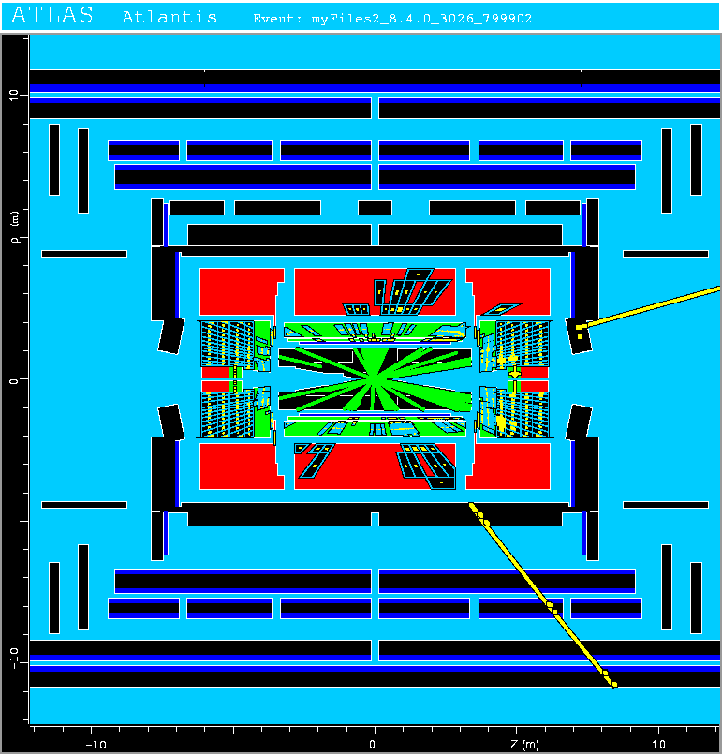
Background events
This event from Standard
Model ttbar production also
has high p_{T} jets and muons,
and some missing transverse
energy.
→ can easily mimic a
signal event.

Slide 25
Classification of proton-proton collisions
Proton-proton collisions can be considered to come in two classes:
signal (the kind of event we’re looking for, y = 1)
background (the kind that mimics signal, y = 0)
For each collision (event), we measure a collection of features:
x₁ = energy of muon x₄ = missing transverse energy
x₂ = angle between jets x₅ = invariant mass of muon pair
x₃ = total jet energy x₆ = ...
The real events don’t come with true class labels, but computer-simulated events do. So we can have a set of simulated events that consist of a feature vector x and true class label y (0 for background, 1 for signal):
(x, y)₁, (x, y)₂, ..., (x, y)_{N}
The simulated events are called “training data”.

Slide 26
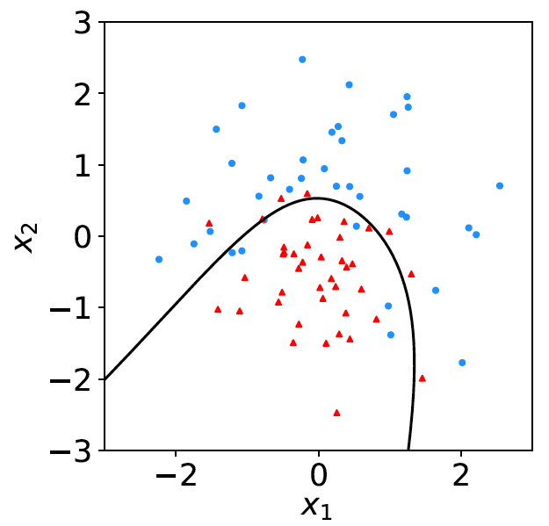
Distributions of the features
If we consider only two
features x = (x₁, x₂), we can
display the results in a scatter
plot (red: y = 0, blue: y = 1).
For real events, the dots are black (true type is not known).
For each real event test the hypothesis that it is background.
(Related to this: test that a sample of events is all background.)
The test’s critical region is defined by a “decision boundary” – without knowing the event type, we can classify them by seeing where their measured features lie relative to the boundary.

Slide 27
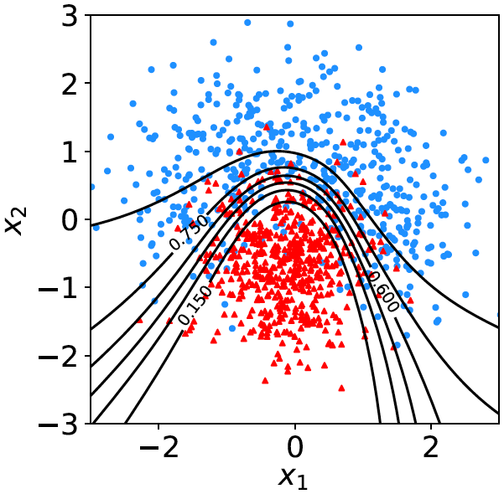

Decision function, test statistic
A surface in an n-dimensional
space can be described by
scalar
function
constant
Different values of the constant
t_{c} result in a family of surfaces.
Problem is reduced to finding
the best decision function or test statistic t (x).

Slide 28
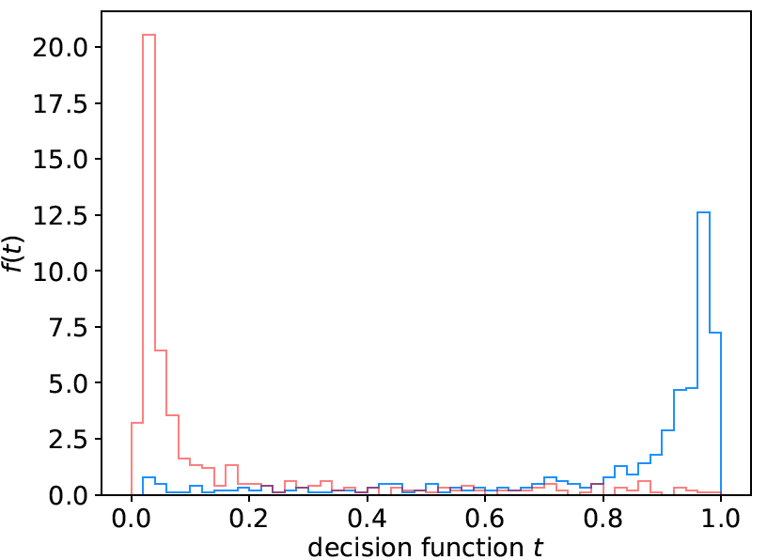
Distribution of t(x)
By forming a test statistic t(x), the boundary of the critical region in the n-dimensional x-space is determined by a single single value t_{c}.
f (t|H₀)
f (t|H₁)
t_{c}
W

Slide 29
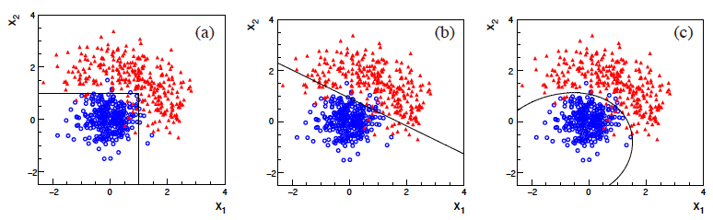
Types of decision boundaries
So what is the optimal boundary for the critical region, i.e., what
is the optimal test statistic t(x)?
First find best t(x), later address issue of optimal size of test.
Remember x-space can have many dimensions.
“cuts”
linear
non-linear

Slide 30
Test statistic based on likelihood ratio
How can we choose a test’s critical region in an ‘optimal way’, in particular if the data space is multidimensional?
Neyman-Pearson lemma states:
For a test of H₀ of size α, to get the highest power with respect to the
alternative H₁ we need for all x in the critical region W
”likelihood
ratio (LR)”
inside W and ≤ c_{α} outside, where c_{α} is a constant chosen to give a test of the desired size.
Equivalently, optimal scalar test statistic is
N.B. any monotonic function of this is leads to the same test.

Slide 31

Neyman-Pearson doesn’t usually help
We usually don’t have explicit formulae for the pdfs f (x|s), f (x|b), so for a given x we can’t evaluate the likelihood ratio
Instead we may have Monte Carlo models for signal and background processes, so we can produce simulated data:
generate x ~ f (x|s) → x₁,..., x_{N}
generate x ~ f (x|b) → x₁,..., x_{N}
This gives samples of “training data” with events of known type.
Use these to construct a statistic that is as close as possible to the optimal likelihood ratio (→ Machine Learning).

Slide 32
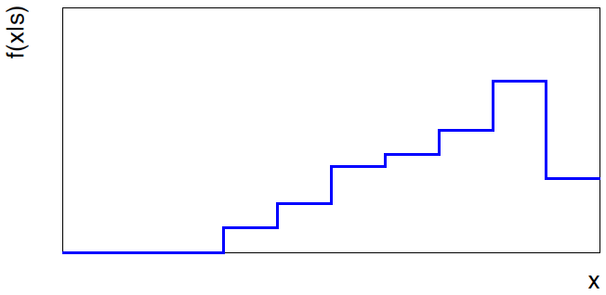
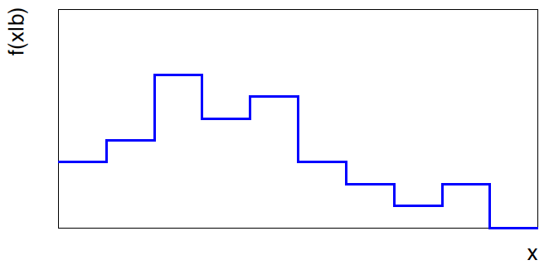


Approximate LR from histograms
Want t(x) = f (x|s)/ f(x|b) for x here
One possibility is to generate
MC data and construct
histograms for both
signal and background.
Use (normalized) histogram
values to approximate LR:
N(x|s)
N (x|s) ≈ f (x|s)
x
N(x|b)
N (x|b) ≈ f (x|b)
Can work well for single
variable.
x

Slide 33
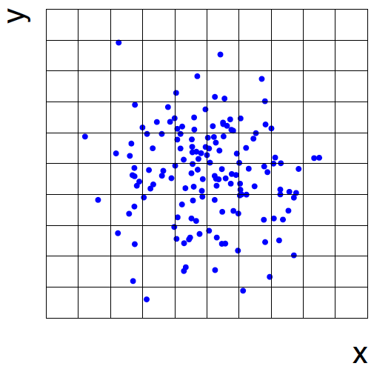
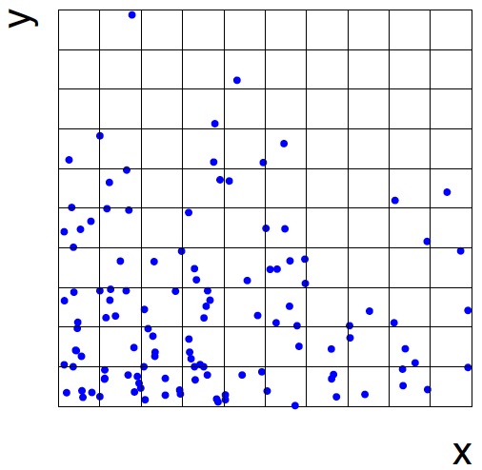
Approximate LR from 2D-histograms
Suppose problem has 2 variables. Try using 2-D histograms:
signal
back-
ground
Approximate pdfs using N (x,y|s), N (x,y|b) in corresponding cells.
But if we want M bins for each variable, then in n-dimensions we
have M^{n} cells; can’t generate enough training data to populate.
→ Histogram method usually not usable for n > 1 dimension.

Slide 34
Strategies for multivariate analysis
Neyman-Pearson lemma gives optimal answer, but cannot be
used directly, because we usually don’t have f (x|s), f (x|b).
Histogram method with M bins for n variables requires that
we estimate M^{n} parameters (the values of the pdfs in each cell),
so this is rarely practical.
A compromise solution is to assume a certain functional form
for the test statistic t (x) with fewer parameters; determine them
(using MC) to give best separation between signal and background.
Alternatively, try to estimate the probability densities f (x|s) and
f (x|b) (with something better than histograms) and use the
estimated pdfs to construct an approximate likelihood ratio.

Slide 35
Multivariate methods (Machine Learning)
Many new (and some old) methods:
Fisher discriminant
(Deep) Neural Networks
Kernel density methods
Support Vector Machines
Decision trees
Boosting
Bagging

Slide 36

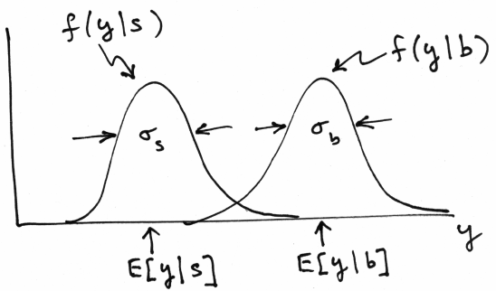
Linear test statistic
Suppose there are n input variables: x = (x₁,..., x_{n}).
Consider a linear function:
For a given choice of the coefficients w = (w₁,..., w_{n}) we will
get pdfs f (y|s) and f (y|b) :

Slide 37





Linear test statistic
Fisher: to get large difference between means and small widths
for f (y|s) and f (y|b), maximize the difference squared of the
expectation values divided by the sum of the variances:
Setting ∂J / ∂w_{i} = 0 gives:
,

Slide 38

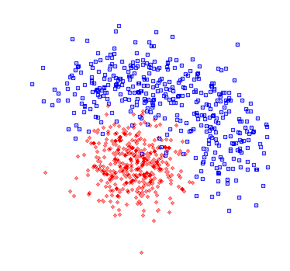



The Fisher discriminant
The resulting coefficients w_{i} define a Fisher discriminant.
Coefficients defined up to multiplicative constant; can also
add arbitrary offset, i.e., usually define test statistic as
Boundaries of the test’s
critical region are surfaces
of constant y(x), here linear
(hyperplanes):

Slide 39
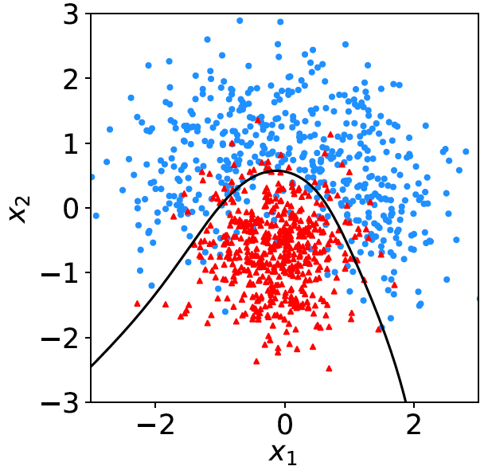
Nonlinear decision boundaries
From the scatter plot below it’s clear that some nonlinear boundary
would be better than a linear one:
And to have a nonlinear boundary, the decision function t (x) must be nonlinear in x.

Slide 40

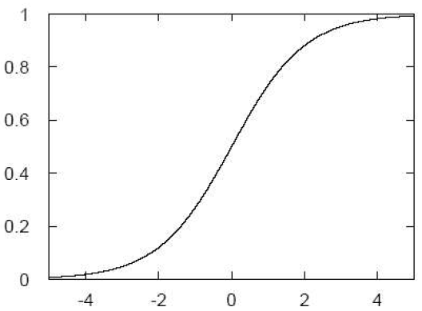

Neural Networks
A simple nonlinear decision function can be constructed as
where h is called the “activation function”. For this one
can use, e.g., a logistic sigmoid function,
u

Slide 41
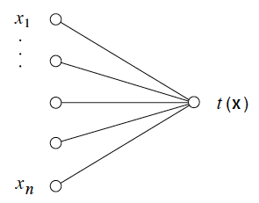

Single Layer Perceptron
In this form, the decision
function is called a
Single Layer Perceptron –
the simplest example of a
Neural Network.
output node
input layer
But the surface described by t (x) = t_{c} is the same as by
So here we still have a linear decision boundary.

Slide 42



Multilayer Perceptron
The Single Layer Perceptron can be generalized by defining
first a set of functions φ_{i}(x), with i = 1,..., m:
The φ_{i}(x) are then treated as if they were the input variables, in
a perceptron, i.e., the decision function (output node) is

Slide 43
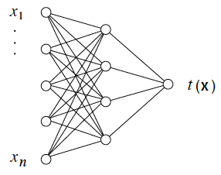
Multilayer Perceptron (2)
output node
hidden layer with m nodes
φ₁(x),..., φ_{m}(x)
input
layer
Each line in the graph represents one of the weights w_{ij}^{(k)},
which must be adjusted using the training data.

Slide 44

Training a Neural Network
To train the network (i.e., determine the best values for the
weights), define a loss function, e.g.,
where w represents the set of all weights, the sum is over the
set of training events, and y_{i} is the (numeric) true class label
of each event (0 or 1).
The optimal values of the weights are found by minimizing
E(w) with respect to the weights (non-trivial algorithms:
backpropagation, stochastic gradient descent,...).
The desired result for an event with feature vector x is:
if the event is of type 0, want t (x) ~ 0,
if the event is of type 1, want t (x) ~ 1.

Slide 45
Distribution of neural net output
Degree of separation between classes now much better than
with linear decision function:
back-
ground
signal

Slide 46
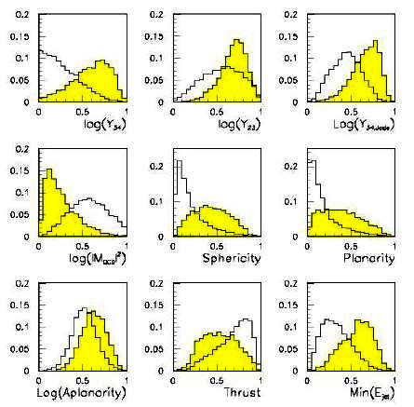
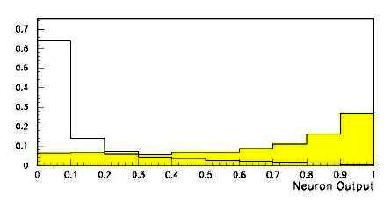
Neural network example from LEP II
Signal: e⁺e⁻ → W⁺W⁻ (often 4 well separated hadron jets)
Background: e⁺e⁻ → qqgg (4 less well separated hadron jets)
← input variables based on jet
structure, event shape, ...
none by itself gives much separation.
Neural network output:
(Garrido, Juste and Martinez, ALEPH 96-144)

Slide 47
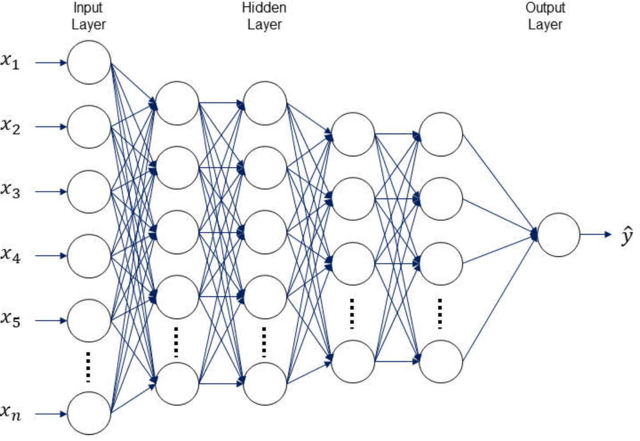
H.I. Kim and K.Y. Han, Water 2020, 12(3), 899
Deep Neural Networks
The multilayer perceptron can be generalized to have an arbitrary number of hidden layers, with an arbitrary number of nodes in each (= “network architecture”).
A “deep” network has several (or many) hidden layers:
“Deep Learning” is a very recent and active field of research.

Slide 48
Comments on network training
The algorithms for adjusting the network parameters have become a very active field of research (and beyond the scope of this course).
Recent ideas include:
“Deep” neural nets, use of ReLU activation function
Stochastic gradient descent: estimate of gradient approximated by a randomly selected subset of the data.
Dropout: randomly exclude nodes during training (prevents “overtraining”)

Slide 49
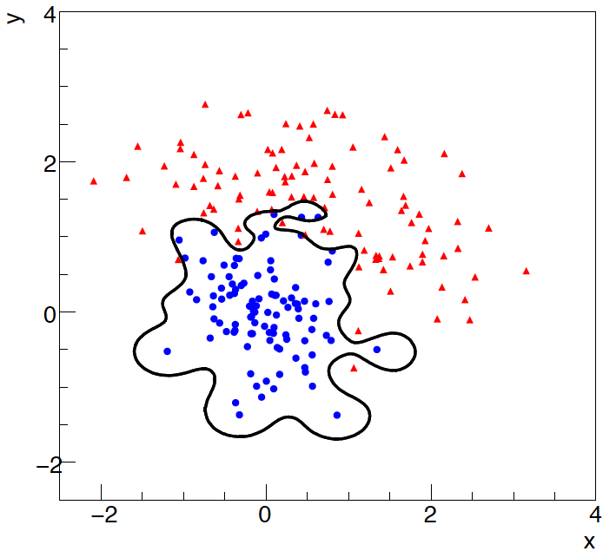
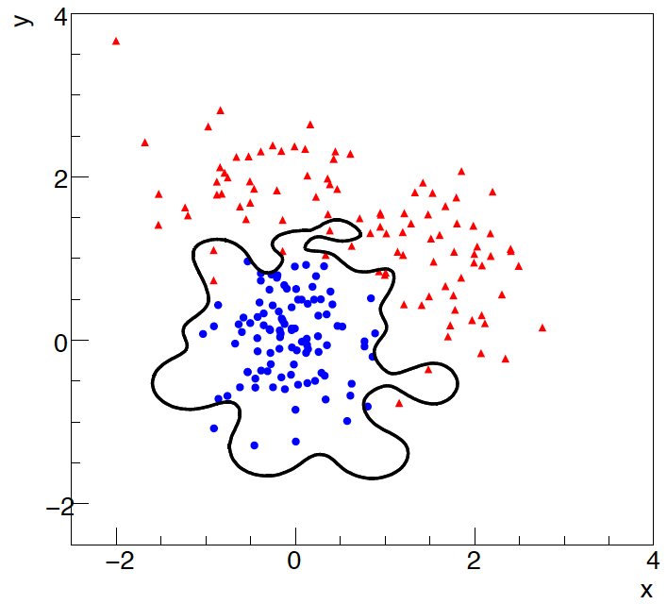
Overtraining
Including more parameters in a classifier makes its decision boundary
increasingly flexible, e.g., more nodes/layers for a neural network.
A “flexible” classifier may conform too closely to the training points;
the same boundary will not perform well on an independent test
data sample (→ “overtraining”).
training sample
independent test sample

Slide 50
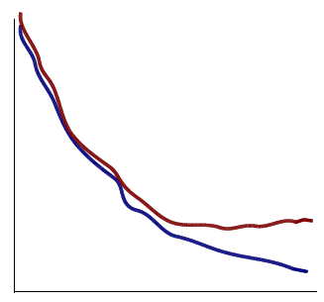
Monitoring overtraining
If we monitor the fraction of misclassified events (or similar, e.g.,
error function E(w)) for test and training samples, it will usually
decrease for both as the boundary is made more flexible:
optimum at minimum of
error rate for test sample
error
rate
increase in error rate
indicates overtraining
test sample
training sample
flexibility (e.g., number
of nodes/layers in MLP)

Slide 51
Other types of classifiers
We have seen only two types of classifiers:
Linear (Fisher discriminant)
Neural Network
There are many others:
Support Vector Machine
Boosted Decision Tree
K-Nearest Neighbour
...
The field is rapidly developing with advances, e.g., that allow one
to use feature vectors of very high dimension, such as the pixels
of an image.
→ face/handwriting recognition, driverless cars...

Slide 52
Extra slides

Slide 53
Some distributions
Distribution/pdf Example use in Particle Physics
Binomial Branching ratio
Multinomial Histogram with fixed N
Poisson Number of events found
Uniform Monte Carlo method
Exponential Decay time
Gaussian Measurement error
Chi-square Goodness-of-fit
Cauchy Mass of resonance
Landau Ionization energy loss
Beta Prior pdf for efficiency
Gamma Sum of exponential variables
Student’s t Resolution function with adjustable tails

Slide 54
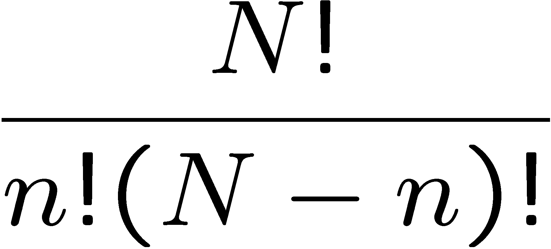
Binomial distribution
Consider N independent experiments (Bernoulli trials):
outcome of each is ‘success’ or ‘failure’,
probability of success on any given trial is p.
Define discrete r.v. n = number of successes (0 ≤ n ≤ N).
Probability of a specific outcome (in order), e.g. ‘ssfsf’ is
But order not important; there are
ways (permutations) to get n successes in N trials, total
probability for n is sum of probabilities for each permutation.

Slide 55
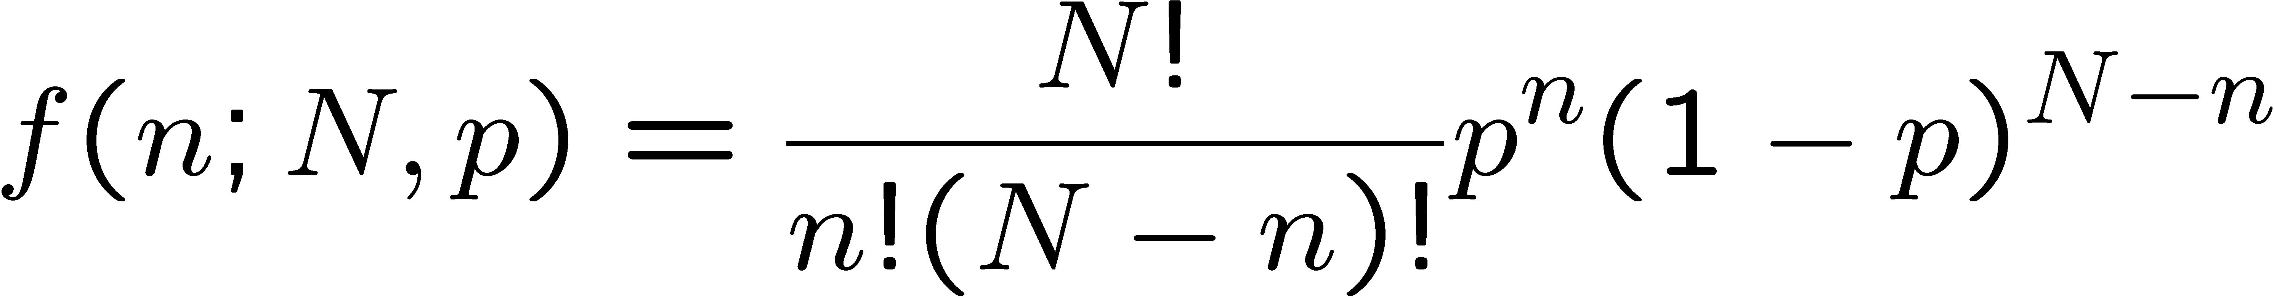
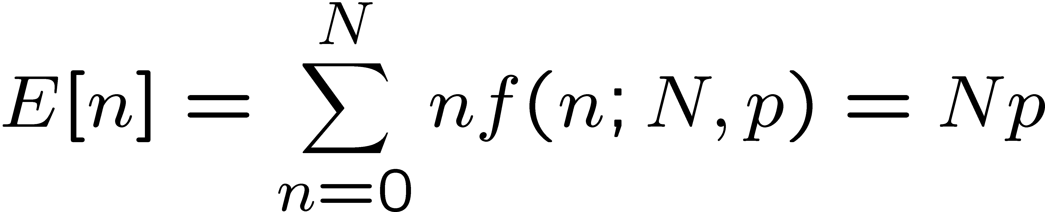
Binomial distribution (2)
The binomial distribution is therefore
random
variable
parameters
For the expectation value and variance we find:

Slide 56
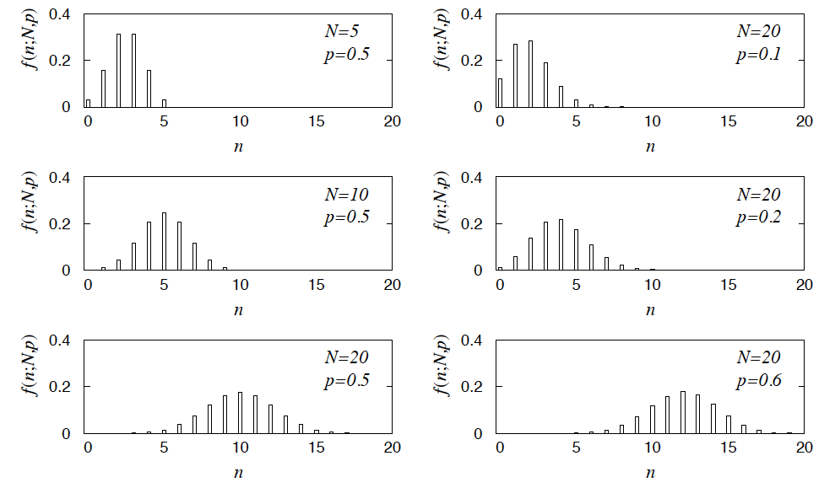
Binomial distribution (3)
Binomial distribution for several values of the parameters:
Example: observe N decays of W±, the number n of which are
W→μν is a binomial r.v., p = branching ratio.

Slide 57
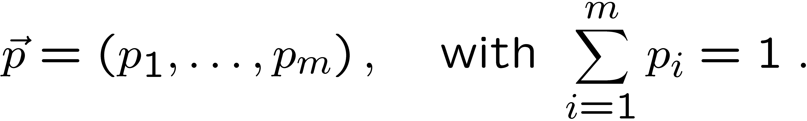
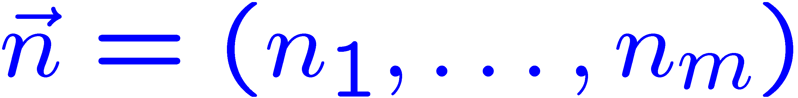
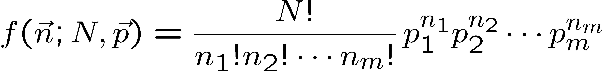
Multinomial distribution
Like binomial but now m outcomes instead of two, probabilities are
For N trials we want the probability to obtain:
n₁ of outcome 1,
n₂ of outcome 2,
⠇
n_{m} of outcome m.
This is the multinomial distribution for

Slide 58

Multinomial distribution (2)
Now consider outcome i as ‘success’, all others as ‘failure’.
→ all n_{i} individually binomial with parameters N, p_{i}
for all i
One can also find the covariance to be
Example:
represents a histogram
with m bins, N total entries, all entries independent.

Slide 59
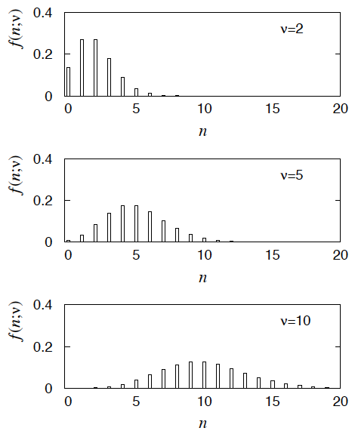
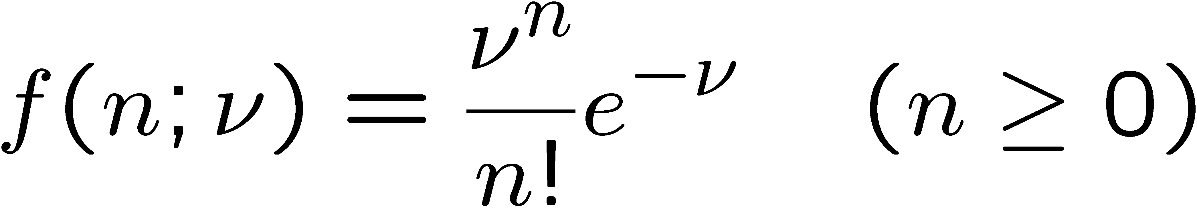
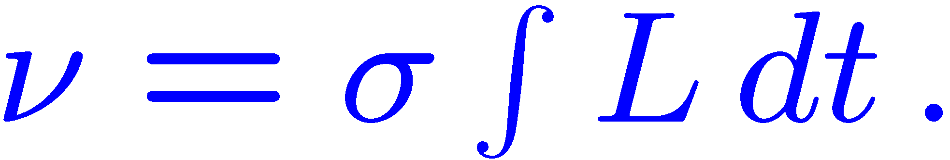
Poisson distribution
Consider binomial n in the limit
→ n follows the Poisson distribution:
Example: number of scattering events
n with cross section σ found for a fixed
integrated luminosity, with

Slide 60
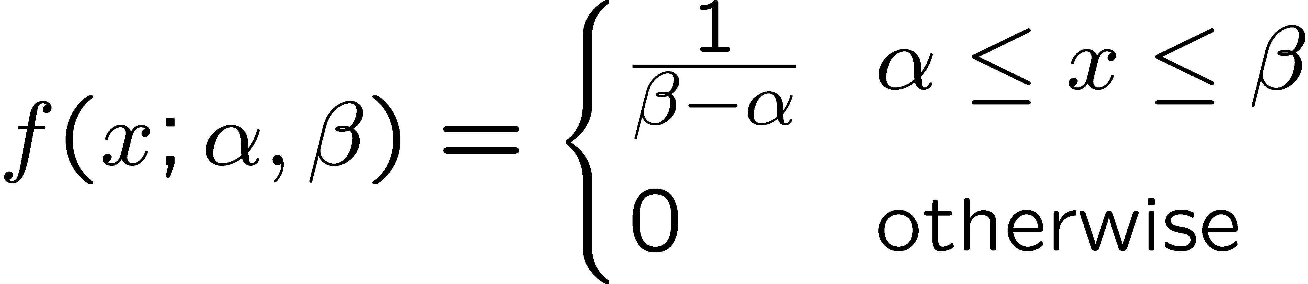
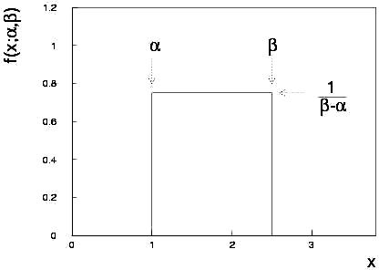
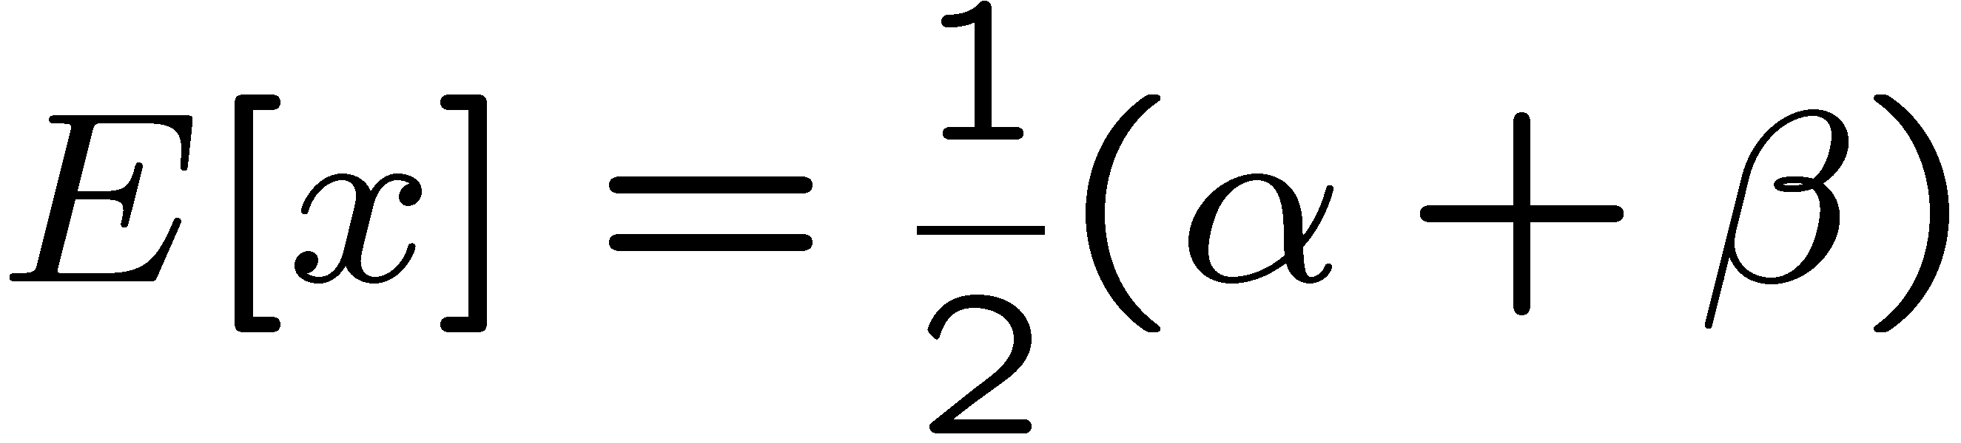
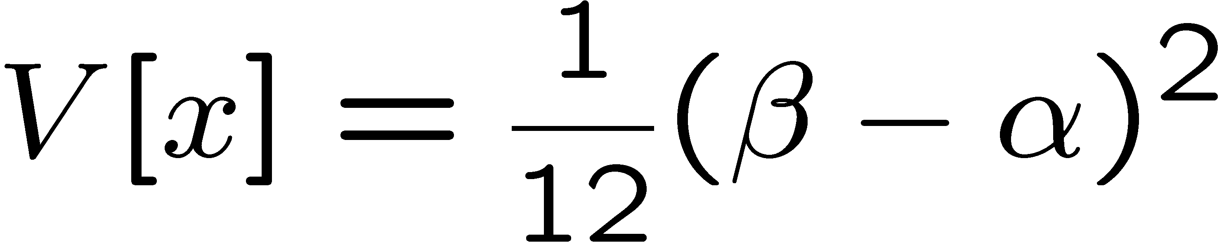
Uniform distribution
Consider a continuous r.v. x with −∞ < x < ∞ . Uniform pdf is:
Notation: x follows a uniform distribution between α and β
write as: x ~ U[α,β]

Slide 61
Uniform distribution (2)
Very often used with α = 0, β = 1 (e.g., Monte Carlo method).
For any r.v. x with pdf f (x), cumulative distribution F(x), the function y = F(x) is uniform in [0,1]:
because f (x) = dF/dx = dy/dx

Slide 62




Exponential distribution
The exponential pdf for the continuous r.v. x is defined by:

Slide 63

Exponential distribution (2)
Example: proper decay time t of an unstable particle
(τ = mean lifetime)
Lack of memory (unique to exponential):
Question for discussion:
A cosmic ray muon is created 30 km high in the atmosphere, travels to sea level and is stopped in a block of scintillator, giving a start signal at t₀. At a time t it decays to an electron giving a stop signal. What is distribution of the difference between stop and start times, i.e., the pdf of t – t₀ given t > t₀?

Slide 64




Gaussian (normal) distribution
The Gaussian (normal) pdf for a continuous r.v. x is defined by:
N.B. often μ, σ² denote
mean, variance of any
r.v., not only Gaussian.

Slide 65

Standardized random variables
If a random variable y has pdf f (y) with mean μ and std. dev. σ,
then the standardized variable
has the pdf
has mean of zero and standard deviation of 1.
Often work with the standard Gaussian distribution (μ = 0. σ = 1)
using notation:
Then e.g. y = μ + σ x follows

Slide 66




Multivariate Gaussian distribution
Multivariate Gaussian pdf for the vector
are column vectors,
are transpose (row) vectors,
Marginal pdf of each x_{i} is Gaussian with mean μ_{i}, standard deviation σ_{i} = √V_{ii} .

Slide 67


https://en.wikipedia.org/wiki/Multivariate_normal_distribution
Two-dimensional Gaussian distribution
where ρ = cov[x₁, x₂]/(σ₁σ₂)
is the correlation coefficient.

Slide 68



Chi-square (χ²) distribution
The chi-square pdf for the continuous r.v. z (z ≥ 0) is defined by
n = 1, 2, ... = number of ‘degrees of
freedom’ (dof)
For independent Gaussian x_{i}, i = 1, ..., n, means μ_{i}, variances σ_{i}²,
follows χ² pdf with n dof.
Example: goodness-of-fit test variable especially in conjunction
with method of least squares.

Slide 69


Cauchy (Breit-Wigner) distribution
The Breit-Wigner pdf for the continuous r.v. x is defined by
(Γ = 2, x₀ = 0 is the Cauchy pdf.)
E[x] not well defined, V[x] → ∞.
x₀ = mode (most probable value)
Γ = full width at half maximum
Example: mass of resonance particle, e.g. ρ, K*, φ⁰, ...
Γ = decay rate (inverse of mean lifetime)

Slide 70





Landau distribution
For a charged particle with β = ν /c traversing a layer of matter
of thickness d, the energy loss Δ follows the Landau pdf:
Δ
β
+ - + -
- + - +
d
L. Landau, J. Phys. USSR 8 (1944) 201; see also
W. Allison and J. Cobb, Ann. Rev. Nucl. Part. Sci. 30 (1980) 253.

Slide 71

Landau distribution (2)
Long ‘Landau tail’
→ all moments ∞
Mode (most probable
value) sensitive to β ,
→ particle i.d.

Slide 72




Beta distribution
Often used to represent pdf
of continuous r.v. nonzero only
between finite limits, e.g.,
y = a₀ + a₁x, a₀ ≤ y ≤ a₀ + a₁

Slide 73




Gamma distribution
Often used to represent pdf
of continuous r.v. nonzero only
in [0,∞].
Also e.g. sum of n exponential
r.v.s or time until nth event
in Poisson process ~ Gamma

Slide 74




Student's t distribution
ν = number of degrees of freedom
(not necessarily integer)
ν = 1 gives Cauchy,
ν → ∞ gives Gaussian.

Slide 75
Student's t distribution (2)
If x ~ Gaussian with μ = 0, σ² = 1, and
z ~ χ² with n degrees of freedom, then
t = x / (z/n)^{1/2} follows Student's t with ν = n.
This arises in problems where one forms the ratio of a sample
mean to the sample standard deviation of Gaussian r.v.s.
The Student's t provides a bell-shaped pdf with adjustable
tails, ranging from those of a Gaussian, which fall off very
quickly, (ν → ∞, but in fact already very Gauss-like for
ν = two dozen), to the very long-tailed Cauchy (ν = 1).
Developed in 1908 by William Gosset, who worked under
the pseudonym "Student" for the Guinness Brewery.
Notes:
here

Slide 76




Proof of Neyman-Pearson Lemma
Consider a critical region W and suppose the LR satisfies the criterion of the Neyman-Pearson lemma:
P(x|H₁)/P(x|H₀) ≥ c_{α} for all x in W,
P(x|H₁)/P(x|H₀) ≤ c_{α} for all x not in W.
W
Try to change this into a different critical region W′ retaining the same size α, i.e.,
δW₊
To do so add a part δW₊, but to keep the size α, we need to remove a part δW₋, i.e.,
W′
δW₋

Slide 77
Proof of Neyman-Pearson Lemma (2)
δW₊
But we are supposing the LR is higher for all x in δW₋ removed than for the x in δW₊ added, and therefore
W′
δW₋
The right-hand sides are equal and therefore

Slide 78
Proof of Neyman-Pearson Lemma (3)
We have
δW₊
W′
Note W and δW₊ are disjoint, and W′ and δW₋ are disjoint, so by Kolmogorov’s 3rd axiom,
δW₋
Therefore

Slide 79
Proof of Neyman-Pearson Lemma (4)
And therefore
i.e. the deformed critical region W′ cannot have higher power than the original one that satisfied the LR criterion of the Neyman-Pearson lemma.

