Slide 1
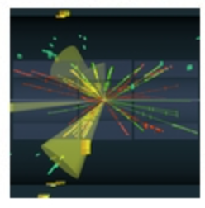


Parameter Estimation
Hands-on Session
Taller de Altas Energías
Benasque, Spain (online)
4,5 September 2023
http://benasque.org/2023tae/
Glen Cowan
Physics Department
Royal Holloway, University of London
g.cowan@rhul.ac.uk
www.pp.rhul.ac.uk/~cowan

Slide 2
Introduction and materials
The exercises for parameter estimation are at
https://www.pp.rhul.ac.uk/~cowan/stat/exercises/fitting
The exercise and are described in the file fitting_exercises.pdf.
There are both python and ROOT/C++ versions.
mlFit.py ← use this for today’s exercises
histFit.py ← binned version (uses python class)
For python, you need python 3 and install iminuit from https://pypi.org/project/iminuit/ with pip install iminuit
For ROOT you should have version 6 and C++ installed with a “cern-like” (e.g., lxplus) setup.
Prior to the exercises we will see how to obtain a confidence interval/region directly from contours of the log-likelihood.

Slide 3
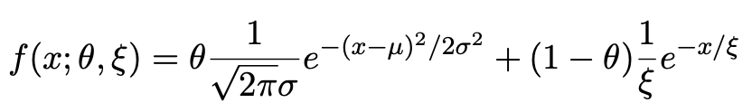
Introduction to the exercises
Consider a pdf for continuous random variable x, (truncate and renormalize in 0 ≤ x ≤ x_{max})
θ = parameter of interest ,
gives signal rate.
Depending on context, take ξ, μ, σ as nuisance parameters or fixed.
Generate i.i.d. sample x₁,..., x_{n}.
Estimate θ (and other params.)

Slide 4
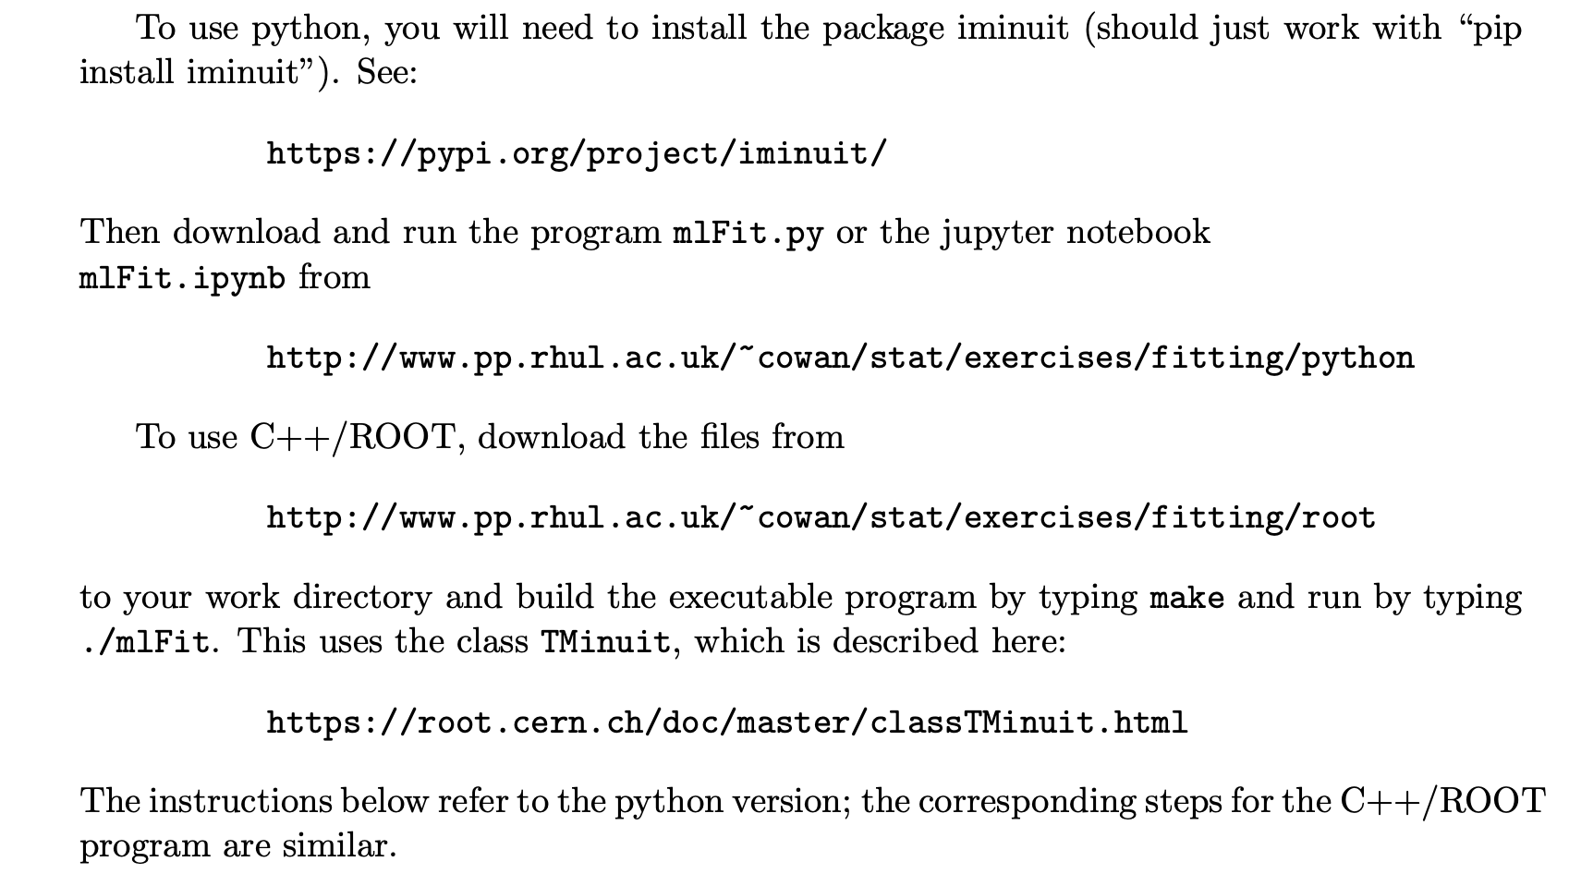
Fitting with MINUIT (python or root/C++)

Slide 5
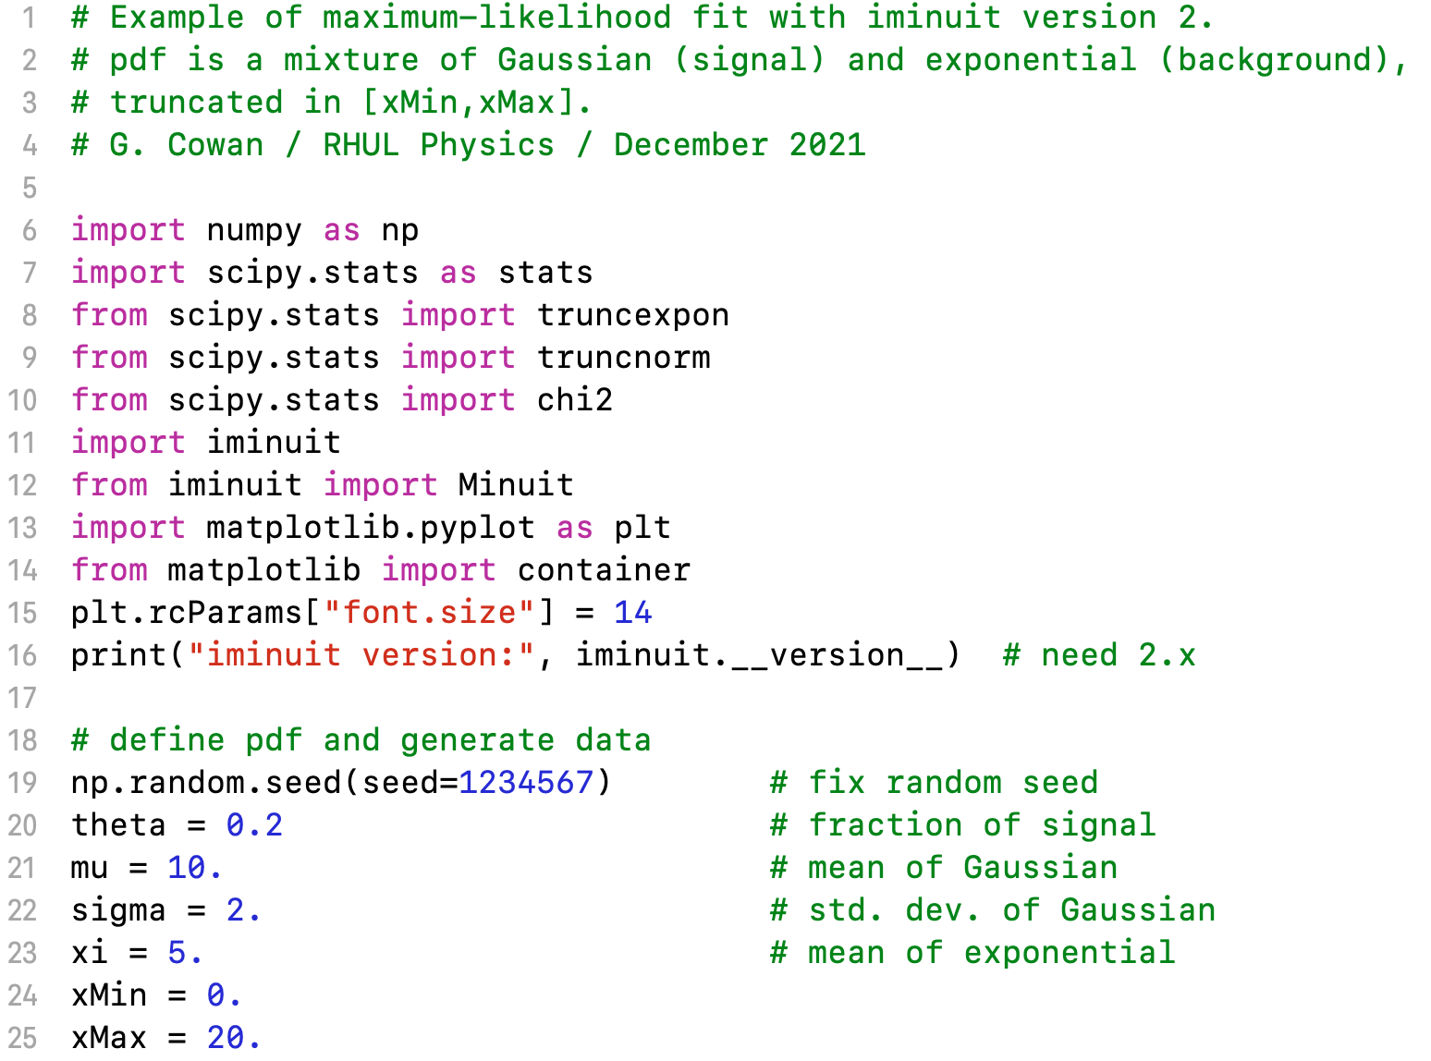
mlFit.py (also jupyter notebook mlFit.ipynb)

Slide 6
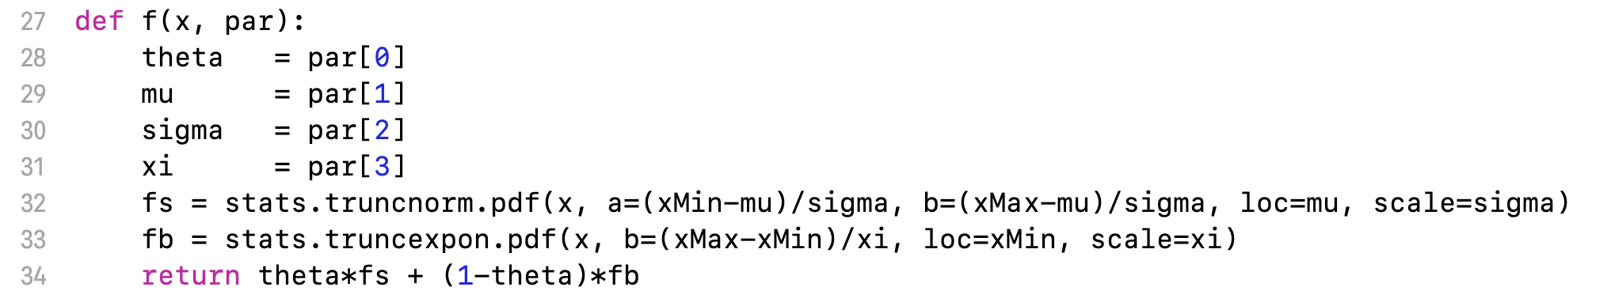
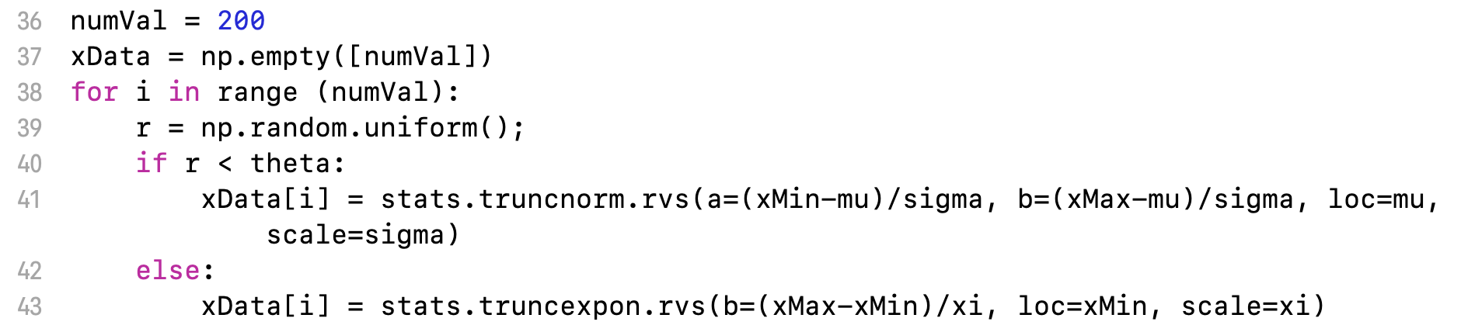
Define the fit function
Generate the data

Slide 7
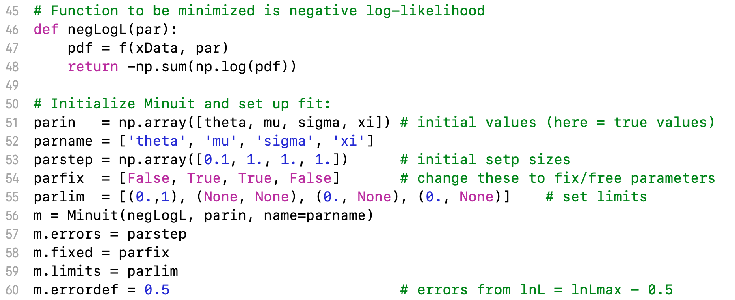
Set up the fit

Slide 8
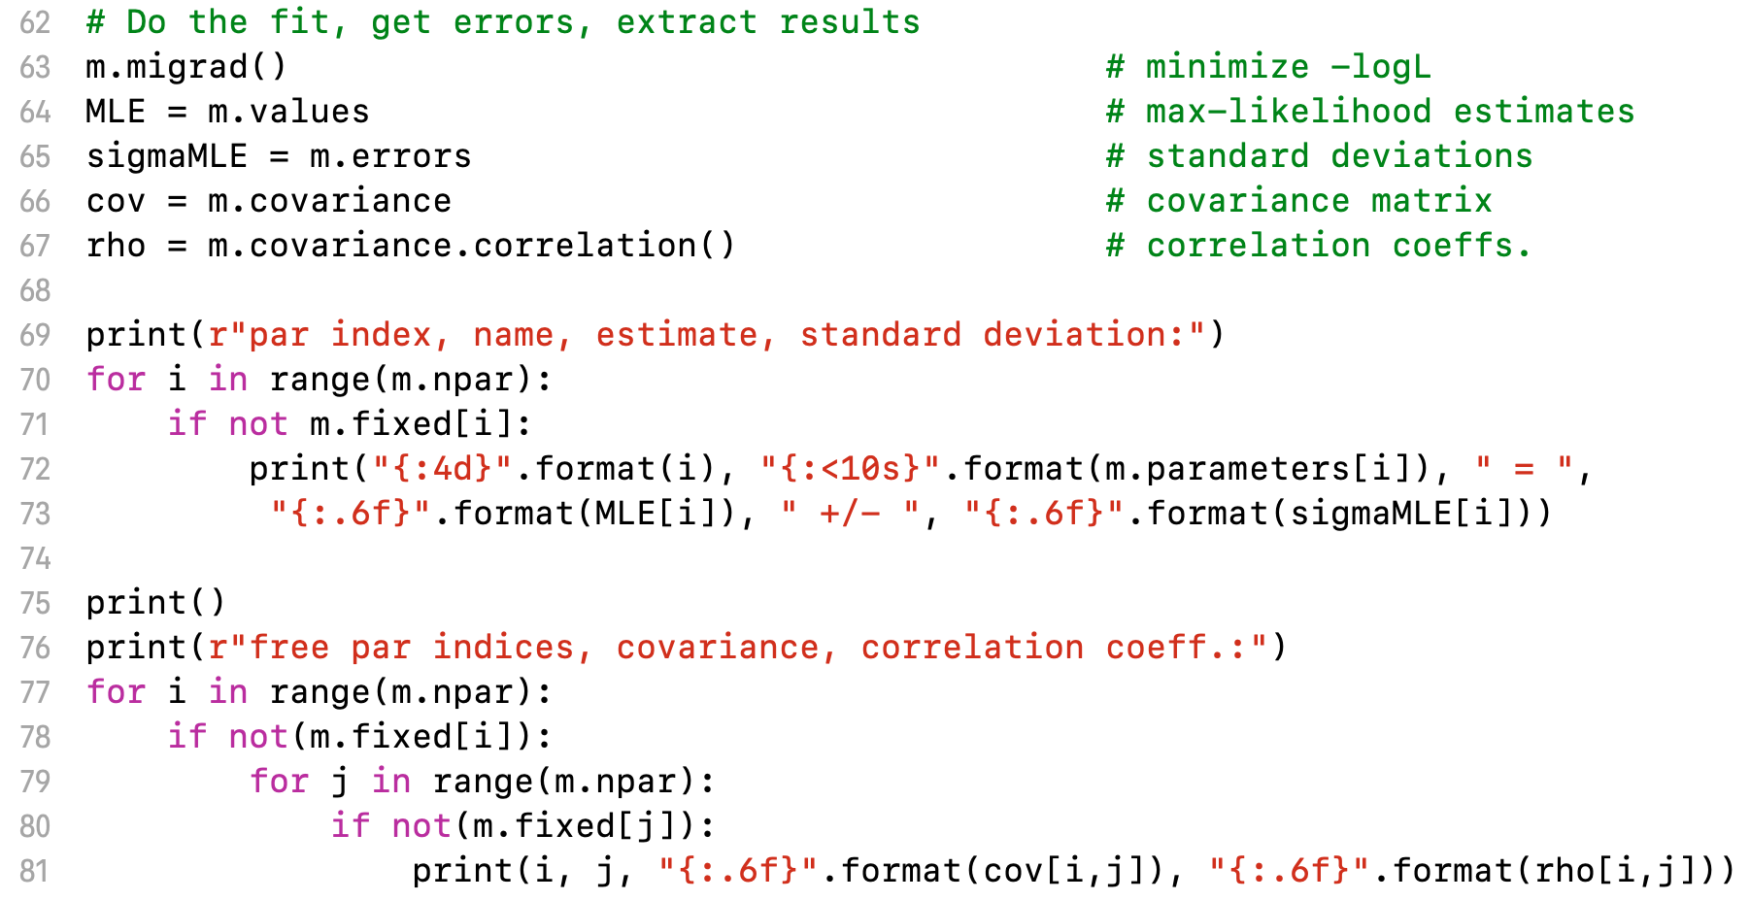
Do the fit, get errors, extract results
Make some plots...

Slide 9




Approximate confidence intervals/regions
from the likelihood function
Suppose we test parameter value(s) θ = (θ₁, ..., θ_{n}) using the ratio
Lower λ(θ) means worse agreement between data and hypothesized θ. Equivalently, usually define
so higher t_{θ} means worse agreement between θ and the data.
p-value of θ therefore
need pdf

Slide 10




Confidence region from Wilks’ theorem
Wilks’ theorem says (in large-sample limit and provided
certain conditions hold...)
chi-square dist. with # d.o.f. =
# of components in θ = (θ₁, ..., θ_{n}).
Assuming this holds, the p-value is
← set equal to α
To find boundary of confidence region set p_{θ} = α and solve for t_{θ}:
Recall also

Slide 11




Confidence region from Wilks’ theorem (cont.)
i.e., boundary of confidence region in θ space is where
For example, for 1 – α = 68.3% and n = 1 parameter,
and so the 68.3% confidence level interval is determined by
Same as recipe for finding the estimator’s standard deviation, i.e.,
is a 68.3% CL confidence interval.

Slide 12
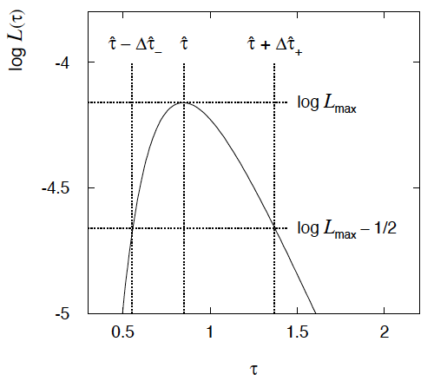

Example of interval from ln L(θ)
For n=1 parameter, CL = 0.683, Q_{α} = 1.
Our exponential
example, now with
only n = 5 events.
Can report ML estimate
with approx. confidence
interval from ln L_{max} – 1/2
as “asymmetric error bar”:

Slide 13

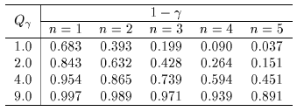

Multiparameter case
For increasing number of parameters, CL = 1 – α decreases for
confidence region determined by a given

Slide 14
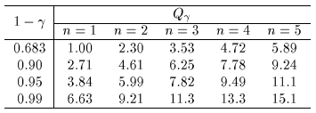
Multiparameter case (cont.)
Equivalently, Q_{α} increases with n for a given CL = 1 – α.

Slide 15
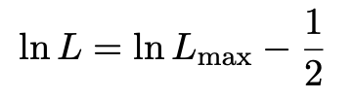
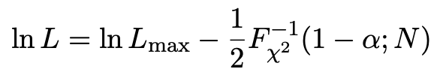

Comment on the lnL = lnL_{max} – ½ contour
In the lectures, we saw that the standard deviations of fitted parameters are found from the tanget lines (planes) to the contour
A similar procedure can be used to find a “confidence region” in the parameter space that will cover the true parameter with probability CL = 1 – α (the “confidence level). This uses the contour
, N = number of parameters
If you want the contour lnL = lnL_{max} – ½ in iminuit, you need to choose CL (= 1 – α) such that F_{χ2}⁻¹(1 – α,N) = 1, i.e.,

Slide 16
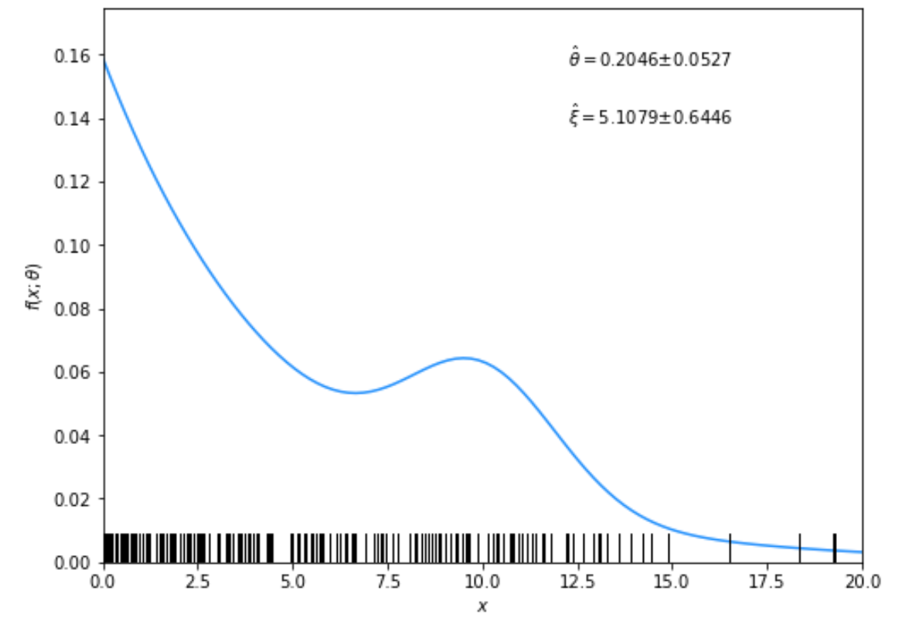
Solutions to exercises
1a) Running the program mlFit.py produces the following plots:
A fit of the pdf:

Slide 17
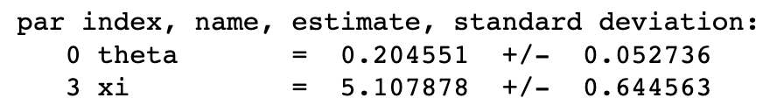
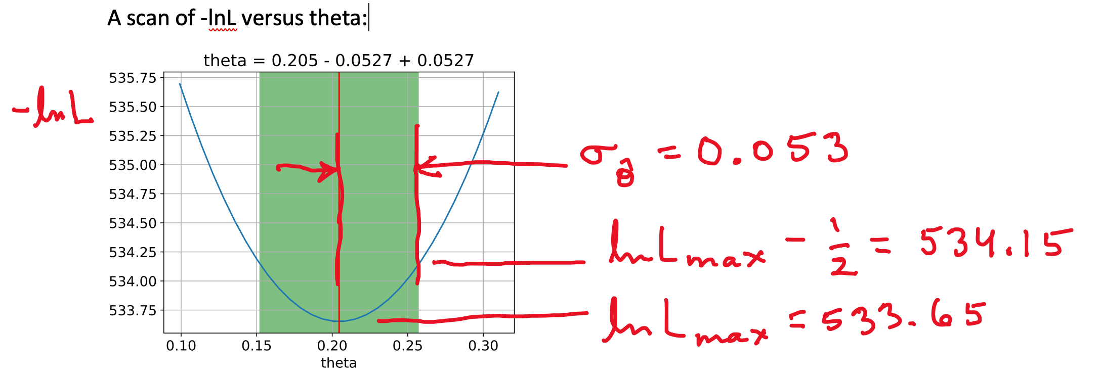
From running program:

Slide 18
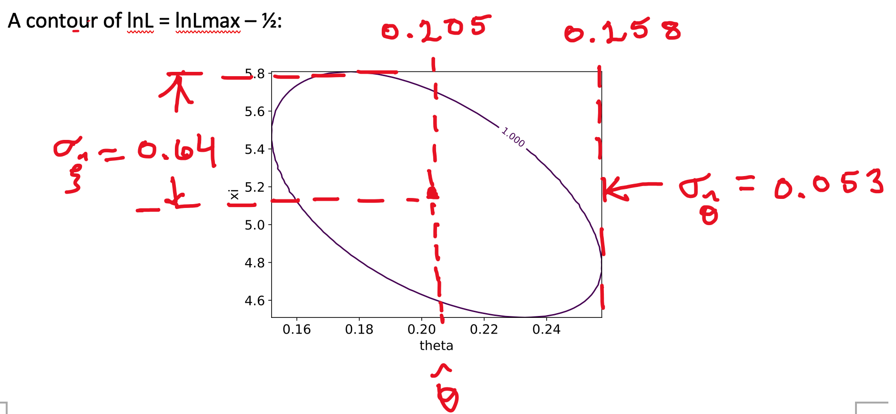

Slide 19
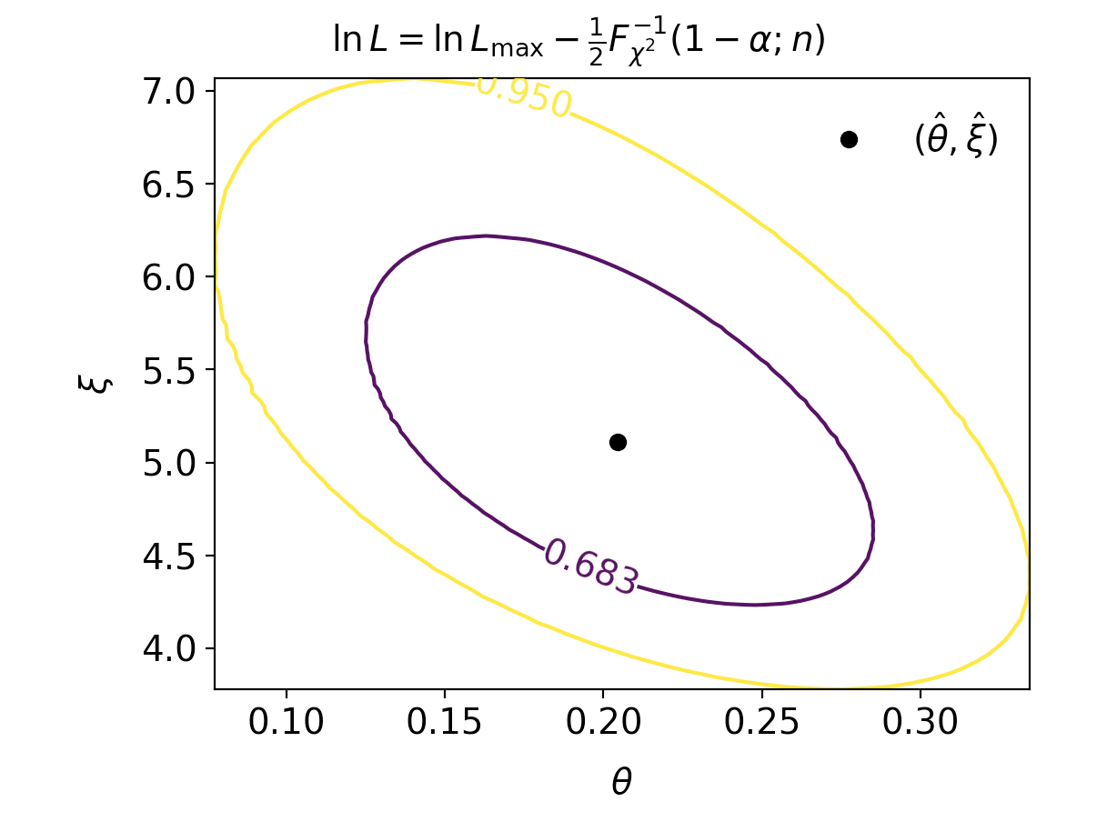

Slide 20
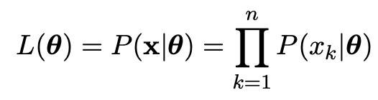
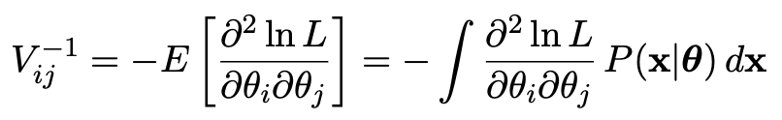
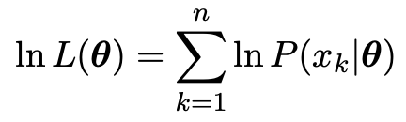
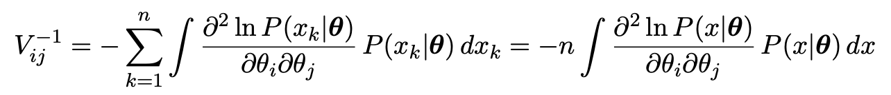

1b) Assume i.i.d. data sample, so
Assume inverse covariance from Fisher Information (large sample):
Since
we find
But V⁻¹V = I so if V⁻¹ ∝ n, then V ∝ 1/n, and so from the square roots of the diagonal elements

Slide 21
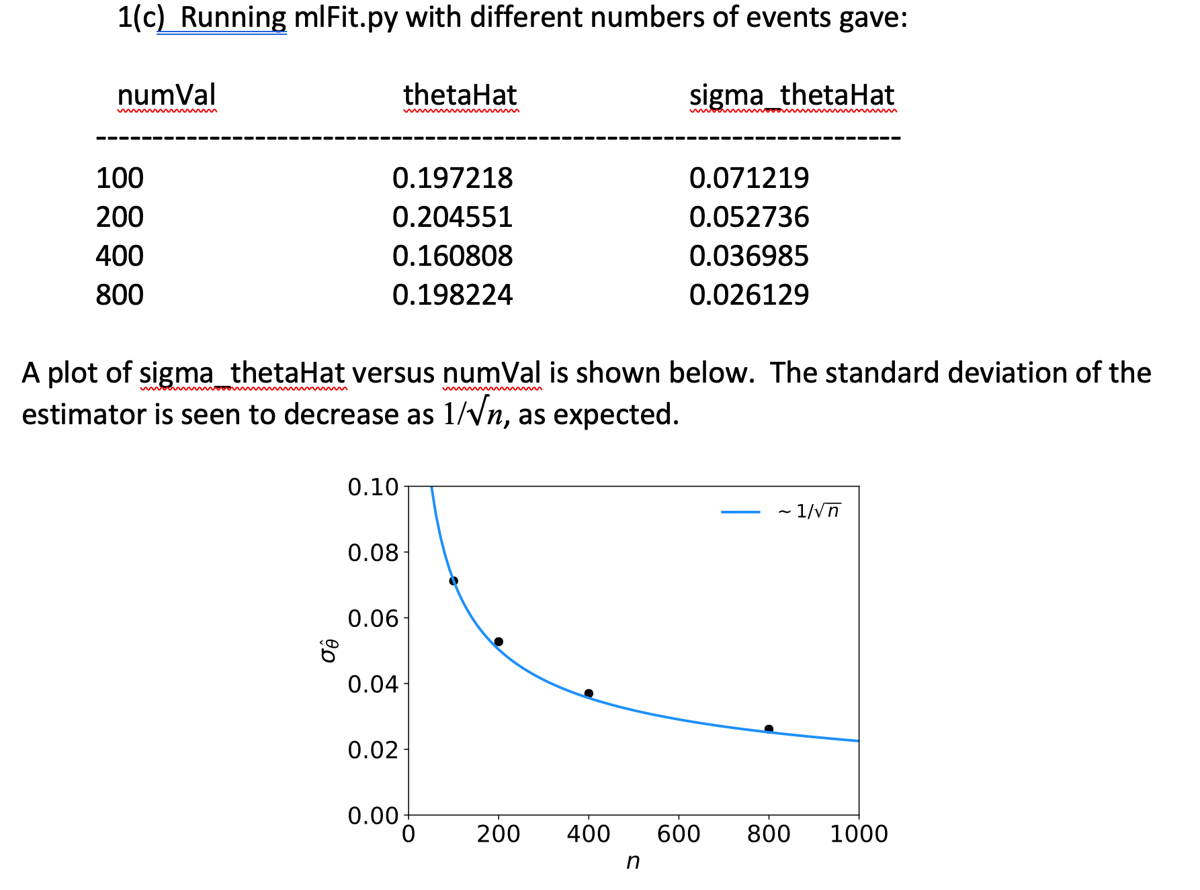

Slide 22
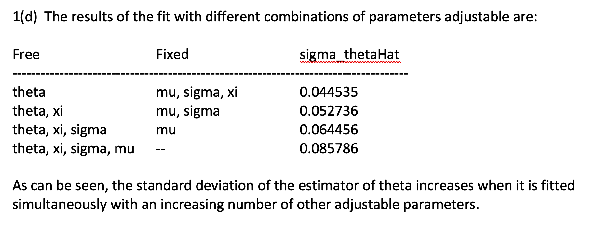

Slide 23
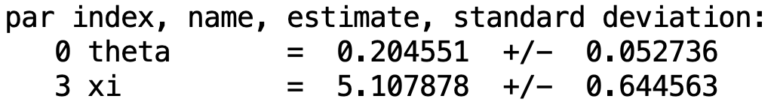
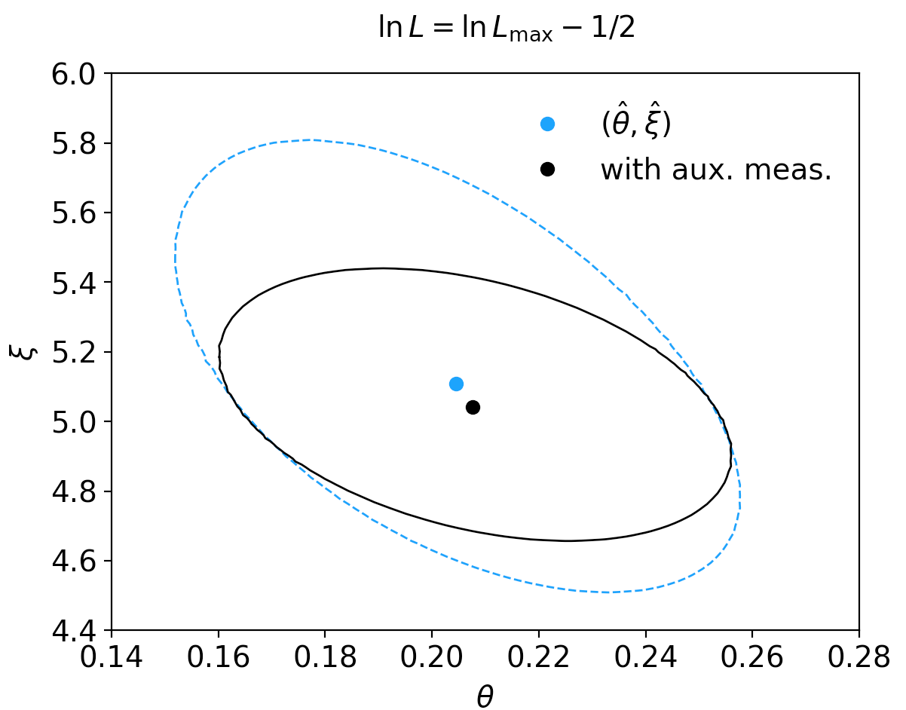
1(e) By including the auxiliary measurement u one uses more information about ξ and thus the covariance ellipse shrinks. This reduces the standard deviations of the MLEs for both ξ and θ.

Slide 24
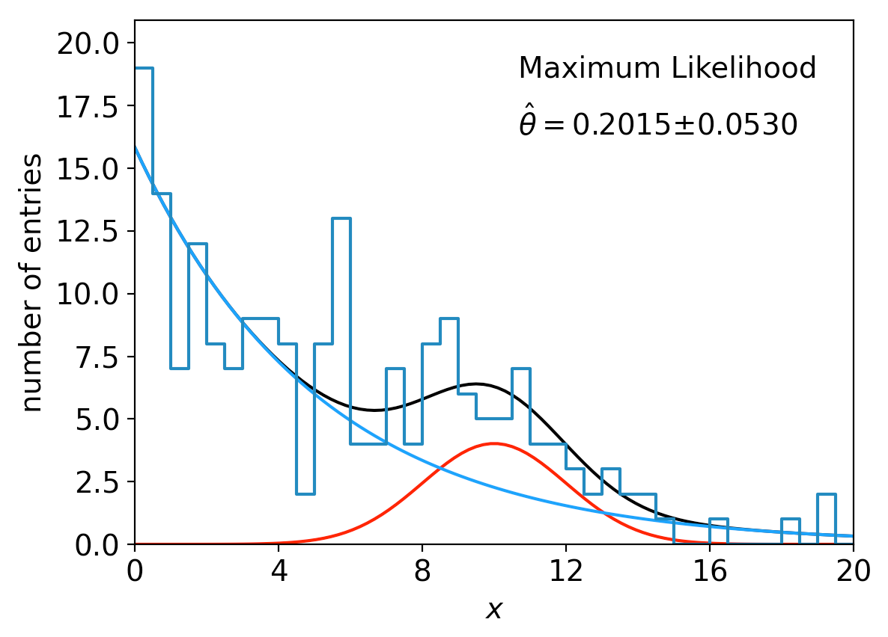
lnL in a class, binned data,...
Sometimes it is convenient to have the function being minimized as a method of a class. An example of this is shown in the program histFit.py (in same directory), which does the same fit as in mlFit but with a histogram of the data:

