Slide 1
Statistical Data Analysis
Discussion slides – week 10
Problem sheet 7
Bonus problem: Bayesian parameter estimation and MCMC

Slide 2
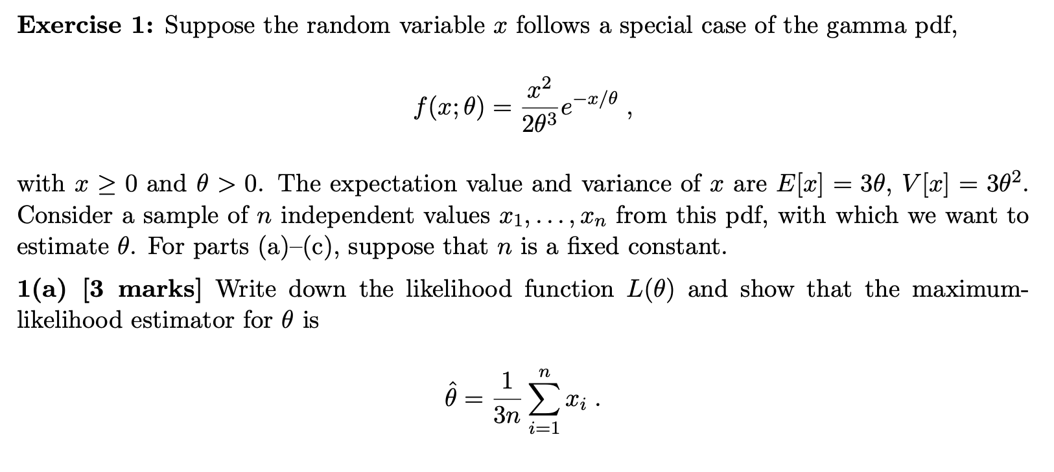
Problem sheet 7

Slide 3
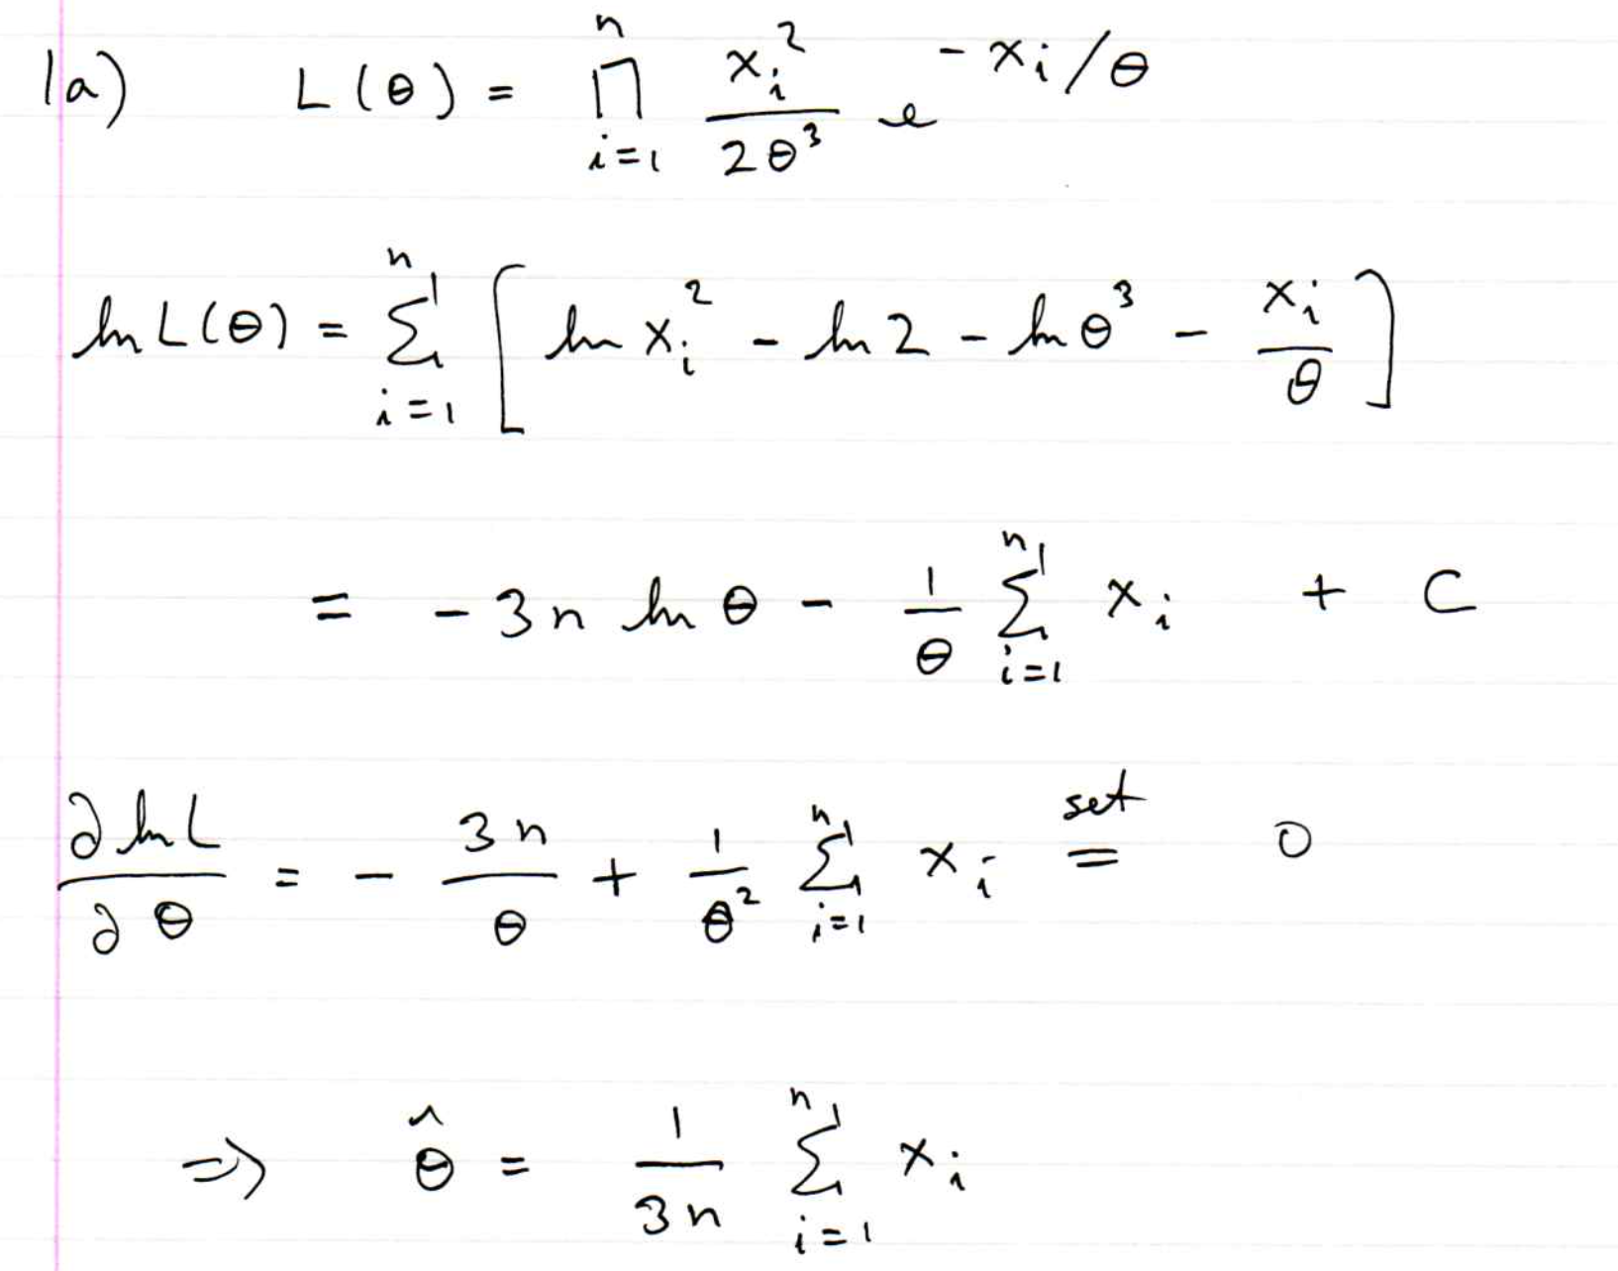
Problem sheet 7

Slide 4
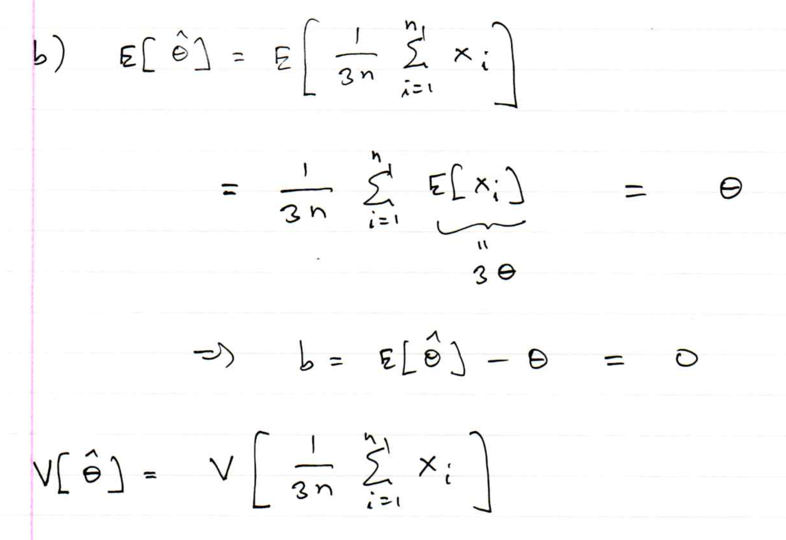
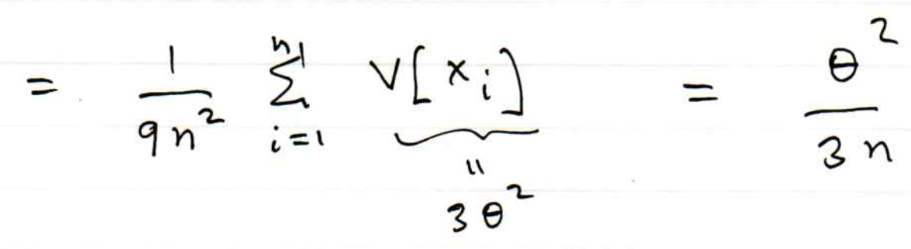
Problem sheet 7

Slide 5
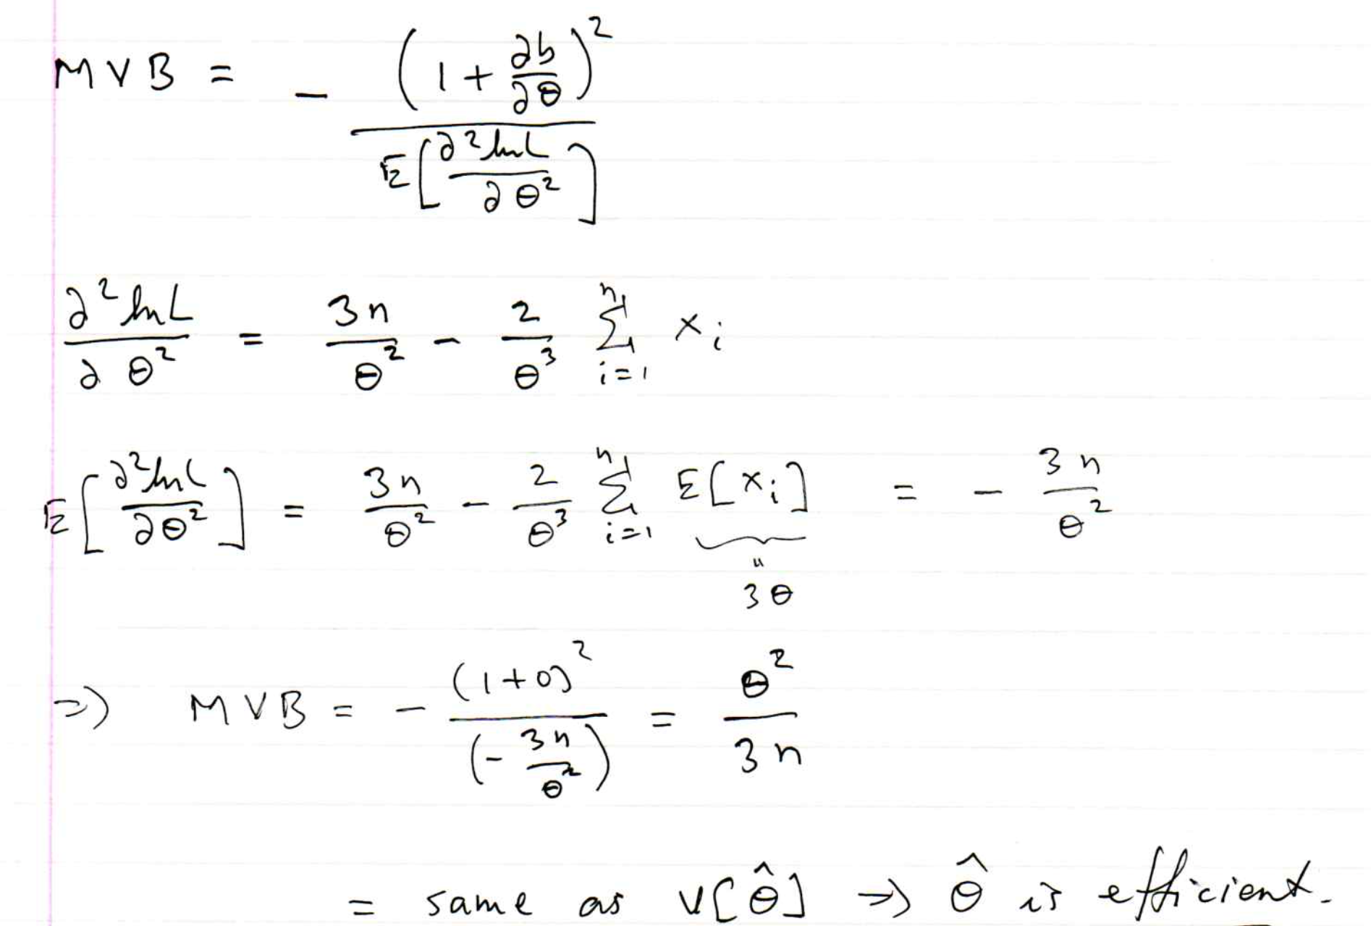
Problem sheet 7
1(b) cont.

Slide 6
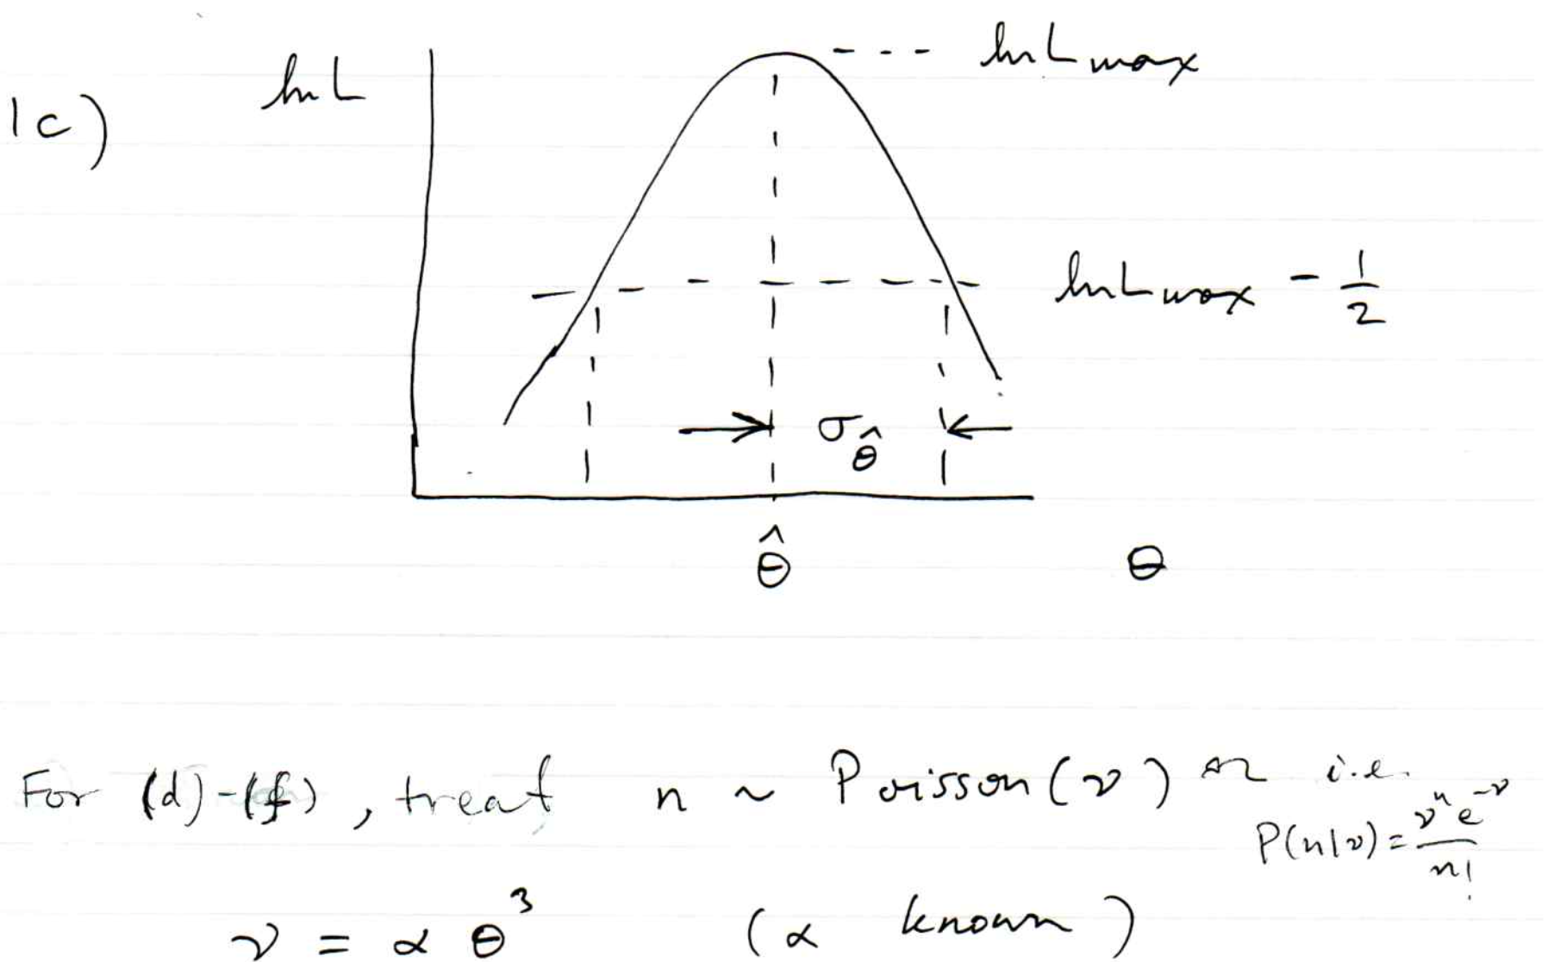
Problem sheet 7

Slide 7
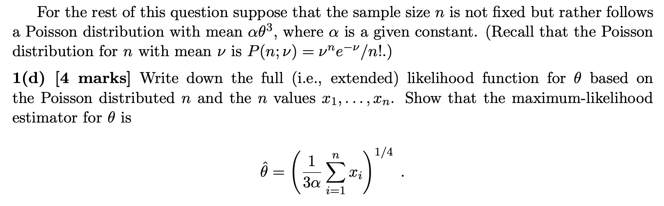
Problem sheet 7

Slide 8
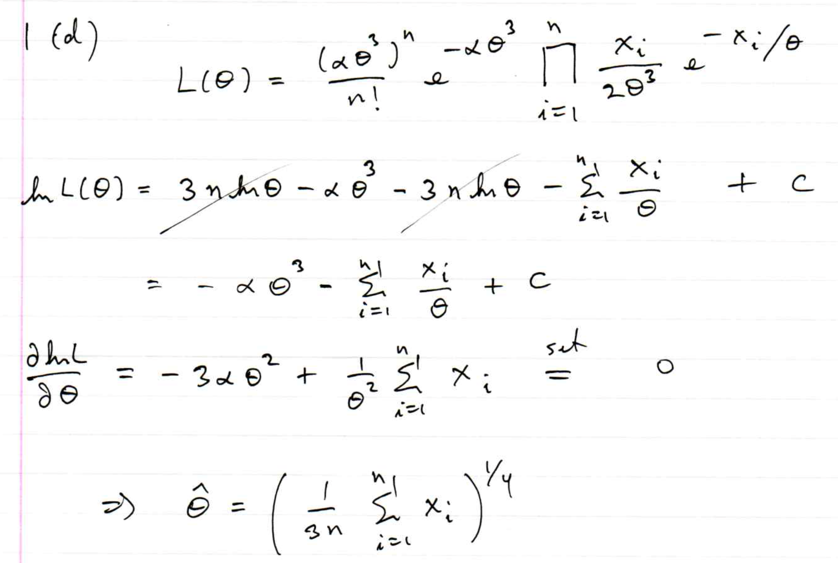
Problem sheet 7

Slide 9
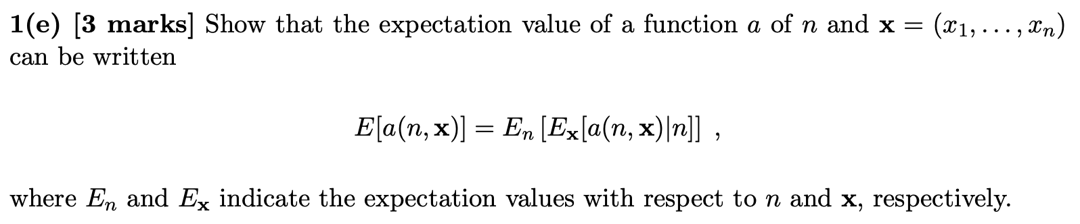
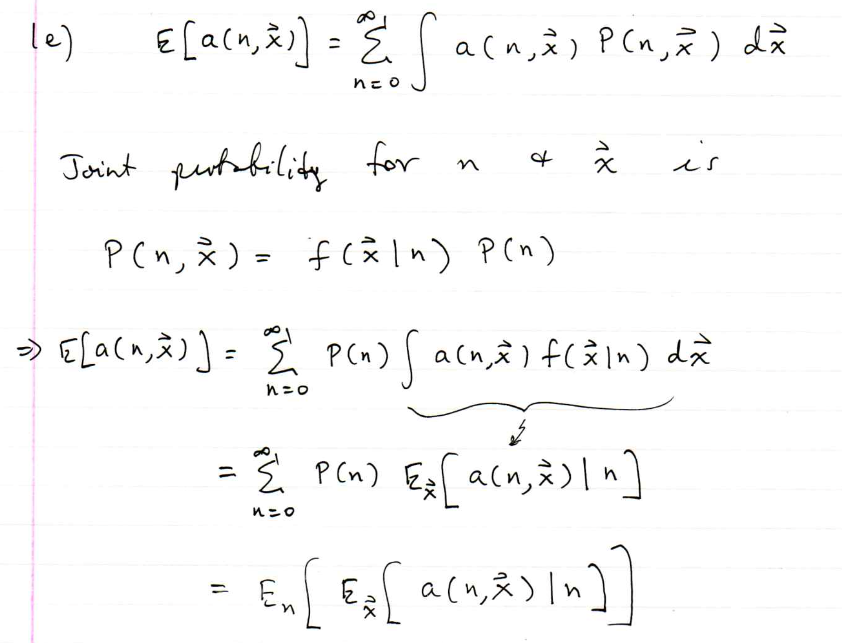
Problem sheet 7

Slide 10
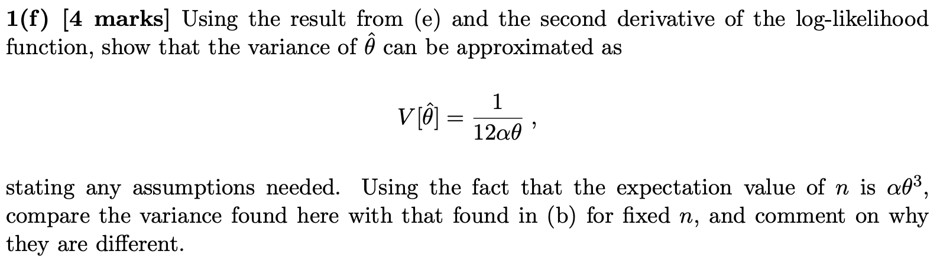
Problem sheet 7

Slide 11
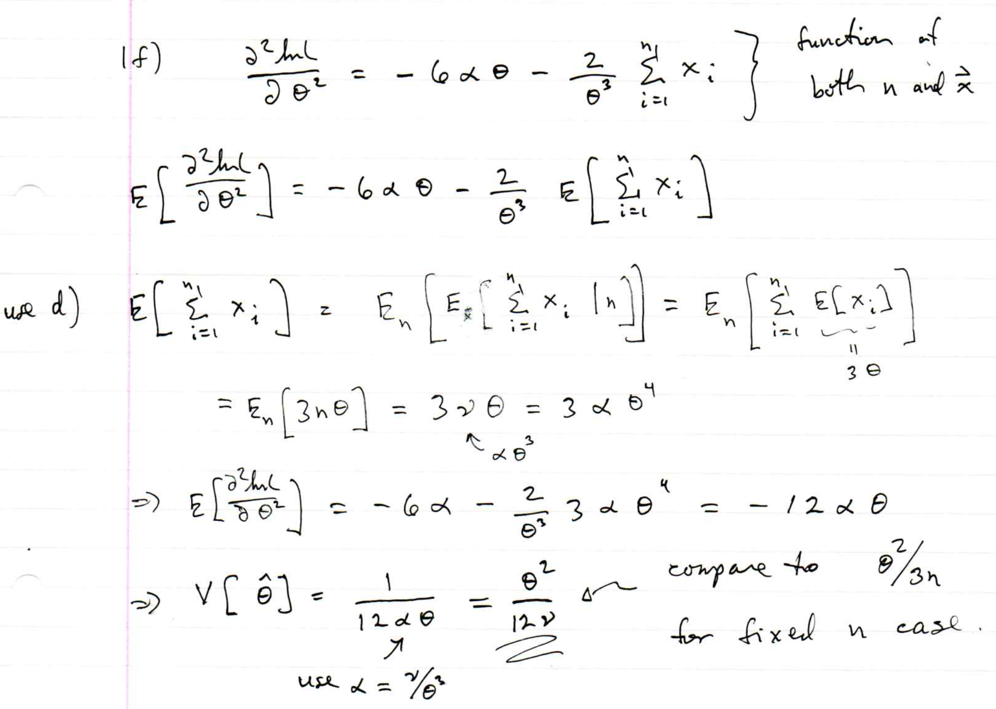
Problem sheet 7

Slide 12
Bonus exercise: Bayesian parameter estimation
The exercise is described in
https://www.pp.rhul.ac.uk/~cowan/stat/exercises/bayesFit/
in the file bayes_fit_exercise.pdf.
The program is in bayesFit.py or bayesFit.ipynb.
This exercise treats the same fitting problem as seen with maximum likelihood, here using the Bayesian approach.
Bayes’ theorem is used to find the posterior pdf for the parameters, and these are summarized using the posterior mode (MAP estimators).
The posterior pdf is marginalized over the nuisance parameters using Markov Chain Monte Carlo.

Slide 13
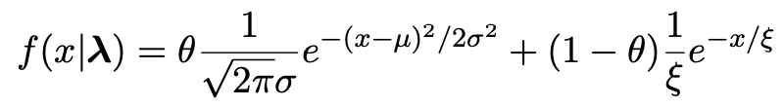
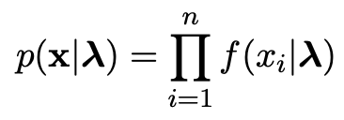

Gaussian signal on exponential background
Same pdf as from mlFit.py (see tutorial 1) with n = 400 independent values of x from
Posterior pdf for parameters λ = (θ, μ, σ, ξ) from Bayes theorem,
where
At first take prior pdf constant for all parameters subject to 0 ≤ θ ≤ 1, σ > 0, ξ > 0 (later try different priors).

Slide 14
Data and MAP estimates
Maximize posterior with minuit (minimize – ln p(λ|x)).
Standard deviations from minuit correspond to approximating posterior as Gaussian near its peak.
Here priors constant so
MAP estimates same as MLE, covariance matrix
V_{ij} = cov[θ_{i}, θ_{j}] also same.

Slide 15
A look at bayesFit.py
Find maximum of posterior with iminuit (minimize – ln p(λ|x)), similar to maximum likelihood:
# Negative log-likelihood
def negLogL(par):
fx = f(xData, par)
return -np.sum(np.log(fx))
# Prior pdf
def prior(par):
theta = par[0]
mu = par[1]
sigma = par[2]
xi = par[3]
pi_theta = 1. if theta >= 0. and theta <= 1. else 0.
pi_mu = 1. if mu >= 0. else 0.
pi_sigma = 1. if sigma > 0. else 0.
pi_xi = 1. if xi > 0. else 0.
piArr = np.array([pi_theta, pi_mu, pi_sigma, pi_xi])
pi = np.product(piArr[np.array(parfix) == False]) # exclude fixed par
return pi
# Negative log of posterior pdf
def negLogPost(par):
return negLogL(par) - np.log(prior(par))
minimize with iminuit

Slide 16
Metropolis-Hastings algorithm in bayesFit.py
# Iterate with Metropolis-Hastings algorithm
chain = [np.array(MAP)] # start point is MAP estimate
numIterate = 10000
numBurn = 100
numAccept = 0
print("Start MCMC iterations: ", end="")
while len(chain) < numIterate:
par = chain[-1]
log_post = -negLogL(par) + np.log(prior(par))
par_prop = np.random.multivariate_normal(par, cov_prop)
if prior(par_prop) <= 0:
chain.append(chain[-1]) # never accept if prob<=0.
else:
log_post_prop = -negLogL(par_prop) + np.log(prior(par_prop))
alpha = np.exp(log_post_prop - log_post)
u = np.random.uniform(0, 1)
if u <= alpha:
chain.append(par_prop)
numAccept += 1
else:
chain.append(chain[-1])
if len(chain)%(numIterate/100) == 0:
print(".", end="", flush=True)
chain = np.array(chain)
Try increasing number of iterations (10k runs in about 20 s).

Slide 17
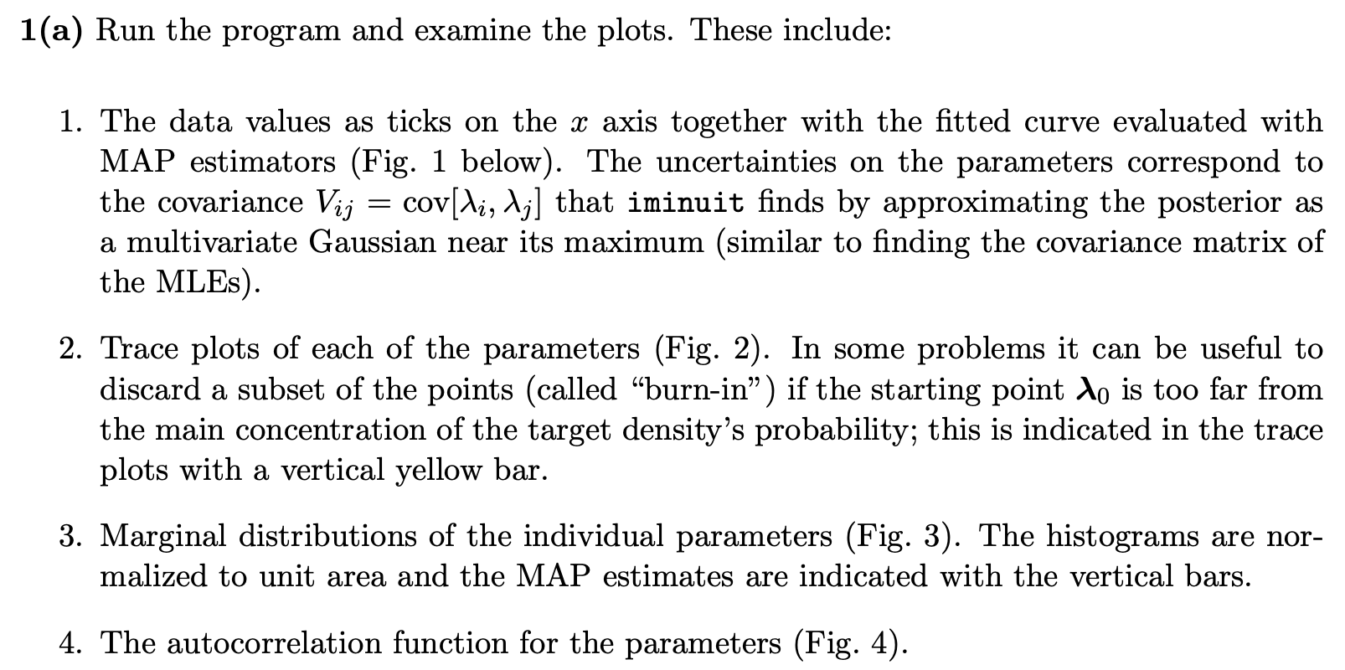
Exercises on Bayesian parameter estimation (a)
1a) Run bayesFit.py, look at the plots

Slide 18
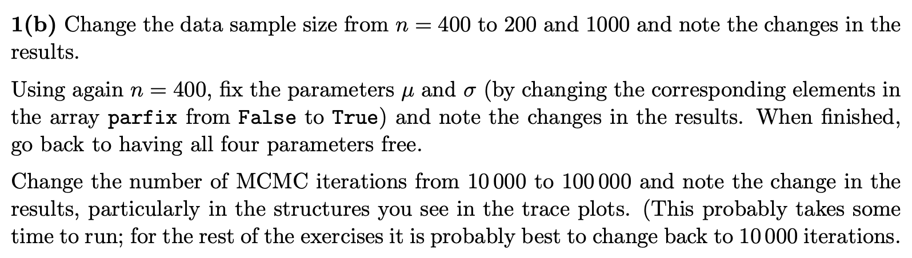
Exercises on Bayesian parameter estimation (b,c)
1b) Investigate effect of data sample size, fixing parameters and length of MCMC chains.
1c) Investigate changing the prior

Slide 19
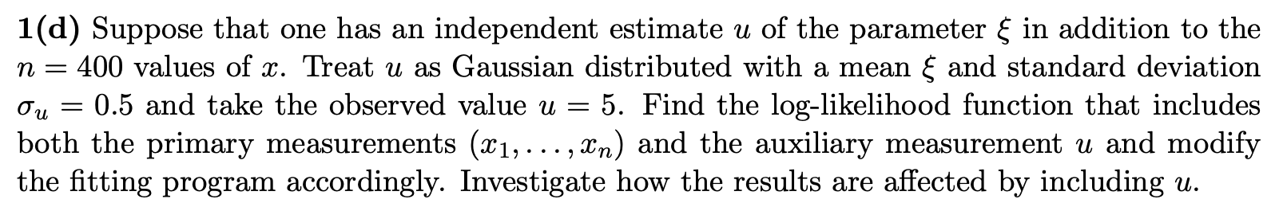
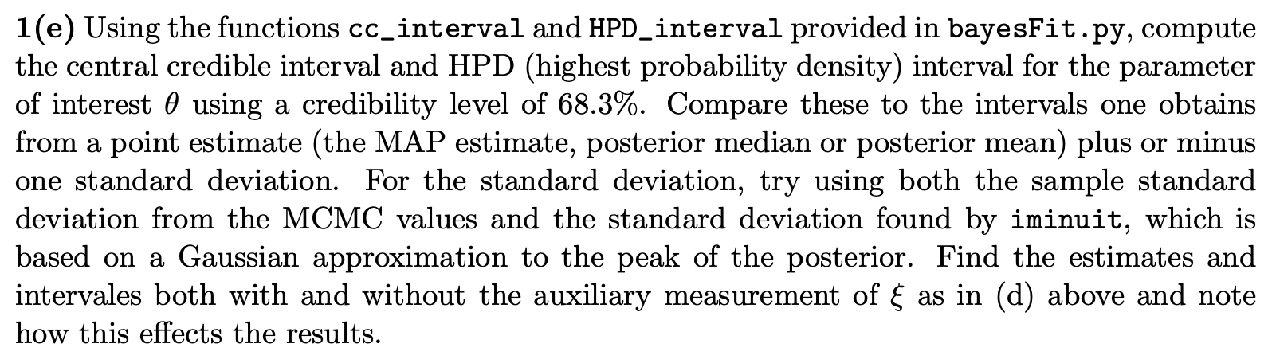
Exercises on Bayesian parameter estimation (d)
1d) Include auxiliary measurement to constrain ξ
1e) Investigate point and interval estimates for θ

Slide 20
MCMC trace plots
Take θ as parameter of interest, rest are nuisance parameters.
Marginalize by sampling posterior pdf with Metropolis-Hastings.
Gaussian proposal pdf, covariance U = sV,
s = (2.38)²/N_{par} = 1.41, gives acceptance
probability ~ 0.24.
See, e.g., http://probability.ca/jeff/ftpdir/galinart.pdf
Here 10 000 iterations (should use more).

Slide 21

Marginal distributions
MAP estimates shown with vertical bars
Note long tails.
Interpretation: data distribution can be approximated by Gaussian term only, (θ large, μ small) with large width (σ ~ 4-8) and a narrow exponential (ξ ~ 1-3).

Slide 22
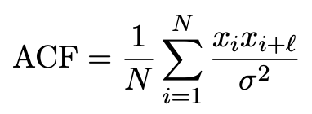
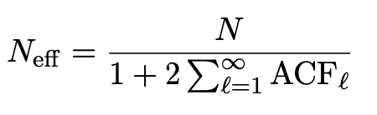
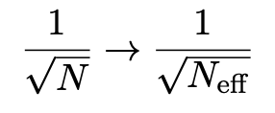
Autocorrelation versus lag
MCMC samples are not independent, autocorrelation function = correlation coefficient of sample x_{i} with x_{i+l} as a function of the lag, l, where x = any of θ, μ, σ, ξ minus its mean:
Effective sample size
In stat. error estimates
See, e.g., https://mc-stan.org/docs/reference-manual/effective-sample-size.html

Slide 23
MCMC trace plots
Increase number of iterations to 100 000.
Regions of parameter space now sampled multiple times.

Slide 24
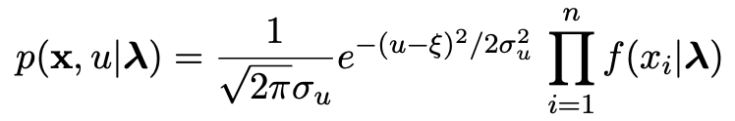
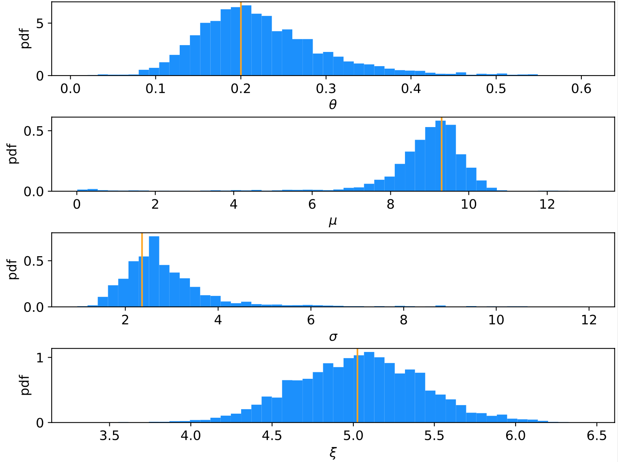
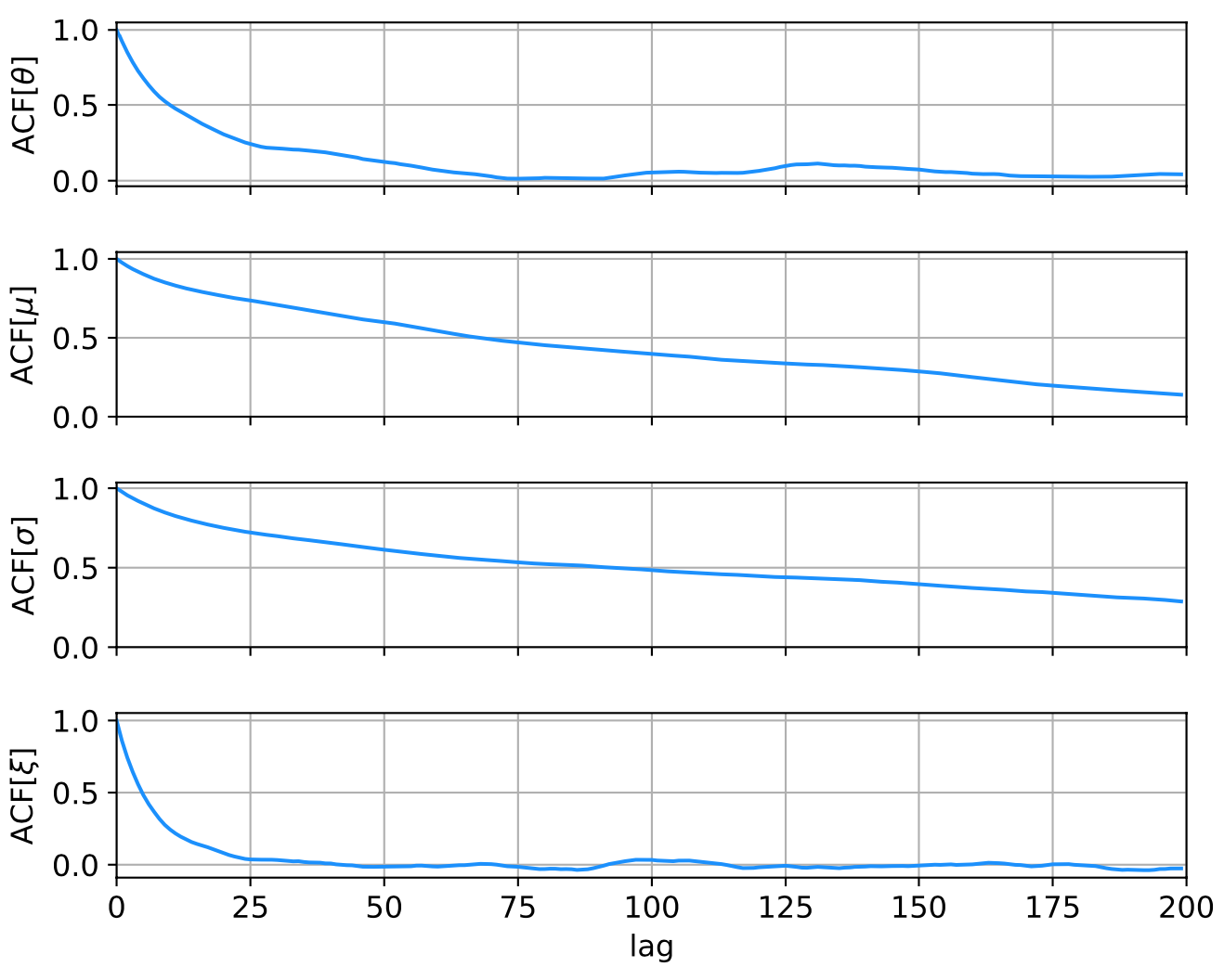
Auxiliary measurement for ξ
Suppose we have an auxiliary measurement u ~ Gauss(ξ, σ_{u}) with σ_{u} = 0.5 and we observe u = 5.
Build into likelihood:
Marginals closer to Gaussian, ACF falls more quickly to ~zero.

Slide 25
Ways to summarize the posterior
Point estimates:
Posterior mode (MAP, coincides with MLE for constant prior).
Posterior median (invariant under monotonic transformation of parameter).
Posterior mean; coincides with above in large-sample limit.
Intervals:
Highest Probability Density (HPD) interval, shortest for a given probability content, not invariant under param. trans.
Central credible intervals, equal upper and lower tail areas, e.g., α/2 for CL = 1 – α.
Point estimate +/- standard deviation, std. dev. from MCMC sample or by approximating core of posterior as Gaussian (from minuit); coincides with above in large-sample limit.

Slide 26
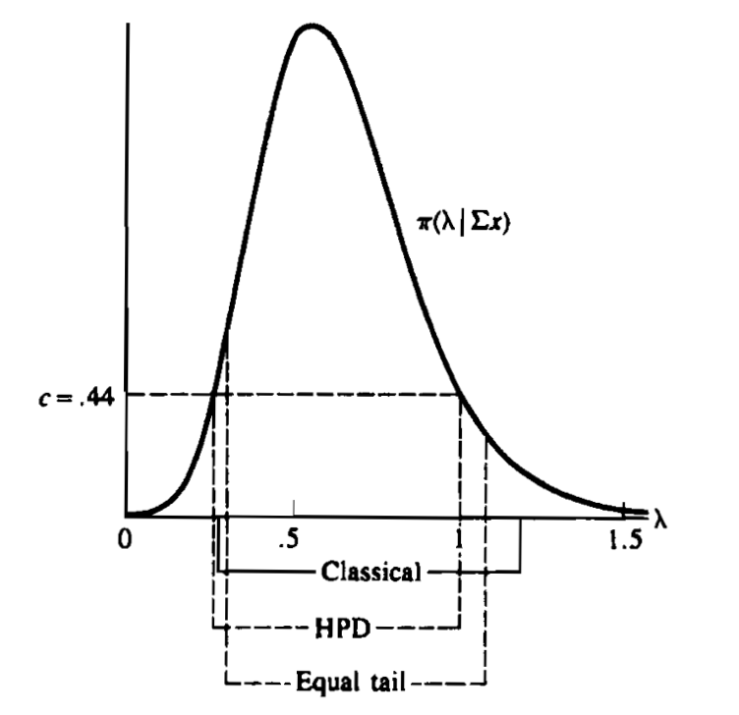
Types of intervals
HPD = Highest Posterior Density
Equal tail (central) from posterior
Classical (frequentist)
G. Casella and R. Berger, Statistical Inference, 2002

Slide 27
Correlation plots and marginal distributions
Estimates/intervals for theta:
MCMC acceptance fraction = 0.3737
Posterior mode (MAP estimate) = 0.197936
Posterior mean = 0.351234
Posterior median = 0.250764
MAP +/- sigmaMAP (from minuit) = [0.140056, 0.255816]
Posterior mean +/- sigmaMCMC = [0.118503, 0.583964]
68.3% central credible interval = [0.158557, 0.685847]
68.3% HPD interval = [0.093997, 0.392642]

Slide 28
Correlation plots and marginal distributions using auxiliary measurement for ξ
Estimates/intervals for theta:
MCMC acceptance fraction = 0.3516
Posterior mode (MAP estimate) = 0.200077
Posterior mean = 0.224898
Posterior median = 0.212835
MAP +/- sigmaMAP (from minuit) = [0.149282, 0.250873]
Posterior mean +/- sigmaMCMC = [0.148481, 0.301314]
68.3% central credible interval = [0.156736, 0.291246]
68.3% HPD interval = [0.137607, 0.267077]

