Slide 1
Statistical Data Analysis
Discussion slides – week 11
Problem sheet 8
Software for Gamma Variance Model (errors-on-errors)
Example from 2019 Exam (Gamma Variance Model)

Slide 2
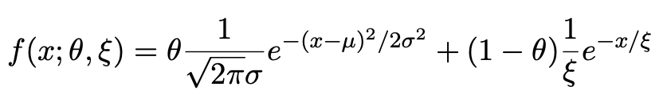
Discussion of problem sheet 8
Gaussian signal on exponential background
Consider a pdf for continuous random variable x, (truncate and renormalize in 0 ≤ x ≤ x_{max})
θ = parameter of interest ,
gives signal rate.
Depending on context, take ξ, μ, σ as nuisance parameters or fixed.
Generate i.i.d. sample x₁,..., x_{n}.
Estimate θ (and other params.)

Slide 3
A quick look at mlFit.py
# Example of maximum-likelihood fit with iminuit version 2.
# pdf is a mixture of Gaussian (signal) and exponential (background),
# truncated in [xMin,xMax].
# G. Cowan / RHUL Physics / December 2022
import numpy as np
import scipy.stats as stats
from scipy.stats import truncexpon
from scipy.stats import truncnorm
from scipy.stats import chi2
import iminuit
from iminuit import Minuit
import matplotlib.pyplot as plt
from matplotlib import container
plt.rcParams["font.size"] = 14
print("iminuit version:", iminuit.__version__) # need 2.x
# define pdf and generate data
np.random.seed(seed=1234567) # fix random seed
theta = 0.2 # fraction of signal
mu = 10. # mean of Gaussian
sigma = 2. # std. dev. of Gaussian
xi = 5. # mean of exponential
xMin = 0.
xMax = 20.

Slide 4
Define the fit function
def f(x, par):
theta = par[0]
mu = par[1]
sigma = par[2]
xi = par[3]
fs = stats.truncnorm.pdf(x, a=(xMin-mu)/sigma, b=(xMax-mu)/sigma, loc=mu, scale=sigma)
fb = stats.truncexpon.pdf(x, b=(xMax-xMin)/xi, loc=xMin, scale=xi)
return theta*fs + (1-theta)*fb
Generate the data
numVal = 200
xData = np.empty([numVal])
for i in range (numVal):
r = np.random.uniform();
if r < theta:
xData[i] = stats.truncnorm.rvs(a=(xMin-mu)/sigma, b=(xMax-mu)/sigma,
loc=mu, scale=sigma)
else:
xData[i] = stats.truncexpon.rvs(b=(xMax-xMin)/xi, loc=xMin, scale=xi)

Slide 5
Set up the fit
# Function to be minimized is negative log-likelihood
def negLogL(par):
pdf = f(xData, par)
return -np.sum(np.log(pdf))
# Initialize Minuit and set up fit:
parin = np.array([theta, mu, sigma, xi]) # initial values (here = true values)
parname = ['theta', 'mu', 'sigma', 'xi']
parname_latex = [r'$\theta$', r'$\mu$', r'$\sigma$', r'$\xi$']
parstep = np.array([0.1, 1., 1., 1.]) # initial setp sizes
parfix = [False, True, True, False] # change these to fix/free parameters
parlim = [(0.,1), (None, None), (0., None), (0., None)] # set limits
m = Minuit(negLogL, parin, name=parname)
m.errors = parstep
m.fixed = parfix
m.limits = parlim
m.errordef = 0.5 # errors from lnL = lnLmax - 0.5

Slide 6
Do the fit, get errors, extract results
# Do the fit, get errors, extract results
m.migrad() # minimize -logL
MLE = m.values # max-likelihood estimates
sigmaMLE = m.errors # standard deviations
cov = m.covariance # covariance matrix
rho = m.covariance.correlation() # correlation coeffs.
print(r"par index, name, estimate, standard deviation:")
for i in range(m.npar):
if not m.fixed[i]:
print("{:4d}".format(i), "{:<10s}".format(m.parameters[i]), " = ",
"{:.6f}".format(MLE[i]), " +/- ", "{:.6f}".format(sigmaMLE[i]))
print()
print(r"free par indices, covariance, correlation coeff.:")
for i in range(m.npar):
if not(m.fixed[i]):
for j in range(m.npar):
if not(m.fixed[j]):
print(i, j, "{:.6f}".format(cov[i,j]), "{:.6f}".format(rho[i,j]))
Make some plots...

Slide 7
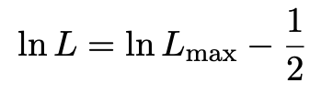
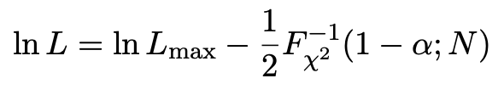

Comment on the lnL = lnL_{max} – ½ contour
In the lectures, we saw that the standard deviations of fitted parameters are found from the tangent lines (planes) to the contour
A similar procedure can be used to find a confidence region in the parameter space that will cover the true parameter with probability CL = 1 – α (the “confidence level”). This uses the contour
, N = number of parameters
If you want the contour lnL = lnL_{max} – ½ in iminuit, you need to choose CL (= 1 – α) such that F_{χ2}⁻¹(1 – α,N) = 1, i.e.,

Slide 8
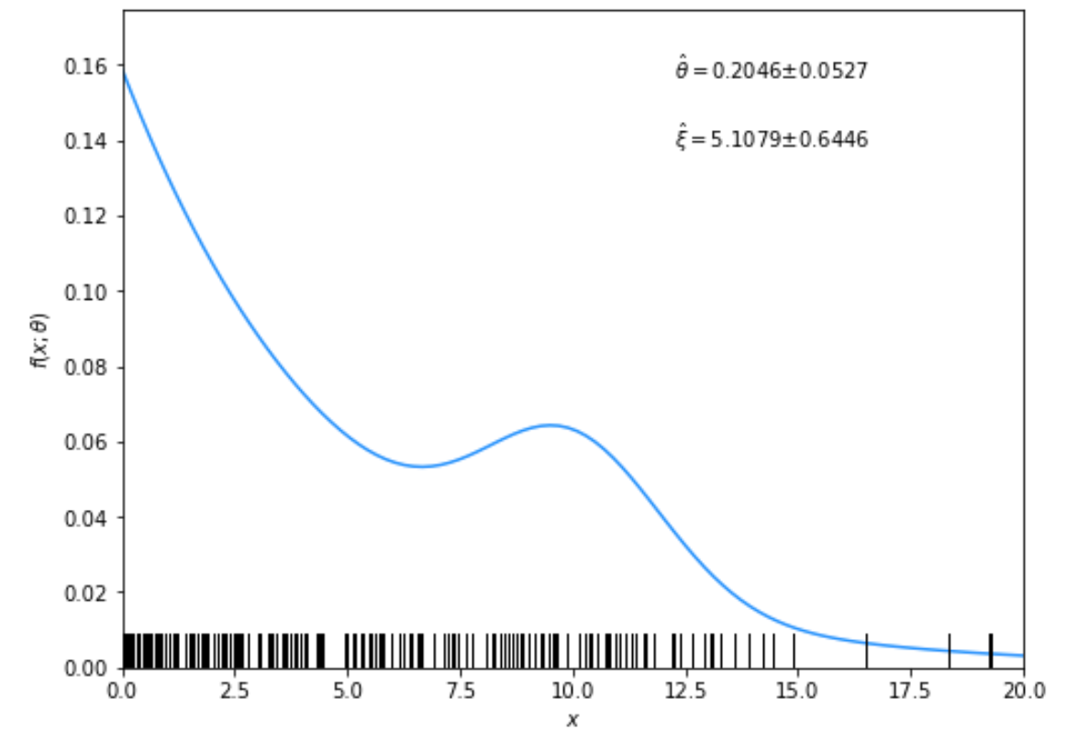
Solutions to exercises
1a) Running the program mlFit.py produces the following plots:
A fit of the pdf:

Slide 9
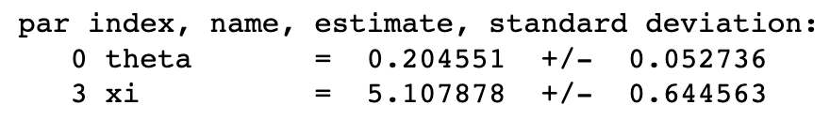
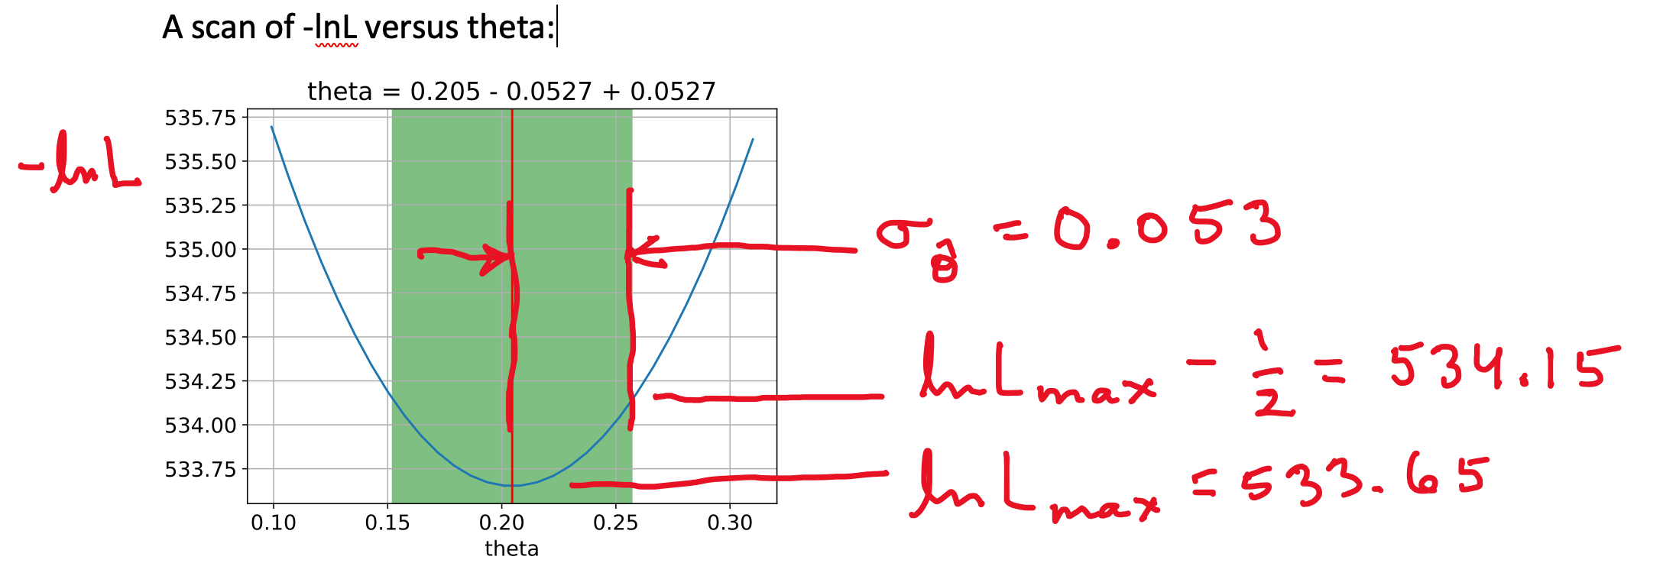
From running program:

Slide 10
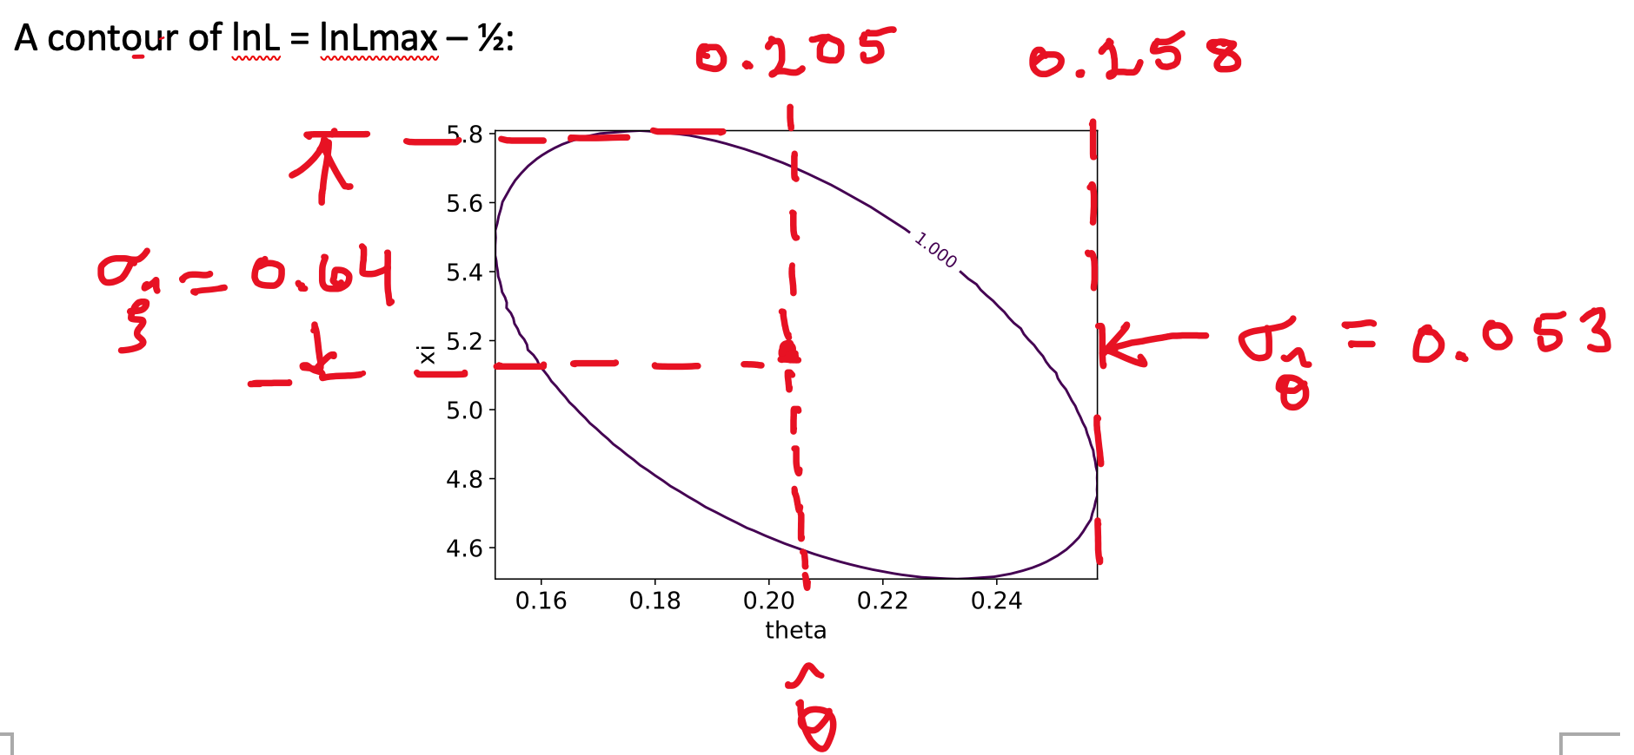

Slide 11
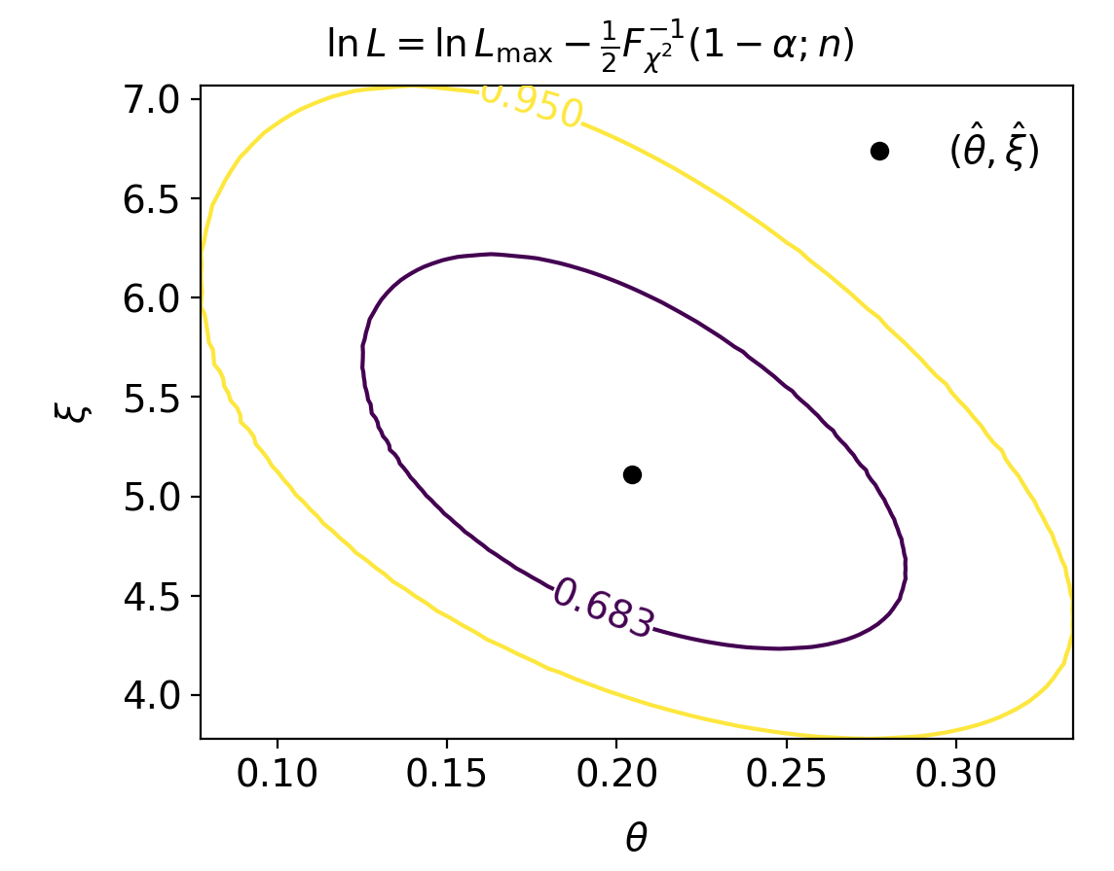
Confidence regions at CL = 68.3% and 95%
In iminuit v2, user can set CL = 1 − α

Slide 12
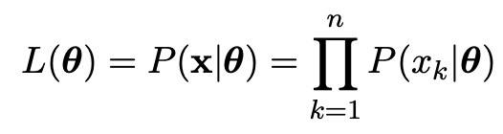
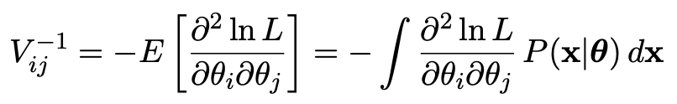
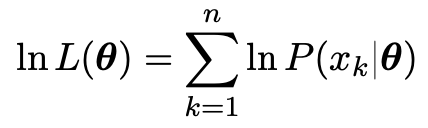
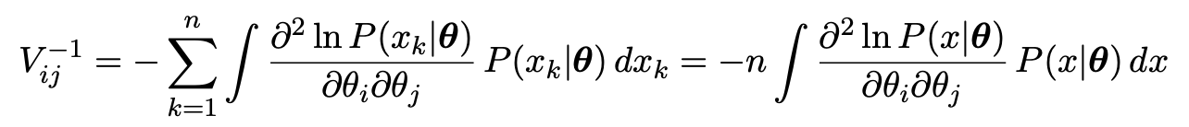

1b) Assume i.i.d. data sample, so
Assume inverse covariance from Fisher Information (large sample):
Since
we find
But V⁻¹V = I so if V⁻¹ ∝ n, then V ∝ 1/n, and so from the square roots of the diagonal elements

Slide 13
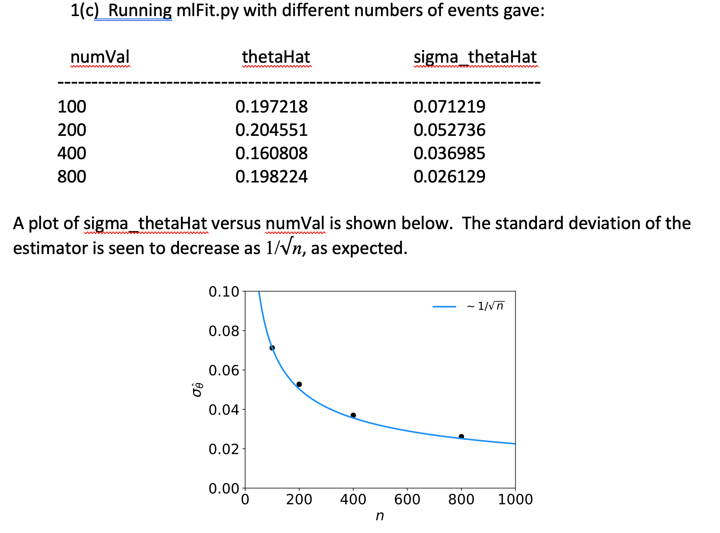

Slide 14
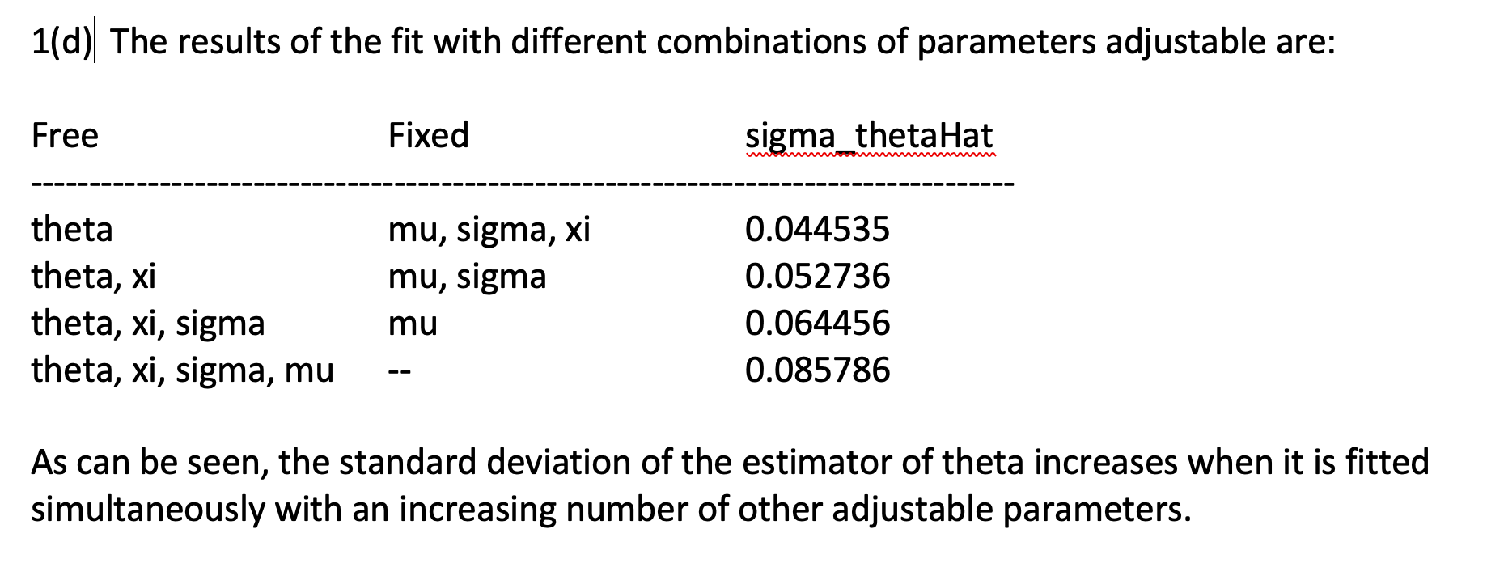

Slide 15
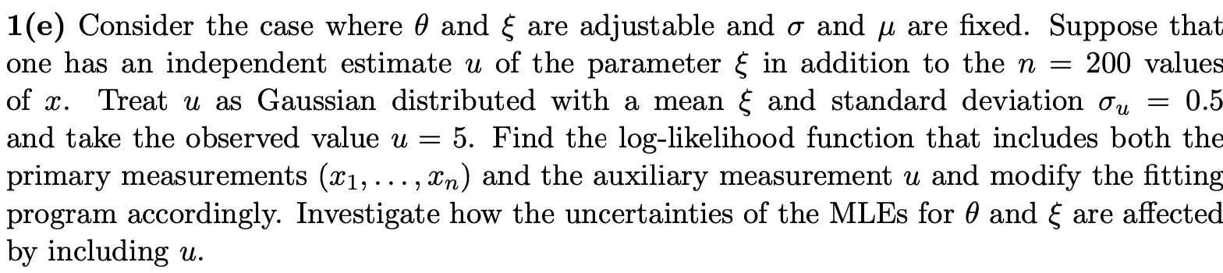
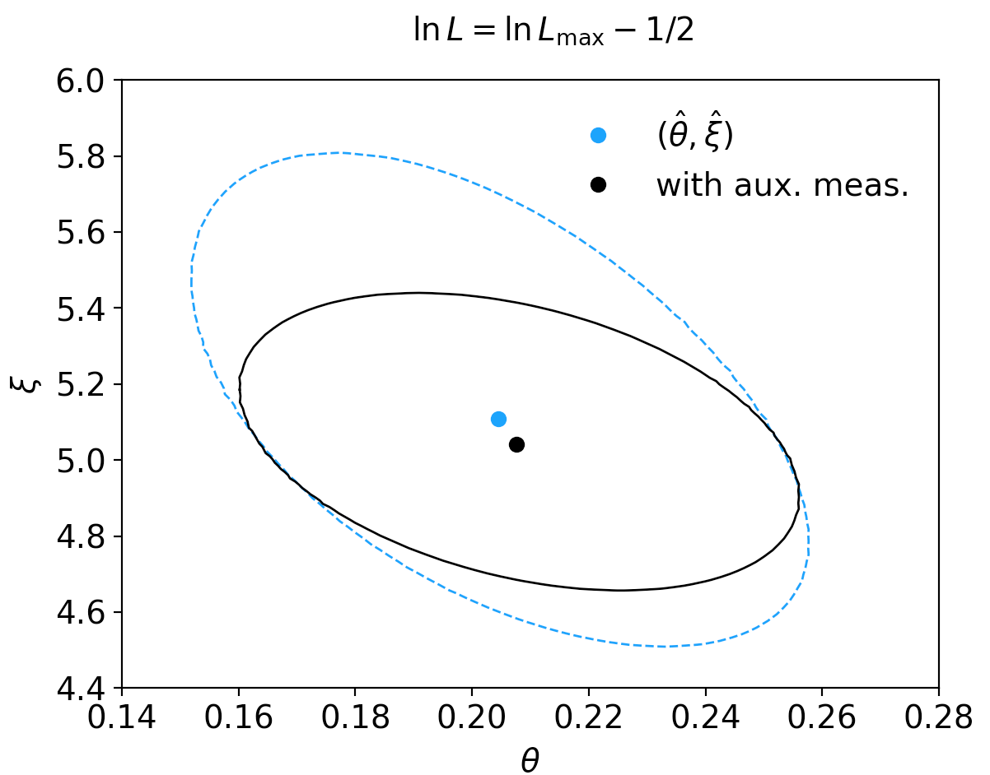
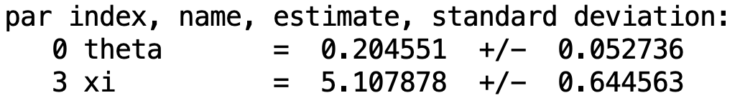
Extra part (not on problem sheet)
1(e) By including the auxiliary measurement u one uses more information about ξ and thus the covariance ellipse shrinks. This reduces the standard deviations of the MLEs for both ξ and θ.

Slide 16
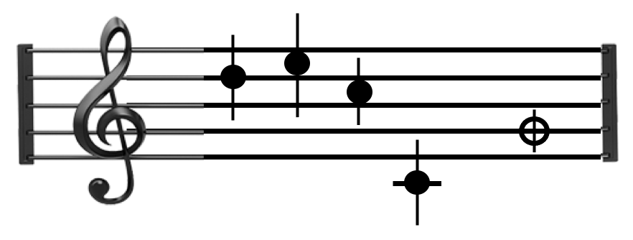
Tutorial 4: Student’s t average
Software: stave.py
The program stave.py implements the Gamma Variance Model (GVM) described in Lecture 3 for averaging N measurements.
For details see G. Cowan, EPJC (2019) 79:133.
In this version the model does not distinguish between statistical and systematic errors.
Confidence interval for the mean μ becomes sensitive to goodness-of-fit (increases if data internally inconsistent).
Estimated mean less sensitive to outliers.

Slide 17
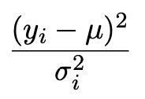
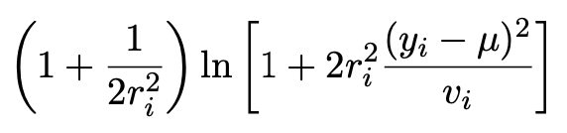
Least Squares vs Gamma Variance Model
Quadratic terms from Least Squares replaced by logarithmic ones:
where
y_{i} = measured value
v_{i} = s_{i}² = estimated variance
r_{i} = relative uncertainty on estimate of variance
Equivalent to replacing Gauss pdf for measurements by Student’s t, number of degrees of freedom = 1/2r_{i}²

Slide 18
A quick look at stave.py
Set measured values, estimates of std. dev., errors on errors:
y = np.array([17., 19., 15., 3.]) # measured values
s = np.array([1.5, 1.5, 1.5, 1.5]) # estimates of std. dev
v = s**2 # estimates of variances
r = np.array([0.2, 0.2, 0.2, 0.2]) # relative errors on errors
log-likelihood:
class NegLogL:
def __init__(self, y, s, r):
self.setData(y, s, r)
def setData(self, y, s, r):
self.data = y, s, r
def __call__(self, mu):
y, s, r = self.data
v = s ** 2
lnf = -0.5*(1. + 1./(2.*r**2))*np.log(1. + 2.*(r*(y-mu))**2/v)
return -np.sum(lnf)

Slide 19
Example average with GVM
Suppose four measurements of the parameter μ.
Each reports an estimated standard dev. of s = 1.5 and
a “relative error on the error” r = 0.2.
Suggested exercise:
Experiment with different numbers of measurements, different levels of internal consistency, different values for the std. dev. and error on error.
outlier

Slide 20
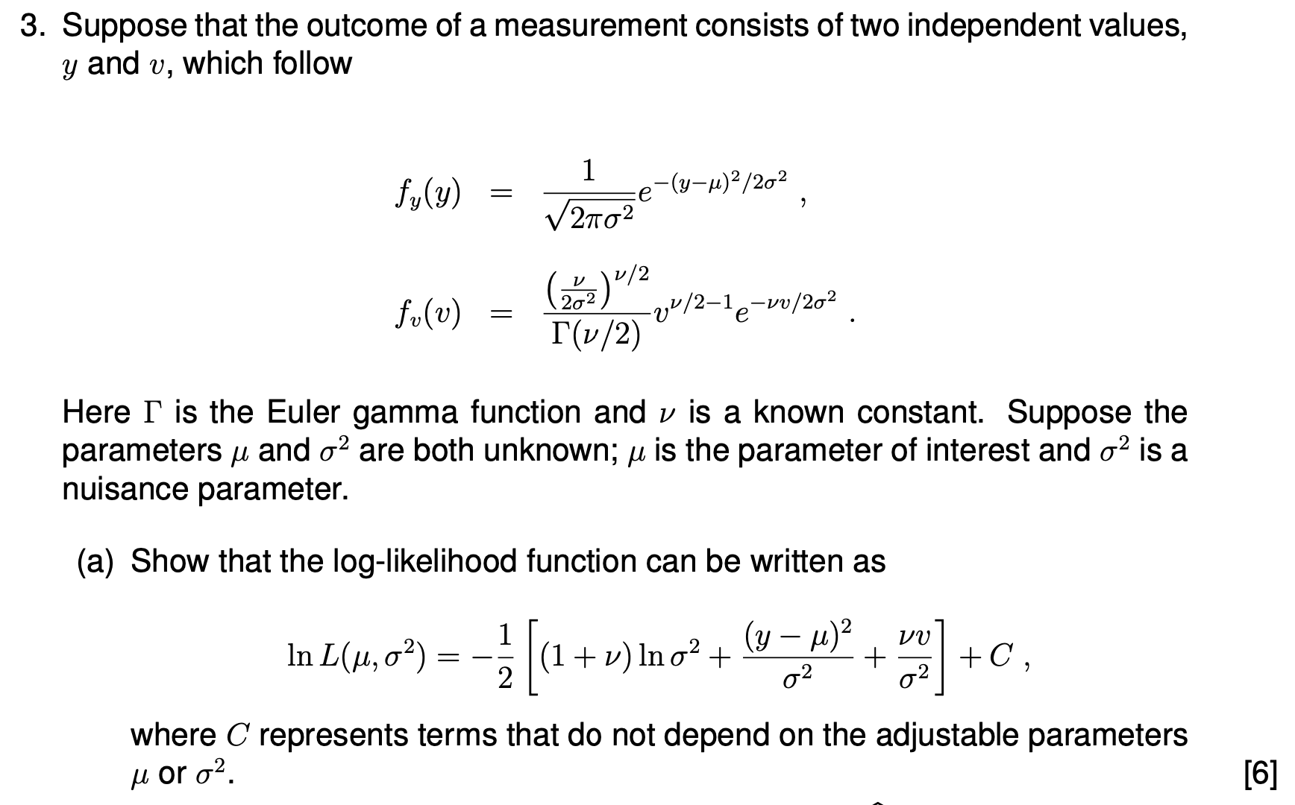
2019 Exam Question 3(a)

Slide 21
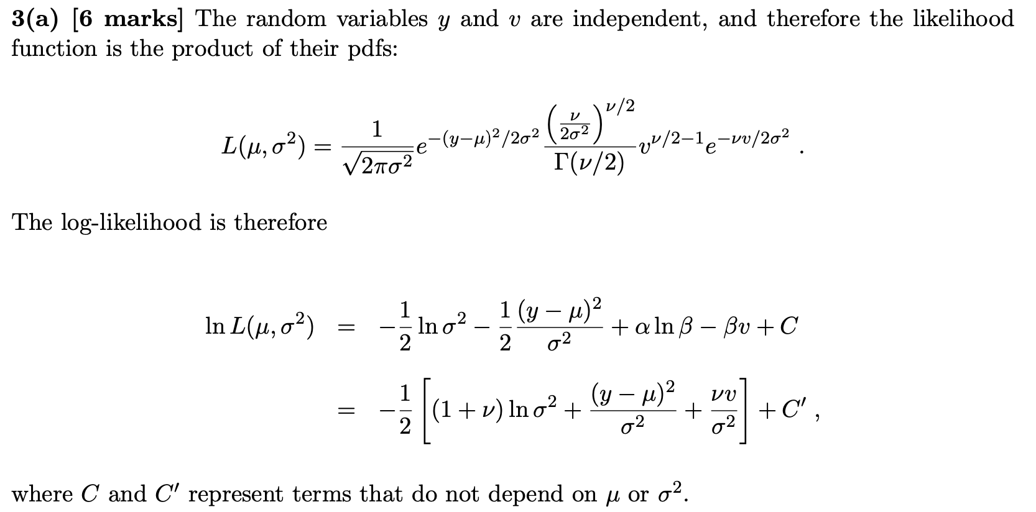
2019 Exam Question 3(a)

Slide 22
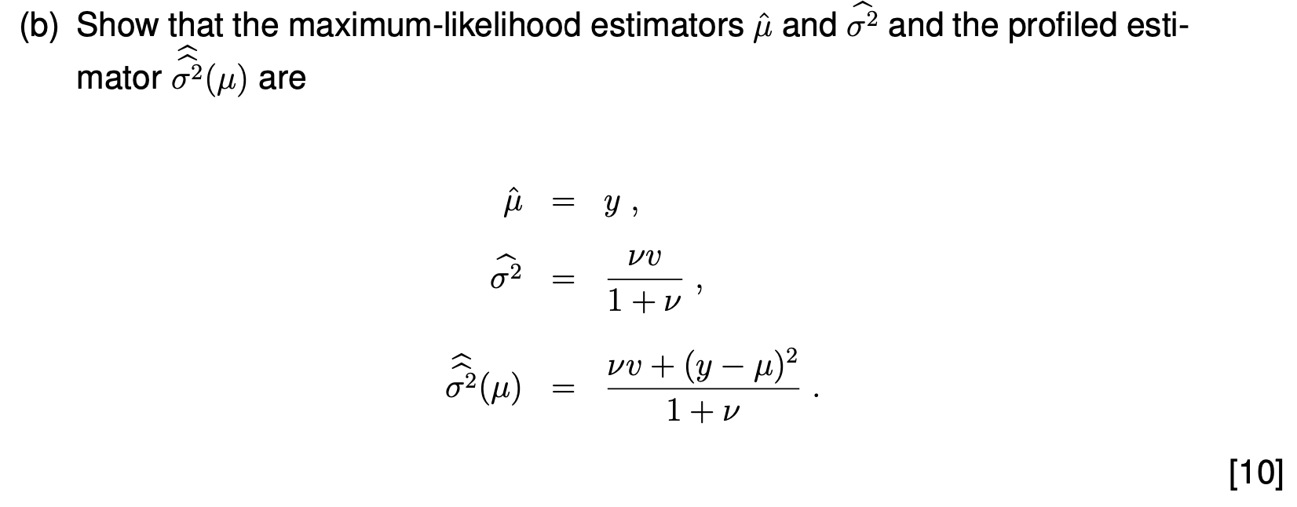
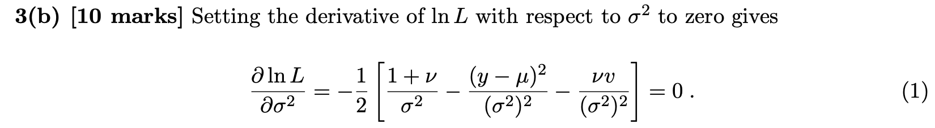
2019 Exam Question 3(b)

Slide 23
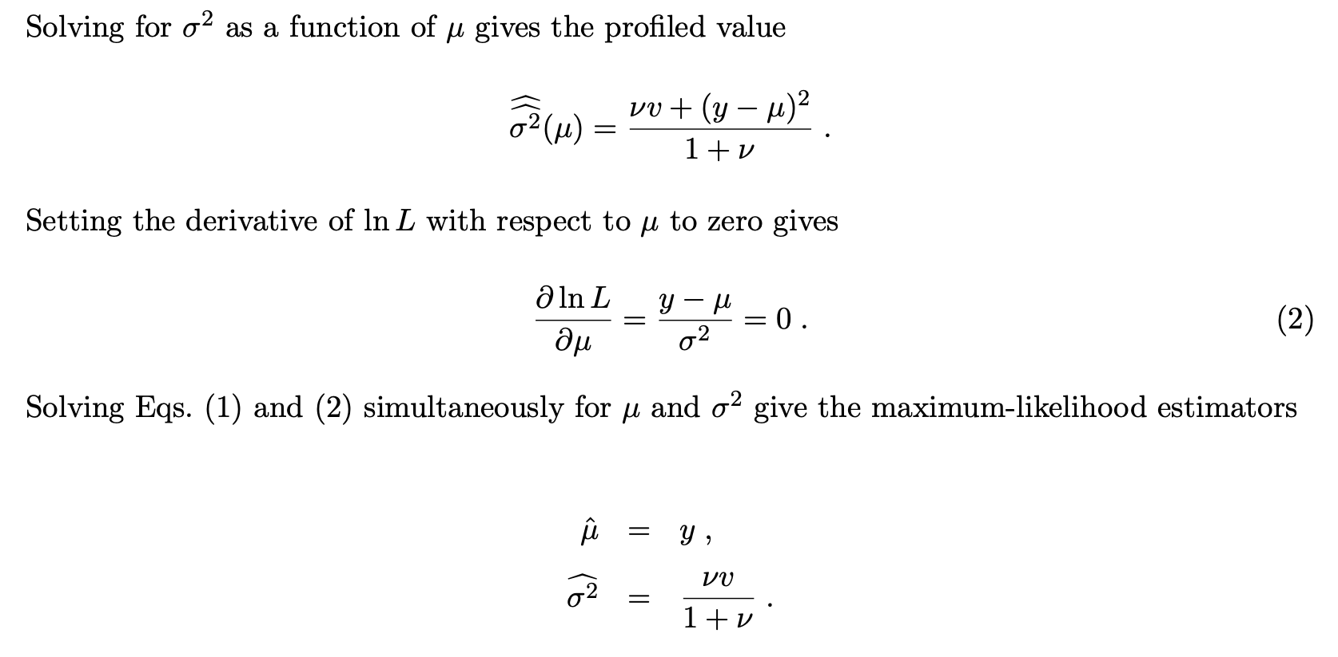
2019 Exam Question 3(b)

Slide 24
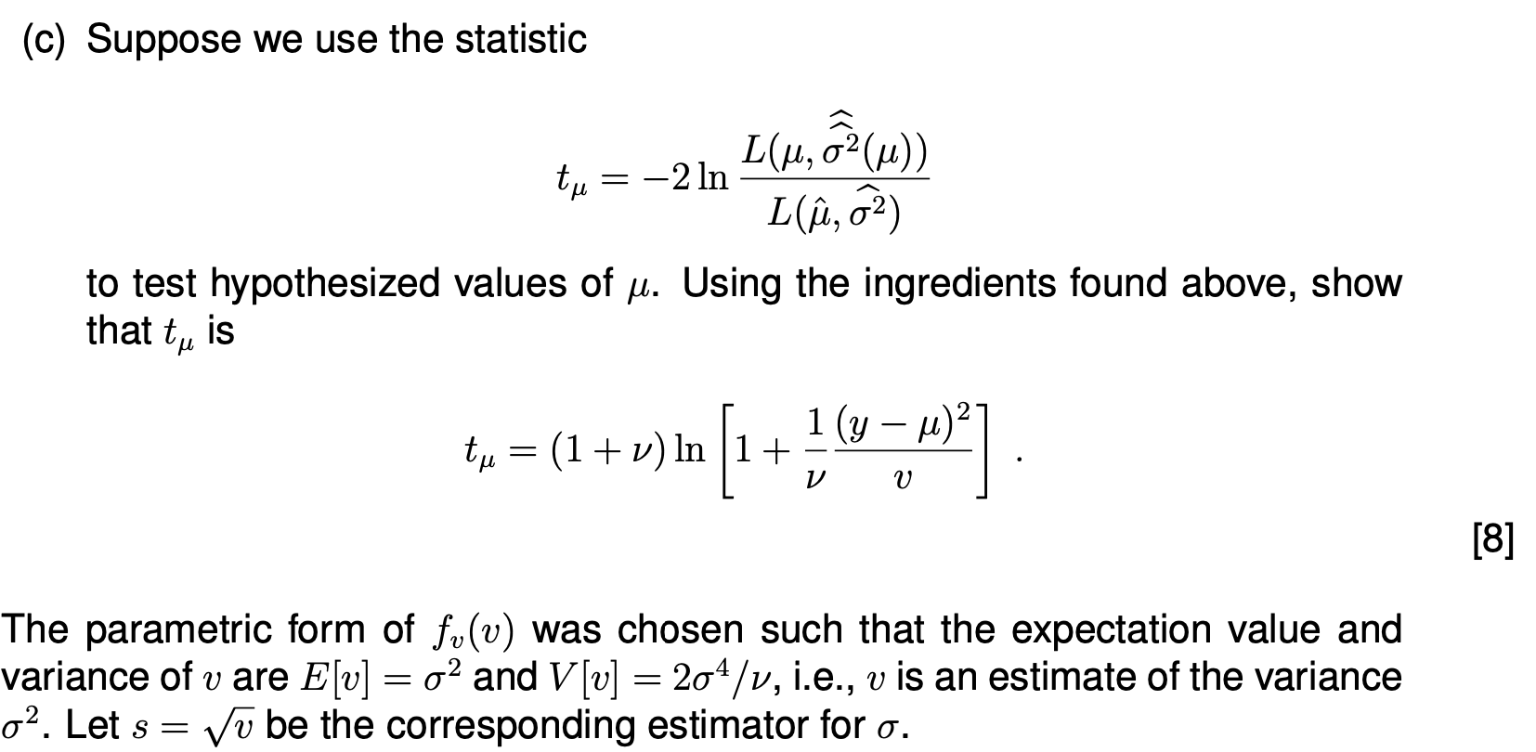
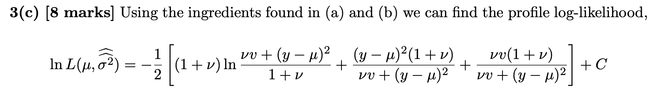
2019 Exam Question 3(c)

Slide 25
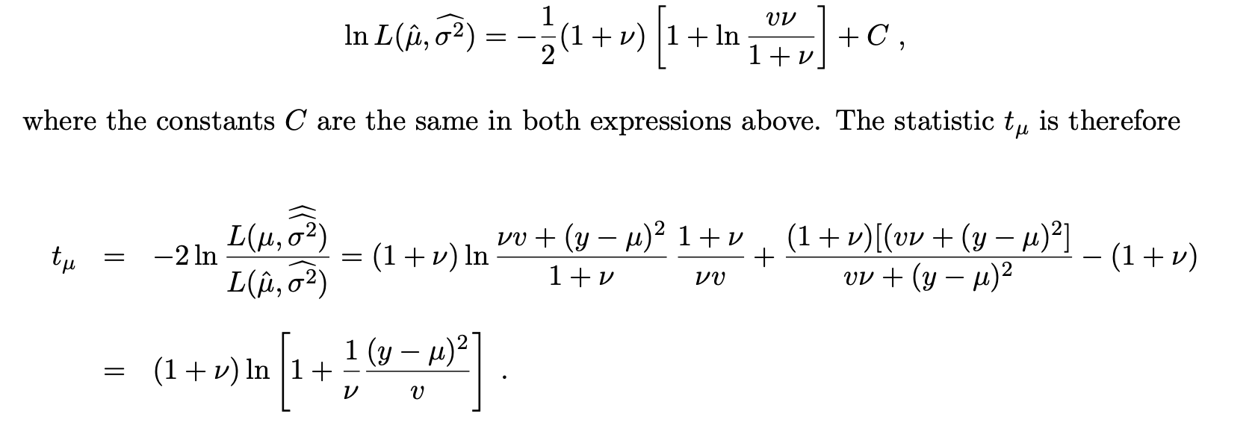
2019 Exam Question 3(c)

Slide 26
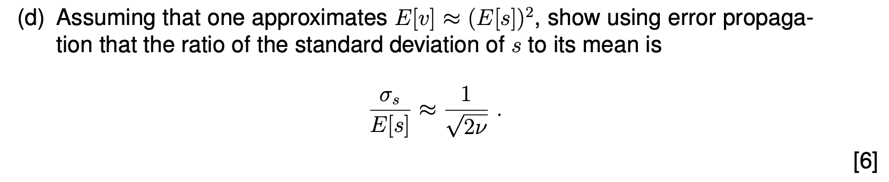
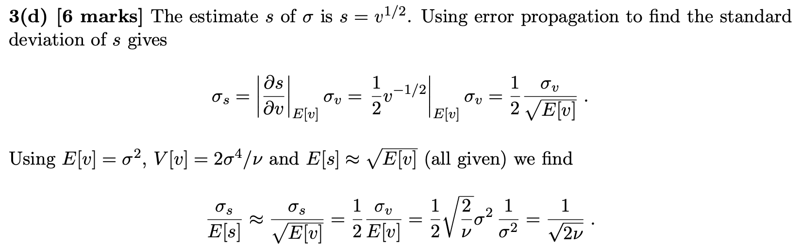
2019 Exam Question 3(d)

Slide 27
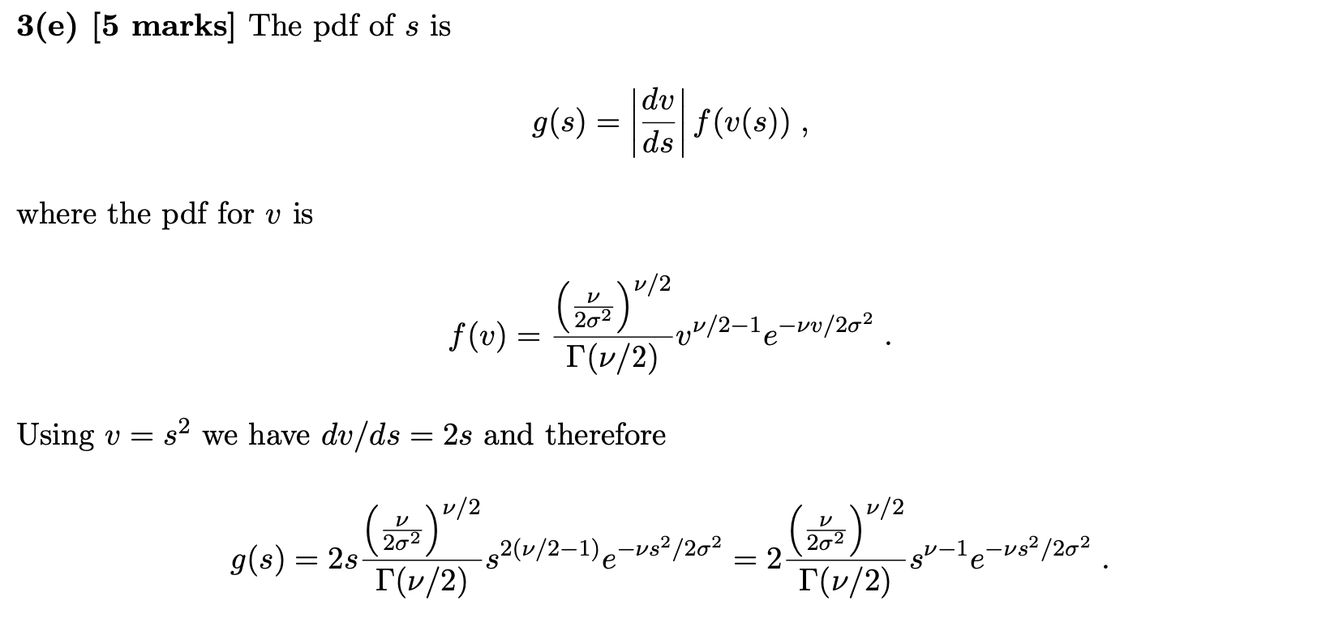
2019 Exam Question 3(e)

Slide 28
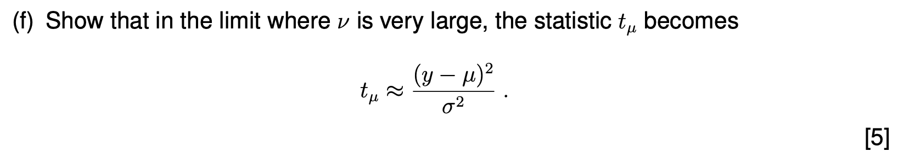
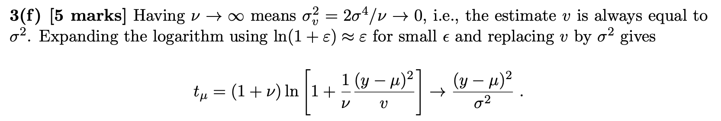
2019 Exam Question 3(f)

