Slide 1
Statistical Data Analysis Discussion notes – week 3
Lack of memory of the exponential distribution
The log-normal distribution
Generating random values from the Cauchy pdf
Importance sampling

Slide 3
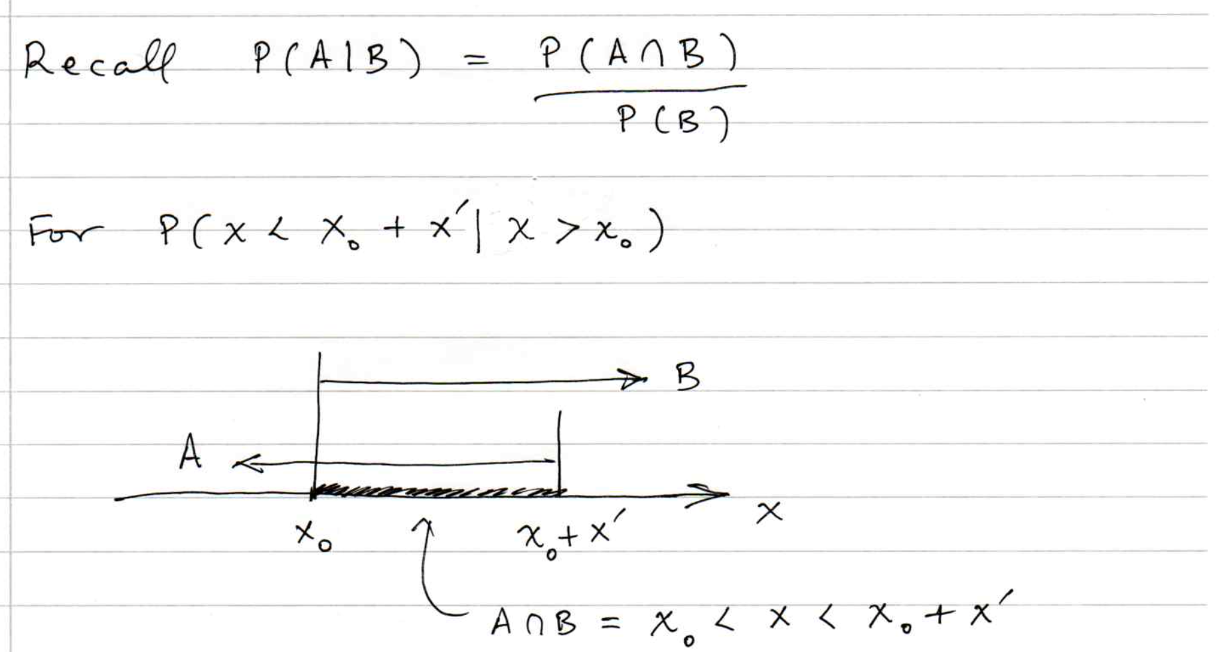

Slide 4
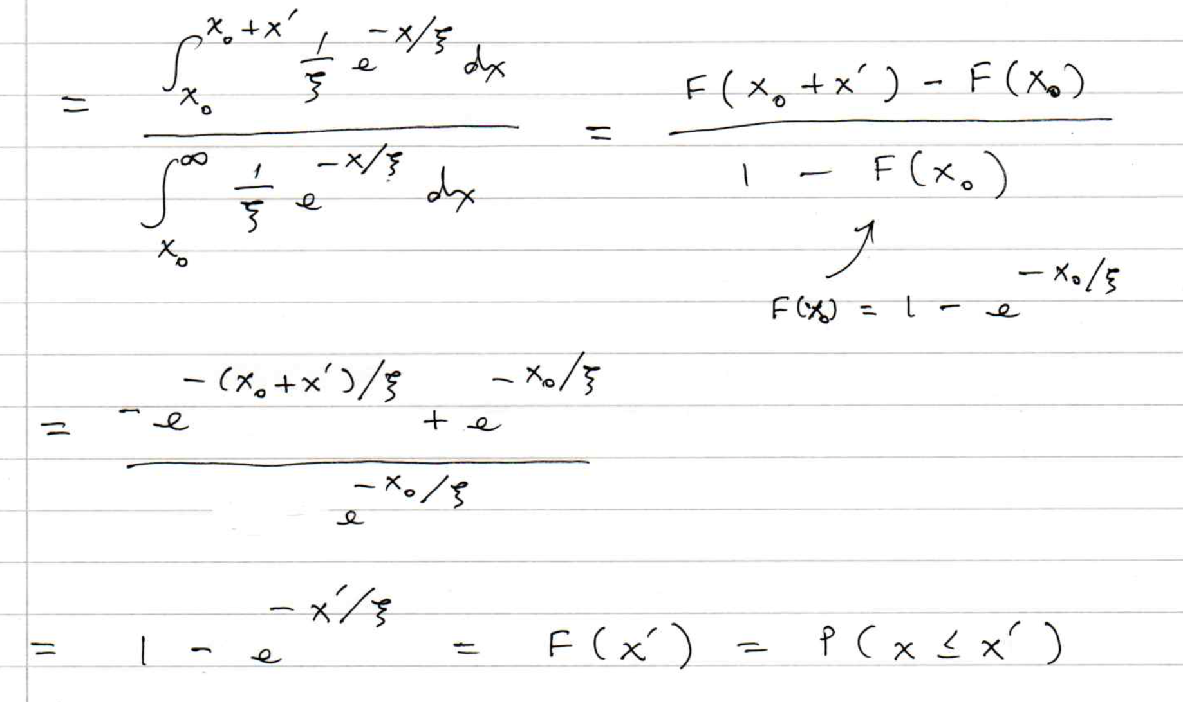

Slide 5
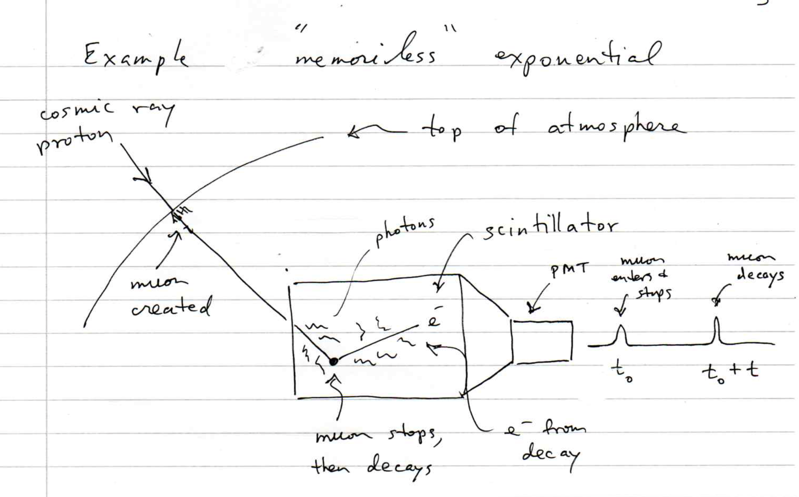

Slide 6
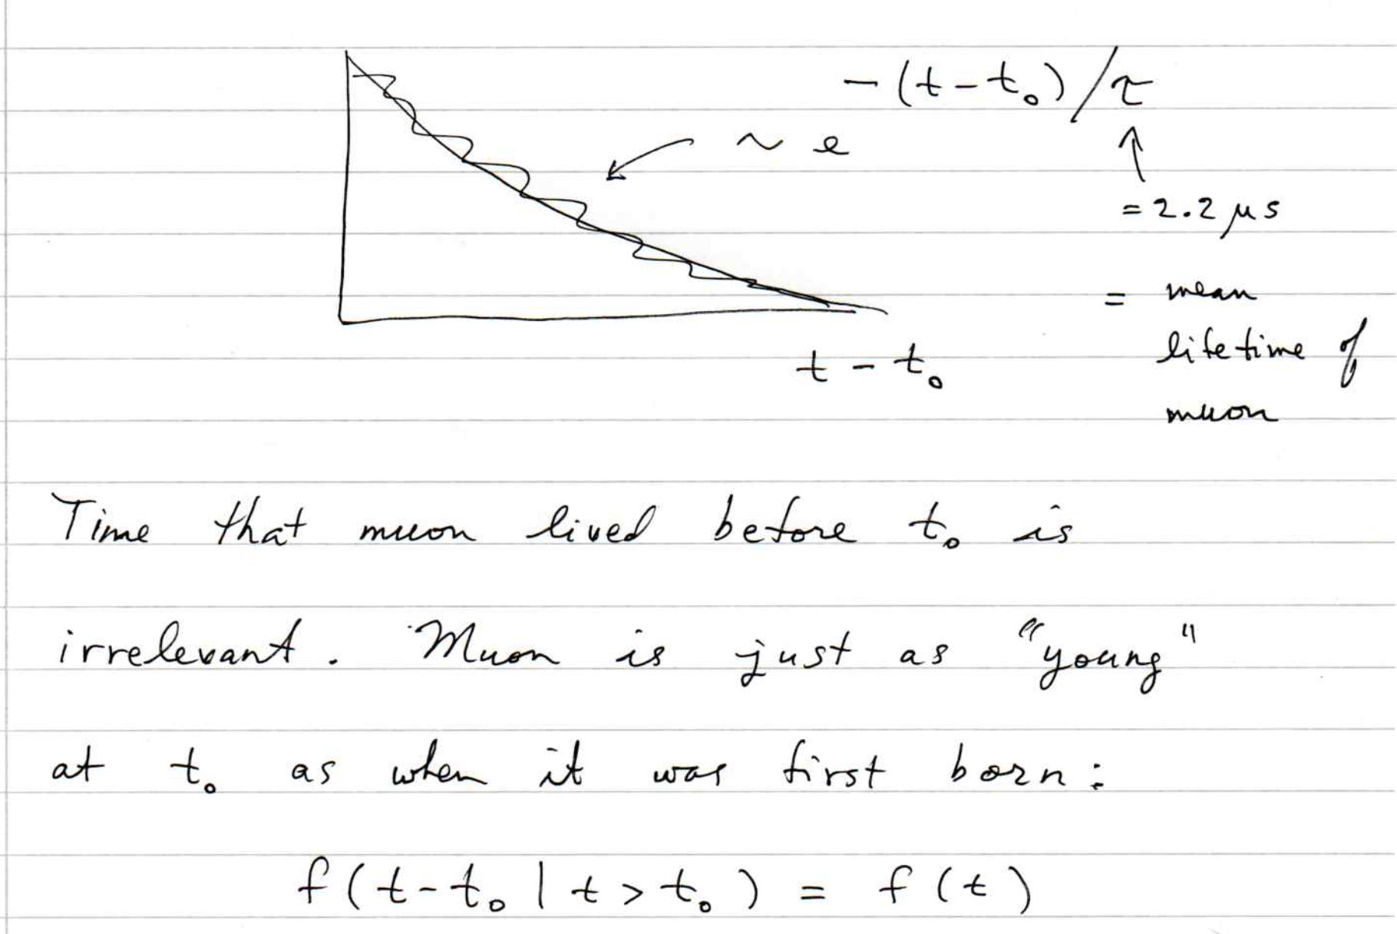

Slide 7
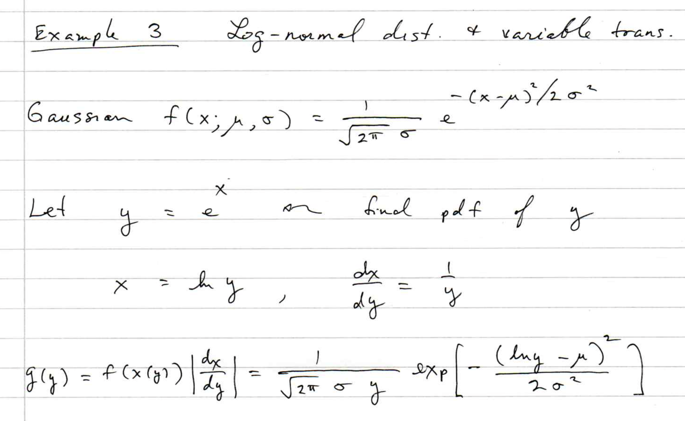

Slide 8
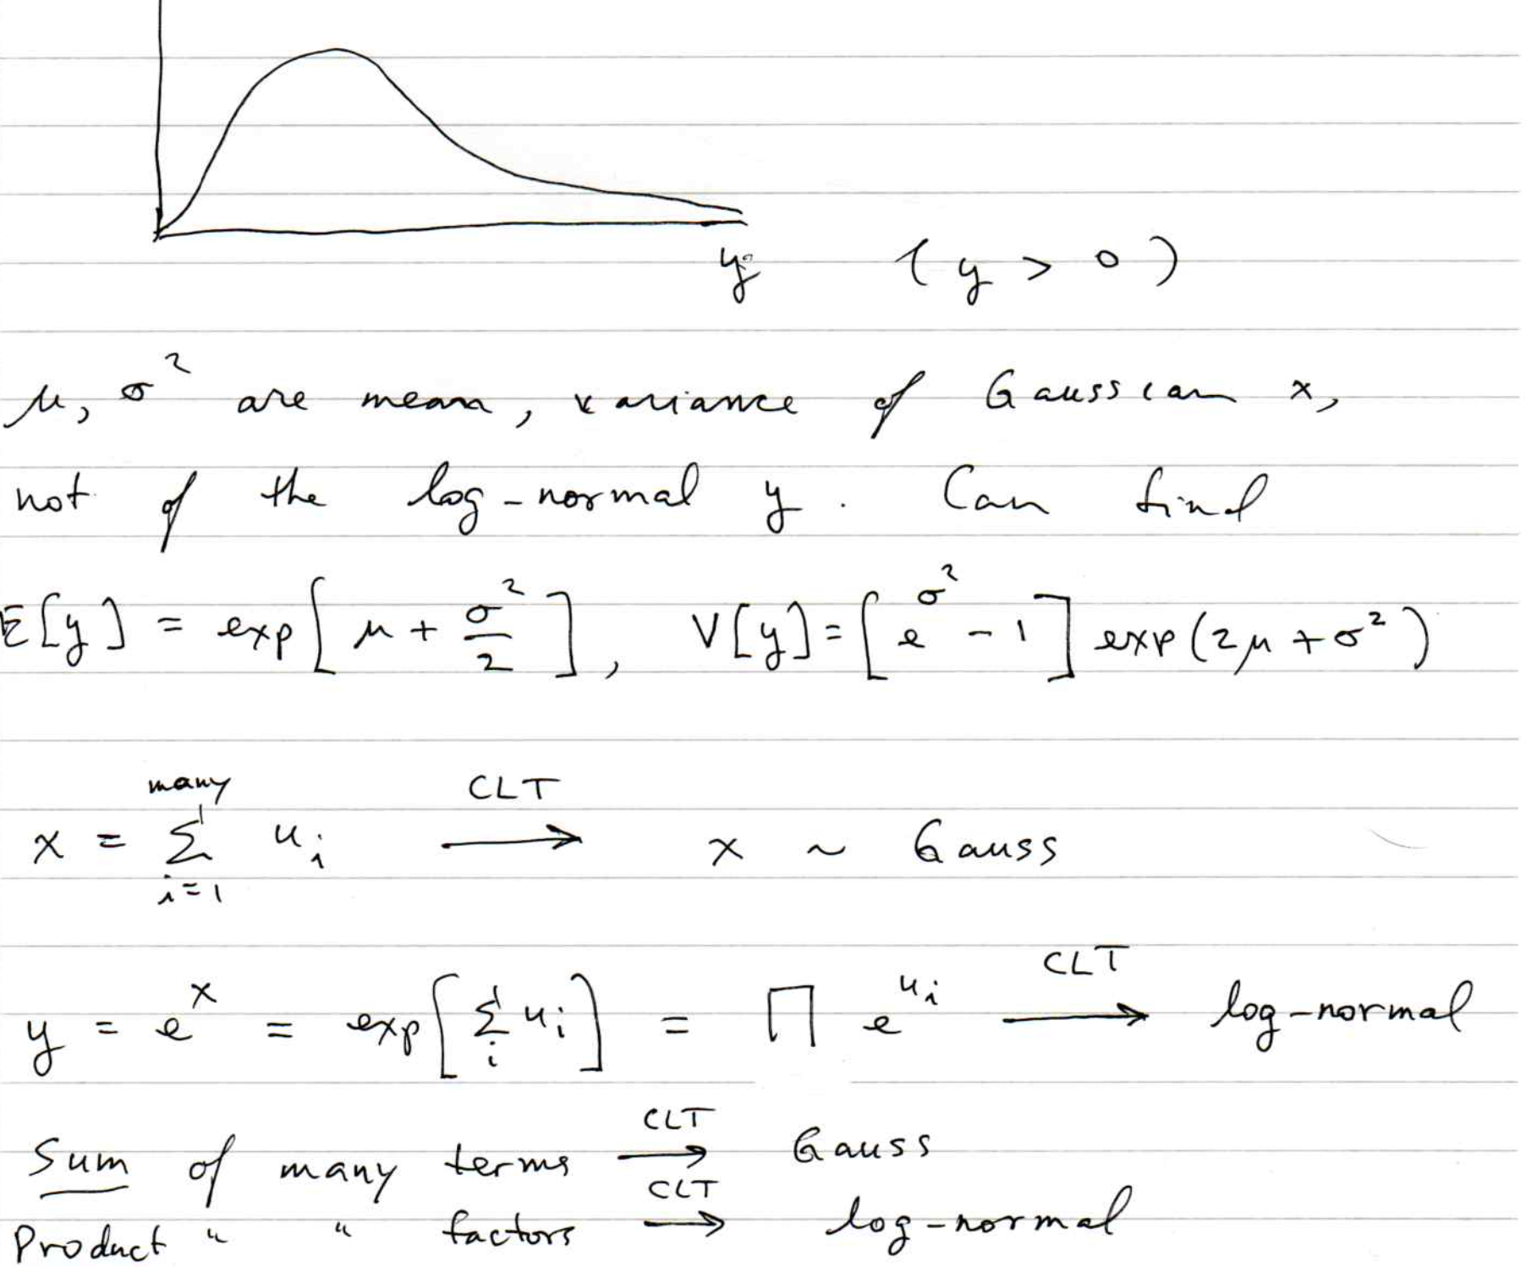

Slide 9
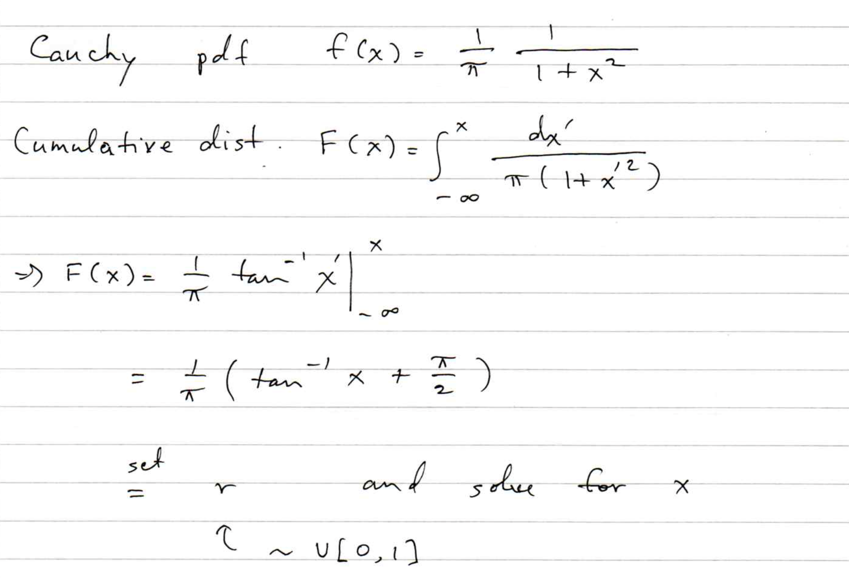
Random numbers from the Cauchy pdf

Slide 10
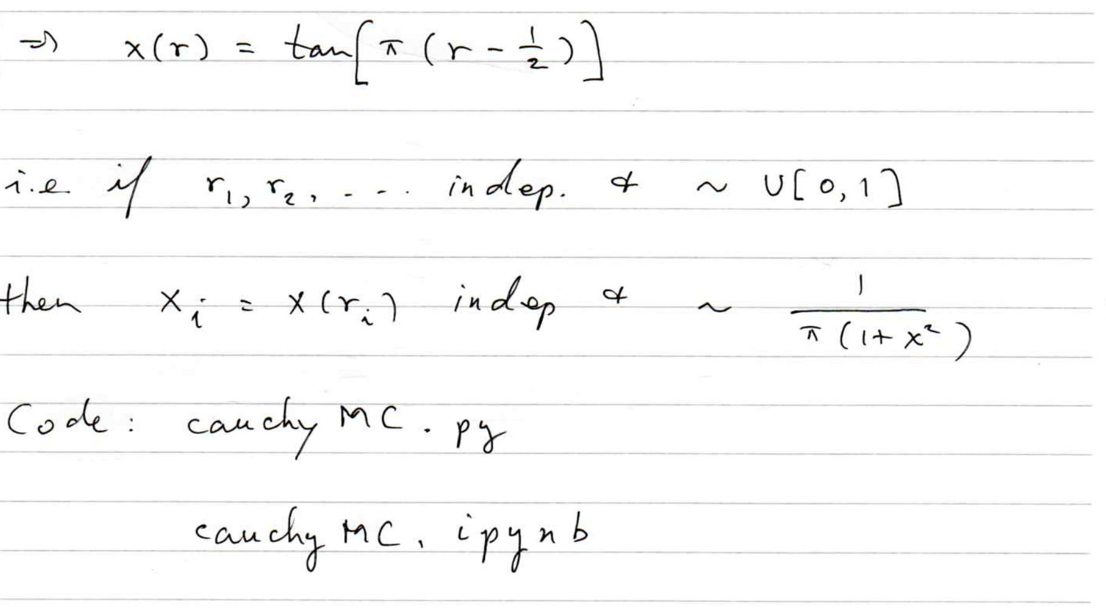

Slide 11
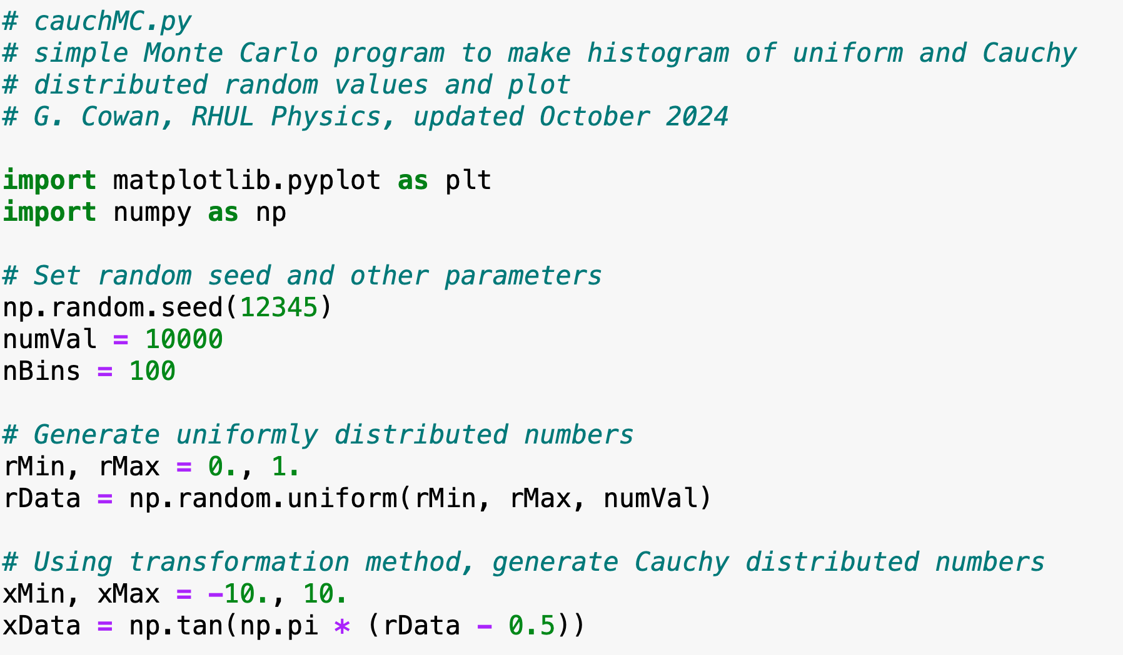
cauchyMC.py, .ipynb

Slide 12
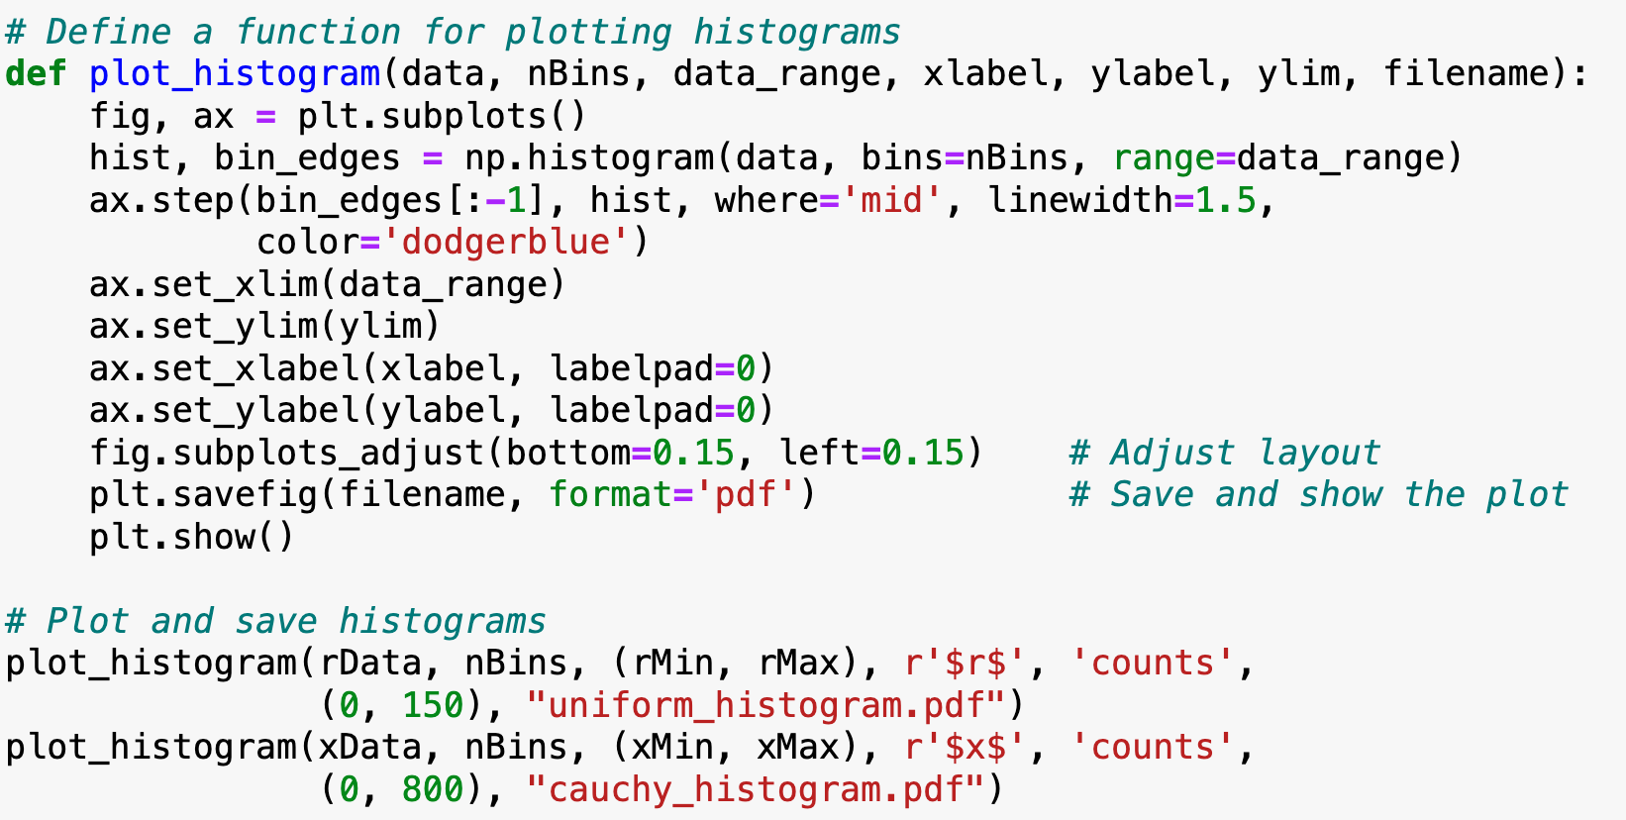
cauchyMC.py, .ipynb (continued)

Slide 13
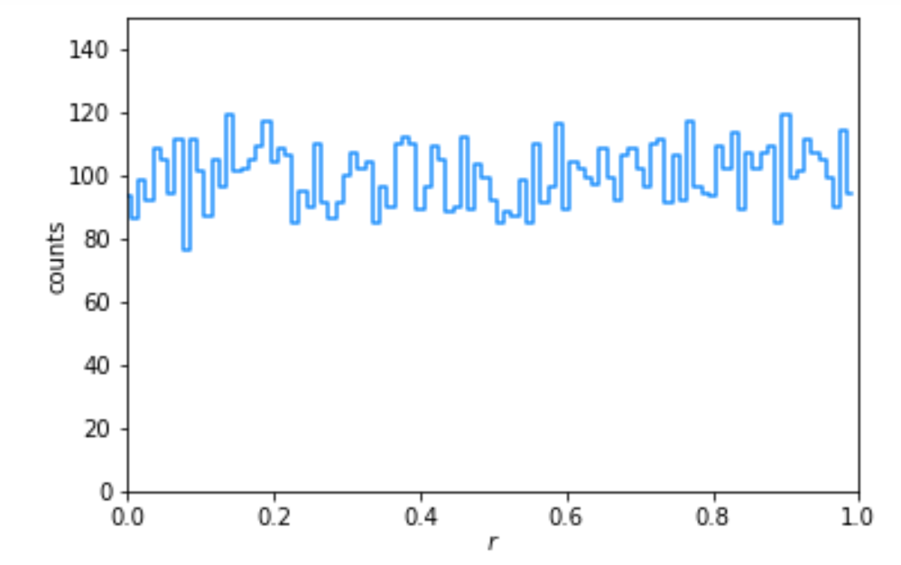
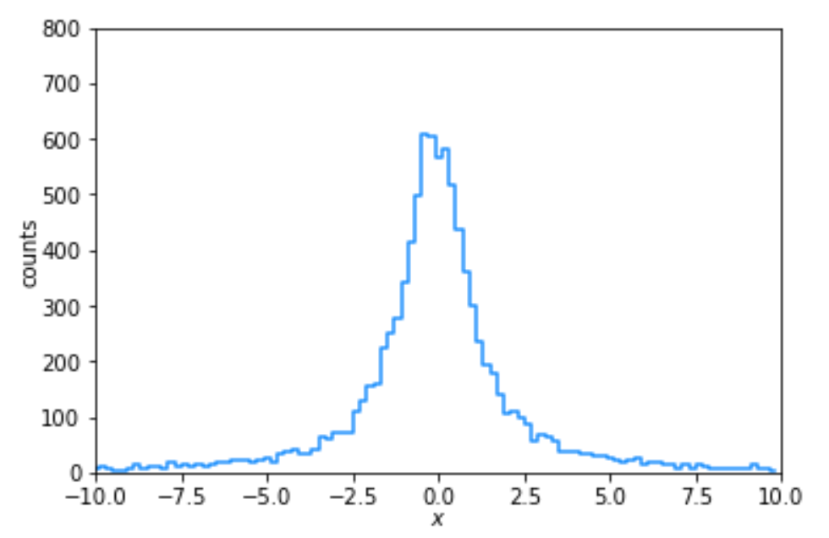
cauchyMC.py, .ipynb (output)
Uniform
Cauchy

Slide 14
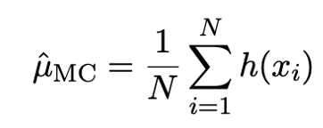
Importance Sampling
Often the goal of an MC calculation is to estimate the mean
value of a function h(x), where x ~ f (x).
An estimator μ_{MC} for μ is the average of N values of h(x) with
x generated from f (x):
＾
This has a variance of

Slide 15
Importance Sampling (2)
With importance sampling, one can reduce the variance for a given number of generated random values N.
Rewrite the desired mean value as
where g (x) is any other pdf nonzero on the same interval as f (x) from which we can generate random values.
Thus μ is the expectation with respect to g of h (x) f (x) /g (x), and can be estimated by generating N values of x ~ g (x) and using

Slide 16
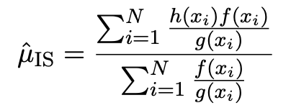
Importance Sampling (3)
＾
The variance of μ_{IS} is
By choosing g (x) such that h (x) f (x) /g (x) is as constant as possible, one can minimize the variance of μ_{IS} .
＾
Minimum achieved when:
Alternative estimator (smaller variance at cost of small bias):
References:

Slide 17
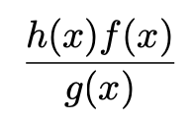
Importance Sampling Example
We can generate uniform random numbers with the pdf:
Suppose we want the mean value on [0,1] of:
In practice we don’t know the exact result.
We need a pdf g (x) from which we can sample such that
is approximately constant on the relevant interval 0 < x < 1.

Slide 18
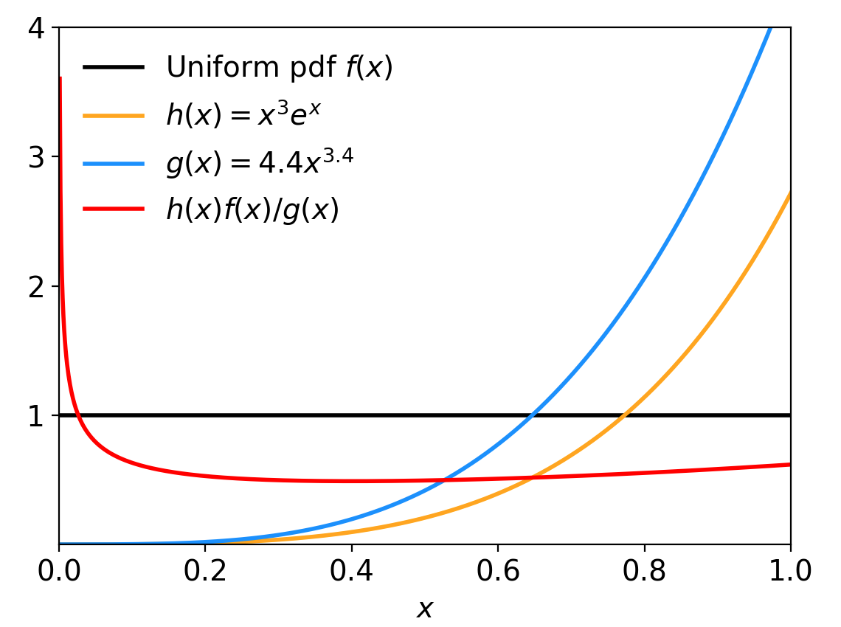
Importance Sampling Example (2)
Guess:
for some θ that we can adjust.
The cumulative distribution is
To sample from g (x), set g (x) = r
where r ~ U[0,1] and solve for x:
For e.g. θ = 3.4 and N = 1000,
Exact value = 0.563436
Monte Carlo estimate:
0.525473 +/- 0.022596
Importance sampling estimate:
0.564376 +/- 0.001159
20 times smaller err. than MC

