Slide 1
Statistical Data Analysis Discussion notes – week 5
Problem sheet 2
Some comments on Machine Learning

Slide 2
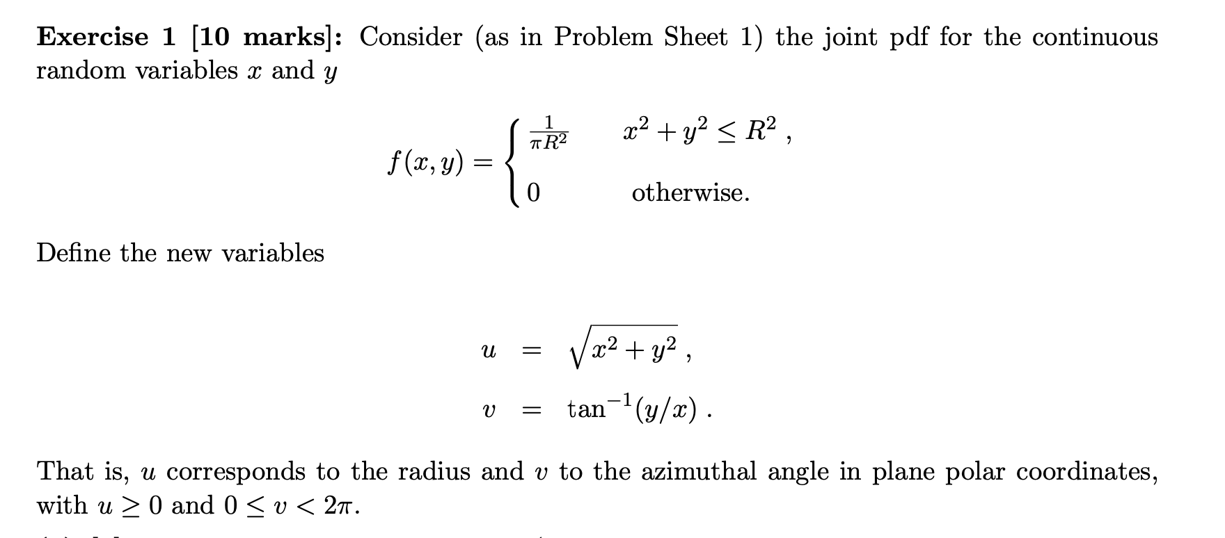
Problem sheet 2
oops, this was not on your PS1

Slide 3
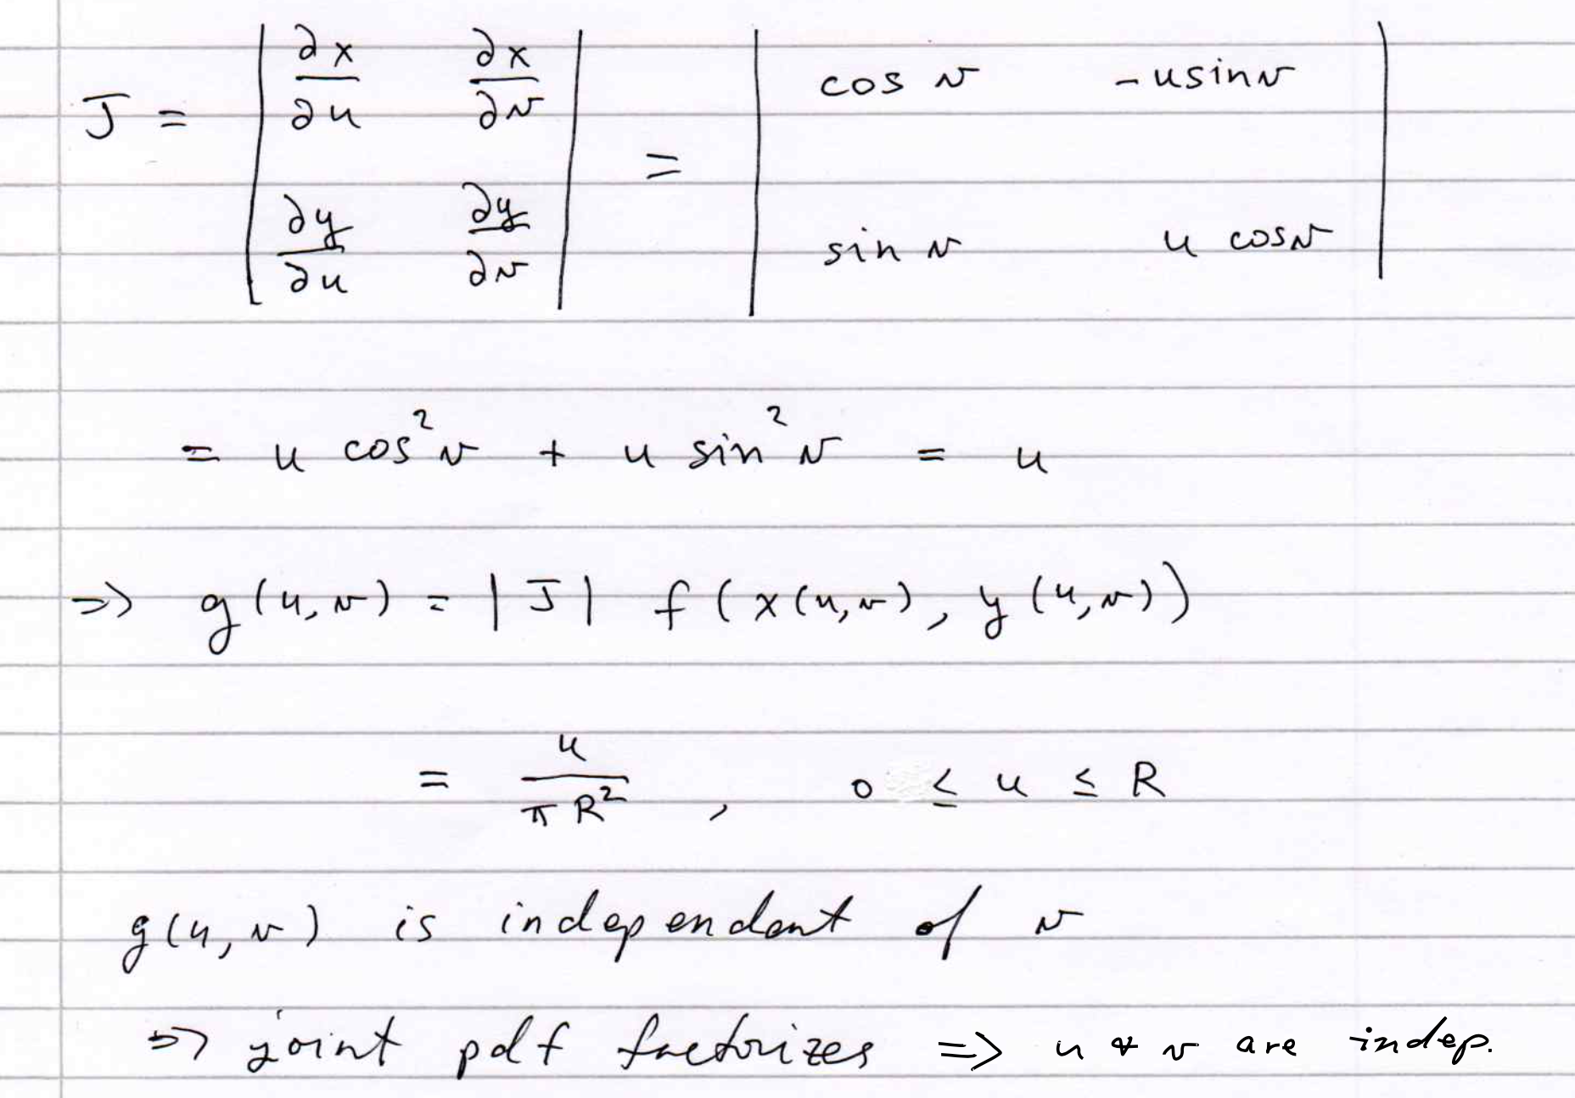
1(a)

Slide 4
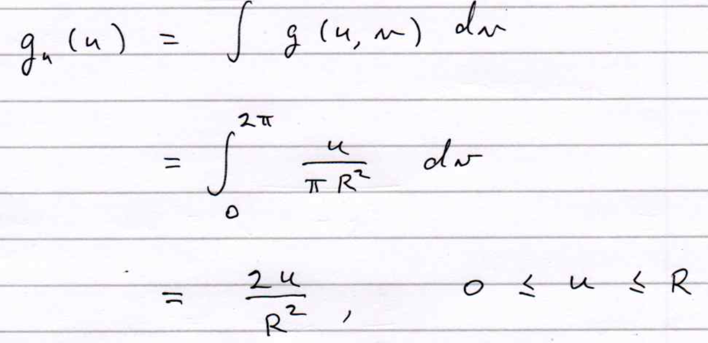
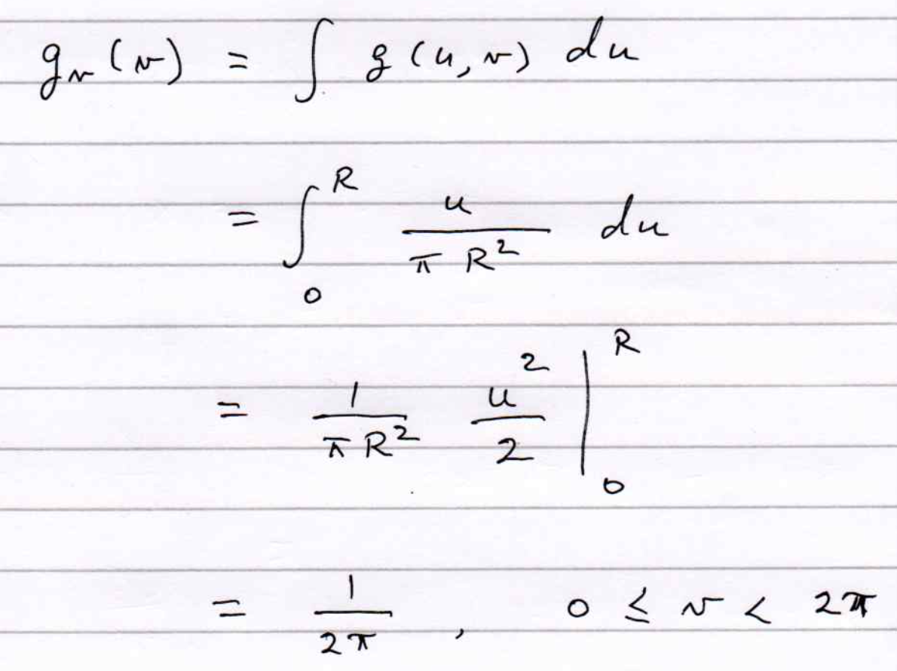
1(b)

Slide 5
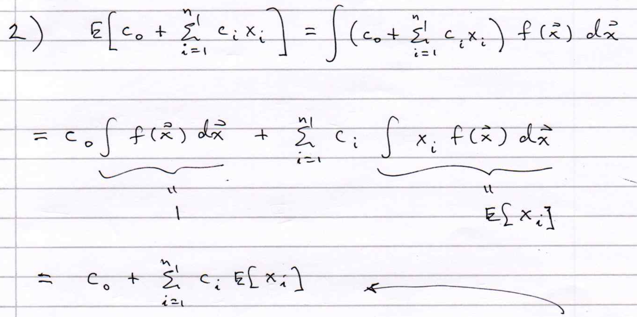

Slide 6
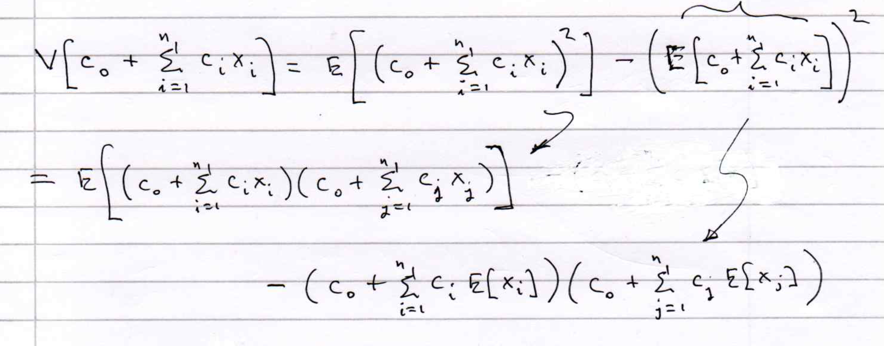

Slide 7
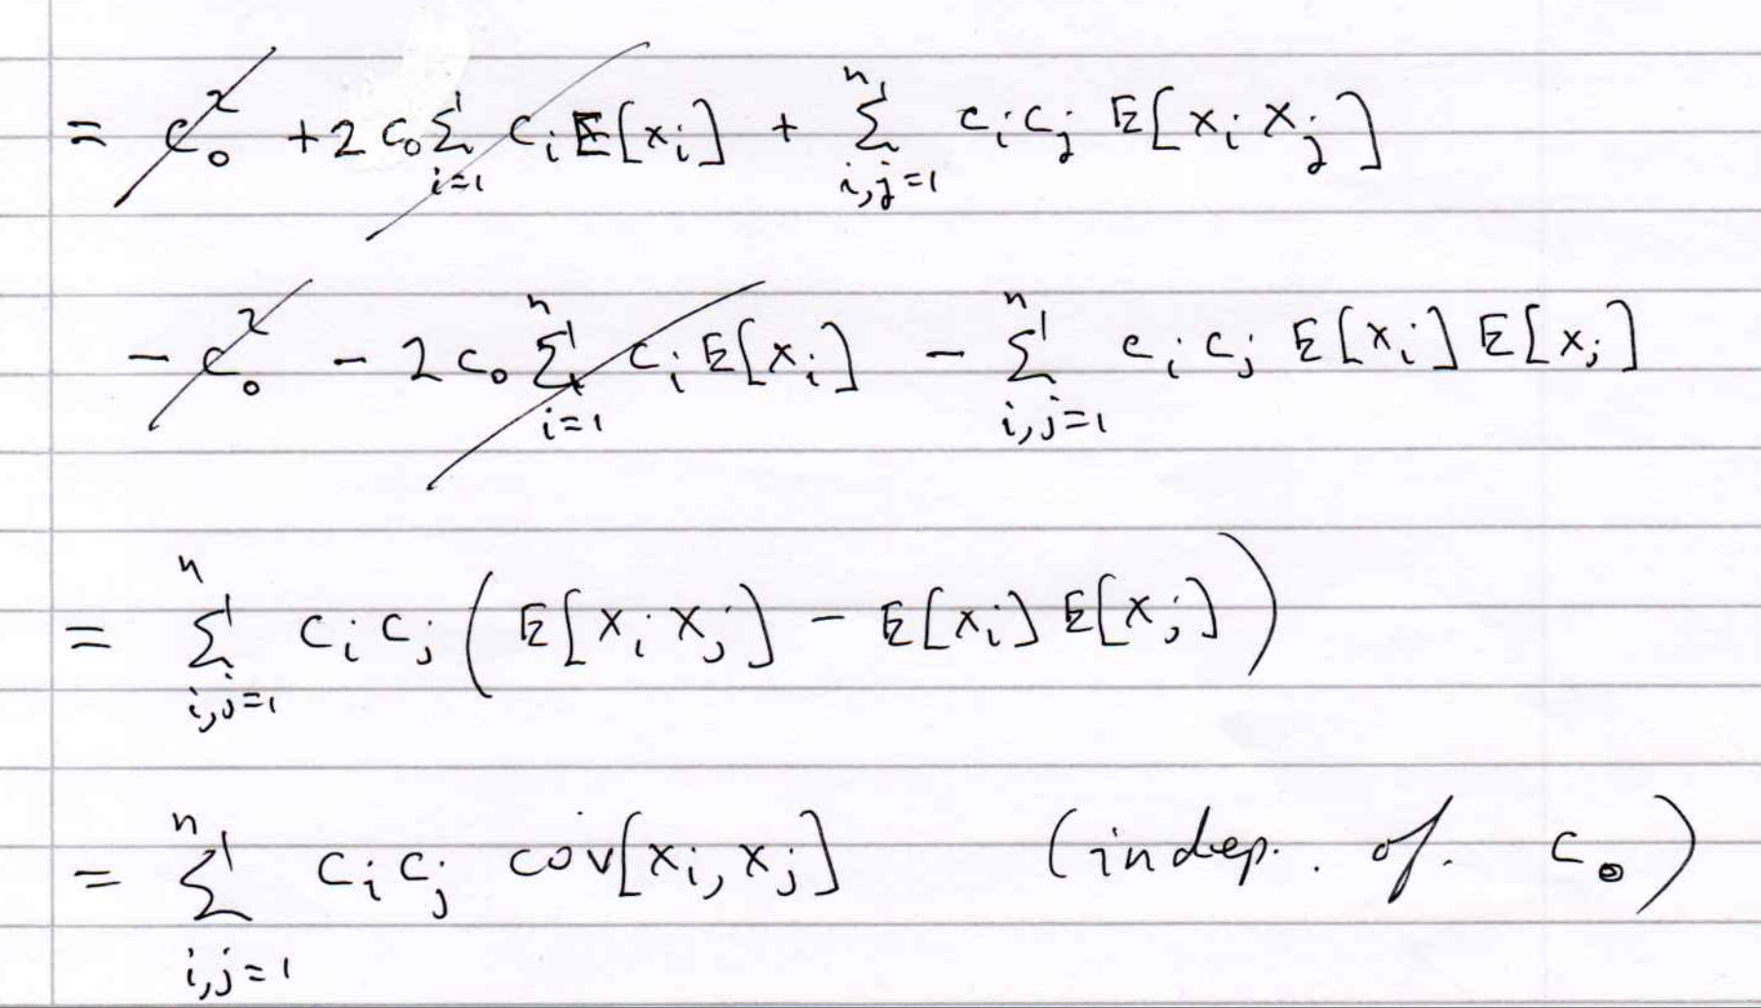
2(b) (cont.)

Slide 8
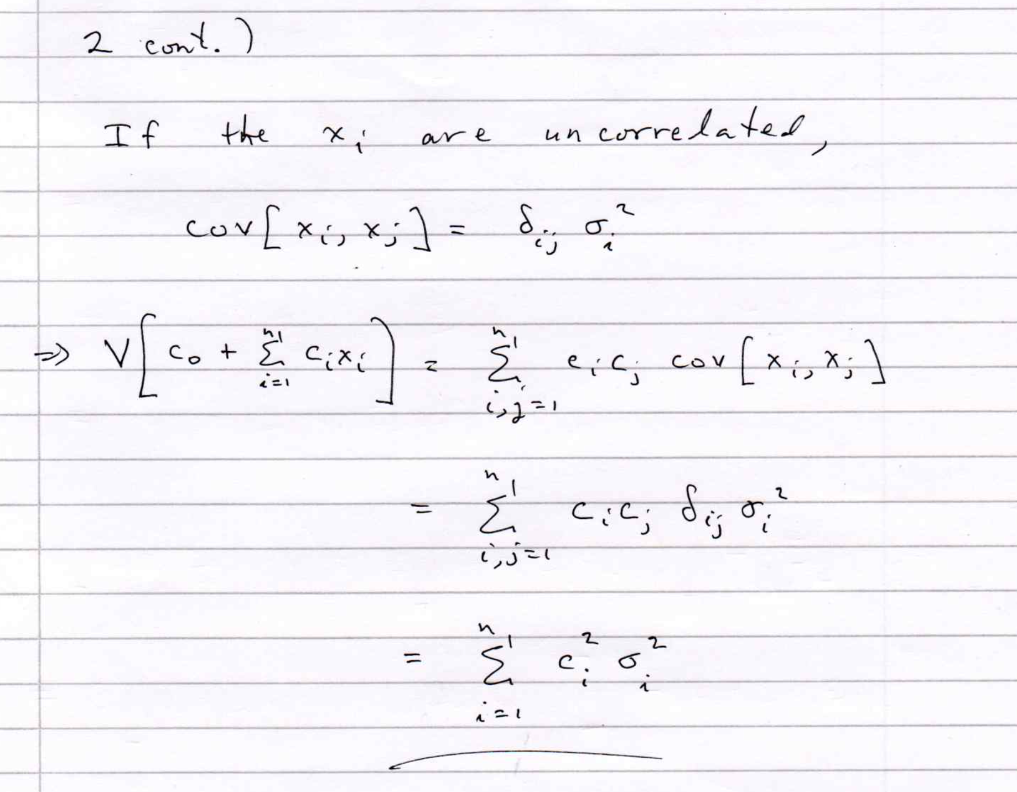

Slide 9
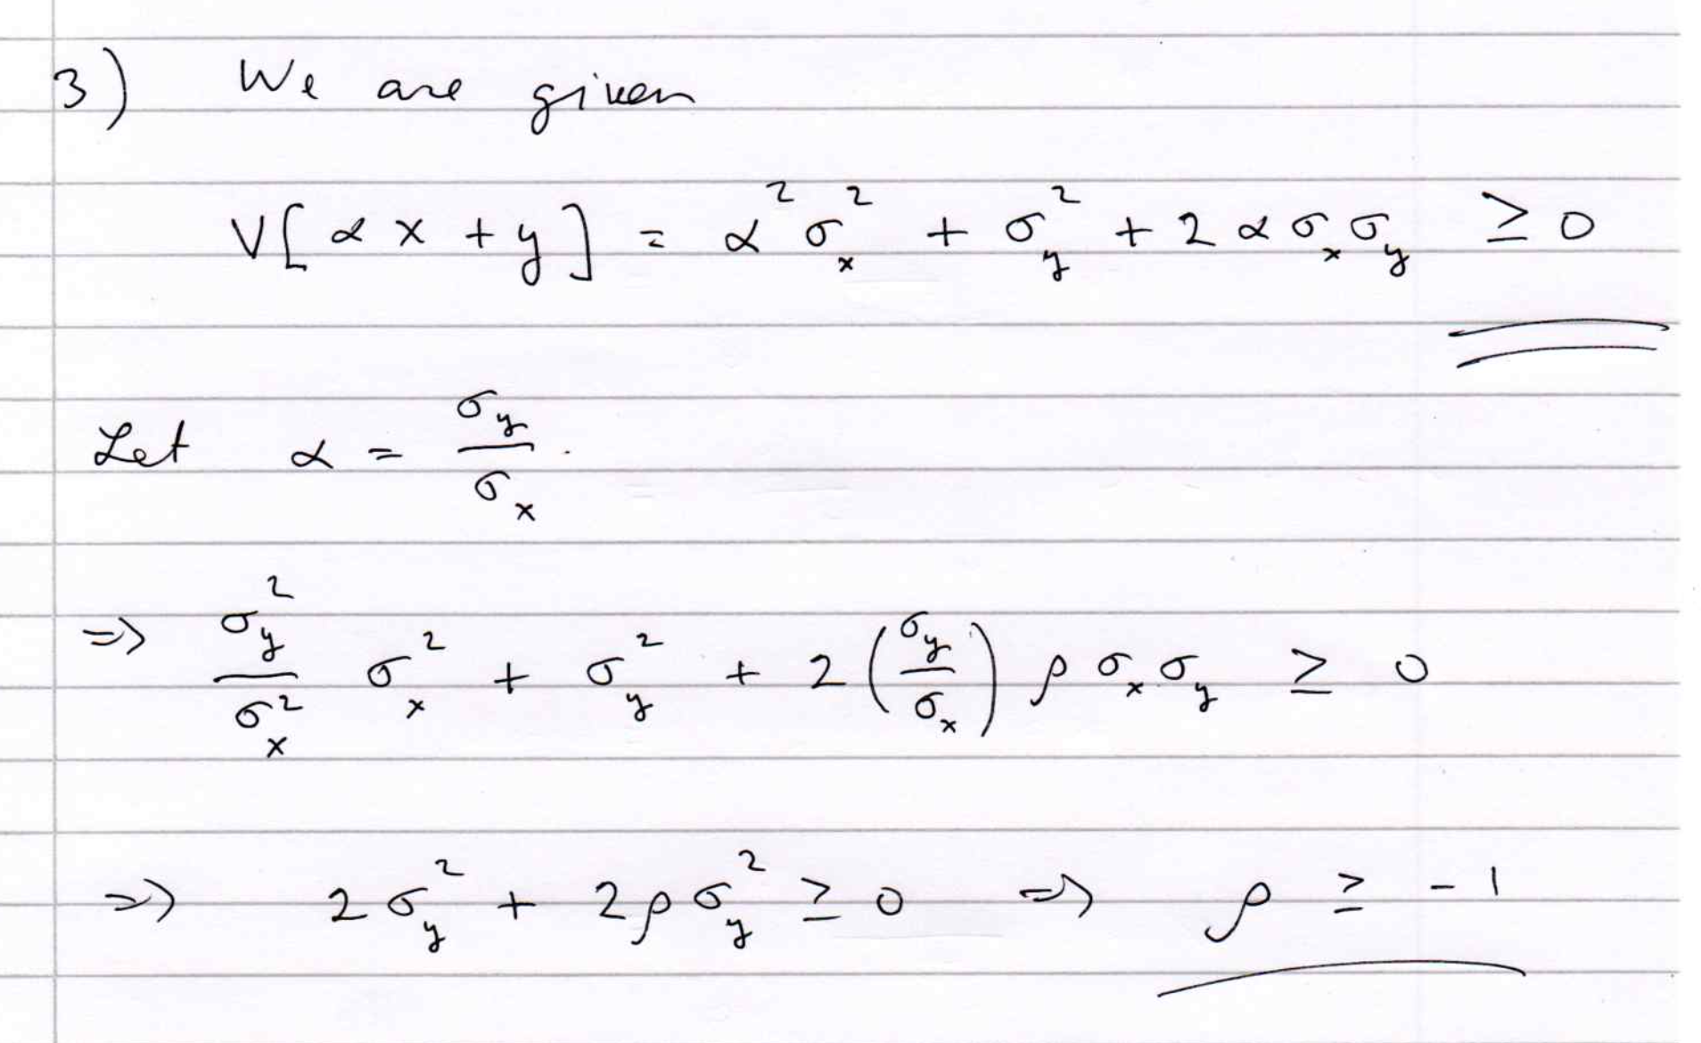

Slide 10
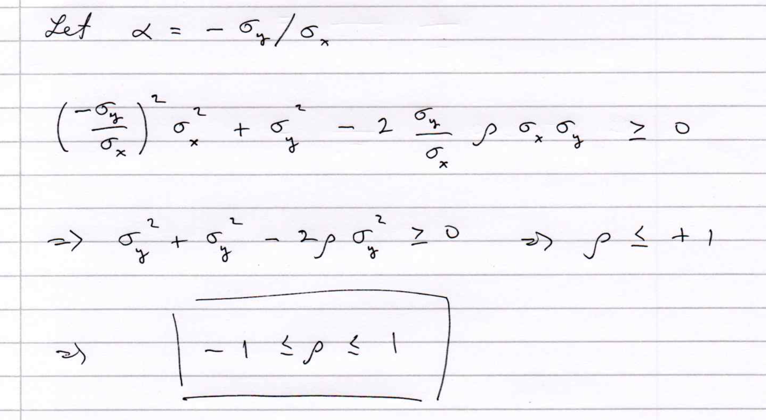
3 (cont.)

Slide 11
A simple example (2D)
Consider two variables, x₁ and x₂, and suppose we have formulas for the joint pdfs for both signal (s) and background (b) events (in real problems the formulas are usually notavailable).
f (x₁|x₂) ~ Gaussian, different means for s/b,
Gaussians have same σ, which depends on x₂,
f (x₂) ~ exponential, same for both s and b,
f (x₁, x₂) = f (x₁|x₂) f (x₂):

Slide 12
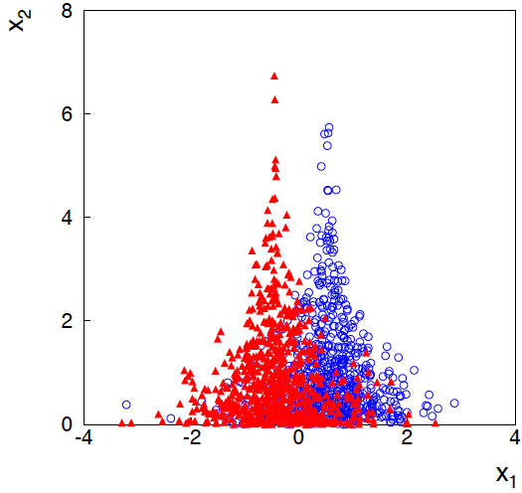
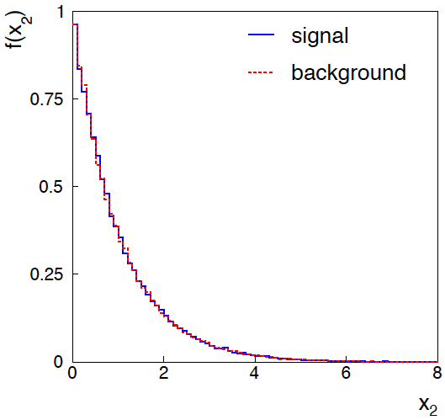
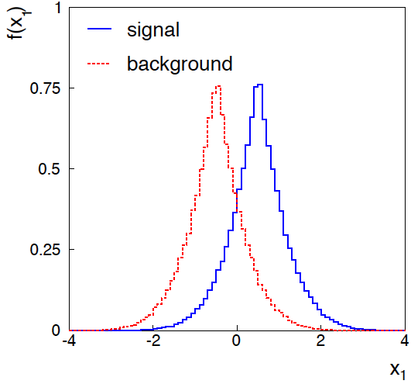
Joint and marginal distributions of x₁, x₂
background
signal
Distribution f (x₂) same for s, b.
So does x₂ help discriminate
between the two event types?

Slide 13
Likelihood ratio for 2D example
Neyman-Pearson lemma says best critical region is determined
by the likelihood ratio:
Equivalently we can use any monotonic function of this as
a test statistic, e.g.,
Boundary of optimal critical region will be curve of constant ln t, and this depends on x₂!

Slide 14
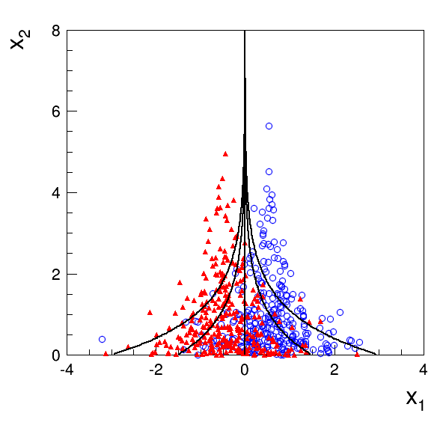
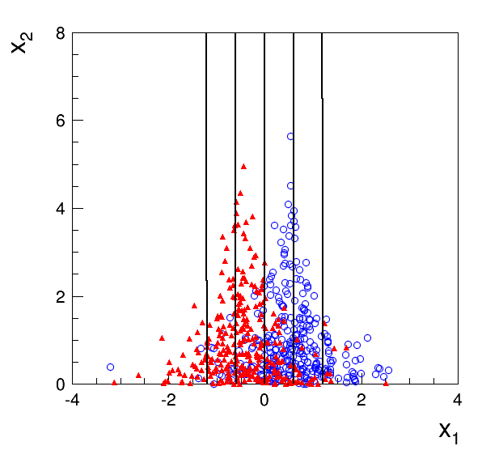
Contours of constant MVA output
Exact likelihood ratio
Fisher discriminant

Slide 15
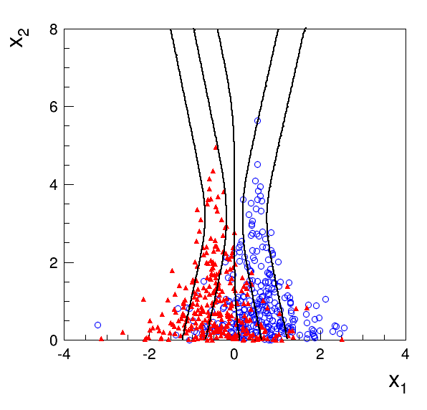
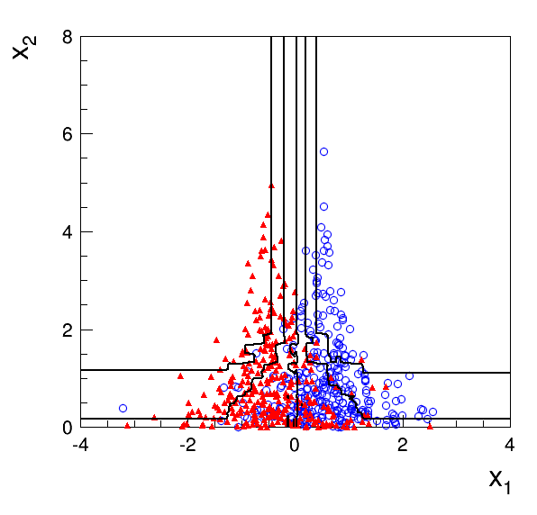
Contours of constant MVA output
Multilayer Perceptron
1 hidden layer with 2 nodes
Boosted Decision Tree
200 iterations (AdaBoost)
Training samples: 10⁵ signal and 10⁵ background events

Slide 16
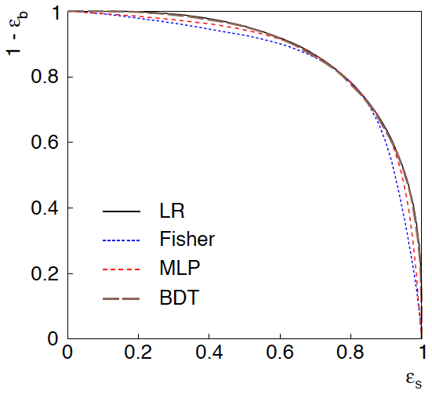
ROC curve
ROC = “receiver operating
characteristic” (term from
signal processing).
Shows (usually) background
rejection (1−ε_{b}) versus
signal efficiency ε_{s}.
Higher curve is better;
usually analysis focused on
a small part of the curve.

Slide 17
2D Example: discussion
Even though the distribution of x₂ is same for signal and background, x₁ and x₂ are not independent, so using x₂ as an input variable helps.
Here we can understand why: high values of x₂ correspond to a smaller σ for the Gaussian of x₁. So high x₂ means that the value of x₁ was well measured.
If we don’t consider x₂, then all of the x₁ measurements are lumped together. Those with large σ (low x₂) “pollute” the well measured events with low σ (high x₂).
Often in HEP there may be variables that are characteristic of how well measured an event is (region of detector, number of pile-up vertices,...). Including these variables in a multivariate analysis preserves the information carried by the well-measured events, leading to improved performance.

Slide 18
K. Cranmer, U. Seljak and K. Terao, Machine Learning, in R.L. Workman et al. (PDG), Prog. Theor. Exp. Phys. 2022, 083C01 (2022); https://pdg.lbl.gov/
Convolutional Neural Networks
Designed for image data (pixels) → number of input variables ≳10⁶.
Intermediate layers include “convolutions” of an area in previous layer, i.e., transformed pixel is a linear combination of pixels in local neighborhood in previous layer
→ far fewer connections than a fully connected MLP.
CNNs widely used for image classification.

Slide 19
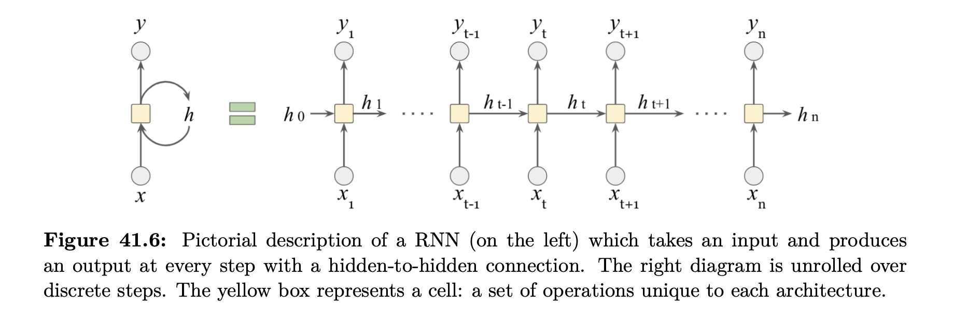
K. Cranmer, U. Seljak and K. Terao, Machine Learning, in R.L. Workman et al. (PDG), Prog. Theor. Exp. Phys. 2022, 083C01 (2022); https://pdg.lbl.gov/
Recurrent Neural Networks
Designed for sequential data (time series).
RNNs used, e.g., in natural language processing.

Slide 20
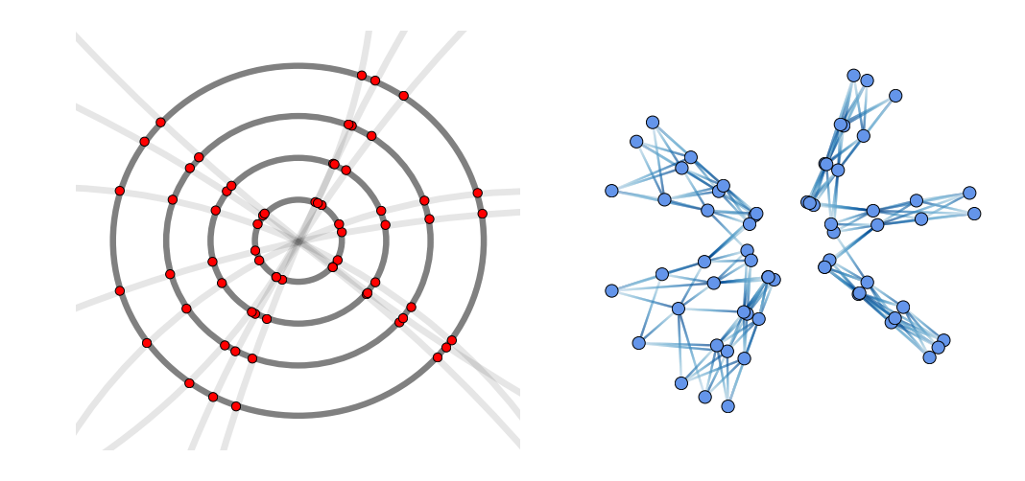
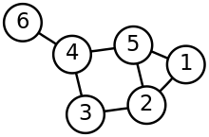
Jonathan Shlomi, Peter Battaglia, Jean-Roch Vlimant, Graph Neural Networks in Particle Physics, 2021 Mach. Learn.: Sci. Technol. 2 021001, 2021; https://arxiv.org/abs/2007.13681.
Graph Neural Networks
GNNs work with graph-structured input data, e.g., signals from particles in tracking detector:
Graph = set of nodes plus set of edges:
Part of a larger field called “geometric deep learning”:
CNN is a type of GNN, graph relates pixel to its neighbors.
Transformer is a GNN that uses a mechanism called “attention”, used in natural language processing (T of ChatGPT).

