Slide 1
Statistical Data Analysis Discussion notes – week 6
Problem sheet 3
Comments on scikit-learn
Comments on p-values

Slide 2
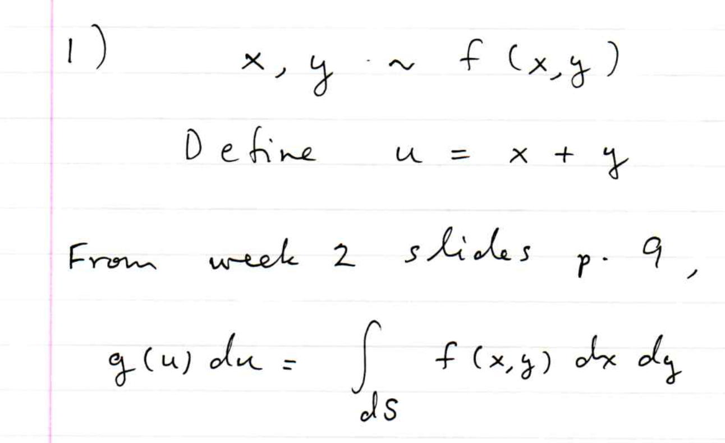
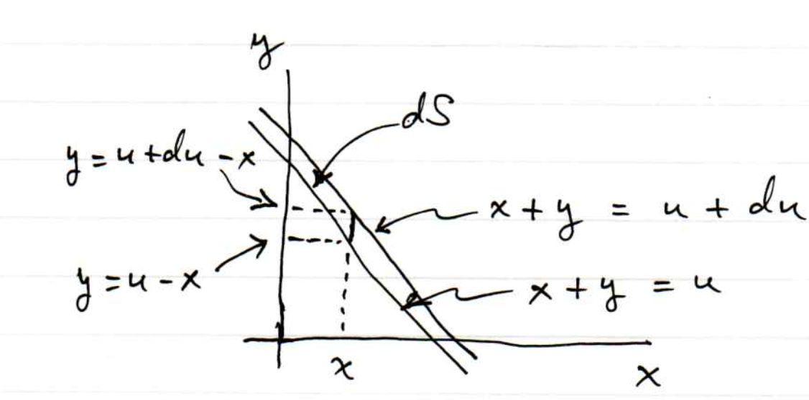
Problem sheet 3

Slide 3
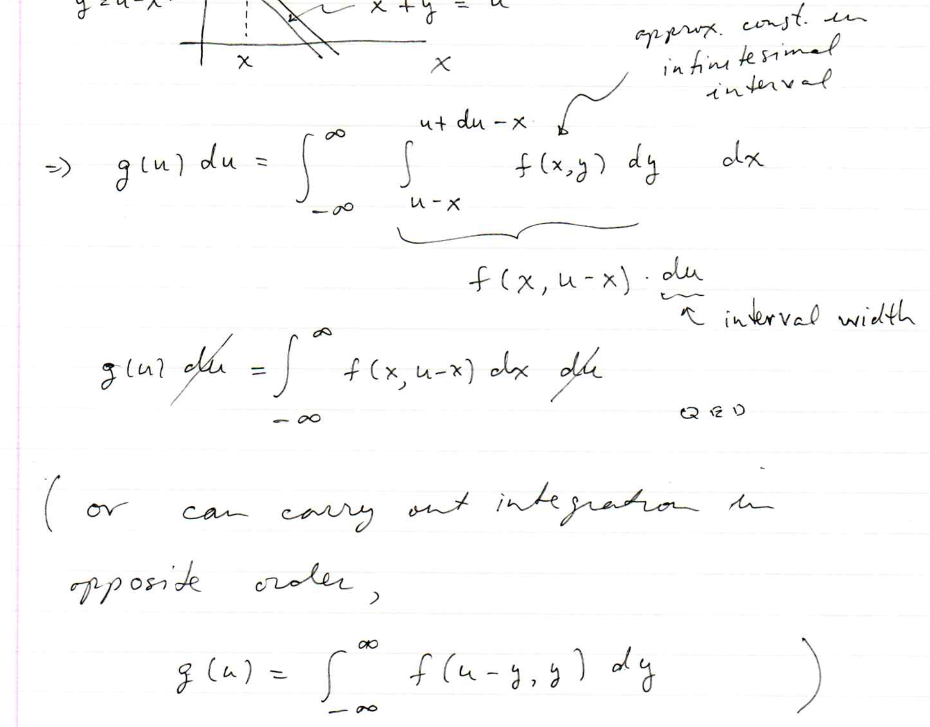
1 (cont.)

Slide 4
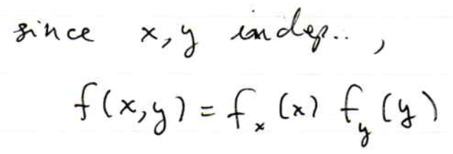
2

Slide 5
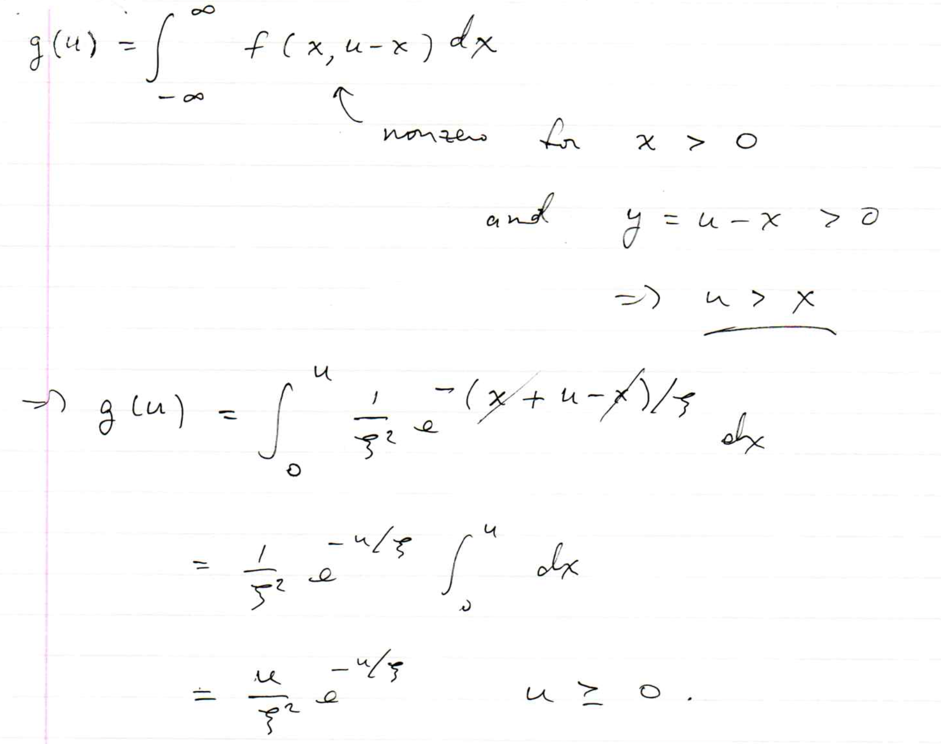

Slide 6
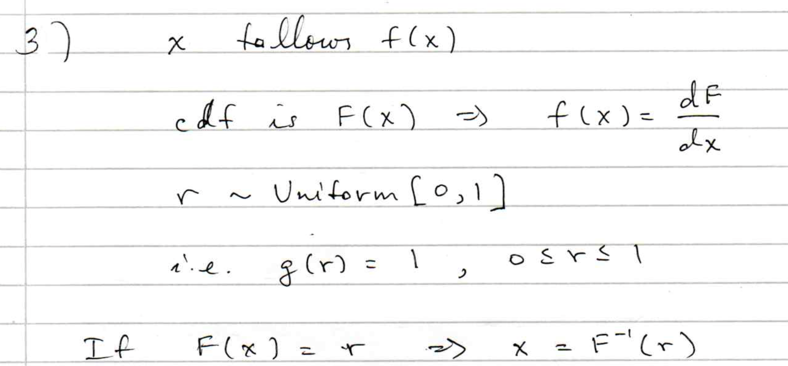
3.

Slide 7
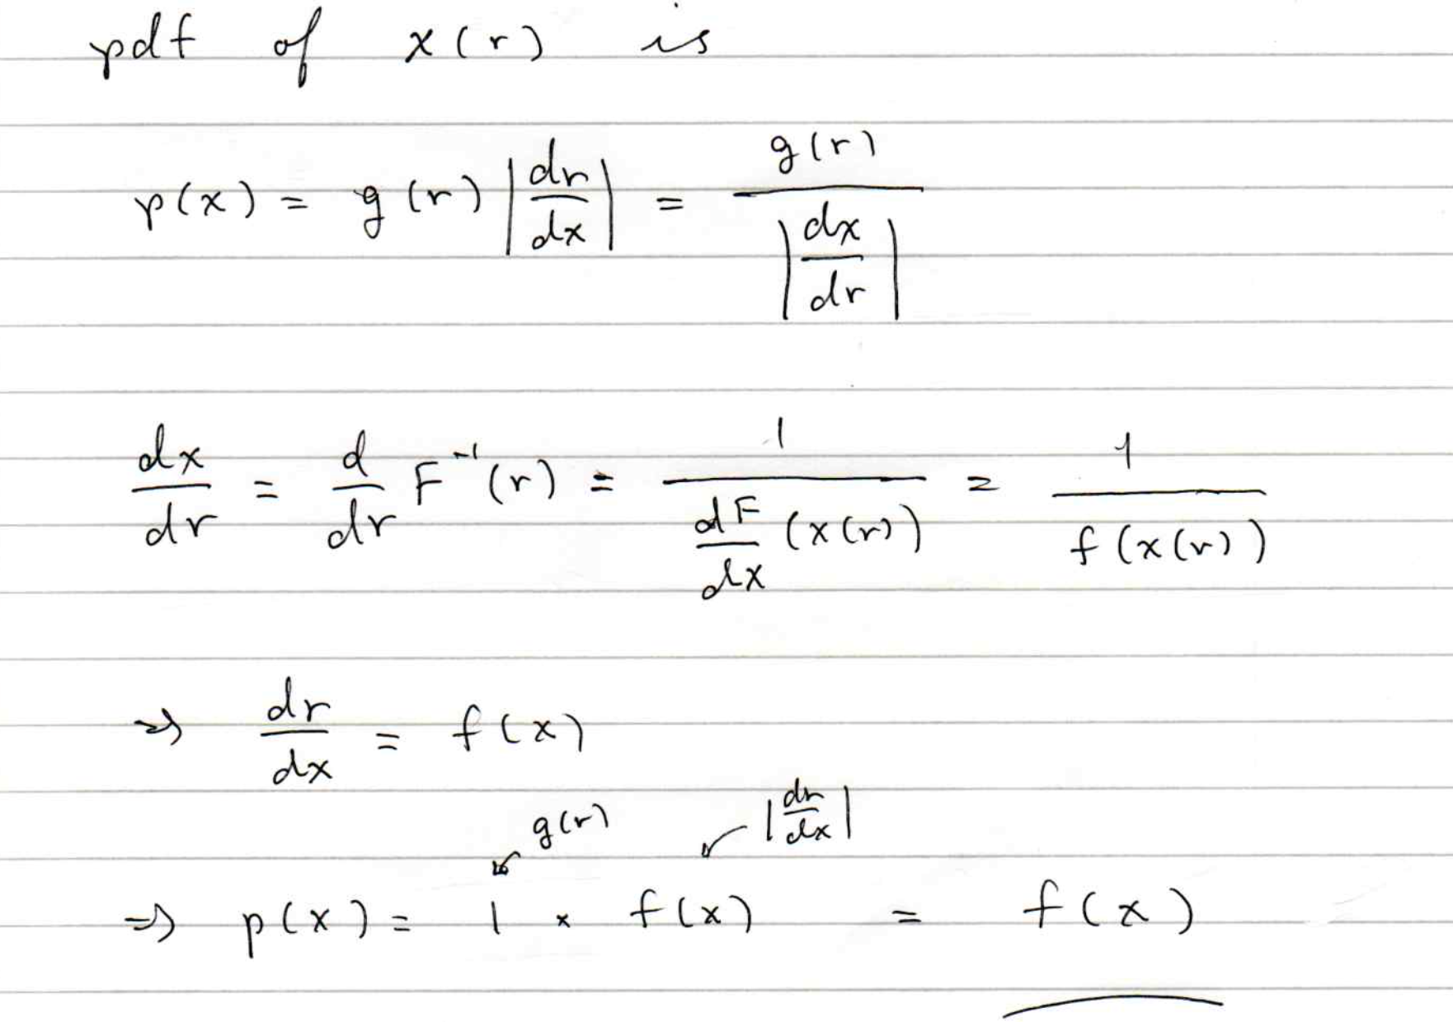

Slide 8
Software for Machine Learning
We will practice ML with the Python package scikit-learn
scikit-learn.org ← software, docs, example code
scikit-learn built on NumPy, SciPy and matplotlib, so you need
import scipy as sp
import numpy as np
import matplotlib
import matplotlib.pyplot as plt
and then you import the needed classifier(s), e.g.,
from sklearn.neural_network import MLPClassifier
For a list of the various classifiers in scikit-learn see the docs
on scikit-learn.org, also a very useful sample program:
http://scikit-learn.org/stable/auto_examples/classification/plot_classifier_comparison.html

Slide 9
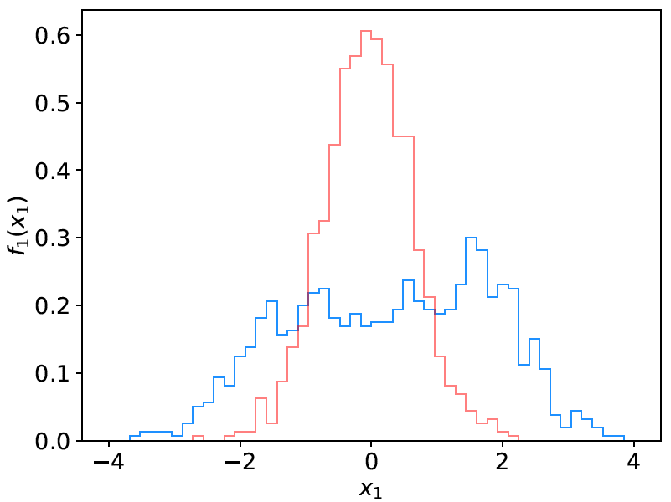
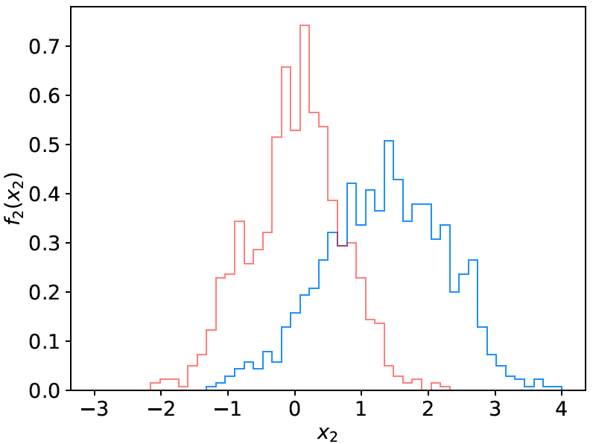
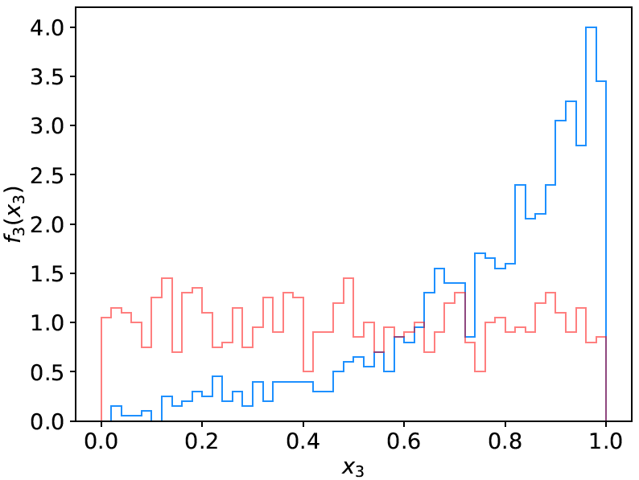
Example: the data
We will do an example with data corresponding to events
of two types: signal (y = 1, blue) and background (y = 0, red).
Each event is characterised by 3 quantities: x = (x₁, x₂, x₃).
Components are correlated.
Suppose we have 1000 events each of signal and background.

Slide 10
Reading in the data
scikit-learn wants the data in the form of numpy arrays:
# read the data in from files,
# assign target values 1 for signal, 0 for background
sigData = np.loadtxt('signal.txt')
nSig = sigData.shape[0]
sigTargets = np.ones(nSig)
bkgData = np.loadtxt('background.txt')
nBkg = bkgData.shape[0]
bkgTargets = np.zeros(nBkg)
# concatenate arrays into data X and targets y
# split into two parts: use one for training, the other for testing
X = np.concatenate((sigData,bkgData),0)
y = np.concatenate((sigTargets, bkgTargets))
# split data into training and testing samples
X_train, X_test, y_train, y_test = train_test_split(X, y, test_size=0.5,
random_state=1)

Slide 11
Create, train, evaluate the classifier
Create an instance of the MLP (multilayer perceptron) class
and “train”, i.e., adjust the values of the weights to minimise
the loss function.
Here we request 3 hidden layers with 10 nodes each:
# create classifier object and train
clf = MLPClassifier(hidden_layer_sizes=(10,10,10), activation='tanh',
max_iter=2000, random_state=6)
clf.fit(X_train, y_train)
Use test data to see what fraction of events are correctly classified
(default takes threshold of 0.5 for decision function)
# evaluate its accuracy (= 1 – error rate) using the test data
y_pred = clf.predict(X_test)
print(metrics.accuracy_score(y_test, y_pred))

Slide 12
Evaluating the decision function
So now for any point (x₁, x, x₃) in the feature space,
we can evaluate the decision:
# Test evaluation of decision function for a specific point in feature space
xt = np.array([0.37, 2.46, 0.42]).reshape((1,-1))
#t = clf.decision_function(xt)[0] # not available for MLP
t = clf.predict_proba(xt)[0, 1] # for MLP use this instead
Usually we have an array of points in x-space, so we can
get an array of probabilities:
t = clf.predict_proba(X_test)[:, 1] # returns prob to be of type y=1
Can get this separately for the signal and background events
and make histograms (see sample code).
Note for most other classifiers, the decision function is called
decision_function – use this instead of predict_proba.

Slide 13
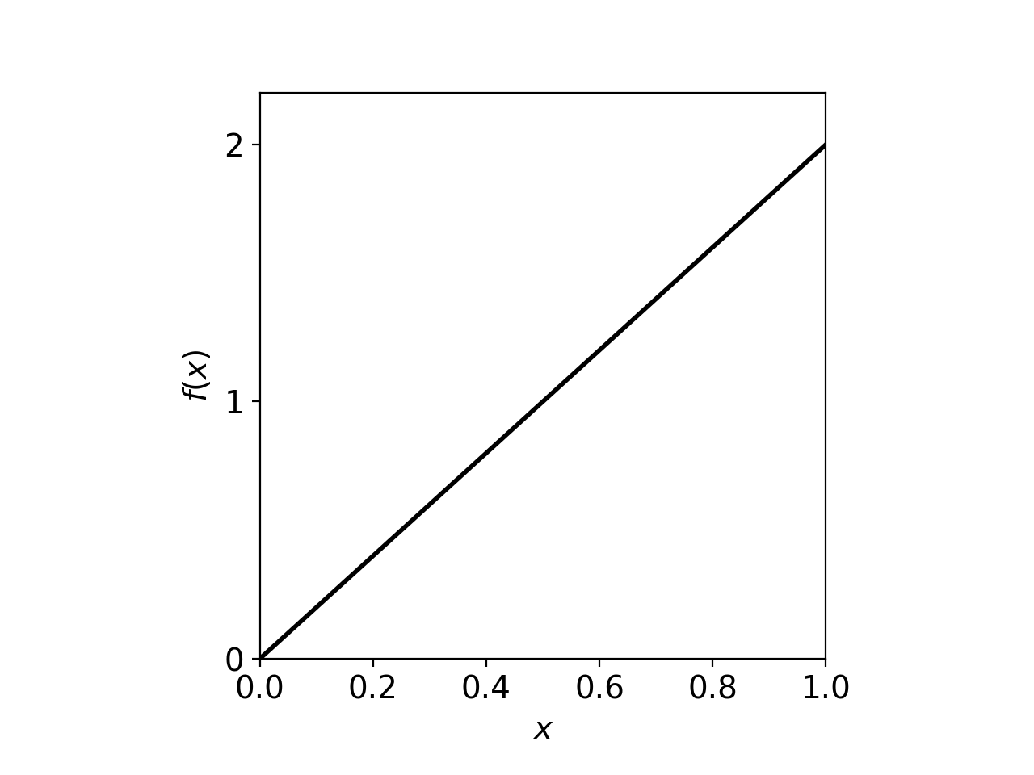
On defining a p-value
Earlier it was argued that the region of “equal or lesser compatibility” with H had greater compatibility with the predictions of some alternative hypothesis.
But shouldn’t it be possible to identify such a region by using the pdf f (x|H)?
In general, no.
Consider cubic crystal grains
produced by a process H that
have a size distribution
Observe grain of uncertain origin,
measure x,
find p-value of H.
If we observe a value x_{obs}, naively we could regard x ≤ x_{obs} as constituting equal or less agreement with the predictions of f (x|H).

Slide 14
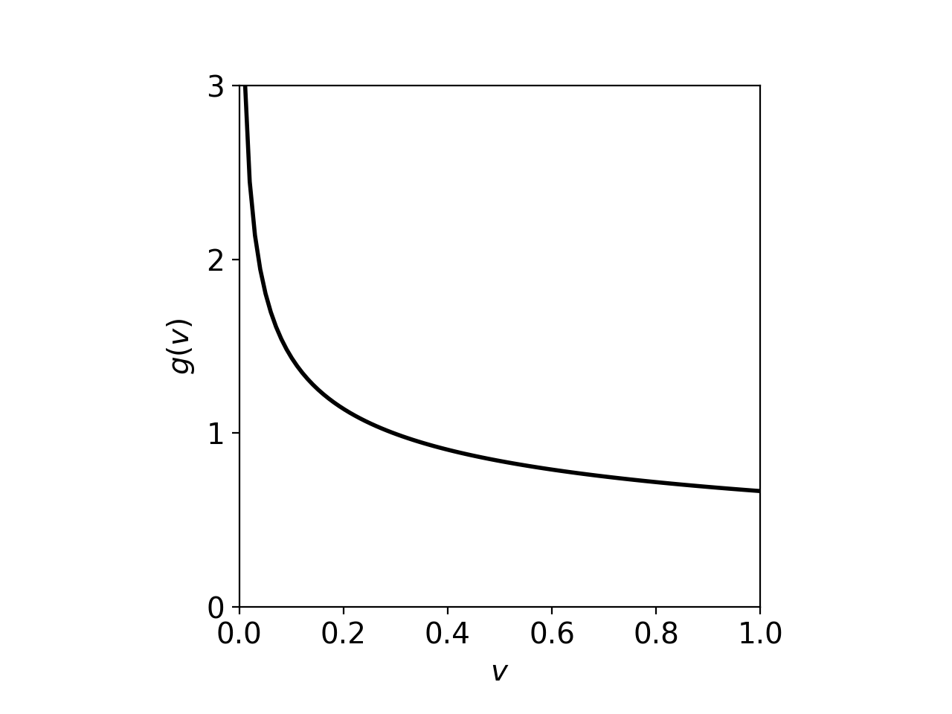
On defining a p-value (2)
But suppose we took the volume v = x³ of the cube to represent its size.
The volume distribution is
So now it appears that smaller sizes are more compatible with H.
Conclusion: deciding what region of data space constitutes greater or lesser
compatibility with H cannot be done by looking at the data distribution alone;
it requires that one consider an alternative H’.

Slide 15
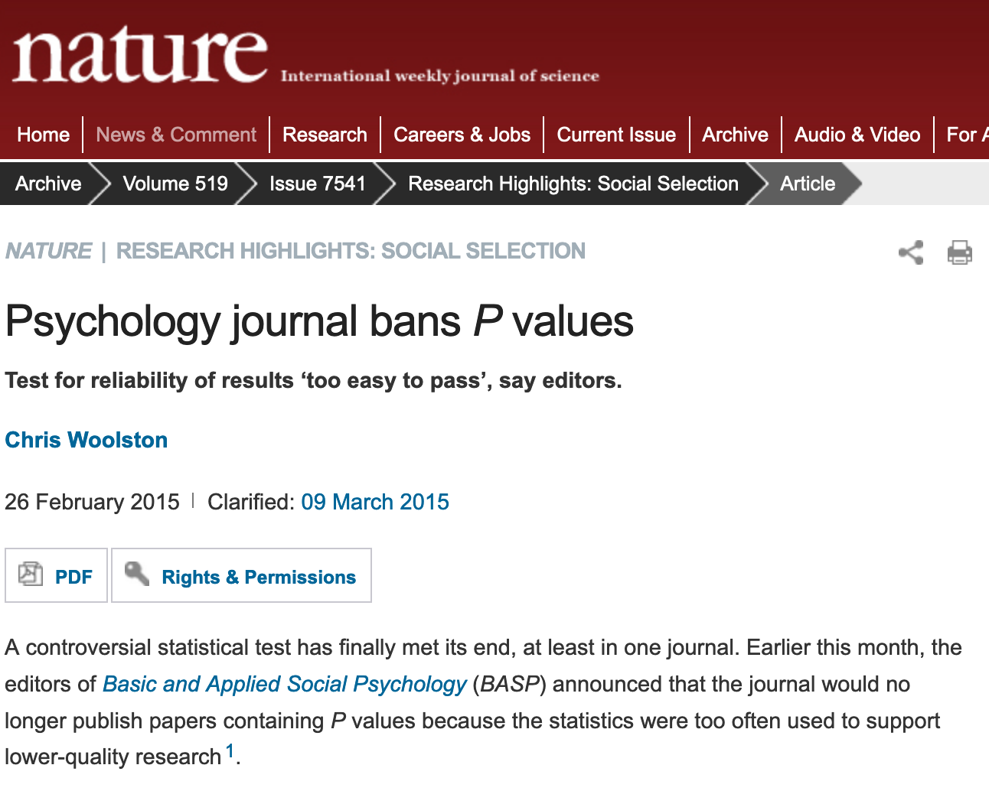

Slide 16
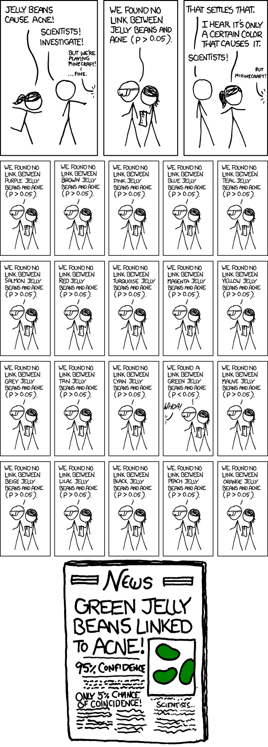
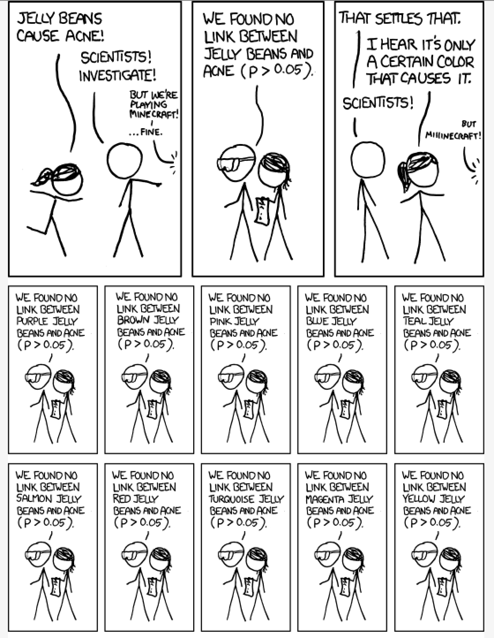
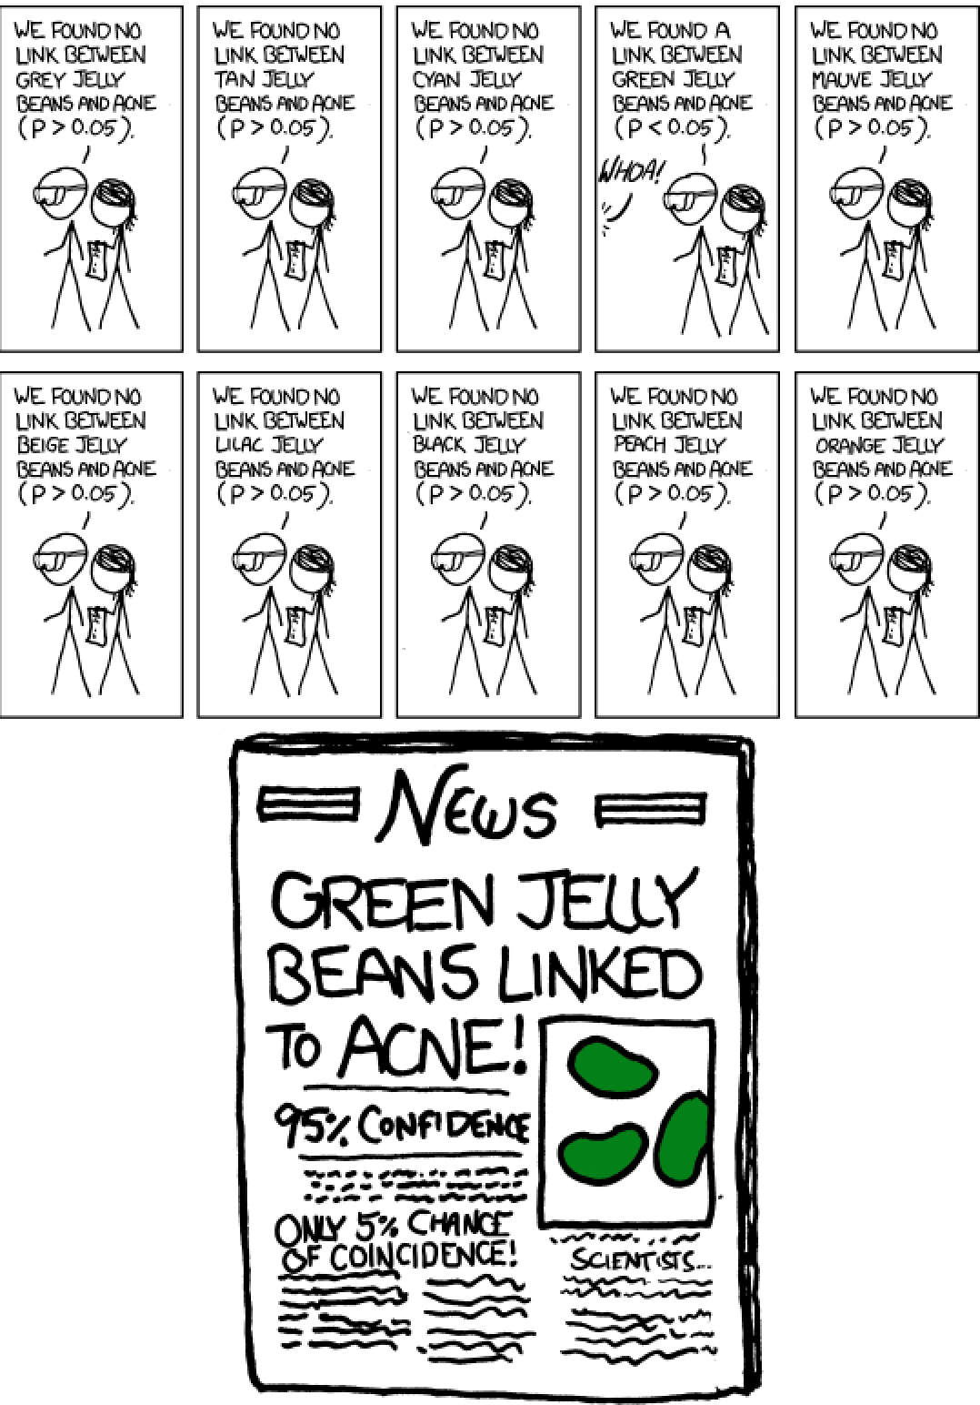
https://imgs.xkcd.com/comics/significant.png

