Slide 1
Statistical Data Analysis Discussion notes – week 7
Problem sheet 4
Maximum Likelihood examples

Slide 2
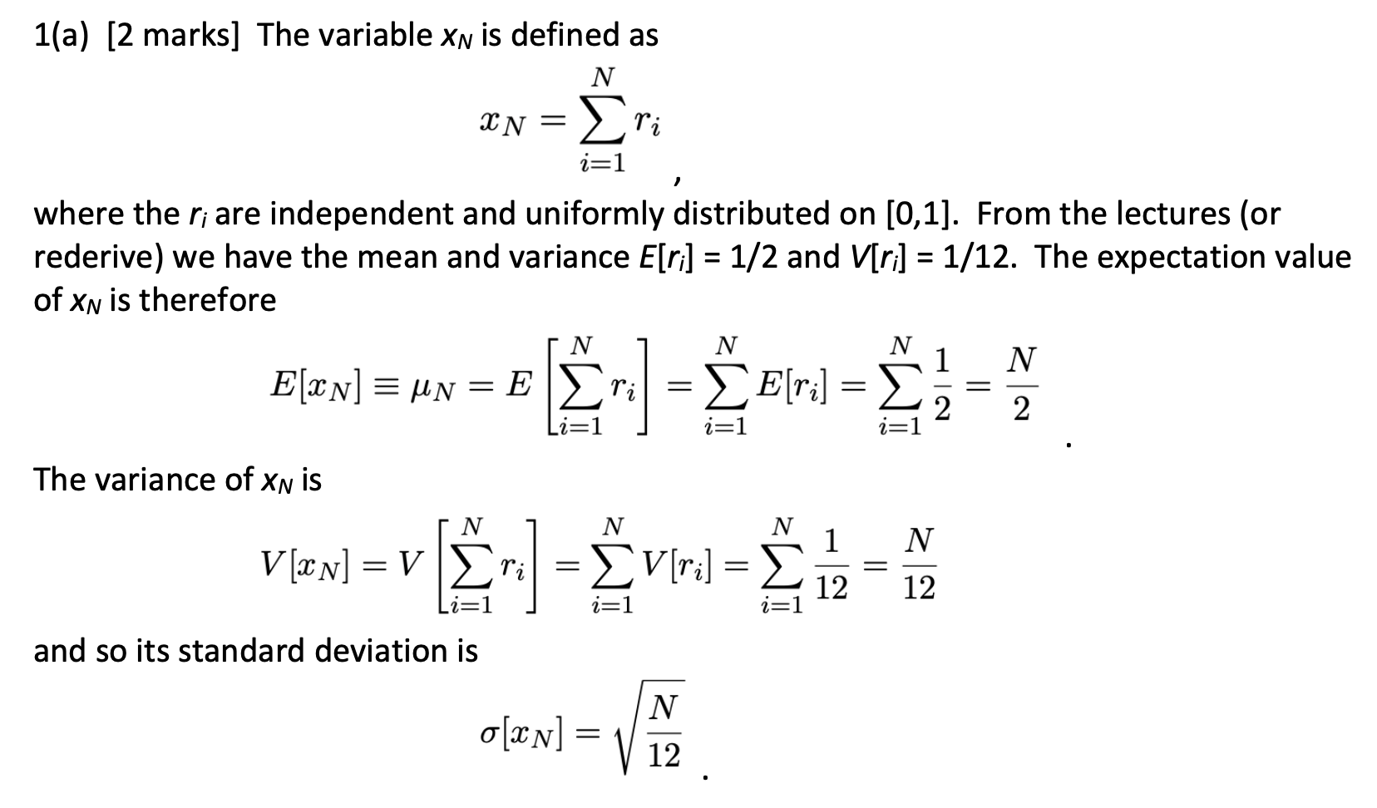
Problem sheet 4

Slide 3
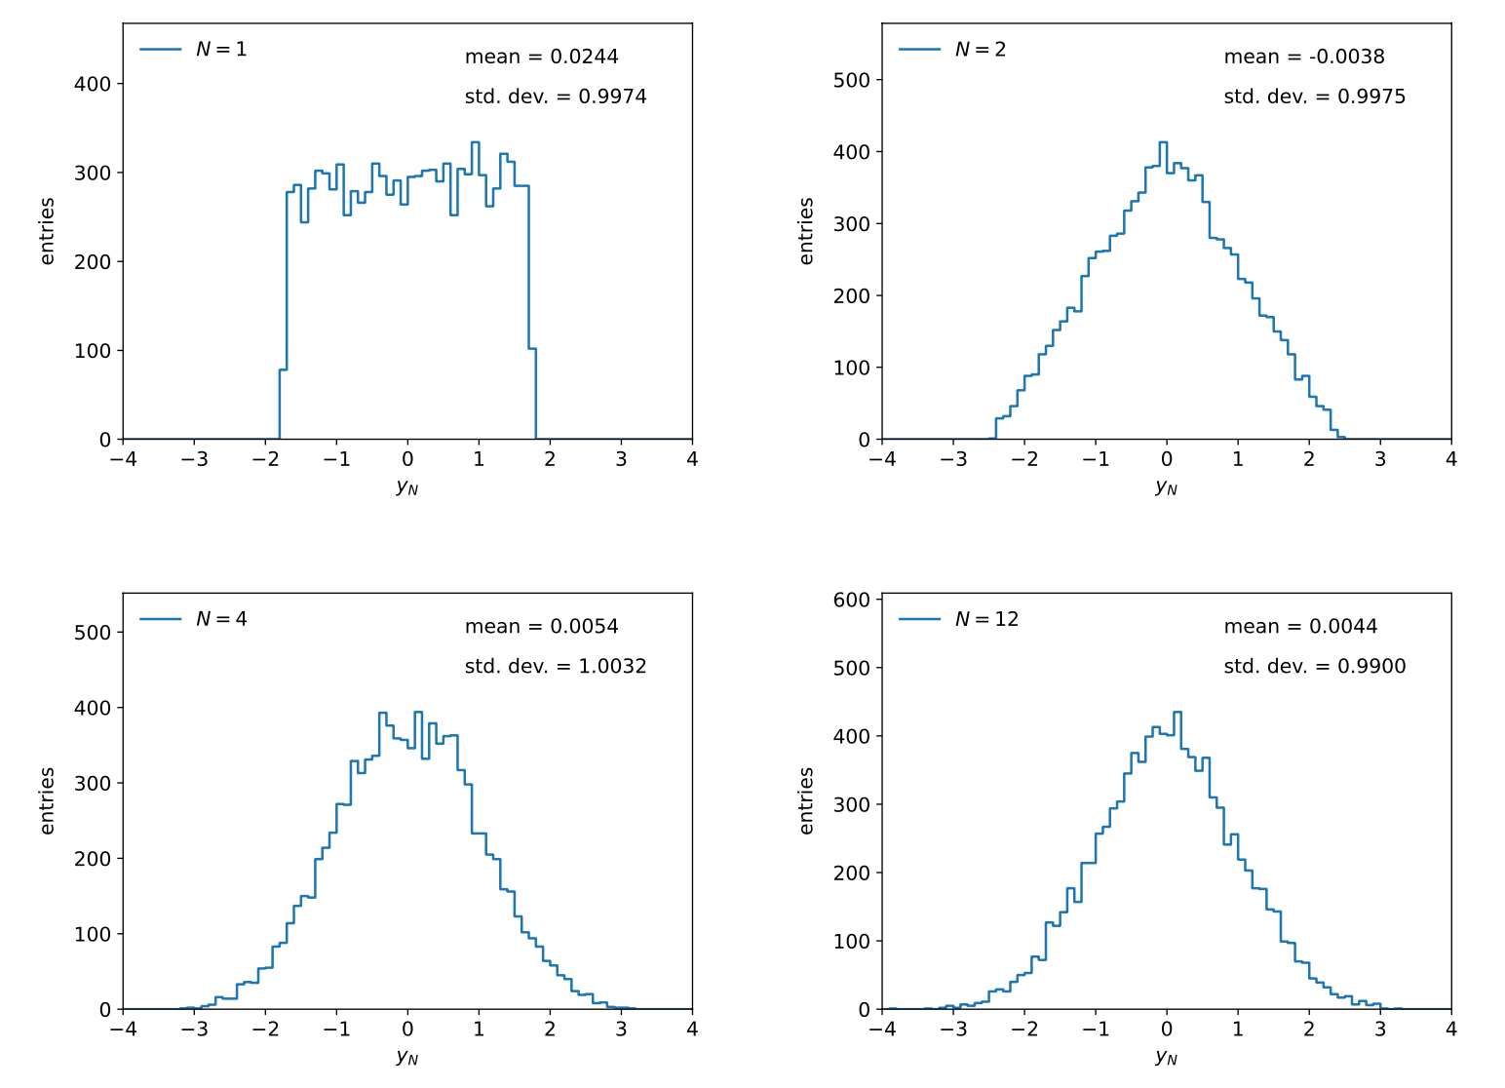
Histograms of y_{N} for N = 1, 2, 4, 12. The means and standard deviations are indicated on the plots. As shown, they are close to μ = 0 and σ = 1, as must emerge by construction for the standardized variable y_{N}.

Slide 4
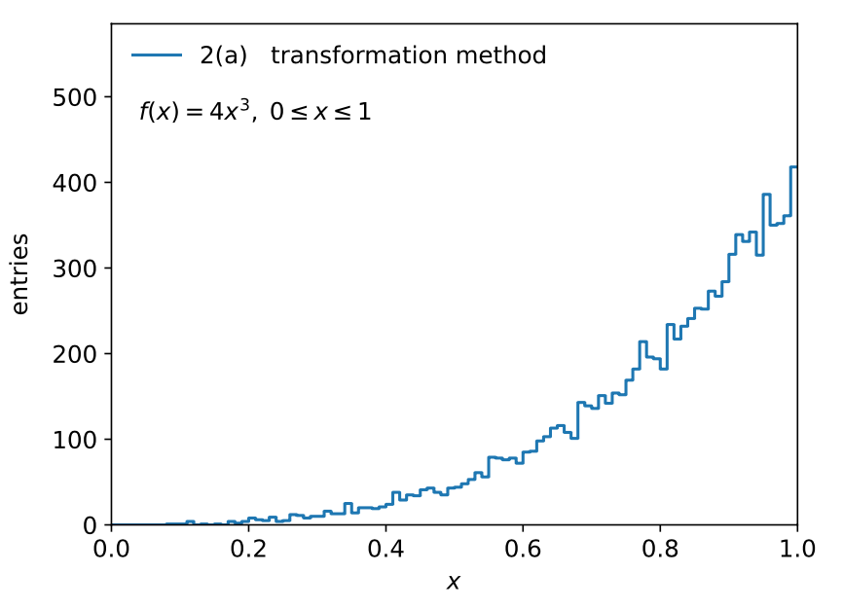

Slide 5
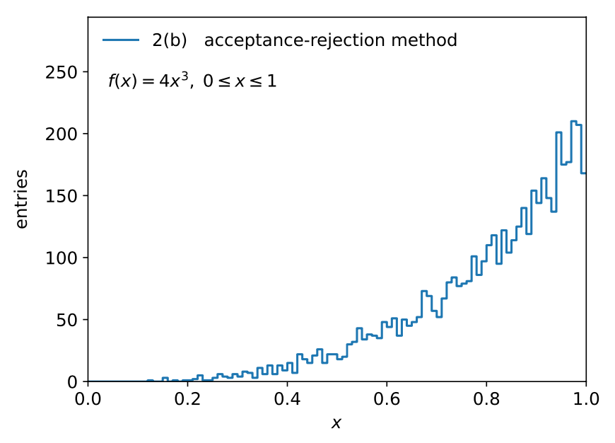
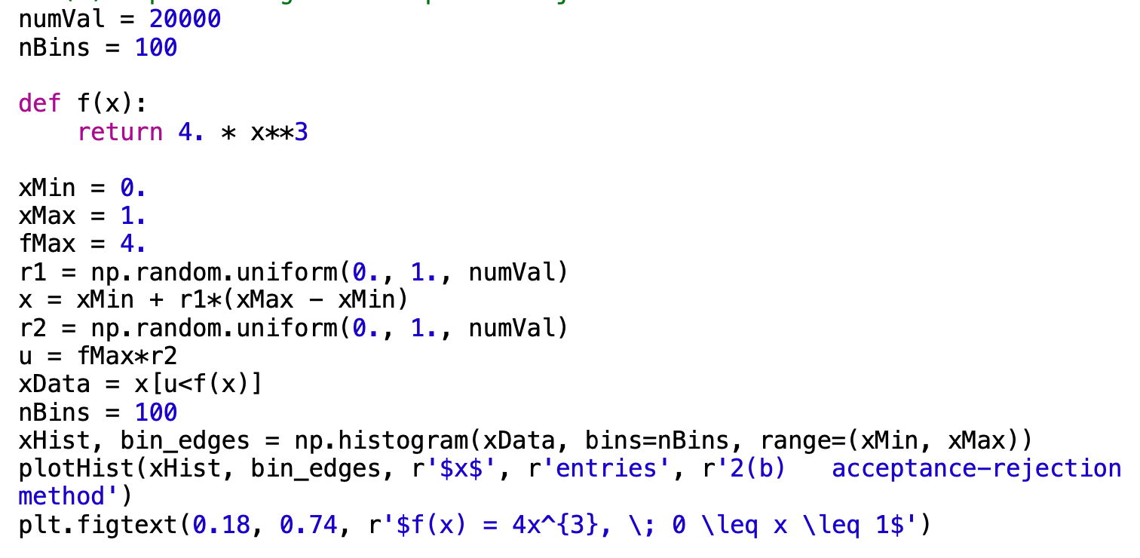

Slide 6
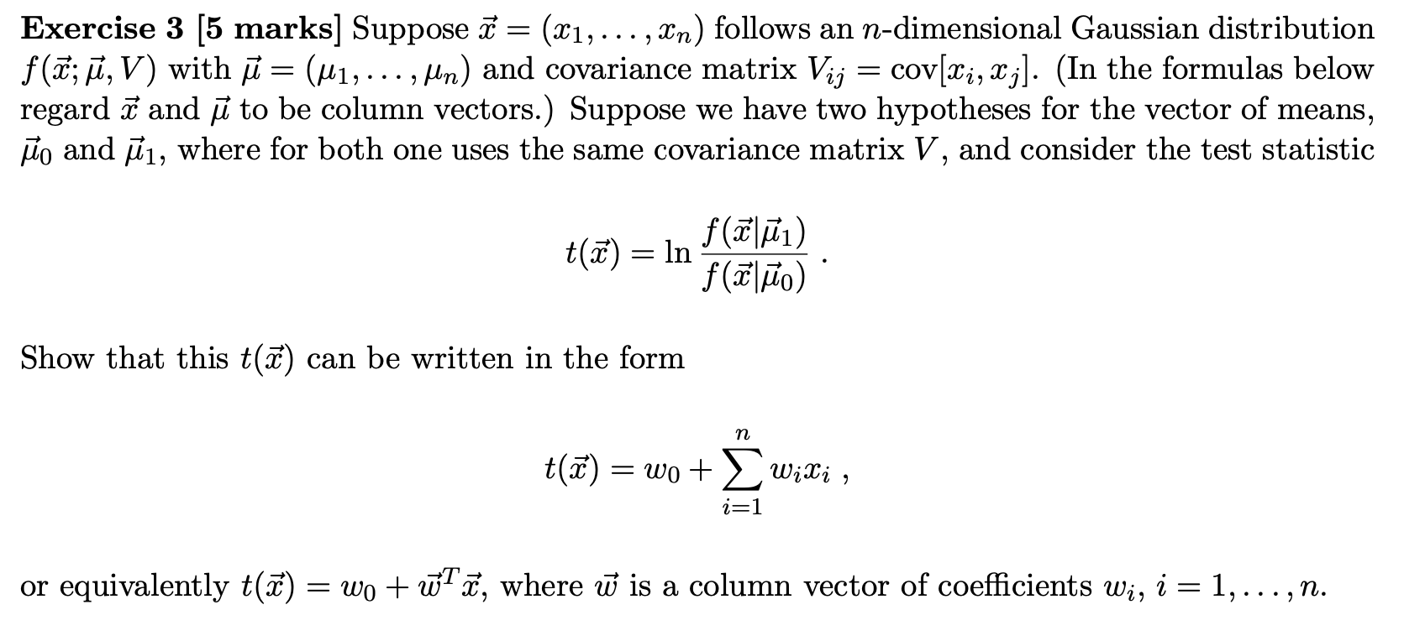

Slide 7
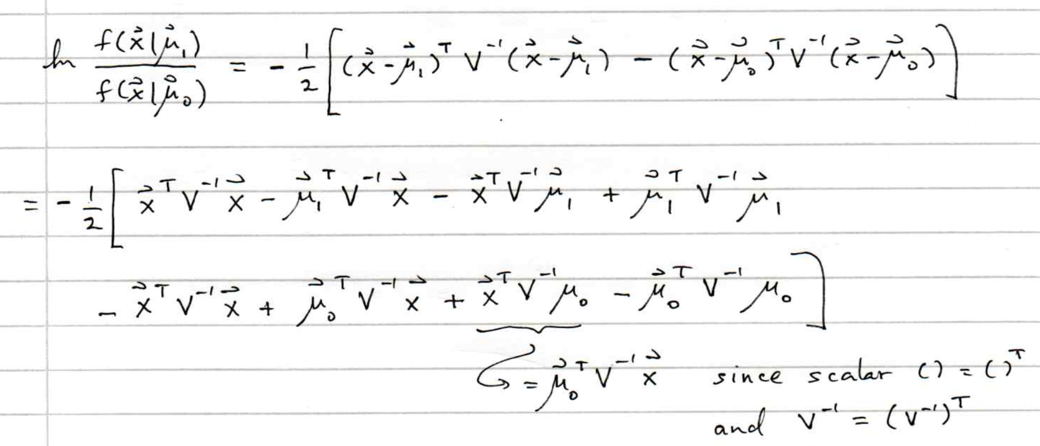
Ex. 3 (cont.)

Slide 8
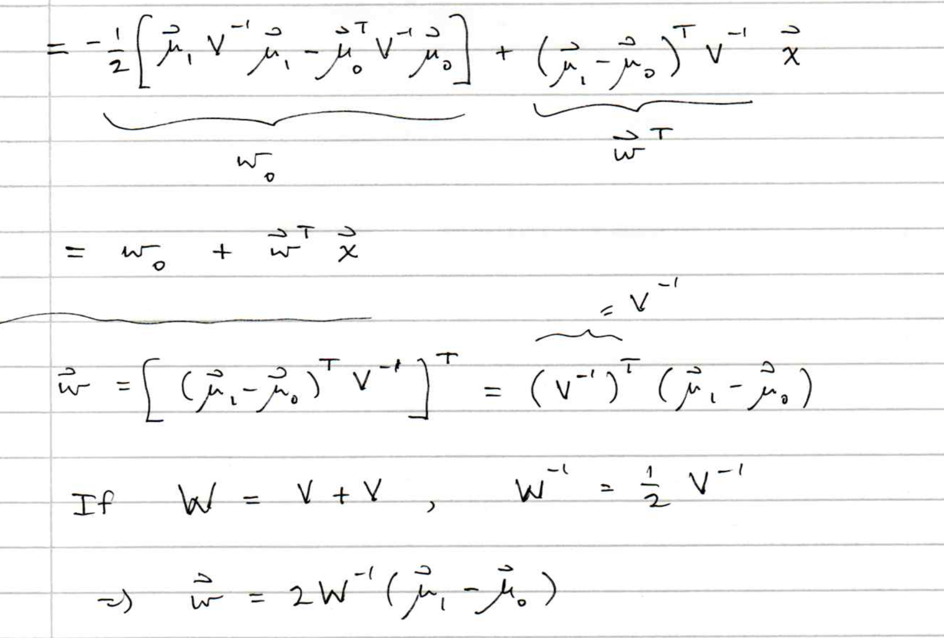
Ex. 3 (cont.)

Slide 9
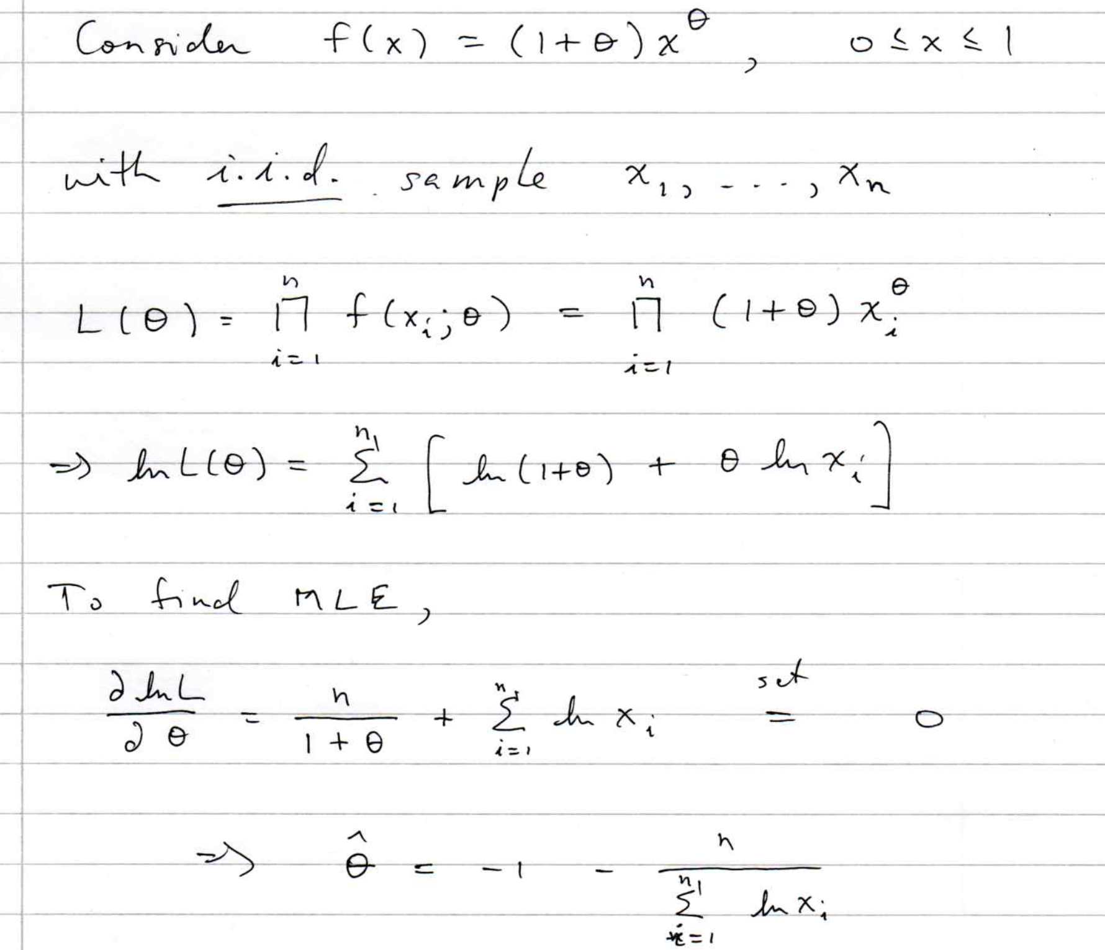
Example of Maximum Likelihood

Slide 10
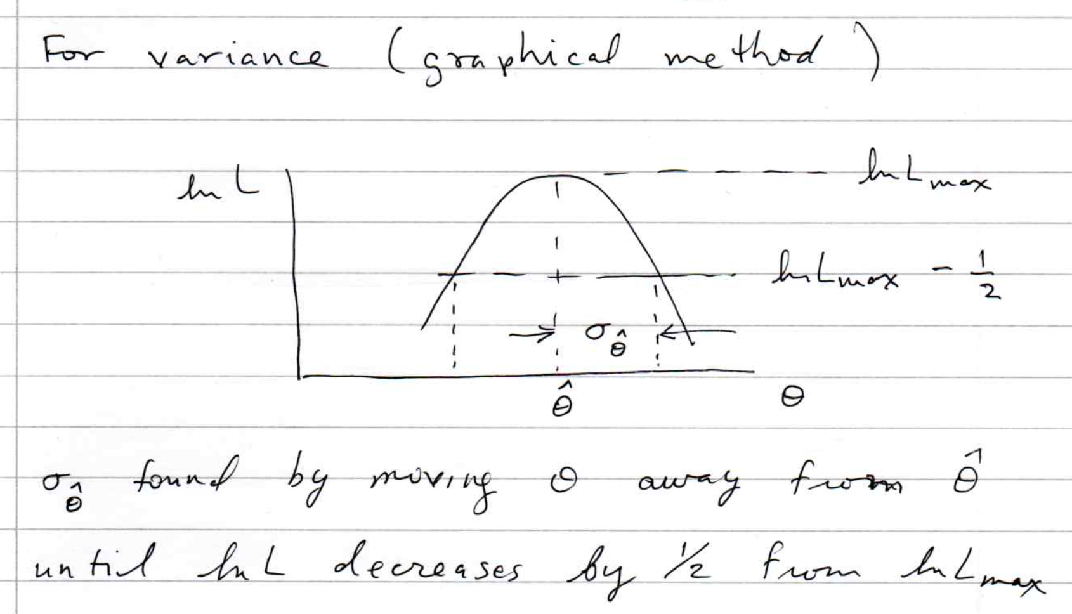
MLE example (cont.)

Slide 12
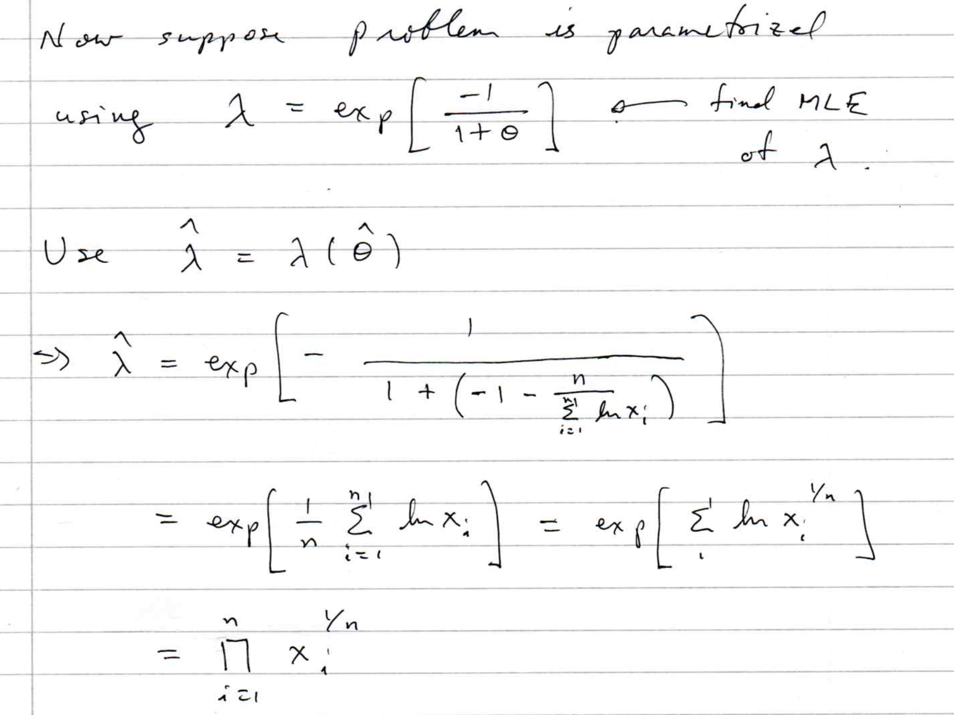

Slide 13
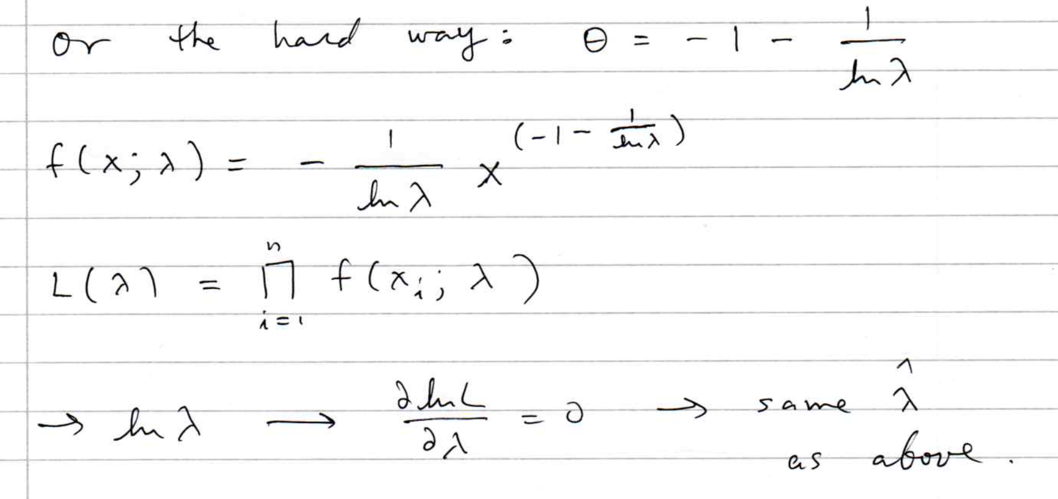

Slide 14
MLE for number of taxis
The number plate of taxis in every canton in Switzerland ends with a number N from 1 to N_{tot}, where N_{tot} is the total number of taxis.
Model the probability for observing plate number N with

Slide 15
MLE for N_{tot}
Suppose you observe one taxi at random with plate number N.
The likelihood function is
which is maximized for
The expectation value and bias of the MLE are
For better estimators, see similar problem with tanks in WW2:
https://en.wikipedia.org/wiki/German_tank_problem
E.g. the minimum-variance unbiased estimator is:

Slide 16
Cheap estimator for mass of W boson
The Particle Physics community has spent huge sums trying to
estimate the mass of the W boson with the smallest possible
statistical and systematic uncertainty.
Here is an estimator with zero statistical uncertainty. And it’s free!
Here is its sampling distribution:
Does this violate the information
inequality?

Slide 17
Cheap estimator for mass of W boson (2)
This estimator’s bias is
Note best estimate of M_{W} is (in 2020) 80.379±0.012 GeV, so the numerical
value of the bias may be fairly small.
But we have
and so
So the information inequality is still satisfied.

Slide 18
Extended ML example
Consider two types of events (e.g., signal and background) each
of which predict a given pdf for the variable x: f_{s}(x) and f_{b}(x).
We observe a mixture of the two event types, signal fraction = θ,
expected total number = ν, observed total number = n.
Let
goal is to estimate μ_{s}, μ_{b}.
→

Slide 19
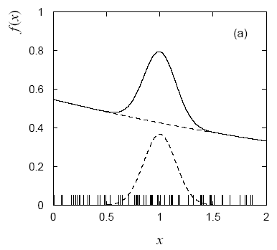
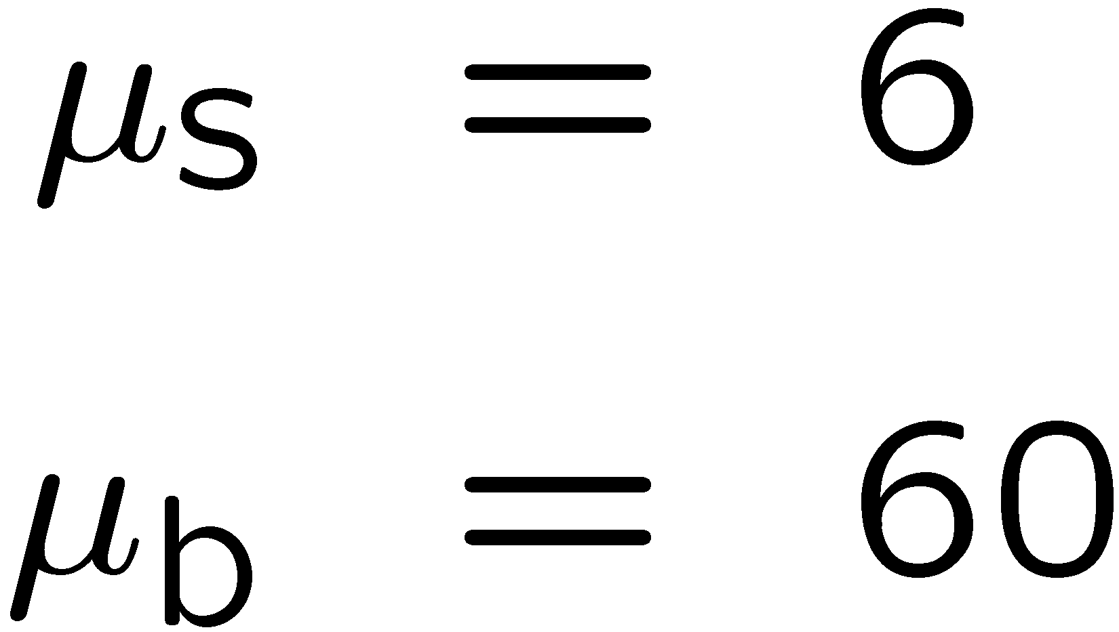
Extended ML example (2)
Monte Carlo example
with combination of
exponential and Gaussian:
Maximize log-likelihood in
terms of μ_{s} and μ_{b}:
Here errors reflect total Poisson
fluctuation as well as that in
proportion of signal/background.

