Slide 1
Statistical Data Analysis Discussion notes – week 8
Problem sheet 5
Example of Least Squares for averaging
Comments on multiple regression
Least Squares with constraints

Slide 2
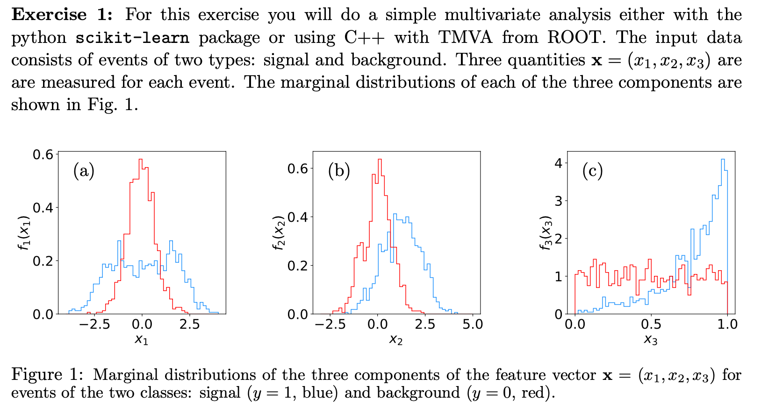
Problem sheet 5

Slide 3
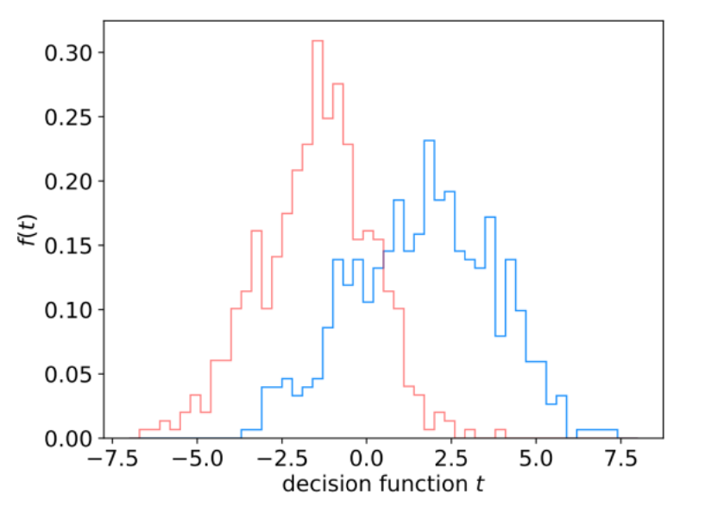
Problem sheet 5 / 1

Slide 4
Problem sheet 5 / 1(a)
For each event we test the hypothesis H₀ : event is of type b
Critical region of test: t > t_{c}
metrics.accuracy_score(y_test, y_pred) takes as input an array of y values (true class labels) y_test (from the test sample) and predicted values y_pred, and returns the fraction of times the prediction is correct, i.e.,
metrics.accuracy_score(y_bkg_test, y_bkg_pred)
= P(reject as b | b) = 1 – P(classify as b | b) = 1 - P(t > t_{c} | b)
So add the code:
size = 1. - metrics.accuracy_score(y_bkg_test, y_bkg_pred)
For the LDA this gives: size of test of background = 0.23387

Slide 5
Problem sheet 5 / 1(b)
with prior probabilities π_{s} = π_{b} = 0.5. To get this, add to the code
purity = effSig*piSig / (effSig*piSig + effBkg*piBkg)
where
For the LDA this gives:
power of test with respect to signal = 0.7916
purity of signal sample = 0.7719

Slide 6
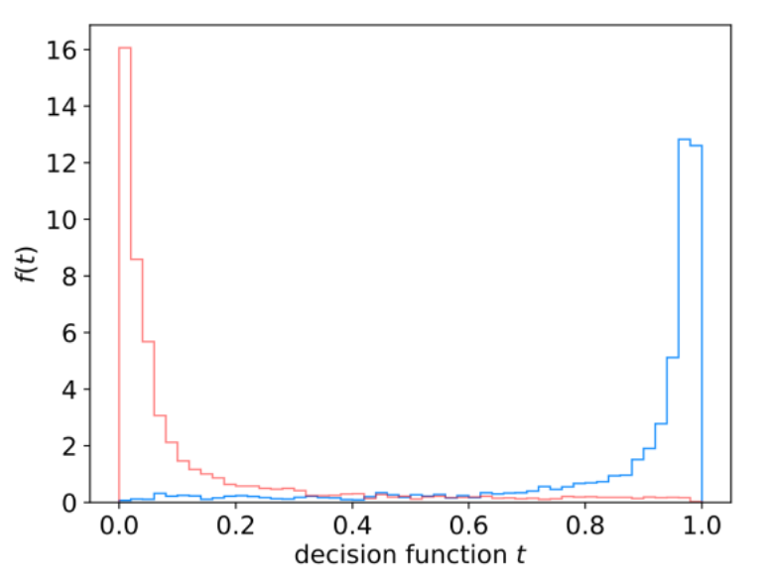
Problem sheet 5 / 1(c)
Include the code:
clf = MLPClassifier(hidden_layer_sizes=(3,), activation='tanh',
max_iter=2000, random_state=0)
Histogram of the MLP output (as given by predict_proba):

Slide 7
Problem sheet 5 / 1(d)
To select events with the MLP, the function predict_proba is used instead of the decision function. As in (b), to find the purity, use the efficiencies in Bayes’ theorem:
Signal efficiency = ε_{s} = P(t>t_{c}|s)
Background efficiency = εb = P(t>t_{c}|b)
Signal purity = P(s|t>t_{c}) = ε_{s} π_{s} /(ε_{s} π_{s} + ε_{b} π_{b})
By defining the critical region with a minimum threshold on its value of 0.5, the program gives:
power of test with respect to signal = 0.8769
size of test of background = 0.1129
purity of signal sample = 0.8859

Slide 8
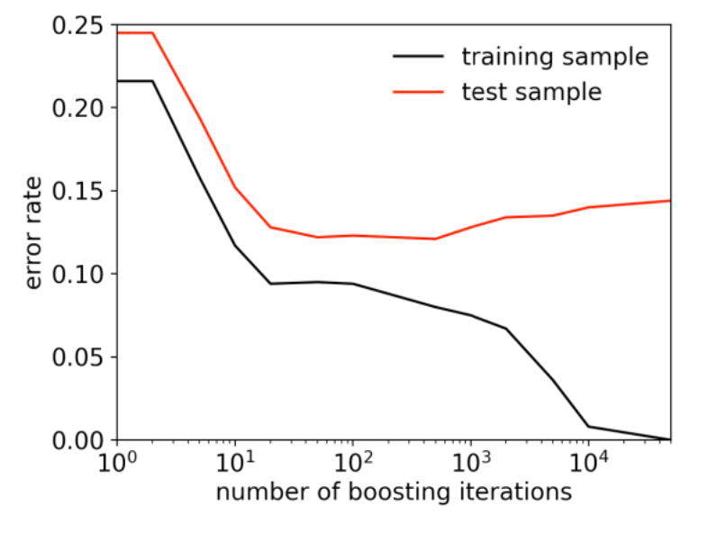
Problem sheet 5 / 2 (bonus question)
The total error rate of a BDT (using AdaBoost) as a function of the number of boosting iterations.
The error rate from the training sample goes to zero after around 10⁴ iterations. For the test sample, a minimum error rate of 12.1% is found at 500 iterations, with a shallow minimum around 12% from 10² to 10³ iterations. For more than 10³ iterations the error rate increases slowly.

Slide 9
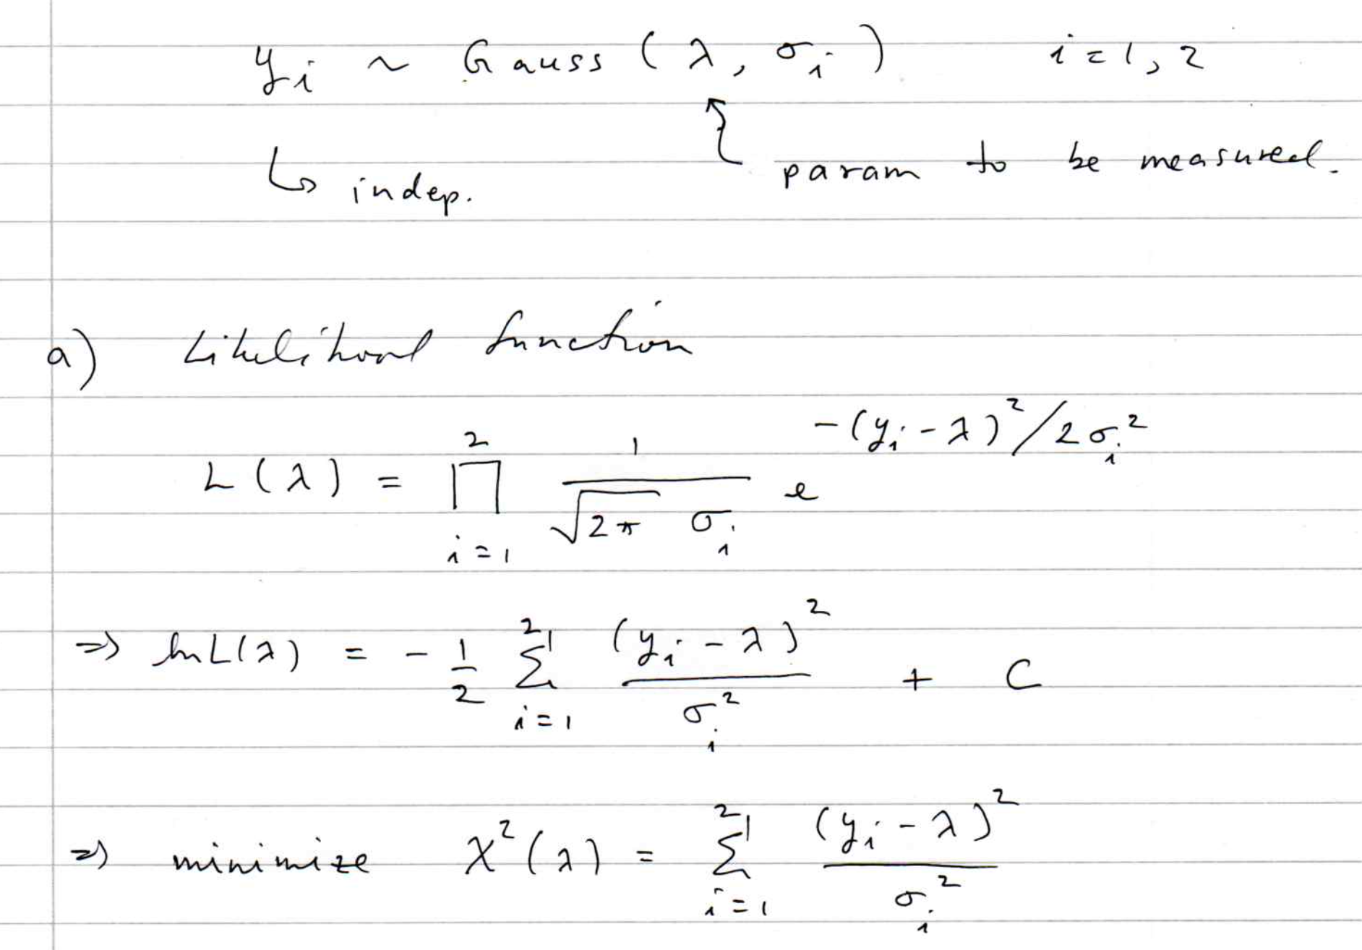
Problem on Least-Squares Averaging

Slide 10
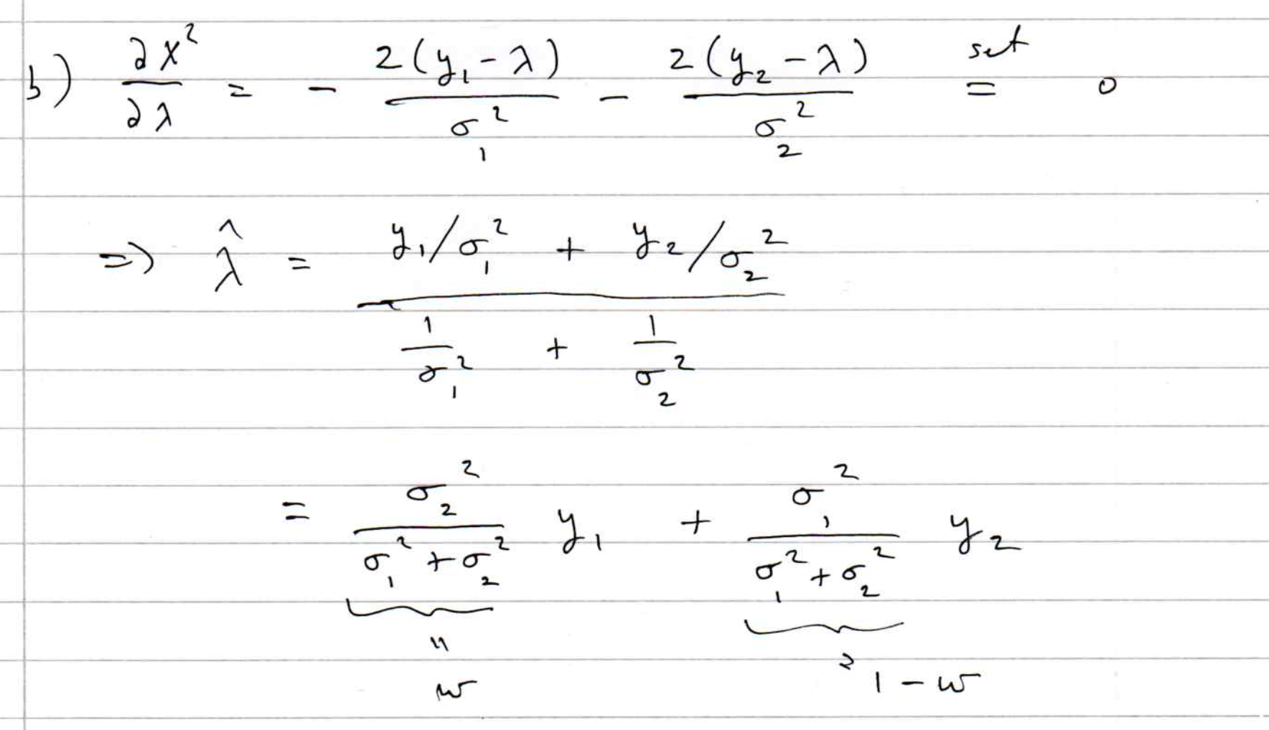
LS averaging (cont.)
Find LS estimator for λ:

Slide 11
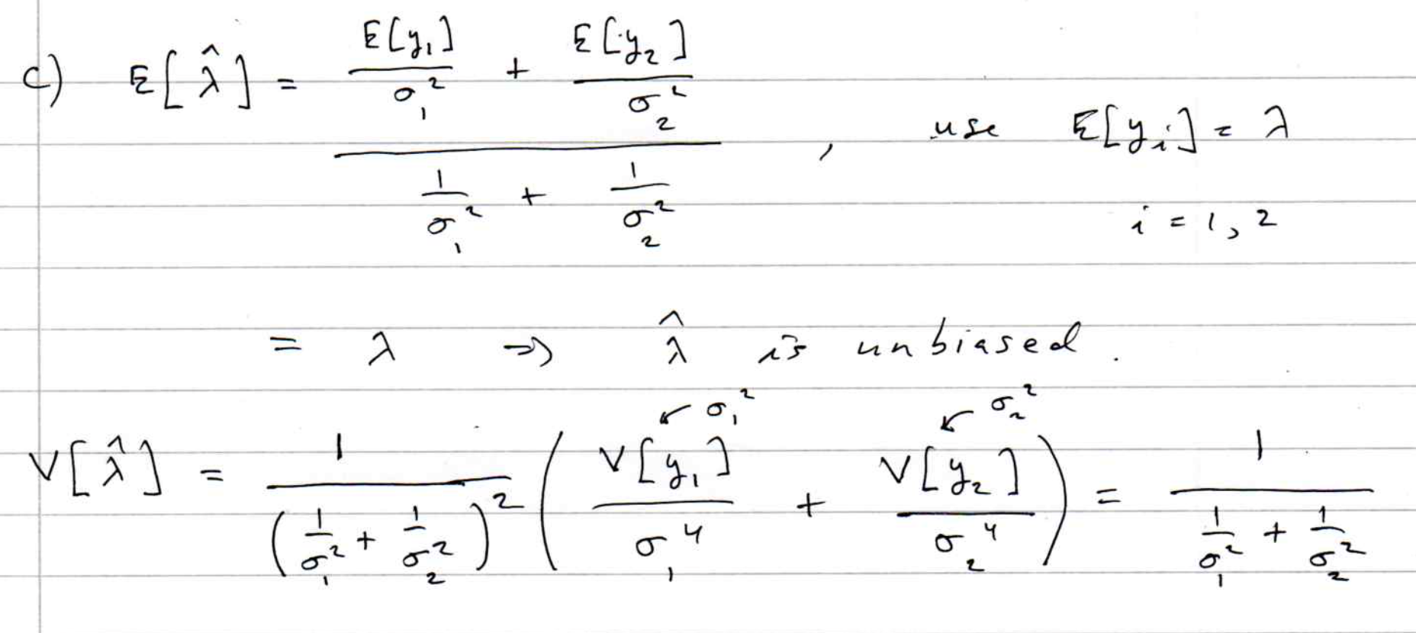
LS averaging (cont.)
Find variance of LS estimator:

Slide 12
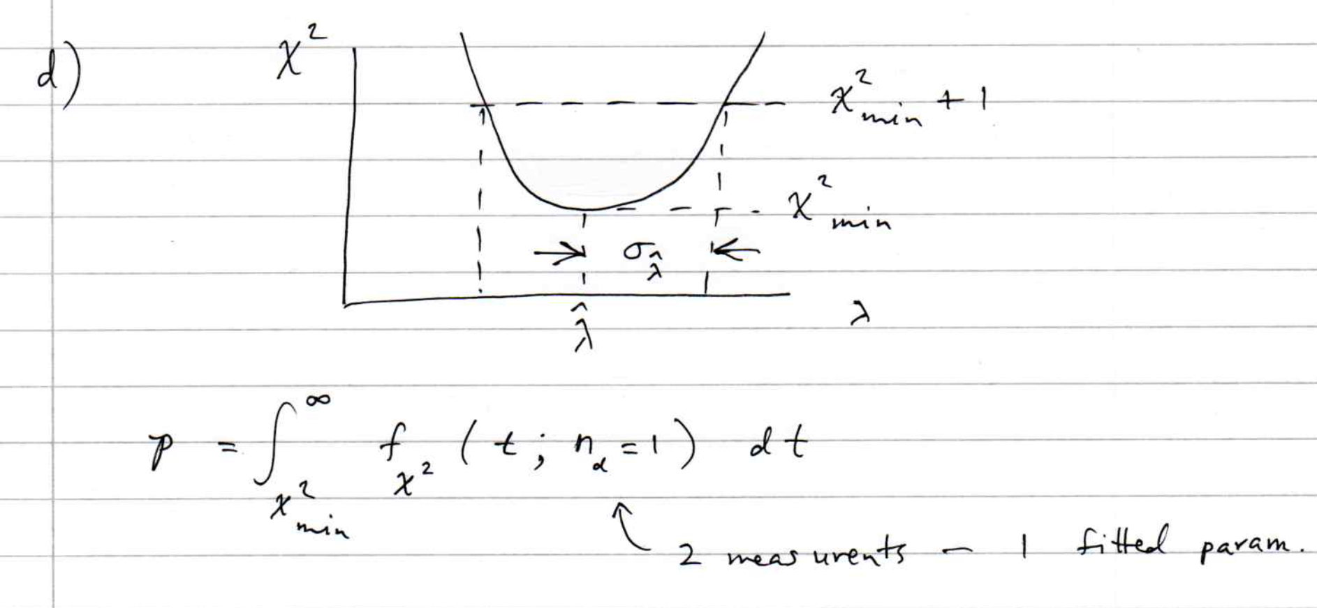
LS averaging (cont.)
Illustrate graphical method for variance of LS estimator;
explain how to find p-value for goodness-of-fit.

Slide 13
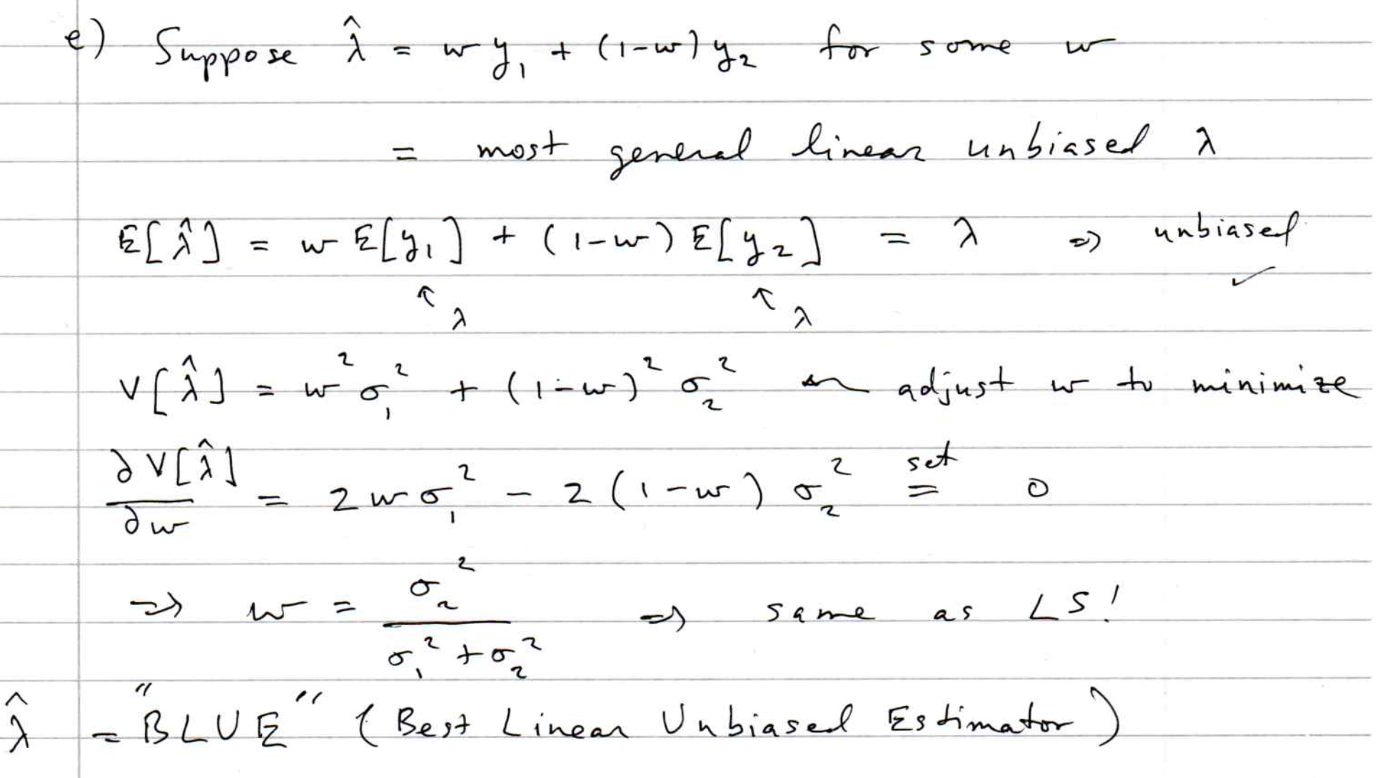
LS averaging (cont.)
Find ”BLUE” estimator:

Slide 14
Simple Least Squares fits
A simple way to do least squares curve fitting is with the python routine curve_fit.
For an introduction to this see the the materials from RHUL's year-3 introduction to statistics.
This includes a short program simpleFit.py for doing least-squares fits; also a root/C++ version simpleFit.C.

Slide 15
Fitting the parameters with Python
The routine routine curve_fit from scipy.optimize can
find LS estimators numerically. To use it you need:
We need to define the fit function μ (x; θ), e.g., a straight line:

Slide 16
Fitting the parameters with Python (2)
The data values (x_{i}, y_{i}, σ_{i}) need to be in the form of NumPy
arrays, e.g,
Start values of the parameters can be specified:
To find the parameter values that minimize χ²(θ), call curve_fit:
Returns estimators and covariance matrix as NumPy arrays.
Need absolute_sigma=True for the fit errors (cov. matrix) to have
desired interpretation.

Slide 17
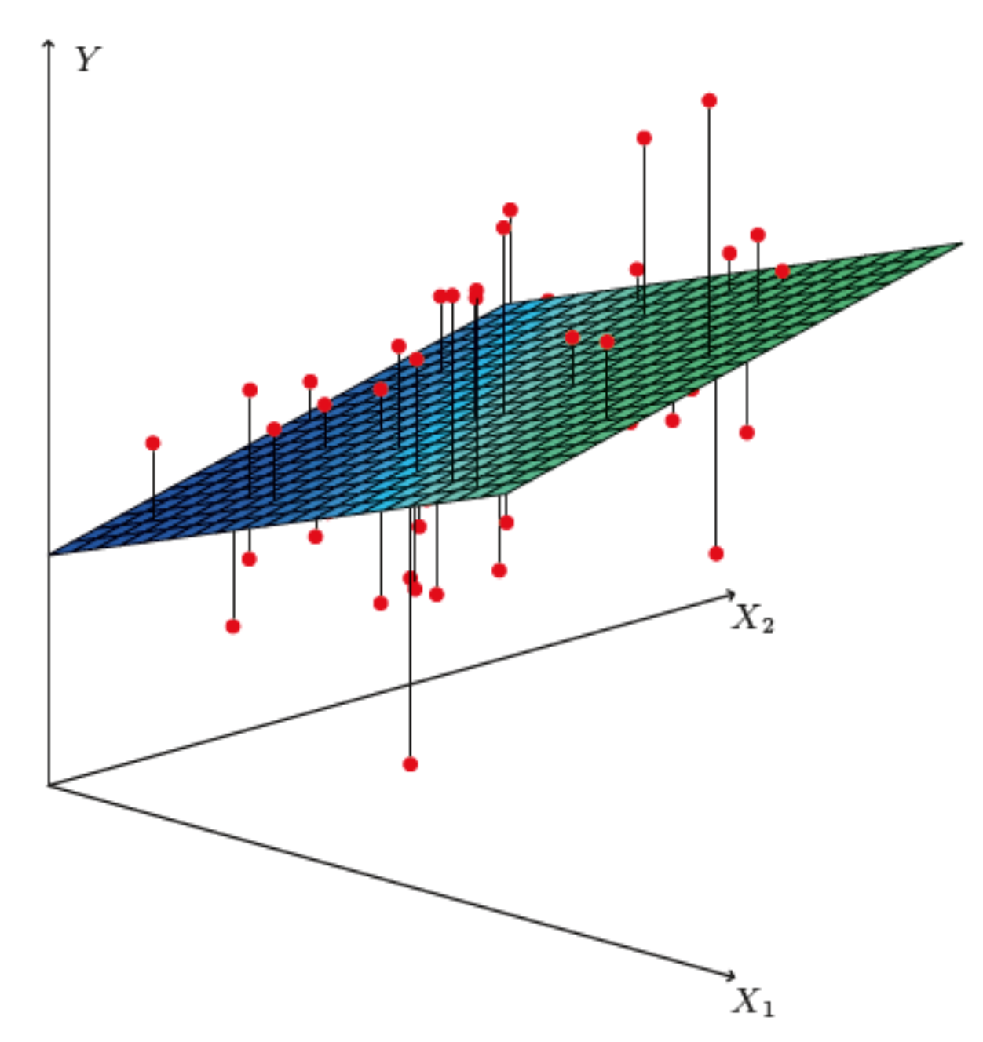
http://www-bcf.usc.edu/~gareth/ISL/
Brief intro to multiple regression
Multiple regression* can be seen as an extension of curve fitting to the case where the variable x is replaced by a multi-dimensional x = (x₁,...,x_{n}), e.g., fitting a surface. Here suppose the data are points (x_{i}, y_{i}), i = 1,...,N (no error bars) and x is usually a random variable, often called the explanatory or predictor variable.
Equivalently, we can view it as an extension to classification with
the discrete class label y = 0, 1 replaced by a continuous target y (and in this context x can also be called the feature vector).
*Note the term ”multivariate” regression refers to a vector target variable y; here we treat only scalar y.

Slide 18
Target (fit) function and loss function
As in the case of curve fitting, we assume some parametric function
of x that represents the mean of the target variable
where w is a vector of adjustable parameters (“weights”).
Suppose we have training data consisting of (x_{i}, y_{i}), i = 1,...,N.
Use these to determine the weights by minimizing a loss function
(analogous to the χ²), e.g.,

Slide 19
https://www.statlearning.com/
Linear regression
In linear regression, the fit function is of the form
i.e. the problem is equivalent to an unweighted least-squares fit of a (hyper-)plane:
Can be generalized to a nonlinear surface in x-space by transforming x to a set of basis functions φ₁(x),...,φ_{m}(x)
(still linear in the weights)

Slide 20
Nonlinear regression
Examples of nonlinear regression include:
MLP (multilayer perceptron) regression
Boosted decision tree regression
Support vector regression
For MLP regression, as with classification, regard the feature vector as the layer k = 0; i.e., φ_{i}⁽⁰⁾ = x_{i}.
The ith node of hidden layer k is
where h is the activation function (tanh, relu, sigmoid,...).

Slide 21
MLP Regression (cont.)
For the final layer (k=K), in MLP regression (in contrast to classification), one omits the activation function, i.e.,
where φ_{j}^{(K−1)} = are the nodes of the last hidden layer (k = K−1).
For info on other types of multiple regression see, e.g.,
https://www.statlearning.com/
and the scikit-learn documentation.

Slide 22
Multiple regression example
Suppose particles with different energies E and angles θ (or equivalently η = − ln tan(θ/2) ) enter a calorimeter and create a particle showers that gives signals in three layers, s₁, s₂ and s₃, as well as an estimate of η.
Some of the energy leaks through, with increased leakage for higher energy and more oblique angles (higher η).
The goal is to estimate the target y_{i} = E_{i} given feature vectors
x_{i} = (η, s₁, s₂,s₃)_{i} for i = 1,...,N training events.

Slide 23
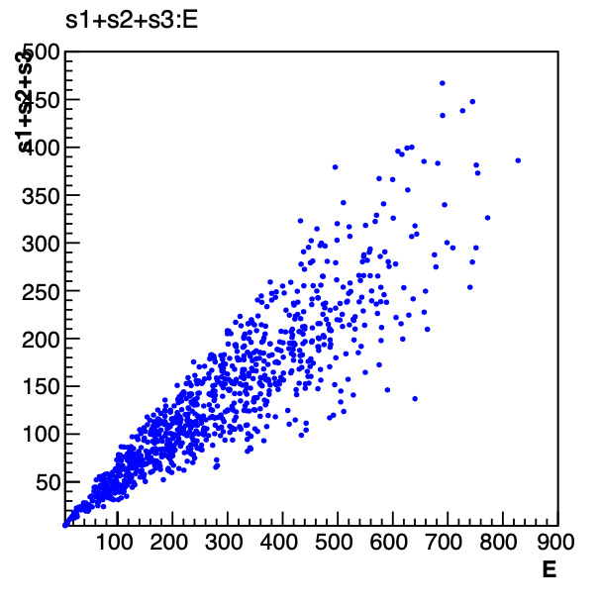
Energy estimate from sum of signals
Naively, one could try just summing the signals:
Gives very poor resolution
because the particles have a
distribution of energies and
angles and hence differing amounts of the energy leak through undetected.

Slide 24
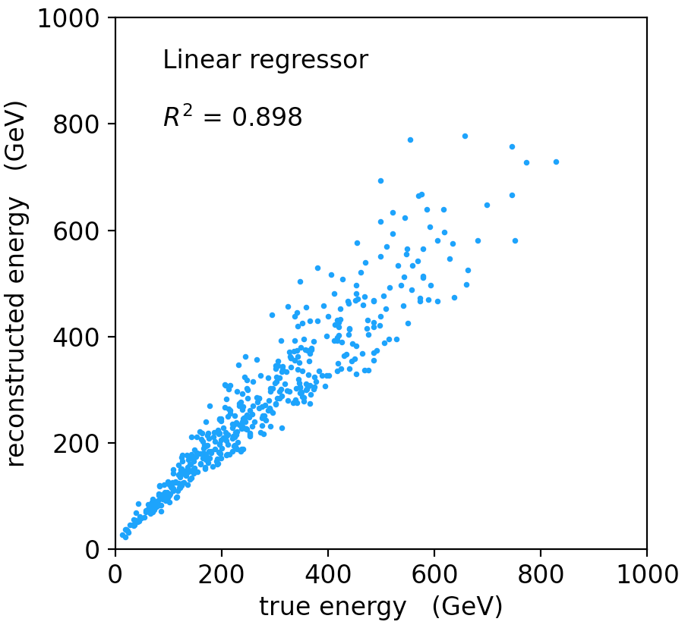
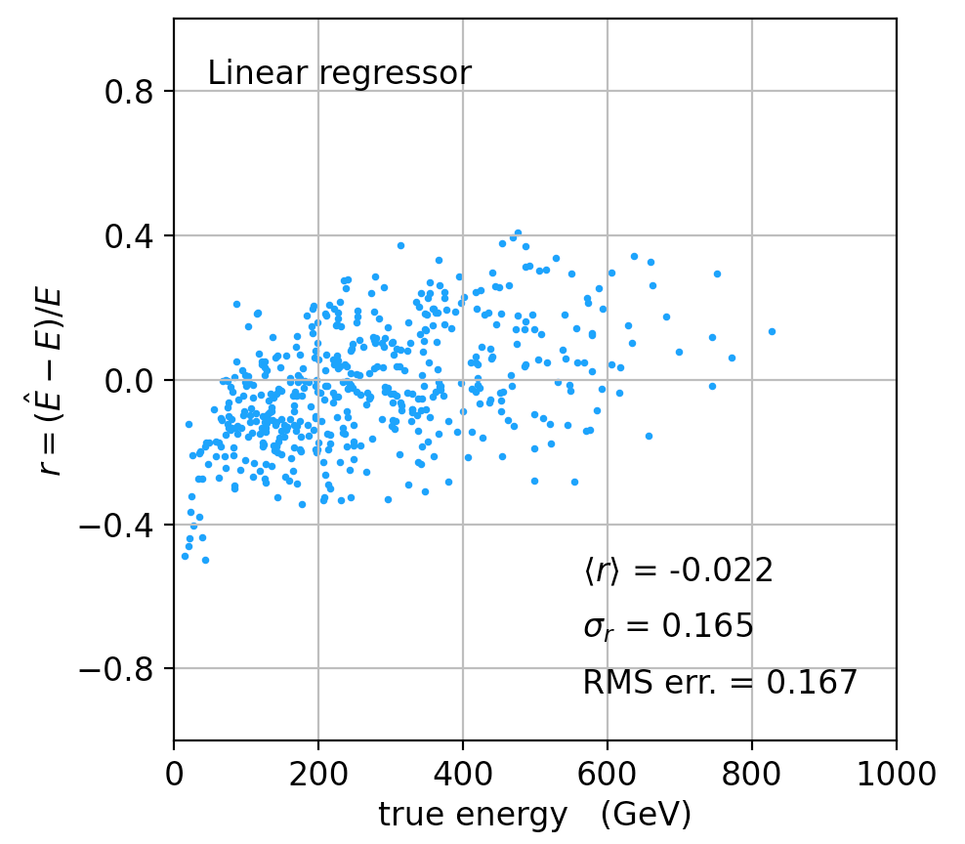
Linear regression
See MVRegressor.py, here using
regr = linear_model.LinearRegression()
regr.fit(X_train, y_train)
Average relative resolution 16.7%.

Slide 25
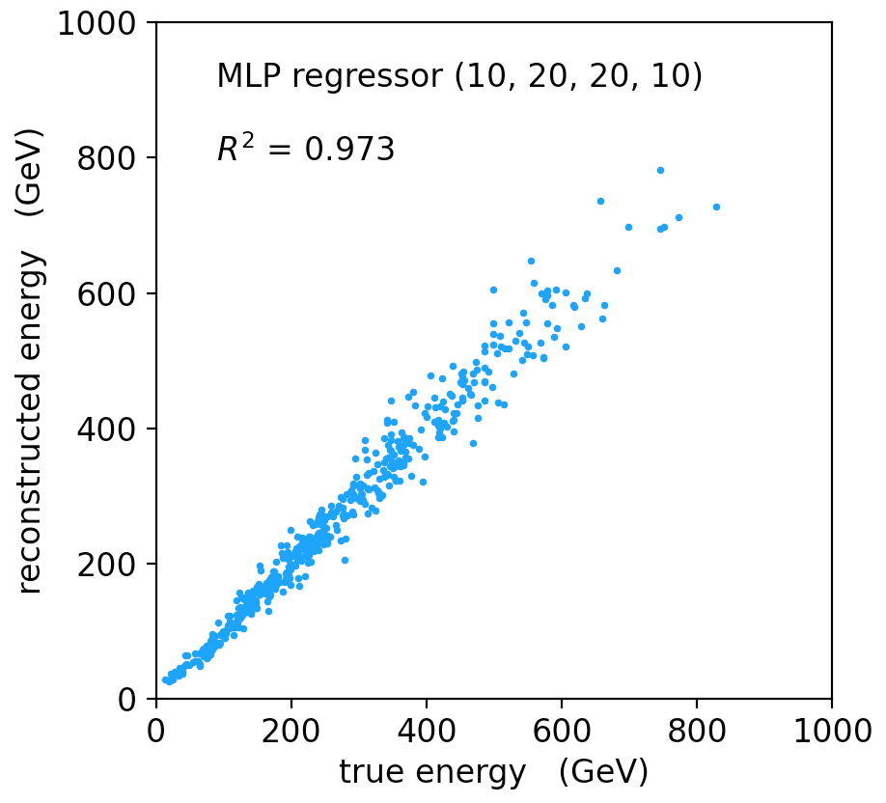
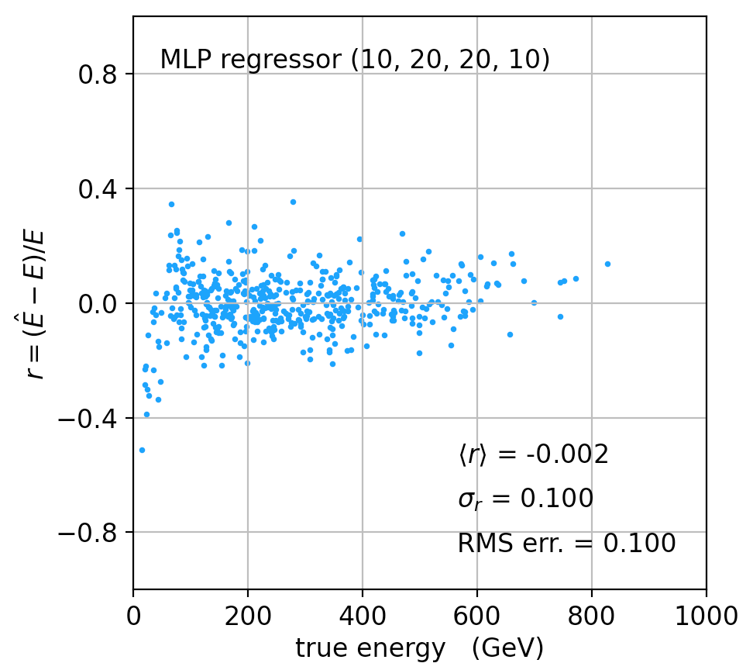
MLP Regression
regr = MLPRegressor(hidden_layer_sizes=(10,20,20,10), activation='relu'
regr.fit(X_train, y_train)
Better resolution (10%), here significant bias at low energies.

Slide 26
Refinements for multiple regression
One can try many improvements:
Scaling of predictor and target variables, e.g., standardize to zero mean and unit variance.
Use cross-validation to assess accuracy (and hence use entire sample of events for training.
Try different loss functions.
Try different regression algorithms (ridge regression, lasso, decision tree, support vector regression,...).
Some simple code using scikit-learn and a short project description can be found here:
https://www.pp.rhul.ac.uk/~cowan/ph3010/ml/regression/

Slide 27
Parameter estimation with constraints
When estimating parameters θ = (θ₁,..., θ_{M}) one may have additional information available in the form of K constraints
In some problems it may be possible to define L = M − K new parameters η₁,..., η_{L} such that every point in η-space satisfies the constraints. If so, estimate η e.g. with Maximum Likelihood or Least Squares and then transform back to θ. But it may be difficult to find new parameters with the required properties.
Suppose the estimators are found by minimizing χ²(θ). One can implement the constraints by minimizing instead the Lagrange function
with respect to θ and the Lagrange multipliers λ = (λ₁,..., λ_{K}).

Slide 28
Finding constrained estimators
Define a K+M dimensional vector to contain the parameters and Lagrange multipliers
The estimators for γ are found from the solutions to
This gives the parameter values that minimize χ²(θ) subject to the constraints.

Slide 29
Covariance matrix of estimators
To find the covariance matrix of the estimators, find the solutions
to the equations above when the data y are equal to their
expected values ⟨y⟩ (in practice estimate with the observed values). This gives estimators
where
,
and where
Using this approximation for , find the covariance matrix
using error propagation, i.e.,
where

Slide 30
Derivation of formula for covariance
For more details see the PDG review on statistics Sec. 40.2.4 at pdg.lbl.gov or the note:
https://www.pp.rhul.ac.uk/~cowan/stat/notes/lscon.pdf

Slide 31
Example of constrained estimators
Suppose we have measurements y₁, y₂ and y₃ of the three angles θ₁, θ₂, θ₃ of a triangle.
Model as independent and Gaussian: y_{i} ~ Gauss(θ_{i}, σ).
To find the estimators, one could replace θ₃ = π − θ₁ − θ₂ and minimize χ²(θ₁,θ₂) .
Alternatively, minimize
→
Variances of estimates reduced by constraint:

