Slide 1
Statistical Data Analysis
Discussion notes – week 9
Problem sheet 6
Some info on Problem Sheet 8 regarding iminuit
Comment about s-sigma covariance ellipse
Another fit example (Snell’s Law)

Slide 2
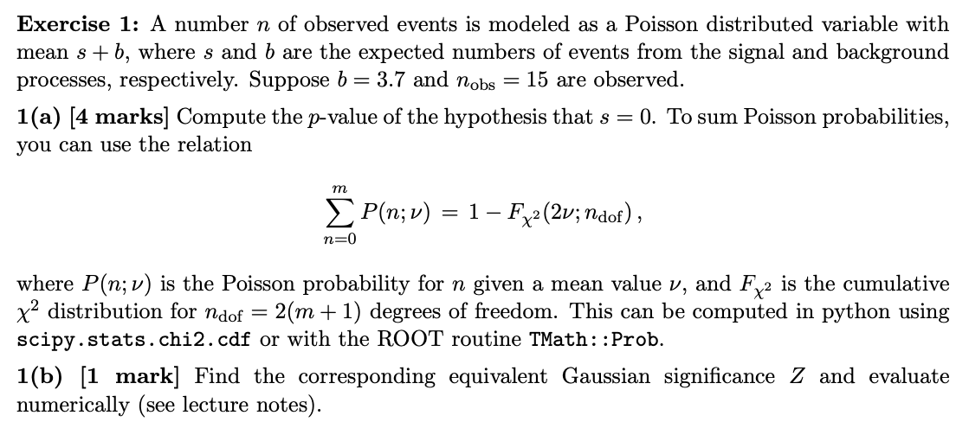
Problem sheet 6

Slide 3
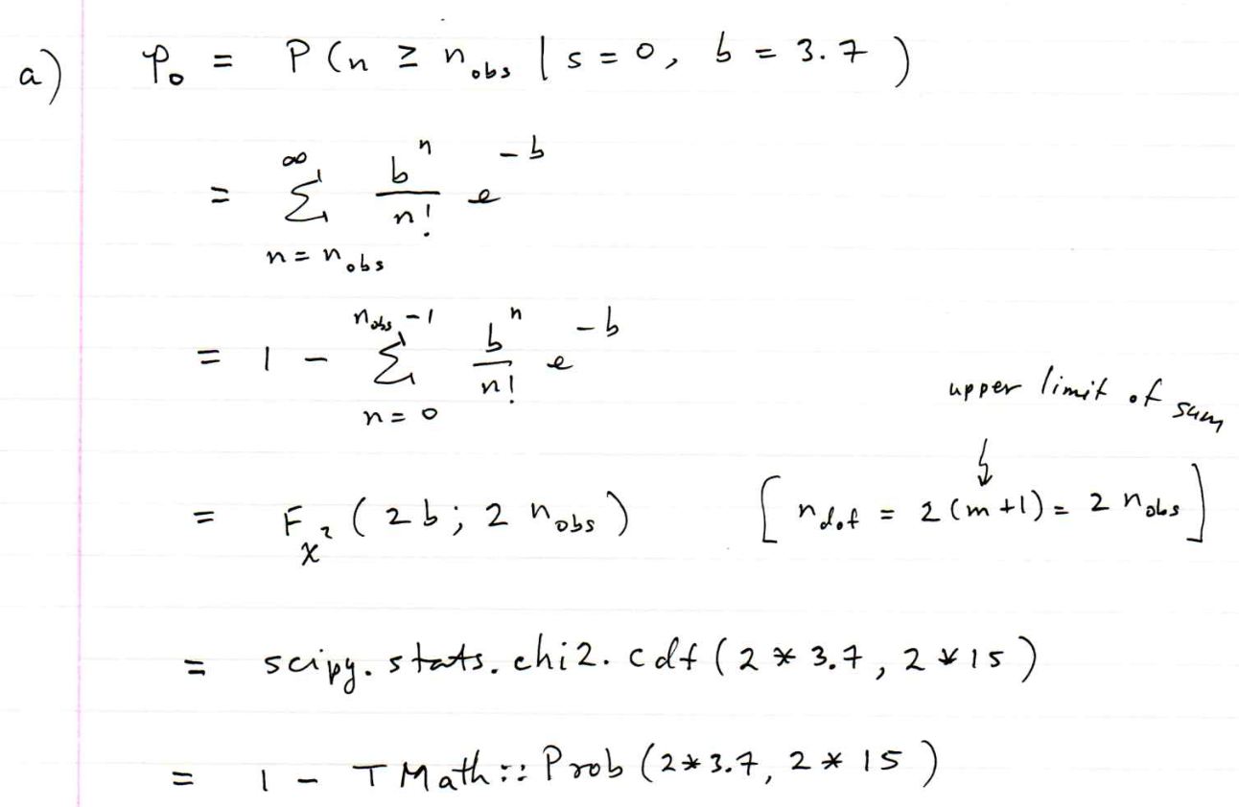
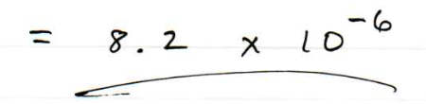
Problem sheet 6 / 1(a)

Slide 4
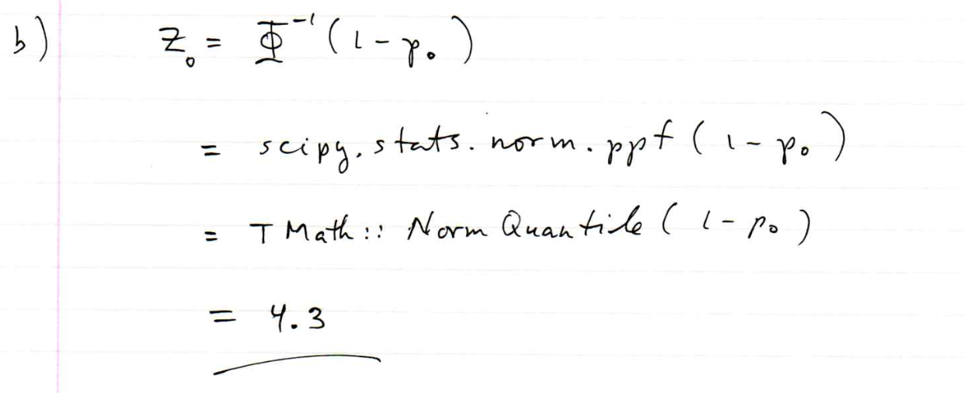
Problem sheet 6 / 1(b)

Slide 5
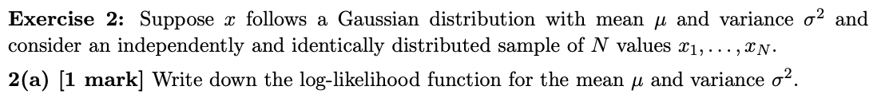
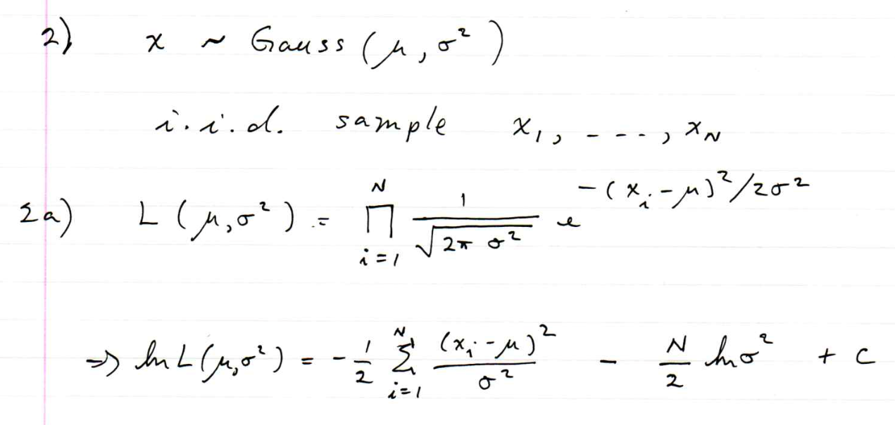
Problem sheet 6

Slide 6
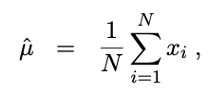

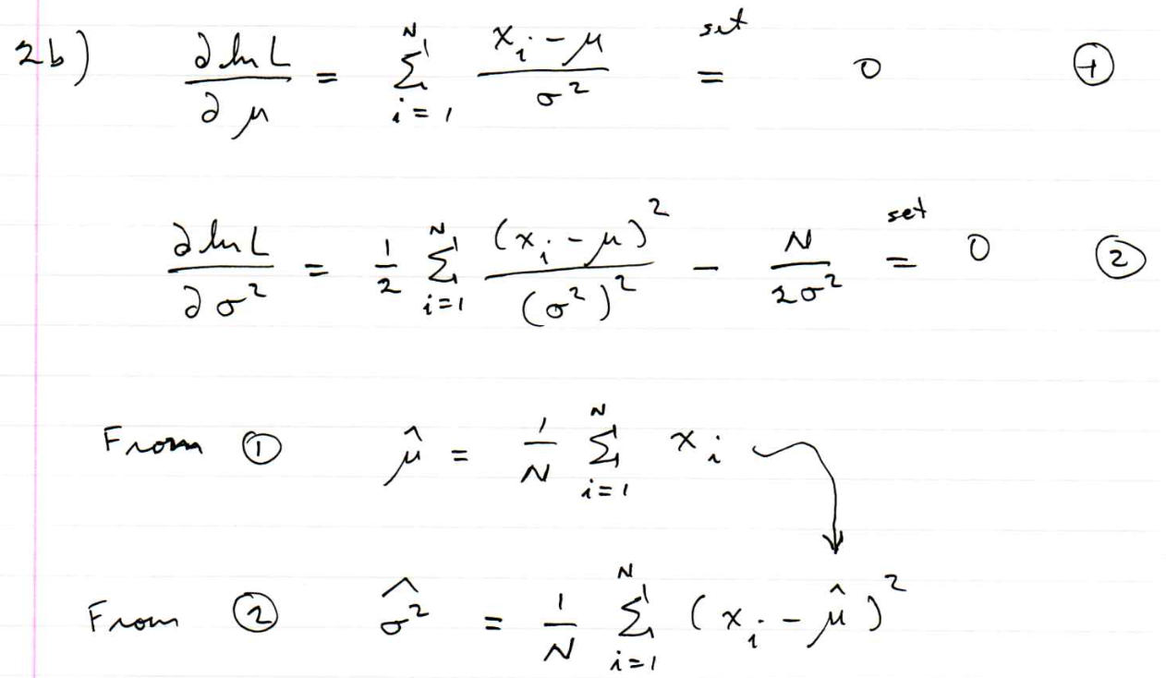
Problem sheet 6

Slide 7
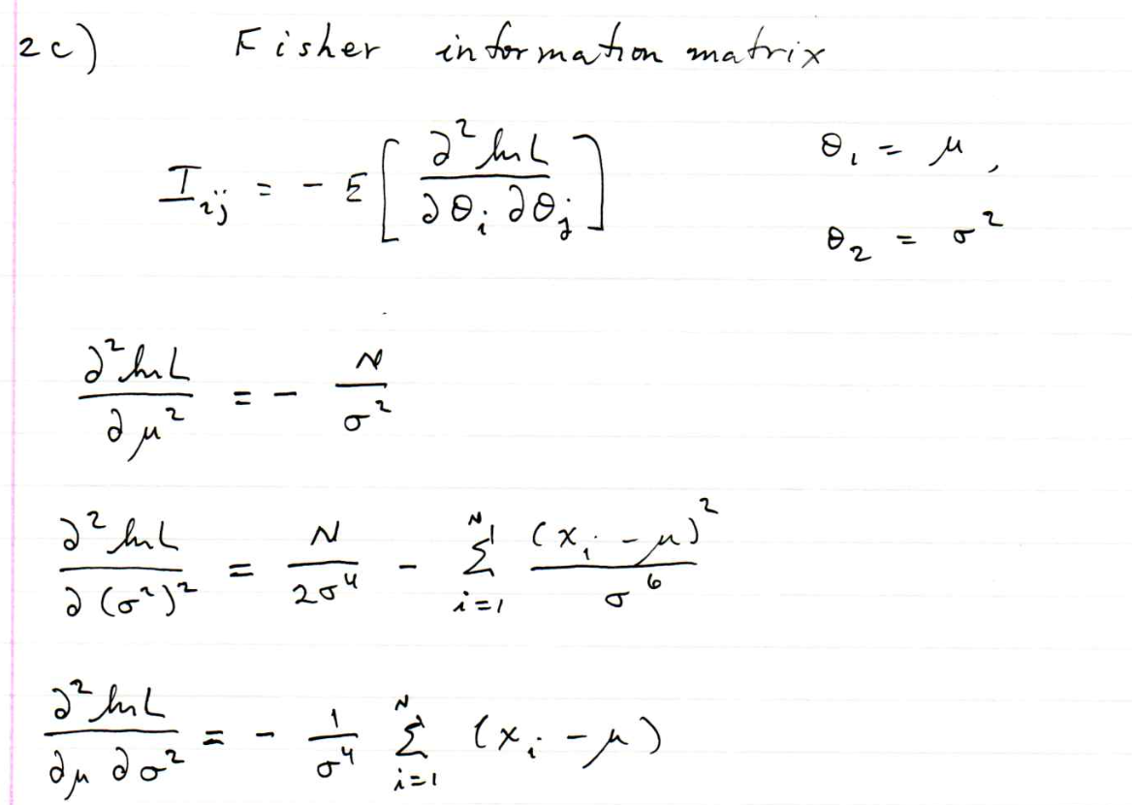
Problem sheet 6

Slide 8
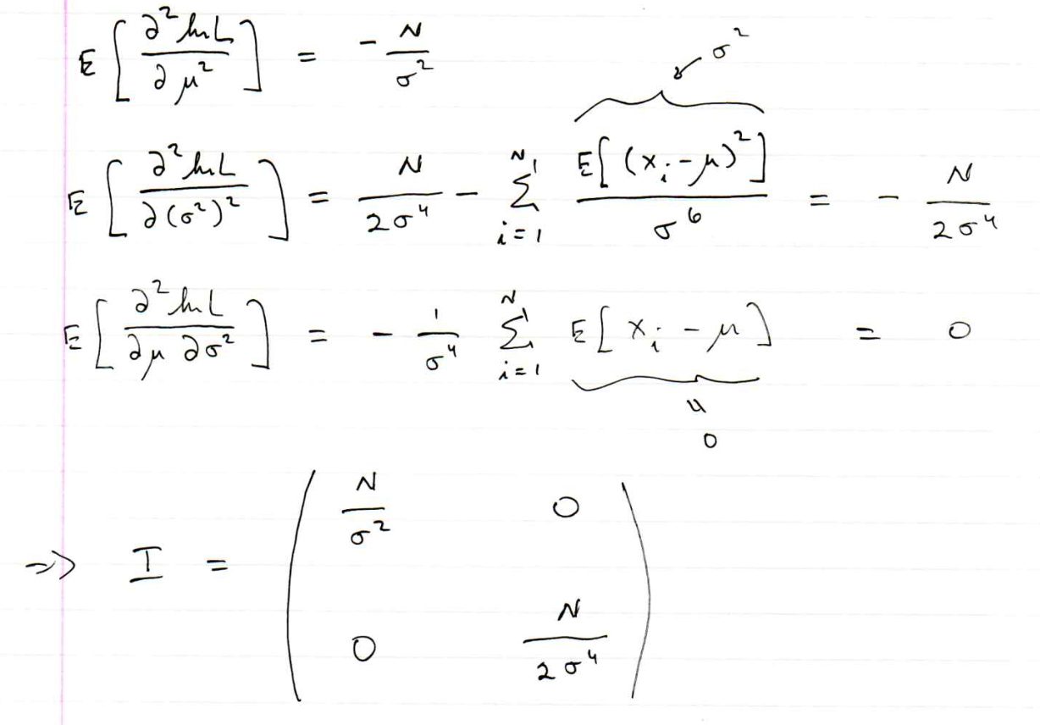
Problem sheet 6

Slide 9
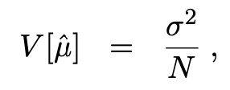
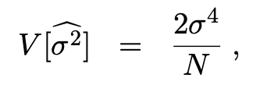

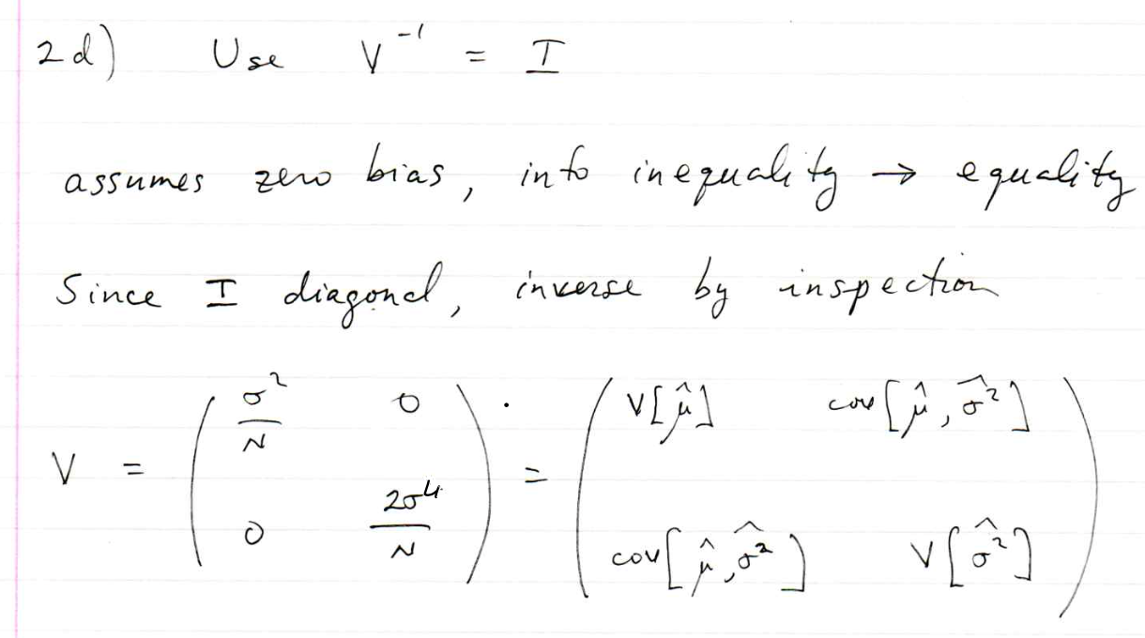
Problem sheet 6

Slide 10

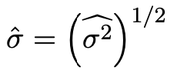
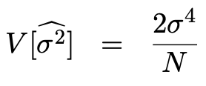
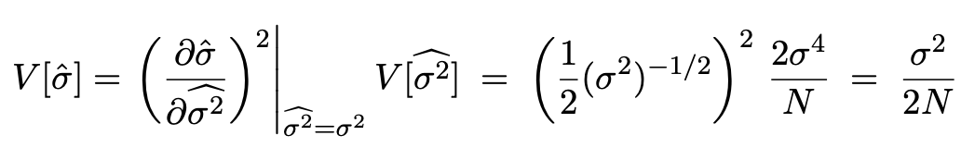
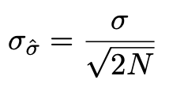
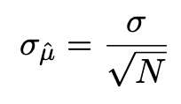
Problem sheet 6 / 2(d) comment
Suppose we don’t want the variance of the estimator of the
variance but rather the standard deviation of the estimator of
the standard deviation (“error of the error”).
Std. dev. is square root of the variance:
MLE of a a function of a parameter:
We found
Use error propagation:
(compare to
.)

Slide 11
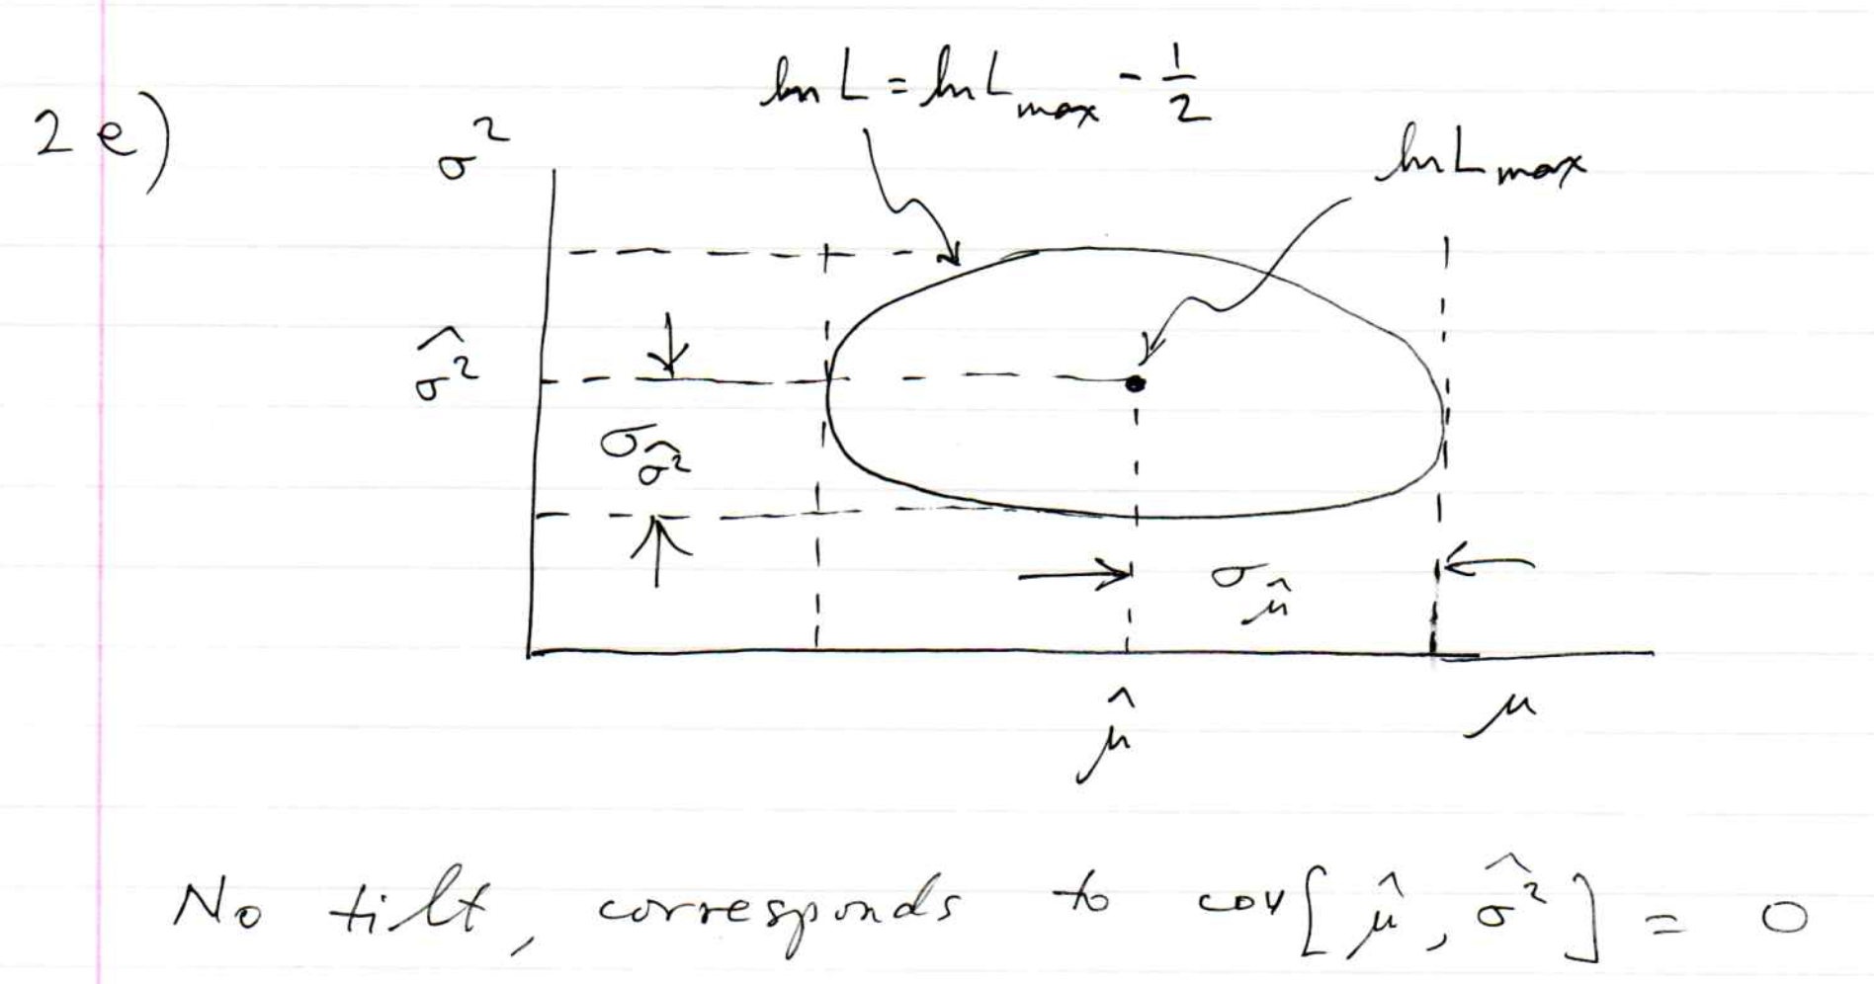
Problem sheet 6

Slide 12
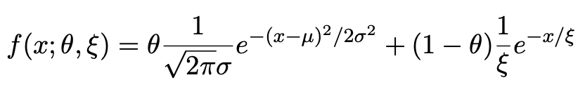
Some info on Problem Sheet 8 (iminuit)
Consider a pdf for continuous random variable x, (truncate and renormalize in 0 ≤ x ≤ x_{max})
θ = parameter of interest ,
gives signal rate.
Depending on context, take ξ, μ, σ as nuisance parameters or fixed.
Generate i.i.d. sample x₁,..., x_{n}.
Estimate θ (and other params.)

Slide 13
A quick look at mlFit.py
# Example of maximum-likelihood fit with iminuit version 2.
# pdf is a mixture of Gaussian (signal) and exponential (background),
# truncated in [xMin,xMax].
# G. Cowan / RHUL Physics / December 2022
import numpy as np
import scipy.stats as stats
from scipy.stats import truncexpon
from scipy.stats import truncnorm
from scipy.stats import chi2
import iminuit
from iminuit import Minuit
import matplotlib.pyplot as plt
from matplotlib import container
plt.rcParams["font.size"] = 14
print("iminuit version:", iminuit.__version__) # need 2.x
# define pdf and generate data
np.random.seed(seed=1234567) # fix random seed
theta = 0.2 # fraction of signal
mu = 10. # mean of Gaussian
sigma = 2. # std. dev. of Gaussian
xi = 5. # mean of exponential
xMin = 0.
xMax = 20.

Slide 14
Define the fit function
def f(x, par):
theta = par[0]
mu = par[1]
sigma = par[2]
xi = par[3]
fs = stats.truncnorm.pdf(x, a=(xMin-mu)/sigma, b=(xMax-mu)/sigma, loc=mu, scale=sigma)
fb = stats.truncexpon.pdf(x, b=(xMax-xMin)/xi, loc=xMin, scale=xi)
return theta*fs + (1-theta)*fb
Generate the data
numVal = 200
xData = np.empty([numVal])
for i in range (numVal):
r = np.random.uniform();
if r < theta:
xData[i] = stats.truncnorm.rvs(a=(xMin-mu)/sigma, b=(xMax-mu)/sigma,
loc=mu, scale=sigma)
else:
xData[i] = stats.truncexpon.rvs(b=(xMax-xMin)/xi, loc=xMin, scale=xi)

Slide 15
Set up the fit
# Function to be minimized is negative log-likelihood
def negLogL(par):
pdf = f(xData, par)
return -np.sum(np.log(pdf))
# Initialize Minuit and set up fit:
parin = np.array([theta, mu, sigma, xi]) # initial values (here = true values)
parname = ['theta', 'mu', 'sigma', 'xi']
parname_latex = [r'$\theta$', r'$\mu$', r'$\sigma$', r'$\xi$']
parstep = np.array([0.1, 1., 1., 1.]) # initial setp sizes
parfix = [False, True, True, False] # change these to fix/free params
parlim = [(0.,1), (None, None), (0., None), (0., None)] # set limits
m = Minuit(negLogL, parin, name=parname)
m.errors = parstep
m.fixed = parfix
m.limits = parlim
m.errordef = 0.5 # errors from lnL = lnLmax - 0.5

Slide 16
Do the fit, get errors, extract results
# Do the fit, get errors, extract results
m.migrad() # minimize -logL
MLE = m.values # max-likelihood estimates
sigmaMLE = m.errors # standard deviations
cov = m.covariance # covariance matrix
rho = m.covariance.correlation() # correlation coeffs.
print(r"par index, name, estimate, standard deviation:")
for i in range(m.npar):
if not m.fixed[i]:
print("{:4d}".format(i), "{:<10s}".format(m.parameters[i]), " = ",
"{:.6f}".format(MLE[i]), " +/- ", "{:.6f}".format(sigmaMLE[i]))
print()
print(r"free par indices, covariance, correlation coeff.:")
for i in range(m.npar):
if not(m.fixed[i]):
for j in range(m.npar):
if not(m.fixed[j]):
print(i, j, "{:.6f}".format(cov[i,j]), "{:.6f}".format(rho[i,j]))
Make some plots...

Slide 17
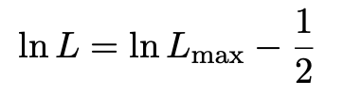
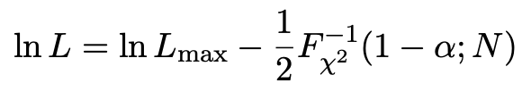

Comment on the lnL = lnL_{max} – ½ contour
In the lectures, we saw that the standard deviations of fitted parameters are found from the tangent lines (planes) to the contour
A similar procedure can be used to find a confidence region in the parameter space that will cover the true parameter with probability CL = 1 – α (the “confidence level”). This uses the contour
, N = number of parameters
If you want the contour lnL = lnL_{max} – ½ in iminuit, you need to choose CL (= 1 – α) such that F_{χ2}⁻¹(1 – α,N) = 1, i.e.,

Slide 18
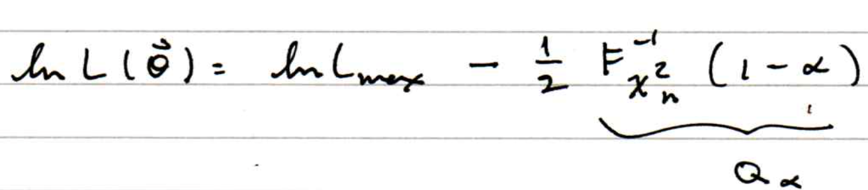
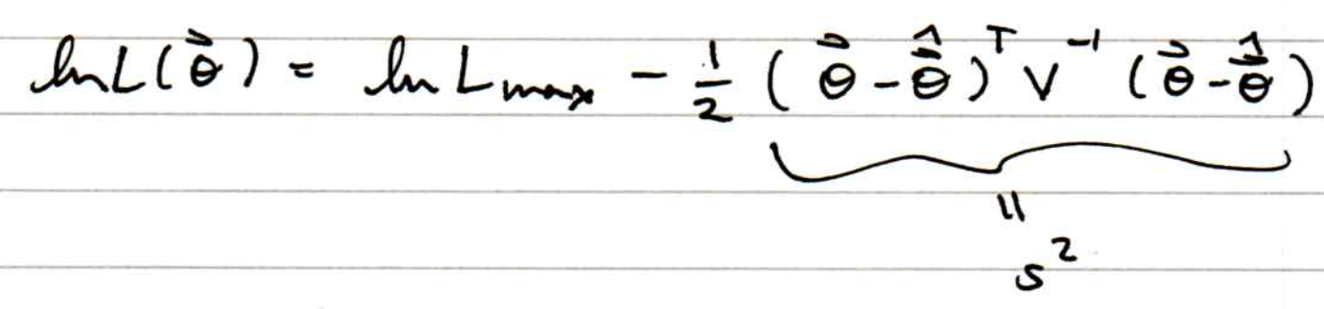
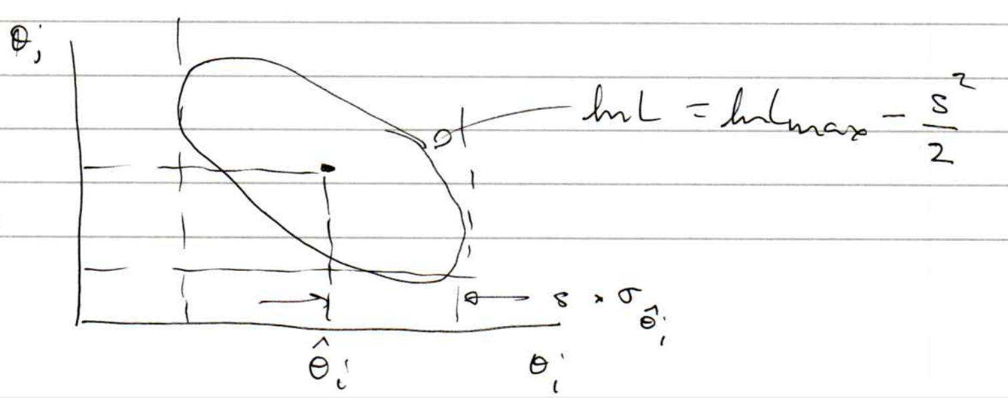


Comment on “s-sigma” covariance ellipse
We have used the formula for the confidence region:
Similar to the ellipse whose tangents give std. deviations:
tangents at
s std. devs.
So s-sigma ellipse corresponds to

Slide 19
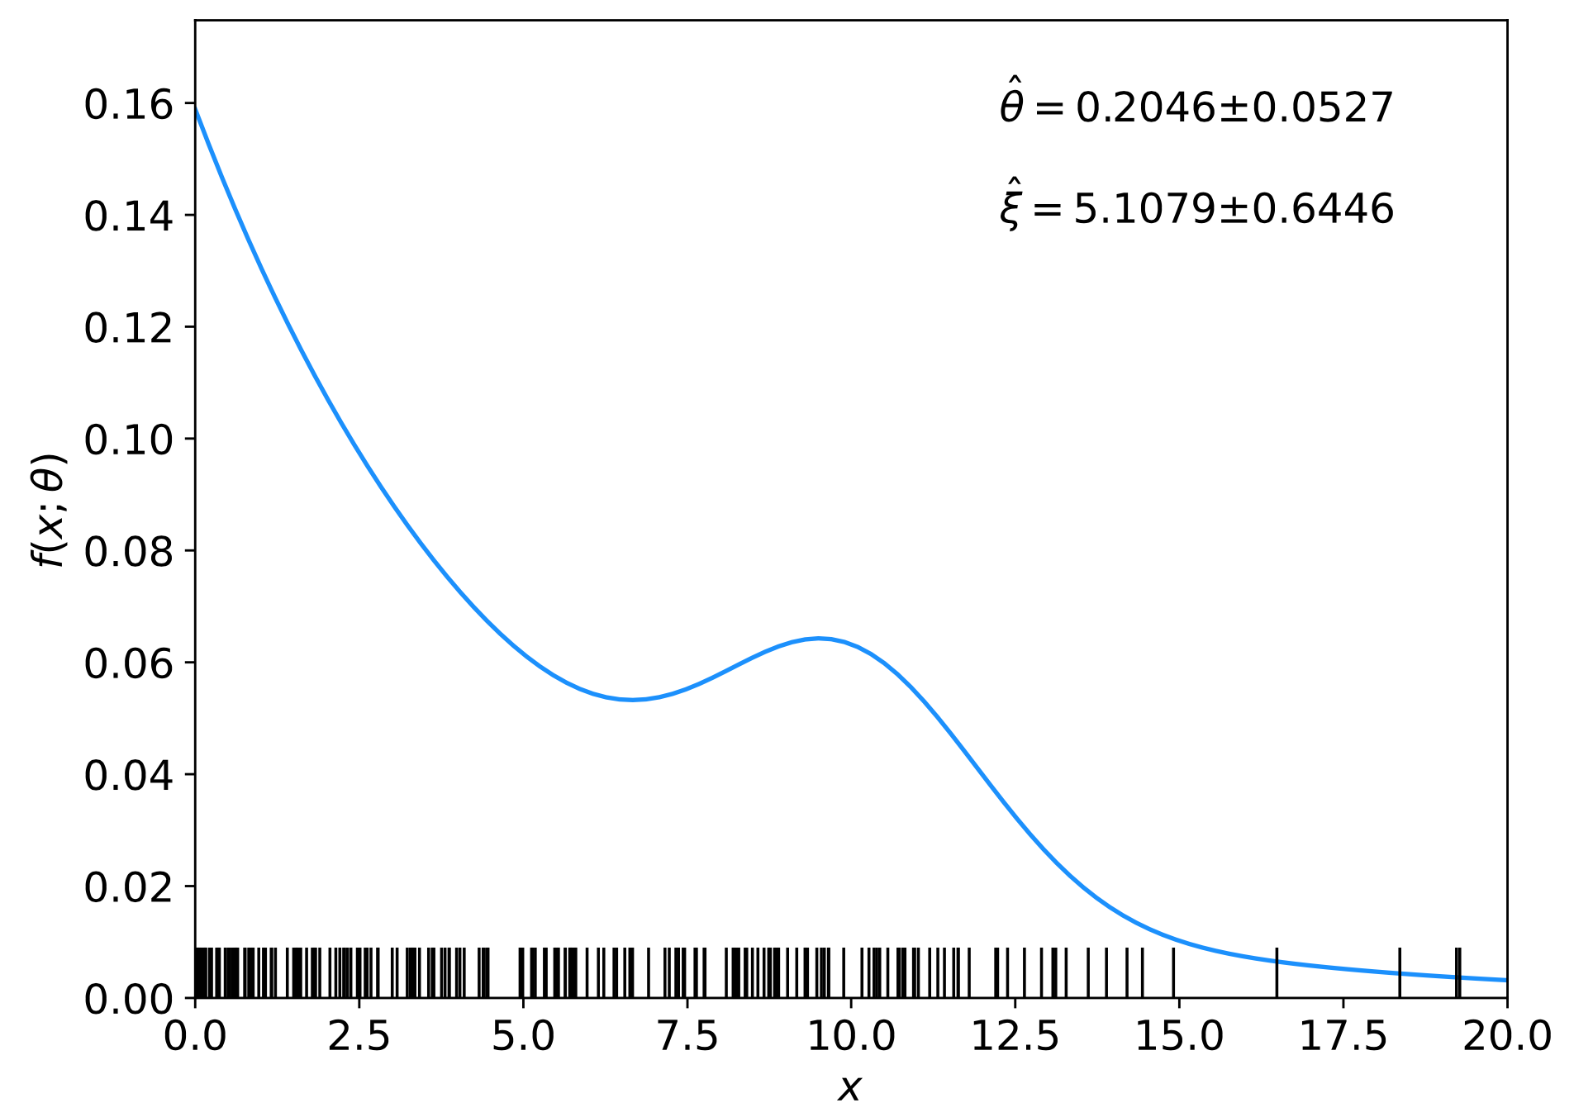
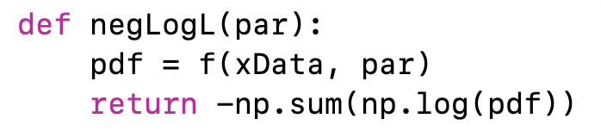
Comments on using iminuit
In our iminuit example mlFit.py, the only argument of the log-likelihood function is the parameter array, and the data array xData enters as global (usually not a good idea):
⠇

Slide 20
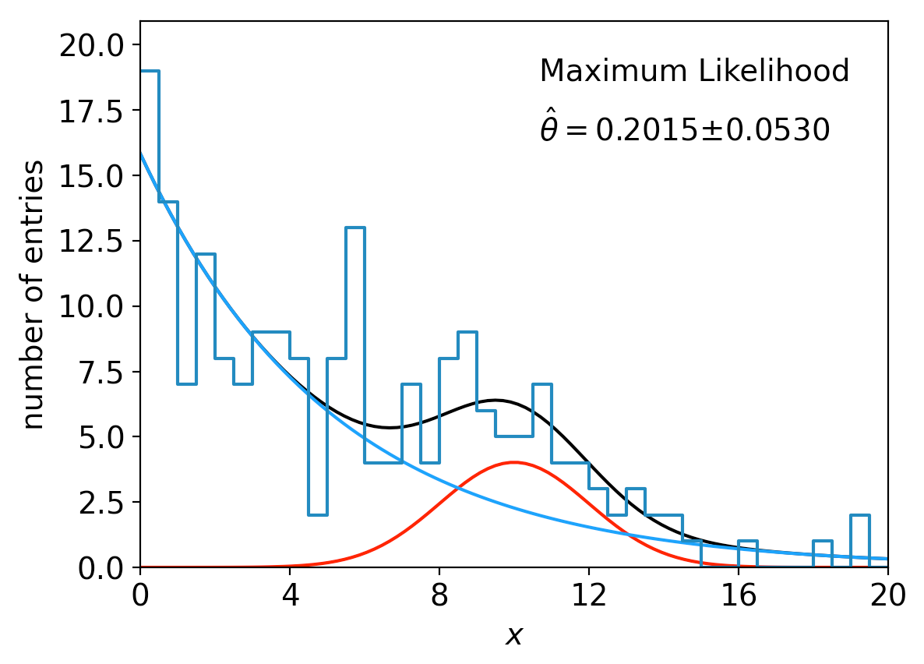
lnL in a class, binned data,...
Sometimes it is convenient to have the function being minimized as a method of a class. An example of this is shown in the program histFit.py, which does the same fit as in mlFit.py but with a histogram of the data:

Slide 21
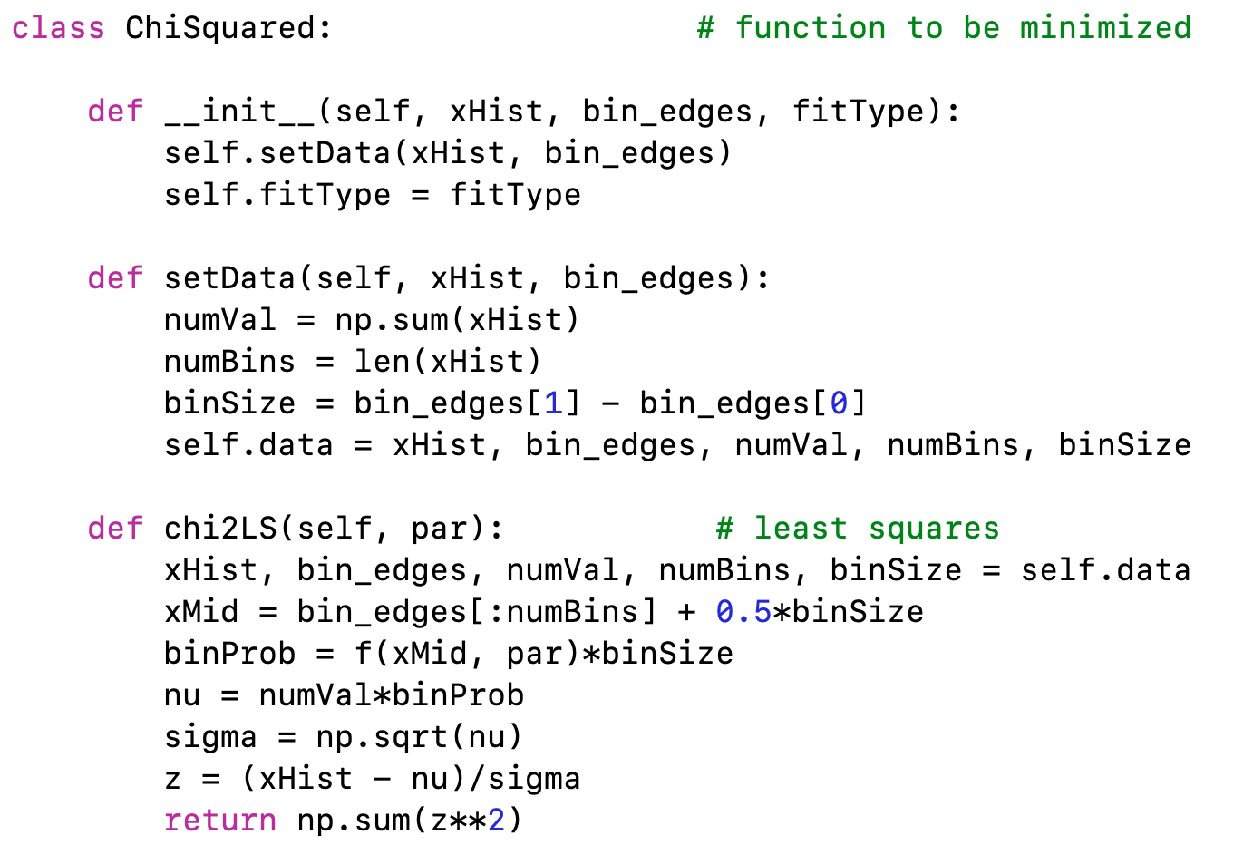
Commentary on histFit.py
The global data can be avoided if we make the objective function a method of a class:
← called when object created
(= “constructor”)

Slide 22
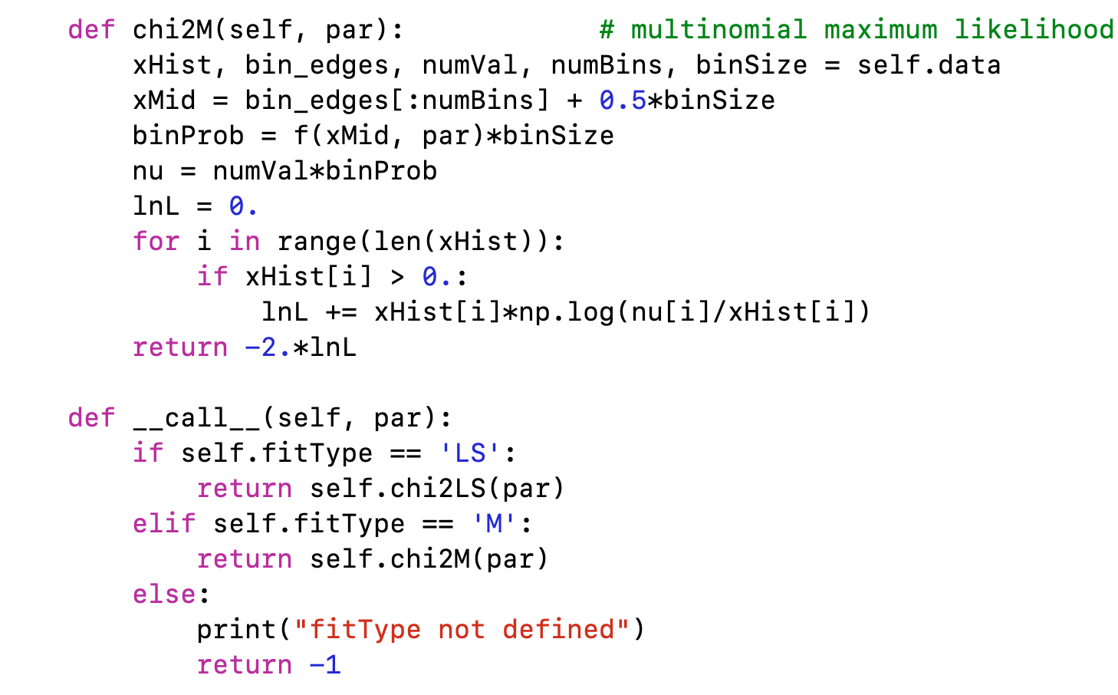
class ChiSquared (continued)
← makes object itself behave like a callable function

Slide 23
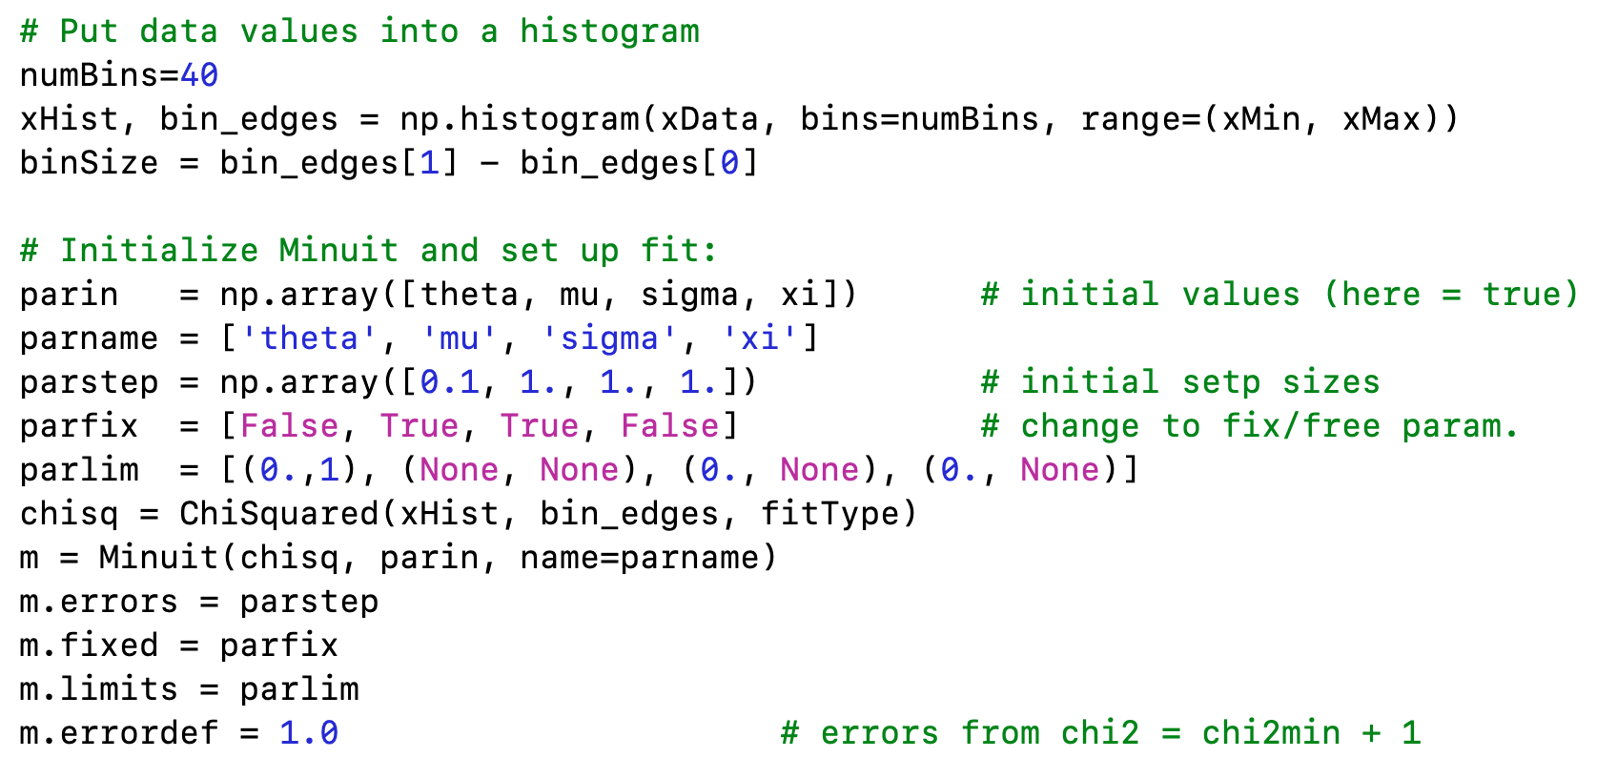
Using the ChiSquared class
For full program see
https://www.pp.rhul.ac.uk/~cowan/stat/exercises/fitting/python/

Slide 24
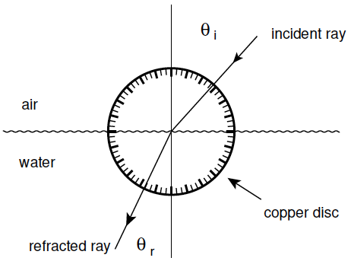
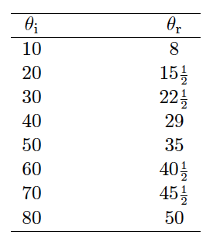
LS example: refraction data from Ptolemy
Astronomer Claudius Ptolemy obtained data on refraction of
light by water in around 140 A.D.:
Angles of incidence and
refraction (degrees)
Suppose the angle of incidence is set with negligible error, and
the measured angle of refraction has a standard deviation of ½°.

Slide 25



Laws of refraction
A commonly used law of refraction was
,
although it is reported that Ptolemy preferred
.
The law of refraction discovered by Ibn Sahl in 984 (and rediscovered by Snell in 1621) is
.
where r = n_{r}/n_{i} is the ratio of indices of refraction of the two media.

Slide 26
LS fit: θ_{r} = αθ_{i}
p = 6.7 ⨉ 10⁻²⁶

Slide 27
LS fit: θ_{r} = αθ_{i} − βθ_{i}²
p = 1.0

Slide 28
LS fit: Snell’s Law
p = 0.051
Fitted index of refraction of water r = 1.3116 ± 0.0056 found not quite compatible with currently known value 1.330.

