Slide 1


Statistical Data Analysis 2024/25
Lecture Week 10
London Postgraduate Lectures on Particle Physics
University of London MSc/MSci course PH4515
Glen Cowan
Physics Department
Royal Holloway, University of London
g.cowan@rhul.ac.uk
www.pp.rhul.ac.uk/~cowan
Course web page via RHUL moodle (PH4515) and also
www.pp.rhul.ac.uk/~cowan/stat_course.html

Slide 2
Statistical Data Analysis
Lecture 10-1
Upper limits on a Poisson rate parameter
  Frequentist approach
  Bayesian approach

Slide 3



Frequentist upper limit on Poisson parameter
Consider again observing n ~ Poisson(s + b), with both s, b ≥ 0.
Suppose b = 4.5, n_{obs} = 5. Find upper limit on s at 95% CL.
Relevant alternative is s = 0 (critical region at low n)
p-value of hypothesized s is P(n ≤ n_{obs}; s, b)
Upper limit s_{up} at CL = 1 – α found from

Slide 4
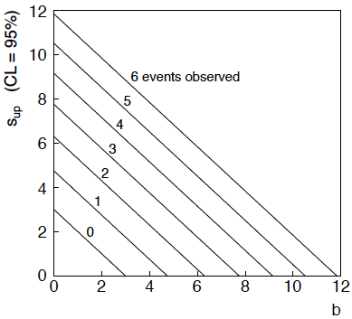
n ~ Poisson(s+b): frequentist upper limit on s
For low fluctuation of n, formula can give negative result for s_{up}; i.e. confidence interval is empty; all values of s ≥ 0 have p_{s} ≤ α.
2.996 →

Slide 5
Limits near a boundary of the parameter space
Suppose e.g. b = 2.5 and we observe n = 0.
If we choose CL = 0.9, we find from the formula for s_{up}
Physicist:
We already knew s ≥ 0 before we started; can’t use negative
upper limit to report result of expensive experiment!
Statistician:
The interval is designed to cover the true value only 90%
of the time — this was clearly not one of those times.
Not uncommon dilemma – note probability to reject very small s (to which one has no sensitivity) is slightly greater than α.

Slide 6
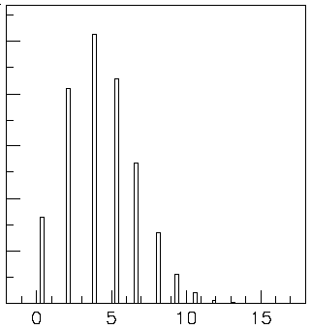

Expected limit for s = 0
Physicist: I should have used CL = 0.95 — then s_{up} = 0.496
Even better: for CL = 0.917923 we get s_{up} = 10⁻⁴ !
Reality check: with b = 2.5, typical Poisson fluctuation in n is
at least √2.5 = 1.6. How can the limit be so low?
Look at the mean limit for the no-signal hypothesis (s = 0) sensitivity).
Distribution of 95% CL limits
with b = 2.5, s = 0.
Mean upper limit = 4.44
Report both observed and expected limits;
other types of limits (Bayesian, CLs, F-C) can mitigate the issue.

Slide 7
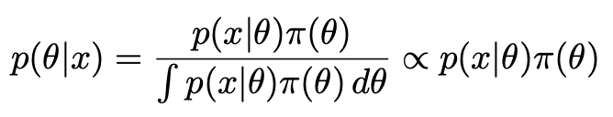
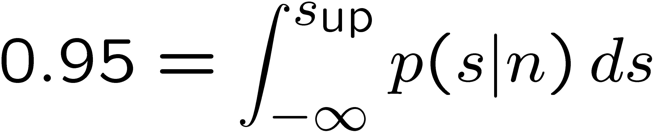
The Bayesian approach to limits
In Bayesian statistics need to start with ‘prior pdf’ π(θ), this
reflects degree of belief about θ before doing the experiment.
Bayes’ theorem tells how our beliefs should be updated in
light of the data x:
Integrate posterior pdf p(θ|x) to give interval with any desired
probability content.
For e.g. n ~ Poisson(s+b), 95% CL upper limit on s from

Slide 8
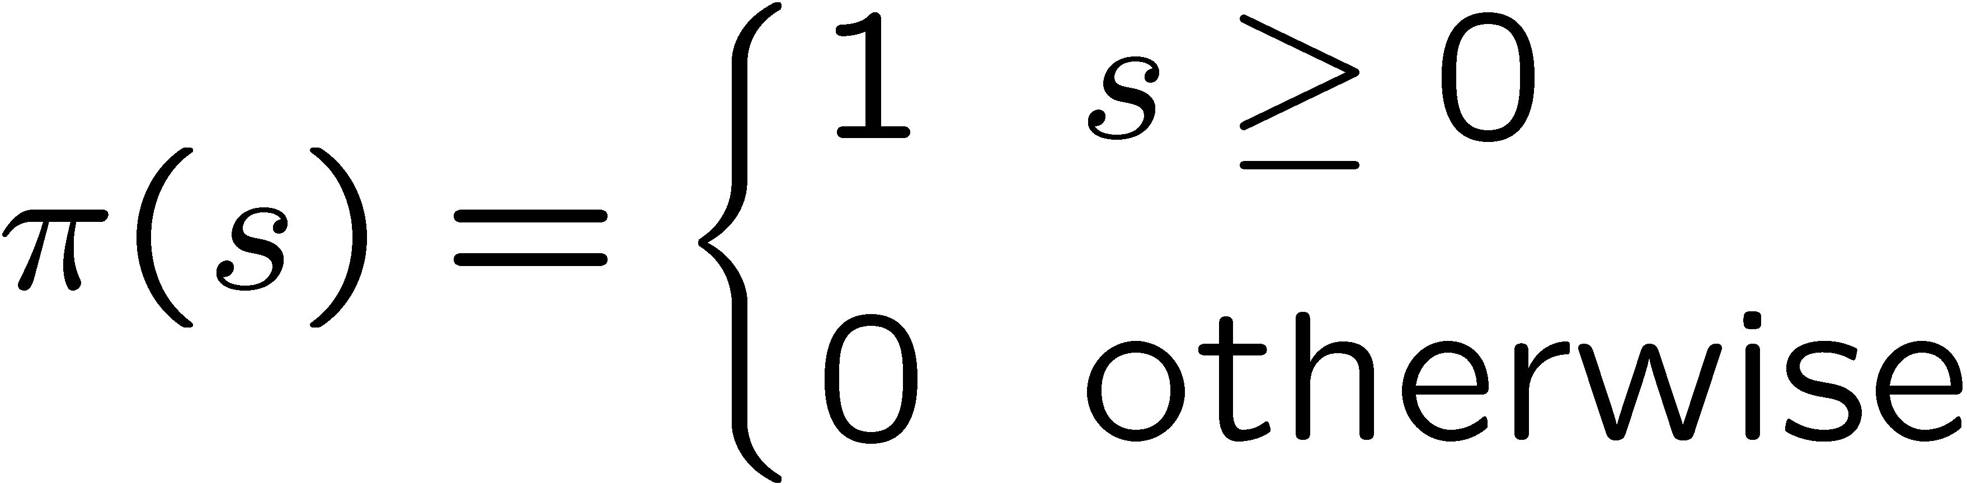
Bayesian prior for Poisson parameter
Include knowledge that s ≥ 0 by setting prior π(s) = 0 for s < 0.
Could try to reflect ‘prior ignorance’ with e.g.
Not normalized; can be OK provided p(n|s) dies off quickly for large s.
Not invariant under change of parameter — if we had used instead a flat prior for a nonlinear function of s, then this would imply a non-flat prior for s.
Doesn’t really reflect a reasonable degree of belief, but often used as a point of reference; or viewed as a recipe for producing an interval whose frequentist properties can be studied (e.g., coverage probability, which will depend on true s).

Slide 9
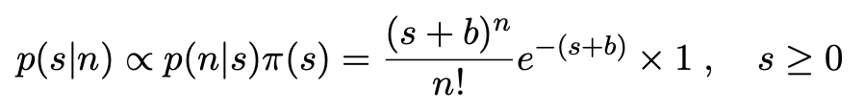






Bayesian upper limit with flat prior for s
Put Poisson likelihood and flat prior into Bayes’ theorem:
Normalize to unit area:
upper incomplete
gamma function
Upper limit s_{up} determined by

Slide 10


Bayesian interval with flat prior for s
Solve to find limit s_{up}:
where
For special case b = 0, Bayesian upper limit with flat prior
numerically same as one-sided frequentist case (‘coincidence’).

Slide 11
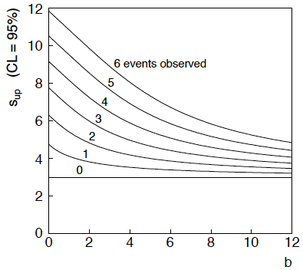
Bayesian interval with flat prior for s
For b > 0 Bayesian limit is everywhere greater than the (one sided) frequentist upper limit.
For b = 0 , Bayesian and frequentist upper limits come out equal.
Never goes negative. Doesn’t depend on b if n = 0.

Slide 12
Statistical Data Analysis
Lecture 10-2
Discussion on Bayesian prior probabilities
Jeffreys’ prior
Example: Poisson mean

Slide 13
Priors from formal rules
Last time we took the prior for a Poisson mean to be constant to reflect a lack of prior knowledge; we noted this was not invariant under change of parameter.
Because of difficulties in encoding a vague degree of belief
in a prior, one often attempts to derive the prior from formal rules,
e.g., to satisfy certain invariance principles or to provide maximum
information gain for a certain set of measurements.
Often called “objective priors”
Form basis of Objective Bayesian Statistics
The priors do not reflect a degree of belief (but might represent
possible extreme cases).
In Objective Bayesian analysis, can use the intervals in a
frequentist way, i.e., regard Bayes’ theorem as a recipe to produce
an interval with a given coverage probability.

Slide 14
Priors from formal rules (cont.)
For a review of priors obtained by formal rules see, e.g.,
Formal priors have not been widely used in Particle Physics, but there has been interest in this direction, especially the reference priors of Bernardo and Berger; see e.g.
L. Demortier, S. Jain and H. Prosper, Reference priors for high
energy physics, Phys. Rev. D 82 (2010) 034002, arXiv:1002.1111.
D. Casadei, Reference analysis of the signal + background model
in counting experiments, JINST 7 (2012) 01012; arXiv:1108.4270.

Slide 15

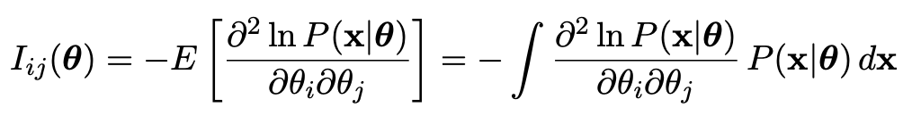
Jeffreys prior
According to Jeffreys’ rule, take prior according to
where
is the Fisher information matrix.
One can show that this leads to inference that is invariant under
a transformation of parameters in the following sense:
Start with the Jeffreys prior for θ: π_{θ}(θ) ~ √(det I(θ))
Use it in Bayes’ theorem to find:

Slide 16
Jeffreys prior (2)
Now consider a function η(θ). The posterior for η is
Alternatively, start with η and use its Jeffreys’ prior:
Use this in Bayes’ theorem:
One can show that Jeffreys’ prior results in the same P(η|x) in both cases. For details (single-parameter case) see:
https://www.pp.rhul.ac.uk/~cowan/stat/notes/JeffreysInvariance.pdf

Slide 17
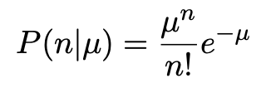
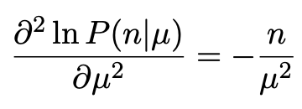
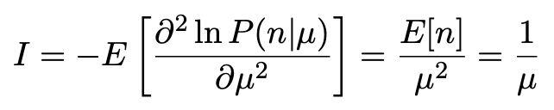

Jeffreys prior for Poisson mean
Suppose n ~ Poisson(μ). To find the Jeffreys’ prior for μ,
So e.g. for μ = s + b, this means the prior π(s) ~ 1/√(s + b), which depends on b. But this is not designed as a degree of belief about s.

Slide 18
Posterior pdf for Poisson mean
From Bayes’ theorem,
Flat, π(μ) = const.
Jeffreys, π(μ) ~ 1/√μ
In both cases, posterior is special case of gamma distribution.

Slide 19
Upper limit for Poisson mean
To find upper limit at CL = 1−α, solve
Jeffreys prior:
= 7.03
n=3,
CL=0.95
Flat prior:
= 7.75
where P⁻¹ is the inverse of the normalized lower incomplete gamma function (see scipy.special)

Slide 20
Statistical Data Analysis
Lecture 10-3
Systematic uncertainties and nuisance parameters
Profile likelihood

Slide 21



Systematic uncertainties and nuisance parameters
P (x|μ)
In general, our model of the data is not perfect:
model:
truth:
x
Can improve model by including
additional adjustable parameters.
Nuisance parameter ↔ systematic uncertainty. Some point in the
parameter space of the enlarged model should be “true”.
Presence of nuisance parameter decreases sensitivity of analysis
to the parameter of interest (e.g., increases variance of estimate).

Slide 22
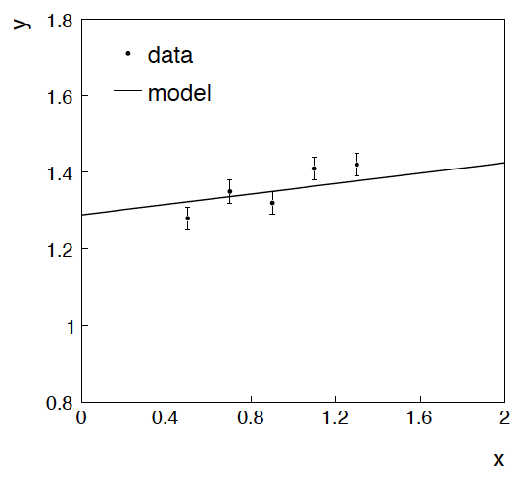
Example: fitting a straight line
Data:
Model: y_{i} independent and all follow y_{i} ~ Gauss(μ(x_{i} ), σ_{i} )
assume x_{i} and σ_{i} known.
Goal: estimate θ₀
Here suppose we don’t care
about θ₁ (example of a
“nuisance parameter”)

Slide 23
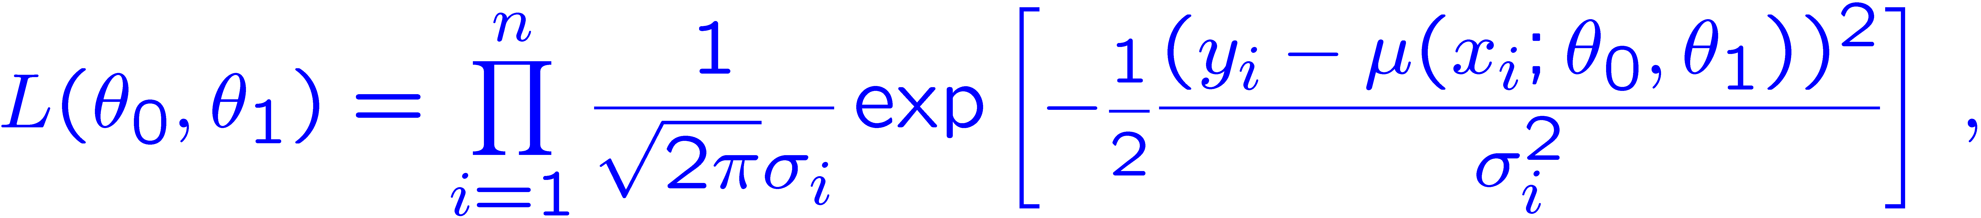
Maximum likelihood fit with Gaussian data
In this example, the y_{i} are assumed independent, so the
likelihood function is a product of Gaussians:
Maximizing the likelihood is here equivalent to minimizing
i.e., for Gaussian data, ML same as Method of Least Squares (LS)

Slide 24
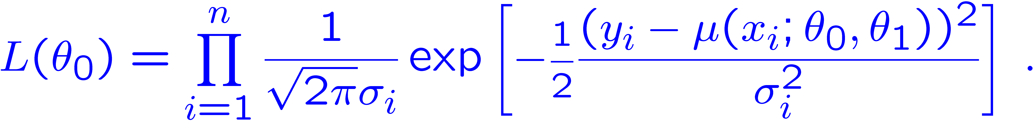
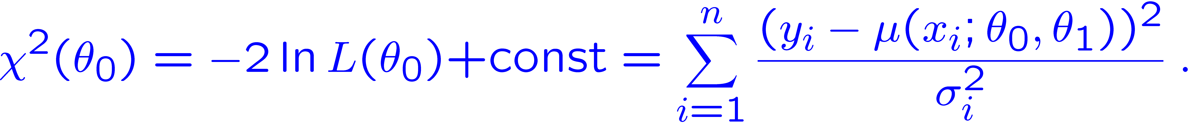
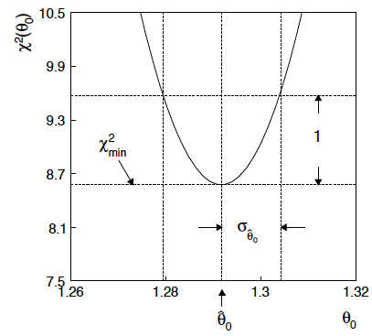
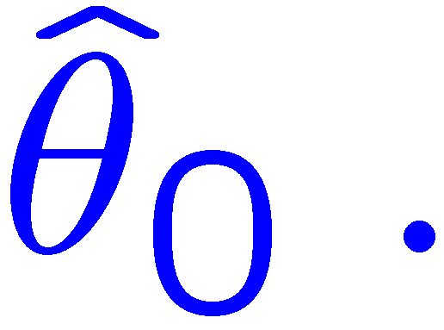
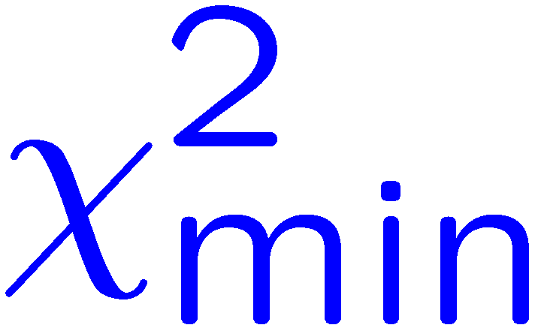
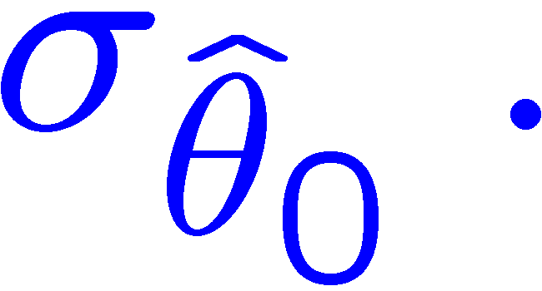
θ₁ known a priori
For Gaussian y_{i}, ML same as LS
Minimize χ² → estimator
Come up one unit from
to find

Slide 25
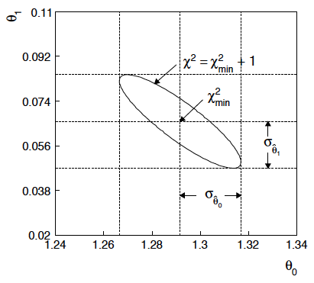
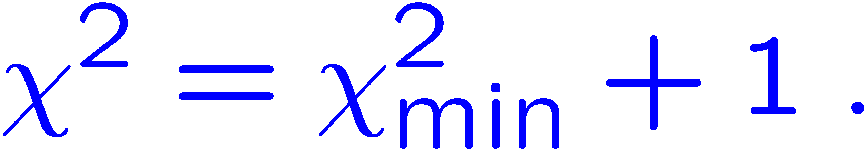
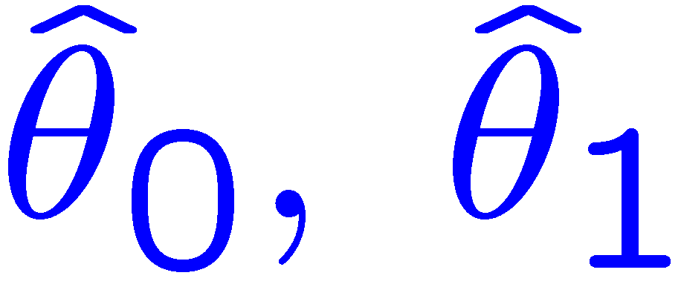
ML (or LS) fit of θ₀ and θ₁
Standard deviations from
tangent lines to contour
Correlation between
causes errors
to increase.

Slide 26


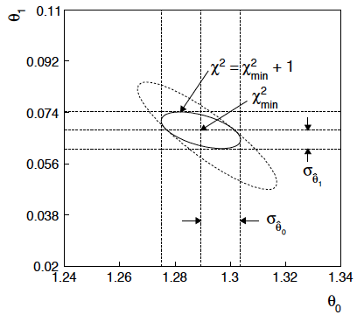
If we have a measurement t₁ ~ Gauss (θ₁, σ_{t1})
The information on θ₁
improves accuracy of

Slide 27




Profiling
The lnL = lnL_{max} – ½ contour in the (θ₀, θ₁) plane is a confidence region at CL = 39.3%.
Furthermore if one wants to know only about, say, θ₀, then the
interval in θ₀ corresponding to lnL = lnL_{max} – ½ is a confidence interval at CL = 68.3% (i.e., ±1 std. dev.).
I.e., form the interval for θ₀ using
where θ₁ is replaced by its “profiled” value

Slide 28
Profile Likelihood
Suppose we have a likelihood L(μ,θ) = P(x|μ,θ) with N parameters of interest μ = (μ₁,..., μ_{N}) and M nuisance parameters θ = (θ₁,..., θ_{M}). The “profiled” (or “constrained”) values of θ are:
and the profile likelihood is:
The profile likelihood depends only on the parameters of interest; the nuisance parameters are replaced by their profiled values.
The profile likelihood can be used to obtain confidence intervals/regions for the parameters of interest in the same way as one would for all of the parameters from the full likelihood.

Slide 29
Profile Likelihood Ratio – Wilks theorem
Goal is to test/reject regions of μ space (param. of interest).
Rejecting a point μ should mean p_{μ} ≤ α for all possible values of the nuisance parameters θ.
Test μ using the “profile likelihood ratio”:
Let t_{μ} = −2 ln λ(μ). Wilks’ theorem says in large-sample limit:
where the number of degrees of freedom is the number of
parameters of interest (components of μ). So p-value for μ is

Slide 30
Profile Likelihood Ratio – Wilks theorem (2)
If we have a large enough data sample to justify use of the
asymptotic chi-square pdf, then if μ is rejected, it is rejected for any values of the nuisance parameters.
The recipe to get confidence regions/intervals for the parameters of interest at CL = 1 – α is thus the same as before, simply use the profile likelihood:
where the number of degrees of freedom N for the chi-square quantile is equal to the number of parameters of interest.
If the large-sample limit is not justified, then use e.g. Monte Carlo to get distribution of t_{μ}.

Slide 31
Statistical Data Analysis
Lecture 10-4
Bayesian parameter estimation
Marginalization of posterior pdf
Markov Chain Monte Carlo

Slide 32
Reminder of Bayesian approach
In Bayesian statistics we can associate a probability with
a hypothesis, e.g., a parameter value θ.
Interpret probability of θ as ‘degree of belief’ (subjective).
Need to start with ‘prior pdf’ π(θ), this reflects degree
of belief about θ before doing the experiment.
Our experiment has data x, → likelihood p(x|θ).
Bayes’ theorem tells how our beliefs should be updated in
light of the data x:
Posterior pdf p(θ|x) contains all our knowledge about θ.

Slide 33
Bayesian approach: y_{i} ~ Gauss(μ(x_{i}; θ₀, θ₁), σ_{i})
We need to associate prior probabilities with θ₀ and θ₁, e.g.,
← suppose knowledge of θ₀ has no influence on knowledge of θ₁
← ‘non-informative’, in any
case much broader than L(θ₀)
prior after t₁,
before y
Ur = “primordial”
prior
Likelihood for control
measurement t₁

Slide 34
Bayesian example: y_{i} ~ Gauss(μ(x_{i}; θ₀, θ₁), σ_{i})
Putting the ingredients into Bayes’ theorem gives:
posterior ∝ likelihood ✕ prior
Note here the likelihood only reflects the measurements y.
The information from the control measurement t₁ has been put into the prior for θ₁.
We would get the same result using the likelihood P(y,t|θ₀,θ₁) and the constant “Ur-prior” for θ₁.
Here posterior only found as a proportionality.

Slide 35
Marginalizing the posterior pdf
We then integrate (marginalize) p(θ₀, θ₁ | y) to find p(θ₀ | y):
In this example we can do the integral (rare). We find
(same as for MLE)
For this example, numbers come out same as in frequentist approach, but interpretation different.

Slide 36
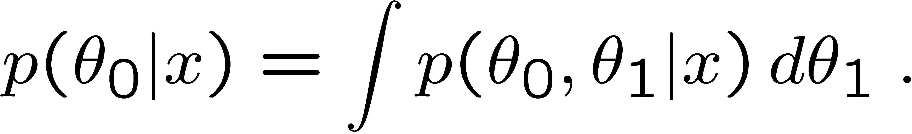
Marginalization with MCMC
Bayesian computations involve integrals like
often high dimensionality and impossible in closed form,
also impossible with ‘normal’ acceptance-rejection Monte Carlo.
Markov Chain Monte Carlo (MCMC) has revolutionized
Bayesian computation.
MCMC (e.g., Metropolis-Hastings algorithm) generates
correlated sequence of random numbers:
cannot use for many applications, e.g., detector MC;
effective stat. error greater than if all values independent .
Basic idea: sample multidimensional θ but look only at distribution of parameters of interest.

Slide 37
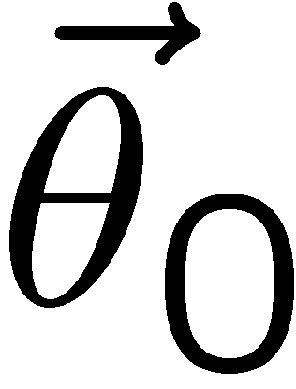
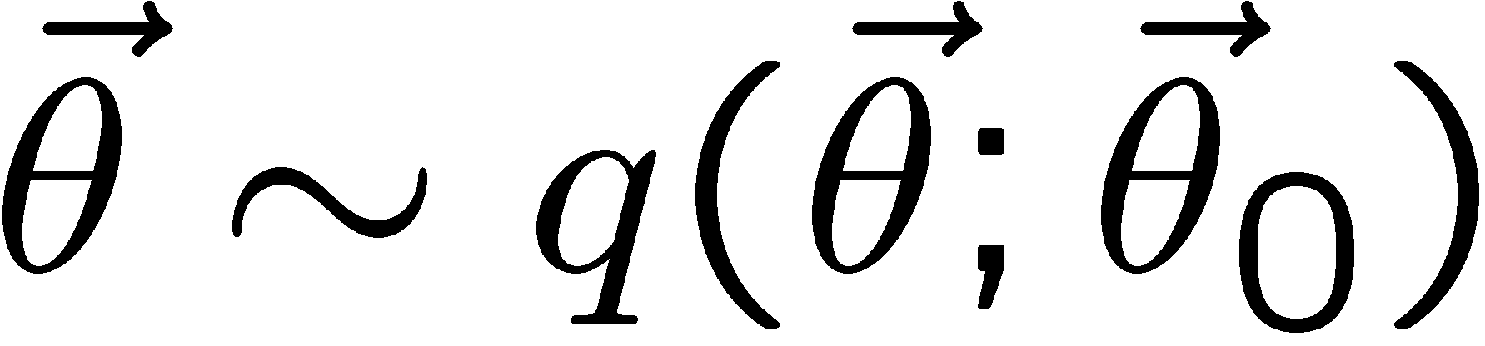
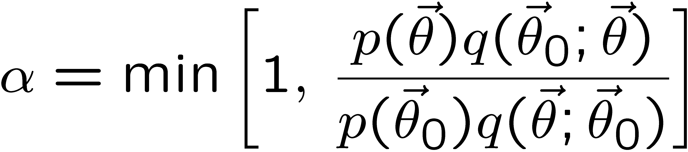
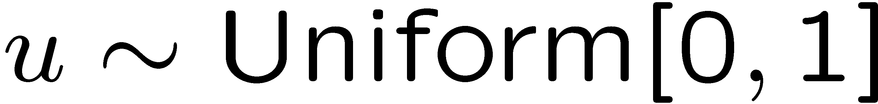
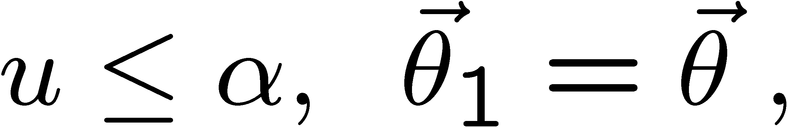
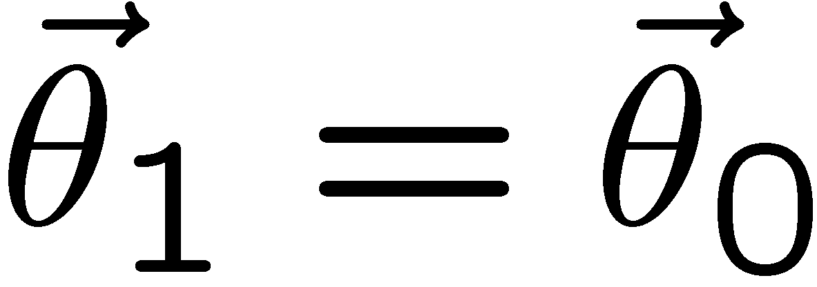
MCMC basics: Metropolis-Hastings algorithm
Goal: given an n-dimensional pdf p(θ) up to a proportionality constant, generate a sequence of points θ₁ , θ₂ , θ₃ ,...
Proposal density q(θ; θ₀ )
e.g. Gaussian centred
about θ₀
1) Start at some point
2) Generate
3) Form test ratio
4) Generate
5) If
move to proposed point
else
old point repeated
6) Iterate

Slide 38
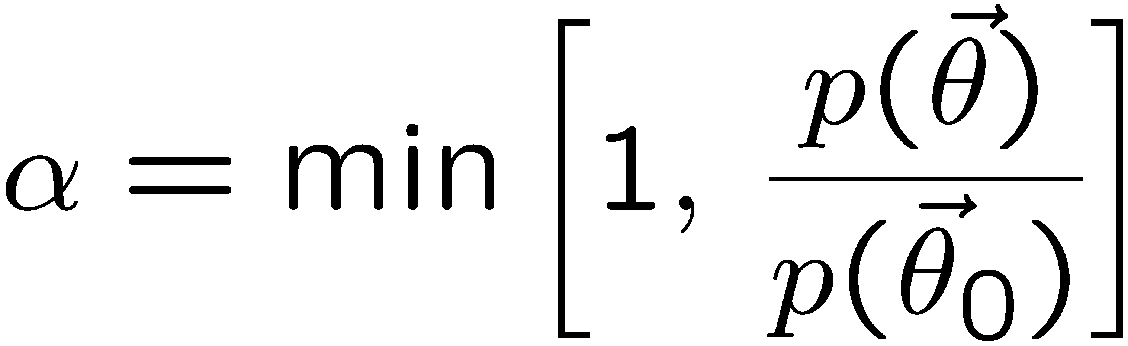
Metropolis-Hastings (continued)
This rule produces a correlated sequence of points (note how
each new point depends on the previous one).
Still works if p(θ) is known only as a proportionality, which is
usually what we have from Bayes’ theorem: p(θ|x) ∝ p(x|θ) π(θ).
The proposal density can be (almost) anything, but choose
so as to minimize autocorrelation. Often take proposal
density symmetric: q(θ; θ₀ ) = q(θ₀; θ )
Test ratio is (Metropolis-Hastings):
I.e. if the proposed step is to a point of higher p(θ), take it;
if not, only take the step with probability p(θ)/p(θ₀).
If proposed step rejected, repeat the current point.

Slide 39

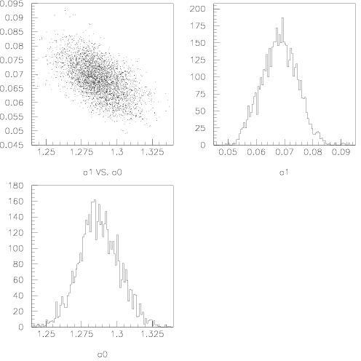
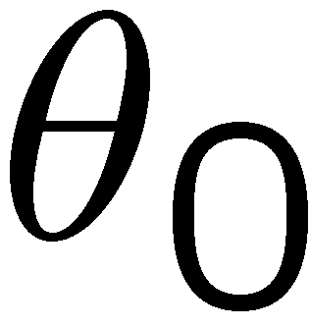
Example: posterior pdf from MCMC
Sample the posterior pdf from previous example with MCMC:
Normalized histogram of θ₀ gives its marginal posterior pdf:

Slide 40
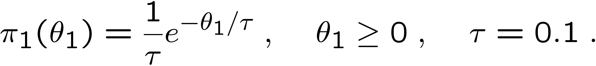
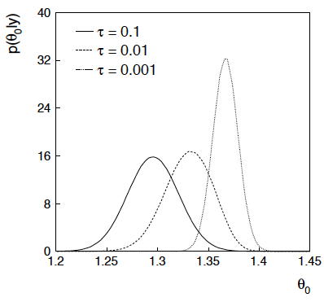
Bayesian method with alternative priors
Suppose we don’t have a previous measurement of θ₁ but rather,
an “expert” says it should be positive and not too much greater than 0.1 or so, i.e., something like
From this we obtain (numerically) the posterior pdf for θ₀:
This summarizes all
knowledge about θ₀.
Look also at result from
variety of priors.

Slide 41
Extra slides

Slide 42
Bonus exercise: Bayesian parameter estimation
The exercise is described in
https://www.pp.rhul.ac.uk/~cowan/stat/exercises/bayesFit/
in the file bayes_fit_exercise.pdf.
The program is in bayesFit.py or bayesFit.ipynb.
This exercise treats the same fitting problem as seen with maximum likelihood, here using the Bayesian approach.
Bayes’ theorem is used to find the posterior pdf for the parameters, and these are summarized using the posterior mode (MAP estimators).
The posterior pdf is marginalized over the nuisance parameters using Markov Chain Monte Carlo.

Slide 43
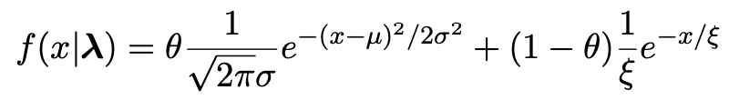
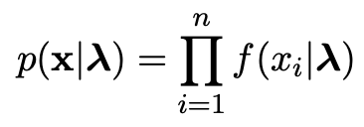

Gaussian signal on exponential background
Same pdf as from mlFit.py (see tutorial 1) with n = 400 independent values of x from
Posterior pdf for parameters λ = (θ, μ, σ, ξ) from Bayes theorem,
where
At first take prior pdf constant for all parameters subject to 0 ≤ θ ≤ 1, σ > 0, ξ > 0 (later try different priors).

Slide 44
Data and MAP estimates
Maximize posterior with minuit (minimize – ln p(λ|x)).
Standard deviations from minuit correspond to approximating posterior as Gaussian near its peak.
Here priors constant so
MAP estimates same as MLE, covariance matrix
V_{ij} = cov[θ_{i}, θ_{j}] also same.

Slide 45
A look at bayesFit.py
Find maximum of posterior with iminuit (minimize – ln p(λ|x)), similar to maximum likelihood:
# Negative log-likelihood
def negLogL(par):
fx = f(xData, par)
return -np.sum(np.log(fx))
# Prior pdf
def prior(par):
theta = par[0]
mu = par[1]
sigma = par[2]
xi = par[3]
pi_theta = 1. if theta >= 0. and theta <= 1. else 0.
pi_mu = 1. if mu >= 0. else 0.
pi_sigma = 1. if sigma > 0. else 0.
pi_xi = 1. if xi > 0. else 0.
piArr = np.array([pi_theta, pi_mu, pi_sigma, pi_xi])
pi = np.product(piArr[np.array(parfix) == False]) # exclude fixed par
return pi
# Negative log of posterior pdf
def negLogPost(par):
return negLogL(par) - np.log(prior(par))
minimize with iminuit

Slide 46
Metropolis-Hastings algorithm in bayesFit.py
# Iterate with Metropolis-Hastings algorithm
chain = [np.array(MAP)] # start point is MAP estimate
numIterate = 10000
numBurn = 100
numAccept = 0
print("Start MCMC iterations: ", end="")
while len(chain) < numIterate:
par = chain[-1]
log_post = -negLogL(par) + np.log(prior(par))
par_prop = np.random.multivariate_normal(par, cov_prop)
if prior(par_prop) <= 0:
chain.append(chain[-1]) # never accept if prob<=0.
else:
log_post_prop = -negLogL(par_prop) + np.log(prior(par_prop))
alpha = np.exp(log_post_prop - log_post)
u = np.random.uniform(0, 1)
if u <= alpha:
chain.append(par_prop)
numAccept += 1
else:
chain.append(chain[-1])
if len(chain)%(numIterate/100) == 0:
print(".", end="", flush=True)
chain = np.array(chain)
Try increasing number of iterations (10k runs in about 20 s).

Slide 47
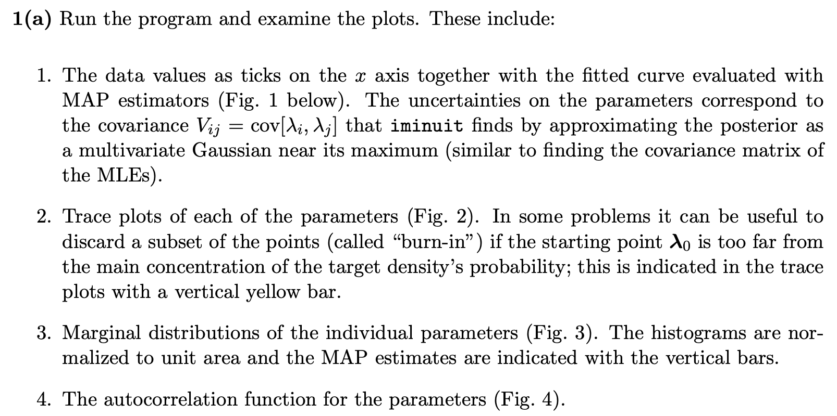
Exercises on Bayesian parameter estimation (a)
1a) Run bayesFit.py, look at the plots

Slide 48
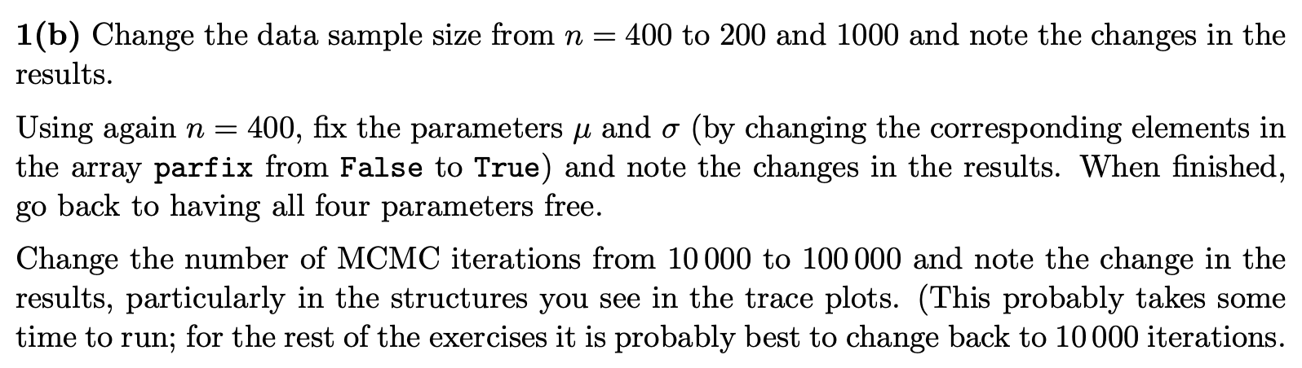
Exercises on Bayesian parameter estimation (b,c)
1b) Investigate effect of data sample size, fixing parameters and length of MCMC chains.
1c) Investigate changing the prior

Slide 49
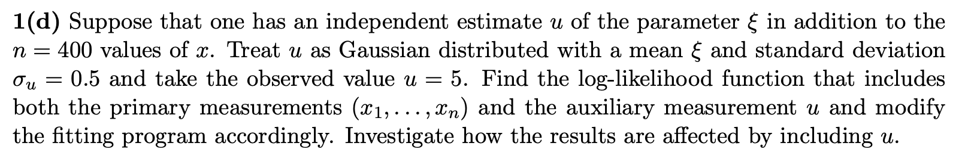
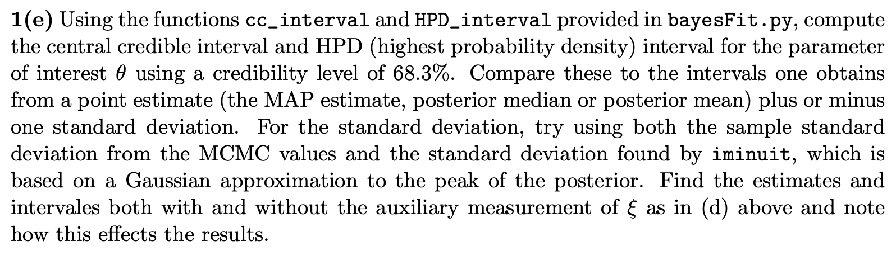
Exercises on Bayesian parameter estimation (d)
1d) Include auxiliary measurement to constrain ξ
1e) Investigate point and interval estimates for θ

Slide 50
MCMC trace plots
Take θ as parameter of interest, rest are nuisance parameters.
Marginalize by sampling posterior pdf with Metropolis-Hastings.
Gaussian proposal pdf, covariance U = sV,
s = (2.38)²/N_{par} = 1.41, gives acceptance
probability ~ 0.24.
See, e.g., http://probability.ca/jeff/ftpdir/galinart.pdf
Here 10 000 iterations (should use more).

Slide 51

Marginal distributions
MAP estimates shown with vertical bars
Note long tails.
Interpretation: data distribution can be approximated by Gaussian term only, (θ large, μ small) with large width (σ ~ 4-8) and a narrow exponential (ξ ~ 1-3).

Slide 52
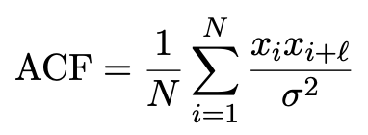
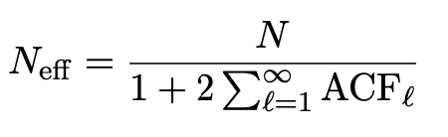
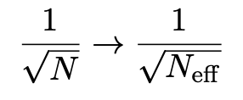
Autocorrelation versus lag
MCMC samples are not independent, autocorrelation function = correlation coefficient of sample x_{i} with x_{i+l} as a function of the lag, l, where x = any of θ, μ, σ, ξ minus its mean:
Effective sample size
In stat. error estimates
See, e.g., https://mc-stan.org/docs/reference-manual/effective-sample-size.html

Slide 53
MCMC trace plots
Increase number of iterations to 100 000.
Regions of parameter space now sampled multiple times.

Slide 54
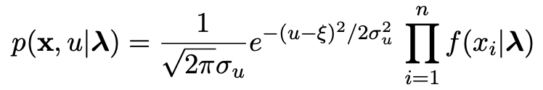
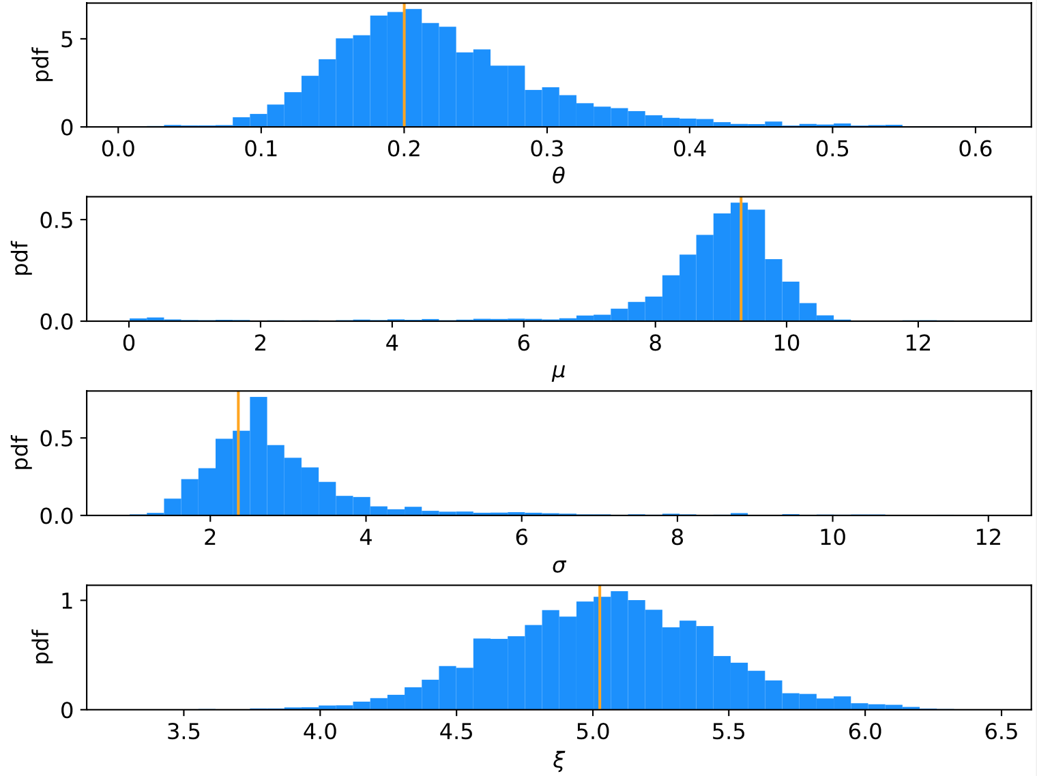
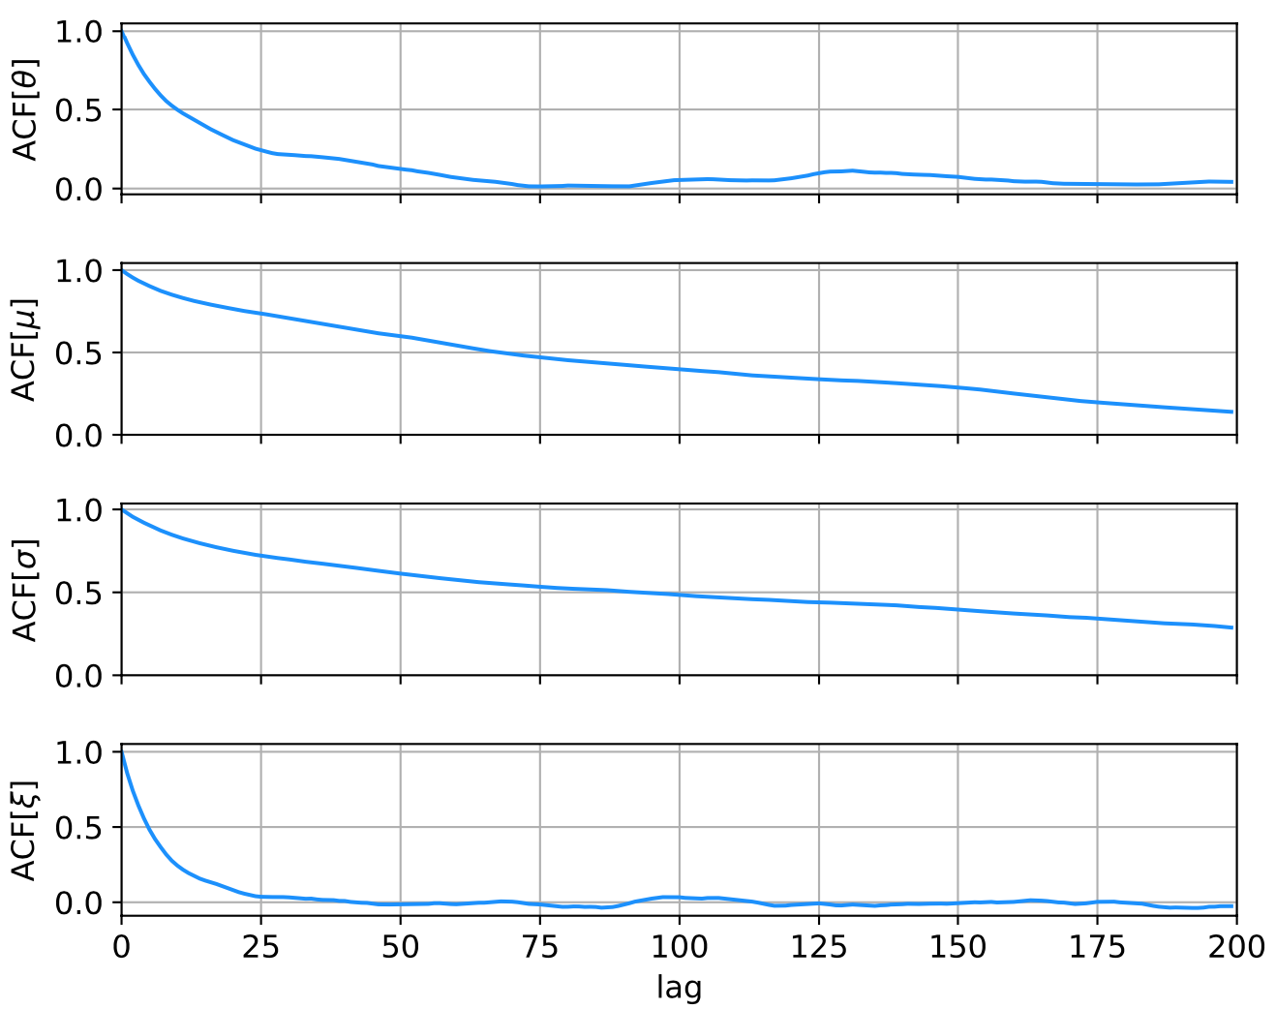
Auxiliary measurement for ξ
Suppose we have an auxiliary measurement u ~ Gauss(ξ, σ_{u}) with σ_{u} = 0.5 and we observe u = 5.
Build into likelihood:
Marginals closer to Gaussian, ACF falls more quickly to ~zero.

Slide 55
Ways to summarize the posterior
Point estimates:
Posterior mode (MAP, coincides with MLE for constant prior).
Posterior median (invariant under monotonic transformation of parameter).
Posterior mean; coincides with above in large-sample limit.
Intervals:
Highest Probability Density (HPD) interval, shortest for a given probability content, not invariant under param. trans.
Central credible intervals, equal upper and lower tail areas, e.g., α/2 for CL = 1 – α.
Point estimate +/- standard deviation, std. dev. from MCMC sample or by approximating core of posterior as Gaussian (from minuit); coincides with above in large-sample limit.

Slide 56
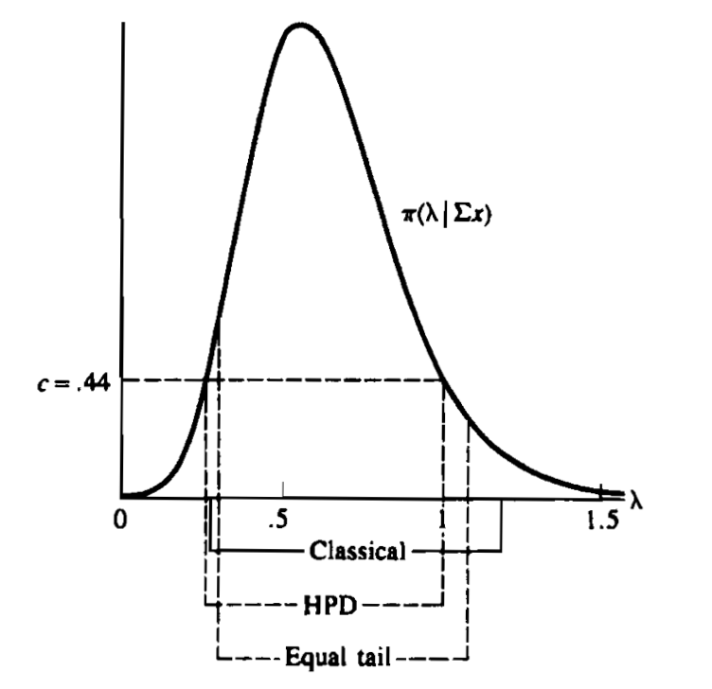
Types of intervals
HPD = Highest Posterior Density
Equal tail (central) from posterior
Classical (frequentist)
G. Casella and R. Berger, Statistical Inference, 2002

Slide 57
Correlation plots and marginal distributions
Estimates/intervals for theta:
MCMC acceptance fraction = 0.3737
Posterior mode (MAP estimate) = 0.197936
Posterior mean = 0.351234
Posterior median = 0.250764
MAP +/- sigmaMAP (from minuit) = [0.140056, 0.255816]
Posterior mean +/- sigmaMCMC = [0.118503, 0.583964]
68.3% central credible interval = [0.158557, 0.685847]
68.3% HPD interval = [0.093997, 0.392642]

Slide 58
Correlation plots and marginal distributions using auxiliary measurement for ξ
Estimates/intervals for theta:
MCMC acceptance fraction = 0.3516
Posterior mode (MAP estimate) = 0.200077
Posterior mean = 0.224898
Posterior median = 0.212835
MAP +/- sigmaMAP (from minuit) = [0.149282, 0.250873]
Posterior mean +/- sigmaMCMC = [0.148481, 0.301314]
68.3% central credible interval = [0.156736, 0.291246]
68.3% HPD interval = [0.137607, 0.267077]

