Slide 1


Statistical Data Analysis 2025/26
Lecture Week 3
London Postgraduate Lectures on Particle Physics
University of London MSc/MSci course PH4515
Glen Cowan
Physics Department
Royal Holloway, University of London
g.cowan@rhul.ac.uk
www.pp.rhul.ac.uk/~cowan
Course web page via RHUL moodle (PH4515) and also
www.pp.rhul.ac.uk/~cowan/stat_course.html

Slide 2
Some distributions
Distribution/pdf Example use in Particle Physics
Binomial Branching ratio
Multinomial Histogram with fixed N
Poisson Number of events found
Uniform Monte Carlo method
Exponential Decay time
Gaussian Measurement error
Chi-square Goodness-of-fit
Cauchy Mass of resonance
Landau Ionization energy loss
Beta Prior pdf for efficiency
Gamma Sum of exponential variables
Student’s t Resolution function with adjustable tails

Slide 3
Statistical Data Analysis
Lecture 3-1
Continuous probability density functions
  Uniform
  Exponential

Slide 4
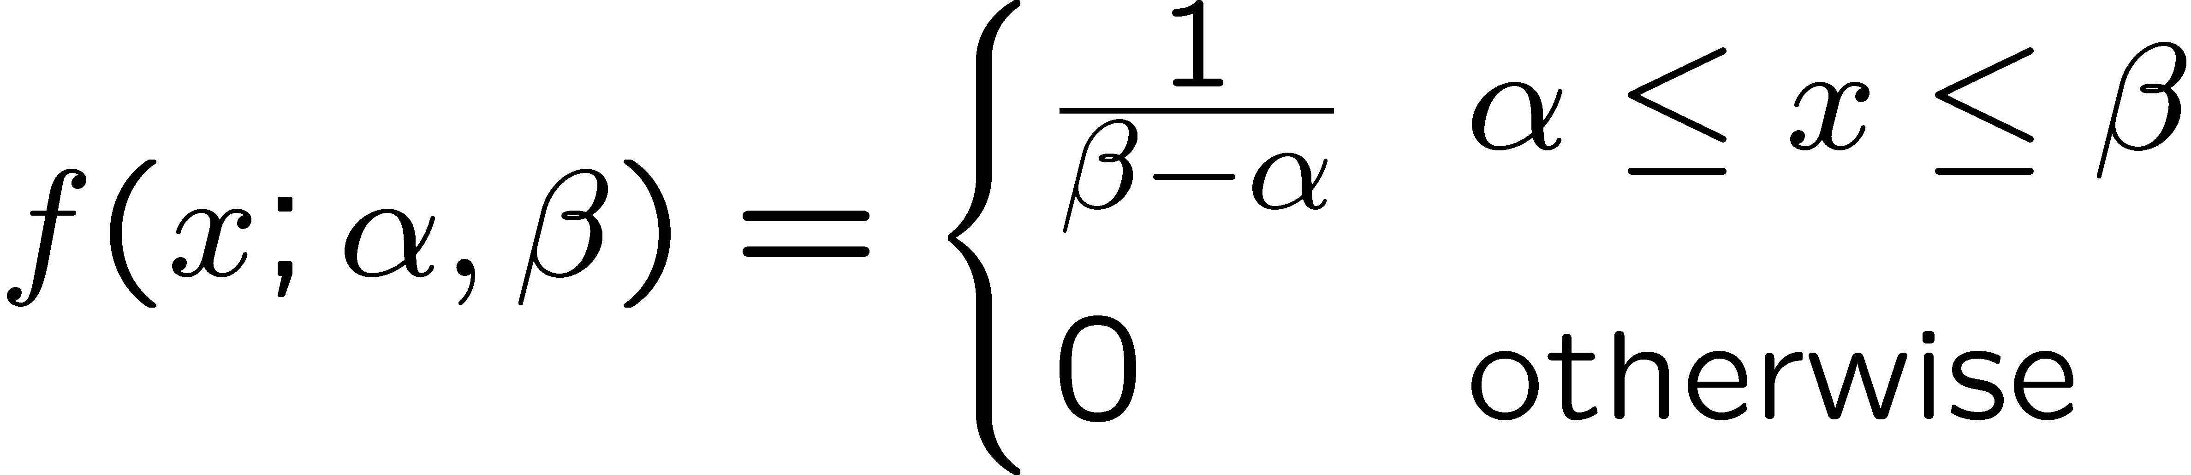
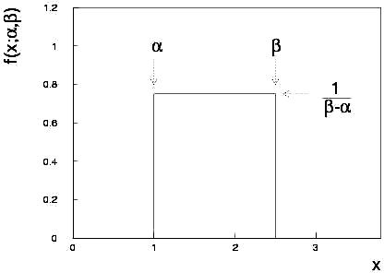
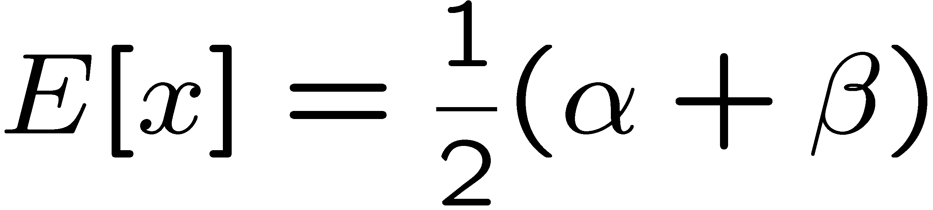
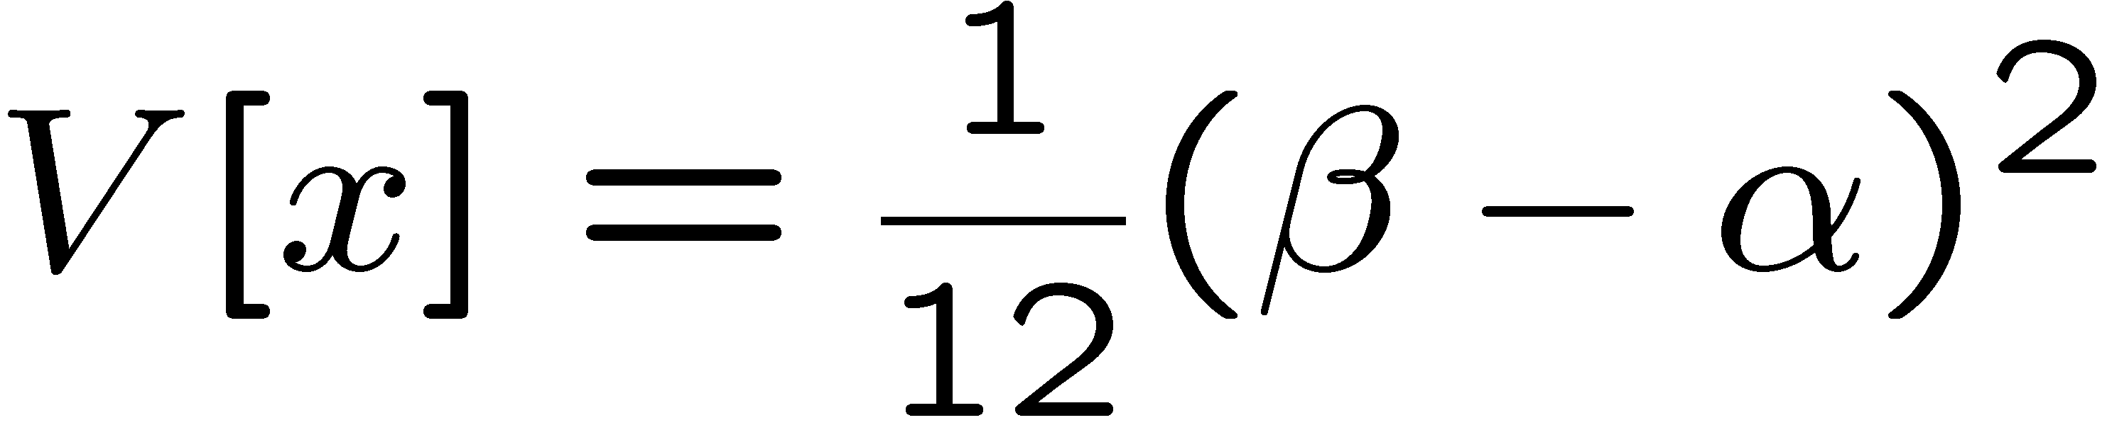
Uniform distribution
Consider a continuous r.v. x with −∞ < x < ∞ . Uniform pdf is:
Notation: x follows a uniform distribution between α and β
write as: x ~ U[α,β]

Slide 5
Uniform distribution (2)
Very often used with α = 0, β = 1 (e.g., Monte Carlo method).
For any r.v. x with pdf f (x), cumulative distribution F(x), the function y = F(x) is uniform in [0,1]:
because f (x) = dF/dx = dy/dx

Slide 6
Uniform distribution: particle detector example
Vertical (y) position of particle’s trajectory uniformly distributed over perpendicular plane of sense wires.
sense wires,
spacing d
y_{i} + d/2
y
y_{i}
incident particle
y_{i} – d/2
z
Sense wire closest to passage of particle gives signal.
If i-th wire gives signal,
estimated y position is y_{i},
actual y position ~ U[y_{i} – d/2, y_{i} + d/2],
V[y] = (y_{i} + d/2 – (y_{i} – d/2))² / 12 = d² / 12,
position resolution = σ_{y} = d/√12

Slide 7




Uniform distribution: particle decay example

Slide 8
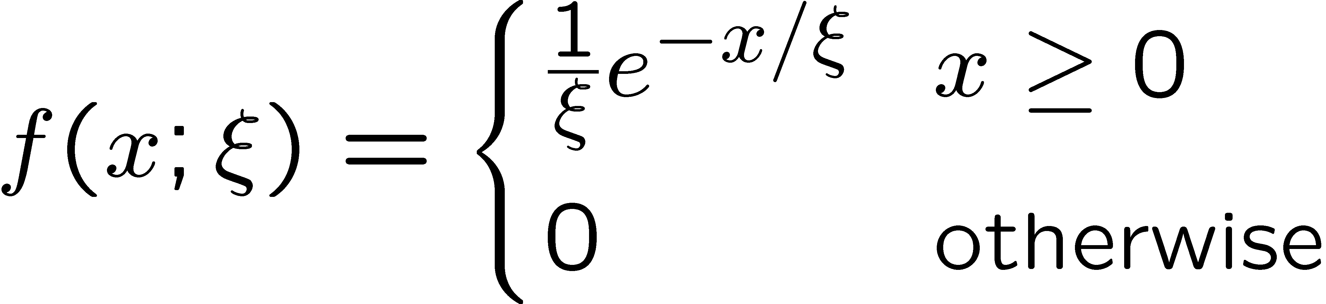
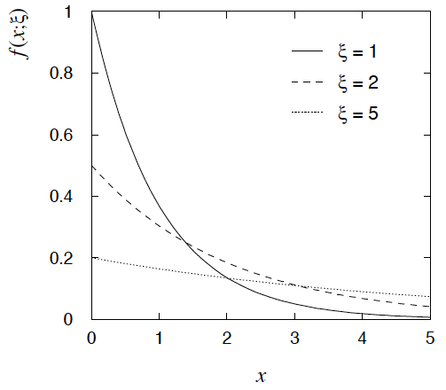

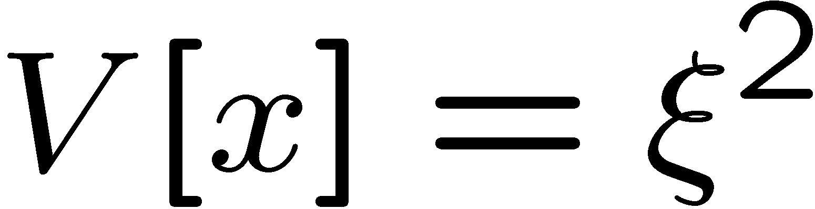
Exponential distribution
The exponential pdf for the continuous r.v. x is defined by:

Slide 9
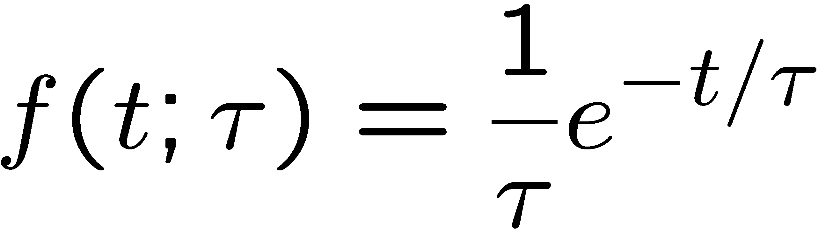
Exponential distribution (2)
Example: proper decay time t of an unstable particle
(τ = mean lifetime)
Lack of memory (unique to exponential):
Question for discussion:
A cosmic ray muon is created 30 km high in the atmosphere, travels to sea level and is stopped in a block of scintillator, giving a start signal at t₀. At a time t it decays to an electron giving a stop signal. What is distribution of the difference between stop and start times, i.e., the pdf of t – t₀ given t > t₀?

Slide 10
Statistical Data Analysis
Lecture 3-2
The Gaussian (normal) distribution
  Univariate Gaussian
  Standardized random variables
  Location and scale parameters
  Central Limit Theorem
  Multivariate Gaussian

Slide 11
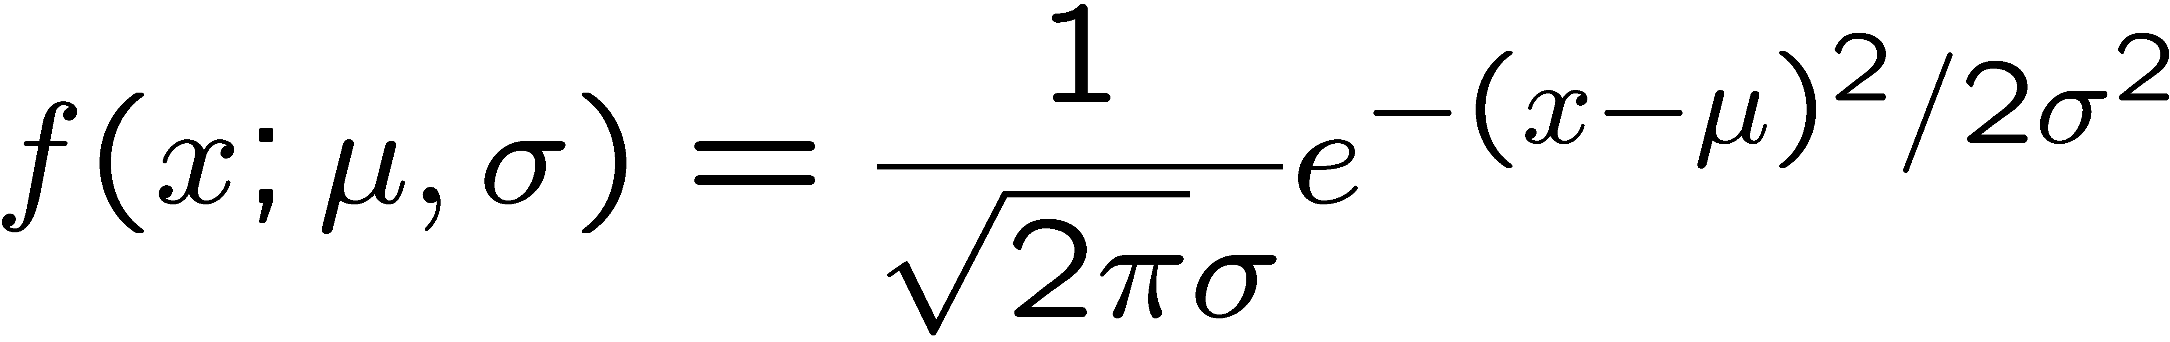
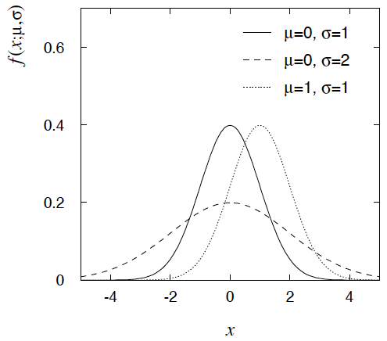

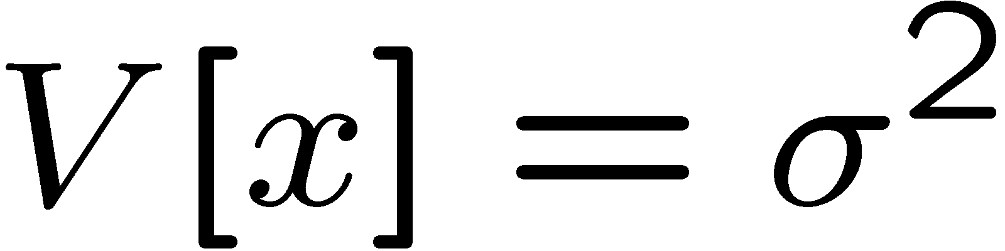
Gaussian (normal) distribution
The Gaussian (normal) pdf for a continuous r.v. x is defined by:
N.B. often μ, σ² denote
mean, variance of any
r.v., not only Gaussian.

Slide 12
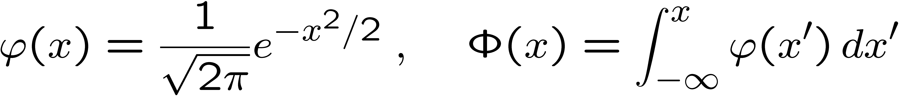
Standardized random variables
If a random variable y has pdf f (y) with mean μ and std. dev. σ,
then the standardized variable
has the pdf
has mean of zero and standard deviation of 1.
Often work with the standard Gaussian distribution (μ = 0. σ = 1)
using notation:
Then e.g. y = μ + σ x follows

Slide 13
Digression: location/scale parameters
If a pdf f (x; a) depending on a parameter a can be written as
then a is called a location parameter. Adjusting a shifts the pdf
to the right/left without changing its shape.
The parameter μ of the Gaussian is an example of a location parameter.

Slide 14
Digression: location/scale parameters (2)
If a pdf f (x; b) depending on a parameter b can be written as
then b is called a scale parameter. Adjusting b changes the ”units”
of the random variable.
The parameter ξ of the exponential
is an example of a scale parameter.
Or if a pdf f (x; a, b) has a location parameter a and can be written
then a and b are said to be location and scale parameters.
Example: μ and σ of Gaussian.

Slide 15
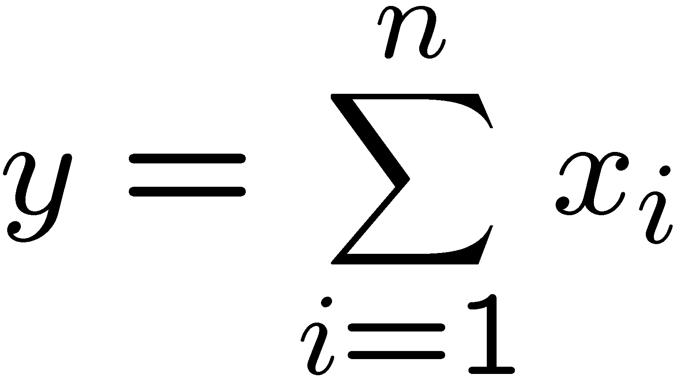
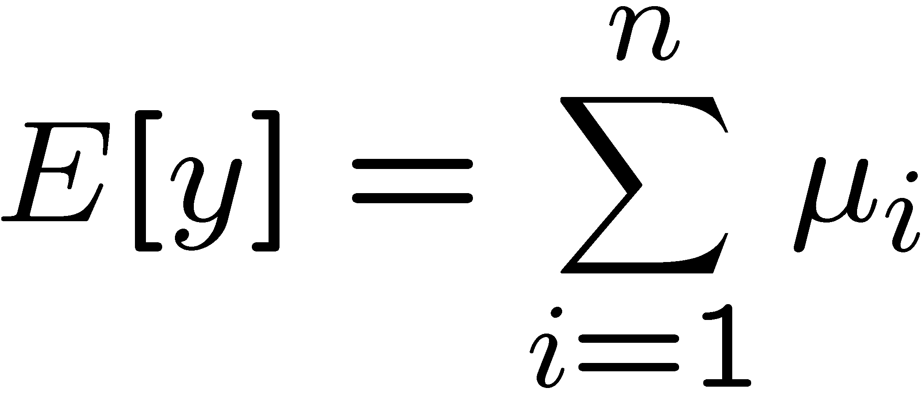
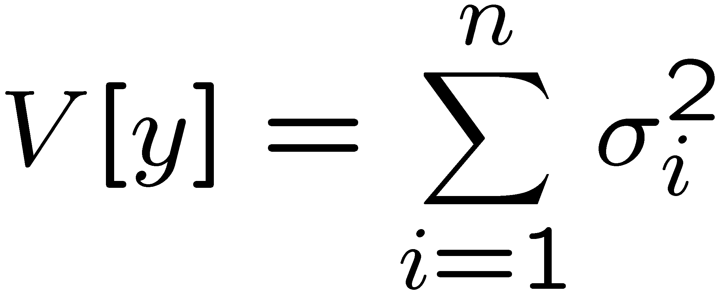
Gaussian pdf and the Central Limit Theorem
The Gaussian pdf is so useful because almost any random
variable that is a sum of a large number of small contributions
follows it. This follows from the Central Limit Theorem:
For n independent r.v.s x_{i} with finite variances σ_{i}², mean values
μ_{i}, otherwise arbitrary pdfs, consider the sum
In the limit n → ∞, y is a Gaussian r.v. with
Measurement errors are often the sum of many contributions, so frequently measured values can be treated as Gaussian r.v.s.

Slide 16
Central Limit Theorem (2)
Versions of CLT differ in criteria for convergence and requirement (or not) of same pdf for all x_{i}.
See e.g. en.wikipedia.org/wiki/Central_limit_theorem
Classical CLT: all x_{i} independent and have same pdf with finite variance, can be proved using characteristic functions (Fourier transforms), see, e.g., SDA Chapter 10.
Physicist’s CLT: for finite n, the sum Σ_{i=1}^{n} x_{i} becomes approximately Gaussian to the extent that the fluctuation of the sum is not dominated by one (or few) terms.
Far enough in the tails the approximation generally breaks down.

Slide 17

Central Limit Theorem (3)
Good example: velocity component of air molecule v_{x} = Σ_{i} δv_{xi}
If v_{x}, v_{y}, v_{z} ~ Gaussian, then
v = (v_{x}² + v_{y}² + v_{z}²)^{1/2} ~ Maxwell-Boltzmann
OK example: total deflection of charged particle from multiple
Coulomb scattering. (Rare large-angle scatters → non-Gaussian tail.)
Bad example: energy loss of charged particle traversing thin
gas layer. Rare collisions make up large fraction of energy loss,
cf. Landau pdf.

Slide 18
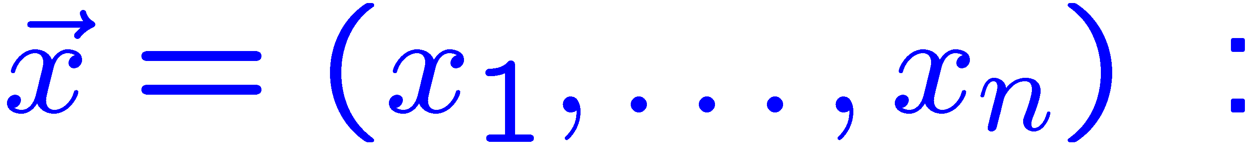

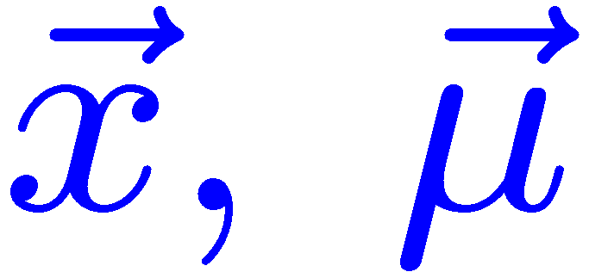
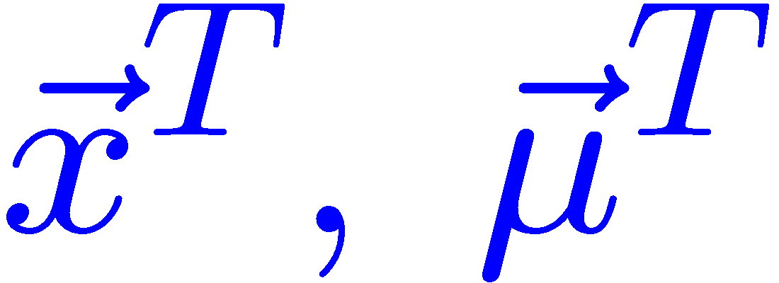
Multivariate Gaussian distribution
Multivariate Gaussian pdf for the vector
are column vectors,
are transpose (row) vectors,
Marginal pdf of each x_{i} is Gaussian with mean μ_{i}, standard deviation σ_{i} = √V_{ii} .

Slide 19
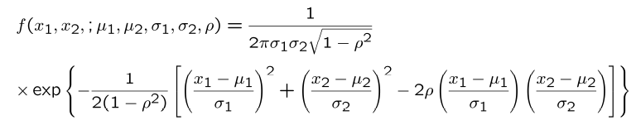
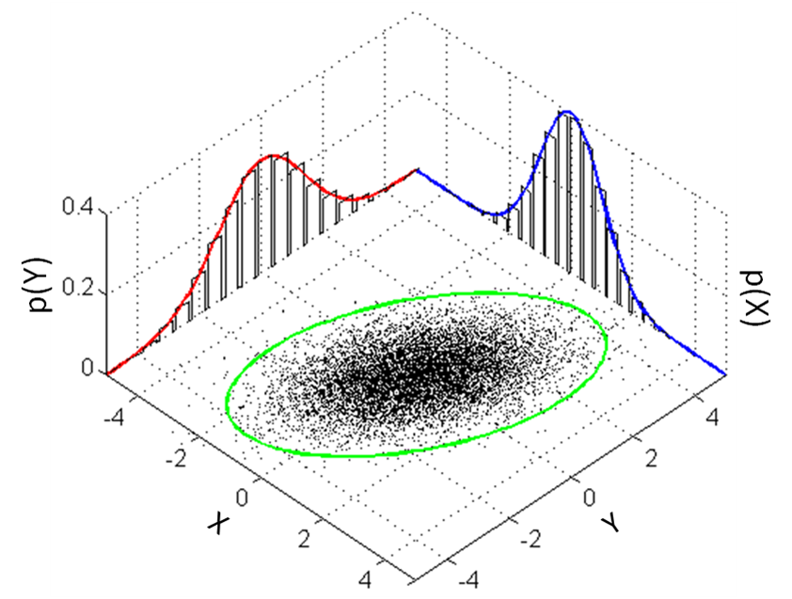
https://en.wikipedia.org/wiki/Multivariate_normal_distribution
Two-dimensional Gaussian distribution
where ρ = cov[x₁, x₂]/(σ₁σ₂)
is the correlation coefficient.

Slide 20
Statistical Data Analysis
Lecture 3-3
More continuous probability density functions
  Chi-square
  Cauchy
  Landau
  Beta
  Gamma
  Student’s t

Slide 21
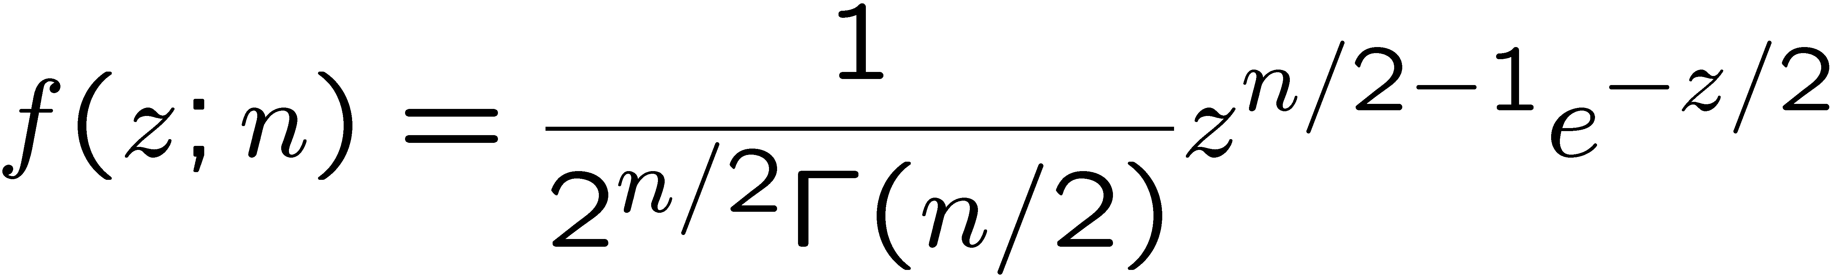
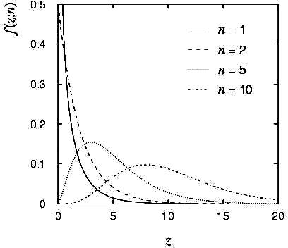
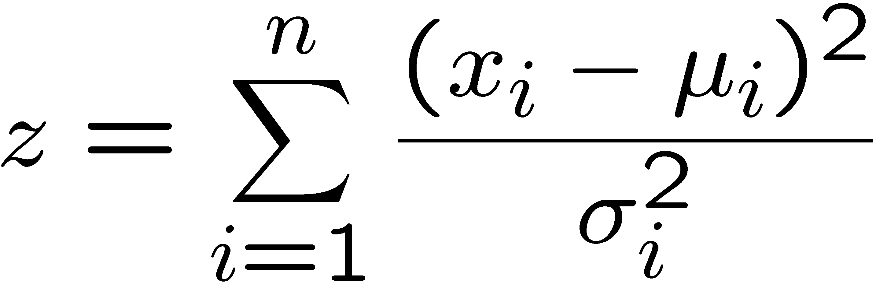
Chi-square (χ²) distribution
The chi-square pdf for the continuous r.v. z (z ≥ 0) is defined by
n = 1, 2, ... = number of ‘degrees of
freedom’ (dof)
For independent Gaussian x_{i}, i = 1, ..., n, means μ_{i}, variances σ_{i}²,
follows χ² pdf with n dof.
Example: goodness-of-fit test variable especially in conjunction
with method of least squares.

Slide 22
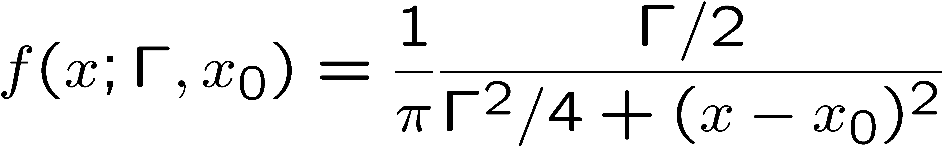
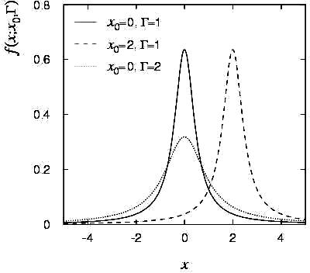
Cauchy (Breit-Wigner) distribution
The Breit-Wigner pdf for the continuous r.v. x is defined by
(Γ = 2, x₀ = 0 is the Cauchy pdf.)
E[x] not well defined, V[x] → ∞.
x₀ = mode (most probable value)
Γ = full width at half maximum
Example: mass of resonance particle, e.g. ρ, K*, φ⁰, ...
Γ = decay rate (inverse of mean lifetime)

Slide 23
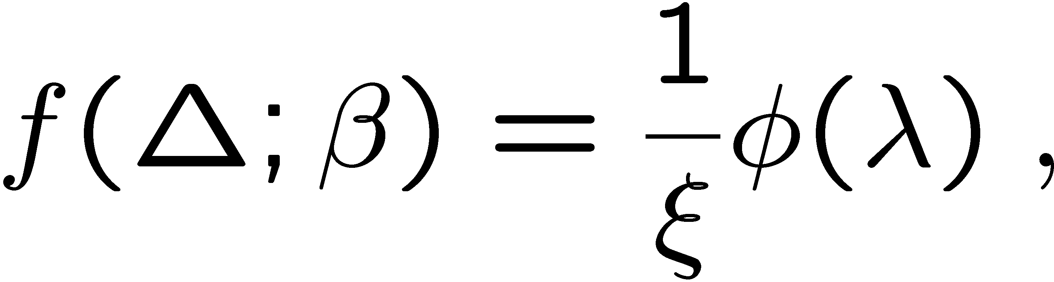
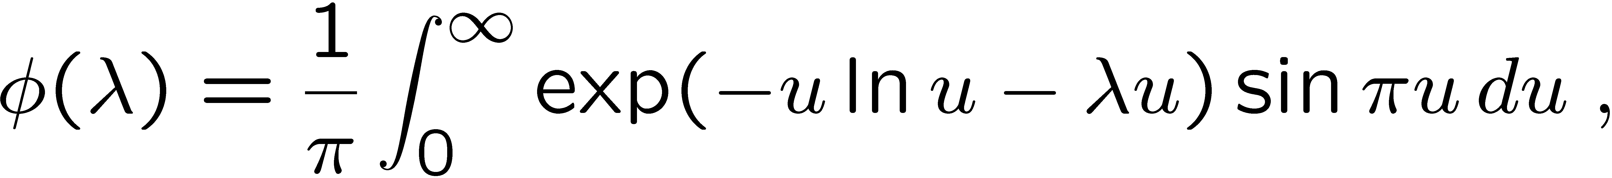
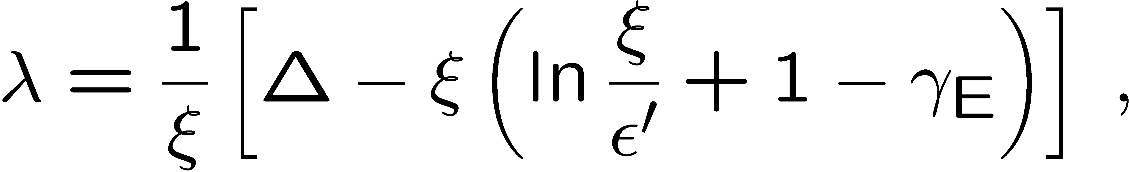
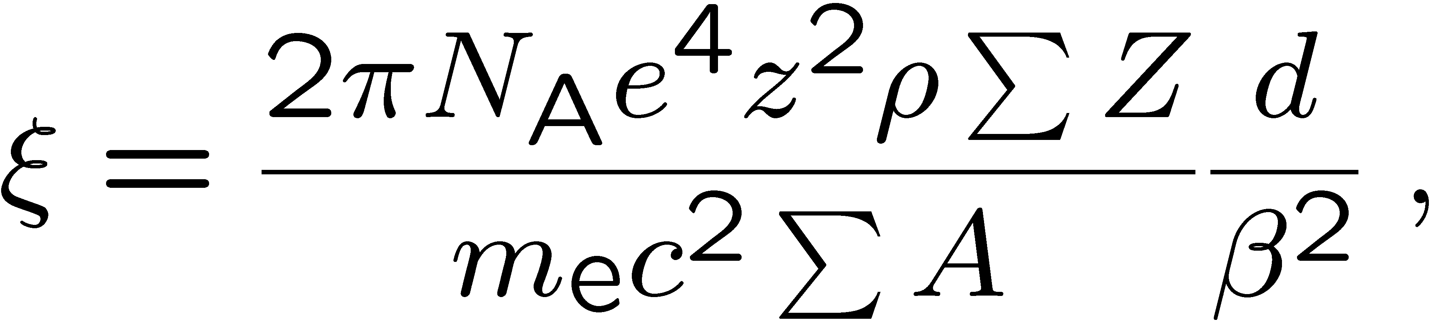
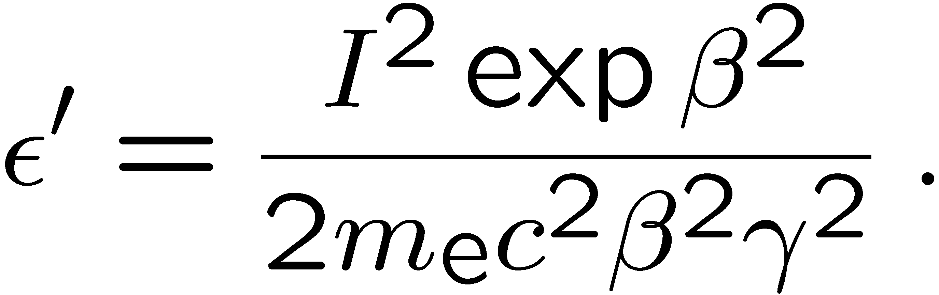
Landau distribution
For a charged particle with β = ν /c traversing a layer of matter
of thickness d, the energy loss Δ follows the Landau pdf:
Δ
β
+ - + -
- + - +
d
L. Landau, J. Phys. USSR 8 (1944) 201; see also
W. Allison and J. Cobb, Ann. Rev. Nucl. Part. Sci. 30 (1980) 253.

Slide 24
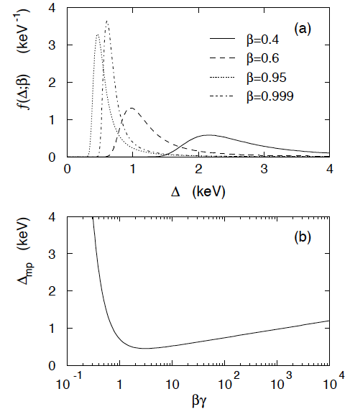
Landau distribution (2)
Long ‘Landau tail’
→ all moments ∞
Mode (most probable
value) sensitive to β ,
→ particle i.d.

Slide 25
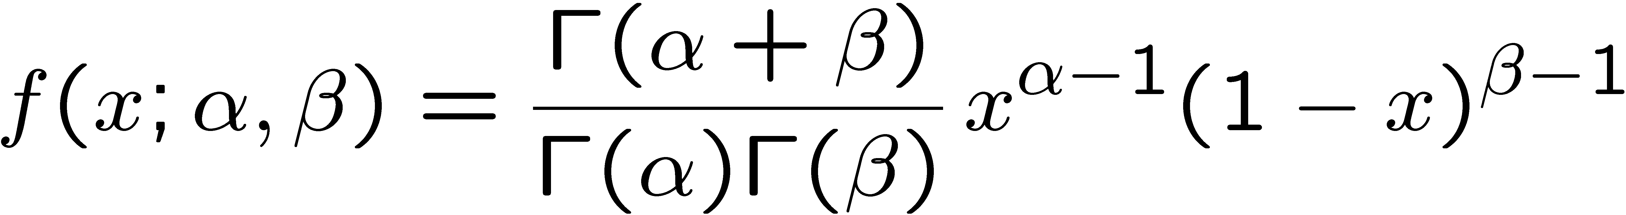
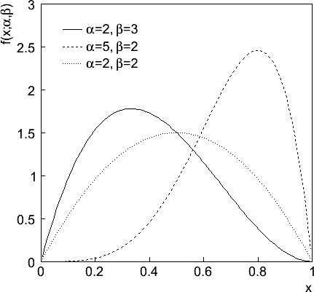
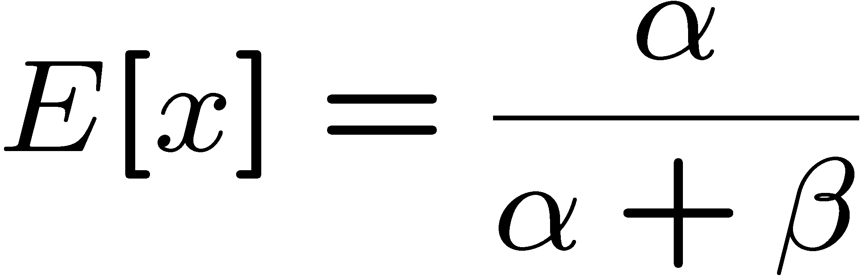
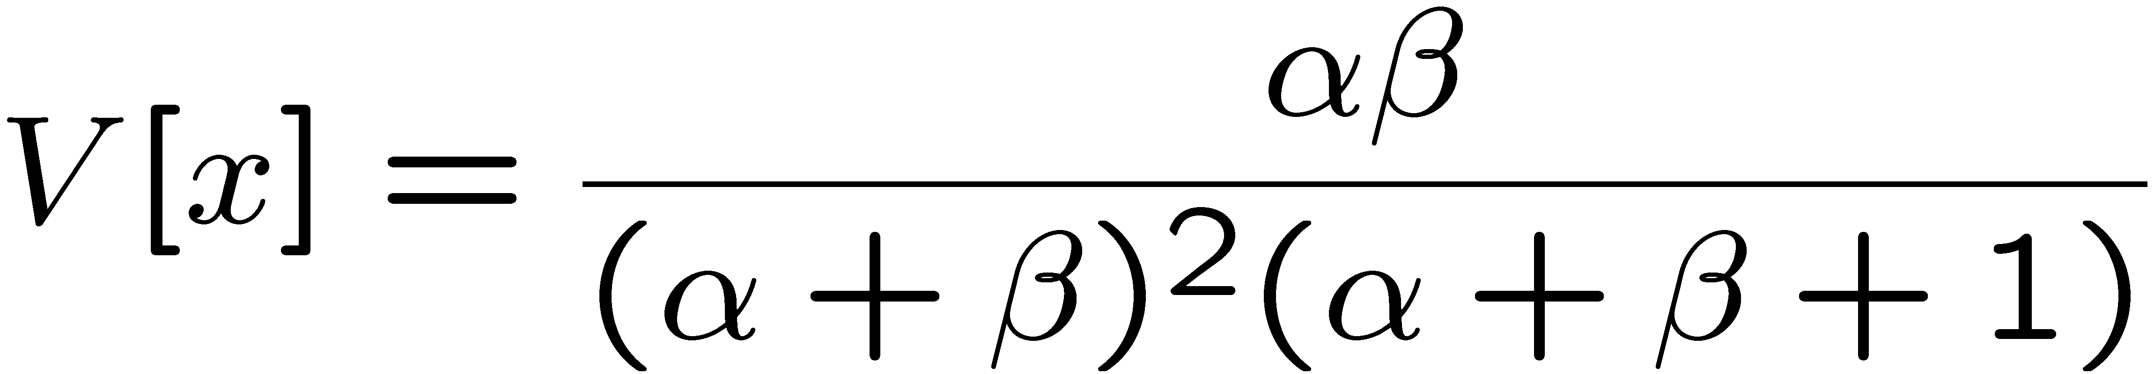
Beta distribution
, 0 ≤ x ≤ 1
Often used to represent pdf
of continuous r.v. nonzero only
between finite limits, e.g.,
y = a₀ + a₁x, a₀ ≤ y ≤ a₀ + a₁

Slide 26
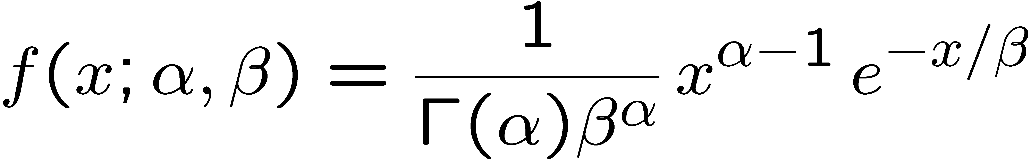

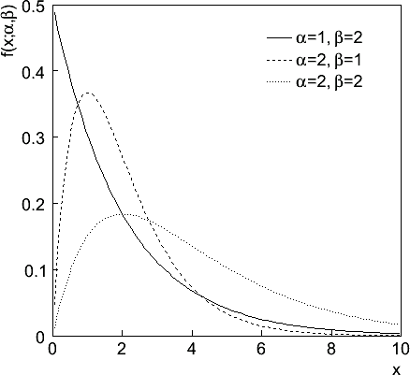
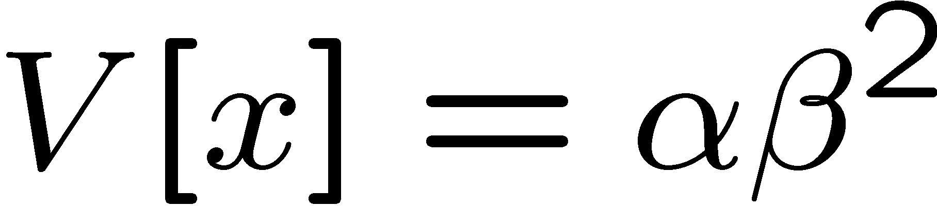
Gamma distribution
, x ≥ 0
Often used to represent pdf
of continuous r.v. nonzero only
in [0,∞].
Also e.g. sum of n exponential
r.v.s or time until nth event
in Poisson process ~ Gamma

Slide 27
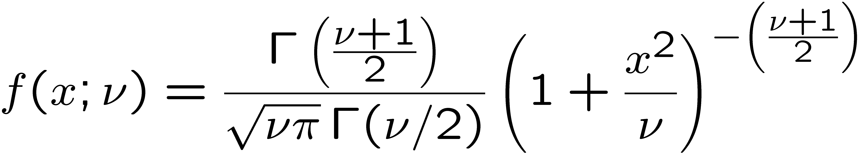
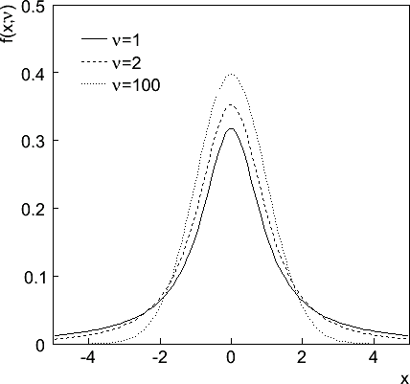

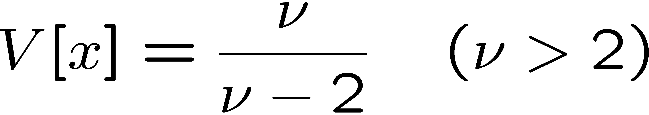
Student's t distribution
ν = number of degrees of freedom
(not necessarily integer)
ν = 1 gives Cauchy,
ν → ∞ gives Gaussian.

Slide 28
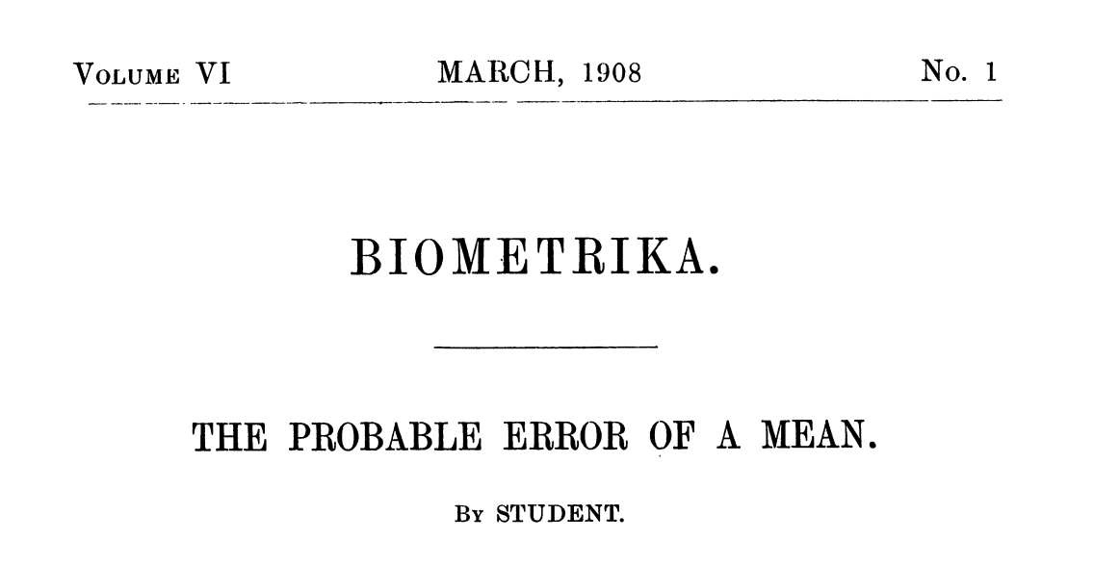
Student's t distribution (2)
If x ~ Gaussian with μ = 0, σ² = 1, and
z ~ χ² with n degrees of freedom, then
t = x / (z/n)^{1/2} follows Student's t with ν = n.
This arises in problems where one forms the ratio of a sample
mean to the sample standard deviation of Gaussian r.v.s.
The Student's t provides a bell-shaped pdf with adjustable
tails, ranging from those of a Gaussian, which fall off very
quickly, (ν → ∞, but in fact already very Gauss-like for
ν = two dozen), to the very long-tailed Cauchy (ν = 1).
Developed in 1908 by William
Gosset, who worked for the
Guinness Brewery and published
under the pseudonym “Student”.
Notes:
here

Slide 29
Statistical Data Analysis
Lecture 3-4
The Monte Carlo method
  basic ingredients
  random number generators
  transformation method
  acceptance-rejection method
  example uses

Slide 30
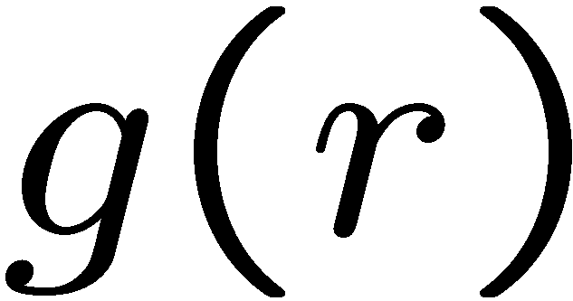



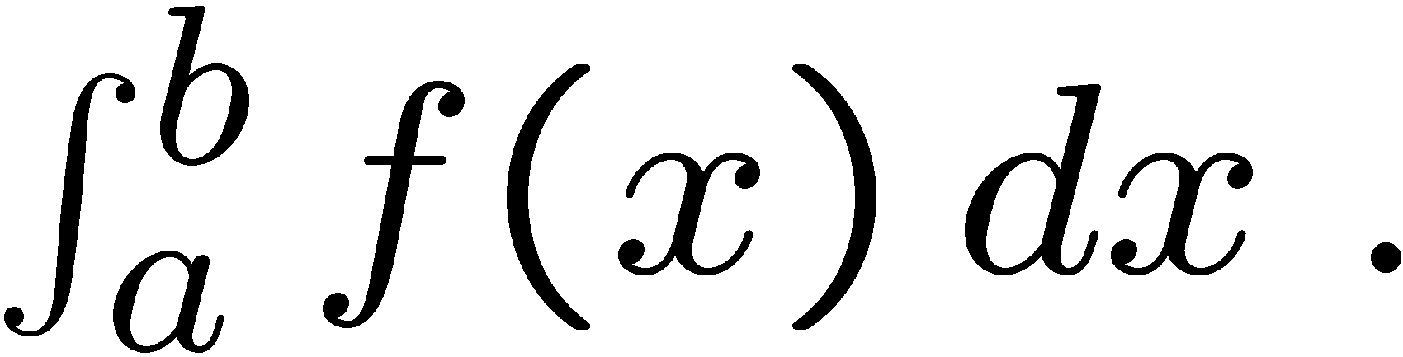
The Monte Carlo method
What it is: a numerical technique for calculating probabilities
and related quantities using sequences of random numbers.
The usual steps:
Generate sequence r₁, r₂, ..., r_{m} independent and uniform on [0, 1].
(2) Use this to produce another sequence x₁, x₂, ..., x_{n}
independent and distributed according to some pdf f (x) in which we’re interested (x can be a vector).
(3) Use the x values to estimate some property of f (x), e.g.,
fraction of x values with a < x < b gives
→ MC calculation = integration (at least formally)
MC generated values = ‘simulated data’
→ use for testing statistical procedures

Slide 31
Random number generators
Goal: generate uniformly distributed values in [0, 1].
Toss coin for e.g. 32 bit number... (too tiring).
→ ‘random number generator’
= computer algorithm to generate r₁, r₂, ..., r_{n}.
Example: multiplicative linear congruential generator (MLCG)
n_{i+1} = (a n_{i}) mod m , where
n_{i} = integer
a = multiplier
m = modulus
n₀ = seed (initial value)
N.B. mod = modulus (remainder), e.g. 27 mod 5 = 2.
This rule produces a sequence of numbers n₀, n₁, ...

Slide 32
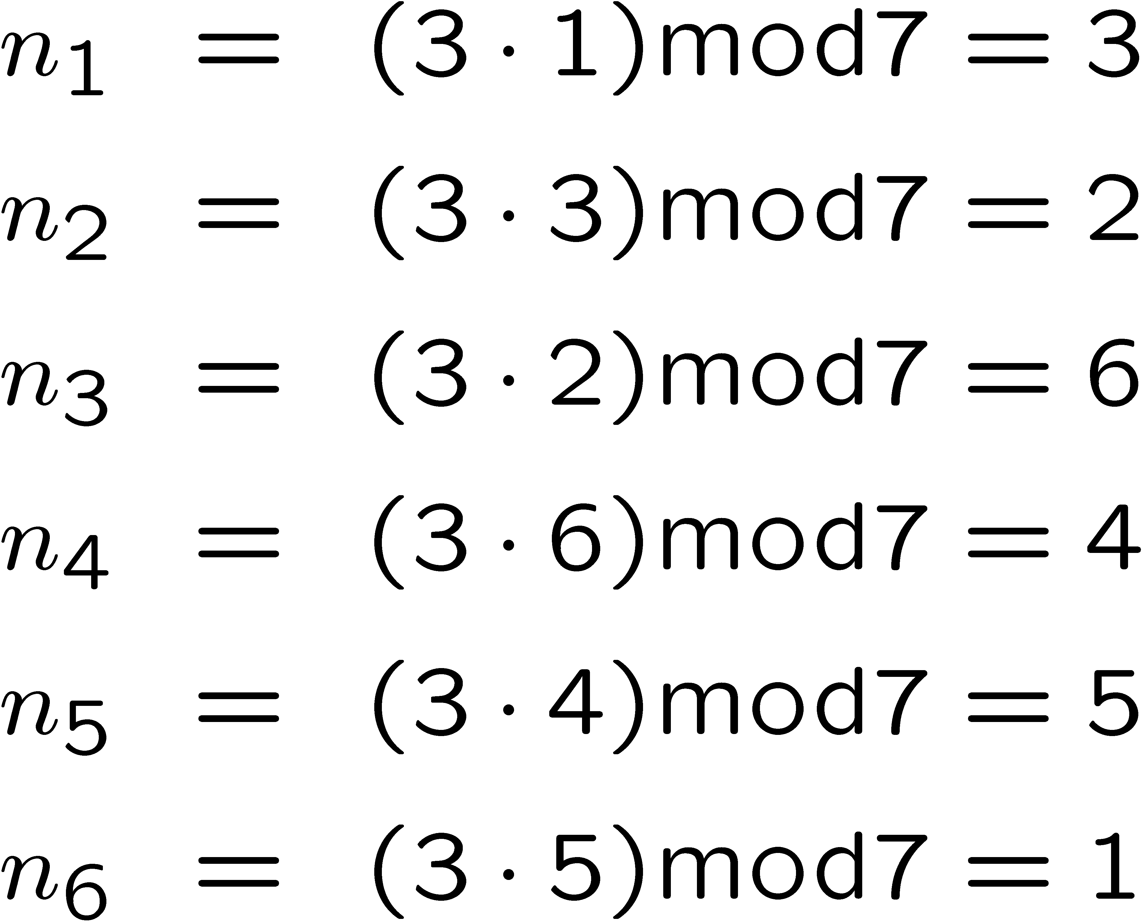
Random number generators (2)
The sequence is (unfortunately) periodic!
Example (see Brandt Ch 4): a = 3, m = 7, n₀ = 1
← sequence repeats
Choose a, m to obtain long period (maximum = m − 1); m usually
close to the largest integer that can represented in the computer.
Only use a subset of a single period of the sequence.

Slide 33
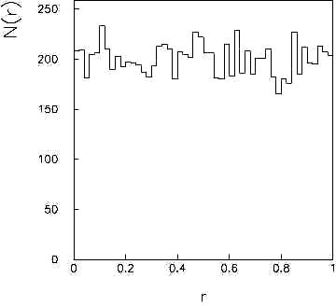
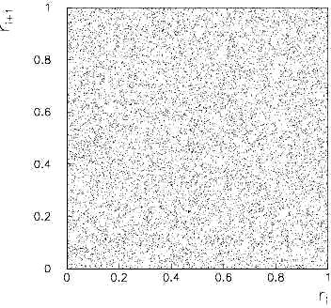
Random number generators (3)
r_{i} = n_{i} / n_{max} are in [0, 1] but are they independent and uniform?
Choose a, m so that the r_{i} pass various tests of randomness:
uniform distribution in [0, 1],
all values independent (no correlations between pairs),
e.g. L’Ecuyer, Commun. ACM 31 (1988) 742 suggests
a = 40692
m = 2147483399
N(r)
r_{i+1}
r
r_{i}
Far better generators available, e.g. TRandom3, based on Mersenne
twister algorithm, period = 2¹⁹⁹³⁷ − 1 (a “Mersenne prime”).
See F. James, Comp. Phys. Comm. 60 (1990) 111; Brandt Ch. 4.

Slide 34
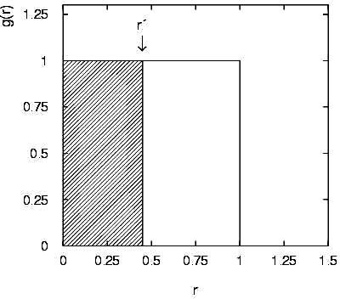
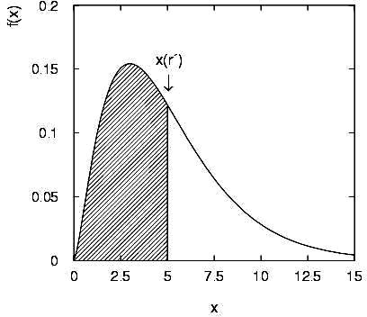
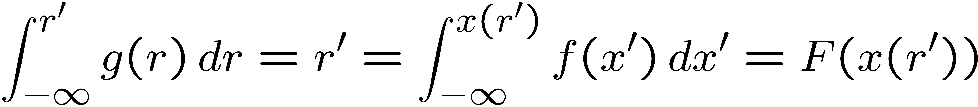

The transformation method
Given r₁, r₂,..., r_{n} uniform in [0, 1], find x₁, x₂,..., x_{n}
that follow f (x) by finding a suitable transformation x (r).
Require:
i.e.
That is, set
and solve for x(r).

Slide 35





Example of the transformation method
Exponential pdf:
Set
and solve for x (r).
→
works too.)

Slide 36


The acceptance-rejection method
Enclose the pdf in a box:
(1) Generate a random number x, uniform in [x_{min}, x_{max}], i.e.
r₁ is uniform in [0,1].
(2) Generate a 2nd independent random number u uniformly
distributed between 0 and f_{max}, i.e.
(3) If u < f (x), then accept x. If not, reject x and repeat.

Slide 37



Example with acceptance-rejection method
If dot below curve, use
x value in histogram.

Slide 38

Improving efficiency of the acceptance-rejection method
The fraction of accepted points is equal to
the fraction of the box’s area under the curve.
For very peaked distributions, this may be very low and
thus the algorithm may be slow.
Improve by enclosing the pdf f(x) in a curve C h(x) that conforms
to f(x) more closely, where h(x) is a pdf from which we can
generate random values and C is a constant.
Generate points uniformly
over C h(x).
If point is below f(x),
accept x.

Slide 39


Monte Carlo event generators
Simple example: e⁺e⁻ → μ⁺μ⁻
Generate cosθ and φ:
Less simple: ‘event generators’ for a variety of reactions:
e⁺e⁻ → μ⁺ μ⁻, hadrons, ...
pp → hadrons, D-Y, SUSY,...
e.g. PYTHIA, HERWIG, ISAJET...
Output = ‘events’, i.e., for each event we get a list of
generated particles and their momentum vectors, types, etc.

Slide 40


A simulated event
PYTHIA Monte Carlo
pp → gluino-gluino

Slide 41
Monte Carlo detector simulation
Takes as input the particle list and momenta from generator.
Simulates detector response:
multiple Coulomb scattering (generate scattering angle),
particle decays (generate lifetime),
ionization energy loss (generate Δ),
electromagnetic, hadronic showers,
production of signals, electronics response, ...
Output = simulated raw data → input to reconstruction software:
track finding, fitting, etc.
Predict what you should see at ‘detector level’ given a certain
hypothesis for ‘generator level’. Compare with the real data.
Programming package: GEANT

Slide 42
Extra slides

Slide 43

Importance Sampling

Slide 44

Importance Sampling (2)

Slide 45


Importance Sampling (3)

