Slide 1


Statistical Data Analysis 2024/25
Lecture Week 5
London Postgraduate Lectures on Particle Physics
University of London MSc/MSci course PH4515
Glen Cowan
Physics Department
Royal Holloway, University of London
g.cowan@rhul.ac.uk
www.pp.rhul.ac.uk/~cowan
Course web page via RHUL moodle (PH4515) and also
www.pp.rhul.ac.uk/~cowan/stat_course.html

Slide 2
Statistical Data Analysis
Lecture 5-1
Beyond linear classifiers
Neural networks

Slide 3
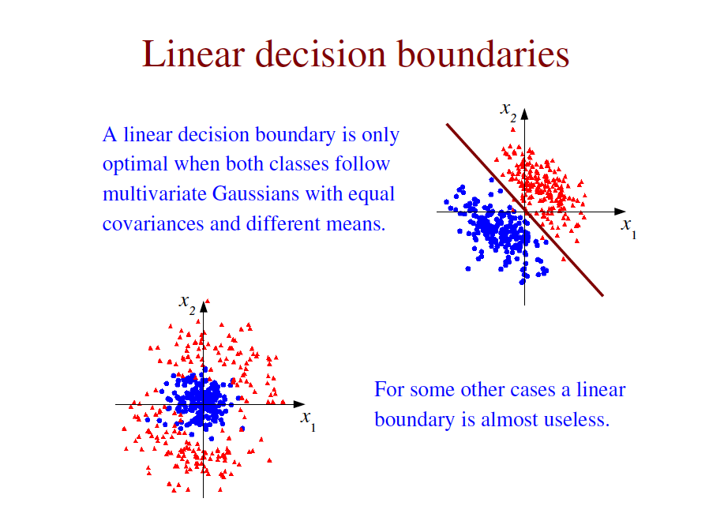

Slide 4
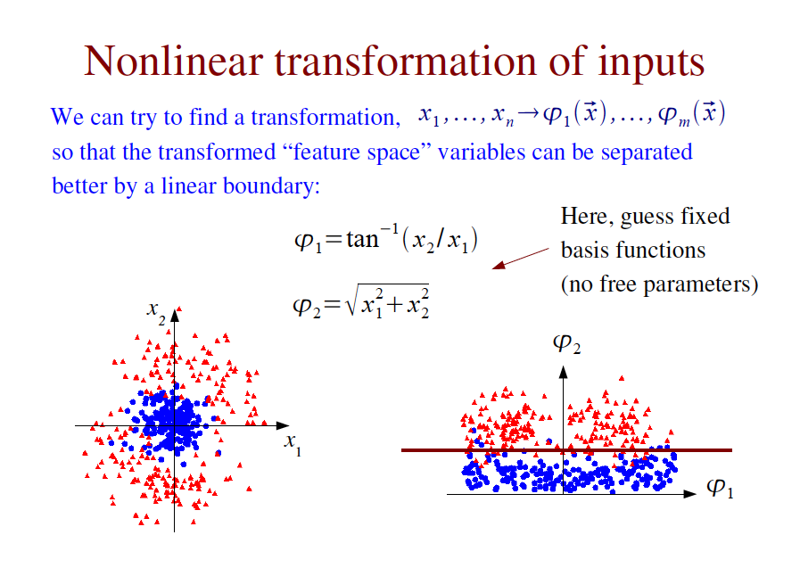

Slide 5
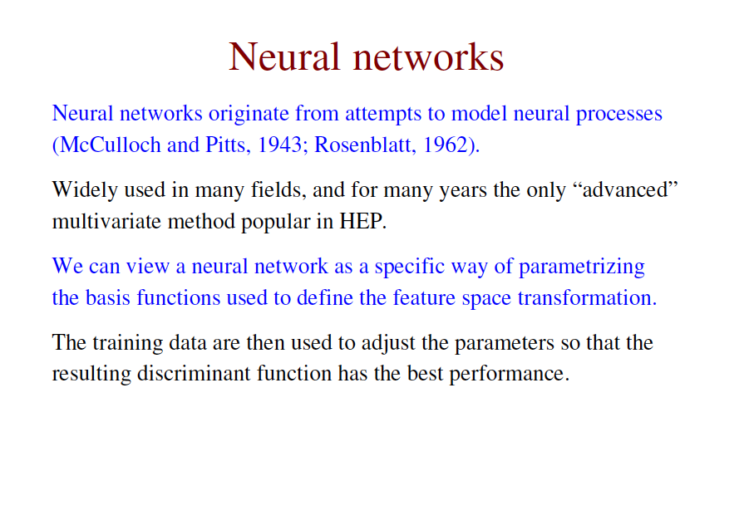

Slide 6
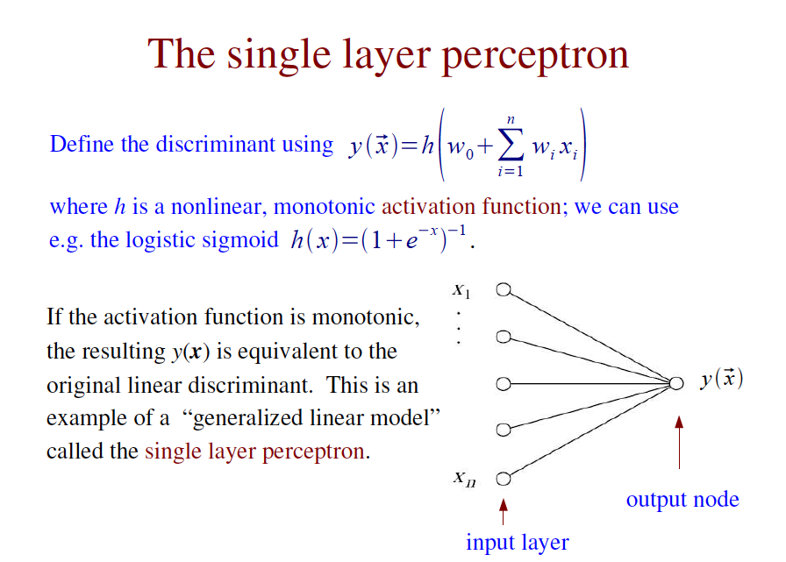
This is called the single layer perceptron:

Slide 7
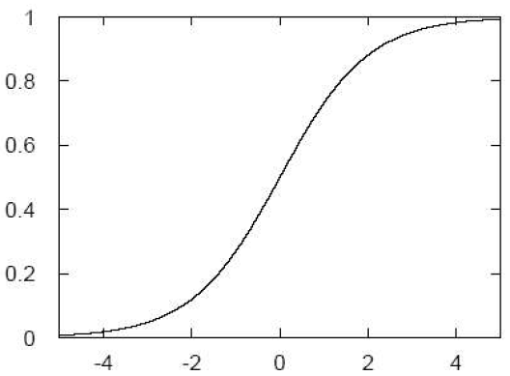


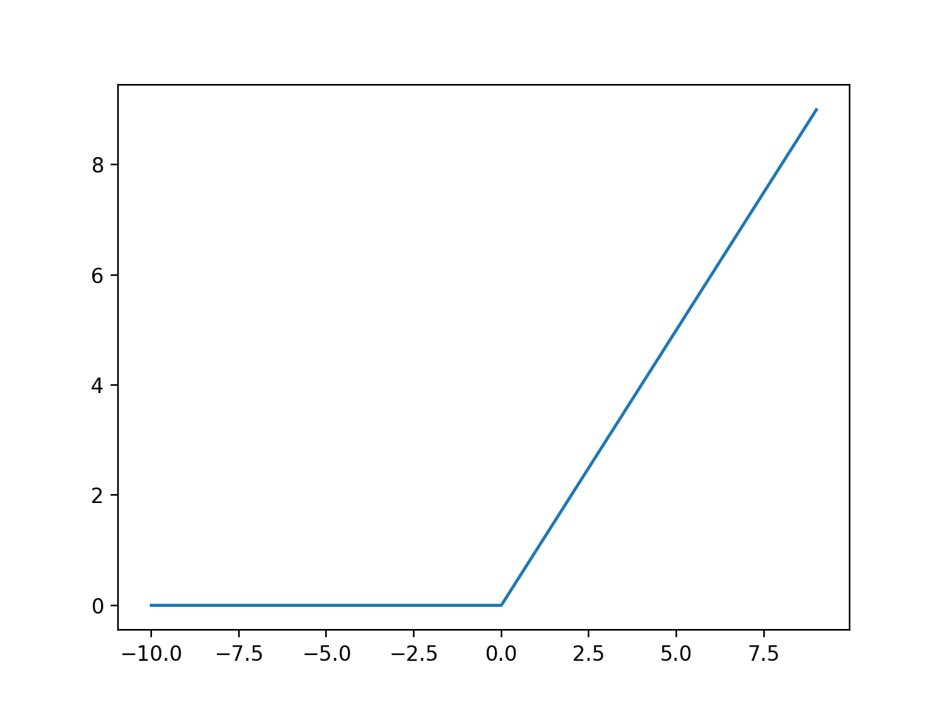
The activation function
Can use e.g. the ”logistic
sigmoid”:
or (esp. with deep neural
networks) the “Rectified
Linear Unit” (ReLU) function:
h(x)
x

Slide 8
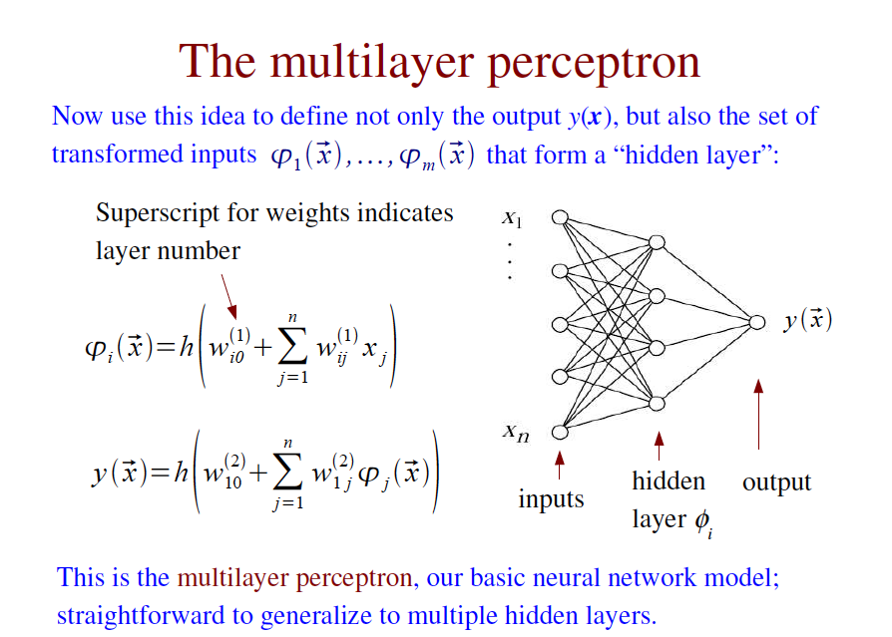

Slide 9
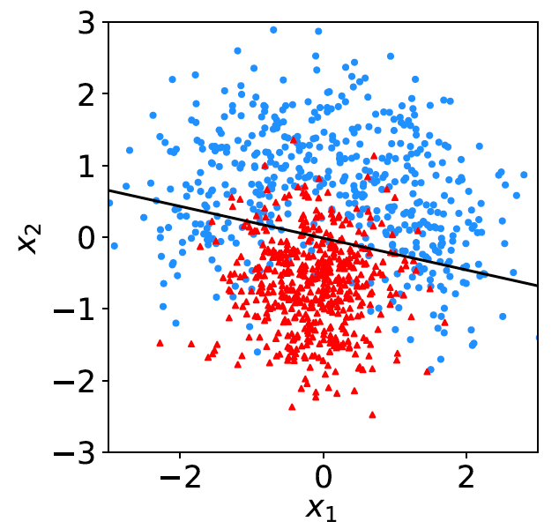
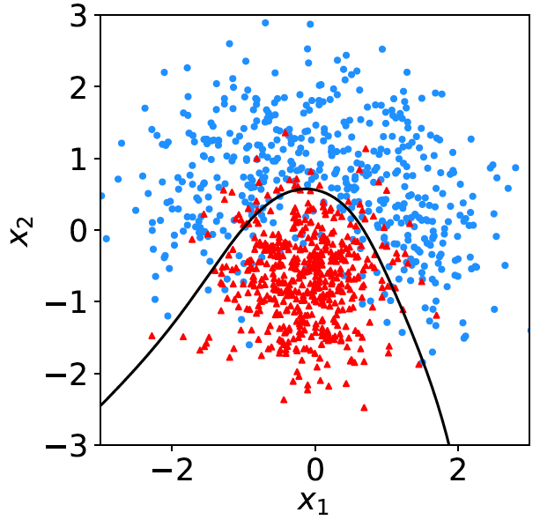
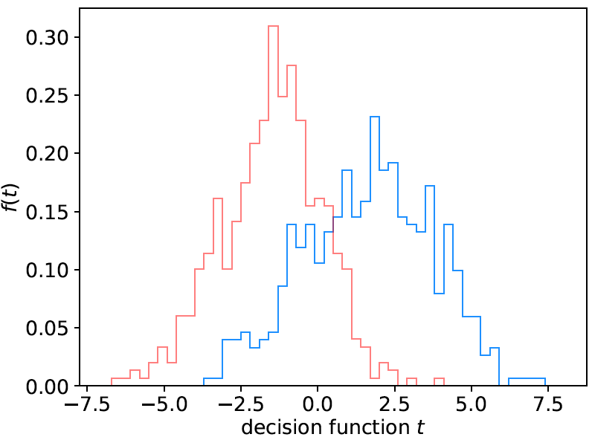
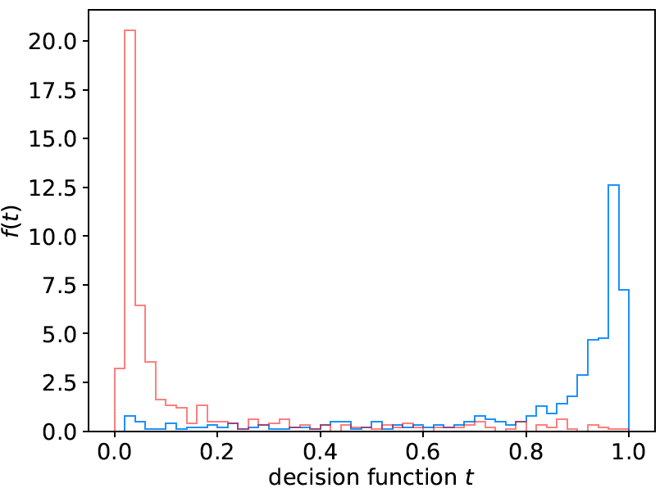
Fisher (linear):
Neural network:

Slide 10
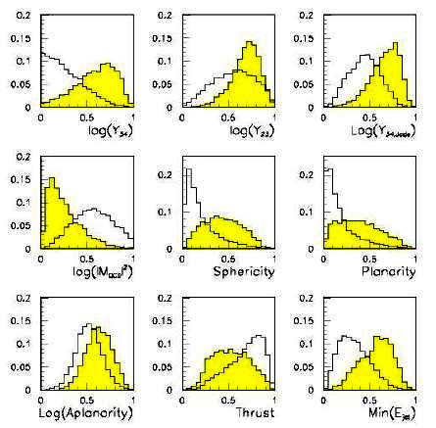
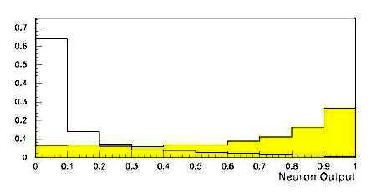
Neural network example from LEP II
Signal: e⁺e⁻ → W⁺W⁻ (often 4 well separated hadron jets)
Background: e⁺e⁻ → qqgg (4 less well separated hadron jets)
← input variables based on jet
structure, event shape, ...
none by itself gives much separation.
Neural network output:
(Garrido, Juste and Martinez, ALEPH 96-144)

Slide 11
Statistical Data Analysis
Lecture 5-2
Network architecture
Training neural networks
Overtraining

Slide 12
Network architecture
Theorem: An MLP with a single hidden layer having a sufficiently
large number of nodes can approximate arbitrarily well the optimal
decision boundary.
Holds for any continuous non-polynomial activation function
Leshno, Lin, Pinkus and Schocken (1993) Neural Networks 6, 861-867
However, the number of required nodes may be very large; cannot train well with finite samples of training data.
Recent advances in Deep Neural Networks have shown important advantages in having multiple hidden layers.
For particle physics applications of Deep Learning, see e.g.
Baldi, Sadowski and Whiteson, Nature Communications 5 (2014); arXiv:1402.4735.
Dan Guest, Kyle Cranmer, Daniel Whiteson, Deep Learning and its Application to LHC Physics, Annu. Rev. Nucl. Part. Sci. 2018. 68:1–22, arXiv:1806.11484.

Slide 13
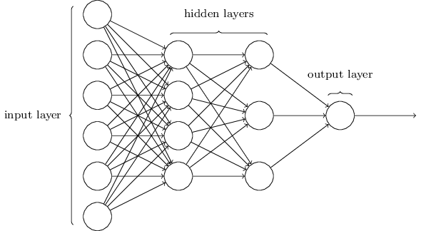
http://neuralnetworksanddeeplearning.com/chap1.html
Deep Neural Networks
The multilayer perceptron can have be generalized to have an arbitrary number of hidden layers, with an arbitrary number of nodes in each (= “network architecture”).
A “deep” network has several (or many) hidden layers:
“Deep Learning” is a very recent and active field of research.

Slide 14
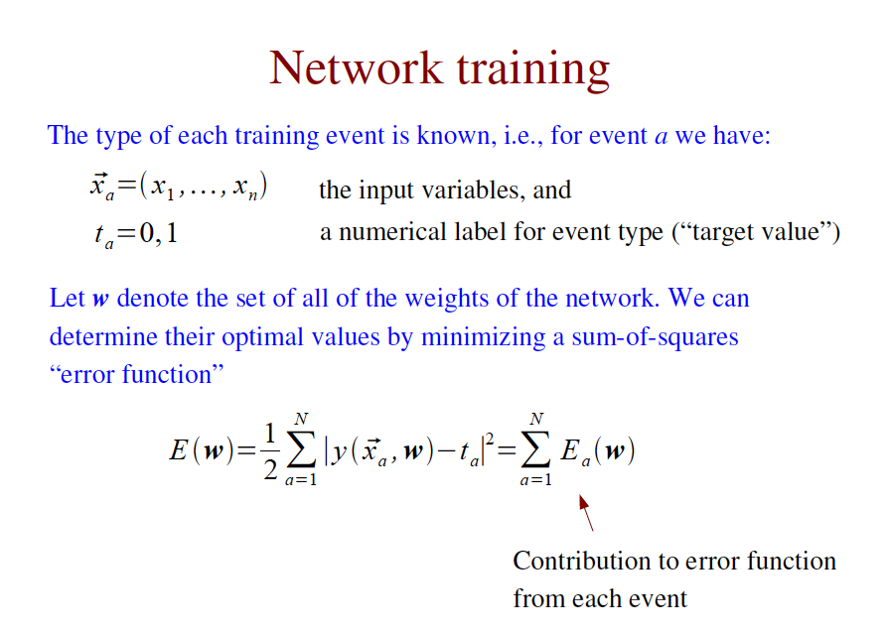
(not examinable)
(or “loss function”)

Slide 15
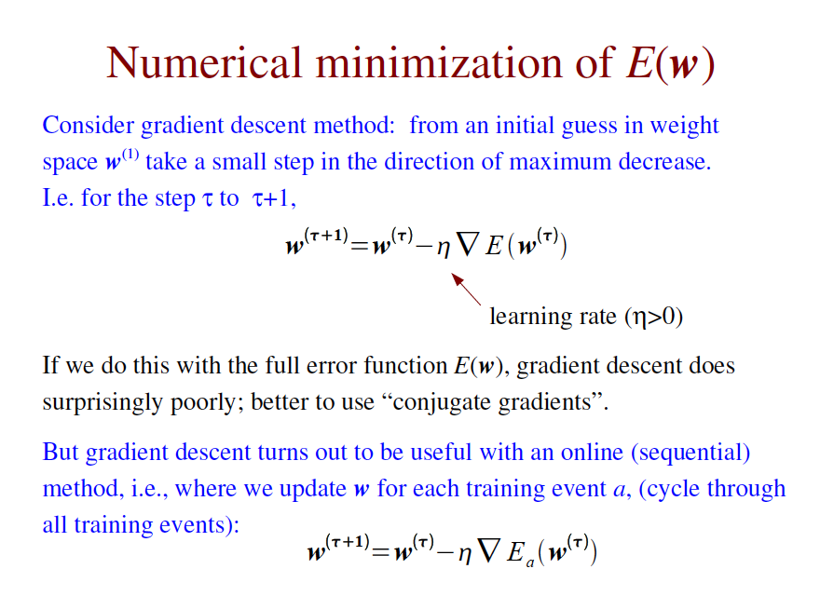
(not examinable)
update w for randomly chosen event a, (or ”mini-batch”)
(“stochastic
gradient descent”)

Slide 16
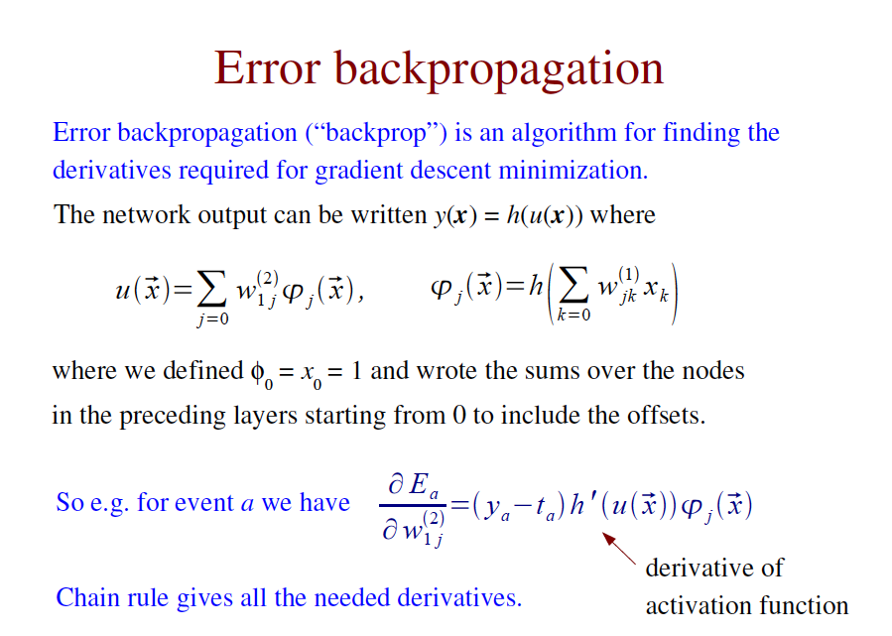
(not examinable)

Slide 17
Comments on network training
The algorithms for adjusting the network parameters have become a very active field of research (and beyond the scope of this course).
Recent ideas include:
“Deep” neural nets, use of ReLU activation function
Stochastic gradient descent: estimate of gradient approximated by a randomly selected subset of the data.
Dropout: randomly exclude nodes during training (prevents “overtraining”)

Slide 18
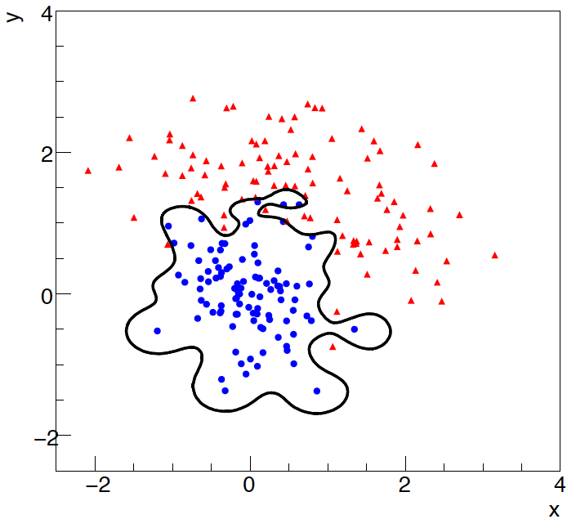
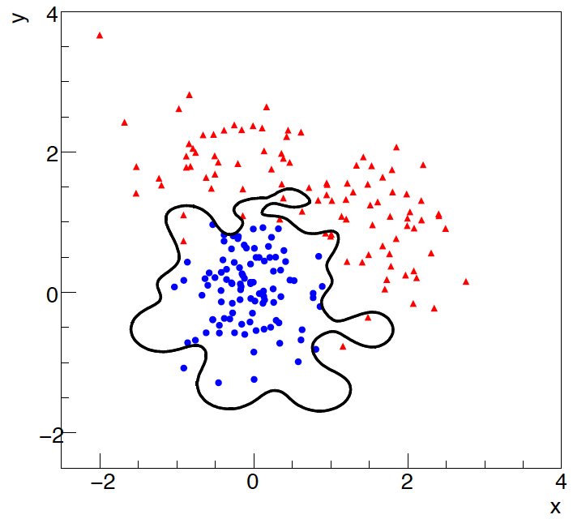
Overtraining
Including more parameters in a classifier makes its decision boundary
increasingly flexible, e.g., more nodes/layers for a neural network.
A “flexible” classifier may conform too closely to the training points;
the same boundary will not perform well on an independent test
data sample (→ “overtraining”).
training sample
independent test sample

Slide 19
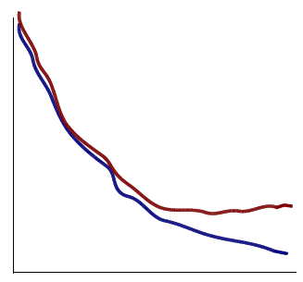
Monitoring overtraining
If we monitor the fraction of misclassified events (or similar, e.g.,
error function E(w)) for test and training samples, it will usually
decrease for both as the boundary is made more flexible:
optimum at minimum of
error rate for test sample
error
rate
increase in error rate
indicates overtraining
test sample
training sample
flexibility (e.g., number
of nodes/layers in MLP)

Slide 20
Statistical Data Analysis
Lecture 5-3
Non-parametric probability density estimation
Kernel density estimator

Slide 21
Probability Density Estimation (PDE)
A possible way to approximate the likelihood ratio for two hypotheses f (x|H₀) and f (x|H₁) is to first find a non-parametric estimator for the corresponding pdfs and then use these to define the test statistic (decision function),
(hats denote
estimators)
Here the term “non-parametric” means the the estimate will be very general, not necessarily from a specific pdf family, and have a “local” character reflecting training data values.
The n-dimensional histogram was a brute-force example of this; there are better ways.
Non-parametric pdf estimates are useful in many ways; here for obtaining a test statistic but one example.

Slide 22

Correlation vs. independence
In general a multivariate pdf f (x) for x = (x₁,...,x_{n}) does not factorize into a product of the marginal pdfs for the individual variables, and
only holds if the components of x are independent.
In particular, the components of x may in general have nonzero covariances, i.e., they are correlated:

Slide 23
Decorrelation of input variables
We can always define new input variables by an orthogonal transformation such that the transformed variables are uncorrelated:
One can show that this is achieved when the rows of the matrix A are the eigenvectors of V_{ij} = cov[x_{i}, x_{j}] (cf. SDA Sec. 1.7).
x₂
u₂
x₁
u₁

Slide 24
Decorrelation is only first step
But even with zero correlation, a multivariate pdf f (x) will in general have features such that the components are not independent.
pdf with zero covariance (no tilt) but components still not independent, since clearly
x₂
and therefore
x₁

Slide 25

Naive Bayes method
First “decorrelate” x, i.e., find u = Ax, with cov[u_{i}, u_{j}] = V[u_{i}] δ_{ij} .
Pdfs of x and u are then related by
where
Suppose that the “decorrelated” g(u) can be approximated by product of marginal pdfs
and take as an estimator for f (x)

Slide 26
Naive Bayes method (2)
Approximate the pdfs separately for the two hypotheses H₀ and H₁ (separate matrices A₀ and A₁ and marginal pdfs g_{0,i}, g_{1,i}). Then define test statistic as
Gives “Naive Bayes” classifier.
Reduces problem of estimating an n-dimensional pdf to finding n one-dimensional marginal pdfs g_{i}(u_{i}).

Slide 27
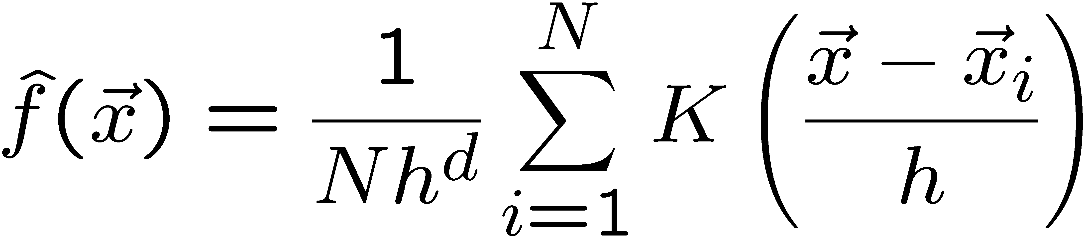
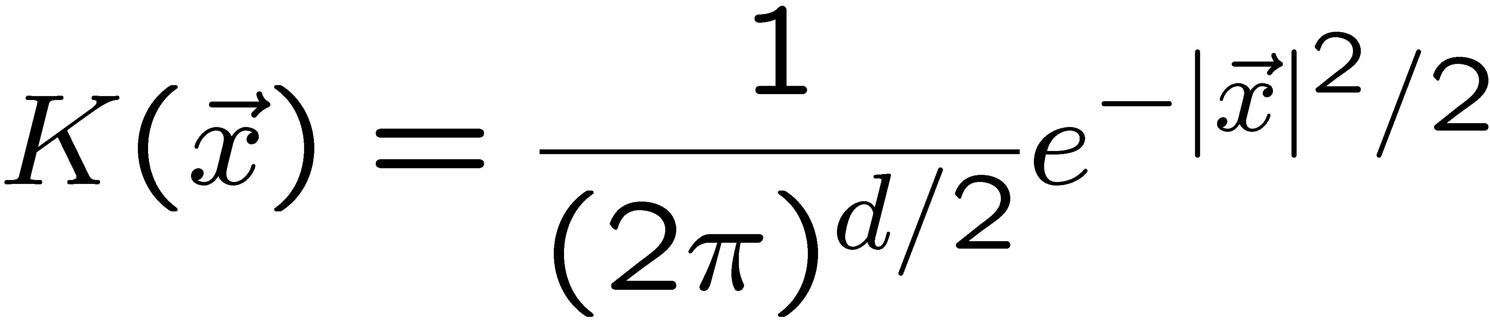
Kernel-based PDE (KDE)
Consider d dimensions, N training events, x₁, ..., x_{N},
estimate f (x) with
x of i^{th} training
event
x where we want
to know pdf
bandwidth
(smoothing parameter)
kernel
Use e.g. Gaussian kernel:
and do individually for each component (i.e. f (x) → g_{i}(u_{i})).

Slide 28
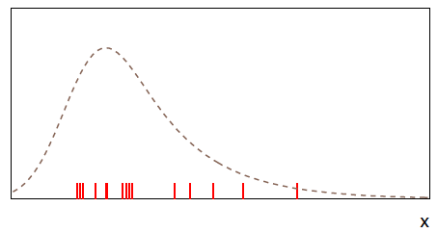
Gaussian KDE in 1-dimension
Suppose the pdf (dashed line) below is not known, but we can generate or observe values that follow it (the red tick marks):
Goal is to find an approximation to the pdf using the data values.

Slide 29
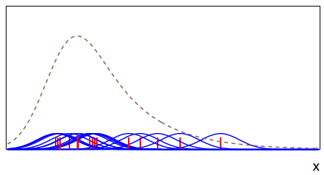
Gaussian KDE in 1-dimension (cont.)
Place a kernel pdf (here a Gaussian) centred around each
generated event weighted by 1/N_{event}:

Slide 30
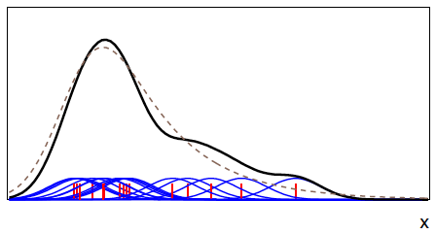
Gaussian KDE in 1-dimension (cont.)
The KDE estimate the pdf is given by the sum of
all of the Gaussians:

Slide 31
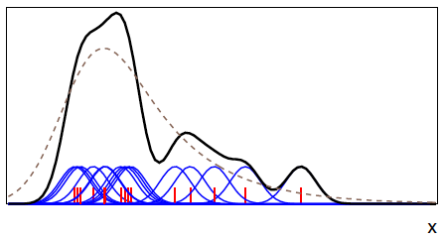
Choice of kernel width
The width h of the Gaussians is analogous to the bin width
of a histogram. If it is too small, the estimator has noise:

Slide 32
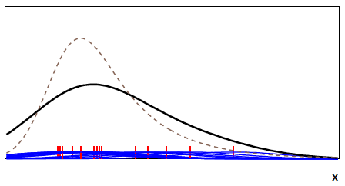
Choice of kernel width (cont.)
If width of Gaussian kernels too large, structure is washed out:

Slide 33
KDE discussion
Various strategies can be applied to choose width h of kernel
based trade-off between bias and variance (noise).
Adaptive KDE allows width of kernel to vary, e.g., wide where
target pdf is low (few events); narrow where pdf is high.
Advantage of KDE: no training!
Disadvantage of KDE: to evaluate we need to sum N_{event} terms,
so if we have many events this can be slow.
Special treatment required if kernel extends beyond range
where pdf defined. Can e.g., renormalize the kernels to unity
inside the allowed range; alternatively “mirror” the events
about the boundary (contribution from the mirrored events
exactly compensates the amount lost outside the boundary).
Software in ROOT: RooKeysPdf (K. Cranmer, CPC 136:198,2001),
or in python: sklearn.neighbors.KernelDensity

Slide 34
Statistical Data Analysis
Lecture 5-4
Examples of classifiers
Boosted decision trees

Slide 35
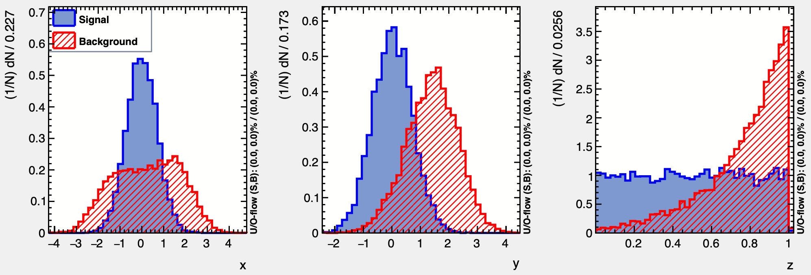
Test example with TMVA
Each event characterized by 3 variables, x = (x₁, x₂, x₃):
x₁
x₂
x₃

Slide 36
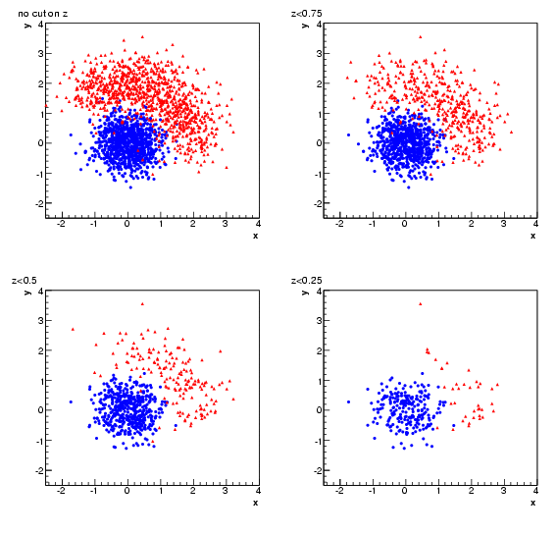
Test example (x₁, x₂, x₃)
x₂
x₂
no cut on x₃
x₃ < 0.75
x₁
x₁
x₂
x₂
x₃ < 0.25
x₃ < 0.5
x₁
x₁

Slide 37
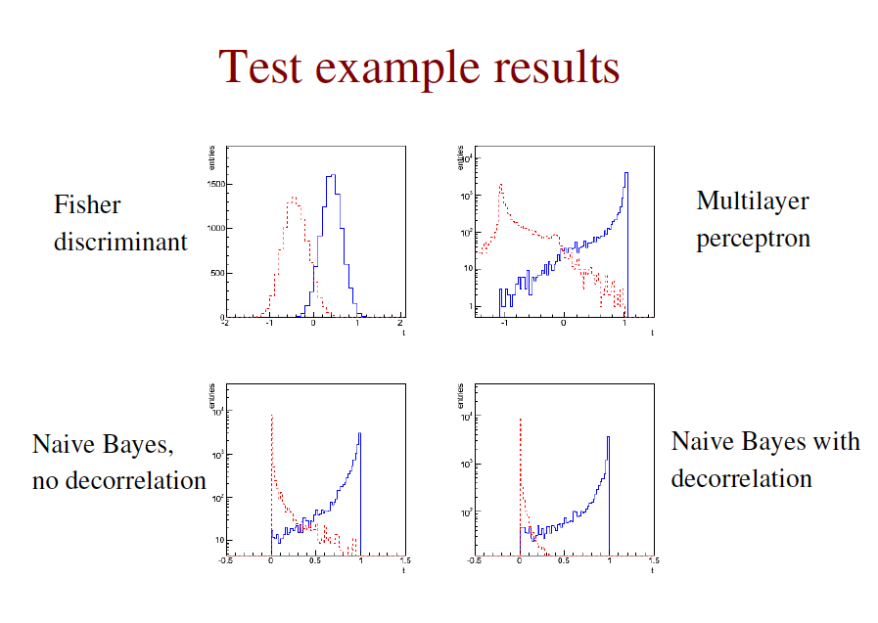
Find these on next homework assignment.
y
y

Slide 38
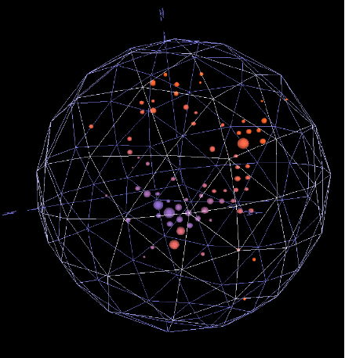
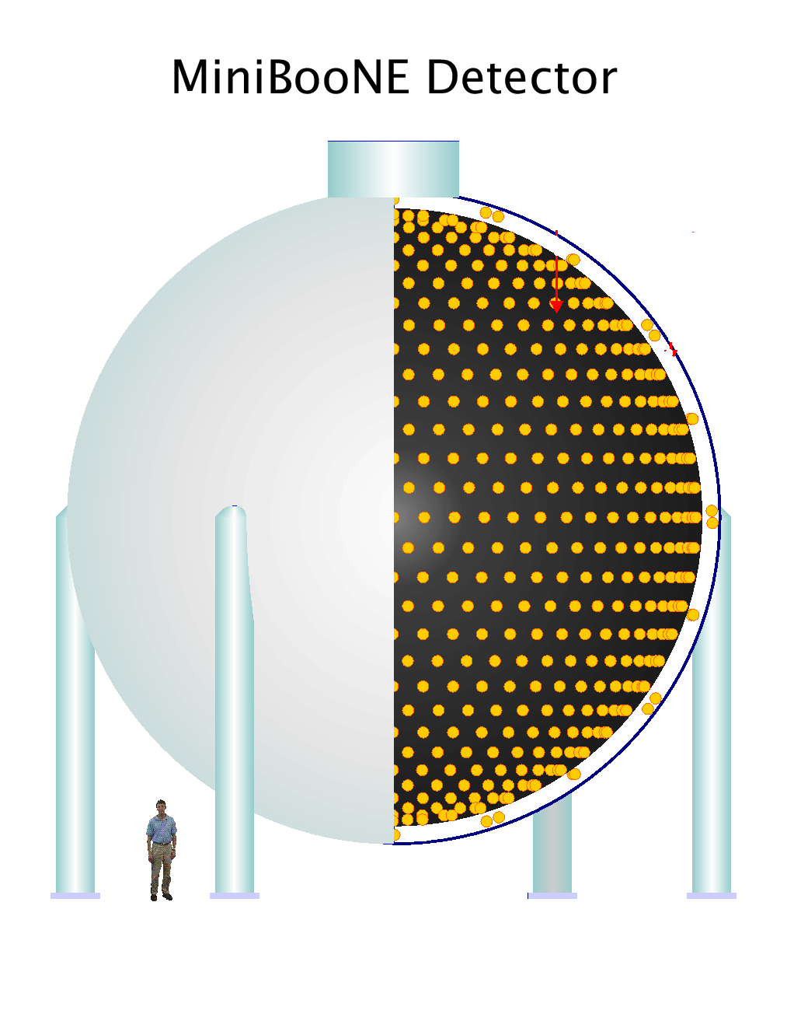
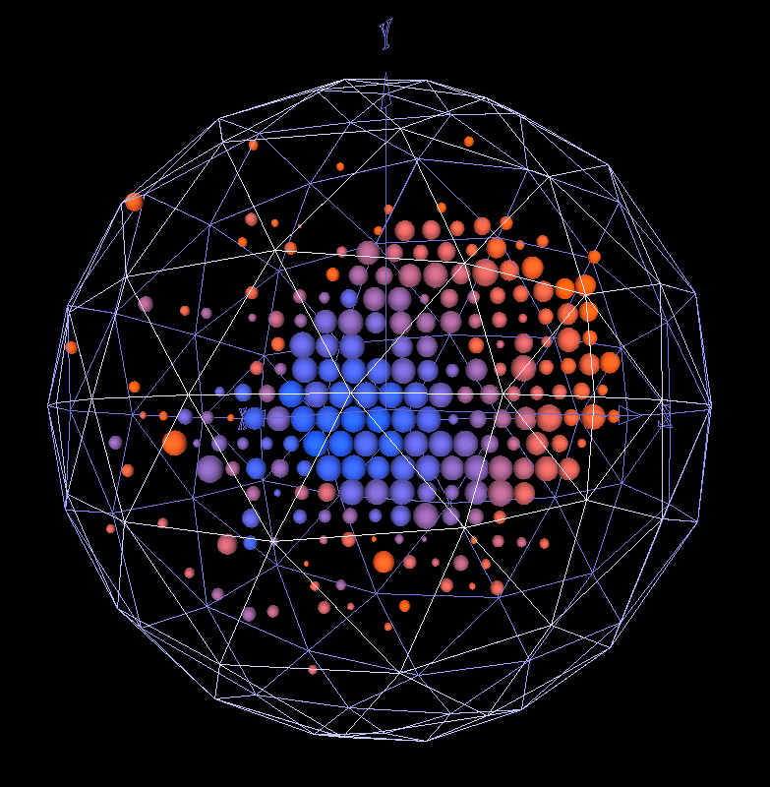
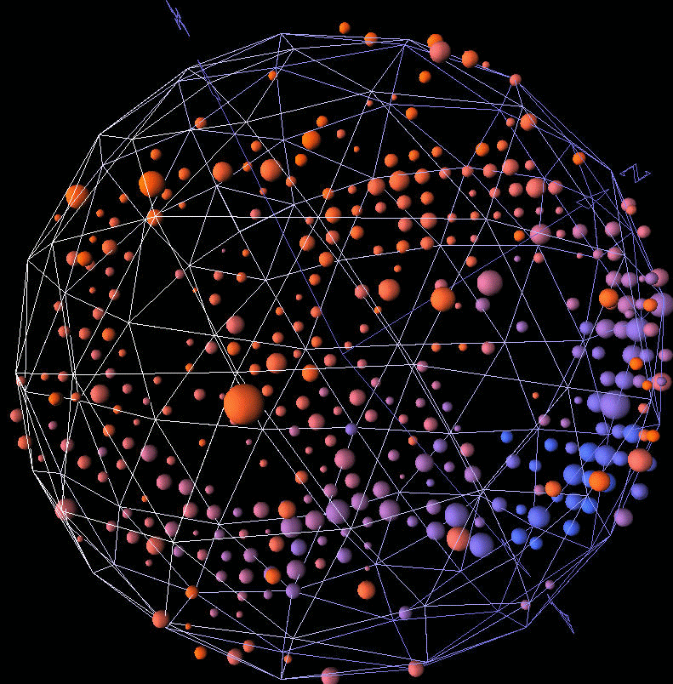
Particle i.d. in MiniBooNE
Detector is a 12-m diameter tank of mineral oil exposed to a beam of neutrinos and viewed by 1520 photomultiplier tubes:
Search for ν_{μ} to ν_{e} oscillations
required particle i.d. using
information from the PMTs.
H.J. Yang, MiniBooNE PID, DNP06

Slide 39
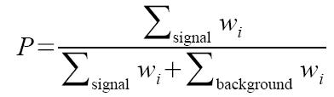
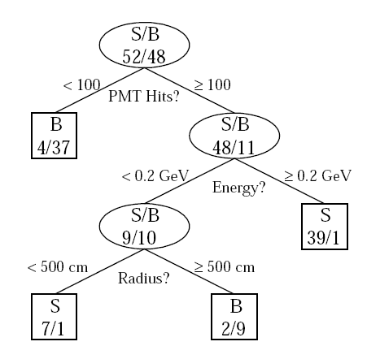
Decision trees
Out of all the input variables, find the one for which with a single “cut” (require e.g. x < x_{c}) gives best improvement in signal purity:
p
where w_{i}. is the weight of the ith event.
Resulting nodes classified as either signal/background.
Iterate until stop criterion reached based on e.g. purity or minimum number of events in a node.
The set of cuts defines the decision boundary.
Example by MiniBooNE experiment,
B. Roe et al., NIM 543 (2005) 577

Slide 40



Finding the best single cut
The level of separation within a node can, e.g., be quantified by the Gini coefficient, calculated from the (s or b) purity p as:
p = 0 or 1 gives min G = 0,
p = 1/2 gives max G = 1/4.
For a cut that splits a set of events a into subsets b and c, one
can quantify the improvement in separation by the change in
weighted Gini coefficients:
where, e.g.,
Choose e.g. the cut to the maximize Δ.

Slide 41
Decision trees (2)
The terminal nodes (leaves) are classified a signal or background
depending on majority vote (or e.g. signal fraction greater than a
specified threshold).
This classifies every point in input-variable space as either signal
or background, a decision tree classifier, with discriminant function
f(x) = 1 if x in signal region, −1 otherwise
Decision trees tend to be very sensitive to statistical fluctuations in
the training sample.
Ensemble methods such as boosting can be used to reduce these fluctuations.

Slide 42
Boosting
Boosting is a general method for creating a set of classifiers that can be combined to achieve a new one that is better than any individual one (an example of ”ensemble learning”).
Often applied to decision trees but can be applied to any classifier.
Suppose we have a training sample T consisting of N events with
x₁,..., x_{N} event data vectors
y₁,..., y_{N} true class labels (+1 or -1)
w₁,..., w_{N} event weights
Define a rule to create from this an ensemble of training samples
T₁, T₂,..., derive a classifier from each and average them.
Trick is to create modifications in the training samples to give
classifiers with smaller error rates than the preceding ones.
A successful example is AdaBoost (Freund and Schapire, 1997).

Slide 43

AdaBoost
First initialize the training sample T₁ using the original
x₁,..., x_{N} event data vectors
y₁,..., y_{N} true class labels (+1 or -1)
w₁⁽¹⁾,..., w_{N}⁽¹⁾ event weights
with the weights equal and normalized such that
Then train the classifier f₁(x) (e.g., a decision tree) with a method
that uses the event weights. Recall for an event at point x,
f₁(x) = +1 for x in signal region, −1 in background region
We will define an iterative procedure that gives a series of
classifiers f₁(x), f₂(x),...

Slide 44


Error rate of the kth classifier
At the kth iteration the classifier f_{k}(x) has an error rate
where I(X) = 1 if X is true and is zero otherwise.
Next assign a score to the kth classifier based on its error rate,

Slide 45

Updating the event weights
The classifier at each iterative step is found from an updated
training sample, in which the weight of event i is modified from
step k to step k+1 according to
Here Z_{k} is a normalization factor defined such that the sum of the weights over all events is equal to one.
That is, the weight for event i is increased in the k+1 training sample if it was classified incorrectly in step k.
Idea is that next time around the classifier should pay more attention to this event and try to get it right.

Slide 46


Defining the decision function
After K boosting iterations, the final decision function is defined as a weighted linear combination of the f_{k}(x),
One can show that the error rate on the training data of the final
classifier satisfies the bound
i.e. as long as the ε_{k} < ½ (better than random guessing), with
enough boosting iterations every event in the training sample will
be classified correctly.

Slide 47
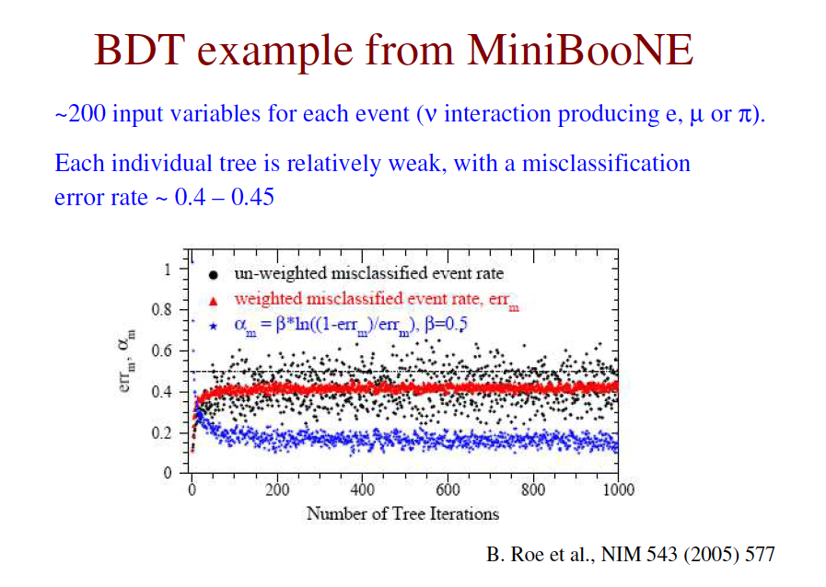

Slide 48
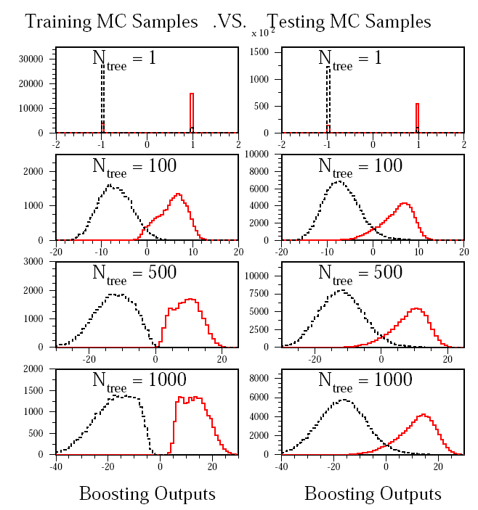
Monitoring overtraining
From MiniBooNE
example:
Performance stable
after a few hundred
trees.
t
t

Slide 49
Ensemble methods
Boosting is an example of “ensemble learning”; the original
training sample is “boosted” into an ensemble of samples.
Other related methods include:
Bagging (bootstrap aggregating) : the training samples are created by sampling events randomly from the original sample with replacement. In a given sample, an event might occur zero, one or multiple times.
Random forest: a type of bagging where features are randomly dropped.
More in Ch. 8 of An Introduction to Statistical Learning with Applications in R by James, Witten, Hastie and Tibshirani; https://www.statlearning.com/ see also the videos by Hastie and Tibshirani:
https://youtube.com/playlist?list=PLOg0ngHtcqbPTlZzRHA2ocQZqB1D_qZ5V

Slide 50
Extra slides

Slide 51
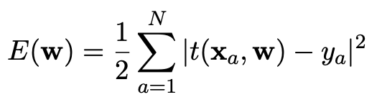
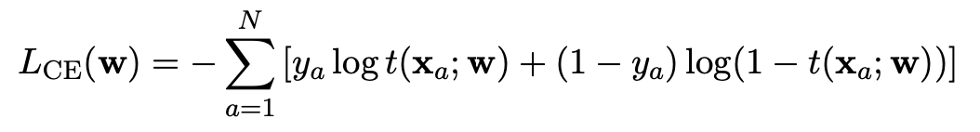
Network training
For each of the training events we have the feature vector
and true event type (class label):
x_{a} = (x₁,..., x_{n}), y_{a} = 0,1, a = 0,...,N
We have a functional form for the decision function t(x; w) that
depends on a vector of weights w.
Use the training data to determine the weights by minimizing
a “loss function”. Various possibilities, e.g.,
quadratic loss function
cross
entropy

Slide 52



A simple example (2D)
Consider two variables, x₁ and x₂, and suppose we have formulas for the joint pdfs for both signal (s) and background (b) events (in real problems the formulas are usually notavailable).
f (x₁|x₂) ~ Gaussian, different means for s/b,
Gaussians have same σ, which depends on x₂,
f (x₂) ~ exponential, same for both s and b,
f (x₁, x₂) = f (x₁|x₂) f (x₂):

Slide 53
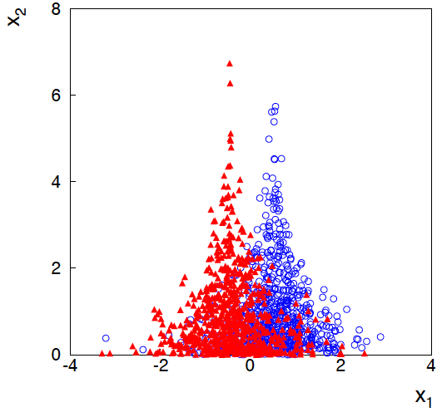
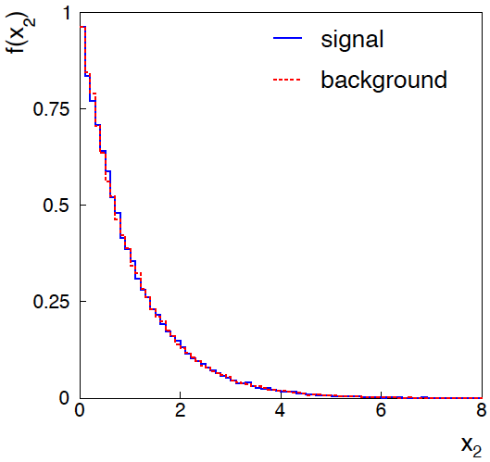
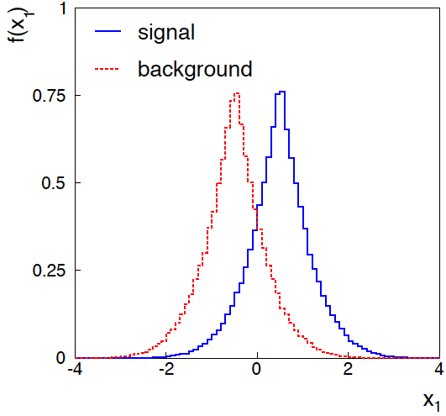
Joint and marginal distributions of x₁, x₂
background
signal
Distribution f (x₂) same for s, b.
So does x₂ help discriminate
between the two event types?

Slide 54


Likelihood ratio for 2D example
Neyman-Pearson lemma says best critical region is determined
by the likelihood ratio:
Equivalently we can use any monotonic function of this as
a test statistic, e.g.,
Boundary of optimal critical region will be curve of constant ln t, and this depends on x₂!

Slide 55
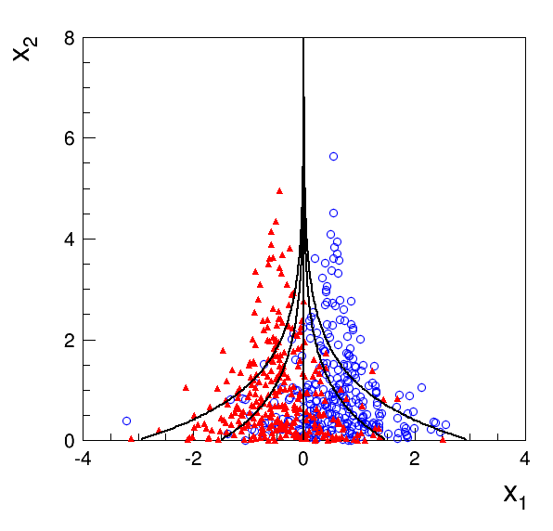
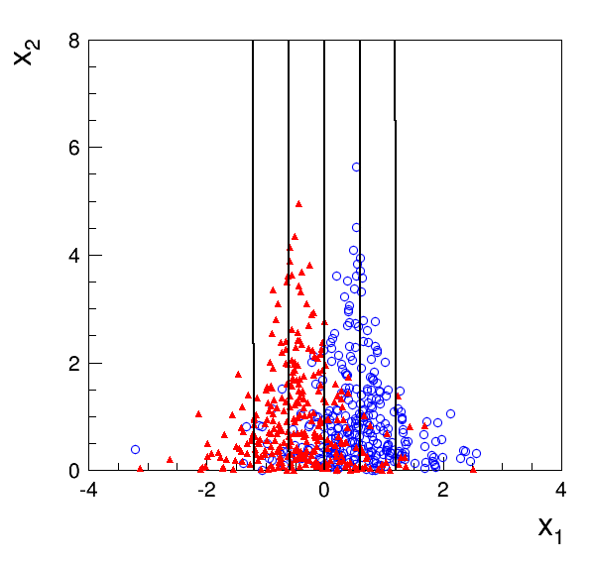
Contours of constant MVA output
Exact likelihood ratio
Fisher discriminant

Slide 56
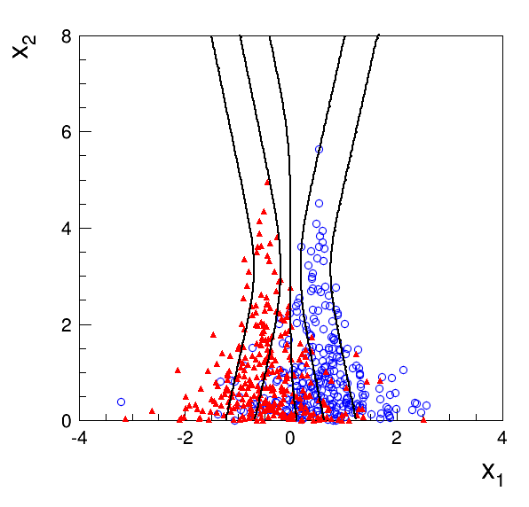
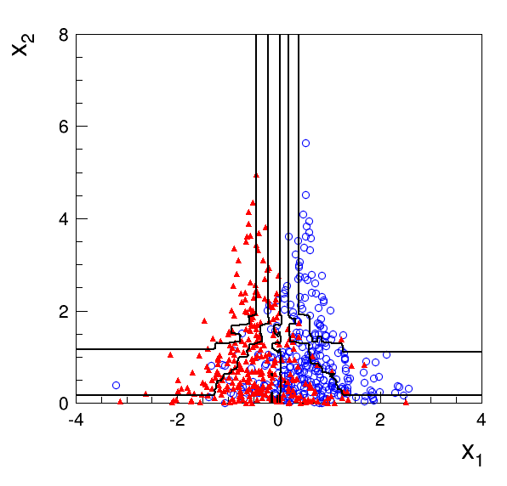
Contours of constant MVA output
Multilayer Perceptron
1 hidden layer with 2 nodes
Boosted Decision Tree
200 iterations (AdaBoost)
Training samples: 10⁵ signal and 10⁵ background events

Slide 57
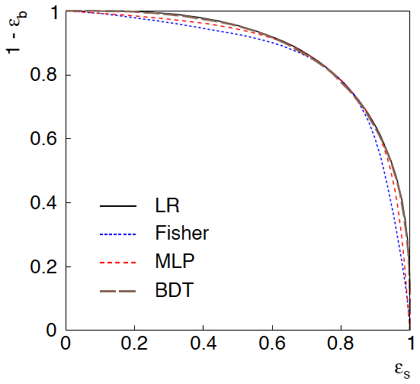
ROC curve
ROC = “receiver operating
characteristic” (term from
signal processing).
Shows (usually) background
rejection (1−ε_{b}) versus
signal efficiency ε_{s}.
Higher curve is better;
usually analysis focused on
a small part of the curve.

Slide 58
2D Example: discussion
Even though the distribution of x₂ is same for signal and background, x₁ and x₂ are not independent, so using x₂ as an input variable helps.
Here we can understand why: high values of x₂ correspond to a smaller σ for the Gaussian of x₁. So high x₂ means that the value of x₁ was well measured.
If we don’t consider x₂, then all of the x₁ measurements are lumped together. Those with large σ (low x₂) “pollute” the well measured events with low σ (high x₂).
Often in HEP there may be variables that are characteristic of how well measured an event is (region of detector, number of pile-up vertices,...). Including these variables in a multivariate analysis preserves the information carried by the well-measured events, leading to improved performance.

Slide 59
Summary on multivariate methods
Particle physics has used several multivariate methods for many years:
linear (Fisher) discriminant
neural networks
naive Bayes
and has in recent years started to use a few more:
boosted decision trees
support vector machines
kernel density estimation
k-nearest neighbour
The emphasis is often on controlling systematic uncertainties between
the modeled training data and Nature to avoid false discovery.
Although many classifier outputs are "black boxes", a discovery
at 5σ significance with a sophisticated (opaque) method will win the
competition if backed up by, say, 4σ evidence from a cut-based method.

Slide 60
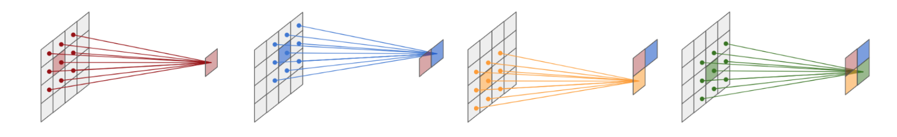
K. Cranmer, U. Seljak and K. Terao, Machine Learning, in R.L. Workman et al. (PDG), Prog. Theor. Exp. Phys. 2022, 083C01 (2022); https://pdg.lbl.gov/
Convolutional Neural Networks
Designed for image data (pixels) → number of input variables ≳10⁶.
Intermediate layers include “convolutions” of an area in previous layer, i.e., transformed pixel is a linear combination of pixels in local neighborhood in previous layer
→ far fewer connections than a fully connected MLP.
CNNs widely used for image classification.

Slide 61
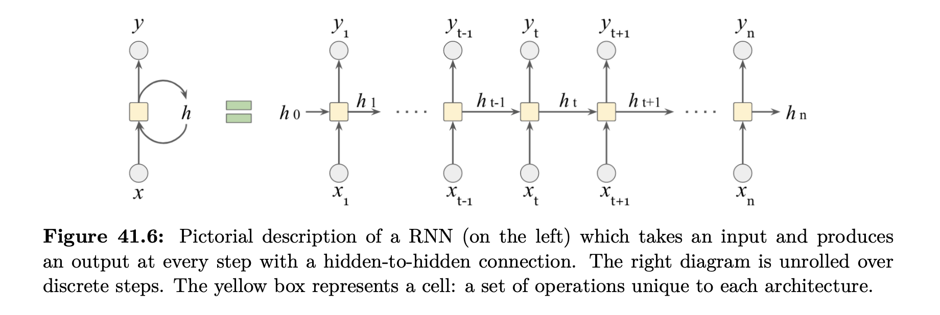
K. Cranmer, U. Seljak and K. Terao, Machine Learning, in R.L. Workman et al. (PDG), Prog. Theor. Exp. Phys. 2022, 083C01 (2022); https://pdg.lbl.gov/
Recurrent Neural Networks
Designed for sequential data (time series).
RNNs used, e.g., in natural language processing.

Slide 62


Jonathan Shlomi, Peter Battaglia, Jean-Roch Vlimant, Graph Neural Networks in Particle Physics, 2021 Mach. Learn.: Sci. Technol. 2 021001, 2021; https://arxiv.org/abs/2007.13681.
Graph Neural Networks
GNNs work with graph-structured input data, e.g., signals from particles in tracking detector:
Graph = set of nodes plus set of edges:
Part of a larger field called “geometric deep learning”:
CNN is a type of GNN, graph relates pixel to its neighbors.
Transformer is a GNN that uses a mechanism called “attention”, used in natural language processing (T of ChatGPT).

